Slide 1
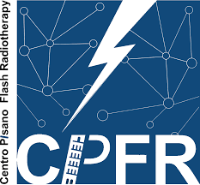

Status of Flash Therapy in Pisa
Maria Giuseppina Bisogni
Universita’ e INFN sezione di Pisa
INFN4LS meeting, Presidenza INFN, Roma, 10/11/2022

Slide 2
Radiation-therapy technology able to deliver at ultra-high dose rate ( ≥40 Gy/sec) a total dose in 100-200 msec
allow to treat tumors without inducing drastic toxicities on the surrounding normal tissues
FLASH RADIOTHERAPY
Notes:
When we irradiate tissues with very high dose rate and the total dose is given in milliseconds we observe a particular effect named Flash effect. Basically The flash effect is a biological phenomenon that consist in a remarkable sparing of normal tissues while the effect on tumors is maintained the same. So we can reach a very strong differential effect between the tumor cells and the healty cells achieving a significant increase in the therapeutic index of radiotherapy.
We can thus achieve a significant increase in the therapeutic index of radiotherapy
The Flash effect is a biological observation wich can be done when we irradiate tissues with very high dose rate and the dose is given in milliseconds and consist in a remarkable sparing of normal tissues while the effect on tumors is maintained the same. So we can reach a very strong differential effect between the tumor cells and the healty cells.
We can thus achieve a significant increase in the therapeutic index of radiotherapy
When we irradiate tissues with very high dose rate and the total dose is given in milliseconds we observe a particular effect named Flash effect. Basically The flash effect is a biological phenomenon that consist consist in a remarkable sparing of normal tissues while the effect on tumors is maintained the same. So we can reach a very strong differential effect between the tumor cells and the healty cells.
We can thus achieve a significant increase in the therapeutic index of radiotherapy

Slide 3

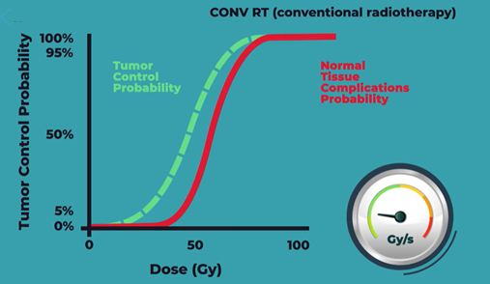
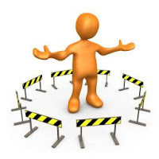
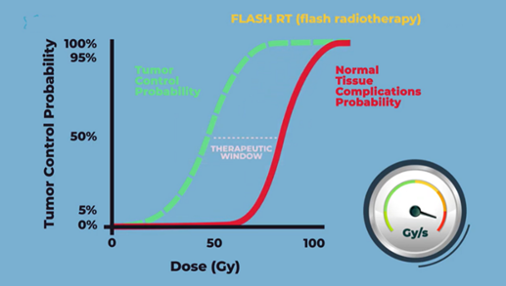

Limitation of ’’Conventional’’ RT
radiation-induced toxicities
Flash-RT would allow:
To treat radioresistant tumor increasing total dose without the associated surrounding tissue toxicity of CONV-RT
To treat diffuse/Non localized tumors where CONV-RT can not deliver tumoricidal doses
To treat tumors where radiotherapy already offers good local control but without the side effects typical of CONV-RT
FLASH radiation therapy
possibility of widening the therapeutic "window"
possibility of increasing the therapeutic doses
Notes:
Infact despite these advances several tumors are still incurable for example radioresistant tumors because the doses that we need to delivery to achieve tumor control often overlaps with those that cause complication. After all the main limitation of conv-RT still remain radiation-induced toxicities and in practice conv-RT can not cure all the patients we would like to cure.
In this scenario a great opportunity to increase the therapeutic index of radiotherapy is represented by flash-radiotherapy this thecnology infact seems to increase the differential effects of radiations between normal tissue and tumor very strongly.
because the main limit of conv-RT still remains the radiation induces toxicities. As you can see in the picture the therapeutic index of radiotherapy that is the relationship between the probability of tumour control (TCP) and the risk of normal tissue complications (NTCP) in several oncological conditions is very narrow because the doses necessary to achieve tumour control usually overlap with those that can cause complications so basically today conv-RT can not cure all the patients we would like to cure.
In this scenario flashradiotherapy has emerged as a treatment technique with the great potential of increase the differential effect of radiotherapy between normal tissue and tumor. compared to conventional radiotherapy increasing the therapeutic index. Flash radiation therapy will allow us to treat…..
The Flash effect is a biological observation wich can be done when we irradiate tissues with very high dose rate and the dose is given in milliseconds and consist in a remarkable sparing of normal tissues while the effect on tumors is maintained the same. So we can reach a very strong differential effect between the tumor cells and the healty cells.
We can thus achieve a significant increase in the therapeutic index of radiotherapy
The dose delivered to the tumor is, hence, limited by the toxicity to nearby healthy tissue; this can mean that a tumor cannot be completely killed, and the efficacy of radiotherapy will be decreased. Thus, preventing or mitigating radiation-induced healthy tissue injury has always been a topic of particular interest in radiotherapy research.
The goal of radiotherapy is to deliver as much dose to the tumour whilst sparing normal tissue. Every dose of radiation delivered to a patient, with the aim of cure of a tumour, is limited by the possibility of serious damage to normal tissues. The balance between the probability of tumour control (TCP) and the risk of normal tissue complications (NTCP) is a measure of the therapeutic ratio of the treatment.
For some tumours, such as carcinoma of the prostate, there is evidence of a dose– response curve with dose escalation leading to increased tumour control rates. As shown in Fig. 1, there is also a dose–response curve for normal tissues and dose escalation may lead to increased normal tissue damage.
Normal tissue damage cannot be completely avoided because the doses necessary to achieve tumour control usually overlap with those that can cause complications.
The therapeutic index of radiotherapy has been progressively increasing thanks to the technological progress of the last 20 years
Flash It could be used in the clinic to allow for an increase of total dose in the treatment of tumours resistant to radiation that are currently associated with worse patient outcomes, as a higher dose could be used without the associated surrounding tissue toxicity of CONV-RT. It could also be used in situations where radiotherapy offers good tumour control but is associated with tissue toxicity as the same dose could be administered but with less toxicity than that of CONV-RT.

Slide 4
Questioni aperte fondamentali per un ampio utilizzo
clinico della Flash e sua ottimizzazione
Teoriche
Quantitative
Capire i meccanismi radiobiologici alla base dell’effetto
Tecnologiche
Dipendenza dose, dose-rate, dose-per-pulse e instantaneous dose-per-pulse
Dipendenza da LET
Campi adiacenti
Frazionamento
Realizzazione LINAC elettroni VHEE (100-250 MeV)

Slide 5
Per capire i problemi teorici e le
dipendenze quantitative cosa serve?
Esperimenti Radiobiologici quantitativi
LINAC dedicato
Dosimetria
Multidisciplinarieta'

Slide 6
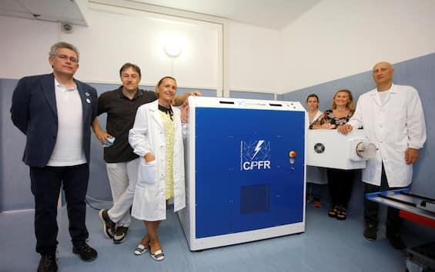
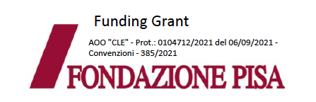
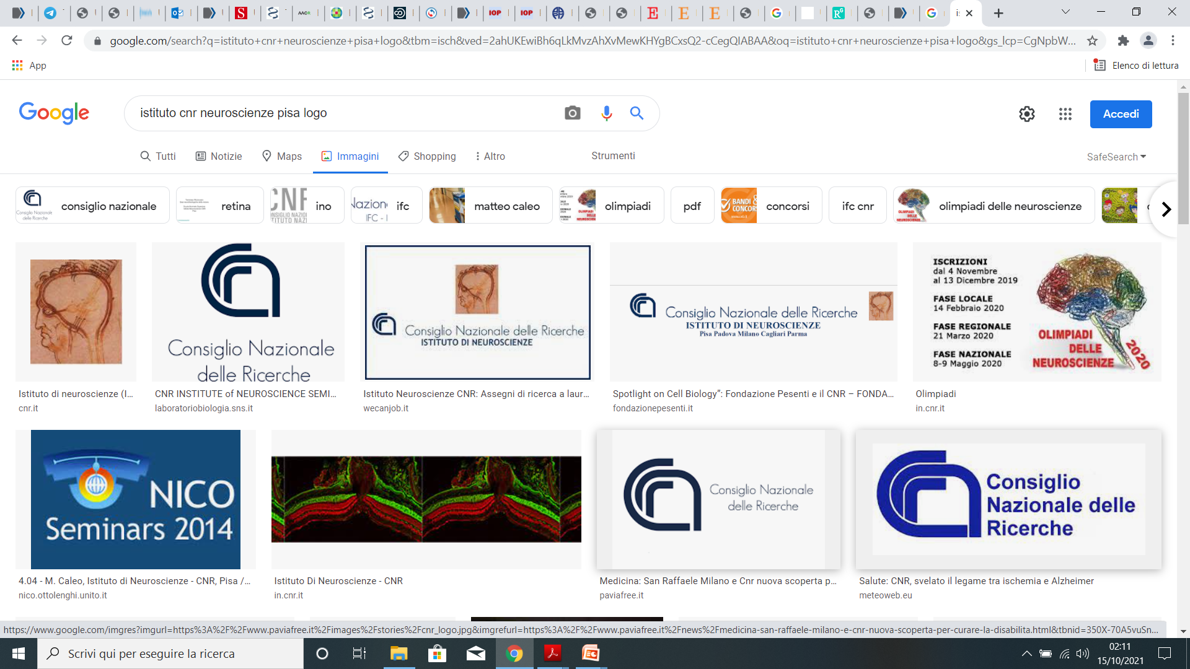

Centro multidisciplinare per lo sviluppo e l’implementazione della Flash radiotherapy (CPFR)
Inaugurazione 28/6/2022
Notes:
We are working to aquire:
-most robust data about the radiobiological
mechanisms underlying the effect
-knowledges of the quantitative
relationships between the flash effect
and the parameters of the beam
(dose-rate, dose-per-pulse, LET…)
and the characteristics of the
irradiated tissue (type, volume…)

Slide 7
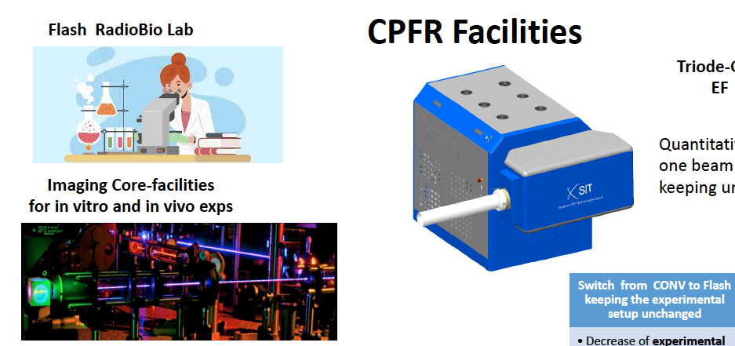

SIT ELECTRONFLASH 4000
Electrons 9 MeV
Triode gun
1 cm ∅ smallest applicator

Slide 8
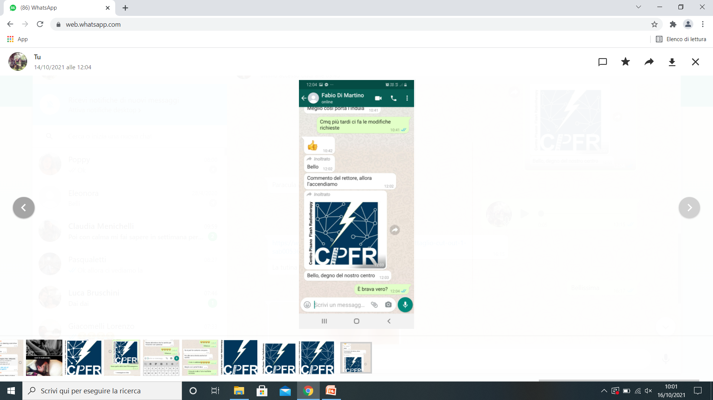
CPFR Research Program
Main Goals
Quantitative Radiobiological Experiments
in vitro/organoids/ex-vivo/in vivo
Theoretical/computational
radiobiological modelling
BASIC RESEARCH GOALS
To optimize the clinical
implementation of the Flash RT with
low energy electrons.
To acquire propedeutic data for the
future development and clinical
implementation of VHEE flash RT
Quantitatively assess the relationship between beam parameters and Flash effect
Understand the mechanism underlying the Flash effect
Notes:
We are going to carry out quantitative radiobiological experiments using in vitro, organoid, ex vivo and in vivo models combined with a multi-scale and multi-methodological computer simulation and modeling approach. To obtein a complete, yet detailed comprehension of the mechanisms of the UHDR differential effects and to asses the relationship between beam parameters and flash effect
8

Slide 9
CPFR Research Program
Main Goals
Pre-clinical in vivo studies
Development of a clinical dosimetric
protocol
Development of a patient
positioning and centering system
Development of a specific TPS
(Treatment Planning System)
CLINICAL GOALS
for Flash low-energy electron beams
SKIN TUMORS
UVEAL MELANOMA
CLINICAL TRIALS
Notes:
Finally, a clinical protocol will be defined for the treatment of dermatological tumors through the optimization of Irradiation parameters, the definition of the most appropriate clinical settings and the criteria for patient selection.
9

Slide 10
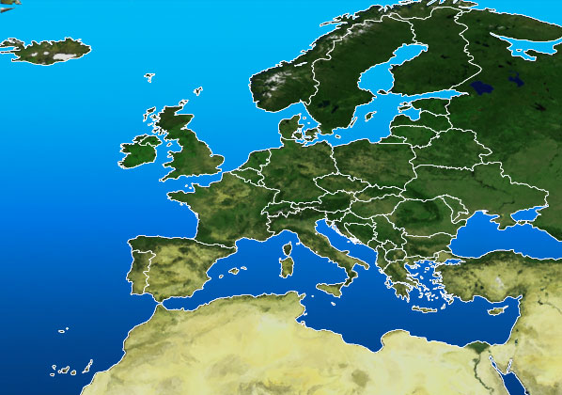
Collaborations
Marie Curie Institute (Parigi)-2020
Iridium Network (Anversa)-2021
CPRF (Pisa)-2022
ELECTRONFLASH
radiobiological experiments
dermatological treatments (3y)
LIAC FLASH
IORT FLASH (5y)
The network between these Centers is paramount for exchanging ideas, standardizing procedures and acquiring more data
VHEE FLASH
treatment of deep tumors (?)
Notes:
to answer these questions also in Pisa we created a multidisciplinary center dedicated to the flash radiotherapy thanks first of all to the knowledge of Doctor Martino who has been involved for many years in IORT and electron beams and the support of Fondazione Pisa, University of Pisa and AOUP and soon we will have an electron linac for the research that will be placed inside the radiotherapy unit of AOUP
We are working to aquire:
-most robust data about the radiobiological
mechanisms underlying the effect
-knowledges of the quantitative
relationships between the flash effect
and the parameters of the beam
(dose-rate, dose-per-pulse, LET…)
and the characteristics of the
irradiated tissue (type, volume…)

Slide 11
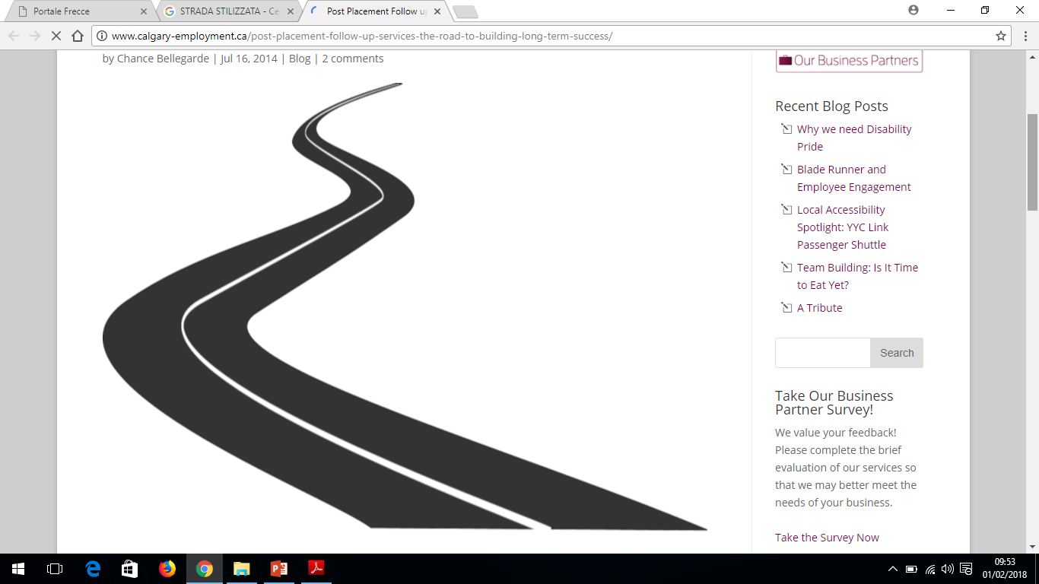
Research Toward VHEE Clinical Device
It is crucial to investigate quantitative dependencies of the flash effect from :
Irradiated volume
Adjacent fields
Fractionaction
Challenges
Optimize the delivery method
Optimize the clinical use
Pencil beam delivery mode
Multiple-field arrangement
to conform the dose
Collaboration with Sapienza Università di Roma and
INFN
Notes:
For the timescale involved in flash effect this is equivalent to the fractionation of the dose.
to optimize depth-dose distribution with electrons of energy greater than 100 MeV
The development of Flash VHEE devices is paramount for exploiting the Flash effect on a wider range of deeply seated tumors. Quantitative experiments and theoretical modelling of the dependencies of the Flash effect are needed to optimize the delivery method and the clinical use of the Very-High-Electron-Energy (VHEE) Flash Therapy.
As we can see on the right, for VHEE it is necessary to investigate quantitative dependencies of the flash effect from total irradiated volume, irradiation modality and total dose delivered. This is because to optimize depth-dose distribution with electrons of energy greater than 100 MeV pencil beam delivery is necessary, since it can mitigate electron lateral spread. This means that the dose is delivered with many small adjacent fields, therefore/thus the volume effect and the adjacent field effect becomes fundamental for evaluating the Flash effect. Also, multiple-field arrangement is necessary to conform the dose . Due to the timescales involved, this is equivalent to fractionating the dose, thus evaluating at which point the flash effect is maintaned and if there is a dose-threshold value for which the flash effect kicks in is of great importance. Another parameter to study is the instantaneous dose per pulse, as shown on the left. This can be of great advantage for laser driven VHEE modalities since the pulse lenght is intrinsically much smaller, resulting in much larger IDPP values.
For the timescale involved in flash effect this is equivalent to the fractionation of the dose
Prima cosa: perché la tecnologia laser-driven?la tecnologia laser-driven è molto indietro attualmente rispetto a quella standard a radiofrequenza (RF) perché si basa su processi fisici intrensecamente meno controllabili e riproducibili, sia in termini di fluenza che di spettro energetico. Il motivo per cui vi è interesse nel loro sviluppo derivano dal fatto che il processo di accelerazione delle particelle avviene in uno spazio molto piccolo, ovviando così alle difficoltà di accelerare in RF elettroni ad alta energia (VHEE) su lunghezze compatibili con i Linac medicali (entro 3 metri).
La caratteristica peculiare di questo tipo di tecnologia è quella di avere impulsi molto più brevi dei microsecondi dei linac a RF, quindi hanno un instantaneous dose-per-pulse (e solo quello) molto maggiore; questo significa che un eventuale incremento dell’effetto Flash con l’IDPP sarebbe una giustificazione anche clinico-radiobiologica (oltre a quella pratica relativa alle dimensioni e all’ingombro) al loro sviluppo.
Quindi te puoi riassumere dicendo:
Per la VHEE in generale – studio delle dipendenze quantitative illustrate a destra
Specificamente per la VHEE tramite tecnologia laser-driven – IDPP perché gli impilsi sono ridotti e di conseguenza è molto maggiore l’IDPP
Passiamo alla colonna di destra, VHEE in generale:
Per ottimizzare la distribuzione di dose in profondità con elettroni con E>100 MeV è necessaria un erogazione mediante pencil beam (singolo fascetto che “spazzola” il volume interessato. Questo per minimizzare lo spread laterale degli elettroni); questo significa erogare la dose mediante una serie di piccoli campi adiacenti. Diventa quindi fondamentale valutare per l’effetto Flash, sia l’effetto volume che quello dei campi adiacenti
oltre all’utilizzo della modalità pencil beam, sempre per conformare in modo accettabile la dose in profondità, è necessario utilizzare tecniche multicampo; per i tempi in gioco riguardanti l’effetto Flash questo equivale a frazionare la dose. E il mantenimento dell’effetto flash frazionando la dose equivale a valutare la dipendenza di quest’ultimo dalla dose (capire se c’è e quanto è un valore soglia e la dipendenza a partire da quel valore)
11

Slide 12
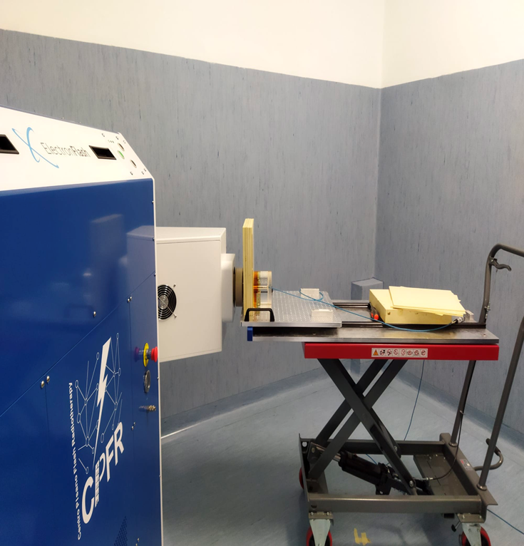
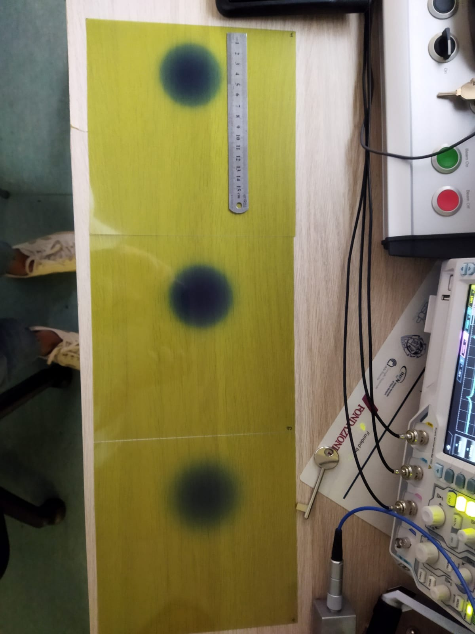
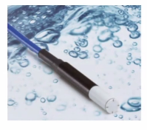
Caratterizzazione fascio
PDD con flashDiamond
Profilo al BU uniforme per diversi cm
DPP circa 23 Gy/p

Slide 13
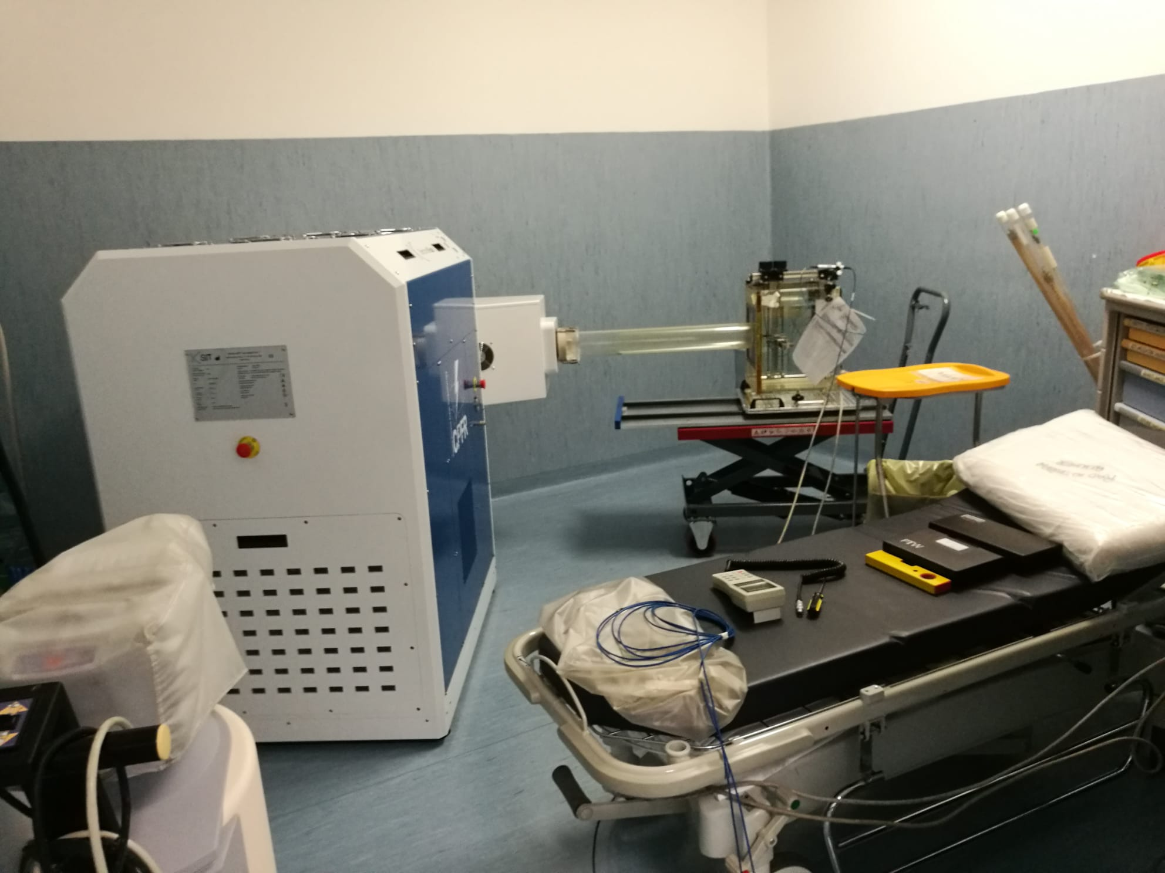
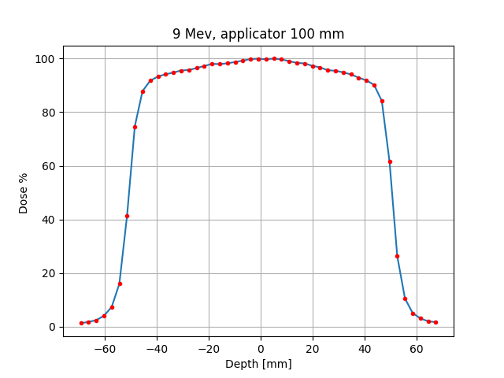
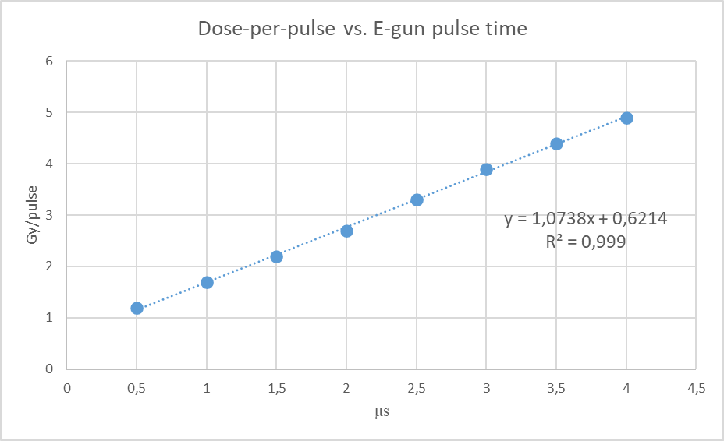
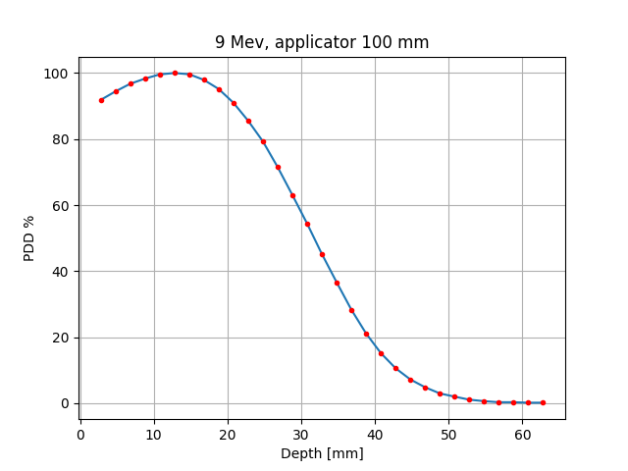

Slide 14


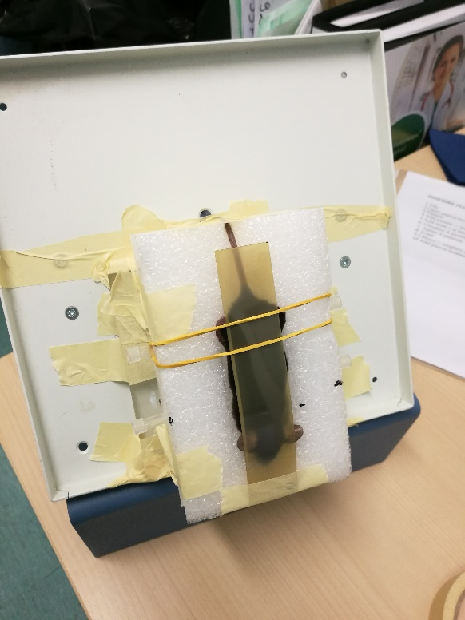
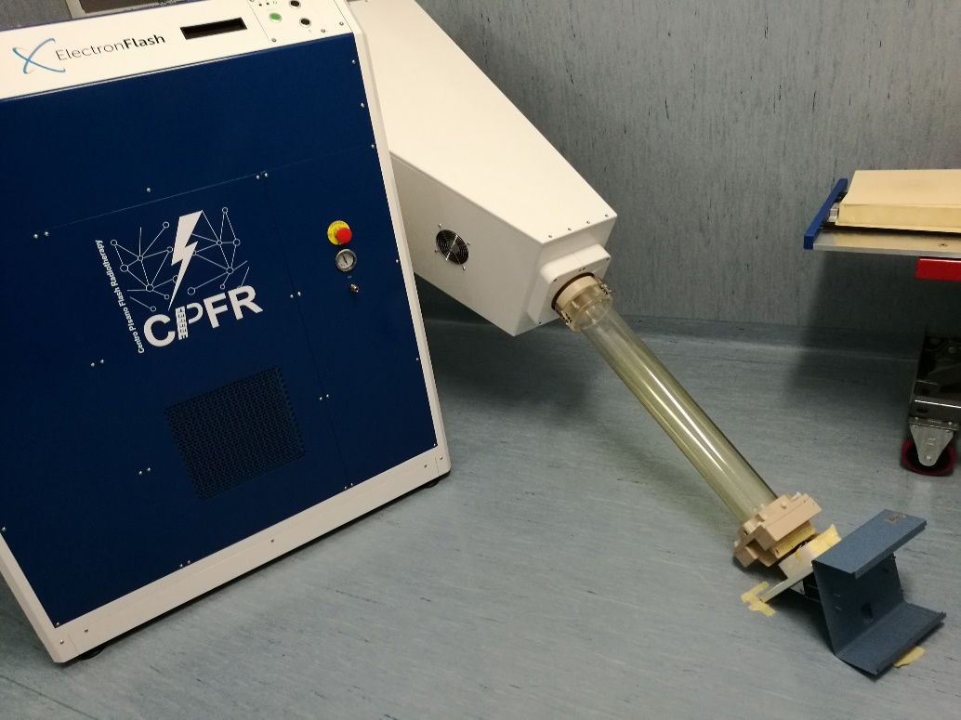
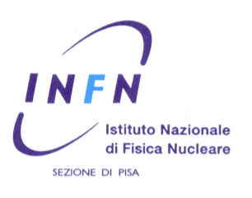
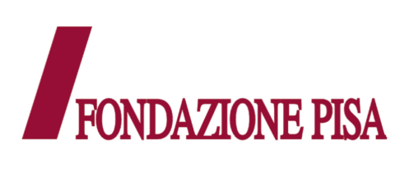
Esperimenti in vitro e in vivo
Esperimenti svolti in vivo e in vitro in condizioni CONV e FLASH
Riproducibilità del set-up garantita dal cannone a triodo

Slide 15

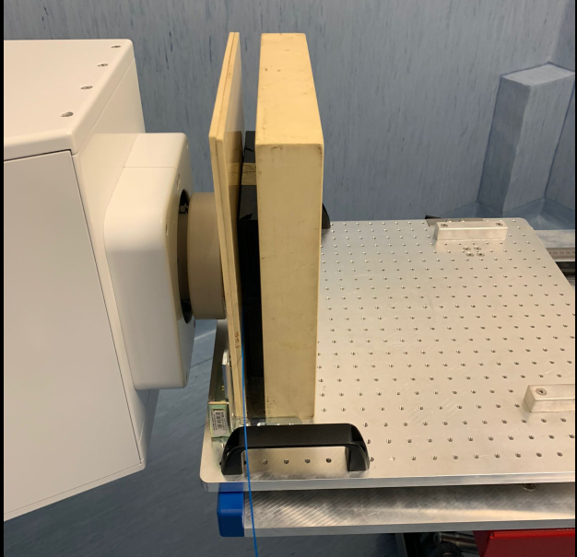
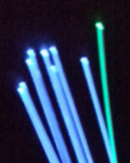
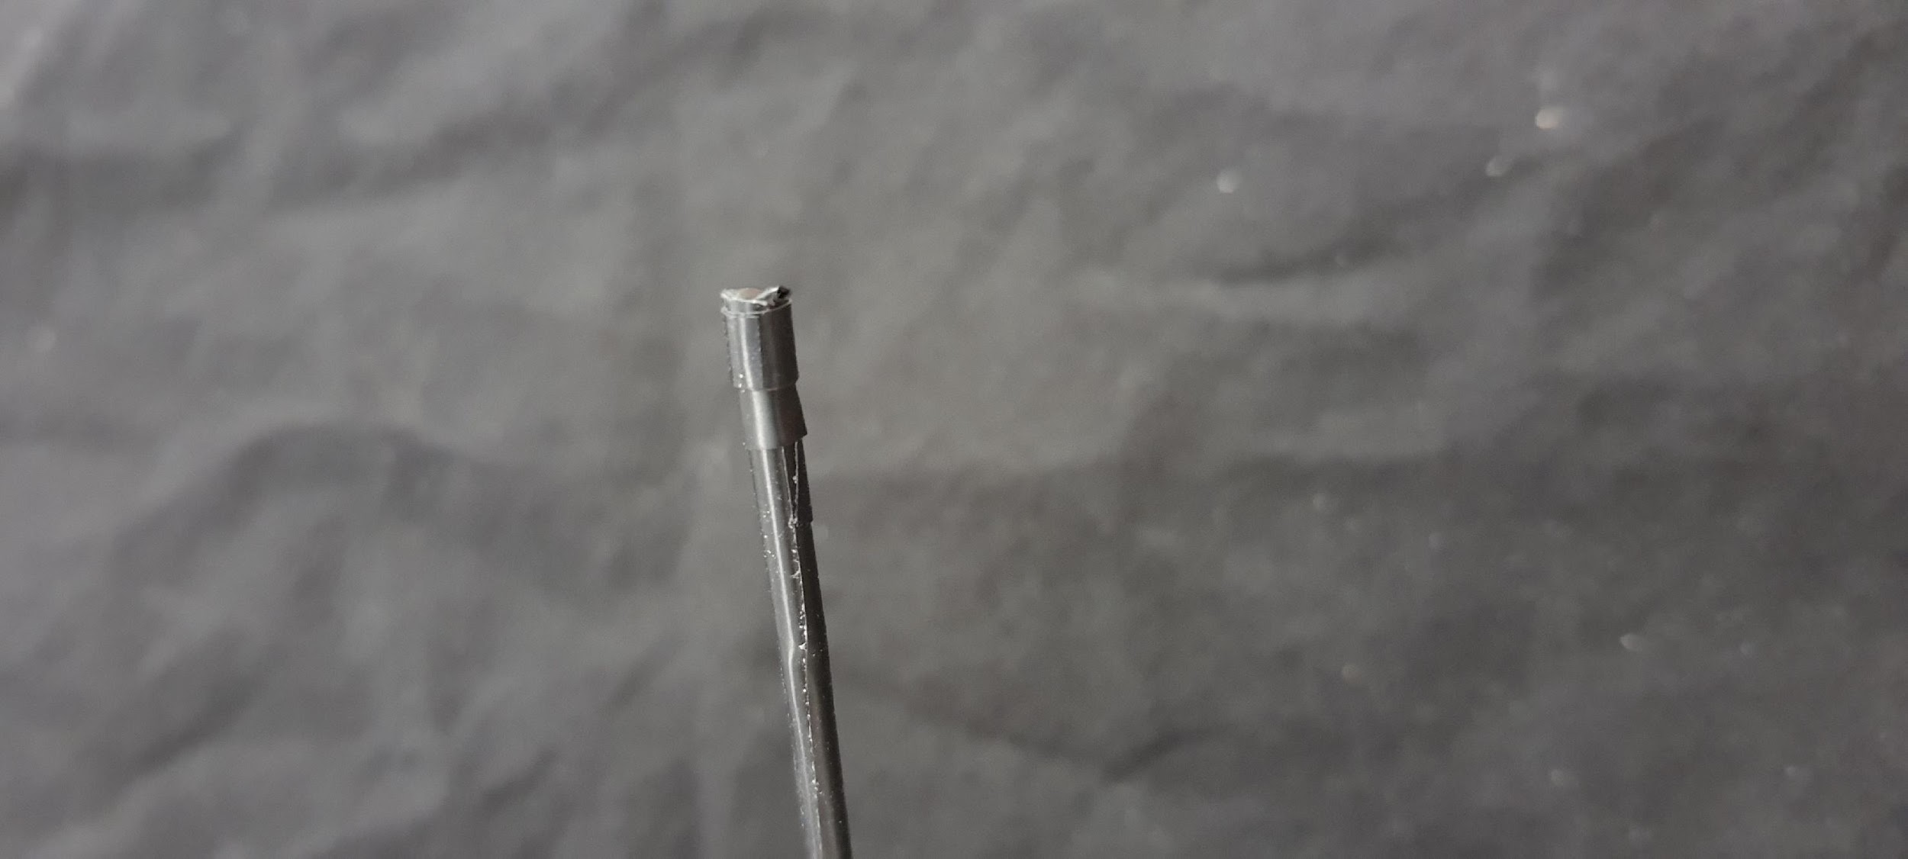
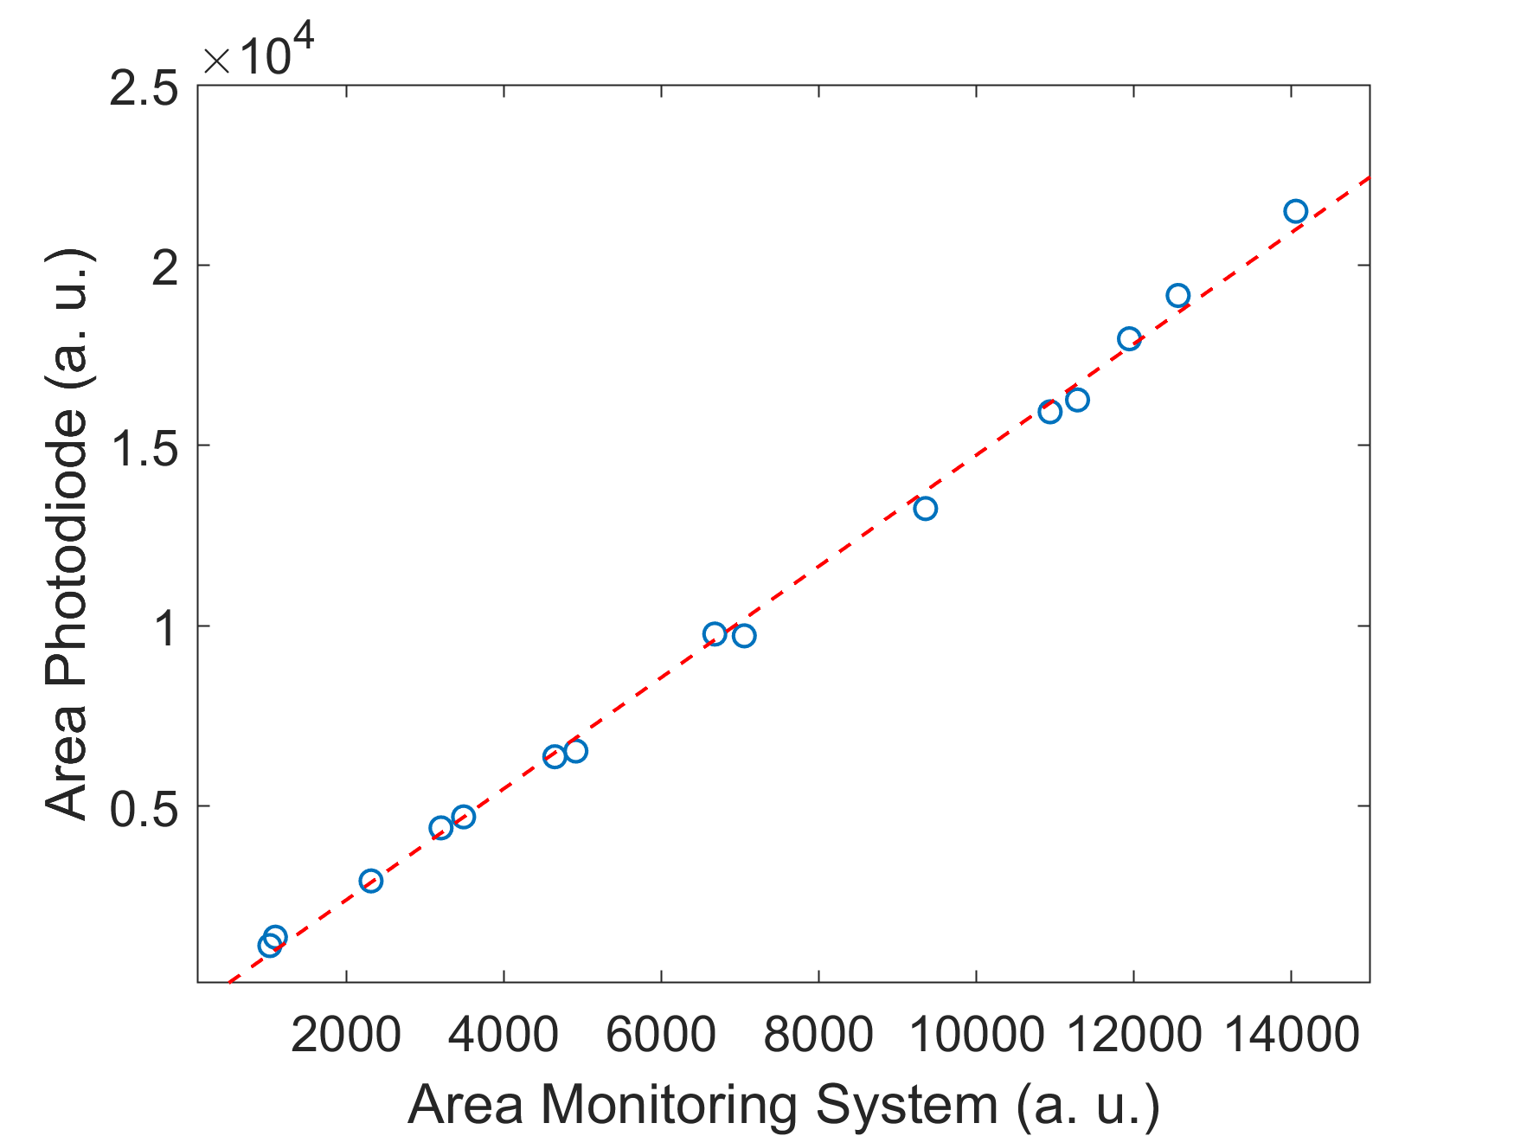
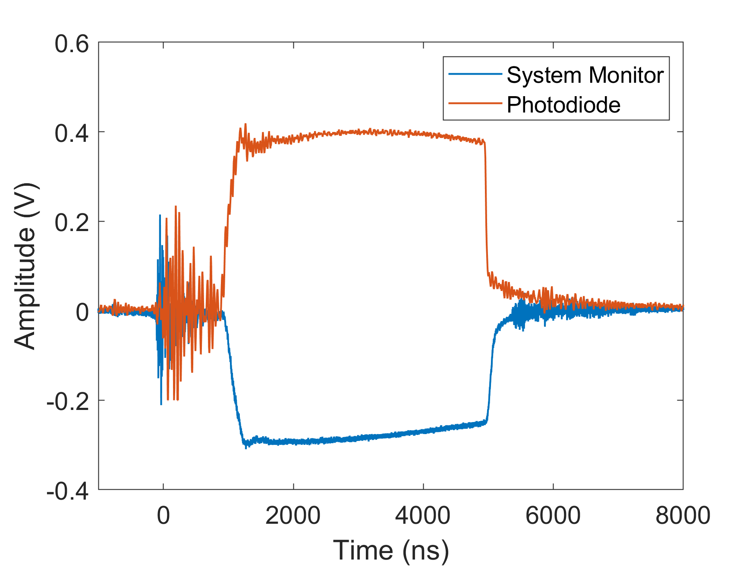
Scintillator Dosimeters
M.G. Bisogni, M. Morrocchi,
E. Ciarrocchi et al.
Pulse time structure and linearity: the area of the signal of the monitoring system.
The linearity was verified in the whole dose range, the maximum available dose rate was tested (23 Gy/pulse) and different pulse widths were used.

Slide 16
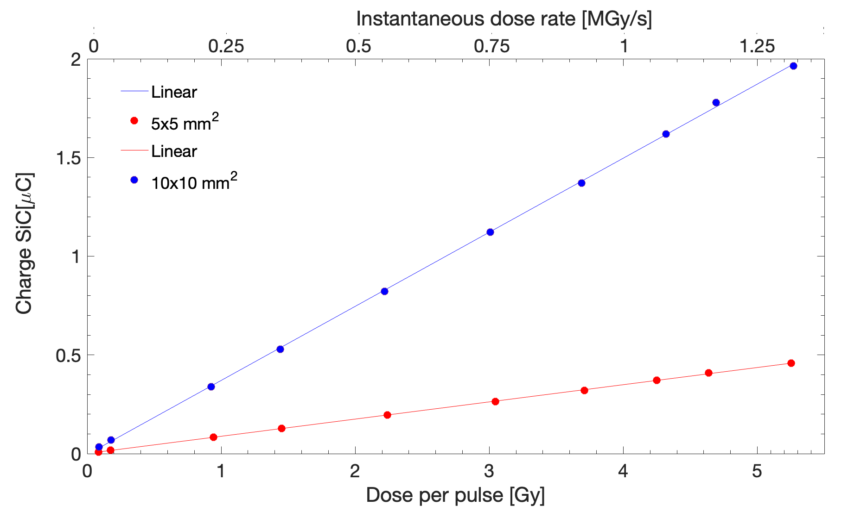
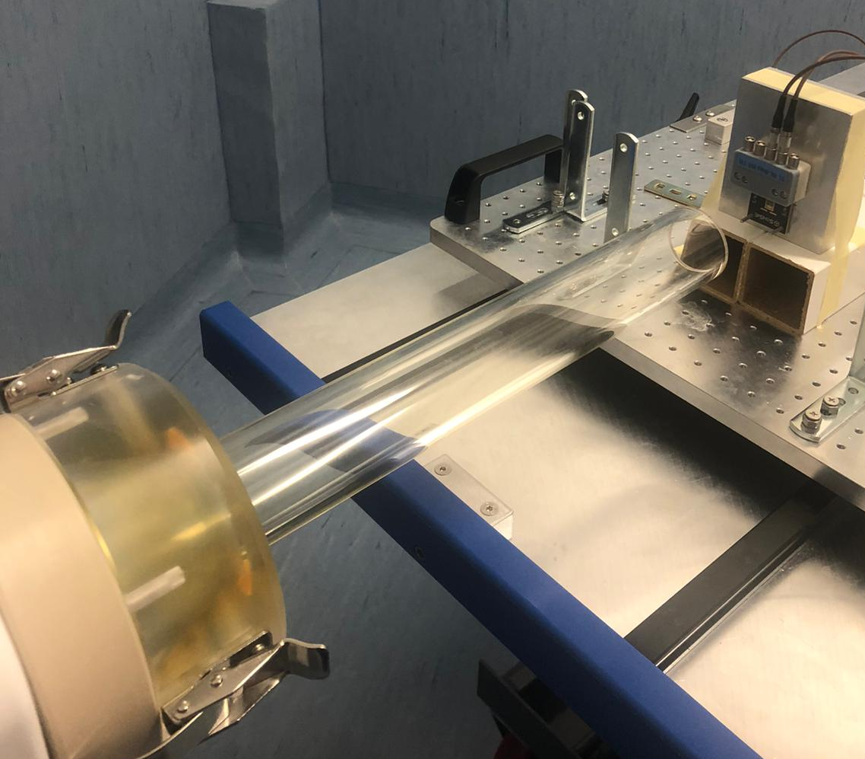
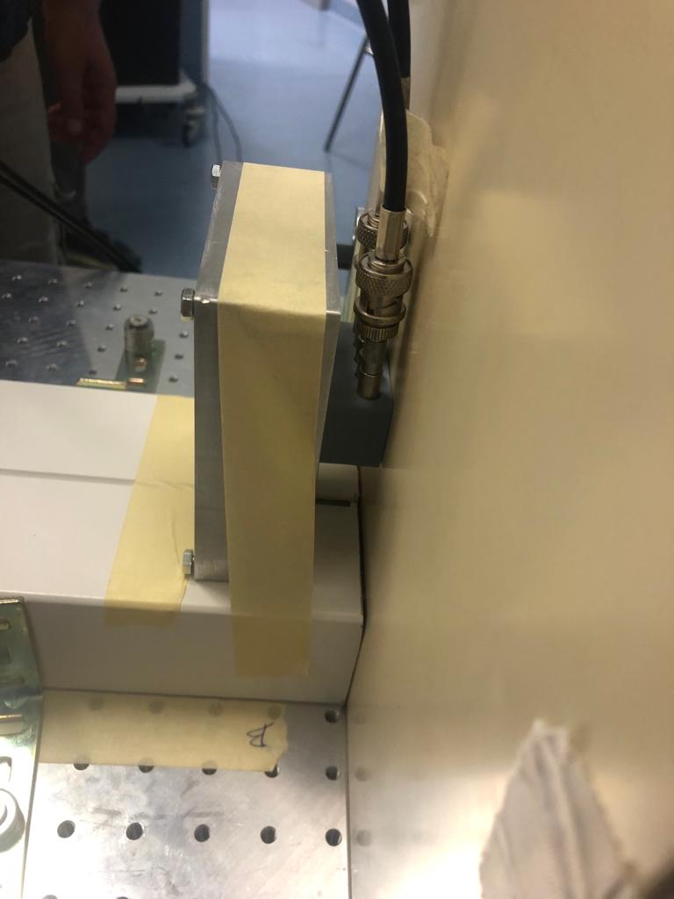

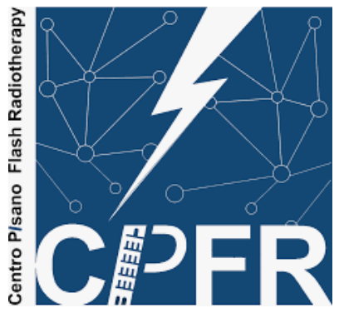
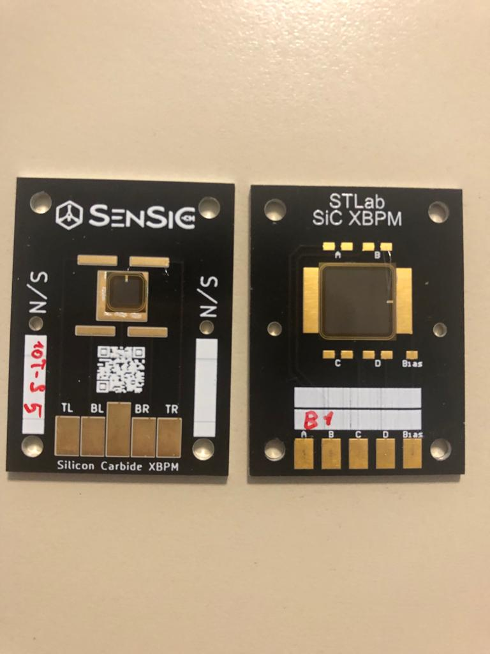
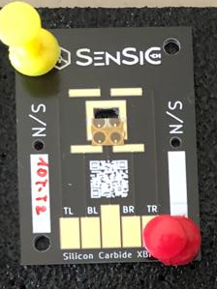
Experiment with Electron FLASH Linac accelerator @ CPFR
Courtesy of F. Romano,
G. Milluzzo
SiC detectors for beam monitoring and dosimetry for FLASH
Experimental conditions
E = 9 MeV
Pulse duration: 0.1-4 us
Dose per pulse: from 0.1-5 Gy
Istantaneous dose rates up to MGy/s
10x10, 5x5, 1x1 mm² 10 um thick SiC
Alanine dosimeters at the build-up
30,40,100 mm Applicator
RC circuit connected to the detector to slow down
the current acquisition in the electrometer
2 cm air
Measurements
SiC response as a function of the BIAS voltage at the maximum dose per pulse and dose rate (5 Gy/pulse)
SiC response as a function of the dose per pulse to verify linearity in single pulse
Comparison with alanine detectors
5x5 mm² 10x10 mm ² 1x1 mm ²
R
C

Slide 17
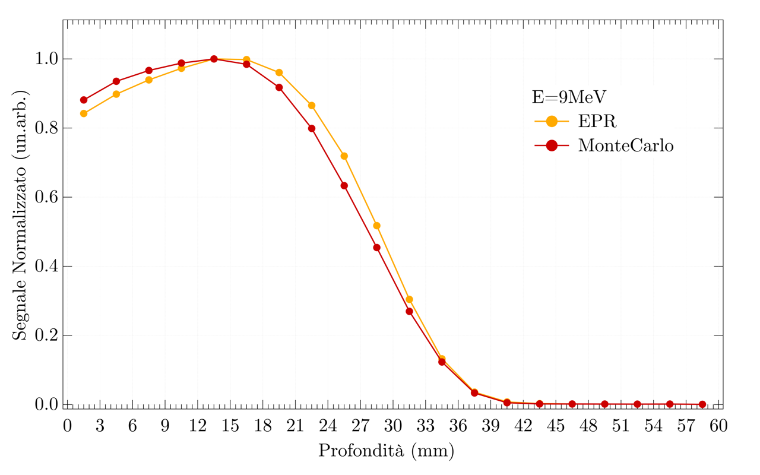

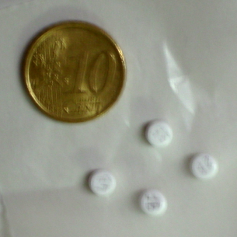
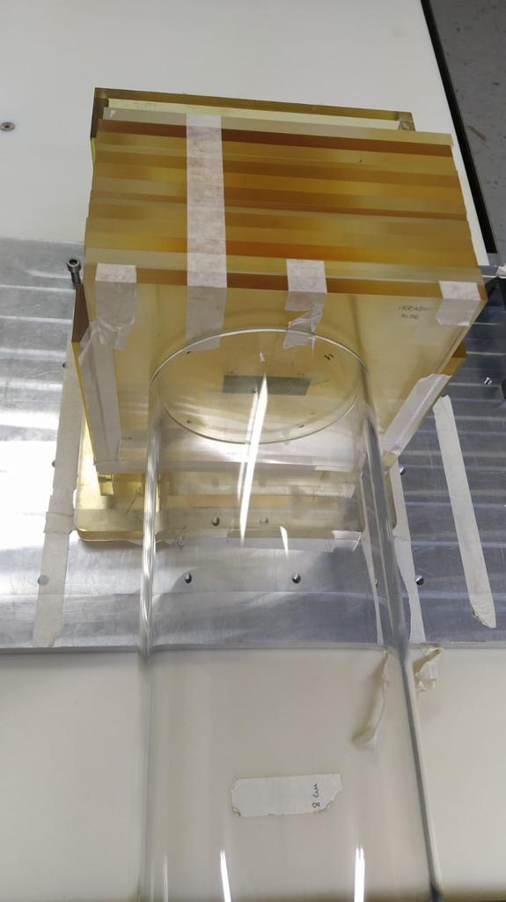
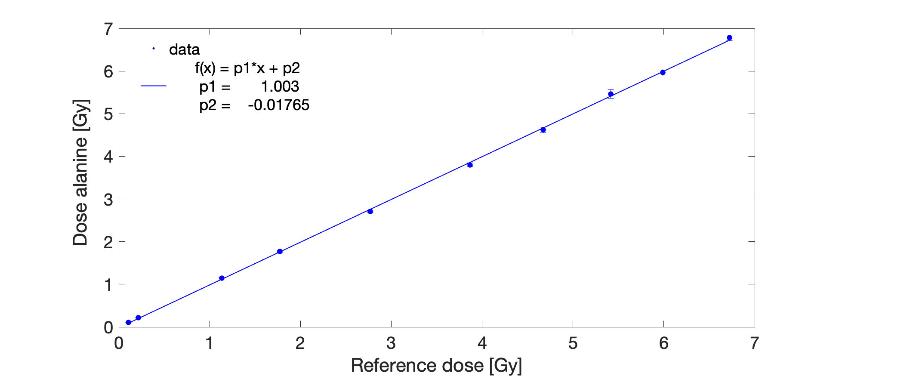
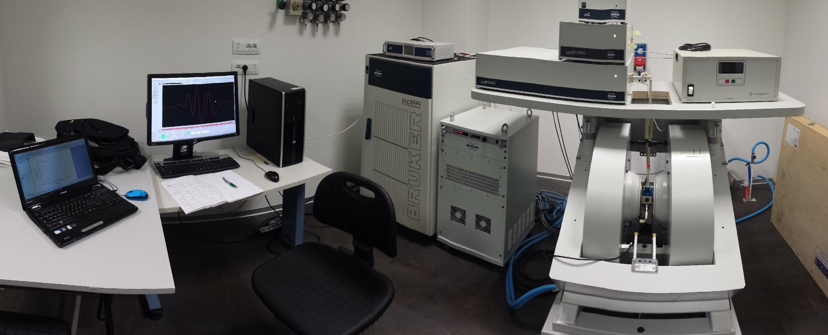
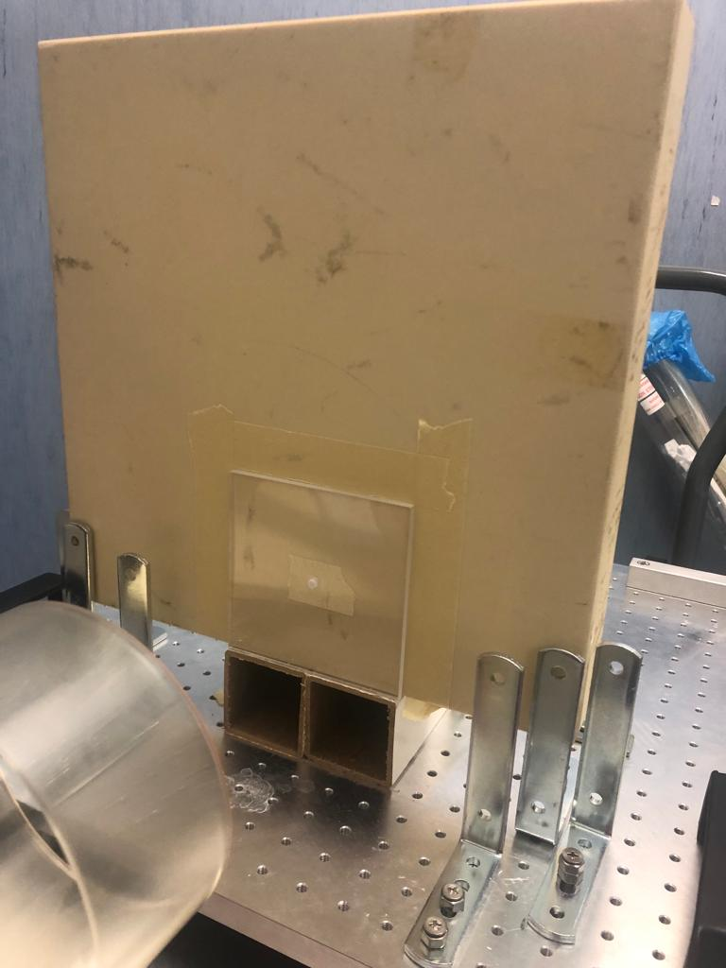
Courtesy of F. Romano, G. Milluzzo,
M. Marrale
Alanine detectors for UHDR beam absolute dosimetry
Stack of alanine pellets for PDD
E = 9 MeV
Pulse duration: 4 us
Istantaneous dose rates up to MGy/s
Comparison with MC simulations
Monte Carlo
EPR
Alanine pellets (diameter ~4.8 mm, height ~3.0 mm, and mass ~68 mg) are simple amino acid sample provided by Gamma Service (Germany).
Depth [mm]
Bruker Elexys E580 EPR spectrometer
  Dose per pulse [Gy]

Slide 18
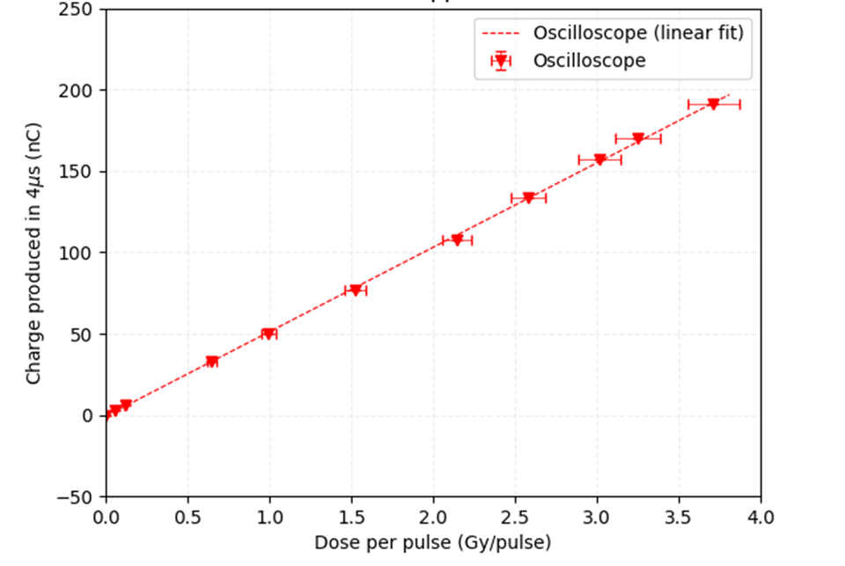
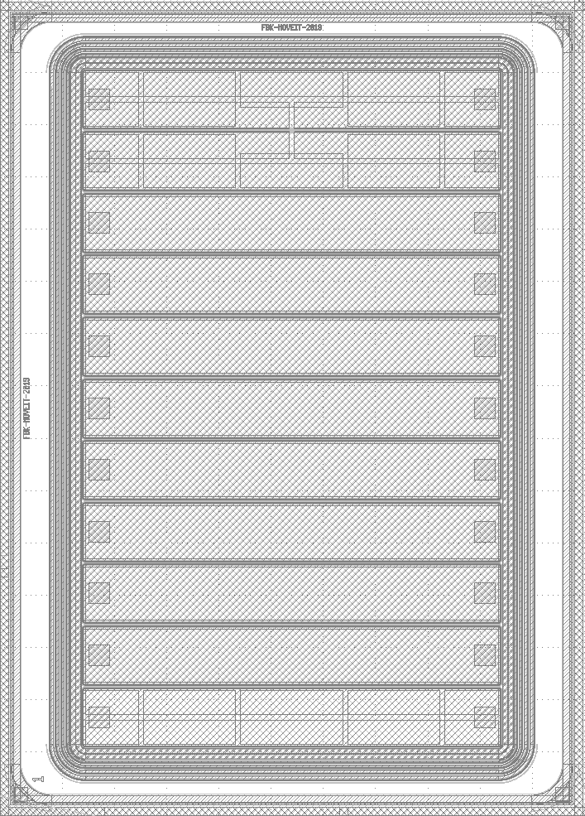
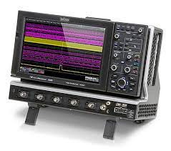
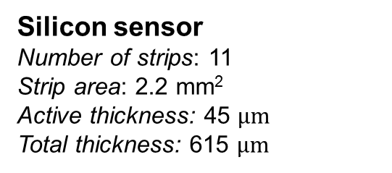
Courtesy of A. Vignati
Beam monitoring
Torino (INFN & Università degli Studi)
Beam test @ CPFR
4-5/10/2022
30 and 40 mm applicator
Silicon sensor
Number of strips: 11
Strip area: 2.2 mm²
Active thickness: 45 $μm$
Total thickness: 615 $μm$
One strip readout through the oscilloscope
LeCroy Digital oscilloscope
(WAVERUNNER 640Zi)
10 GS/s sampling rate

Slide 19
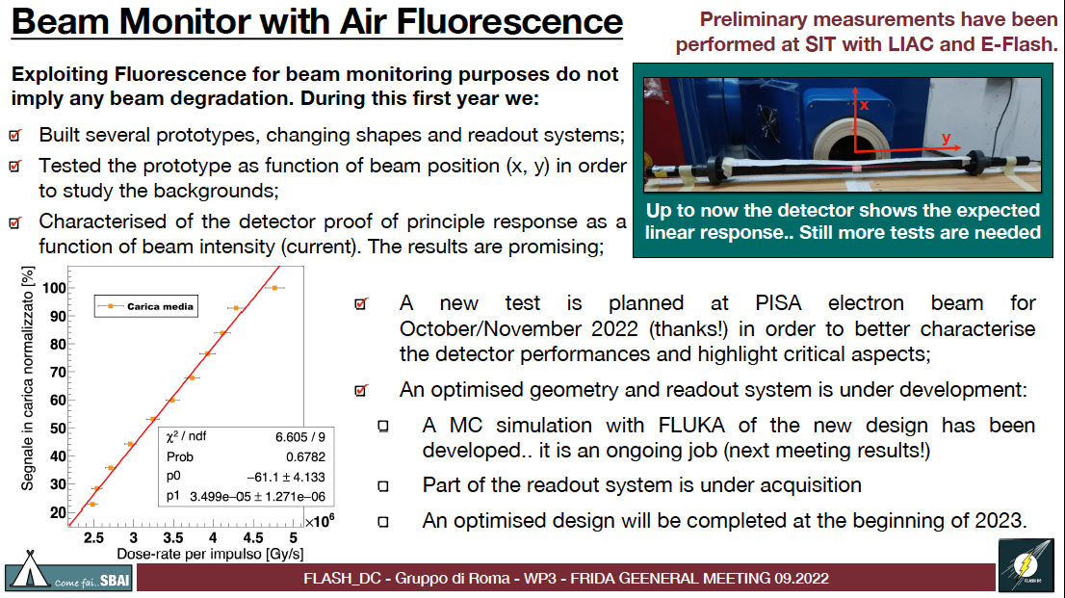
Courtesy of M. Marafini

Slide 20
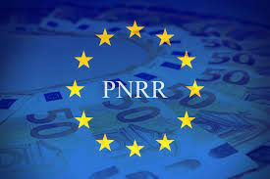


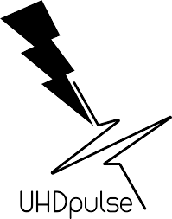
Ecosistema Innovazione «Tuscany Health Ecosystem» THE (HUB UNIFI- partners UNIPI and INFN) 110 spoke1: Advanced radiotherapies and diagnostics in oncology (spoke leader CNR; partner affiliati UNIFI, UNIPI, INFN)
Partenariato esteso Medicina di Precisione (PE6) Diagnostica e terapie innovative nella medicina di precisione (HEAL ITALY – PE6)
«Health Extended ALliance for Innovative Therapies, Advanced Lab-research, and Integrated Approaches of Precision Medicine»
SPOKE 5) Next-Gen Therapeutics
SPOKE 6) Healthy Toolbox
MISE/IPCEI Salute (superata fase 1)
EU UHD Pulse 2 (INFN, UNIPI)

Slide 21
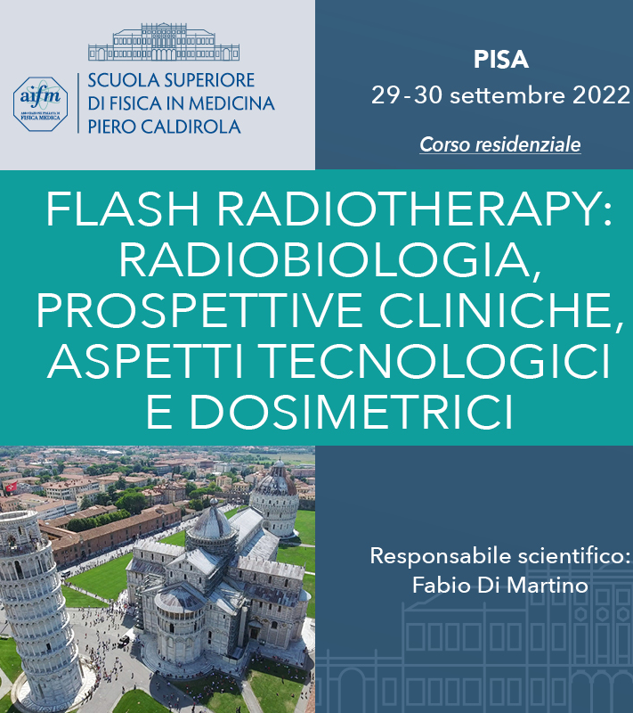
Organizzata da AIFM in collaborazione anche con INFN
~200 partecipanti
18 invited talks
Round table

Slide 22
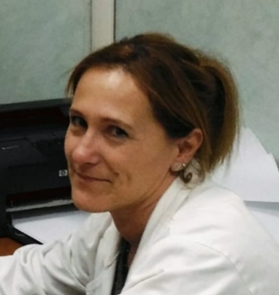
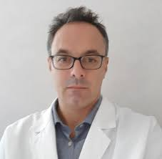
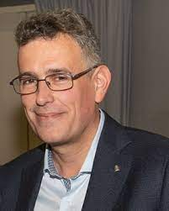


Acknowledgments
F. Paiar
S. Ursino
S. Capaccioli
F. Di Martino
M. Costa
M. Marafini, Centro Fermi and INFN Roma1
F. Romano, INFN Catania
A. Vignati, INFN and UNI Torino
E. Ciarrocchi, D. Del Sarto, S. Linsalata, A. Kraan, M. Montefiori, M. Morrocchi, J. Pensavalle, A. Retico, V. Rosso

Slide 23
Thank you

Slide 24
Back up

Slide 25




CPFR Research Program
Main Goals
SKIN
2D biological array for radiobiological
experiments
Skin tumours: Flash-RT tumour response/
initial clinical application of low energy EF
Healthy skin: fundamental organ at risk for
the VHEE
BASIC RESEARCH GOALS
BRAIN
Promising results from preclinical data
(neurocognitive sparing flash effect)
Poor prognosis of primary tumors and
metastases (unmet needs)
Specific expertise in “in vivo” quantitative-
functional analysis
CLINICAL GOALS
for Flash low-energy electron beams
SPINAL CORD
Cornerstone of primary organs at risk in
clinical practice
Yet to be investigated
(most available data focused on brain, lung
and bowel)
Notes:
Our next step will be to reach these two main goals one related to basic research and the secondo to the clinic application of Low ernergy EF to treat superficial tumors we planned to achieve these two main goals one related to basic research and the other to the clinical implementation of our electron flash device for the treatment of superficial tumors.
We are going to focus our attention on these organ/tissues.
…. the spinal cord is the main organ limiting the administration of high doses on tumors arising in the head and neck and thorax and finally because it is Yet to be investigated
25

Slide 26



Structure of the dosimeter
Plastic scintillator - Kuraray SCSF-78J, 10 mm length and 1 mm diameter
Clear optical fiber - Thorlabs, 1 mm diameter and 25 m long
Optical coupling - Cyanoacrylate glue in Peek tube
PMMA
block
irradiated region
3
Courtesy of E. Ciarrocchi

Slide 27


(F. Romano, G. Milluzzo)
SiC response as a function of the dose-per-pulse
Voltage
Signal
Keithley 6517A
SiC
Results
First test ever performed with SiC with UHDR beams for FLASH radiotherapy successfully caried out
Optimal linearity od the two investigated SiC detectors up to several Gy/p (→ correspondent to instantaneous dose rate of several MGy/s)
Promising results for an implementation of these detectors in the protocols
Design and realization of 2D high spatial resolution configuration in progress
Pulse duration=4 us
Unpublished data
G. Milluzzo et al., in prep. for Med. Phys.

Slide 28





Courtesy of F. Romano,
G. Milluzzo
SiC detectors for beam monitoring and dosimetry for FLASH
  Silicon carbide instead of Si or C
  Scalable device fabrication
  Diamond-like properties
Diamond
SiC with bulk
Freestanding membranes
collaboration
5x5 mm² 1x1 cm²
20um 2um 0.2um
Test with proton micro-beam with IBIC technique
Characterization with UHDR electron beams @CPFR

