Slide 1

WP8 – Cooling Cell Integration
Lucio Rossi
D. Giove, M. Statera et al.
INFN – LASA- Milano,
Università degli Studi di Milano
MUCOL Italia
Pavia – 20 December 2022

Slide 2
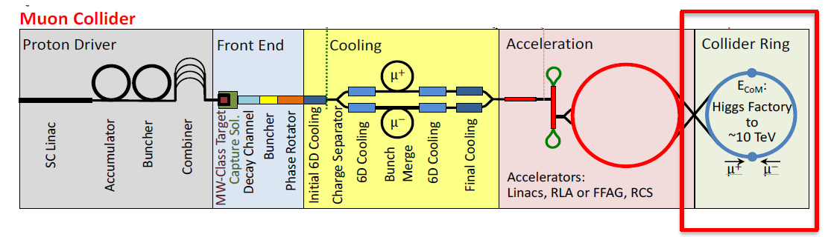
WP8
Scope:
WP8 will select the technologies that are more suitable for the design and construction of a cooling cell that will demonstrate the feasibility of the Ionisation Cooling concept
produce a 3D model of a complete cooling cell. Technologies of the individual components will be selected in collaboration with WP4, WP6 and WP7
. solution of all issues of interference, for instance of couplers, feeders, cables, cooling pipes, solenoid and RF cavity infrastructure and support structures.
Partecipants:
INFN Milano
L. Rossi, M. Statera, D. Giove
UNIMI
Rossi, S. Sorti, J. Pavan, L. Balconi
INFN-LNS
S. Mauro
CERN
L. Bottura, R. Losito
STFC-UK
C. Rogers

Slide 3
Description of the tasks
WP8 will be led by the University of Milano, with the support of CERN (who will provide a deputy WPL)
It will be structured in 5 tasks (task leader underlined):
  8.1 RadioFrequency (INFN)
  8.2 Solenoids (CERN, INFN, UMIL)
  8.3 Absorbers and windows (CERN)
  8.4 Cooling cell performance (UKRI)
  8.5 Integration (UMIL, CERN, INFN, )

Slide 4
Ionisation cooling

Slide 5
Final Cooling

Slide 6
MICE Experiments

Slide 7
MICE Cooling solenoids
Spectrometer solenoids upstream and downstream
  400 mm diameter bore, 5 coil assembly
  Provide uniform 2-4 T solenoid field for detector systems
  Match coils enable choice of beam focus
Focus coil module provides final focus on absorber
  Dual coil assembly - possible to flip polarity

Slide 8
Cooling demonstrator:EU infra call 2024 one European facility

Slide 9
Concetto preliminare cooling Cell

Slide 10
Pre kickoff meeting held in Milano-LASA
The Meeting was preceded by a seminar of C. Rogers at the LASA lab, upon invitation of INFN, on “Muon Generation and Cooling Cell for the International Muon Collider”. The seminar is available at the Indico site: https://indico.cern.ch/category/16286/
The Meeting is the 1st pre-kickoff meeting for HE-MuCol-WP8-Cooling Cell Integration with participation of WP4-The Muon Production and Cooling, WP6-Radio Frequency Systems and WP7-Magnet Systems.
The discussion revolved around the demand from beam physics on magnets and RF in a Muon Collider Cooling Cell (MCCC), and how to demonstrate them.

Slide 11
A first parameter of relevance is the frequency of the RF (MCCC is 704 MHz) for the test stand Testing requires relatively large powers to probe breakdown limits (the RF cavities are resistive).
CERN: <400 MHz (several values, including 352 MHz)), 3 GHz and 12 GHz
CEA: 704 MHz
Daresbury: 3 GHz
INFN-LASA: 1.3 and 3 GHz (TBC)
Magnetic field : a split pair in parallel (series powered) and antiparallel (oppositely powered) configuration
uniform field of 7 T (on axis)
gradient field of 30 MV30 T/m (on axis) over the cavity volume.

Slide 12
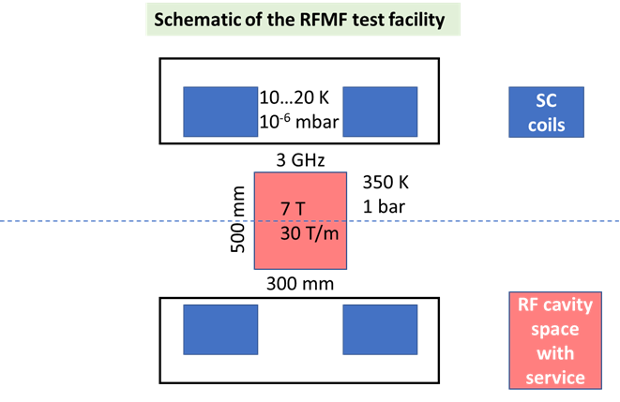
Radio Frequency in Magnetic Field facility
To consider and study
Space
For 3 GHz test stand free bore: ∅ = 500 mm free RT bore
For 704 MHz test stand free bore: ∅ = 600 mm free RT bore
For 352 MHz test stand free bore: ∅ = 1000 mm free RT bore
Heat load
Vacuum
Stray magnetic field
Filed configuration and magnet technology(also relevant for MCC)
RF couple position (also relevant for MCCC)
Single vacuum enclosure

Slide 13
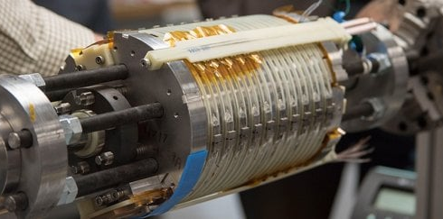
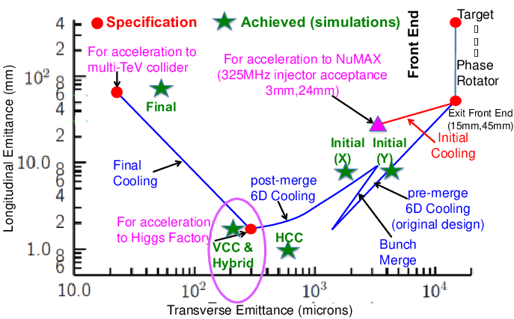
Cooling solenoids
A field of 40 T (minimum), up to 60 T (target) is needed to meet emittance specification at the end of the cooling stage
30 T assumed in MAP
40…60 T required
HTS insert of NHMFL all SC 32 T
32 T in 40 mm (15 T LTS + 17 T HTS)
Present state of the art is the 32T all-SC solenoid in operation at NHMFL.
Novel technology is required (NI/PI) for compact, UHF solenoids operating without (or minimal) helium
D. Neuffer, et al.
Solenoids for a muon collider need to be compact (reduce cost), mechanically strong (withstand extraordinary e.m. forces) and well protected against quench (large stored energy)
Targeted R&D is required to address these challenges

Slide 14
Cooling solenoids R&D plan
The conceptual design of UHF solenoids has started, exploring limits of performance (field and stress), operating efficiency (temperature), lean and compact designs (mass and cost)
We are defining a Solenoid Coil Demonstrator (SCD), a representative test configuration (20 T, 50 mm, 500 MPa) to support the conceptual design with a strong experimental basis. This configuration could be a basis for collaborative work across laboratories
Some 10 SCD’s per year will be needed (manufacturing and testing). Each SCD requires approximately 150 m of 12 mm HTS tape
HTS tape, initially in the range of 1 to 1.5 km (12 mm) is the single most critical item to start manufacturing and experimental work
  Define initial experimental needs by performing material characterization
  Provide material for the manufacturing of the first SCD’s
INFN-LASA engagement
1-1.2 km of HTS tape for SCD

Slide 15
Programma 2023
Partecipare al design delle bobine dimostratori (SCD).
Prendere la leadership nel procurement e qualifica dell’ HTS tape.
Contribuire alla costruzione della prima bobina (attività principalmente svolta al cern)
Collaborazione: CERN, INFN, Univ di Twente (NL), Univ. di Ginevra, KIT, CE ecc…
Il costo è valutato in ca 120 k€ per 1 km di tape (+ IVA) → ca. 150 k€

Slide 16
Thank you
for your attention

