Slide 1
Programma di sviluppo per il design di cavità SC per la sezione alta energia: contributo INFN
D. Sertore
INFN Milano – LASA
for the SRF group

Slide 2
Introduction
Fast acceleration is key for muon survival rate
Needs large RF voltage in short length
High-gradient RF system
Huge total RF voltage per turn in circular accelerator
Few turns, one μ⁺ and one μ⁻ bunch simultaneously
This presentation is freely taken from «SRF Systems for Rapid Cycling Synchotron» presented at 2022 Muon Collider Annual Meeting

Slide 3
Introduction
Rapid cycling synchrotrons (RCS) chain, counter-rotating μ⁺/μ⁻ bunches
Conventional RCS and 2…3 hybrid RCS: normal and supercon. magnets
hybrid RCS 5 TeV
0.75 TeV → 1.5 TeV
(1.5 TeV → 5 TeV)
63 GeV → 0.31 TeV
0.31 TeV → 0.75 TeV
hybrid RCS 1.5 TeV
norm. cond. RCS
hybrid RCS
Both in the same tunnel

Slide 4
Distributed RF system along the circumference
Limit energy gain per RF station
Avoid large energy difference between counter-rotating μ⁺/μ⁻ beams
During first turn in RCS1 energy gain is about 20% of beam energy!
Transverse optics can limit the impact of beam energy differences
Not the most stringent constraint
E_{in}
E_{in}+eV_{RF}sin(φ_{S})
E_{in}+eV_{RF}sin(φ_{S})
E_{in}

Slide 5
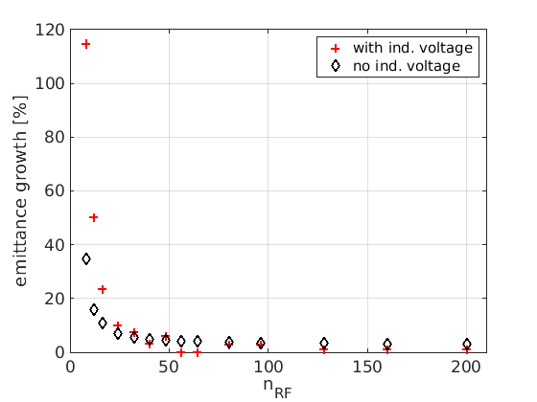
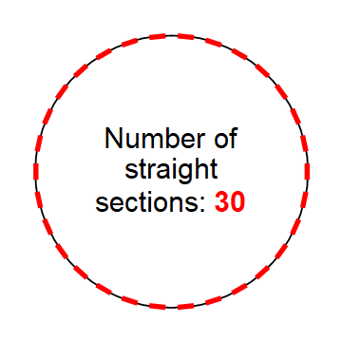
Why distributed RF system? How many stations?
Multiple longitudinal kicks per turn to smoothen synchrotron motion again
Stable synchrotron oscillations and phase focusing for Q_{S} << n_{RF} ∙ 1/π
Tracking simulations to determine longitudinal emittance growth (with BLonD code)
Favourable range of n_{RF} ≈ 30
Tune Q_{S} as large as 1.5
Long. emittance growth versus n_{RF} in RCS1
F. Batsch

Slide 6
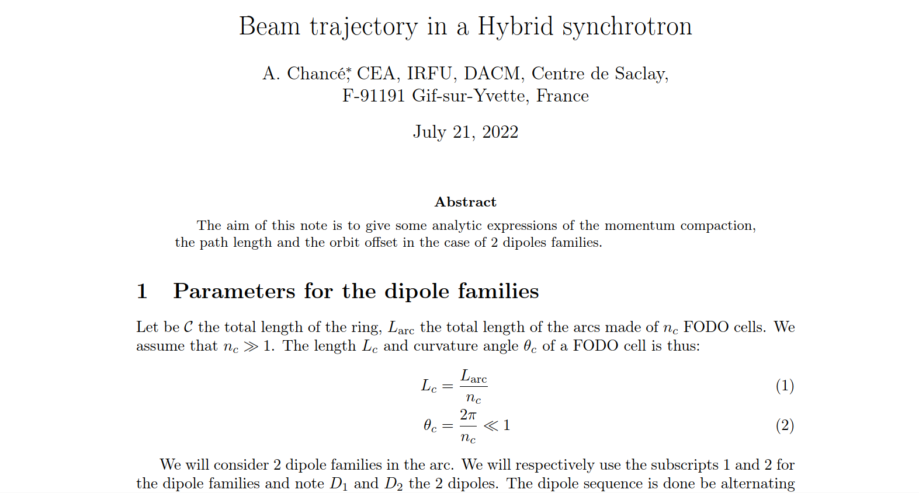
Rapid Cycling Synchrotron (RCS) parameters
Principle of hybrid RCS (RCS2, 3 and 4):
Fast ramping of normal conducting magnets from negative to positive field: -1.8 T → + 1.8 T
Fixed-field super-conducting magnets in addition (max. 10 T)
Beam orbit moves during acceleration → f_{rev} and f_{RF} sweep
Assume max. 10 cm orbit length change for RCS2
A. Chancé

Slide 7
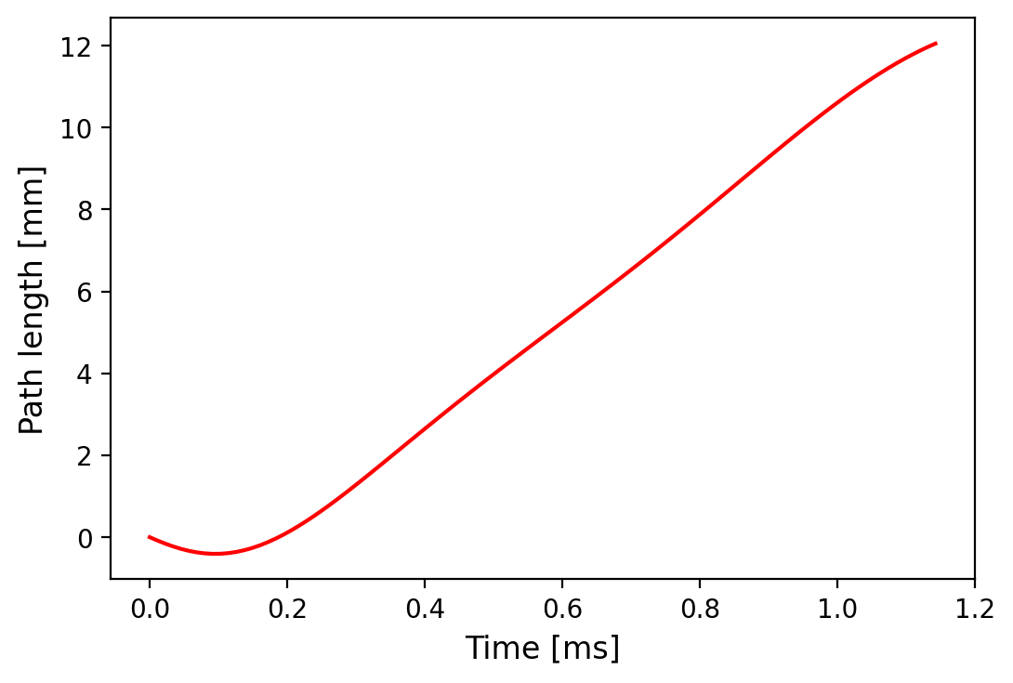
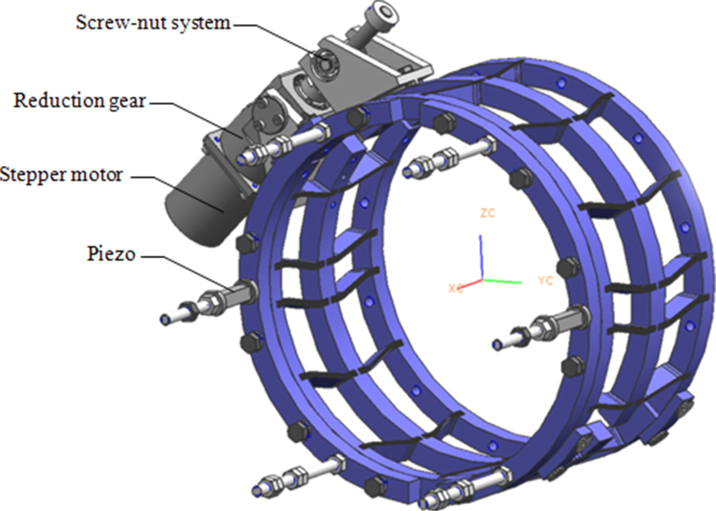
RF frequency sweep (example of RCS2)
Typical path length change during
acceleration
RF frequency sweep need in ~1 ms, from injection to extraction
Δf/f = Δl/(2πR) ≈ 1.7 ∙ 10⁻⁶ → Δf ≈ 2.2 kHz
Control RF frequency during ‘beam pulse’
In addition to compensation of Lorentz force detuning
Reported tuning ranges for ILC-style cavities
W. Cichalewski et al., ICALEPCS2015: Δf ≈ 1.2 kHz
Y. Pischalnikov, ILCX2021-ILC: Δf ≈ 3 kHz
Faster: Turn-by-turn transient beam-loading correction
FerroElectric Fast Reactive Tuners (FE-FRT)
A. Chancé
Piezo

Slide 8
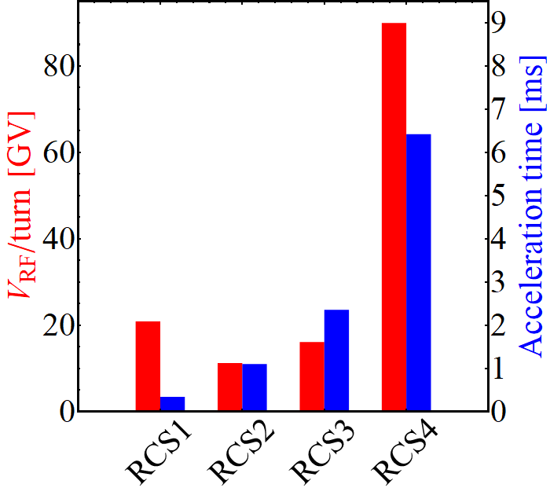
Why super-conducting?
RF voltage and acceleration time
Large RF voltage during long pulses
Energy efficient acceleration technology
High accelerating gradient per RF structure length: 30 MV/m
Standing wave operation for counter-rotating bunches

Slide 9
RCS RF system choices
Common frequencies for superconducting RF
Starting assumption
Frequency | Accelerator | Remark
352 MHz | LEP | Moderate gradient
400 MHz | LHC, FCC | Moderate gradient
800 MHz | ERL, (FCC) | Alternative option also for μRCS
1.3 GHz | TESLA, ILC, FELs (XFEL) | Wide-spread technology with decades of experience
1.5 GHz | JLab-CEBAF

Slide 10
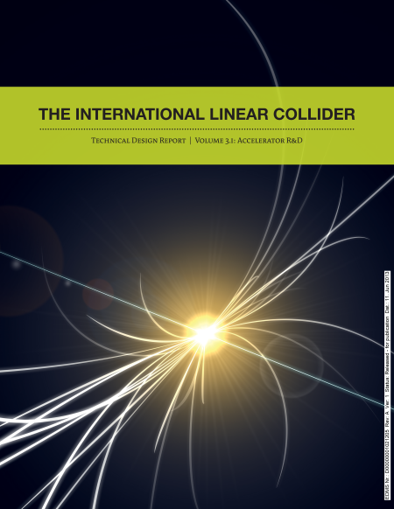
Pulsed of operation, duty cycle
Repetition rate of RCS chain: 5 Hz (as ILC)
Minimum beam pulse length for RF system?
Pulse length ~1.6 ms same order as for ILC (beam pulse length 0.7 ms)
 | RCS1 | RCS2 | RCS3 | (RCS4)
Ejection energy, E_{ej} [TeV] | 0.31 | 0.75 | 1.5 | (5.0)
Circumference, 2πR [km] | 5.99 | 5.99 | 10.7 | (35)
Acceleration time, beam pulse length, τ_{acc} [ms] | 0.34 | 1.1 | 2.4 | (6.4)
Beam pulse

Slide 11
First beam loading considerations
Only one high-intensity bunch (of each type) accelerated in RCS
Average beam current more than three times (2×) above ILC
Very strong transient beam loading
 | ILC | RCS1 (and RCS2)
Number of bunches, n_{b} | 1312 | 1 each μ⁺ and μ⁻
Bunch spacing, τ_{bs} | 554 ns | T_{rev} = 20 μs
Bunch intensity, N_{b} | 2 ∙ 10¹⁰ p/b | 2.5 (2.3) ∙ 10¹² p/b
Average beam current, I_{b} | 5.8 mA | 2 × ~20 mA

Slide 12
External loading and feedback requirements
Steady-state detuning to minimize reflected power (reactive beam loading compensation)
Δf_{RF}/f_{RF} ≈ 5 ∙ 10⁻⁷ → Δf_{RF} ≈ 2 × 0.32 kHz
Optimal external quality factor
Optimal external quality factor Q_{ext,opt} ≈ 1…2 ∙ 10⁶ (within 1…10 ∙ 10⁶ of tunable fundamental power coupler for ILC)
Assuming constructive interference of counter-rotating μ⁺ and μ⁻-bunches
Beam-loading of counter-rotating beams subject to further studies

Slide 13
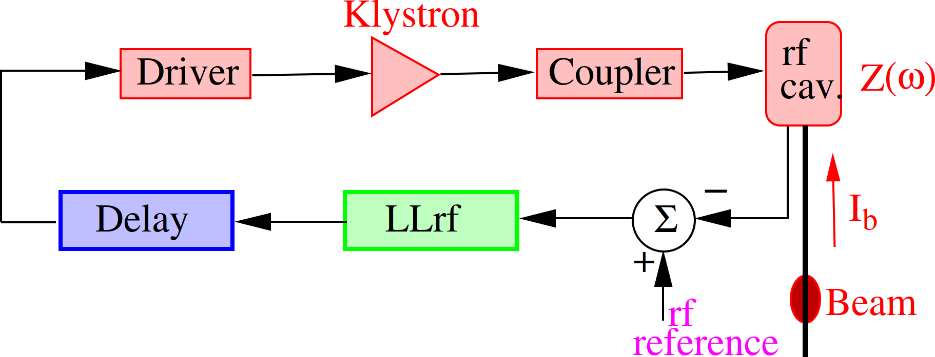
Transient power and feedback considerations
With 2 × 20 mA beam current, power to beam ~2 × 430 kW
Beam induced voltage at f_{RF} about 2 x 1.7 MV during bunch passage (builds up)
Conventional direct feedback (e.g., loop delay, t_{d} ≈ 700 ns in LHC) too slow
Correction would be applied after bunch
Need 1-turn delay feedback with m⁺/m⁻ separation
Muon RCS advantage: only one bunch per beam and few turns
Explore cycle-by-cycle adaptive compensation
Example: LHC RF feedback system
P. Baudrenghien, T. Mastoridis, PRAB 20, 011004 (2017)
μ⁺
μ⁻

Slide 14
Summary
Challenging 1.3 GHz RF system for μRCS
Main ‘non-conventional’ assumptions
Modular, distributed RF system: ~30 RF stations (700 9-cell cavities, RCS1) ideally equidistant → infrastructure
Longer pulses than ILC: 2.4 ms (6.4 ms) beam pulse for RCS3(4)
More power, larger beam current
Cavity tuning to compensate orbit length sweep during acceleration (~few kHz) → in addition to measures against Lorentz force detuning and mechanical resonances

Slide 15
WP6 task 6.1 Status
“… aims to provide a preliminary design concept for the SRF cavities for acceleration in the Rapid Cycling Synchrotrons (RCS) of the HEC of the muon collider …”
Two meetings up to now
From 2023, monthly meeting
First discussion on parameters presented at October Meeting (reported in this presentation)
All partners (CEA, INFN, Uni. Rostock*) share all thematic. Within this:
CEA
Fundamental power coupler (FPC)
Beam Loading
INFN
High Order Mode
Frequency sweep
Uni. Rostock
SRF Cavity study, especially frequency choice.
* WP task leader

Slide 16
Summary of RF requirements
Parameter | Value | Remark
Frequency, f_{RF} | 1.3 GHz
Tuning range (piezo), Δf | 2.2 kHz | Sweep for acceleration, hybrid RCS2/3/4
Gradient, V_{RF}/l | 30 MV/m
Beam pulse length, τ_{acc} | 0.34/1.1/ 2.4/6.4 ms | RCS1/2/3/4
Beam current, I_{DC} | 2 × 20 mA
Power to the beam (max., RCS1) | 2 × 250 MW | ~2 × 430 kW/cavity

Slide 17
General parameters
 | RCS1→314 GeV | RCS2→750 GeV | RCS3→1.5 TeV
Circumference, 2πR [m] | 5990 | 5590 | 10700
Energy factor, E_{ej}/E_{inj} | 5.0 | 2.4 | 2.0
Repetition rate, f_{rep} [Hz] | 5 (asym.) | 5 (asym.) | 5 (asym.)
Number of bunches | 1μ⁺, 1μ⁻ | 1μ⁺, 1μ⁻ | 1μ⁺, 1μ⁻
Bunch population | 2.5x10¹² | 2.3x10¹² | 2.2x10¹²
Survival rate per ring | 90% | 90% | 90%
Acceleration time [ms] | 0.34 | 1.04 | 2.37
Number of turns | 17 | 55 | 66
Energy gain per turn, ΔE [GeV] | 14.8 | 7.9 | 11.4
Acc. gradient for survival [MV/m] | 2.4 | 1.3 | 1.1
Acc. field in RF cavity [MV/m] | 30 | 30 | 30
Max. RF voltage for φ_{s}=45° [GV] | 20.9 | 11.2 | 16.1

Slide 18
Thank you !

