Slide 1
Programma di sviluppo cavità RF per cooling channel
Dario Giove
per il gruppo RF partecipante alla
attività INFN

Slide 4
Diktys Stratakis – Workshop on a Muon Collider Testing Opportunities - March 2021

Slide 5
Diktys Stratakis – Workshop on a Muon Collider Testing Opportunities - March 2021

Slide 6
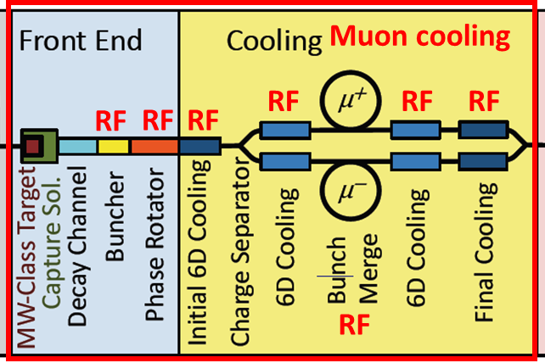
NC RF system for muon capture and cooling
It is a very large and complex RF system with high peak power

Slide 7
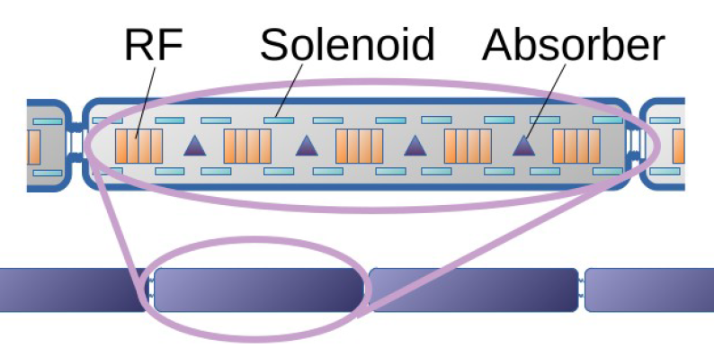
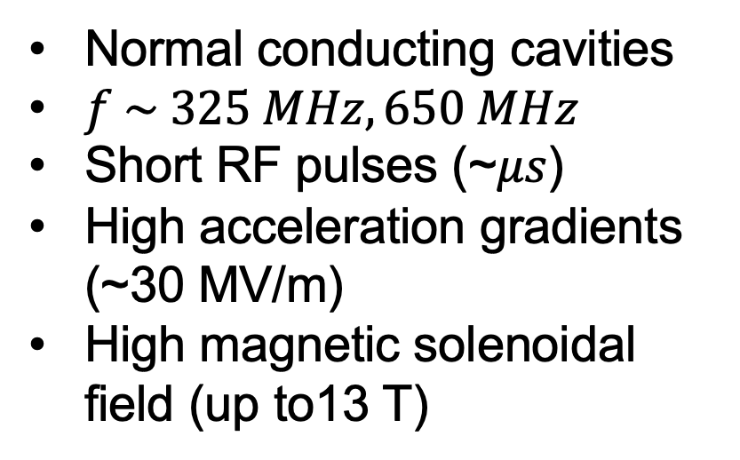
RF cavities for muon cooling cells
Normal conducting cavities
$f \sim 325 MHz, 650 MHz$
Short RF pulses (~𝜇𝑠)
High acceleration gradients (~30 MV/m)
High magnetic solenoidal field (up to13 T)
Creates problematics of break-down that needs to be mitigated

Slide 9
For the past decades, R&D efforts have been carried out to understand the breakdown mechanism in the presence of a strong magnetic field. In this framework RF cavities has been designed, built and demonstrated stable operation at ~10 MV/m
The experimental data available on the subject are related mainly to 201 MHz and 805 MHz cavities with different approaches involving the application of surface quality enhancements and low Z materials.
The contribution that we will provide in the framework of the European project may be summarized in the following issues:
Design the compact multiple-cavity module, with efficient frequency tuning and RF power feeding systems. In the cooling channel, the voltage in each segment requires multiple cavities or one LINAC with multiple cells. In order to have strong solenoid fields, the cavity design should be as compact as possible in the transverse direction.
Study the possibilities offered by improved copper surface qualities, new copper based alloys or low Z materials as Berillium to improve the breakdown properties of a NC cavity.
Look into a suitable RF frequency choice (in the range 805 to 325 MHz) to define a trade off between the above discussed phenomena and the magnet design. This will contribute to the proposal of a demonstrator of a cooling channel section.

Slide 10
805 MHz
440 mm bore diameter
custom designed power coupler
10 Hz rep rate
32 microsec pulse
Diktys Stratakis – Workshop on a Muon Collider Testing Opportunities - March 2021

Slide 11
For 2023 we get a small funding from CSN1 to evaluate the possibility to carry out some tests on selected materials and polishing technologies on a DC HV (100kV) test set up in magnetic field (1 T) @ LASA. This may be considered as the starting point of a more ambitious program.
study of innovative materials to create electrodes to be tested with a high DC static field in the presence of a magnetic field of at least 1 T or higher
study of surface finishing, coating and cleaning techniques for the above materials
DC high static field test in the presence of a magnetic field of at least 1 T or higher
design of single cells at different frequencies in the 650-3000 Ghz range to verify the feasibility of structures with a reduced number of brazing (against joining techniques that allow the parts to be removed)
low frequency test
high power tests
test in magnetic fields of at least 5 T of single cells with RF power.
R=2.405c/2pf
f0 = 352 MHz, Rc = 326.2 mm;
f0 = 704 MHz, Rc = 163.1 mm;
f0 = 1500 MHz, Rc = 76.6 mm;
f0 = 3000 MHz, Rc = 38.3 mm.

Slide 12
The first year would be dedicated to the first two points as well as to a timely review of the world panorama in the sector, with a broad vision of NC cavities with a high gradient even not operating in a magnetic field.
The second year should lead to a focus on those solutions deemed most promising by experiences and indications received from the various groups operating in the sector. Experimental measurements could be carried out as per point 3 and at the same time point 4 could be addressed.
Then, depending on the availability of adequate resources, we could proceed as per points 5-7 in the framework of a program up to 2027.

Slide 13
In the context of these activities, a common laboratory (at LASA ?) could be thought of for the low-power qualification of these cavities. If this laboratory could count on a new and dedicated staff resource, it could also take care of transferring and increasing the know-how available in the context of LLRF systems and integrate with similar national and international initiatives.
The activities listed above, in the face of a recent survey, met the interest of the groups working on NC RF cavities of the following structures:
LNS (e.m. design power coupler design)
Naples (e.m. design)
Milan (e.m. design, measurements, tests and sample preparation)
LNL (limited to the analysis part of the surface finishes of materials)

