Slide 1
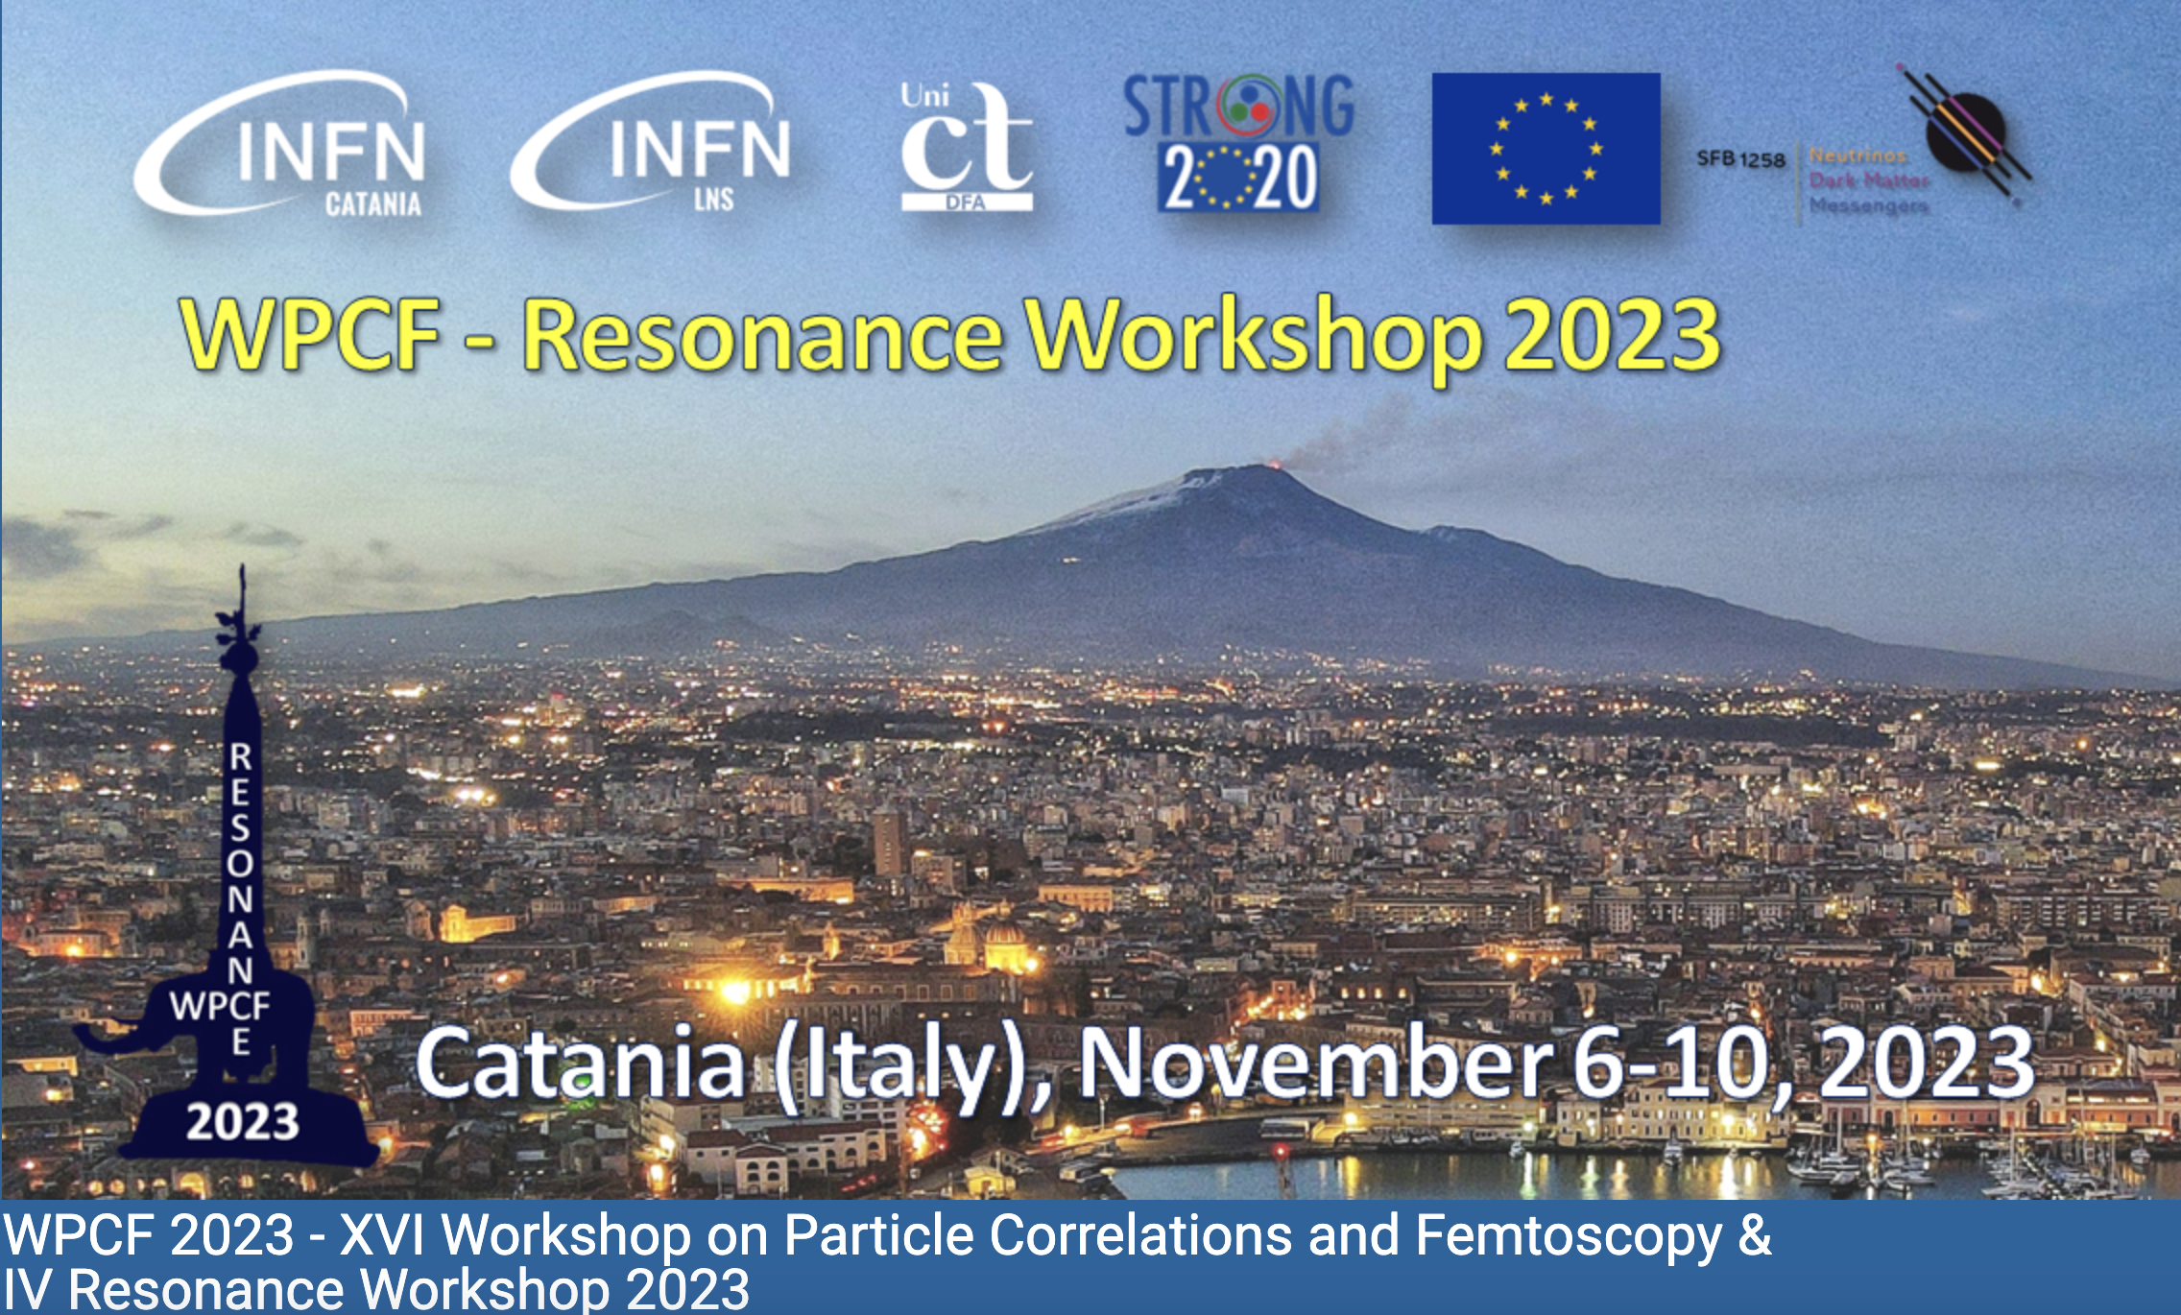
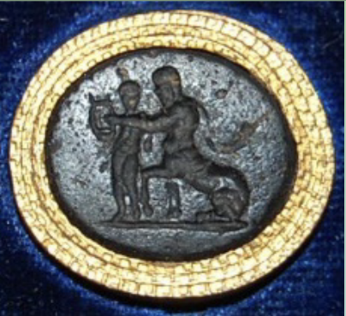
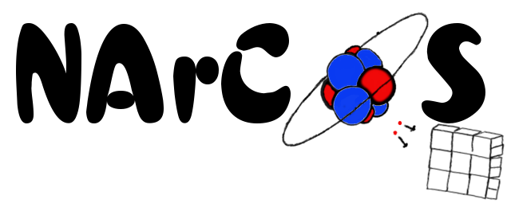
NArCoS: a new correlator for neutrons and charged particles with high angular and energy resolution
(Neutron Array for Correlation Studies)
E. V. Pagano¹, C. Boiano², G. Cardella³, A. Castoldi^{2,5}, E. De Filippo³, E. Geraci^{3,4}, B. Gnoffo^{3,4}, C. Guazzoni^{2,5}, G.
Lanzalone^{1,6}, C. Maiolino¹, N.S. Martorana³, F. Noto¹, A. Pagano³, S. Pirrone³, G. Politi^{3,4}, F. Risitano^{3,7}, F. Rizzo^{1,4}, P. Russotto¹, G. Santagati³, M. Trimarchi^{2,4}, and C. Zagami^{1,4}
1INFN, Laboratori Nazionali del Sud, Catania, Italy
2INFN, Sezione di Milano, Milano, Italy.
3INFN, Sezione di Catania, Catania, Italy. 4Dipartimento di Fisica ed Astronomia, Università di Catania, Catania, Italy.
⁵Politecnico di Milano, Dip. Elettronica, Informazione e Bioingegneria, Milano, Italy
6Università di Enna ‘‘Kore’’, Enna, Italy.
7Dipartimento di Scienze MIFT, Università di Messina, Messina, Italy.
CHIRONE Coll.

Slide 2
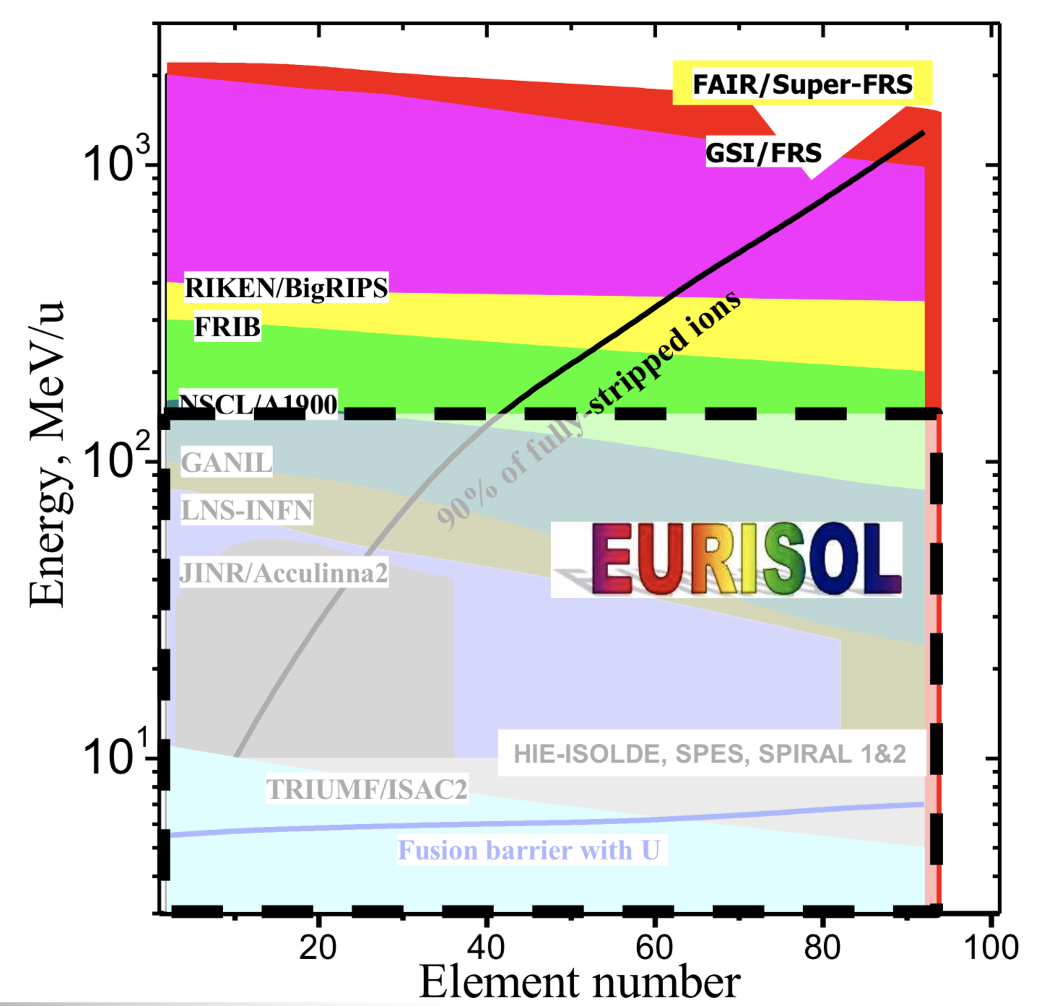
Project’s motivations
The advent of the new facility for Radioactive Ion Beams (RIBs)
in particular for the n-rich ones
“The RIBs are an important opportunity”
From: M. Lewitowicz EURISOL-DF 15-16 Nov 2017, Lisbon
(C. Horovitz)
FRAISE@LNS
E. V. Pagano. LNS-INFN
WPCF 2023 – Catania (Italy) - 7 november 2023
1

Slide 3
IDEA
To realize a prototype of detector able to detect at the same time charged particles and neutrons with high energy and angular resolution for reaction studies and applications
Candidate: The plastic scintillator EJ276-Green Type (ex EJ299-33) (3x3x3cm³)
1 cluster: 4 consecutively cubes -> 3x3x12 cm³
Reading the light signal: SiPM and digitalization
Neutron detection efficiency ≈ 50% for the prototype (16 clusters)
Modular, reconfigurable (in mechanic and electronic)
Discrimination of n/γ from PSD (but also light charged particles)
Energy measurement from ToF (Δt≤0.5 ns with L_{ToF}≈1÷1.5m)
TOF measured using the RF of the CS or with an ancillary MCP (low intensity exotic beams)
NArCoS
≈ 12 cm
300 μm
DSSSD 32x32
300 μm
6.4 cm
CP
3x3x3cm³
32 strip back
T
EJ276G
32 strip front
n
6.4 cm
Δstrip = 2 mm
Interstrip = 0.1 mm
50/75 cm
SiPD
100/150 cm
E. V. Pagano. LNS-INFN
WPCF 2023 – Catania (Italy) - 7 november 2023
2

Slide 4
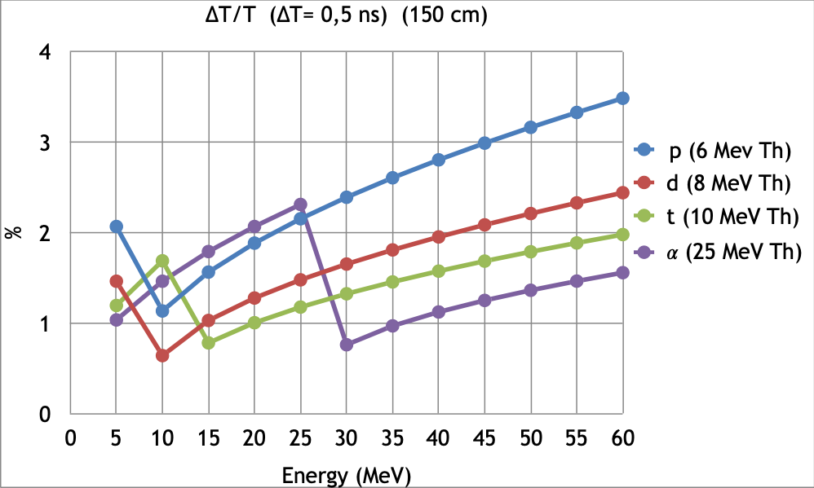
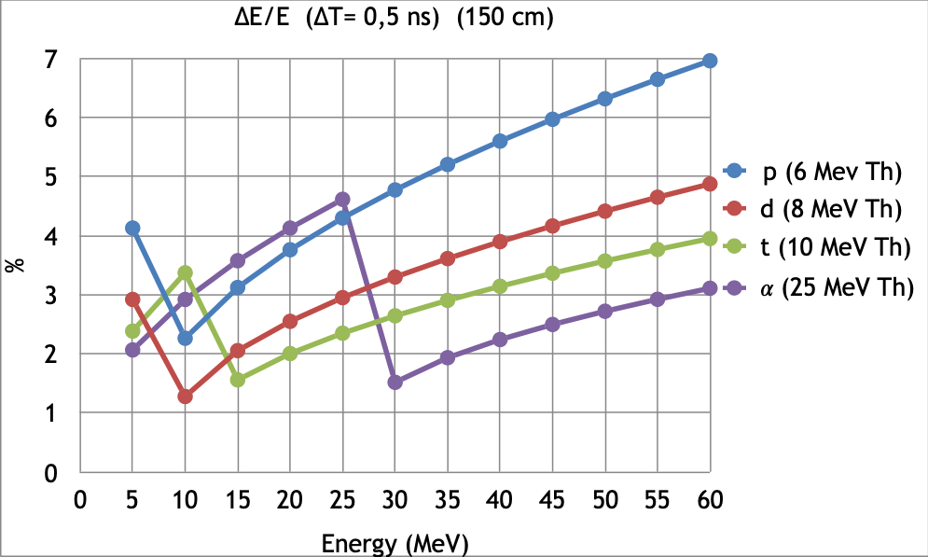
Expected performances
Time of flight
NArCoS
≈ 12 cm
L=150 cm; ΔT=0.5 ns
DSSSD 32x32
*
300 μm
T
Solid angle ≈ 7 msr (0.07%)
Angular resolution DSSSD ≈ 0.15°
Angular resolution NArCos ≈ 1.25°
<EFF>≈25%
For one cluster
θ≈5°
L_{DSSSD}=75 cm
L_{NArCoS}=150 cm
*the mechanical structure will have the possibility of an angular muvimentation
E. V. Pagano. LNS-INFN
WPCF 2023 – Catania (Italy) - 7 november 2023
3

Slide 5
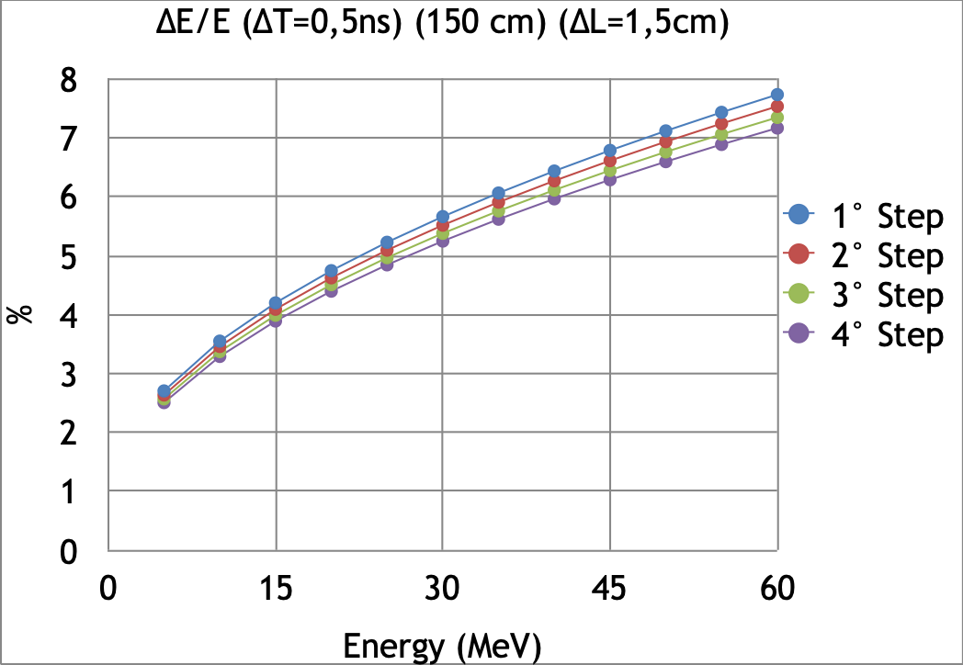
Expected performances
Time of flight
NArCoS
≈ 12 cm
L=150 cm; ΔT=0.5 ns
DSSSD 32x32
*
300 μm
T
Solid angle ≈ 7 msr (0.07%)
Angular resolution DSSSD ≈ 0.15°
Angular resolution NArCos ≈ 1.25°
<EFF>≈25%
For one cluster
θ≈5°
L_{DSSSD}=75 cm
L_{NArCoS}=150 cm
*the mechanical structure will have the possibility of an angular movimentation
E. V. Pagano. LNS-INFN
WPCF 2023 – Catania (Italy) - 7 november 2023
4

Slide 6
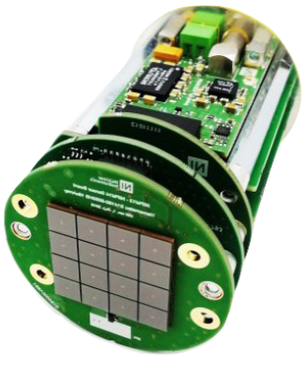
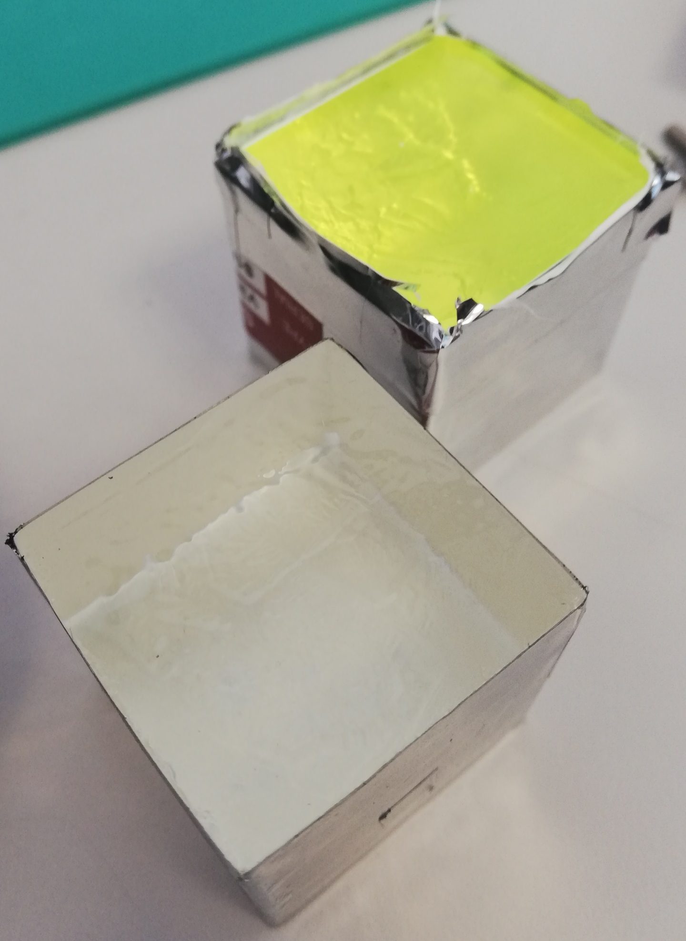
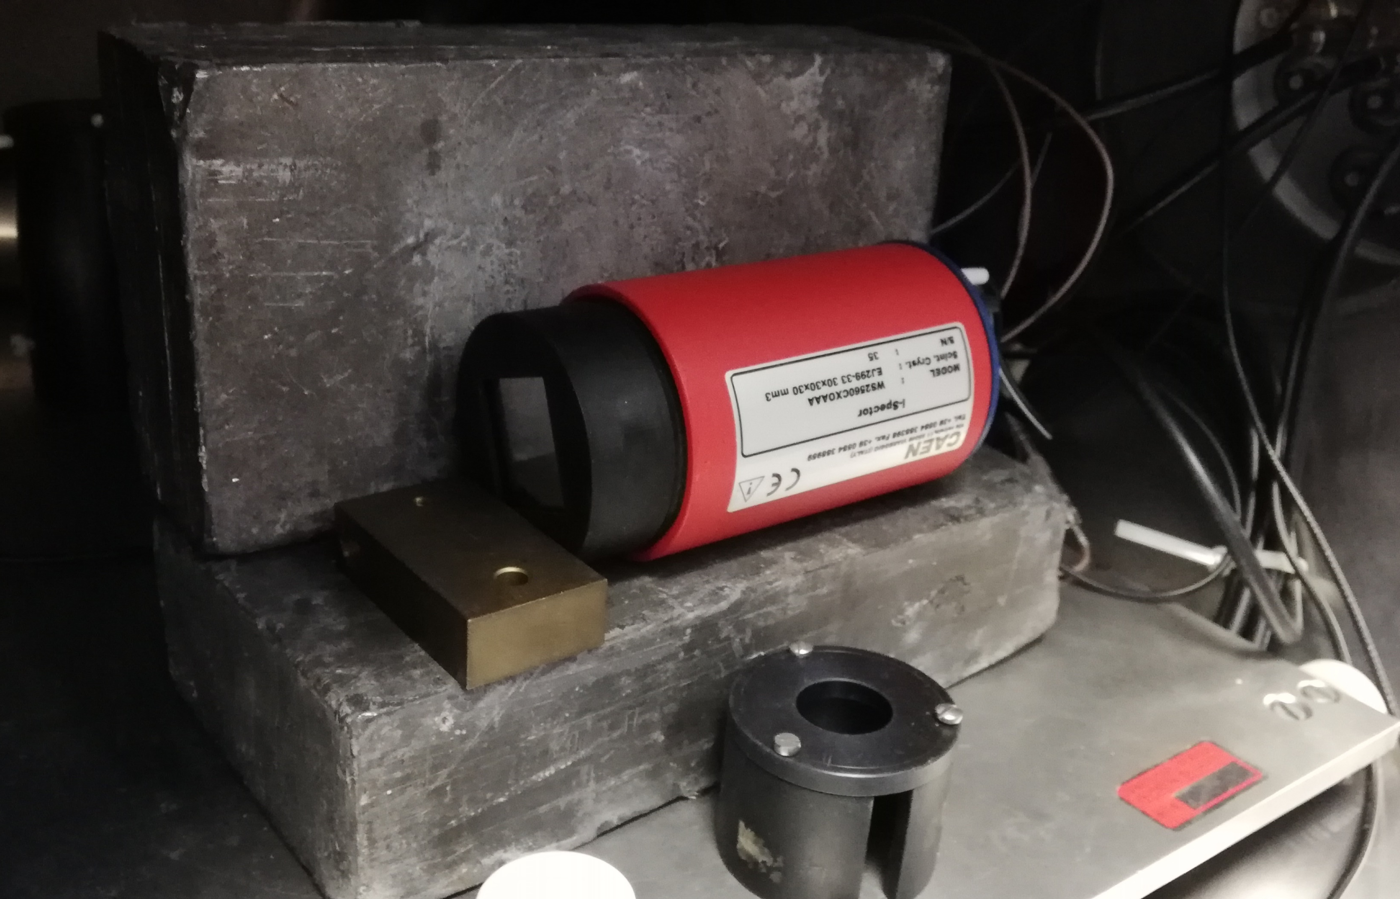
Latest resuls: tests by using the SiPM (i-Spector CAEN)
The test was done during the master thesis work of A. Simancas in Catania (EVP tutor)
Detector Configurations:
EJ-276G + PMT
EJ-276 + i-Spector
EJ-276G + i-Spector
Lab measurements with radioactive sources:
Vacuum Chamber
Pb shield
Gamma sources: ¹³³Ba, ¹³⁷Cs, ⁶⁰Co, ¹⁵²Eu
Alpha source: ²⁴¹Am
Digitizer from CAEN
Data analysis of heavy ion reactions:
CHIMERA scattering chamber (LNS)
Detector at 11˚ in lab frame
Beam: ¹²⁴Sn at 20 MeV/A (CHIFAR experiment)
Targets: ⁶⁴Zn and ⁶⁴Ni
GET digital electronics
E.V.Pagano, G. Politi, A. Simancas et al., submitted at NIM A
EJ2766
EJ276
i-Spector from CAEN (3x3 cm SiPM and electronics)
Example of signal and integration windows
E. V. Pagano. LNS-INFN
WPCF 2023 – Catania (Italy) - 7 november 2023
5

Slide 7
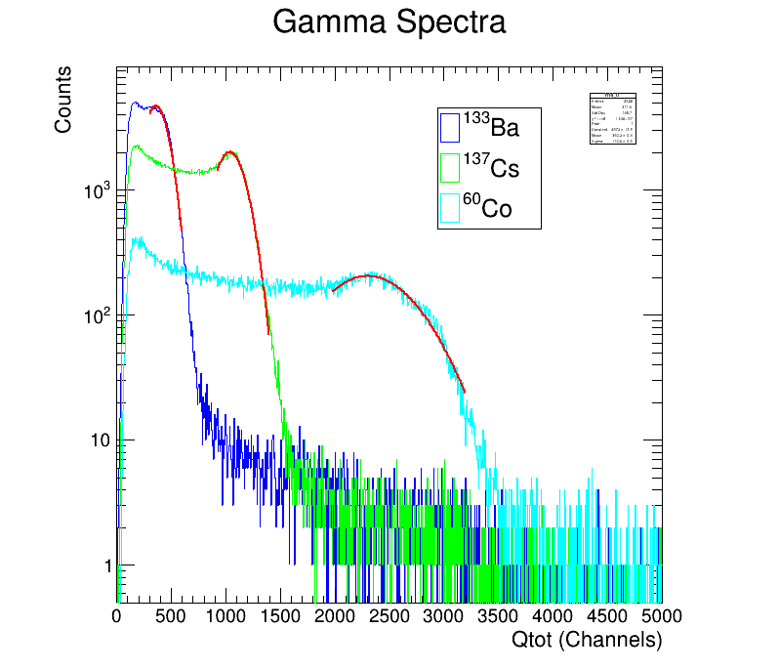
Gamma spectra
50%
Pagano E.V. et al., Nucl. Instr.. Methods A, 889 (2018) 83-88 )
EJ-276G + i-Spector
E. V. Pagano. LNS-INFN
WPCF 2023 – Catania (Italy) - 7 november 2023
6

Slide 8
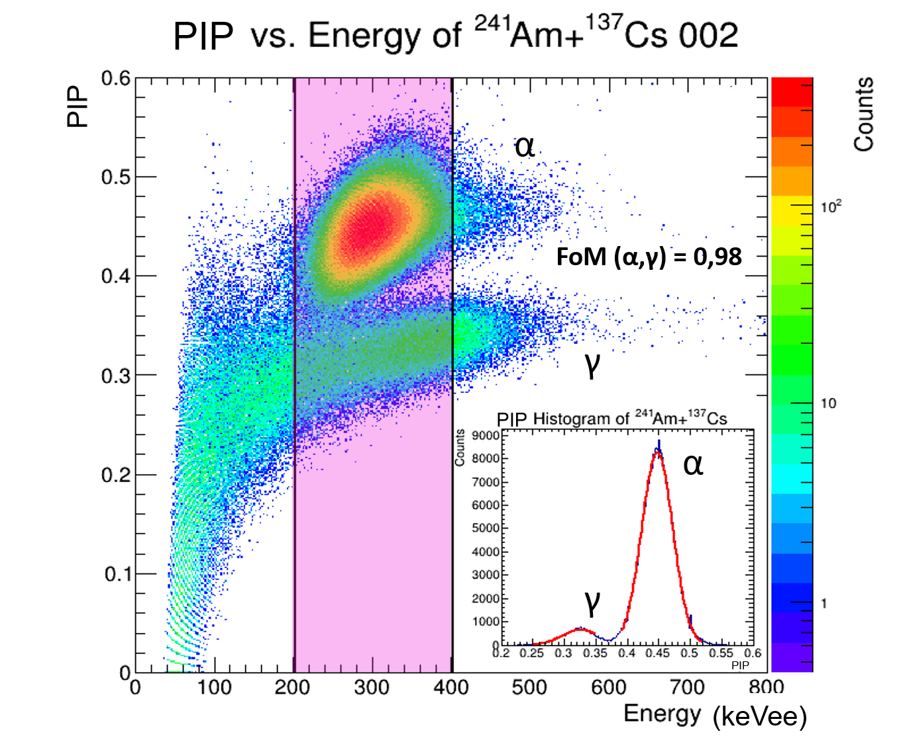
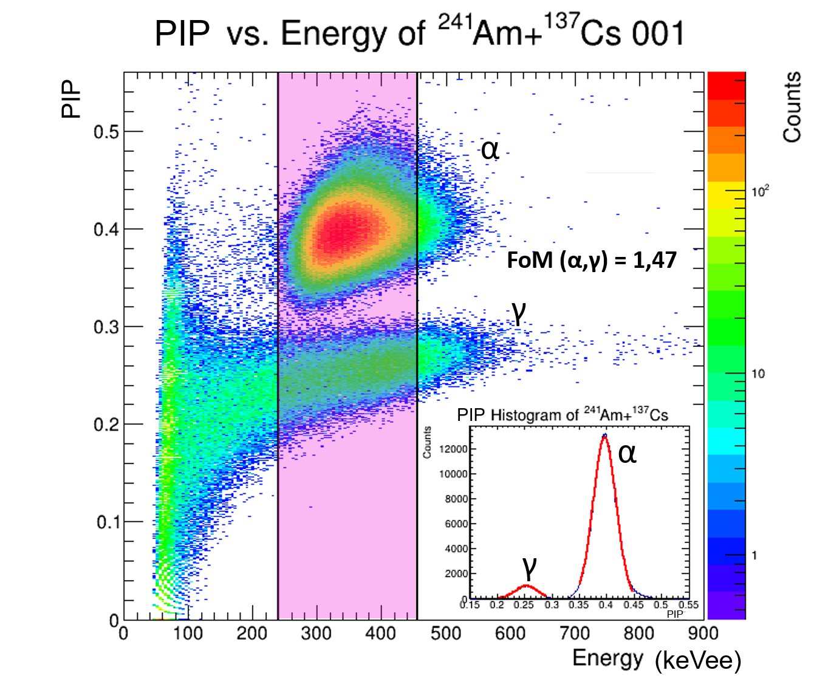
PSD studies using sources
Particle Identification Paramenter
Test with radioactive sources (low background). Sources ²⁴¹Am + ¹³⁷Cs. Setup: EJ276 + SiPM (I-spector). EJ276G + SiPM (I-spector)
Comparison between the two plastic versions: the “ordinary” and the “green shifted”
$$PIP=1-\frac{Q_{fast}}{Q_{tot}}=\frac{Q_{slow}}{Q_{tot}}$$
EJ-276 + i-Spector
EJ-276G + i-Spector
Detector | FoM
i-Spector + EJ-276 | 0.98
i-Spector + EJ-276G | 1.47
PMT + EJ-276G | 1.03
E. V. Pagano. LNS-INFN
WPCF 2023 – Catania (Italy) - 7 november 2023
7

Slide 9
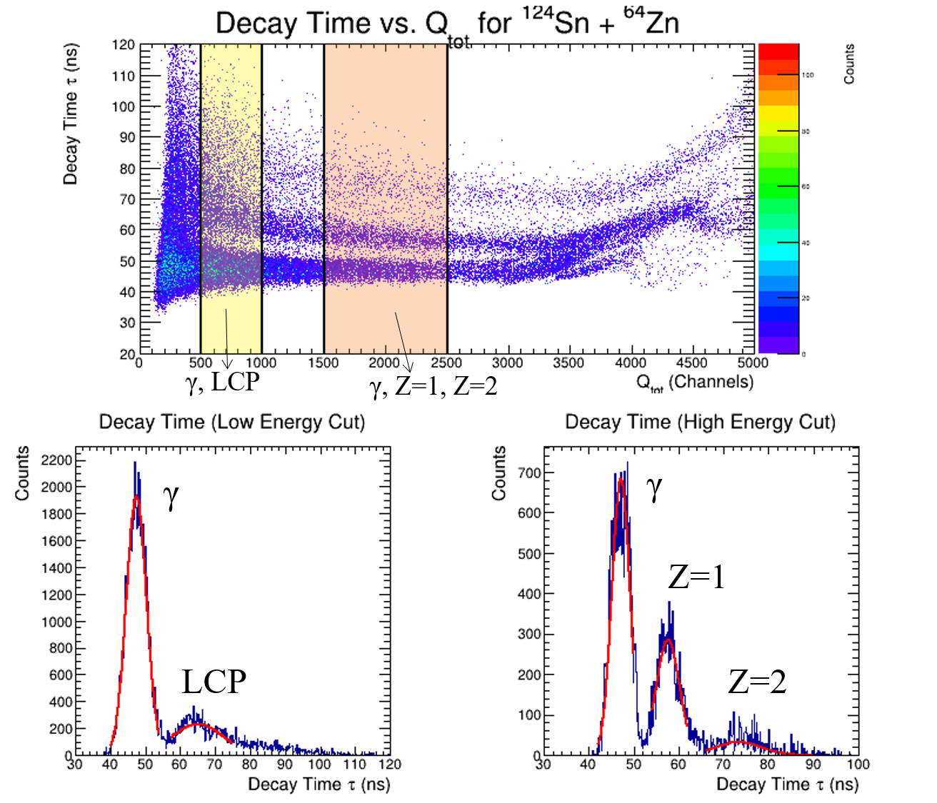
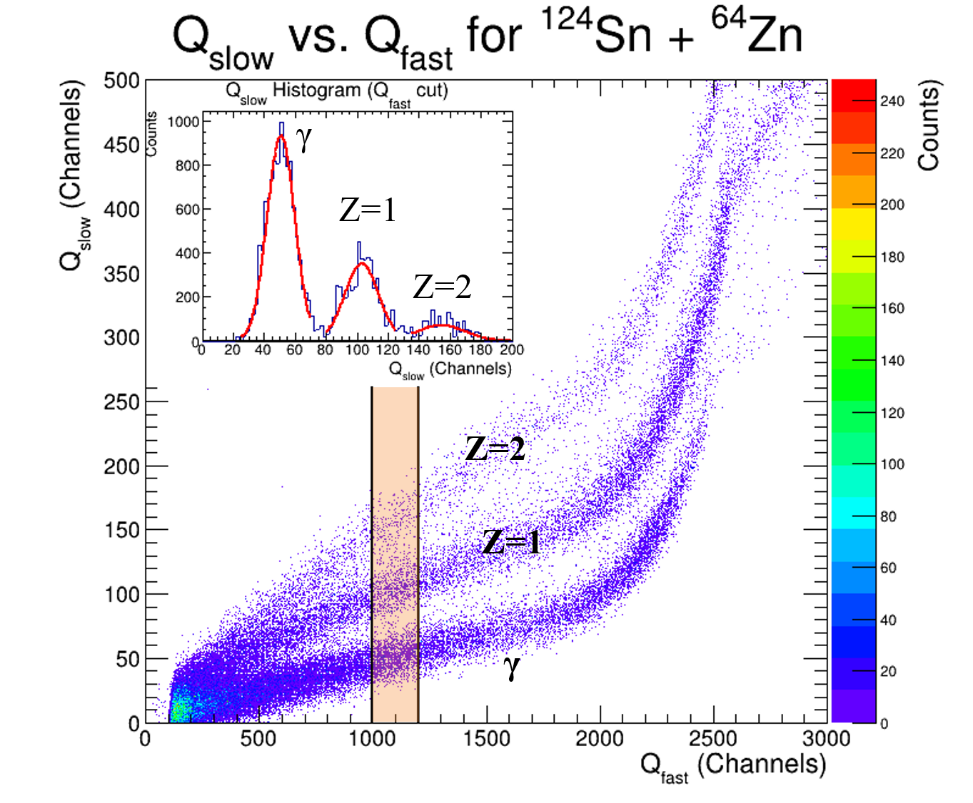
PSD studies using beams
CHIFAR exp @LNS (spokesperson:EVP, E. De Filippo, P. Russotto)
Test with beam (high background). Setup: EJ276 + PMT (1.6 kV) reaction ¹²⁴Sn + ⁶⁴Zn @ 20 AMeV
EJ-276 + i-Spector
LCP = Light Charged Particles
Neutrons included in Z=1
PSD Method | FoM(γ, Z=1) | FoM(Z=1, Z=2) | FoM(γ, LCP)
Integration | 1.08 | 0.78 | -
Decay Time | 0.95 | 0.87 | 0.71
More information about the “Decay time” identification technique:
E. V. Pagano et al. NIM A 905 (2018) 47-52
E. V. Pagano. LNS-INFN
WPCF 2023 – Catania (Italy) - 7 november 2023
8

Slide 10
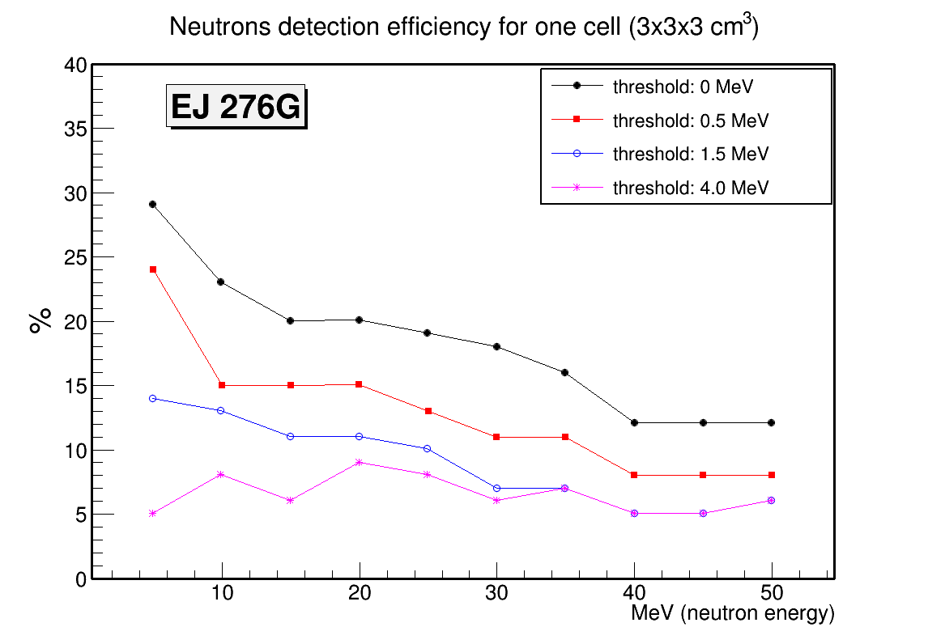
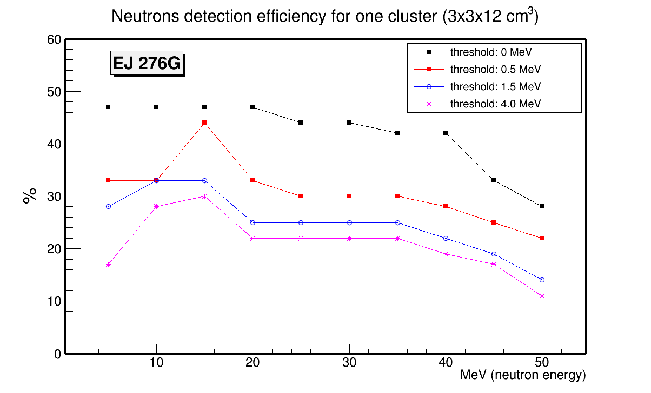
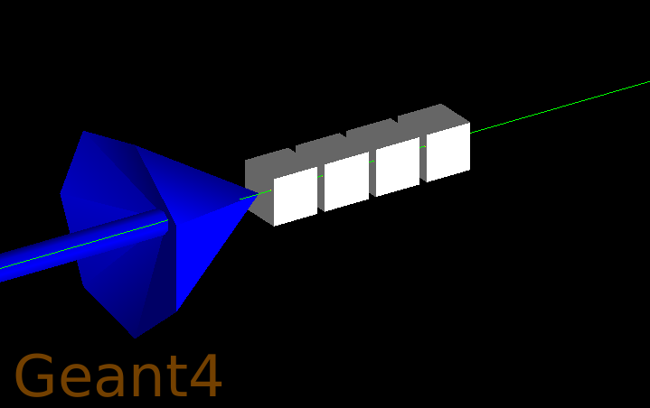
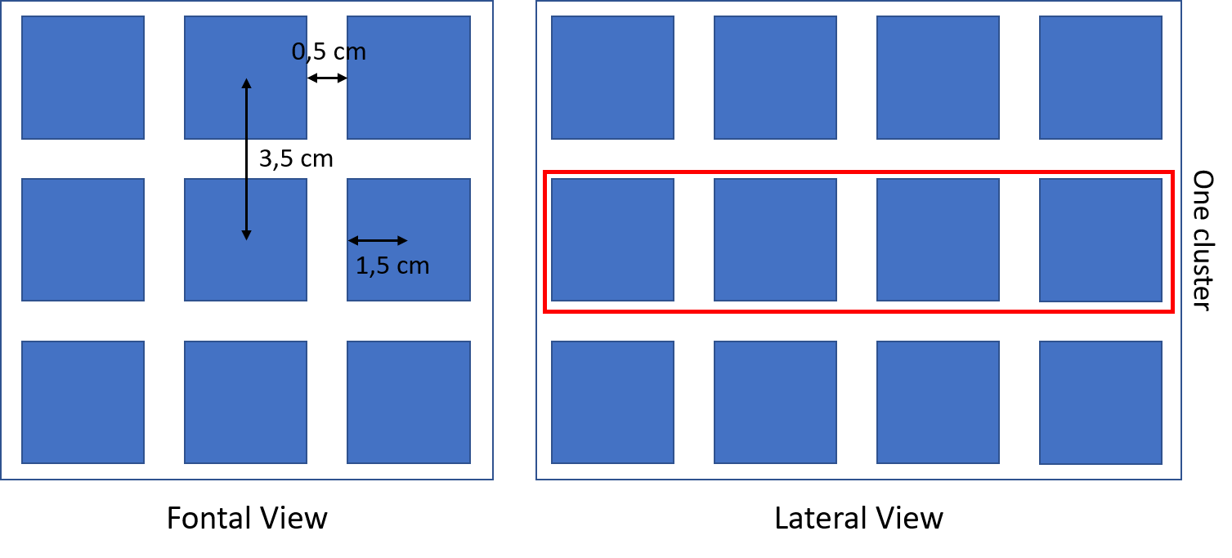
What about the neutron detection efficiency?
GEANT 4 simulation in order to estimate the neutron detection efficiency
Mean value for one detection cell (3x3x3 cm³) ≅ 9%
Libraries: QGSP_BIC_HP
Mean value for one detection cluster (3x3x12 cm³) ≅ 25%
Mean value for a 36-cell array (9x9x12 cm³) ≅ 33%
Scheme of Simulation Geometry: 36 (3 x 3 x 4) cell array
E. V. Pagano. LNS-INFN
WPCF 2023 – Catania (Italy) - 7 november 2023
9

Slide 11
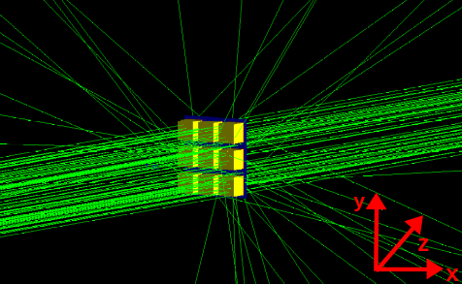
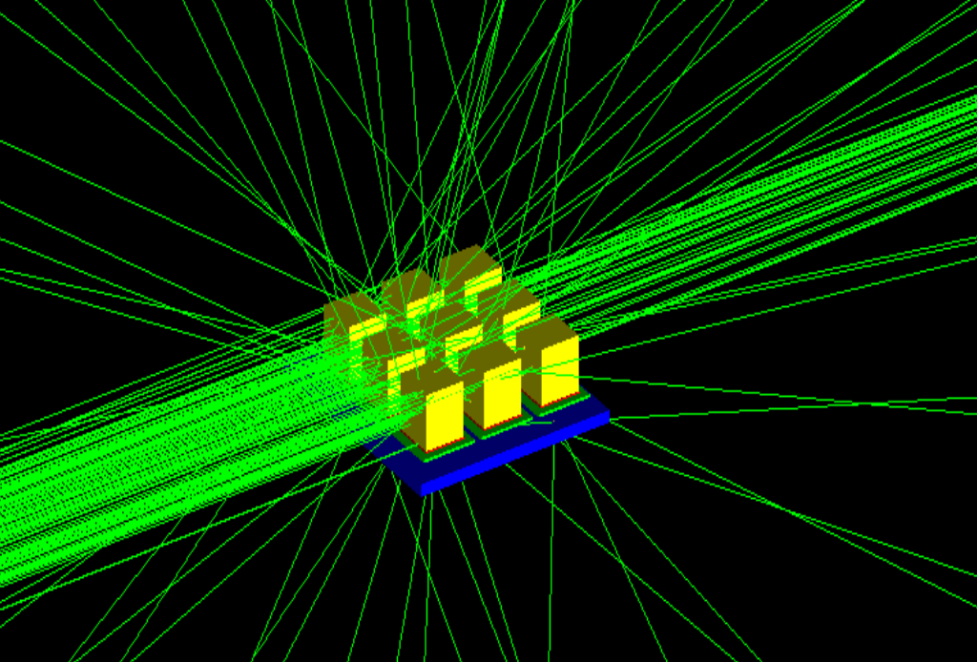
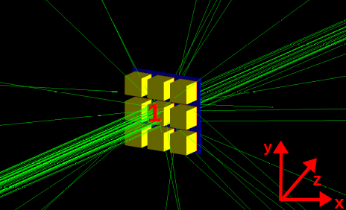
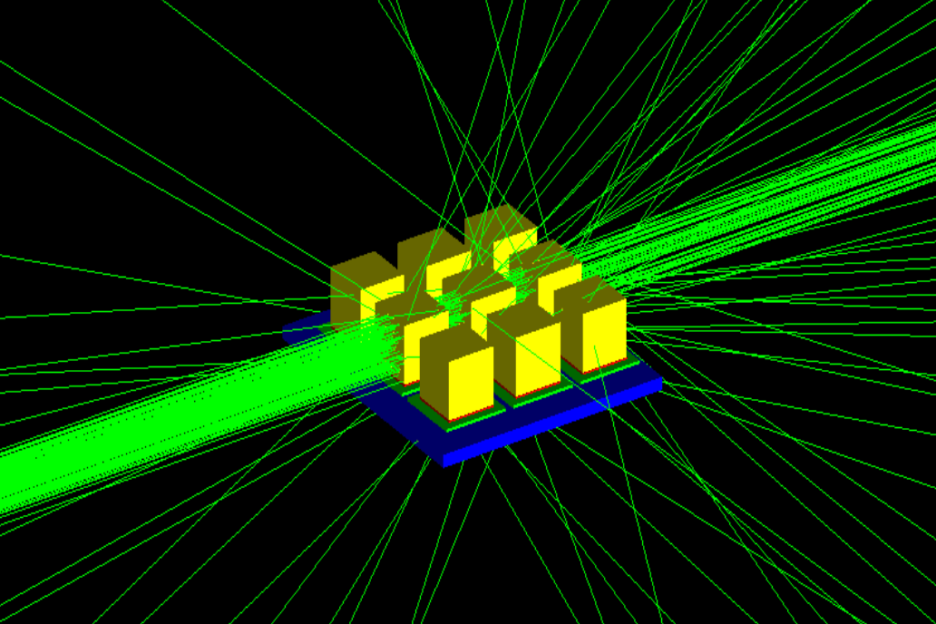
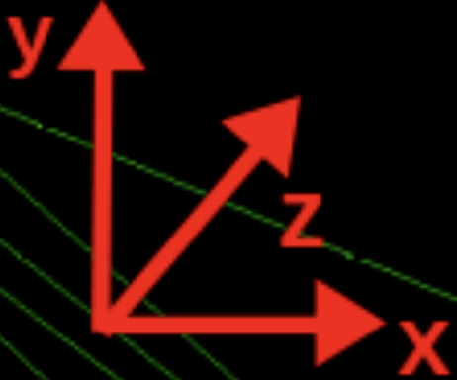
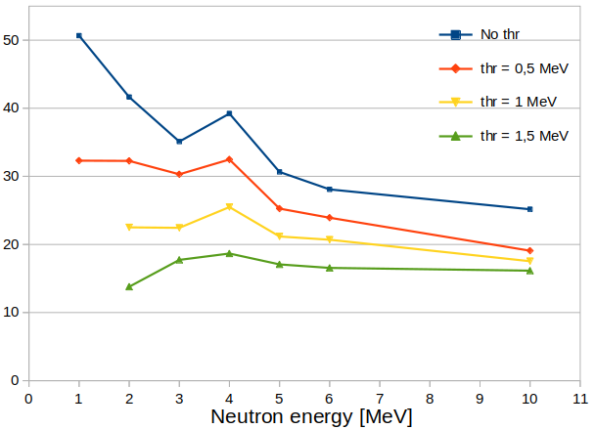
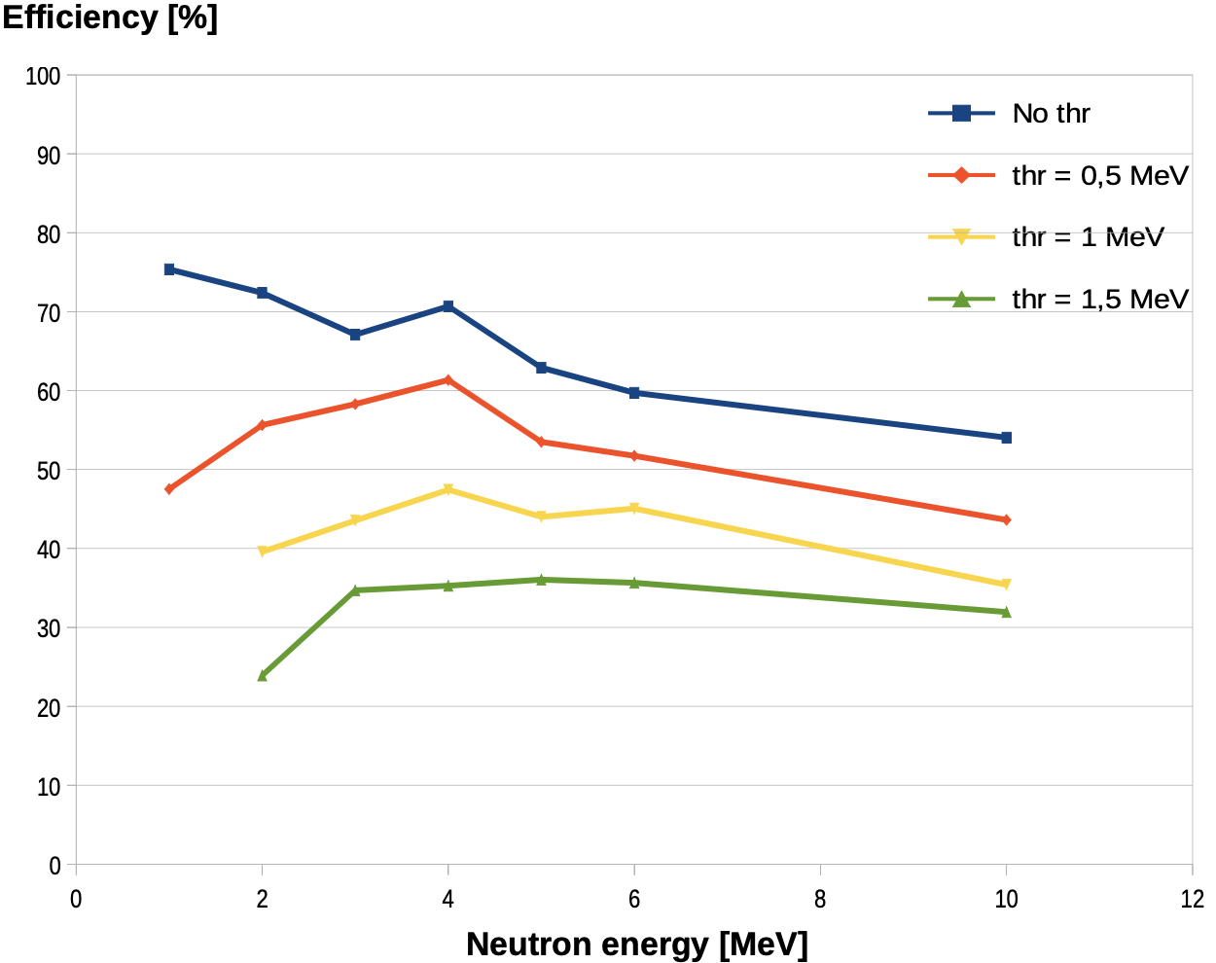
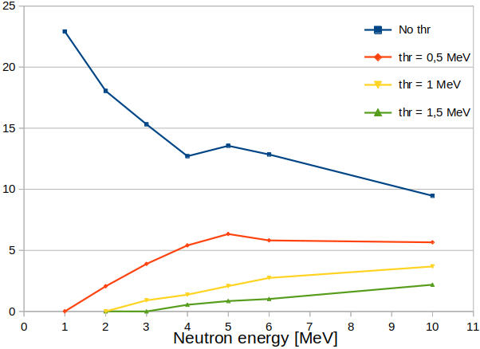
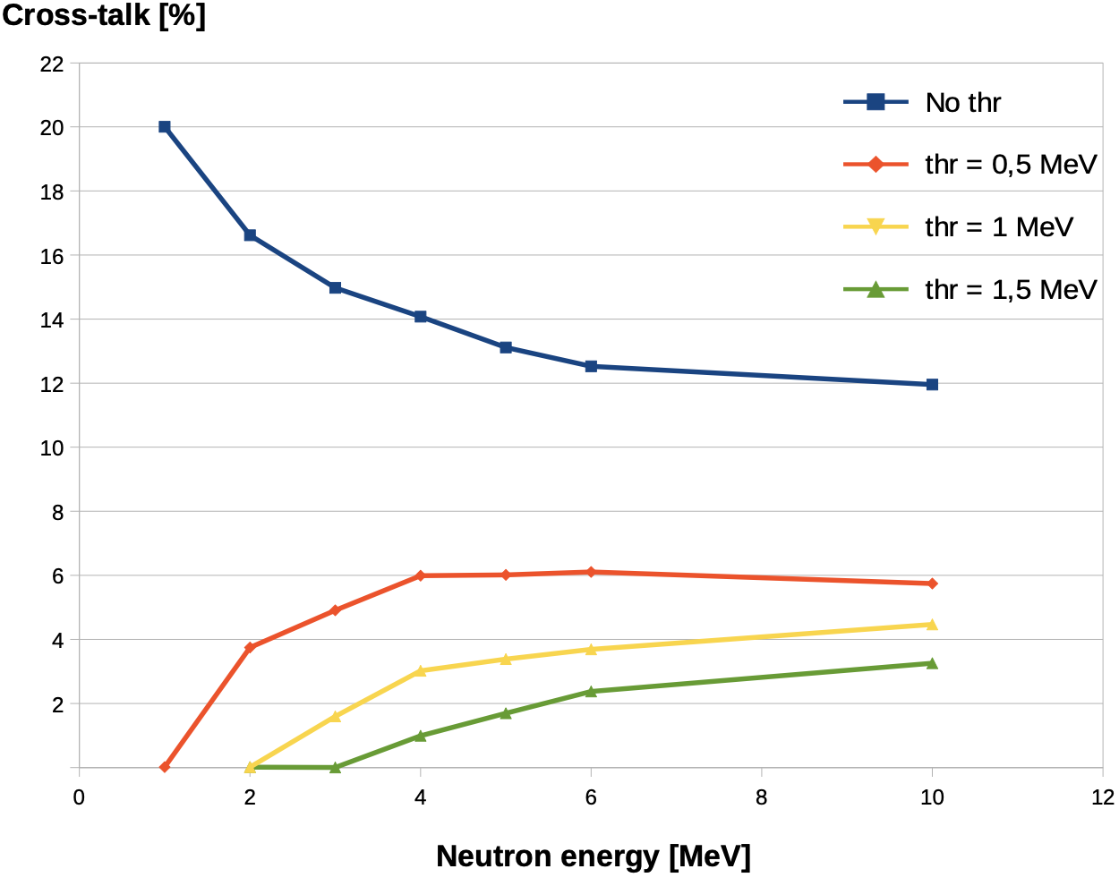
Preparation of the CROSSTEST exp at LNL (23-30 Nov 2023)
Neutron beam from the reaction: p + ⁷Li —> n + ⁷Be @5.5 MeV (proton energy of the CN accelerator)
Two configurations will be tested in order to study the crosstalk problem
The central cel at 5° in the Lab Frame
Simulation studies
Efficiency calculation (GEANT4)
Crosstalk problem study (GEANT4)
3x3 Matrix
3 clusters
3x3 Matrix
3 clusters
%
%
%
%
See G. Santagati talk for details
E. V. Pagano. LNS-INFN
WPCF 2023 – Catania (Italy) - 7 november 2023
10

Slide 12
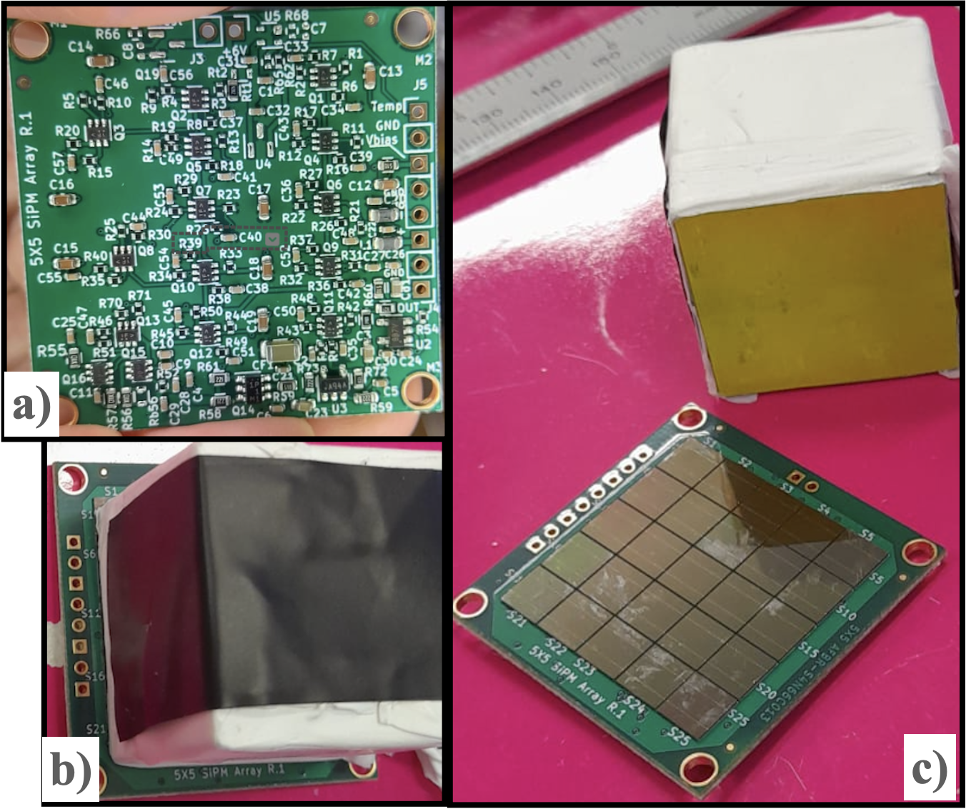
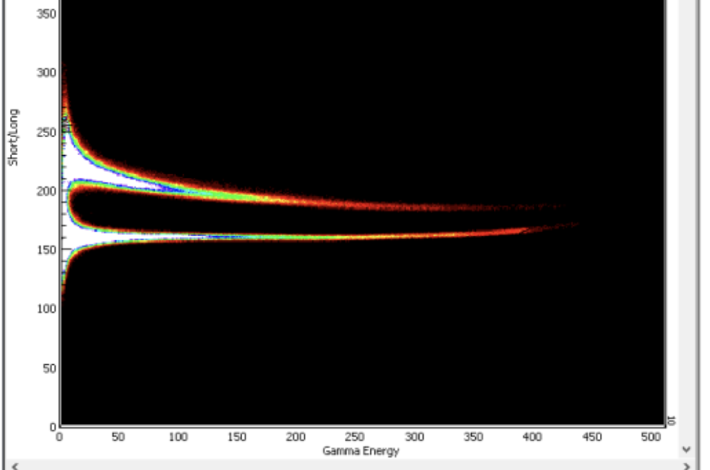
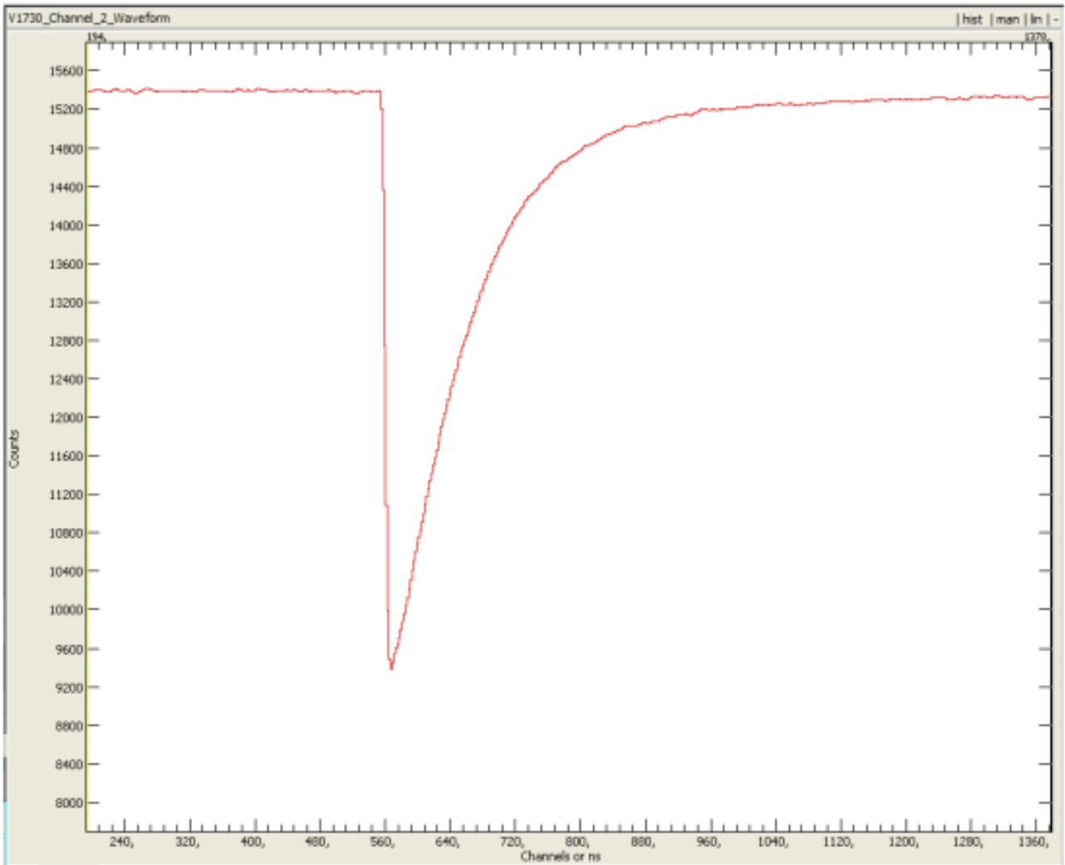
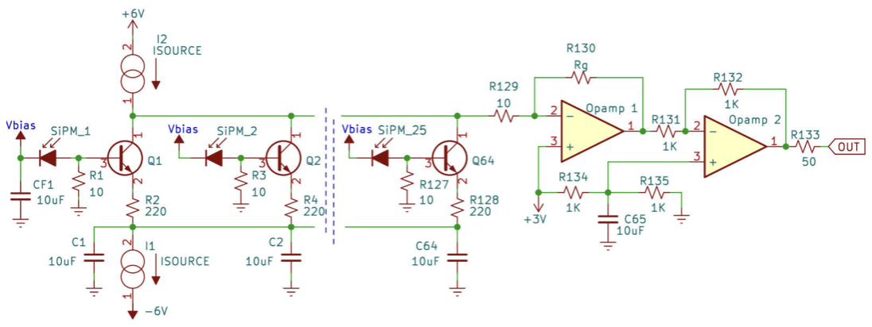
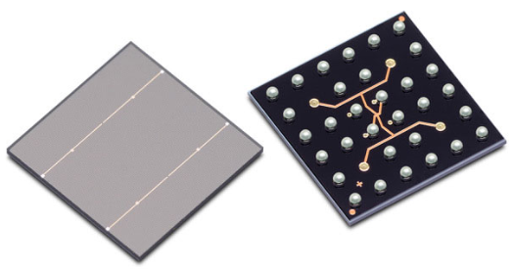
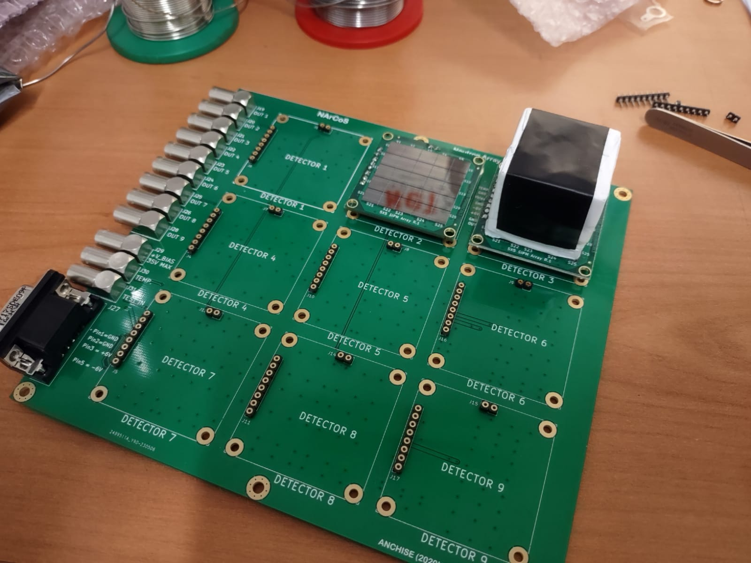
Preparation of the CROSSTEST exp at LNL (23-30 Nov 2023)
Prototype Electronics
Prototypal readout electronic and mechanic for the CROSSTEST exp at LNL (23-30 Nov 2023)
in coll. with INFN-MI (C. Boiano)
AmBe source: PSD test
Fast respons < 4 ns
400 ns
500 MHz sampling
Pulser signal test
Each elementary cell of EJ276G (3x3x3 cm³) is equipped with a matrix of 25 SiPM (6x6 mm²) of 30 𝜇m of thickness (≈ 40k microcells). The SiPM matrix is coupled with the plastic having theirs PAC and bias/temperature compensation circuit
Electronic Board for housing the 9 elementary cells with its electronic readout boards, with the out of the signals, test ingress, temperature monitoring and bias ingress
E. V. Pagano. LNS-INFN
WPCF 2023 – Catania (Italy) - 7 november 2023
11

Slide 13
Purposes of the project
Energy of interest: 5≤ E ≤100 AMeV (having particular attention to the Fermi regime)
Nuclear fundamental physics
Intensity interferometry (HBT effect)
n-n, n-p, n-LCP, n-IMF, n-TLF, n-PLF
Studies related to the nuclear symmetry energy (EOS) and its dependence to the nuclear density
Neutron stars (nuclear astrophysics)
Reaction mechanism
Reaction times
Clustering
Validation of nuclear dynamics model (BUU,QMD)
Measurements of the neutron signal in the n-rich RIBs (SPES, SPIRAL2, FRIB, FAIR)
Some applications
Radioprotection
Measurement of neutron flux (single measurement, cross section)
Validation of MC based code (GEANT4, MCNPX)
Homeland security
E. V. Pagano. LNS-INFN
WPCF 2023 – Catania (Italy) - 7 november 2023
12

Slide 14
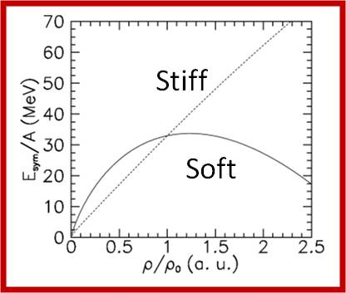
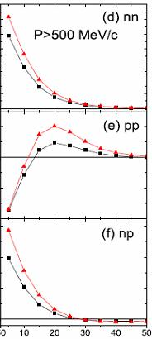
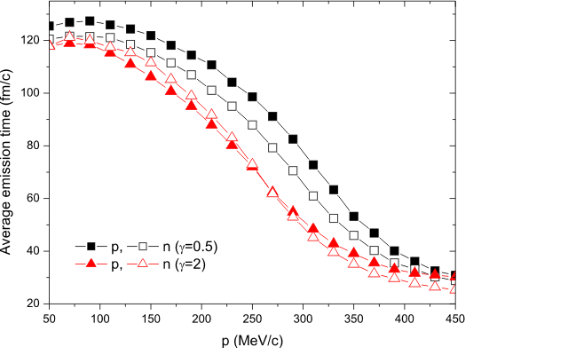
Purposes of the project: a few example for the fundamental nuclear physic
Intensity interferometry (HBT effect)
N. Colonna et al., PRL 75, 23 (1995) 4190-4193
R. Ghetti et al., PRL 87, 10 (2001)
neutron-neutron
Correlation functions
7
5
Space-time characterization of the emitting source
3
52Ca+48Ca E/A=80MeV
Central collision
1
1.5
1+R(q)
1.0
proton-proton
0.5
0.0
4
3
proton-neutron
2
Lie-Wen Chen et al., PRL (2003); PRC(2005)
1
q (MeV/c)
E. V. Pagano. LNS-INFN
WPCF 2023 – Catania (Italy) - 7 november 2023
13

Slide 15
Purposes of the project: a few example applications
Anti-cancer therapy:
Risk of secondary radio-induced cancers
In proton therapy, in particular in the pediatric one (but not only), the “damage” caused from the neutron to the healthy cells is one of the principal causes of the so called “ secondary radio-induced tumors” in particular if there are used degraders or collimators (passive technique)[1].
[1] Hall, E. J (2006) Intensity-modulated radiation therapy, protons, and the risk of second cancers.
Int J Radiat Oncol Biol Phys 65: 1-7.
Validation of Monte Carlo codes
Measurement of cross sections (d²σ/dθdE) have a huge interest for the validations of Monte Carlo code like GEANT4 in particular for neutrons in the Fermi energy regime
Neutron Camera
Possible device for homeland security and health safety to be installed in airports, ports, etc...
E. V. Pagano. LNS-INFN
WPCF 2023 – Catania (Italy) - 7 november 2023
14

Slide 16
Conclusions and perspectives
The results obtained with the EJ276 scintillator coupled to a SiPM are encouraging. It seems possible to build a versatile and modular detector for neutrons and light charged particles with high angular and energy resolution, readout by using silicon photomultiplier and signal digitalization. The studies of the neutron detection efficiency and of the crosstalk problem and their influence on the experimental results are going on using the GEANT4 software, moreover these studies will be extended by means of a real experiment, the CROSSTEST at the LNL, within the end of the 2023.
The prototypal electronics readout is ready to be tested with sources and also in the CROSSTEST experiment
New studies on the timing properties of the EJ-276 green version and on its PSD capability coupled with the new electronic have to be done in the next future.
The study of the mechanical configuration of the NArCoS prototype is ongoing.
An extension of the study for the efficiency and for the crosstalk problem for the prototype in its final configuration has to be done by means of GEANT4 and also with new experiments to be performed in Catania at LNS and in Legnaro at LNL
E. V. Pagano. LNS-INFN
WPCF 2023 – Catania (Italy) - 7 november 2023
15

Slide 17
For more info see :
1) Pagano E.V. et al., N.S., Nucl. Instrum. Methods A, 889 (2018) 83-88
2) Pagano E.V. et al., N.S., Nucl. Instrum. Methods A, 905 (2018) 47-52
3) Pagano E.V. et al., IL NUOVO CIMENTO 41 C (2018) 181
4) Pagano E.V. et al., JPS Conf. Proc. 32, 010096 (2020)
5) Pagano E.V. et al., IL NUOVO CIMENTO 43 C (2020) 12
6) Pagano E.V. et al., J. Phys.: Conf. Ser. 1643 (2020) 012037
7) Pagano E.V. et al., IL NUOVO CIMENTO 45 C (2022) 64
8) Pagano E.V. et al., Front. Phys. 10:1051058
9) Pagano E.V. et al., LNS Report (2022)
10) Pagano E.V., G. Politi, A. Simancas et al., NIM A submitted (PSD comparisons between EJ276G+SiPM and EJ276+SiPM)
11) Pagano E.V., G. Santagati et al., NIM in prep. (simulations on efficiency and crosstalk )
Thanks for the attention
E. V. Pagano. LNS-INFN
WPCF 2023 – Catania (Italy) - 7 november 2023
16

