Slide 1
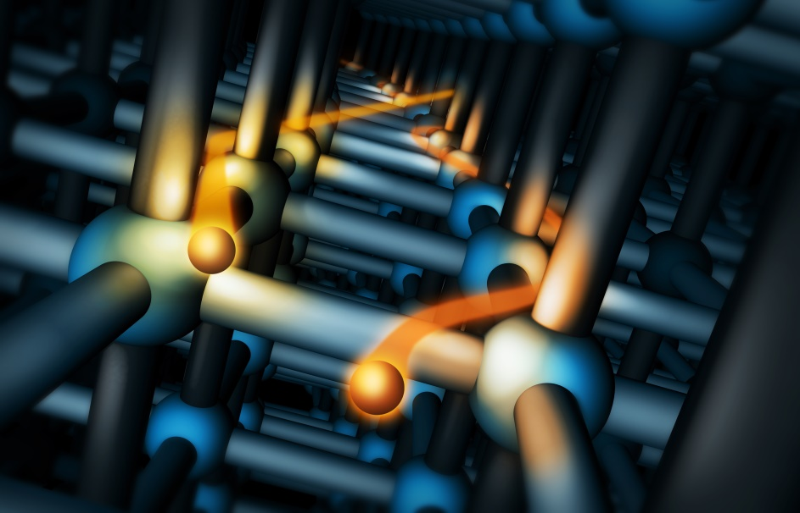
CHANNELING in crystals:
INFN-Ferrara activities
L. Bandiera, A. Mazzolari
12/11/2022
Contacts: bandiera@fe.infn.it
mazzolari@fe.infn.it

Slide 2
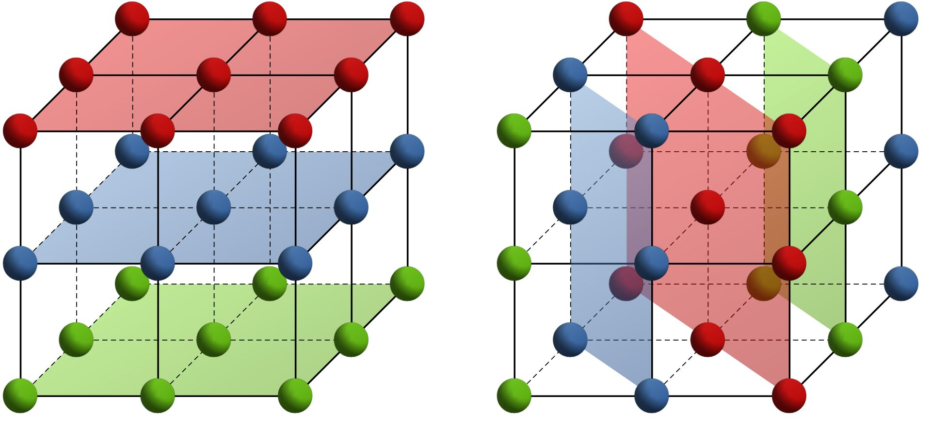


Crystal Channeling
crystalline plane
proton
proton
electron
Amorphous medium/
non oriented crystal
Oriented crystal

Slide 3
Channeling in a bent crystal
Channeling of a charged particle beam in a bent crystal results in steering of its trajectory
Bent crystals can be used in particle accelerators as elements for collimation or extraction
E. Tsyganov, 1976

Slide 4
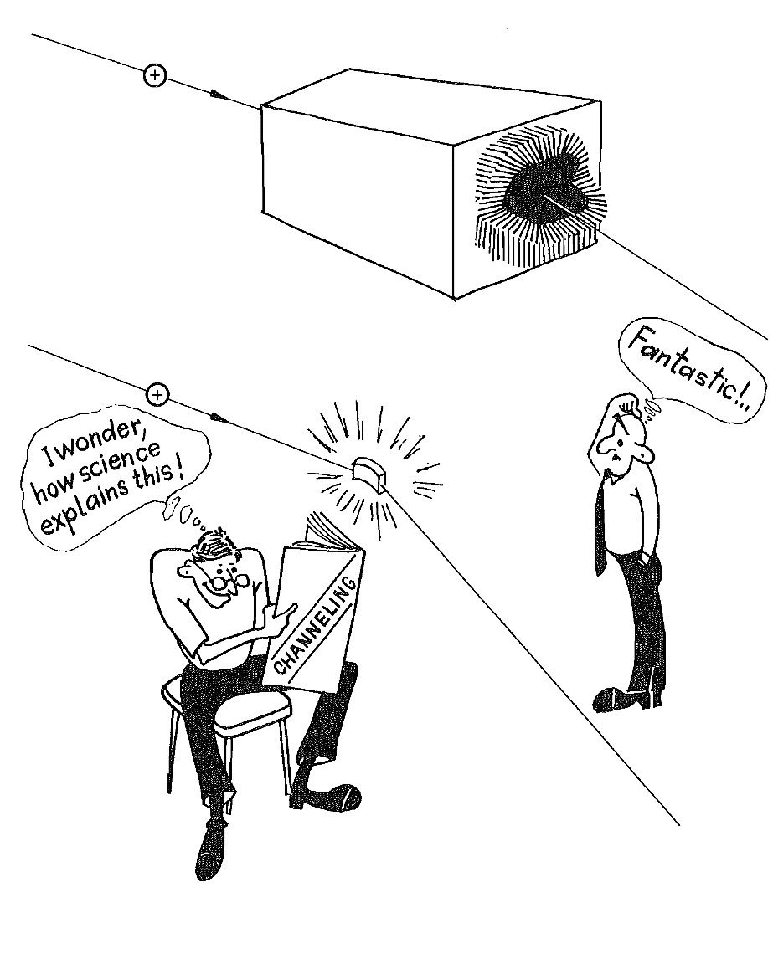
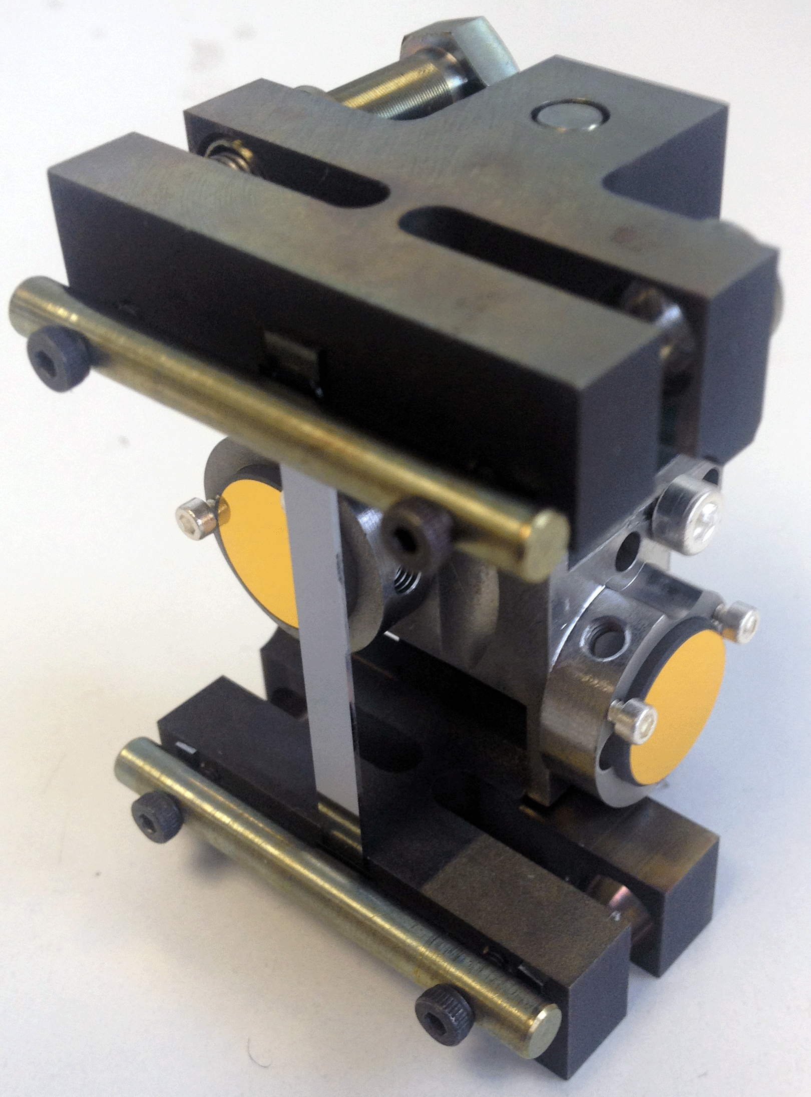
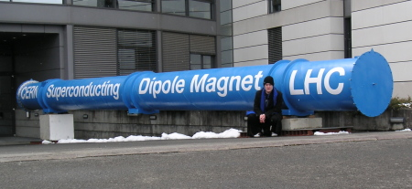
Bent crystals to steer ultrarelativisitc particle beams
V.S.
Bent Si crystal – 4 mm long
8.3 Tesla supermagnet – 15 m long
A 50 μrad at 6.5 TeV is equivalent to a 300 T dipole magnet bending!!!
Elective applications in crystal assisted
beam collimation and extraction

Slide 5


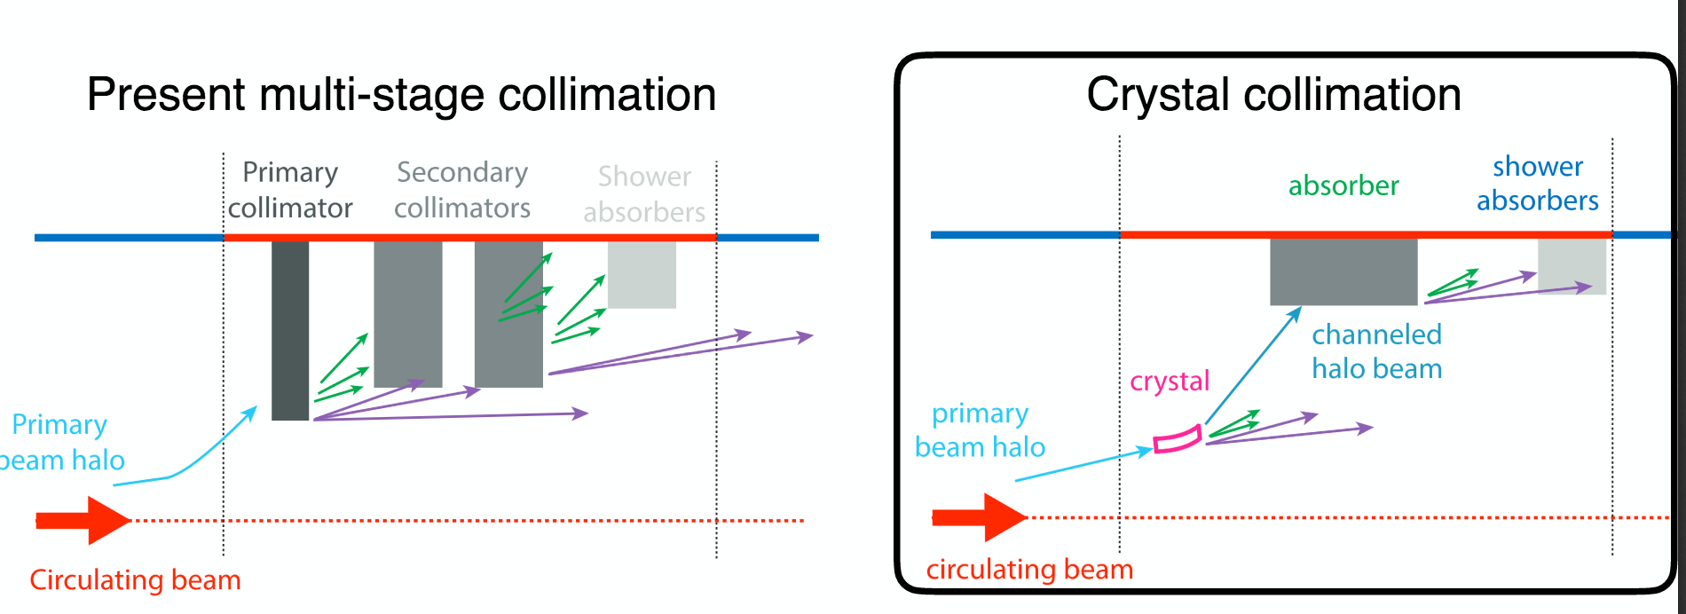
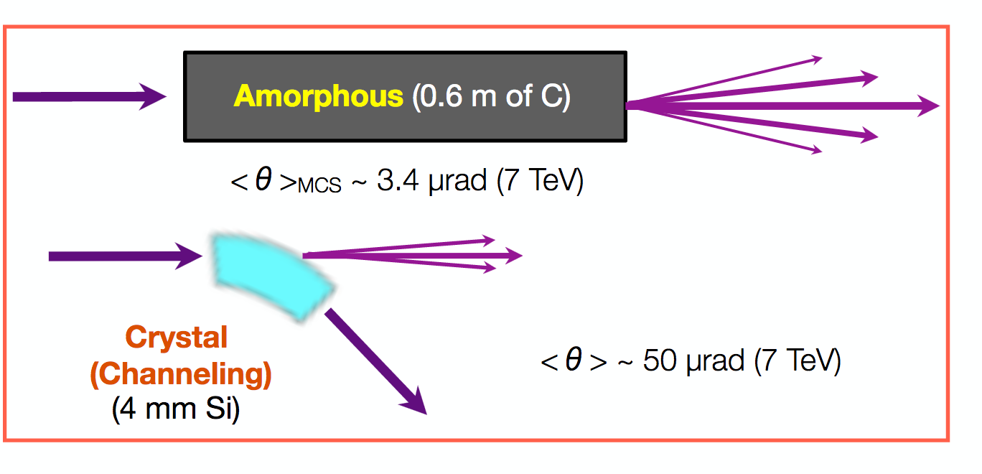
Crystal collimation at LHC
Losses on a single absorber, reduction of machine impedance, higher currents
A possible scheme for upgraded collimation at HL-LHC
  Reduction of losses in cold regions (i.e. protect magnets from quenching)
  Present collimation system already at its limit for ions:
  fragmentation of heavy-ion beams in secondary particles of small divergence and Z/A slightly different from the primary beam -> difficult to intercept by the collimation system and can produce significant heat-load in the superconducting magnets.
Since 2009, ten years of experimental investigation carried on by UA9 collaboration @SPS & @LHC together with the LHC Collimation group.
Notes:
he collimation system, which is optimized to provide a good protection with proton beams, has shown a cleaning efficiency with heavy-ion beams which is worse by up to two orders of magnitude. The reason for this reduced cleaning efficiency is the fragmentation of heavy-ion beams into isotopes with a different mass to charge ratios because of the interaction with the collimator material.

Slide 6
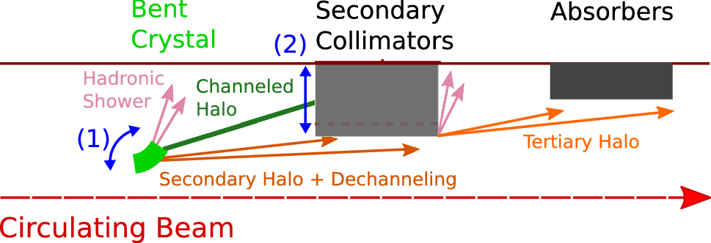
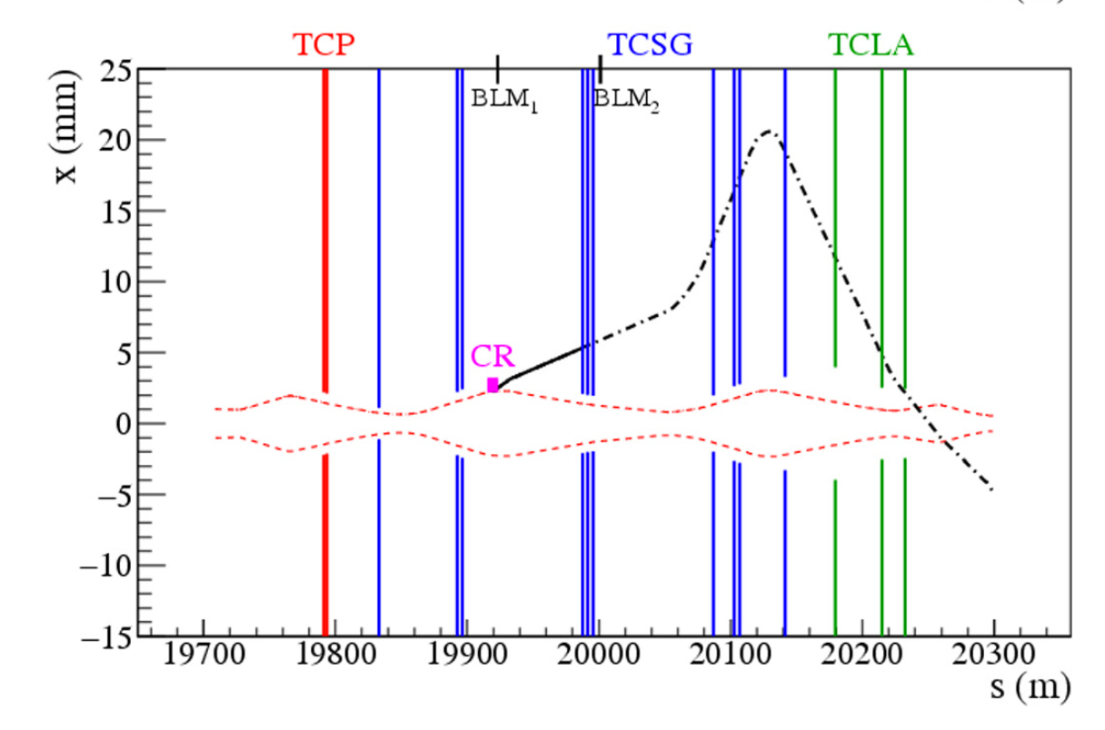
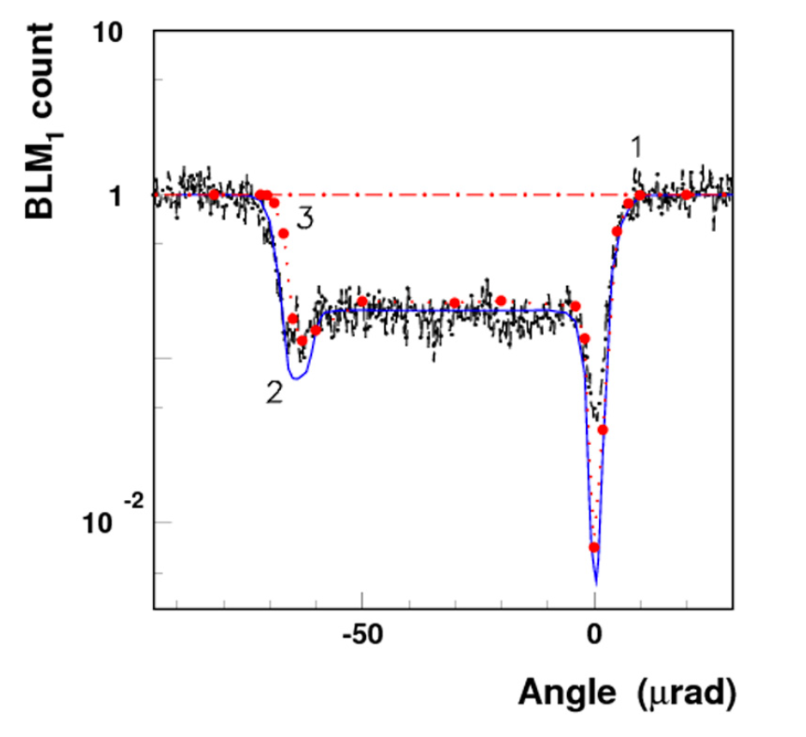
Crystal channeling with 6.5 TeV protons @LHC
First successful test with 6.5 TeV protons in Nov 2015!
W. Scandale et al., Phys.Lett. B758 (2016) 129-133
beam loss monitor
channeling
Beam trajectory in LHC
Studies still on-going at LHC (2+2 crystals installed): INFN-CERN contract for bent crystals supply!
~50 μrad deflection
Piezo-goniometer (CERN/EN-STI)
https://cds.cern.ch/journal/CERNBulletin/2015/49/News%20Articles/2105080?ln=en
http://home.infn.it/newsletter-eu/pdf/NEWSLETTER_INFN_17_italiano_pag3.pdf
Strip Si crystal (INFN)
In collaboration with LHC Collimation group
Notes:
The horizontal projection of the trajectory of a halo particle deflected by the crystal due to channeling at the bend angle α = 65 μrad (solid line up to the first horizontal TCSG1 and then by dot-dashed line to show the trajectory propagation in the case without the collimators): (a) for the beam injection with 450 GeV/c, (b) for the maximum momentum of 6500 GeV/c. Dashed lines show the beam envelope for the crystal distance from the orbit. Vertical lines show the positions of the collimators TCSG and TCLA and the primary collimators TCP (they are not visible for the injection case because they were shifted far from the orbit for the measurements). The positions of BLM1 and BLM2 for measuring the losses in the crystal and in the first horizontal TCSG1 behind the crystal, respectively, are shown schematically.

Slide 7
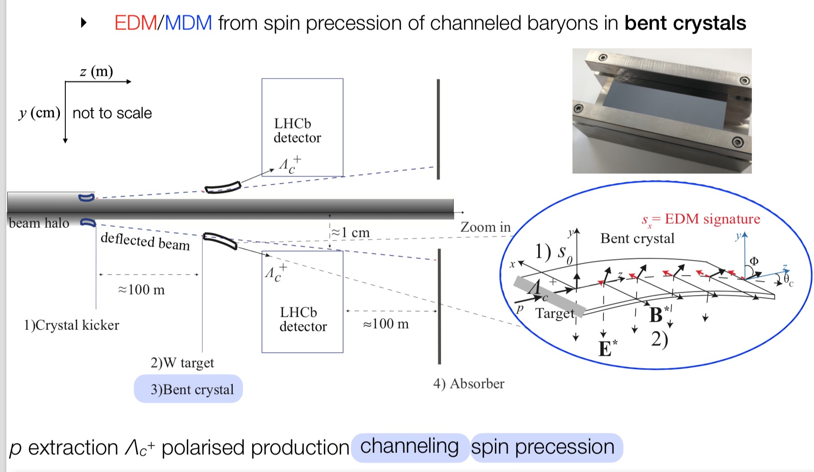

Measuring baryons MDM & EDM @LHC
“Parasitic fixed-target experiments” were proposed for LHC
(see SPSC-EOI-012 and Eur. Phys. J. C (2017) 77:181)
New experiment @IR3
Before a possible test @LHCb detector, a proof-of-principle demonstration in a different LHC point is required @Interaction Region 3 in LHC (IR3).
Sensitive to g-2 of the particle
Large deflection (15 mrad) to enhance the precession effect
and to send particles within the LHCb acceptance
N.Neri, https://indico.cern.ch/event/755856/contributions/3260539/attachments/1779601/2895655/Neri_PBCJan19.pdf
Cofinanced by ERC CoG SELDOM (PI N. Neri, Milano)
From: E. Spadaro Norella https://agenda.infn.it/event/31703/timetable/?print=1

Slide 8
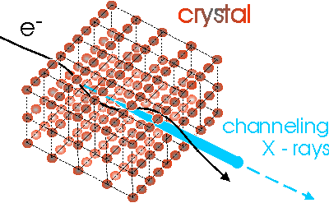
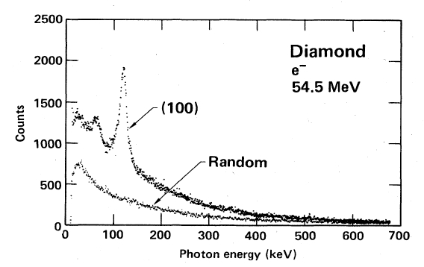
Enhancement of bremsstrahlung in aligned crystals
String of atoms
Single atom
e⁻
e⁻
Channeling Radiation (1976, Kumakhov)
HE
e⁻
Notes:
Crystal-assisted collimation: a curved crystal deviates the halo directly to the primary absorber.
8

Slide 9
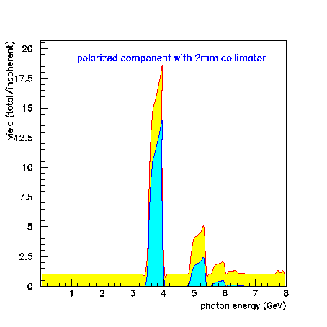
Coherent Bremsstrahlung gamma-ray sources
e⁻ @ 8 GeV
Intense and monochromatic gamma source
Degree of linear photon polarization achievable @MAMI in different diamond orientation
Linearly polarized photons
usually exploited
for photonuclear researches
JLAB example: underlying symmetry of the quark degrees of freedom in the nucleon, the nature of the parity exchange between the incident photon and the target nucleon.
MAMI – Germany
JLAB – USA
MAXLAB – Sweden
ELSA - Germany
Notes:
Crystal-assisted collimation: a curved crystal deviates the halo directly to the primary absorber.
9

Slide 10

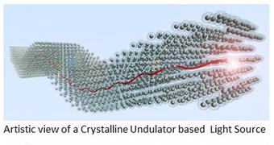
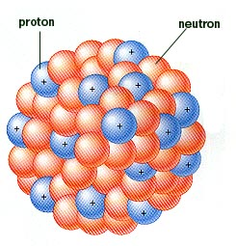
Crystalline undulator
as an intense X- and γ-ray source
TECHNO-CLS
Classical scheme: magnetic undulator in a free electron laser
keV X-rays
λu⁓ cm
Korol, Solov'yov, Greiner, J.Phys.G, v.24, L45 (1998)
APPLICATIONS: in basic sciences (from nuclear physics to solid state) and life, in technology and medicine. For example, they can be used for the disposal of radioactive waste or the production of radioisotopes for nuclear medicine by photo-transmutation.
Innovative scheme:
Crystalline undulator->
Hard X-rays and gamma rays
λu < mm
An operating CU could produce highly monochromatic X- and γ-ray beams
-

Slide 11
Hybrid crystal based positron source for future colliders
UNPOLARIZED POSITRON SOURCES
1. Conventional
e+
3. Hybrid crystal based positron source
γ
e-
e-
amorphous
Option for FCCee
Ideal for linear colliders or LEMMA
2. e+ from channeling radiation
crystal
e+
e-
γ
e-
Tests performed at CERN (WA 103) and at KEK
R.Chehab/FCPPL-Clermont/2014
Idea of R. Chehab, V. Strakhovenko and A. Variola, NIM B 266 (2008) 3868

Slide 12
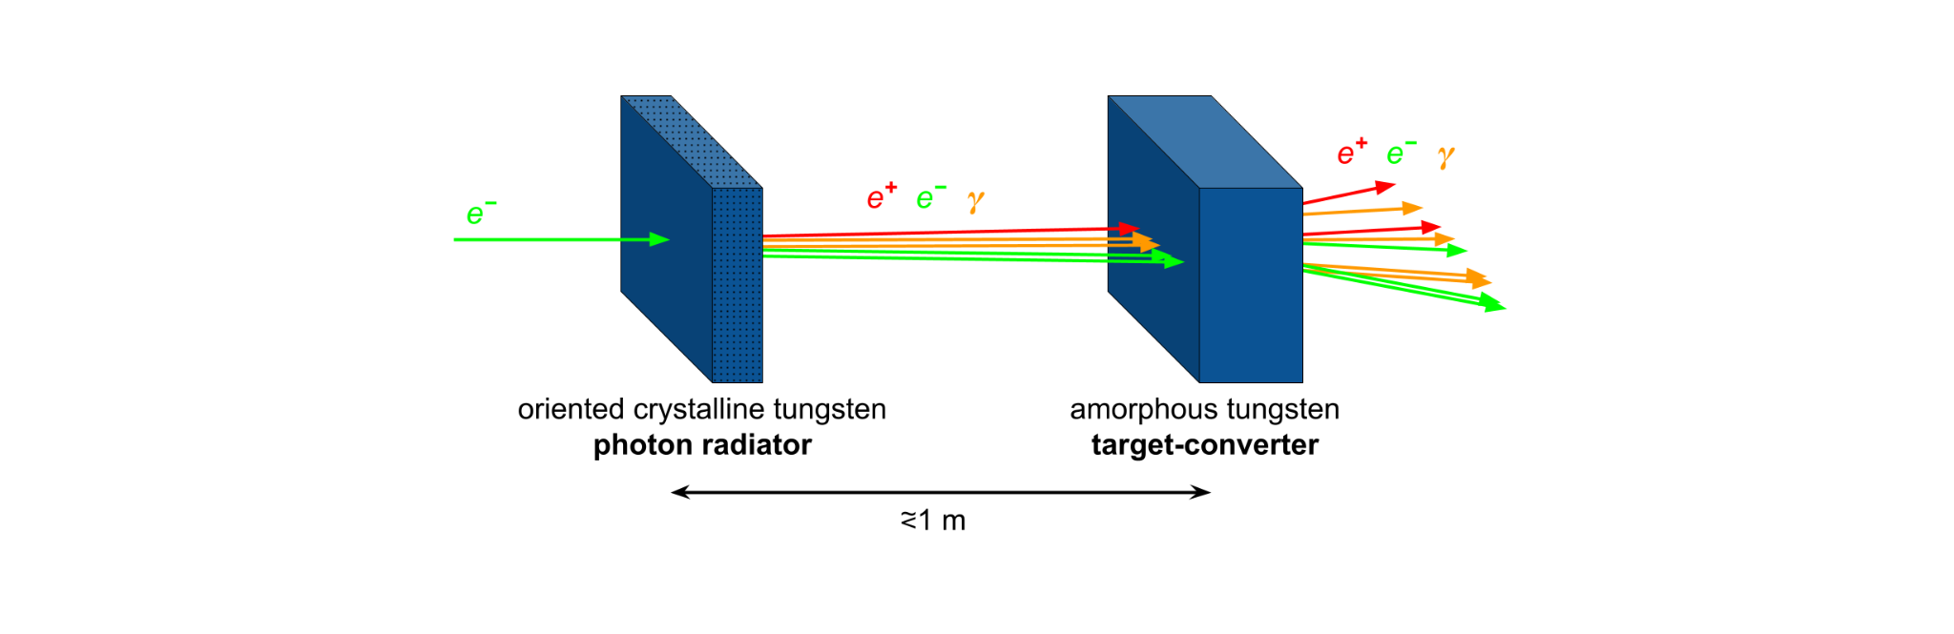
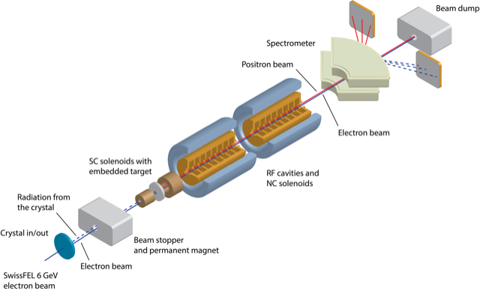
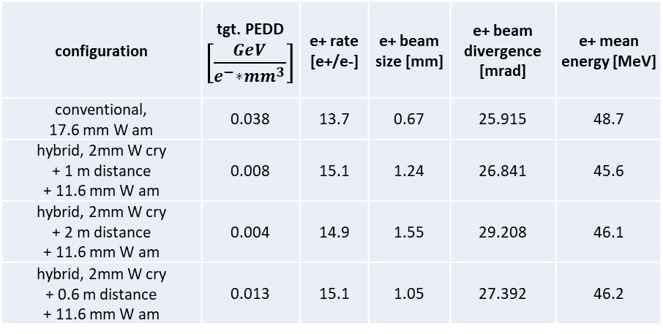
Hybrid source for FCCee
L. Bandiera et al., Eur. Phys. J. C (2022) 82:699
Comparable e+ rate at the target exit, but much less PEDD in the converter target!
e+ source optimization with 6 GeV e- beam**
configuration | tgt. PEDD $\left[\frac{GeV}{e^{−}∗{mm}^{3}}\right]$ | e+ rate [e+/e-] | e+ beam size [mm] | e+ beam divergence [mrad] | e+ mean energy [MeV]
conventional, 17.6 mm W am | 0.038 | 13.7 | 0.67 | 25.915 | 48.7
hybrid, 2mm W cry + 1 m distance + 11.6 mm W am | 0.008 | 15.1 | 1.24 | 26.841 | 45.6
hybrid, 2mm W cry + 2 m distance + 11.6 mm W am | 0.004 | 14.9 | 1.55 | 29.208 | 46.1
hybrid, 2mm W cry + 0.6 m distance + 11.6 mm W am | 0.013 | 15.1 | 1.05 | 27.392 | 46.2
Crystal radiator
Test foreseen at PSI in 2025

Slide 13





Crystals technology at INFN-Ferrara
Collimation & beam steering
Innovative radiation sources
Pair production studies
Innovative detectors
Involved in Channeling experiments since 2000
Beam steering
Innovative radiation sources
Innovative radiation and positron sources
Innovative detectors
Beam extraction
Innovative radiation sources
Beam steering
ERC-CoG CRYSBEAM (LHC beam extraction)
ERC-CoG SELDOM (Studies of MDM and EDM of charmed baryons)
MCA-IRSES CUTE (crystalline undulators)
MSCA-RISE PEARL (crystalline undulators)
MSCA-RISE N-LIGHT (crystalline radiation sources)
EIC-PATHFINDER TECHNO-CLS (crystalline radiation sources)

Slide 14
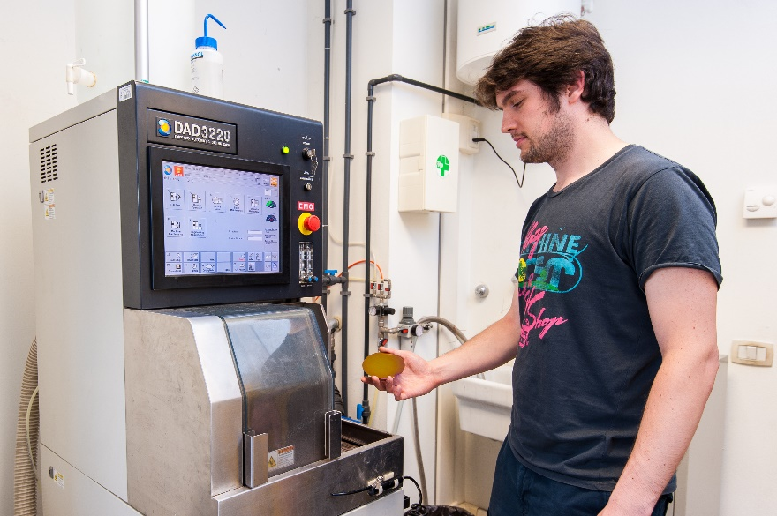
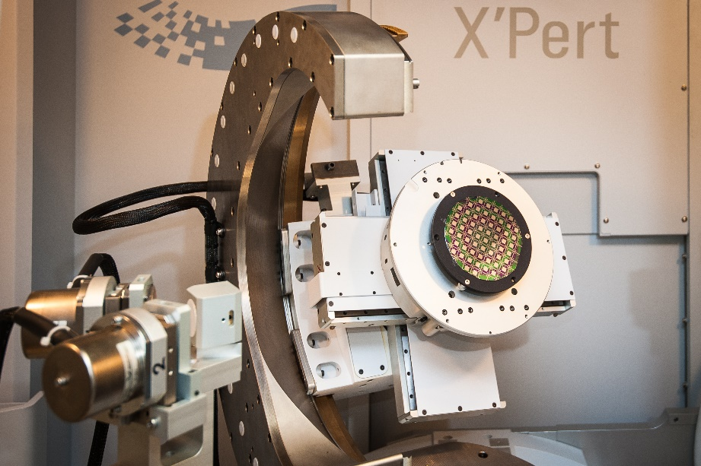
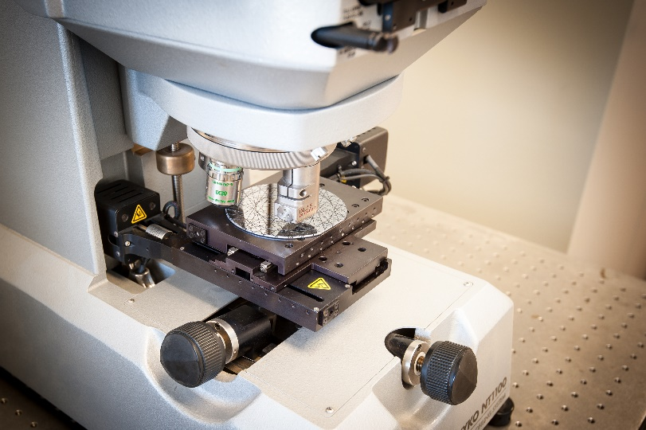
INFN-Ferrara infrastructure
Laboratory fully equipped for silicon micro and nanomachining
ISO4 certified clean room (130 m²)
High-resolution x-ray diffraction
Dicing and polishing equipment
White light and Fizeau inteferferometers

Slide 15
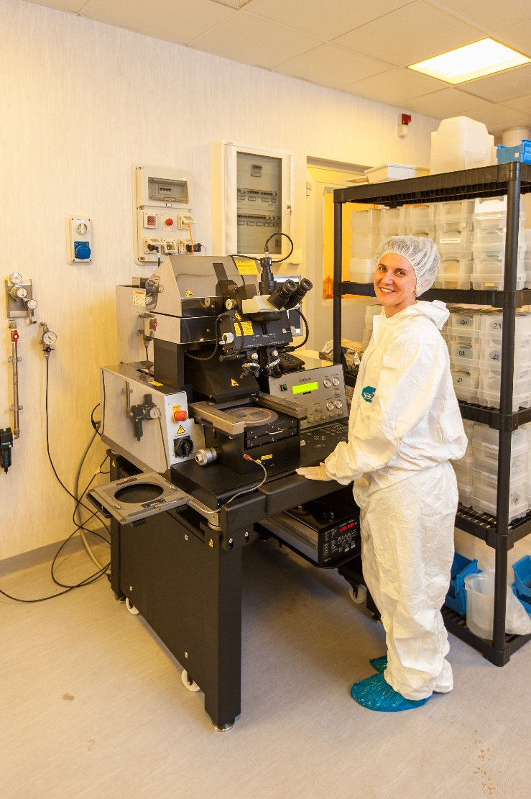
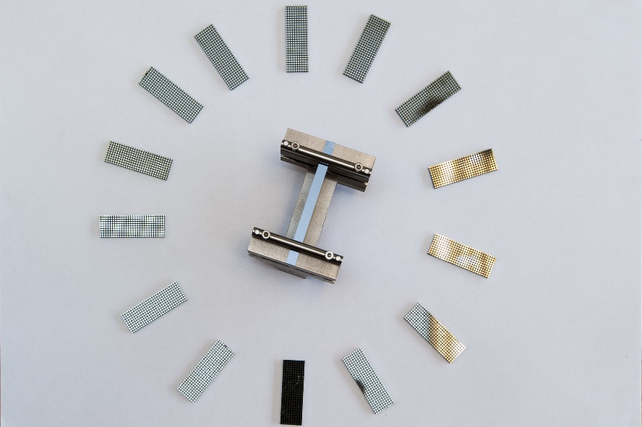

INFN-Ferrara infrastructure
Laboratory fully equipped for silicon micro and nanomachining
Fotolitography
Equipment for silicon chemical etching
Nanoimprint

Slide 16
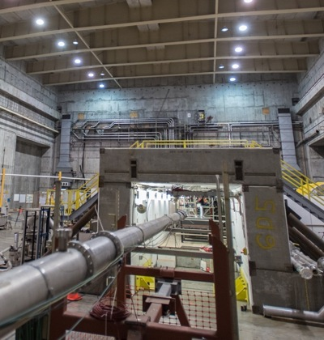
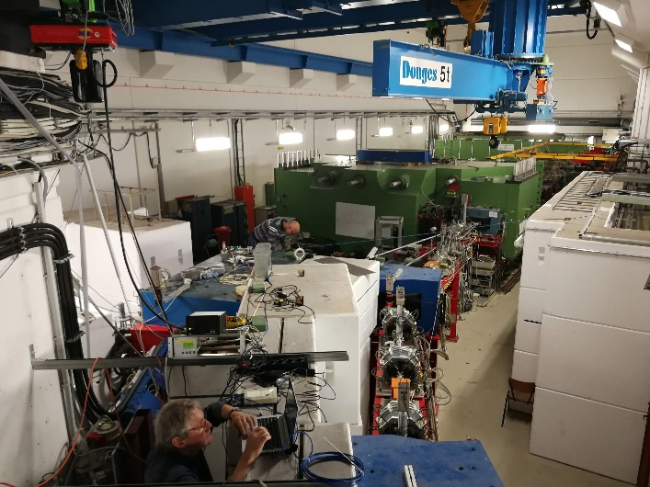

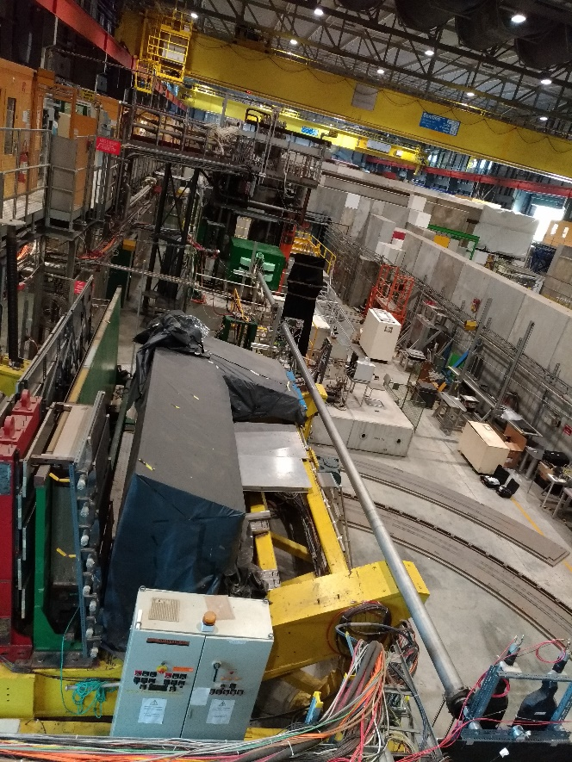

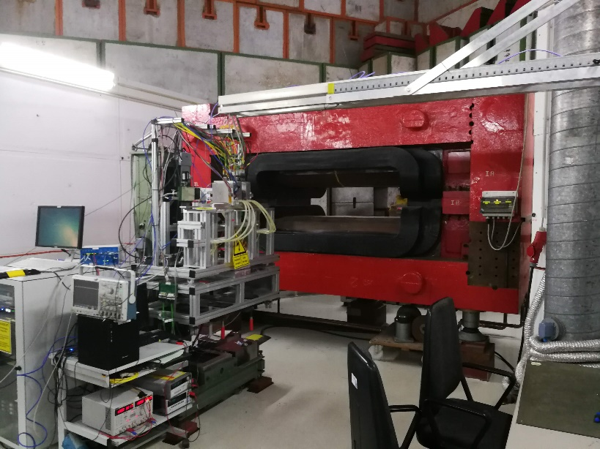
Test facilities
e⁻ @multi-GeV
SLAC (Stanford, USA)
e⁻ @ subGeV
MAMI (Mainz, Germany)
p, e±, π± @ (1-400) GeV
CERN EA&NA
(Geneve, Switzerland)
e± @6 GeV
DESY (Hamburg, Germany)

Slide 17
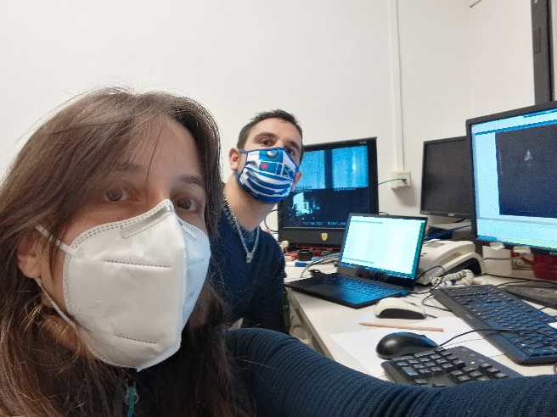
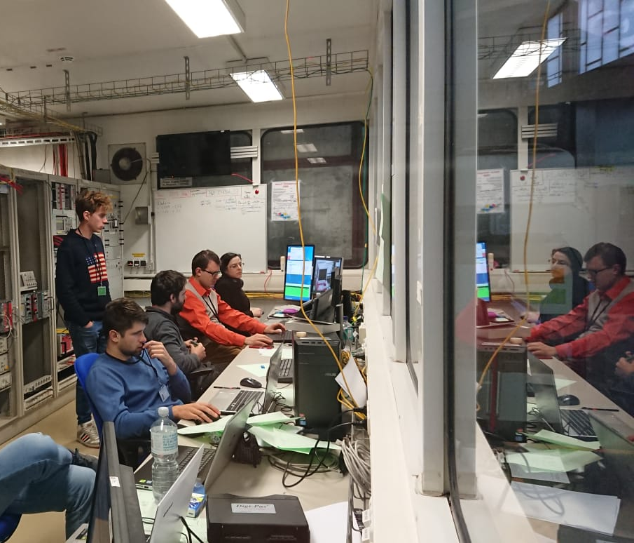
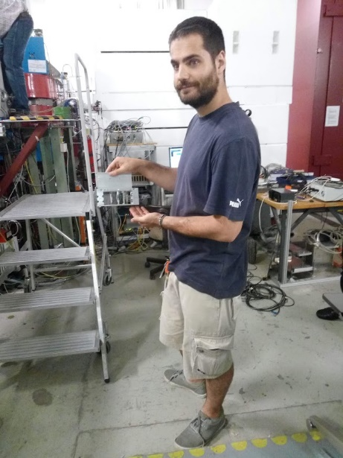
FERRARA TEAM
Laura Bandiera
Vincenzo Guidi
Andrea Mazzolari
Marco Romagnoni
Mattia Soldani
Alexei Sytov
Main italian collaborations
UniPD, UniRoma, UniInsubria, UniMilano
Legnaro labs, Frascati Labs
Main external collaborations
CERN, DESY, MAMI, MBN Center, INP Minsk, IJCLab

Slide 18
Summary
INFN-Ferrara has unique infrastructures in the world for the production of crystals for the manipulation of particle beams.
Collaborations with laboratories and accelerators all over the world.
Crystals as innovative elements for the manipulation of particle beams, for the realization of intense radiation and particle sources and useful elements for fundamental physics research .
Contacts: bandiera@fe.infn.it
mazzolari@fe.infn.it

