Slide 1
Towards the Diagnostic of Spin-Polarized Particle Beams: Application of Compton Polarimeters
Renate Märtin ^{1,2}
¹ GSI Helmholtzzentrum für Schwerionenforschung, Germany
² Physikalisches Institut, Universität Heidelberg, Germany

Slide 2
Collaborators
Atom Physics Group @ GSI
W. Chen, R. DuBois, A. Gumberizde, S. Hagmann, M. Hegewald, S. Hess, C. Kozhuharov, U. Spillmann, D. Thorn, S. Trotsenko, G. Weber, D. Winters, N. Winters and
Th. Stöhlker
Electron source @ TU Darmstadt
R. Barday, C. Eckardt, A. Göök, Y. Poltoratska, M. Wagner and J. Enders
Theory
D. Jakubassa-Amundson, A. Surzhykov, V. A. Yerokhin

Slide 3
Outline of the Talk
Motivation
Description of the photon linear polarization
Experimental technique: Compton polarimetry with strip detectors
Polarization transfer in polarized particle collisions
Bremsstrahlung linear polarization of spin polarized electrons
Outlook

Slide 4


Motivation
Diagnosis of spin-polarized particle beams
Spin-polarized heavy ion-atom collisions may reveal important
knowledge on relativistic, QED and even parity-violation effects!
Search for the electric dipole moment!
!STORI presentation by Andrey Surzhykov!
…within Stored Particle Atomic Physics Research Collaboration

Slide 5

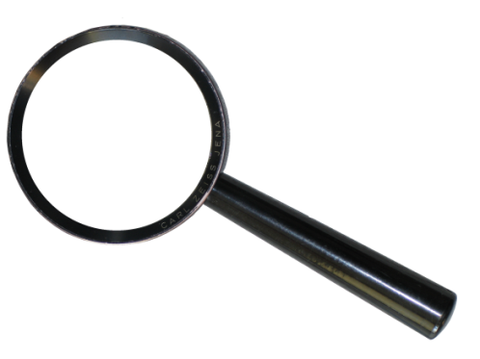
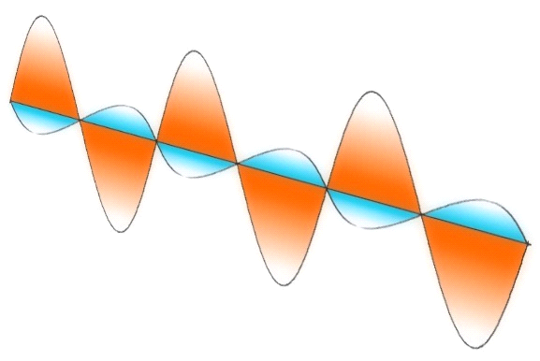
Polarization transfer
Idea of “polarization transfer” between incoming ions/electrons and emitted photons
(first discussed by U. Fano and R. Pratt in 1960’s)
E
B
We expect to get information on the incident particle beam polarization from the measurement of the properties of x-ray linear polarization = spin diagnostic!
Proof-of-principle: Linear polarization of bremsstrahlung from spin-polarized electrons

Slide 6
Photon Linear Polarization – Stokes Parameters
Photon linear polarization can be described in terms of Stokes parameters
[W. H. McMaster, Am. J. Phys. 22, 351 (1954)]
I_{90°}
P₁
I_{135°}
I_{45°}
P₂
k
I_{0°}
k
P₁ and P₂ denote the degree and direction of the photon linear polarization of the light in the plane perpendicular to the photon momentum k → Complete description of the photon linear polarization.

Slide 7
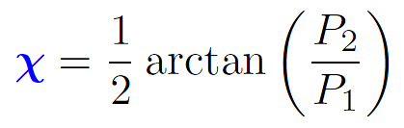
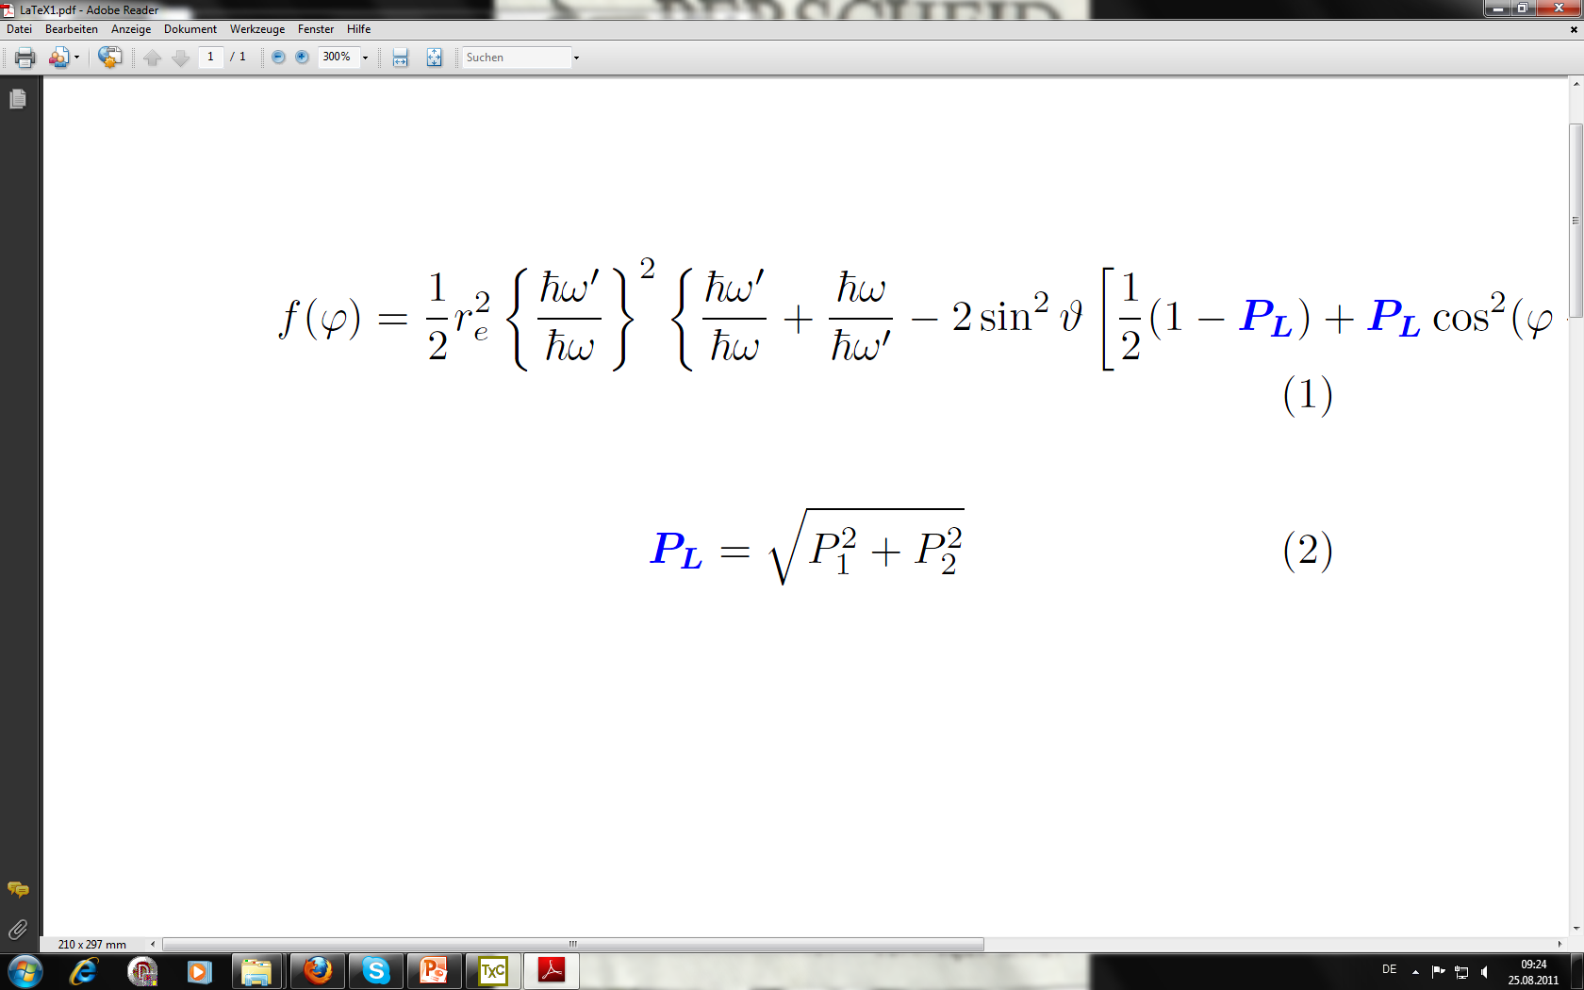
Photon Linear Polarization – Experimental Observables
Another set of polarization parameters:
P_{L}
χ
P_{L} and χ are the experimental observables and represent the linear polarization of light in terms of the polarization vector
k
The vector is characterized by the total linear polarization P_{L} and by the angle χ. Both parameters can be expressed in terms of P₁ and P₂:

Slide 8
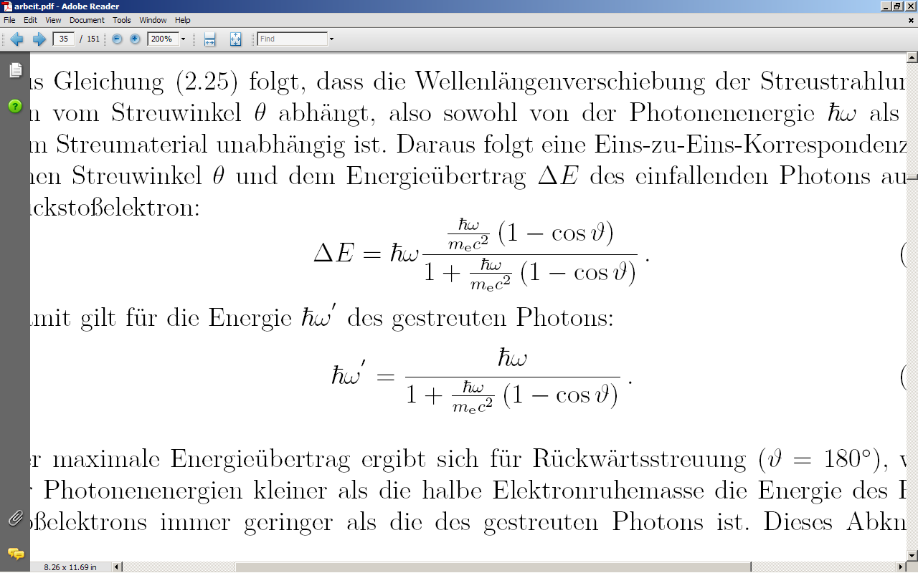

Our tool: Compton scattering
ħω'
ΔE >> E_{B}
Azimuthal scattering distribution
θ
ϕ
φ
E
ħω
e⁻
ΔE
E
Klein-Nishina equation:
Inelastic photon scattering:
High Polarization Sensitivity !

Slide 9
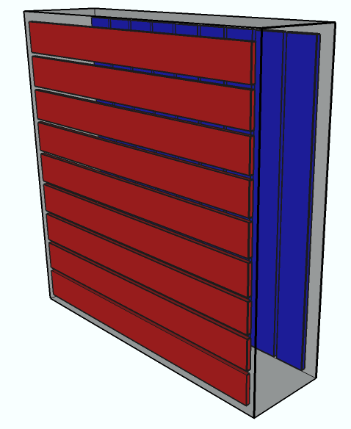
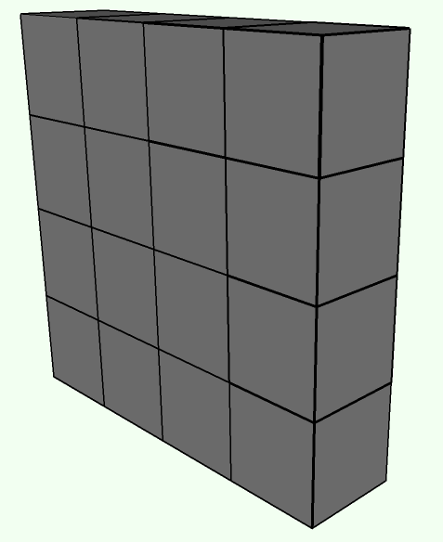
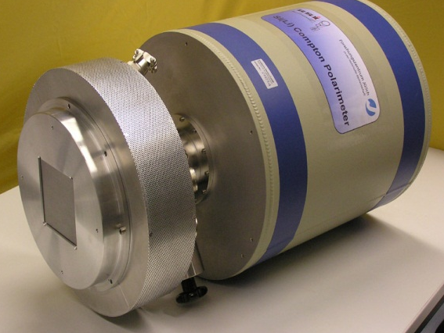
Compton polarimetry
Our approach:
Double-sided segmented
X-ray detectors applied as
Compton polarimeters.
ħω'
ħω
[ G. Weber et al., J. Inst. 5 C07010 (2010) ]

Slide 10
From ϕ Distribution to Polarization
Example: Bremsstrahlung
Unpolarized electrons on carbon target
ϕ
E
Projection on the azimuthal angle ϕ

Slide 11
From ϕ Distribution to Polarization
Unpolarized electrons on carbon target
Klein-Nishina formular
½ ( 1 - P ) + P cos²( φ – χ)
Preliminary

Slide 12
Photon linear polarimetry as a tool for controlling spin-polarized ion beams

Slide 13
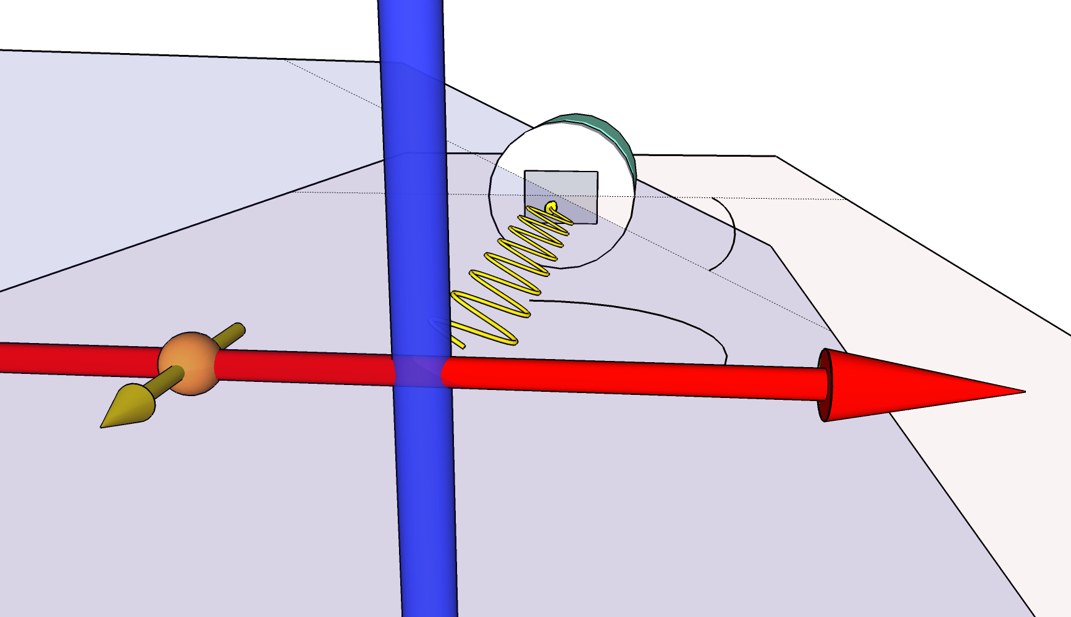
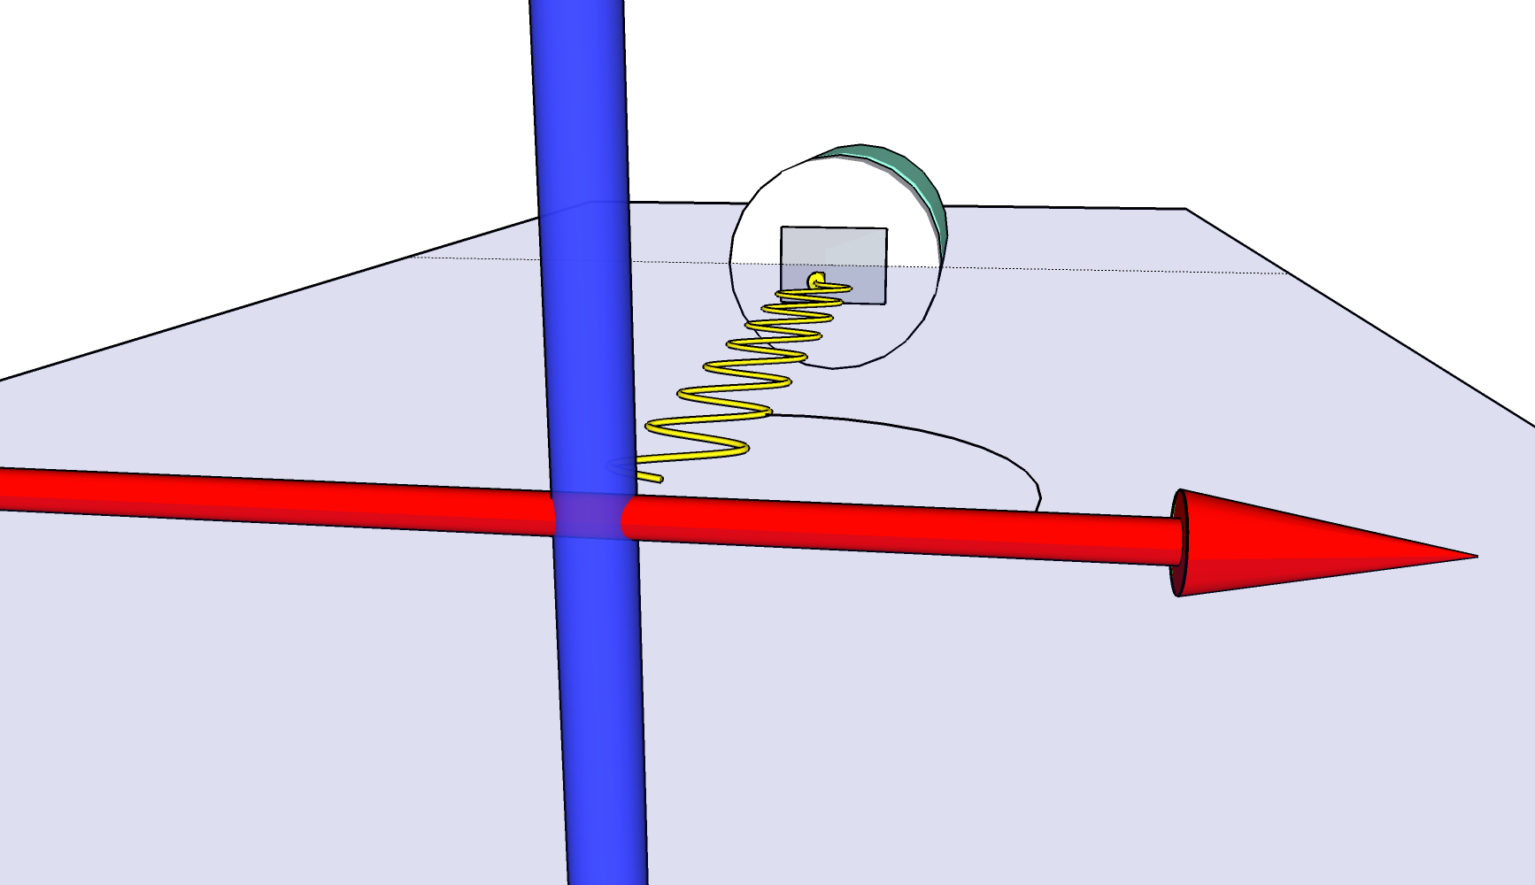
Probing spin-polarized particle beams by means of Compton polarimetry
target
Rotation of scattered photon distribution
reaction plane
E
E
unpolarized ion beam
polarized ion beam
[A.Surzhykov et al.,
PRL 94, 203202 (2005)]
[R. Pratt, R. Levee, R. Pexton, and
W. Aron, Phys. Rev. 134, A916 (1964)
„ polarization transfer for the photeffect“]
Unpolarized collision system:
Emitted photons are polarized along the reaction plane.
Polarized collision system:
Orientation of photon polarization depends on the spin polarization of the colliding particles. → Polarization transfer from particles to photons → Spin diagnostic !

Slide 14
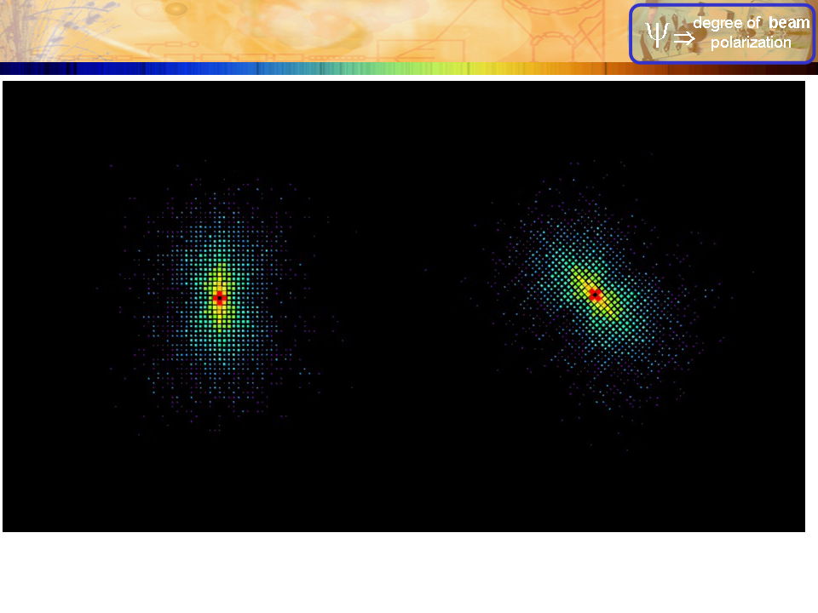
Probing spin-polarized particle beams by means of Compton polarimetry
Rotation of scattered photon distribution
unpolarized
polarized
spin-polarized
E
Simulation
[A.Surzhykov et al.,
PRL 94, 203202 (2005)]
[R. Pratt, R. Levee, R. Pexton, and
W. Aron, Phys. Rev. 134, A916 (1964)
„ polarization transfer for the photeffect“]
Polarized collision system:
Orientation of photon polarization depends on the spin polarization of the colliding particles. → Polarization transfer from particles to photons → Spin diagnostic !

Slide 15
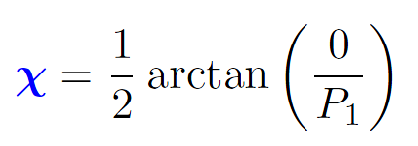
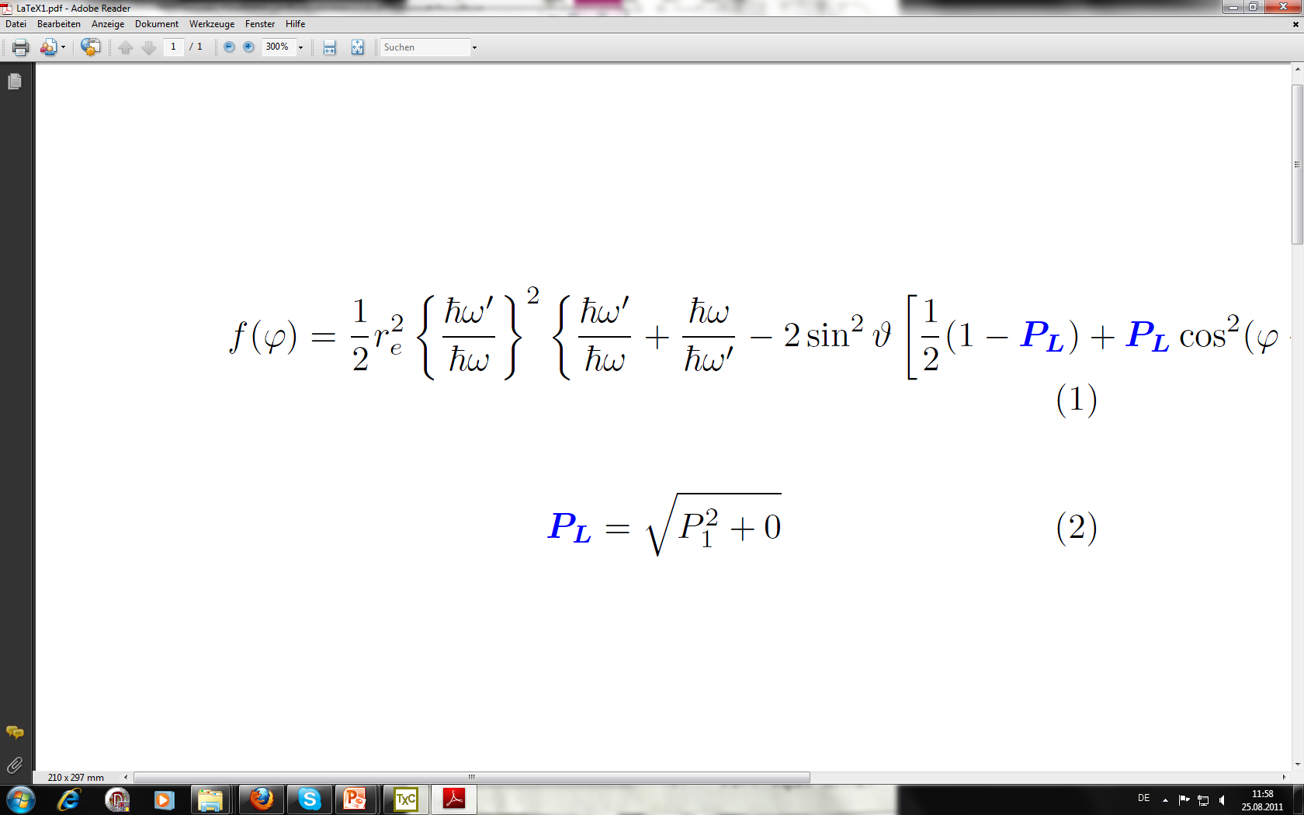
Probing spin-polarized particle beams by means of Compton polarimetry
E
E
Sensitve to the spin polarization of the incident
particle!
Unpolarized collision system:
Vanishing Stokes parameter P₂
Polarized collision system:
Non-zero Stokes-Parameter P₂

Slide 16
Bremsstrahlung linear polarization from spin-polarized electrons

Slide 17
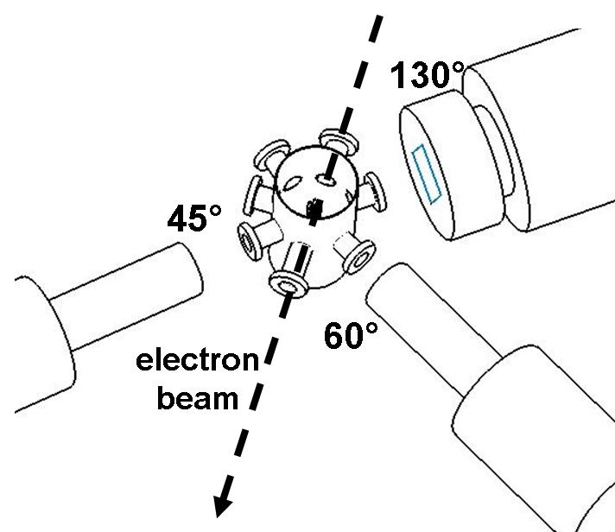
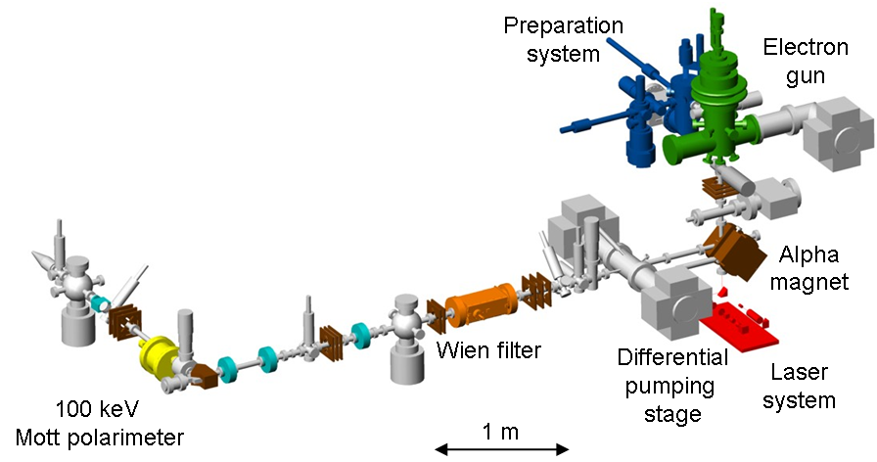
Experimental Setup
@ the polarized electron source of the TU Darmstadt
[C. Heßler, Conf. Proc. EPAC08, 1482-1494 (2008)]

Slide 18
Experimental Setup
@ the polarized electron source of the TU Darmstadt
100 keV electrons
electron polarization 76±5%
gold target foil (thickness: 90 μg/cm²)
x-ray polarimeter at 130°
[C. Heßler, Conf. Proc. EPAC08, 1482-1494 (2008)]

Slide 19
Bremsstrahlung of spin-polarized electrons
100 keV e⁻→ Au @ 130 deg
Kα
Kβ
Reconstructed Compton events

Slide 20
Unpolarized vs. transversely polarized electrons
Unpolarized electrons
100 keV e⁻→ Au @ 130 deg
Kα
Kβ
Transversely
polarized electrons
Reconstructed Compton events
Photon energy: 92.5 ± 3 keV
°

Slide 21
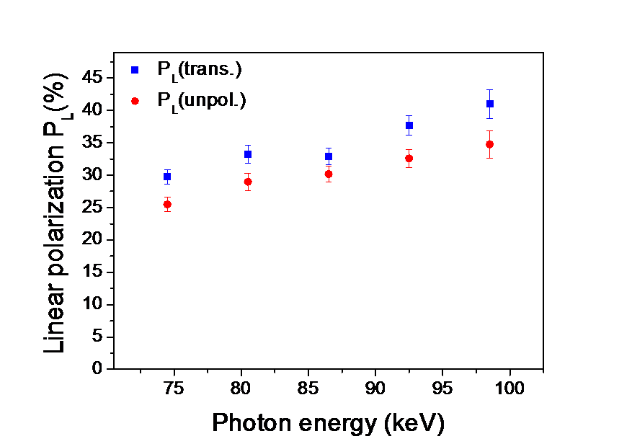
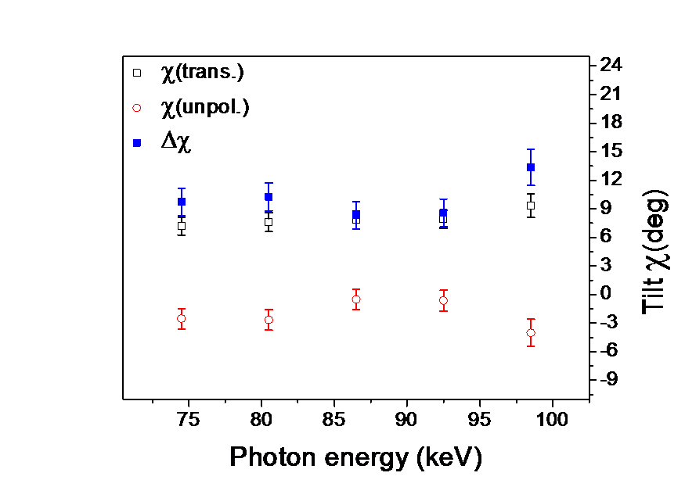
Unpolarized vs. transversely polarized electrons
Preliminary Results
Preliminary Results
Experimental data include corrections for (P_{L} only):
Characteristic transitions
Polarimeter quality Q
Random coincidences

Slide 22
Target effects
Correction for target effects resulting form scattering of electrons in finite-thick target foils (90 µg/cm² Au)
E
e⁻
E
!No single collision conditions!
[PEBSI: G. Weber, R. Märtin, A. Surzhykov, M. Yasuda, V. A. Yerokhin, Th. Stöhlker; submitted to Nucl. Instr. Meth. B]; [Theory: V. A. Yerohkin and A. Surzhykov]

Slide 23
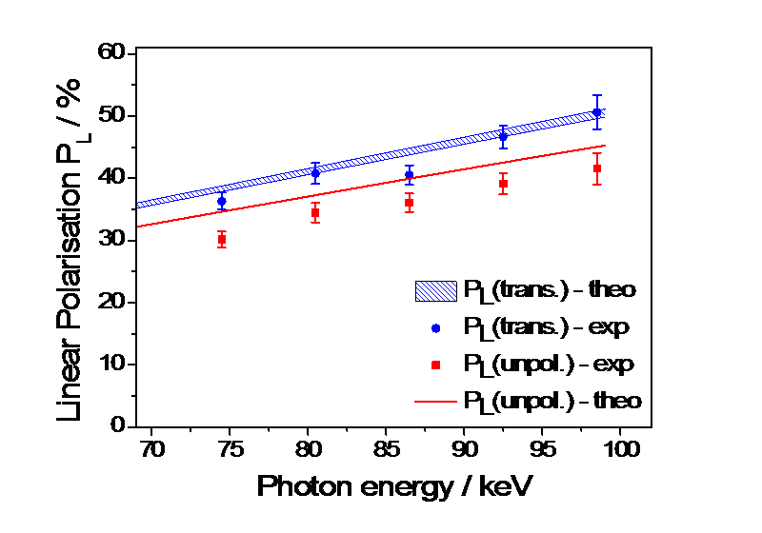
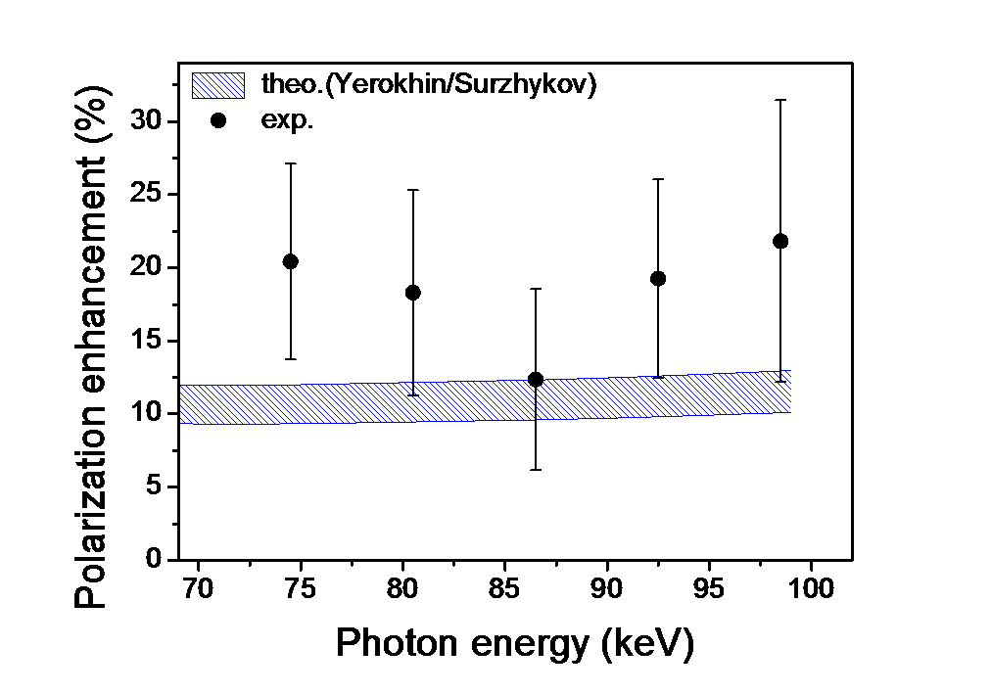
Enhanced degree of linear polarization
Experimental data include corrections for target effects
Preliminary Results
Experiment:
76 ± 5 %
transversal
polarization
in the reaction
plane
Preliminary Results
[Theory: V. A. Yerohkin and A. Surzhykov]

Slide 24
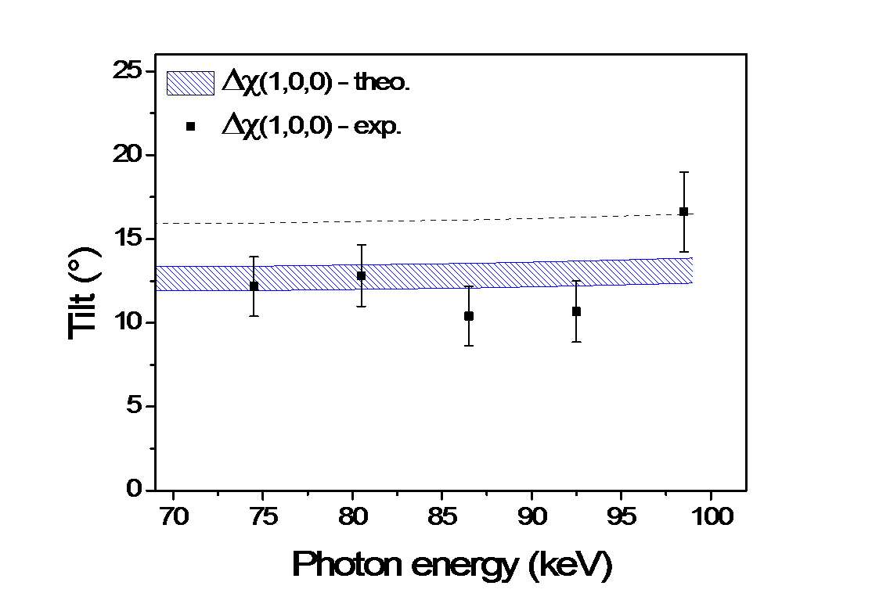
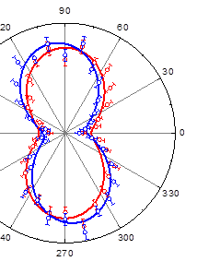
Rotation of the polarization vector
Preliminary Results
Experiment:
76 ± 5 %
transversal
polarization
in the reaction
plane

Slide 25
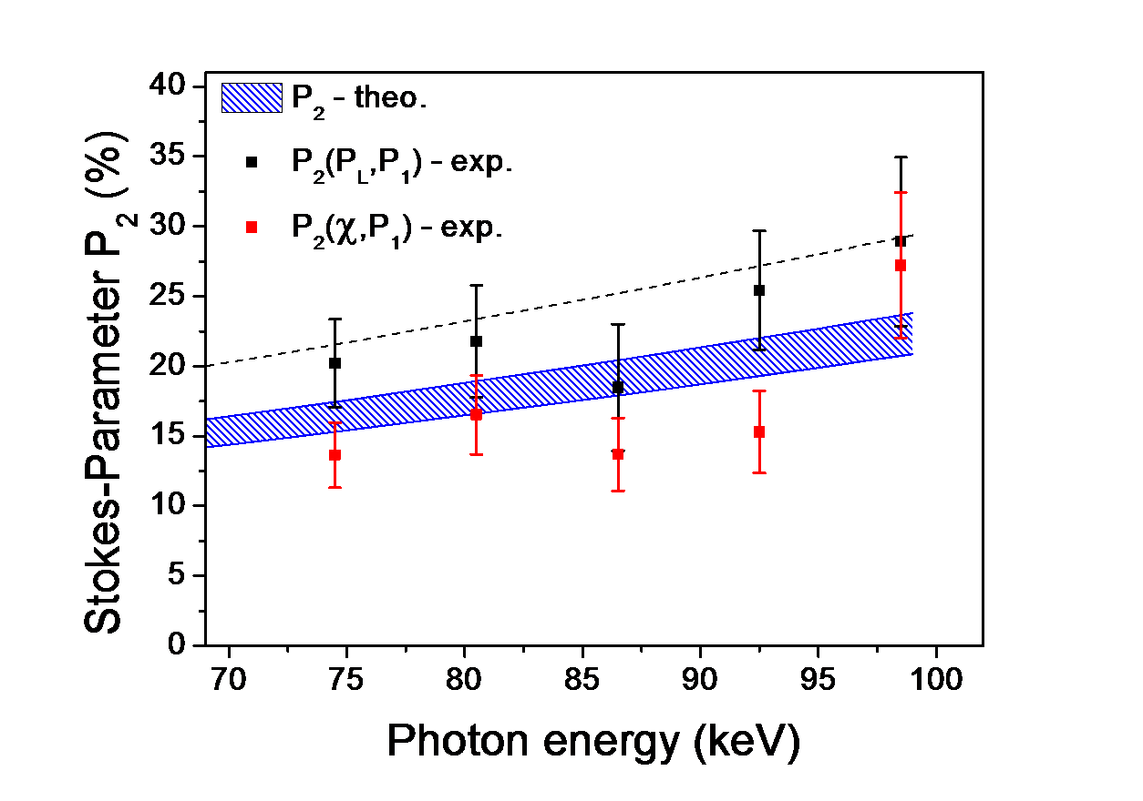
Determination of the spin-dependent Stokes parameter P₂
Mean value
Electron polarization:
73.9 ± 4.4%
Mott polarimetry:
76 ± 5%
Preliminary Results

Slide 26
Outlook
Development of a spin-polarized electron target for storage rings
Polarization transfer in REC process
Photon-photon/photon-electron correlations
Measurements at synchrotron facilities (DESY, ESRF)
Polarization in elastic and inelatic x-ray scattering
Detector development
Digital readout & pulse shape analysis
New polarimeter designs for lower x-ray energies and higher photon fluxes

Slide 27
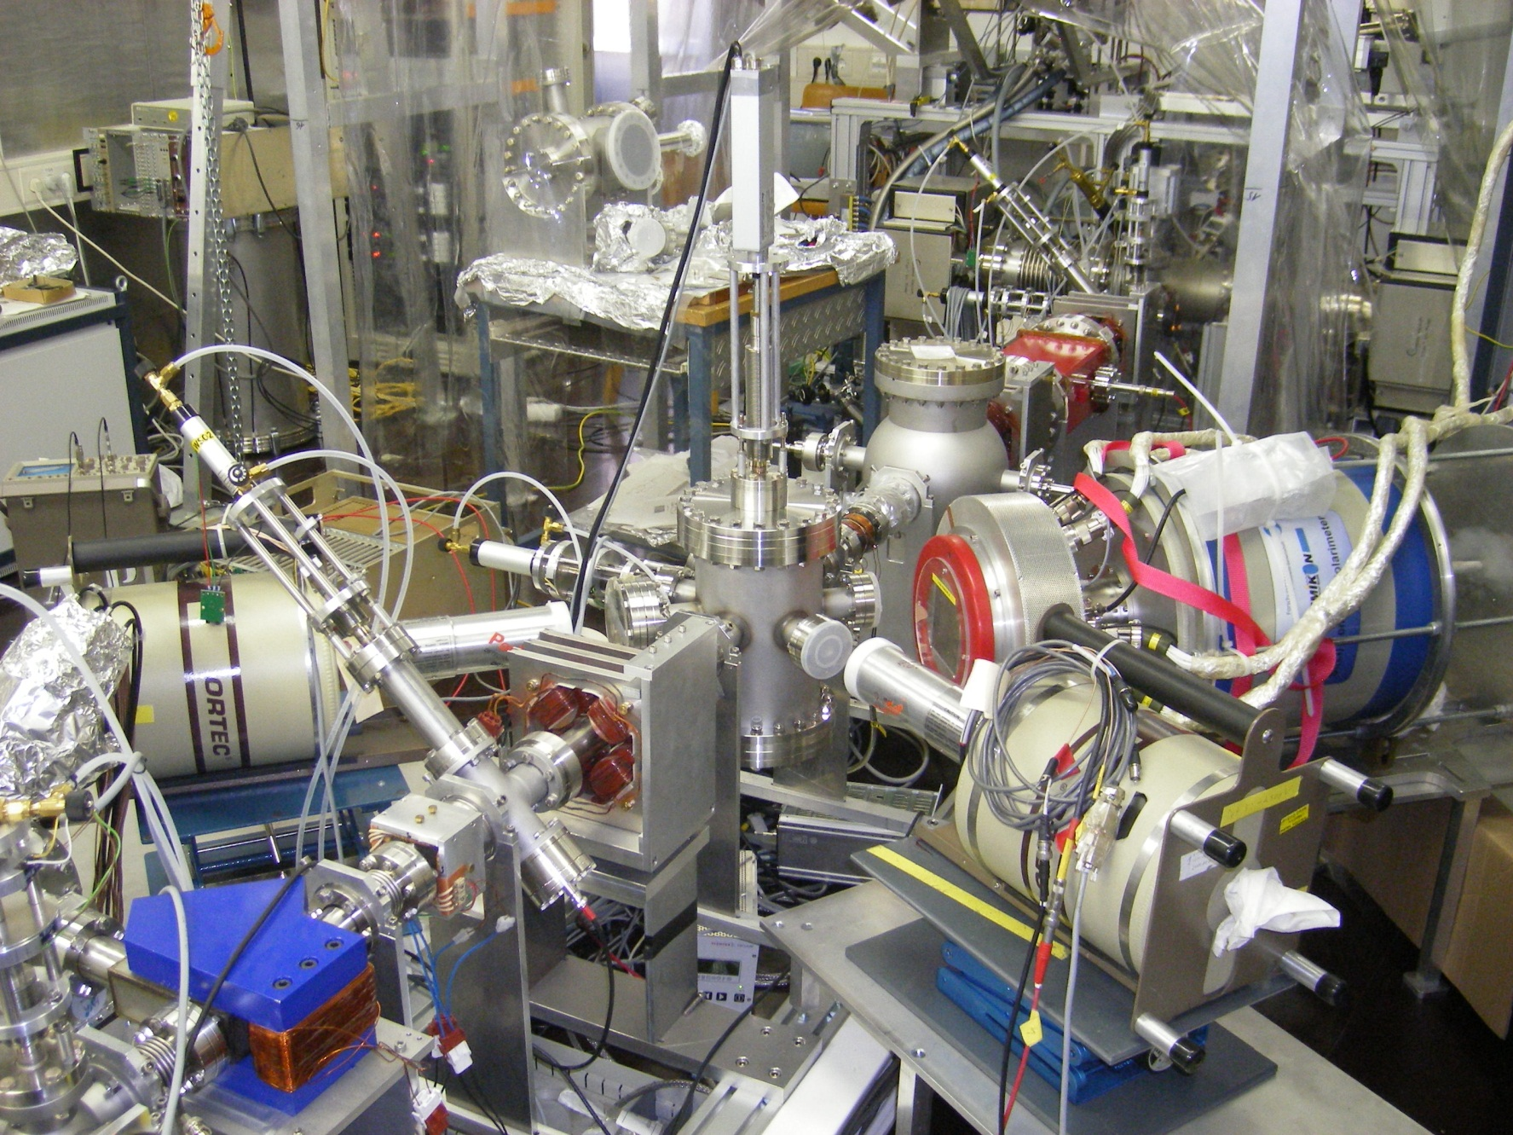
THANK YOU FOR YOUR ATTENTION

