Slide 1
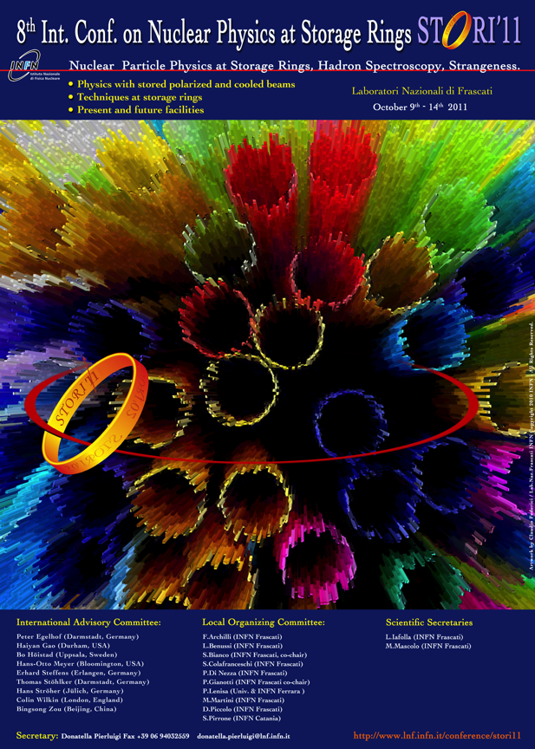
Upgrade of the
ALICE Inner Tracking System
Vito Manzari – INFN Bari
(vito.manzari@cern.ch)

Slide 2
Outline
Outline of current detector
Upgrade: Physics motivations & Design goals
Upgrade options & Preliminary studies
Ongoing R&D
Timeline
Conclusions

Slide 3
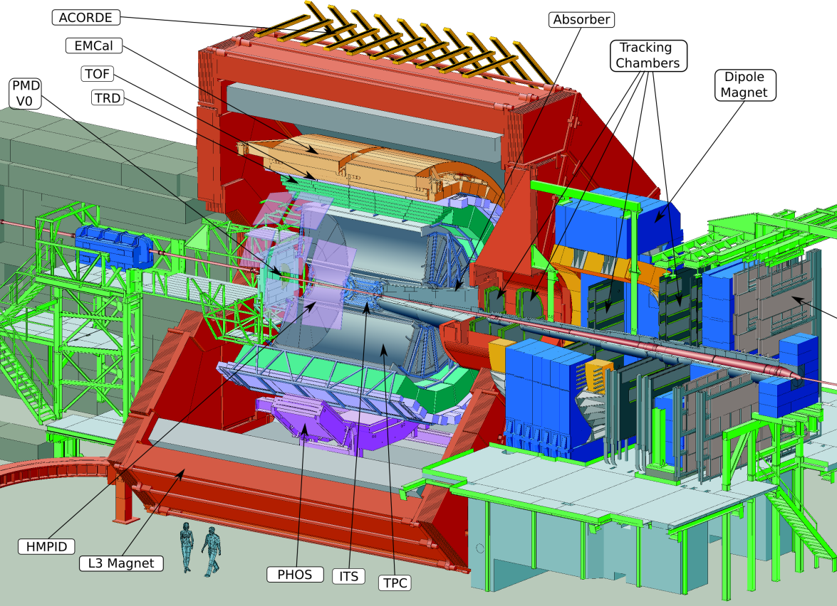
ALICE detector layout
Central Barrel
2 π tracking & PID
Δη ≈ ± 1
Detector:
Size: 16 x 26 meters
Weight: 10,000 tons

Slide 4
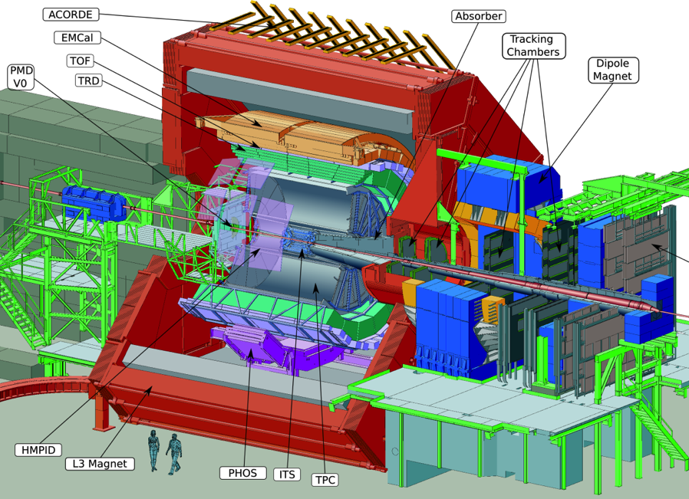
The ALICE experiment
Dedicated heavy ion experiment at LHC
Study of study behavior of strongly interacting matter under extreme conditions of compression and heat in heavy-ion collisions, mostly by means of Pb-Pb collisions 5.5 TeV CM-energy (NN)
Proton-proton collision program
  Reference data for heavy-ion program
  Genuine physics (momentum cut-off < 100 MeV/c, excellent PID)
Barrel Tracking
Pseudo-rapidity coverage |η| < 0.9
Robust tracking for heavy ion environment
  up to 150 points along the tracks
Wide transverse momentum range (100 MeV/c – 100 GeV/c)
  Low material budget (13% X₀ for ITS+TPC)
  Large lever arm provides good tracking resolution at high p_{t}
PID over a wide momentum range
Combined PID based on several techniques: dE/dx, TOF, transition and Cherenkov radiation
Rate capabilities
Interaction rates: Pb-Pb < 8kHz, p-p < 200 kHz (~30 events in the TPC)
Multiplicities: central Pb-Pb events ~2000, Pb-Pb MB ~ 600

Slide 5

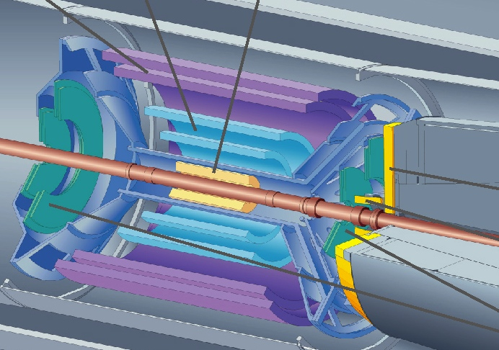
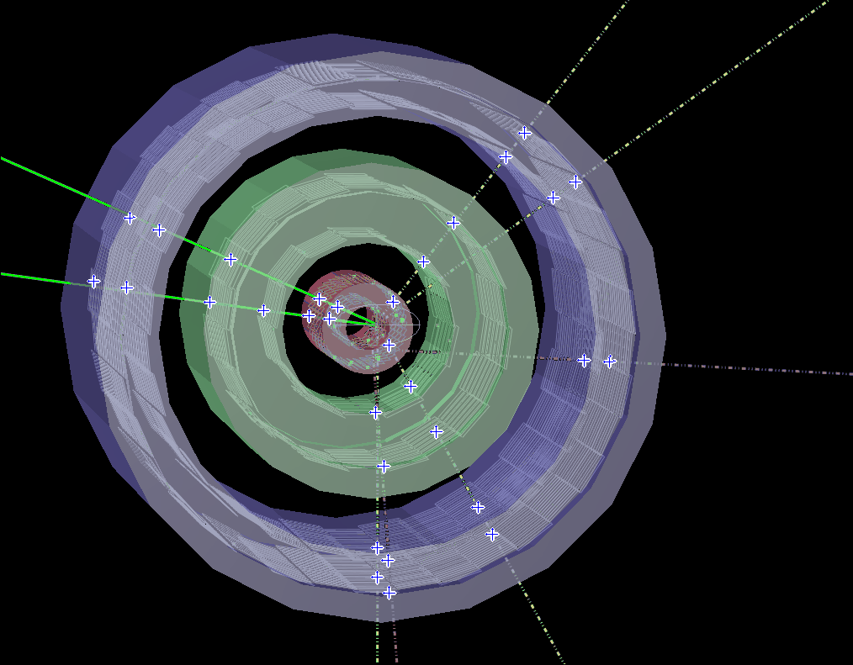
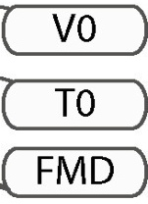
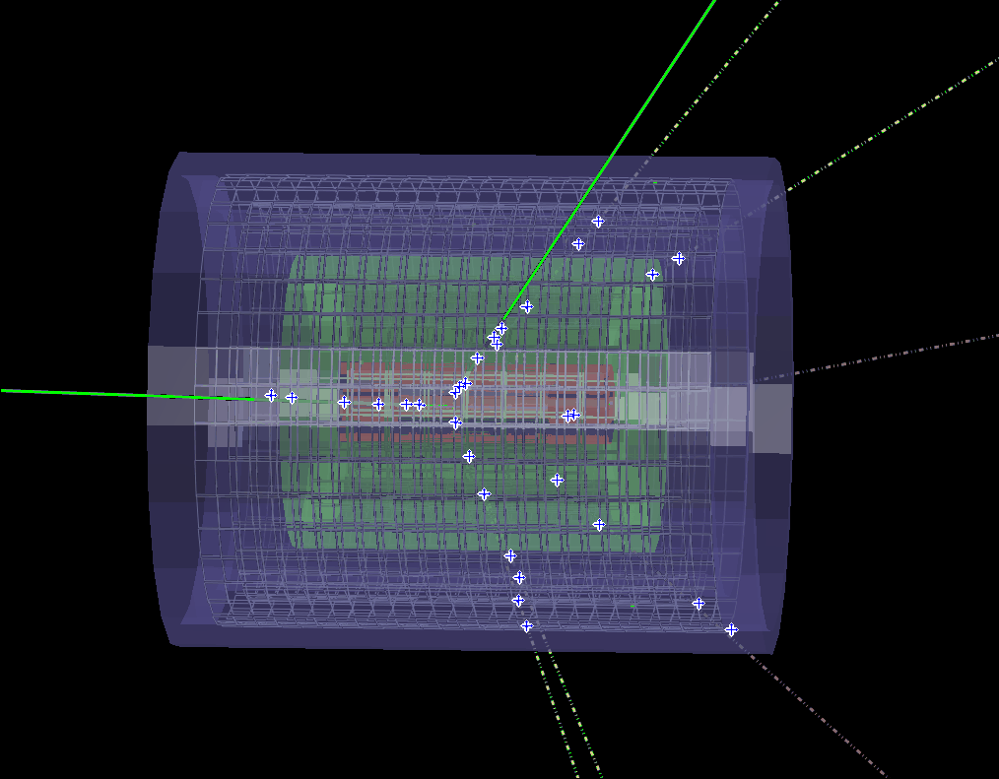
“Current” Inner Tracking System
The ITS (Inner tracking System) consists of 6 concentric barrels of silicon detectors based on 3 different technologies
  2 layers of silicon pixel (SPD)
  2 layers of silicon drift (SDD)
  2 layers of silicon strips (SSD)

Slide 6
“Current” Inner Tracking System
  The ALICE ITS in numbers
Layer | Det. | Radius (cm) | Length (cm) | Surface (m²) | Chan. | Spatial precision (mm) |  | Cell (μm²) | Max occupancy central PbPb (%) | Power dissipation (W)
 |  |  |  |  |  | rφ | z |  |  | barrel | end-cap
1 | SPD | 3.9 | 28.2 | 0.21 | 9.8M | 12 | 100 | 50x425 | 2.1 | 1.35k | 30
2 |  | 7.6 | 28.2 |  |  |  |  |  | 0.6
3 | SDD | 15.0 | 44.4 | 1.31 | 133K | 35 | 25 | 202x294 | 2.5 | 1.06k | 1.75k
4 |  | 23.9 | 59.4 |  |  |  |  |  | 1.0
5 | SSD | 38.0 | 86.2 | 5.0 | 2.6M | 20 | 830 | 95x40000 | 4.0 | 850 | 1.15k
6 |  | 43.0 | 97.8 |  |  |  |  |  | 3.3
Radial coverage defined by beam-pipe (inwards) and requirements for track matching with TPC (outwards)
Inner layers: high multiplicity environment (~100 tracks/cm2)  2 layers of pixel detectors

Slide 7
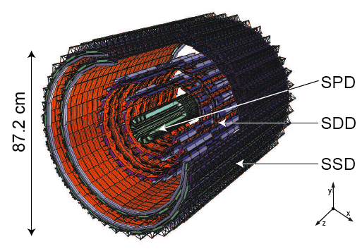
ITS role in ALICE
The ITS is the main tool for studying yields and spectra of particles containing heavy quarks
The ITS tasks in ALICE:
  Secondary vertex reconstruction (c, b decays) with high resolution
    Good track impact parameter resolution
    < 60 µm (rφ) for p_{t} > 1 GeV/c in Pb-Pb
  Improve primary vertex reconstruction, momentum and angle resolution of tracks from outer detectors
  Tracking and PID of low p_{t} particles, also in stand-alone
  Prompt L0 trigger capability (FAST OR) with a latency <800 ns (SPD)

Slide 8
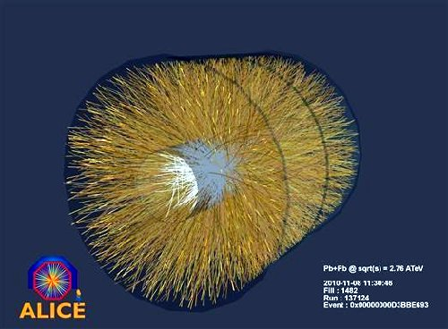
Pb-Pb event

Slide 9
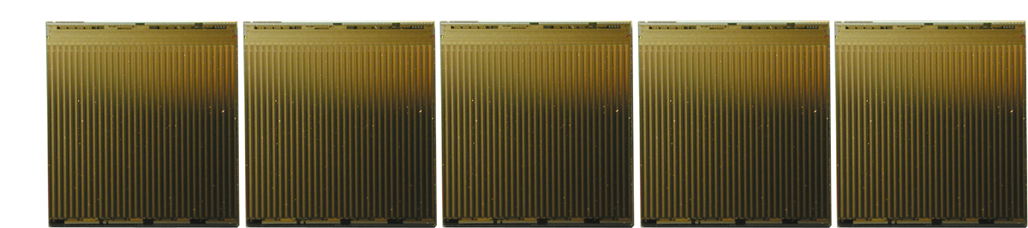
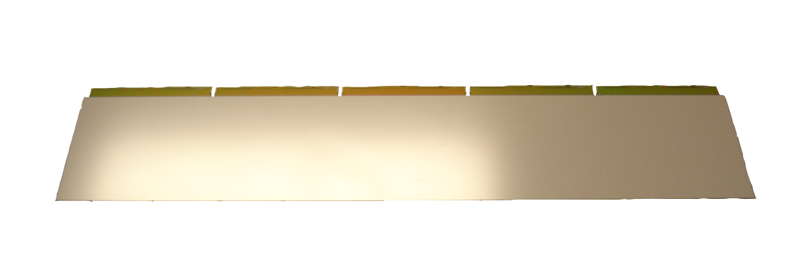
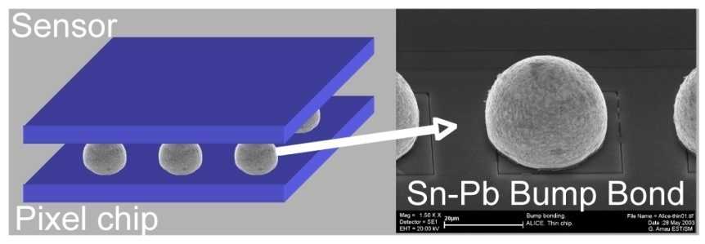
SPD sensor and pixel chip
5 readout chips/sensor
  0.25µm CMOS
  13.68 mm x 15.58 mm
  thinned to 150 µm
p-in-n silicon sensor
  72.72 mm x 13.92 mm
  200 µm thin
40960 bump bonds
  ~25µm diameter
  Stand-off:
  ~12 µm (Pb-Sn)

Slide 10
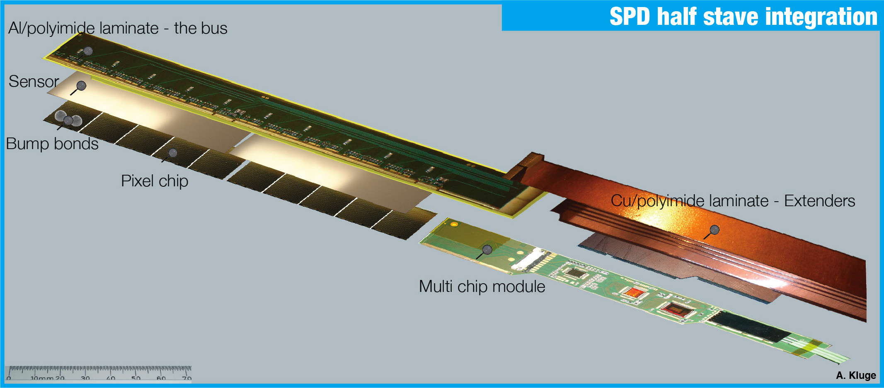
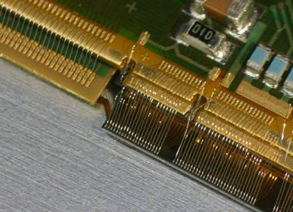

SPD module integration
~1200 wire-bonds

Slide 11
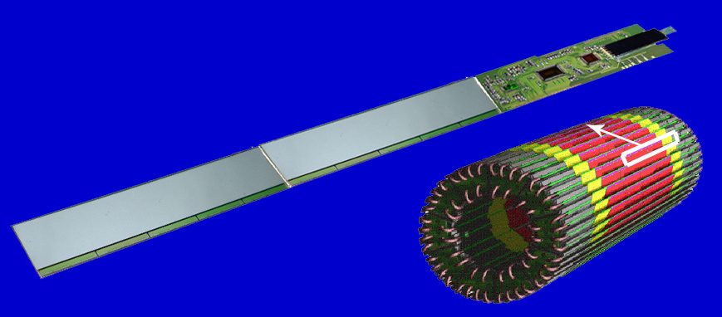
SPD module
physical size = 200 mm x 15 mm x 2 mm
material budget = 1.1% X₀ -> no copper
1 sensor
1 sensor
10 readout chips
~10 million channels in 1200 pixel chips
120 detector modules – half staves (40 on inner and 80 on outer layer)
10 sectors

Slide 12
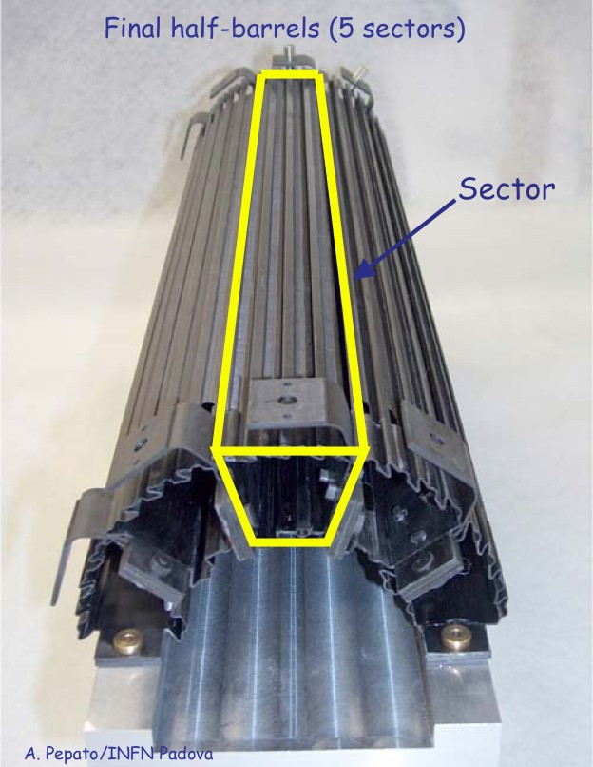
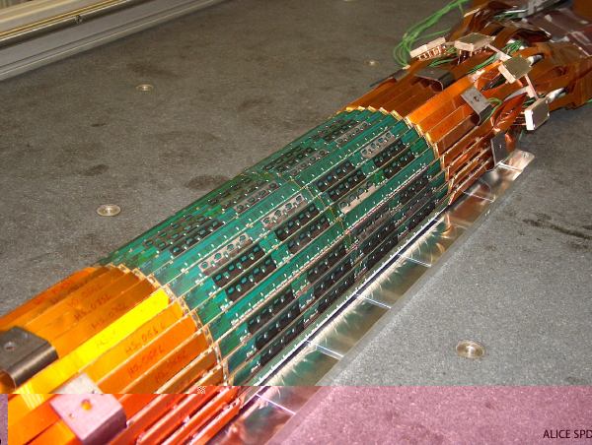
SPD half-barrel
200 µm thick carbon fiber support
Δz= 28.3 cm, r= 3.9 cm & 7.6 cm

Slide 13
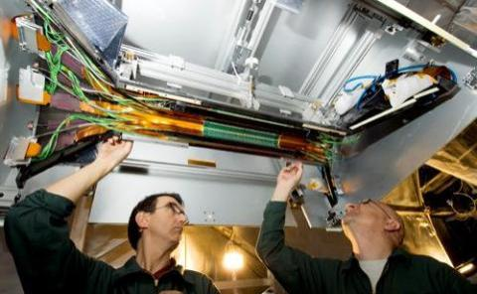
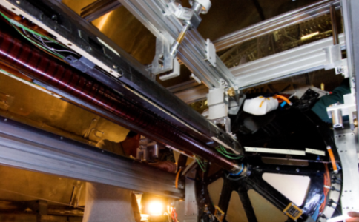
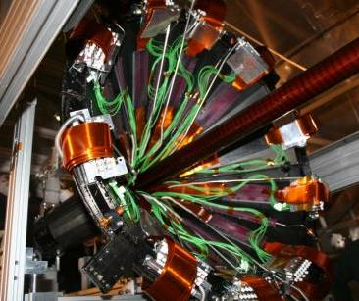
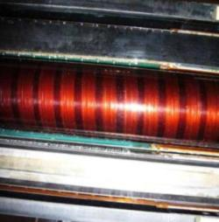
SPD integration
The SPD was installed in ALICE in Jun‘07
Inner layer
Beam pipe
Outer layer
Minimum clearance to beam pipe ≈5 mm

Slide 14
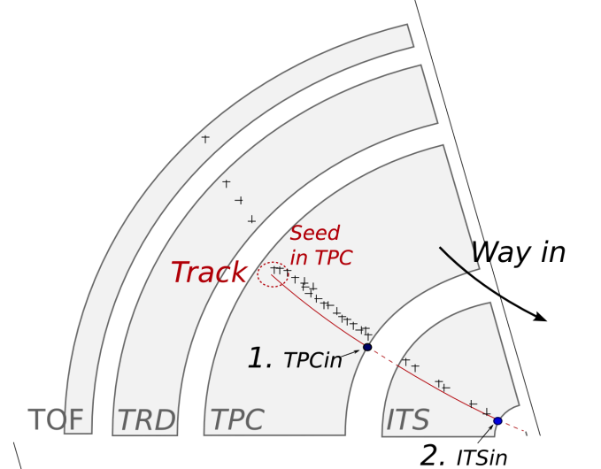
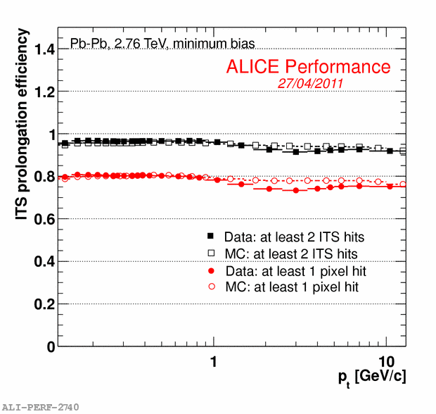
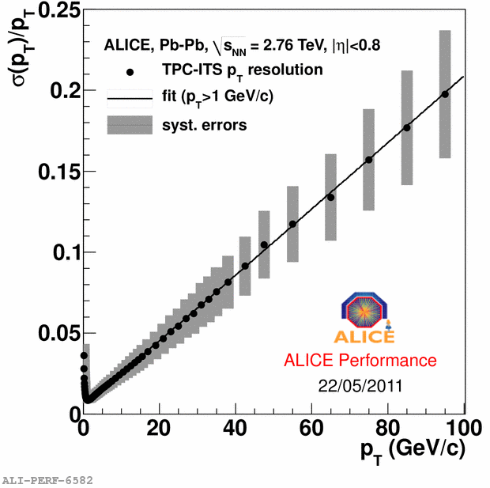
Tracking strategy and Performance
“Global”
  Seeds in outer part of TPC @lowest track density
  Inward tracking from the outer to the inner TPC wall
  Matching the outer SSD layer and tracking in the ITS
  Outward tracking from ITS to outer detectors → PID ok
  Inward refitting to ITS → Track parameters OK
“ITS stand-alone”
  Recovers not-used hits in the ITS layers
  Aim: track and identify particles missed by TPC due to p_{t} cut-off, dead zones between sectors, decays
    p_{t} resolution <≈ 6% for a pion in p_{t} range 200-800 MeV/c
    p_{t} acceptance extended down to 80-100 MeV/c (for π)
TPC-ITS prolongation efficiency
p_{t} resolution

Slide 15
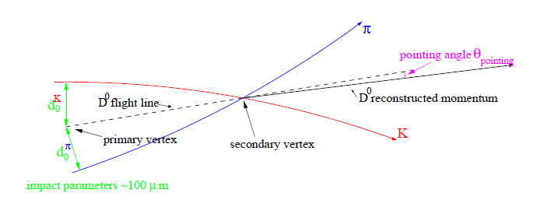
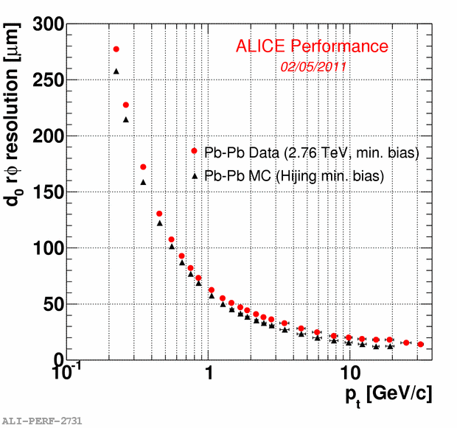
“Current” ITS performance: impact parameter
The transverse impact parameter in the bending plane d₀(rφ) is the reference variable to look for secondary tracks from strange, charm and beauty decay vertices
Impact parameter resolution is crucial to reconstruct secondary vertices : below 75 µm for p_{t} > 1 GeV/c
Good agreement data-MC (~10%)
The material budget mainly affect the performance at low p_{t} (multiple scattering)
The point resolution of each layers drives the asymptotic performance
ITS standalone enables the tracking for very low momentum particles (80-100 MeV/c pions)
Pb-Pb
Notes:
in the bending plane: d₀(rφ)

Slide 16
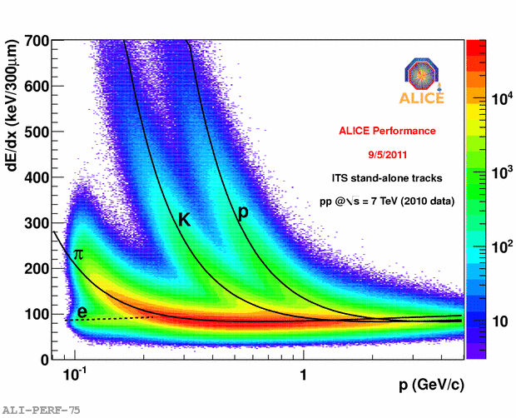
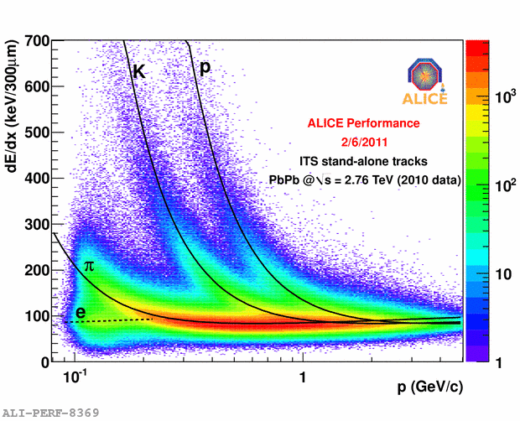
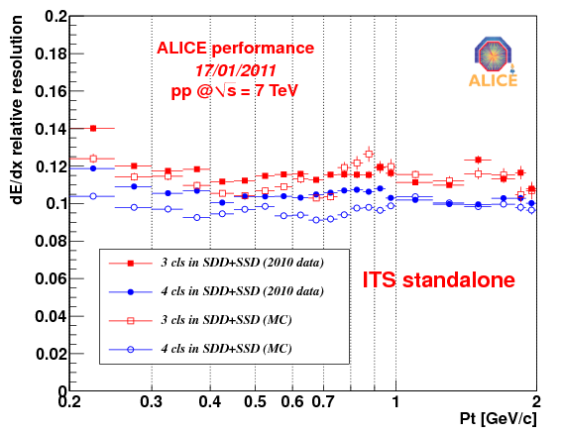
“Current” ITS performance - PID
dE/dx measurement
  Analogue read-out of charge deposited in 4 ITS layers (SDD & SSD)
  Charge samples corrected for the path length
  Truncated mean method applied to account for the long tails in the Landau distribution
PID performance
  PID combined with stand-alone tracking allows to identify charged particles below 100 MeV/c
  p-K separation up to 1 GeV/c
  K-π separation up to 450 MeV/c
  A resolution of about 10-15% is achieved
p-p
Pb-Pb
p-p

Slide 17
ITS Upgrade – Physics Motivations
Extend ALICE capability to study heavy quarks as probes of the QGP in heavy-ion collisions
  Main Physics Topics
    Energy loss
      charm and beauty R_{AA} vs p_{T} down to low p_{T}
    Thermalization of heavy quarks: charmed and beauty baryons
      baryon to meson ratio, flow
    Quarkonia
  Mapping to ALICE
    Heavy flavour at midrapidity with hadronic (and semi-electronic)
    decays → ITS barrel upgrade
    Heavy flavour and resonances with muons in the forward direction → endcap on the MUON side

Slide 18
ITS Upgrade – Design goals
Increase vertex resolution by a factor of ~3
  Identification of secondary vertices from decaying charm and beauty
  Increase statistical accuracy of channels already measured by ALICE: e.g. displaced D₀, J/Ψ
  Measurement of new channel:
    e.g. charmed baryon Λ_{c}
    or even more exotic channels: Λ_{b}
Higher standalone tracking efficiency
  Extended trigger capabilities
  Selection of event topologies with displaced vertices at Level 2 (~100 μs)
    impact parameter of displaced tracks
    distance from prim. to sec. vertices
    pointing angle
    selection cuts: kinematics, PID? (being studied)
Improve standalone p_{T} resolution
  Charm and beauty with ITS standalone (or +TRD) tracking and TOF PID (??)

Slide 19
How to improve the impact parameter resolution
Get closer to the IP
  Radius of innermost PIXEL layer is defined by central beam pipe radius
    Present beam pipe: R_{OUT} = 29.8 mm, ΔR = 0.8 mm
    ⇩
    New Reduced beam pipe: R_{OUT} = 19 mm, ΔR = 0.5 mm
Reduce material budget (especially innermost layers)
    reduce mass of silicon, electrical bus (power and signals), cooling, mechanics
    Present ITS pixel layers: X/X₀ ~1.14% per layer
  ⇩
    Target value for new ITS: X/X₀ ~0.3 – 0.5% per layer
Reduce pixel size
  Reduce size of interconnect bumps, monolithic PIXELS
    currently 50mm x 450mm

Slide 20
How to improve tracking, triggering and p_{T} resolution
Higher standalone tracking efficiency
  Higher granularity
    increase number of layers in the outer (seeding) and inner region (occupancy)
    increase granularity of central and outer layers
Extended trigger capabilities
  High standalone tracking efficiency
  Low readout time < 50μs for Pb-Pb, ~μs for p-p (current ITS ~1ms in both cases)
Increase momentum resolution
  increase track length
  increase spatial resolution
  reduce material budget

Slide 21
Requirements for the ITS upgrade
Up to 7 silicon layers (r = 2.2 ÷ 45 cm) to cover from IP to TPC
4 innermost layers made of pixels, outer 3 layers either pixels or double sided strips
Hit density ~ 100 tracks/cm² in HI collisions
Possibility of topological trigger – central Pb-Pb readout time < 50 µs
Add high resolution pixel layer closer to IP (r=2.2 cm)
Pixel size ~ 20-30 µm (rφ), σ(rφ) ~ 4 ÷ 6 µm
Material budget 0.3 ÷ 0.5% X₀ per layer
Power consumption 250-300 mW/cm²
Radiation tolerant design (innermost layer) compatible with 2 Mrad / 2 x10¹³ n_{eq} over 10 years (safety factor ~2 included)

Slide 22
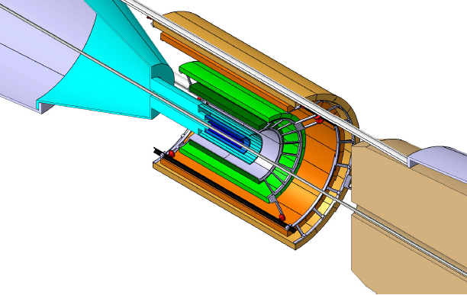
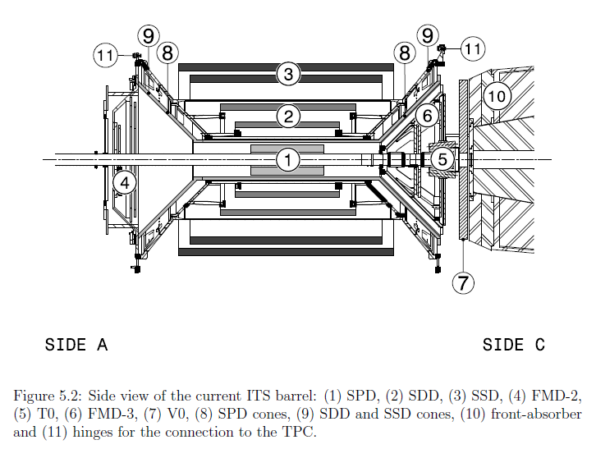
ITS Upgrade scenarios
Two design options are being studied
  “New SPDs”: replace SPD with new SPD consisting of 3 layers
   improve pointing resolution
  “All New”: replace entire ITS with a combination of Pixel/Strips  topological trigger
Current
Upgrade

Slide 23
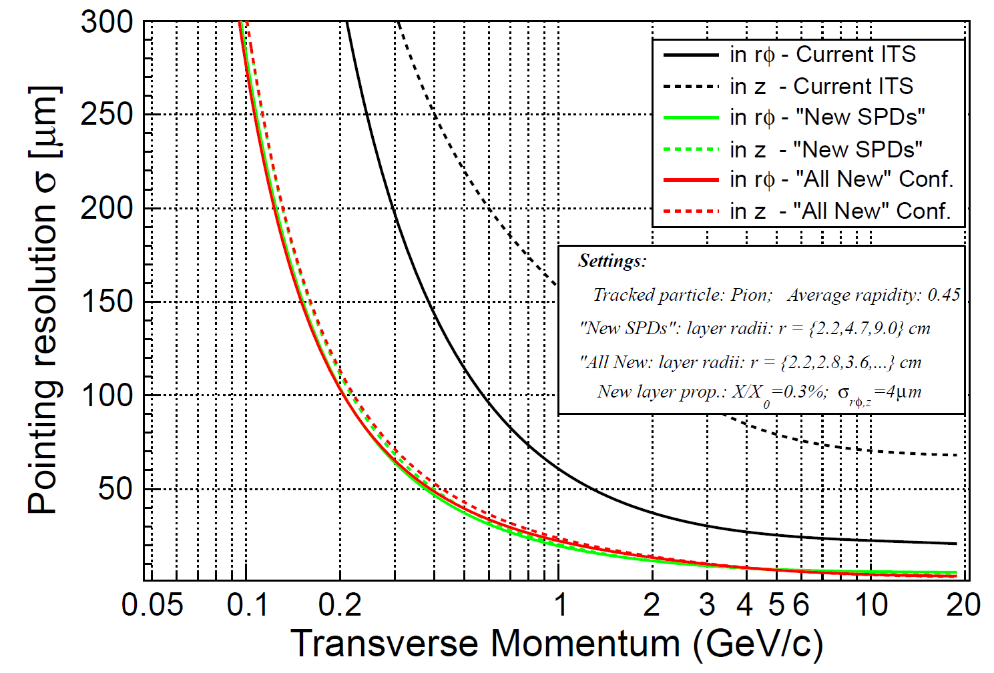
Improvement of the
impact parameter resolution

Slide 24
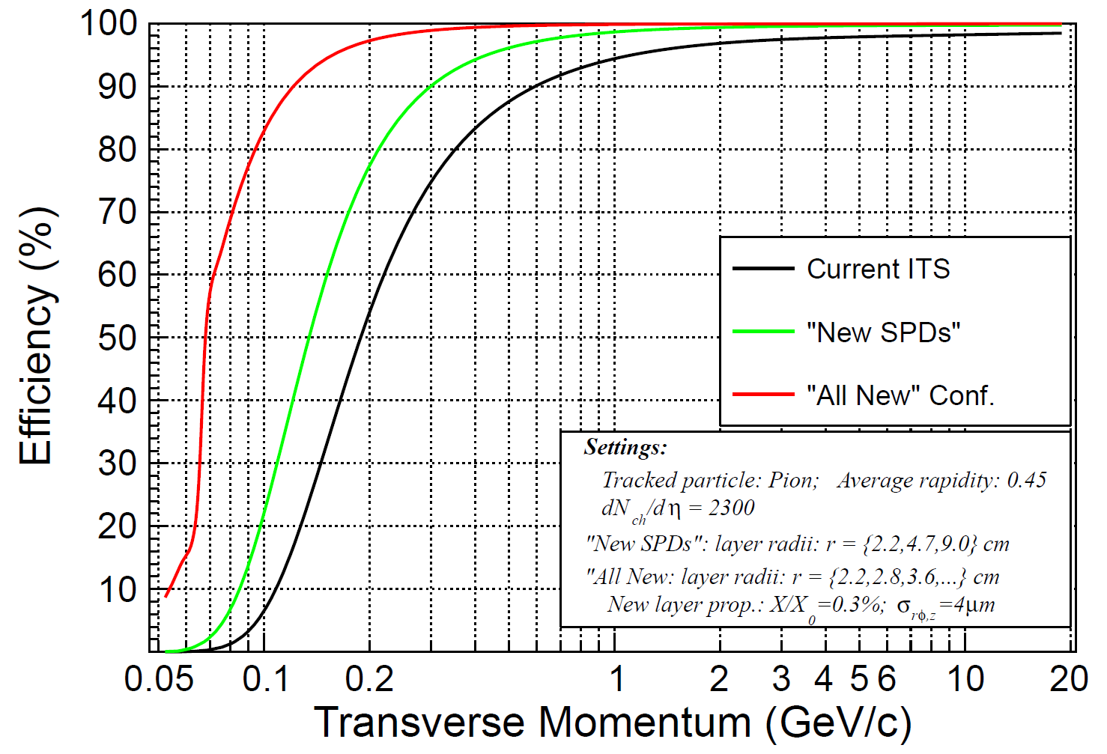
Improvement of the
standalone tracking efficiency

Slide 25
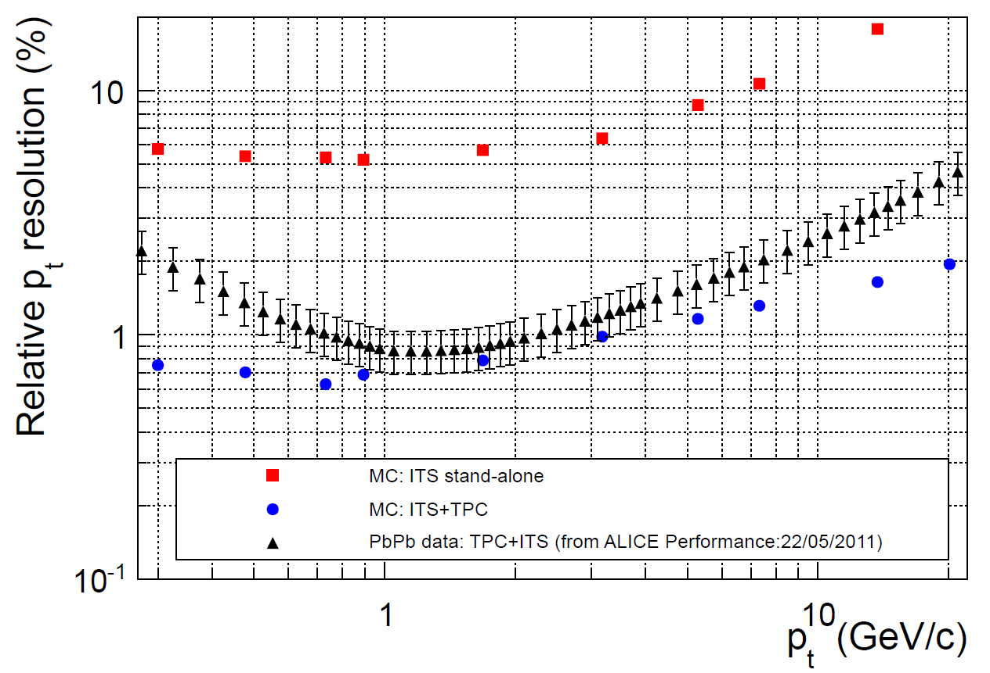
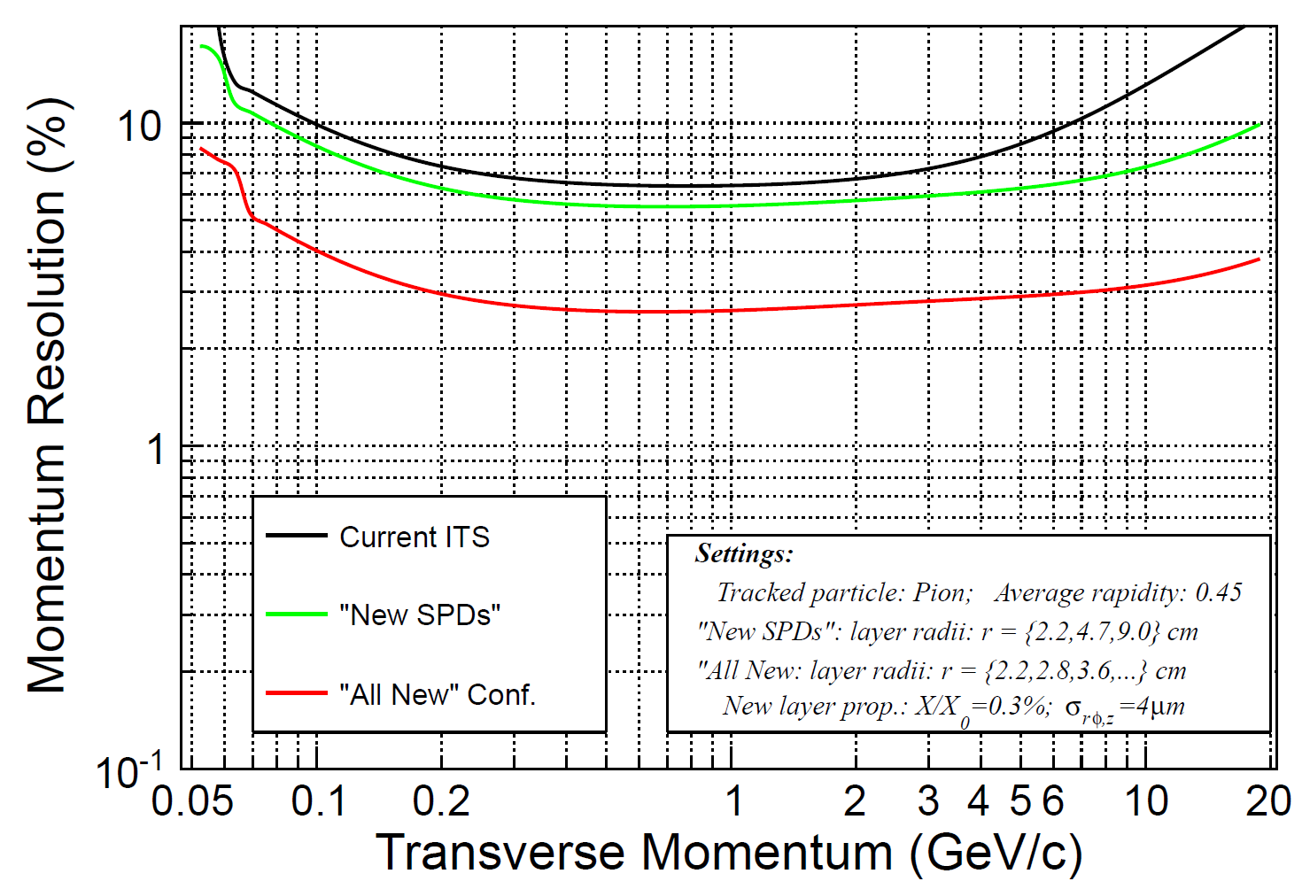
Improvement of the
standalone p_{T} resolution
ITS standalone
ITS standalone
outermost layer at 43 cm
Extending ITS tracking
to ~50cm 
outermost layer at 50 cm

Slide 26
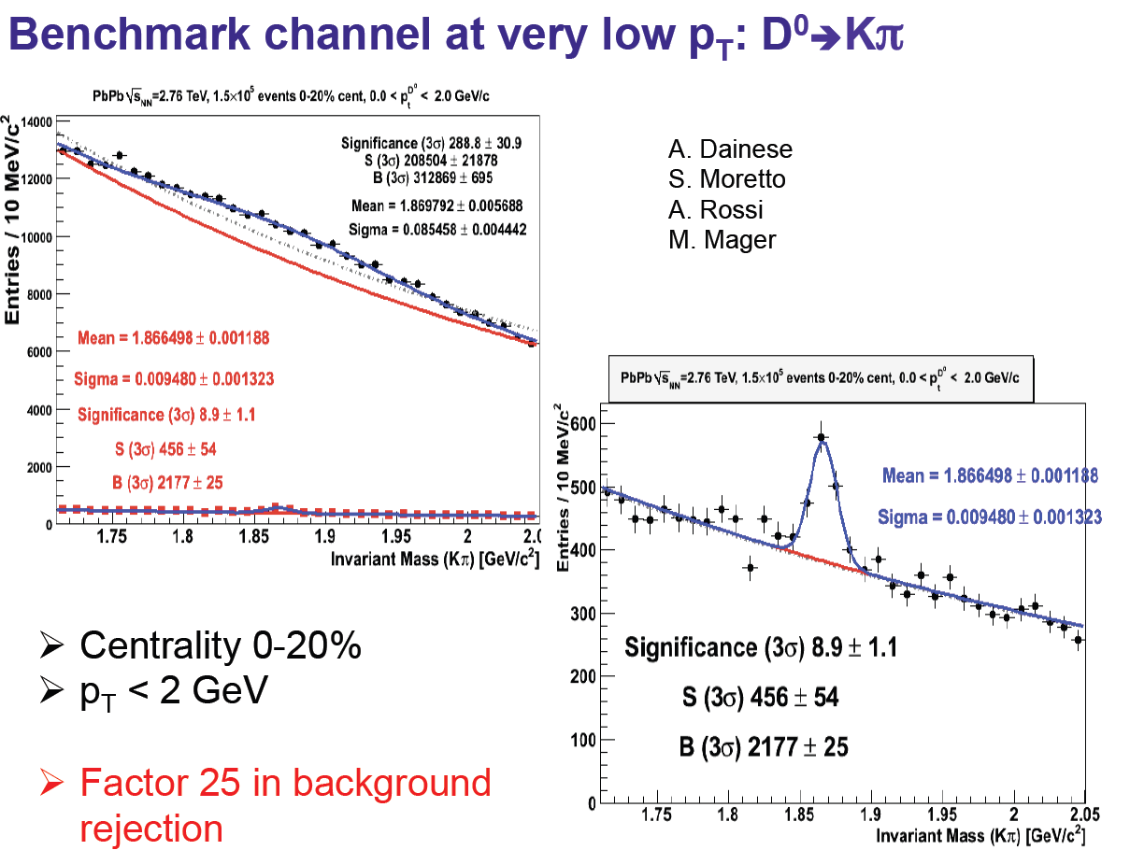
An example of physics performance – D⁰
Preliminary
(cuts to be optimized)

Slide 27
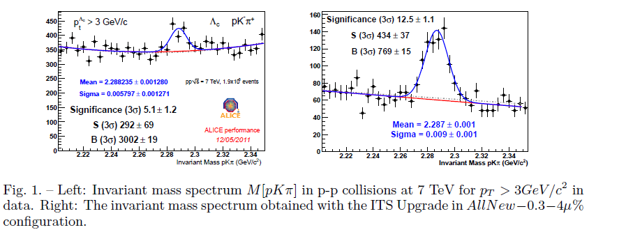
An example of physics performance – Λ_{c}
Λ_{c} pKπ as a benchmark case in p-p
Comparison between current and new ITS in the same p_{T} bin (p_{T} > 3GeV/c)
Very preliminary

Slide 28
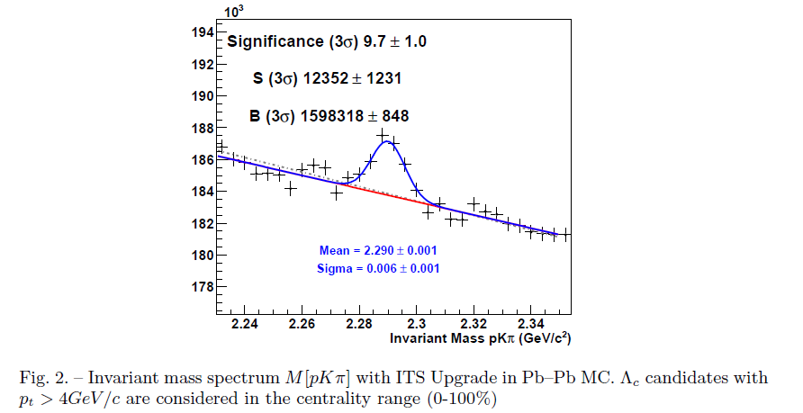
An example of physics performance – Λ_{c}
Λ_{c} pKπ as a benchmark case in Pb-Pb
No signal in data with the current ITS in any p_{T} bin
Very preliminary

Slide 29
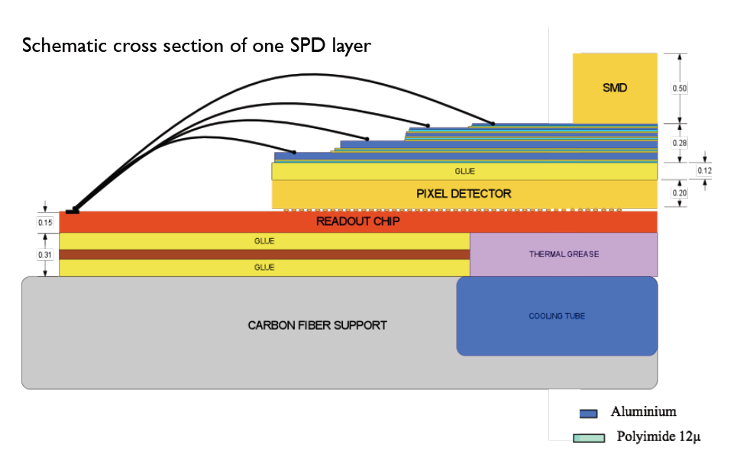
Material budget of each current SPD layer
In one current SPD layer
  Carbon fiber support: 200 μm
  Cooling tube (Phynox): 40 μm wall thickness
  Grounding foil (Al-Kapton): 75 μm
  Pixel chip (Silicon): 150 μm  0.16%
  Bump bonds (Pb-Sn): diameter ~15-20 μm
  Silicon sensor: 200 μm  0.22%
  Pixel bus (Al+Kapton): 280 μm  0.48%
  SMD components
  Glue (Eccobond 45) and thermal grease
Two main contributors: silicon and interconnect structure (bus)

Slide 30
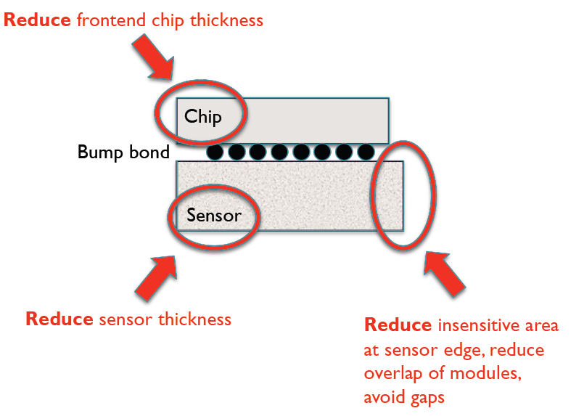
How material budget can be reduced
How can the material budget be reduced?
  Reduce silicon chip thickness
  Reduce silicon sensor thickness
  Thin monolithic structures
  Reduce bus contribution (reduce power)
  Reduce edge regions on sensor
  Review also other components (but average contribution 0.1-0.2%)
What can be a reasonable target
  Hybrid pixels: ~0.5% X₀
    silicon: 0.16% X₀ (at present 0.38%)
    bus: 0.24% X₀ (at present 0.48%)
    others: ?? (at present 0.24%)
  Monolithic pixels: 0.37% X₀ (e.g. STAR)

Slide 31
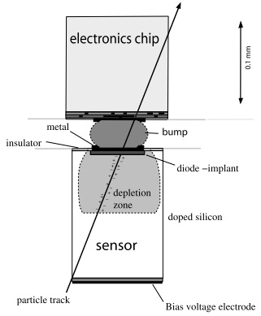
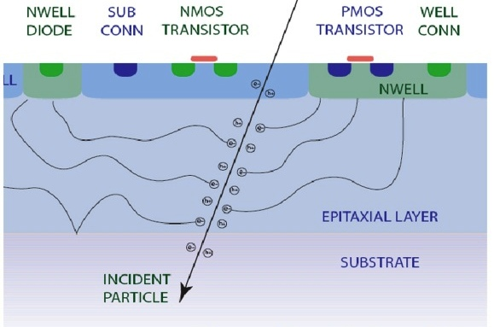
Pixel Technologies
Hybrid pixels
  State-of-the art in LHC experiments
  2 components: CMOS chip and high-resistivity sensor connected via bump bonds
Monolithic pixels
  Made significant progress, soon to be installed in STAR
  1 component, sensing layer included in the CMOS chip
Figure - Rossi, L., Fischer, P., Rohe, T. & Wermes, N. (2006). Berlin: Springer.
Figure Stanitzki, M. (2010). Nucl. Instr. and Meth. A doi:10.1016/j.nima.2010.11.166

Slide 32

Hybrid Pixels & Ongoing R&D
Limit on pixel size given by current flip chip bonding technology ~ 30 µm
Material budget target < 0.5 % X₀ ( 100 µm sensor, 50 µm chip)
High S/N ratio, ~ 8000 e-h pairs/MIP
Edgeless sensors to reduce insensitive overlap regions
Power/Speed optimization possible (shaping time O(µs)) to reduce the power budget
Proven radiation hardness
R&D: thinning, low cost bump bonding, edgless detectors, lower
power FEE chip

Slide 33
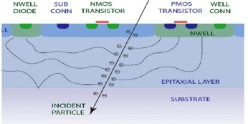
Monolithic Pixels & Ongoing R&D
State-of-the-art architecture (MIMOSA family) uses rolling-shutter readout
Pixel size ~20 µm possible
Material budget target < 0.3 % X₀ (50 µm chip)
New developments:
  1. Evaluation of properties of a quadruple well 0.18 CMOS
    radiation tests structures
    study characteristics of process using the MIMOSA architecture as reference
    design of new circuit dedicated to ALICE (MISTRAL)
    investigation of in-pixel signal processing using the quadruple-well approach
  2. Novel high resistivity base material for depleted operation (LePix)

Slide 34
Other R&D activities
Development of new strip detectors for outer layers
  R&D: double sided, shorter strips, new readout electronics
Electrical bus for distribution of power and signals
  at present: multilayer (5 layers) for SPD and double sided for SDD and SSD
  R&D: new power distribution techniques, layout optimization, integration of cooling
Cooling system options
  air cooling
  liquid cooling with carbon foam structure
  liquid cooling with polyimide micro-channels structure
  evaporative cooling with silicon micro-channels structure

Slide 35
ITS Upgrade Timeline
The upgrade should target the 2017-18 (Phase I) shutdown
  The scope of the upgrade Phase I should be well tailored to what can be reasonably prepared and tested within the next six years and installed in 15 months, with safety margin, in order not to degrade the present detector
  Decisions on upgrade plans in terms of physics strategy, detector feasibility, funding availability, will be taken in 2012
end 2011: Preparation of a technical proposal
2011-2014: R&D for Phase I
2014-2016: Production and pre-commissioning for Phase I
2017-2018: Installation and commissioning for Phase I
It will possibly require a two-stage approach: Phase I in 2017 and Phase II
in 2020 and beyond)

Slide 36
Conclusions
The current Inner Tracking System performance is well in agreement with the design requirements and expectations
  The achieved impact parameter resolution allows to reconstruct the secondary vertices of charm decays
  Standalone capability allows to track and identify charged particles with momenta down to 100 MeV/c
An upgraded ITS will extend the ALICE physics capabilities:
  Spectacular increase of the statistical accuracy in the measurements of yields and spectra of charmed mesons and baryons already possible with the present detector
  A significant extension of the present physics programme with many new measurements that at present are not possible
Several options for the detector technology implementation are being investigated and developed

Slide 37
Back-up slides

Slide 38
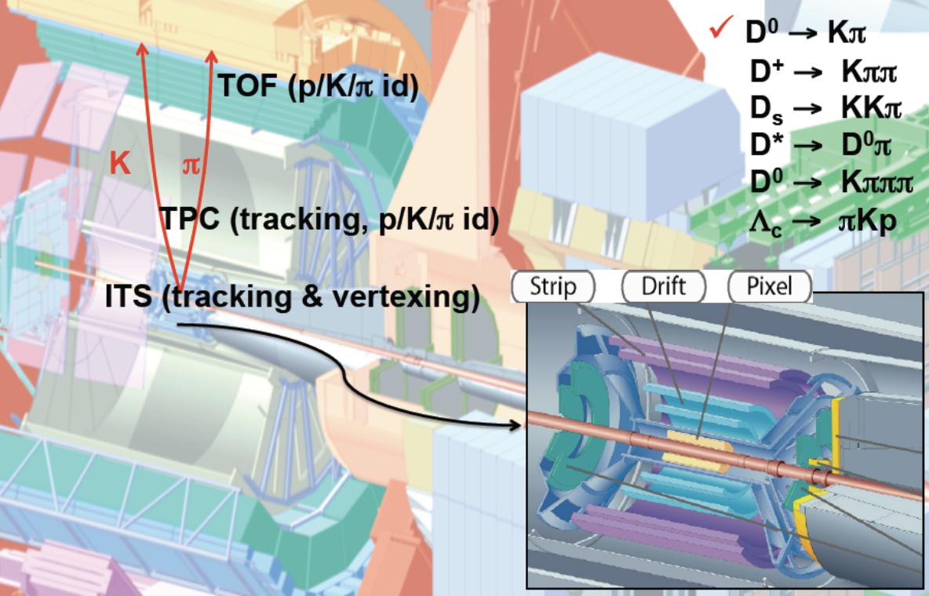
Heavy-flavours at midrapidity - mesons and baryons

Slide 39
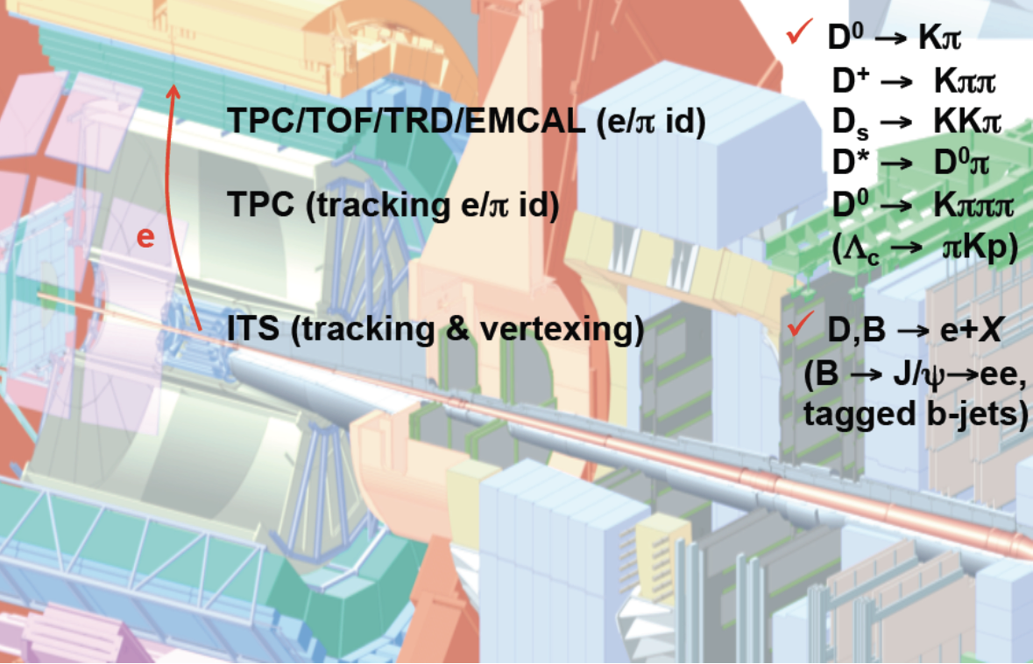
Heavy-flavours at midrapidity - electrons

Slide 40
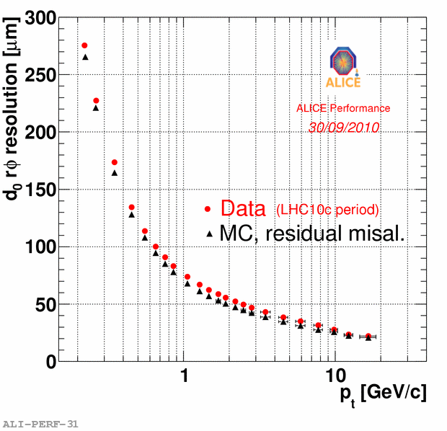
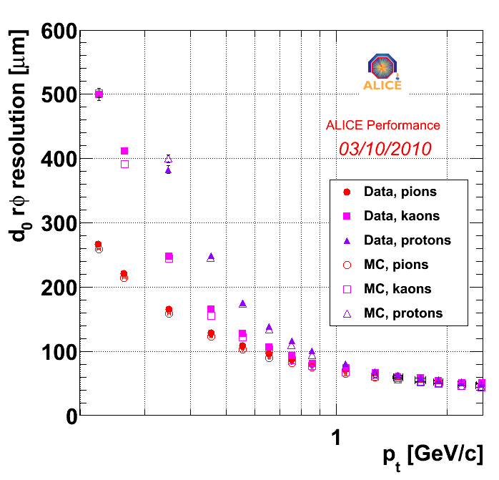
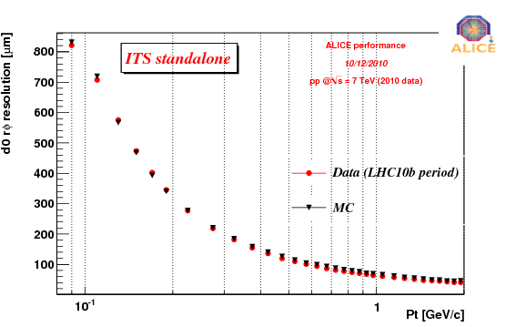
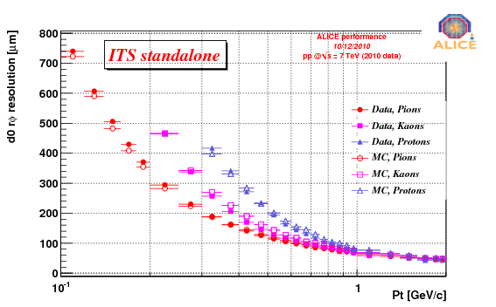
“Current” ITS performance - impact parameter
p-p
p-p
p-p
p-p
< 100 MeV/c
< 100 MeV/c

Slide 41
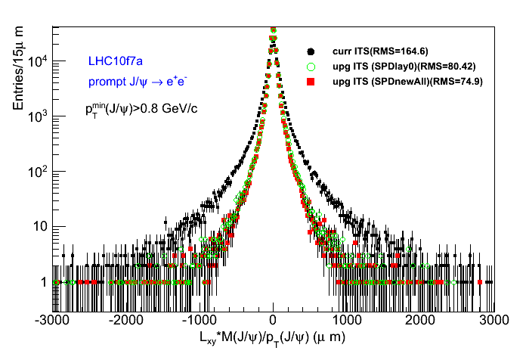

B from displaced J/Ψ: current vs upgrade
CURRENT
UPGRADE
41

Slide 42

Vertex reconstruction
Vertex resolution in Pb-Pb collisions at √s = 2.76 TeV as a function of half of the tracklets multiplicity of the event
Vertex resolution estimation in Pb-Pb
Method to evaluate resolution on the vertex position
The track sample is randomly divided into two
A primary vertex is reconstructed for each of the sub-sample
The resolution is extracted from the σ of the distribution of the residual between the two vertices
The resolution is extrapolated for most central (5%) Pb-Pb collisions
Notes:
The asymptotic limit estimates the size of the luminous
region, seen for the vertices reconstructed with tracks
(filled markers).
The resolution is extrapolated
for most central (5%) Pb-Pb
collisions (orange box).

Slide 43


Radial distance of the innermost pixel layer
1 additional SPD layer (Layer 0) at a few mm radial distance from beampipe
Study effect of variation of beampipe radius from 25 to 19mm
r = 25mm (CMS request) r = 22 mm (ATLAS request)
r = 19mm (ALICE request)

Slide 44


Effect of layer thickness
1 additional SPD layer (Layer0) at a 22mm radius
Study effect of variation of Layer0 thickness from 1.0% to 0.3% X₀
  Current SPD + Layer0 with 1.0% X₀
  Current SPD + Layer0 with 0.8% X₀ (150mm silicon: sensor + readout chip
  Current SPD + Layer0 with 0.6% X₀ (150mm silicon and lighter multilayer bus)
  Current SPD + Layer0 with 0.4% X₀ (Monolithic pixels a la STAR)

Slide 45


Effect of spatial resolution
1 additional SPD layer (Layer 0) at 22mm radius
Study effect spatial resolution: 12 μm (present design), 6 μm, 2 μm

Slide 46

ALICE Running Scenario
ALICE PPR Vol. 1, p. 1591

Slide 47
Timing requirements
Pb-Pb collisions
  max interaction rate: 5kHz
  minimum time distance between interactions: ~5μs (pile-up in TPC)
  event tagging in ITS: matching with external detectors ( bunch crossing not required)
  signal shaping: ~μs (determined by signal/noise optimization)
  event size (innermost layer): 1.2 kbit/cm²
    30 clusters/cm² (MB events)
    <fired pixels> ~ 8/cluster for MAPS 20x20μm²
    18-bit cluster address + 21-bit cluster shape (no smart encoding) 40-bit / cluster
  data throughput: 6 Mbit /s×cm²
  readout time: <50μs
  required bandwidth: 24 Mbit /s×cm²
  a bandwidth of 250 Mbit /s×cm² is adequate for a maximum interaction rate ~50kHz MB

Slide 48

Beauty via displaced electrons: strategy and results

Slide 49

Beauty via displaced electrons: strategy and results
The impact of the ITS upgrade is two-fold:
  Reduced material budget decreases electrons from photon conversions, one of the main background sources → increase S/B
  Better impact parameter resolution improves the separation of displaced electrons (from B) and backgrounds from the primary vertex (e.g. Dalitz decays)

Slide 50

Properties of Open Charm Hadrons
Example - Direct Topological Identification of the Open Charm
Particle | Decay Channel | cτ (μm) | Mass (GeV/c²)
D⁰ | K⁻ π⁺ (3.8%) | 123 | 1.8645
D⁺ | K⁻ π⁺ π⁺ (9.5%) | 312 | 1.8694
 | K⁺ K⁻ π⁺ (5.2%) π⁺ π⁺ π⁻ (1.2%) | 150 | 1.9683
 | p K⁻ π⁺ (5.0%) | 59.9 | 2.2865
Goal:
determine DCA (distance of closest approach) of decay vertex (secondary vertex) relative to the primary vertex
50-150 μm

Slide 51

Λ_{c} daughter particles p_{T} spectra

