Slide 1
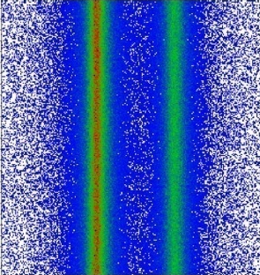
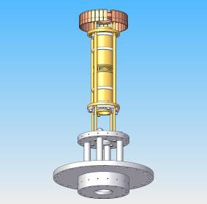
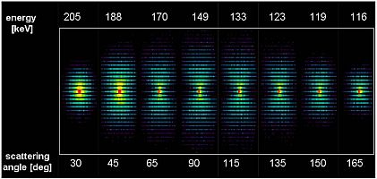
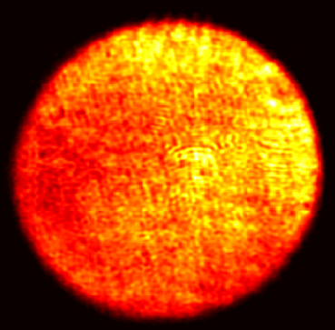
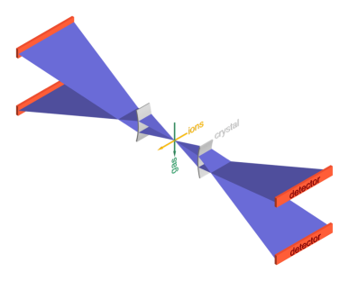
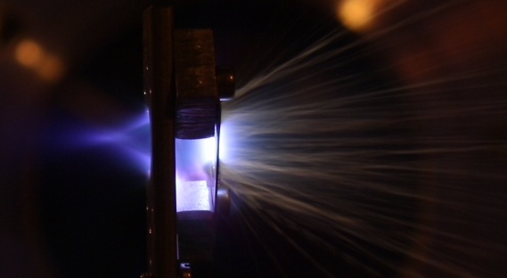

The SPARC Collaboration –
Atomic Physics Research with Highly Charged Ions and Exotic Nuclei at the Future FAIR Facility
Thomas Stöhlker
GSI-Darmstadt, Helmholtz-Institute Jena

Slide 2
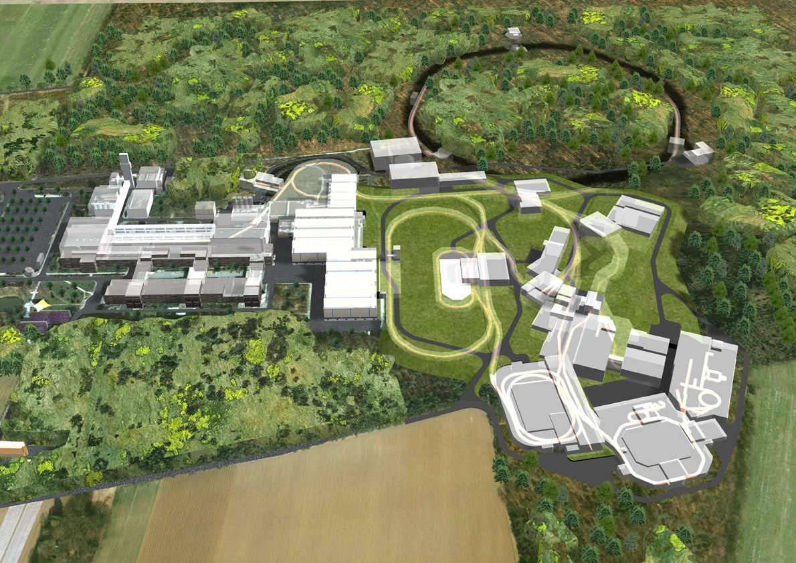
Heavy Highly Charged Ions
I. Extreme Dynamic Fields
II. Extreme Static Fields
III. Fundamental Physics
Making all
the Difference !

Slide 3
Introduction
Facilities & instrumentation
Low energy experiments
  Bound state QED
  HITRAP/FLAIR: from fundamentals to applications
  Super-Critical Fields
Experiments with highly-charged ions at
relativistic energies
  Target Ionization
  Pair-production phenomena
  Radiative Processes
  Study of Bound State QED and Nuclear Parameters
  Fundamental Physics
Summary

Slide 4
Quantum Dynamics in Extreme Fields: The Program of the SPARC Collaboration
Scientific Goal: Precision Studies of the Quantum Dynamics of Atomic Systems in Critical and Super-Critical Fields
Discovery Potential:
new concepts for QED in extreme fields
inside into the correlated many-body dynamics via ultrashort and super intense field pulses (<10⁻¹⁸ s)
precision determination of fundamental constantes (α, m_{e})
proof of fundamental symmetries
discovery and understanding of new decay modes of nuclei
determination of fundamental nuclear properties via atomic data
SIS100/300
High
Energy
Cave
FLAIR
Observable: high-resolution x-ray, electron, positron, projectile and recoil-ion spectroscopy
SPARC
Experimential areas
NESR

Slide 5
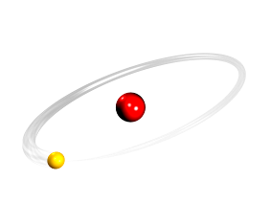
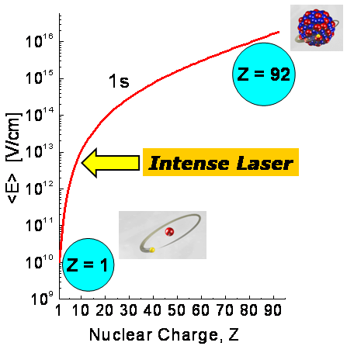
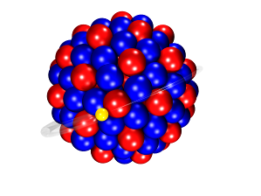
Atomic Physics: Quantum Electrodynamics in the
Extreme Field Limit
hydrogen
Strong Field QED
Z=1
E_{b} = 13.6 eV
Z·α « 1
1s-Lamb Shift
g-factor
hyperfine structure
towards super-
critical fields
border line to
nuclear physics
uranium ion
Z=92
E_{b} = 132 keV
Z·α ≈ 1

Slide 6
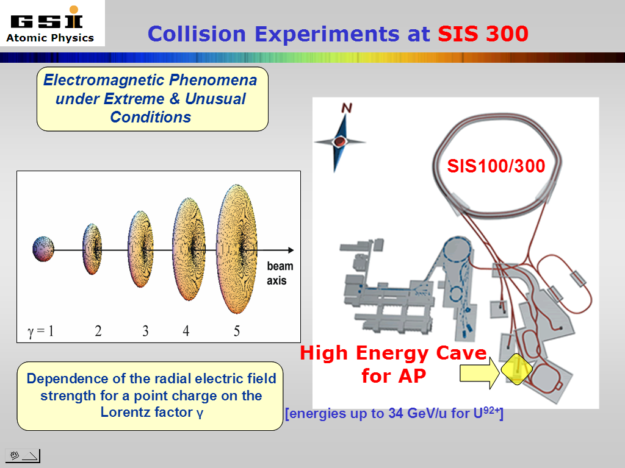
Extreme Dynamic Fields
Explore correlated electron dynamics
- on sub-attosecond time-scale
- not accessible by other means
b ~ 10⁶ fm
U⁹²⁺
Explore relativistic quantum dynamics
- particle production
- non-perturbative regime
- coupling to the radiation field
t ≤ 0.1 as
I ≈ 10²¹ W/cm²
0 87 94 97 98
Percent of Light Velocity

Slide 7
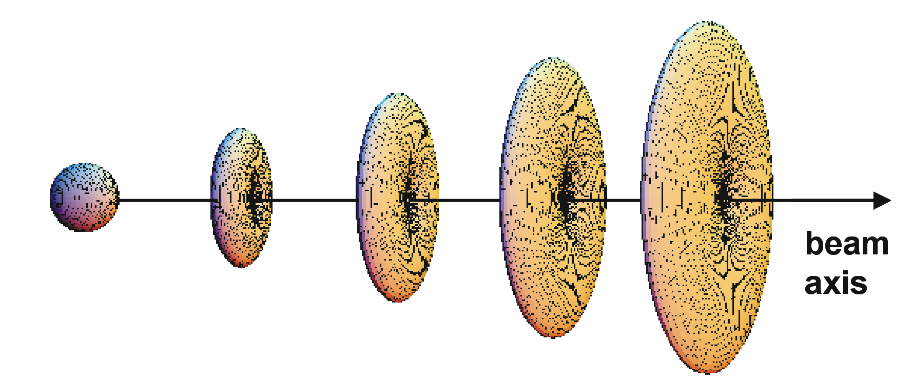
Electromagnetic Phenomena under Extreme
& Unusual Conditions

Slide 8
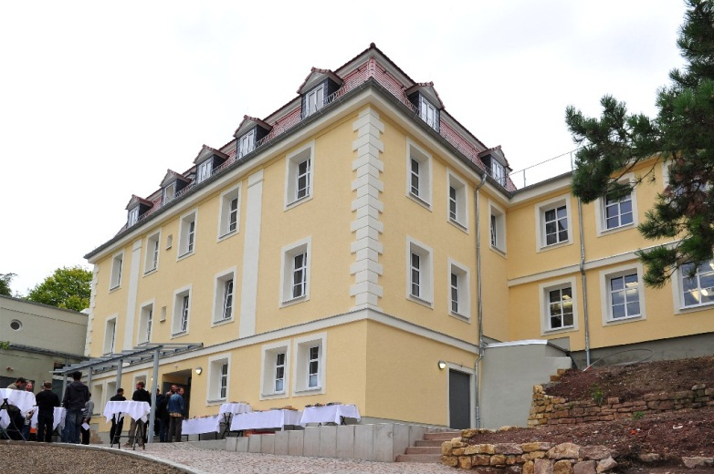
Helmholtz Institute Jena, HI-Jena
Great expertise of the FSU in the fields of laser physics and photonics
Research of FSU complementary to the research programs at GSI/FAIR und DESY/XFEL
DESY
HZDR
HI-Jena
GSI
HI-JENA& SPARC: Laser developements,
x-ray spectrometers and detectors, x-ray science

Slide 9
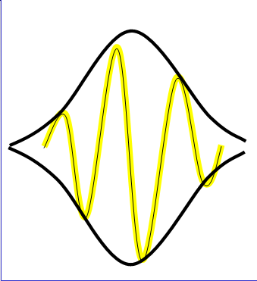
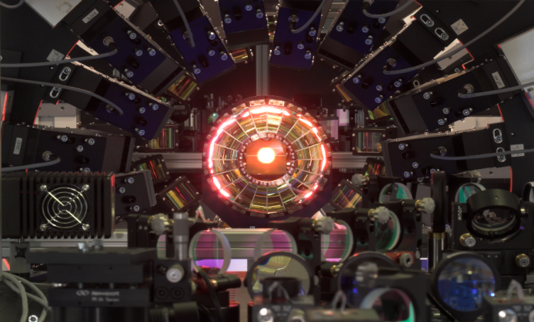
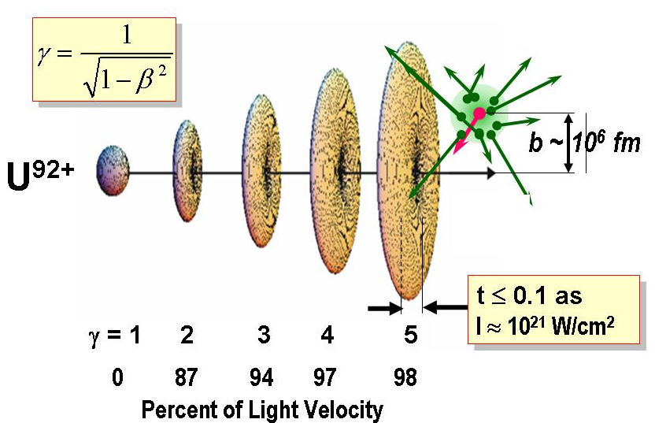
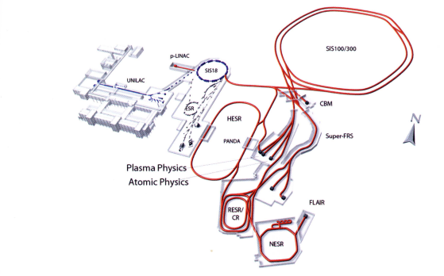
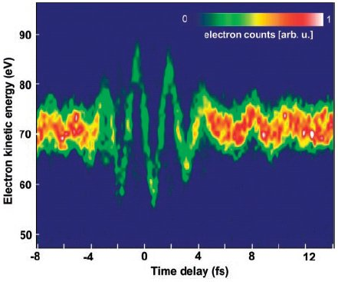
Complementarity: Extreme Light and Extreme Particle Beam Collisions
The fastest pulses
Laser: Sub Femtosecond
Attosecond pulse trains can be generated in the VUV by phase
locking laser harmonics
E. Goulielmakis et al., Science 305 p1267 (2004)
Ions: Sub Attosecond

Slide 10
Introduction
Facilities & instrumentation
Low energy experiments
  Bound state QED
  HITRAP/FLAIR: from fundamentals to applications
  Super-Critical Fields
Experiments with highly-charged ions at
relativistic energies
  Target Ionization
  Pair-production phenomena
  Radiative Processes
  Study of Bound State QED and Nuclear Parameters
  Fundamental Physics
Summary

Slide 11



Laser Cooling and Precision Spectroscopy
Outlook: Precision Laser X-Ray Spectroscopy at FAIR
Schematic
Experimental
Setup
Li-like ²³⁸U⁸⁹⁺
= 30
Laser (same as @ ESR)
λ_{laser} = 257.34 nm
hω_{laser} = 4.818 eV
hω_{rest} = 280.59 eV
Measure
absolute transition wavelength
ω ²_{rest} = ω_{laser} · ω_{X-ray}
hω_{X-ray} = 19.6 keV
Crystal
Monochromator
X-Ray
Detector
this scheme will also work out at SIS100 and HESR
SPARC
M. Bussmann, U. Schramm, D. Habs et al.

Slide 12
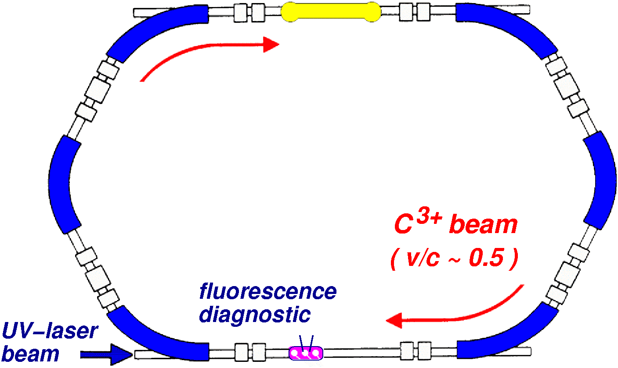
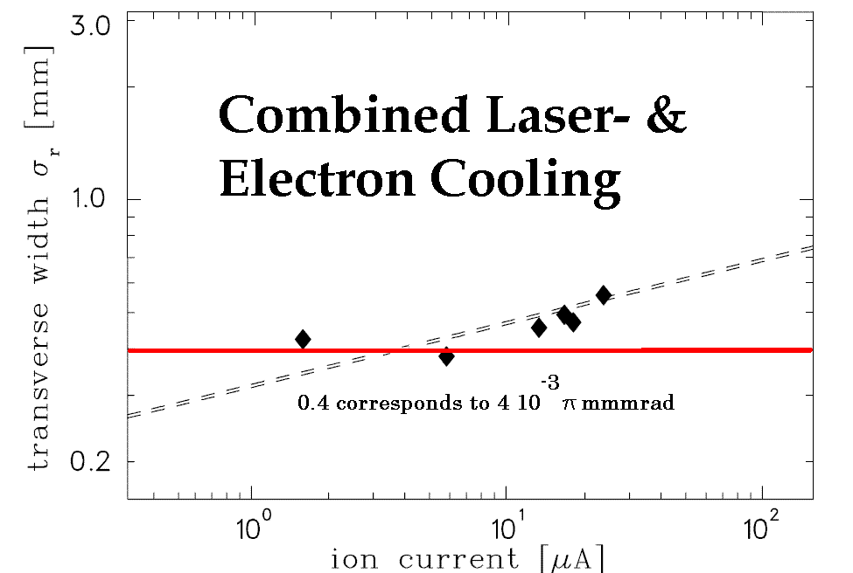
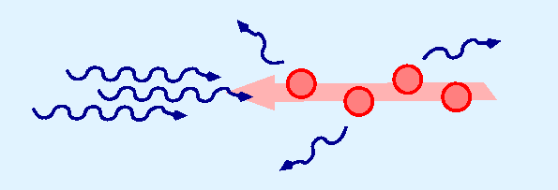
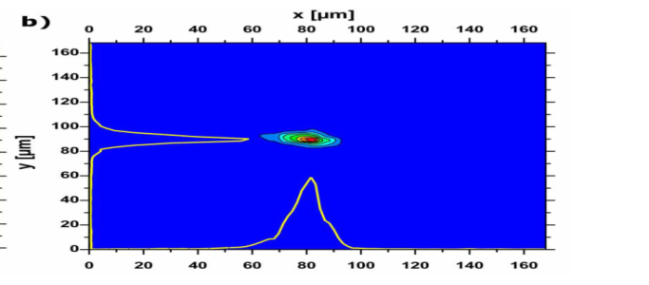
Test case: Laser cooling of C³⁺ beams
momentum dependent (Doppler tuned)
laser deceleration + bunching
(restoring force) --> cooling
Demonstration of laser cooling of C³⁺ Ions at 122 MeV/u in the ESR for application at SIS 100/300 (2004)
probing of the velocity width by rapid laser scan of the Doppler profile for different revolution frequencies
bunch length reduced by a factor 2
beam diameter reduced by a factor 4
momentum spread reduced by a factor 10
U. Schramm et al.
Notes:
12

Slide 13
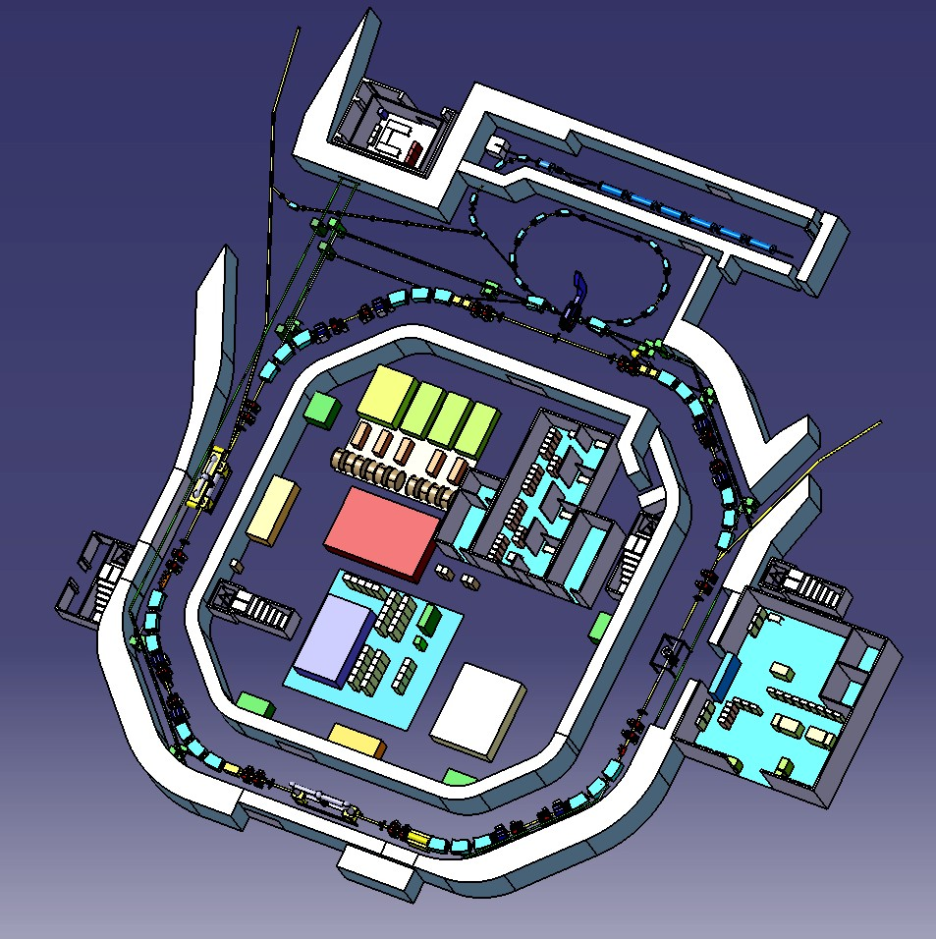
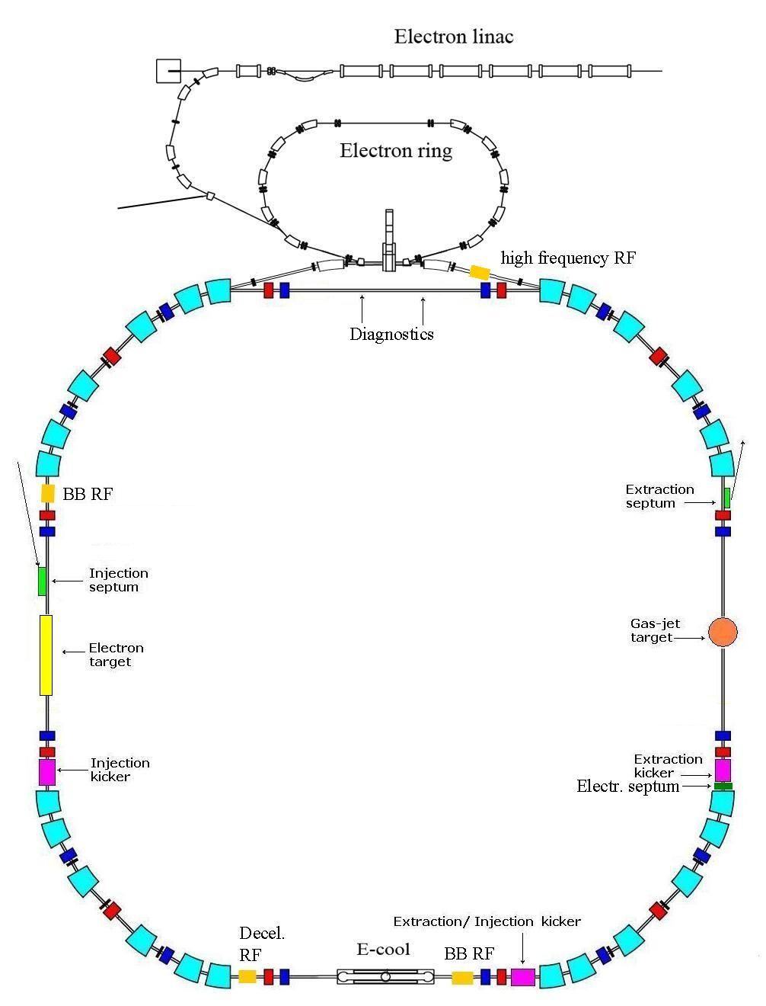
The New Experimental Storage Ring
Instrumentation
Ultracold electron target
Internal Target (atomic, cluster, micro-cluster)
In-Ring Recoil Momentum Microscope
High Resolution X-Ray and
Electron Spectrometers
Highly Intense Laser Beams
pbars
from RESR
to
FLAIR
ions, pbars
from
RESR
NESR
stable and exotic ions
anti-protons
Notes:
Electron cooling of ions and antiprotons
Fast deceleration of ions to 4 MeV/u
and antiprotons to 30 MeV
Fast extraction (1 turn)
Slow (resonance) extraction
Ultraslow (charge changing) extraction
Longitudinal accumulation of RIBs
Electron-Ion collisions (bypass mode)
Antiproton-ion collisions
Internal target
Electron target
High precision mass measurements

Slide 14
Examples for R&D for SPARC
Prototpye dense cluster target (in Operation at the ESR Storage Ring)
H₂, He, N₂, Ar, …. , Xe
(see presentation by R. Grisenti et al.)
For SPARC, all R&D projects and in kind contributions are related to the NESR and to the FLAIR facility!
Decision in 2009: NESR is not part of the modularized start version
Micro calorimeter
(C. Enss et al., P. Egelhof et al.)
Position sensitive solid state detectors for x-ray imaging and polarimentry
prototype systems available (see presentations by R. Märtin
and G. Weber)
Electron cooler from Uppsala to serve as an electron target
available (C. Brandau and C. Kozhuharov)
X-Ray laser beamline
test beamline in preperation for the ESR (HI-Jena)
and many more e.g. Cryring …

Slide 15













Strategy of SPARC for the Modularized Start Version of FAIR
FAIR – Facility for Antiproton and Ion Research
HESR
FLAIR
Transfer of NESR experiments to the HESR: most of the planned experiments will profit from the high-energies
Pushing for the RESR in order to allow for the FLAIR facility: HITRAP and low-energy experiments with HCI and pbar
RESR
CN DE ES FI FR GB GR IN IT PL RO RU SE
Notes:
15

Slide 16
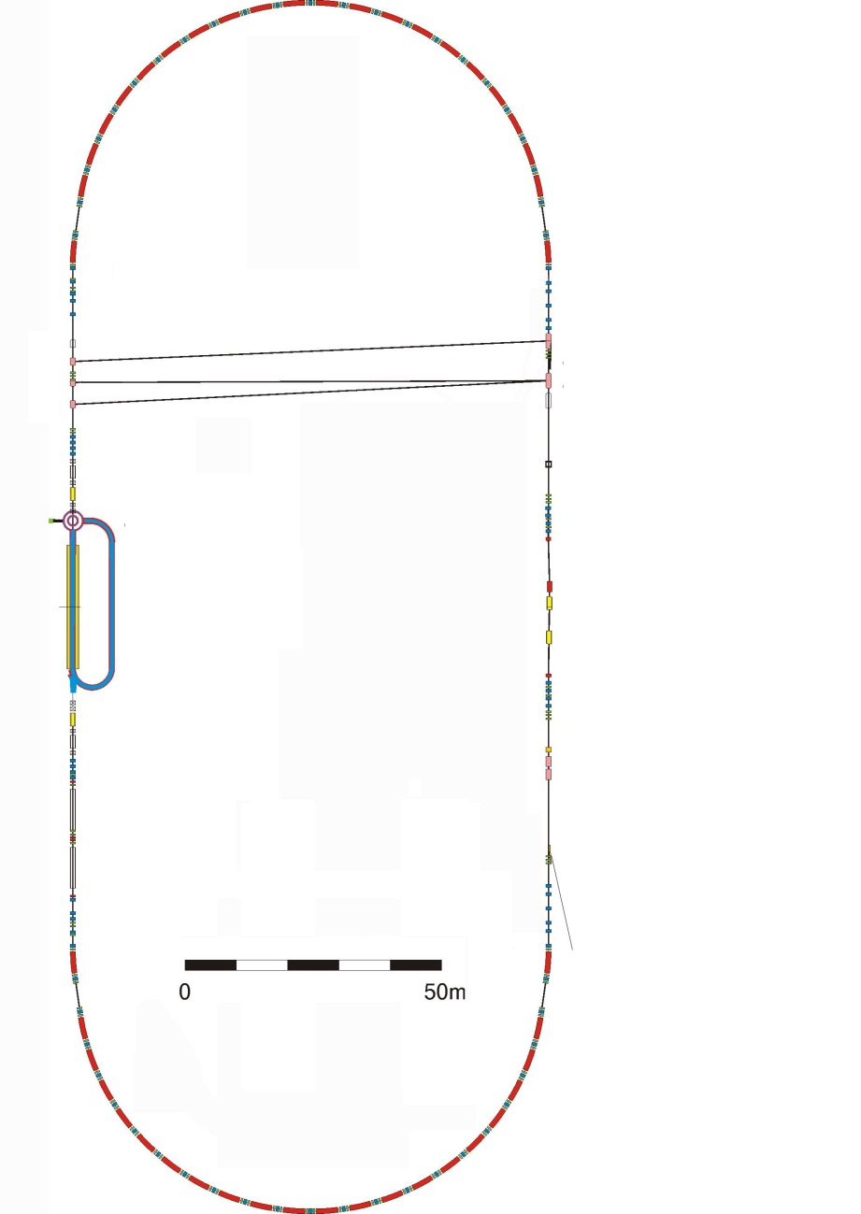
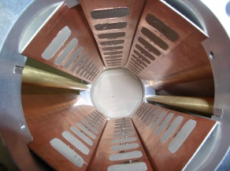
The High Energy Storage Ring HESR
Electron cooling
Storage of heavy ions
HESR Parameters
circumference 574 m
Injection energy 740 MeV/u
Bρ = 50 Tm
for U⁹²⁺: 4.937 GeV/u
γ_{MAX}=6.30; β_{MAX}=0.987
momentum (energy) range
1.5 to 15 GeV/c (0.8-14.1 GeV)
injection of antiprotons from CR
accumulation with barrier bucket
and stochastic cooling
(later accumulation in RESR)
internal cluster and jet target
COSY
2 MeV
Stochastic cooling
PANDA
experiment
arc section
Most of the equipment foreseen for the NESR can be transferred to the HESR

Slide 17
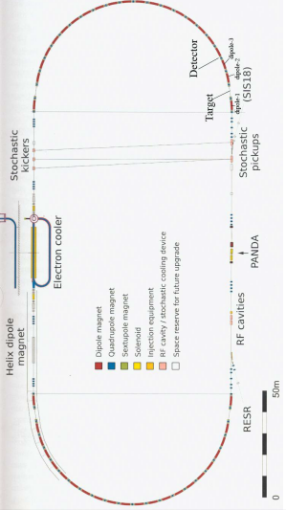
Experimental Conditions at the HESR
Some requirements
Stochastic cooling (& electron cooling)
Broadband Schottky
Target stations needed
  electron-, gasjet-, fiber-targets
Particle detectors
Ion Stacking
Acceleration and Deceleration
electron target
Possible location of target stations.
Straight sections are also well suited.
Internal jet and fiber target

Slide 18
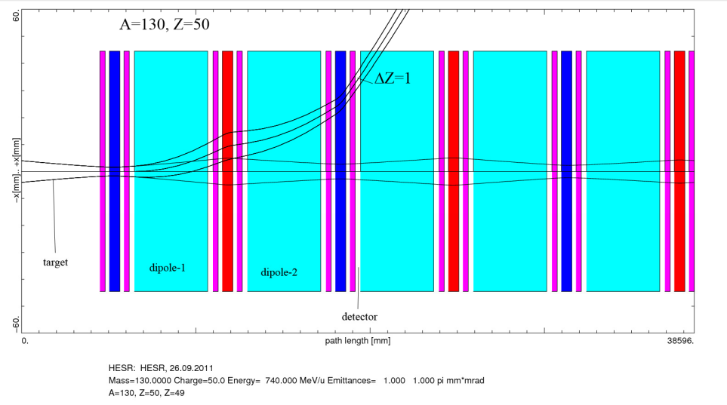
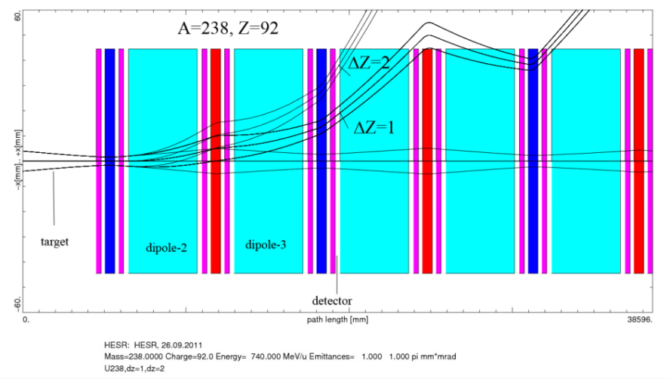
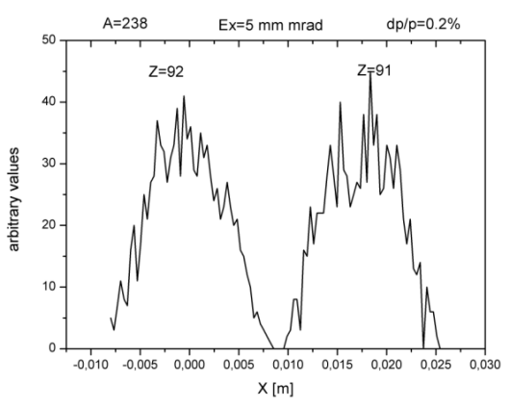
Target and detector position
target
target
Z=50
Z=92
detector
detector
Beam emmittance of 1π mm mrad assumed
(no electron cooling)
Many thanks to
Alexei Dolinskii

Slide 19
Beam lifetimes at the HESR
Moderate
beam lifetimes
and charge exchange rates
No limitations
due to residual
gas conditions at the
HESR (assumed: 10⁻⁹ mbar)
Even fiber targets of
high-Z materials can be
used

Slide 20
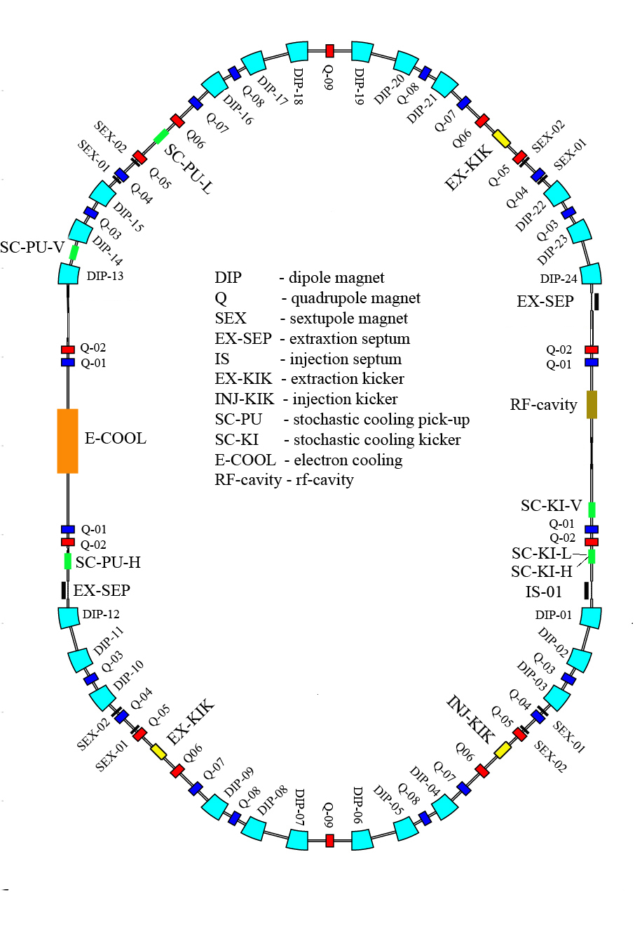
Antiproton Accumulator Ring RESR
circumference (240 →) 246 m
magnetic bending power 13 Tm
tunes Q_{x}/Q_{y} 3.12/4.11
momentum acceptance ±1.0 %
transverse accept. h/v 25×10⁻⁶ m
transition energy 3.3-6.4
accumulation of antiprotons
by a combination of rf and
stochastic cooling
max. accumulation rate 3.5 (7)×10¹⁰/h
max. stack intensity ∼ 1 × 10¹¹
additional mode:
fast deceleration of RIBs (antiprotons)
to a minimum energy of 100 MeV/u
for injection into NESR (ER)
for collider mode experiments

Slide 21
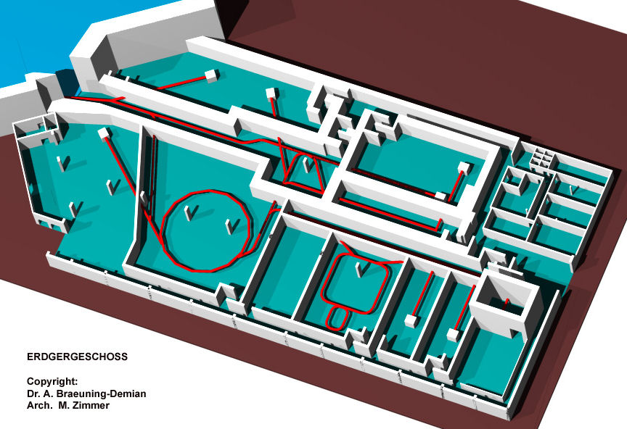
FLAIR Layout

Slide 22
Introduction
Facilities & instrumentation
Low energy experiments
  Bound state QED
  HITRAP/FLAIR: from fundamentals to applications
  Super-Critical Fields
Experiments with highly-charged ions at
relativistic energies
  Target Ionization
  Pair-production phenomena
  Radiative Processes
  Study of Bound State QED and Nuclear Parameters
  Fundamental Physics
Summary

Slide 23
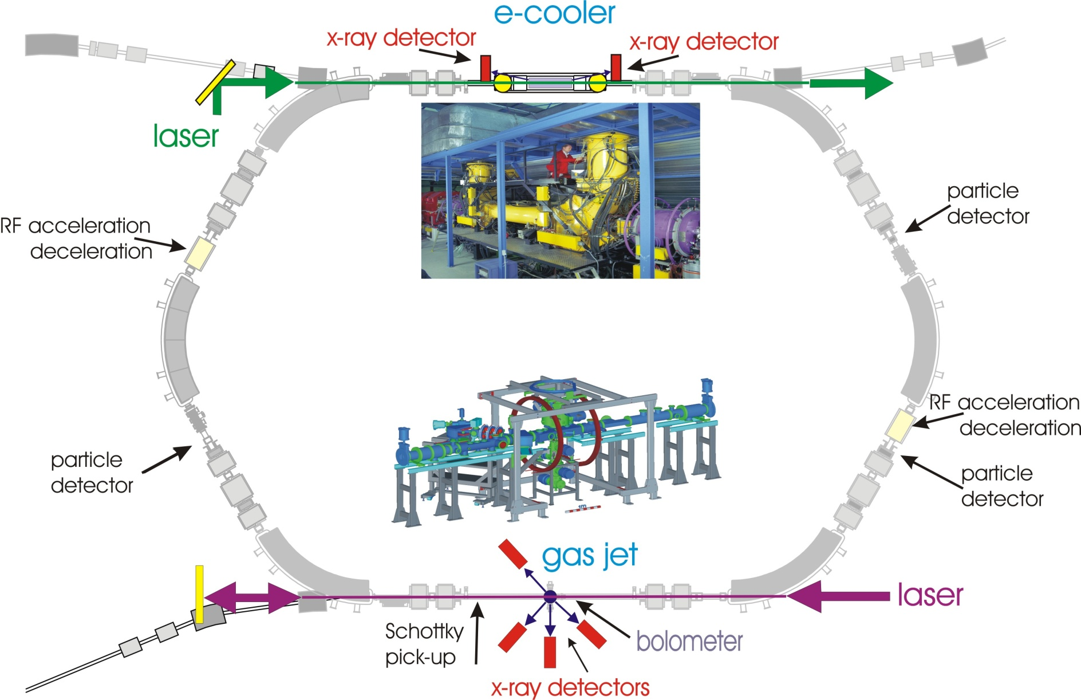
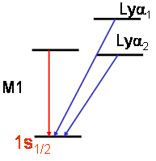
X-Ray and Laser Spectroscopy at the ESR
Injection Energy
400 MeV/u
Injection Energy
400 MeV/u
deceleration
Unique: deceleration of intense beams
of highly charged ions to very low energies
Experiment
@ 10 MeV/u

Slide 24
Test of Quantum Electrodynamics (1s-LS)
The 1s-LS in H-like Uranium
2p_{3/2}
140
120
Lyα₁
2s_{1/2}
Lyα₁ (E1)
1s-Lamb Shift
Experiment: 459.8 eV ± 4.6 eV
Theory: 463.95 eV
100
2p_{1/2}
80
Lyα₂
counts
M1
Lyα₂ (E1)
60
K-RR
40
20
Most accurate test of bound-state
QED for simple one-electron ions at high-Z
1s_{1/2}
0
1s Lamb shift
80
100
120
140
160
180
200
photon energy [kev]
Theory
Research Highlights
Nature 435, 858-859
(16 June 2005)
A. Gumberidze
PRL 94, 223001
(2005)

Slide 25
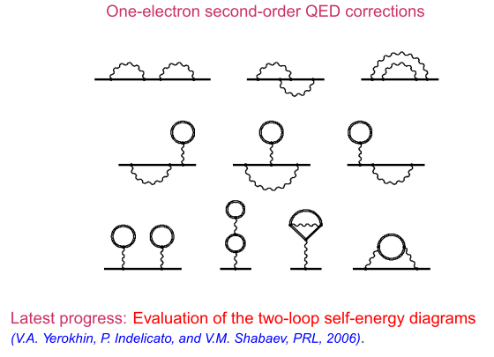

Non perturbative QED:$Z ≈1$

Slide 26
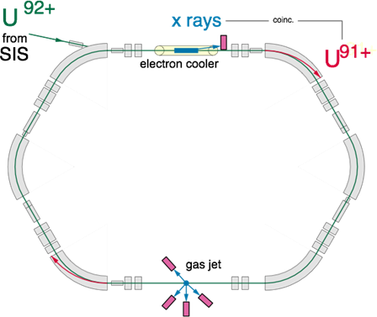
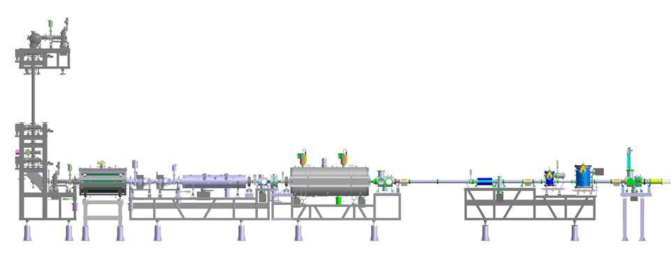
Quantum Electrodynamical Effects in Extreme Electromagnetic Fields
hydrogen
Lamb Shift
Hyperfine Structure
g-Factor
Z=1
E_{b} = 13.6 eV
Z·a « 1
Collisions of highly charged ions with atoms, molecules and surfaces
Trap based experiments
g-factor measurements
laser spectroscopy
x-ray spectroscopy
mass measurements
HITRAP
STORAGE RING ESR
uranium ion
Z=92
E_{b} = 132 keV
Z·a ≈ 1

Slide 27
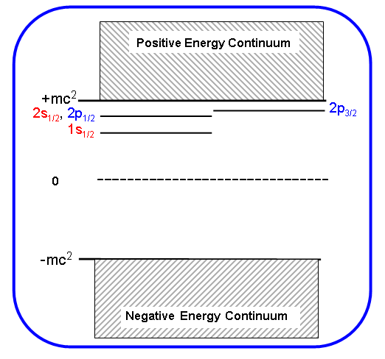
Dirac
(total energy)
First excited states of one-electron ions
What about supercritical fields ?
Notes:
27

Slide 28
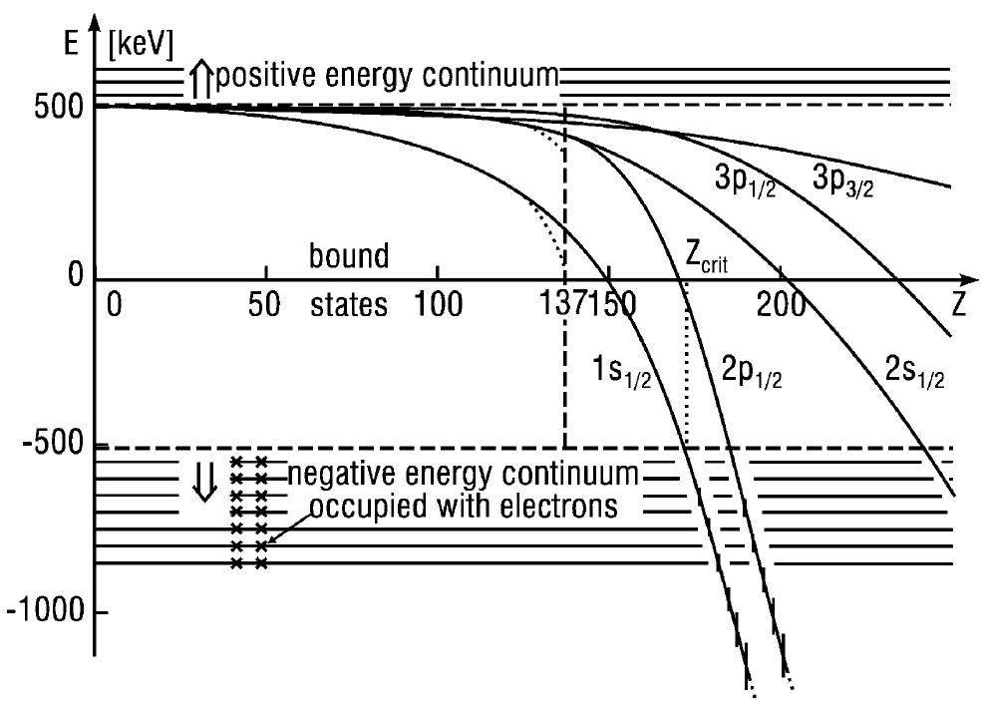
Critical electromagnetic fields
Let us come back to Dirac energy of a single hydrogen-like ion:
What happens if we increase the nuclear charge Z?
If nuclear charge of the ion is greater than Z_{crit} the ionic levels can “dive” into Dirac’s negative continuum.
Physical vacuum becomes unstable: creation of pairs may take place!

Slide 29
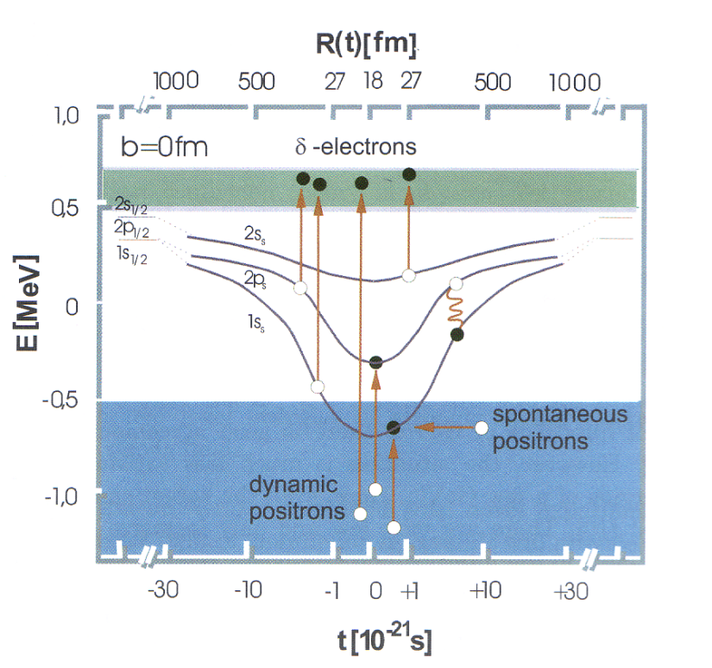
Supercritical fields: Formation of Quasi-Molecules
Merged Beams
U⁹¹⁺
U⁹²⁺
A. Artemyev, et al. J. Phys. B 43 (2010) 235207

Slide 30
Introduction
Facilities & instrumentation
Low energy experiments
  Bound state QED
  HITRAP/FLAIR: from fundamentals to applications
  Super-Critical Fields
Experiments with highly-charged ions at
relativistic energies
  Target Ionization
  Pair-production phenomena
  Radiative Processes
  Study of Bound State QED and Nuclear Parameters
  Fundamental Physics
Summary

Slide 31
Atomic Physics with Relativistic Ions:
Some Examples
Pair-production phenomena
  non-perturbation regime (αZ₁≈αZ₂≈1)
  multiple pairs (???)
  negative continuum dielectronic recombination
Radiative Processes
  recombination (angular distribution
          and polarization phenomena etc.)
  Photon-photon angular correlation (2E1-decay)
Target Ionization
  correlated electron motion – exploding the ultrafast, extremely strong transient fields of relativistic ions
Study of Bound State QED and Nuclear Parameters
  laser excitation of finestructure transitions in Li-like ions
Test of Special Relativity
  Precision laser spectroscopy
Fundamental Physics
  PNC effects in high-Z ions
Techniques
  Laser cooling

Slide 32
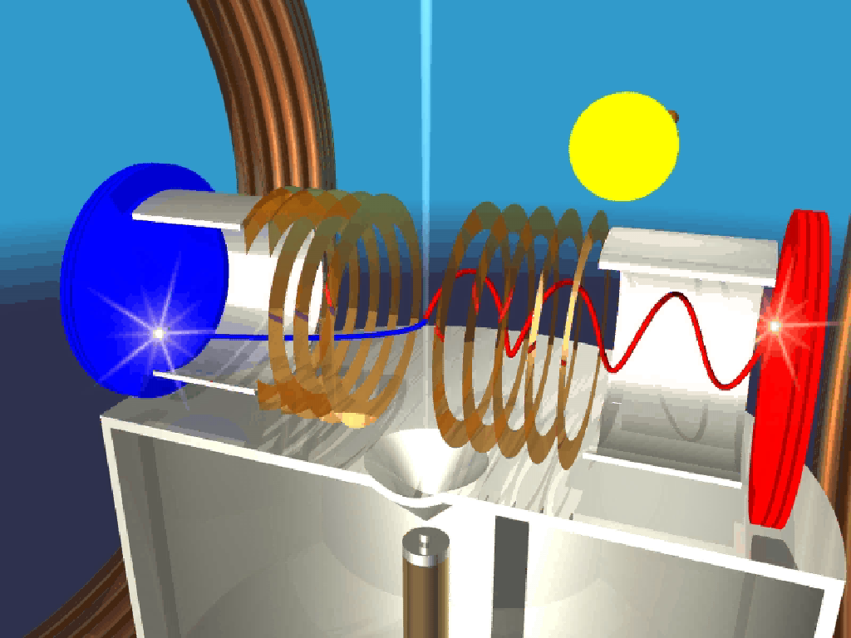
recoil ion spectrometer …
From the times-of-flight and hitting positions:
- vector momenta of electrons: ΔE_{e} ~ meV
- vector momenta of ions: ΔE_{R} < μeV

Slide 33
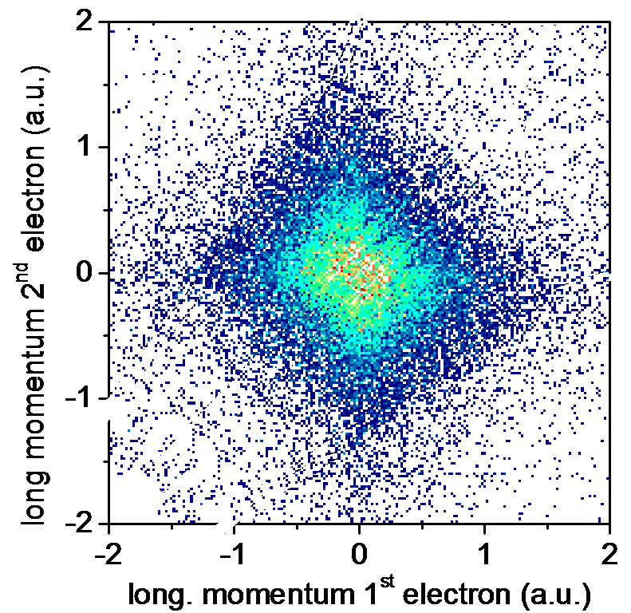
SPARC
Relativistic Collisions
What makes the difference?
”Heisenbergs dream”
e⁻
e⁻
10 GeV/u
γ = 10
field pulse
PCI
e⁻
no Post-Collision Int.
3.6 MeV/u
 = 1.003
First results of two electron momenta
230 MeV/u U⁹⁰⁺ - Ar
PCI
D. Fischer, S. Hagmann, J. Ullrich et al.

Slide 34
Electron capture by pair production - transfer from the negative energy continuum
Experiments
1GeV/u (Belkacem et al. 94)
?
10GeV/u (Belkacem et al. 94)
200GeV/u (Vane et al. 94)
example: U⁹²⁺ + U⁹²⁺ => U⁹²⁺ + U⁹¹⁺ + e⁺
+ mc²
+ mc²
0
„transfer-like“
0
„excitation-like“
- mc²
- mc²
e⁺
e⁺
target projectile
- non-perturbative regime (energies close to 1 GeV/u)
- two-center models required
Ionescu & Eichler 96
Becker et al. 87

Slide 35
Study of Bound State QED and Nuclear Parameters
simplest atomic systems with
„low-energy“ intra-shell transitions
(Δn = 0 )
large contributions from QED and
nuclear size
⇒ high sensitivity
simple to describe theoretically,
e.g. Li-like
⇒ 1 „valance“ electron with small
contributions from e-e-interaction
e.g. Li-like ions (3 e⁻)
2p_{3/2}
L-shell
2p_{1/2}
2s_{1/2}
K-shell
1s_{1/2}
X-ray laser gives access to the fine structure of lithium-like ions

Slide 36
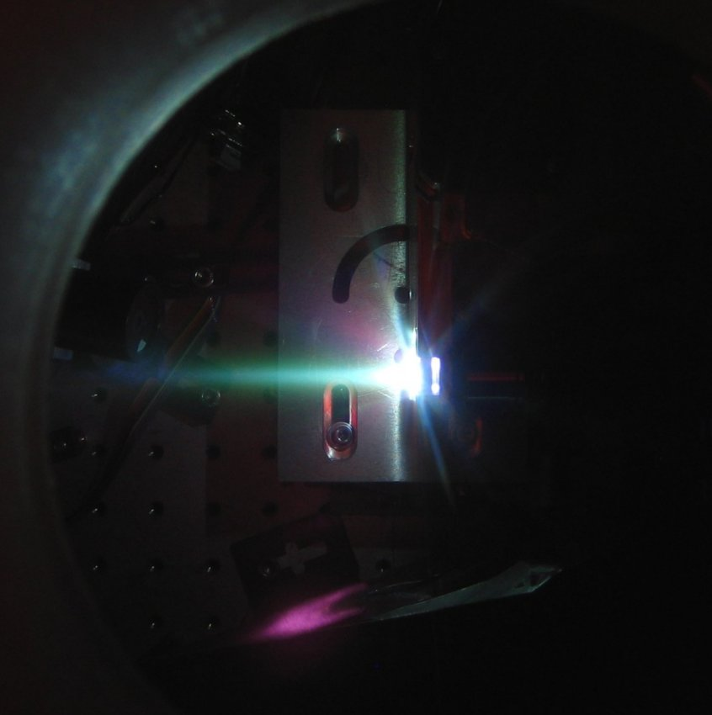
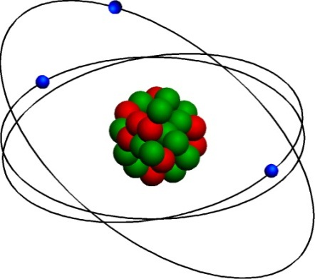
X-ray laser gives access to lithium-like ions
²P_{3/2}
²P_{1/2}
²S_{1/2}
0.8
0.7
0.6
13,9nm/89eV (Ag)
Will allow for precision tests of QED, atomic physics and nuclear models !
Ideally suited for the HESR: All fine structure transition can be addressed for all excotic nuclei
0.5
14,7nm/84eV (Pd)
0.4
18,9nm/66eV (Mo)
22,0nm/56eV (Zr)
0.3
ESR-Magnets (10 Tm)
0.2
Electron Cooler (240 kV)
0.1
Steerer-Magnets (7,2 Tm)
0
50
60
70
80
90
Nuclear Charge Z

Slide 37
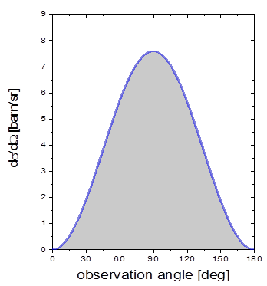
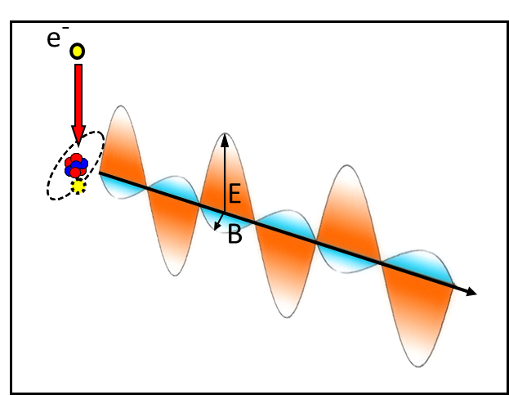
Dynamics in Strong Fields: Radiative Processes
Radiative Recombination
E_{KIN}
continuum
electron
Electron capture into a bound ionic state by emission of a photon
Time-reversed photionization
bound
states
Schnopper et al., PRL 29, 898 (1972)
angular distribution
Polarization
Spindler et al.,
42, 832 (1979)

Slide 38
K-REC Distribution for Xe⁵⁴⁺ (200 MeV/u)
R. Anholt et al., PRL 53, 234 (1984)
BEVALAC experiment
Lab. angular distribution
of an isotropic transition
in the projectile frame
Using non-relativistic wave functions, complete cancellation between retardation and Lorentz transformation occurs (verified by Anholt for 197 MeV/u Xe⁵⁴⁺⇒ Be)

Slide 39
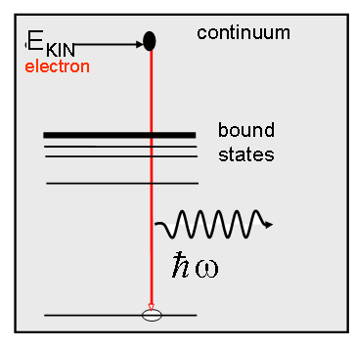
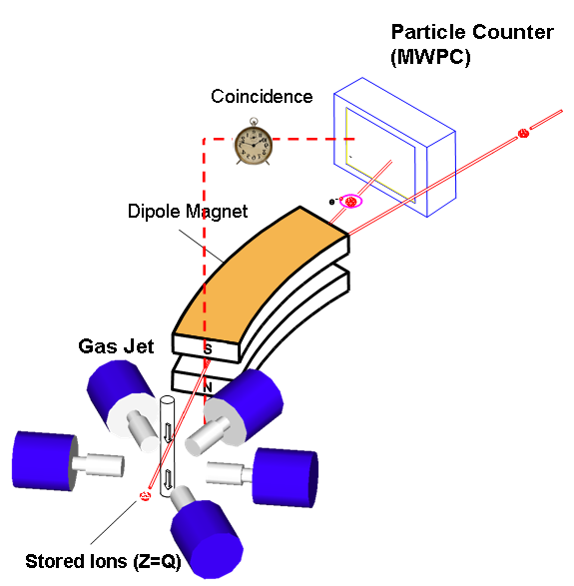
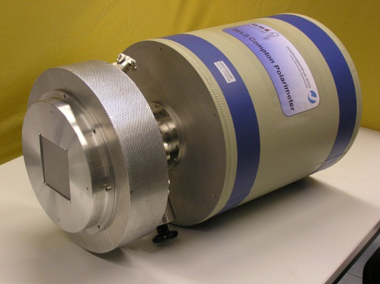
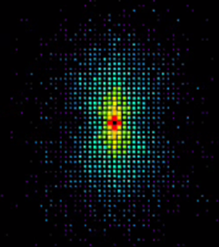
Polarization Studies for K-REC; Xe⁵⁴⁺ (155 MeV/u)
Xe⁵⁴⁺ => H₂, 155 MeV/u
K-REC
Anholt et al,
Xe⁵⁴⁺ => Be
S. Hess et al., PHD thesis, to be published (2010)

Slide 40




Position sensitive x-ray detectors (> 50 keV)
Compton imager for hard x-rays: hard x-ray polarimetry
Simulation:
linearly polarized x-rays
2D image (experiment):
Compton distribution
Azimuthal intensity
distribution

Slide 41

Radiative Recombination: Source of Intense, Monoenergetic,
Almost Completely Polarized Hard X-Rays in Ion-Atom Collisions
K-REC Distribution for Xe⁵⁴⁺ (155 MeV/u)
Comparison of xenon and uranium proofs the importance of the nuclear charge for the higher-multipole
contribution, leading to a depolarization of the RR photons.
Xe⁵⁴⁺ => H₂, 155 MeV/u
Degree of linear
Polarization:
98 ± 1 %
S. Hess et al., PHD thesis, to be published (2011)

Slide 42
Linear polarization study for radiative recombination into bare uranium
S. Tashenov et al., PRL 97, 223202 (2006)
Theory:
J. Eichler and A. Ichihara, Phys. Rev. A 65, 052716 (2002)
A. Surzhykov et al., PRA 68, 022710 (2003)
100 MeV/u
400 MeV/u
800 MeV/u
cross over feature:
never observed
Linear polarization studies are a very sensitive probe for the occurence of higher-multipole components. The higher the photon energies the larger the depolarization effects.

Slide 43

Recombination: spin polarized particles beams
(ions or electrons)
Spin Polarized
Ion Beams
unpolarized
spin-polarized
for spin polarized ions, the polarization plane and
scattering plane are not equal.
A.Surzhykov et al.,
PRL 94, 203202 (2005)
R. Pratt, R. Levee, R. Pexton, and
W. Aron, Phys. Rev. 134, A916 (1964)
„ polarization transfer for the photeffect“
control over the spin-polarization of stored ions:
required for the search of the electric-dipole momentum of elementary particles and for atomic PNC experiments.
Recombination would be a possible tool:
Polarization transfer from the particles to the photons !

Slide 44
Relativistic Photon-Matter Interaction
5 GeV/u
uranium

Slide 45
Radiative processes involving high-Z ions
1 GeV/u
2 GeV/u
5 GeV/u
Predicted strong cancellation between
retardation and Lorentz transformation.
Projectile x-ray emission even at backward angles
Cross over phenomena for the polarisation clearly visible.

Slide 46

Unique Opportunities
. . . & Challenges
FAIR – Facility for Antiproton and Ion Research
Atomic Physics with Stored and Cooled
Ions and Antiprotons
Extreme Static Fields
Extreme Dynamic Fields
Antimatter and Fundamental Physics
Notes:
46

Slide 47
Atomic parity-violating studies
We have applied the multi-configuration Dirac-Fock (MCDF) approach and quantum electrodynamics (QED) to re-investigate the parity-forbidden two-photon 2E1 transition between ¹S₀ and ³P₀ states of helium-like uranium U⁹⁰⁺:
Novel, accurate predictions were obtained for the rate of this induced parity-violating transition:
Induced 2E1 (PNC) transition
1s 2s ¹S₀
1s 2p ³P₀
1s 2p ³P₁
1s 2s ³S₁
Spontaneous 2E1 decay
Rate ~ 7.2 ^{x} 10¹² s⁻¹
1s² ¹S₀
To “compete” with the spontaneous decay channel we have to induce two-photon PNC transition by polarized light with intensity:
F. Ferro, et al., Phys. Rev. A 81, 062503 (2010)
F. Ferro, et al., J. Inst. 5, C08006 (2011)
A. Surzhykov et al., submitted to Phys. Rev. A (2011)
Relativistic energies required

Slide 48
Working Groups of the SPARC-Collaboration
Charge Separator for Relativistic Collisions
Reaction Microscope
Electron and Electron/Positron Spectrometers
Photon and X-Ray Spectrometers
Detector Developments
Target Developments
Electron Cooler/Target
Low Energy Setups
Traps/HITRAP
Ion Sources
Laser Spectroscopy/Laser Cooling
Intense Laser/Ion Interaction Theory

Slide 49
Electron Capture Cross Sections
NRC:
Non-radiative electron capture
REC:
Radiative electron capture
EC-pp:
Electron capture by pair production
At the HESR, ideal conditions for the study of pair production phenomena

Slide 50


Negative Continuum DR
e.g. Pb⁸²⁺ + e⁻ => Pb⁸⁰⁺ + e⁺

Slide 51




Experimental Facilities
CHANNELING
PAIR PRODUCTION
SIS100/300
Stored and Cooled
From Rest to Relativistic Energies:
Highly-Charged Ions and Exotic Nuclei
Intense Beams of Radioactive Isotopes
Intense Source of Virtual X Rays
XUV Energies via Lorentz Boost of Optical Wavelengths
High
Energy
Cave
FLAIR
NESR
Novel Instrumentation

Slide 52



Structural properties of heavy ions
2s_{1/2}
2p_{1/2}
2p_{3/2}
(nuclear size)
R ~ 10⁻¹⁴ m
(electron orbit)
r ~ 10⁻¹³ m
From the Bohr model one can estimate the electron “velocity” in the ground state:
(for U⁹¹⁺)
n=3
Spin and QED effects are of great importance!
n=4
Explore QED, the most precise theory
- in the non-perturbative regime
- not well-known up to now!
2p_{3/2}
2p
4 keV
Electron is exposed to huge fields (of microscopic) dimension
2p_{1/2}

Slide 53

g-factor of the bound electron in a HCI
cyclotron frequency
bound state electron g-factor for C⁵⁺
theoretical value: 2.001 041 589 9(9)
experimental value: 2.001 041 596 4(10) {44}
Lamor frequency
B
B
assume QED is correct
m_{e} = 0.000548 579 909 2(4) u
van Dyck (1995) m_{e} = 0.000548 579 911 1(12) u
CODATA (1998) m_{e} = 0.000548 579 911 0(12) u
  improvement by a factor of 4*
'experimental g-factor'
comparison with theory
external input parameter
measurement

Slide 55

@ Relativistic Energies
Quantum Electrodynamics, Cooling, Crystalline Beams
QED in Li-like systems
SIS100/300
improved resolution factor of 10 to 20
Laser cooling of C³⁺ beams has been demonstrated at the ESR
H. Backe, arXiv:physics/0701056 (2007)

Slide 56
Test case: Laser cooling of C³⁺ beams
momentum dependent (Doppler tuned)
laser deceleration + bunching
(restoring force) --> cooling
Demonstration of laser cooling of C³⁺ Ions at 122 MeV/u in the ESR for application at SIS 100/300 (2004)
probing of the velocity width by rapid laser scan of the Doppler profile for different revolution frequencies
bunch length reduced by a factor 2
beam diameter reduced by a factor 4
momentum spread reduced by a factor 10
U. Schramm et al.
Notes:
56

Slide 57



Experiments – at the Electron Target
Dielectronic Recombination
e + A^{q+} A^{(q-1)+}
electron cooler
DR experiments for Li-like heavy ions at the ESR:
The already achieved
accuracy is comparable with precise x-ray experiments
electron target

Slide 58
Stored Particle Atomic Physics Research Collaboration
AUSTRIA
Vienna University of Technolgy
CANADA
University of Manitoba
York University
CHINA
China Institute of Atomic Energy, Beijing
Institute of Applied Physics and Computational Mathematics, Beijing
Institute of Modern Physics, Fudan University, Shanghai
Institute of Modern Physics, Chinese Academy of Sciences, Lanzhou
Institute of Atomic and Molecular Physics, Jilin University, Jilin
Lanzhou University, Lanzhou
University of Science and Technology of China, Hefei
Wuhan Institute of Physics and Mathematics, Wuhan
Physics Department, Northwest Normal University
Department of Physics and Astronomy, University of Aarhus
DENMARK
Department of Physics and Astronomy, University of Aarhus
EGYPT
Physics Department, Beni-Suef Faculty of Science
FRANCE
Laboratoire kastler-Brossel, Ecole Normale Sup. Paris
INSP, Univ. Pierre et Marie Curie
CIRIL Ganil
Ecole Normale Superieure – Lyon
Institut de Physique Nucléaire de Lyon
GERMANY
Ernst Moritz Arndt Universität Greifswald
Forschungszentrum Jülich
Freiburg University
GSI, Darmstadt
Institut für Kernphysik, Justus-Liebig-Universität Gießen
Institut für Atom- und Molekülphysik, Justus-Liebig-Universität Gießen
Sektion Physik, LMU Munich
Max-Planck-Institut für Kernphysik, Heidelberg
Institut für Theoretische Physik, TU Dresden
Tübingen University
IKF, J.W.v.Goethe Universität Frankfurt am Main
Institut für Physik, Universität Mainz
Institut für Physik, Universität Kassel
Institut für Theoretische Physik, TU Clausthal
Kirchhoff-Institut für Physik, Universität Heidelberg
TU Darmstadt
Physikalisch-technische Bundesanstalt
Mathematics Institute, University of Munich, 80333 Munich
HUNGARY
Inst. of Nuclear Research (ATOMKI), Debrecen
INDIA
Tata Institute of Fundamental Research
Vaish College, Rohtak
Nuclear Science Centre, New Delhi
Bhabha Atomic Research Centre
ITALY
Inst. Naz. Fisica Nucleare, Dip. di Fisica, Catania
JAPAN
University of Tokyo & Atomic Physics Laboratory RIKEN, Wako
JORDAN
Hashemite University
POLAND
Institute of Physics, Swietokrzyska Academy
Institute of Physics, Jagiellonian University
Institute of Theoretical Physics, Warsaw University
Institute of Nuclear Physics of Polish Academy of Sciences
The Soltan Institute For Nuclear Studies
ROMANIA
NIPNE National Institute for Physics and Nuclear Engineering
RUSSIA
Lebedev Physical Institute, Moscow
Institute of Physics, St. Petersburg State University
Institute of Metrology for Time and Space at VNIIFTRI
Institute of Spectroscopy of the RAS
V.G.Khlopin Radium Institute, St.Petersburg
SERBIA AND MONTENEGRO
Institute of Physics, Belgrade
SWEDEN
Chalmers University of Technology and Goteborg University
Stockholm University
Mid-Sweden University
Lund University
SWITZERLAND
CERN
Department of Physics, University Fribourg
Institut für Physik, Universität Basel
UNITED KINGDOM
Department of Physics, The University of Durham
Queen's University, Belfast
UNITED STATES
Lawrence Berkeley National Laboratory
Georgia State University
University of Missouri Rolla
Oak Ridge National Laboratory
Western Michigan University
Harvard-Smithsonian Center for Astrophysics
Brown University, Physics Department
Univeristy of Texas at Austin
Kansas State University
Columbia Astrophysics Laboratory, Columbia University
290 participants from over 20 countries
Board: 15 Members from 12 Countries
Events
Mar 2004 LoI and green light for Technical Proposal
Oct 2004 First collaboration meeting @ GSI
Janu2005 Technical Proposal submitted
Mar 2005 Evaluation of TP ⇒ green light
June 2005 Evaluation of costs ⇒ green light
July 2005 SPARC part of the core facility of FAIR
July 2005 Collaboration meeting @ Rosario, Argentina
Sept2005 Cost planning for 2006 and 2007
Sept 2005 SPARC Workshop @ Piaski
Jan 2006 Technical Report
Aug 2006 Collaboration meeting @ Belfast, UK
Aug 2006 Interim Memorandum of Understanding
Febr 2007 SPARC Workshop @ Paris
July 2007 SPARC Theory Workshop @ GSI
April 2008 Heraeus school HCI, Anti-protons@Bonn
June 2008 Strong Field workshop @ GSI
Aug 2008 SPARC sessions@CAARI Dallas
Sept 2008 SPARC Workshop @ Predal
Jan 2009 Heraeus school, strong-fields@Bonn
Sept 2009 SPARC Workshop @ Lisboa
Sept 2010 SPARC Workshop @ Lanzhou
Sept 2011 SPARC Workshop @ Moscow
https://gsi.helmholtz.de/fair/experiments/sparc

Slide 59




Research Instruments at GSI for Atomic Physics
ELECTRON SPECTROSCOPY
high-resolution electron
spectroscopy
complementray to the
x-ray channel
electron
gas jet
NESR
spectrometer
beam
-
RECOIL ION MOMENTUM
SPECTROSCOPY
impact parameter sensitive
studies
(e,2e) processes in HCI atom
collisions
X
ray chamber
reaction microscope
X-RAY SPECTROSCOPY
e.g.
precision spectroscropy
photon correlation studies
polarization phenomena
”focal”

Slide 60



Research Fields of the Institute
Light sources for accelerators
Optics (X-Ray) for FELs, synchrotrons, storage rings, and traps
Advanced laser-based accelerator concepts
Physics in extreme laser and particle fields
Diagnostics and Detectors
Ions and Antiprotons
Photons

