Slide 1
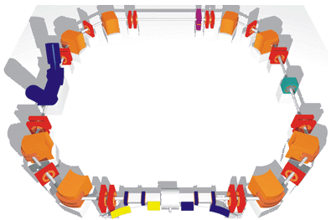
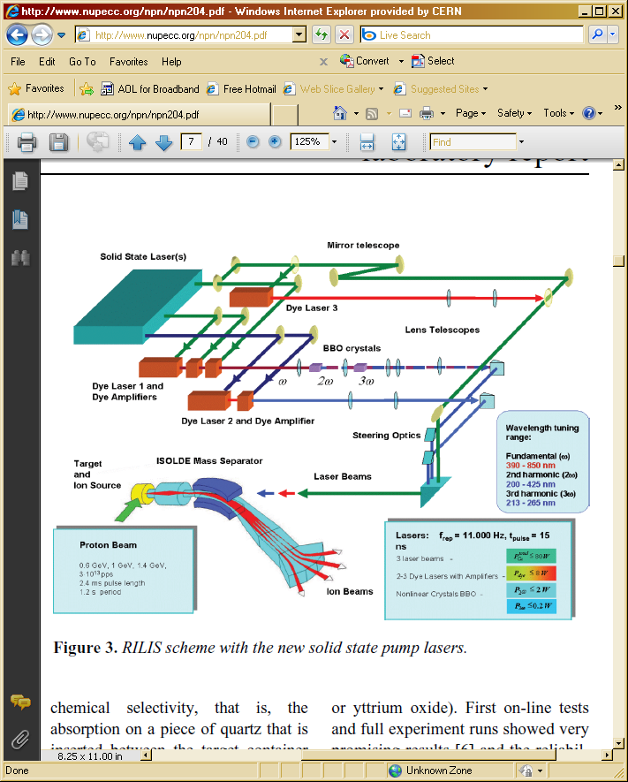
TSR @ ISOLDE
Technical aspects of connecting the Heidelberg Test Storage Ring
to the HIE-ISOLDE Linac
F. Wenander for the TSR working group
STORI 11, Frascati 2011
ISOLDE
TSR
+
= True?
1. Introduction to ISOLDE
2. The REX-ISOLDE post accelerator
3. The HIE-ISOLDE Linac upgrade
4. The Heidelberg Test Storage Ring
5. TSR at HIE-ISOLDE
Disclaimer
* No detailed TSR expose
* No physics cases –
covered by Y. Litvinov on Friday
* Not a storage ring specialist!
Notes:
What you don’t get
* No expose of TSR features in detail, only put them in relation to HIE-ISOLDE
* No physics cases - covered by K. Blaum on Friday
* Not a storage ring specialist! So, appreciate your feedback during the coffee

Slide 2
Motivation for ISOL facility + Storage ring
1. Higher intensities and cooler beams than in-flight storage rings
2. Compared to thick experimental target and beam direct from post-accelerator:
+ no background from target container or beam dump
+ reduced energy straggling for projectile and reaction products in thin target
+ smaller beam size ‐> improved kinematic corrections for reaction products
+ decreased detector dead-time as CW beam (REX and HIE-ISOLDE pulsed)
3. Question marks / differences from TSR at Heidelberg
? Internal target -> beam storage lifetime
? Beam injection scheme – exotic ions, limit loss
? Loading rate
? Luminosities sufficient for nuclear physics
First time a storage ring would be connected to an ISOL-facility
Notes:
Luminosities in a storage-ring experiments can be comparable to thick target setups
To be done at ISOLDE different from Heidelberg
Operational complications?
The small beam spot size is rather important for the angular resolution, which in inverse kinematics also impacts the excitation energy resolution. In fact, with a 1mm beam spot and a thin gas target one can hope to have a good enough resolution from the particle measurement so as not to have to measure gamma-rays at all. This would be even more true if one could install a Helios-type device in the TDR (??)
high energy and angular resolutions
+ Reduced momentum spread
CW beam instead of pulsed (coasting beam inside TSR)

Slide 3
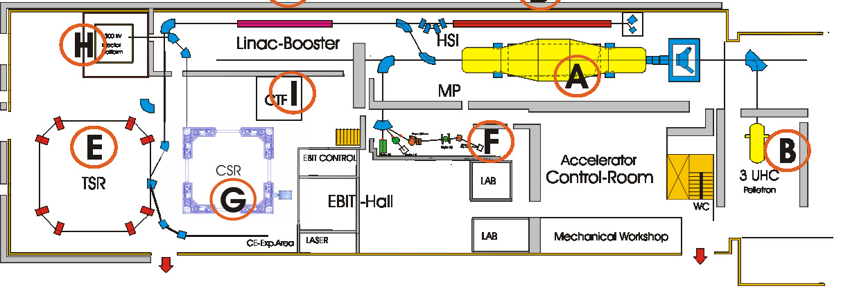
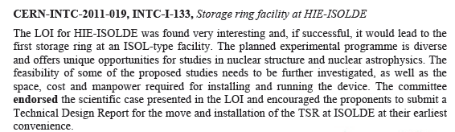
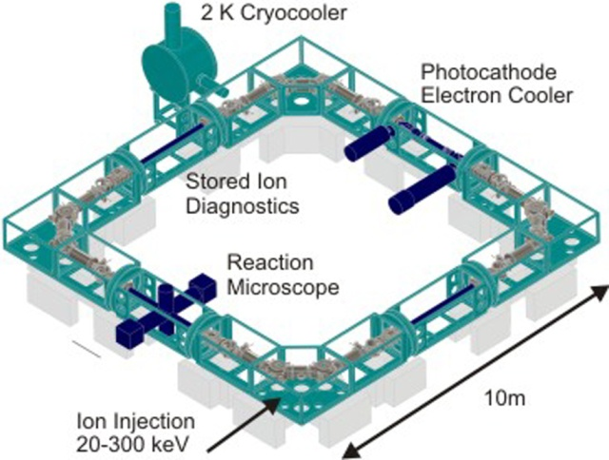
Background
Accelerator complex at Max-Planck-Institute for Nuclear Physics
MPI-K Heidelberg in the process of replacing the Heavy Ion Test Storage Ring TSR with the Cold Storage Ring (CSR)
1. TSR@ISOLDE workshop at MPI-K Heidelberg 28-29/10 2010 evaluated the future for TSR
2. LoI to the ISOLDE and Neutron Time-of-Flight Committee
http://cdsweb.cern.ch/record/1319286/files/INTC-I-133.pdf
3. Technical Design Report under preparation

Slide 4
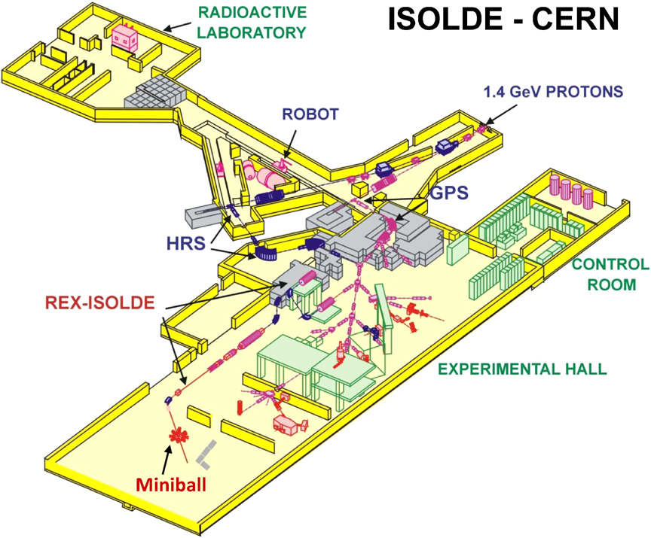
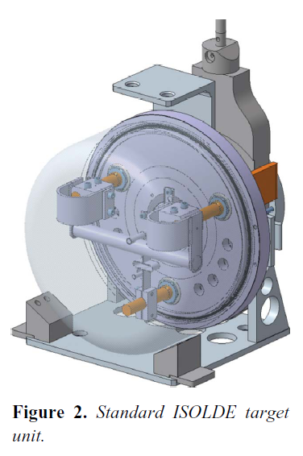
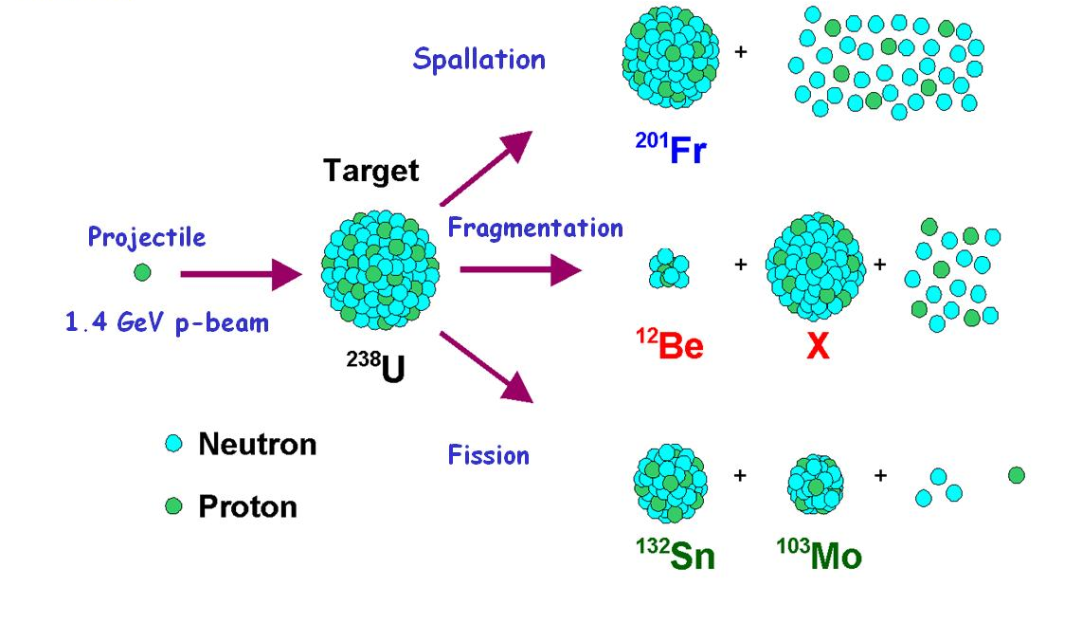
ISOLDE
nuclear ISOL-type facility at CERN
Pulsed (100 us)
proton beam
1.4 GeV
future 2 GeV
60 keV beams at
ISOLDE until 2001
Standard ISOLDE target unit
(courtesy S. Marzari)
* <3.3E13 protons per pulse every N*1.2 s (N=1,2,3…)
* <2 uA average proton current on the target
* Target material: UCx, SiC, CaO, YO, molten Pb etc
* Material diffusion, effusion and sticking time
govern the release time
* Magnetic separator
Notes:
Material diffusion, effusion and sticking time to the ion source governing the release time
ISOLDE’s RIB are produced using the 1.4 GeV proton beam from the PS-Booster accelerator at CERN. Beam pulses of about 3×1013 protons per pulse are send to the ISOLDE target every 1.2 s or multiples of this period resulting in an average beam intensity of 2 particle μA. Various solid and liquid target materials are used to produce a wide spectrum of radioactive isotopes covering essentially the whole nuclear chart below uranium (Z = 92). Radioactive isotopes are produced via proton-induced target fragmentation, spallation and fission reactions. The most frequently used target material is uranium carbide (UCx ). In 2007, it was used for 67% of the beam time, followed by SiC (9%) and liquid lead (6%). The radioactive products are thermalized in the target material and are subsequently transported from the target container to the ion source via diffusion and effusion processes. To speed up this process, the whole target–ion source unit is kept at high temperature, typically 2000 ◦C for e.g. a UCx target. The speed of the diffusion and effusion process is governed by the physical and chemical properties of the radioactive elements of interest and of the specific materials that the target container, transfer line and ion source are made of. Consequently, radioactive isotopes that have small diffusion coefficients or very long lingering times at the surface of the target or container material, like
the isotopes from some of the refractory elements, undergo radioactive decay before they are ionized and are thus lost. Once the atoms reach the ion source, a large fraction is ionized to a 1+ charge state. Different ion sources are used at ISOLDE implementing different ionization
mechanisms: electron impact ionization in high-temperature plasma sources and, surface and laser ionization in a hot cavity. The ions are subsequently extracted from the ion source, accelerated to typically 60 keV, mass separated according to the mass-over-charge ratio using
a dipole magnet
The relevant time scales and time structures are given in Fig. 9. The "driver beam" of ISOLDE is a 1.4 GeV proton beam delivered by the Proton Synchrotron Booster (PSB) at CERN. The PSB provides proton bunches of 100 s every 2.4 s on average to the ISOLDE primary
target. In general, ISOLDE utilizes around 40% of all proton pulses available in the so-called CERN "supercycle", which is a grouping of several proton pulses. The total integrated proton beam current on the primary target can amount up to 2 A. With each impact of a proton pulse on the primary target, radioactive isotopes are produced by either ssion, spallation or fragmentation of a variety of primary target materials. In 70% of the cases this is proton induced ssion of 238UCx. The radioactive isotopes diuse through the thick primary target towards a transfer line, where potentially some chemical selectivity prevents undesired species from diusing into the ion source (for an example on Rb suppression, see [28]). The ionization of the desired chemical element takes place in either the transfer line (surface and laser ion source) or just after the transfer line (plasma ion source). A review of target ion-source technology can be found in [29]. The target-ion source combination is heated between 700 and 2000C to decrease the diusion time. Though, the high temperature increases the probability for surface ionization, which is in most cases undesired. The ionized species (1+ charge state) are extracted from the target-ion source by applying an electrostatic potential which is typically 30 kV for REX-ISOLDE experiments. After mass separation, the isotopes are guided towards the REX-ISOLDE experiment. In Fig. 10 and Fig. 9(B), a characteristic release prole of the mass separated isotopes is shown.

Slide 5
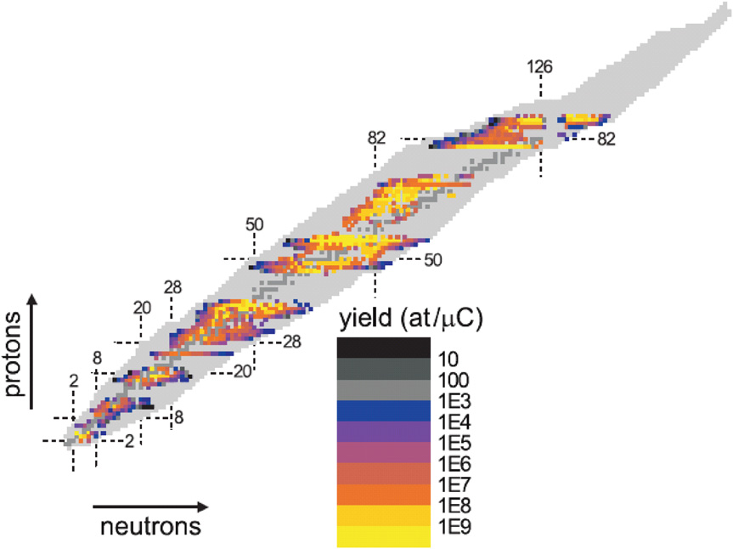
Beams from ISOLDE
* Largest range of available isotopes of any ISOL facility
* >800 RIB from >70 elements
* From ⁶He to ²³²Ra
* New beams under development (~2 years)
ISOLDE’s strength:
heavy isotopes produced with spallation from UCx
The gaps with no beams available correspond to refractory-type elements e.g. the Ti(Z=22)–V(23), Zr(40)–Rh(45) and Ta(73)–Pt(78) regions or extremely short-lived isotopes.
http://isolde.web.cern.ch/ISOLDE/
Old data from 2006
Notes:
* Isotopes with Z from 2 to 88 and N from 4 to 144
* ISOLDE today offers the largest range of available isotopes of any ISOL facility worldwide (>600 radioactive isotopes of >60 elements) in an energy range between 60 keV and 3 AMeV.
* The color code gives the intensity of the 60 keV beams.

Slide 6
Electron beam ion source
* 1+ ions to n+
* Super conducting solenoid, 2 T
* Electron beam <0.4 A, 3-6 keV
REX-ISOLDE
layout
* Energy from 60 kV to few MeV/u
* Until now:
>30 elements
close to 100 isotopes
ISOLDE
REXEBIS
Primary
target
Optional stripper for beam cleaning
MASS SEPARATOR
Protons
from PS
9-GAP RESONATOR
7-GAP RESONATORS
IH
RFQ
ISOLDE beam
Rebuncher
60 keV
3.0 MeV/u
2.2 MeV/u
1.2 MeV/u
0.3 MeV/u
REXTRAP
Experiments
Penning trap
* Longitudinal accumulation and bunching
* Transverse phase space cooling
* 3 T solenoid field
+ quadratic electrostatic potential
+ RF cooling
* Buffer gas filled (5E-4 mbar)
Linac
Type normal conducting
6 accelerating cavities
Length 11 m
Duty cycle 1 ms 100 Hz
In order to boost the energy of the existing RIB of ISOLDE from typically 60 keV to a few
MeV u−1, a new concept was proposed whereby the existing singly charged ion beams from
ISOLDE could be accelerated in a universal, fast, efficient and cost-effective way [7, 13, 14].
The concept is based on ion beam cooling and bunching in the buffer gas of a Penning trap
[23], charge-state breeding in an EBIS [24] and post-acceleration in a room-temperature linear
accelerator [25]. The original aim of the project was to prove the new concept’s principle and
to perform pilot experiments with short-lived post-accelerated RIB [7]. The 60 keV RIB from
ISOLDE are retarded and continuously injected into a Penning trap situated at a high-voltage
platform with a potential of nearly 60 kV. In the trap the ions are accumulated and at the same
time cooled via buffer gas collisions. After a fixed time, which is determined by the required
charge breeding time, the ion bunch is extracted from the Penning trap, accelerated to 60 keV,
transferred to the EBIS and retarded to ground potential prior to injection into the EBIS.
The typical duration of the ion bunches extracted from the Penning trap is 10 μs. After charge
breeding to the required mass-to-charge ratio (A/Q) <4.5, the ion bunch is extracted from the
EBIS, mass separated and injected into the radiofrequency quadrupole (RFQ) accelerator. The
charge breeding time depends on the required charge-to-mass ratio and thus on the isotope of
interest. It varies from typically 20 ms for light mass elements (A < 40) to over 200 ms for
the heavy elements in the lead region (A 200). The typical time width of the ion bunch
extracted from the EBIS is 100 μs. As the required injection energy for the RFQ is 5 keV u−1,
the EBIS platform potential is lowered from the 60 kV retarding potential down to ∼20 kV
while charge breeding takes place. The room-temperature accelerator typically runs with a
10% duty cycle (e.g. a radiofrequency-on period of 2 ms every 20 ms). The RFQ accelerator
is followed by an interdigital H-type (IH) structure with a final energy between 1.1 and
1.2 MeV u−1, three seven-gap resonators that create an energy range from 0.8 to 2.2 MeV u−1
and finally by a nine-gap resonator boosting the beam energy to a maximum of about
3 MeV u−1. The time structure of the accelerated ions is shown in figure 2 of [14]. It is
determined by the repetition rate of the proton beam pulse from the PS-Booster (a proton
pulse every 1.2 s or an integer multiple of this period), the release profile of the isotope of
interest from the ISOLDE target ion source unit (typically tens of ms to s scale), the duty cycle
of the accelerator (typically one ∼40 to 150 μs wide pulse from the EBIS every 20 ms) and
the micro time structure of the linear accelerator (a few ns pulse width every 10 ns).
Notes:
Inverse kinematics – nuclei of interest is the projectile
ISOLDE beam energy 2.8-3 MeV/u

Slide 7
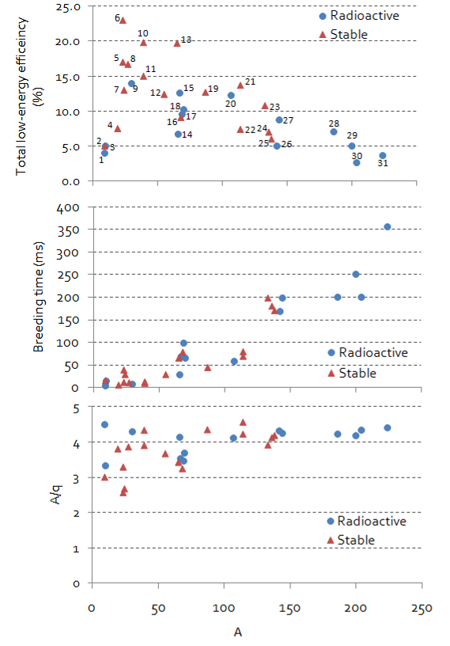
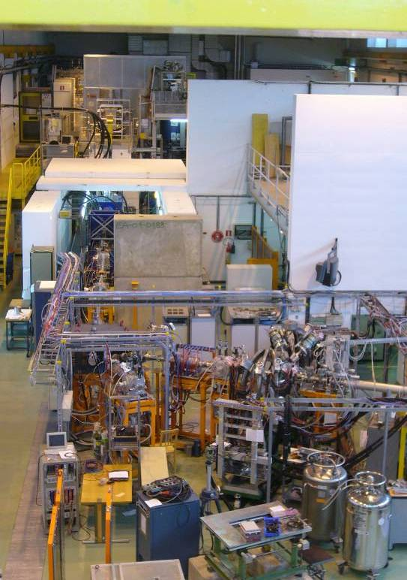
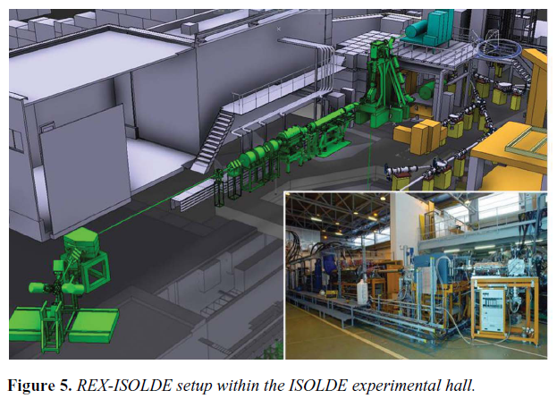
REX-ISOLDE performance
charge breeder
Penning trap
LINAC
Miniball
setup
F. Wenander, Jour Instrum 5 C10004 2010
Top: Charge breeding time for a selection of elements (excluding cooling-bunching time inside REXTRAP). Bottom: Mass-to-charge ratio for the same elements.
November 2009
T_{cooling} + T_{breeding} at least 20 ms
-> T_{1/2} > 20 ms
2nd experimental
beam line
Notes:
Adapted for isotopes with T_{1/2}>20 ms

Slide 8
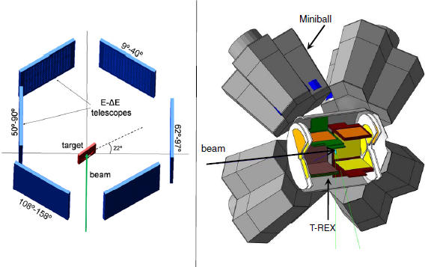
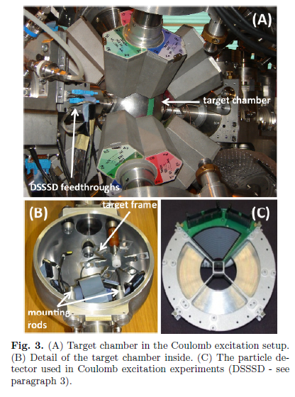
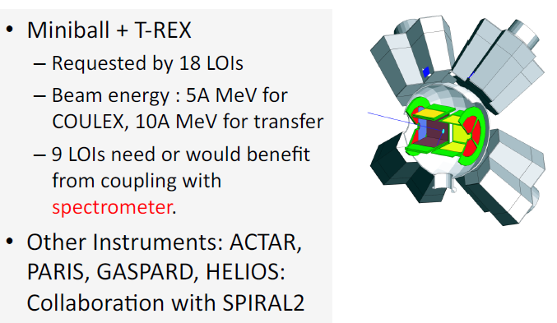
Present experimental program at REX-ISOLDE
Focus of experimental program at REX-ISOLDE:
Coulomb excitation
few-nucleon transfer reaction studies
fusion evaporation studies
light particle elastic scattering
using radioactive beams
Z=3 to 88, up to 3 MeV/u
Miniball
Low-multiplicity Ge array + Si pixel
particle detectors for Doppler correction
2nd beam line
Mobile experiments, e.g. scattering chamber
β-NMR experiment
Test to produce polarized beams
using tilted foils method
REX physics reference: P Van Duppen and K. Riisager,
J. Phys. G: Nucl. Part. Phys. 38 024005 (2011)
Miniball reference: ‘The Miniball at REX-ISOLDE’,
J. Van de Walle., EPJ to be published
Setup for scattering experiments of light nuclei, e.g. ¹¹Be
T-REX silicon barrel detector with Miniball germanium array for few-nucleon transfer reaction experiments
Miniball main results
The changing shell structure far off the valley of beta stability probed by Coulomb excitation and transfer reactions
The investigation of shape co-existence by means of (multiple) Coulomb excitation
Miniball, 2nd beam line for mobile experiment and fixed beta-NMR experiment for polarized beams
scattering experiment (Coloumb excitaion and/or transfer experiments)
Precision reaction experiments performed at a few MeV u−1—such as elastic scattering, few nucleon transfer and fusion experiments
Miniball used in numerous Coulomb-excitation and transfer-reaction experiments with exotic RIBs with energies up to 3 MeV/u
Eight clusters containing 3 encapsulated Ge crystals
Solid angle coverage 60% of 4 pi around reaction chamber
Dedicated chambers for Coulomb excitation and transfer reactions
DSSSD:150 and 500 um
Sometimes combined with 1 mm thick unsegmented for telescope configuration
For γ -ray detection, an array of six-fold segmented, individually encapsulated and tapered germanium crystals was constructed [32]. The so-called Miniball array is optimized with respect to full-energy peak efficiency and angular resolution rather than resolving power. The granularity is essential to obtain proper Doppler corrected spectra as the RIB from ISOLDE have a typical velocity of 8.5% of the speed of light.
Notes:
In both cases “thick” secondary targets

Slide 9
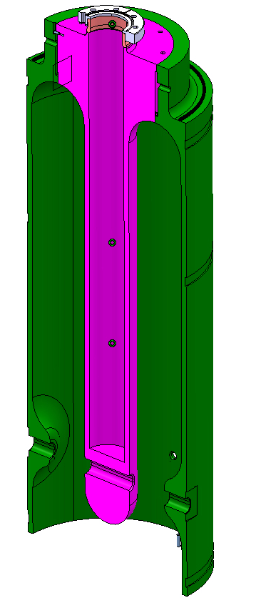
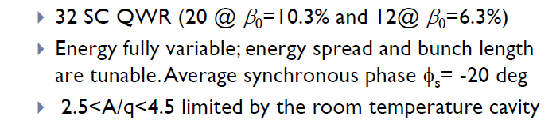
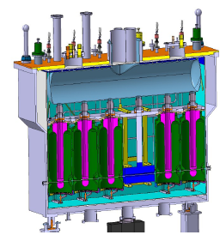
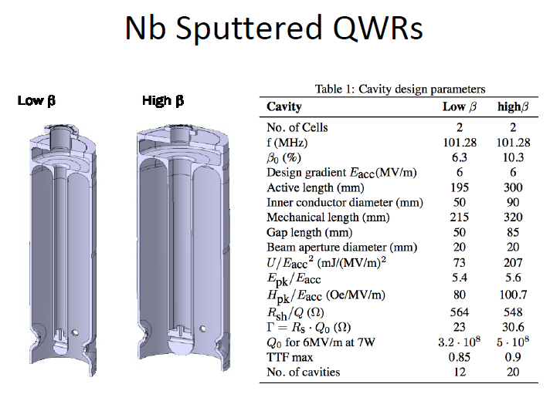
HIE-ISOLDE SC linac
Courtesy HIE-ISOLDE Linac working group
Cryostat with 5 high-β
cavities and 1 SC solenoid
Nb sputtered QWR
High-β cavity
Courtesy HIE-ISOLDE Linac working group

Slide 10
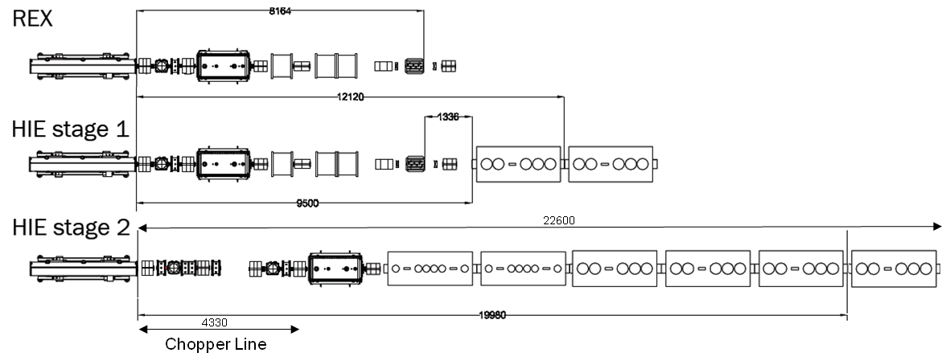
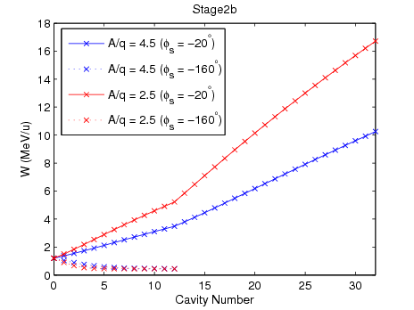
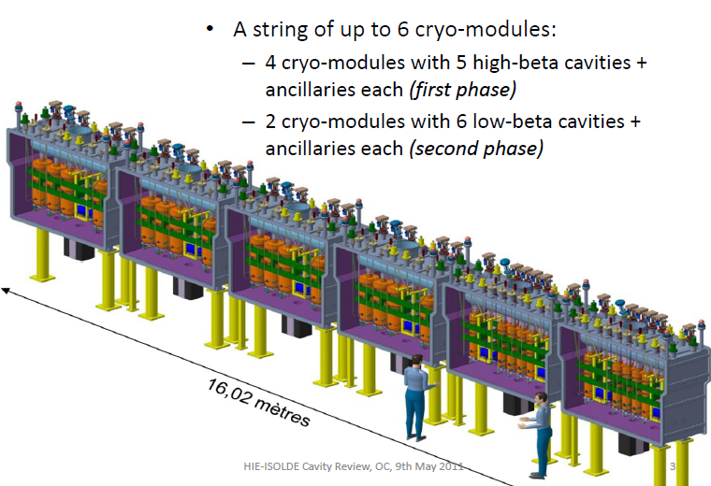
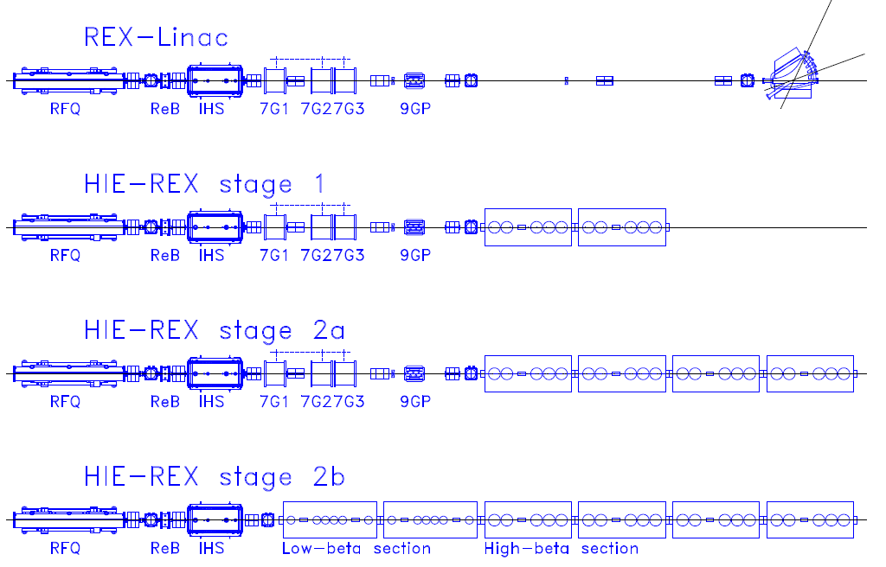
HIE-ISOLDE Linac installation and performance
Present situation 3 MeV/u
Y2014 5.5 MeV/u
High- β section
Low-β section
High- β section
Y2017 10 MeV/u
Courtesy HIE-ISOLDE Linac working group
 | Energy spread (%) |  | Norm. trans. emittance (mm mrad)
 | rms | 95 % | 90%
Stage 1: | ±0.25 | ±0.60 | 0.47
Stage 2: | ±0.14 | ±0.34 | 0.47
Courtesy M. Fraser
Transverse emittance
Simulated using what programme?
Notes:
In addition new beam transfer lines to the experimental stations
Linac beam energy and emittances
* The HIE-ISOLDE linac energy: fully variable between 1.2 and 10 MeV/u for A/q ≤ 4.5.
* Higher energies to be attained for lower A/q, e.g. ions with A/q = 3 will be accelerated to over 14 MeV/u.
* Deceleration down to about 0.45 MeV/u can be performed although with a reduced beam quality
* Expected longitudinal beam parameters at the SC linac output.
* The expected transverse emittance at the output of the SC linac is 0.47 mm.mrad normalised emittance => 3.5 mm mrad geometrical emittance at 10 MeV/u

Slide 11
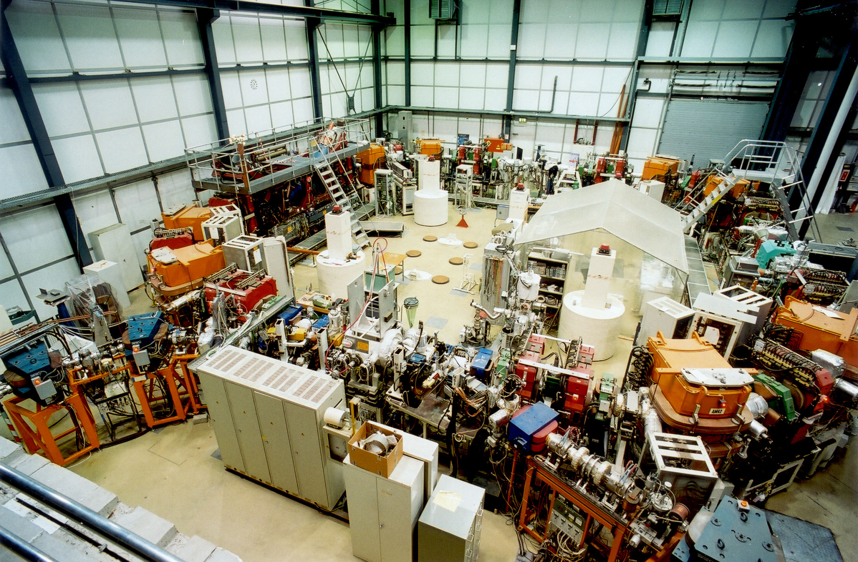
The heavy ion storage ring at Heidelberg
target
* In operation since 1988
* Mainly for atomic physics studies and accelerator development
* One nuclear physics experiment – FILTEX
(internal polarized
H₂ gas target)
ECOOL
resonator
extraction
injection
http://www.mpi-hd.mpg.de/blaum/storage-rings/tsr/index.en.html
Notes:
* Post accelerator uses 7-gap cavities similar to REX-ISOLDE’s

Slide 12
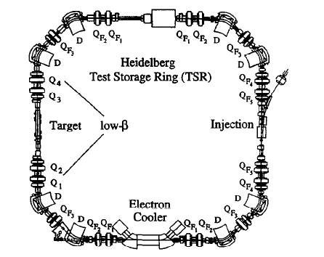
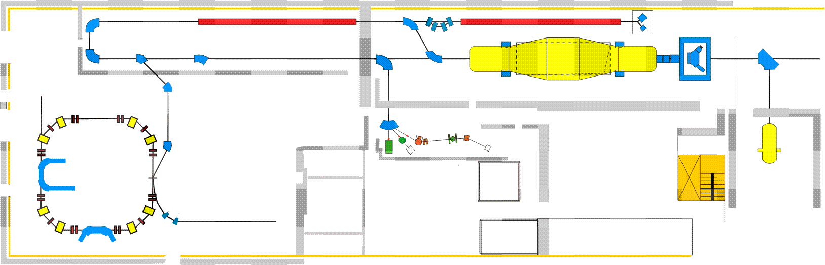
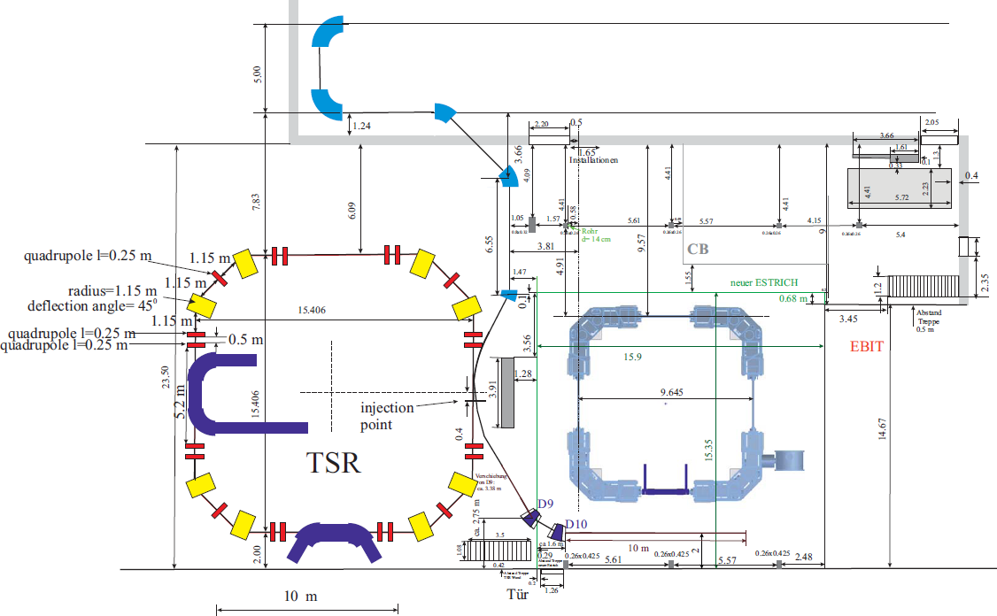
TSR data
Circumference: 55.42 m
Vacuum: ~few 1E-11 mbar
Acceptance: 100 mm mrad
Multiturn injection: mA current
Electron cooler: transverse T_{cool} in order of 1 s
RF acceleration and deceleration possible
Typical energy ¹²C⁶⁺: 6 MeV/u
Lattice
* 8 dipole magnets, B_{max}=1.3 T
* 20 quadrupoles in 5 families
* 4 low-β quad
Courtesy M . Grieser
* Presently coupled to 12 MV MP-tandem,
high current injector and post accelerator
Ring works in an achromatic mode?
Notes:
Acceptance ellipse of the TSR: 120 mm mrad => well suited for REX-ISOLDE
Multiturn injection => mA of stored beam possible
Bumper magnets
displace the closed orbit (40 mm) at the electrostatic septum
Principle working point close to Q_{x}=2.75, Q_{y}=2.825
Dispersion free regions at cooler and RF cavity
Broad rigidity acceptance -> permit operation with simultaneous charge states of ions
Multiple charge states, e.g. iodine 45+ to 49+, equivalent to a momentum range of delta_p/p=+-4%

Slide 13
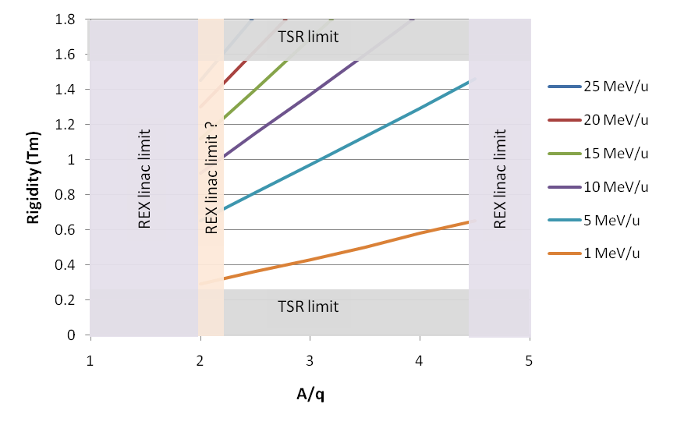
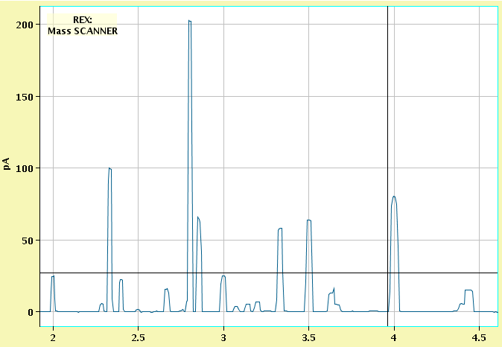
Beam energy range
Storage
energy
Magnetic rigidity range of
TSR between 0.25-1.57 Tm
REX Linac 2(?)<A/q<4.5
A/q-scan for residual gases from REXEBIS
REX & HIE-ISOLDE Linac limitations
1. Worse beam quality close to A/q=2 due to
sensitivity to RF jitter and beam steering
2. Have to find a contamination free A/q
A/q
Residual gas from EBIS (C,N,O,Ar)
and buffer gas (Ne) from trap
Notes:
Up to ~30 MeV/u for A/q=2, corresponding to magnetic rigidity B*rho=1.5 Tm
M. Fraser always simulated the range (as we understood) of A/q accepted by REX from 2.5 to 4.5. To shift from 2.5 to 2 is no big deal. We use all the voltage in the SC cavities, don't scale, and adjust the phasing. The only real comment is that the beam quality will be worse compared to beams with A/q = 4.5 as they are more sensitive to rf jitter and to the beam steering, however this will not be a serious problem.
Would you say that multipackting (in the buncher for example) can become an issue if we run with A/q-values close to 2?
I don’t think so. I think the main problem is to have enough voltage on the pick-up for the amplitude and phase regulation to work. We have seen multipacting on the IHS in the past but it seems to go away with time/conditioning.

Slide 14
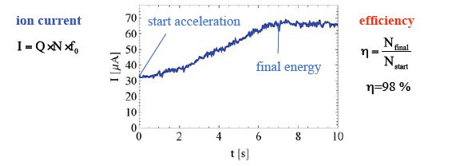
Beam acceleration…
Ion current during acceleration of ¹²C⁶⁺ ions from 6.11 to 30.2 MeV/u
M . Grieser et al.,
HIAT 09 Proceedings,
Venice, June 2009
+ Not limited to 10 MeV/u from HIE-ISOLDE
- But:
Long ramping time (magnet PS restriction)
excludes short-lived ions
not fully compatible with REX repetition rate
Pre-cooling with e-cooler to obtain good efficiency
Notes:
…and deceleration
¹²C⁶⁺ from 6.11 to 0.8 MeV/u
Any need? HIE-ISOLDE
provides down to 1.2 MeV/u
Procedure:
multi-turn injection => e-cool beam => accelerate
=> target on + physics => ramp down
Similar long cycle time for deceleration, lower η

Slide 15
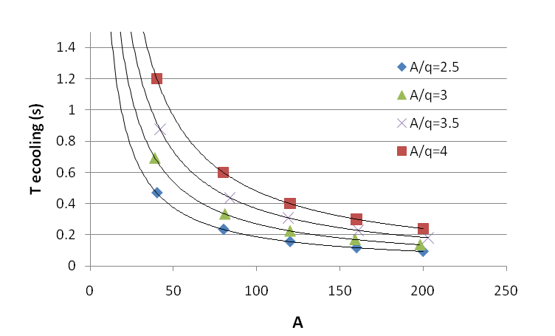
Electron cooling
e-cooling essential for three reasons
1. Beam quality
Smaller beam profile -> improved kinematics correction
Reduced σ_{p}/p spread -> better exp. energy resolution
(from 7E-4 to high E-5 at 10 MeV/u)
2. Multiturn e-cool stacking
3. Compensate for
ion Coulomb multiscattering
energy losses in target
e-cooler
ecooler
T_{cool} – horizontal cooling time for beam with
large diameter
T_{cool} independent of ion velocity (0.03<β<0.16)
and electron density. For α≈10 => k₁≈3 s
Essential for experiments
emittance growth
particle losses
Notes:
Tcool important for lifetime of beam and for multiturn stacking
Calculated cooling times for different A/q
Particles having small betatron amplitudes are cooled faster -> peaked profile
The beam’s equilibrium emittance and momentum distribution after cooling will be limited by intrabeam scattering and the interaction in an internal target.
For short-lived ions skip e-cooling and just inject one bunch after the other
If the storage half life is shorter than the cooling time, do the same
Coasting beam – e-cooler compensates for losses in target

Slide 16
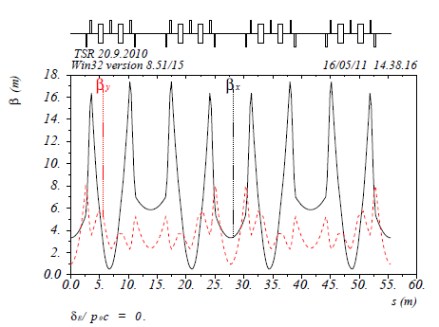
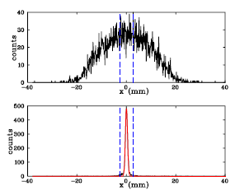
Calculated β functions for main operation mode
Beam dimensions
Profile of multiturn injected and cooled ¹²C⁶⁺ beam taken at β_{x}=4 m
M. Grieser
RF
system
Beam profiler
Injection
septum
e-cooler
Target
station
exchange
Beam dimensions:
Courtesy M. Grieser
x_{max}=18 mm
y_{max}~ 6 mm
non-cooled
multiturn injection
Experimental
beam size
x_{max}< 1 mm
y_{max}< 1 mm
e-cooled
Notes:
After multi-turn injection an beam having a horizontal width of approximately 4 cm (compare fig. 6) at the position of the beam profile monitor is obtained.
Exchange positions of RF and target area
Non-cooled y-emittance (depending on injected beam)
Measured where? Measured for 20 uA. Beam intensity dependent?
small Δp/p and D_{x}
TSR shows typcial equilibrium emittances of emitt_x~emitt_y<0.5 mm mradat intensities of a few uA starting with uncooled beams of 120 mm mrad

Slide 17
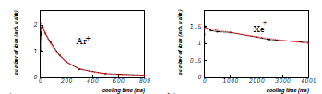
REX repetition rate vs e-cooling rate
Hot from the lab
EBIS breeding time
T_{breed} < T_{ecool} in many cases
²³Na⁷⁺
Keep them in 1. REXEBIS or 2. REXTRAP
q⁺ dependent
A
Holding time in REXTRAP?
* ⁶⁰Ni⁺ and ⁸⁷Rb⁺ kept for at least 1.5 s
* Noble gas ions - charge exchange
P. Delahaye et al., Nucl Phys A746 (2004) 604
Worries
- REXTRAP space-charge effects (ω_{c} changes; efficiency decreases)
- Short-lived ions
? Speed up e-cooling ?
Discuss REX low energy efficiency for varying holding times
Long cooling times => long collection times => space charge effects in REXTRAP
include high beam study of 23Na
mention change in cyclotron frequency
What current would one be limited to? Trap limited to 1E8 ions/bunch, thus with 2 Hz around 30 pA injected beam
Notes:
REXTRAP space-charge effects (ω_{c} changes; efficiency decreases) if collection time is long
Light ions –heated?
Mention problems with He and Ne
See a problem for e-cooler injection of most ions from REX as rep rate > 5Hz.
Improve ebeam cooler, ignore that losses occur due to incomplete cooling?
Speed up the e-cooling?
increase perveance of electron gun
use post-deceleration of e-beam energy
inject smaller beams (short beam pulse)
Long trapping time important for:
Acceleration
Cooling before physics
Ecool stacking
Should separate storing in trap from breeding in breeder
Functionality of REX low energy
trapping time in REXTRAP > than breeding time in REXEBIS
Can be avoided by cw injection into REXEBIS
If ecooling stacking is to be used, good to have REXTRAP before the
breeder as the trapping time is long.
What is the loss rate inside REXTRAP for long trapping times?
* Very poor for noble gases.
* Light elements?
* Condensable elements (check next week, check also Ar today)
Alternative 2 - keep them inside the EBIS
end up with high charge state
light ions will be lost, works as evaporative coolant for heavier residual gas ions
doesn’t help for noble gases as ions first spend equal amount of time in REXTRAP
Alternative 3 – cw injection into the EBIS
no trapping in REXTRAP, only long in EBIS
3.1. Non noble gases
For normalization, measurements with non-noble-gas ions for which the charge exchange
process can be neglected during the cooling time scale of REXTRAP have been realized.
K+ ions were produced using a surface ionization source.
When the cyclotron excitation was applied, it has been observed that K+ ions could be
stored for several seconds without any significant loss. If it was not applied, a decrease
of the number of ions with time was expected because of the spatial expansion of the ion
cloud caused by the magnetron motion increase and Coulomb repulsion. This decrease
was effectively seen and could be fitted by an exponential law of time constant 250 ms.

Slide 18
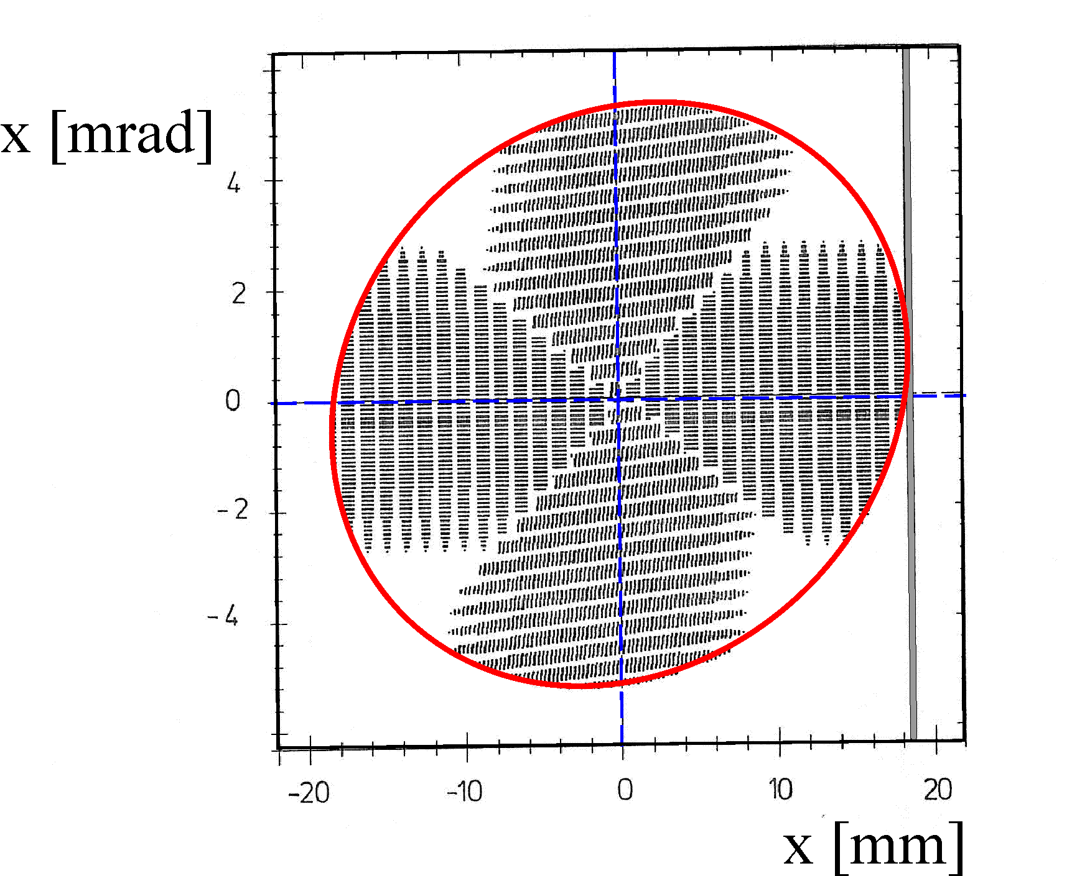
Multiturn injection at TSR
septum thickness
phase space injector beam (tandem)
ε=1.5 mm mrad at ~6 MeV/u
TSR acceptance ellipse
Courtesy M. Grieser
Completely filled transverse phase space
after multiturn injection (simulation)
M = multiplication factor
I_{m} = multiturn current
I_{inj} = injector current
ε_{inj_geo_x} hor. injector emittance
d_{dilution} phase space dilution factor ≈ 1.5-2
A_{TSR_geo_x} ≈ 3⋅A_{TSR_geo_y} ≈ 100 mm mrad
(TSR geometrical acceptances)
Heidelberg values
T_{injection} 100 to 200 µs => circa hundred turns
Notes:
Fill transverse horizontal acceptance of the storage ring with ions.
Injection time typically 100 to 200 µs corresponding to a hundred turns
Four magnets, called bumper magnets (BM41, BM42,BM11 ,BM12), properly placed along the ring perimeter, two before and two after the injection point, create a bump of the closed orbit
Since the horizontal tune in this simulation is chosen to be close to 2.75, the small ellipse of the injected particles is 90± in advance, in the phase space with respect to the particles injected in the following turn.
Machine arrangement
* 2 magnetic septa and 1 electrostatic septum
* 4 bumper magnets to move closed orbit
* Q_{x}=2.75, 90° phase advance

Slide 19
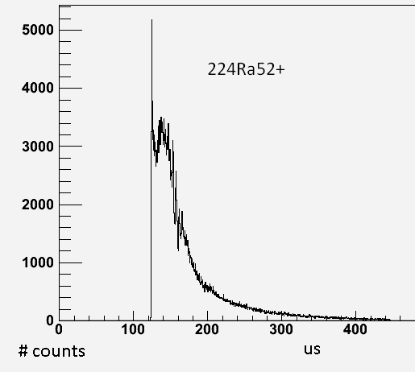
Multiturn injection at HIE-ISOLDE…
NB! High injection efficiency of outmost importance – exotic ions
=> Adapt EBIS T_{extraction} to fit beam pulse into transverse acceptance
N_{turn} - number of multiturns
v_{injection} - injection velocity
C_{TSR} = 55.42 m
c = 3E8 m/s
ε_{REX_norm_x} = 0.5 mm mrad
<I_{REX}> = averaged REX current
γ ≈ 1
=> T_{extraction} ≈ 37 us from REXEBIS
EBIS extraction pulse
…with e-cool stacking
FWHM 50 us
adjustable
I_{0_TSR} – equlibrium current with e-cool stacking
Can we reach T_{extraction} <10 us?
=> More efficient injection
=> Smaller beam size
=> Faster cooling
I_{inj} concept adapted for injector with fixed injector current
I_{inj}=<I_{REX}>T_{breed}/T_{extraction}
T_{breed} variable, T_{extraction} locked by injection conditions
* T_{ramp} bumper magnets (max 5 Hz)
* T_{cool} in e-cooler or T_{breed} in EBIS
=> From a single multiturn injection
Notes:
n_{r} - loading rate
M. Grieser has a different way of calculating the extraction time
??Ramping time of bumper magnets??
What is the injection efficiency?
TSR at Heidelberg optimized for injection of constant current over at least 200 us
(tandem emittance 1.5 mm mrad at ?? MeV/u)

Slide 20
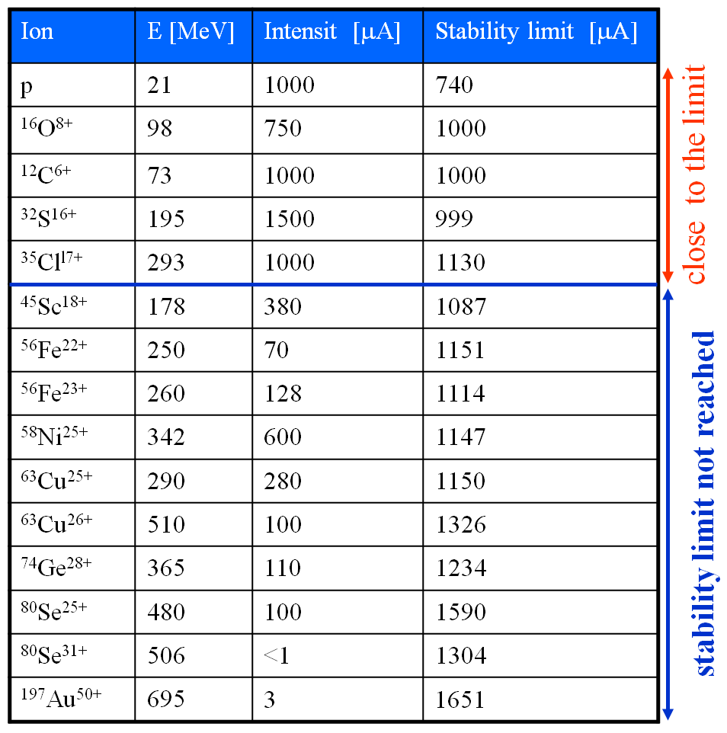
Maximum beam intensities
Space charge limit in TSR
Incoherent space-charge tune shift
Transverse instabilities
intensity limit:
E (MeV), I (uA), const=279
calculated from the ¹²C⁶⁺ data
const valid for e-cooled beams
So far highest REX beam:
3E7 ions/s ¹¹⁰Sn²⁷⁺ => <I_{REX}>= 130 epA
Exp. Theory
for 10 MeV/u, ε_{m}=0.8,
d_{dilution}=2, T_{lifetime}=5 s
=>
I_{0_TSR}(¹¹⁰Sn²⁷⁺)≈ 200 uA
below the incoherent
tune shift limit of ~1 mA
Intensities obtained in TSR
M. Grieser
presentation
Notes:
Transverse instabilities – prediction

Slide 21
Internal gas target
Miniball target thickness 0.1 to 4 mg/cm² -> N_{MB_target} ~ 1E19 atoms/cm²
(³H-loaded Ti, CD₂, Sn, Pd, Ag etc)
To reach the same reaction rate at TSR:
Assume:
T_{lifetime}=1 s d_{dilution}≈2 ε_{m}=0.8 => N_{TSR_target} = 3E13 atoms/cm²
v_{projectile}=0.14⋅c (10 MeV/u)
Integrated residual gas thickness much smaller
(55.42 m, 5E-11 mbar) => 6.7E9 atoms/cm²
* Target types: H₂ or ^{3,4}He (or even Ar, Xe?)
* To address:
Interaction length - ideally 1 mm
Pressure around target?
Notes:
Miniball TSR
e.g. C_{x}H_{y} Pure gas
Advantage: target purity
Orifice size of the differential pumping?
Sufficient He target thickness?

Slide 22
Lifetime discussion
1/e-lifetime
Storage lifetime depends on:
1. multiple (ms) and single (ss) Coulomb scattering in target & residual gas
2. electron stripping (st) and capture (cap) in target & residual gas
3. radiative recombination (RR) and dielectronic capture (DC) in e-cooler
ok
ok
?
?
ok
ok?
Storage times recorded at TSR
p @ 21 MeV: 60 h
⁹Be⁺ @ 0.8 MeV/u: 16 s
¹²C⁶⁺ @ 6.1 MeV/u: 7470 s
³⁵Cl¹⁷⁺ @ 5.8 MeV/u: 318 s
¹⁹⁷Au⁵¹⁺ @ 3.6 MeV/u: 23 s
NB! No internal target
Method to calculate stripping and capture:
electron capture: Nicolaev or Schlachter
electron stripping: Franzke or Dmitriev
Nicolaev and Dmitriev most conservative
Claims I47+ at 8 MeV/u has an expected 1/e-lifetime as short as 100 s even at 1E-11 Torr.
Claim further that charge exchange processes scale as Z^4/E^5
Notes:
The ions circulating in the storage ring will interact with the residual gas atoms and molecules and with the internal gas jet target if present. Due to electron capture and stripping processes the ions will attain an equilibrium charge state in gas, which can be calculated using Schiwietz and Grande [8]. Table 2 lists the charge states for different ions and for 5 and 10 MeV/u. The influence of the gas composition is negligible. The equilibrium charge state in a gas and a foil are similar as seen in the section below.

Slide 23
Coulomb scattering losses
e-cooler losses
1. Radiative recombination with electrons in electron cooler
* τ_{ms} and τ_{ss} : e⁻¹ time for losses due to
multiple and single scattering
* τ_{ss} >> τ_{ms}
* ms avoided by e-cooling
* ms and ss lifetime for residual gas a
factor 100 longer
2. Dielectronic recombination
* >50 times higher σ than RR for certain complex HCI
* Generally factor 1.5-5 higher than RR
for electron-ion energies <10 meV
A. Wolf et al, Nucl Instr Meth A441 (2000) 183-190
Conclusions: τ_{ss}, τ_{ms}, τ_{RR} , τ_{DC} > 10 s in most cases
Notes:
Z_res=6.5 based on fitting with TSR calculation – non-baked system?
T(multiple scattering)~beta^3*(A/Z)^2/Zgas^2

Slide 24
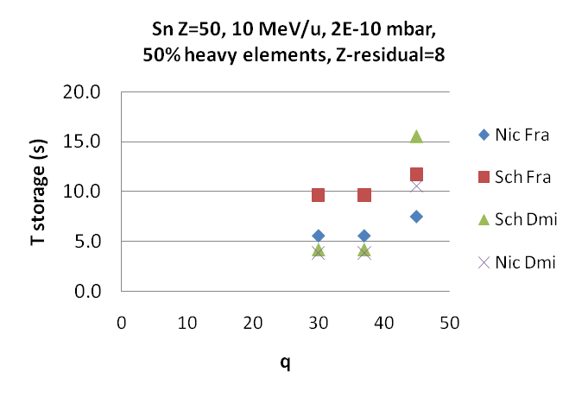
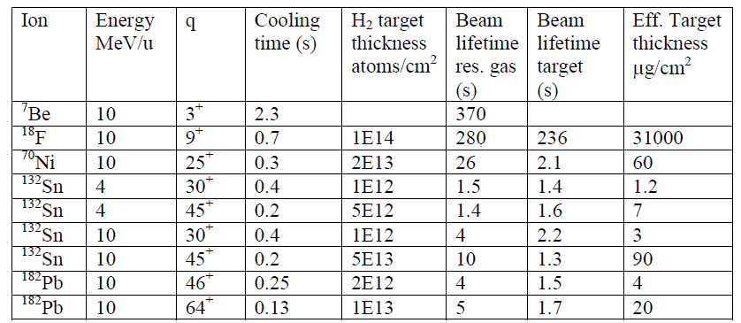
Capture and stripping processes
Worst case
– high pressure and heavy gases
Residual gas
Selection of beams for TSR
Conclusions:
1. avoid too low q
2. He target ->
shorter T_{storage}
3. reduce H₂
target thickness
4. There’s hope:
⁹⁶Rh – 40 s
Internal target
Shorter lifetimes for He targets
Residual gas 2E-10 mbar; Nicolaev & Dmitriev; summary P. Butler, Miniball ref 100 ug/cm²
Sn | H target 1E14 /cm2
 | 10 MeV/u
 | storage time (s)
q | Nic Fra | Sch Fra | Sch Dmi | Nic Dmi
30 | 4.4 | 4.6 | 0.02 | 0.02
37 | 5.5 | 5.6 | 0.1 | 0.1
45 | 6 | 5.1 | 0.6 | 0.6
50 | 7.6 | 5 | 5 | 7.6
U | H target 1E14 /cm2
 | 10 MeV/u
 | storage time (s)
q | Nic Fra | Sch Fra | Sch Dmi | Nic Dmi
28 | 0.7 | 0.3 | 0.007 | 0.007
65 | 2.5 | 0.9 | 0.1 | 0.1
89 | 2.1 | 0.5 | 0.5 | 1.9
One slide with lifetimes for different charge states
fully stripped and equilibrium
H2 vs He targets
Experimental data from TSR

Slide 25
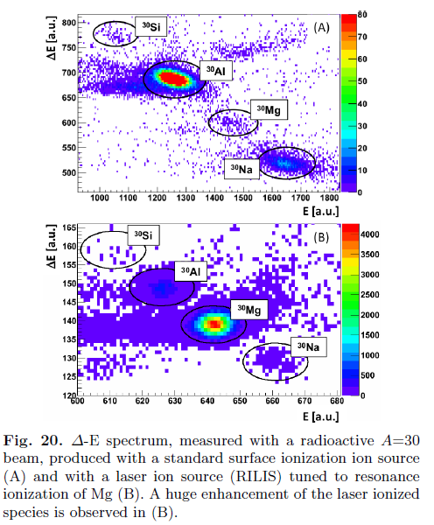
Beam contamination at ISOLDE
a. Isobaric contamination from the ISOLDE
proton target
b. A/q-contamination from EBIS
A/q
* To resolve isobars => ~10000 < m/Δm < ~100000
* To resolve A/q => ~1000 < m/Δm
Miniball reference: ‘The Miniball at REX-ISOLDE’,
J. Van de Walle., EPJ to be published
Can we use TSR to clean beams?
Notes:
* Number of ISOLDE/REX tricks to clean the beam
Not always sufficient
Target chemistry
cold line -> suppress condensable elements
quartz line -> suppress alkalis
Resonant Ionization Laser Ion Source (RILIS)
Surface ionization
Molecular sideband beams, e.g. SrF⁺
Mass separation in REXTRAP (Penning tap)

Slide 26
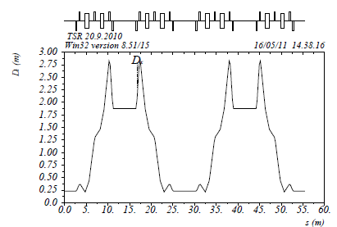
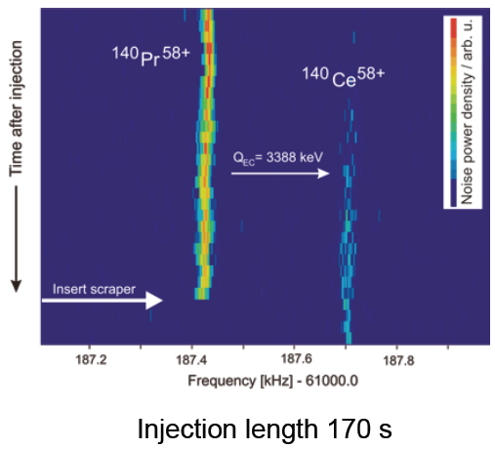
Beam cleaning at TSR
1. Collimator scraping using the ring dispersion
Δx – horizontal displacement
D_{x} – dispersion function
Δm – mass deviation
Δv – velocity deviation
Δq – charge deviation
* e-cooled beam -> beam size ~1 mm
=> m/Δm ~ 3000
Similar to High Resolution Separator at ISOLDE
* Increase D_{x} to 10 or 20 m -> TSR operation very difficult
* Cycle time - few seconds
(inject, e-cool, move in scrapers, physics)
TSR dispersion function D_{x}
for normal operation mode
2. Dielectronic recombination in the electron cooler
NB: method 1 sufficient to suppress EBIS A/q-contaminations
Cross-sections too small -> slow process
Levels known for different elements and charges?
Dispersion function 3 m, m/delta_m=50000
Delta_x=1/50000*3=0.06 mm (too small)
Notes:
For non-cooled beam -> no resolution at all
Sufficient resolution to remove contaminations from the EBIS as low requirement for A/q-resolution
Setup the ring with a larger dispersion and use scarping to remove undesired isotopes?
Multi turn injection is used to fill the ring with particles. This injection process leads to a large emittance of the stored ion beam.
To separate different masses first the emittance of the beam has to be reduced by electron cooling. After electron cooling the typically horizontal beam width is about 1 mm. At this method also electron cooling is required, witch need time and not suitable for short life isotopes. In principle the dispersion of the TSR can be increased to 10 m. In that mode the TSR is very difficult to operate. Also it takes time to move the scraper into the storage ring for mass separation. For multi turn injection the scrapers has to be outside the acceptance of the storage ring.
Multi turn injection is used to fill the ring with particles. This injection process leads to a large emittance of the stored ion beam.
To separate different masses first the emittance of the beam has to be reduced by electron cooling. After electron cooling the typically horizontal beam width is about 1 mm. At this method also electron cooling is required, witch need time and not suitable for short life isotopes. In principle the dispersion of the TSR can be increased to 10 m. In that mode the TSR is very difficult to operate. Also it takes time to move the scraper into the storage ring for mass separation. For multi turn injection the scrapers has to be outside the acceptance of the storage ring.
Beam size at ESR um => higher resolution

Slide 27
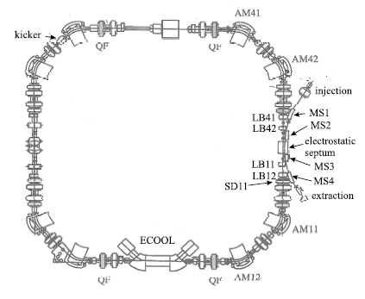
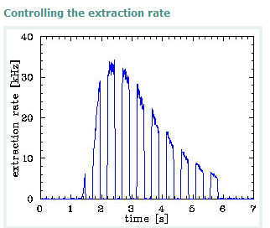
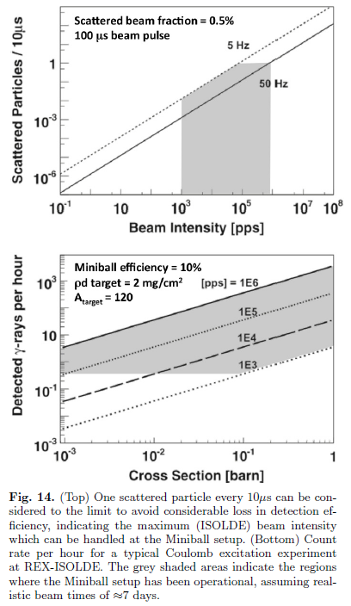
Slow beam extraction
Normal procedure for ¹²C⁶⁺
Inject at Q_{x}=2.64
e-cool for 1 s
Shift Q_{x} close to resonance 8/3
Apply 30 kHz noise on injection septum
Emittance increase -> beam extraction
Extracted
beam
Extraction efficiency
85±5% for pre-cooling
27±2% without e-cooling
(A_{y} limit in extraction line)
Noise on
Noise off
Modification of procedure to TSR@ISOLDE
No e-cooling
Quick excitation
Emptying before next loading
Courtesy M. Grieser
Charge = momentum acceptance
4.4 Rate limitations
The continuous beam, released from the primary target
(see Fig. 9(B)) is bunched into few EBIS pulses, as described
in paragraph 4.1. The beam intensity per EBIS
pulse is thus much higher than the beam intensity per second
from the primary target. If, for example, 104 ions/s
are extracted from the ion source at ISOLDE and the
EBIS and REXTRAP operate at 10 Hz (breeding and
cooling times of 100 ms), 103 particles are injected into
the linac with each EBIS pulse. The particles arrive at
the setup within 100 us ("standard" extraction). This is
equivalent to 107 ions/s if this were a continuous beam.
A limit on the incoming beam intensity is imposed by the
dead time in the particle detector electronics. This dead
time amounts up to 10 s for the CAEN ADC's and 2 s
for the MADC's. Fig. 14 shows the maximum (continuous)
beam intensities from the primary target which can be
handled without considerable loss in detection eciency
at Miniball. In this gure, typical REXTRAP and EBIS
repetition rates for heavy and light ion beams are used of
5 and 50 Hz, respectively. Furthermore, it is assumed that
a typical fraction of 0.5% of the incident beam is scattered
in the particle detectors. Fig. 14 summarizes the achievable
statistics per hour as a function of the cross section.
Notes:
Why would we need this?
Beam size / emittance (hor and ver) if no cooling
Can we use this with constantly injected beam?
The extraction efficiency is the ratio between number of
extracted particle to the stored ion number reduction. A efficiency of 85%
was measured [24] if electron pre-cooling is used before extraction takes place.
Without electron pre-cooling the extraction efficiency is reduced to 27% [24],
because without electron cooling the vertical width of the stored ion beam is
much larger than the vertical acceptance of the extraction channel, resulting in
ion collisions with the extraction vacuum chambers.
e-cool off during extraction
SD11 is utilized to excite the 3rd order resonance Q_{x}=8/3
The extraction rate can be set up
(a) by the noise level given to the horizontal kicker
(b) by the distance of the tune to the third order resonance 2.66666
If the momentum spread of the stored ion beam is small than the
extracted ion beam has approximately the same emittance as an electron cooled ion beam.

Slide 28
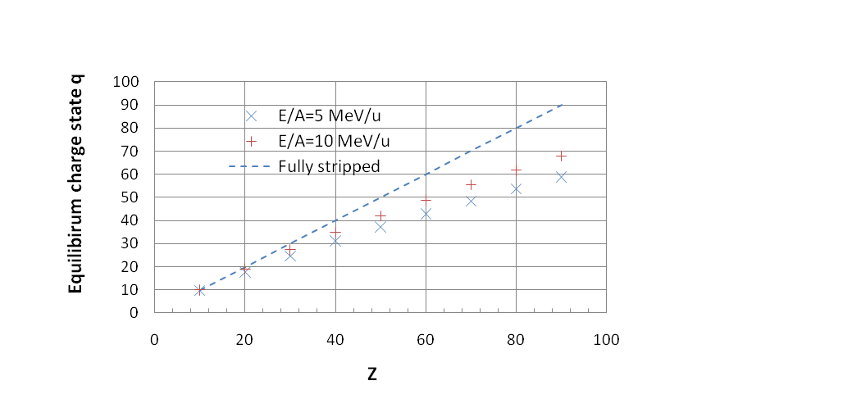
Upgraded breeder performance
Some experiments might require:
* Fully stripped to Z=60 (REXEBIS goes to Z=19)
* Few-electron system, e.g. for Th/U (REXEBIS reaches 56+)
* SuperEBIT at LLNL - up to U⁹⁰+
* Heidelberg EBIT
Stripper foil after the linac (at 10 MeV/u) an option?
 | Superbreeder | REXEBIS
Electron current | >5 A | 0.3 A
Electron current density | >50 kA/cm2 | 150 A/cm2
Electron beam energy | >100 keV | <5 keV
Solenoid field | >6 T | 2 T
Full-field trap length | >50 cm | 80 cm
Trap region pressure | <1E-13 mbar | 1E-11 mbar
Main design parameters for an upgraded EBIS/T charge breeder aimed to produce very highly charged ions
G. Schiwietz and P. L. Grande, Nucl. Instrum. Meth B175 (2001) 125
Big challenge to produce a few stable ions with this charge state.
Doing it as an efficient charge breeding is one step further!
REXEBIS upgrade required to cover all suggested physics cases
(as it stands now)

Slide 29
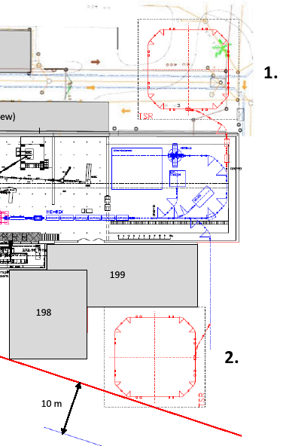
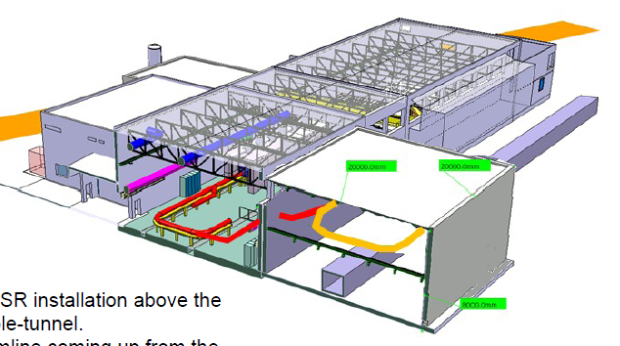
TSR location at ISOLDE
- On top of CERN service tunnel
- Close to road behind
- Beam level 2.8 m up from HIE-ISOLDE
2. - Cryo coldbox and compressor building
- 10 m distance limit to border
+ Excavate a basement for power supplies
F-CH border
Evaluation by
M. Fraser, D. Voulot, E. Siesling
Courtesy E. Siesling
Notes:
Possible TSR installation above the CERN cable-tunnel
Will also verify the level (2.8m) and the possible ways of access and spacing for the power-supplies left and right of the service tunnel and get back to you asap
B198 – compressor building
B199 – box cryo building
Questions marks: Weight of >140 tons a problem?

Slide 30
Summary
* Soon 5 to 10 MeV/u RIBs from HIE-ISOLDE
* TSR and HIE-ISOLDE would be a nice couple, with:
broad range of elements and isotopes
wide energy range
e-cooled beams
several tools for beam manipulation and detection
…and plenty of opportunities for new physics!
* So far it looks technically feasible

Slide 31
Thanks for...
1. Information and pictures taken from among others…
M. Grieser (TSR)
M. Pasini and M. Fraser (HIE-ISOLDE linac)
P. Butler (beam storage times)
D. Voulot (REX linac + interfacing)
2. Discussions with members in the
TSR@ ISOLDE working group
3. Your attention!

Slide 32
Complementary slides

Slide 33
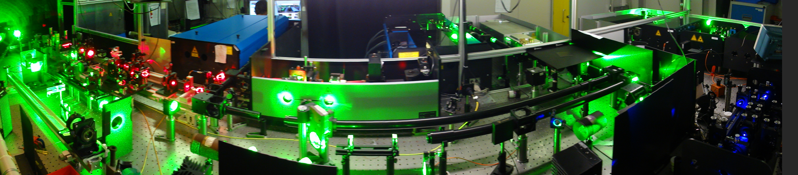
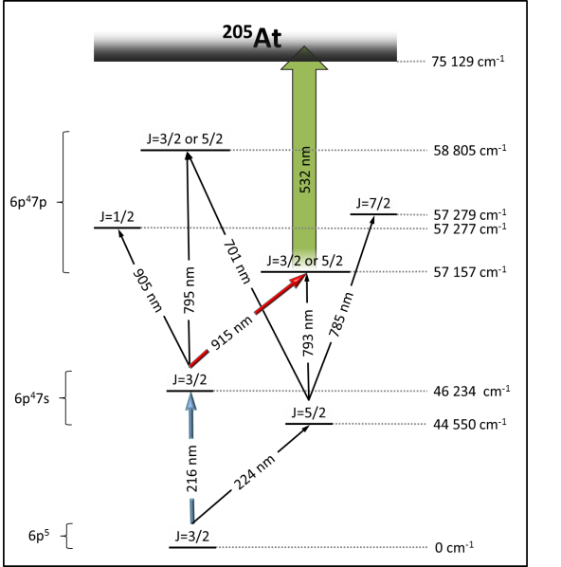
ISOLDE’s ion source flagship
Ionization in either
* Surface ionizing sources for
alkaline and alkaline earth metals
* Various plasma sources
(FEBIAD, ECRIS, helicon)
* Resonant laser ion source (RILIS)
Notes:
Ion beams of 31 elements are produced at ISOLDE with RILIS
Laser generates 3 beams at 10 kHz:
Main green beam – 532nm, 70-80 W, 8 ns
Residual green beam – 532 nm, 12-28 W, 9 ns
UV beam - 355 nm, 18-20 W, 11 ns
Copper Vapor Lasers are replaced by Diode Pumped Solid State Nd:YAG Lasers
The Resonance Ionization Laser Ion Source (RILIS) is the most selective ion source at ISOLDE, since it relies on the resonant ionization of one specific element by means of three laser frequencies.
Resonant laser ionization is an element selective process whereby atoms are irradiated by two or three lasers exciting the electron in two or three resonant steps to the continuum. This allows the production of very pure beams as only atoms of the element of interest are ionized.

Slide 34

REX temporal properties
FWHM 50 us
Miniball reference: ‘The Miniball at REX-ISOLDE’,
J. Van de Walle., EPJ to be published
Notes:
Discuss fast extraction and CW beams
Show trapping tube schematics

Slide 35



by 2017

Slide 36

Vacuum system
Attainable pressure 5E-11 mbar
Residual gas composition
After a bakeout to 250 °C
93% hydrogen
2% carbon,
1% nitrogen
6% oxygen and
0.3% argon
Integrated number of particles
around the ring (for 5E-11 mbar)
=> ~7E9 cm⁻²
Improve the vacuum?
* NEG coat all vacuum tubes?
* CERN NEG expertise
* Design goal was 1E-12 mbar region
Vacuum in few E-11 mbar or better important for beam storage around 10 MeV/u
Pump down: pumping station
Steady state: getter, sublimation, NEG pumps
Notes:
Pumping stations to pump down to 1E-5 mbar
Ring baked-out to 300 °C
Ring pumped by 30 ion getter pumps (each 60 l/s)
40 titan sublimation pumps
In electron cooler 2x400 l/s ion getter pumps and 34 NEG ST 707 modules (15000 l/s)

Slide 37

Detector systems
* 8 BPMs (vertical and horizontal positions)
* Residual-gas ionization beam profile monitors. Spatial resolution +-0.3 mm
transverse beam temperature
* Current transformer for DC and bunched beam
DC resolution 1 uA, bunched beam 10 nA
* Schottky pick-up for measuring the f_{rev} and Δp/p of a stored ion beam
* High-Q resonantor to be designed for single ion detection
MCP
Notes:
Residual gas monitor
study transverse cooling and heating mechanisms
observe ion beam behavior during experiments
determine storage-ring parameters such as dispersion function
The rate of ions on the detector surface is given by:
(see formula)
where N is the number of stored ions, v the ion velocity, ρ the residual gas density (ρ ≈ 1E6 cm⁻³ at P = 5E-11 mbar), σ is the ionization cross section of the residual gas, L_{det} the length of the detector and C_{TSR} the storage ring circumference. A typically counting rate for 12C6+ ions with E=50 MeV at I=1 μA is R≈200 1/s (L_{det}=1.7 cm).

Slide 38

Laser cooling in TSR
Laser cooling used for:
1. Cooling the beam
2. Store ultracold precision target in the ring
J. Kleinert et al, Hyperfine Interactions 146/47, (20030 189-195
Method:
Light-pressure force in a near-resonance laser field
-> longitudinal ion motion cooling
-> coupling to transverse motion for transverse cooling
Results
1a. Very high phase-space densities are achieved by three dimensional laser cooling of a coasting ⁹Be⁺ beam at 7.3 MeV.
1b. Unprecedented low ion temperatures, Δp/p~1E-7
2. Laser-cooled, trapped Cs atoms are used as an ultracold precision target for the study of ion–atom interactions with a 74 MeV beam of ¹²C⁶⁺ ions.
* Stopped 10 years ago (at TSR energies limited number of ions Li+, Be+, Mg+)
Notes:
Apply advanced laser cooling techniques to stored ion beams. Very high phase-space densities are achieved by three dimensional laser cooling of a coasting 9Be+ beam at 7.3 MeV. Laser-cooled, trapped Cs atoms are used as an ultracold precision target for the study of ion–atom interactions with a 74 MeV beam of 12C6+ ions.
The longitudinal ion motion of fast stored ion beams can be cooled by the light-pressure force in a near-resonance laser field. The light force can be extended to the transverse motion by coupling the different degrees of freedom.
Unprecedented phase-space densities can be achieved by direct laser cooling of stored ion beams. On the other hand, laser-cooled atoms can be used as ultracold precision targets for the study of ion-atom interactions at MeV center-of-mass energies.
A target based on laser-cooled atoms confined in an optical trap can serve as a high-precision diagnostic tool for weak ion beams
Intrinsic resolution limit given by the minimum spatial extension of the atom cloud, <100 um
Only works for 1+ ions?
How quick is it?
We stopped laser cooling 10 years ago, because laser cooling can only be done for a very limited ion species. At TSR energies laser cooling is only possible by Li+,Be+, Mg+ ions. Laser cooling only can be done in the longitudinal degree of freedom. Indirectly with IBS or dispersive cooling techniques low transverse cooling rates of about 1~1/s could be achieved. For highly charge ions laser cooling is only possible at relativistic energies.
* Only possibly at relativistic energies for highly charged ions
* Low transverse cooling rate – how low?

Slide 39

TSR ultracold electron target
* TSR the only(?) heavy-ion storage ring equipped with two independent merged electron-ion facilities.
* Electron cooler normally operated in velocity-matched
mode -> ion beam is continuously phase-space cooled.
* The electron target can be detuned in velocity with respect to the ions. Used for electron-ion recombination experiments.
Taken from D. A. Orlov
Notes:
The photo cathode source provides an electron gas with an initial thermal energy spread of 10 meV.
The beam optics of the target section reduces the electron temperature to much lower values in the
Co-moving frame of the beam.
TSR the only heavy-ion storage ring equipped with two independent merged electron-ion facilities.
Electron cooler normally operated in velocity-matched mode, such that the stored ion beam is continuouslly
phase-space cooled. The electron target can be detuned in velocity with respect to the ions
Cryogenic photoelectron gun instead of thermocathode
Adiabatic magnetic expansion by field ratios alfa of typically 20 to 40 reduces the transverse kinetic energy spread
According to kboltz*Ttrans=kboltz*Tcath/alfa. Values of kboltz*Ttrans as low as 0.5 meV has been observed.
Subsequent adiabatic acceleration of the electron cloud kinematically reduces the longitudinal velocity spread in the co-moving frame of the beam
Guided by magnetic field 0.04 T
Compare electron beam values with electron cooler

Slide 40
Beam acceleration…
Ion current during acceleration of ¹²C⁶⁺ ions from 6.11 to 30.2 MeV/u
M . Grieser et al.,
HIAT 09 Proceedings,
Venice, June 2009
Restrictions:
* Pre-cooling with e-cooler to obtain good efficiency
* Long ramping time (magnet PS restriction)
excludes short-lived ions
not fully compatible with REX repetition rate
* Internal gas target switched on at full energy
Procedure:
multi-turn injection => e-cool beam => accelerate
=> target on + physics => ramp down
…and deceleration
¹²C⁶⁺ from 6.11 to 0.8 MeV/u
Similar long cycle time, lower η
Any need? HIE-ISOLDE
provides down to 1.2 MeV/u

Slide 41

Principle of multiturn injection
injected
beam
septum
cental orbit staring injection
central orbit one
revolution time later
bumper1
bumper2
bumper3
bumper4
horizontal
phase space
injector beam
Q_{x}=2.75
1. turn 2. turn
septum
thickness
central orbit
start injection
septum
3. turn 4. turn 5. turn
hole in the
transverse phase
space
Notes:
Time development of the transverse phase space during the first injections into the ring acceptance. Since the distance between the closed orbit increases, mot of the particles pass after four turns (Qx=2.75) on the inner side of the septum and are kept safely circulating.

Slide 42

The electron cooler
collector
interaction
soleonid
gun
electrons
electrons
ions
ions

Slide 43


Electron cooler
* The electron cooler delivers an intensive cold electron beam with densities up to 1.0E8 cm⁻³.
* Phase space compression of ion beams by electron cooling leads to ion beams with extreme small horizontal and vertical emittance of about 0.05 π mm mrad
* E-cooler increases the phase space density of the heavy ion beam by 4-6 orders of magnitude
ecooler
Normal expansion factor: 7 to 10?!
Five solenoidal and two toroidal coils
7 sets of correction coils
Pressure of <5E-11 mbar has to be reached;
high gas loads from gun and collector
Discuss e-cooling effect on emittance, what’s the final emittance?
Avoid beam losses for long storing times
* phase space cooling
    To avoid emittance growth of the beam due to Coulomb scattering of the ions by themselves
    To avoid emittance growth by the residual gas of by the internal target
    To battle large cross section for electron pickup and stripping
Otherwise limits the beam lifetime
Insufficient cooling => large beam diameter
large gas jet target
poor precision for Doppler corrections
1 A at 7-20 keV, corresponding to a beam rigidity of 1.1 Tm
0.3 to 30 MeV/u corresponds to electron energies between 0.16 and 16 keV
Electron beam diameter 40 mm?
Non-dispersive at RF acceleration and e-cooler
Ions experience a drag force when they pass through the electron gas due to the Coulomb interaction between the two particle species
Adiabatic invariant
The ion beam of a diameter of 1... 3 mm travels in the center of the dectron beam of 5.1 cm diameter over a nominal length of 1.5 m. A magnetic field of ~ 50 roT, collinear to the electron beam, prevents the electrons from diverging because of their space charge.
Electron cooling suited to higher energies (H. Danared) or to light fully stripped ions at low energies
Average electron longitudinal velocity <u> is equal to the average ion longitudinal velocity
Thermal equilibrium Ti=Te => deltav(ion)=sqrt(me/mi)*deltau(electron)
Can use the ebeam at different energies to cool beams with different velocity but same rigidit
Notes:
The rms velocity spreads of the ions in all degrees of freedom is reduced by Coulomb interaction and this process is called electron cooling.

Slide 44
Multi-turn injection at HIE-ISOLDE
NB! High injection efficiency of outmost importance – exotic ions
=> Adapt EBIS T_{extraction} to fit beam pulse into transverse acceptance
N_{turn} - number of multiturns
v_{injection} - injection velocity
C_{TSR} = 55.42 m
c = 3E8 m/s
ε_{REX_norm_x} = 0.5 mm mrad
<I_{REX}> = averaged REX current
γ ≈ 1
=> T_{extraction} ≈ 37 us from REXEBIS
EBIS extraction pulse
I_{inj} concept adapted for injector with fixed injector current
I_{inj}=<I_{REX}>T_{breed}/T_{extraction}
T_{breed} variable, T_{extraction} locked by injection conditions
FWHM 50 us
adjustable
=> From a single multiturn injection
Can we reach T_{extraction} <10 us?
=> More efficient injection
=> Smaller beam size
=> Faster cooling

Slide 45


e-cool stacking
Multiturn injection combined
with electron cooling
-> e-cool stacking
A_{TSR_ecool} = A_{TSR_geo_x}⋅η_{estack} < A_{TSR_geo_x}
since phase space for multiturn injection
smaller at e-cool stacking
Courtesy M. Grieser
=> shorter ~30 us
with multiturn
injection filled
phase space
I_{em} - effectively injected current with
multiturn injection: I_{em}≤ I_{m}
n_{r} – loading rate
ions left, just before the next multiturn injection
Notes:
Factor 0.8 from the definition of cooling time T_{cool}
In order to inject more particles, the already filled phase space must be emptied of particles, which can be accomplished by phase space compression by electron cooling. To avoid collision between the electron cooled ion beam and the septum foil the deflection angle of the bumper magnets has to be reduced compared to a normal multi-turn injection. Phase space needed for a new multi-turn injection is thus made available.

Slide 46

measured I(t) for ³⁵Cl¹⁷⁺ ions, TSR
e-cool stacking current
I_{em} – effectively injected current
with single multiturn injection
I₀ – equlibrium current with e-cool stacking
steady state solution
n_{r} - loading rate determined by
* T_{ramp} bumper magnets (max 5 Hz)
* T_{cool} in e-cooler or T_{breed} in EBIS
Notes:
5 Hz rate limit given by the power supplies of the bumper magnets

Slide 47

Maximum future beam intensities from HIE-ISOLDE
Challenging cases: Be, Kr, Cs and Fr
up to >1E9 ions/s delivered by HIE-ISOLDE Linac
(assuming an upgrade ISOLDE target station and REX of low-energy part)
Ion | Intensity [mA] | Stability limit [mA]
¹⁰Be⁴⁺ | 1 | 1.5
⁷⁸Kr³⁶⁺ | 9 | 1.3
¹³⁶Cs⁵⁵⁺ | 13 | 1.4
²²⁰Fr⁸⁷⁺ | 21 | 1.5
HIE-ISOLDE: the physics opportunities, CERN-2007-008
Worst case assumptions
1E9 ions/s from REXISOLDE
Fully stripped ions
T_{lifetime}=5 s
>10 mA for non-cooled beams
Notes:
Intensity limit scales with beam emittance
With optimized electron cooling, currents up to 2 mA can be stored stable, limited by the onset of transverse coherent instabilities. The highest intensity of 18 mA for a ¹²C⁶⁺ beam could only be accumulated by misaligning the electron beam with respect to the ion beam.

Slide 48
Target thickness
Miniball target thickness 0.1 to 4 mg/cm² -> N_{MB_target} ~ 1E19 atoms/cm²
(³H-loaded Ti, CD₂, Sn, Pd, Ag etc)
Reaction rate at Miniball: σ_{reaction}⋅N_{MB_target}⋅<I_{REX}>/(qe)
q - ion charge, <I_{REX}> - averaged REX current
Reaction rate at TSR:
To reach the same reaction rate at TSR:
Assume:
T_{lifetime}=1 s
d_{dilution}≈2 => N_{TSR_target}=3E13 atoms/cm²
v_{projectile}=0.14⋅c (10 MeV/u)
ε_{m}=0.8
N_{MB_target} =1E19 atoms/cm²
Integrated residual gas thickness much smaller
(55.42 m, 5E-11 mbar) => 6.7E9 atoms/cm²
Notes:
Luminosity = number of target atoms / cm2 x number of projectile passing through the target per second
Reaction rate = luminosity * differential cross section * detector efficiency * solid angle
Ekstrom says: 1E20 atoms/cm2 => 0.16 mg/cm2 – correct for hydrogen target
Residual gas thickness much thinner but <Z_{residual}> higher than for H₂ and He targets
Need target to be stable for several days
What about density changes in radial direction? Affect ‘angular’ cross-sections
In case of Coulomb excitation reactions, this is typically a thin foil of 2-4 mg/cm2 of a stable isotope.
In case of transfer reactions, the foil typically consists of 10-100 um of deuterated polyethylene or tritium-loaded titanium foils.
Target thickness from 3H-loaded Ti, CD2, Sn, Pd, Ag, Mo, Ti, Pt among other
Thickness from 0.5 to 4 mg/cm2

Slide 49
Internal gas target
* Target types: H₂ or He (or even Ar, Xe?)
* 1E14 atoms/cm² in reach for H₂ target
(ESR, ANKE spectrometer, PANDA)
* To address:
Interaction length - ideally 1 mm
Pressure around target?
Orifice size of the differential pumping?
Sufficient He target thickness?
Advantage of target purity
Miniball TSR
e.g. C_{x}H_{y} Pure gas
Effects of internal target
Circulating beam + internal gas target => beam particle scattering on the e⁻ and nucleons of the gas
1. increased emittance – compensated by electron cooling
2. energy loss of stored beam – compensated by e-cooler or RF acceleration
3. reduced beam lifetime due to losses in target
a. electron stripping and electron capture
b. multiple scattering and single scattering
Notes:
Since reaction studies are one of the main applications of the TSR at HIE-ISOLDE, it would seem that beam cooling is mandatory, as the measurements cannot tolerate a ~ 3cm target size. However, if the cooling time is shorter than the beam lifetime then this may not present a problem.
Only reaction physics for cooled beams -> no need for a target covering the 18 mm beam radius
In the interaction region β_{x}=3.3 m, β_{y}=1 m =>
beam radius 18 mm for 100 mm mrad emittance
Storage cell – is that really an option?
has finite wall thickness
long interaction length
in 1992 a storage cell with a target thickness of 5x 10^(13) atoms/cm^2 were installed at the TSR. I start to write up a chapter about this experiment, compare page 34, but I havn’t finished it. When the Filtex experiments was installed in the TSR there was some effect on the residual gas. I belief when the target was switched on the average residual gas pressure was a little bit above 10^(-10) mbar. The gas jet target should always used together with electron cooling to compensate the emittance increase due to coulomb scattering and to compensate the energy loss in the target, with can easily calculated with Bete Bloch equation. The energy loss measurement was also used to determine the target thickness. Using only a gas jet target I don’t know which target densities are possible.

Slide 50
Practicality of gas jet targets
For H₂ target
1. At ANKE spectrometer at COSY
Target density of up to 2E14 atoms/cm2 with diameter Δx≈7 mm
Expanding H₂ gas at T₀ ≈25 K through a 16 μm diameter de Laval-type nozzle
2. ~1E15 atoms/cm² with Δx≈20 mm in a PANDA-like geometry
3. ESR gas-jet target 1E11 to 1E14 atoms/cm3, length 3-5 mm ->0.5E10 to 5E13 atoms/cm2
For He targets
Is 1E14 atoms/cm² in reach for a He target? To check!
General performance
* Normal gas jet 1E10 atoms/cm2
* Supersonic gas jet reaches 1E13 atoms/cm2 at room temperature
*1E14 atoms/cm2 in reach with so-called cluster jet, obtained by cooling the nozzle
General points
Reduce interaction length
Will it affect the surrounding vacuum?
R. Schuch claims <1E13 1/cm3 with a surrounding vacuum of <1E-11 Torr

Slide 51
Coulomb scattering losses
τ_{ms} and τ_{ss} : e⁻¹ time for losses due to
multiple and single scattering
Θ_{max} = maximum acceptance angle of the ring = 2 mrad
β, γ = relativistic quantities
Conclusions: residual gas not limiting
τ_{ss} approximately one order of magnitude longer than τ_{ms}
multiple Coulomb scattering avoided by electron cooling

Slide 52
Losses due to Coulomb scattering
τ_{ms} and τ_{ss} : e⁻¹ time for losses due to multiple and single scattering
Θ_{max} = maximum acceptance angle of the ring = 2 mrad
β, γ = relativistic quantities
3E13 atoms/cm²
A/Z=100/50
5E-11 mbar
A/q=100/50
Conclusions: residual gas not limiting
τ_{ss} approximately one order of magnitude higher than τ_{ms}
multiple Coulomb scattering avoided by electron cooling

Slide 53
Lifetime limitations due to e-cooler
1. Radiative recombination with electrons in electron cooler
L_{eff} = e-cooler effective length
C_{TSR} = ring circumference
kT⊥=0.044 eV
n_{e}=1.5E7 cm⁻³
2. Dielectronic recombination
* Large cross-section for certain complex highly charged ions (>50 times higher than RR)
* Generally factor 1.5-5 higher than RR for most ion species for electron-ion energies <10 meV
A. Wolf et al, Nucl Instr Meth A441 (2000) 183-190

Slide 54

Capture and stripping processes
Residual gas
Worst cases – high pressure and heavy gases
Conclusions:
avoid too low q
He target ->
shorter T_{storage}
reduce H₂
target thickness
Internal target
Shorter lifetimes for He targets
Residual gas 2E-10 mbar; Nicolaev & Dmitriev; summary P. Butler

Slide 55
Maximum beam intensities
Space charge limit in TSR
Incoherent space-charge tune shift
Transverse instabilities
intensity limit:
E (MeV), I (uA), const=279
calculated from the ¹²C⁶⁺ data
const valid for e-cooled beams
So far highest REX beam intensity for light and medium heavy nuclei:
1.2E7 ions/s ¹⁰Be³⁺ => <I_{REX}>= 5.8 epA
3E7 ions/s ¹¹⁰Sn²⁷⁺ => <I_{REX}>= 130 epA
for 10 MeV/u, ε_{m}=0.8,
d_{dilution}=2, T_{lifetime}=5 s
I_{TSR}(¹⁰Be³⁺)≈ 9 uA and I_{TSR}(¹¹⁰Sn²⁷⁺)≈ 200 uA
=> below the incoherent tune shift
limit of ~1 mA
Intensities obtained in TSR
M. Grieser
presentation

Slide 56

Beam cleaning at TSR
3. Mass selective acceleration
injection
increase resonator voltage
Requires either:
* low σ_{p}/p spread from injector
* e-cooling
TSR example (figure):
Tandem injector σ_{p}/p < few 10⁻⁵
=> m/Δm~4000
REX example:
σ_{p}/p=7*10⁻⁴ (at 10 MeV/u)
=> m/Δm <1000
change synchronous phase
scraping
- Long period time (few s)
- Need beam acceleration
M . Grieser et al., HIAT 09 Proceedings, Venice, June 2009
Notes:
Since the magnetic field of the storage ring is matched to the DCND+ ions, the false ions will hit with the vacuum chamber of the storage ring during the acceleration process, due to
the limited momentum acceptance of the storage ring.
Δp/p=1/eta*Δ f/ f => Δ f=0.9*65000*3E-5=1.8 Hz (1 sigma)
Resolve frequency band if Δf>10 Hz
Δf/f=-1/2(1+alfa)*Δ m/m => 10/65000/0.55=3575
Same velocity, different mass

Slide 57


Pick up reaction at TSR
^{A+1}Y^{(q+1)+}
gas jet:
hydrogen
target
quadrupole
^{A}X^{(q+1)+}
detector
chamber
^{A}X^{q+}
TSR
dipole
stored
ion beam
^{A}X^{(q-1)+}
^{A}X^{q+}
separation
Reactions
^{A}X^{q+}+ p →^{A+1}Y^{(q+1)+} + γ
Issue
rigidities of ^{A}X^{(q+1)+} and ^{A+1}Y^{(q+1)+} are equal
nuclear:
ionization: ^{A}X^{q+} → ^{A}X^{(q+1)+} +e
recombination: ^{A}X^{q+} + e → ^{A}X^{(q-1)+}
Energy deviation of ^{A+1}Y^{(q+1)+} and ^{A}X^{(q+1)+}
experiment has to be carried
out with bare ^{A}X^{q+} ions
Dead-time /pile-up due to high flux ^{A}X^{(q+1)+}
Slide info from M. Grieser
example
^{A}X^{q+} : ⁹⁶Ru²⁶⁺
Notes:
B-field separation of ^{A}X^{(q+1)+} and ^{A+1}Y^{(q+1)+} not possible
ΔE-E detector?
Even so, dead-time problems
in the detector due to high-flux of
stripped X(q+1)+ particles

Slide 58

Upgraded breeder performance
* SuperEBIT at LLNL - up to U⁹⁰+
* Heidelberg EBIT
 | Superbreeder | REXEBIS
Electron current | >5 A | 0.3 A
Electron current density | >50 kA/cm2 | 150 A/cm2
Electron beam energy | >100 keV | <5 keV
Solenoid field | >6 T | 2 T
Full-field trap length | >50 cm | 80 cm
Trap region pressure | <1E-13 mbar | 1E-11 mbar
Main design parameters for an upgraded EBIS/T charge breeder aimed to produce very highly charged ions
Charge state development simulations for Z=56 for an electron beam energy of 150 keV. RR has been included as well as charge exchange with a residual gas pressure of 1E-13 mbar and neutral ionization potential of 12 eV.
Big challenge to produce a few stable ions with this charge state.
Doing it as an efficient charge breeding is one step further!
Z | I_{Mg->Na-like} (eV) | I_{Be->Li-like} (eV) | I_{He->H-like} (eV) | I_{H-like->bare} (eV)
15 | x | 586 | 2690 | 2953
30 | 754 | 2596 | 11440 | 11980
45 | 2197 | 6273 | 26720 | 27550
60 | 4326 | 11750 | 49140 | 50290
75 | 7288 | 19390 | 79850 | 81360
90 | 11380 | 28780 | 120900 | 122800
Ionization energies (in eV) for different electronic configurations and for different elements.
Notes:
Four EBIT devices capable of producing very highly charged ions
a. Requires 20 times higher EBIS electron beam energy
b. >300 times higher ionization factor j_{e}*T_{breeding}
Tokyo EBIT - He-like Bi⁸¹⁺ and bare I⁶⁴⁺
Heidelberg EBIT - He-like Hg⁷⁸⁺ or H-like Ba⁵⁵⁺
Shanghai EBIT
Most common charge states lower than listed
Common design features
Trapping region at 4.2 K or 2.4 K
None has been tested with ion injection
Overall efficiency poor/unknown
Use gas injection for evaporative ion-ion cooling
Ionization time several seconds

Slide 59
Attainable charge state using carbon foils
Some experiments might require:
* Fully stripped to Z=60 (REXEBIS goes to Z=19)
* Few-electron system, ideally down to Li-like for very heavy ions,
such as Th/U (REXEBIS goes to 56+)
Stripper foil after the linac (at 10 MeV/u) an option?
C stripper foil (~150 ug/cm²) after Linac
+ boost charge state in certain cases
reduced ion transmission
(only 15-25% in the correct charge state)
fully stripped and few-electron systems
cannot be attained
G. Schiwietz and P. L. Grande, Nucl. Instrum. Meth B175 (2001) 125
REXEBIS upgrade required to cover all suggested physics cases
(as it stands now)
Notes:
+ short T_{breeding} maintained – not really necessary
(for 10 MeV/u the stripper foil technique can force at least 10% of the beam into H-like charge state for elements below Z=35)
Remember that A/q spectrum is crowed with residual gas peaks close to 2
+ For most of the suggested experiments REXEBIS (+ optional stripper foil after 10 MeV/u) will give sufficient charge state

Slide 60


Next steps
* TDR in preparation
* Submit TDR to INTC
Tentative dismantling
and installation time
schedules

Slide 61
Pick up reaction at TSR
^{A}X^{q+}+ p → ^{A+1}Y^{(q+1)+} + γ
^{A+1}Y^{(q+1)+}
gas jet:
hydrogen
target
quadrupole
^{A}X^{(q+1)+}
detector
chamber
^{A}X^{q+}
TSR
dipole
stored
ion beam
^{A}X^{(q-1)+}
^{A}X^{q+}
separation
reactions
^{A}X^{q+}+ p →^{A+1}Y^{(q+1)+} + γ
Issue
rigidities of ^{A}X^{(q+1)+} and ^{A+1}Y^{(q+1)+} are equal
B-field separation of ^{A}X^{(q+1)+} and ^{A+1}Y^{(q+1)+} not possible
nuclear:
ionization: ^{A}X^{q+} → ^{A}X^{(q+1)+} +e
recombination: ^{A}X^{q+} + e → ^{A}X^{(q-1)+}
Energy deviation of ^{A+1}Y^{(q+1)+} and ^{A}X^{(q+1)+}
ΔE-E detector?
Even so, dead-time problems
in the detector due to high-flux of
stripped X(q+1)+ particles
experiment has to be carried
out with bare ^{A}X^{q+} ions
example
^{A}X^{q+} : ⁹⁶Ru²⁶⁺
Slide info from M. Grieser

Slide 62
Pick up reaction at the TSR
^{A+1}Y^{(q+1)+}
^{A}X^{q+}+ p → ^{A+1}Y^{(q+1)+} + γ
detector
chamber
^{A}X^{(q+1)+}
^{A}X^{q+}
reaction microscope
^{A}X^{(q-1)+}
gas jet:
hydrogen
target
^{A}X^{(q+1)+}
^{A}X^{(q-1)+}
^{A+1}Y^{(q+1)+}
^{A}X^{q+}
^{A}X^{q+}
quadrupole
stored
ion beam
TSR dipole
separation of
^{A+1}Y^{(q+1)+}, ^{A}X^{(q+1)+}
and ^{A}X^{(q-1)+} from the
stored ion beam ^{A}X^{q+}
reactions
^{A}X^{q+}+ p →^{A+1}Y^{(q+1)+} + γ
nuclear:
ionization: ^{A}X^{q+} → ^{A}X^{(q+1)+} +e
recombination: ^{A}X^{q+} + e → ^{A}X^{(q-1)+} +e
Slide from M. Grieser

Slide 63

Separation of ^{A+1}Y^{(q+1)+} and ^{A}X^{(q+1)+}
1. Nuclear reactions ^{A}X^{q+}+ p → ^{A+1}Y^{(q+1)+} + γ
momentum conservation
v_{p}-projectile velocity
v- velocity of ^{A+1}Y^{(q+1)+}
rigidity ^{A+1}Y^{(q+1)+}
^{A+1}Y^{(q+1)+}
TSR dipole
^{A}X^{(q+1)+}
2. Ionization projectile: ^{A}X^{q+} → ^{A}X^{(q+1)+} + e
rigidity ^{A}X^{(q+1)+}
detector
chamber
rigidities of ^{A}X^{(q+1)+} and ^{A+1}Y^{(q+1)+} are equal
^{A}X^{(q+1)+} and ^{A+1}Y^{(q+1)+} can not separated with magnetic fields !
^{A}X^{(q+1)+} and ^{A+1}Y^{(q+1)+} ions are one same detector position
experiment has to carry out with bare ^{A}X^{q+} ions
example: ³⁵Cl¹⁷⁺ + p → ³⁶Ar¹⁸⁺ +γ
Slide from M. Grieser

Slide 64

Energy deviation of ^{A+1}Y^{(q+1)+} and ^{A}X^{(q+1)+}
^{A+1}Y^{(q+1)+}
^{A+1}Y^{(q+1)+}
^{A}X^{(q+1)+}
TSR dipole
E- energy projectile: E_{x}=E
^{A}X^{(q+1)+}
example
detector
chamber
^{A}X^{q+} : ⁹⁶Ru²⁶⁺
* ΔE-E detector arrangement?
* Even so, run into dead-time problems in the detector due to high flux of stripped X(q+1)+ particles
Slide from M. Grieser

Slide 65

Some remarks on ³⁵Cl¹⁷⁺ + p→ ³⁶Αr¹⁸⁺ + γ at the TSR
stored ion beam ³⁵Cl¹⁷⁺ E=293 MeV
assumption:
σ≈10 mb
⇒ R≈1 1/s
background free
target thickness
n_{t}=3·10¹¹ 1/cm²
from the
target
³⁶Ar¹⁸⁺
³⁵Cl¹⁶⁺
l_{d}
R≈20000 1/s
R_{bg}≈30000 1/s
I= 1 mA
⇔ N=5·10⁸
Background: electron capture in residual gas, very sensitive to C,N,O…
T_{cap}≈ 3000s at p=5·10⁻¹¹ mbar and normal TSR residual
gas composition
⇒background counting rate for
life time T of ³⁵Cl¹⁷⁺
determined by REC.
full electron current
and α_{ex}=9.6: T≈300 s
T_{cap}- capture life time
C₀- circumference of the TSR
l_{d}- distance between two dipole
Slide from M. Grieser

Slide 66



Can scattered ions hit the detector plane on the inside ?
ions produced by
a pick up reaction
are deflected to the
inside of TSR
reaction:
¹³C⁶⁺+ α→ ¹⁶O⁸⁺ + n
E_{kin}= 4 MeV/u
scattered ions can only hit
the detector plane
on the inside at position
|x|≤5cm
detector plane
separation
dipole
gas jet
outside
if the nuclear reaction products hit the detector at a position |x|>5 cm
there is no background caused by elastic scattered ions
5 mrad
10 mrad
¹³C⁶⁺ energy
versus α
15 mrad
20 mrad
inside
orbit hit vacuum chamber
for α>20 mrad
= 20 mrad maximum possible
scattering angle that
ions hit the detector plane on the inside
energy of elastic scattered
¹³C⁶⁺ almost constant
Slide from M. Grieser

