Slide 1
Mass fits for Jpsi/psi’ ratio

Slide 2
Data and selection
Aim to measure the Jpsi/psi(2S) Xsect. ratio separately for the prompt and non prompt components.
Ingredients: efficiencies, yields and lifetime fit.
Full 2010 stat. (MuOnia PD)
HLT: DoubleMu0_Quarkonium_v1 OR DoubleMu0
Almost same cuts of J/psi paper:
J/psi vtx prob. > 1% (was 0.1%)
Chi2/ndof inner tracks < 1.8 (was 4)
Muon ID “TMOneStationThight” (was “TMLastStationAngThight”
pT scale correction (mode 4):
pT’=pT(1.002-0.002|η|+0.001 η²-0.0001pT)

Slide 3
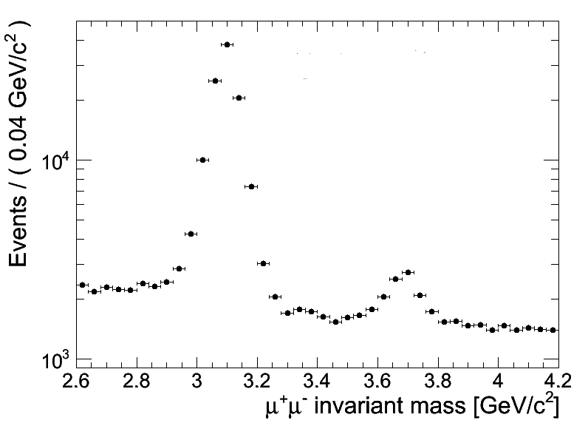
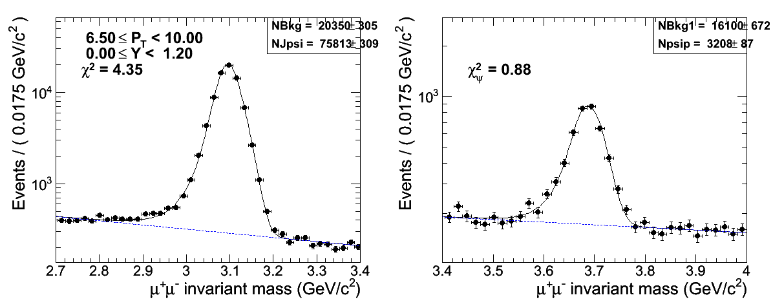
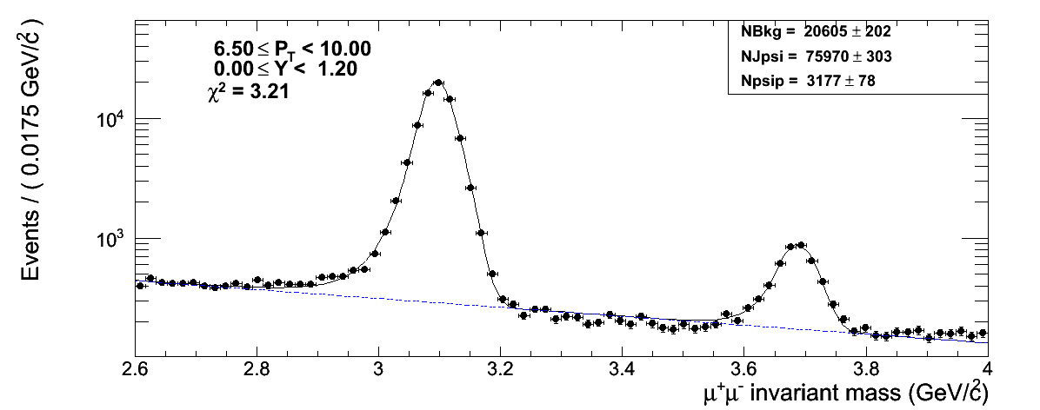
The fit procedure
MLL fit (RooFit):
CB+Gauss for the J/psi
CB psi’
Exp for the Bkg
11 pT bins and 3 Y bins
pT {2, 2.75, 3.5, 4.5, 5.5, 6.5, 8, 9, 10, 12, 15, 30}
Y {0, 1.2, 1.6, 2.4}
3 steps:
prefit of the sidebands
Fit separately the J/psi and psi’ (Signal+Bkg)
Fix some shape params (alpha,n, σ), and fit the full interval all together

Slide 4
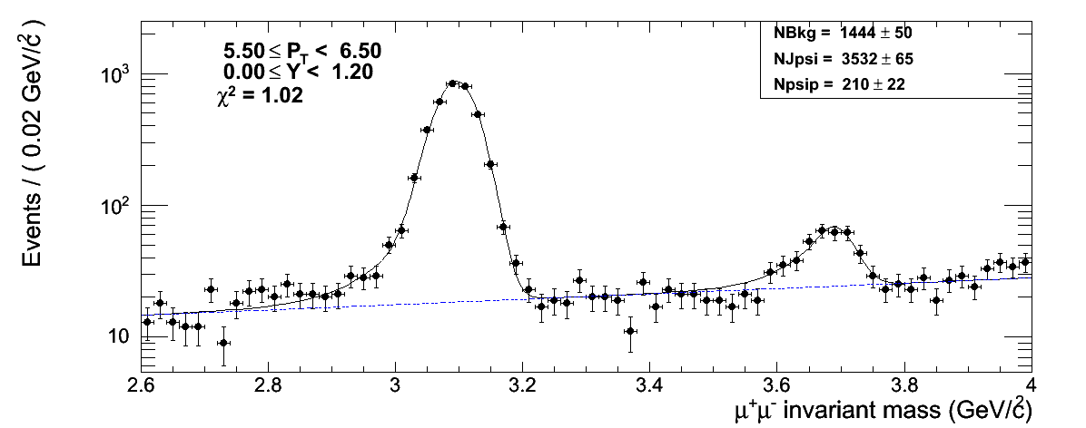
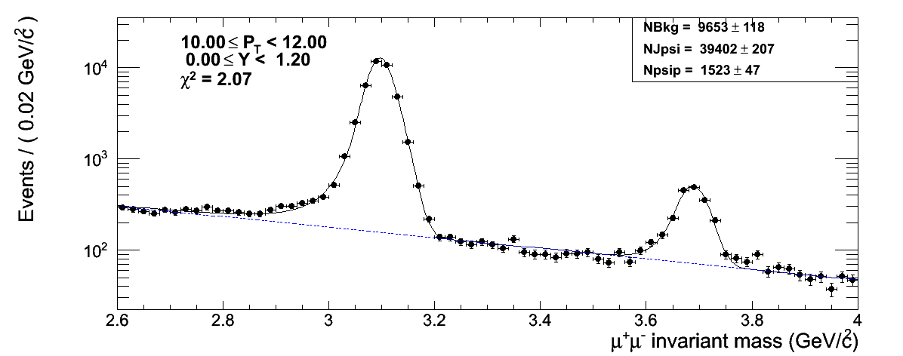
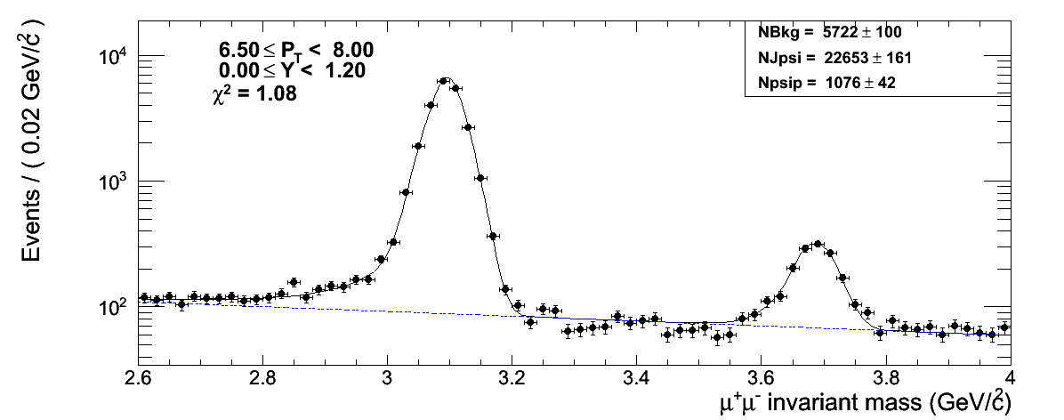
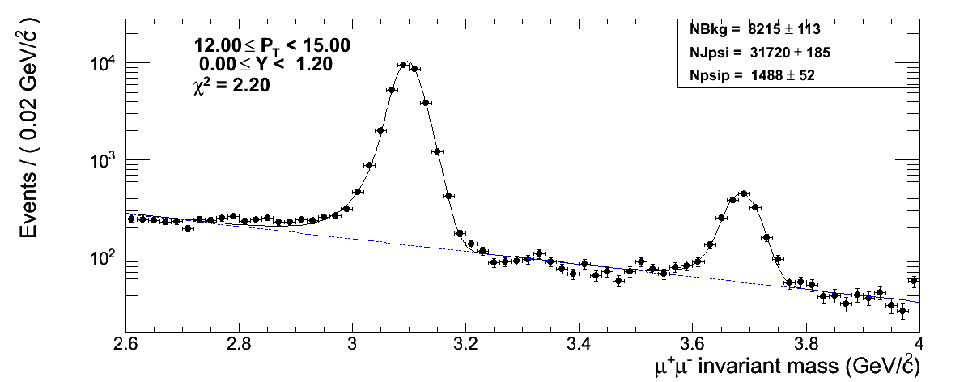
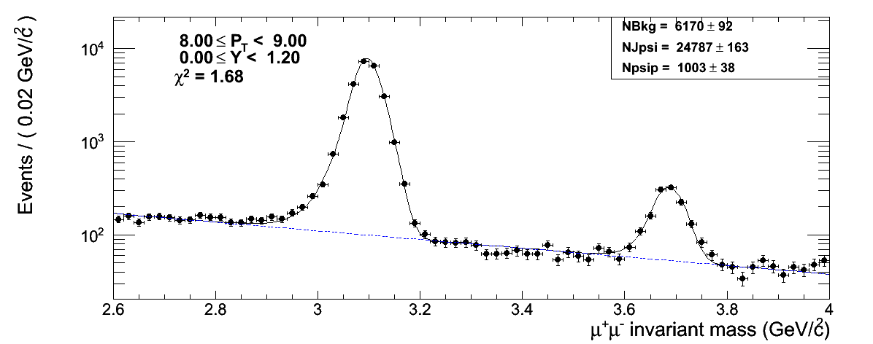
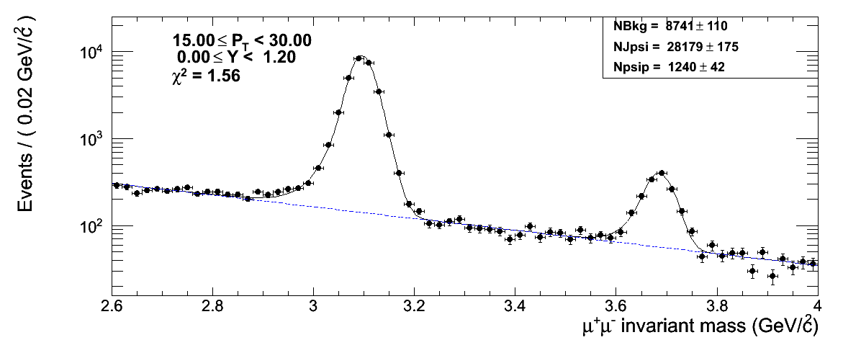
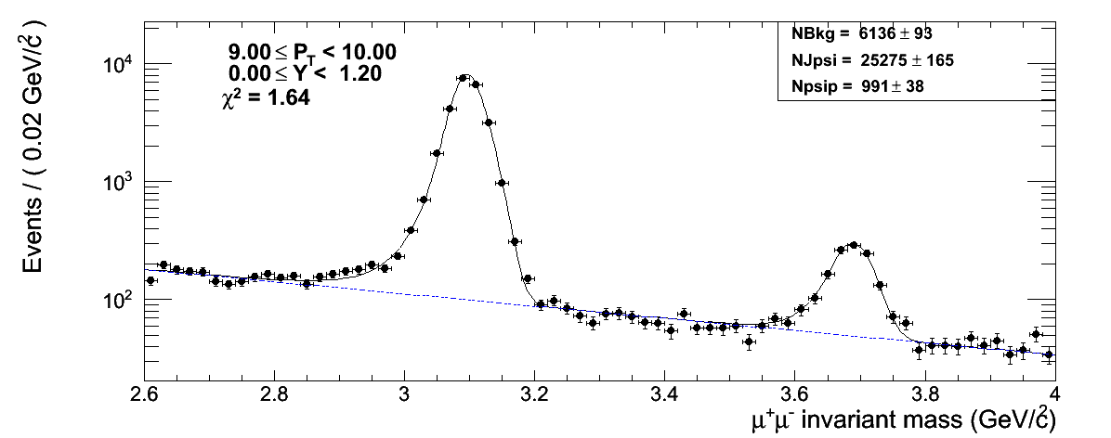
The fits: Barrel (|Y|<1.2)

Slide 5
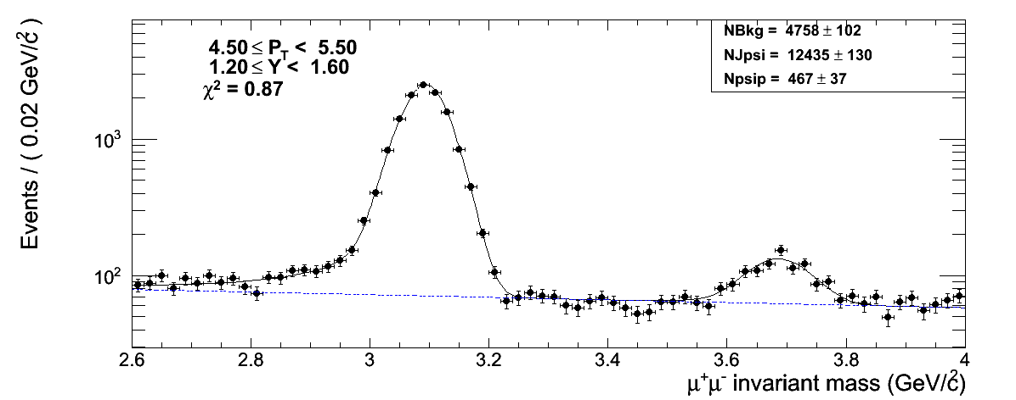
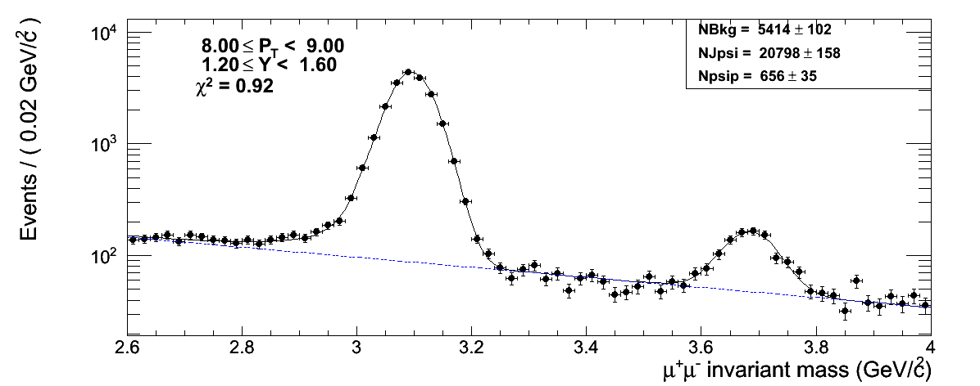
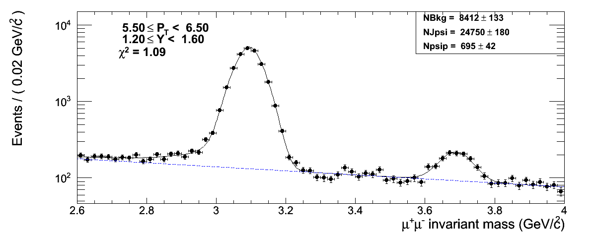
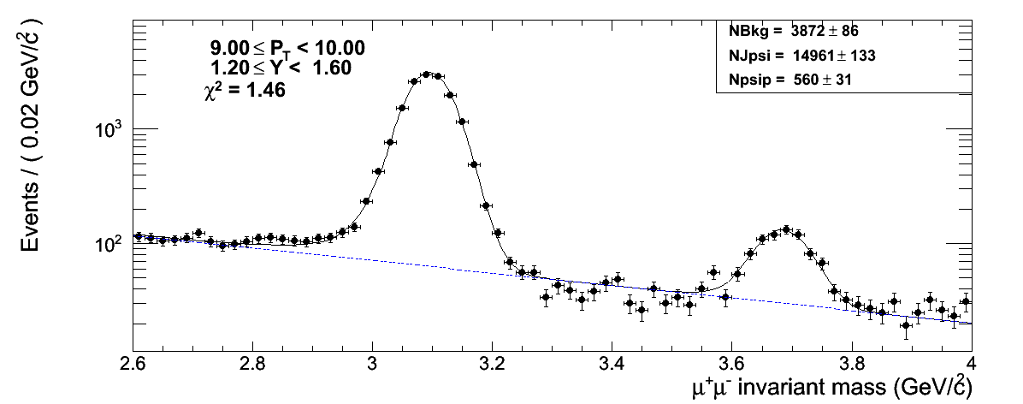
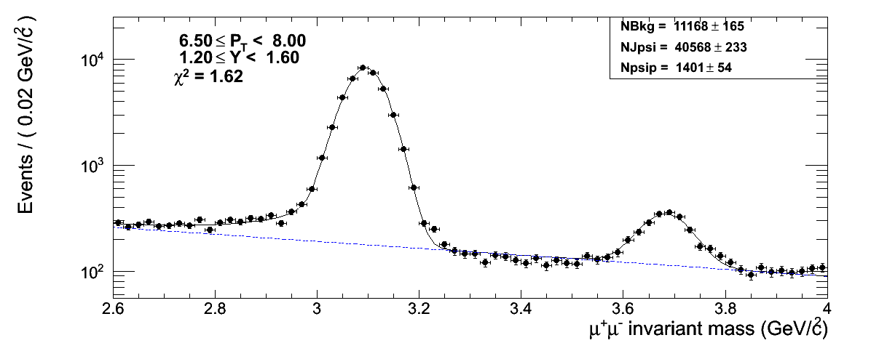
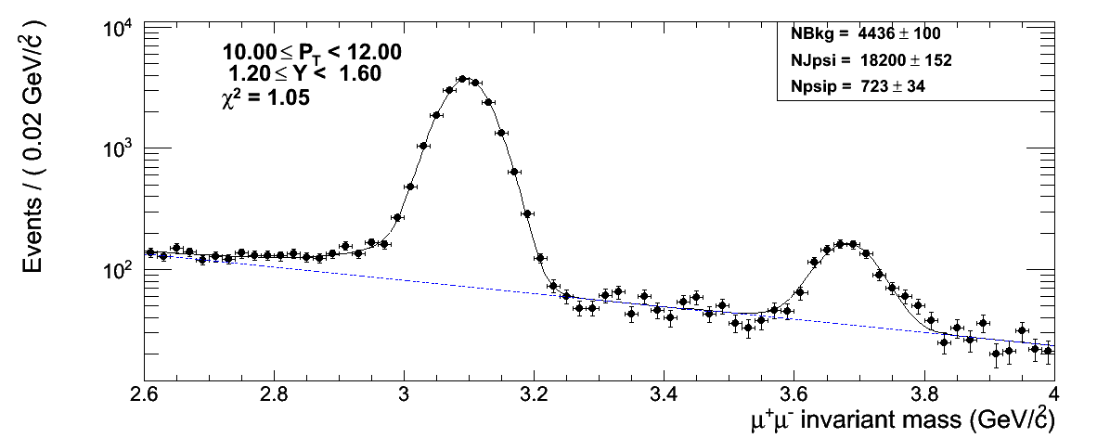
Middle (1.2 <|Y|< 1.6)
😐

Slide 6
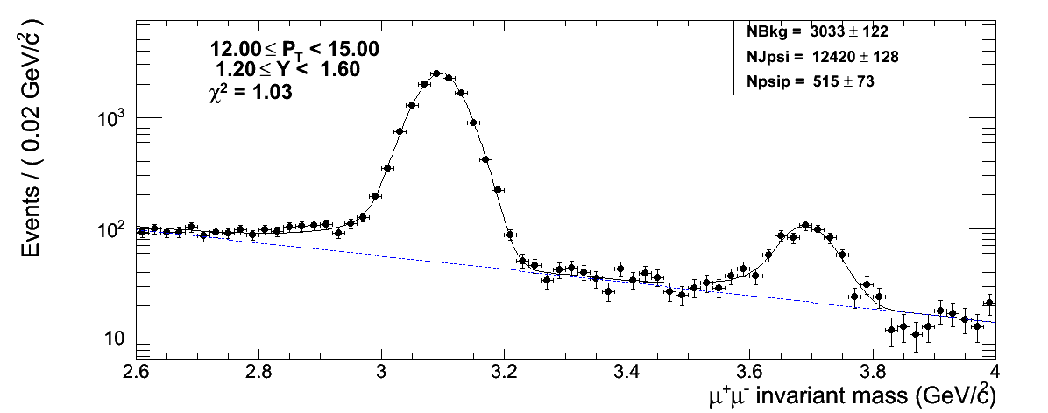
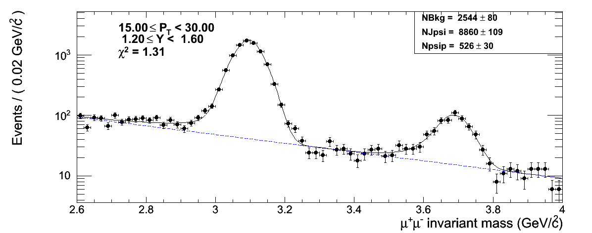
Middle (1.2 <|Y|< 1.6) (II)
😐

Slide 7
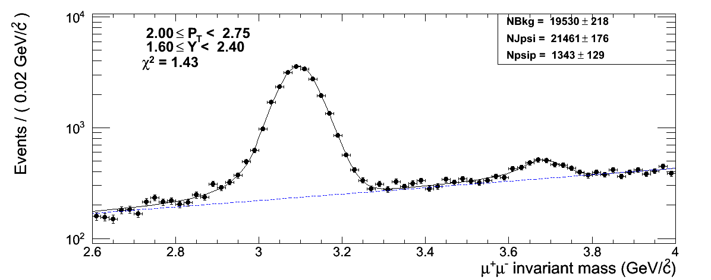
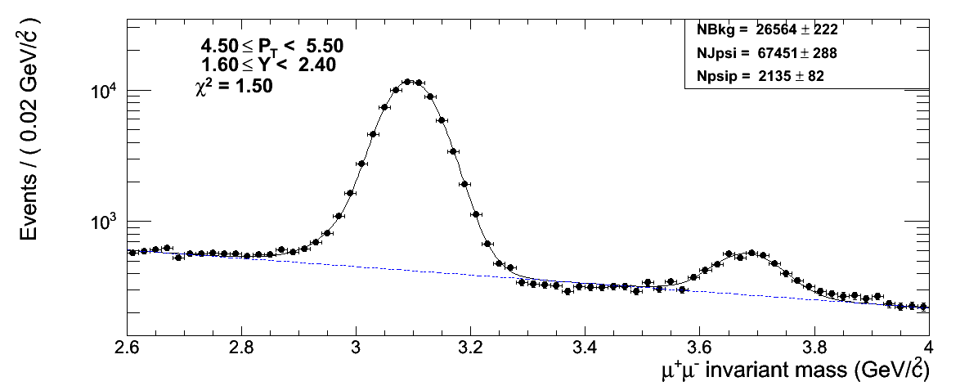
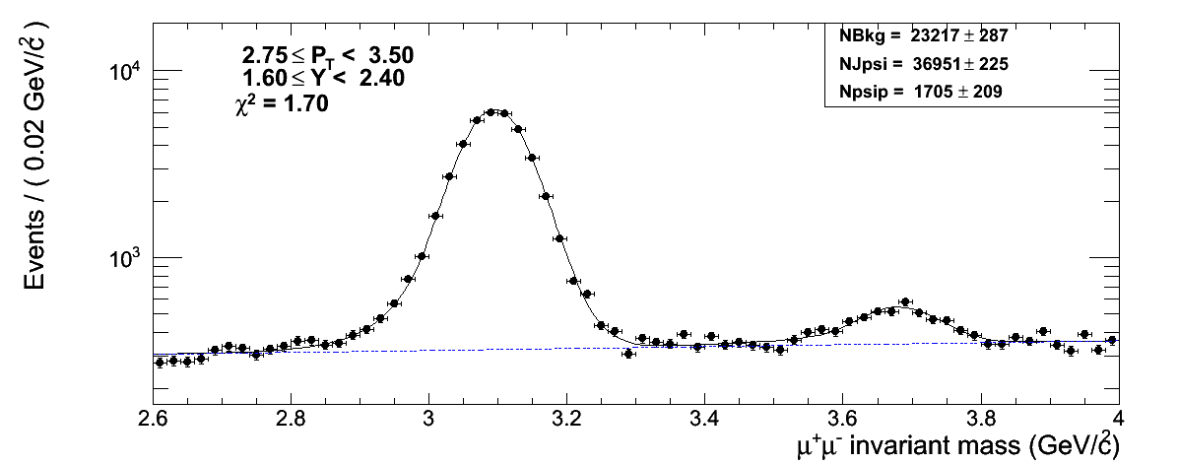
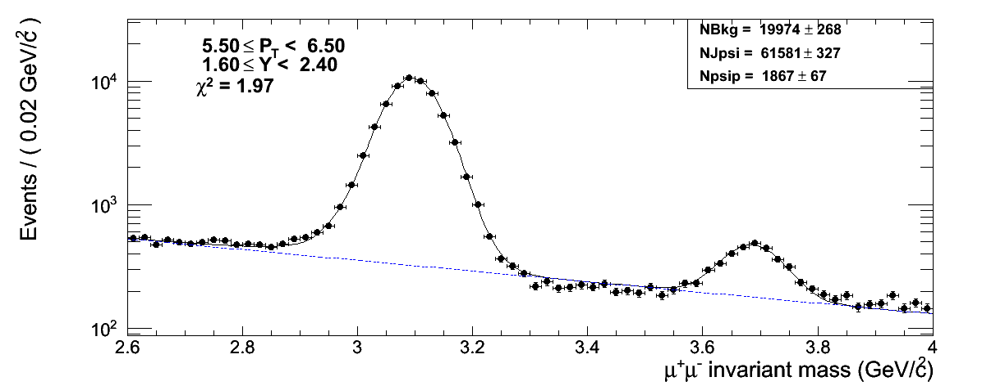
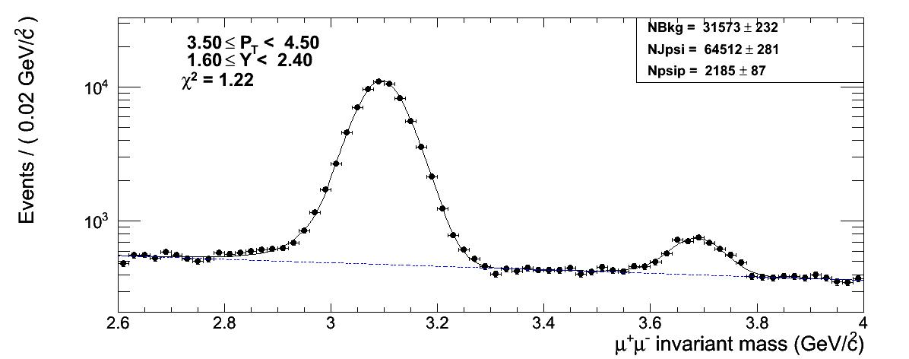
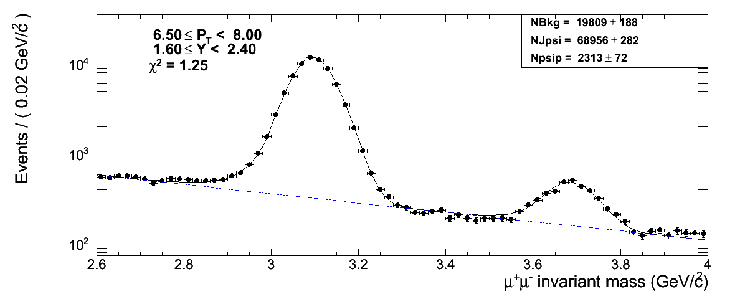
Forward (1.6 <|Y|< 2.4)

Slide 8
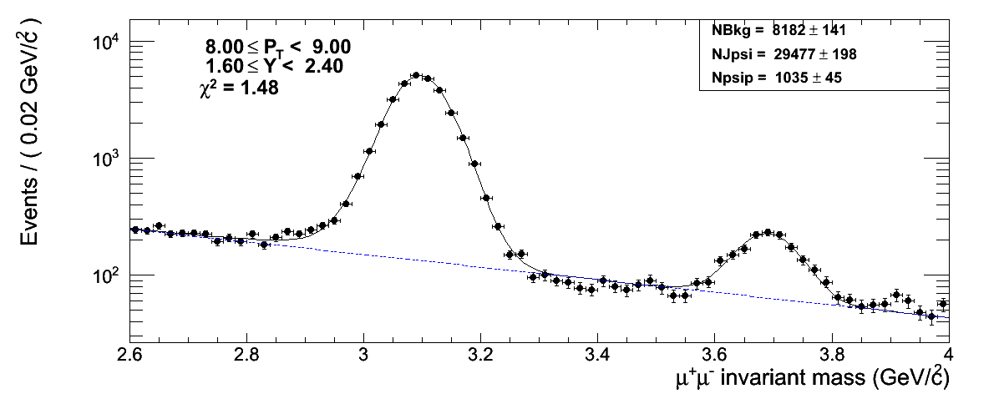
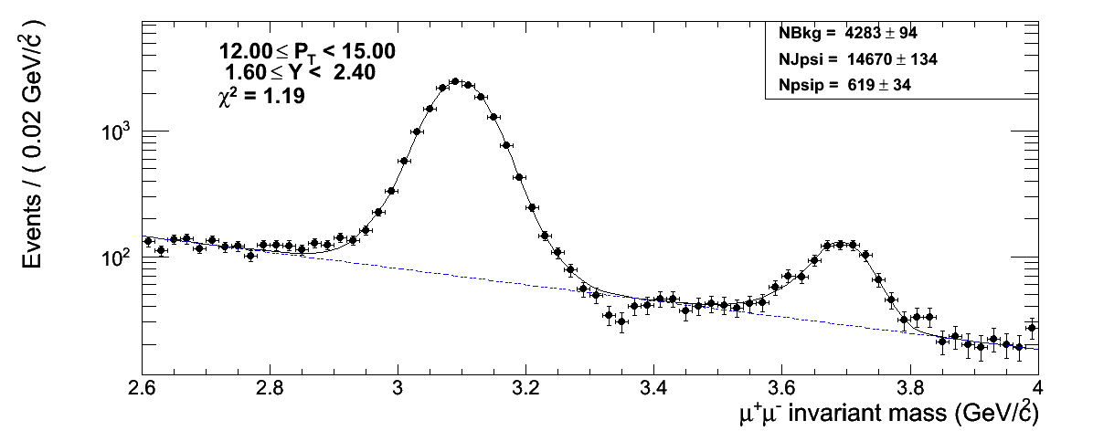
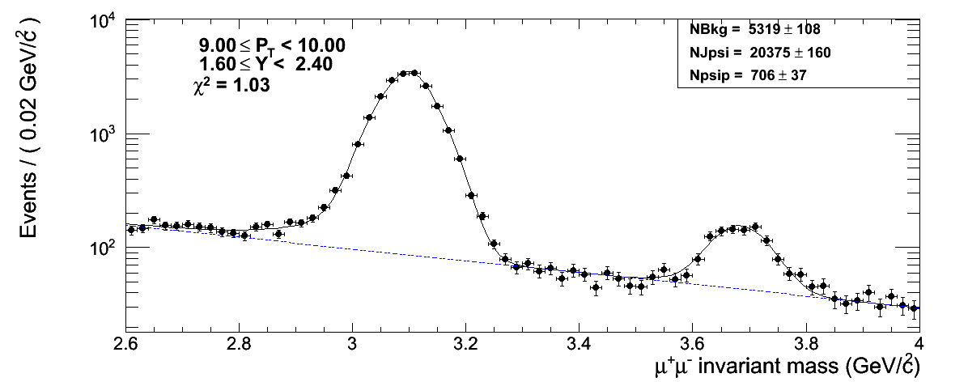
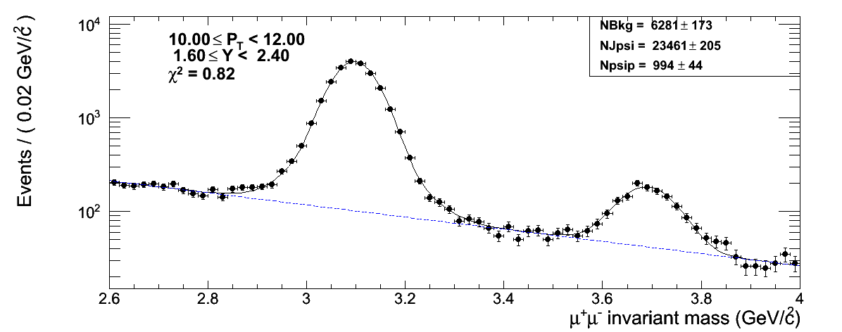
Forward (1.6 <|Y|< 2.4) (II)
😐
😐

Slide 9
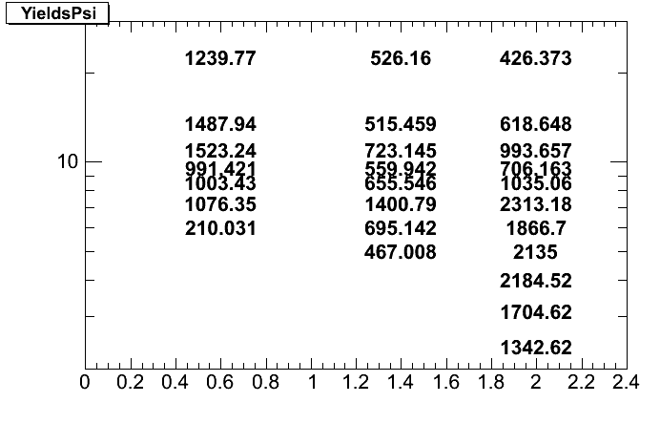
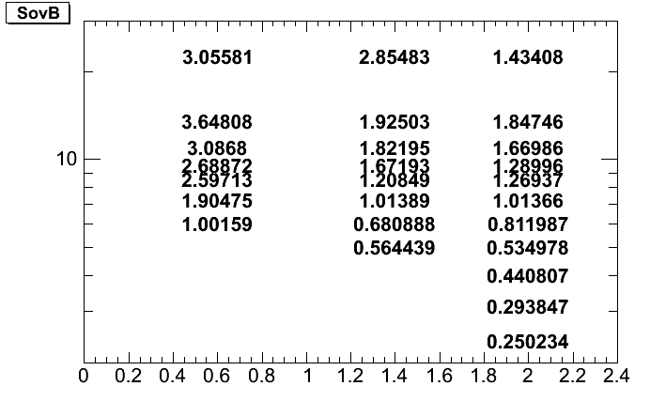
Results
J/psi
psi’
in +/- 2.5 sigma around the psi’ peak
ratio
S(psi’)/B

Slide 10
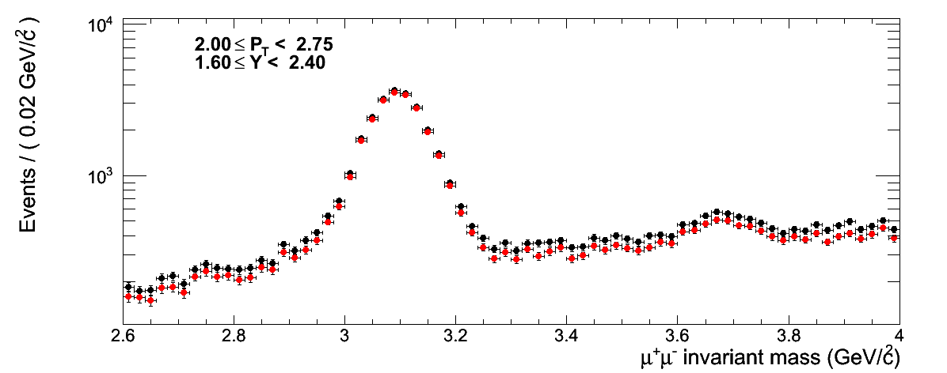
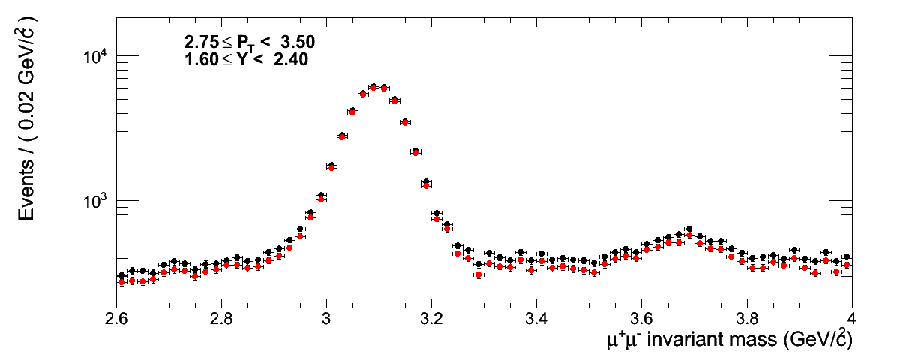
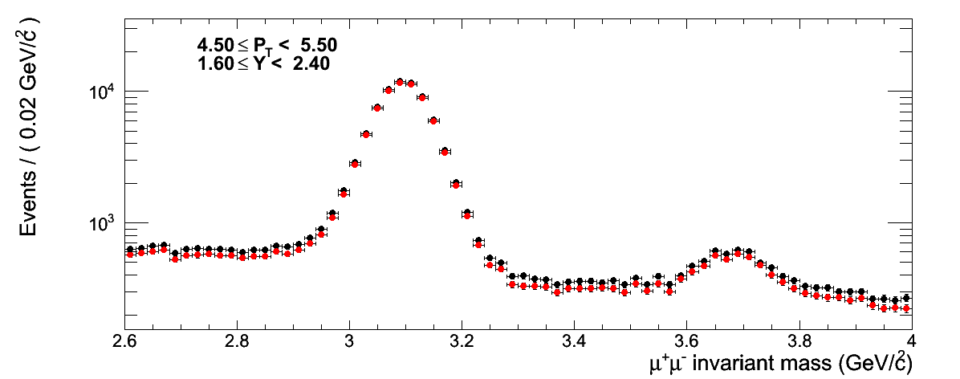
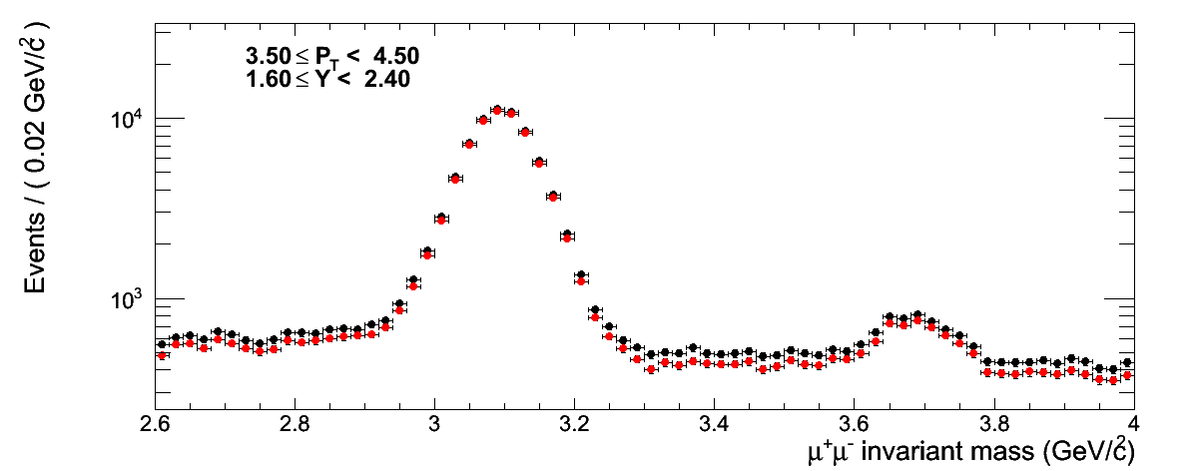
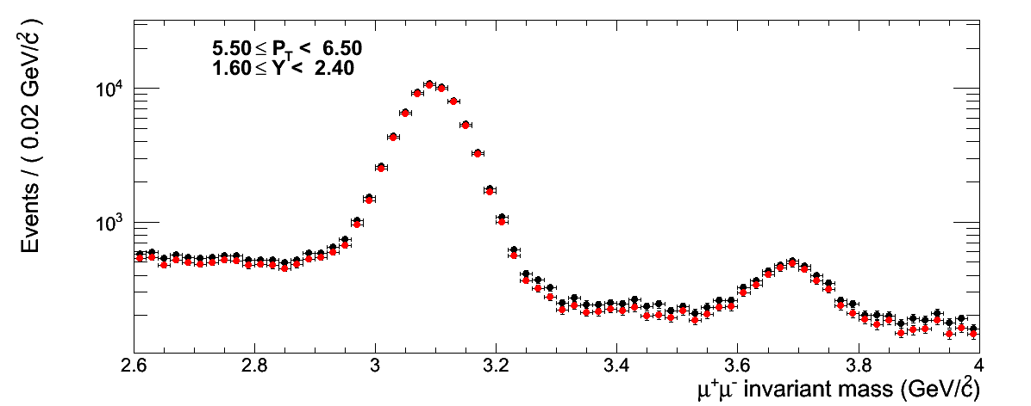
New vs Old cuts
What is the effect of the new cuts in vprob and tracks chi2?
OLD
NEW

Slide 11
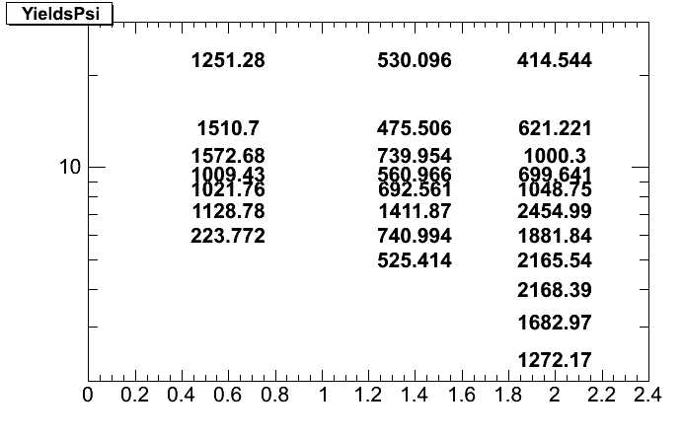
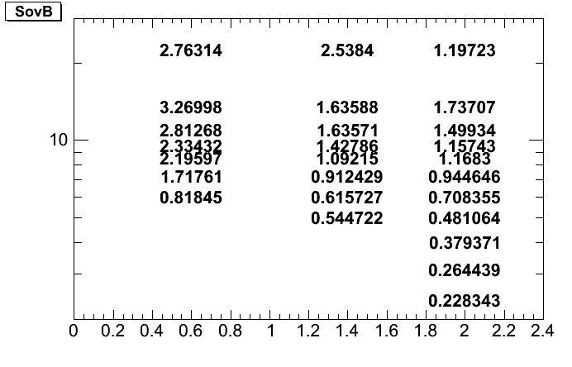
New vs Old cuts (II)
New
YIELDS
OLD
New
S/B
OLD
The yields are quite the same, S/B rise by a 10%

Slide 12
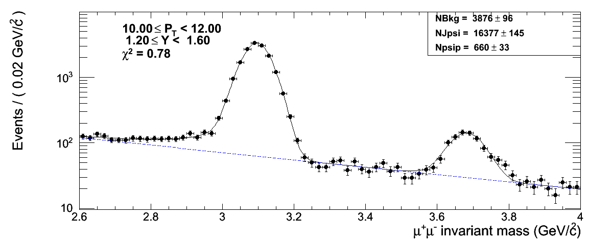
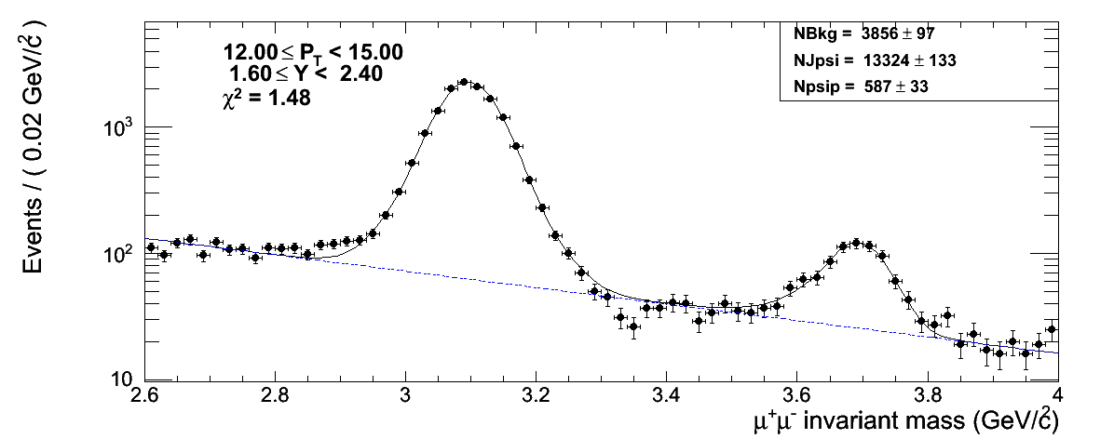
Use only GG ?
Better quality of fits and enhanced S/B
However ... same features in the fits
ALL TYPES
GG Only
ALL TYPES
GG Only

Slide 13
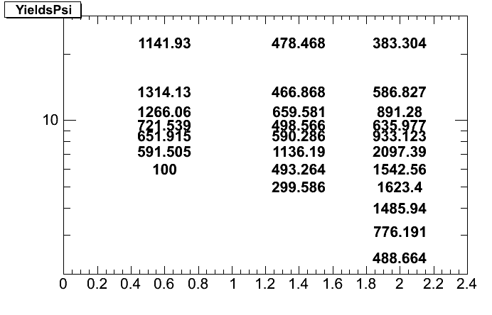
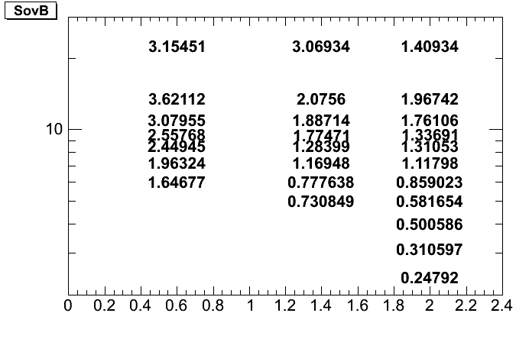
Use only GG ? (II)
YIELDS
GG Only
ALL TYPES
S/B
It doesn’t seem convenient

Slide 14
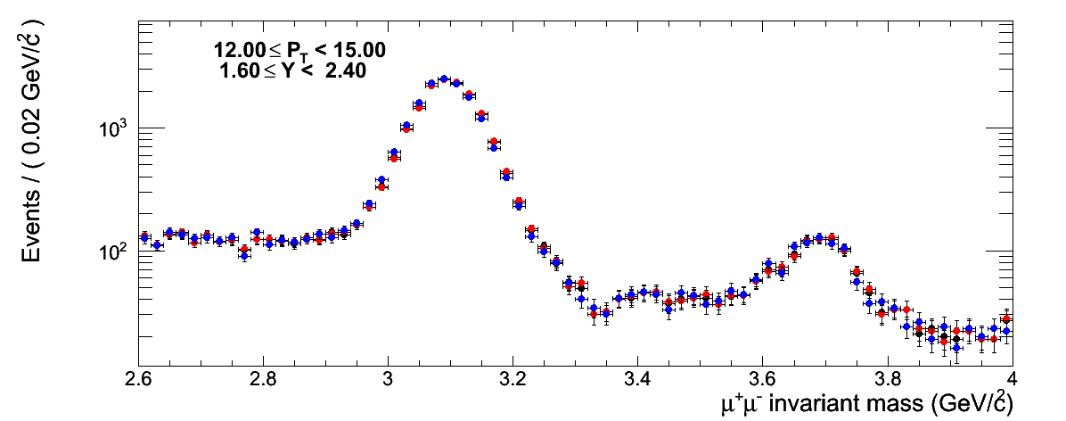
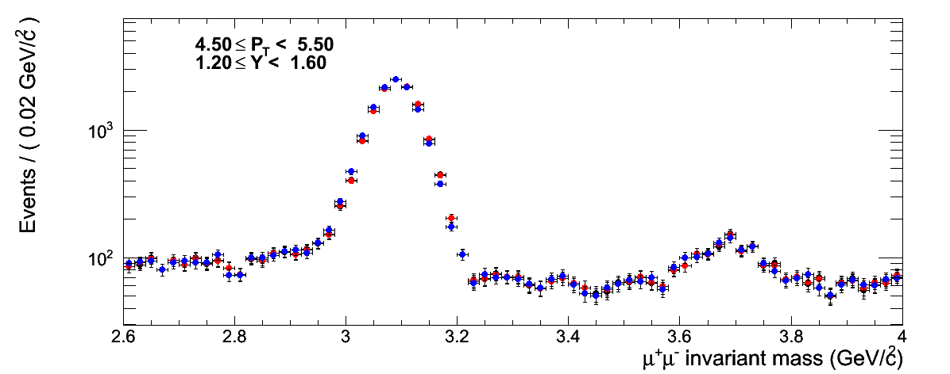
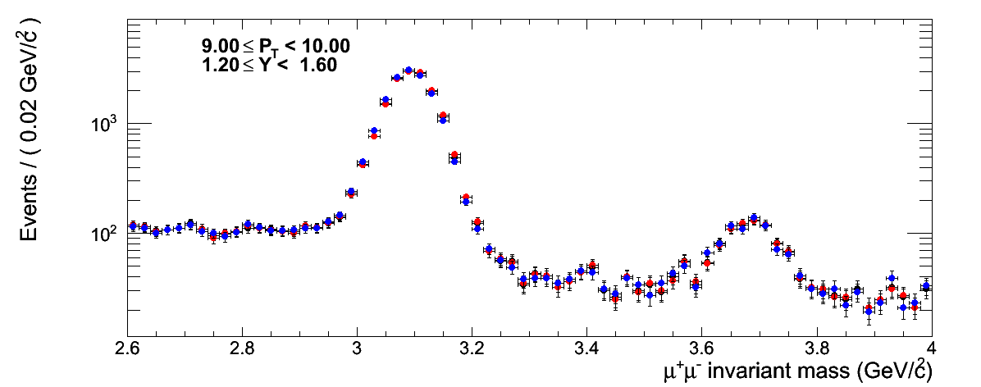
Which mass (pT) correction?
4 modes available, modes 3 and 4 pT and η dependent
Is it the cause of strange features in the bkg shape?
Mode 4
Mode 3
Not Corrected
The features are there independently by the pT correction

Slide 15
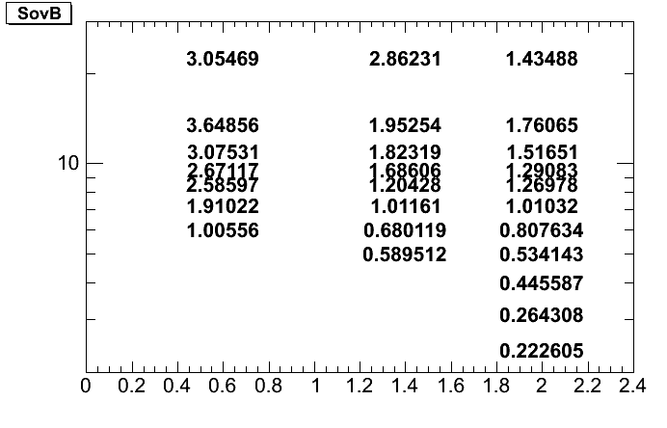
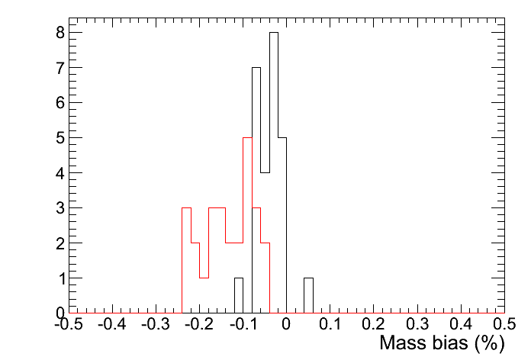
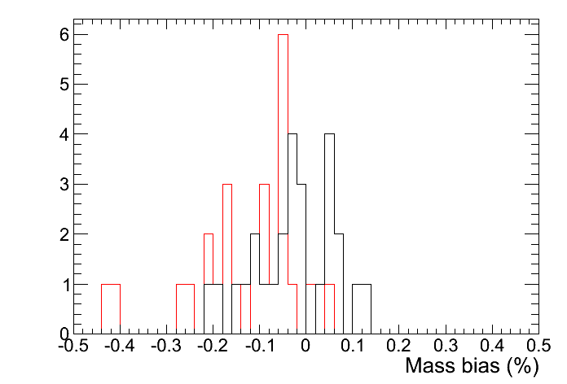
Which mass (pT) correction? (II)
The effect on S/B is negligible ....
Mode 4
Not Corrected
However the mass peak measurement improve, as expected .... stay with mode 4
J/psi
Mode 4
Not Corrected
psi(2S)

Slide 16
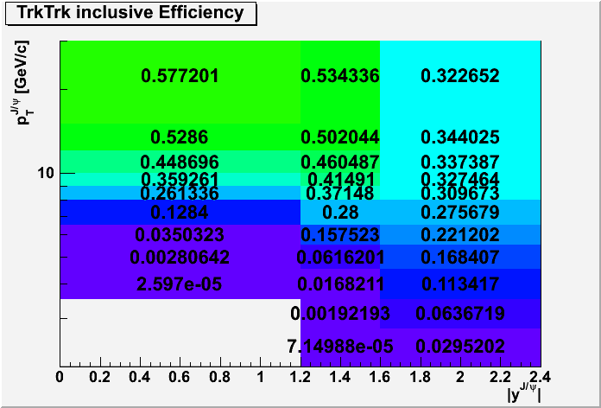
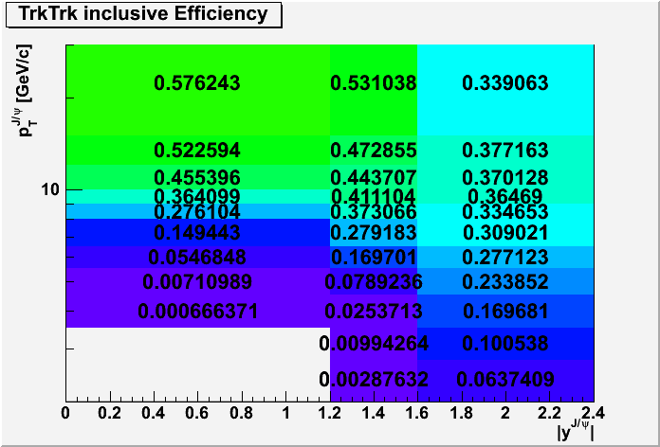
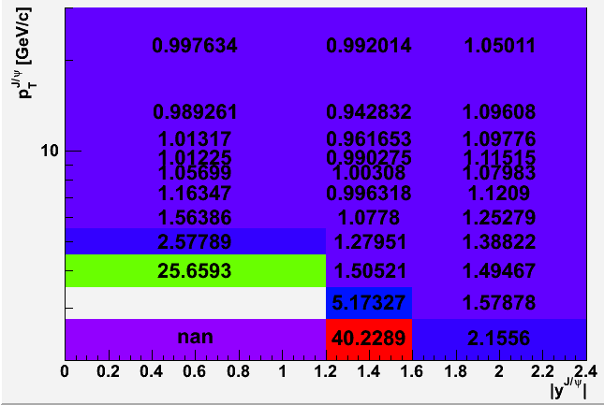
Efficiencies
Total efficiency (Muon ID + Track + Trigger + Analysis cuts)
J/psi
psi(2S)
Ratio of efficiencies

Slide 17
Summary and plans
The mass fit to extract the J/psi and psi’ yields is in place with a stable behavior (few bins to be tuned)
The effect of new vprob and chi2 cuts have been reported
Possible enhancement of S/B by using only GG or possible biases due to the pT correction have been discussed
The next step will be to put all the pieces together to have a first measurement

