Slide 1
“Mission impossible IV: qqH→qqbb” Preliminary HLT

Slide 2
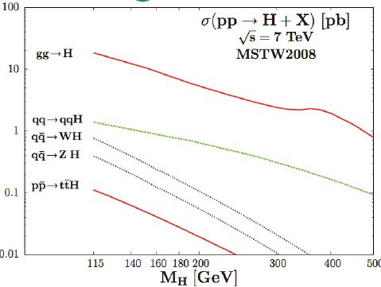
qqH →qqbb
M_{H} = 120 GeV
~1000 events / 1 fb⁻¹
~ 100 k at 7 TeV & 8 TeV
(no difference)
QCD background:
/QCD_TuneD6T_HT-50To100_7TeV-madgraph/Fall10-START38_V12-v1 0.2M
/QCD_TuneD6T_HT-100To250_7TeV-madgraph/Fall10-START38_V12-v1 10 M
/QCD_TuneD6T_HT-250To500_7TeV-madgraph/Fall10-START38_V12-v1 4.5M
/QCD_TuneD6T_HT-500To1000_7TeV-madgraph/Fall10-START38_V12-v1 7 M
/QCD_TuneD6T_HT-1000_7TeV-madgraph/Fall10-START38_V12-v1 1.5M

Slide 3
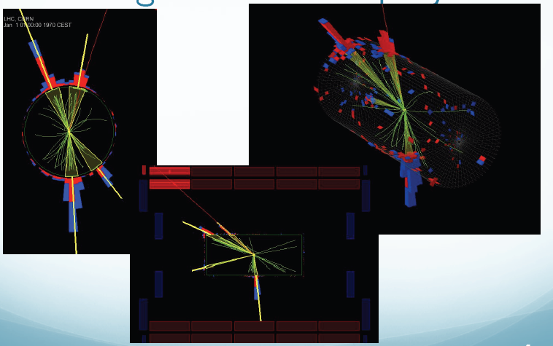

Slide 4
HLT current tables 1.7*10³² m⁻²s⁻¹
HLT | HLT Rate Hz | HLT eff | L1 | L1 eff | L1 Rate Hz
HLT_QuadJet25U | 4.76 | 14% | L1_QuadJet8U | 78% | 4050
HLT_HT200U_v3 | 14.9 | 22% | L1_HTT50 | 93% | 1930
HLT_HT140U_J30U_Eta3_v3 | 38.2 | 31% | L1_HTT50 | 93% | 1930
 |  |  | L1_TripleJet14U | 76% | 500
 |  |  | L1_HTT100 | 66% | 390
 |  |  | L1_ETT140 | 68% | 706
To start the study I require L1_TripleJet14U

Slide 5
Fast evaluation of HLT rates
HLT study is started one week ago, so I need of a fast way to evaluate HLT rate for a preliminary study
OpenHLT: for evaluation of a new trigger some rootuples are created from CMS on real data and C++ macros that run on them (Rateff macros)
In the following I will use OpenHLT rootuples of data and of MC events to evaluate the rate and the efficiency on signal events
At now I am not using Rateff macros for the evaluation but a simple private C++ code

Slide 6
Method for HLT rate
Require a loose HLT to normalize the rate: HLT_Jet15U_v3 (L1_SingleJet6) = N1
On these events I apply my HLT cuts as pt of jets, HT ecc… and compute the efficiency of these cuts
Due to low L1 jet pt resolution , I finally require that events also fire the L1 seed
L1_TripleJet14 or L1_QuadJet8 = N2
R= <rate of HLT_Jet15U_v3 (#RUN 149181 at L=1.7*10³² m⁻²s⁻¹) > = 0.97 Hz
R_{newHLT} = R*(N2/N1)* N1_L1Presc*N1_HLTPresc/N2_L1Presc
N1_L1Presc = 1200, N1_HLTPresc = 20, N2_L1Presc = 1
L1 Seed | HLT cuts | Rate Computed | Rate Data
L1_QuadJet8U | #jet>3, pt>20 | 1.62 ± 0.35 | 1.36
L1_QuadJet8U | #jet>3, pt>25 | 4.65 ± 2 | 4.76
L1_SingleJet20 | #jet>0,pt >30 | 1.1 ± 0.05 | 1.03
L1_SingleJet30 | #jet>0,pt >50 | 1.36 ± 0.12 | 1.3
L1_SingleJet50 | #jet>0,pt >70 | 1.9 ± 0.23 | 2.
L1_SingleJet60 | #jet>0,pt >100 | 2.6 ± 0.4 | 2.35
L1_SingleJet60 | #jet>0,pt >140 | 10.5 ± 2 | 8.5
Rates are in
agreement and this
simple method
works

Slide 7
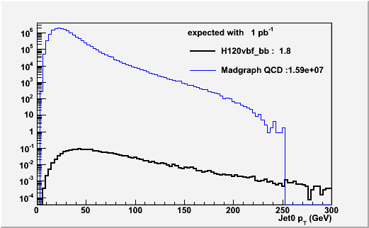
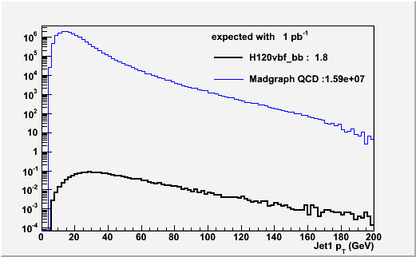
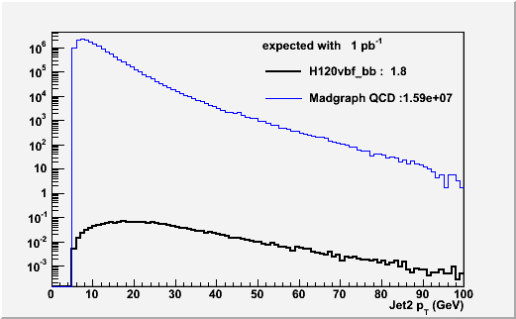
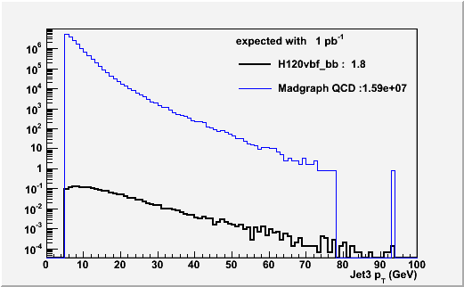
Pt of 4 leading Jets
Madgraph HT >50
1-st
2-nd
3-rd
4-th

Slide 8
Some HLT rates & efficiency
L1_TripleJet14 (ε_{L1}=76%)
HLT cuts Pt > X GeV : 35-25-18-5
ε_{HLT|L1}=73.5% ε_{HLT} = 55.76%
R_{2*10}³³ = 996 ± 90 Hz
HLT cuts Pt > X GeV : 50-35-25-12 && HT>150 GeV
ε_{HLT|L1}=27.8% ε_{HLT} = 21.2%
R_{2*10}³³ = 143 ± 37 Hz (120 Hz using σ_{QCD} = 61 nb)
HLT cuts Pt > X GeV : 75-50-30-15 && HT>200 GeV
ε_{HLT|L1}=13.2% ε_{HLT} = 10%
R_{2*10}³³ = 38 ± 20 Hz (26 Hz using σ_{QCD} = 12.8 nb)

Slide 9
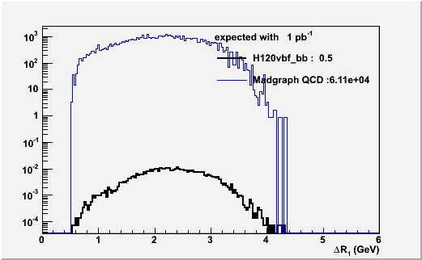
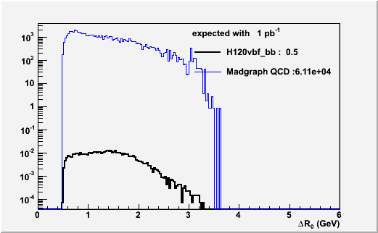
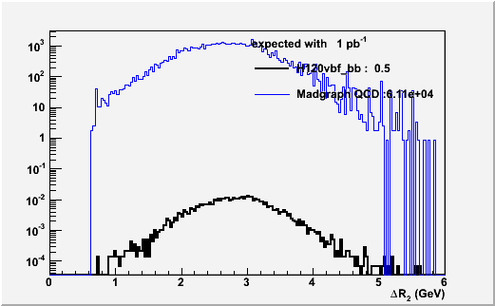
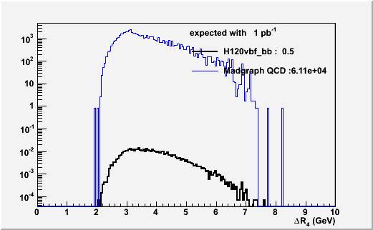
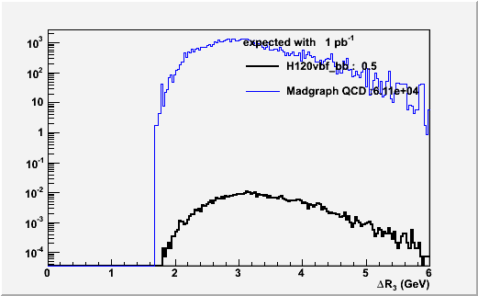
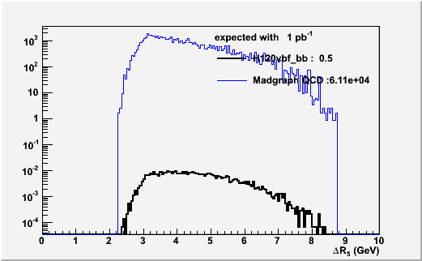
Other topologic/kinematic variables 50-35-25-12 && HT>150 GeV
ΔRjj, jet pt asimmetry, mjj ecc… (not very discriminant)
ΔRjj 1
ΔRjj 0
ΔRjj 2
ΔRjj 4
ΔRjj 3
ΔRjj 5

Slide 10
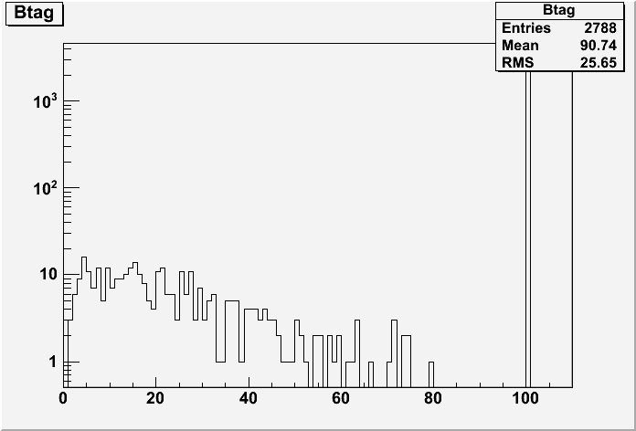
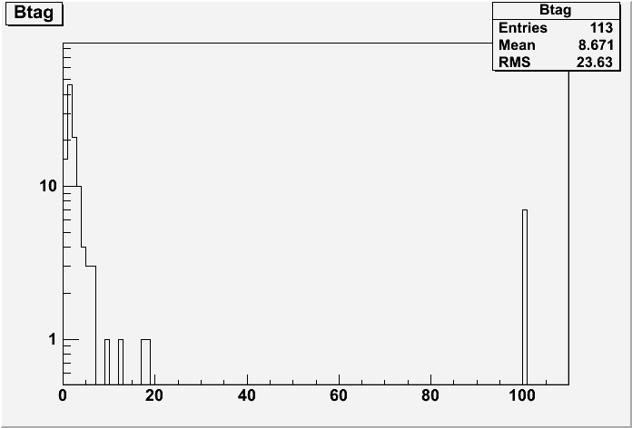
Btag information(trackcounting3D) 35-25-18-5
Very preliminary and to check
Maximum Btag value for L2jet with pt>5 GeV
qqH MC
QCD data
=100 if variable is not computed
In MC qqH events (no-pileup) , a very little fraction of events Btag is computed
In QCD data, Btag distribution is mostly below 10
With a cut Btag>10 a factor 13 of reduction of QCD rate but the question is on the signal.
Effect of pile-up and be sure to run properly the HLT Btag software (but seems ok).

Slide 11
Plans
Investigate other variables
Investigate btagging on MC background and generate MC signal events with pile-up
Investigate pixel tracks and vertices
Run Rateff macros for HLT infos: time,
correlations, efficiencies, rates
Conclusion
Is it a mission impossible?

