Slide 1


Search for a muon EDM
Philipp Schmidt-Wellenburg :: Scientist :: Paul Scherrer Institute
Muon4Future, Venice, 05/30/23

Slide 2


















CP violation & edm
$$\vec{μ}=μ\vec{s}$$
$$\vec{d}=d\vec{s}$$
A non-zero particle EDM
violates P, T and,
assuming CPT conservation, also CP.
$$|\left.↑\right\rangle$$
$$|\left.↑\right\rangle$$
$$U=− \vec{μ}⋅\vec{B}$$
$$U=− \vec{d}⋅\vec{E}$$
$$ΔU=ℏω_{e}$$
$$|\left.↓\right\rangle$$
$$|\left.↓\right\rangle$$
$$B$$
$$E$$
`
T
T
$$|\left.↑\right\rangle$$
$$U=−\vec{μ}⋅\vec{B}$$
Baryon asymmetry
of the Universe
$$U=\vec{d}⋅\vec{E}$$
$$|\left.↑\right\rangle$$
$$B$$
$$E$$
Arises “naturally” in
beyond SM theories
EDM
CPV
Strong CP violation
($θ$-term)
Notes:
Symmetries and the breaking of symmetries are an important concept of all modern physics theories.
To better understand the violation of discrete symmetries by an EDM I have made this sketch of the energie levels of a spin-1/2 particle in a magnetic and electric field.
The left side every body is familiar with. It corresponds to the classical zeeman splitting in atoms. Depending on the spin of the particle the magnetic moment will lead to an increase or decrease in energy.
Similar on the right side, the electric dipole moment leads to a similar level splitting in the electric field.
Lets concentrate on the spin up state. [click]
Now we apply a Ti

Slide 3
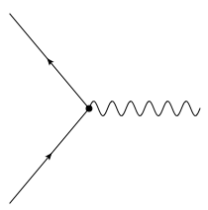



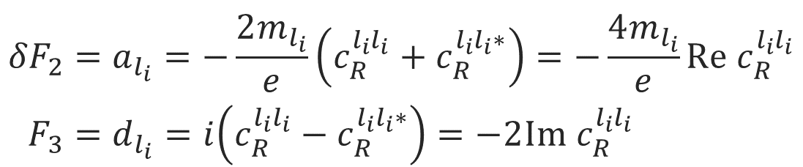

Lepton form factors and dipole moments
$$l_{f}$$
$$ℋ_{eff}=c_{R}^{l_{f}l_{i}}{\overline{l}}_{f}σ_{μν}P_{R}l_{i}F^{μν}+h.c.$$
$$F^{μν}$$
Effective Hamiltonian:
$$l_{i}$$
magnetic-dipole
Anapole - moment
$$\left\langle p′ | J_{μ}^{EM} | p\right\rangle =\overline{Ψ}\left(p^{′}\right)\left[F_{1}γ_{μ}+\frac{iF_{2}}{2M}σ_{μν}q^{ν}+\frac{iF_{3}}{2M}σ_{μν}γ_{5}q^{ν}+\frac{F_{4}}{M^{2}}(q^{2}γ_{μ}−γ^{μ}q_{μ}q_{μ})\right]Ψ\left(p\right)$$
charge
electric-dipole
$${δF}_{2}=a_{l_{i}}=−\frac{2m_{l_{i}}}{e}\left(c_{R}^{l_{i}l_{i}}+c_{R}^{l_{i}l_{i}∗}\right)=−\frac{4m_{l_{i}}}{e}Re c_{R}^{l_{i}l_{i}} \\ F_{3}=d_{l_{i}}=i\left(c_{R}^{l_{i}l_{i}}−c_{R}^{l_{i}l_{i}∗}\right)=−2Im{ c}_{R}^{l_{i}l_{i}}$$
Notes:
For the purpose of a general discussion, effective field theories are particular useful, as no assumptions are needed for the exact realization of a high energy theory.
The most general form in which one can write down the interaction of a lepton current with a external electric/magnetic field is using this electro magnetic current with all possible bilinears.
In this case the first form factor is the electric charge, the second the magnetic and the third the electric dipole moment. The anapole moment I just depicted for completeness
Interestingly the anomalous magnetic moment is connected to the same Wilson coefficient in effective field theories. The real part of this Wilson coefficient is proportional to the anomalous magnetic momentum, while the imaginary part is related to the electric dipole moment.

Slide 4
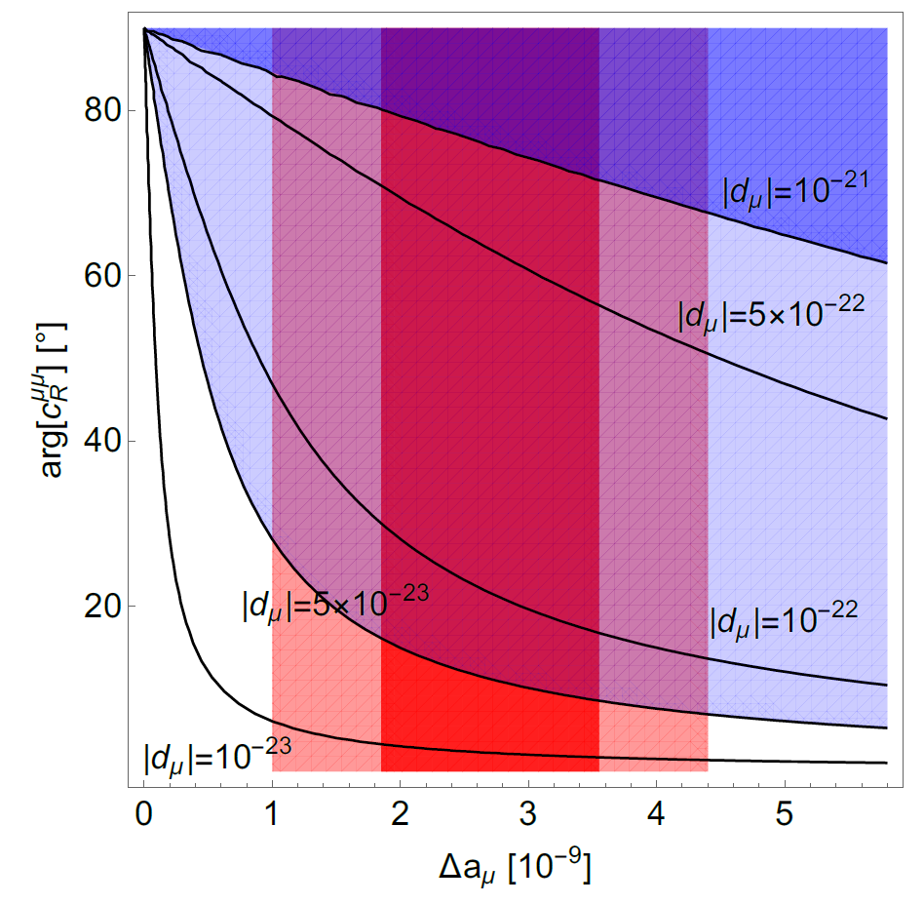
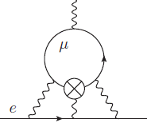
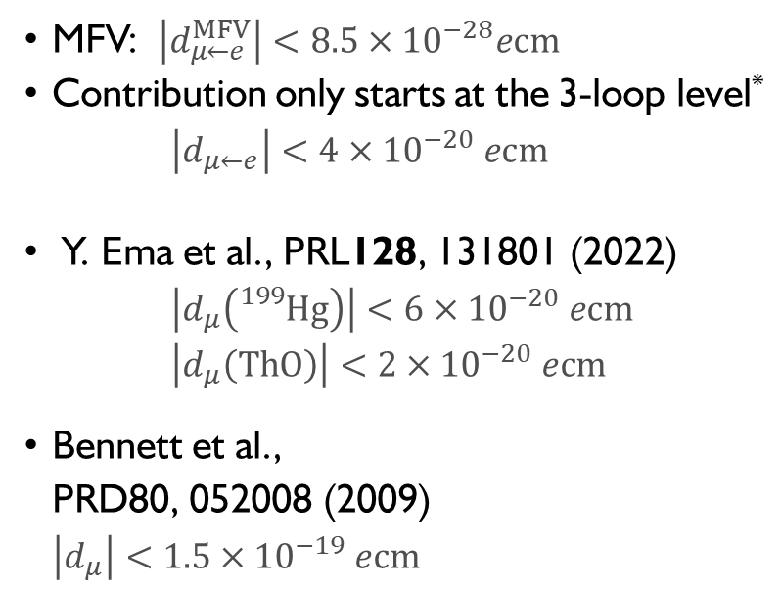
General limits on $μ$EDM
Fermilab/J-PARC
MFV: $\left|d_{μ←e}^{MFV}\right|<8.5×{10}^{−28}ecm$
Contribution only starts at the 3-loop level* $\left|d_{μ←e}\right|<4×{10}^{−20} ecm$
Y. Ema et al., PRL128, 131801 (2022)
$\left|d_{μ}\left({}_{}^{199}{Hg}\right)\right|<6×{10}^{−20} ecm$
$\left|d_{μ}\left(ThO\right)\right|<2×{10}^{−20} ecm$
Bennett et al.,
PRD80, 052008 (2009)
$\left|d_{μ}\right|<1.5×{10}^{−19} ecm$
PSI (frozen spin)
*A.Crivellin, M. Hoferichter, PSW PRD 98, 113002 (2018)

Slide 5
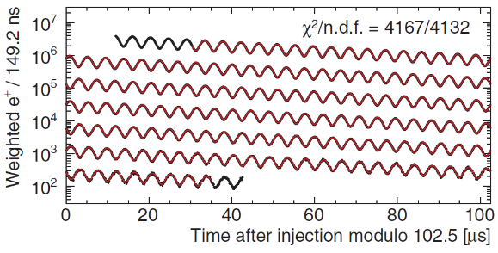
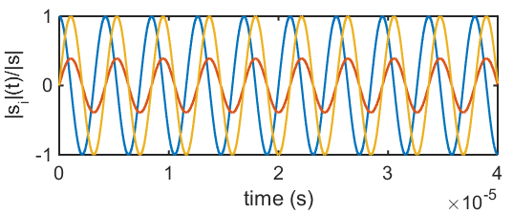

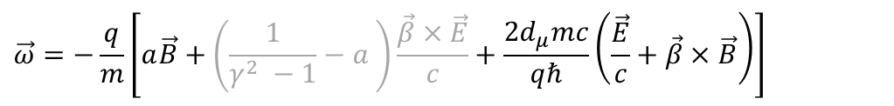


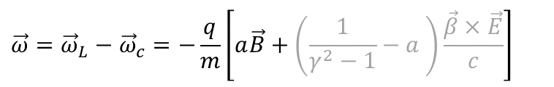







Muon dipole moments and frequencies
$$\vec{ω}=−\frac{q}{m}\left[a\vec{B}+\left(\frac{1}{γ^{2} −1}−a \right)\frac{\vec{β}×\vec{E}}{c}+\frac{2d_{μ}mc}{qℏ}\left(\frac{\vec{E}}{c}+\vec{β}×\vec{B}\right)\right]$$
$$\vec{ω}={\vec{ω}}_{L}−{\vec{ω}}_{c}=−\frac{q}{m}\left[a\vec{B}+\left(\frac{1}{γ^{2}−1}−a \right)\frac{\vec{β}×\vec{E}}{c}\right]$$
g-2 term $ω_{a}$
EDM term $ω_{e}$
B
$${\vec{ω}}_{a}$$
$$\sqrt{{\vec{ω}}_{a}^{2}+{\vec{ω}}_{e}^{2}}$$
$$ζ$$
$$R=7.114 m$$
$$ζ=\operatorname{atan}\left(\frac{2d_{μ}βcm}{a}\right)$$
$$\vec{s}$$
FNAL* & JPARC**:
$$σ\left(d_{μ}\right)≈{10}^{−21}ecm$$
$${\vec{ω}}_{e}$$
[Abi et al., PRL126 141801(2021)]
[*Chislett et al., EPJConf.118 01005(2016), Abi et al., PRL126 141801(2021), **Abe et al., PTEP053C02 (2019)]
Notes:
Many of you probably know about the g-2 measurement of the muon at Fermilab.
The principle physics are described in the equation. The difference between the Larmor frequency of the muon, essentially the precision due to the magnetic moment, and the cyclotron frequency of the muon moving in a magnetic and electric field.
The muon moves along its reference orbit perpendicular to the main magnetic field. Due to the small anomalous magnetic moment the difference is not exactly zero and one can observe the famous wiggle plot by measuring in the number of decay positrons per time.
The electric field is required for steering the muon inside the storage ring. By selecting the correct momentum the electric term can be set to zero and the observed oscillation frequency directly relates to the anomalous magnetic moment.
Now in the presence of a electric dipole moment the plane of oscillation tilts and one could observe a tiny vertical observation of the positron intensity, and the measured frequency would be a little bit larger.
The prospected sensitivity is about 10E-21 ecm for the EDM at Fermilab and JPARC.

Slide 6
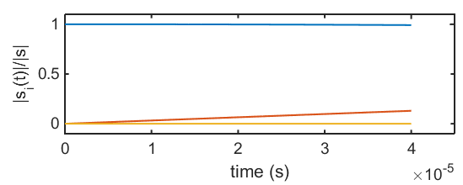



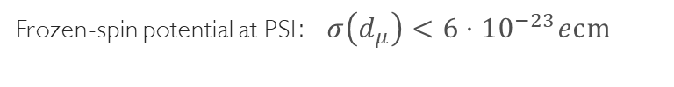


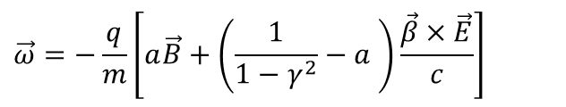

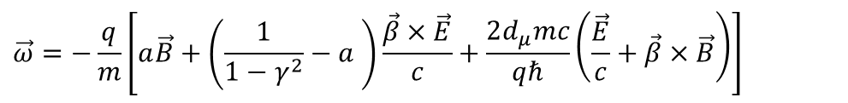


Muon dipole moments –freezing the spin at PSI
$$\vec{ω}=−\frac{q}{m}\left[a\vec{B}+\left(\frac{1}{1−γ^{2}}−a \right)\frac{\vec{β}×\vec{E}}{c}+\frac{2d_{μ}mc}{qℏ}\left(\frac{\vec{E}}{c}+\vec{β}×\vec{B}\right)\right]$$
$$\vec{ω}=−\frac{q}{m}\left[a\vec{B}+\left(\frac{1}{1−γ^{2}}−a \right)\frac{\vec{β}×\vec{E}}{c}\right]$$
g-2 term $ω_{a}$
EDM term $ω_{e}$
$$s_{z}$$
Frozen-spin potential at PSI:$σ\left(d_{μ}\right)<{6⋅10}^{−23}ecm$
B
$$s_{y}$$
$$R=31 mm$$
$${\vec{ω}}_{e}$$
E
$$s_{x}$$
set $E ≅aBcβγ^{2}$
Phase I: $σ\left(d_{μ}\right)<{3⋅10}^{−21}ecm$
[*Farley et al,, PRL93 042001 (2004) ] ,
Notes:
To further increase the sensitivity to a muon EDM we propose to use the frozen-spin technique to measure the electric dipole moment.
By applying a well tuned electric field this entire term can be canceled and the spin exactly follows the momentum, essentially it is frozen to the momentum.
The only term present is the one of the electric dipole moment which leads to a precession of the spin around the radial axis like a bicycle going in a circle.
This in turn leads to a build up of a asymmetry of positron decays along and against the direction of the magnetic field, the signal we are searching for.

Slide 7
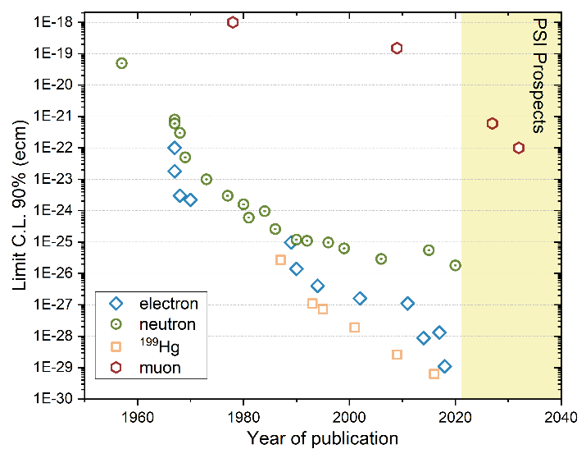
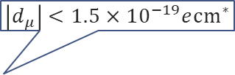

A not so brief history of EDM searches
$$\left|d_{μ}\right|<1.5×{10}^{−19}e{cm}^{∗}$$
Neutron
Electron
Muon
log(d) /ecm
log(d) /ecm
log(d) /ecm
-18
-20
-22
-24
-26
-28
-30
-32
-34
-36
-38
-18
-20
-22
-24
-26
-28
-30
-32
-34
-36
-38
-18
-20
-22
-24
-26
-28
-30
-32
-34
-36
-38
$$\frac{m_{μ}}{m_{e}}$$
10¹⁸
10⁶
*Bennett et al.,PRD80(2009)052008
** Abel et al., PRL124(2020)081803
10⁸
Notes:
Searches for electric dipole moments started a long time ago in the 1950 when Ramsey and Purcell were first searching an EDM using a beam of neutrons.
Since then, the race to the bottom started.
Here on this graph I depicted for you the 90% limits versus the year of publication. In green the neutron, the blue diamonds are measurements on atoms and molecules extracting the EDM off the electron.
In yellow squares the impressive story of the mercury EDM. Lagging far behind is the muon, the only sizable search for an EDM of a particle in the second generation.
On the right side you see the expectation range for standard model EDM from the small imaginary phase of the CKM matrix in relation to the current limit.
The neutron still has another 6 orders of magnitude until they will hit the SM background. The electron another 9 order of magnitude, while the muon is today where Ramsey started 70 years ago and has another 18 orders of magnitude of legroom.

Slide 8
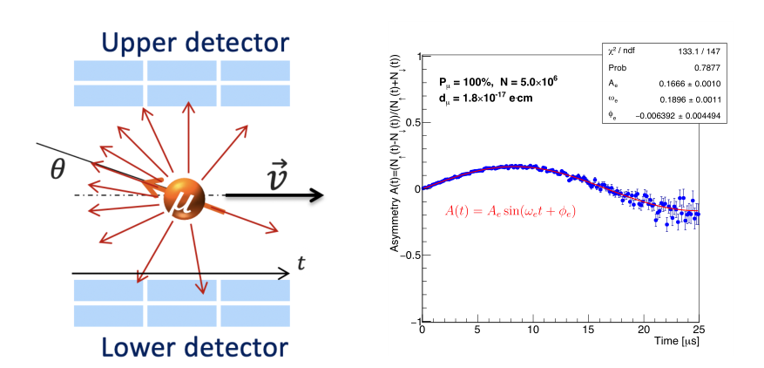



The general experimental idea
If the EDM ≠ 0, then there will be a vertical precession out of the plane of the orbit
  An asymmetry increasing with time will be observed recording decay positrons
If the EDM = 0, then the spin should always be parallel to the momentum
asymmetry should be zero
Some asymmetry could still be
observed due to systematic effects
B
$$R=31 mm$$
$${\vec{ω}}_{e}$$
E
$$A=\frac{N_{u}−N_{d}}{N_{u}+N_{d}}$$

Slide 9
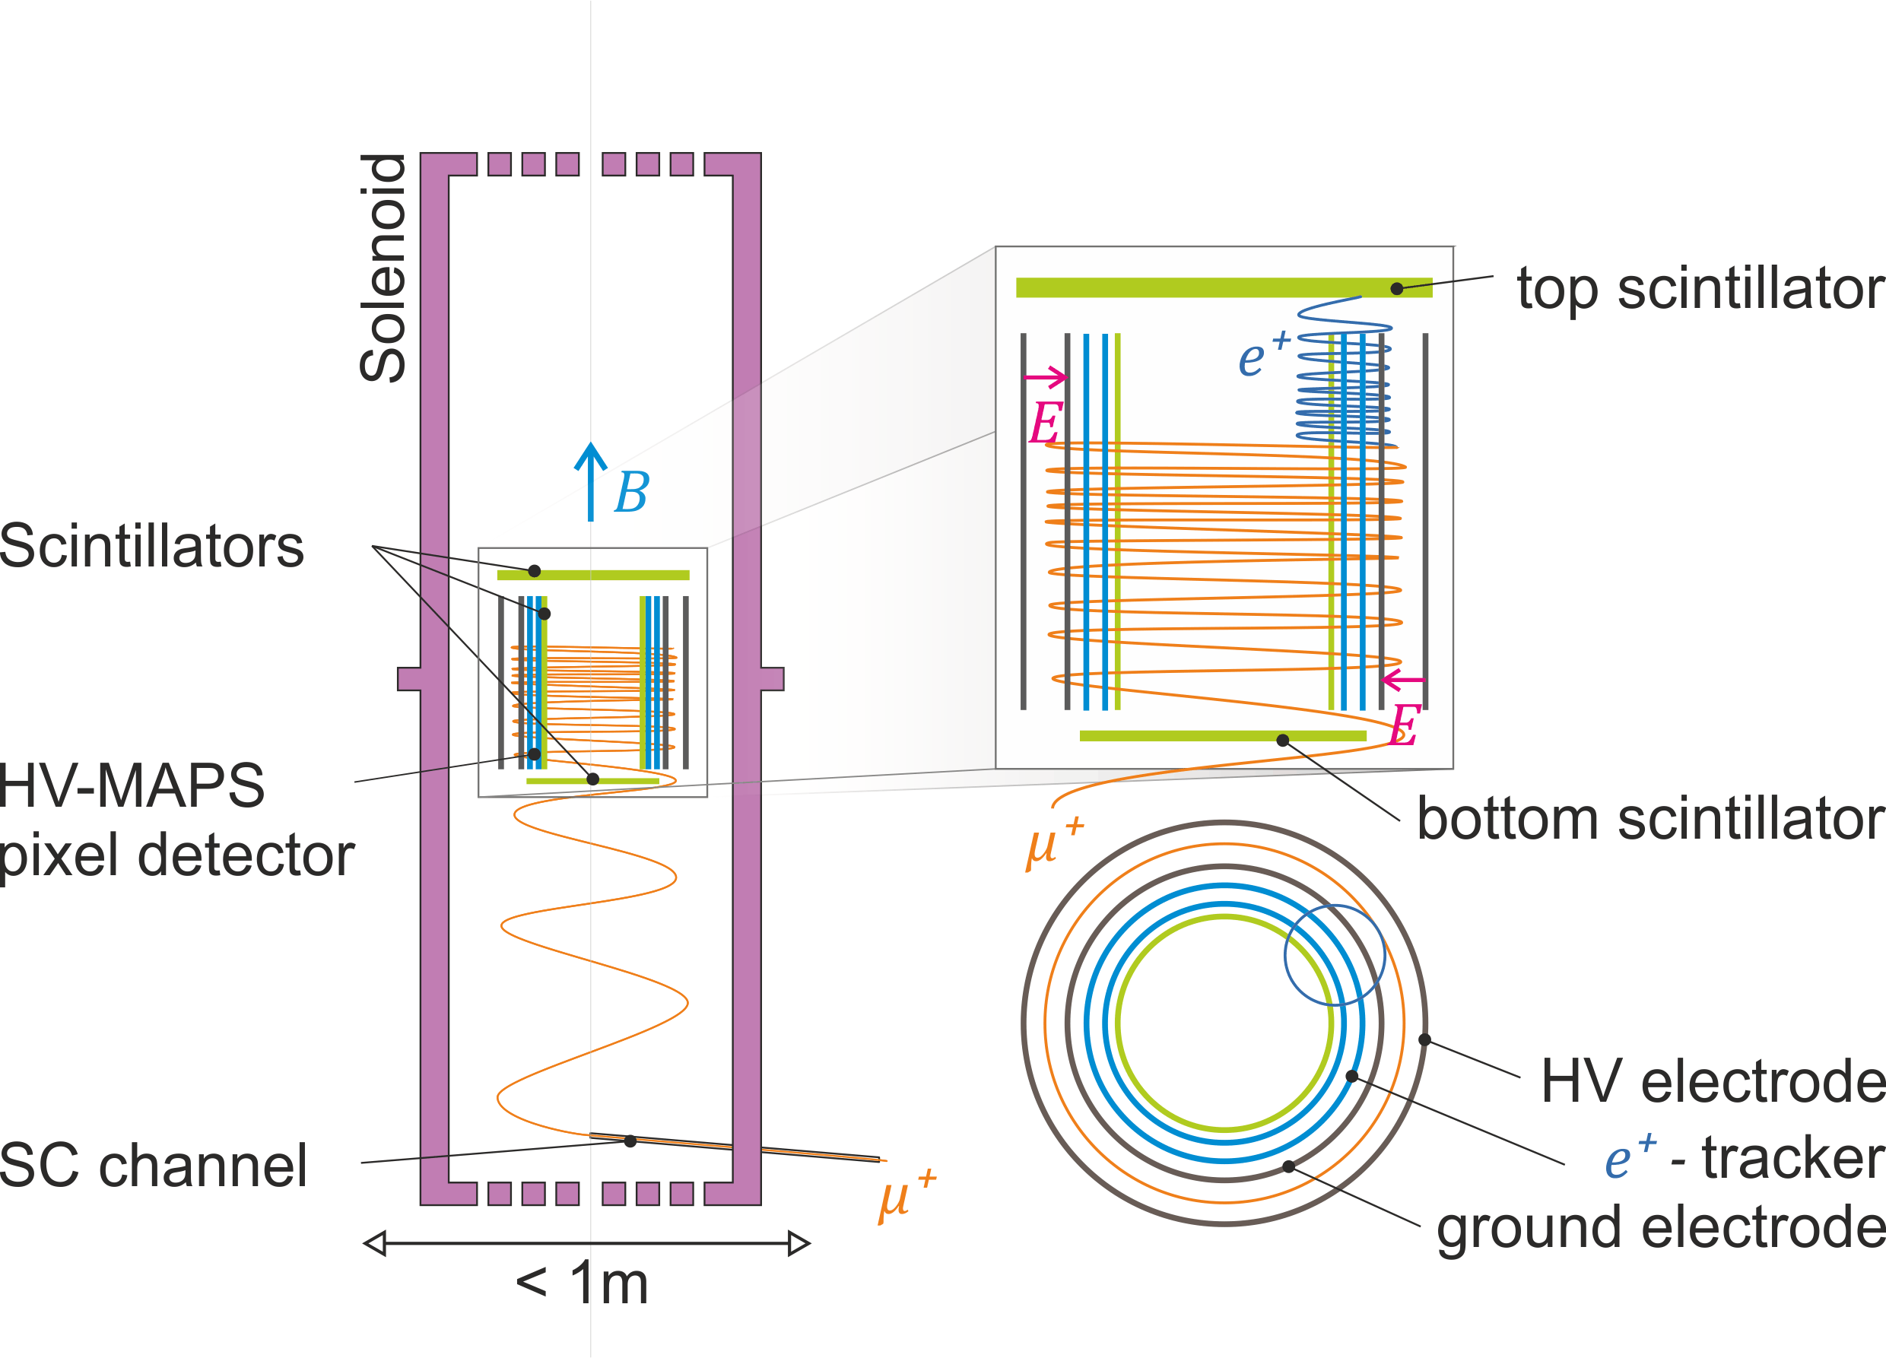
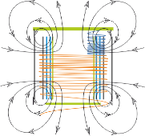




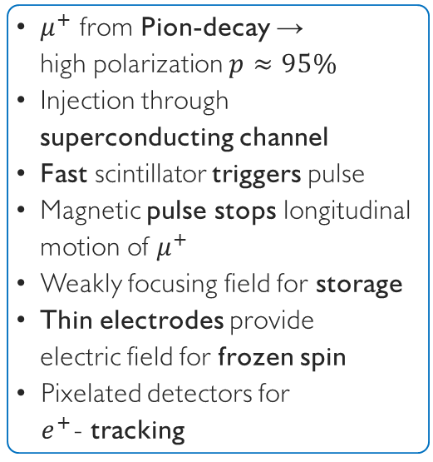




Search for a muon EDM using the frozen-spin technique with longitudinal injection
$μ^{+}$ from Pion-decay →
high polarization $p≈95\%$
Injection through superconducting channel
Fast scintillator triggers pulse
Magnetic pulse stops longitudinal motion of $μ^{+}$
Weakly focusing field for storage
Thin electrodes provide
electric field for frozen spin
Pixelated detectors for
$e^{+}$- tracking
$$B=3T$$
$$R=0.14 m$$
$$\vec{s}$$
$$\vec{s}$$
$$π$$
$${\overline{ν}}_{μ}$$
$$μ^{+}$$
$μ^{+} @ 125MeV/c$ or $28MeV/c$
Notes:
Here is a conceptional sketch of the proposed instrument to search for an electric dipole moment of the muon using the frozen spin technique.
The plan is to use a dedicated highly uniform solenoid, with a weakly focusing field in the center.
We will use positive muons from backwards decaying pions with a very high polarization.
[click]
The are injected through a superconducting channel into the high field region of a very homogeneous solenoid.
Scintillators inside the collimation channel trigger a magnetic pulse.
[click]
While the muon spirals into the central region, a magnetic pulse is prepared to stop the longitudinal motion, such that the muon finally is stored on a stable orbit in the weakly focusing field in the center of the magnet.
[click]
Two cylindrical and very thin electrodes provide the electric field for the frozen spin condition.
[click]
Once the muon decays into a positron, the positron can be observe by a cylindrical tracker within the ground electrode.

Slide 10
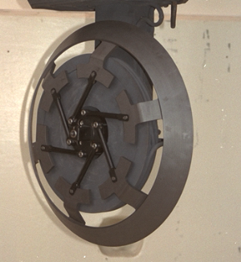
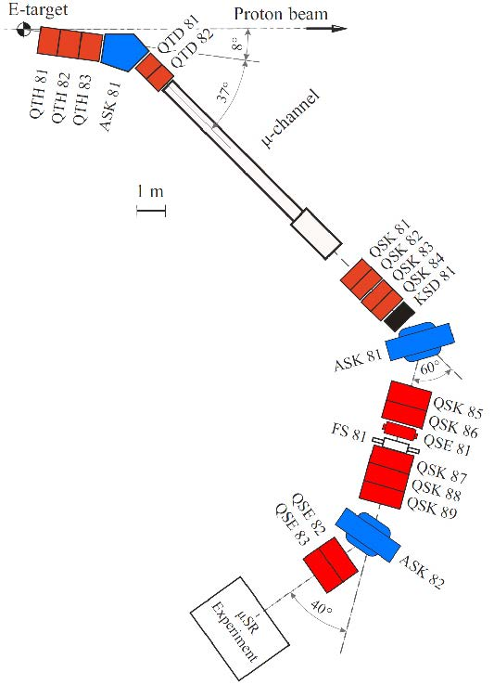
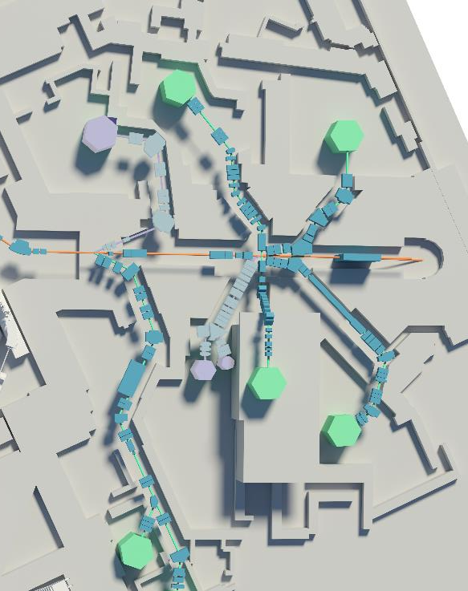
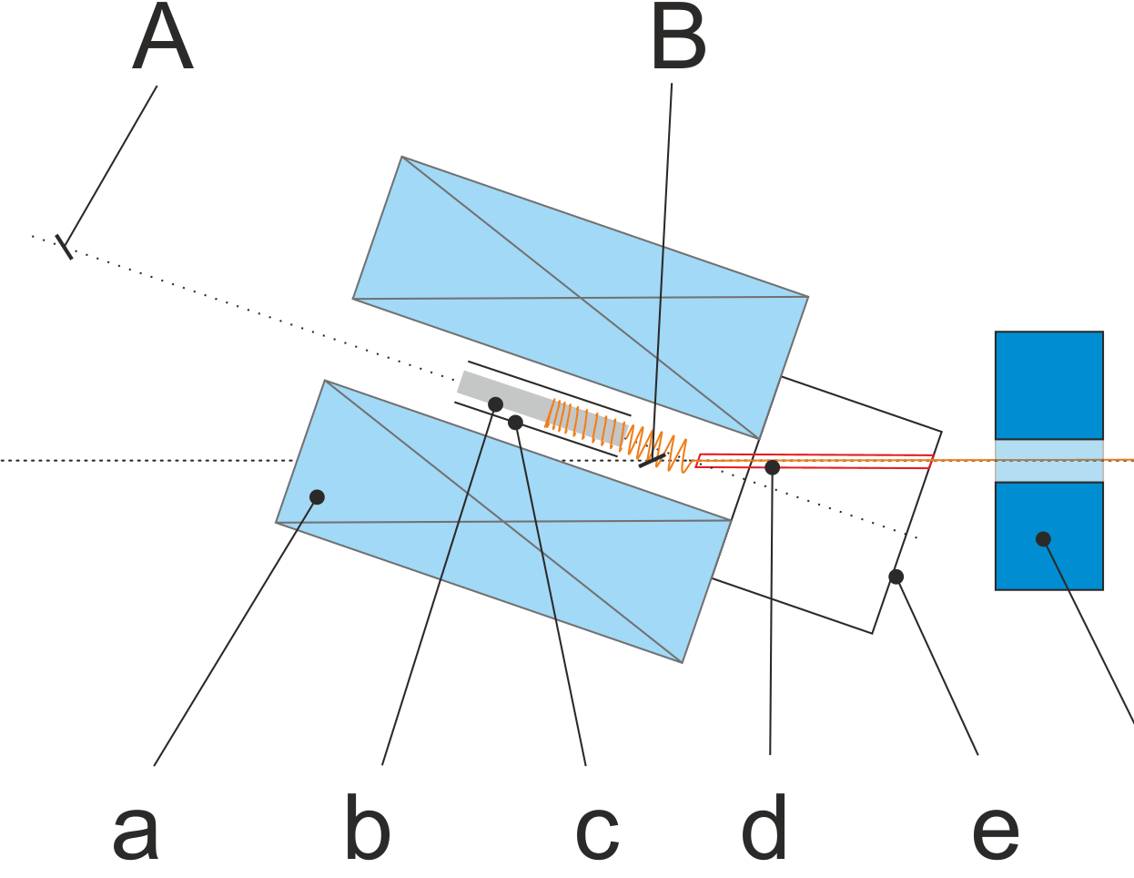


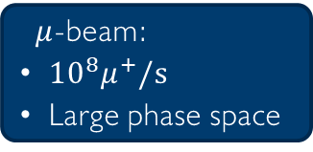

A search for a $μ$EDM at PSI
$$p_{π}=220MeV$$
p -beam
pion decay channel
(8m, 4T)
$μ$-beam:
${10}^{8}μ^{+}/s$
Large phase space
$$p_{μ}=125MeV/c$$
$$μE1$$

Slide 11
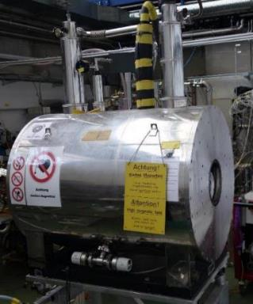
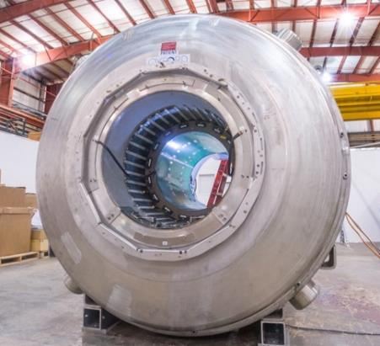
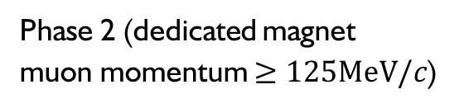
A phased approached
Phase I (small solenoid, surface muons)
Phase 2 (dedicated magnet
muon momentum $≥125MeV/c$)
Argonne 4T solenoid
Existing solenoid at PSI, max 5T
Bore diameters 200mm
Field was measured in 2022
(found suitable for injection)
Large bore (up to 900 mm diameter)
High Temporal field stability (10ppb/h)
Excellent spatial field uniformity
  (<1 ppb/mm)

Slide 12
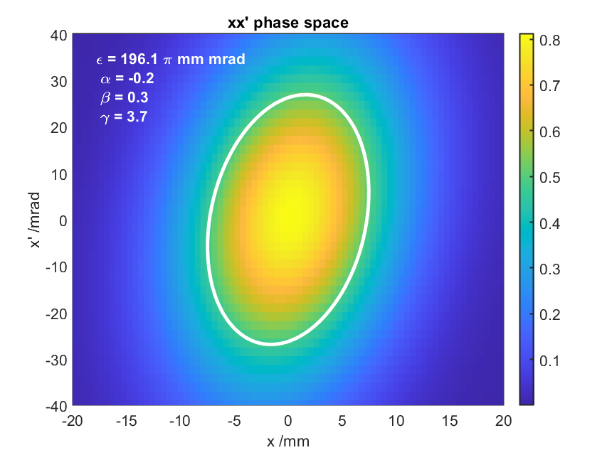
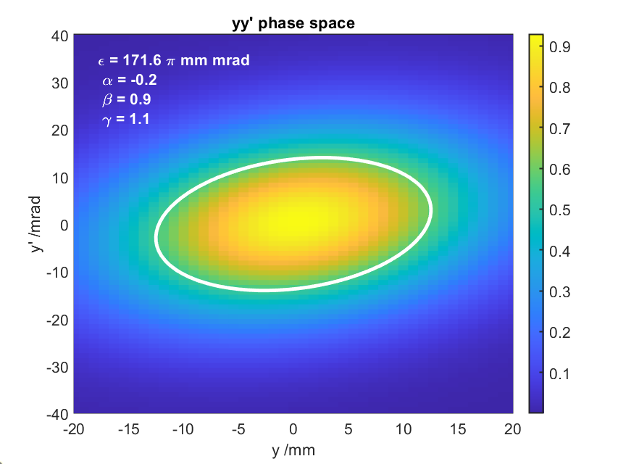
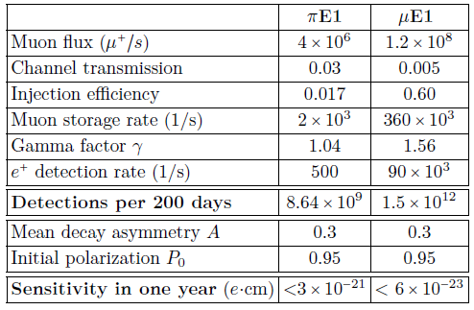

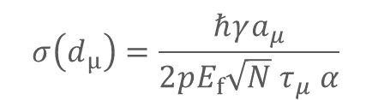
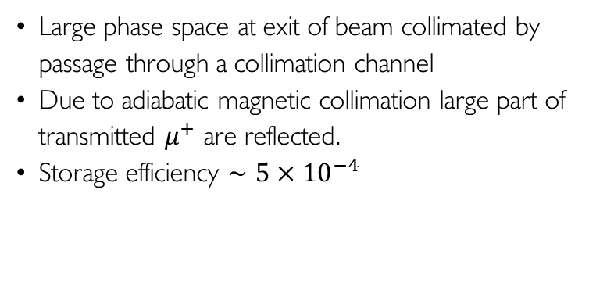

Injection and statistical sensitivity
$$σ\left(d_{μ}\right)=\frac{ℏγa_{μ}}{2pE_{f}{\sqrt{N} τ}_{μ} α}$$
xx’: $ε=196πmm mrad$
yy’: $ε=171 πmm mrad$
Large phase space at exit of beam collimated by passage through a collimation channel
Due to adiabatic magnetic collimation large part of transmitted $μ^{+}$ are reflected.
Storage efficiency $∼5×{10}^{−4}$
Page 12
Notes:
At PSI we will profit from the highest muon fluxes in the world.
The two possible beamlines provide very different energies and phase spaces.
For the precursor experiment we will use low energy muons and profit from a high transmission through the collimation channel
As the solenoid is not optimized only a small fraction will be stored.
Already this precursor experiment will have a sensitivity better than 3E-23 ecm.
In the long run with a dedicated magnet, using higher energetic muons we expect a sensitivity better than 10E-23ecm.

Slide 13
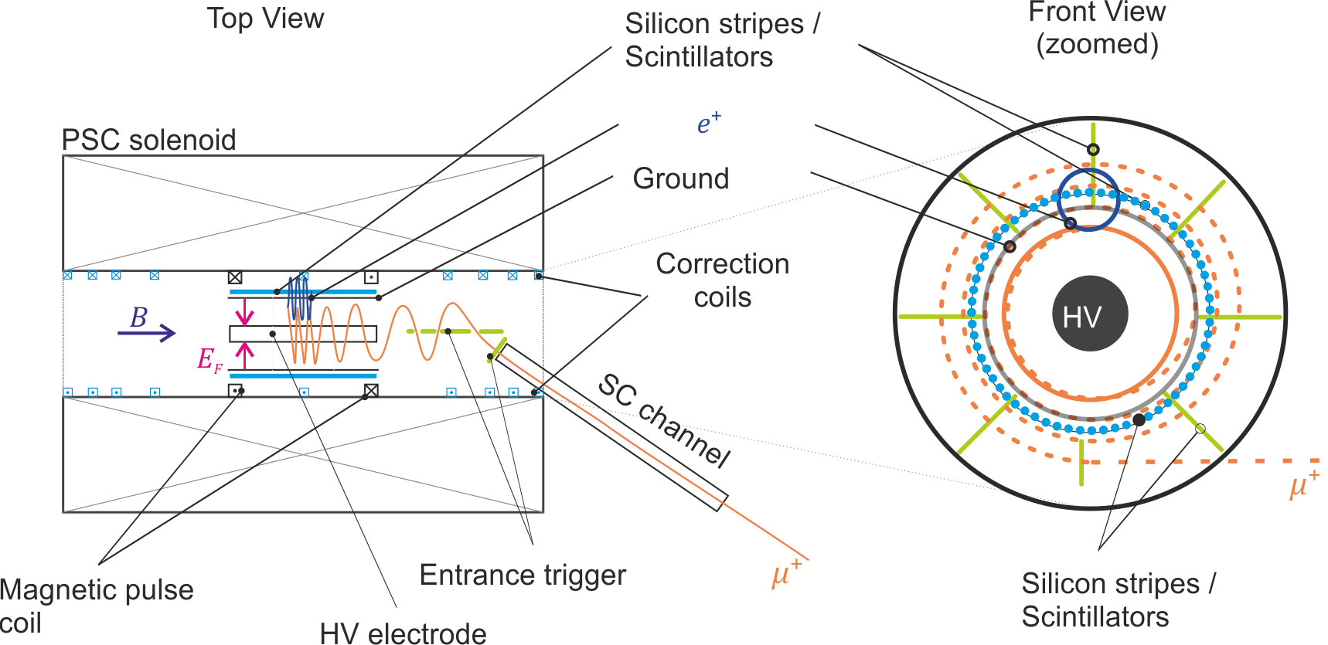
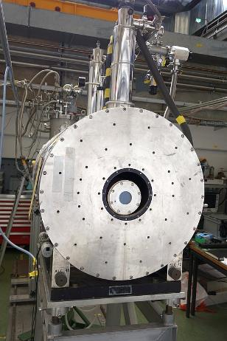

The muEDM phase I on piE1
Test bed and frozen spin demonstrator
muEDM measurement $<3⋅{10}^{−21}ecm$
Notes:
In this application I propose to set up a precursor experiment using an existing soleonid operated at 2T at PSI.
It will feature all relevant technical developments and demonstrate the feasibility of the frozen spin technique.
[click]
A first PhD student will optimize the magnetic field and demonstrate the magnetic pulse for muon storage
[click]
A second PhD student will develop a superconducting injection channel and demonstrate the efficient injection and triggering
[click]
A third PhD student will take care about the high voltage system an demonstrate the frozen spin technique
[click]
We will use scintillating detectors to detect the positrons and trigger the muon acceptance
Finally when all subsystems work we will deploy the frozen-spin technique to measure the muon EDM better than 3E-21 ecm

Slide 14
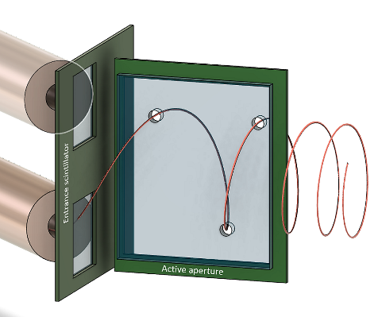
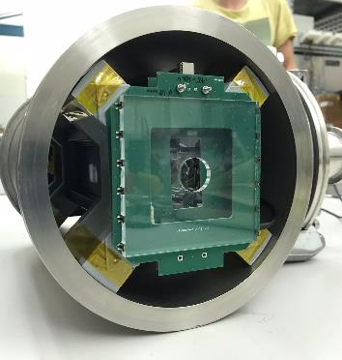
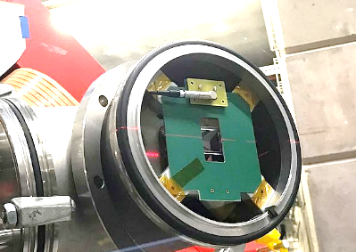
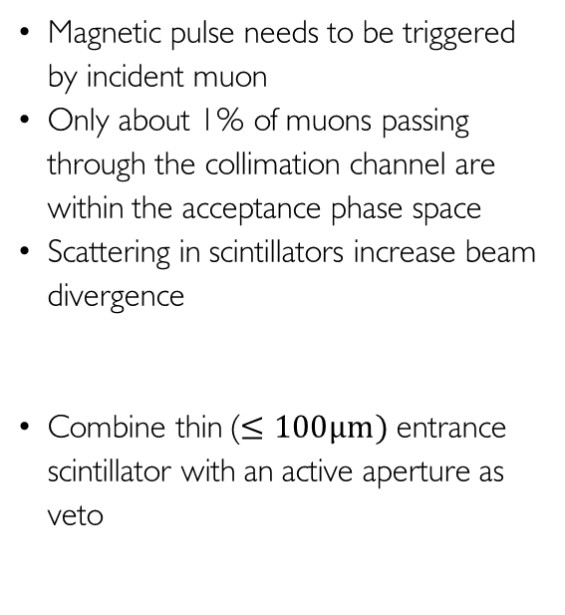
Muon entrance trigger
Entrance
Veto
Magnetic pulse needs to be triggered
by incident muon
Only about 1% of muons passing through the collimation channel are within the acceptance phase space
Scattering in scintillators increase beam divergence
Combine thin ($≤100μm)$entrance scintillator with an active aperture as veto
Entrance
Veto

Slide 15
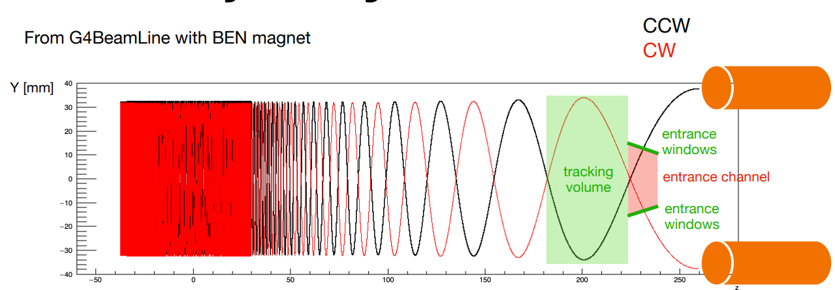
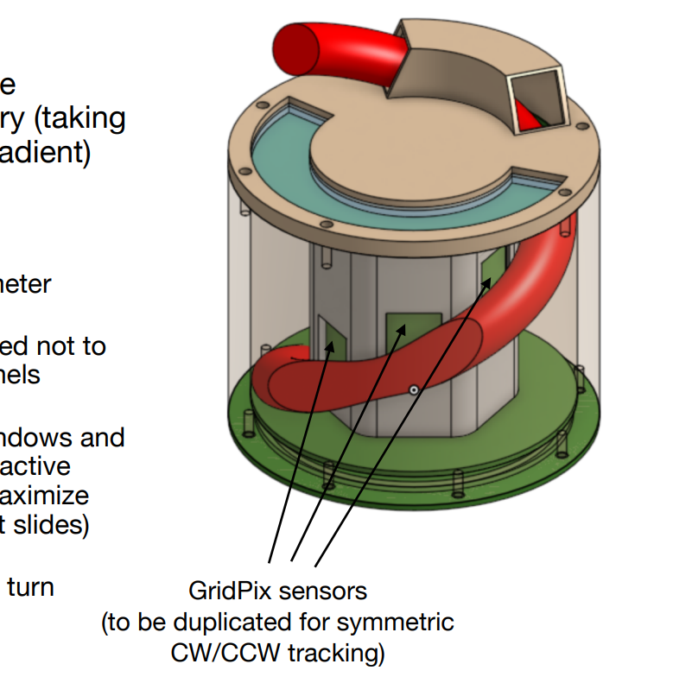
Muon Tracking Detectors
Need to characterize muon trajectory
before EDM measurement
Requires ~ mrad angular and
~0.1% momentum resolution
Gaseous TPC with 2 geometries possible:
longitudinal drift (for momentum), radial drift (for angle).
Design satisfying constraints with sufficient phase-space acceptance possible with current trajectory parameter
Resolution of the phase space reconstruction, with realistic ionization and drift properties from beam test measurements and investigation of low pressure gas options
(courtesy F. Renga)
21

Slide 16
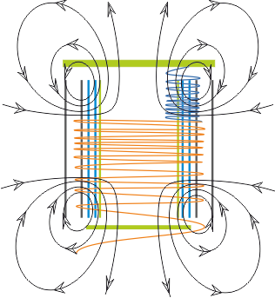
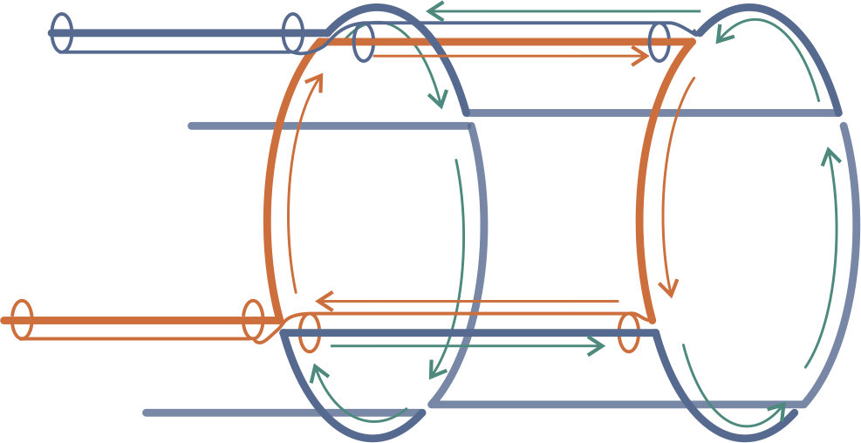
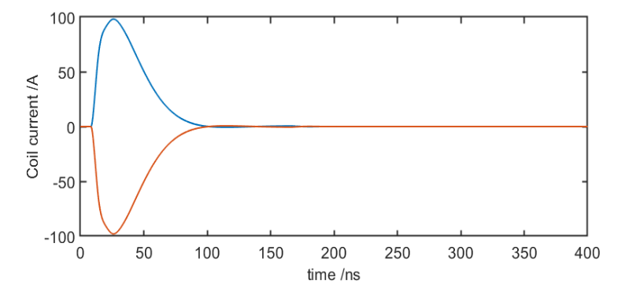
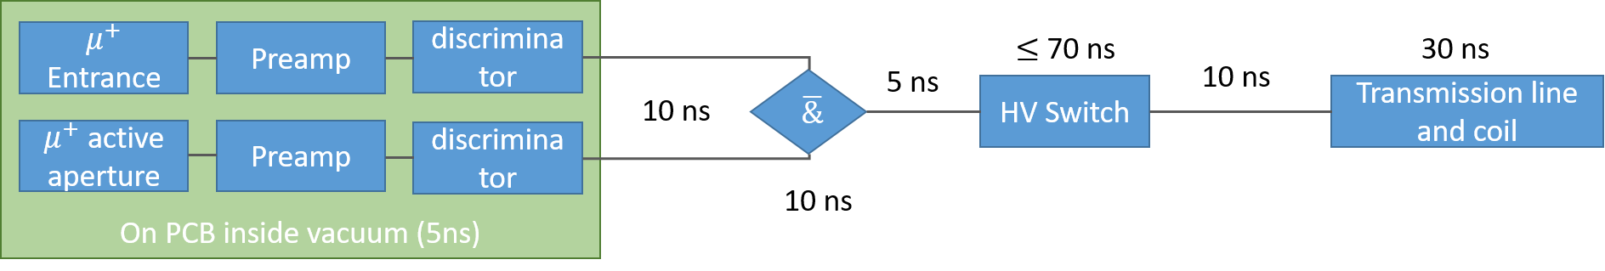

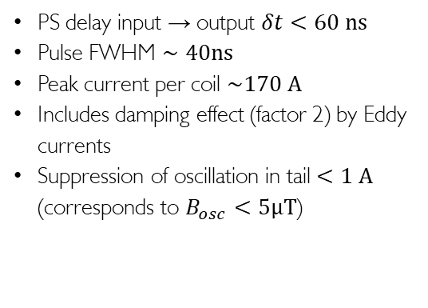
Radial magnetic field pulse to kick muons
$$r=25mm$$
Pulse shape
Pulse generator
PS delay input → output $δt<60 ns$
Pulse FWHM $∼40ns$
Peak current per coil $\sim 170 A$
Includes damping effect (factor 2) by Eddy currents
Suppression of oscillation in tail $<1 A$
(corresponds to $B_{osc}<5μT$)
Page 16

Slide 17
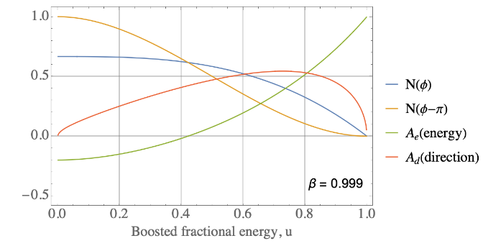
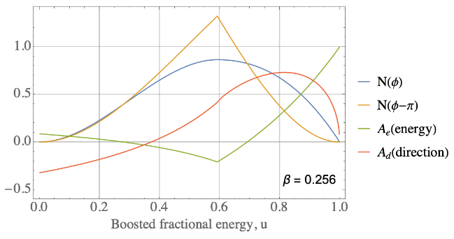


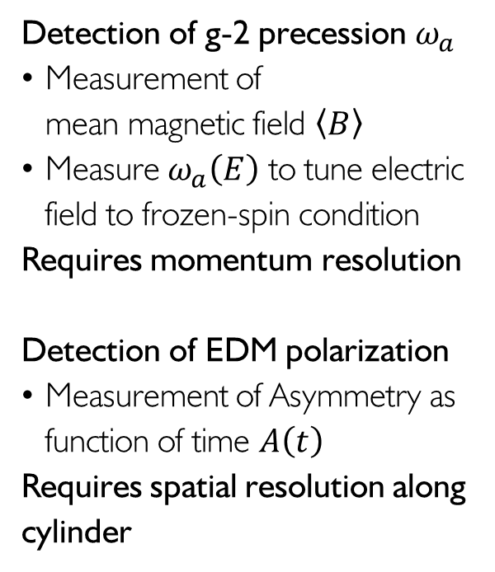
Positron detection – figure of merit
Detection of g-2 precession $ω_{a}$
Measurement of
mean magnetic field $〈B〉$
Measure $ω_{a}\left(E\right)$ to tune electric field to frozen-spin condition
Requires momentum resolution
Detection of EDM polarization
Measurement of Asymmetry as function of time $A\left(t\right)$
Requires spatial resolution along cylinder
FNAL
$$82\%$$
$$\overline{A}=0.46$$
Phase I (PSI)

Slide 18
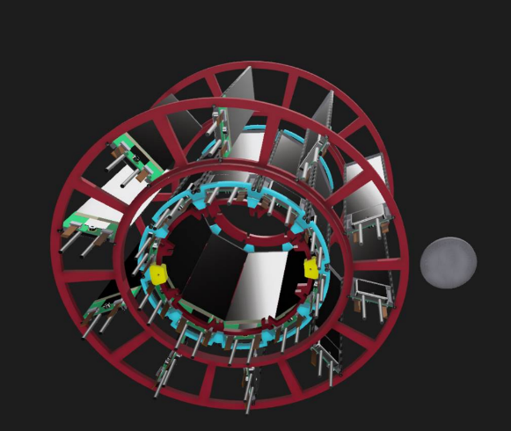


Positron Detection for g-2
Measurement of g-2 to measure B-field and determine voltage
for frozen spin condition
For Phase I (p = 28MeV) maximum energy is ~68.65 MeV
Positrons with momentum greater than 59 MeV will hit the magnet
regardless of decay direction.
For (31 < p < 59) MeV positrons
it depends on decay direction
Cylindrical (silicon strip) tracking
detectors at r=35 mm,47.5 mm
At least 3 hits needed to get a track
(courtesy J. Price)
22

Slide 19


Positron Detection for EDM
For EDM signal, detect up-down asymmetry in photons
Double barrel Scifi tracker, radius of the inner detector currently equal to 50 mm
Bundles of fibers with good resolution
  transverse and longitudinal fibers
  transverse fibers with longitudinal straw/pix
Photon time and position (longitudinal info on internal barrel)
Large number of readout channel a challenge
Considering other possible geometries
23
(courtesy B. Vitali)

Slide 20



muEDM/(g-2) needs in the future
Low emittance & high flux
to inject all delivered muons
“Muon on request”
or pulsed beam
The more muons the merrier
$$E≈aBcβγ^{2}$$
~2.5 mrad
~2.5 mm

Slide 21
g-2 at PSI?
c.f. D. Taqqu
6T

Slide 22
Conclusions and Outlook
A dedicated experiment to experimentally search for muon EDM is being set-up at PSI
In case of null result, it will improve the current experimental upper limit by 3 orders
of magnitude, further improvement with pulsed beams possible (e.g. Fermilab FFA?)
The experiment will take place in two phases, where we will demonstrate the frozen-spin technique in phase 1
Optimization of the design for Phase 1 underway using simulation studies:
prototype building of important components
Test beams demonstrating feasibility
A tinny g-2 could profit from a re-accelerated low emittance cold muon source
Muon multiplicity would require much higher efficiency for muCool
24

Slide 23

The Collaboration

Slide 24
Backup

Slide 25


courtesy: M. Seidel

Slide 26

HIPA – high intensity proton accelerator
Pion and Muon
research
Main cyclotron
590 MeV
I_{p} = 2.4 mA
P=1.4 MW
Cockcroft-Walton
800 keV
nEDM
Injector cyclotron
72MeV
UCN area

Slide 27


Muon Entrance Monitor
Focus muon beam onto opening of injection channel
Scintillator tiles coupled to SiPMs
Hole in center to let muon beam pass
Front tile thickness 1-2 mm to stop
surface muons
A thicker (up to ∼5 mm) scintillator layer could be added to better discriminate muons and positrons
Centering procedure optimized in simulation
Next step, prototype building
(courtesy L. Morvaj)
20

Slide 28



Storage and injection
Strength of weakly focusing field in the center region defines “depth” of storage
The deeper/stronger the weakly-focusing field, the stronger
the pulse needs to be
deceleration
acceleration
Page 28

Slide 29


Tuning the electric field to the frozen-spin condition
Measure the g-2 frequency $ω_{a}$
Two momentum bins
$28 MeV/c$ $<p_{1}<50MeV/c$
${50 MeV/c<p}_{2}$
Change E field in the range
$±E_{frozen}≈±3kV/cm$
Extrapolate to $E_{frozen}$ where $ω_{a}=0$

Slide 30



Silicon strip detector for g-2 detection
Silicon strip detector for g-2 detection
Reconstruction of transverse
positron momentum ($Δp≈5MeV/c$)
Timing $Δt≈2ns$
Spatial resolution $≈0.1mm$
(lateral)
Si-Petal detector

Slide 31



Scintillating fiber detector for EDM-signal
Scintillating fiber detector for EDM asymmetry measurement and timing
Horizontal fiber ribbons with $250μm$
pitch and $100μm$ resolution
Timing resolution $<2ns$
Reconstruction of longitudinal momentum
SciFi-EDM detector

Slide 32



Surface muons for phase-1
Horizontal Emittance: $200 πmm mrad$
Vertical Emittance: $170 π mm mrad$
Beam rate about $4×{10}^{6} s^{−1}$
Acceptance phase space:
  High transmission through channel 3%
  Injection efficiency about 0.4%
  Expected $μ^{+}$ storage rate 2kHz
  Expected $e^{+}$ detection rate 0.5kHz
Moderate E field 3kV/cm

Slide 33


Systematic studies (example)
Systematic effects: all effects that lead to a real or apparent precession of the spin around the radial axis that are not related to the EDM
Major sources of systematic effects in the frozen spin technique:
  Coupling of the magnetic moment with the EM fields of the experimental setup (real)
  Early to late variation of detection efficiency of the EDM detectors (apparent)
Rotations that could mimic the EDM:
  Radial around x
  Azimutal around z
y
x
z

Slide 34








Sources of Ey field: conical central electrode
anode
$$B$$
None constant radius of
cylindrical anode (cone)
Cylindricity on the order of 50 nm is measurable even on large samples and
possible to machine
Ground electrode made of thin foil more difficult to keep deviations from cylindricity below $30μm$
$$E_{y}$$
$$E$$
Will move orbit out of central plane until:
$$\left\langle B_{r}^{∗}\right\rangle =−\left\langle E_{v}/βγ\right\rangle$$
Cancels by reversing $\vec{β}$
needs CW and CCW injection

Slide 35



Geometric phases, and non-uniformities
Magnetic field
Electric field

Slide 36


Detection efficiency asymmetry
The EDM will be deduced from the accumulation of asymmetry between the upstream and downstream detectors that increases with time
Static differences in the detection efficiency of one detector compared to the other is not a problem
Change of the detection efficiency with time is a problem as it will introduce time dependent asymmetry
Positron detectors
y
$$n_{L}=κ_{L}N$$
py
-py
$$n_{R}=κ_{R}N$$

Slide 37



Constraints on the total detection efficiency
Assumption: Change of detection efficiency triggered by pulse,
exponential decay
Detection efficiency of up and downstream detectors:
Change in measured asymmetry
with time:

Slide 38

Systematic study - overview
Systematic effects are studied using analytic expressions
Comparison with GEANT4 spin tracking Monte Carlo for verification
Deduce specifications for experiment
Next steps:
Parametrization of magnetic-field non-uniformity
Deduce magnetic-field requirements

Slide 39






Going from phase I to phase II
Phase I
B-Field 3T
Momentum 28 MeV/c
Muon radius 31mm
Most positrons outside
Phase II
B-Field 3T
Momentum 125 MeV/c
Muon radius 141 mm
Most positrons inside
$≤3×{10}^{−21}$ ecm
$≤6×{10}^{−23}$ ecm

Slide 40



















The collaboration
Now hiring Post Doc

Slide 41

Conclusions and outlook
At PSI we are setting up an experiment to demonstrate the frozen-spin technique with a sensitivity of a few 10⁻²¹ ecm to the EDM of the muon
In the next four years we will demonstrate all necessary techniques, and design a dedicated hi-fidelity solenoid
Using muons with a moment larger than125 MeV/c and the new solenoid we will reach a sensitivity of 6x10⁻²³ ecm

Slide 42
Backup

Slide 43

Finding New Physics with Flavor
At colliders one produces many (up to 10¹⁴) heavy quarks or leptons and measures their decays into light flavors
Experiment
SM
b→sµµ
PIONEER
New Physics
Mu3e
MEG
LHC
Flavor observables are sensitive to higher energy scales than collider searches
Courtesy Andreas Crivellin

Slide 44

Fine-Tuning?
Bigaran, Volkas, 2110.03707
No signifcant tuning necessary
8
Courtesy Andreas Crivellin

Slide 45



Eddy current damping of magnetic pulse
Exist off the shelf without substrate down to $17μm$
Still considerable damping of magnetic pulse possible
Tests requires
Alternative one dimensional wires
(carbon fibers / tungsten)

Slide 46






Multiple scattering measurement on carbon
Exit scintillator
Characterization of potential electrode material with
positrons and muons
$$50 MeV/c<p<145 MeV/c$$
$$μ^{+}, e^{+}$$
Carbon foil $17μ$
MuPIX10
Notes:
So far we have characterized two potential muon beam lines
piE1
muE1
Both have high polarization above 95% and very high muon fluxes
We have measured the lateral phase space
Here you see the vertical phase space of muE1
Only a small fraction will pass through the collimating channel
We started to simulate the muon injection and positron detection
Measurement of multiple scattering of muons and positrons on thin foils for electrode construction
Use of 6 layer beam telescope made of pixelated silicon detectors.

