Slide 1
Muon cooling at J-PARC
S. Kamioka
KEK, IPNS
Muon4Future

Slide 2
Table of contents
Introduction
Key technologies and expected performance
Current status of muon cooling experiments
Future prospect

Slide 3
Table of contents
Introduction
Key technologies and expected performance
Current status of muon cooling experiments
Future prospect

Slide 4
Ultra-slow muon (USM)
μ⁺ cooling is important technique for future experiments using μ⁺
  Muon precision measurement, muon acceleration and colliders…
Development of ultra-slow muon source: muon cooling at J-PARC
Laser ionization of thermal muonium
  Surface μ → Mu target→ Emission of thermal Mu → Laser ionization of vacuum emitted Mu → USM → Extracted by E-field
Pulsed UV laser
Ultra-slow muon (USM)
E = 30 meV, p = 2.3 keV/c, Δp/p = 0.4
(thermal)Mu
Surface Muon
E: 3.4 MeV
P = 27 MeV/c
Δp/p = 0.05
μ⁺
Immersion lens
Muonium target
Laser ionization (Mu→μ + e)

Slide 5
Specification of USM
Normalized RMS emittance : ~ 0.5 π mm mrad.
  Surface muon: ~ 1000 π mm mrad.
  Determined by Mu spatial distribution and its energy
Energy: 30meV
  Determined by temperature of the target. p_{x,y} ~ 3keV/c.
Polarization: 50%
  Due to fast spin exchange interaction of muonium (4GHz)
Efficiency: up to 10⁻³ / μ
  Depends on the laser energy and muonium target.
Timing profile: short pulse. FWHM ~ 2 ns
  Determined by laser pulse. USM is short pulse in usual.
Only positive muon can be cooled

Slide 6
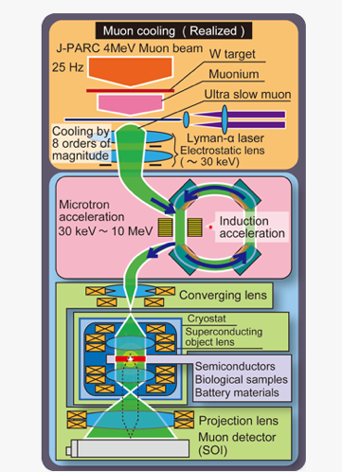
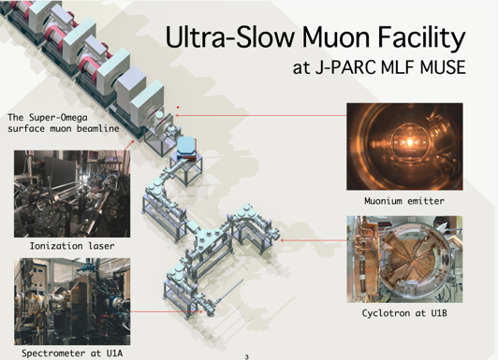
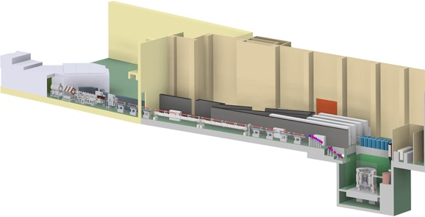
Proposed experiments featuring USM
USM = short pulse & low energy muon source
Many experiments featuring USM are proposed (some of them: ongoing).
  Muon g-2/EDM experiment
  Mu 1S-2S spectroscopy experiment shares the same technique
  muSR
  Transmission muon microscope
  μTristan
Transmission Muon Microscope
J-PARC MLF U-line (USM facility)
Muon g-2/EDM experiments

Slide 7
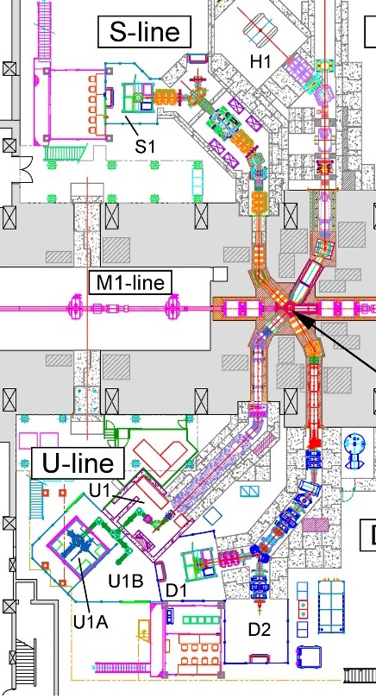
Overview of current USM experiment at J-PARC
Several experiments featuring USM are underway at different beamlines.
U-line: Study of USM→muSR & muon microscope.
S-line: muonium 1S-2S spectroscopy experiment + RFQ acceleration of USM
H-line: H2 area is under construction and will be used for g-2 experiment and muon transmission microscope

Slide 8
Table of contents
Introduction
Key technologies and expected performance
Current status of muon cooling experiments
Future prospect

Slide 9
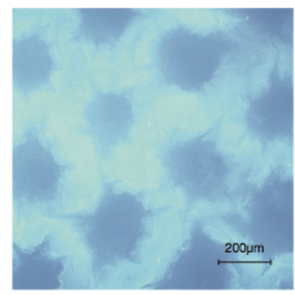
High efficiency muonium target
A laser ablated aerogel target
  Aerogel: Long term stability and room temperature
  Holes at the surface to increase the effective emission area.
  10 times better emission efficiency compared to a conventional aerogel.
Modeling of the target using random walk inside a target.
  Temperature is evaluated to be 320K from the measured emission profile.
Another target: Hot tungsten (2000K)
This target is also used at MLF.
Today, I focus on the aerogel target.

Slide 10




Resonant multi-photon ionization
Ionization of muonium directly from its ground state is very difficult.
  No intense 13.6eV light source exists.
Mu is once excited to its higher energy state, then it is ionized.
  Mu excitation w/ VUV or DUV pulse and ionization using UV pulse.
  Feasible as excitation is much efficient + longer wavelength.
Two development: 1S→2P→unbound & 1S→2S→Unbound.
Unbound
Unbound
Unbound
355nm
244 nm
2P state
2S state
91nm
Plan. A
Most efficient
Plan. B
+ Useful for
spectroscopy
Very difficult
122nm
244nm
1S state
1S state
1S state

Slide 11
Resonant multi-photon ionization
Ionization of muonium directly from its ground state is very difficult.
  No intense 13.6eV light source exists.
Mu is once excited to its higher energy state, then it is ionized.
  Mu excitation w/ VUV or DUV pulse and ionization using UV pulse.
  Feasible as excitation is much efficient + longer wavelength.
Two development: 1S→2P→unbound & 1S→2S→Unbound.
Technically easier wavelength, but high energy is required
The most efficient process, but technically difficult
Unbound
Unbound
Unbound
355nm
244 nm
2P state
2S state
91nm
Plan. A
Most efficient
Plan. B
+ Useful for
spectroscopy
Very difficult
122nm
244nm
1S state
1S state
1S state

Slide 12
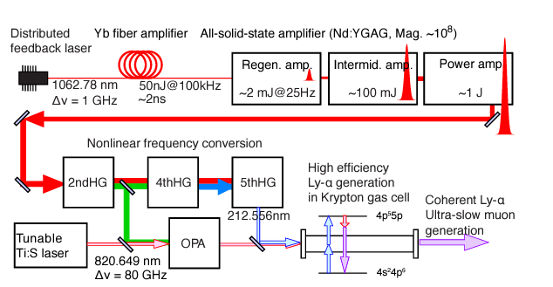
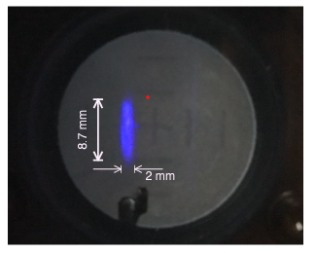
Solid state VUV light source
Key technology for 1S->2P->Unbound scheme is a high energy, 25Hz, long time stable VUV light source
  Large Mu emission region→ (relatively) high energy is required.
  Goal: 122nm, 100μJ, 2ns, 80GHz linewidth, 25Hz rep
All solid-state laser for 122-nm light source at J-PARC
  Solid state laser → long lifetime and better stability.
5μJ at the muonium target is under operation at MLF U-line.
Y. Oishi et al, 2023 J. Phys.: Conf. Ser. 2462 012026

Slide 13
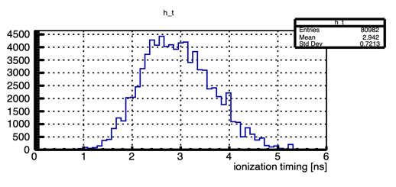
Expected performance at MLF H-line
Simulation assuming J-PARC MLF H-line. (efficiency depends on a beamline)
  Surface μ→stopping inside target→muonium diffusion→laser ionization
Expected USM flux : ~10⁵ Hz with 100μJ @122-nm+300mJ @355-nm.
  Efficiency: ~ 1×10⁻³ / surface μ
Expected USM spatial distribution
Mesh electrode (surface of aerogel at z=0)
X-Y
Y-Z
Surface
μ
Laser
Laser
Timing profile
Velocity distributions
2ns
30meV

Slide 14
Table of contents
Introduction
Key technologies and expected performance
Current status of muon cooling experiments
Future prospect

Slide 15
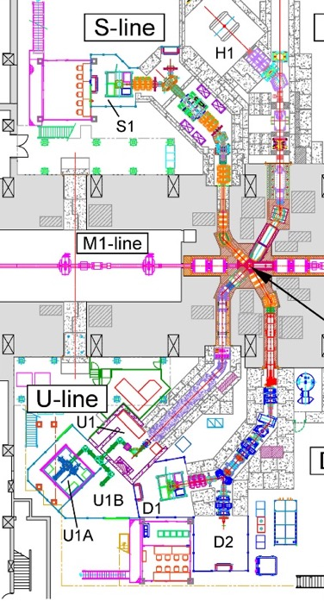

Demonstration of muon cooling
Recently, experimental demonstrations and evaluations of USM w/ aerogel target are being performed at J-PARC MLF.
Extracting the USM with a SOA lens, then USM is detected by a MCP after magnetic and electrical bend.
Schematic view of the experimental setup
Mesh electrodes
Target
B and E bend for particle selection
Surface μ
Electrostatic
lens
Laser
Up to 30keV
MCP

Slide 16
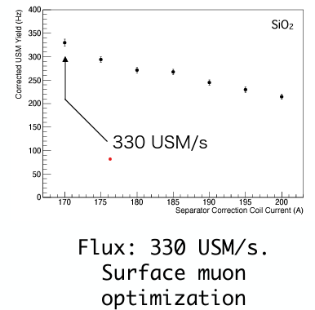
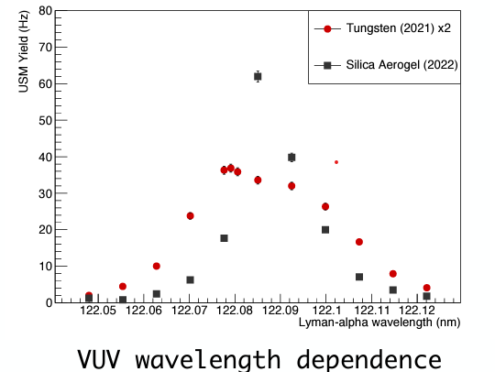
Demonstration @ MLF U-line
1S-2P-unbound scheme. Performed last year at MLF U-line.
Aerogel target + Laser (~2.5μJ @122-nm and ~7mJ @355-nm.)
  USM rate after extraction is 330Hz. The best record so far.
Laser frequency scan→ observing narrower resonance width than that of Mu emitted from a hot target (2000K)
Convolution of doppler effect and linewidth of 122nm pulse
Report in the Muon Advisory Committee 2022

Slide 17
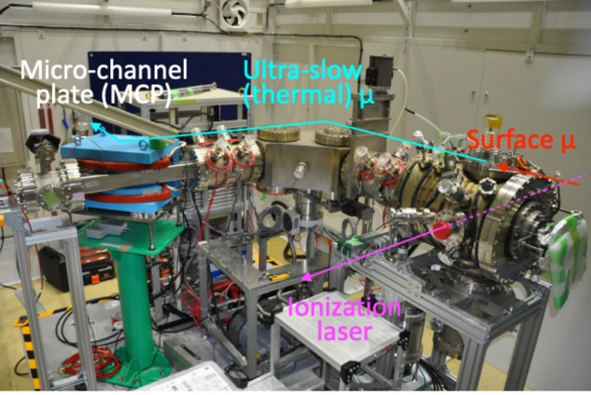
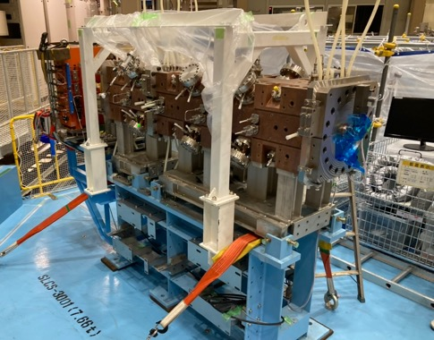
Demonstration @ MLF S-line
Collaborating with Muonium 1S-2S spectroscopy experiment, evaluation of the emittance of USM is ongoing (from March 2023).
  A 244-nm pulsed laser is developed by Okayama univ.
Using MCP and CCD camera as a beam profile monitor, q-scan measurement is underway to estimate the initial phase space of USM.
  RFQ acceleration test in this FY.
MCP for counting event rate & Beam profile monitor to measure USM beam size after extraction
World 1st acceleration of USM
will be performed in this FY
RFQ @ MLF

Slide 18
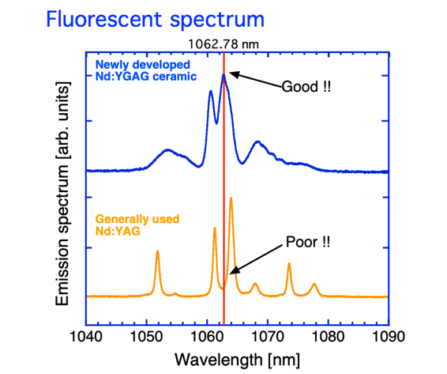
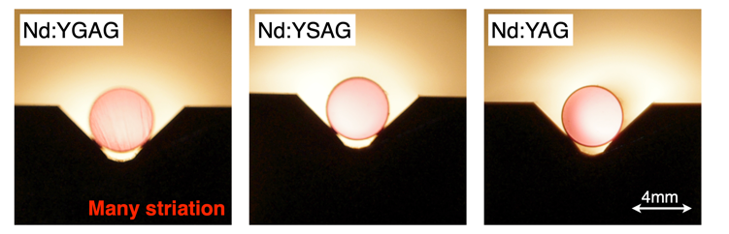
Recent laser upgrade activities:
1S-2P-unbound scheme
Difficulty is the amplification of 1062.78nm for generation of 122nm.
  Nd:YGAG/Nd: YSAG for 1062.78nm has worse crystal quality.
  Brute-force amplification using longer/larger crystals results in worse quality.
Another important R&D is the degradation of optics
  VUV/DUV is harmful for optics and crystal.
R&D of new amp. for ×2 energy.
R&D to increase the lifetime of optics (Recently, focusing on residual gases)
Improvement of design for H2 area
  For better laser efficiency by design

Slide 19

Recent laser upgrade activities:
For 1S-2S-unbound scheme
High energy 244-nm pulse laser is under development at KEK Tsukuba.
  To see the possible best performance of 1S-2S-unbound scheme.
  Easier handling/evaluation than 122-nm → Useful for USM R&D
  It can also generate intense 355-nm pulse→ for 1S-2P scheme.
355 nm
(for 1S-2P)
810 nm or 885nm LD
(Solid state)
Nd:YAG laser
1064nm
AMP
SHG
532 nm
Two applications
Nd:YAG crystal
Ti:S laser
732 nm
AMP
THG
244 nm
Ti:Sapphire crystal

Slide 20
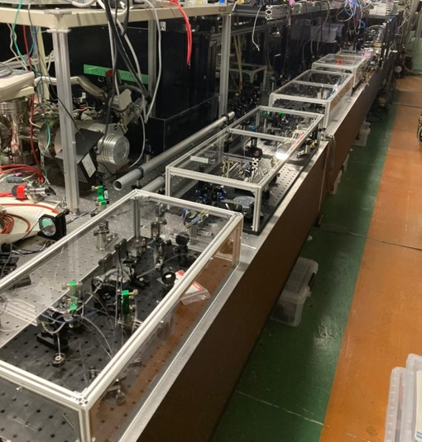
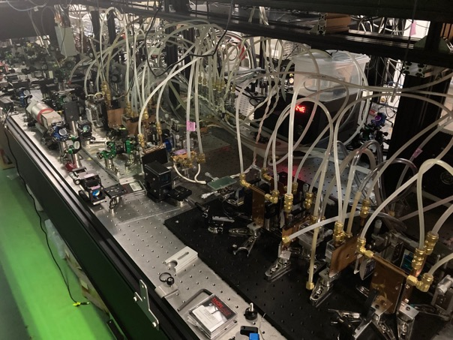
Current status of the laser at Tsukuba
Development at 5Hz is underway to focus on study of laser efficiency.
  Solid-state Nd:YAG laser can generate <1.8J at 1064nm (goal: 2J)
  High energy 244nm generation test in this summer + high energy 355nm generation in this FY.
  Switched to 25Hz after that.
Ti:S laser system
Nd:YAG laser system

Slide 21
Table of contents
Introduction
Key technologies and expected performance
Current status of muon cooling experiments
Future prospect

Slide 22
Milestones of
USM source development
Towards >10⁵ Hz in FY 2026 at MLF H2 area
  Laser upgrade, new beam area and acceleration test. (4MeV)
First USM acceleration using an RFQ
Construction of a new laser room
USM flux 1kHz @ MLF U-line (2023-2024)
USM flux: 10kHz at MLF U-line
4.3 MeV acceleration of USM using IH
FY 2023
FY 2024
FY 2025
FY 2026
H2 area is ready
Lasers for short term R&D is installed at H2.
USM generation test at H2 area
Start the development of a new laser for 100μJ @ 122-nm.
100μJ@122-nm and 300mJ@355-nm for long-term use are ready.
Designed USM flux @ H2-area

Slide 23
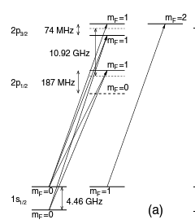
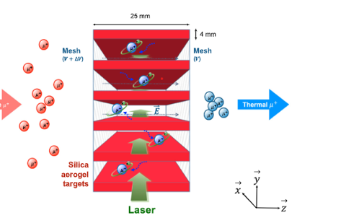
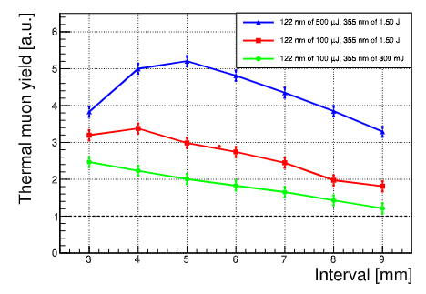
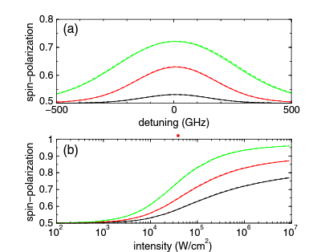
For future
Proposals to achieve more USM flux or better spin polarization.
  Just increasing the laser energy more and more is not efficient at some point.
Exciting ideas as candidates for the future improvement.
Proposal of multi-layered Mu target
Proposal of optical pumping of Mu
C. Zhang et al, NIM. A, 1042 (2022) 167443
Circularly polarized laser→ re-polarization of spin
Color: # of pulse (one, two, three)
Larger Mu emission region
→ Ideally five times more USM flux with five times more laser.
→ 2.5 time more USM with the same laser energy
T. Nakajima. Journal of the Optical Society of America B 2012, 29(9): 2420-2424

Slide 24
Summary
Muon cooling with a high efficiency muonium target and high energy pulsed lasers are being developed at J-PARC.
Ultra-slow muon (USM)
Demonstration of ultra-slow muon generation with a laser ablated aerogel target and lasers are ongoing.
Development of more intense laser towards 10⁵ Hz are ongoing in parallel.
  Two schemes in parallel for efficient development.
New ideas for more intense or polarized USM have been proposed. Interesting future plans.

Slide 25
Acknowledgments
J-PARC g-2/EDM muon source group
  T. Mibe, J.H. Brewer, K. Ishida, S. Kamel, G.M. Marshall, A. Olin, K. Suzuki
MLF U-line
  S. Kanda, N. Teshima
Laser development
  Y. Oishi, M. Yoshida
Mu 1S-2S spectroscopy group from Okayama univ.
  S. Uetake, Y. Imai, S. Yamamoto and others.

