Slide 1

Muon ionization cooling results and prospects
… with a focus on MICE
K. Long, Imperial/STFC; — 29 May, 2023

Slide 2

A pleasure to
acknowledge!
Friend and
colleague

Slide 3
Unique advantages of muon accelerators
Energy frontier lepton-antilepton:
No brem-/beam-strahlung
  Rate ∝ m⁻⁴
  [5 × 10⁻¹⁰ cf e]
Efficient acceleration
  Favourable rigidity
Enhanced Higgs coupling
  Production rate ∝ m²
  [5 × 10⁴ cf e⁺e⁻]
Neutrino beams
ν_{e}, ν_{μ}
Precisely known energy spectrum

Slide 4
Muon Collider: MAP schematic
Pastrone et al.

Slide 5

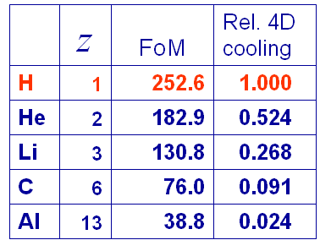
The principle of ionization cooling
Competition between:
  dE/dx [cooling]
  MCS [heating]
Optimum:
  Low Z, large X₀
  Tight focus
  H₂ gives best performance

Slide 6
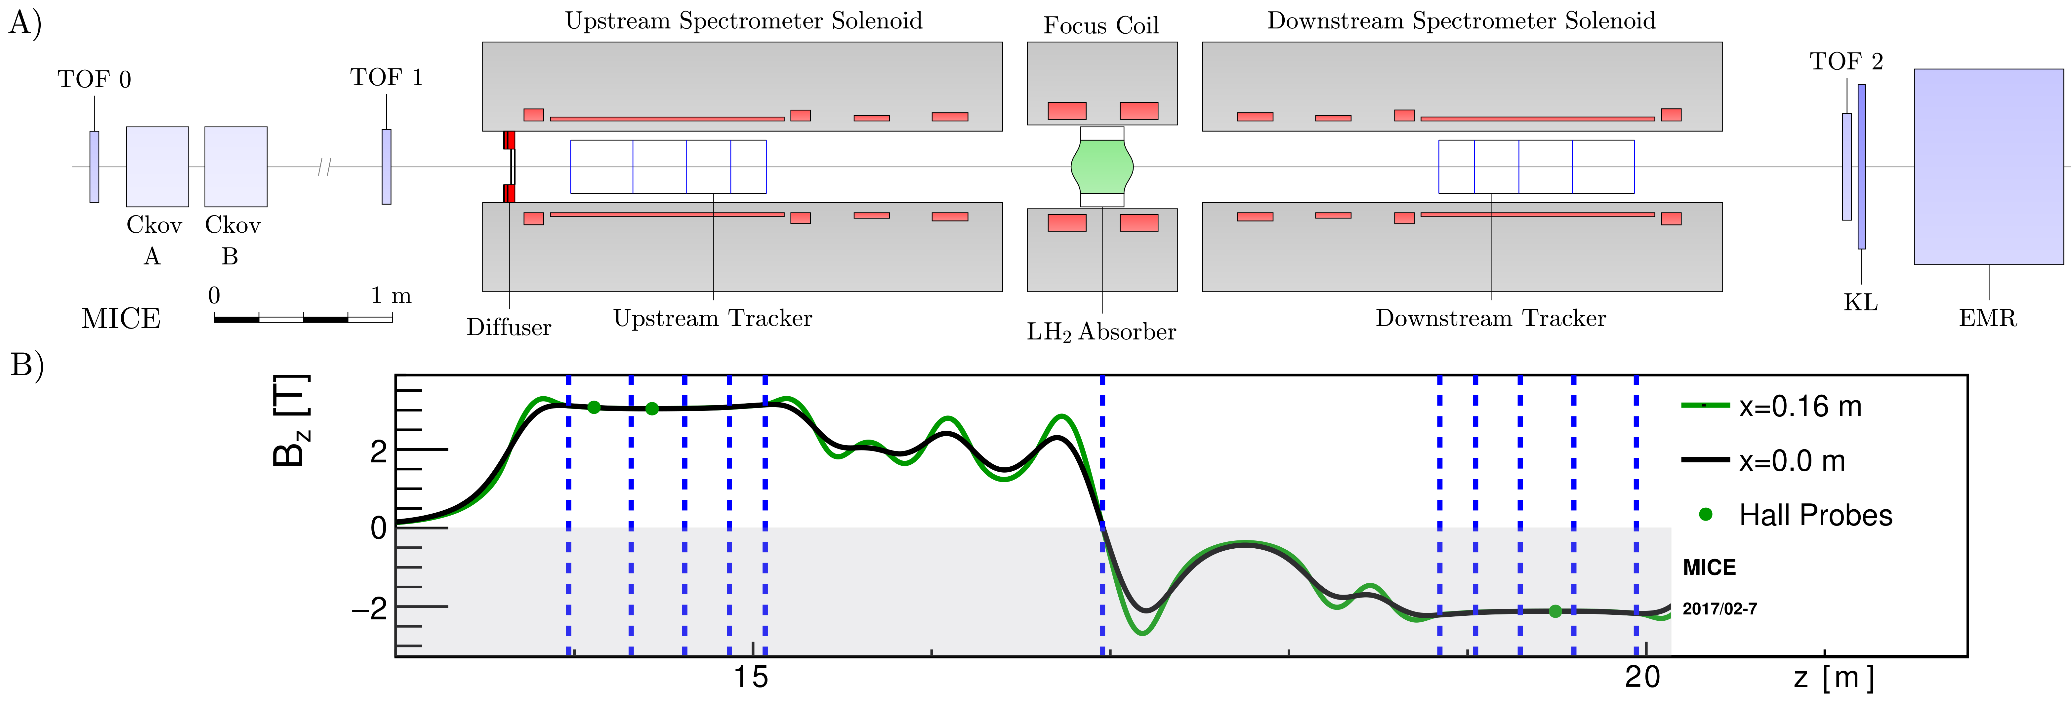
Schematic of the experiment

Slide 7
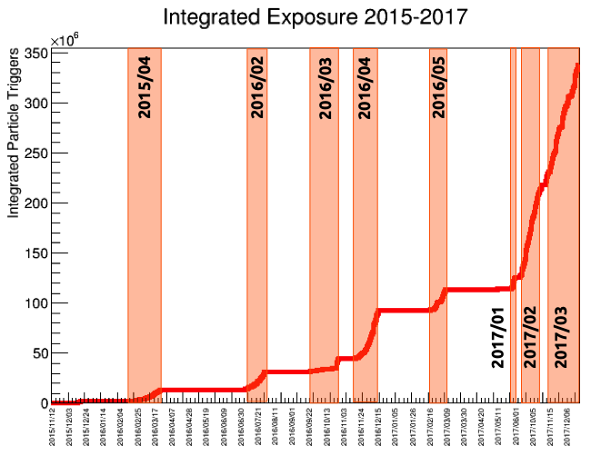
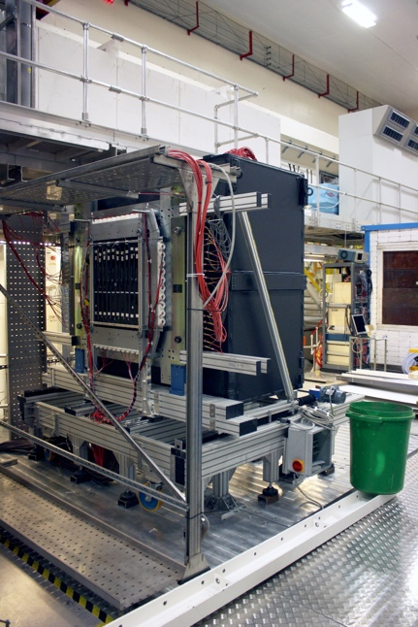
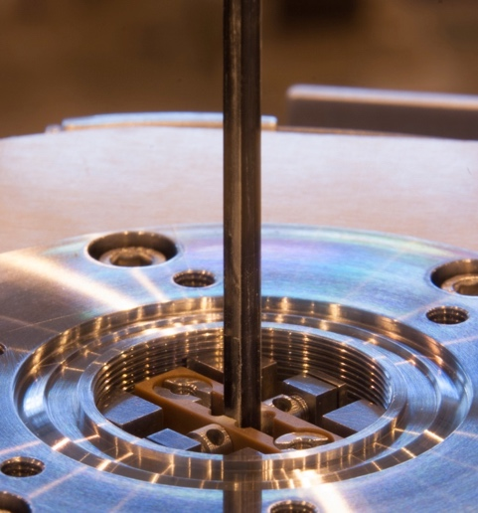
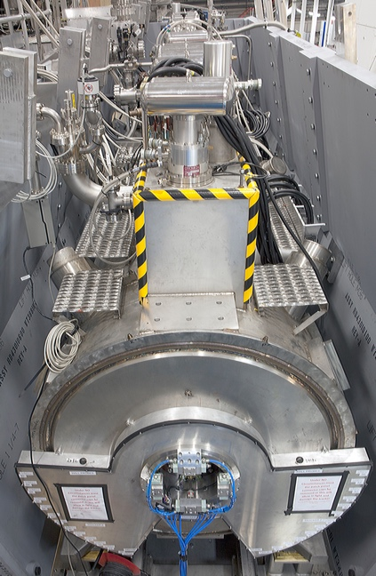
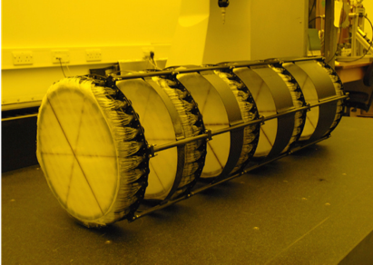
Rejection of decays:
TOF2
KLOE Light ‘preshower’ (KL)
Electron Muon Ranger (EMR)
‘e-tag’ efficiency w\ EMR: > 98.6%
Pure muon beam selection:
High precision (55 ps) time-of-flight
hodoscopes (TOF0, TOF1)
Threshold aerogel Cherenkov counters
Measured π contamination < 1.4% (90% C.L.)
^{(w\ KL)}
Transverse phase space measurement:
Scintillating-fibre trackers
Spectrometer solenoids

Slide 8
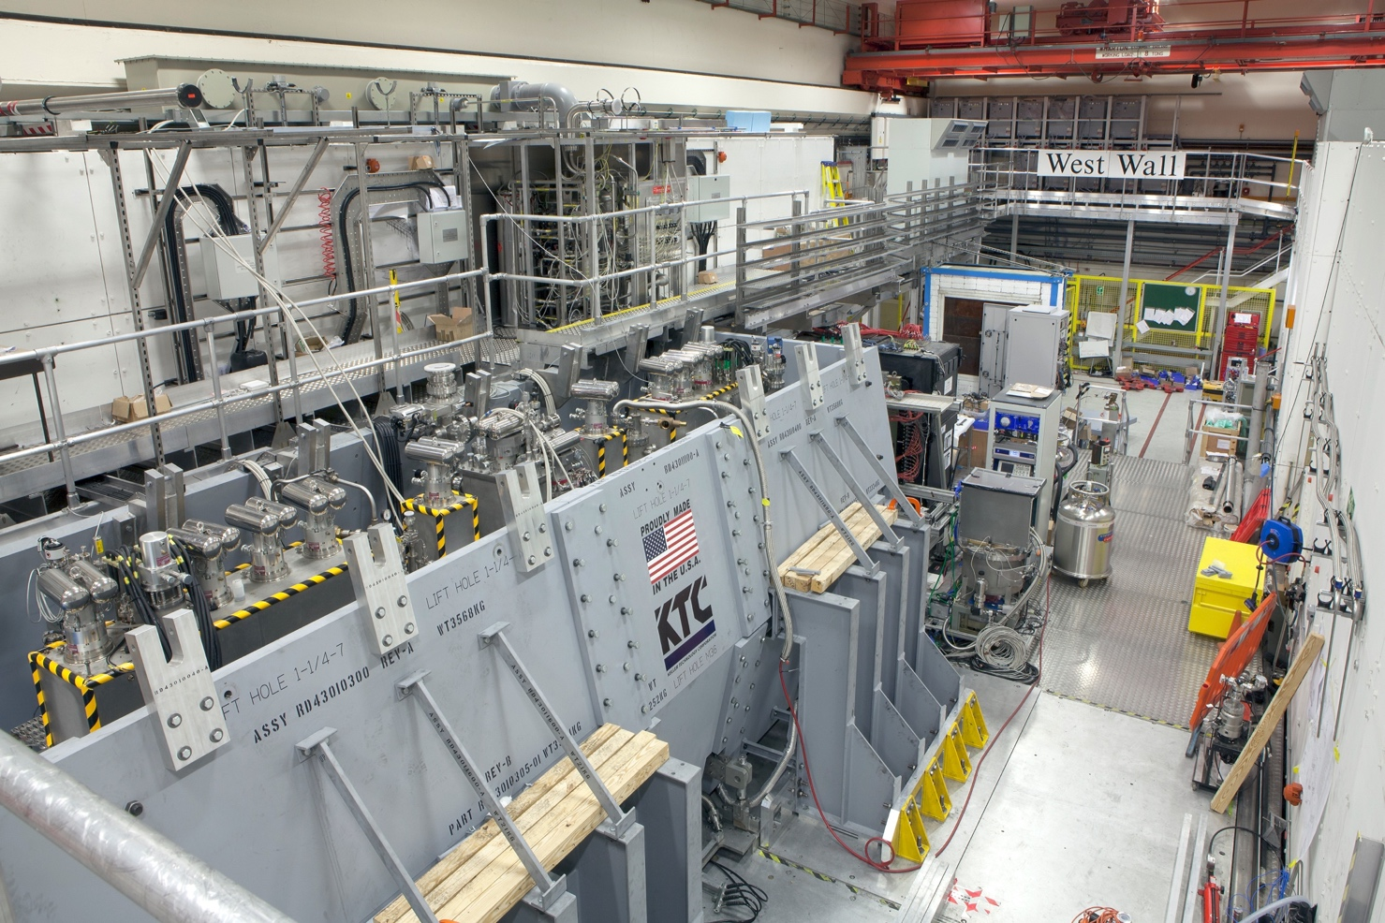
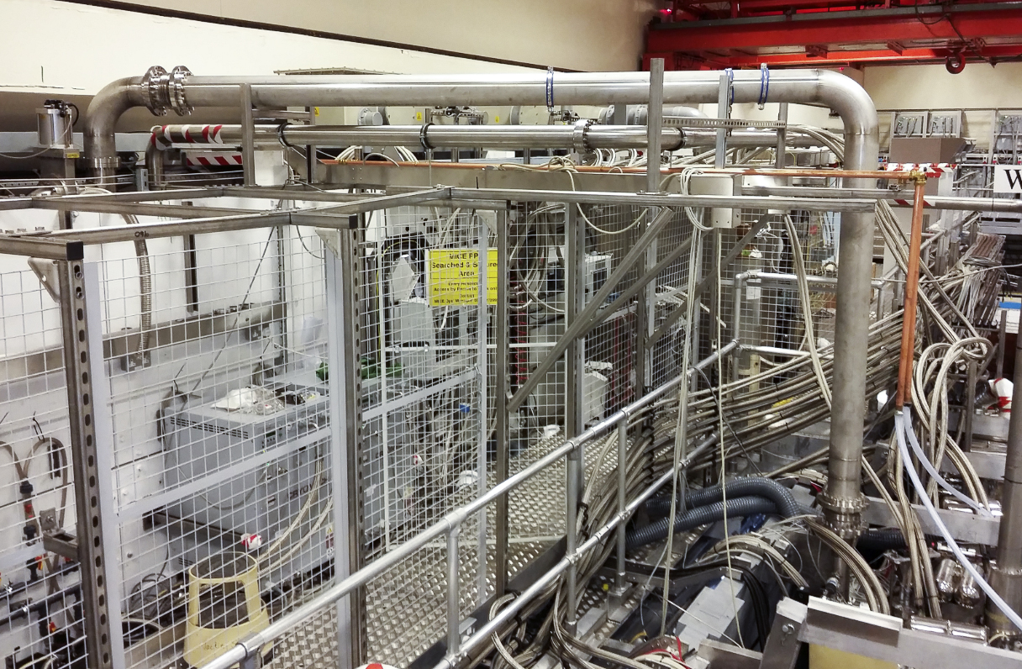

Slide 9
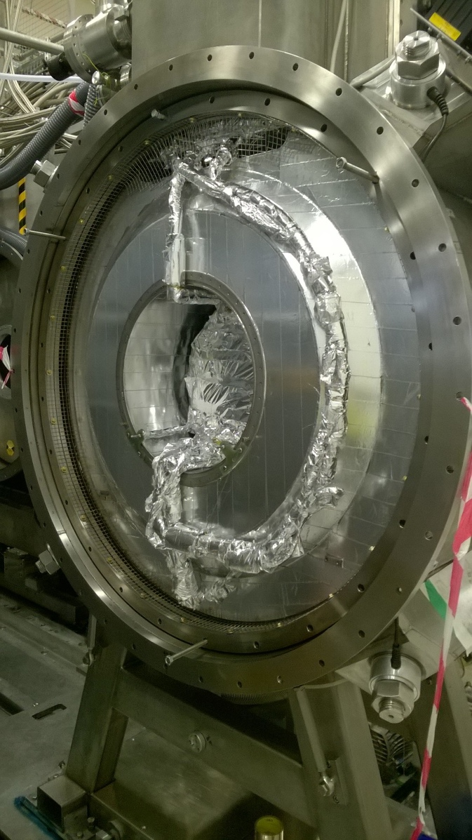
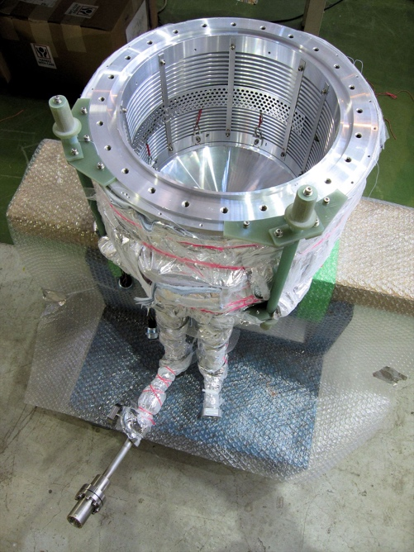
Liquid-hydrogen absorber
Online reconstruction:
Mean momentum lost by muons as they pass through the liquid-hydrogen absorber.
The data were recorded while the absorber was filling.

Slide 10
Characterisation of the cooling equation
Evolution of normalized transverse emittance:
  Measured dependence on:
    Input emittance:
      Vary beam optics/diffuser;
    Material:
      Absorber LH2; LiH
    p, E and β:
      Vary beam momentum, optics
Analagous to SR cooling
Absorbers:
65 mm thick lithium hydride disk
350 mm thick liquid hydrogen vessel
45º polythene wedge absorber

Slide 11
Single-particle technique
Powerful! Fully measure one muon at a time:
  Fast instrumentation, matched to beam intenstity:
    Measure all 6D phase-space coordinates of each muon
  Build muon ensemble offline:
    Calculate ensemble
    properties
      E.g. ε_{T}

Slide 12
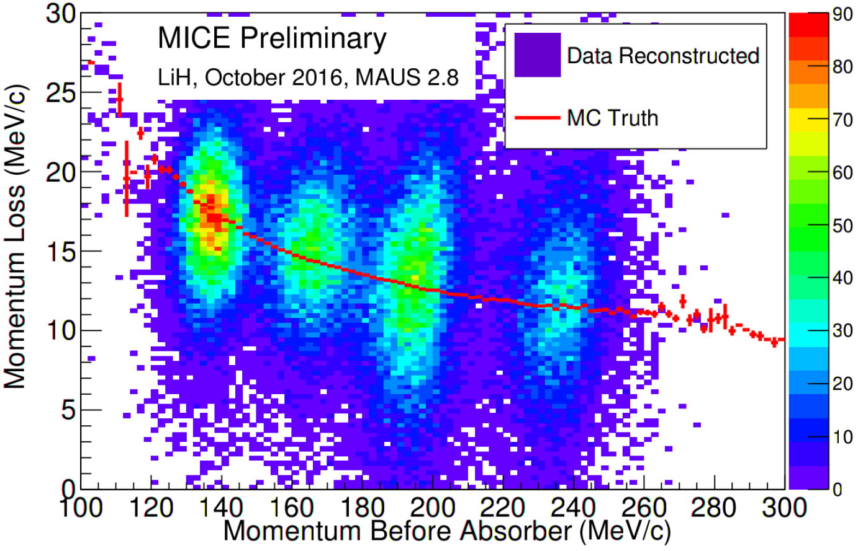
Measurement of muon-LiH scattering
Precision measurement
of multiple Couomb
scattering
172 MeV
200 MeV
Phys.Rev.D 106 (2022) 9, 092003
Consistency
of energy-loss
model validated
240 MeV

Slide 13
Emittance determination
Nominal beam
Upstream solenoid
Eur.Phys.J.C 79 (2019) 3, 257

Slide 14
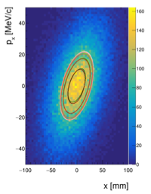
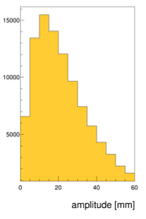
Emittance and amplitude
Emittance:
  Evaluated from RMS beam ellipse
Amplitude:
  Distance from core of beam
Mean amplitude ~ RMS emittance

Slide 15
Nature 578 (2020) 7793, 53-59

Slide 16
Nature 578 (2020) 7793, 53-59

Slide 17
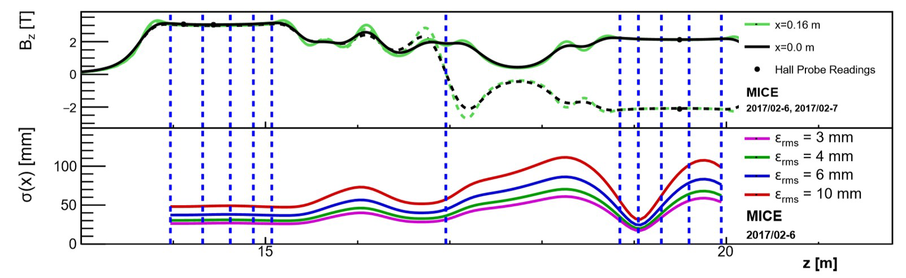
Solenoid mode
doi:10.18429/JACoW-IPAC2021-WEPAB277

Slide 18
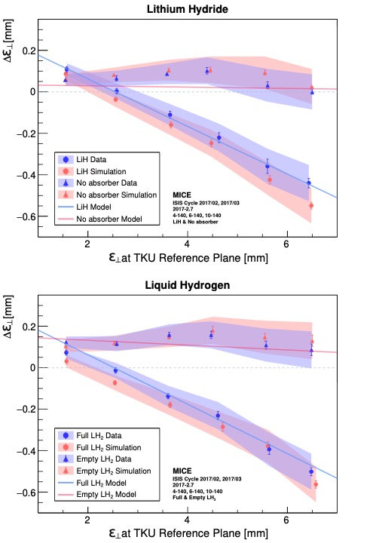
Systematic investigation via sampling
4 mm beam
1.5 mm
2.5 mm
6 mm beam
3.5 mm
4.5 mm
10 mm beam
5.5 mm
6.5 mm
PoS EPS-HEP2021 (2022) 859

Slide 19
Next steps in study of ionization cooling
MICE has:
  Demonstrated principle of 4D ionization cooling
  Studied flip- and solenoid-mode lattices
  Developed and demonstrated simulation tools
Ambitious next step:
  Design and implement a 6D cooling experiment
    Essential R&D for development of multi-TeV muon collider
  …

Slide 20

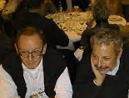


Historical interlude
20th century:
  ‘70s Budker, Skrinskii
  ‘90s Palmer, Tollestrup, Sessler:
    MCC, MCNFC, NFMCC
  ‘99 Autin, Blondel, Ellis
    …
21st century:
  CERN MC/NF study
  BENE, EUROnu
  NFMCC → MAP
  MICE
  P5 (2013) …
Snowmass ‘96

Slide 21
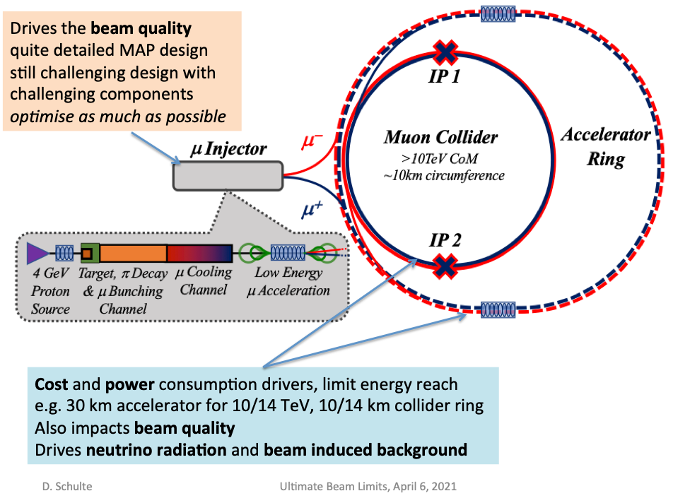
Science case remains fantastic
Technological R&D still ground-breaking
Risks to programme remain too
Demonstrator is critical to the programme:
  6D cooling and world-leading particle physics

Slide 22
Thank you

