Slide 1
THE KEY ROLE OF RADAR IMAGES IN THE UNDERSTANDING OF EARTHQUAKES
Simone Atzori
INGV researcher

Slide 2
A bit of history
1978 Launch of the first SAR satellite (SEASAT)
198* Pioneer experiments on radar interferometry (InSAR)
1992 Launch of ERS-1 (ESA) satellite
1992 M 7.3 Landers earthquake
1993 First interferogram of an earthquake
1995 Launch of ERS-2 (ESA) satellite
2002 Launch of Envisat (ESA)
2007 Launch of the first COSMO-SkyMed (ASI) satellite
2012 End of my contract

Slide 3
Presentation outline
Synthetic Aperture Radar images: image characteristics, advantages and limitations;
InSAR processing: from SAR raw data to the maps of displacement
Seismic source: from the displacement map to the seismic source
Examples: L’Aquila and New Zealand EQ

Slide 4
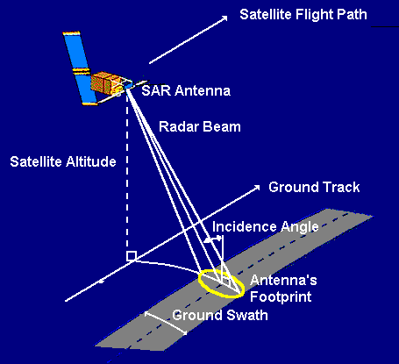
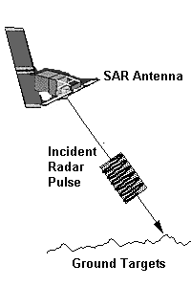
Synthetic Aperture Radar images
SAR antenna is an active sensor: a set of microwave pulses is sent toward the Earth and their backscattered echoes are recorded by the same antenna.
A lateral transmission is used to avoid the return of overlapping echoes

Slide 5
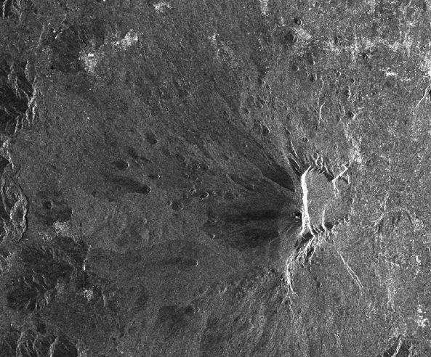
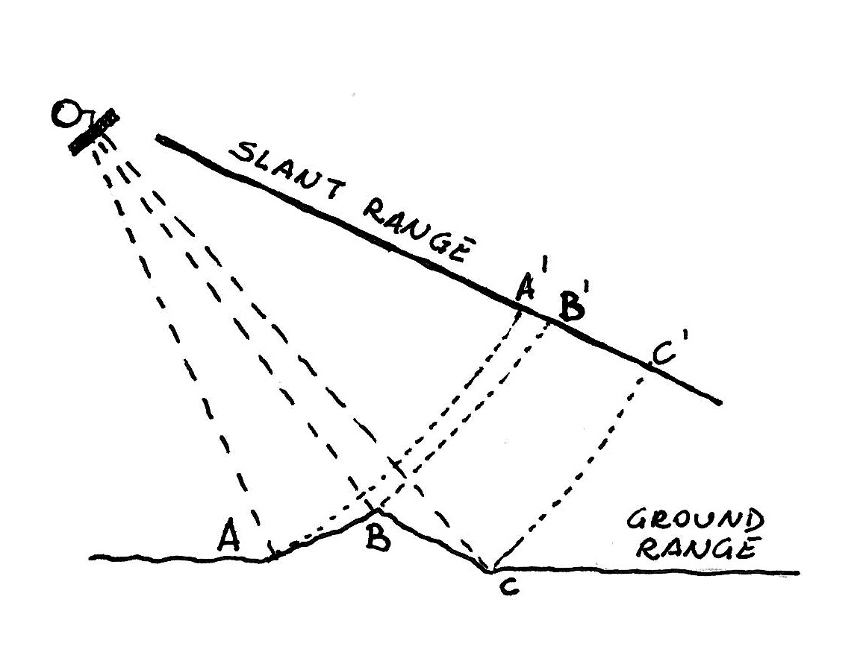
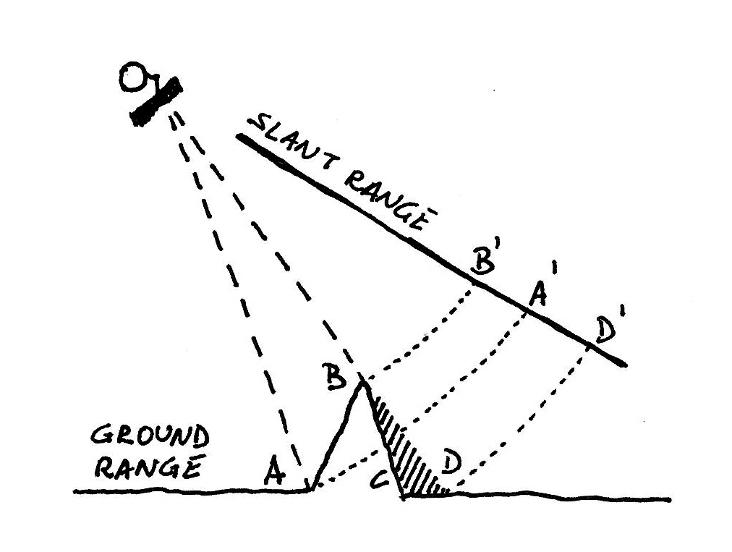
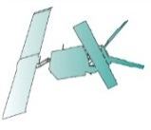
SAR image characteristics
Imaging is day/night and all-weather
High spatial resolution are achieved with the synthetic aperture
Intensity and phase of the backscattered signal are recorded
The pixel position is based on the satellite/earth round-trip travel time
Side looking results in images with distorted geometry (slant range)
Flight direction
foreshortening
layover and shadow
Mt. Etna

Slide 6
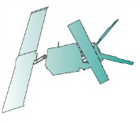
Focused SAR image (amplitude)
ENVISAT image (27/04/2008)
C-band (λ = 5.6 cm)
Abruzzi (Italy) region
Flight direction
Mountains “lay down” toward the SAR antenna. Geometric distortions must be compensated to pass from the range/azimuth geometry (slant range) to the ground-corrected and geocoded reference system.
azimuth
range

Slide 7
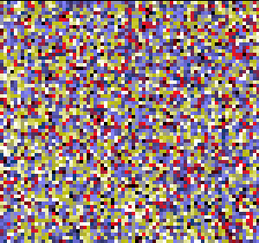
Focused SAR image (phase)
In a single image the phase is “wrapped” and completely uncorrelated between adjacent pixels. Apparently the phase content is not meaningful.
Flight direction
azimuth
range
$$−π<φ<+π$$

Slide 8
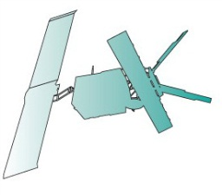
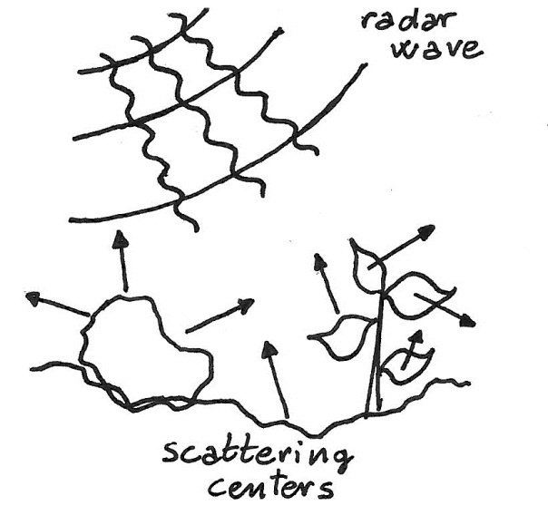
The radar phase
Im
ϕ
Re
Centers of signal scattering in a single ground cell
All the scattering centers contribute to the composition of the phase backscattered to the antenna
Phase content of a single SAR image

Slide 9
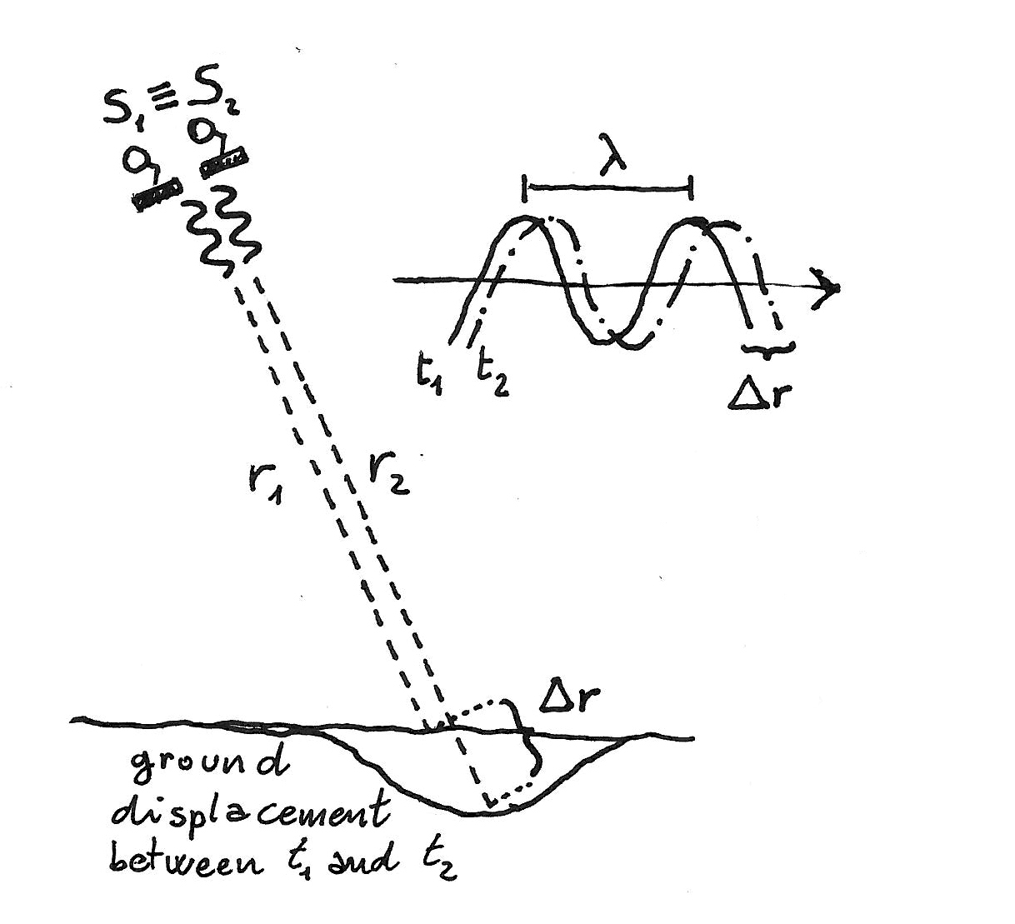
Ground displacement
If the phase content of a single image is of no practical use, the comparison between the phase change across two images acquired at different times can be representative of the surface topography and/or the ground displacement:
two images are acquired at times t₁ and t₂, encompassing a ground deformation.
S₁ satellite at time t₁
S₂ satellite at time t₂
Satellites are supposed to acquire images from the same position
If scattering centers in a pixel are stable, the phase difference is only due to the change in the antenna/pixel distance, the line-of-sight direction

Slide 10
From theory to real world
condition
consequence
Scattering centers in a ground cell are not so stable (e.g. tree leaves)
Phase difference can be uncorrelated with the displacement (loss of coherence)
Satellite never passes twice exactly in the same position
Phase difference contains a contribution from the topography and the Earth curvature
Radar signal can change velocity trough the atmosphere
Phase difference is due to a propagation delay and not a real displacement

Slide 11
InSAR processing
Image focusing
Image coregistration
Phase difference
Removal of fringes due to earth curvature and topograpy
Filtering (interferogram enhancement)
Phase unwrapping
Phase to displacement conversion
Geocoding

Slide 12
Interferogram generation
27/04/2008 before an EQ
Phase difference
Raw interferogram
12/04/2009
after EQ
$$−π<φ<+π$$

Slide 13
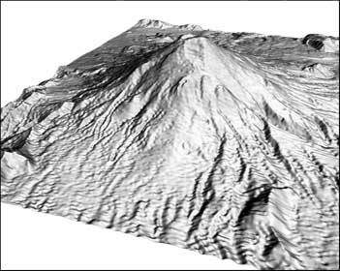
Differential interferogram
Real ground deformation
Atmospheric artifacts
raw interferogram
“flat earth”
topography
Differential interferogram
$$−π<φ<+π$$

Slide 14
Phase Unwrapping
unwrapping algorithm
wrapped interferogram
unwrapped interferogram

Slide 15
Ground resolution and accuracy
Ground resolution
wavelenght (λ) 5.6 cm
antenna height (H) 870 km
look angle (θ) 23°
bandwidth (B) 15.6 MHz
light speed 300·10⁶ m/s
antenna length (L_{ant}) 10 m
assuming…
when…
then…
(accuracy)

Slide 16
InSAR application field
Land subsidence (water pumping, oil spill, etc.)
Urban areas monitoring
Landslide monitoring
Ice sheet motion
Volcanic deformation
Earthquake induced deformation

Slide 17
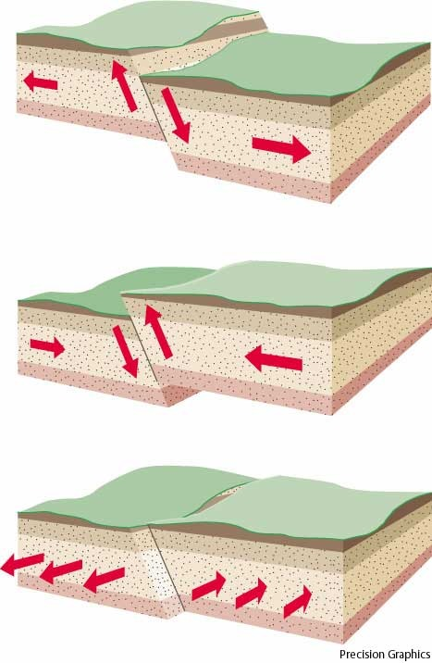
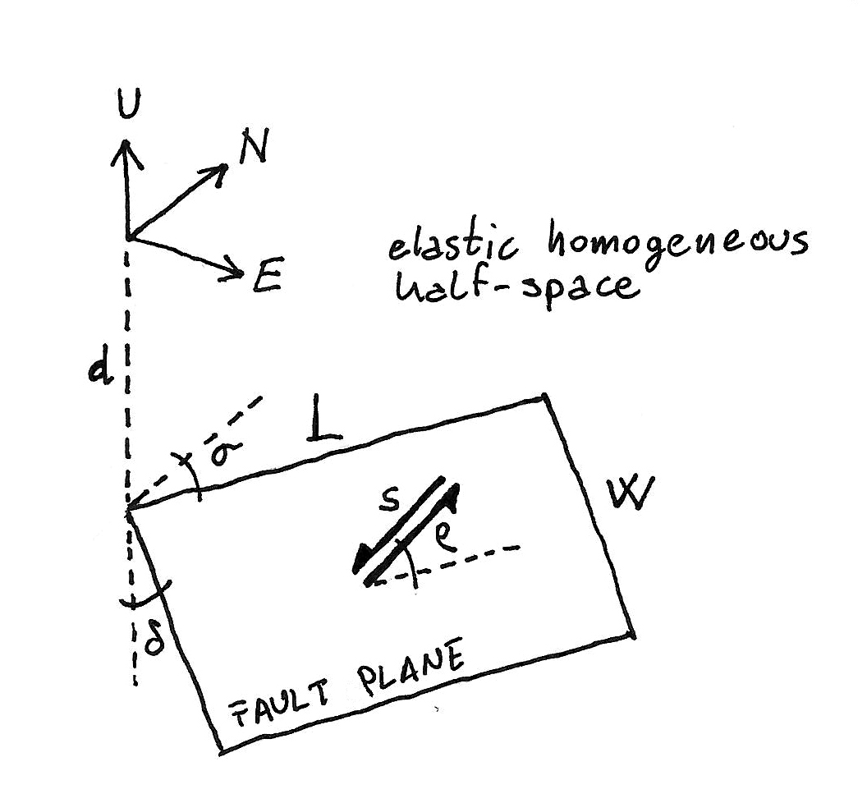
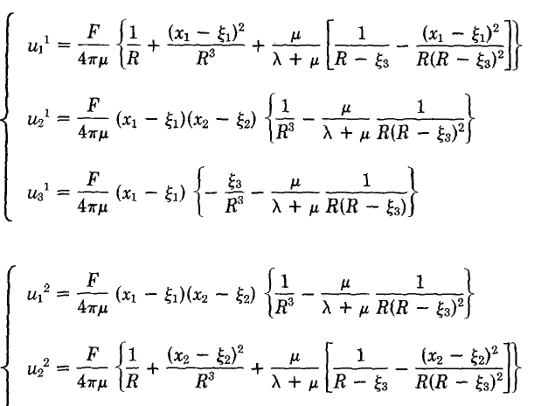
The seismic source model
Source parameters
position
L length
W width
d depth
σ strike angle
δ dip angle
s dislocation
ρ rake angle
(and others…)
From Okada (1985), BSSA

Slide 18
InSAR data modeling
Cost Function minimization
Inversion algorithm
(linear, non-linear)
Observed data
Source model
Geophysical model
Forward modeling
Predicted data
Geophysical model

Slide 19
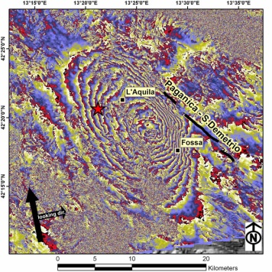
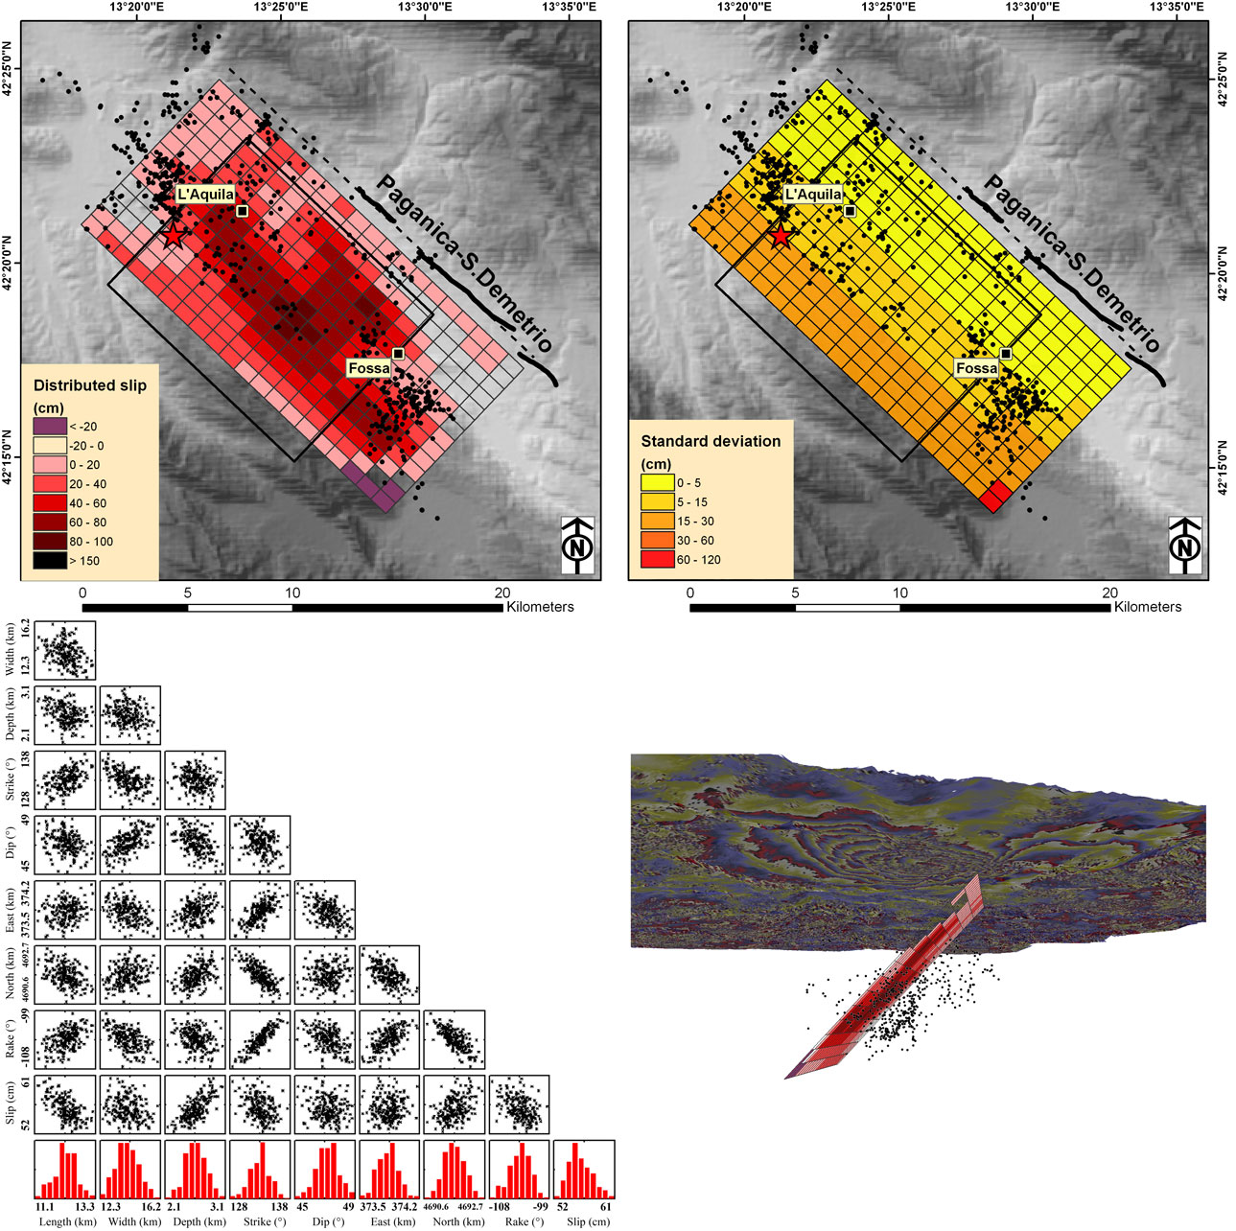
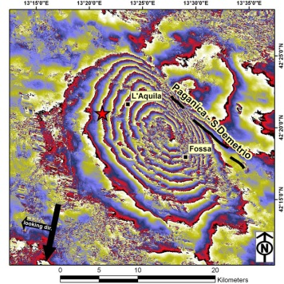
The L’Aquila earthquake
data
model
X-band interf.
C-band interf.

Slide 20
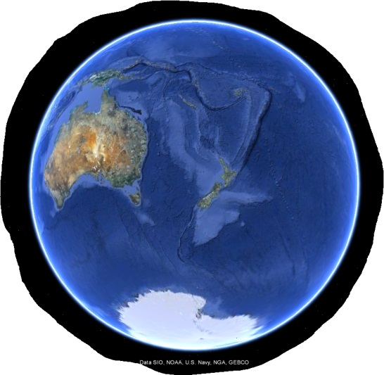
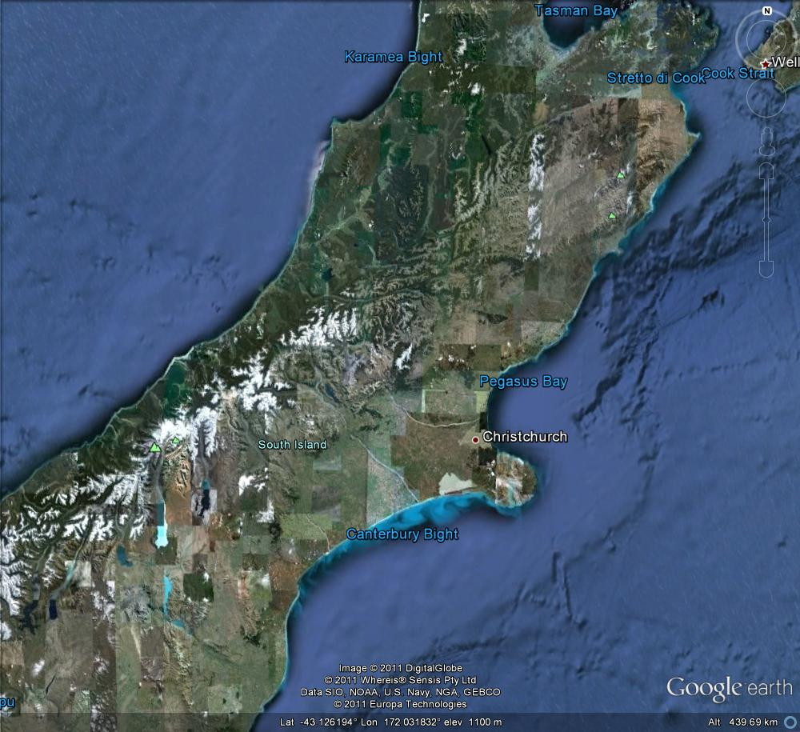
The New Zealand sequence
September 4, 2010, Darfield earthquake: M_{w} 7.0
February 21, 2011, first Christchurch earthquake: M_{w} 6.1
June 13, 2011, second Christchurch earthquake: M_{w} 6.0

Slide 21
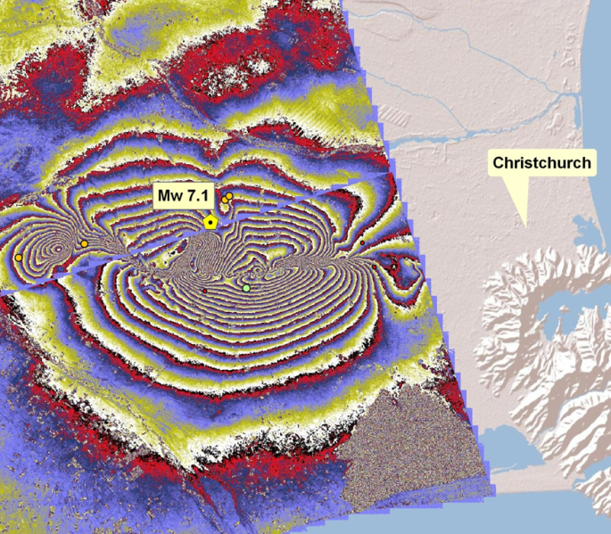
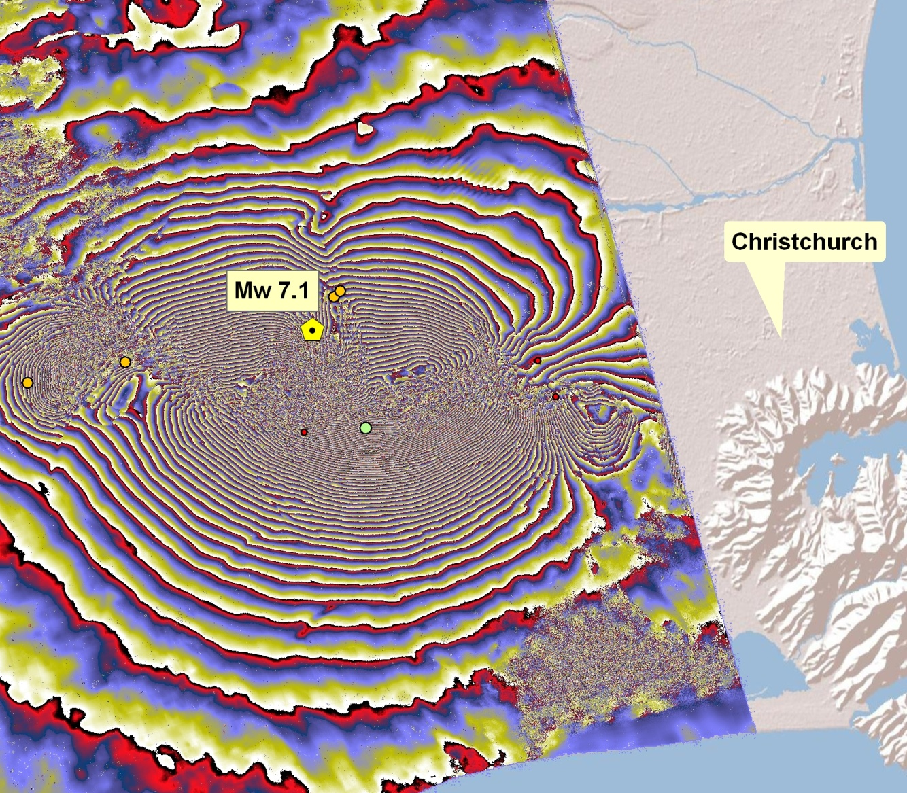
InSAR maps of the Darfield EQ
ALOS-Palsar
L-band: 23.6 cm
PRE: August 13
POST: September 28
Look Angle: 38.9°
Spatial Baseline: 357 m
Temp. Baseline: 30 d
Orbit: Ascending
ENVISAT
C-band: 5.6 cm
PRE: September 1
POST: October 6
Look Angle: 23.3°
Spatial Baseline: 300 m
Temp. Baseline: 35 d
Orbit: Ascending

Slide 22
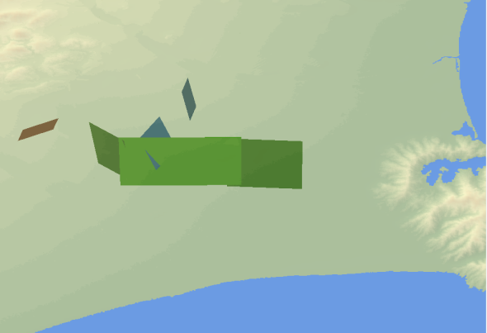
A complex fault system
3D view from south-east
3D view from north-west

Slide 23
Thanks!

