Slide 1



Multilayer coatings and their use in spectroscopic applications
Maria Guglielmina Pelizzo, A.J. Corso, P. Zuppella, P. Nicolosi
National Research Council of Italy
Institute for Photonics and Nanotechnologies, Lab. LUXOR
Padova
2nd International Conference Frontiers in Diagnostic Technologies
28-30 Novembre 2011

Slide 2
What is a multilayer?
Multilayer is a nanostructured stack based on two or more materials
The layer thickness is regulated in such a way that all the reflected component at each interface add in phase
A capping layer (i.e. structure on top of it) can be deposited to improve performances or for protection

Slide 3
When is it necessary to use a multilayer?
Instruments at normal incidence operating at shorter wavelengths then 30 nm
  Mirrors and gratings for normal incidence configuration spectrograph limited by mechanical constraints, high resolution spectrograph
  Mirrors for spectro-imaging
  Mirrors for EUV Projection systems
  Mirrors for short pulse beam manipulation/spectral selection (using the filter properties without affecting the beam shape)
  Mirrors for short pulse re-shaping

Slide 4
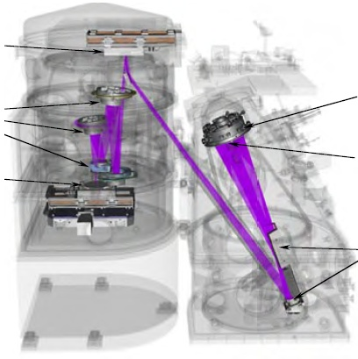
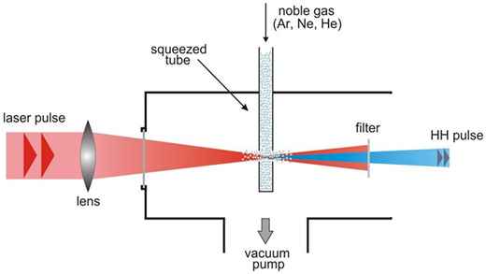
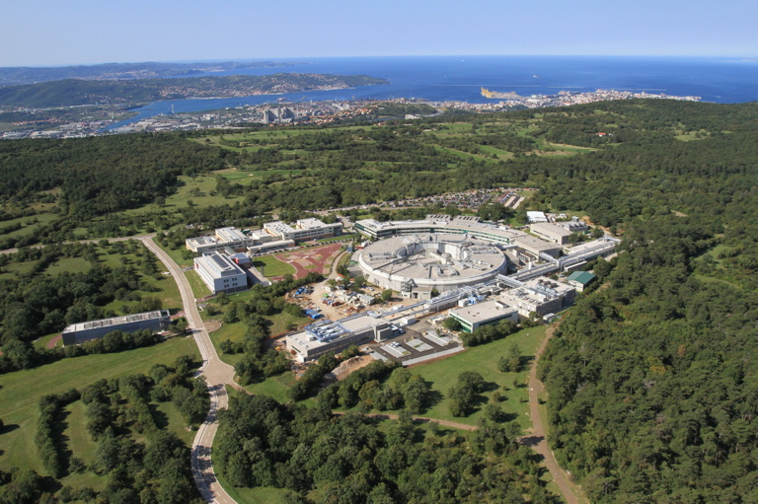
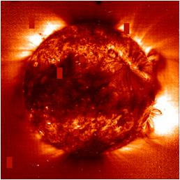
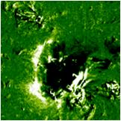
Applications
Lithography
Atto-physics
Mask
Projection
optic
Collection
optic
Wafer
Plasma
Condenser
optic
EUV Large scale facilities
Solar observations from space

Slide 5
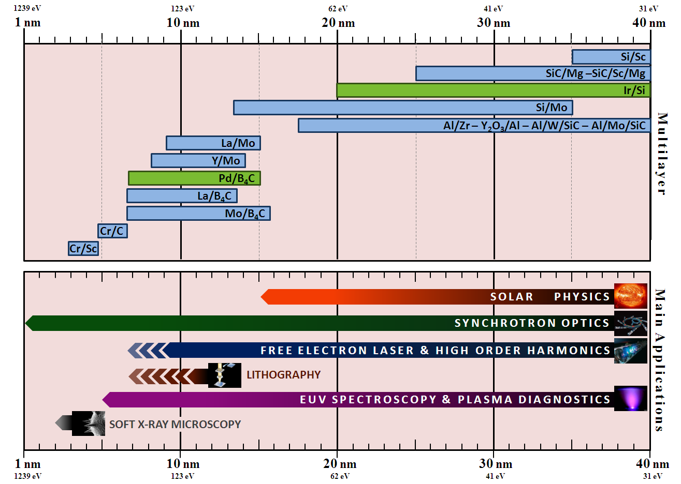
State of art

Slide 6
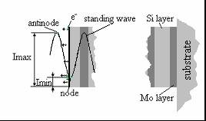
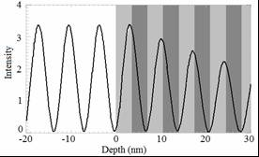
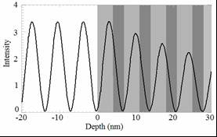
Standing wave in periodic Mo/Si MLs (λ=13.5 nm)
When the EUV radiation interacts with the ML structure, the superposition of the incident and reflected electromagnetic wave generates a standing wave field distribution in the ML. An aperiodic design allows the regulation of the distribution of this field, attributing specific properties to the ML.
In the case of a quarter wave stack anti-nodes of the standing wave are placed in the absorber material with a consequent high absorption of radiation in the first layer.
In the case of a periodic stack with Γ = 0.6, anti-nodes of the standing wave are placed in the spacer material with less absorption and consequent deeper penetration of the radiation into the stack.
Γ=0.5
Γ=0.6

Slide 7
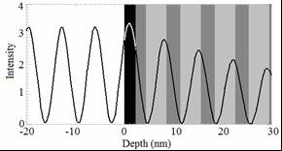
Standing wave distribution in with CL (1)
EUV MLs for lithography or astronomic application in harsh space environment require capping layers
If on top of the structure a capping layer (CL) is deposited, the maximum of the standing wave coincides with this layer. In case this one is an absorbing material, the radiation is strongly weakened.
For example: 2.3 nm RuO₂ on top of 2 nm Mo; total CL thickness is 4.3 nm > d_{n-a}=3.3 nm —> the standing wave anti-node is placed inside the RuO₂ layer.
No CL
Mo/RuO₂ CL

Slide 8
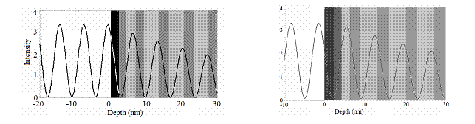
ML with CL and pre-capping layer(2)
By varying the thickness of the last top layers underneath the capping layer, the standing wave field is shifted; the anti-node is placed outside the CL, obtaining a reduction of the absorbance.
Mo/RuO₂ CL
B₄C/RuO₂ CL
Two layers varied (pre-CL)
Two layers varied (pre-CL)
Structures claimed in patent PCT/EP2007/060477, University of Padova, CNR-INFM, RXOLLC (N.Y. USA), 2007

Slide 9
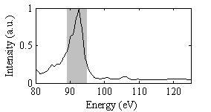
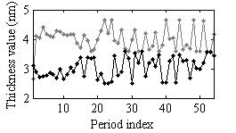
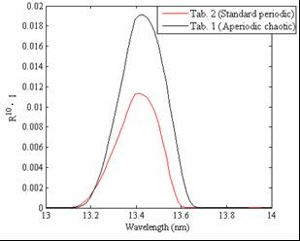
Optimization of MLs for EUV lithography
The MF used to maximize the EUV lithographic apparatus flux is
where is the source spectrum, is the reflectivity of the structure, N is number of mirror in the apparatus; in this work we have assumed N=10 and as a source a Sn laser produced plasma
Max gain of total throughput for a 10 mirrors lithographic system with respect to a standard ML:
Aperiodic:118%
Last top layer varied (pre-CL): 109%
Mo/RuO₂ CL
Mo/Pt CL
Experimental
results
Pelizzo M.G. et al., Optics Express, vol. 16(19), pp. 15228-15237, 2008.
Suman M. et al, Applied Optics. vol. 47(16), pp. 2906-2914, 2008
Structures claimed in patent PCT/EP2007/060477, University of Padova, CNR-INFM, RXOLLC (N.Y. USA), 2007

Slide 10
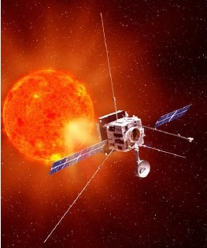
On-going projects
Developement of multilayer mirrors for METIS coronagraph on board of Solar Orbiter ESA mission
Developement of multilayer mirrors for Free Electron Laser applications

Slide 11
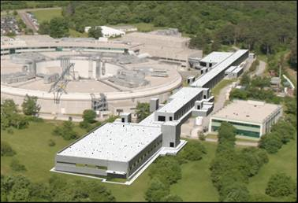
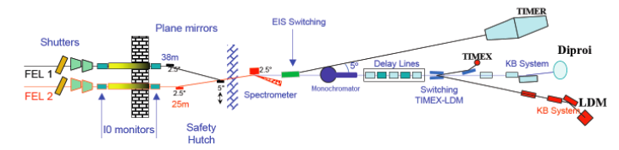
Development of ML for FERMI@ELETTRA
Developement of multilayer mirrors for Free Electron Laser applications
Activity carried on in a collaboration framework with FERMI@ELETTRA
Funded by FONDAZIONE CARIPARO, Research Project 2009-2010

Slide 12
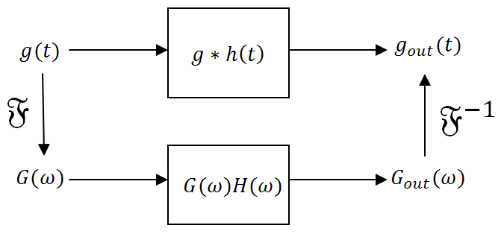
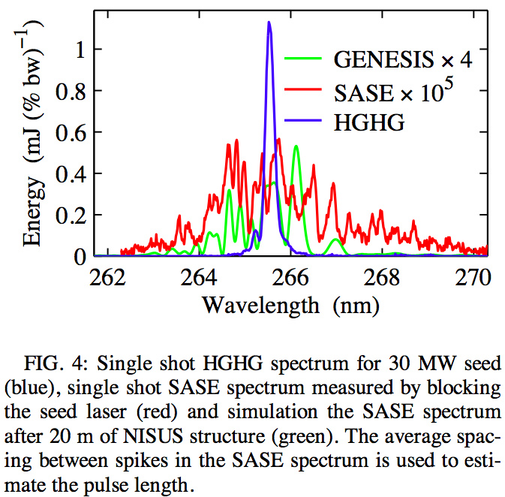
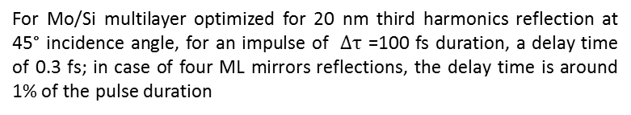
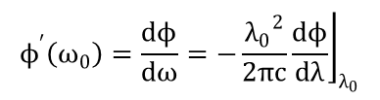
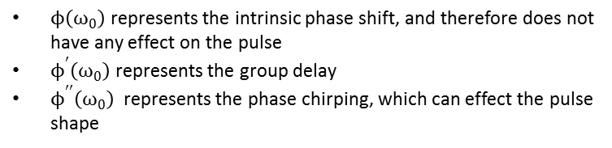


Why multilayers?
High Gain Harmonics Generation provide a more compact and fully temporally coherent source, control of pulse length and control of spectral parameters.
Thanks to the filter properties, ML can use for selecting proper harmonic, without affecting temporal shape of the beam
$$r_{s}(ω)=\left|r_{s}(ω)\right|e^{ϕ(ω)}$$
$$ϕ\left(ω\right)= ϕ\left(ω_{0}\right)+ϕ^{′}\left(ω_{0}\right)\left(ω−ω_{0}\right)+\frac{ϕ^{′′}\left(ω_{0}\right){(ω−ω_{0})}^{2}}{2}+…$$
$ϕ\left(ω_{0}\right)$ represents the intrinsic phase shift, and therefore does not have any effect on the pulse
$ϕ^{′}\left(ω_{0}\right)$ represents the group delay
$ϕ^{′′}\left(ω_{0}\right)$ represents the phase chirping, which can effect the pulse shape
$$ϕ^{′}\left(ω_{0}\right)=\frac{dϕ}{dω}=−{\left.\frac{{λ_{0}}^{2}}{2πc}\frac{dϕ}{dλ}\right\rfloor }_{λ_{0}}$$
Li-Hua Yu DUV-FEL
For Mo/Si multilayer optimized for 20 nm third harmonics reflection at 45° incidence angle, for an impulse of $Δτ$ =100 fs duration, a delay time of 0.3 fs; in case of four ML mirrors reflections, the delay time is around 1% of the pulse duration

Slide 13

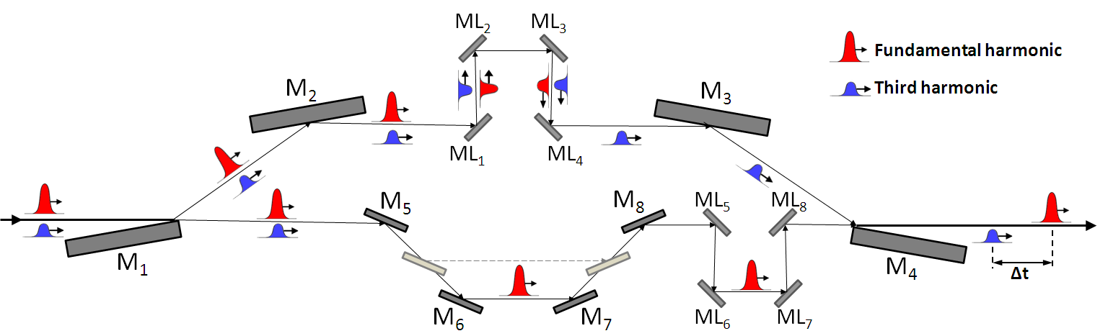
FERMI@ELETTRA Delay line scheme
Application to: DiProI, LDM, Timer beamline
Key third harmonics wavelength: 6.7 nm, 13.5 nm, 16 nm, 21 nm
Multilayer with high efficiency at the working wavelength (s polarization)
Multilayer with high
Pulse delay:
-1 ps < Δt < 15 ps without multilayers (achromatic no polarizing dependent)
Δt up to 1 ns with multilayer

Slide 14
Structures for 6.7 nm third harmonic selection

Slide 15
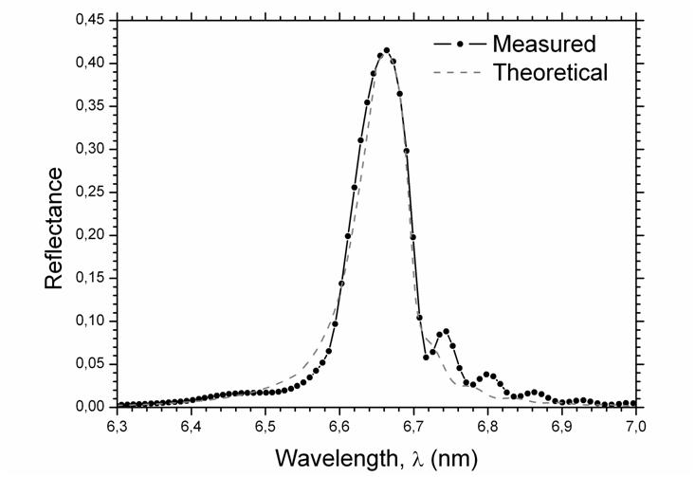
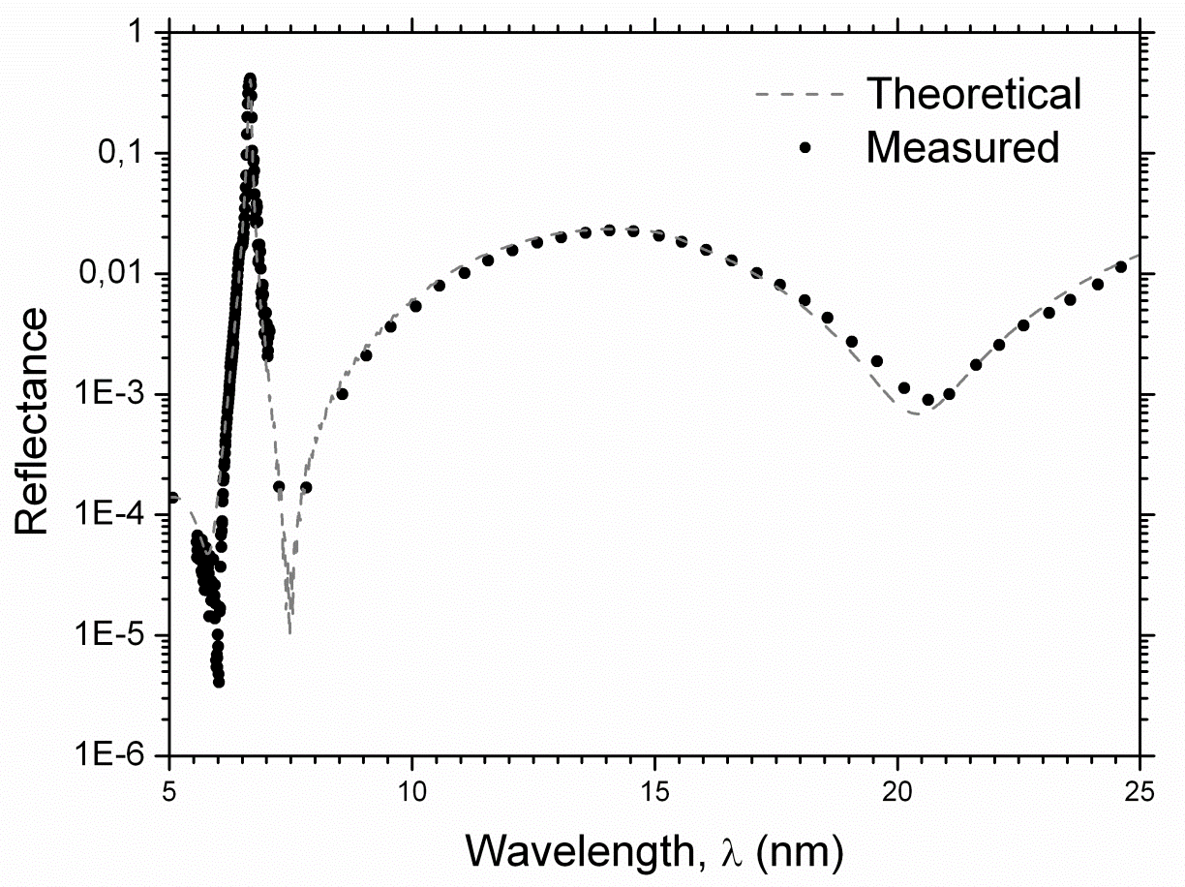
Experimental results
ELETTRA- BEAR
45°
45°

Slide 16
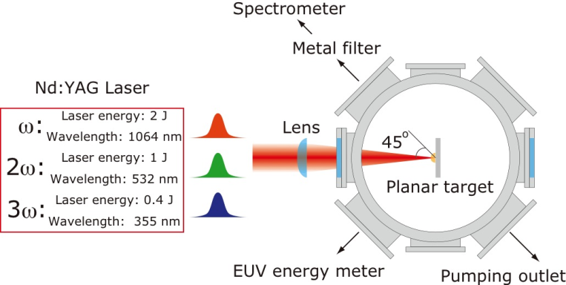
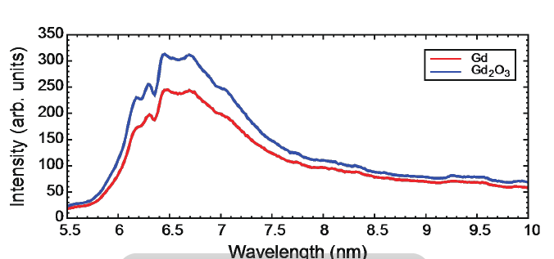
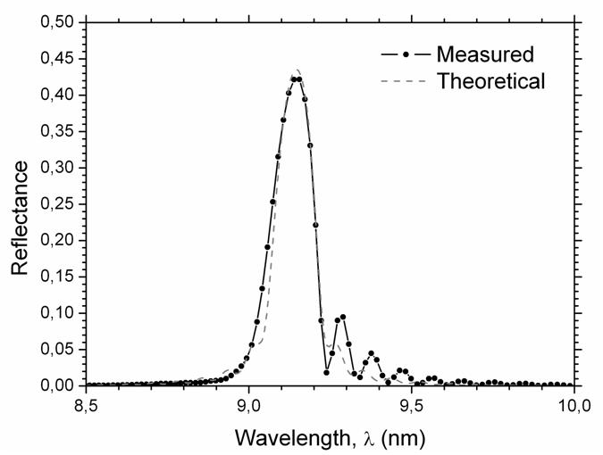
New Frontier EUV photolithography
From Takamitsu Otsuka, Deirdre Kilbane, John White, Noboru Yugami, Weihua Jiang, Akira Endo, Padraig Dunne, and Gerry O'Sullivan, Rare-earth Plasma Extreme Ultraviolet Sources at 6.5-6.7 nm for Next Generation Semiconductor Lithography, EUVLitho 2010, http://www.euvlitho.com/2010/2010%20EUV%20Source%20Workshop%20Proceedings.pdf:
Our goal: apply the ML concept design developed at 13.5 nm to 6.7 nm, using aperiodic design and the new ML structure obtained.
10°

Slide 17
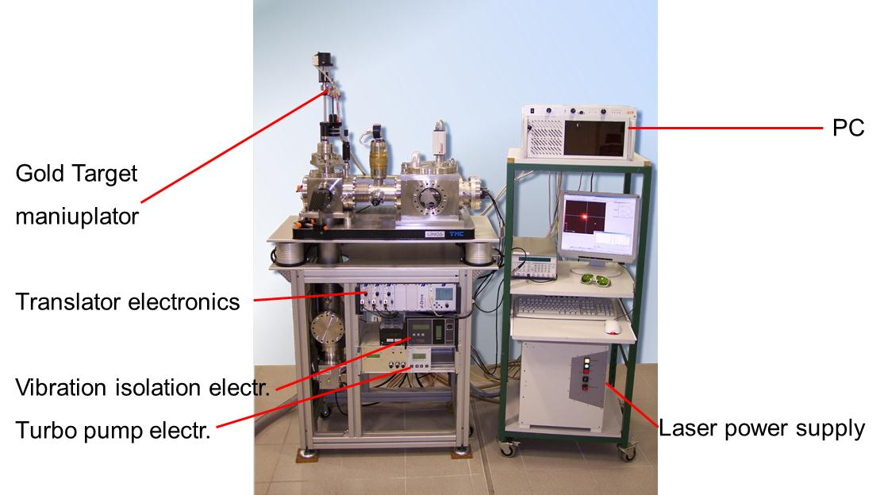
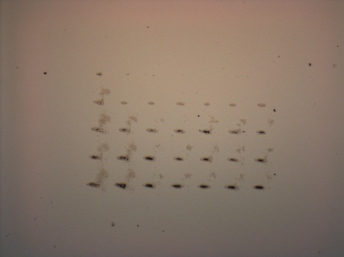
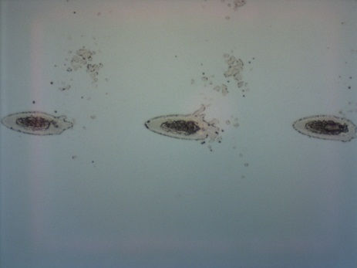
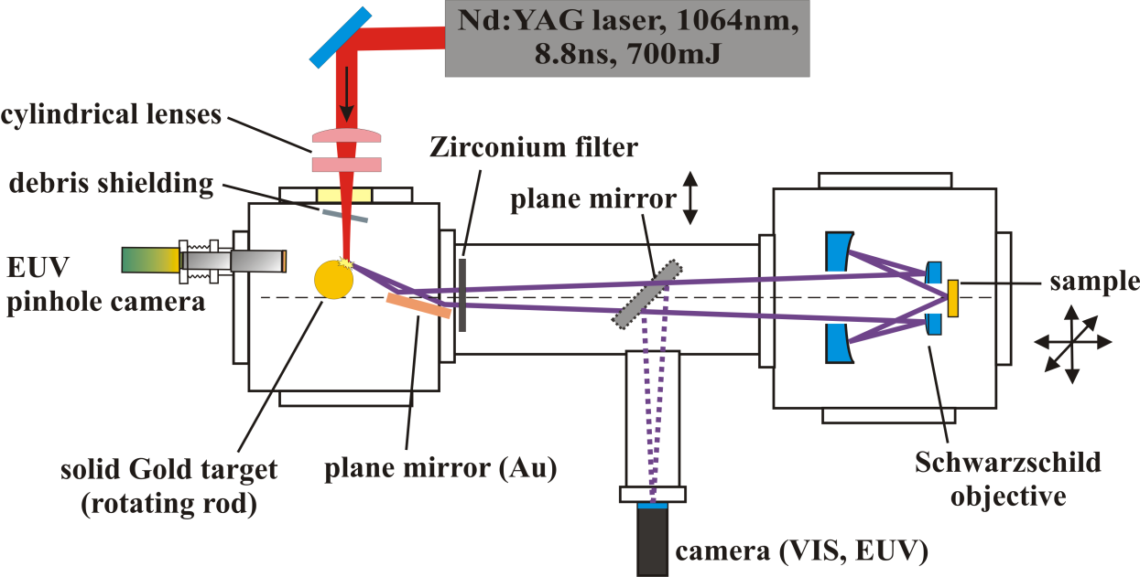
Damage of MLs by EUV high energy short pulses
Collaboration with Laser-Laboratorium Göttingen e.V (K. Mann, F. Barusky)
Image at microscope showing the surface of an Mo/Si ML + Ir capping layer damaged by E=2-6 J/cm^2, # of pulses: 1 to 10
Fig.5

Slide 18
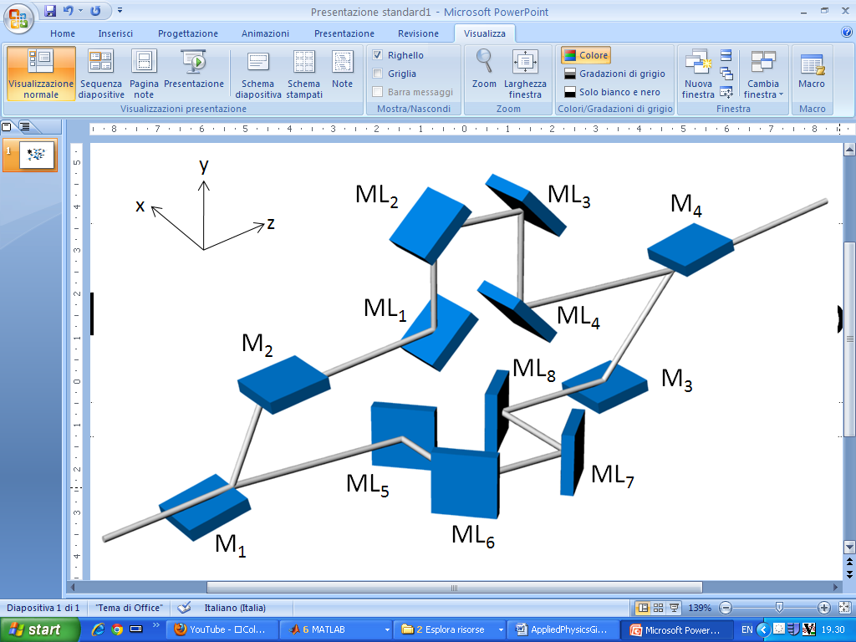

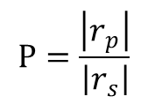
New optical configuration for polarization state control
$$Ρ=\frac{\left|r_{p}\right|}{\left|r_{s}\right|}$$
$$SNR=\frac{1}{Ρ_{ML}^{8}}$$

Slide 19
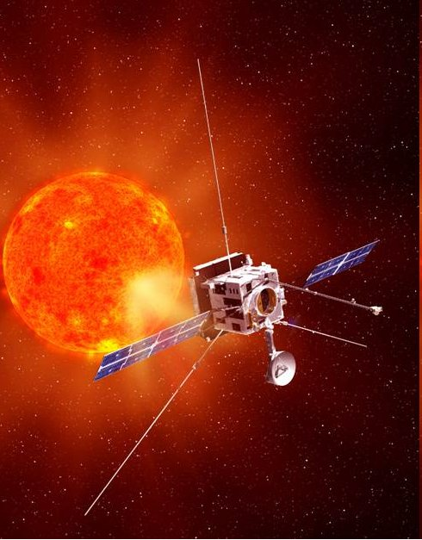
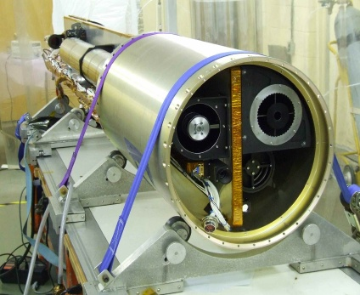
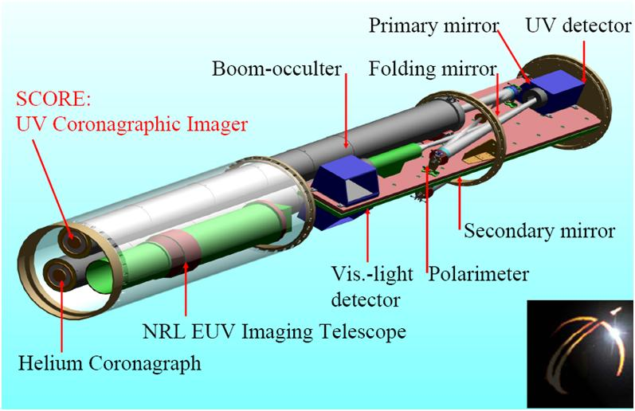
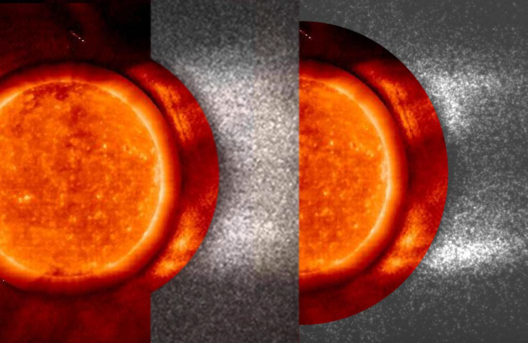
Framework
METIS, THE MULTI ELEMENT TELESCOPE FOR IMAGING AND SPECTROSCOPY for the SOLAR ORBITER MISSION (PI: E. Antonucci, INAF Osservatorio Astronomico Torino)
SCORE Sounding rocket – METIS Coronagraph Prototype (PI: E. Antonucci, INAF Osservatorio Astronomico Torino)
GOAL: Full Imaging of the extended corona (1.5 – 3.5 Ro) in EUV (30.4 nm), UV (121.6 nm), and visible light
30.4 nm
121.6 nm

Slide 20
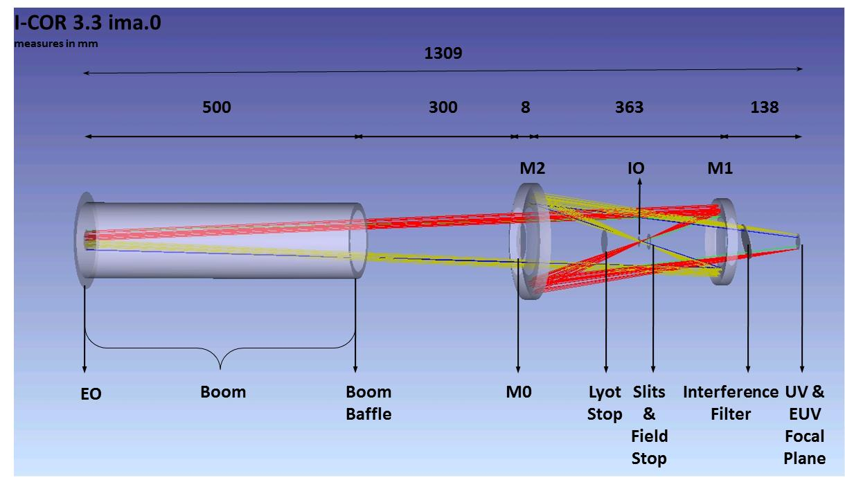
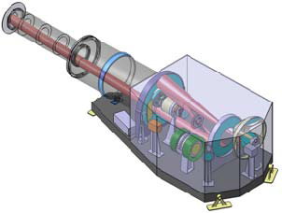
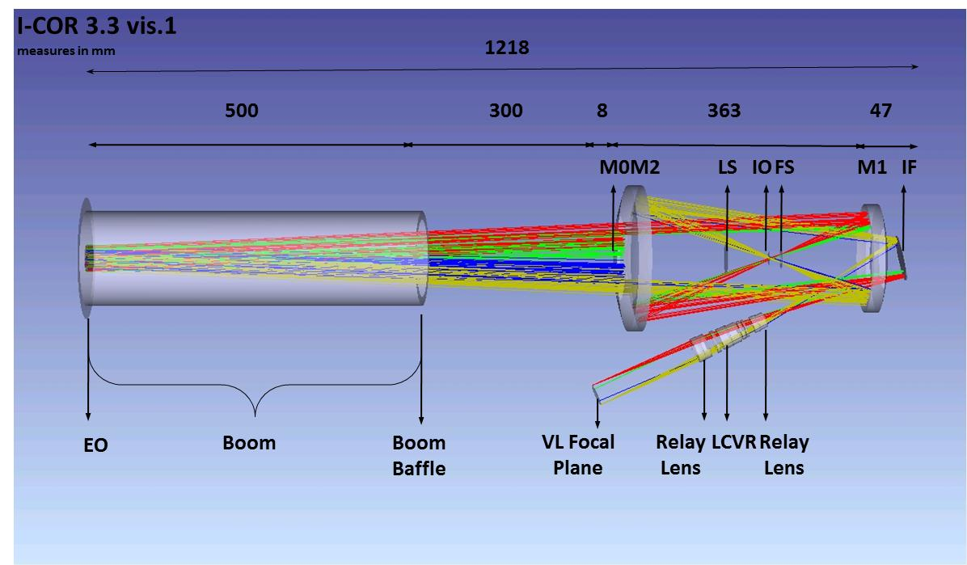
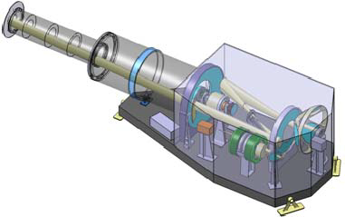
METIS and SCORE optical design

Slide 21
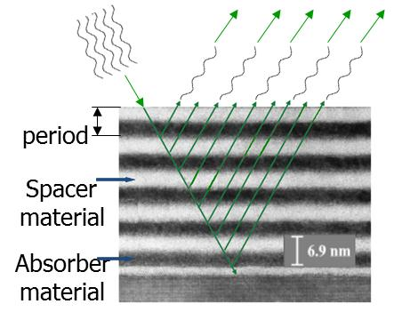
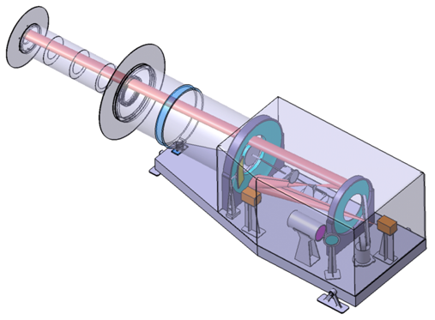
METIS Multilayer optics and requirements
MO sun disk rejection mirror
MLs have to be deposited on M1, M2 and grating
Mirrors Requirements
  High reflectivity at 30.4 nm, 121.6 nm and in the VIS spectral range for simultaneous observations METIS
  Stability over time LONG TERM MISSION
  Stability to ion-bombardment
  Thermal stability
M1 and M2 are ML coated
ML
SOLAR ORBITER orbit

Slide 22
Multilayer prototypes considered
Standard Mo/Si (nominal coating - REF) – R _{30.4 nm} = 20%
ML with different capping layers (CL) materials (4 different types):
  Mo/Si + CL1 Ir/Mo (R _{30.4 nm} = 26%)
  Mo/Si + CL2 Ir/Si (R _{30.4 nm} = 26%)
  Mo/Si + CL3 Ru/Mo (R _{30.4 nm} = 25%)
  Mo/Si + CL4 W/Si (unstable)
  Corso, Alain Jody; Zuppella, Paola; Nicolosi, Piergiorgio; Windt, David L; Gullikson, E; Pelizzo, Maria Guglielmina, Capped Mo/Si multilayers with improved performance at 30.4 nm for future solar missions, Optics Express, Vol. 19 Issue 15, pp.13963-13973 (2011)
Ir/Si ML (R _{30.4 nm} = 24%)
P. Zuppella, G. Monaco, A.J. Corso, P. Nicolosi, D.L. Windt, V. Bello, G. Mattei, M.G. Pelizzo, “Iridium/Silicon multilayers for extreme ultraviolet applications in the 20-35 nm wavelength range”, Optics Letters 36(7), 1203-1205 (2011).
SiC/Mg ML (R _{30.4 nm} = 40%)

Slide 23
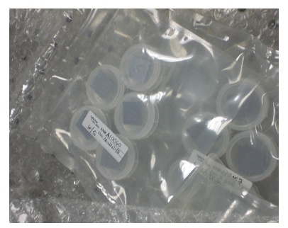
Multilayer prototypes considered

Slide 24
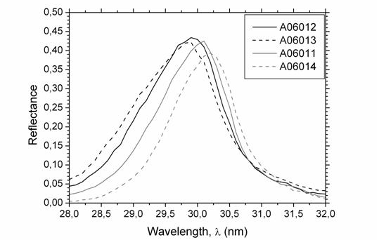
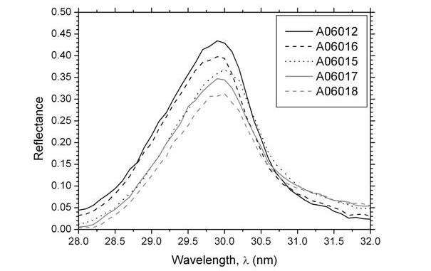
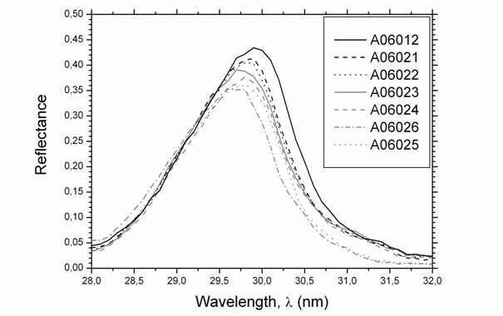
Multilayer reflectance curve
NSLS – Beamline X24C

Slide 25
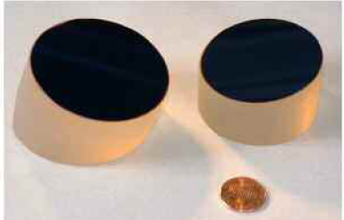
Multilayer prototypes considered

Slide 26
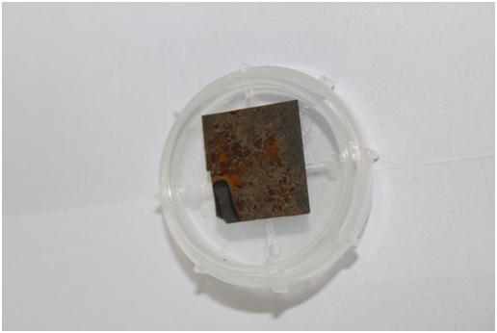
Four years after….(1)
Γ varied
SiC cap
Si cap
The amount of degradation seems more related to the structural parameters of the multilayer and the characteristic of the capping layer. In particular:
samples with an Si top layer degraded
samples with a SiC top layer deposited onto the last SiC layer have unaltered performances
samples with varied Γ ratio show a partial degradation, which can be put in correlation with the thickness of the Mg in the bilayers

Slide 27

Four years after….(2)
ELETTRA BEAR

Slide 28


AFM analysis (1)
AFM of reference sample A06012.
AFM of samples with Г varied

Slide 29


AFM analysis (2)
AFM of samples with SiC additional top layer.
AFM of samples with a Si additional top layer.

Slide 30

XPS analysis
BEAR – ELETTRA
Sample A06011

Slide 31
Multilayer prototypes considered
Standard Mo/Si (nominal coating - REF) – R _{30.4 nm} = 20%
ML with different capping layers (CL) materials (4 different types):
  Mo/Si + CL1 Ir/Mo (R _{30.4 nm} = 26%)
  Mo/Si + CL2 Ir/Si (R _{30.4 nm} = 26%)
  Mo/Si + CL3 Ru/Mo (R _{30.4 nm} = 25%)
  Mo/Si + CL4 W/Si (unstable)
Ir/Si ML (R _{30.4 nm} = 24%)
SiC/Mg ML (R _{30.4 nm} = 40%)

Slide 32
Multilayer prototypes considered
Standard Mo/Si (nominal coating - REF)
ML with different capping layers (CL) materials (4 different types):
  Mo/Si + CL1 Ir/Mo
  Mo/Si + CL2 Ir/Si
  Mo/Si + CL3 Ru/Mo
  Mo/Si + CL4 W/Si
Ir/Si ML

Slide 33
Reflectance tests prior thermal cycling and proton bombardment
Tests at 30.4 nm (large band) performed at ELETTRA- BEAR beamline + some tests at ALS 6.3.2 Beamline
Tests at 30.4 nm (peak) in Padova, using our grazing incidence facility equipped with an hollow cathode lamp

Slide 34

Si/Mo ML + CL W instability

Slide 35



Ir/Si analysis

Slide 36


SOLO operation environment
SOLO will be the closest mission to the sun
Minimum perihelium will be 0.23 AU
Temperature of MO: 236°
Low energy Ions bombardment
 | At 1AU (in the earth) | average
H+ Density (cm⁻³) | 8,7 | 25
H+ Speed (km/s) | 468 | 468
N_{alpha}/N_{proton} | 0,047 | 0,047
N_{O}⁶⁺/N_{proton} | 0,0003 | 0,0003
N_{Fe}¹⁰⁺/N_{proton} | 8,77 x 10⁻⁶ | 8,77 x 10⁻⁶
ESA Solar Orbiter Enviromental Specification, Issue2, 2008

Slide 37
Analysis of SOLO orbit and temperatures determination
Active T control
20°
62°
The gradient at which the optics will be subjected would be 42° (± 15°) in 14 days
The multilayer will be heated and cooled for 5 time from 20 to 77 °C in a vacuum chamber
Performances will be re-tested after cycling

Slide 38

Thermal cycling
The ML samples have been placed on a substrate holder by clamping them with a stainless steel screw
The have been heating with 3 quartz halogen lamps
5 cycles between 20°C and 77°C have been carried on, with a gradient slope increased by six time in order to compress the time duration of the experiment
The vacuum pressure in chamber was 5x 10⁻⁷ mbar at 20 ° C
The experiment lasted about 570 hours (more than 23 days)

Slide 39
Re-tested reflectance after thermal cycling

Slide 40


Protons implantation experiment
The ion implantation experiment has been performed at Ion beam implantation in the Forschungszentrum Dresden-Rossendorf in Germany (ex Helmholtz-Zentrum Dresden-Rossendorf) using the LE implanter facility.
The vacuum in the chamber during the implantation was lower than 10⁻⁷ mbar.
The protons current was measured and integrated in order to evaluate the total dose provided to the samples.
The chamber of the LE implantation facility and the ML samples fixed in the support inside the chamber

Slide 41




Reflectance after proton implantation (I)
A witness sample has also been re-tested to verify that non natural aging degradation occurred
3 months exposure dose
1 year exposure dose
CL1 (Ir/Mo)
CL2 (Ir/Si)

Slide 42




Reflectance after proton implantation (II)
3 months exposure dose
1 year exposure dose
CL3 (Ru/Mo)
REF

Slide 43


Reflectance after proton implantation (III)
After 3 months
After 1 year
Ir/Si

Slide 44


Experimental evidences
Mo/Si REF shows an increased R after 3 month; due to C overlayer deposition (XPS); this does not explain change in R observed in other samples
TEM show damage on CL3 Ru/Mo
Pelizzo, M G; Corso, Alain Jody; Zuppella, Paola; Windt, D L; Mattei, G; Nicolosi, P, «Stability of extreme ultraviolet multilayer coatings to low energy proton bombardment», Optics Express, Vol. 19 Issue 16, pp.14838-14844, 2011

Slide 45



AFM on Ir/Si
SPIE paper 8148-32, San Diego 2011
AFM of an Ir/Si sample after session A (left) and B (right)
3D-AFM of image B

Slide 46
Anyone interested?
A post-doc position available at CNR-IFN UOS Padova
Please, send your CV to the following address: pelizzo@dei.unipd.it

Slide 47
Acknowledgements
D. Windt, RXO LLC
D. Cocco, M. Zangrando, F. Parmigiani, FERMI@ELETTRA TS
E. Antonucci, S. Fineschi, Osservatorio Astronomico di Torino
A. Giglia, N. Mahne, S. Nannarone, BEAR Beamline, ELETTRA TS
Sh. Akhmadaliev, Institute of Ion Beam Physics and Materials Research Research Center Dresden-Rossendorf
G. Mattei, Unversity of Padova
F. Barusky, K. Mann, Laser-Laboratorium Göttingen e.V
John Seely, Naval Research Laboratory, Space Science Division
Benjawan Kjornrattanawanich, USRA and NSLS, Brookhaven National Laboratory
E. Gullikson, ALS, Berkeley
F. Barusky, K. Mann, Laser-Laboratorium Göttingen e.V
Italian Space Agency (ASI/INAF/015/07/0 and Solar Orbiter - METIS)
Scientific Framework CNR-IFN and ELETTRA Trieste
This work has been supported by the European Community as an Integrating Activity “Support of Public and Industrial Research Using Ion Beam Technology (SPIRIT)” under EC contract no. 227012.
FONDAZIONE Cassa di Risparmio di Padova e Rovigo, Progetti di Eccellenza 2009/2010
COST MP0601 for scientific support

