Slide 1
CN Test Beam Preparation
Rui Qiao; Ke Gong, on behalf of IHEP
JiaJu Wei, on behalf of PMO

Slide 2
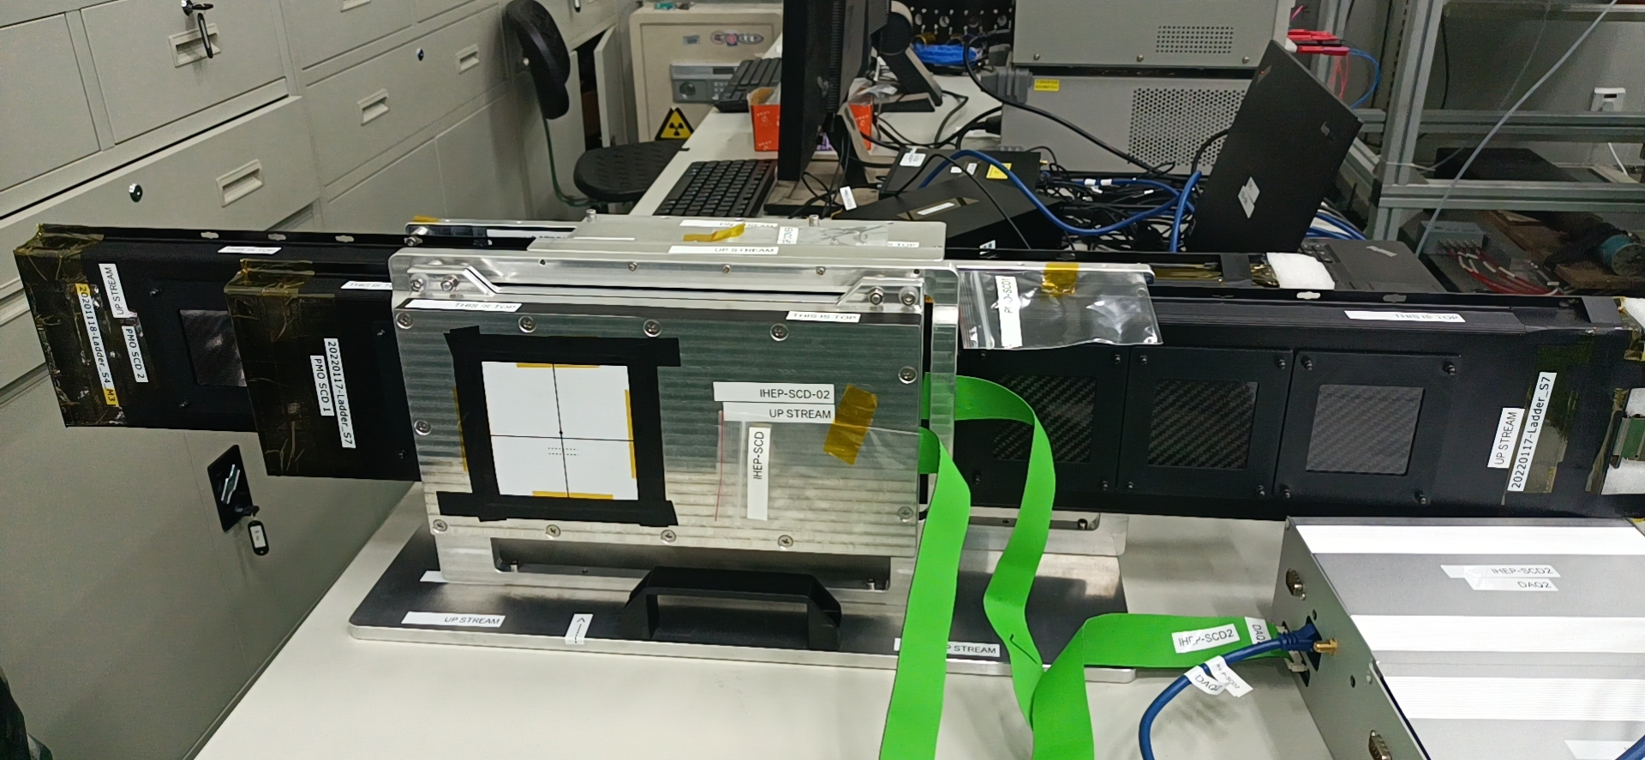
Full connection test
IHEP PSD (not shown)
PMO SCD2
IHEP SCD
PMO SCD1
Base
2 IHEP SCD & 2 PMO SCD on the common base

Slide 3
Full connection test
220V
Swiss ->CN
Adaptor
10m power cable
5m power strip. 8 sockets
NoteBook1
NoteBook2
PC & Mon 1
PC & Mon 2
DAQ1
DC
DAQ2
DAQ1
DC
DAQ2
SCD1
SCD2
SCD1
SCD2
IHEP
PMO

Slide 4
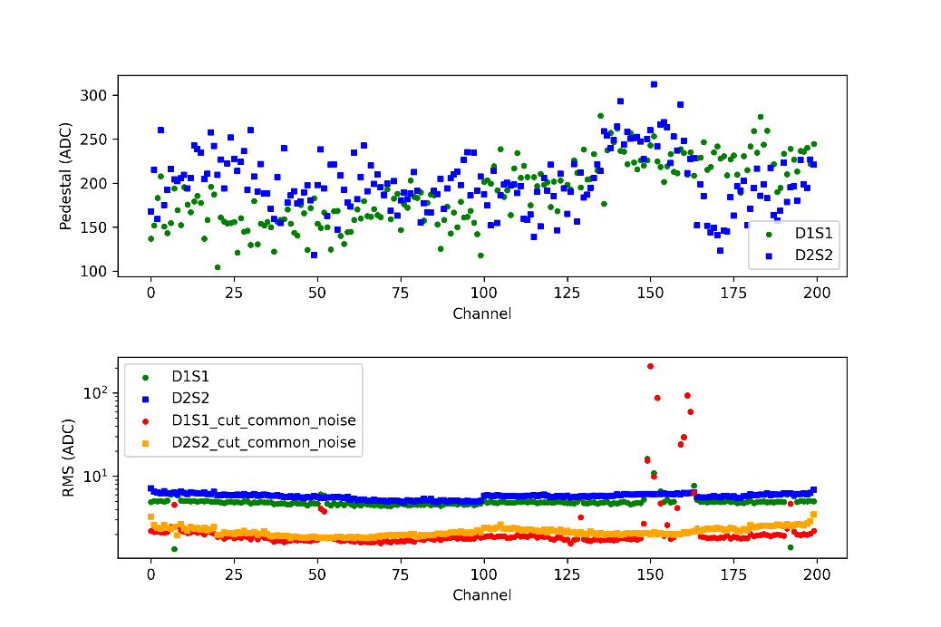
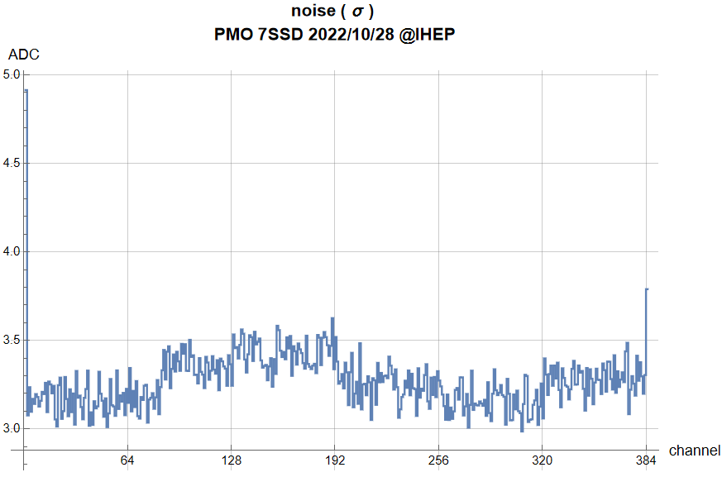
Full connection test
IHEP SCD pedestal(top) and noise level (bottom)
The noise level is 2~3 ADC counts after common noise subtraction
PMO SCD noise level distribution. The noise level is 3~3.5 ADC counts after common noise subtraction

Slide 5
DAQ Test
IHEP PC1
IHEP PC2
PMO PC1
PMO PC2
Sync Start/Stop
Backup Host PC
Backup Trigger Board
DI2C
IHEP DAQ1
IHEP DAQ2
PMO DAQ1
PMO DAQ2
The CN SCD follow the DI2C & Sync Start/Stop protocol.
After properly connection and setting IP, the DAQ will automatically start/stop. NO manual control is in need.

Slide 6
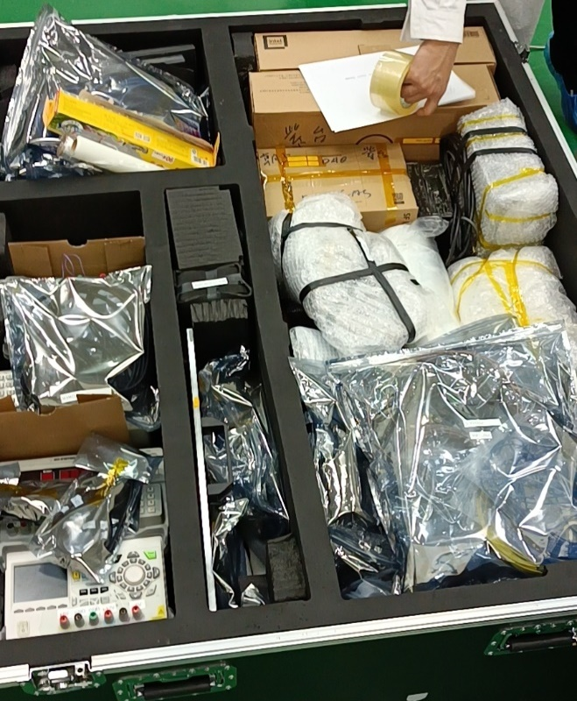
Transportation
detector | component | ID | Region
IHEP SCD | Detector *2 | A01 | 3
 | DC& Power cord *1 | A02 | 2
 | DAQ *2 | A03 | 1
 | PC *2 | A04 | 1
 | Network cable *4 | A05 | 1
PMO SCD | Detector *2 | B01 | 4
 | bracket *2 | B02 | 3
 | DC& Power cord *1 | B03 | 2
 | DAQ *2 | B04 | 4
 | PC *2 | B05 | 4
 | monitor *2 | B06 | 1
 | Network cable *4 | B07 | 1
PSD | Detector | C01 | 4
 | Support | C02 | 3
 | DC&Power cord *3 | C03 | 2
 | Pre-Amplifier | C04 | 4
 | DT | C05 | 4
 | ADC | C06 | 4
 | Cables | C07 | 4
 | Router | C08 | 4
 | PC&USB Converter | C09 | 4
 | Mobile Platform | C10 | 4
 | backup NDL SiPM board | C11 | 3
 | SPARE Calbles | C12 | 4
other | Base | D01 | 3
 | Top cover | D02 | 3
 | 220V Power supply cable*2 | D03 | 4
 | tool、gasket *2 | D04 | 3
1
4
2
3
The package has already been send to Geneva at Nov. 2nd by plane.

Slide 7
Documentation
We have been writing the ‘Installation Manual’ . The Chinese version is finished, and we are doing the translation.
The CN SCD can automatically start/stop during experiment. So No ‘Operation Manual’ is in need.
The ‘Uninstallation Manual’ will be prepared.

Slide 8
Solution to illuminate all 10 regions of IHEP SCD
5*20channels
5*20channels
0ohm
0ohm
The beam spot of high-Z ion is small.
The beam spot should illuminate all 10 regions with various setups.
However, no mobile platform is prepared.
68pf
47pf
20pf
100pf
60um
25um
3.6 cm

Slide 9
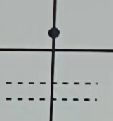
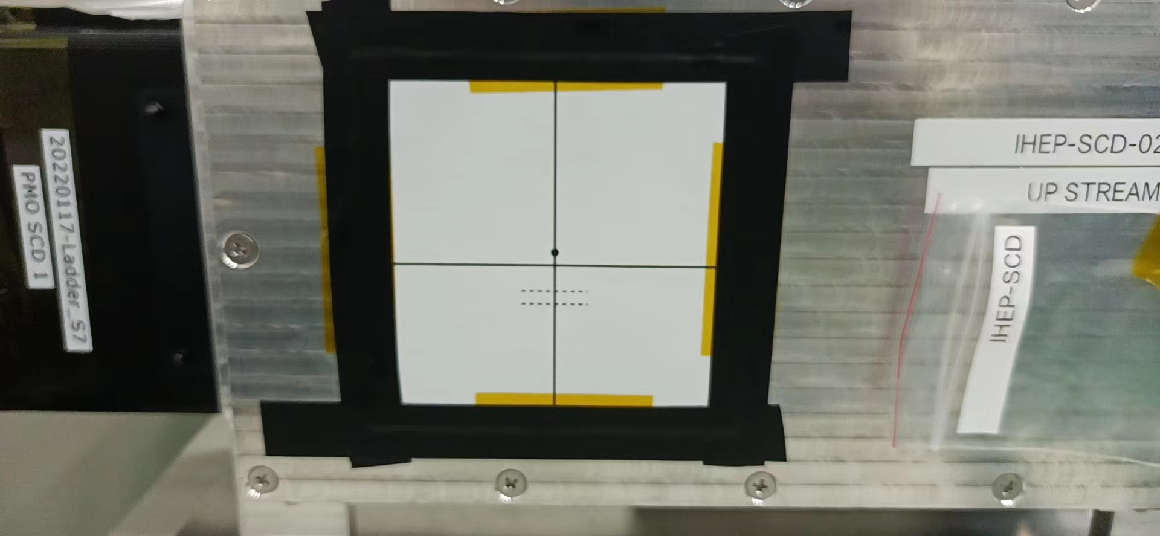
Solution to illuminate all 10 regions of IHEP SCD
0 ohm
0 ohm
IHEP SCD2
60um width
68 pF
68 pF
IHEP SCD1
25um width
47 pF
47 pF
20 pF
20 pF
100 pF
100 pF
100 pF
100 pF
3.6mm
Ion beam
20 pF
20 pF
47 pF
47 pF
IHEP SCD2
25um width
68 pF
68 pF
IHEP SCD1
60um width
0 ohm
0 ohm
Common Base

Slide 10
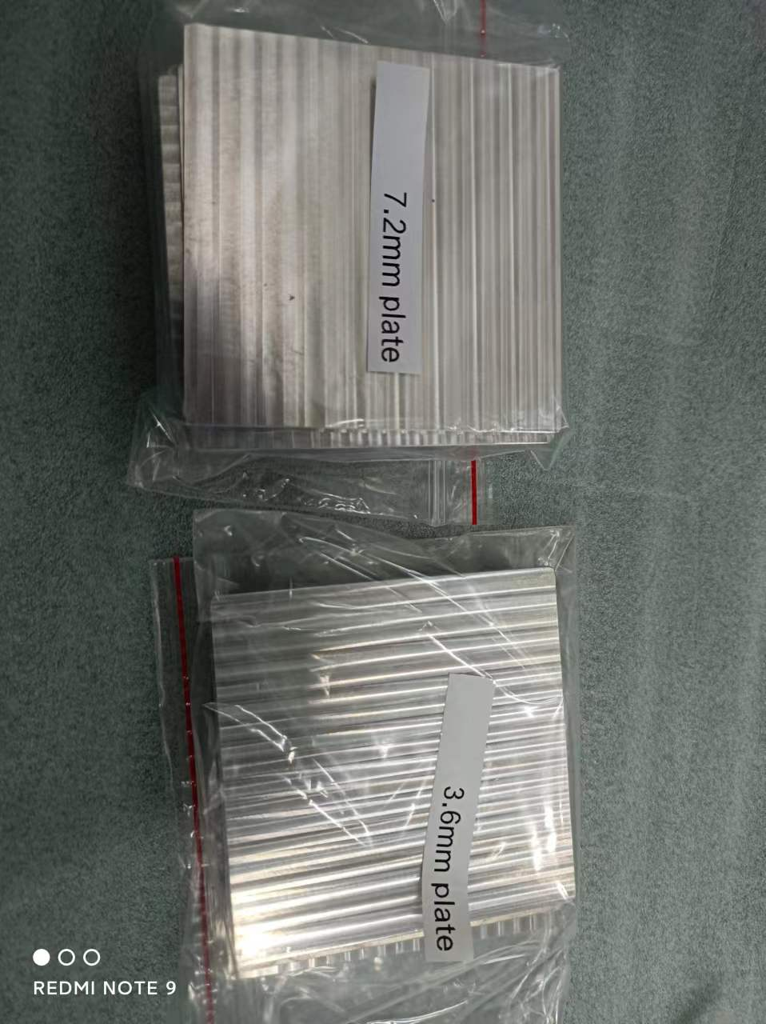
Solution to illuminate all 10 regions of IHEP SCD
0 ohm
0 ohm
IHEP SCD2
60um width
68 pF
68 pF
IHEP SCD1
25um width
47 pF
47 pF
20 pF
20 pF
100 pF
100 pF
100 pF
100 pF
3.6mm
Ion beam
20 pF
20 pF
47 pF
47 pF
IHEP SCD2
25um width
68 pF
68 pF
IHEP SCD1
60um width
7.2 mm aluminum plate*4
7.2 mm
plate
0 ohm
0 ohm
7.2 mm
plate
Common Base

Slide 11
Solution to illuminate all 10 regions of IHEP SCD
0 ohm
0 ohm
IHEP SCD2
60um width
68 pF
68 pF
IHEP SCD1
25um width
47 pF
47 pF
20 pF
20 pF
100 pF
100 pF
100 pF
100 pF
3.6mm
20 pF
20 pF
47 pF
47 pF
IHEP SCD2
25um width
IHEP SCD1
60um width
Ion beam
68 pF
68 pF
0 ohm
0 ohm
3.6 mm
3.6 mm
3.6 mm aluminum plate*4
7.2 mm
plate
7.2 mm
plate
Common Base

Slide 12
Conclusion
A full connection test of IHEP & PMO SCD has been performed. The noise level is low.
An automatic DAQ system has been test. After proper setup, NO manual control is in need.
The package has been seen to Geneva at Nov. 2nd by plane.
‘Installation Manual’ is being prepared.
Proposal to illuminate all 10 regions by inserting 2 types of plates.

