Slide 1
The Injection Channel of the muEDM Experiment
Anastasia Doinaki
New Frontiers in Lepton Flavor
Pisa, 16.05.2023

Slide 2
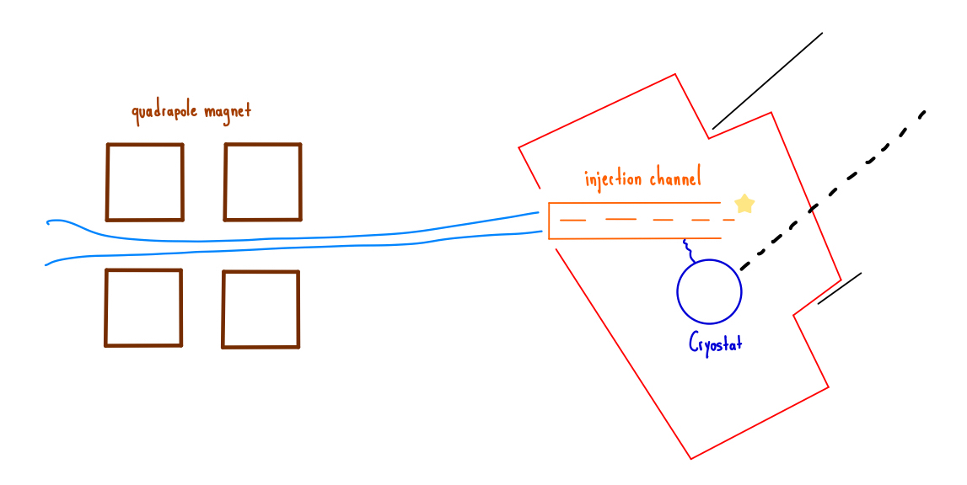
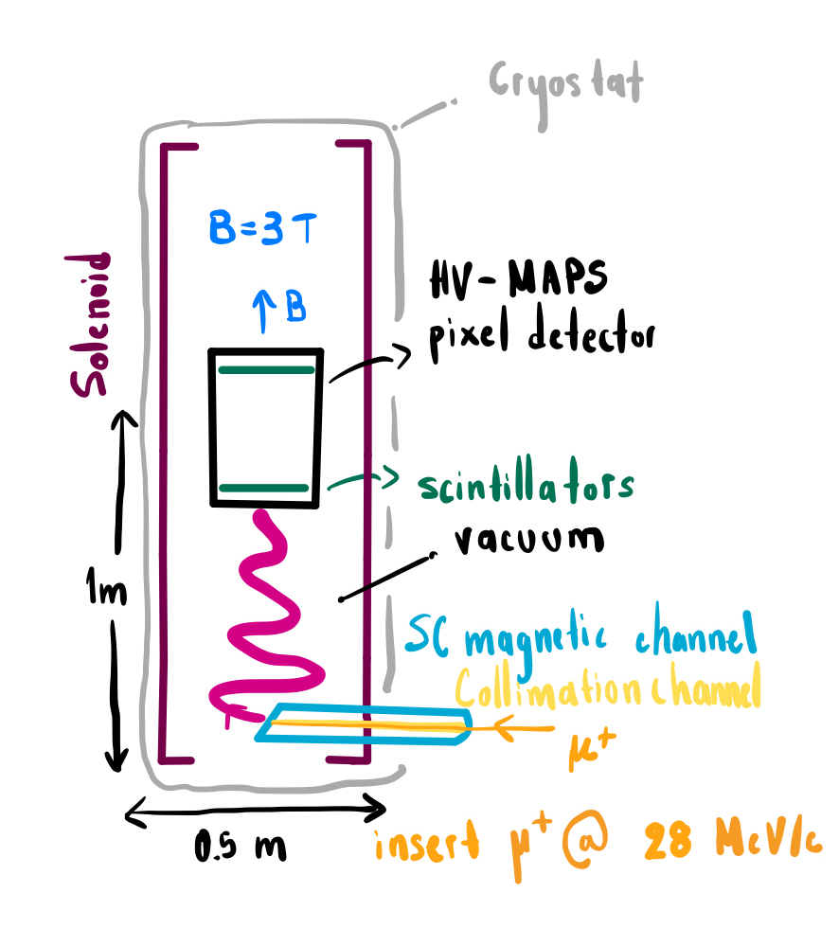
Injection Channel
Goal Off-axis injection of muons into a solenoid.
Muons (p$≈28$ MeV/c) from pion decay at rest (πE₁).
Muons injected through a Collimation Channel (ID=15 mm, l=800mm).
Around the Collimation Channel, a SuperConducting (SC) Shielded Channel (SC-Channel) to magnetically shield the Injection Channel.

Slide 3
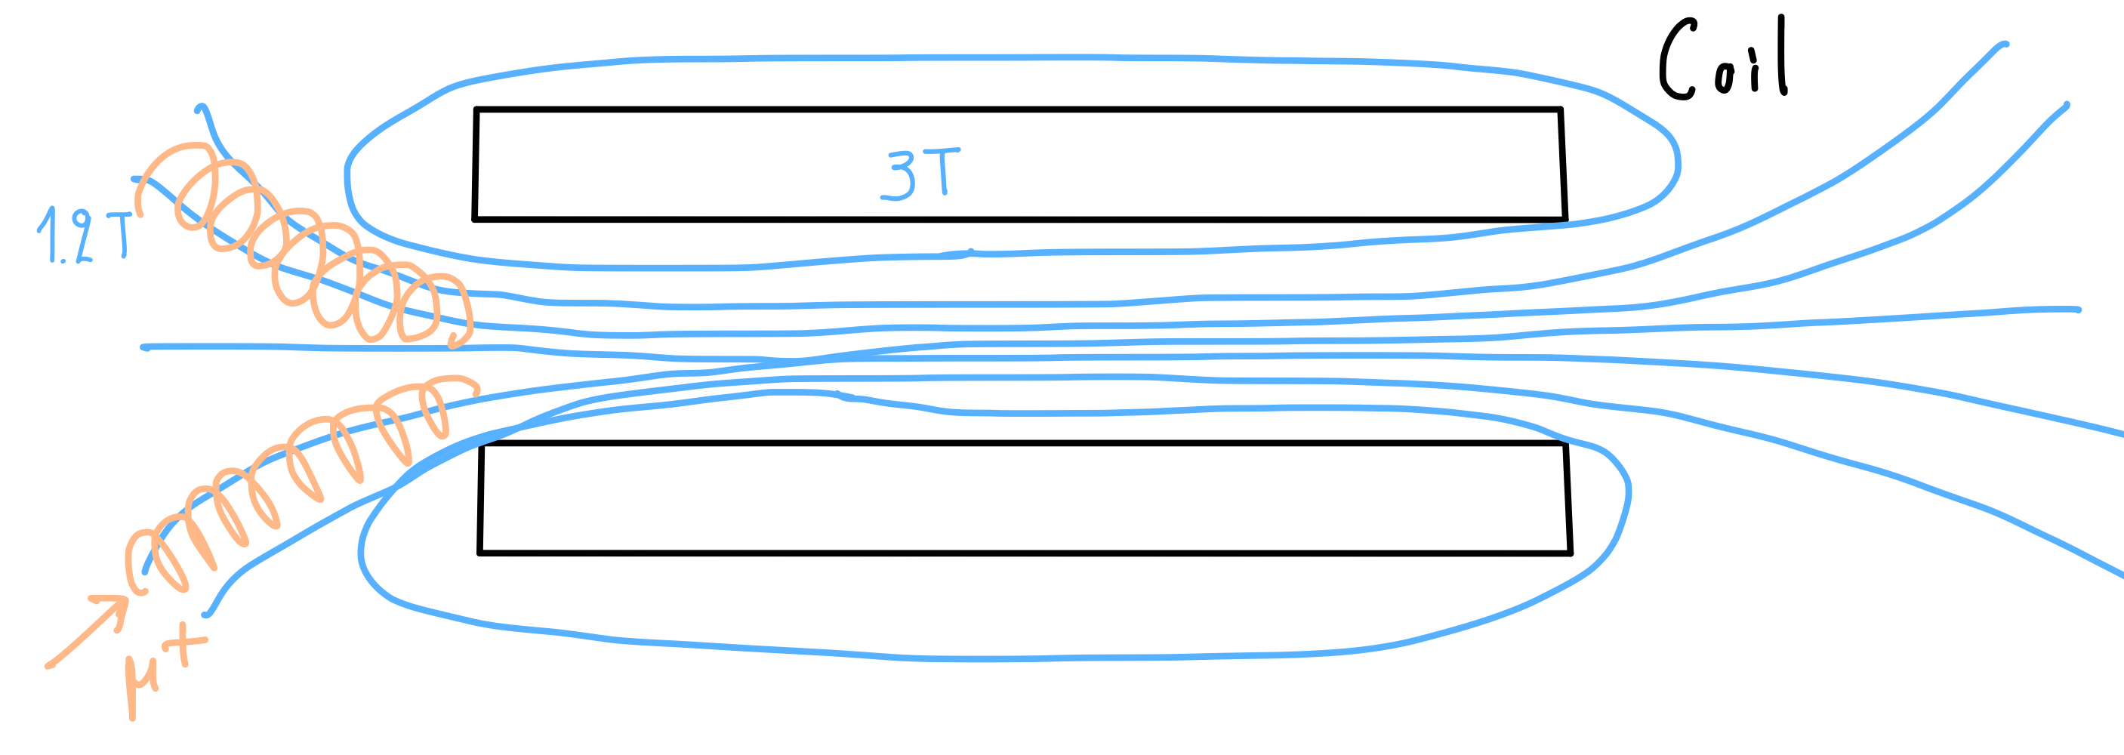
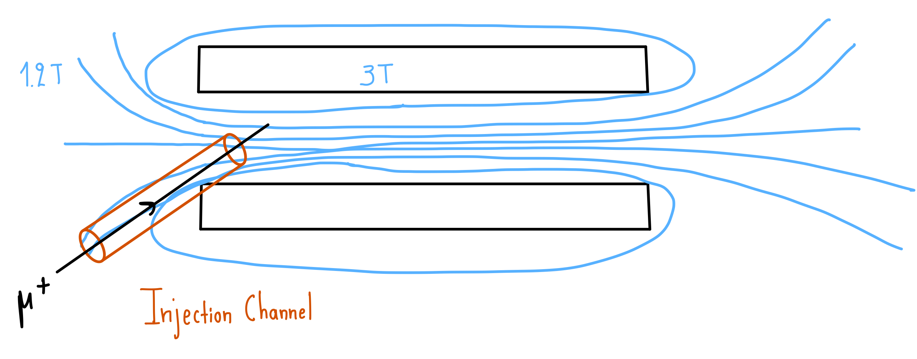
Magnetically Shielded Channel
Muons transported from a low-field (fringe field<1T) to a high-field region (solenoid$\sim 3T)$ muons will spiral in and then spiral out (Magnetic Mirror Effect).
A magnetically shielded channel is needed for the transportation of the muons from the exit of the πE1 beamline in the solenoid, and it consists of:
Fringe field<1T: Thick Iron Tubes
Solenoid$\sim 3T$: SC-Shielded Tubes

Slide 4
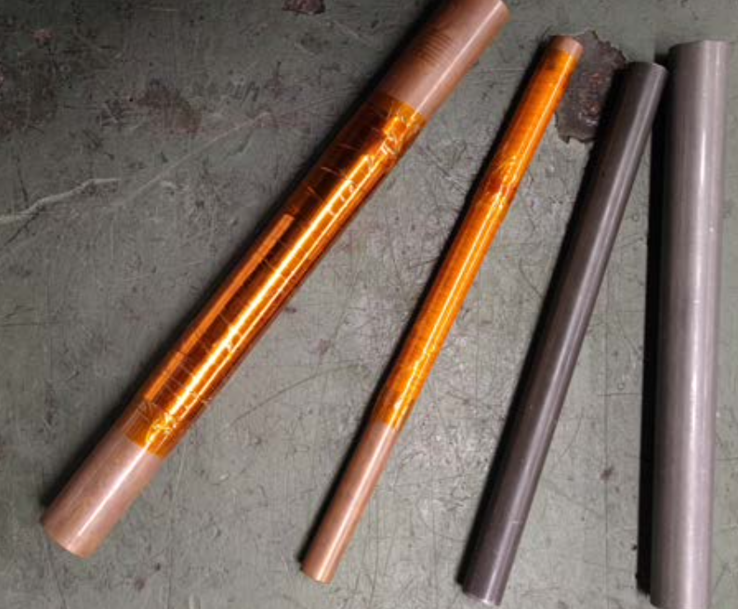
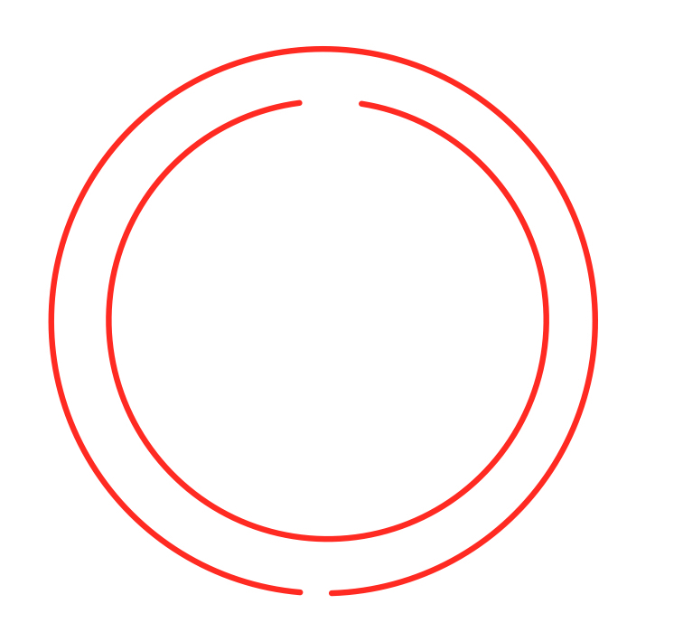
Superconductivity and Superconducting-Shielded Prototypes
Supercoductivity (SC) is observed in many metals when they are cooled down below a certain, critical, temperature.
zero resistance
Electric current loops appear on the surface of the metal when it becomes superconducting. These currents (eddy currents), create a magnetic field that compensates the external, applied magnetic field.
Total magnetic field becomes zero in the SC-volume.
Prototype I: High-Temperature Superconducting (HTS) Tape, helically coiled around a copper tube.
Prototype II: Copper tubes wrapped with Nb-Ti/Nb/Cu SC-Sheets (borrowed from CERN).
Prototype III: Combination of a Bi-2223 casted tube with superconducting tape wrapped around it.

Slide 5
Superconductivity and Superconducting-Shielded Prototypes
Supercoductivity (SC) is observed in many metals when they are cooled down below a certain, critical, temperature.
zero resistance
Electric current loops appear on the surface of the metal when it becomes superconducting. These currents (eddy currents), create a magnetic field that compensates the external, applied magnetic field.
Total magnetic field becomes zero in the SC-volume.
Prototype I: High-Temperature Superconducting (HTS) Tape, helically coiled around a copper tube.
Prototype II: Copper tubes wrapped with Nb-Ti/Nb/Cu SC-Sheets (borrowed from CERN).
Prototype III: Combination of a Bi-2223 casted tube with superconducting tape wrapped around it.
Prototype 0

Slide 6
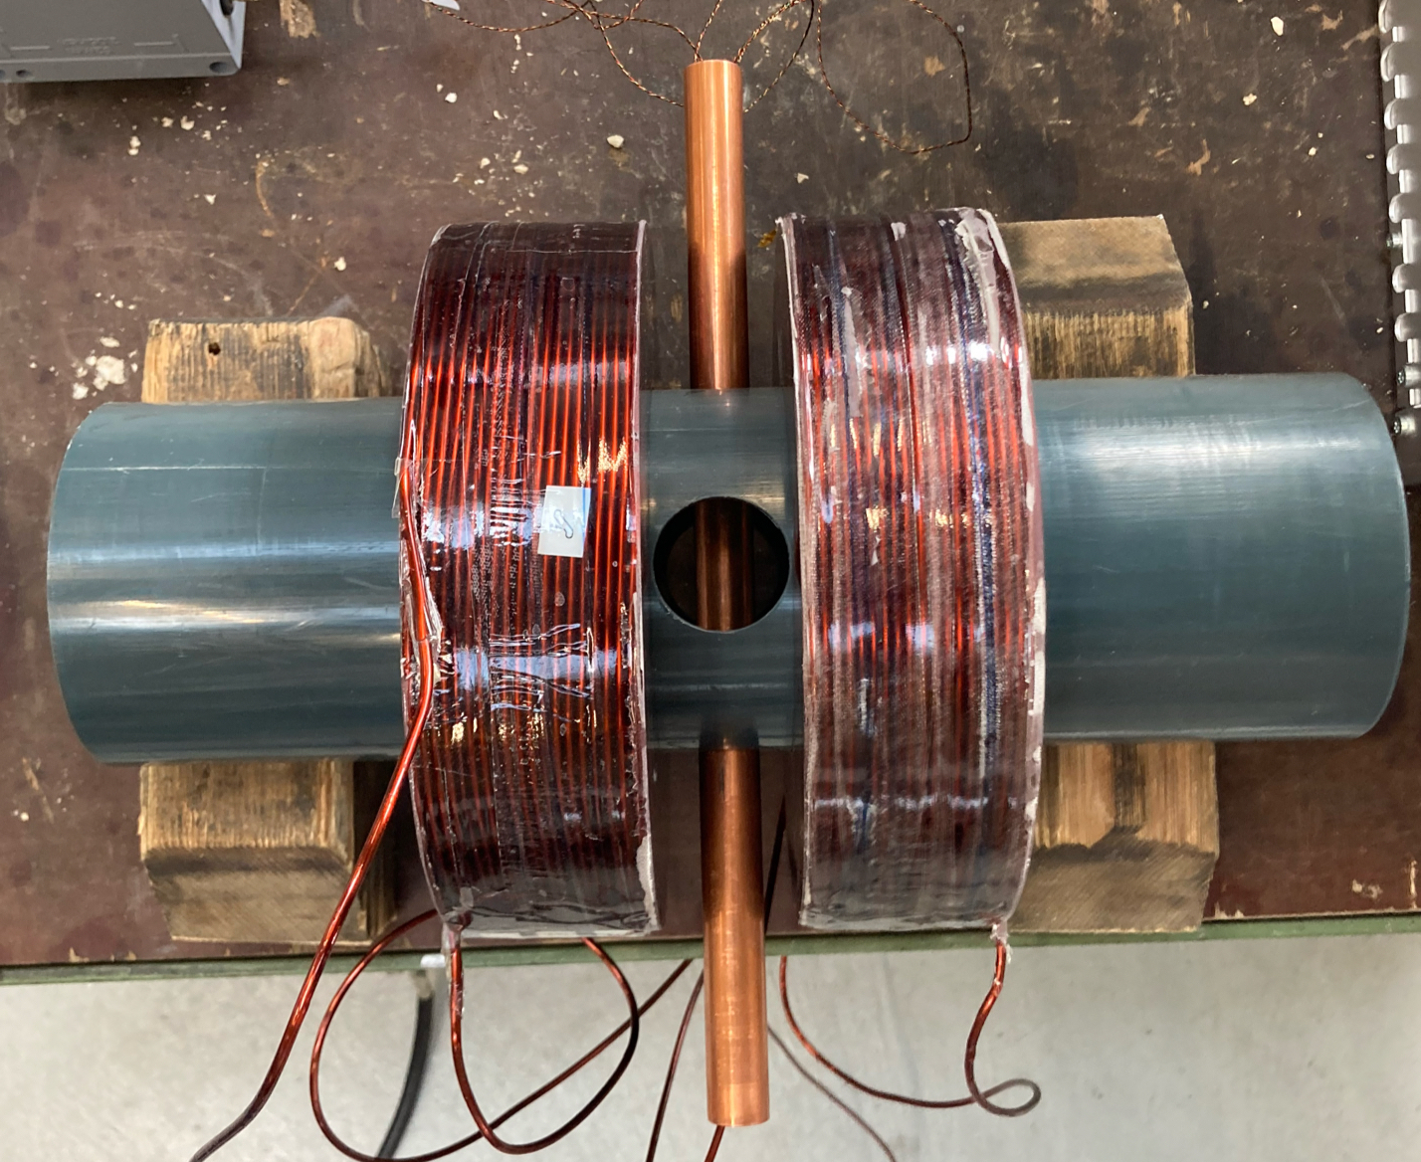
Setup SC-shielding Test
Study of the SC- shielding effectiveness of SC-shielded injection tubes under the magnetic field of a Helmholtz coil:
By measuring the magnetic field in SC–tubes with and without SC-shielding at room and cryogenic temperatures.

Slide 7
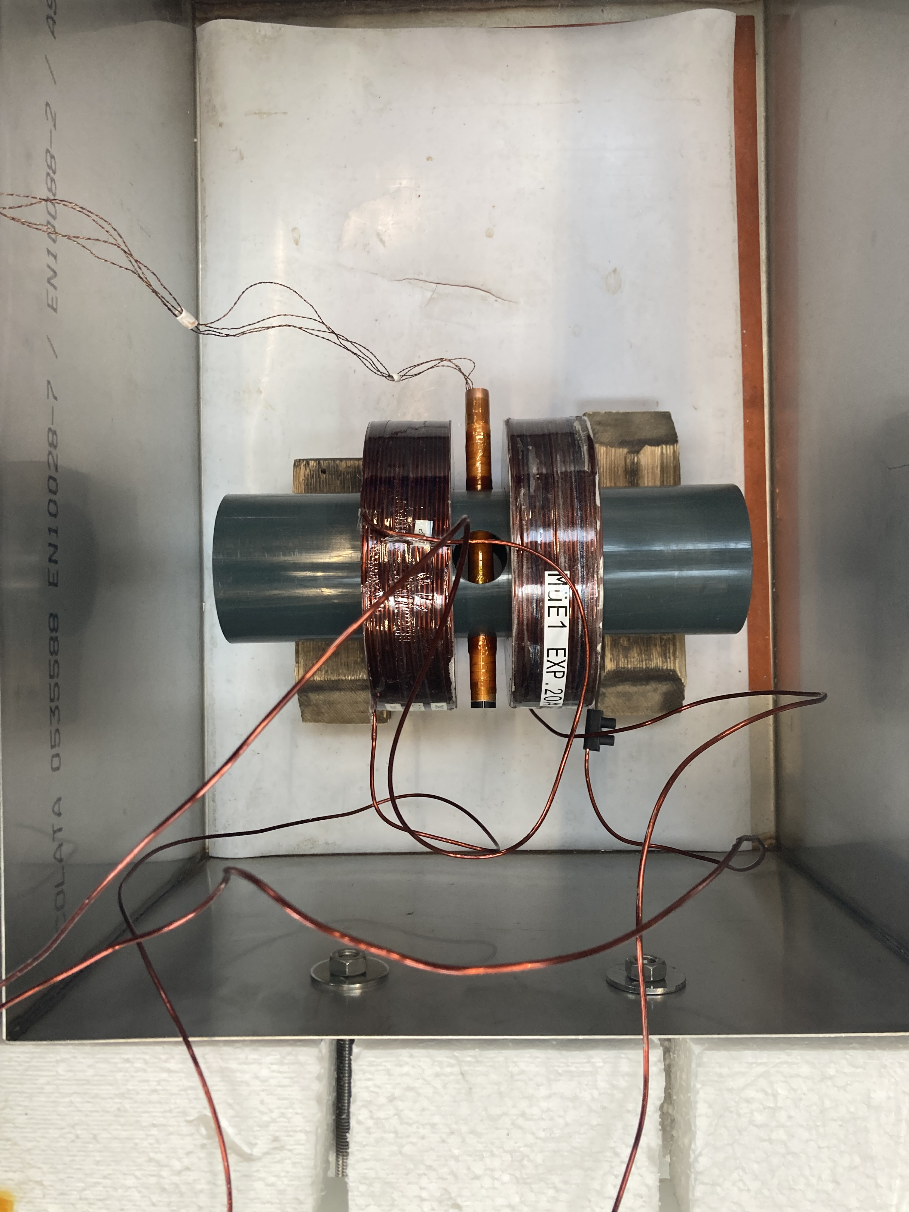
Setup SC-shielding Test
Study of the SC- shielding effectiveness of SC-shielded injection tubes under the magnetic field of a Helmholtz coil:
By measuring the magnetic field in SC–tubes with and without SC-shielding at room and cryogenic temperatures.
Cryogenic Temperature measurements taken by submerging the system, Helmholtz coil plus SC-tube, in a cryogenic (LN₂) bath.

Slide 8
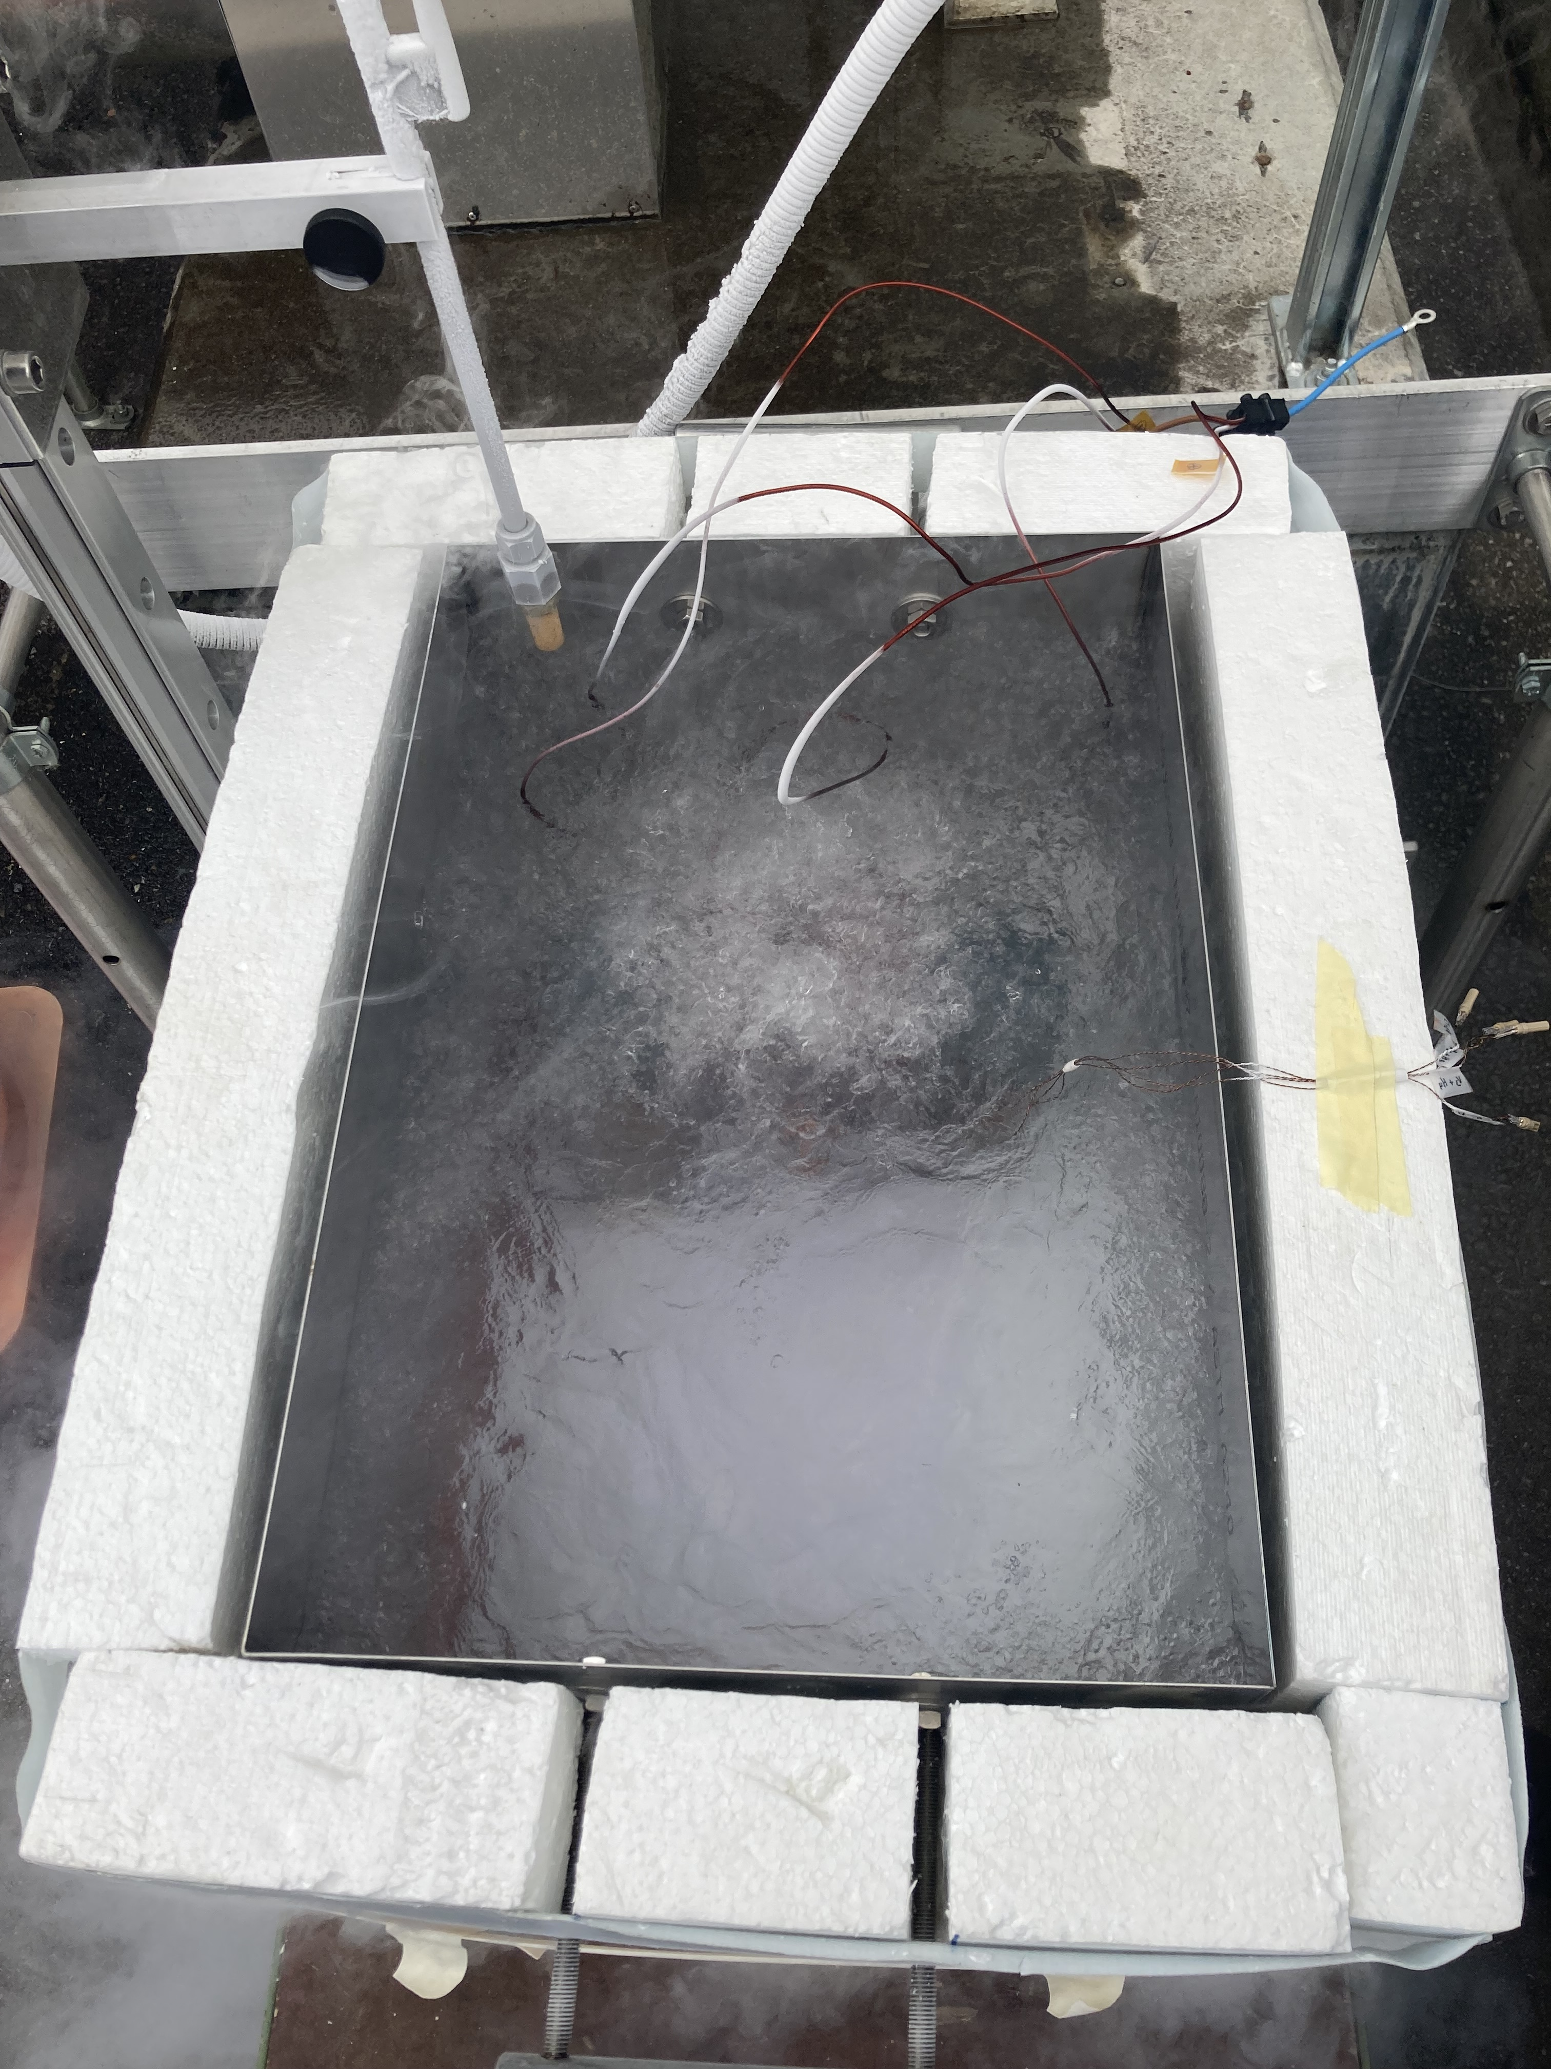
Setup SC-shielding Test
Study of the SC- shielding effectiveness of SC-shielded injection tubes under the magnetic field of a Helmholtz coil:
By measuring the magnetic field in SC–tubes with and without SC-shielding at room and cryogenic temperatures.
Cryogenic Temperature measurements taken by submerging the system, Helmholtz coil plus SC-tube, in a cryogenic (LN₂) bath.

Slide 9
Setup SC-shielding Test
Study of the SC- shielding effectiveness of SC-shielded injection tubes under the magnetic field of a Helmholtz coil:
By measuring the magnetic field in SC–tubes with and without SC-shielding at room and cryogenic temperatures.
Cryogenic Temperature measurements taken by submerging the system, Helmholtz coil plus SC-tube, in a cryogenic (LN₂) bath.
In correlation with the different mounting techniques and layers of the SC-shield.

Slide 10
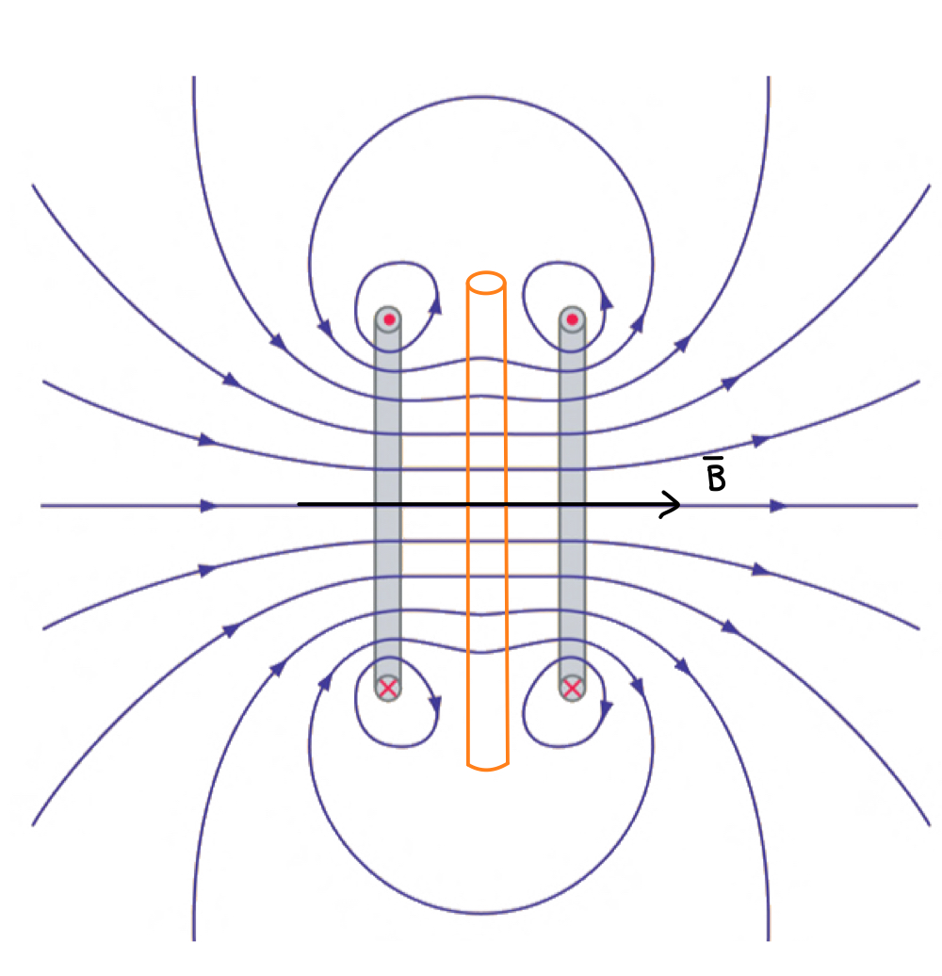
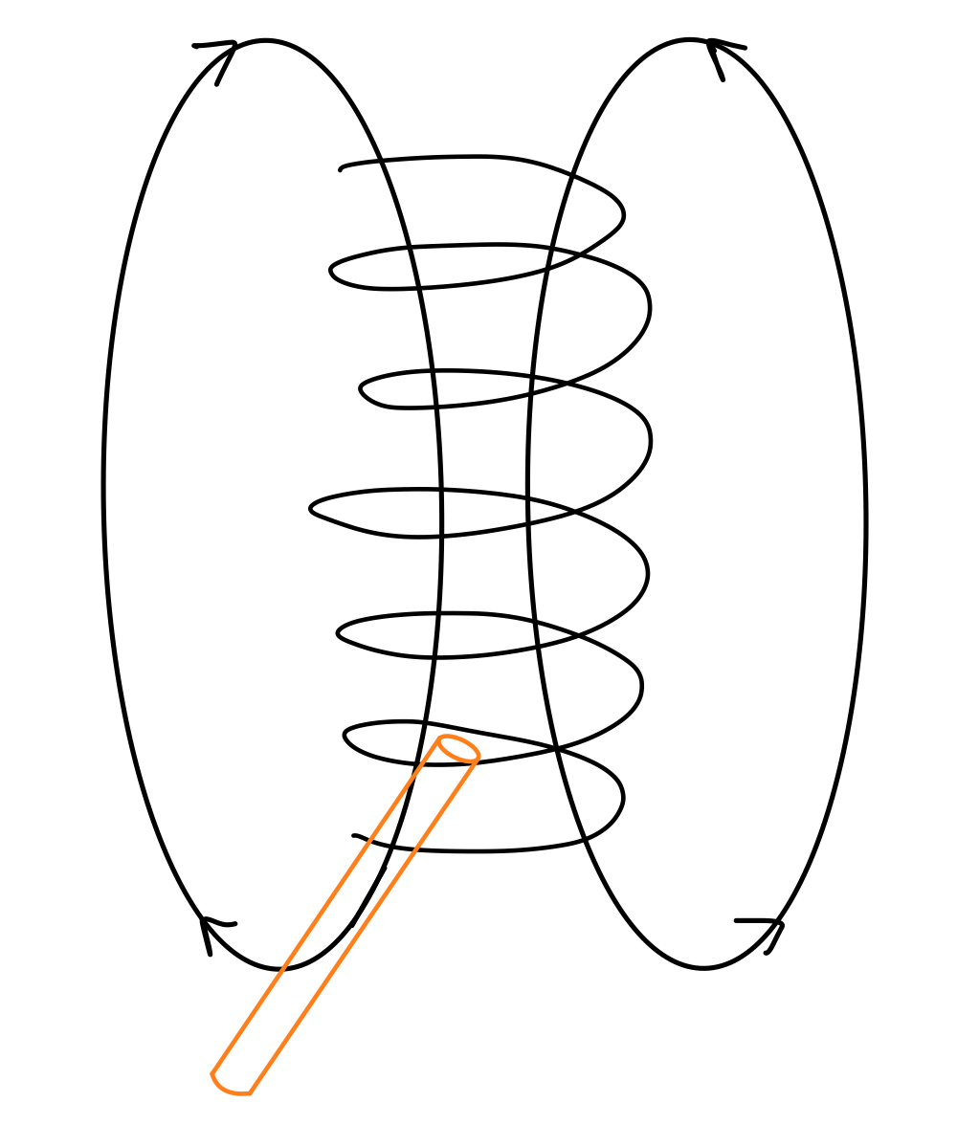
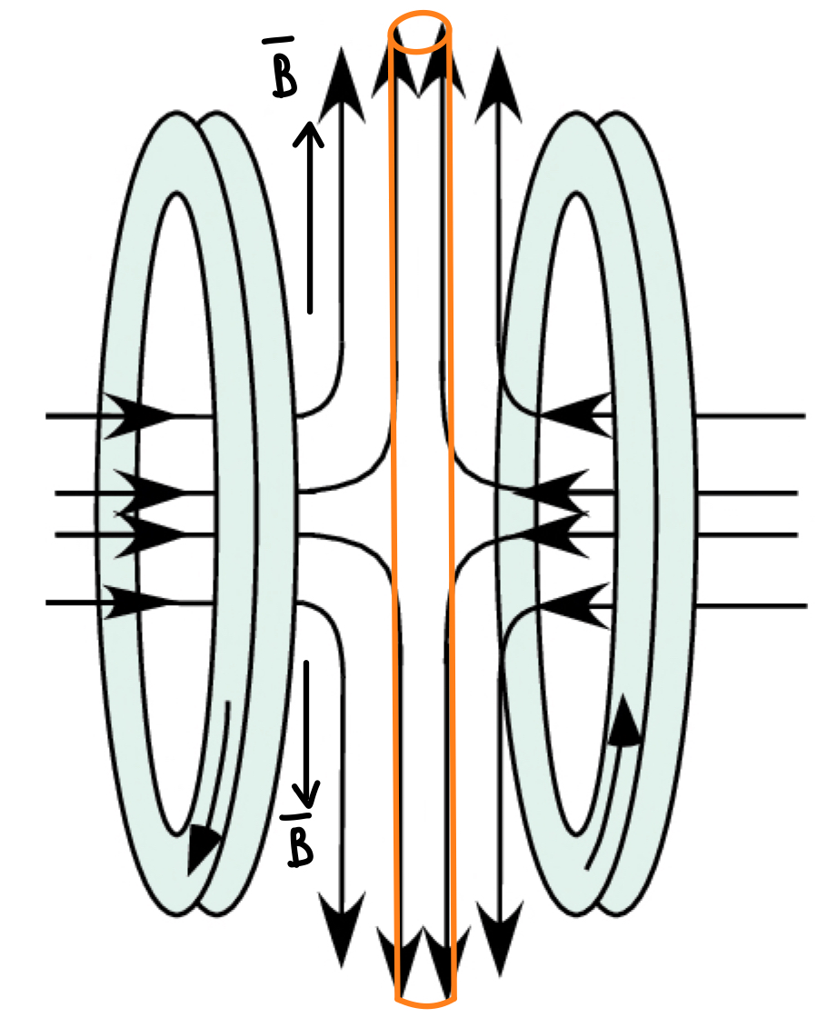
Setup SC-shielding Test
Study of the SC- shielding effectiveness of SC-shielded injection tubes under the magnetic field of a Helmholtz coil:
By measuring the magnetic field in SC–tubes with and without SC-shielding at room and cryogenic temperatures.
Cryogenic Temperature measurements taken by submerging the system, Helmholtz coil plus SC-tube, in a cryogenic (LN₂) bath.
In correlation with the different mounting techniques and layers of the SC-shield.
Why a Helmholtz coil?
We want to study both transverse and axial fields applied on our injection tubes. Also, it provides a relatively uniform magnetic field.

Slide 11
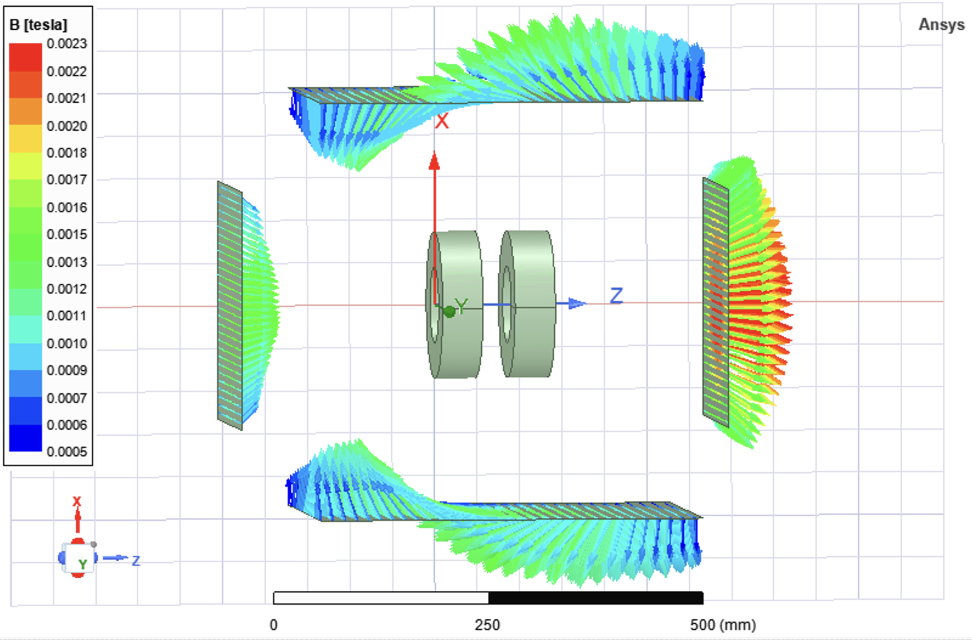
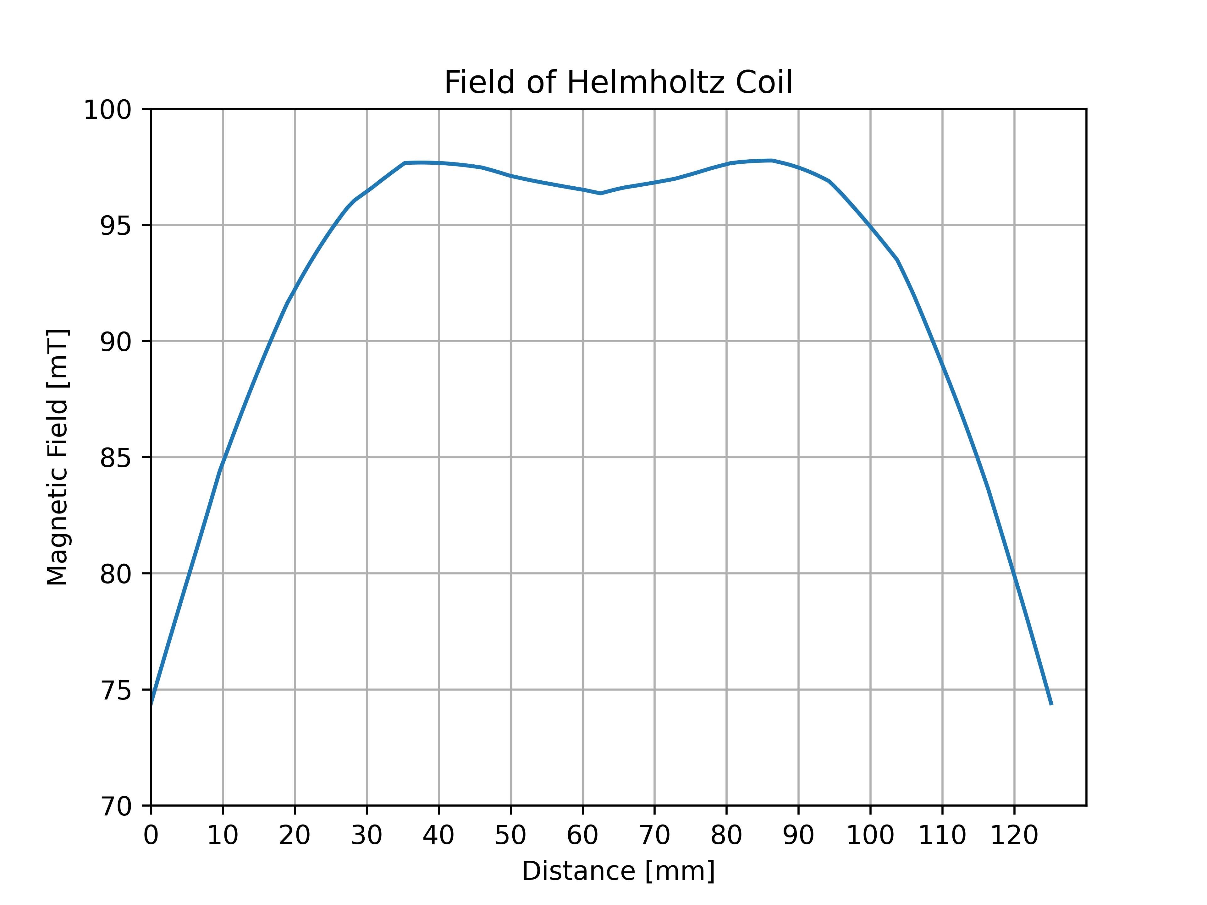
Setup SC-shielding Test, Helmholtz Coil
Designed and constructed a Helmholtz coil; 100 mT at the center of the coil when inducing a current of I=20 Amps while the coils are connected in series.

Slide 12
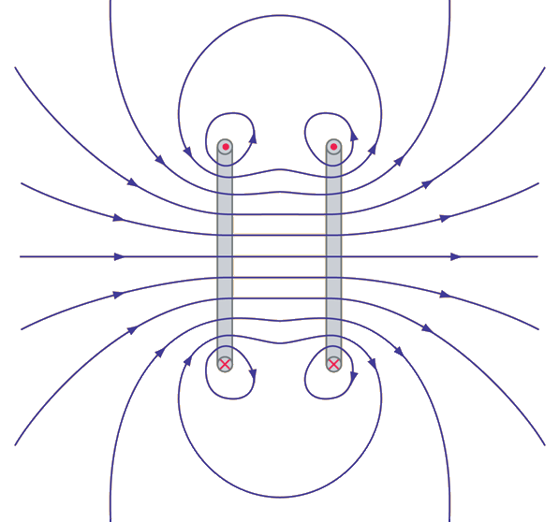
Setup SC-shielding Test, Helmholtz Coil
Designed and constructed a Helmholtz coil; 100 mT at the center of the coil when inducing a current of I=20 Amps while the coils are connected in series.

Slide 13
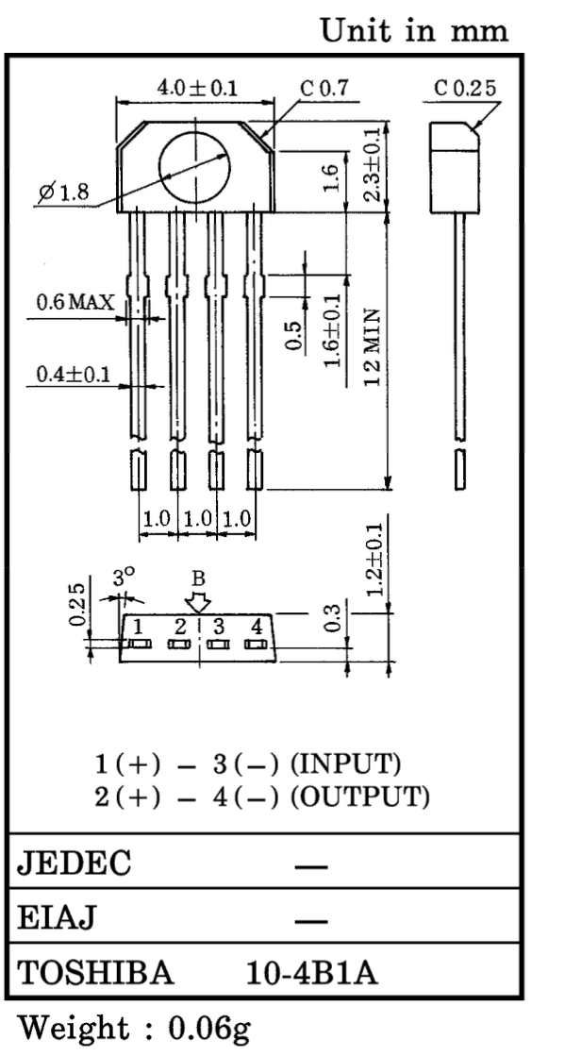
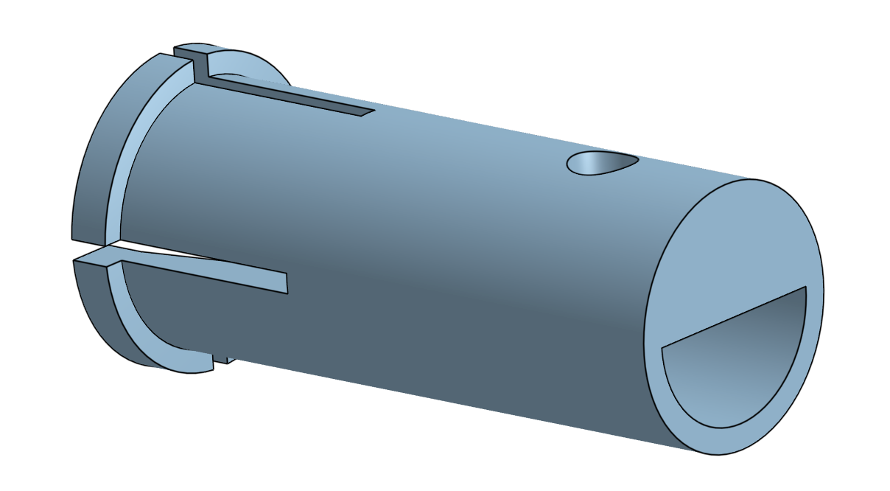
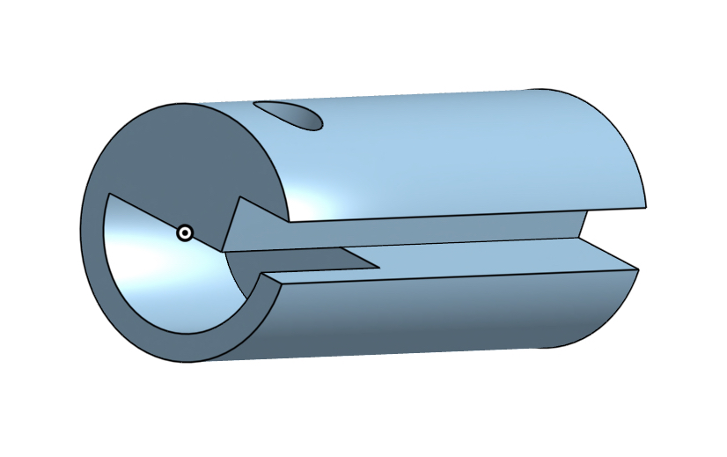
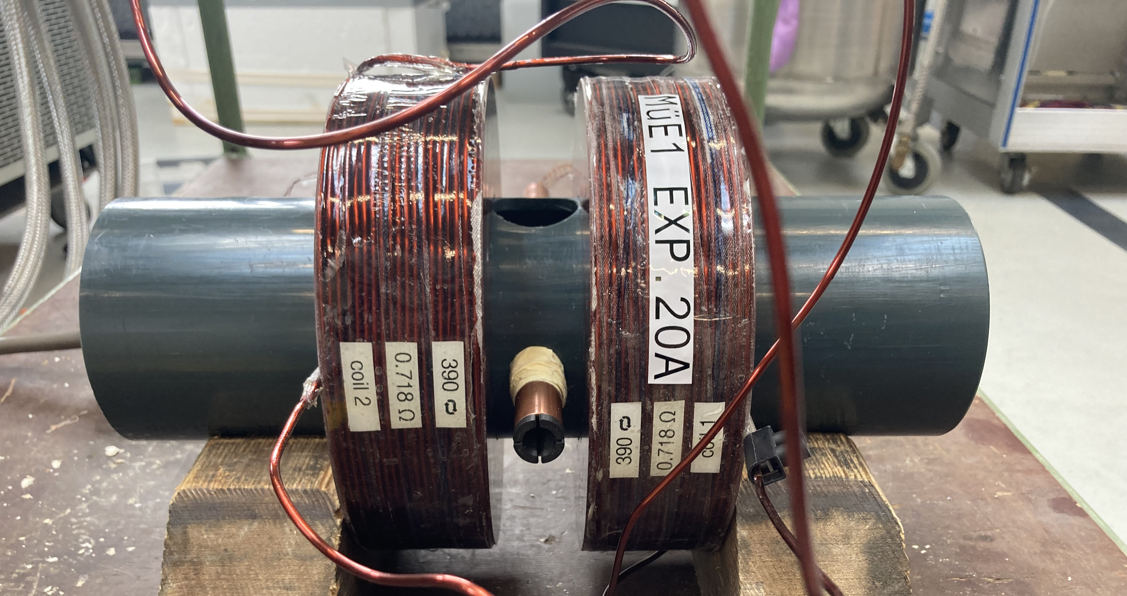
Setup SC-shielding Test, Hall Sensor Support System
In order measure the magnetic field inside the SC-shielded tube; 3D designed and printed a Hall Sensor Support system that fulfilled the following requirements:
Cryogenic-proof material, Onyx.
The support remaining fixed inside the SC-tube 7 sensor slots (4 horizontal, 3 vertical).
Glued and soldered seven Toshiba THS119 Hall Sensors on the support system.

Slide 14
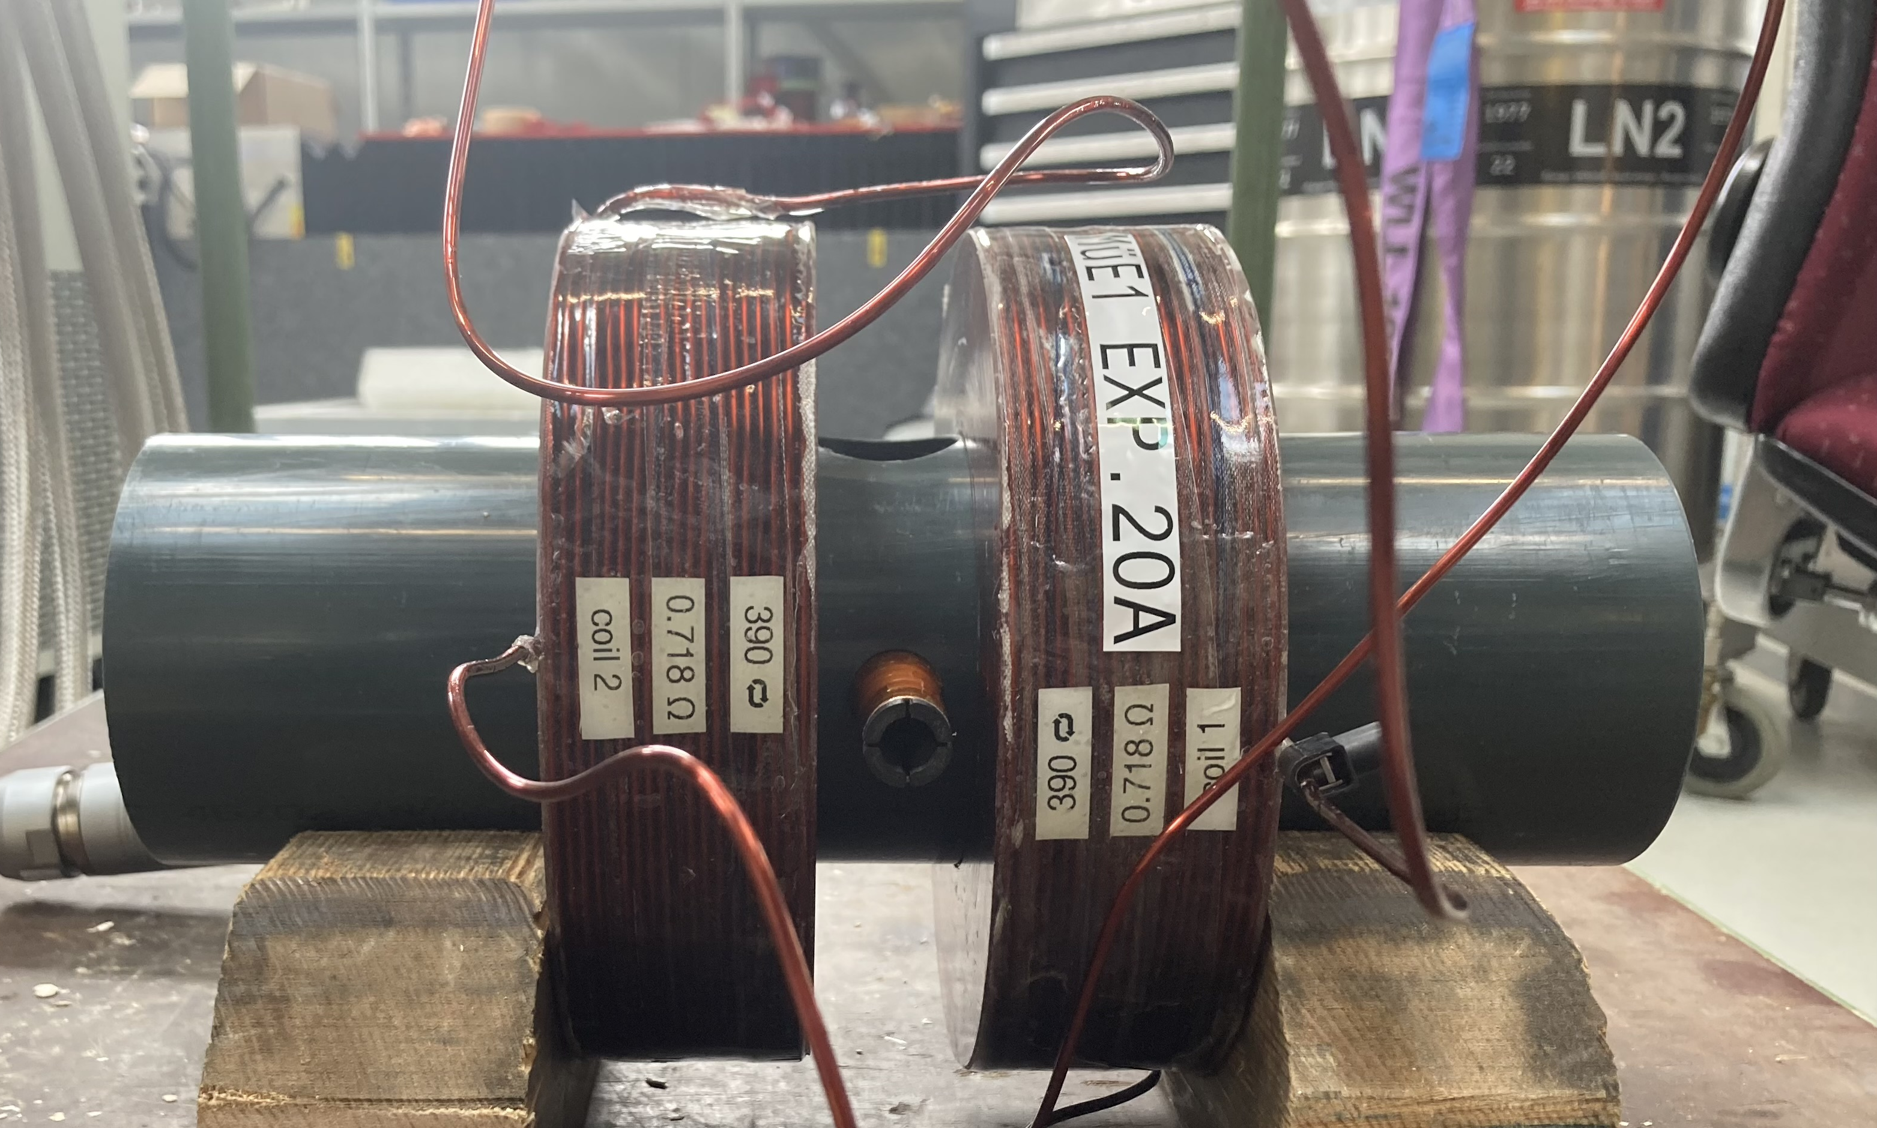
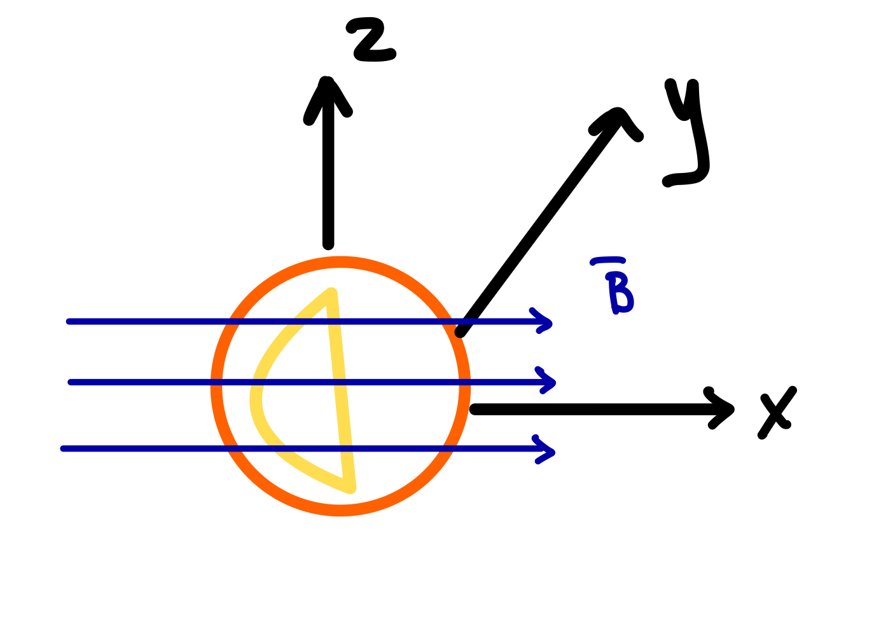
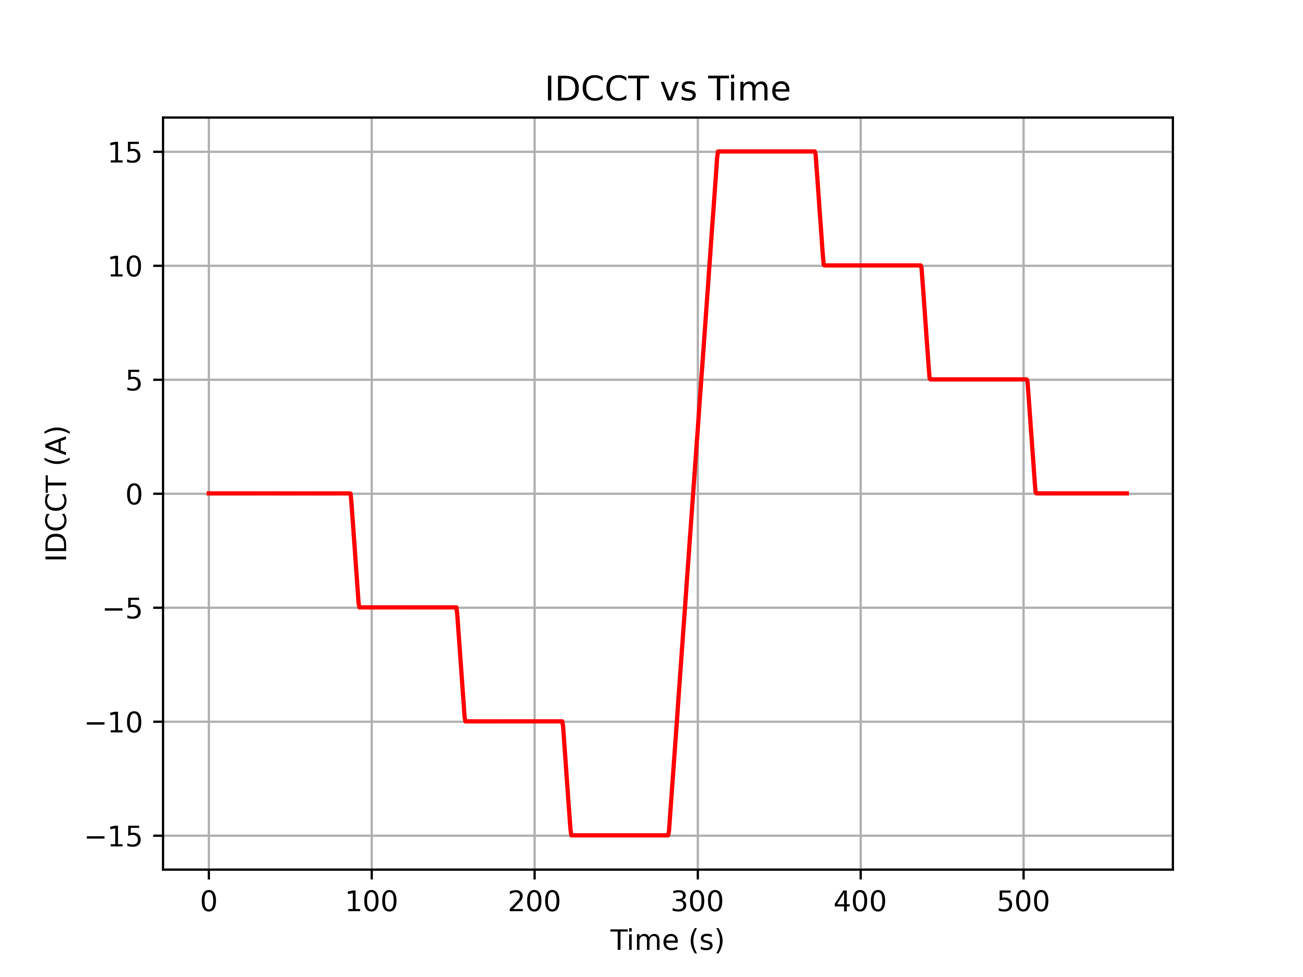
Testing the SC-Shieled Injection Tube, Prototype 0
First measurements taken at room temperature along the injection plane of the SC-tube, Prototype 0.
Coils connected in parallel.
The Hall Sensor support was centered inside the SC tube and was placed in 90º angle:
Horizontal sensors facing the opposite direction of the magnetic field lines.
Measurement Plan:
Ramping up the magnetic field with 1Amps/s ramping up rate.
Plateue at the following current I=-5, -10, -15, 15, 10 and 5 Amps for 60 seconds each.
Note At Room Temperature measurements we don’t induce 20 Amps;
Overheating of the Coil

Slide 15
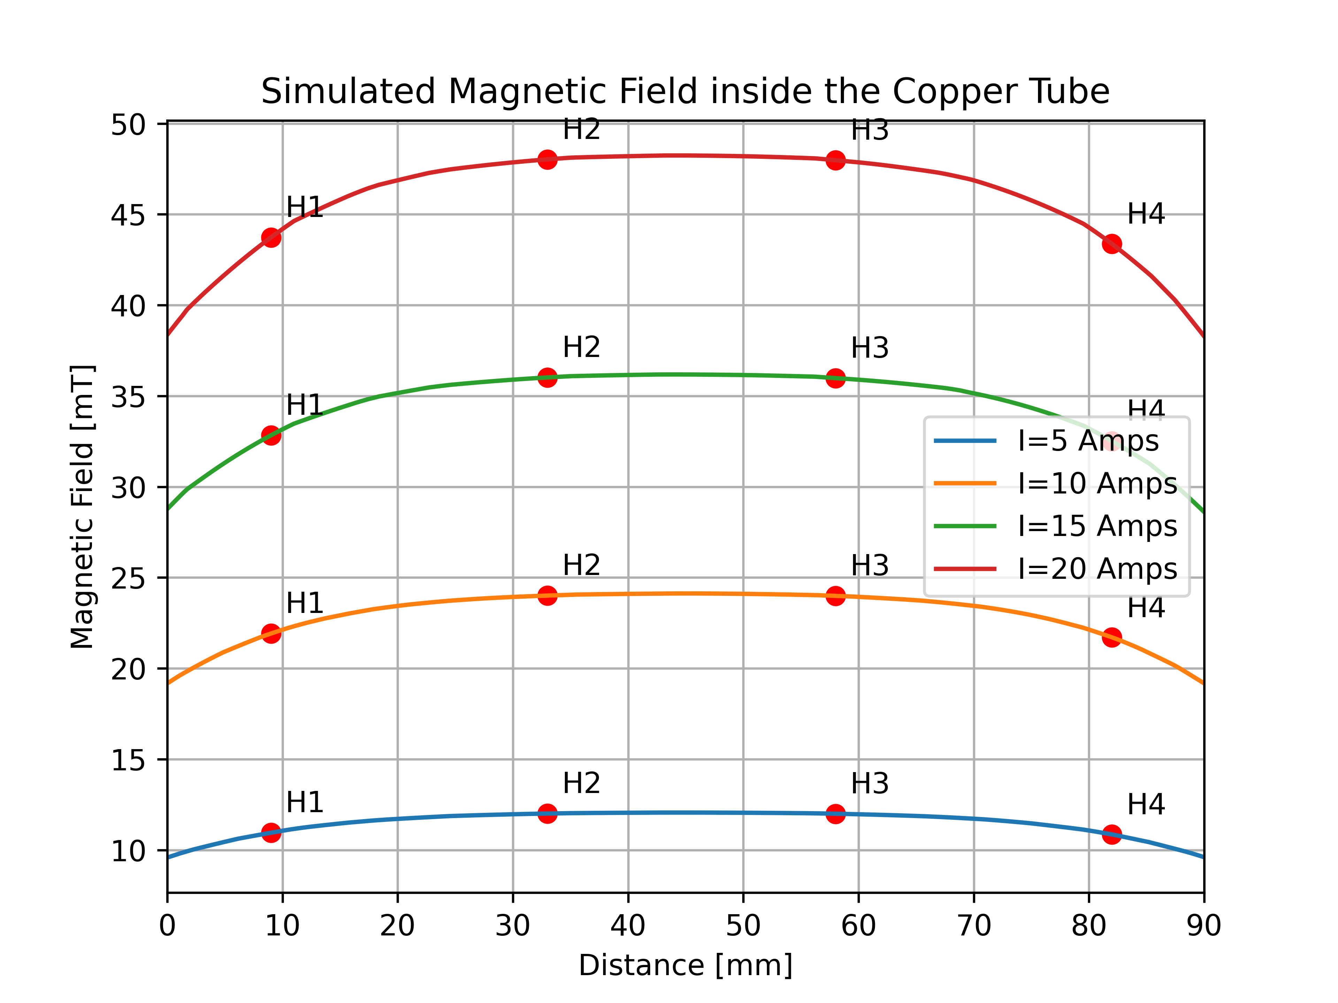
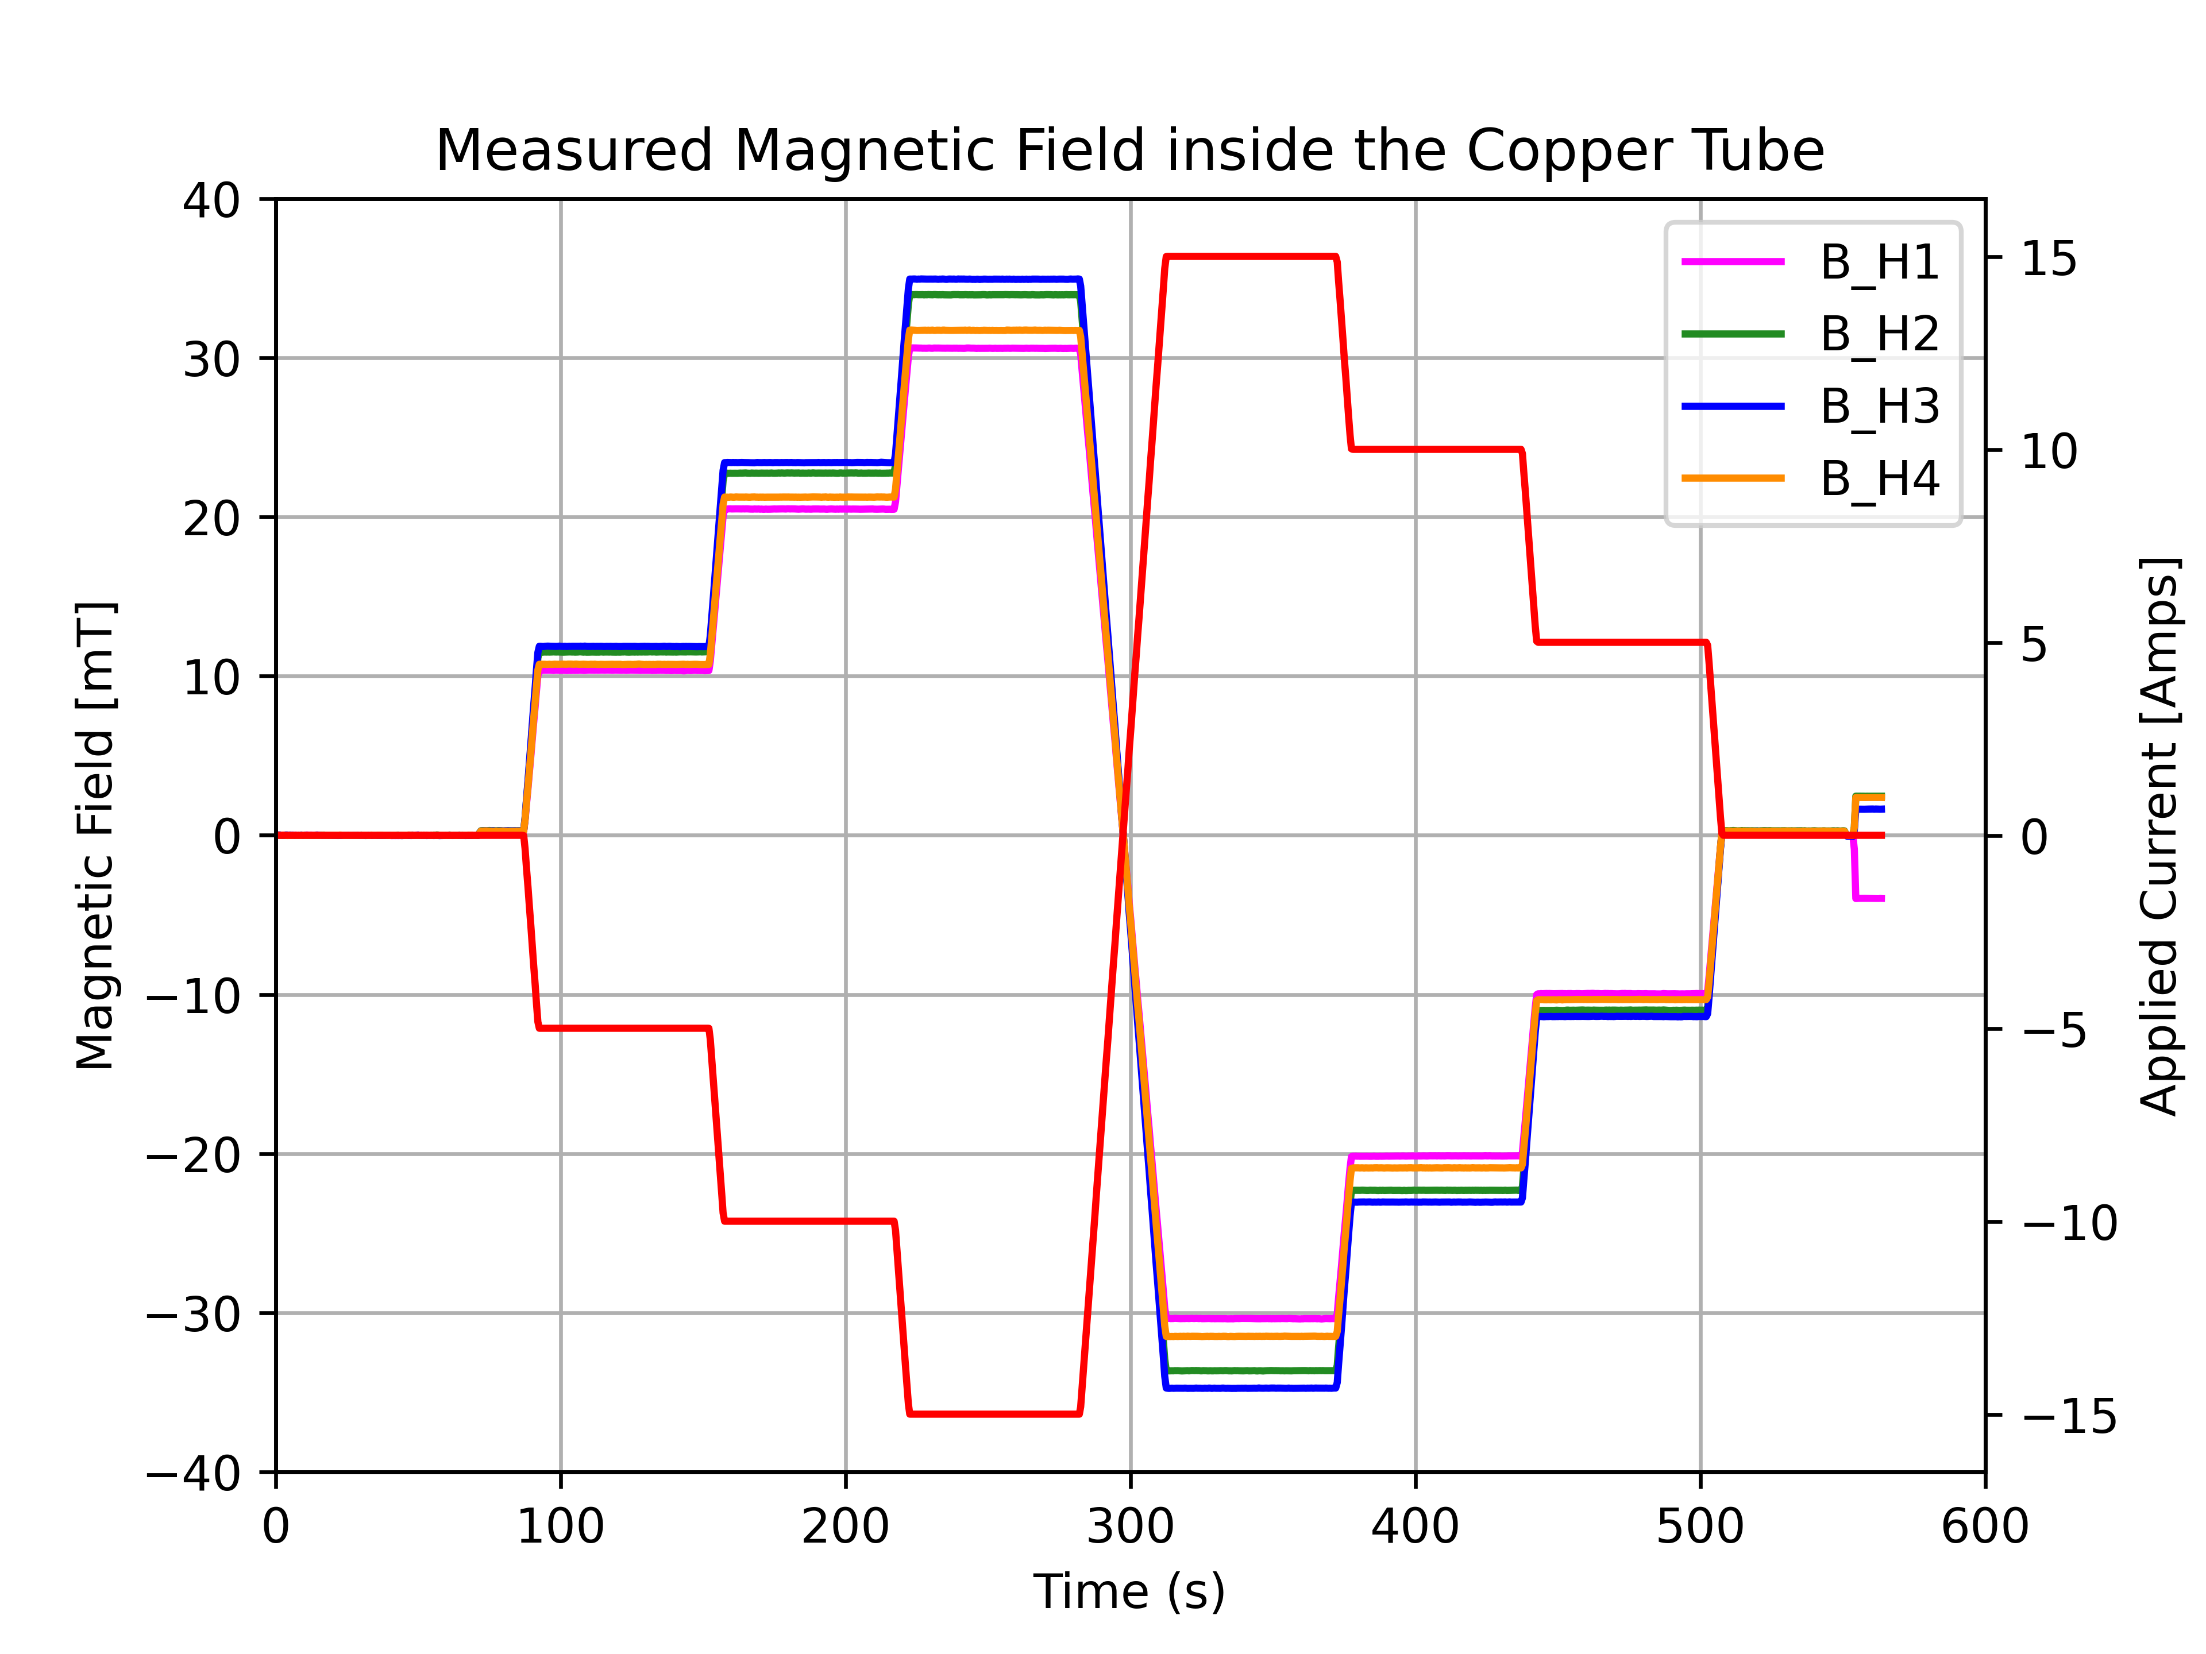
Testing Prototype 0, Room Temperature
For I= 15 Amps :
Horizontal Hall Sensor | Position [mm] | Simulated Magnetic Field [mT] | Measured Magnetic Field [mT]
H1 | 9 | 32.83 | 30.59
H2 | 33 | 36.02 | 33.96
H3 | 58 | 35.98 | 34.93
H4 | 82 | 32.51 | 31.72

Slide 16
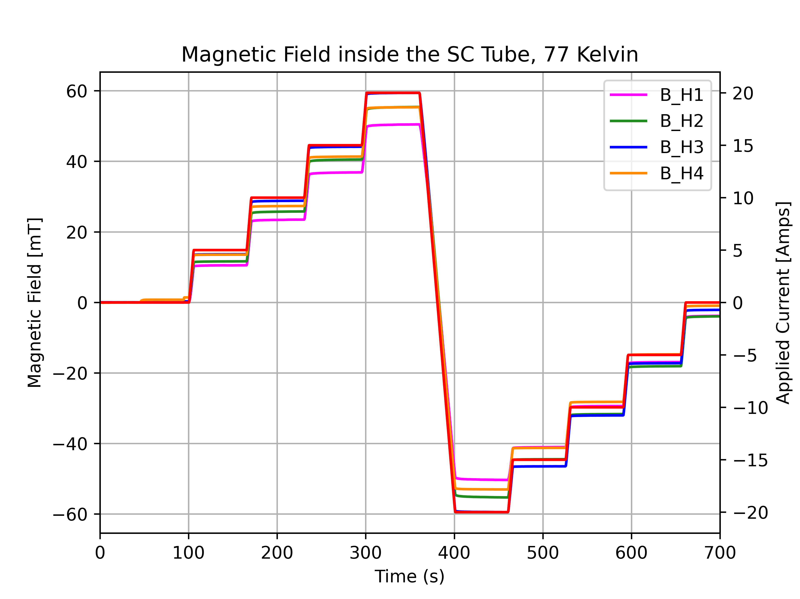
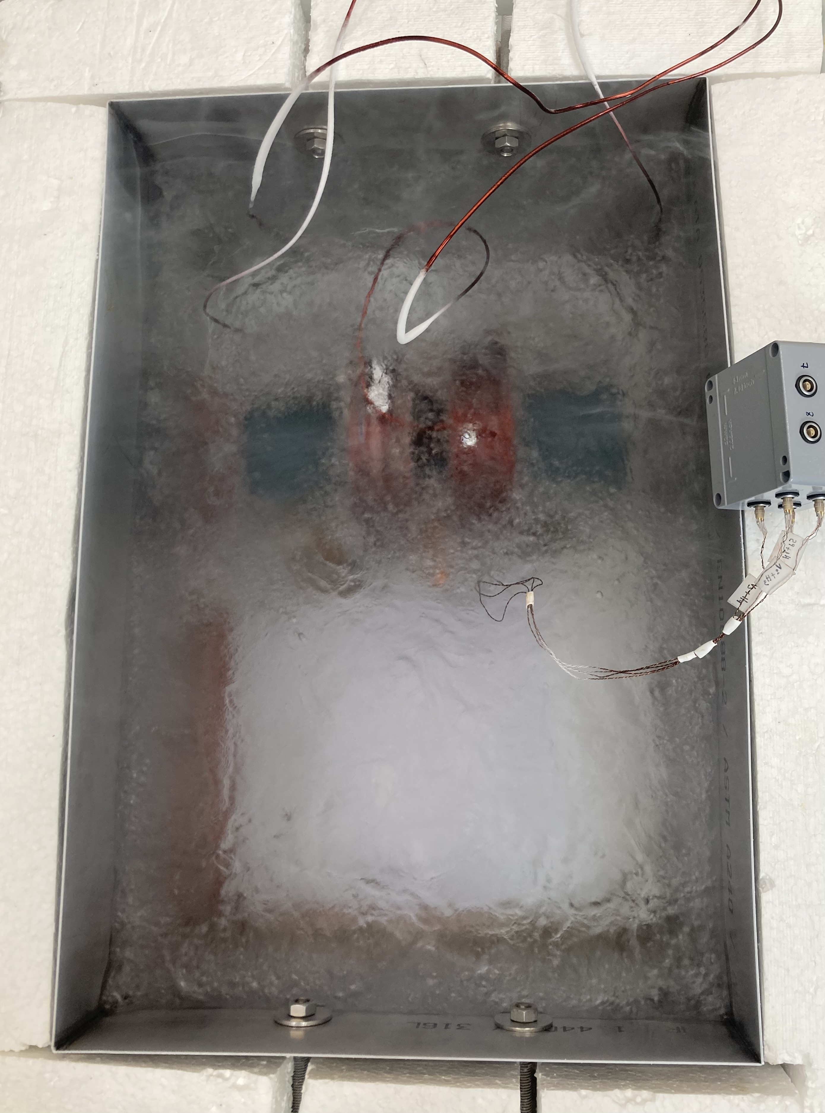
Testing Prototype 0, Cryogenic Temperature
The system, Helmholtz Coil and SC-tube, was submerged in a cryogenic bath filled with LN₂ (77K).
Ramping up the magnetic field with 1Amp/s, ramping up rate, up to I=20 Amps, induced current.
The Prototype 0 did not superconduct, although we can observe curved plateus (not sharp),
indicating the existance of eddy currents.

Slide 17
Conclusion
A superconducting shielded channel is needed for the injection of muons from the exit of the πE1 beamline, low fringe field, to a 3T storage magnet, high magnetic field, for the muEDM experiment.
Three prototypes are being developed and tested in the magnetic field of a Helmholtz coil.
Study of the SC-shielding effectiveness.
Running first tests with Prototype 0 in room and cryogenic temperatures.
Next Steps: Study the shielding efficiency as a function of :
Different ramping up rates of the applied magnetic field.
Different coiling/mounting techniques and layer numbers of the SC-shield.

Slide 18
Thank you for your attention!

Slide 19
Backup Slides

Slide 20
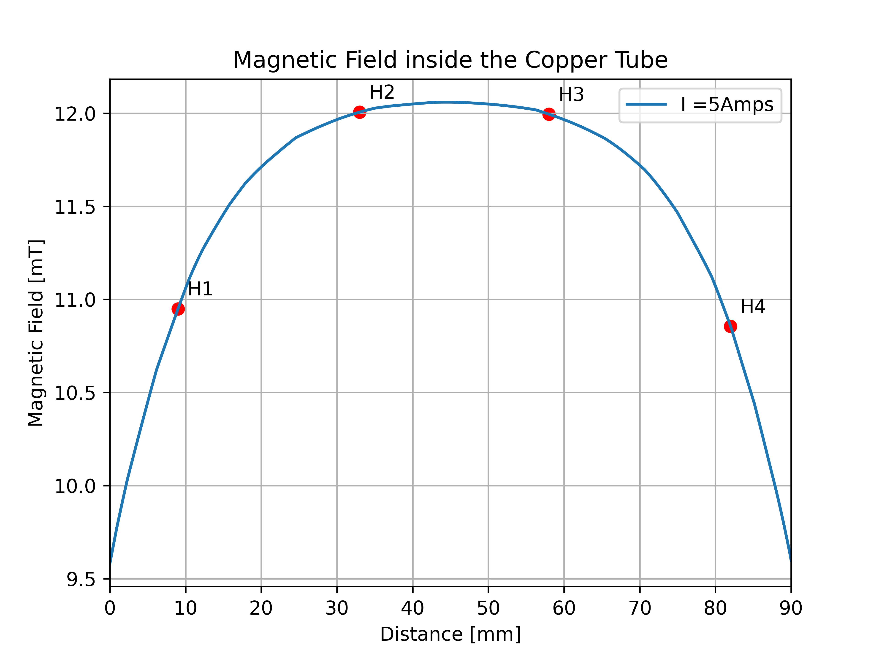
Testing Prototype 0, Room Temperature, I=5 Amps
For I= 5 Amps :
Horizontal Hall Sensor | Position [mm] | Simulated Magnetic Field [mT] | Measured Magnetic Field [mT]
H1 | 9 | 10.95 | 10.36
H2 | 33 | 12.00 | 11.51
H3 | 58 | 11.99 | 11.87
H4 | 82 | 10.86 | 10.74

Slide 21
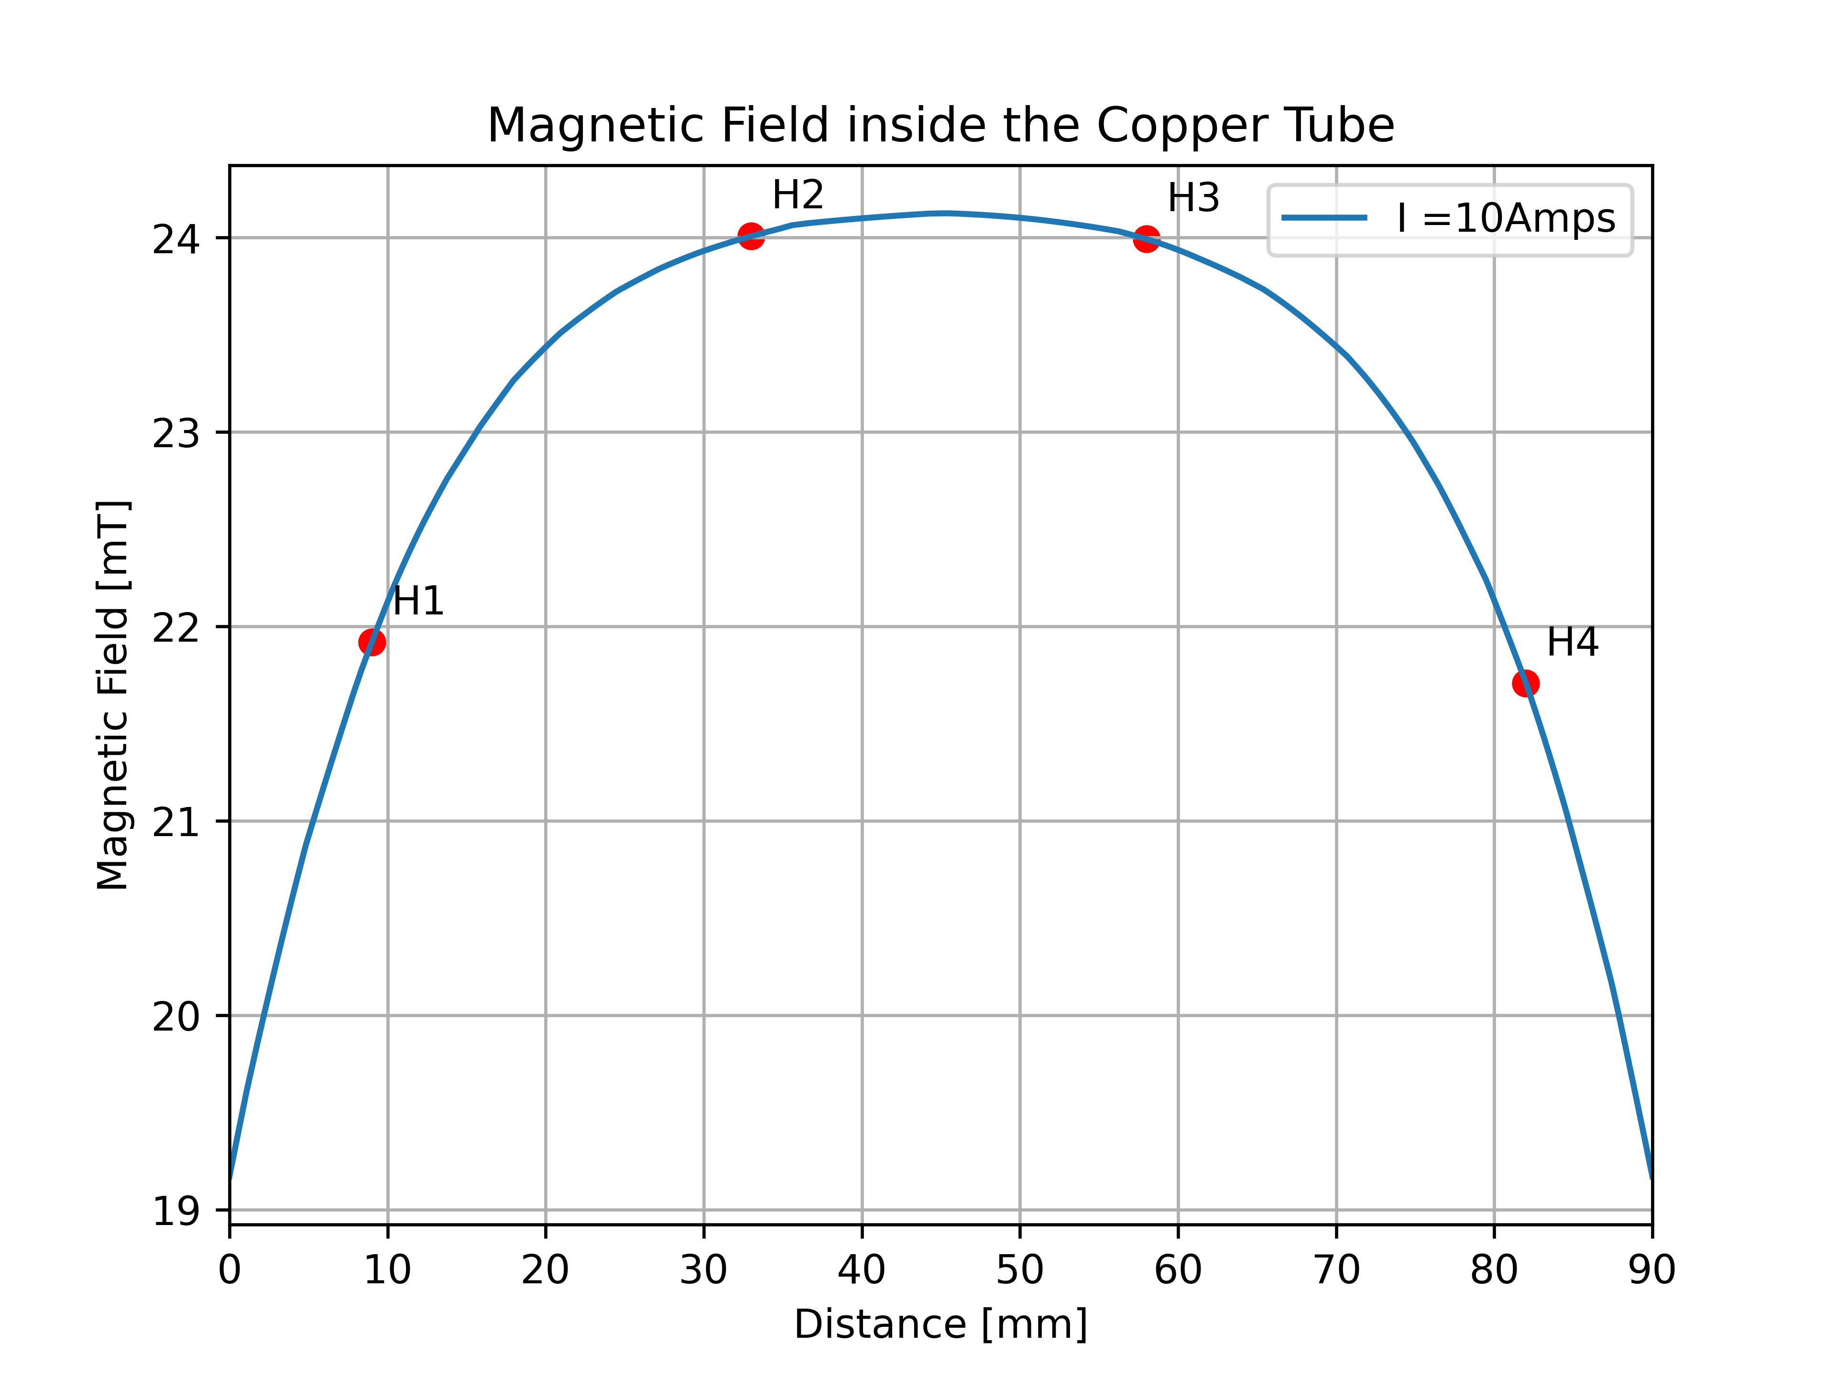
Testing Prototype 0, Room Temperature, I=10 Amps
For I= 10 Amps :
Horizontal Hall Sensor | Position [mm] | Simulated Magnetic Field [mT] | Measured Magnetic Field [mT]
H1 | 9 | 21.92 | 20.49
H2 | 33 | 24.00 | 22.75
H3 | 58 | 23.99 | 23.41
H4 | 82 | 21.71 | 21.24

Slide 22
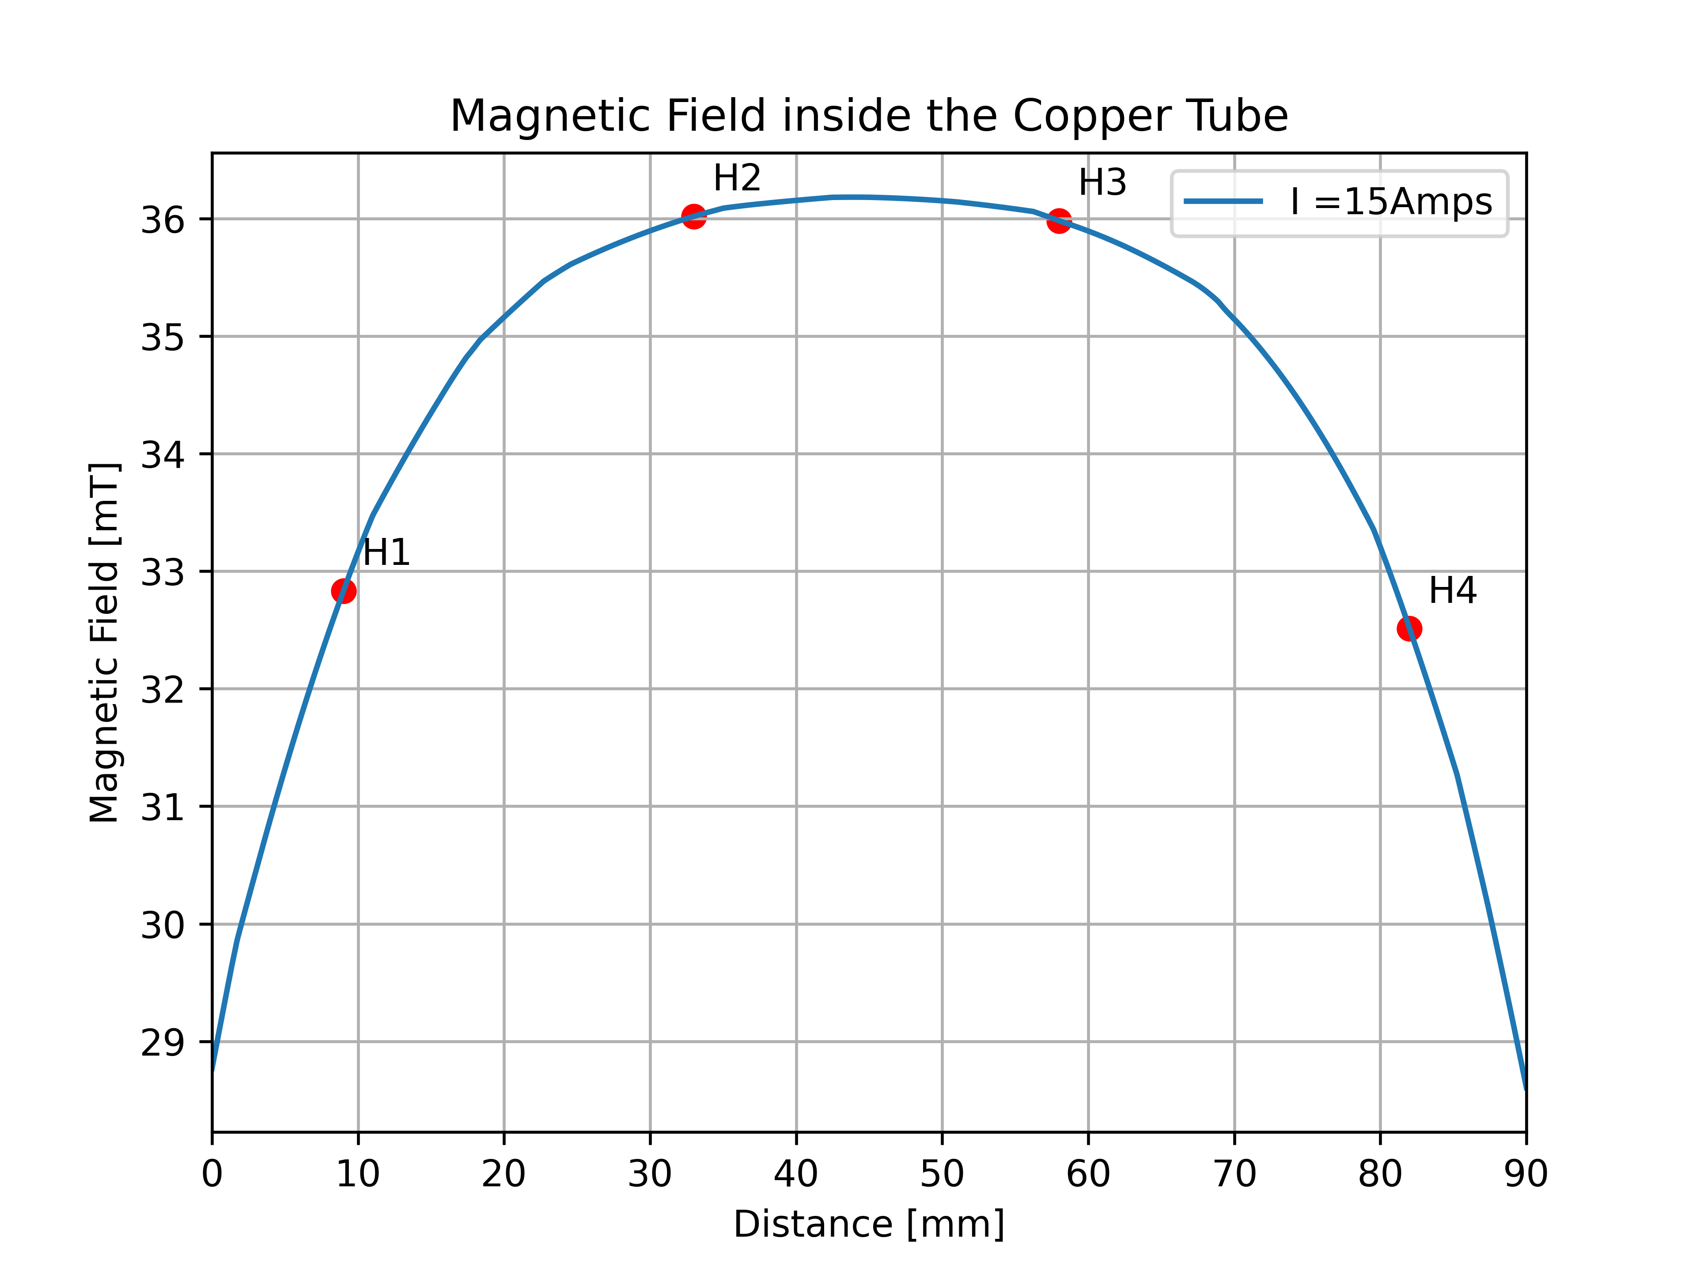
Testing Prototype 0, Room Temperature, I=15 Amps
For I= 15 Amps :
Horizontal Hall Sensor | Position [mm] | Simulated Magnetic Field [mT] | Measured Magnetic Field [mT]
H1 | 9 | 32.83 | 30.59
H2 | 33 | 36.02 | 33.96
H3 | 58 | 35.98 | 34.93
H4 | 82 | 32.51 | 31.72

Slide 23
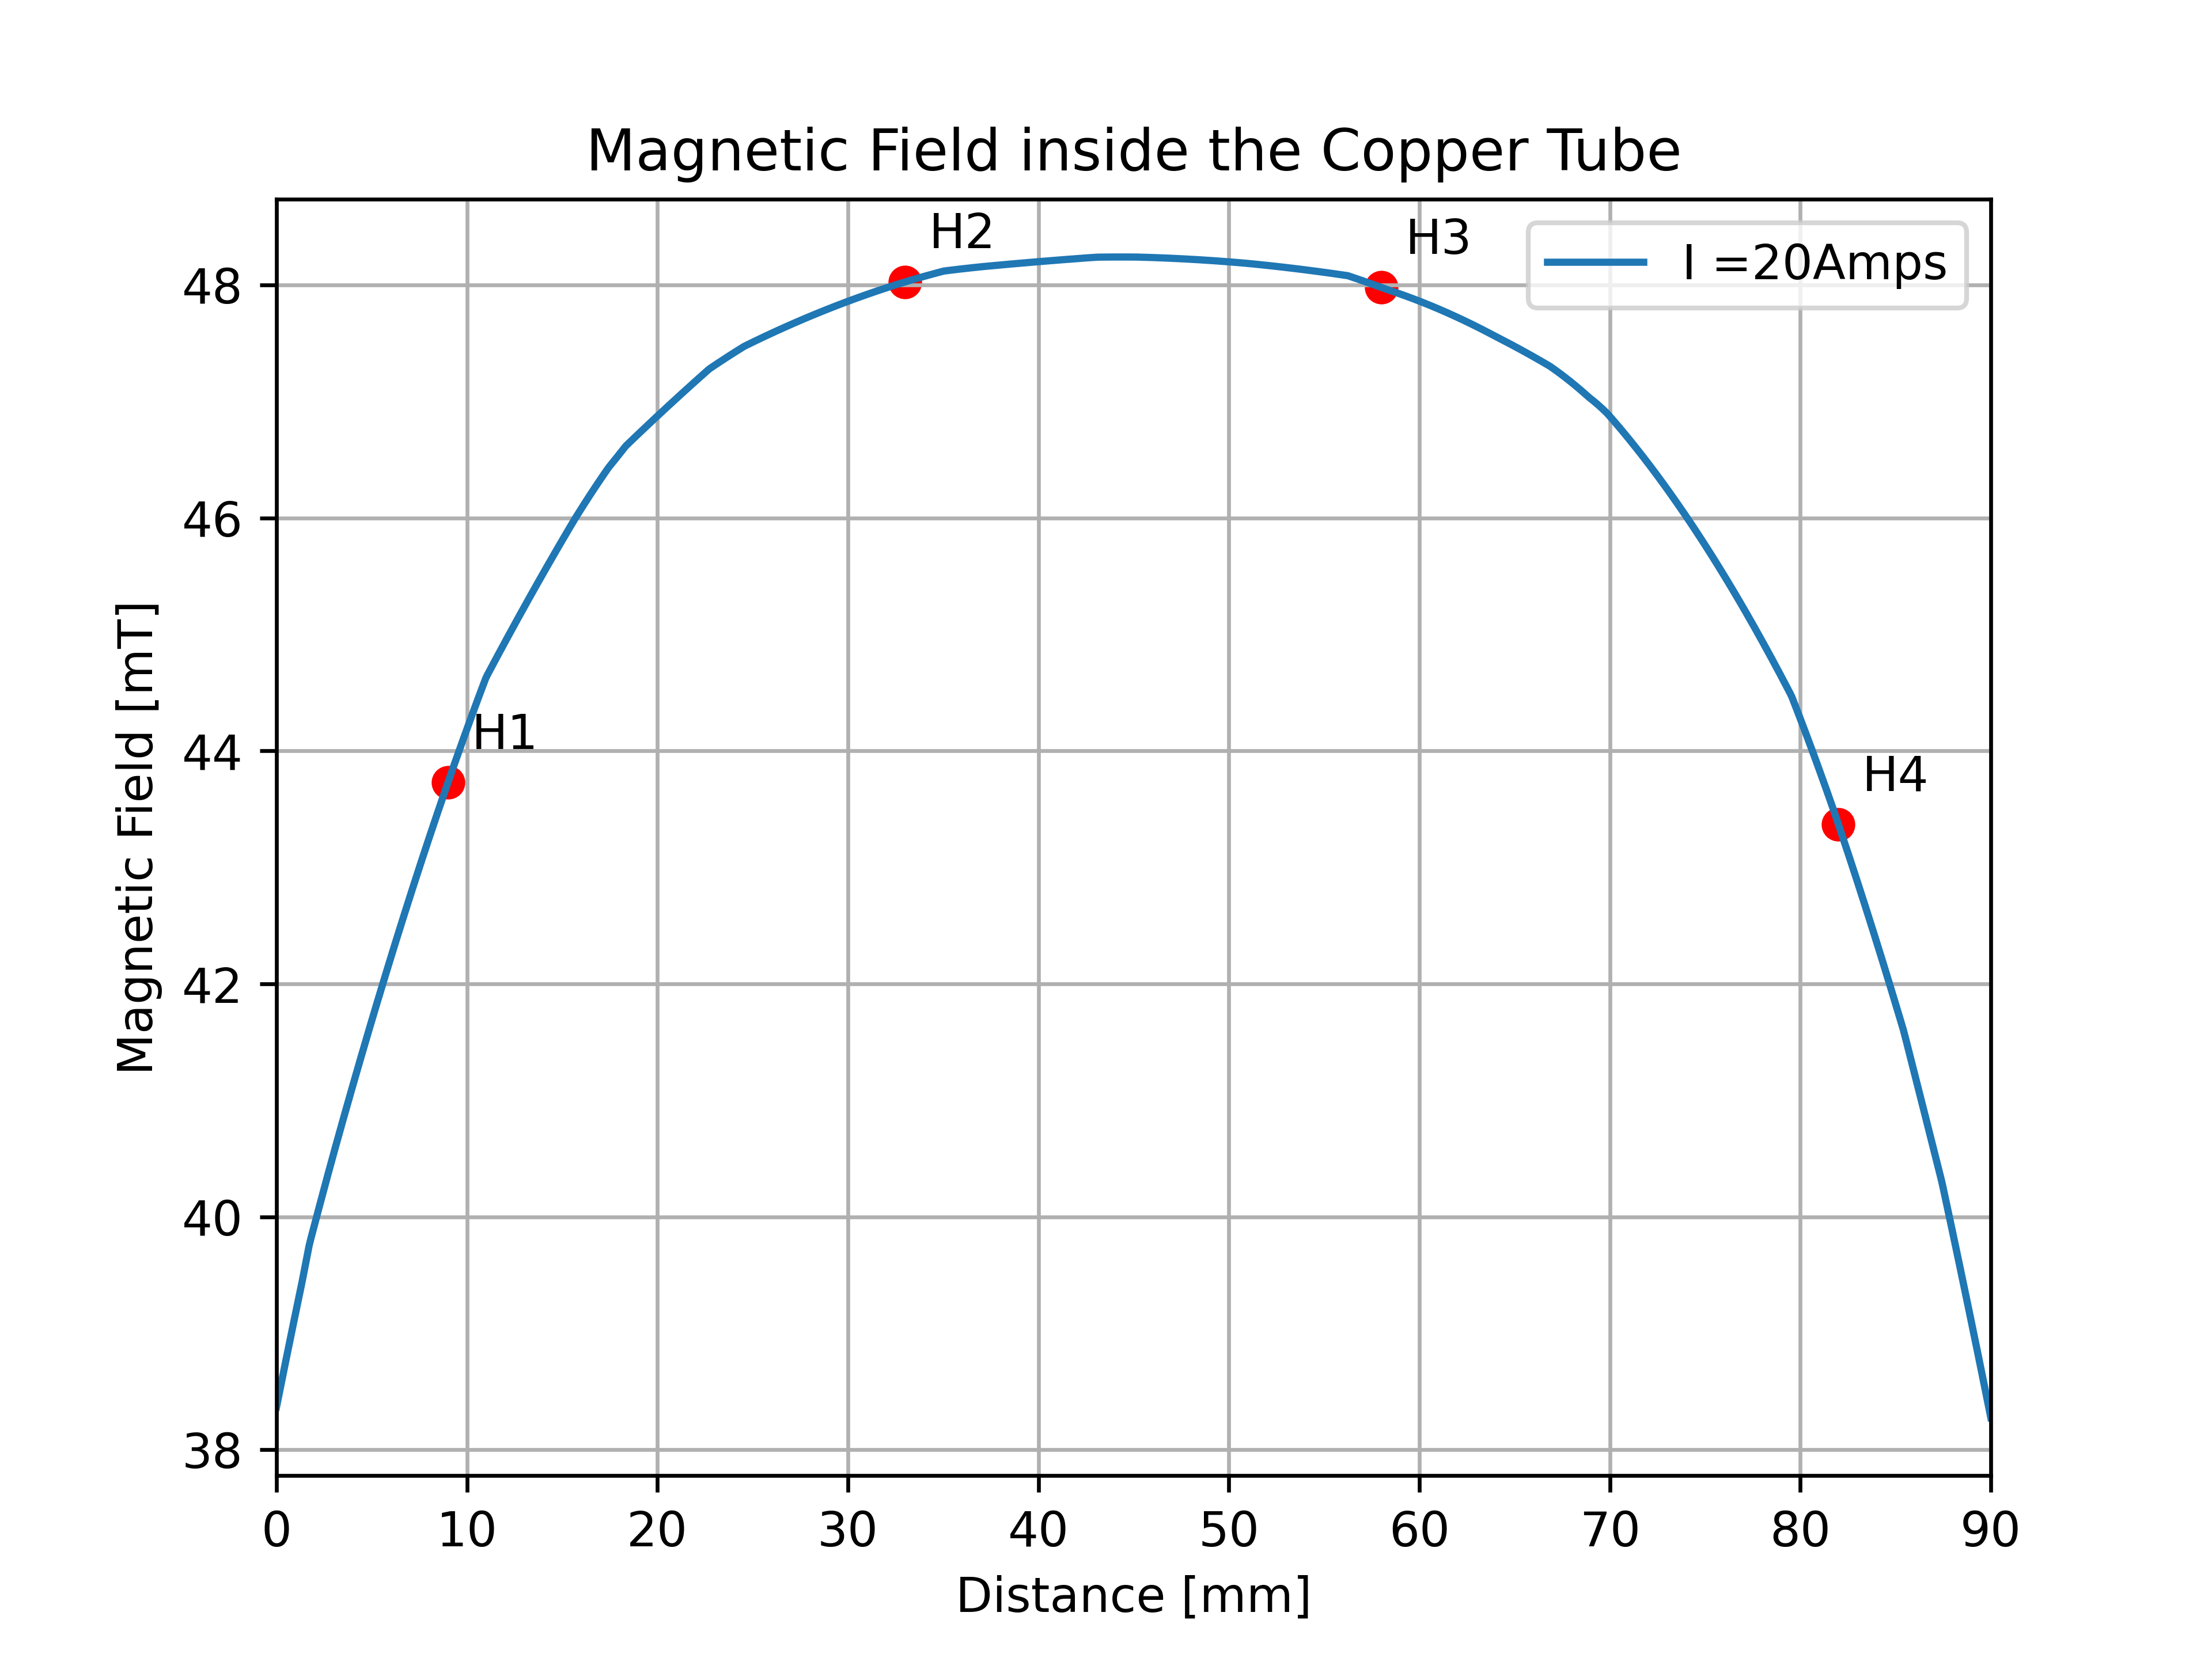
Testing Prototype 0, Room Temperature, I=20 Amps
For I= 20 Amps :
Horizontal Hall Sensor | Position [mm] | Simulated Magnetic Field [mT]
H1 | 9 | 43.73
H2 | 33 | 48.03
H3 | 58 | 47.98
H4 | 82 | 43.37

Slide 24
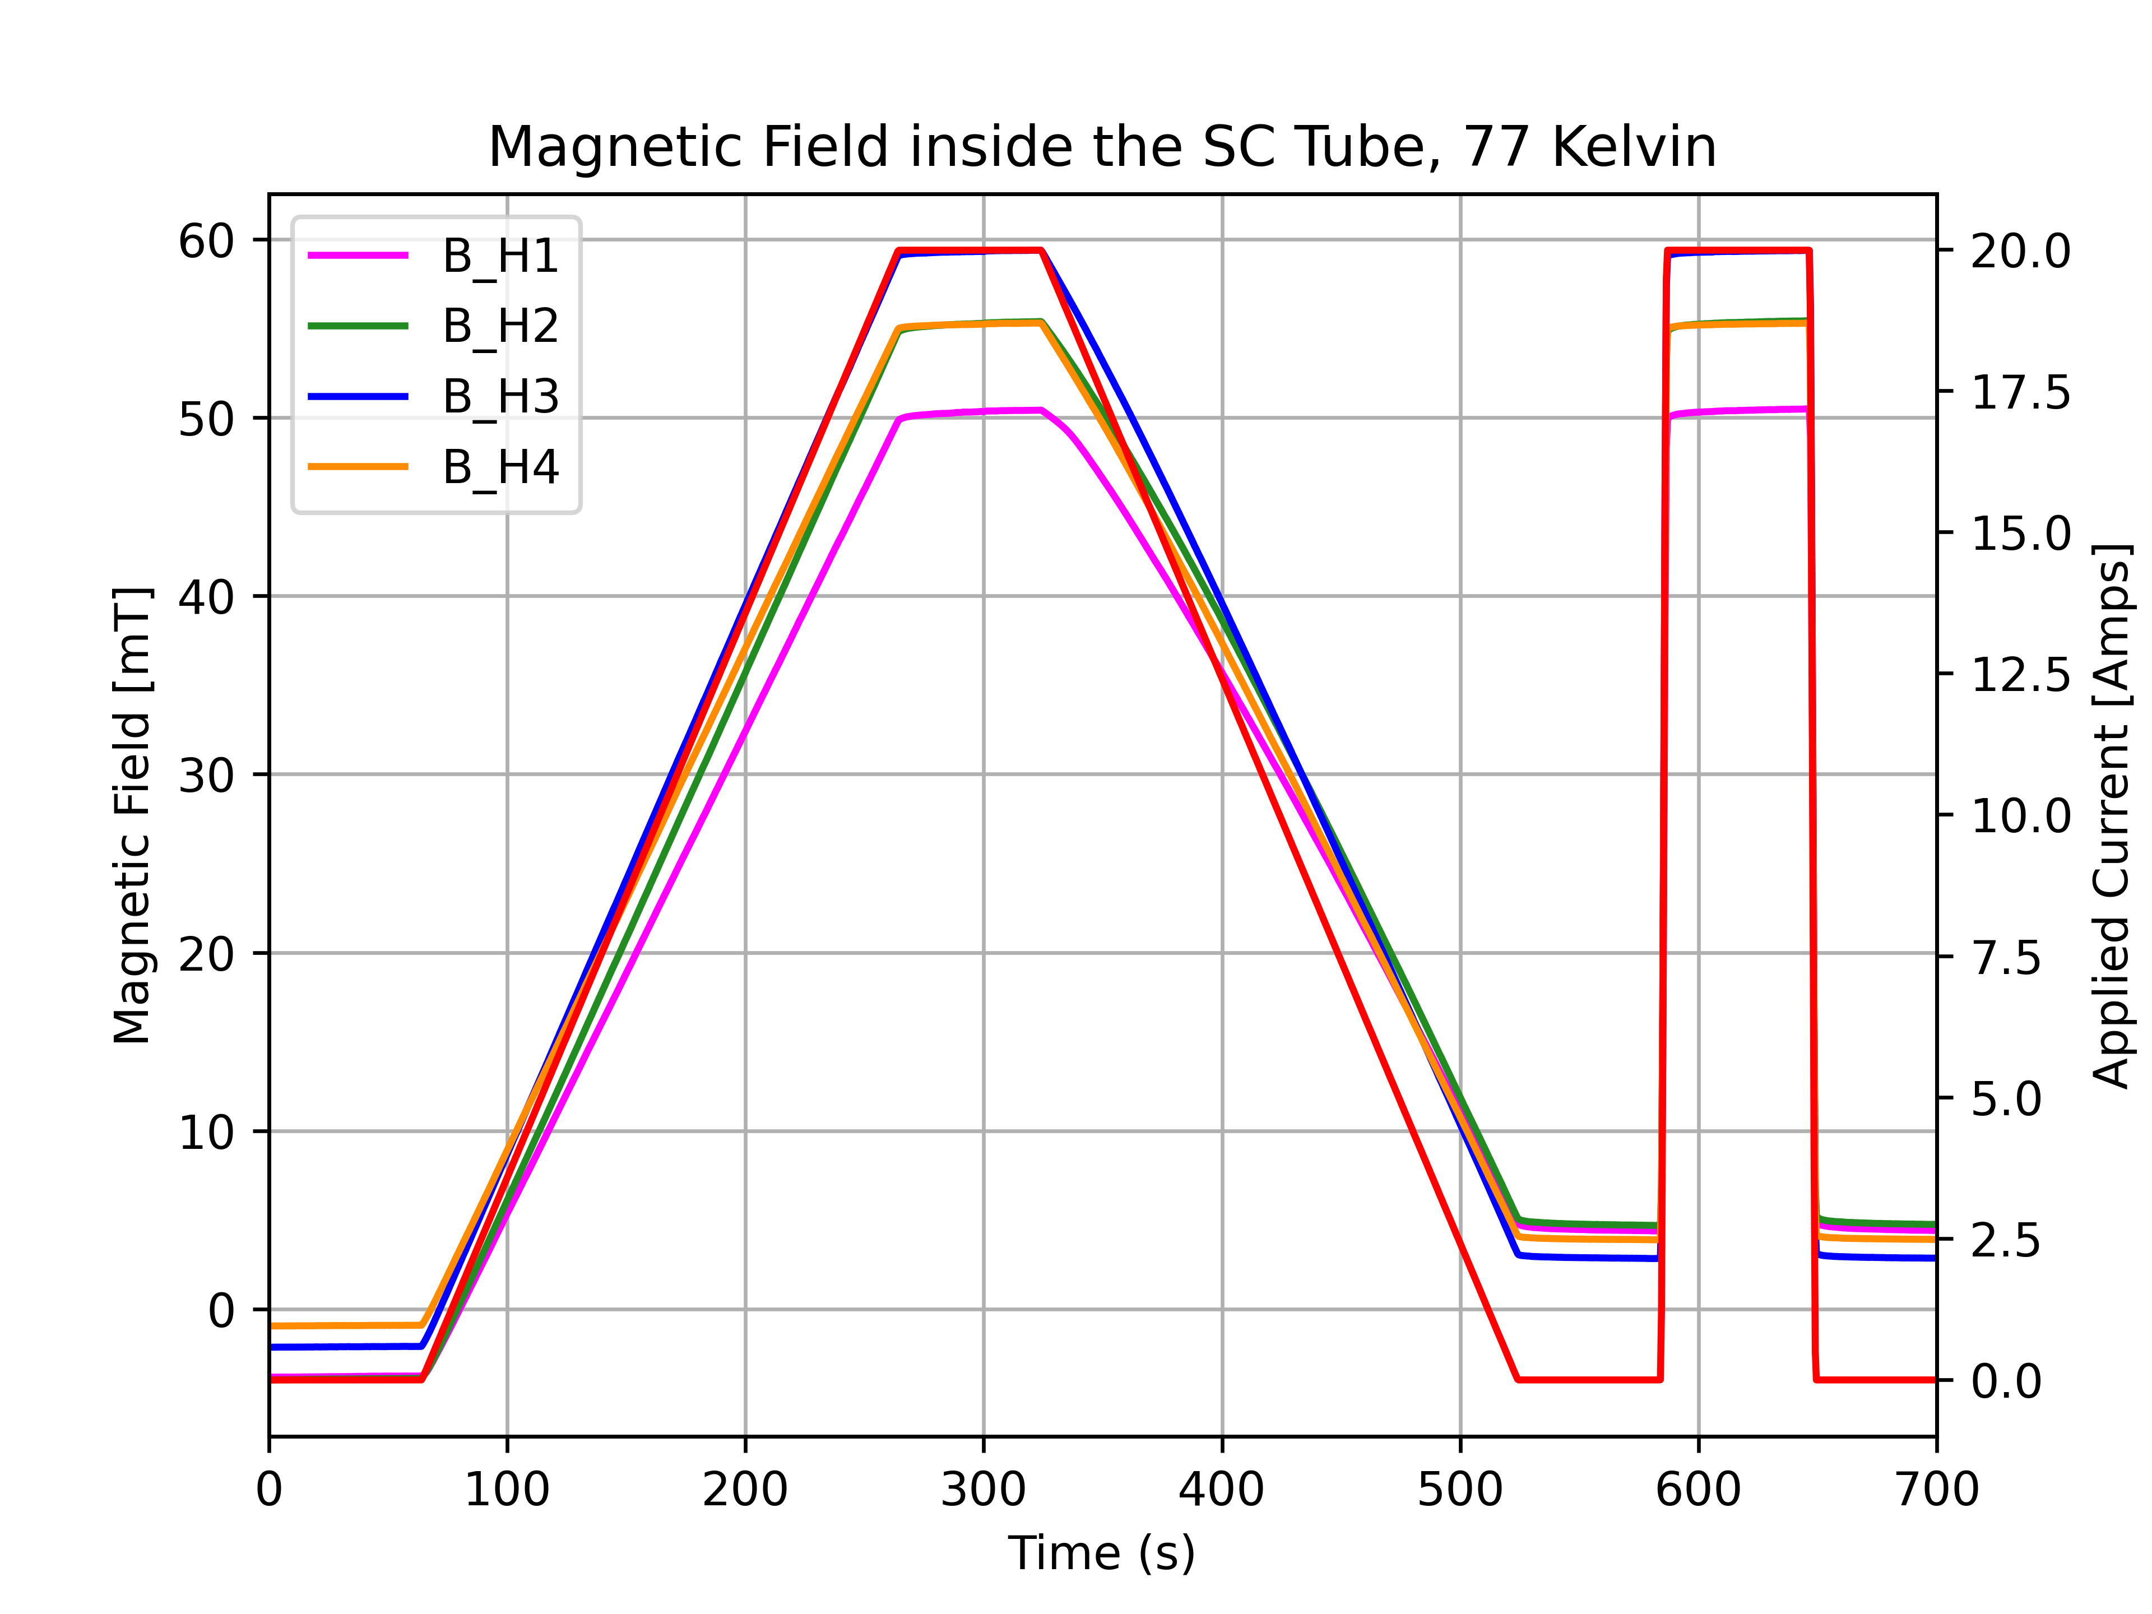
Different Ramping up Rates in Cryogenic Temperatures
10 Amps/s
0.1 Amps/s

