Slide 1


Digital holographic interferometry method for tracking detector modules displacement
Aldo Arena, Giovanni Cantatore, Marin Karuza

Slide 2
Content:
Muon gyromagnetic anomaly
MUonE project
Holographic Alignment Monitor (HAM) - experimental setup
Digital holography principles
Holographic interferometry
Image recording and reconstruction
HAM – results and video example
Conclusions

Slide 3
Muon gyromagnetic anomaly
Experimental results from the g-2 collaboration measure of a_{μ} showing a gap of 4.2σ between the experimental average and the theoretical prediction.
(B. Abi, T. Albahri, S. Al-Kilani, D. Allspach, L. P. Alonzi et al., “Measurement of the positive muon anomalous magnetic moment to 0.46 ppm,” Phys. Rev. Lett., vol. 126, p. 141801, Apr 2021)

Slide 4
Muon gyromagnetic anomaly
Part of the theoretical value of a_{μ} cannot be calculated using the perturbation method (data-driven calculation).
The largest contribution to the uncertainty comes from the leading order hadronic vacuum polarization parameter.
Feynman diagrams of the main Standard Model contributions to the muon gyromagnetic anomaly. From the left, the first two diagrams represent first-order electroweak processes, then follow the leading-order hadronic (H) vacuum polarization and the hadronic light-by-light contributions (HLbL).
(B. Abi, T. Albahri, S. Al-Kilani, D. Allspach, L. P. Alonzi et al., “Measurement of the positive muon anomalous magnetic moment to 0.46 ppm,” Phys. Rev. Lett., vol. 126, p. 141801, Apr 2021)

Slide 5
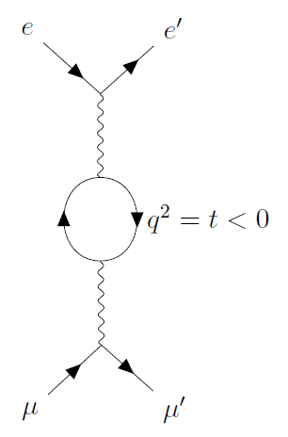
MUonE project
In development experiment at CERN
Direct determination of hadronic contribution to the muon gyromagnetic anomaly
High precision measurement of muon-electron differential scattering cross-section
Competitive accuracy of less than 0.5%

Slide 6
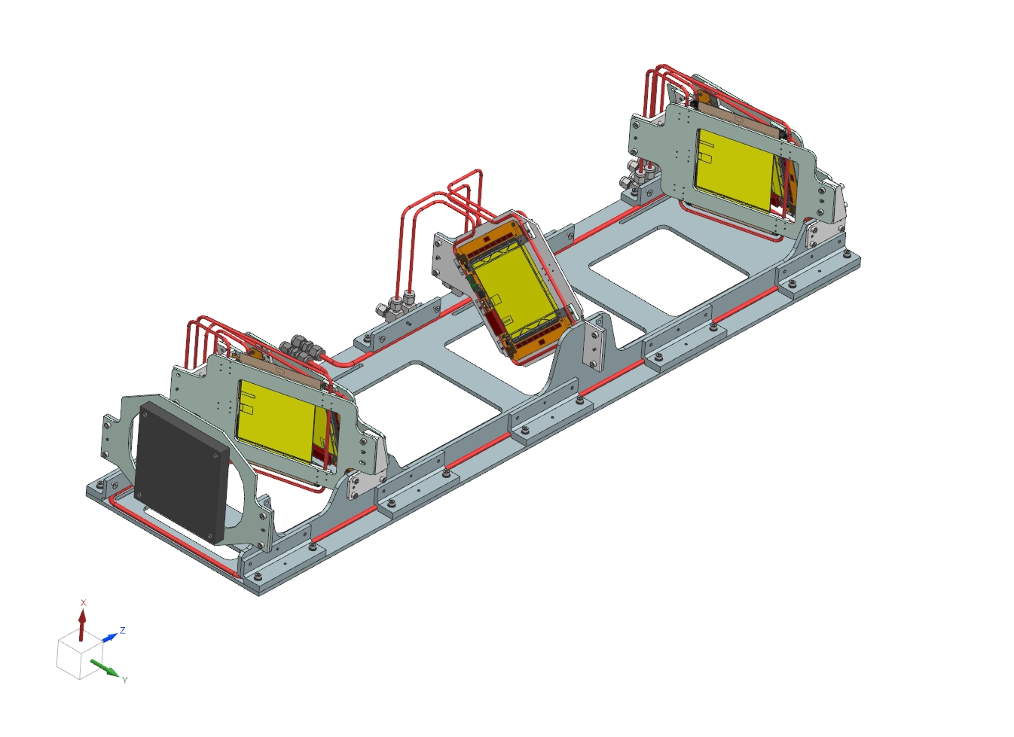
MUonE project
Schematic of a tracking station: the muon beam comes from the left and hits the target, then the scattered electrons and muons are tracked by the silicon detectors.
(G. Abbiendi, “Status of the MUonE experiment,” Physica Scripta, vol. 97, no. 5, p. 054007, Apr 2022.)
Critical parameter -> the relative position shift between the silicon detector planes must stay under 10 microns
Digital holographic interferometric system developed to monitor this relative displacement
CAD Of a MUonE tracking detector ("station"). From left to right, along the z axis, the incoming CERN M2 beam hits the low-Z target electrons (in black). The paths of the
scattered particles are then recorded by the 2S modules (in yellow) on the three detector plane
pairs located behind the target.

Slide 7
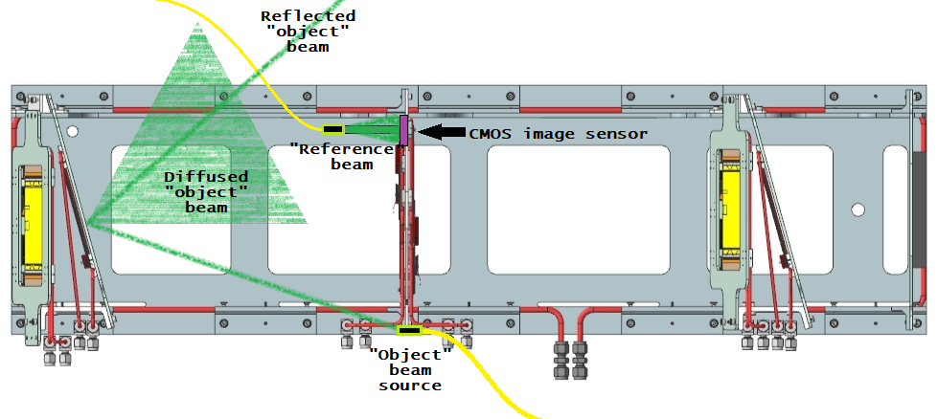
Holographic Alignment Monitor (HAM) - experimental setup

Slide 8
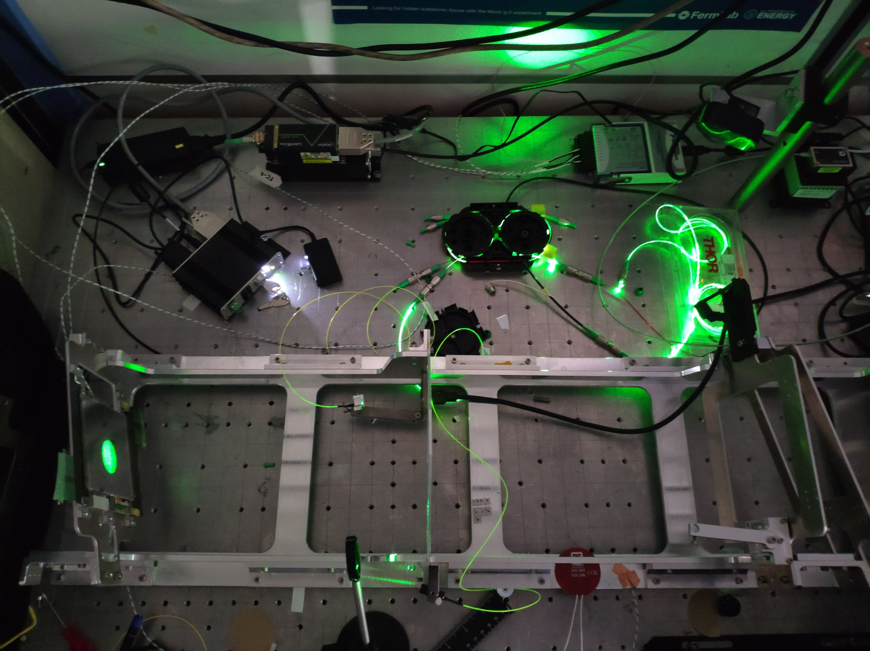
Holographic Alignment Monitor (HAM) - experimental setup
CW laser (Oxxius LCX-532S):
  λ=532.1 nm
  P≈85 mW
  Fiber-coupled
90:10 fiber optic splitter:
  90% output for the «object» beam
  «Reference» beam attenuated by ND filter (OD=3.0)
All fibers are single mode
CMOS image sensor (IDS UI-3581LE):
  4.92 megapixels
  2.2 μm pixel size
The object is a illuminated portion of the Si detector:
  diameter of ≈35 mm
LabVIEW (raw data processing and reconstruction)
Laser
Splitter
CMOS sensor
«REFERENCE» beam
Object
«OBJECT» beam source

Slide 9
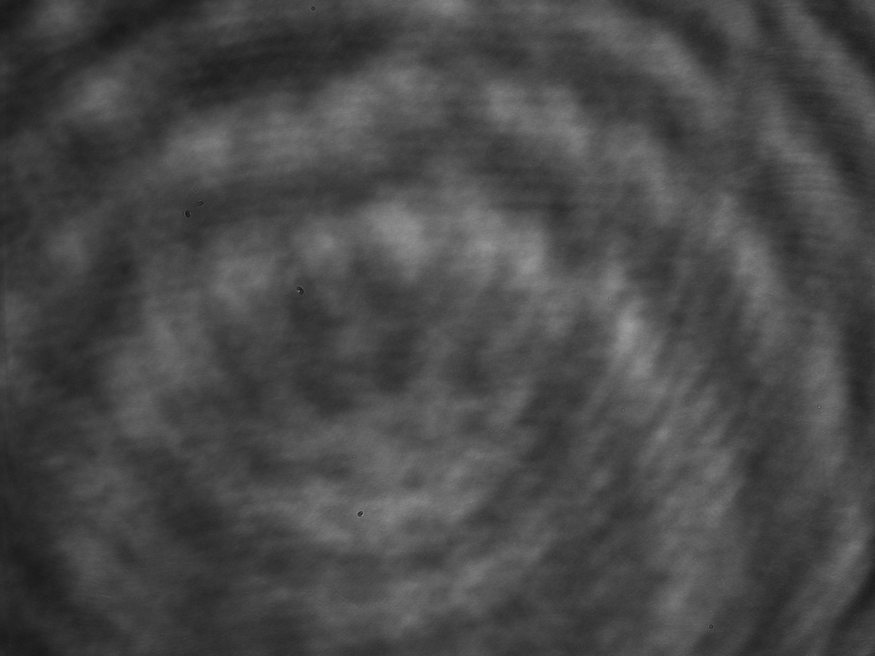
Digital holography
Interferometric imaging method using CCD or CMOS sensors
Illumination of an object with a monocromatic coherent beam (laser)
The scattered «object» wave recorded together with a «reference» beam coming from the same source
The superposition of the two EM waves generates an holographic image
Raw holographic image

Slide 10
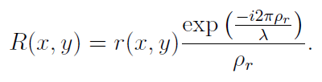
Digital holography
A image sensor records the intesity of the interference between the O and the R
The reconstruction is done by «illuminating» the raw data by a reference beam of the same charateristics
The complex object wave O is isolated (the module gives the amplitude-contrast image)

Slide 11
Off-axis lens-less holography
The «object», O, and «reference», R, beam are not aligned with the image sensor
No lenses or collimators are used in the setup
Reference beam is a spherical wave
Recostruction depends on the position of the O and R, pixel size and λ
Fresnel solution of the Rayleigh–Sommerfeld diffraction integral
Zero, +1 and -1 orders are spatially separated in recostruction
Noise cancellation and image extraction by spatial filtering

Slide 12
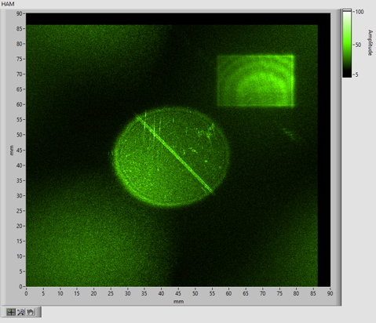
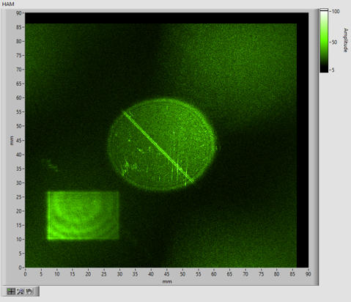
Off-axis lens-less holography
+1 order in focus
-1 order in focus

Slide 13
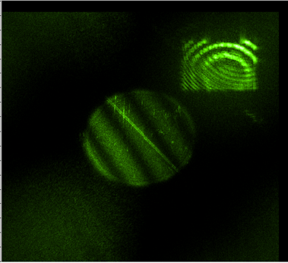
Off-axis lens-less holography
d
y
η
x
ε
ρ_{r}
ρ
R
θ
h(x,y)
Γ(ε, η)
d_{r}
Holographic image reconstruction principle

Slide 14
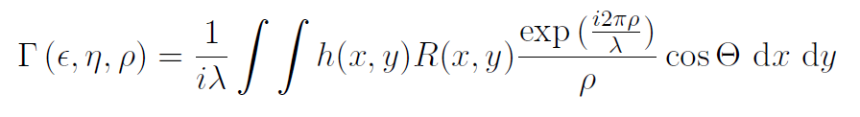

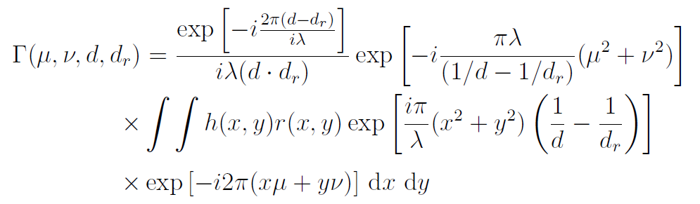


Off-axis lens-less holography
The field of the diffracted R(x,y) on an aperture, the raw hologram h(x,y), is described by the Rayleigh-Sommerfeld diffraction formula:
By using the Fresnel approximation and Taylor expansion on ρ:

Slide 15
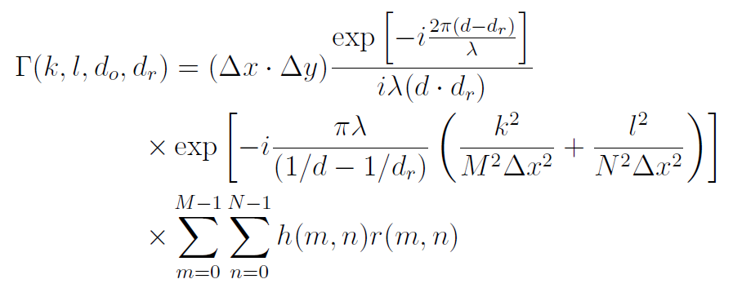


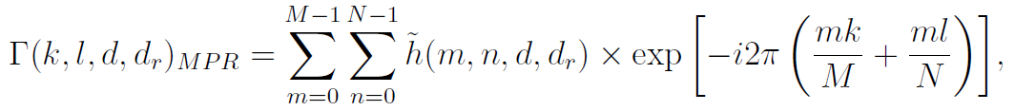
Off-axis lens-less holography
The recorded data is digital, done by a sensor of MxN points, with the size of Δx by Δy
My solution:
Where
Discrete Fourier Transform

Slide 16

Holographic Interferometry
Time-dependent interferometry
Made by digital superposition of raw holographic images at different time t
Displacement of the recorded object is represented by fringes
Fringes generates for half wavelength (λ /2) displacements

Slide 17
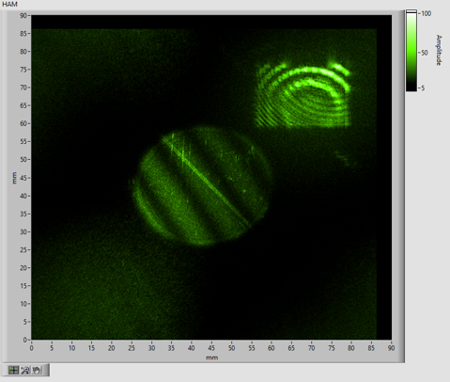
IMAGE PROCESSING: capture, interference and reconstruction
Diffracted «OBJECT» beam
CMOS image sensor
-
2560x1980
8-bit Image
Raw image at t₀
Raw image at t_{n}
Raw image at t₁
Raw image at t₂
…
Direct «REFERENCE» beam
Image Subtraction
–
interference
by superposition of t₀ and t_{n}
2D array data with «zero padding» -
total size 4096x4096
Multiplication with complex phase [exp(iΦ)]
Discrete Fourier transform (or FFT)
Spatial filter
–
1600x1600 array
Absolute value
–
Contrast-amplitude image

Slide 18
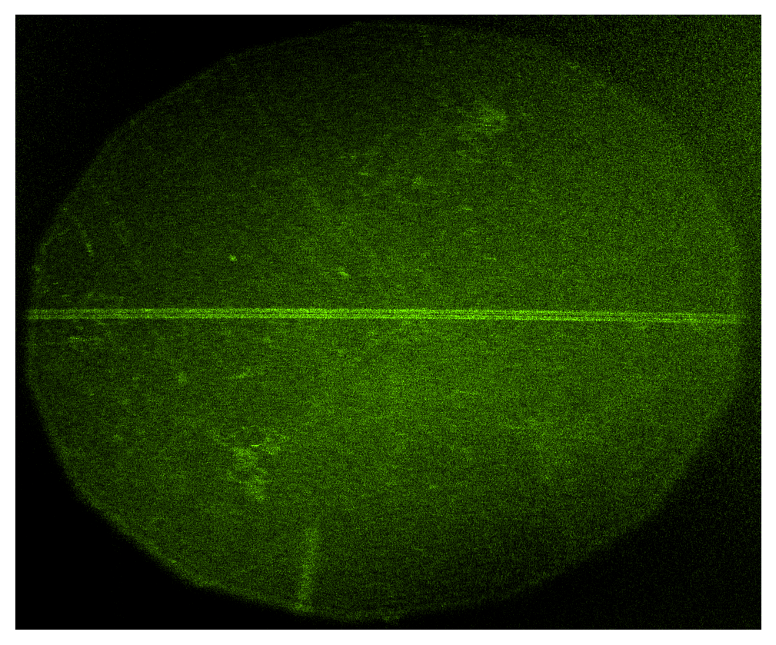
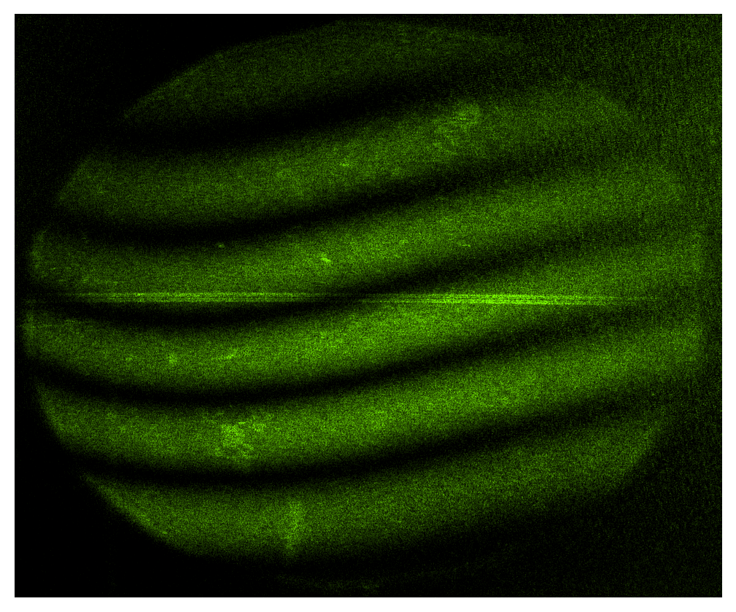
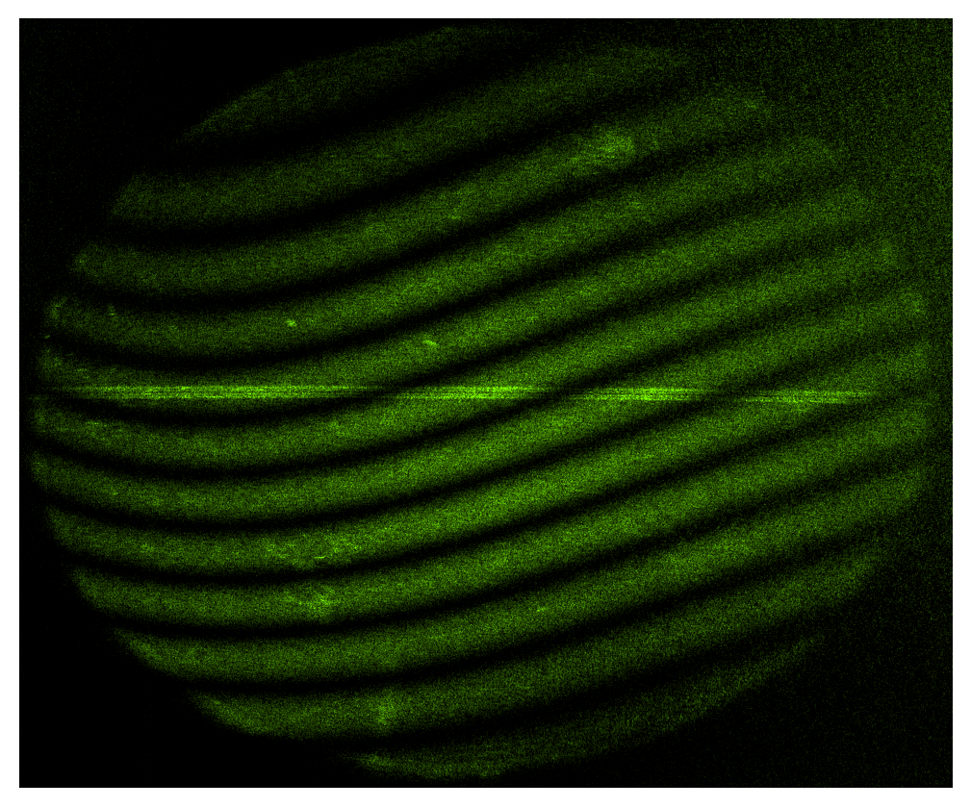
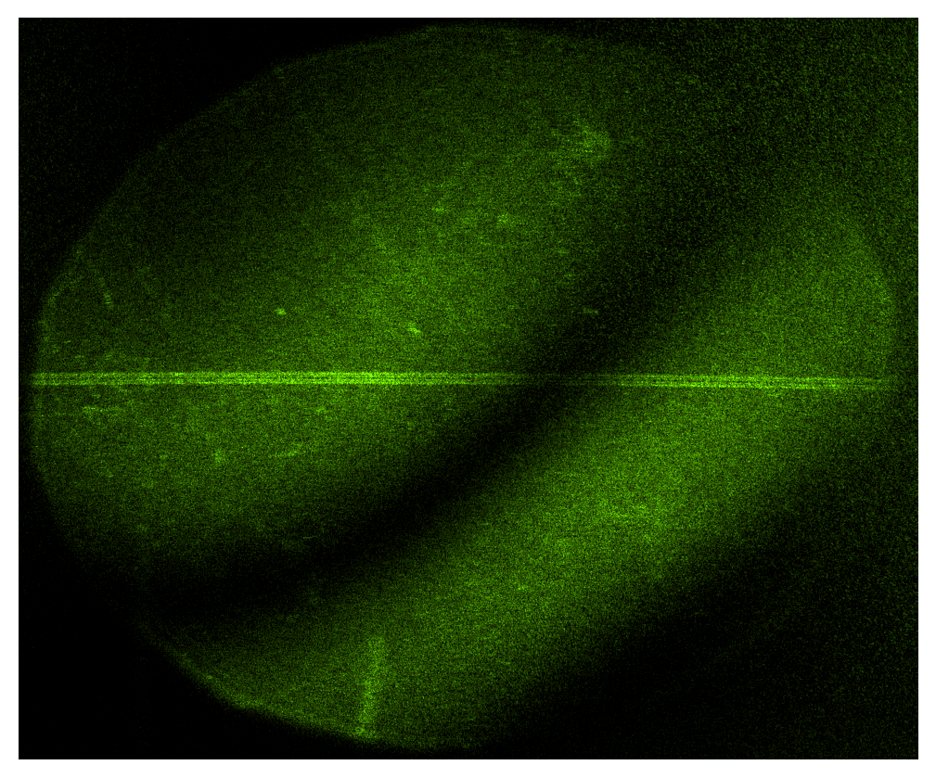
Holographic Alignment Monitor examples of holograms recorded overnight
(a)
(b)
(c)
(d)
The shift of the silicon detector plane on the MUonE station was observed, caused by the temperature fluctuations in the laboratory. The images were taken at different times: (a) at the beginning of data acquisition, without fringes; (b) after a few hours, with 6 fringes; (c) in the middle of the night, with 11 fringes; (d) in the morning after, with 2 fringes.

Slide 19
Holographic Alignment Monitor
Overnight displacement and temperature data
LabVIEW program for testing automatic fringe detection from holographic interferometric images.
The data in red: relative displacement from the beginning of the acquisition
The data in black: relative temperature changes
Automatic fringe detection is not completely reliable but shows a correlation between the temperature change and the displacement
Consistent with the theory of linear thermal expansion

Slide 20

HAM weight load video example

Slide 21
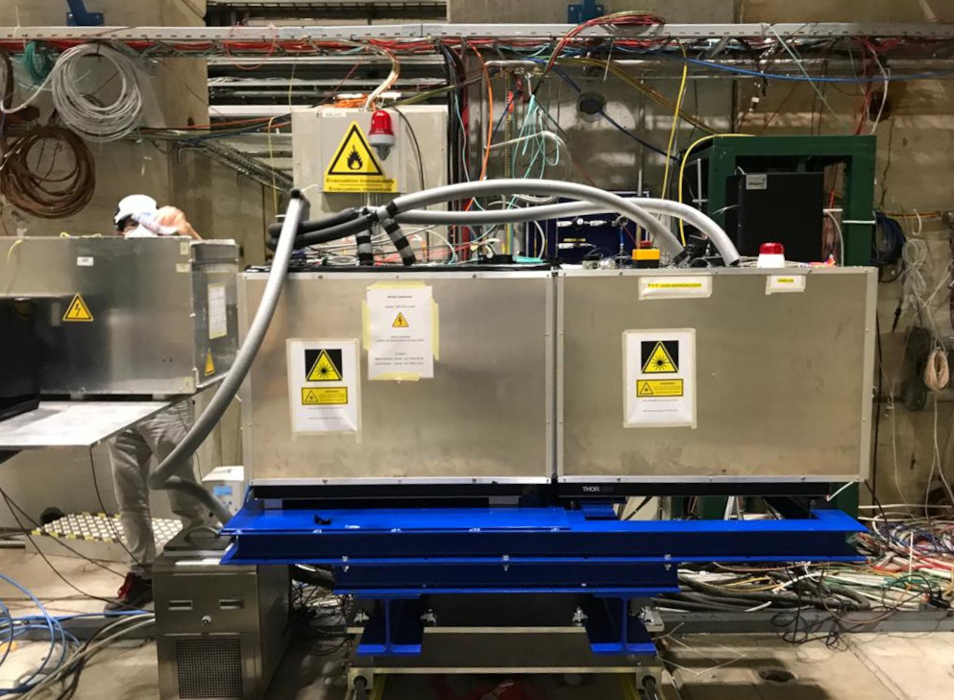
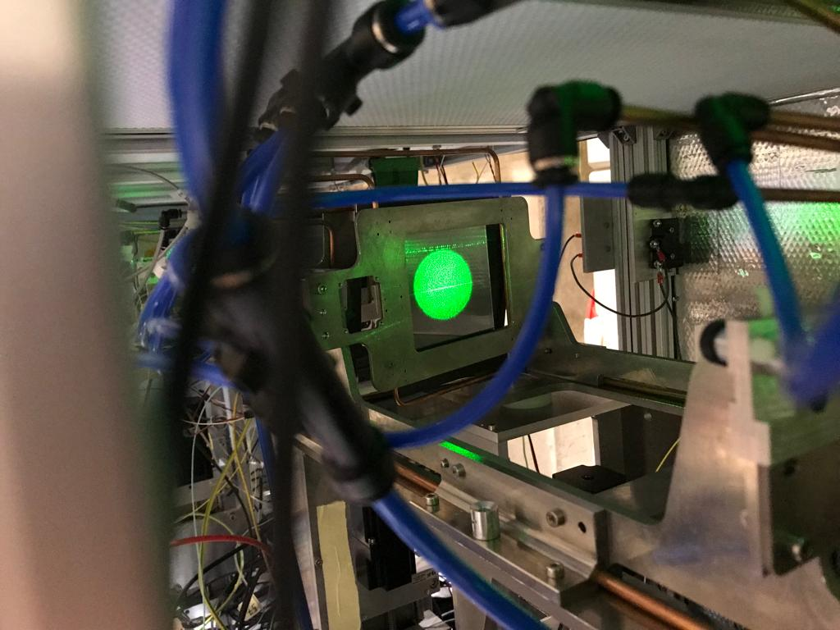
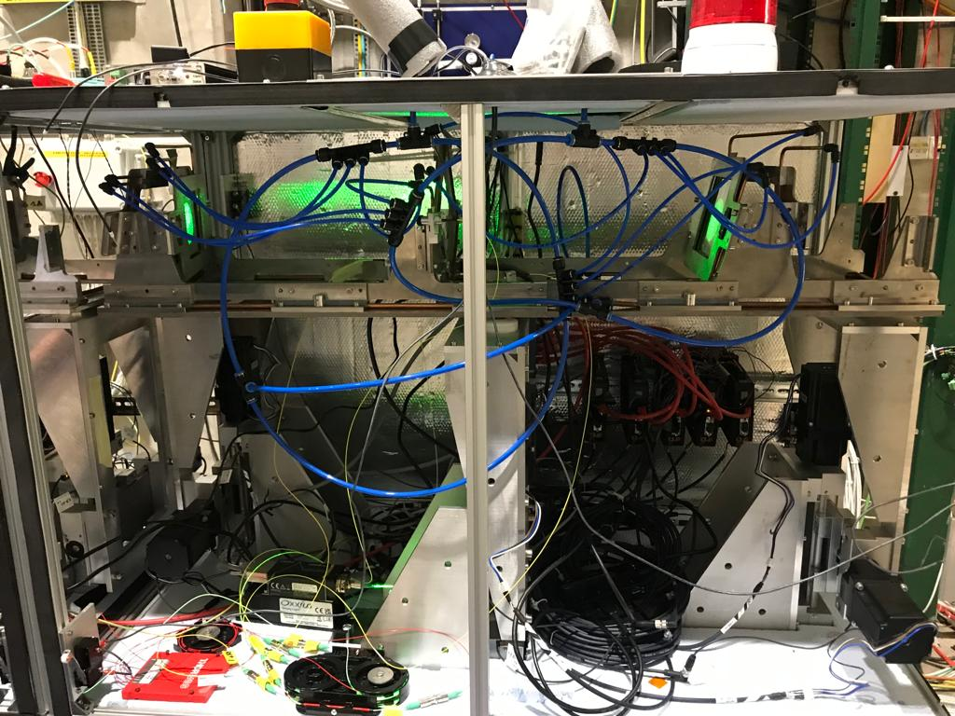
The HAM system in the Test Beam of October 2022

Slide 22
Conclusions
The HAM setup is simple, no lenses, and adaptable, off-axis geometry and fiber-coupled
Fast computational and reconstruction time with single FFT, <2 s
Real-time monitoring of the relative displacements of the Si plane with respect to an adjacent frame with 256 nm resolution (1 fringe = λ/2 displacement)​
The system is able to follow relative displacements from 0.25 μm up to several microns​
The fringes analysis is qualitative
The integration of a fringe analysis algorithm could enable the system to determine the relative displacement in an automated manner.

Slide 23
Thank you

Slide 24
References
T. Albahri, A. Anastasi, A. Anisenkov, K. Badgley, S. Baeßler et al., “Measurement of the anomalous precession frequency of the muon in the fermilab muon g-2 experiment,” Phys. Rev. D, vol. 103, p. 072002, Apr 2021.
T. Aoyama, N. Asmussen, M. Benayoun, J. Bijnens, T. Blum et al., “The anomalous magnetic moment of the muon in the standard model,” Physics Reports, vol. 887, pp. 1–166, 2020, the anomalous magnetic moment of the muon in the Standard Model.
B. Abi, T. Albahri, S. Al-Kilani, D. Allspach, L. P. Alonzi et al., “Measurement of the positive muon anomalous magnetic moment to 0.46 ppm,” Phys. Rev. Lett., vol. 126, p. 141801, Apr 2021.
J. Schwinger, “On quantum-electrodynamics and the magnetic moment of the electron,” Phys. Rev., vol. 73, pp. 416–417, Feb 1948.
P. Kusch and H. M. Foley, “The magnetic moment of the electron,” Phys. Rev., vol. 74, pp. 250–263, Aug 1948.
F. Jegerlehner, The Anomalous Magnetic Moment of the Muon. Springer, 2017, vol. 274.
G. W. Bennett, B. Bousquet, H. N. Brown, G. Bunce, R. M. Carey et al., “Final report of the e821 muon anomalous magnetic moment measurement at bnl,” Phys. Rev. D, vol. 73, p. 072003, Apr 2006.
NobelPrize.org, “The Nobel Prize in Physics 1971.” [Online].
T. M. Kreis, M. Adams, and W. P. O. Jueptner, “Methods of digital holography: a comparison,” in Optical Inspection and Micromeasurements II, C. Gorecki, Ed., vol. 3098, International Society for Optics and Photonics. SPIE, 1997, pp. 224 – 233.

Slide 25
References
T. Kreis, “Handbook of holographic interferometry: Optical and digital methods,” Handbook of Holographic Interferometry: Optical and Digital Methods, by Thomas Kreis, pp. 554. ISBN 3-527-40546-1. Wiley-VCH , January 2005., 07 2005.
G. Abbiendi, “Letter of Intent: the MUonE project,” CERN, Geneva, Tech. Rep., 2019, the collaboration has not yet a structure, therefore the names above are for the moment an indication of contacts.
G. Abbiendi, “Status of the MUonE experiment,” Physica Scripta, vol. 97, no. 5, p. 054007, Apr 2022.
“The Phase-2 Upgrade of the CMS Tracker,” CERN, Geneva, Tech. Rep., Jun 2017.
T. Dorigo, “Geometry optimization of a muon-electron scattering experiment,” 2020.
A. Arena, G. Cantatore, and M. Karuza, “Digital holographic interferometry for particle detector diagnostic,” in 2022 45th Jubilee International Convention on Information, Communication and Electronic Technology (MIPRO), 2022, pp. 235–237.
Oxxius Laserbox, Jan 2021.
P. Picart and J. Leval, “General theoretical formulation of image formation in digital fresnel holography,” J. Opt. Soc. Am. A, vol. 25, no. 7, pp. 1744–1761, Jul 2008.

