Slide 1
SAND: Integration and Milestones
C. Montanari
FNAL – INFN Pavia
DUNE-IT Annual Meeting – November 7, 2022

Slide 2
Outline
  Underground installation
  Interfaces
  Internal DUNE MoU and sharing of responsibilities
  Organizational Structure and Technical Working Groups
  High level Milestones
  Conclusions

Slide 3
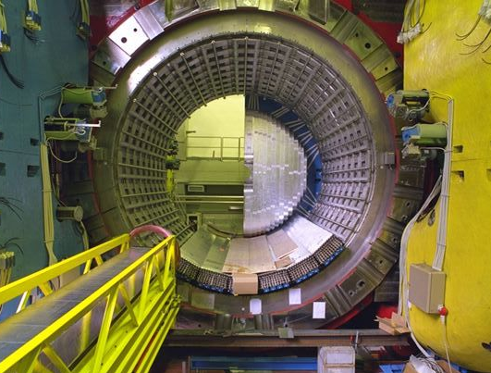
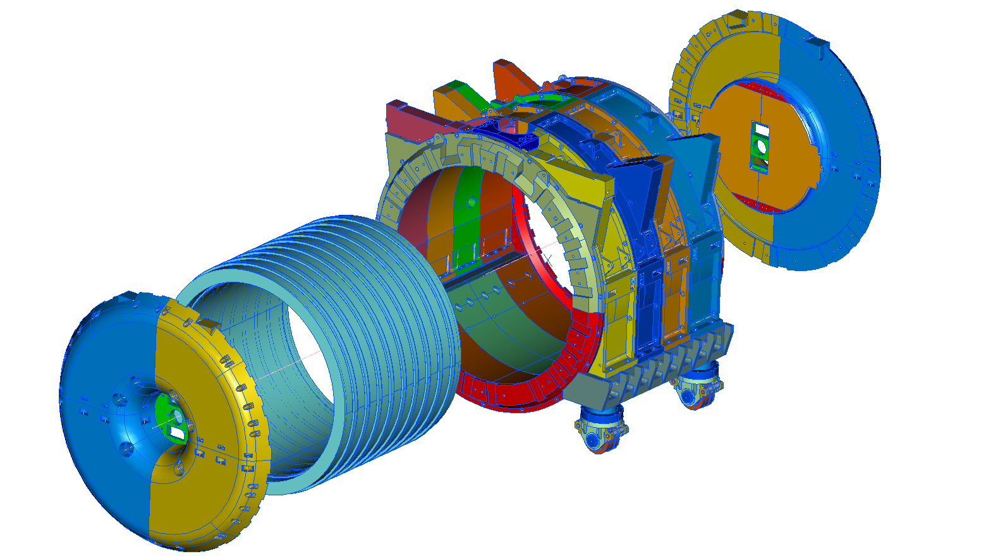
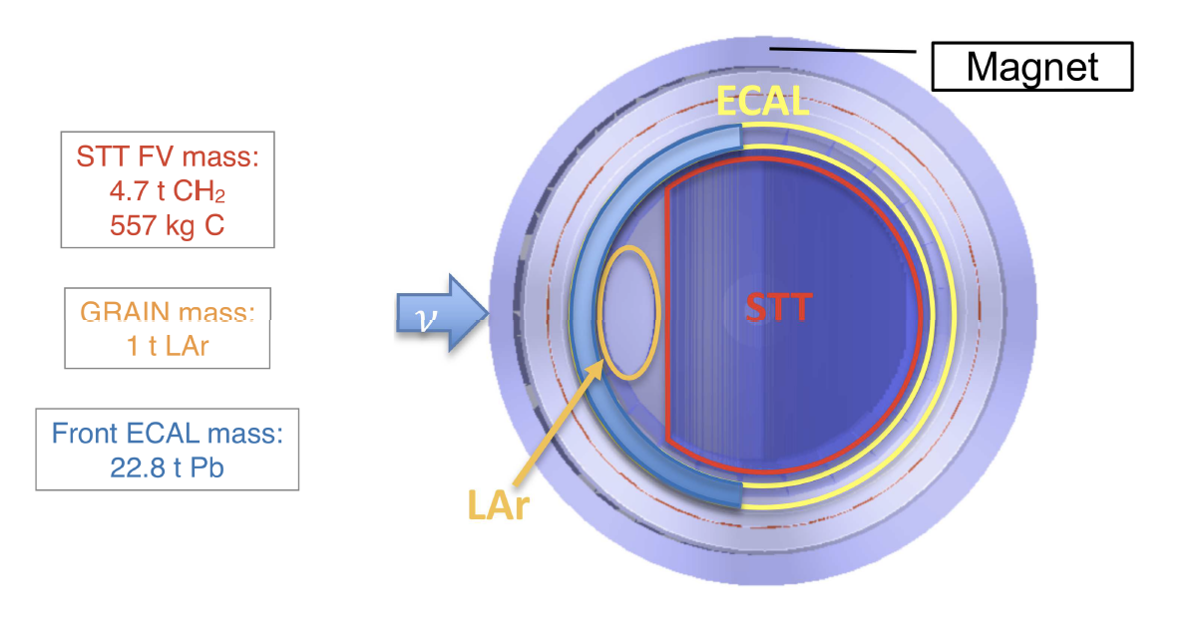
SAND Layout
  After the decision on the inner tracker, taken at the end of last summer, SAND layout has been completely defined as consisting of:
Electromagnetic Calorimeter (ECAL) (Covering the surface of the magnetized volume - 4π)
Yoke
Superconducting Magnet
The yoke, the magnet and the ECAL are repurposed from the KLOE detector.
The STT and GRAIN are new detectors, to be engineered and built.
GRAIN

Slide 4
DUNE-ND Site Map
Wilson Hall
ND Building

Slide 5
DUNE-ND Underground Facilities

Slide 6
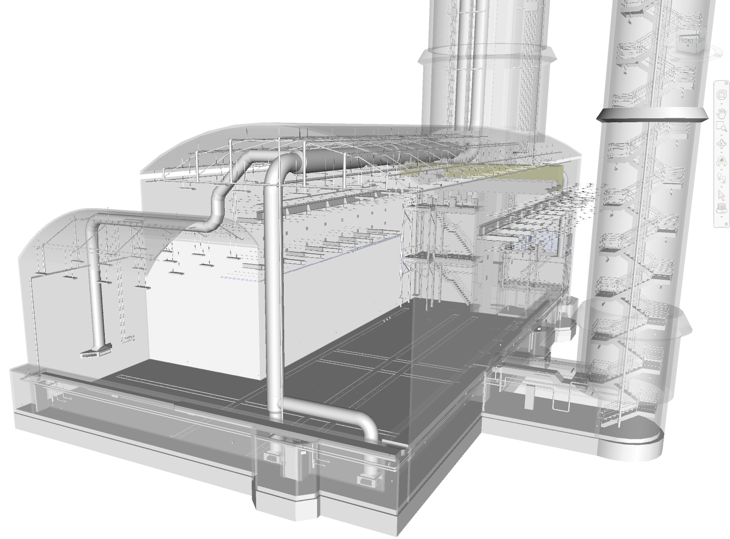
DUNE-ND Underground Building
Shaft
Safety Egress
SAND Alcove

Slide 7
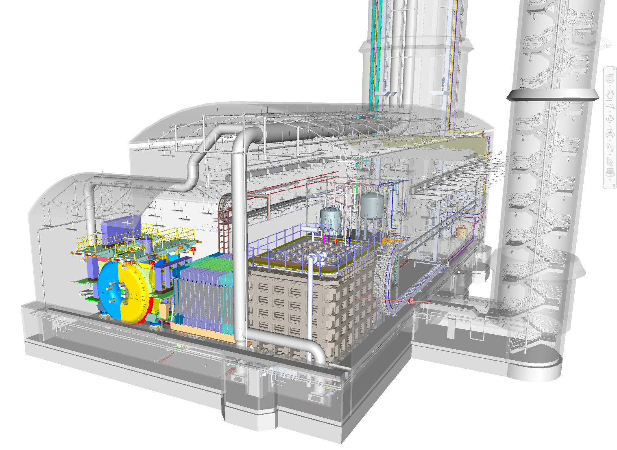
DUNE-ND Space occupation during operation
ND-LAr
TMS
SAND

Slide 8
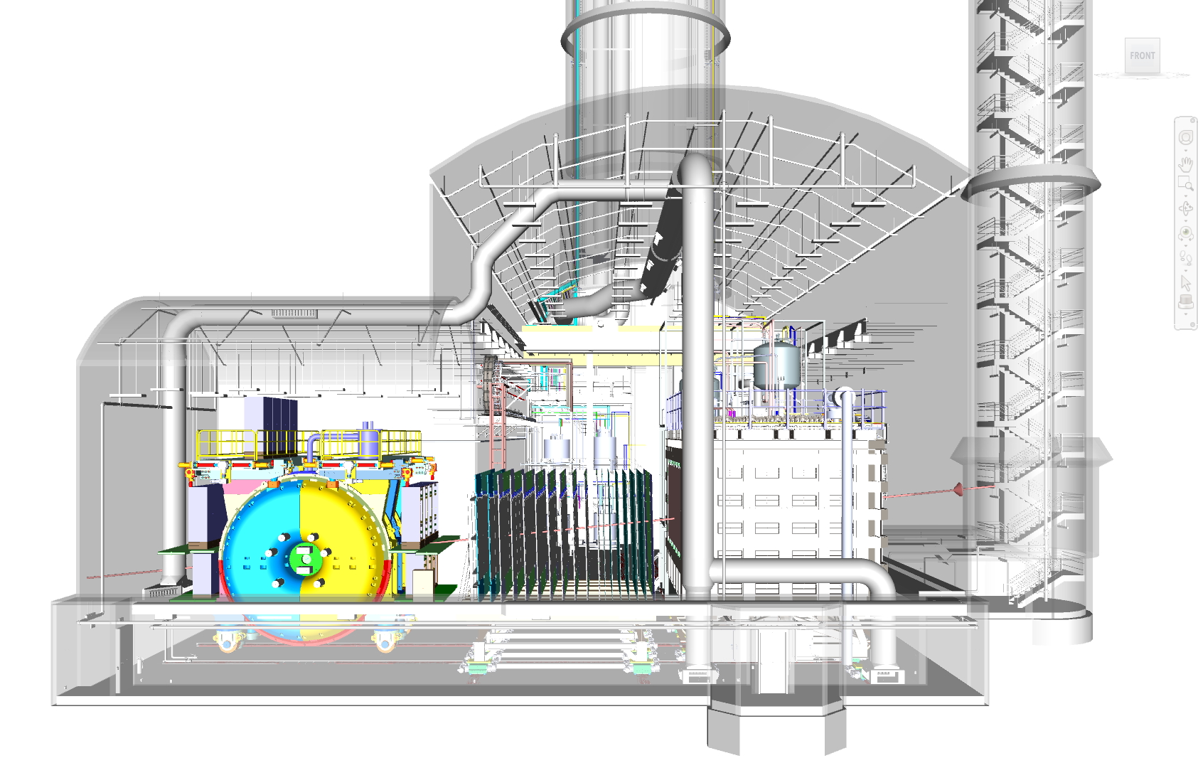
DUNE-ND Space occupation during operation
ND-LAr
TMS
SAND

Slide 9
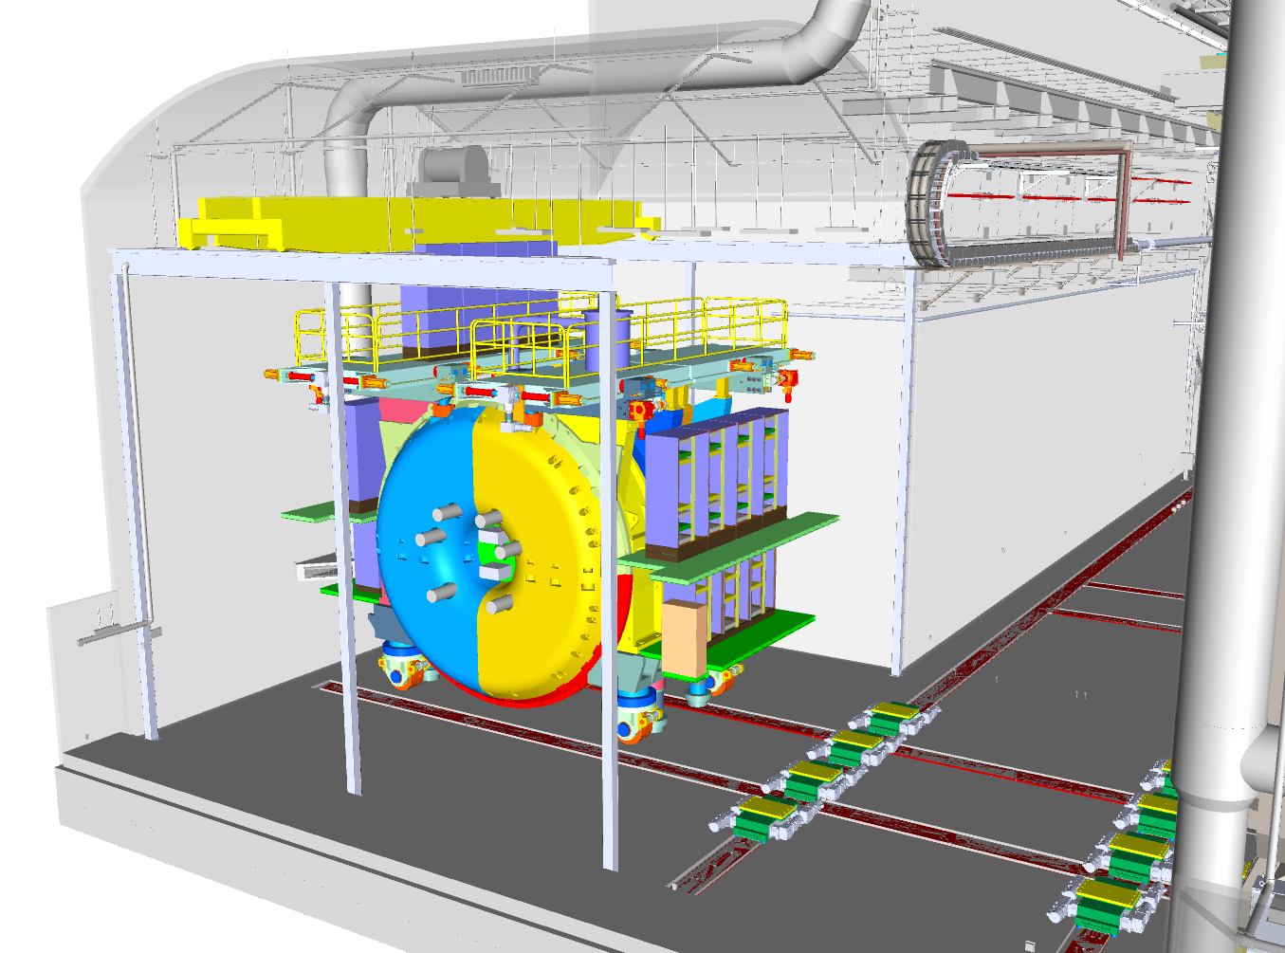
DUNE-ND SAND Position

Slide 10
SAND Installation sequence
  We recently reconsidered our original installation sequence.
  SAND will be the first detector installed according to the following sequence:
    Assemble the yoke (80%).
    Lower and install the magnet inside the yoke and install the turret.
    Complete the yoke, including the platforms.
    Install the ECAL.
    Install the supporting frame.
    Install the STT modules.
    Install the GRAIN detector.
    Move the assembly in the alcove.
    Complete the installation with external components, connections and cabling.

Slide 11
DUNE-ND SAND Installation steps
Final Installation area:
External equipment, connections, cabling
First Installation area:
Yoke ← Magnet ← ECAL ← STT ← GRAIN

Slide 12
SAND Installation
  According to the present schedule, all detector components should be ready for installation by the time the experimental hall becomes available (2028?).
  QA/QC plans have to be developed to ensure the functionality of the components before installation. These plans include after-production testing and inspection and some testing upon delivery at Fermilab. Test of the magnet is part of this part of this process. Spaces at Fermilab are available to support these activities.
  We will be competing for the occupation of the space in the main cavern with the other two detectors, so we have to keep our installation outside the alcove schedule as short as possible. At the moment, a time slot of 4-6 months has been allocated.
  Installation of STT modules and GRAIN (not the ECAL and the supporting structure) in the alcove is also possible, but it will take longer, it is more risky and it will interfere with activities on the other SAND subdetectors. This has to be considered as a Plan B.

Slide 13
DUNE-ND Interface Documents
  During the past months the requirements for SAND installation and operations were reviewed and refined. In particular we specified the requirements for electrical power (2 x 113 kVA transformers), cooling water (it will be available in the alcove, but we will provide a chiller, if needed), cryogenic fluids (He, LAr and LN2) and related venting pipes, heat loads, compressed air.
  A number of interface documents have been created and are available on edms to be used as inputs for the specifications of the experimental hall, which has reached 100% design completion. The experimental hall drawings have been reviewed by us to verify conformity with our needs.
  Several interface documents will be finalized in the coming months, including all details that will become available as the detector design will reach final maturity.
    General Interface edms structure: https://edms.cern.ch/project/CERN-0000224161
    SAND Specific Interface Documents: https://edms.cern.ch/project/CERN-0000231814

Slide 14
DUNE-ND Floor occupation
SAND
TMS
ND-LAr

Slide 15
DUNE-ND Side occupation
SAND
ND-LAr
TMS

Slide 16
Contributions to SAND
  SAND Consortium provides the detector components, expertise and resources for testing and installation.
  DUNE-US/Fermilab is proposed to provide logistics, technical support and engineering oversight for pre-assembly activities, pre-shipping and post-shipping acceptance tests happening outside the DUNE-ND complex prior to installation.
  DUNE-US/Fermilab is proposed to provide cryogenics for detector operation, logistics, technical support and engineering oversight for final installation activities in the DUNE-ND complex.

Slide 17
Deliverables and sharing of responsibilities
An annex to the DUNE MoU with a detailed list of deliverables and sharing of responsibilities between DUNE-SAND Consortium, DUNE Project and Fermilab is in preparation.
Excerpt from the Annex to the Multi-Institutional MoU for DUNE (Draft)
The SAND Consortium is responsible for the delivery, installation and commissioning of the SAND detector at Fermilab’s DUNE ND facility.
This Annex describes the planned design and construction, and integration and installation of SAND. SAND detector components are provided as in kind contributions of SAND Consortium collaborating institutions. The INFN contribution is regulated by the high level Implementing Arrangement between the Department of Energy of the United States of America and the Ministry of Universities and Research of the Italian Republic for cooperation in the areas of High Energy, Astroparticle and Nuclear Physics concerning Neutrino Physics Research - Addendum 2: Deep Underground Neutrino Experiment Program. According to this Arrangement, INFN is responsible for delivering and re-assembling the KLOE superconducting magnet, the yoke, the KLOE electromagnetic calorimeter, all appropriately refurbished and instrumented for operation as parts of SAND. INFN is also responsible for the development, construction of the GRAIN sub-detector. Sharing of responsibilities, within the Consortium, for the development, construction, delivery and re-assembly of the STT sub-detector are under definition. (…)

Slide 18
Excerpt from the DUNE-SAND Annex to MoU (cont.)
Excerpt from the Annex to the Multi-Institutional MoU for DUNE (Draft)
(…)
Activities following the delivery of detector components at Fermilab such as, pre-assembly and testing at the Fermilab site, installation and integration at the DUNE-ND facility as well as activities preceding the delivery, aiming at the qualification of components for acceptance for operation at the Fermilab site are conducted in cooperation between SAND Consortium and Fermilab/DOE personnel. Fermilab is expected to provide infrastructures and onsite support for post-shipping tests and pre-assembly activities taking place at the Fermilab site, before installation at the DUNE-ND facility. DUNE-US project is expected to provide the infrastructures and onsite support required for installation and commissioning of the SAND detector at the DUNE-ND facility, including the cryogenic equipment for the delivery of helium and nitrogen as required for the commissioning and operation of the SAND magnet and of the GRAIN sub-detector. (…)

Slide 19
Deliverables and sharing of responsibilities (draft)
# | item | Effort | To be done | SAND (%) | DUNE Proj (%) | FNAL(%) | start | end
SAND Detector components
A | Magnet's Yoke
A.1 | KLOE's magnet yoke components (iron blocks) | in-kind | N | 100 | 0 | 0
A.2 | Onboard moving mechanisms (roolers, cranes, engines) | in-kind | N | 100 | 0 | 0
A.3 | Structure to host onboard readout electronics and other equipment that have to be in close proximity to the detector | in-kind | M | 100 | 0 | 0
A.4 | Tools for assembly and handling | in-kind | Y | 100 | 0 | 0
A.5 | Documentation: engineering notes, drawings (translation into CAD format), 3d models and assembly manual | in-kind | Y | 100 | 0 | 0
A.6 | Disassembly, packaging and transport to FNAL | in-kind | Y | 100 | 0 | 0
B | Superconducting magnet
B.1 | Magnet's main cryostat | in-kind | N | 100 | 0 | 0
B.2 | Superconducting coil | in-kind | N | 100 | 0 | 0
B.3 | Internal cooling circuits (heat exchangers)Internal cooling circuits (heat exchangers) | in-kind | N | 100 | 0 | 0
B.4 | All the internal (to the cryostat) cryogenic equipment (valves, sensors, probes, interfaces) | in-kind | N | 100 | 0 | 0

Slide 20
Technical Working Groups
Collection of individuals/Institutions interest (January 2022)
Identification of preliminary chairs
Working Groups started meeting during February 2022
Activities / Sub-systems Initial chair(s)
Magnet and Yoke G. Delle Monache
ECAL D. Domenici, A. Di Domenico
STT G. Sirri, S. Di Falco, R. Petti
GRAIN A. Montanari, L. Di Noto
DAQ/Trigger & Timing/Slow Controls M. Pozzato, S. Di Domizio, C. Mariani
Additional working groups can be defined, according to specific needs.

Slide 21
First set of high level milestones
Design review of Yoke + Magnet + ECAL and of related installation procedures: April 2023
Preliminary design review of STT: November 2023
Preliminary design review of GRAIN: April 2024
Being organized in Cooperation with the JPO review office.

Slide 22
Conclusions
The SAND organization is well advanced.
Base detector configuration is defined with optimizations in progress:
  Robust R&D program underway for STT and GRAIN;
  Disassembly of KLOE in Italy is in progress.
Financial resources and personnel are almost completely identified with the deliverables and sharing of responsibility defined in the high level agreement between DOE and Italian Ministry of Universities and Research.
The SAND configuration allows for a full integration into DUNE-ND complex.
THANK YOU!

Slide 23
BACKUP

Slide 24
DUNE-SAND ECAL Working Group
It includes KLOE dismounting and transport to FNAL
Weekly meetings
Lots of activities at Frascati (Italy) – large engineering personnel (about 10 FTE)
  Technical, formal and bureaucratic steps
  Established procedures with LNF director and LNF safety officer
  Paper working for CE and US accomplishments
ECAL refurbishing and tests
  PMT spares at FNAL in December 2022
  ECAL modules: mechanical tools for movement, temporary storage and test
  (at LNF and FNAL) => by product of KLOE-to-SAND operations
  ECAL modules: maintenance and test at LNF => end 2022
  ECAL modules transportation: tools and box
  ECAL modules: maintenance and test at FNAL
  ECAL simulation, HV, LV, read-out electronics, ECAL alternative read-out with SiPMs

Slide 25
DUNE-SAND ECAL Working Group
Pre-shipping magnet test, at LHe temperature, in Frascati during 2023
  To be designed to reduce the cost of the test to be performed at Fermilab upon delivery.
  To be developed in cooperation with Fermilab experts to ensure compatibility with FNAL infrastructures and regulations.

Slide 26
KLOE-to-SAND Project

Slide 27
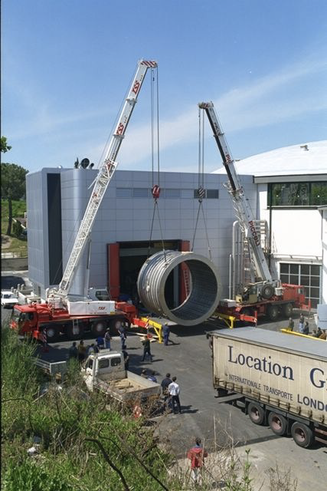
KLOE-to-SAND: dismounting of KLOE
List of operations:
  survey and revision and design of mechanical tools
  un-cabling
  extraction of KLOE Drift Chamber
  extraction of 24 ECAL barrel modules
  dismounting of ECAL endcaps
  extraction of coil
  dismounting of iron yoke
Confirmed available manpower for operation 2.
LE, LNS, FE, BO, RM1, LNF (supervision P. Ciambrone)
Design (and safety) responsibilities for 3-7:
extraction of KLOE Drift Chamber (A. Miccoli – LE)
extraction of 24 ECAL barrel modules (F. Raffaelli – PI)
dismounting of ECAL endcaps (F. Noto – LNS)
extraction of coil (A. Saputi – FE)
dismounting of iron yoke (S. Gazzana – LNF)
EDMS (responsibility A. Saputi – FE)

Slide 28
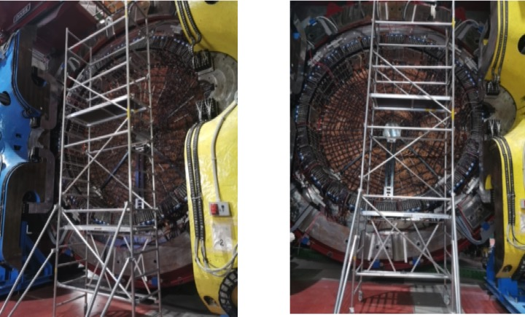
KLOE-to-SAND: Start of disassembly
Installation of scaffolding for un-cabling

Slide 29
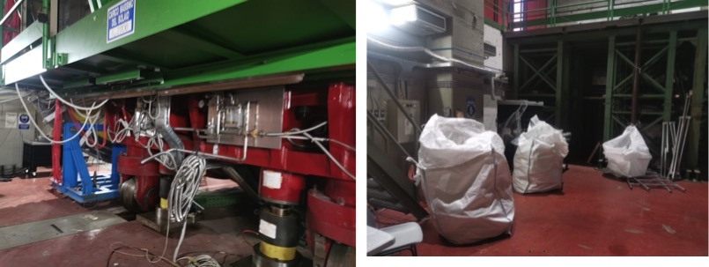
KLOE-to-SAND: Start of the operations
Cleanup and removal of non re-usable instrumentation

Slide 30
STT Working Group
Deﬁned scope of activities required for the completion and installation of the STT.
Preliminary schedule and related deliverables:
  Identiﬁed main tasks and tentative timeline (to be revised following inputs/developments);
  Uncertainties on availability of ND site and current situation (covid19, conﬂict in Europe, supplies, etc.).
2020
2021
2022
2023
2024
2025
2026
2027
2028
2029

Slide 31
STT Working Group: prototyping and tests
Demonstrate all aspects of the STT design in increasing order of complexity:
Produce straws of required quality & maximal length with ultrasonic welding (UW)
⇒Validation of model production lines at JINR (5m) and GTU (2m)
Verify UW straws fulﬁll requirements from STT conceptual design & assembly procedure
⇒Measurement of maximal internal pressure, radial and longitudinal deformations
vs. pressure, relaxation vs. time and humidity, gas tightness,etc.
Verify XXYY straw layer assembly
⇒Gluing and pressure tests of 1m×1m XXYY test assembly
Verify assembly procedure of XXYY straws to frame, gas tightness, etc.
⇒Mockup prototype(s) with plexiglass frame (in progress)
Verify module design with C-composite frame and related performance
⇒Complete 1.2m×0.8m prototype with XXYY straws and actual STT frame design
Verify full scale module (module 0) with maximal straw length and complete assembly
⇒Complete 4m×0.5m prototype with XXYY straws and C-composite frame
Demonstrate readoutperformance:
Verify charge measurement with55Fe source & cosmics
⇒Readout small STT prototype with Mu2e FE boards with VMM3/VMM3a ASICs
Verify time measurement with signal generator
Verify time and charge measurement at testbeam
⇒Readout small STT prototype with FE boards with VMM3/VMM3a ASICs

Slide 32
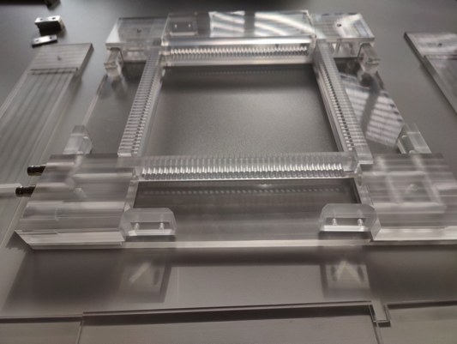
STT Working Group: prototype frame
Plexiglass frame for the mockup prototype ready for assembly in Hamburg

Slide 33
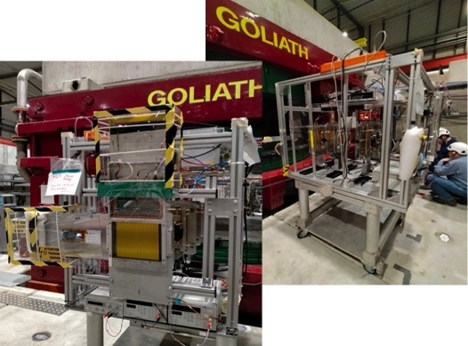
STT Working Group: test beam at CERN
Start with minimal setup:
- One plane of 6 mm
straws equipped with mu2e board (one VMM3 chip)
- Scintillator for trigger
-3 MM trackers with APV readout
Test beam schedule (2022):
25 April – 3 May parasitic
18 May – 24 May main user
25 May – 8 June parasitic

Slide 34
GRAIN Review
GRAIN (GRanular Argon for Interaction of Neutrinos) concept aims at obtaining relevant information on nuclear effects by comparing topologies of neutrino scattering events off Argon, Carbon and Hydrogen, within the same detector, immersed in a uniform magnetic field.
Identification of ν-Ar events is achieved by imaging a (small) LAr volume through the fast component of the LAr scintillation light. Tracks exiting the LAr volume are then reconstructed by the STT and ECAL detectors.
Two technologies are being explored for the production of images from LAr scintillation light: one based on Hadamard masks and the other using concentration lenses. In both cases the optical sensors are SiPM readout by high density ASICs, specifically designed to operate at LAr temperature.
An internal DUNE review was conducted, in February 23rd and 24th, to verify the maturity of GRAIN concept, in particular the physic potentials, the level of integration with other SAND and DUNE-ND detectors and, to a lesser extent, its technological implementation.
Committee report can be found at: https://indico.fnal.gov/event/53099/

Slide 35
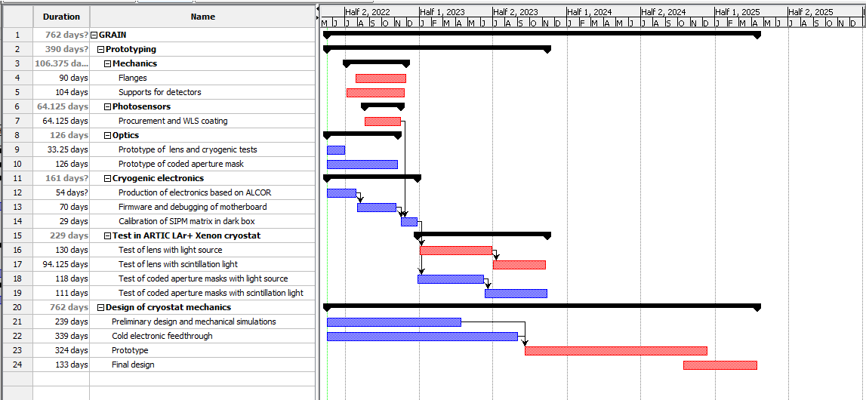
GRAIN Preliminary Timeline

Slide 36
Deliverables and sharing of responsibilities (draft)
# | item | Effort | To be done | SAND (%) | DUNE Proj (%) | FNAL(%) | start | end
Onsite pre-assembly, testing and final assembly activities
H | Pre-assembly and testing at FNAL
H.1 | Onsite storage and related book-keeping |  | Y | 0 | 0 | 100
H.2 | Onsite transport |  | Y | 0 | 0 | 100
H.3 | Rigging |  | Y | 0 | 0 | 100
H.4 | Scaffolding |  | Y | 0 | 0 | 100
H.5 | Lifting platforms and lifting equipment |  | Y | 50 | 0 | 50
H.6 | Engineering for magnet test (engineering notes, compliance with FESHM requirements, ORCs) | 2 FTE | Y | 50 | 0 | 50
H.7 | Magnet test infrastructure (cryogenics, power distribution, safety) |  | Y | 0 | 50 | 50
H.8 | Technical support for magnet installation and test | 0.75 FTE | Y | 0 | 0 | 100
H.9 | Cryogenic liquids for magnet test |  | Y | 0 | 0 | 100
H.10 | Engineering for sub-components test (engineering notes, compliance with FESHM requirements, ORCs) | 3 FTE | Y | 30 | 0 | 70
H.11 | Technical support for sub-components test and pre-assembly | 1 FTE | Y |  | 0 | 100
H.12 | Personnel for pre-assembly and testing (technicians) | 1 FTE | Y | 100 | 0
H.13 | Personnel for pre-assembly and testing (engineers/physicists) | 3 FTE | Y | 100 | 0
H.14 | Fermilab technical coordination |  | Y | 0 | 0 | 100
H.15 | Safety management |  | Y | 0 | 0 | 100
H.16 | Project management |  | Y | 0 | 0 | 100

Slide 37
Deliverables and sharing of responsibilities (draft)
# | item | Effort | To be done | SAND (%) | DUNE Proj (%) | FNAL(%) | start | end
G | Assembly at DUNE ND facility
G.1 | Onsite storage and related book-keeping |  | Y | 0 | 100 | 0
G.2 | Onsite transport |  | Y | 0 | 100 | 0
G.3 | Rigging |  | Y | 0 | 100 | 0
G.4 | Rental crane for heavy equipment lowering in the cavern |  | Y | 0 | 100 | 0
G.5 | Cryogenic infrastructure |  | Y | 0 | 100 | 0
G.6 | Welders for rigging supports | 0.1 FTE | Y | 0 | 100 | 0
G.7 | Welders for cryogenic and gas system connection | 0.1 FTE | Y | 0 | 100 | 0
G.8 | Scaffolding |  | Y | 0 | 100 | 0
G.9 | Lifting platforms and lifting equipment |  | Y | 50 | 50 | 0
G.10 | Personnel for final assembly and testing (technicians) | 2 FTE | Y | 100 | 0 | 0
G.11 | Personnel for final assembly and testing (engineers/physicists) | 4 FTE | Y | 100 | 0 | 0
G.12 | Engineering for ORCs | 1 FTE | Y | 50 | 50
G.13 | Technical support for ORCs | 0.5 FTE | Y | 50 | 50
G.14 | Engineering to verify compliance of installations with FESHM | 1 FTE | Y | 0 | 100 | 0
G.15 | Fermilab technical coordination (ELO) |  | Y | 0 | 100 | 0
G.16 | Safety management |  | Y | 0 | 100 | 0
G.17 | Project management |  | Y | 0 | 100 | 0

Slide 38
SAND internal detectors

Slide 39
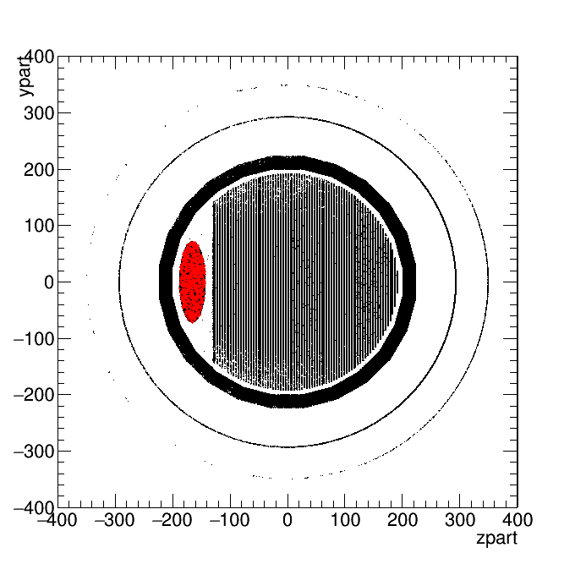
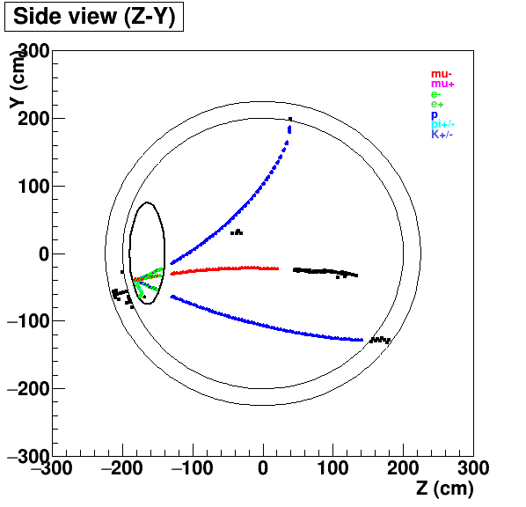
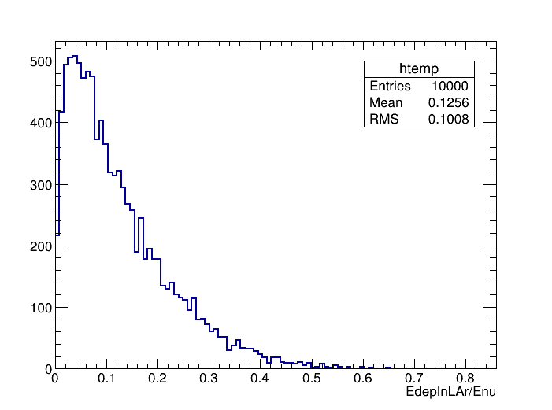
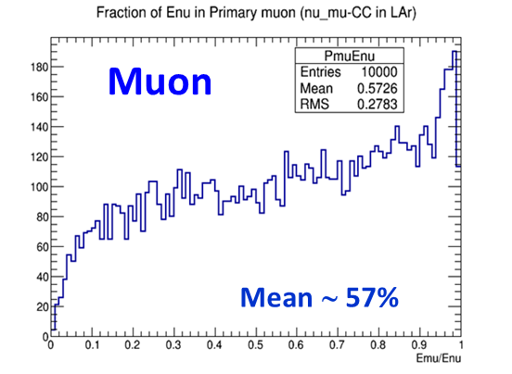
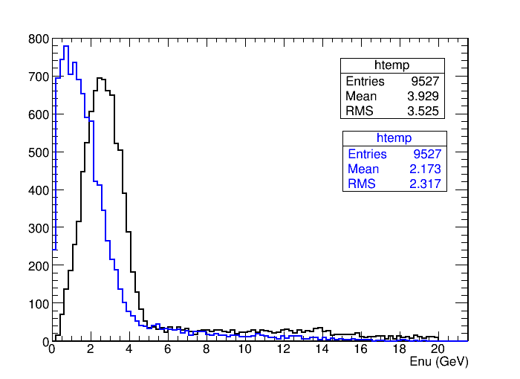
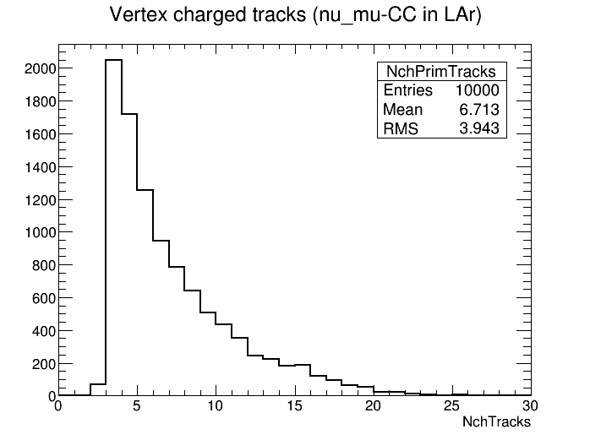
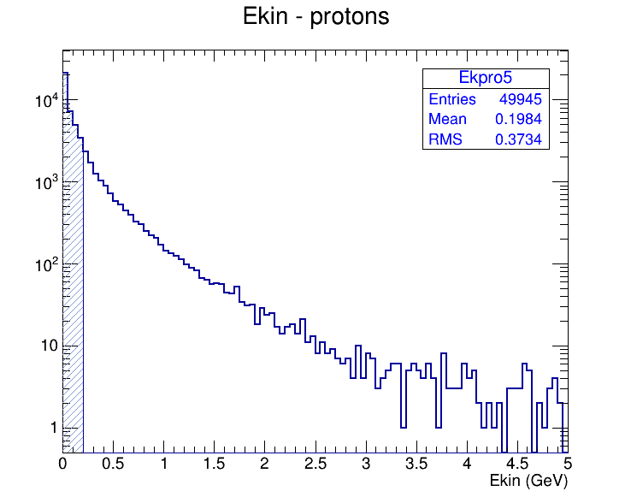
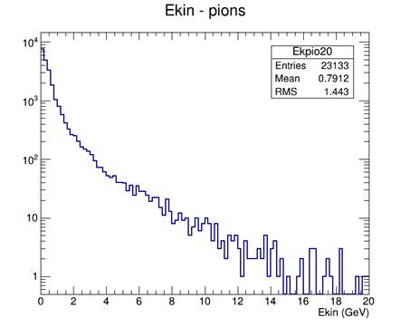
Events from ν_{μ}-CC interaction in GRAIN
LAr target
STT
CC-ν_{μ} interactions by FLUKA
Event reconstruction in SAND by STT and ECAL
Features of neutrino beam (flux, flavors, ..) and of ν_{μ} interactions in LAr
ECAL
E_{dep} in LAr
E carried-out by μ
Spectrum of interacting ν_{μ} and produced muons
Multiplicity of primary charged particles (can depend on the generator)
E_{LAr} / E_{nu} ∼ 0.12
ν
muon
∼ 6.7/ev
protons
pions
<Ek>∼ 200MeV
<Ek> ∼ 800MeV
E_{μ−peak} ∼ 1÷2 GeV
73%

Slide 40
GRAIN - Specs

Slide 41
GRAIN Geometry

Slide 42
GRAIN – Geometry of the lens option

Slide 43
Example of an event reconstructed with lenses

Slide 44
Coded aperture masks option: optics

Slide 45
Mask geometry in GRAIN

Slide 46
3D Reconstruction in GRAIN with masks

Slide 47
STT Working Group: prototype frame

Slide 48
STT Working Group: prototype frame

Slide 49
STT Working Group: prototype frame

Slide 50
STT Working Group: prototype frame

