Slide 1


COLD Lab activity report
Claudio Gatti
64nd LNF Scientific Committee – November 2022

Slide 2

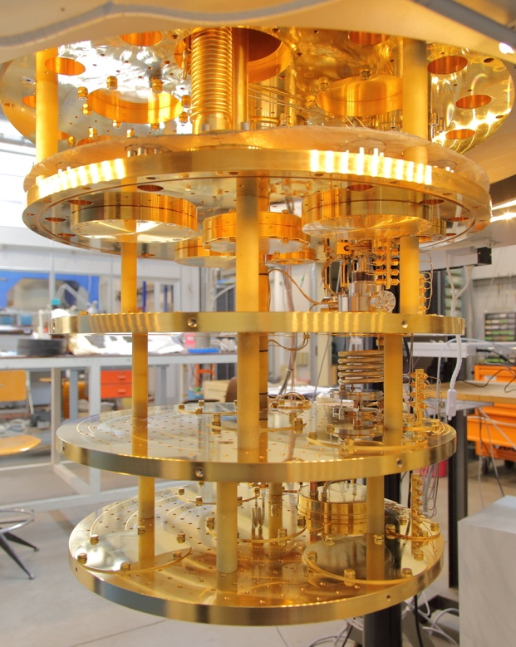
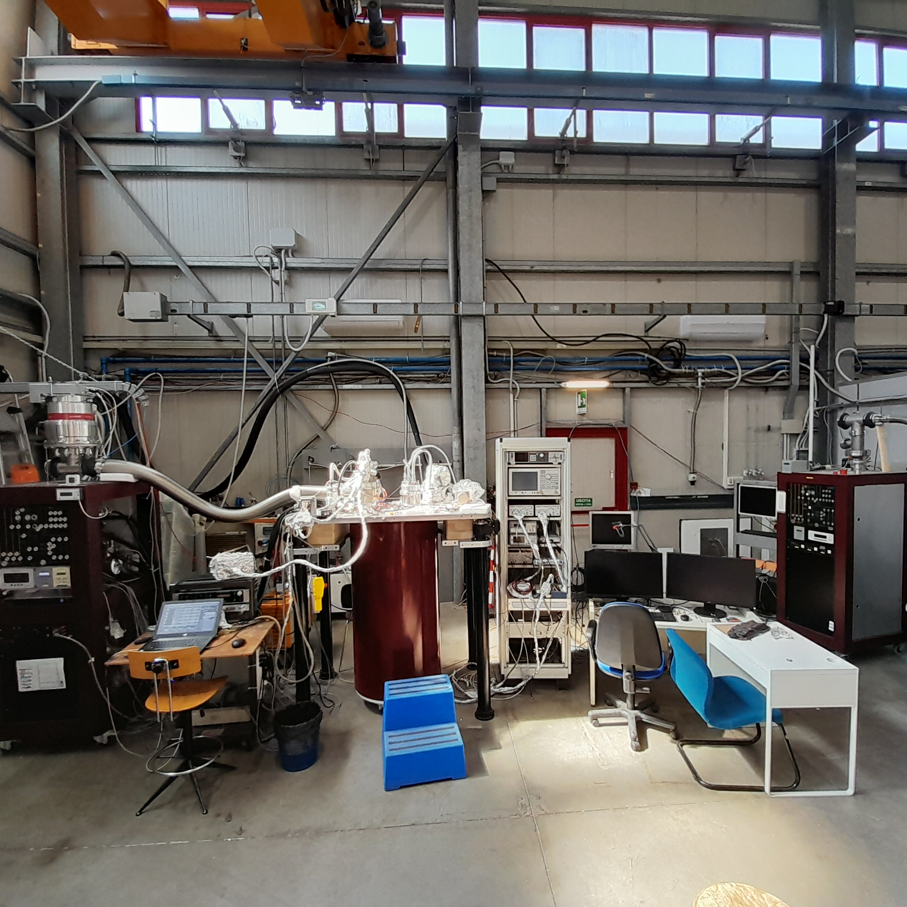

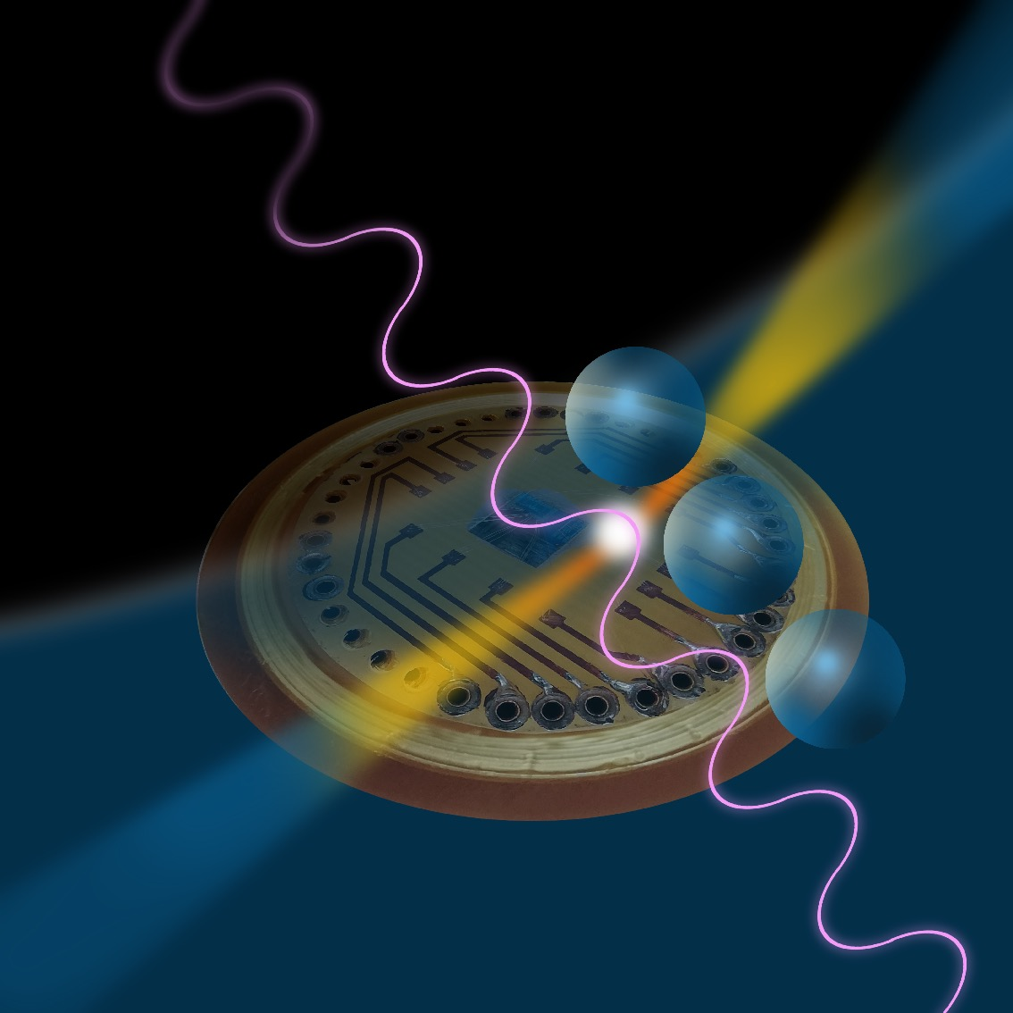




EXPERIMENTS
COLD - Cryogenic Laboratory for Detectors
Axion Experiments
Superconducting Quantum Devices
Superconducting Cavities
Magnetic Measurements
QUAX – QUest for AXions
Search for galactic axions with Sikivie’s Haloscopes at 10 GHz (Ongoing experiments at LNL and LNF).
(K)FLASH
Search for galactic axions with a Sikivie’s Haloscope at 100 MHz (Design Study).
Superconducting Devices
DART WARS (Detector Array Readout with Travelling Wave AmplifieRS)
Development of wide band quantum amplifiers for multi-channel detector readout (Ongoing).
SIMP (Single Microwave Photon detectors)
Development of single-microwave photon detector (Ends 2021)
Qub-IT Quantum Sensing with superconducting qubits (Started 2022).
Supergalax FET H2020 Project
SC-qubits array photon-detector for axion experiments
SQMS USA DOE Project
Superconducting Quantum Materials and Systems
SC materials for cavities

Slide 3

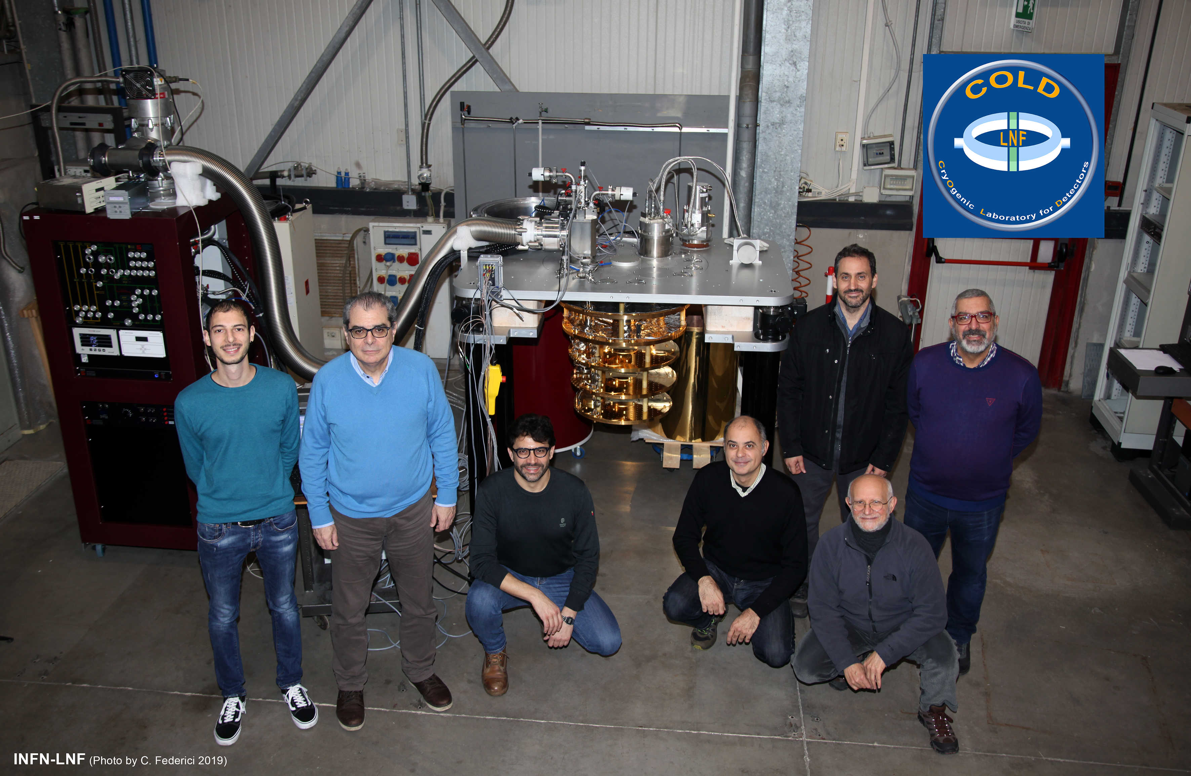
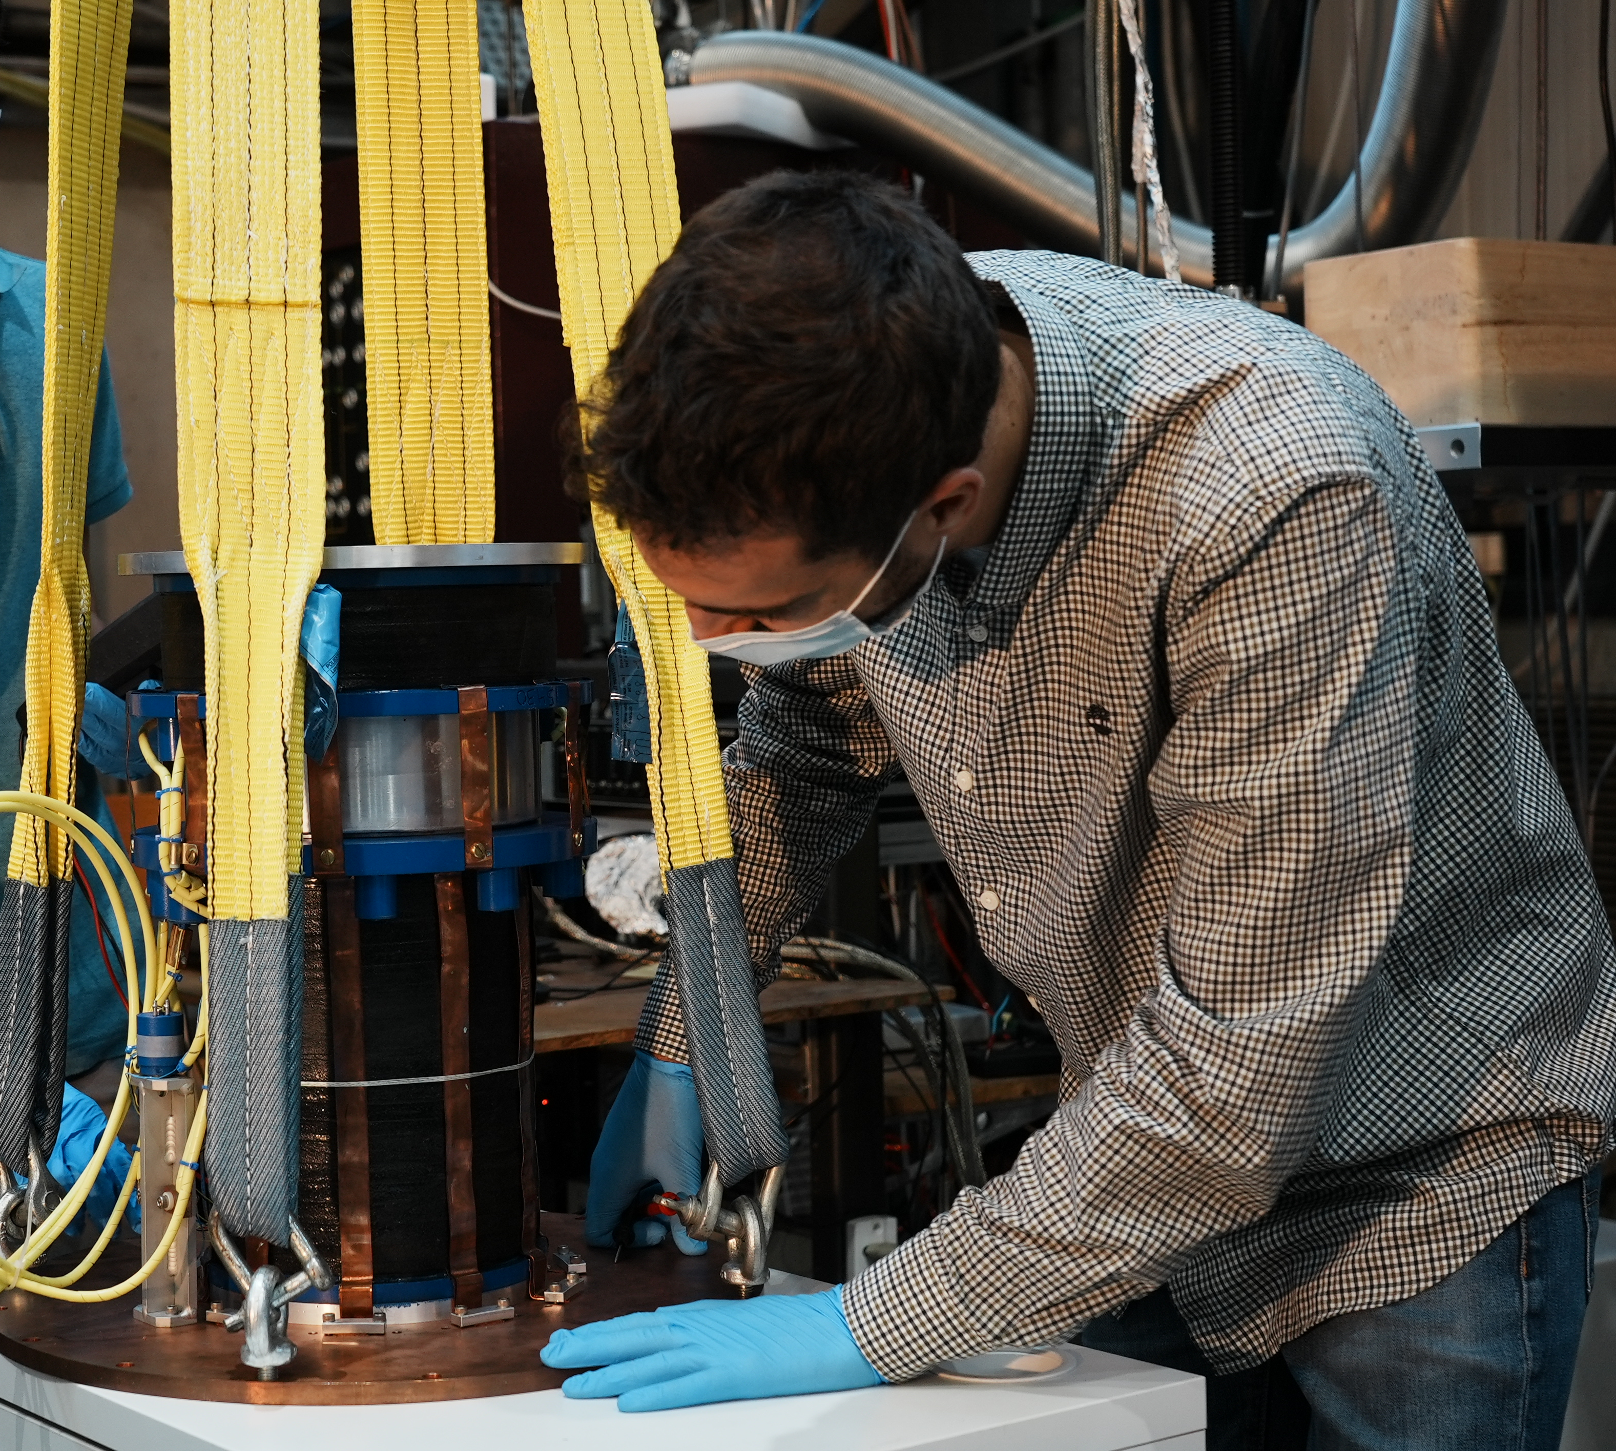
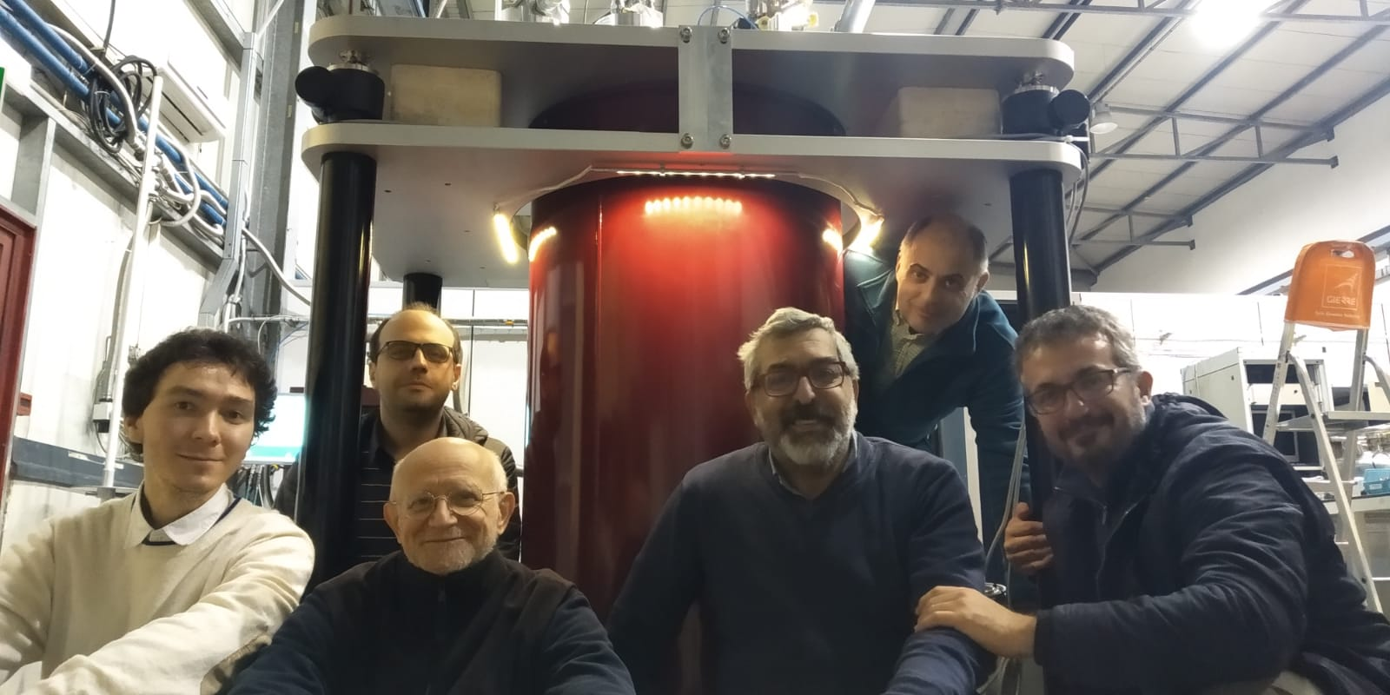
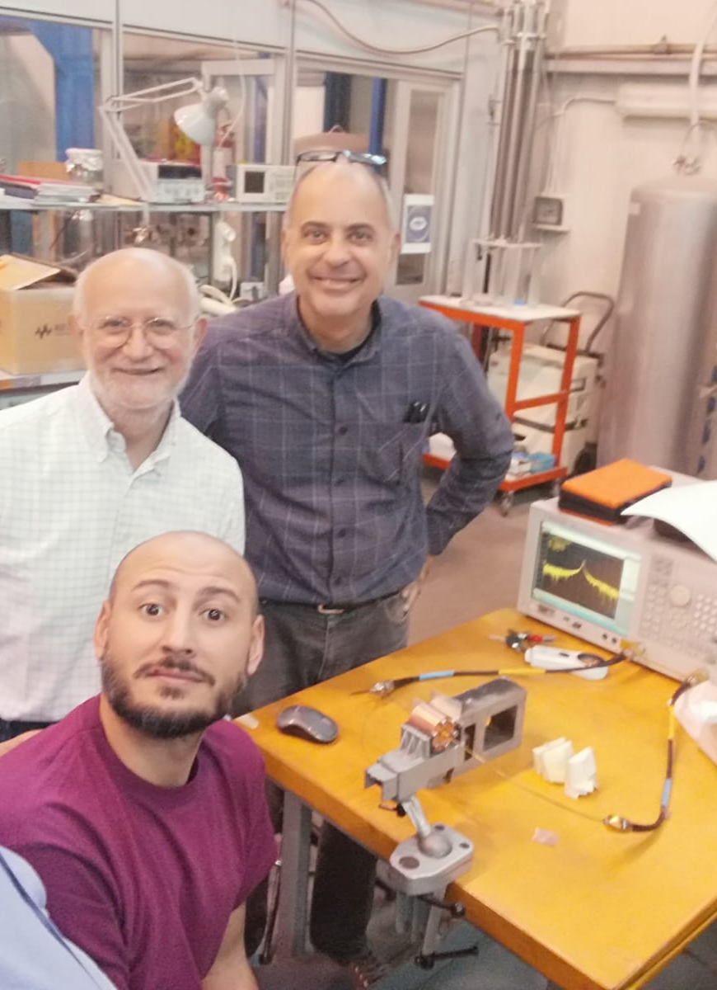
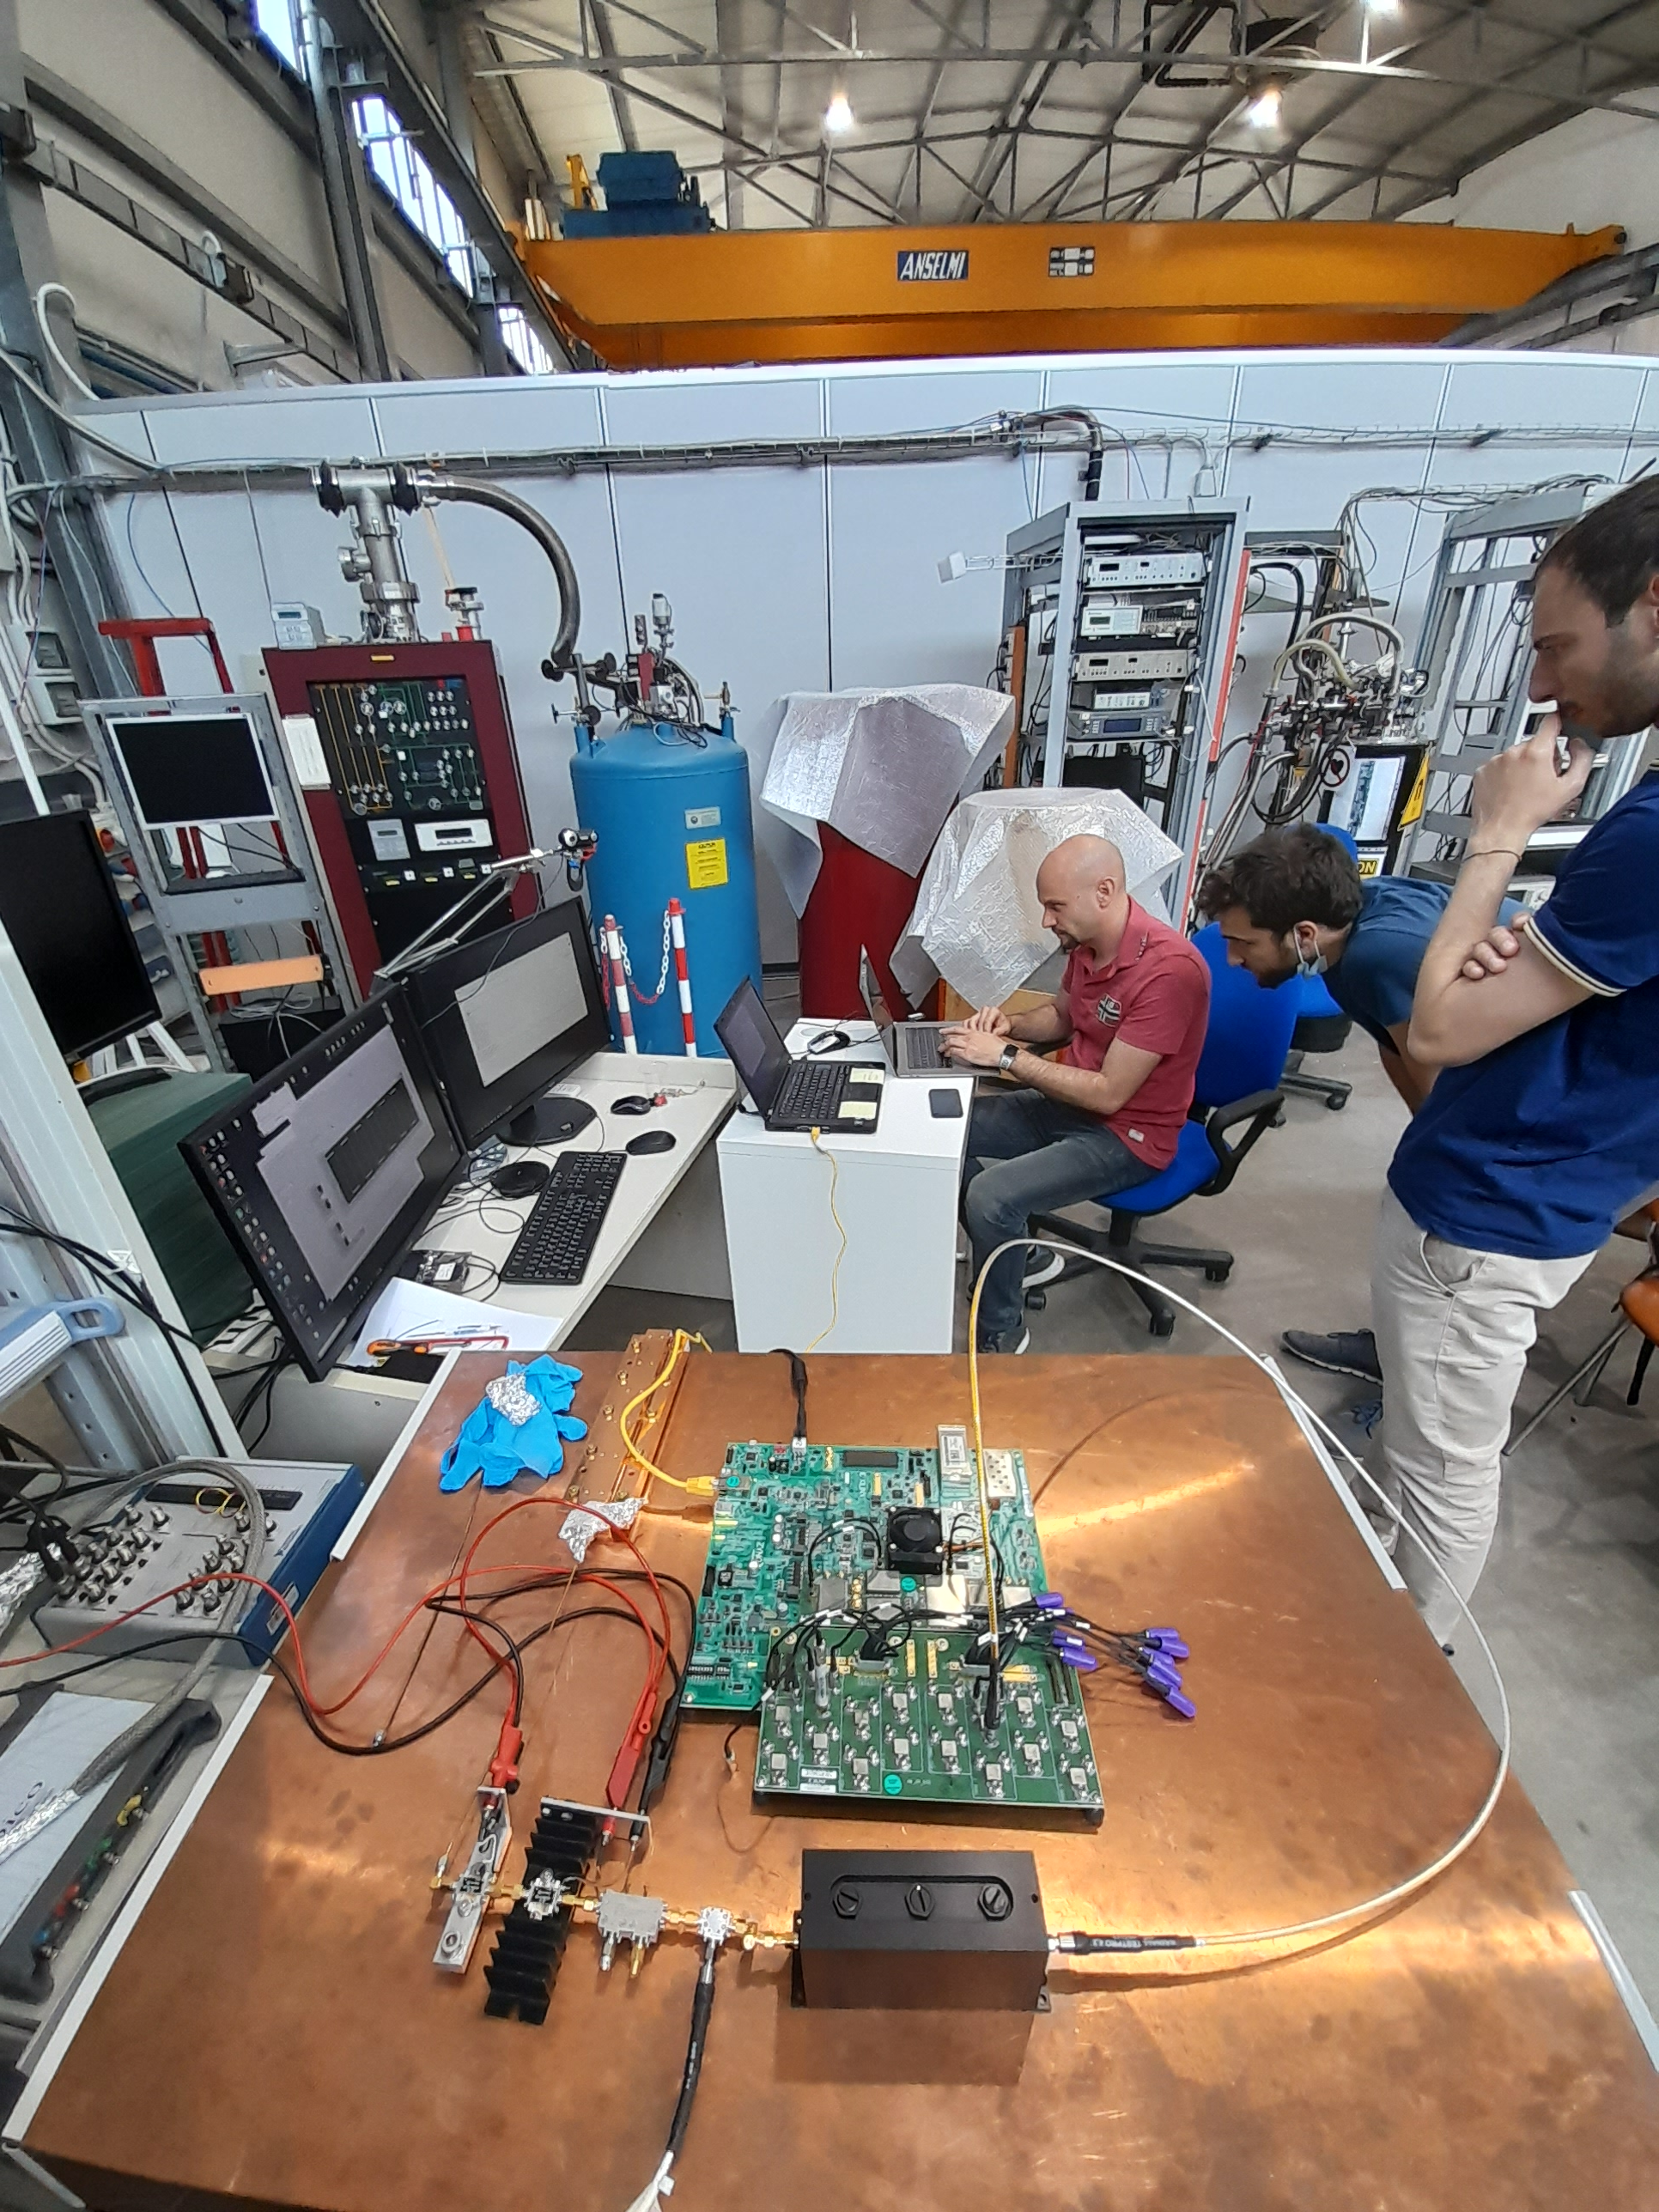
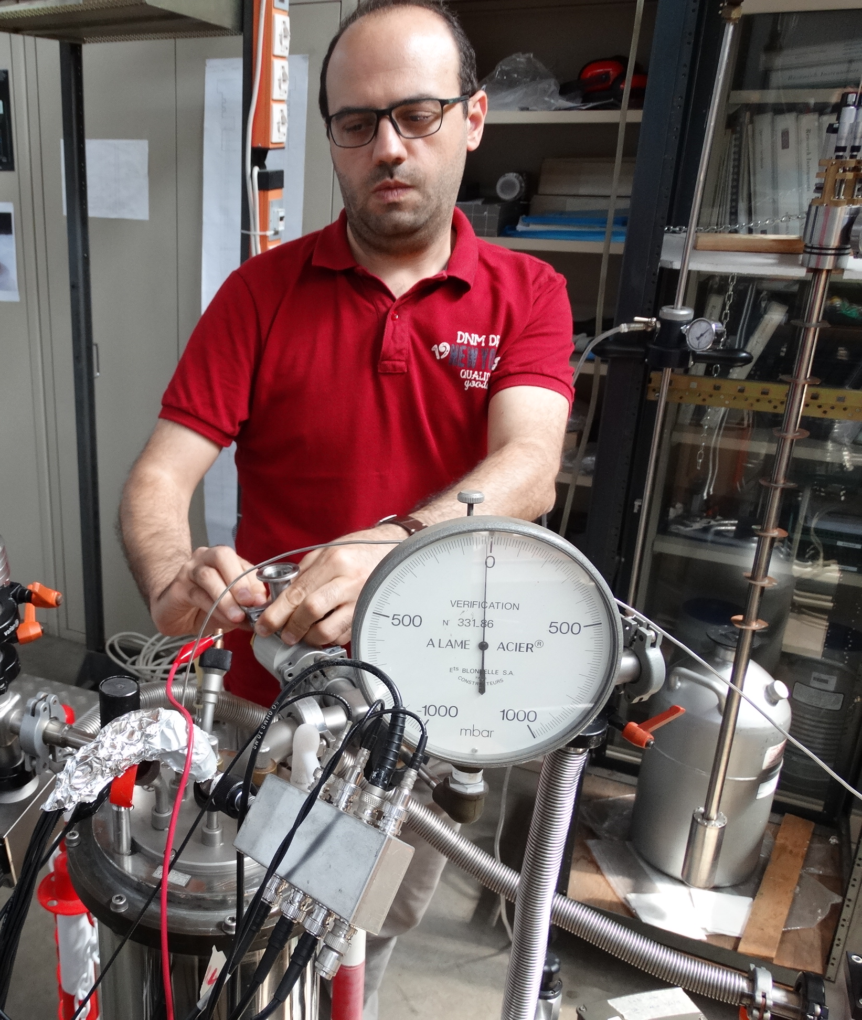
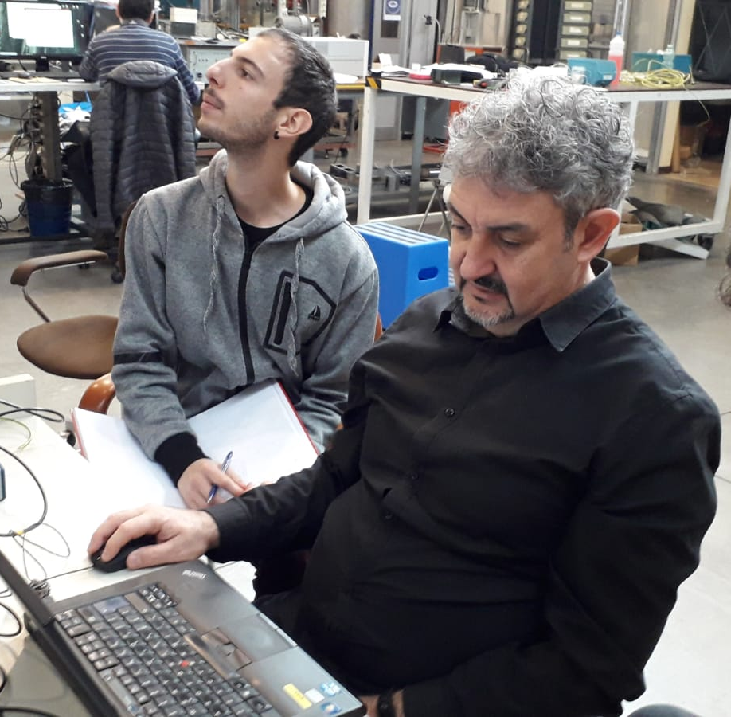
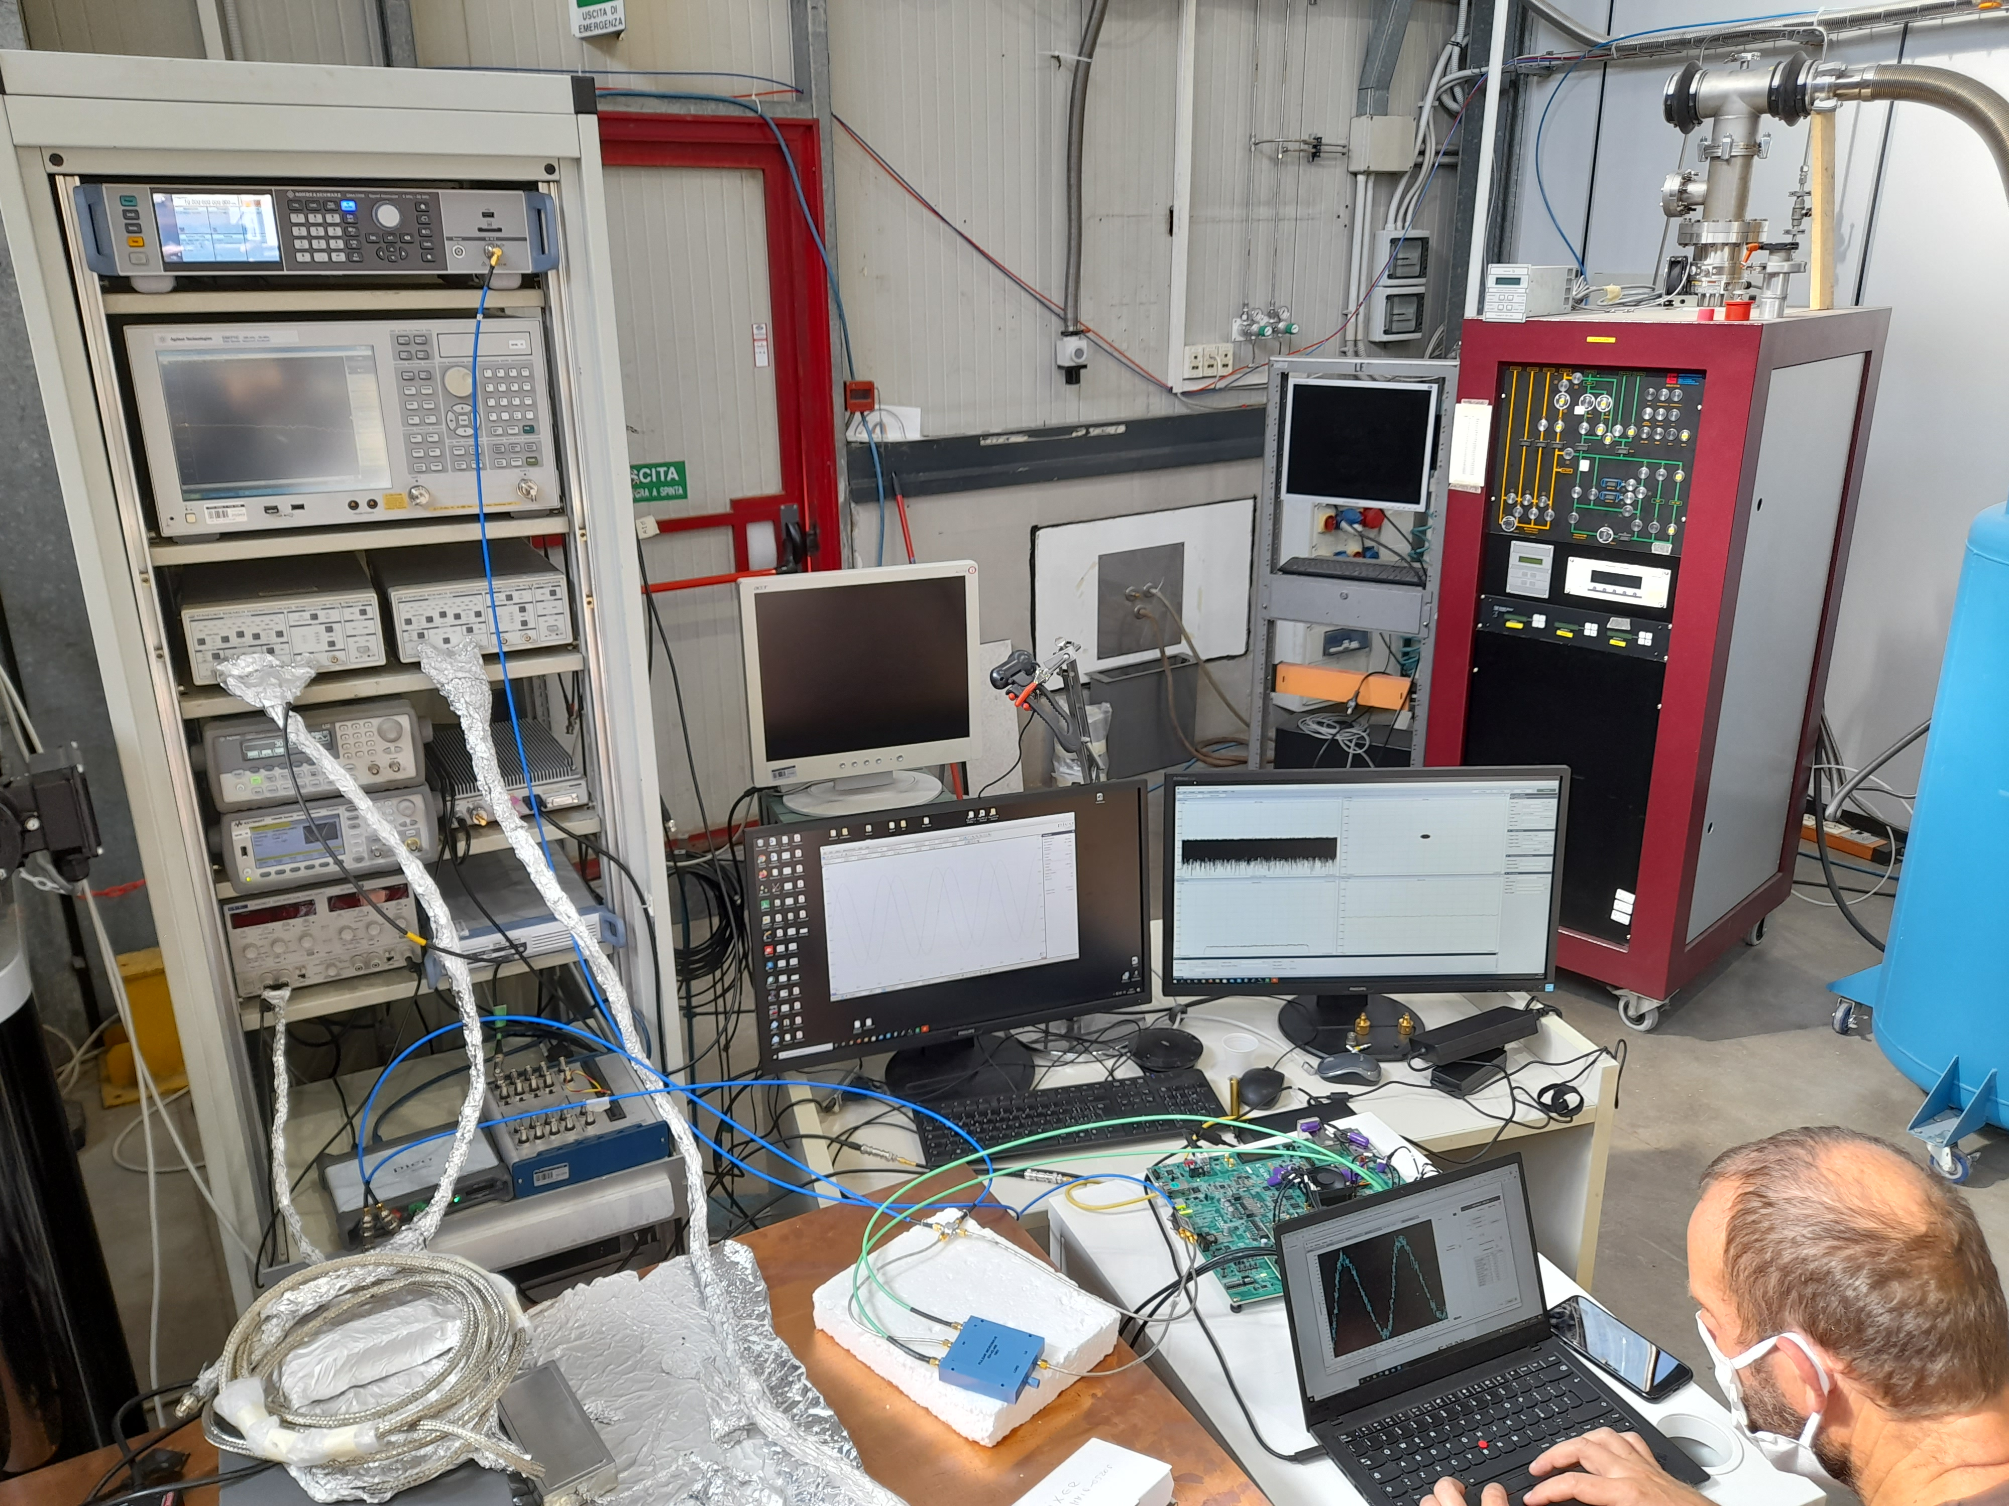

Slide 4

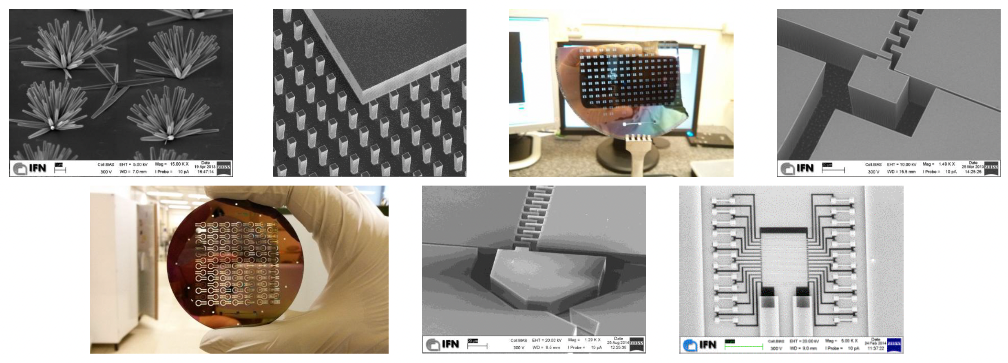
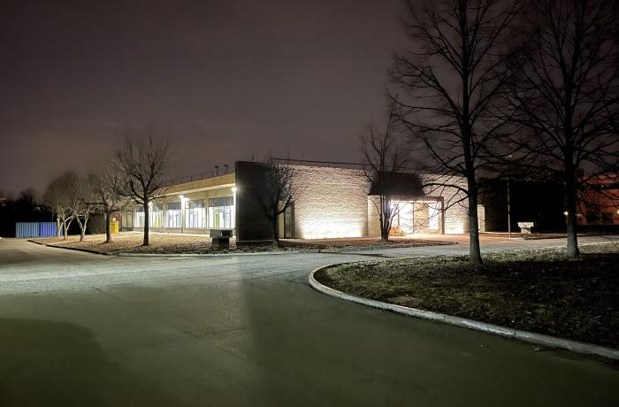


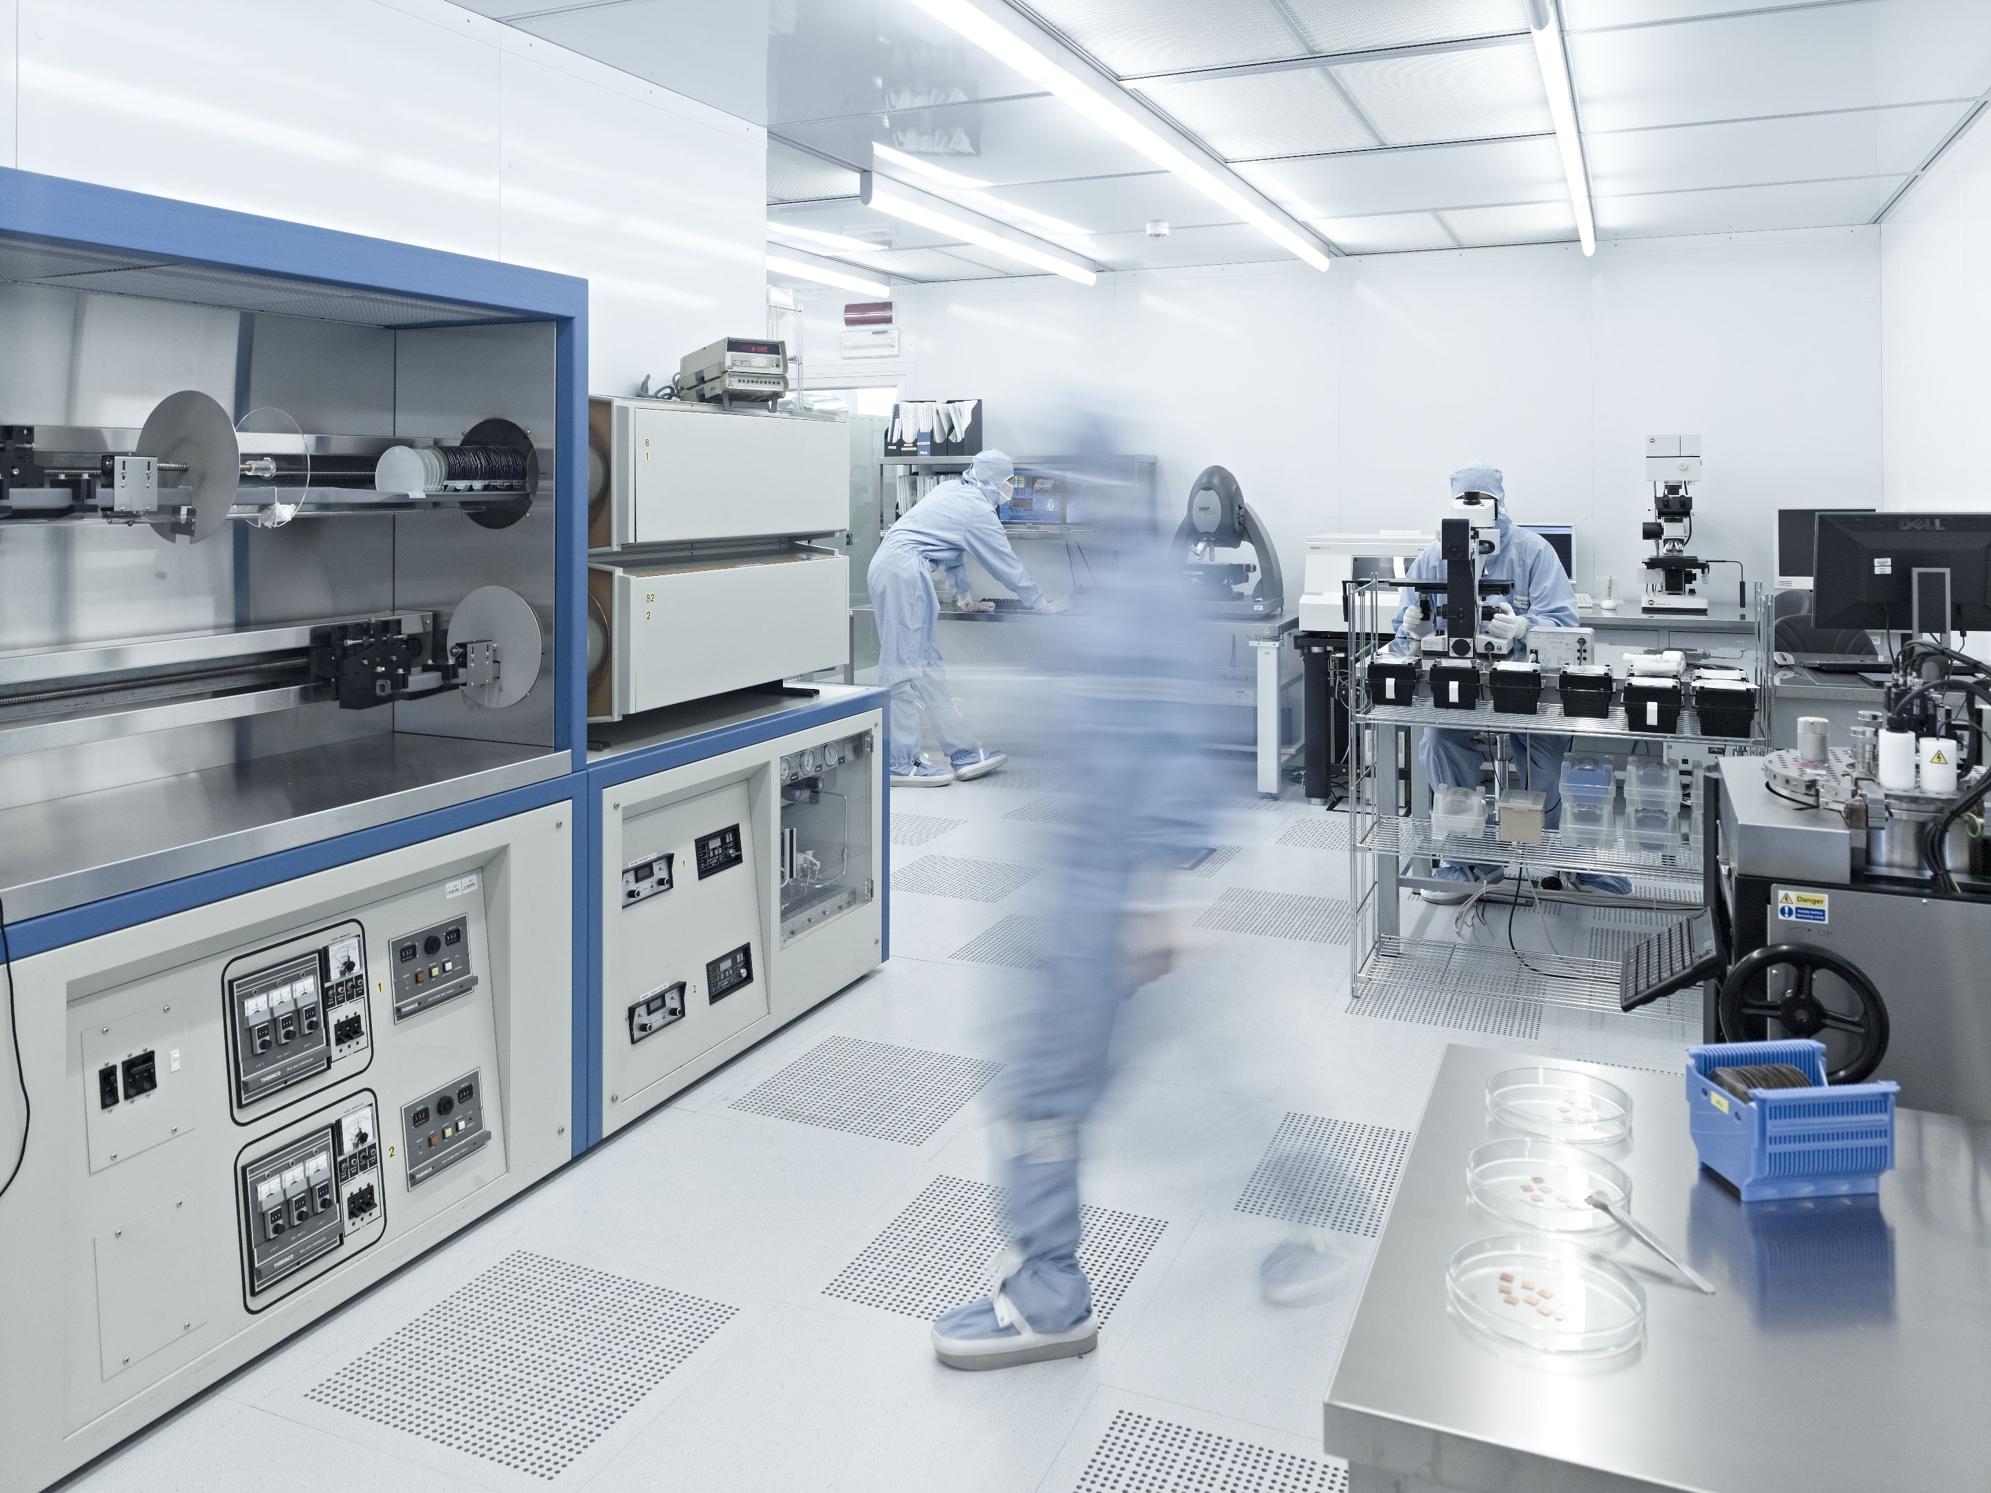

CNR, National Research Council
INRiM, Italian Metrology Institute
FBK, Fondazione Bruno Kessler

Slide 5
Experiments
SC devices
Test of 10 Flux-Qubits device
Operations for the test of the FINUDA Magnet
Update of FLASH CDR
Flux JPA
Qubit design
Stub-tuner JJ device
First run with QUAX-LNF Haloscope
QUAX-LNL data analysis and paper submission (PRD)
Multicavity DAQ for TWPA
COLD Lab activity in 2022
SC resonant cavities
Design, fabrication and vacuum test of a 4 GHz cavity for FNAL
Mechanical Design of 9GHz Nb₃Sn cavity
Test of NbTi cavities
Characterization of YBCO tapes

Slide 6
Experiments
SC devices
Test of 10 Flux-Qubits device
Operations for the test of the FINUDA Magnet
Update of FLASH CDR
Flux JPA
Qubit design
Stub-tuner JJ device
First run with QUAX-LNF Haloscope
QUAX-LNL data analysis and paper submission (PRD)
Multicavity DAQ for TWPA
COLD Lab activity in 2022
SC resonant cavities
Design, fabrication and vacuum test of a 4 GHz cavity for FNAL
Mechanical Design of 9GHz Nb₃Sn cavity
Test of NbTi cavities
Characterization of YBCO tapes

Slide 7
FLASH
Finuda magnet for Light Axion SearcH
Galactic axion search at 100 MHz (0.4-1.1 mev)

Slide 8
FLASH - Preparation for the TEST of the FINUDA MAGNET
The FINUDA Superconducting Solenoid was shut down in 2007. Since then, it wasn’t switched on again and it must now be tested for operation before considering it for the FLASH experiment.
Some work needs to be done in order to cool and energize the magnet again:
  modification and reconnection of the transfer line between FINUDA and the cryogenic plant
  maintenance and restarting of the cryogenic plant (stopped since 2018)
  revamping of the control system of the FINUDA cryogenics
  replacement of the FINUDA/cryogenic plant safety valves
  check of the magnet Power Supply operation
  check for the ancillary systems operation
  check for the operation of the closing system of the magnet iron-endcaps
  check and update of the safety procedures
Thanks to the collaboration of the LNF divisions (DA, DT, DR) and to the LNF-service managers and staff.

Slide 9
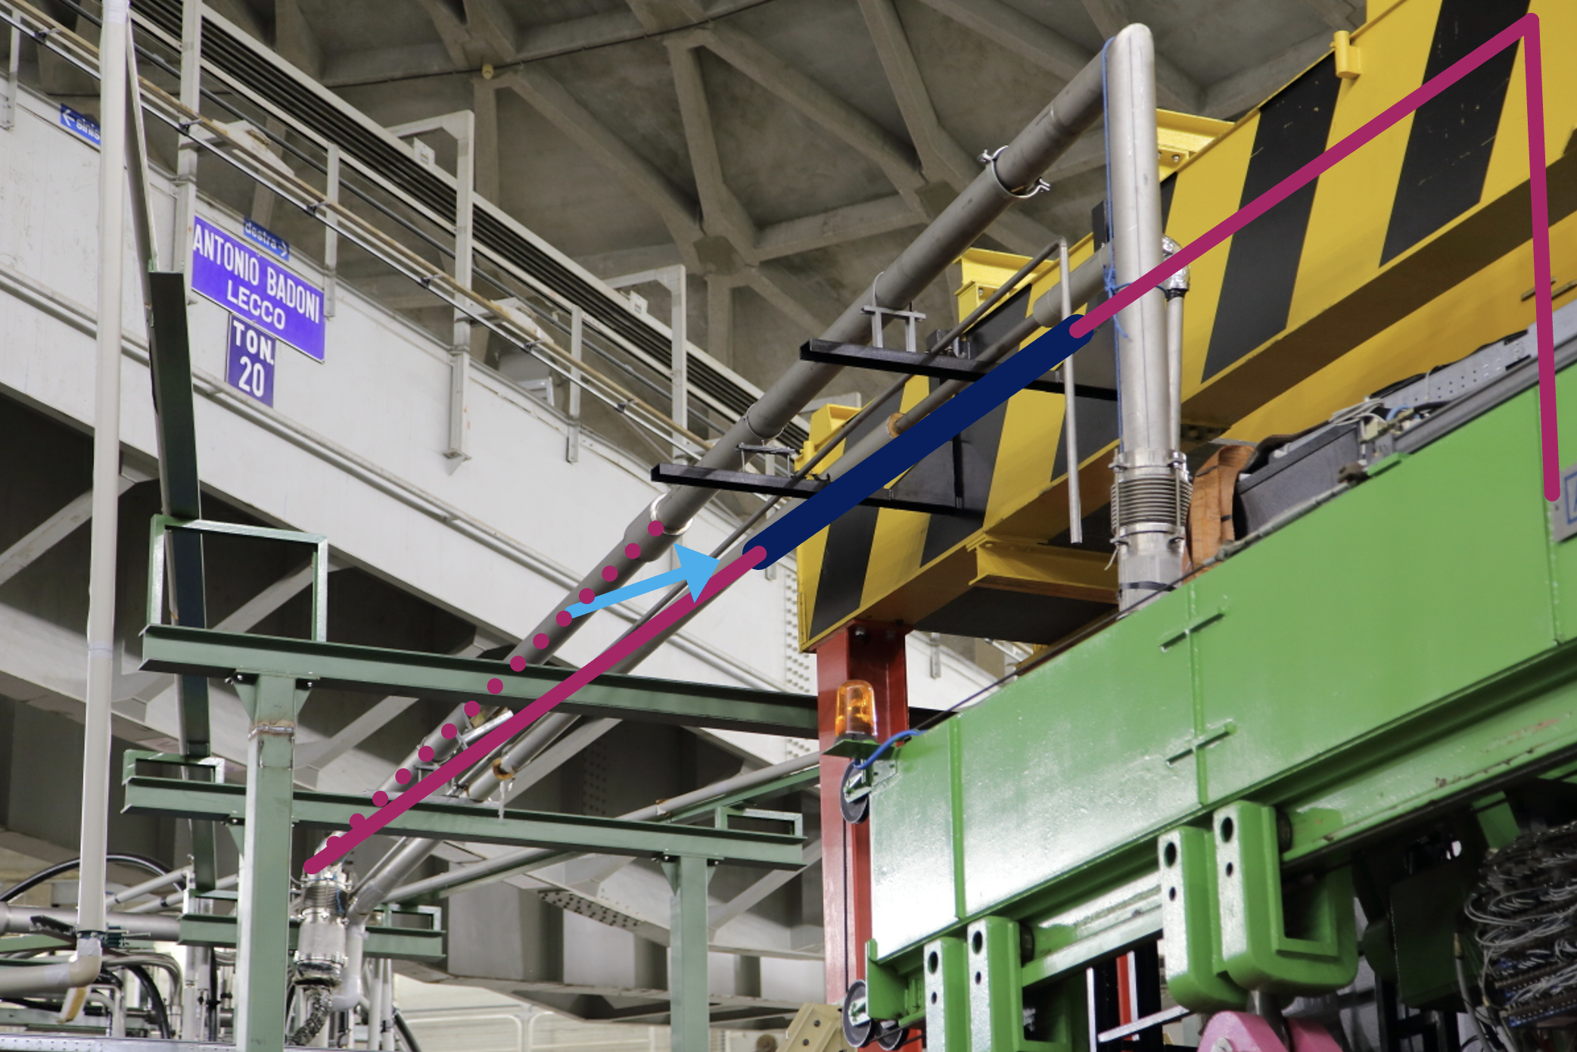
  Modification and Reconnection of the Transfer Line Between FINUDA and the Cryogenic Plant
FINUDA was supplied with liquid/gaseous Helium from the cryogenic Valve Box using a cryogenic transfer line which was dimensioned to reach the FINUDA position in the 2nd DAFNE interaction region. Now it is moved about 5 meter far from there, so the TL must be dismounted, prolonged and remounted to reach the new placement.
Two companies will do the work: the first one will dismount and remount the line; the second will modify it.
We are making the order and we expect to finish the work before the DAΦNE restarting (Jan or Feb 2023)

Slide 10
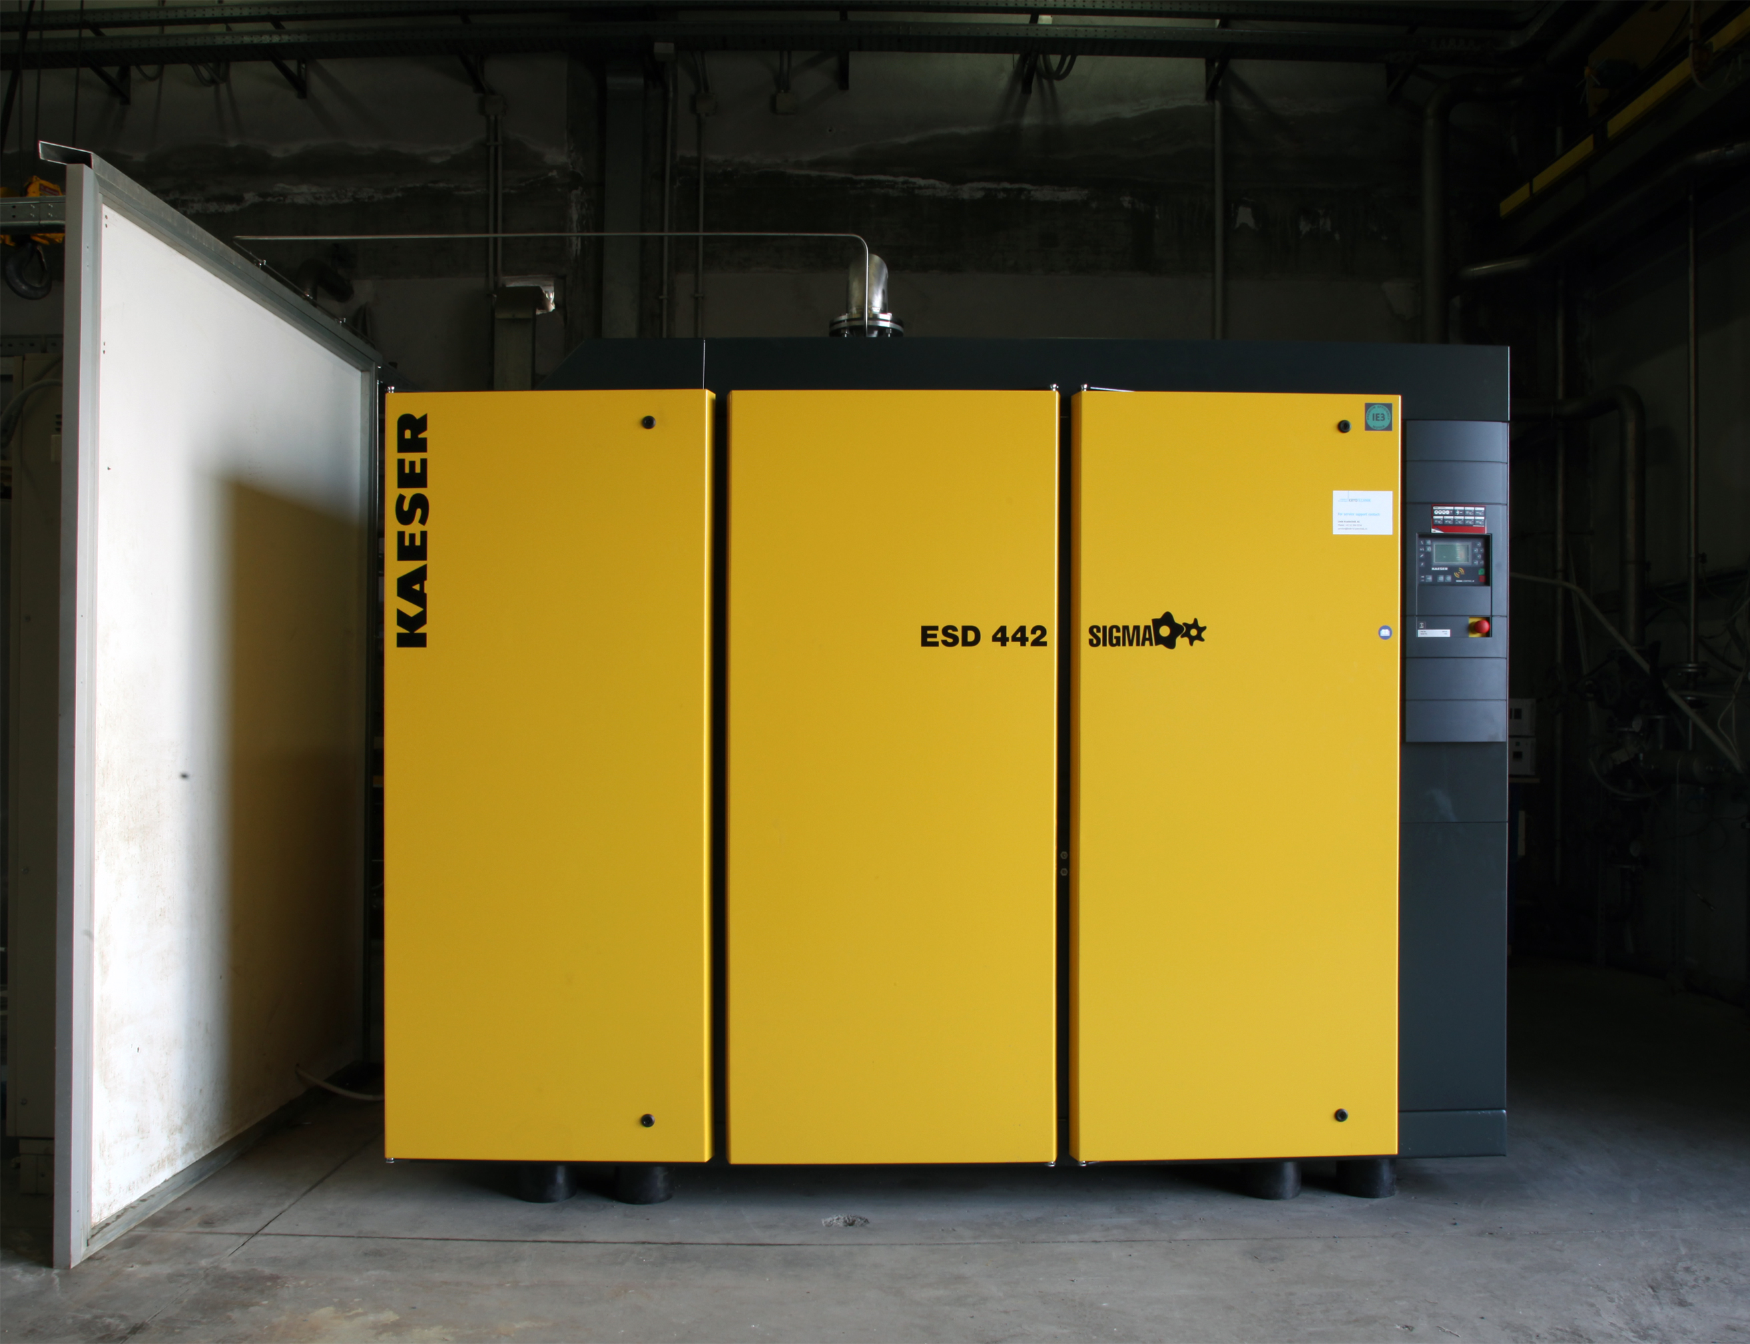
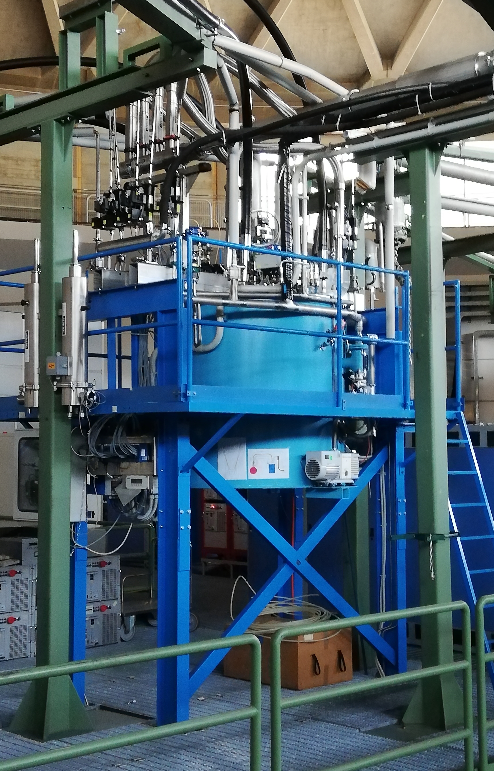
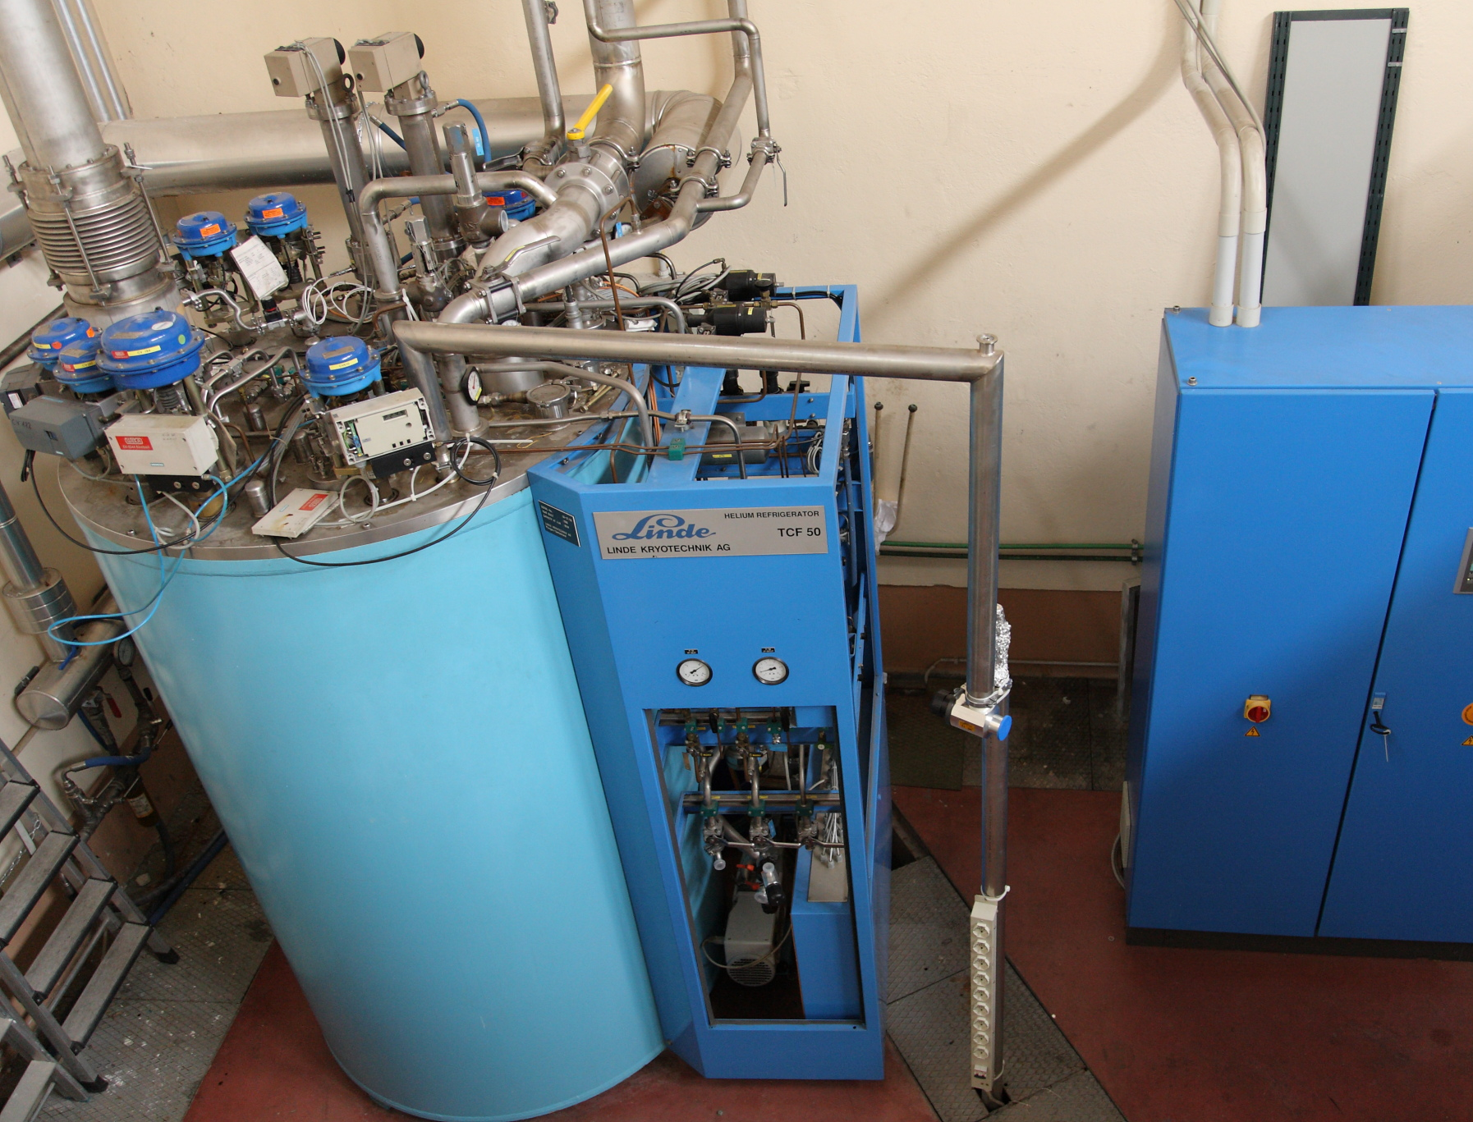
  Maintenance and Restarting of the Cryogenic Plant
The DAFNE cryogenic plant is based on a LINDE TCF50 Helium refrigerator/liquefier. It kept cold the SC magnets during the KLOE and FINUDA runs. It was stopped in 2018
We restarted the PLC, but it losts its memory due to a backup-battery fault, so we must reload the software before checking the hardware (already done by an external company in the past).
Warning: we need about 300 m³ of Helium to cool FINUDA, but on the next months a global Helium shortage is foreseen
Test of cryo plant foreseen on Feb 2023

Slide 11
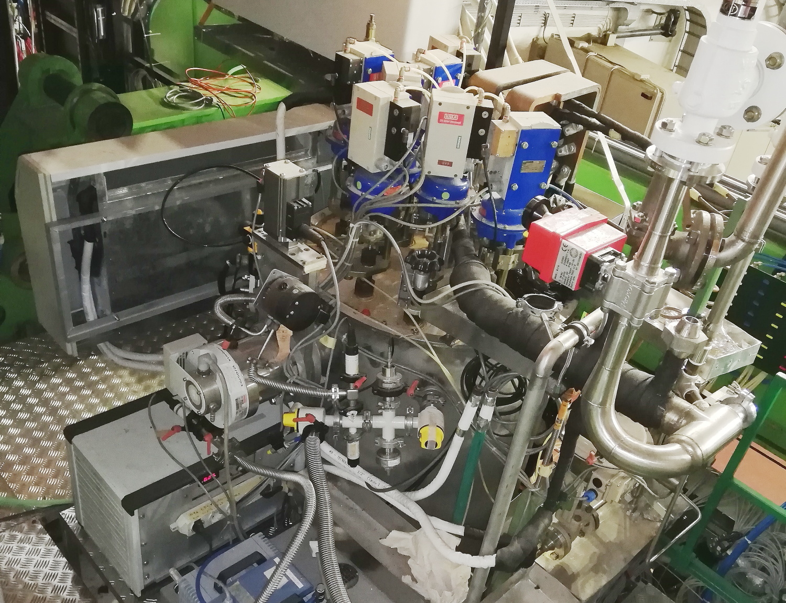
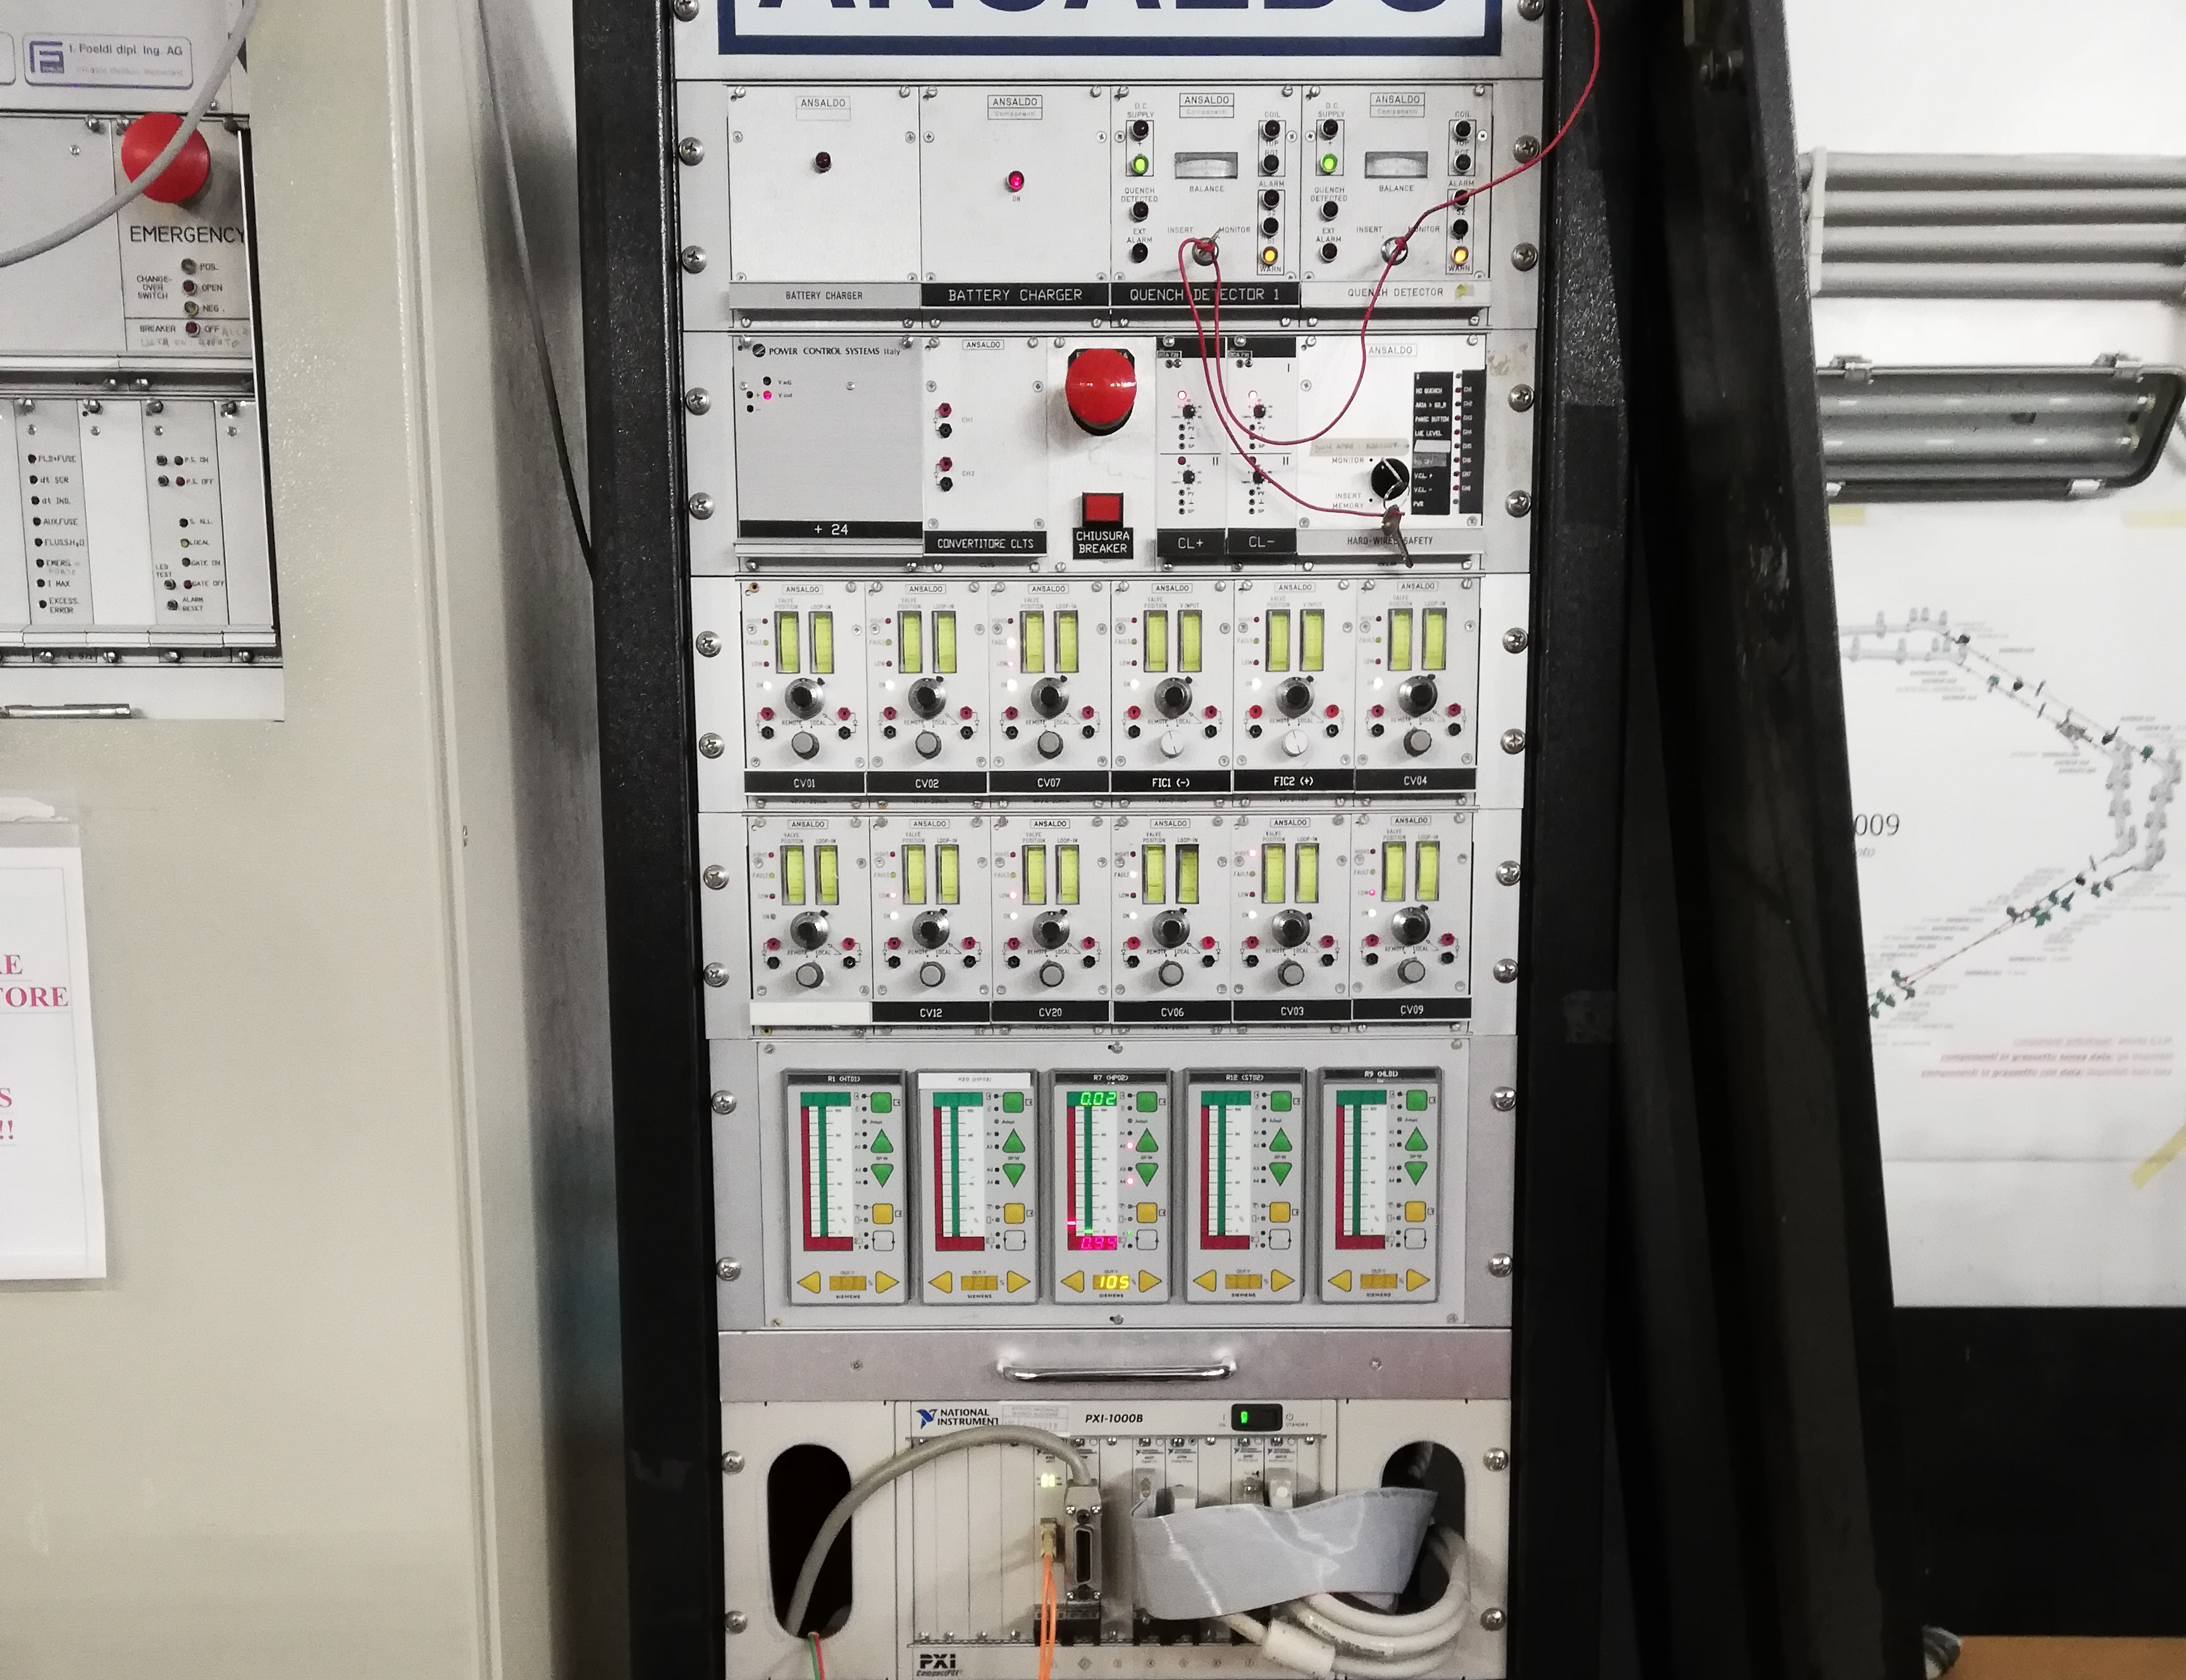
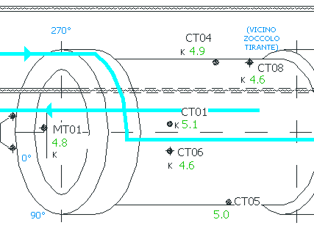
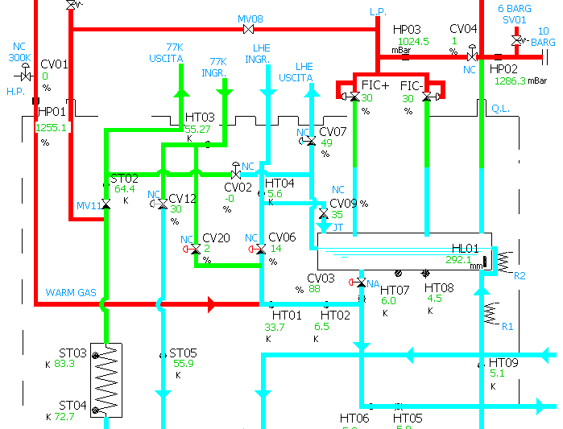
  Revamping of the Control System of the FINUDA Cryogenics
The control system of the FINUDA cryogenics is based on an old hardware for valve control, which has been checked for operation and found no more reliable.
The control system is a Labview 5-based program running on a Windows-2000 NI PXI
We are planning to revamp all this system with a new control hardware/software, replacing the hardware PIDs and 4-20 mA controls with a new Labview-based program and DACs.
We are discussing the involvement of LNF experts in these days. Timing to be understood yet.

Slide 12
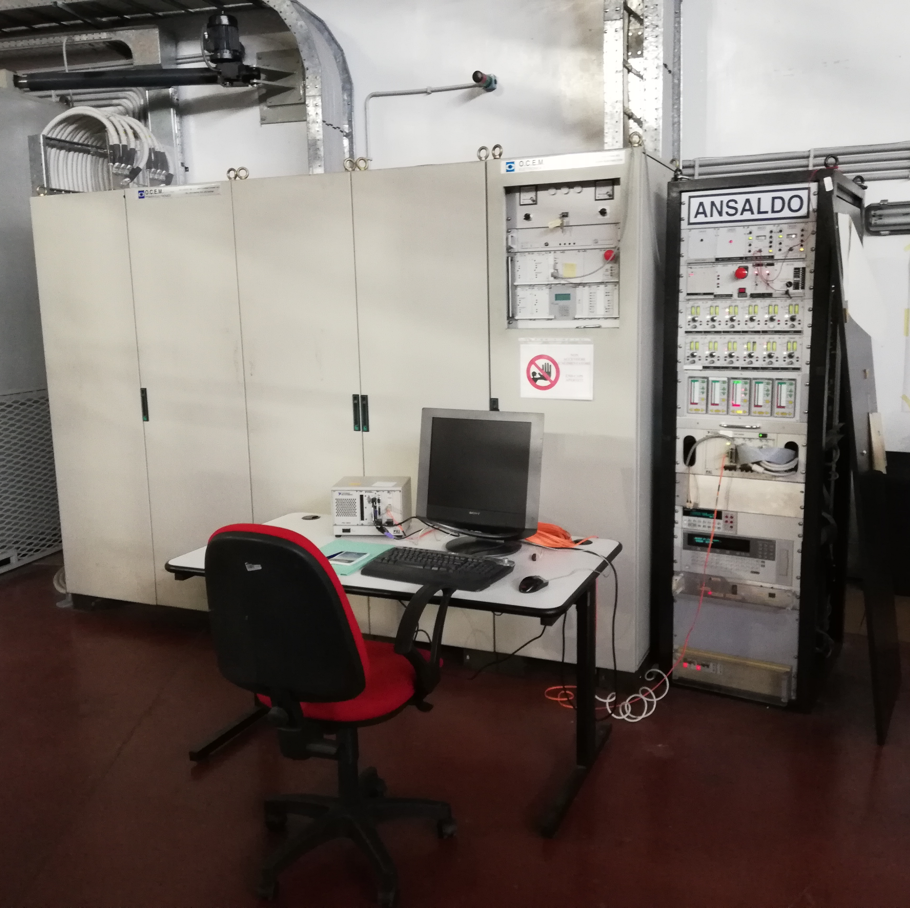
  Check of the Operation of the Magnet Power Supply
The FINUDA magnet Power Supply has been preliminary checked and it seems all is working correctly.
An internal battery pack must be replaced, we’re going to buy a new one.
Connection with the water cooling system was dismounted and must be remounted. Some solutions have been proposed to do it.

Slide 13
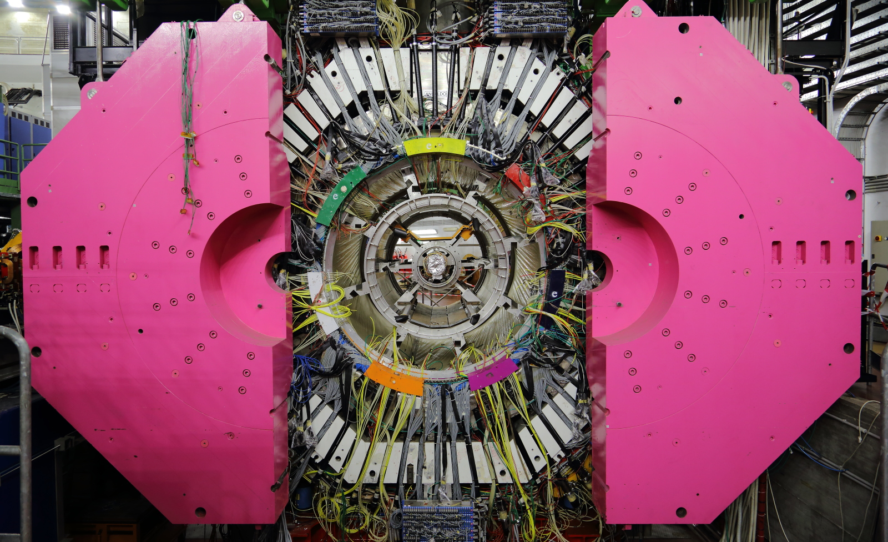
  Check of the Closing System of the Magnet Iron-Endcaps
We planned the operations to check for the operation of the endcaps hanling. They have been indicated in a Gantt diagram and will be done in the next weeks

Slide 14
  Others
The connection between the FINUDA cryogenic valves and the compressed air system has been restored
The safety valves of FINUDA and Cryogenic Plant have been dismounted and we asked for an offer for their replacement
The magnet’s Quench Detector must be checked for functioning.

Slide 15
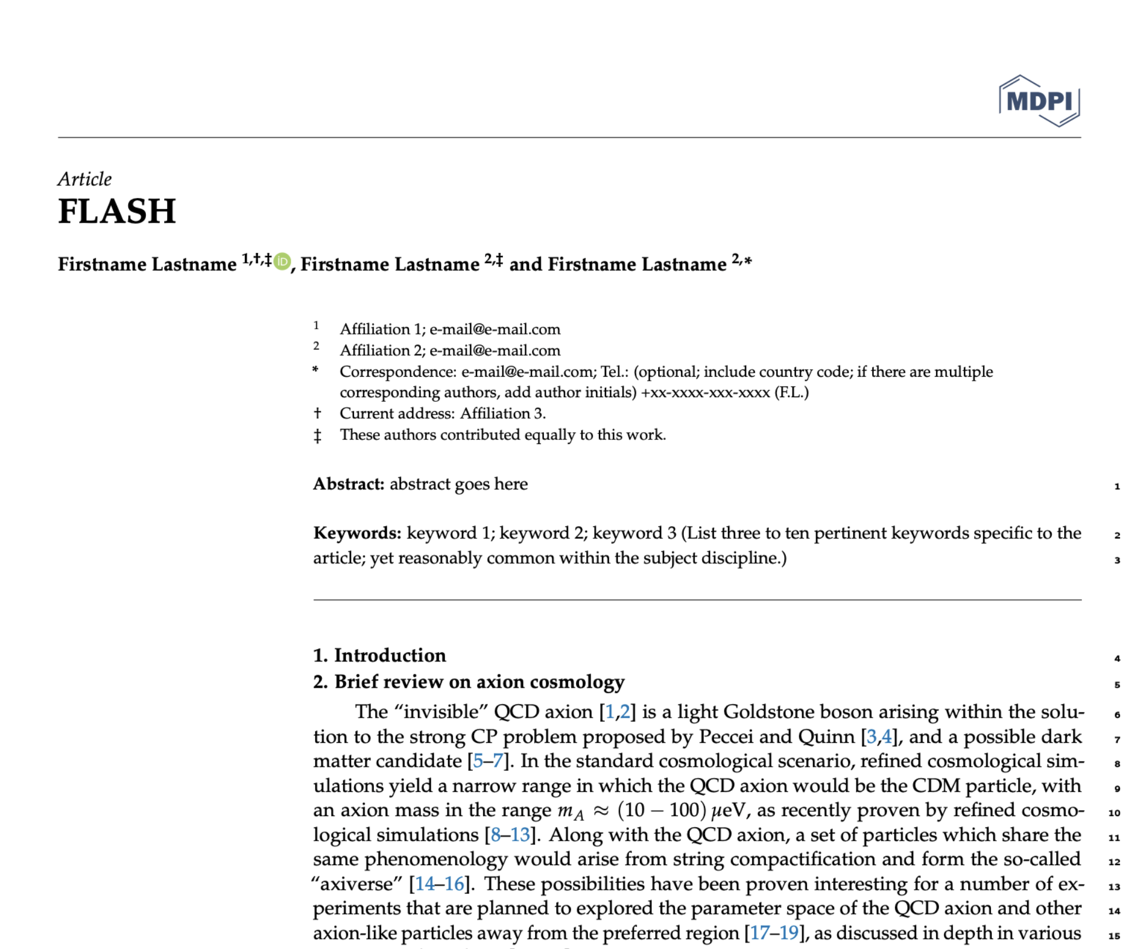
Preparing FLASH CDR
KLASH CDR https://arxiv.org/abs/1911.02427

Slide 16
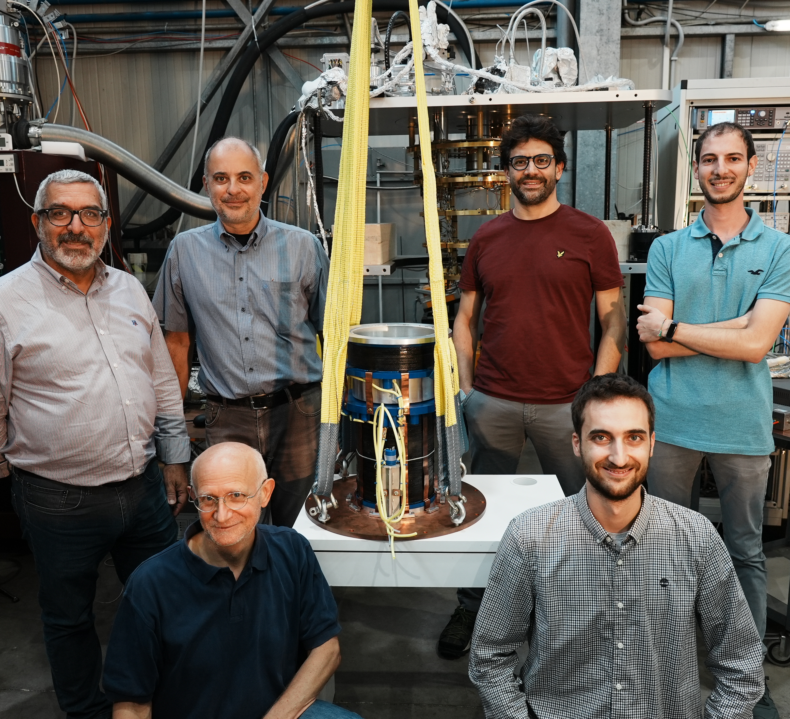
QUAX-LNF

Slide 17
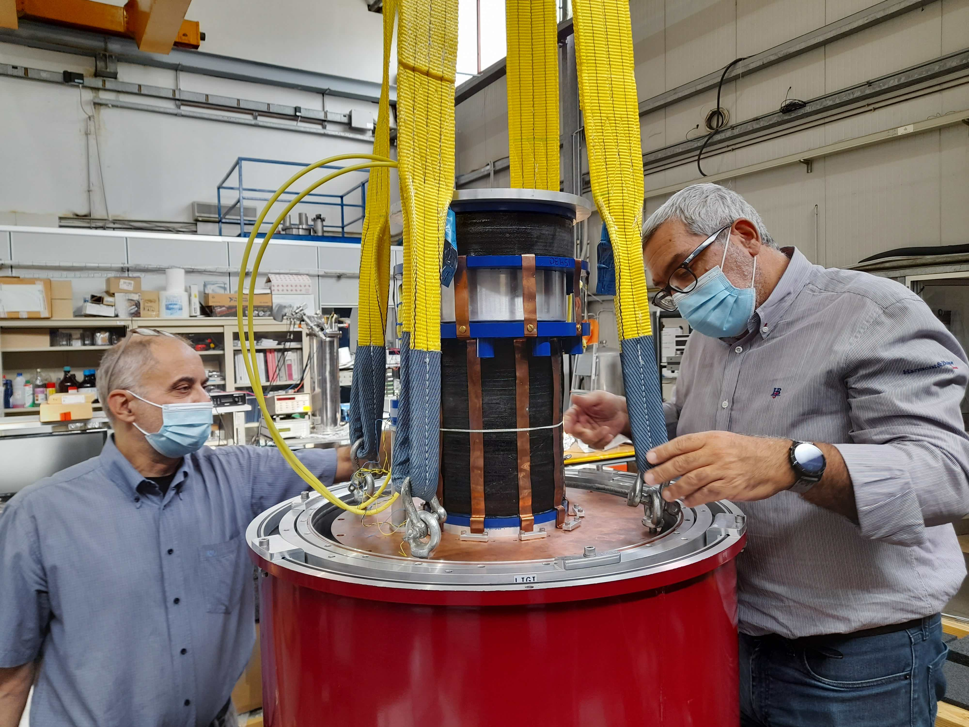
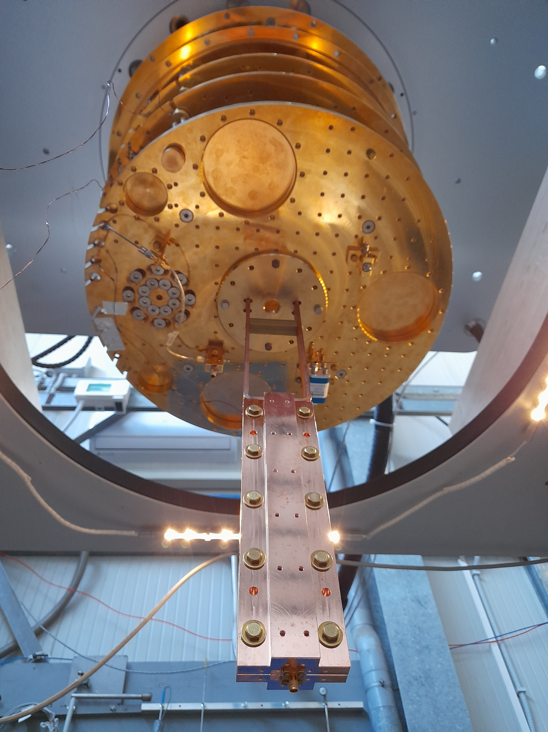
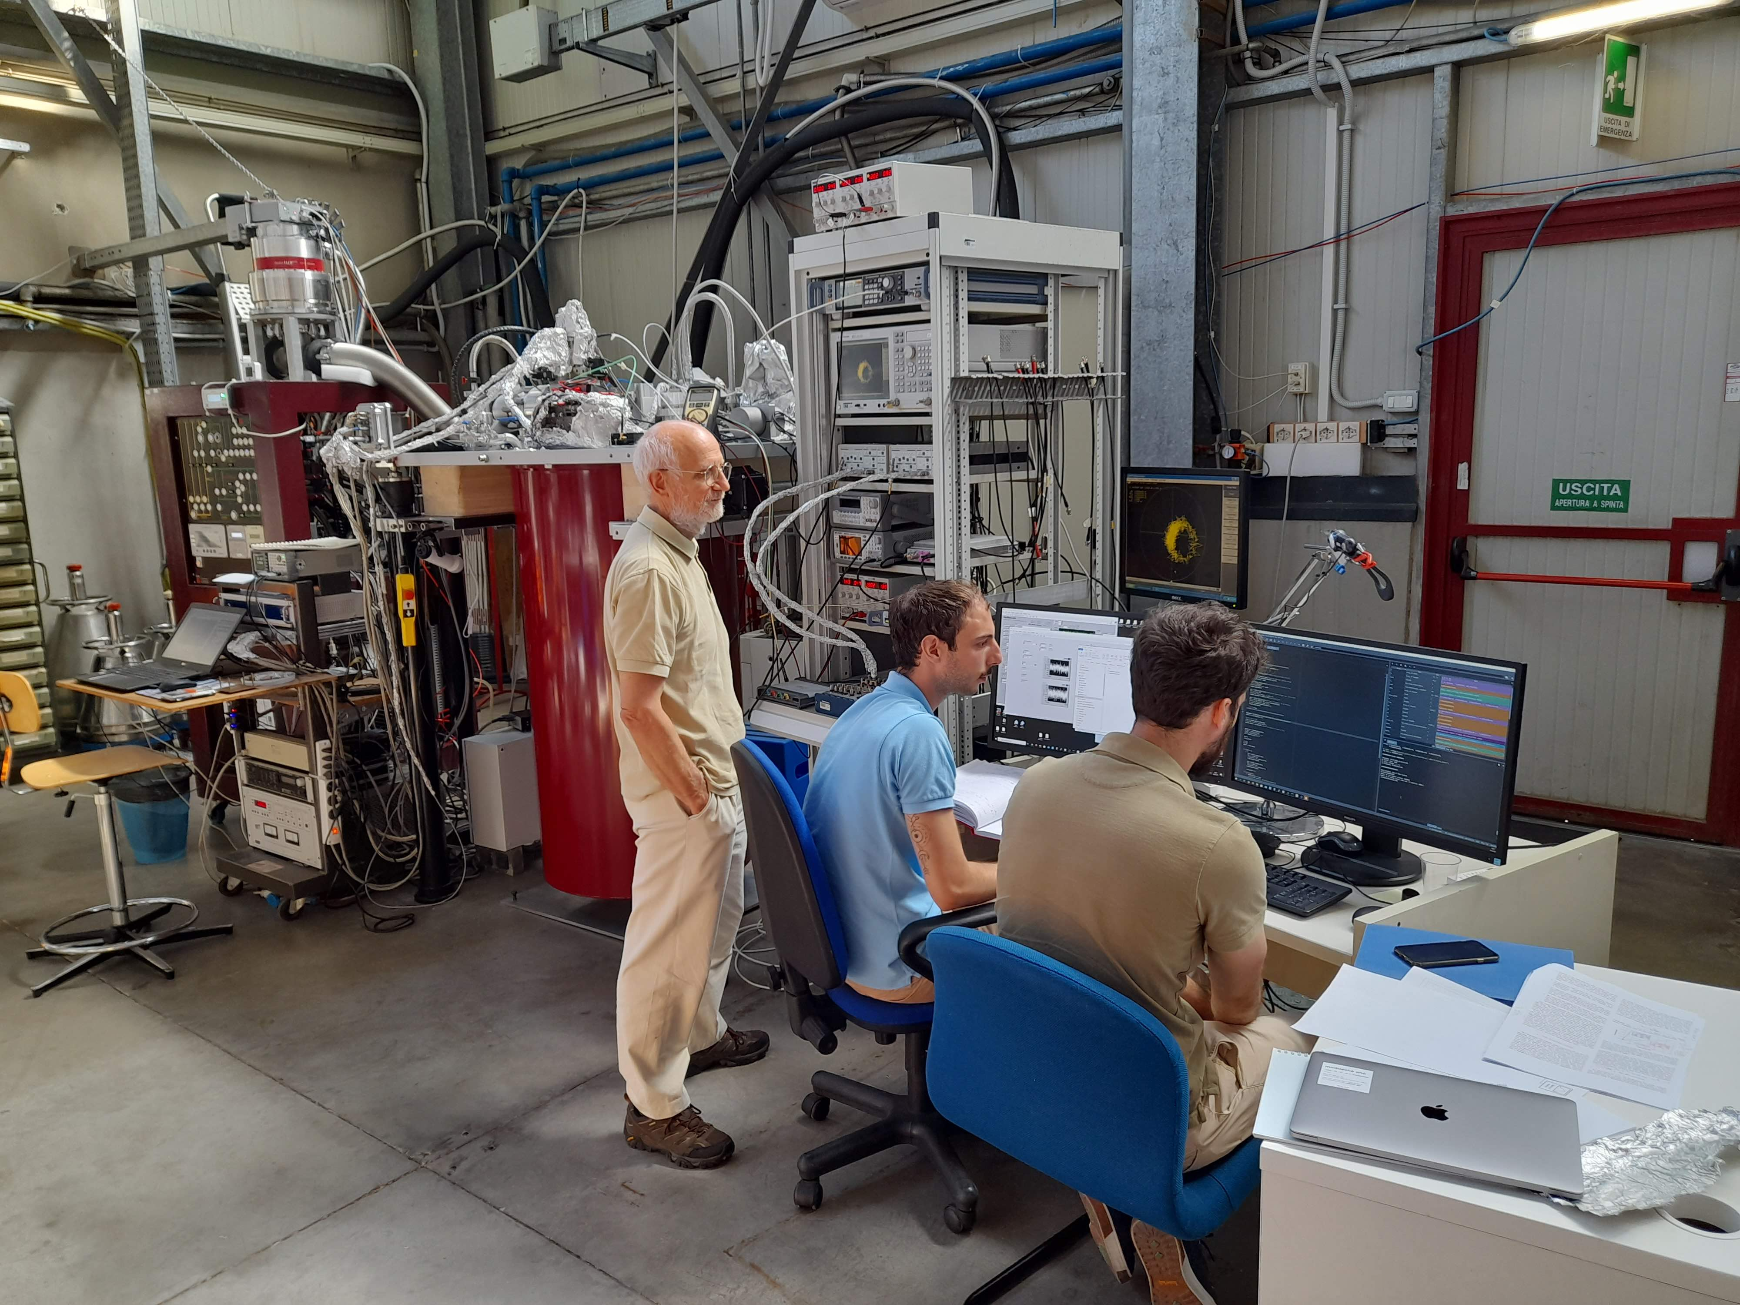
First Run of LNF Haloscope
Frequency | 8.5 GHz
Volume | 0.14 L
Q₀ | 100,000
B | 9 T
Tcavity | 20 mK
Leiden Cryogenics CF-CS110-1000

Slide 18
First Run of LNF Haloscope
Problems during cooldown:
We operated with HEMT at 5.5 K and 50K plate at 70K.
Operated with lower B field (2.5 instead of 9 T)
Higher cavity temperature than expected (150 instead of 10mK)
Pick up noise due to bad grounding (solved)
QUAX@LNF this run
@ m_{a}=35 μeV
Gagg 90% cl | T_{noise} | Q | B(T)
3.3×10⁻¹³ (2h) | 8 K (HEMT) | 100,000 Cu Cavity | 2.5
6.6×10⁻¹⁴ | 3 K (HEMT) | 100,000 Cu Cavity | 9
2.5×10⁻¹⁴ | SQL (JPA) | 100,000 Cu Cavity | 9
1.6×10⁻¹⁴ | SQL (JPA) | 250,000 SC Cavity | 9
Current status
2nd pulse tube and HEMT expected noise
With JPA
With JPA and SC cavity
1h data taking

Slide 19
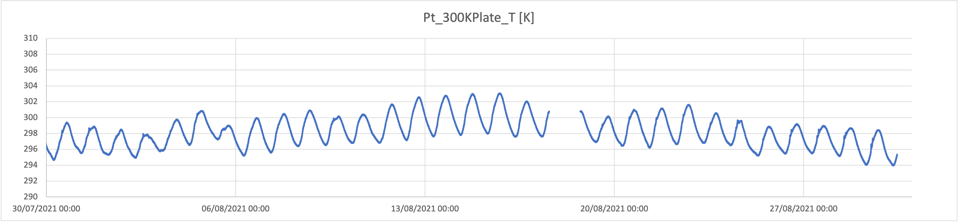
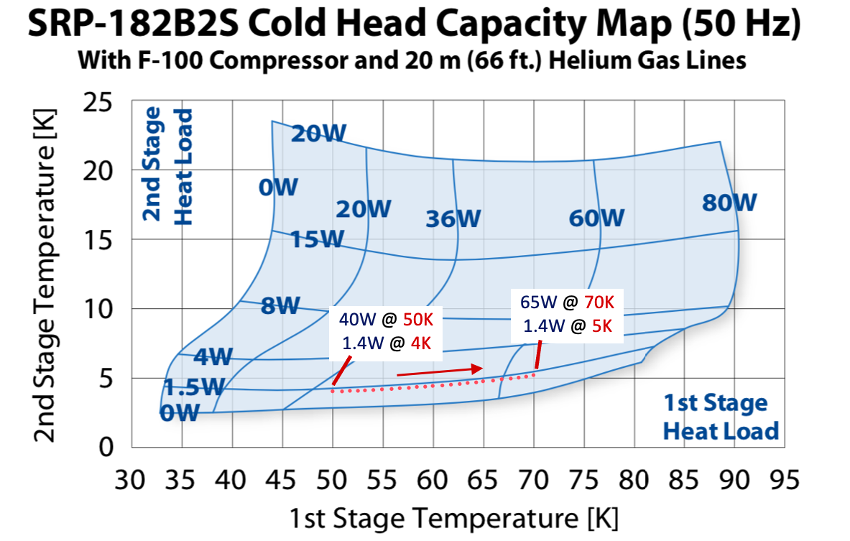
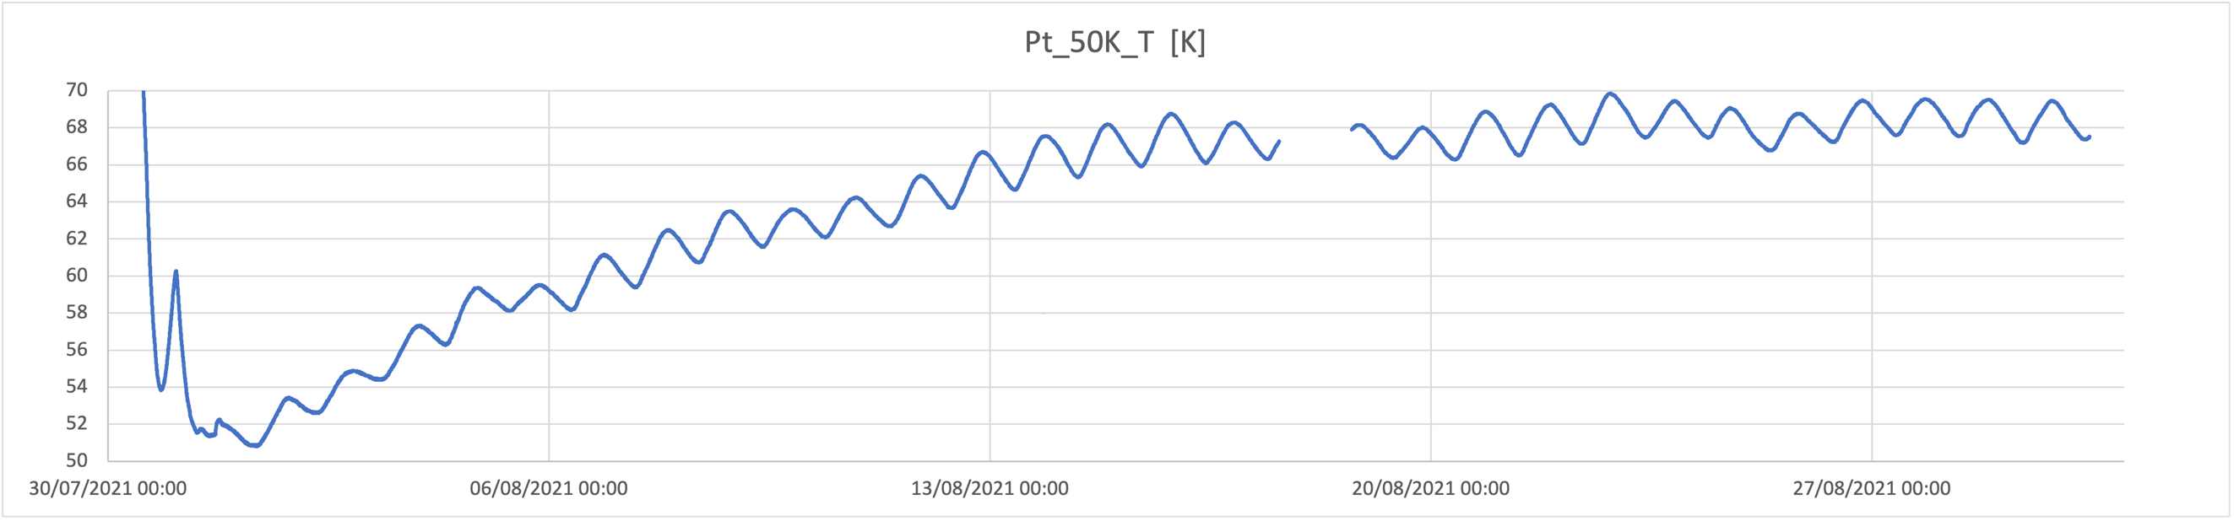
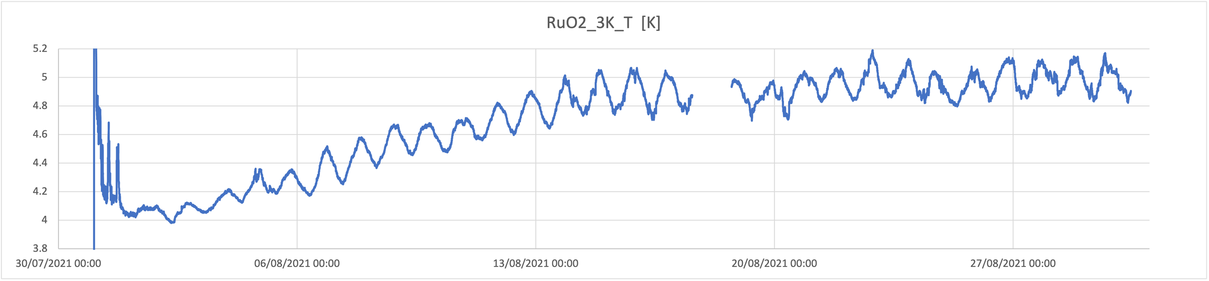
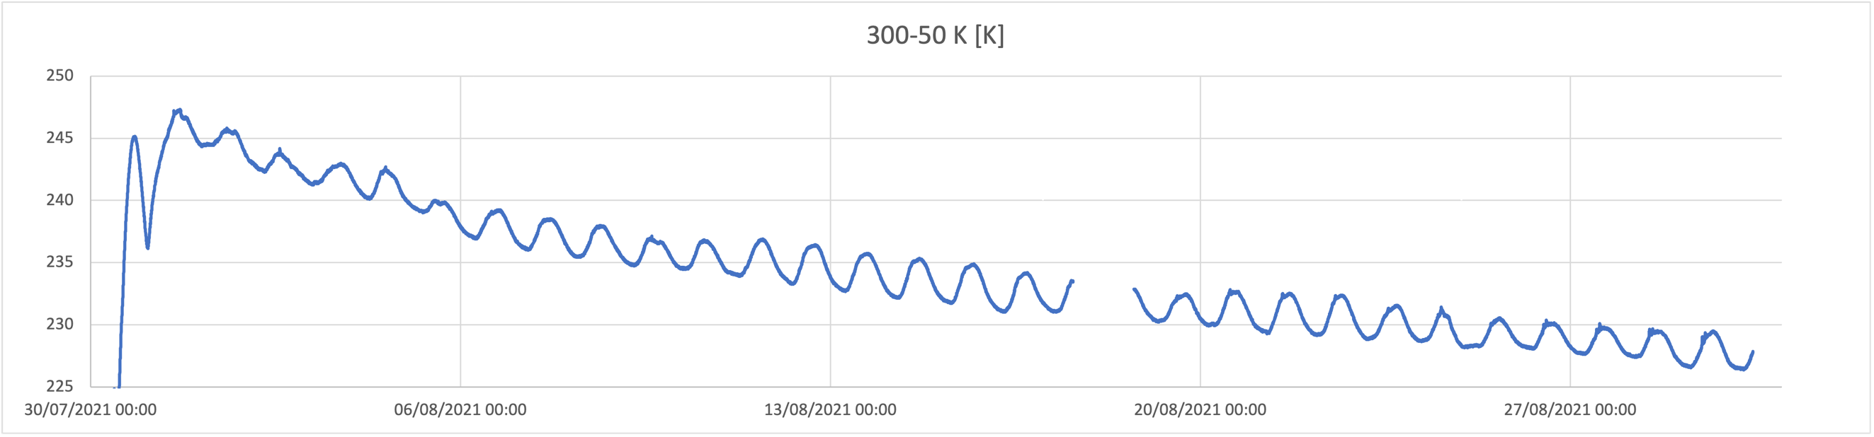
PT temperature drift on COLD lab CF-CS110 cryostat
300K T
70K
1st stage T
50K
5K
2nd stage T
4K
1st stage T rise from 50 to 70 K in 3 weeks
25W of extra heat input on the 50K stage
2nd stage follows the 1st one (4 to 5 K)
cause not yet clear
ΔT (300-50K)

Slide 20
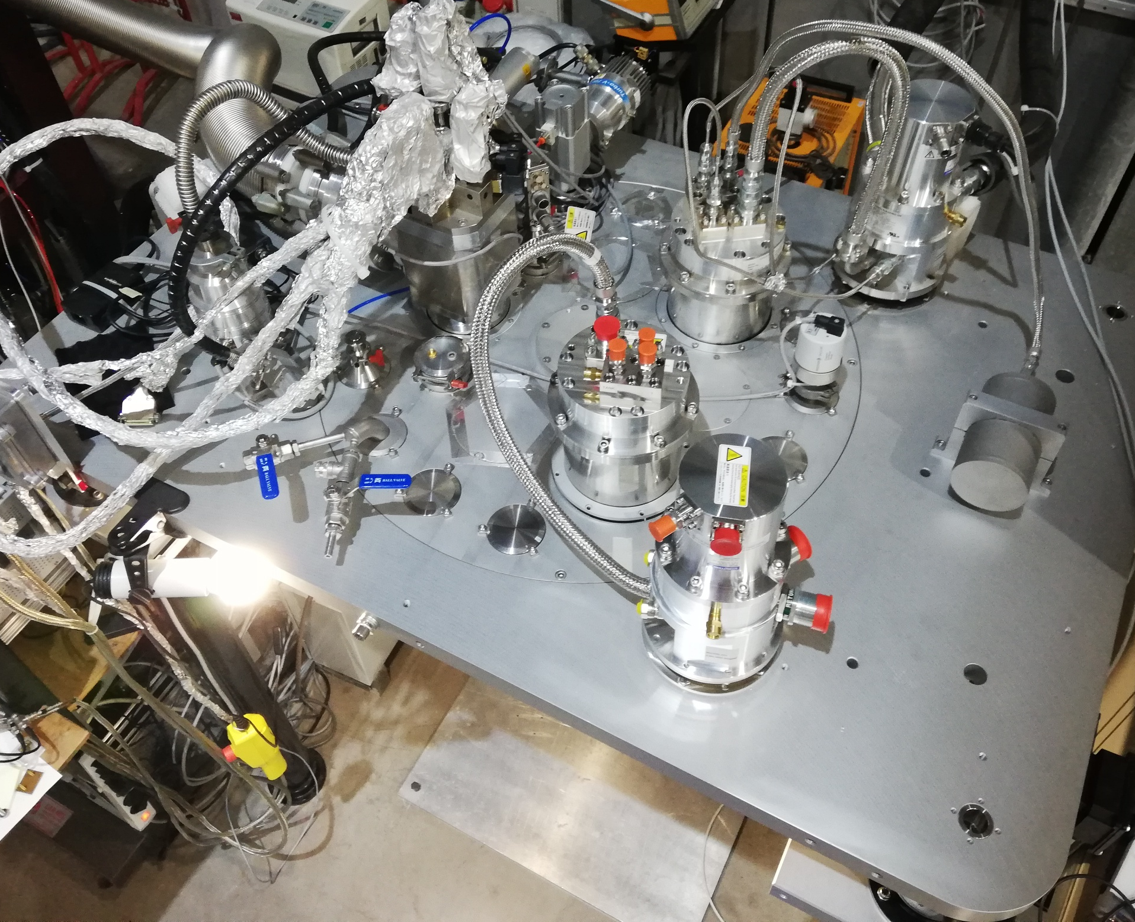
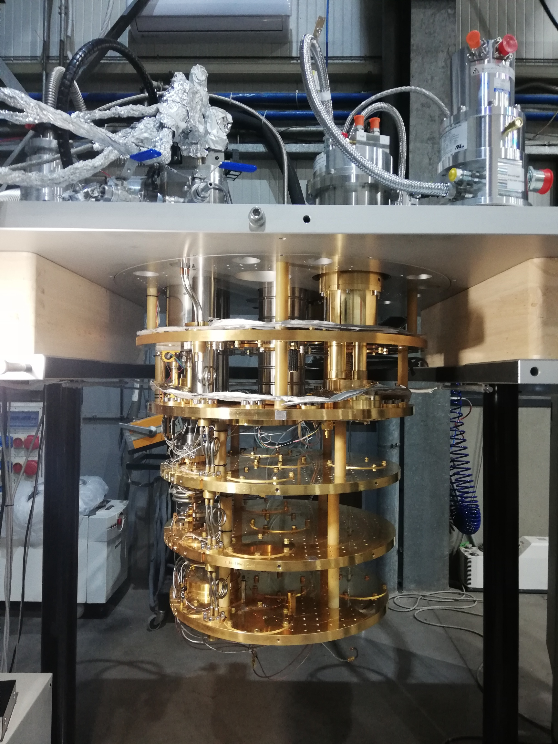
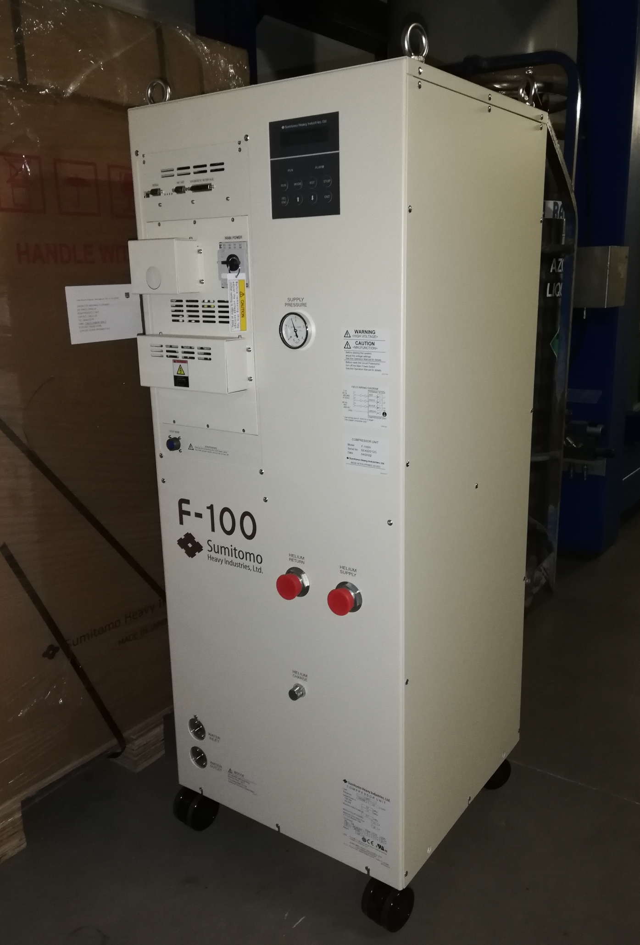
Second Pulse Tube Arrival and Mounting on the 10 mK Cryostat
A 1.5 W Pulse Tube refrigerator was procured and is currently being assembled on the COLD Lab cryostat with dilution refrigerator
It is identycal to the one already mounted (Sumitomo SRP-182B2S) and will work as a booster for the cooling capacity at 4 K and 50 K
This update will overcome the problem in the SC magnet supply above 5 T

Slide 21
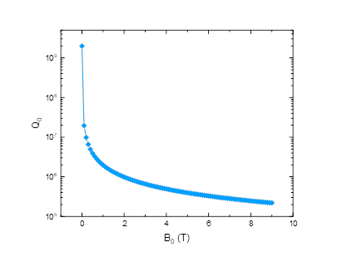
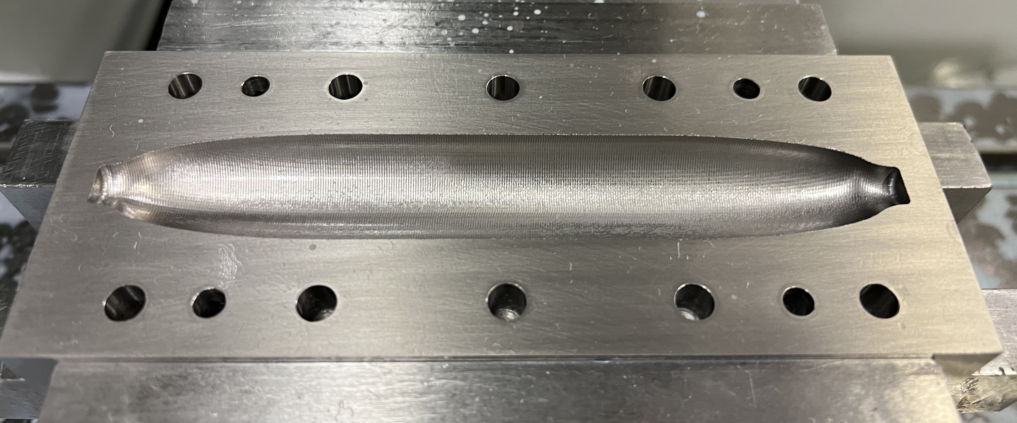
Superconductive Cavity: Nb₃Sn
Fabrication in progress at FNAL

Slide 22
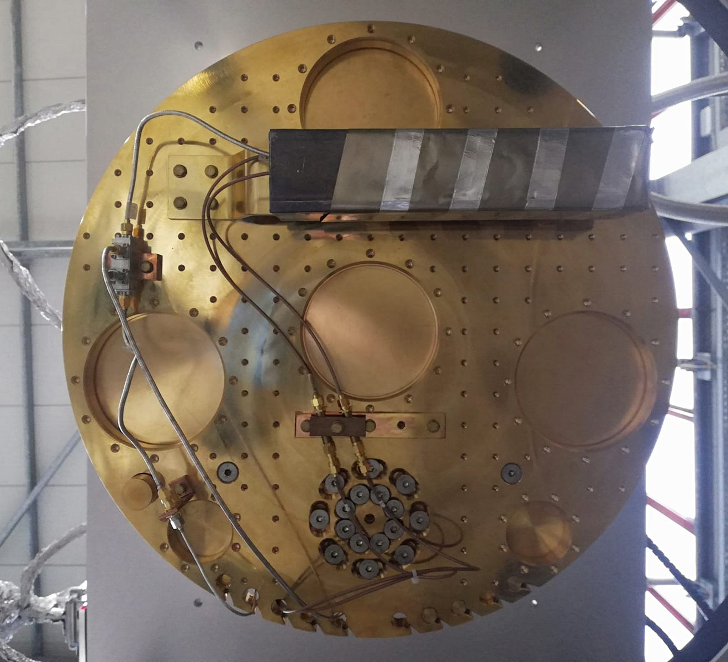
Quantum Limited Amplifiers

Slide 23
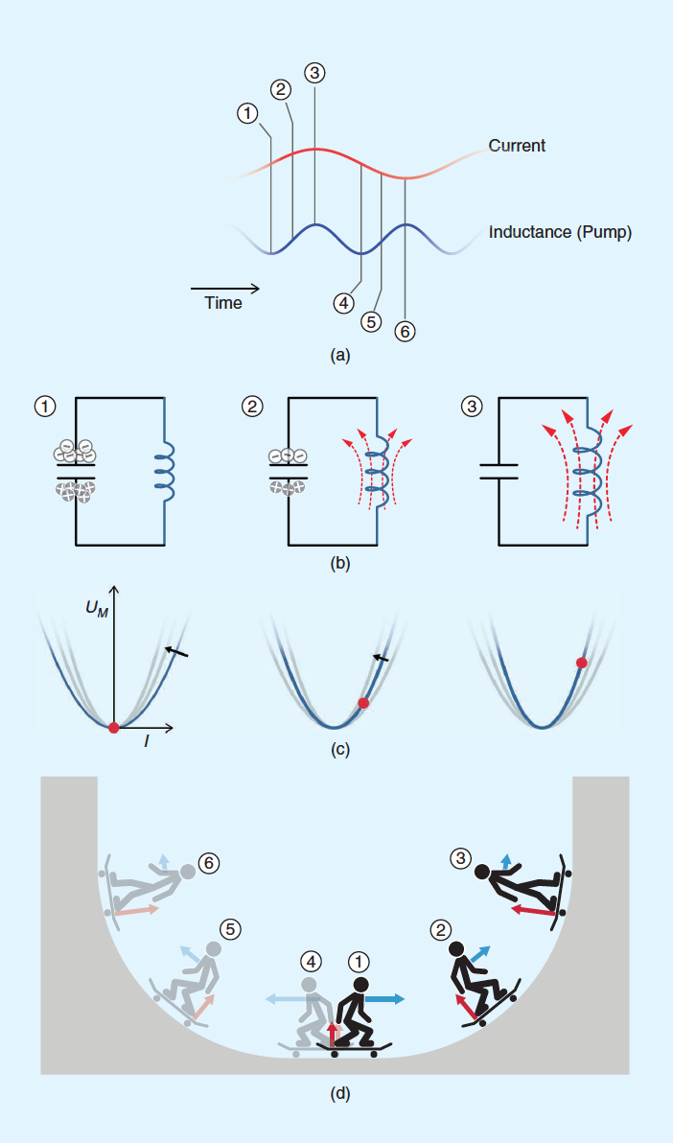
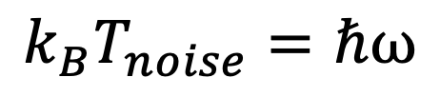
Parametric Amplification
Parametric amplification is obtained by modifying the parameters of an oscillating system.
In electrical circuits is obtained by modulating capacitances or inductors with “pump” currents.
In lossless superconducting circuits parametric amplification allows to reach the noise at the quantum limit.
$$k_{B}T_{noise}=ℏω$$
Phase
Amplitude
J. Aumentado IEEE Microwave Magazine

Slide 24
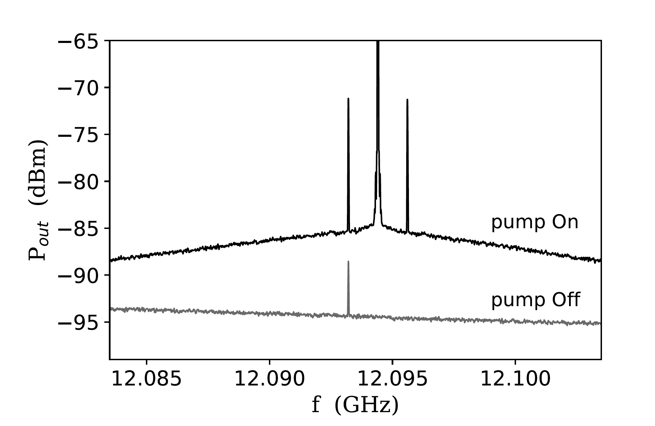
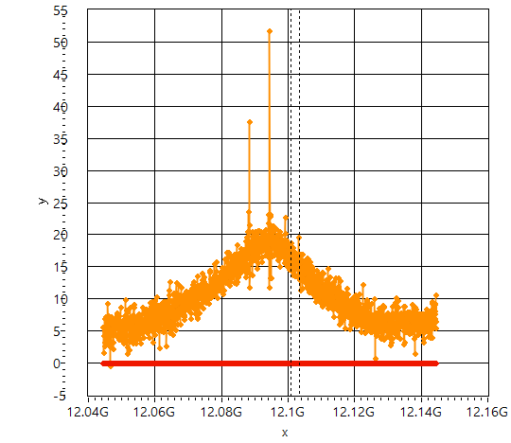
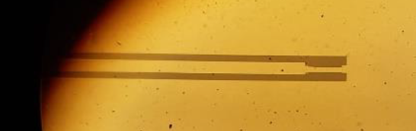
First result on a Josephson Parametric Amplifier based on single junction
Noise reduced from 8K (HEMT) to about 1.3K
VNA/SA
pump
dc
Gain (db)
T_{noise} (K)
signal
rf
20 db Gain and 10 MHz bandwith
ν≃12 GHz
Gain (db)
20 db
Collaboration with
20 MHz
Frequency (GHz)

Slide 25
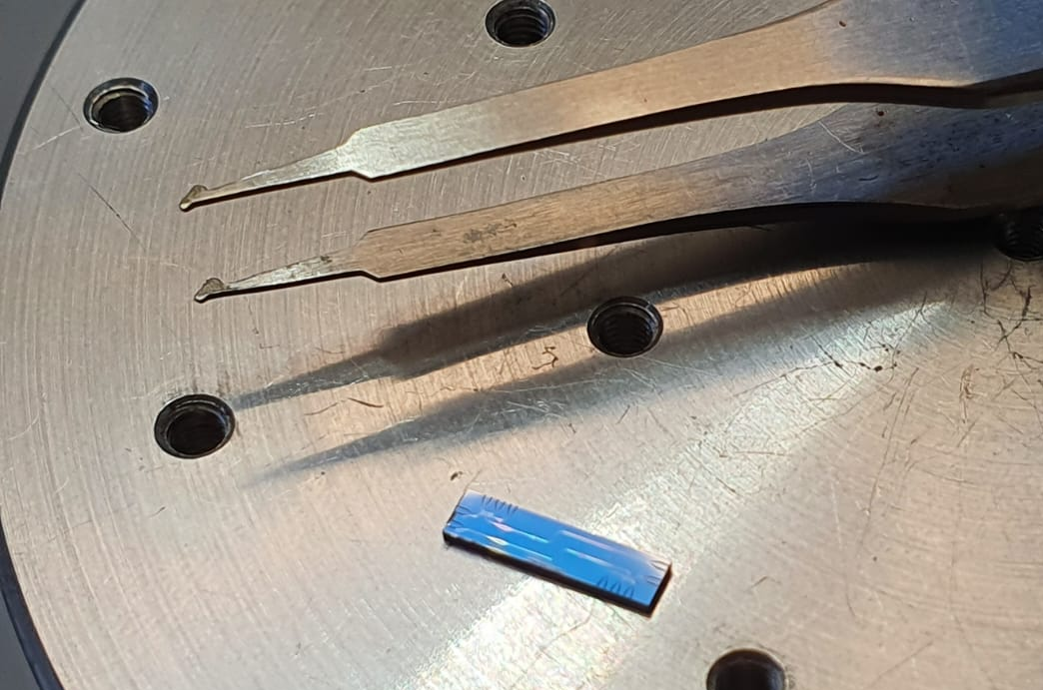
Realization and test of a Flux JPA
Input signal at frequency ω
L=λ/4
RF pump at 2 ω
Z₀
C_{c}
ω_{p}
Amplified reflected signal
Chip realized at FBK with submicrometric optical lithography and Al shadow evaporation technique.

Slide 26

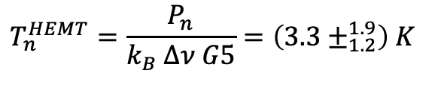
Frequency [GHz]
I_{C} junction = 0.47 μA
Mutual inductance QSUID M=70 fH
Hybridization with spurious mode
Flux bias (Φ₀ units)
HEMT line gain calibration:
$Gain=(64.5±2.0)$ dB
$$T_{n}^{HEMT}=\frac{P_{n}}{k_{B} Δν G5}=\left(3.3±_{1.2}^{1.9}\right) K$$
~3K from Low Noise Factory datasheet

Slide 27
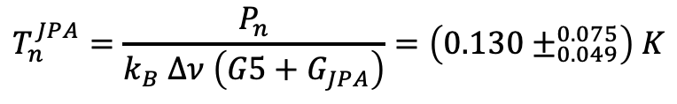

Degenerate JPA Gain and Noise
Theoretical expectation
5 MHz
2×5MHz
Measured Gain
$G_{JPA}=15.5$ dB
Measured Noise
Working point
f_{signal}=7.418 GHz
f_{pump}=2f_{signal}
P_{signal}= -135 dbm
P_{pump}= -45 dbm
$$T_{n}^{JPA}=\frac{P_{n}}{k_{B} Δν \left(G5+G_{JPA}\right)}=\left(0.130±_{0.049}^{0.075}\right) K$$
Expected quantum noise
½ hν/k_{B} T=0.174 K
Φ=0.19 Φ₀

Slide 28
Scan in pump phase
Scan in pump power
+57 db

Slide 29
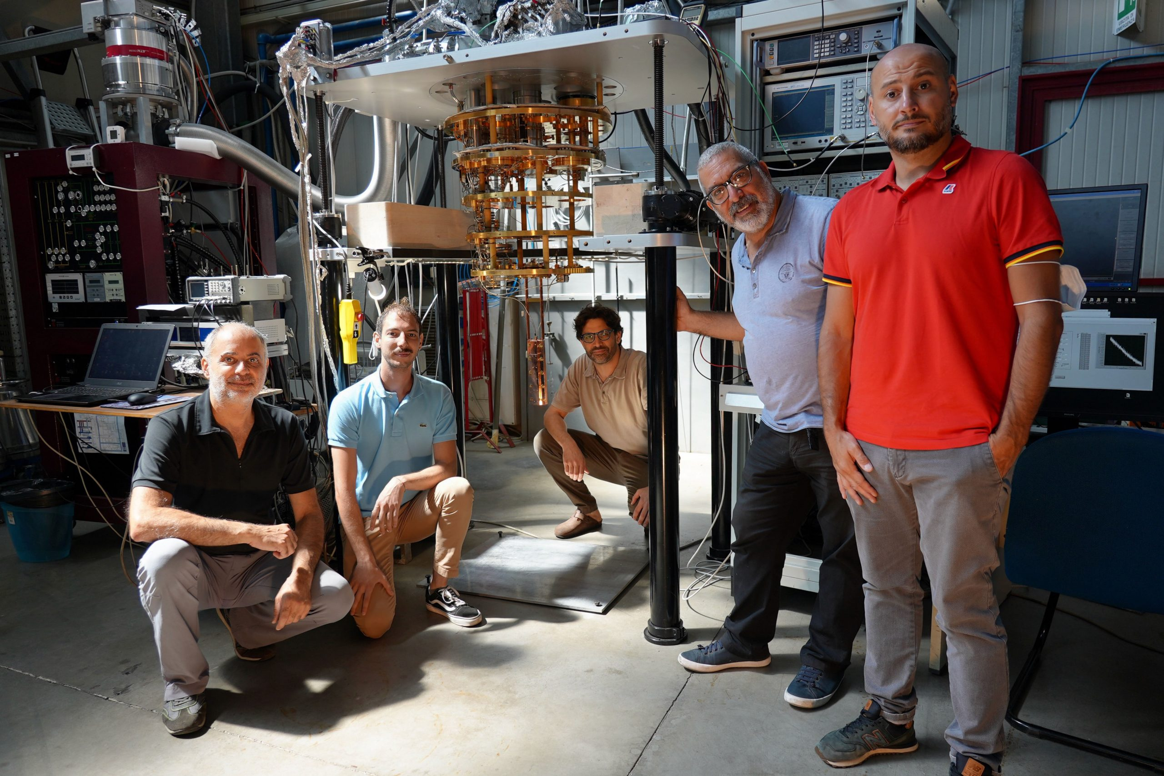
SummaRy
Ongoing work for the operation of the FINUDA magnet in 2023
FLASH CDR under writing with sensitivity to HFGW
First Run with Quax-LNF haloscope done in July 2022
2nd pulse tube now installed (→9T)
First Flux JPA fabricated (→SQL noise)
Nb₃Sn cavity in fabrication at FNAL (→ higher Q₀)

