Slide 1

EuPRAXIA @ SPARC_LAB
Antonio Falone
On behalf of the EuPRAXIA Team
Scientific Committee - 14/11/2022

Slide 2


EuPRAXIA @SPARC_LAB Follow up
Progress on the EuPRAXIA@SPARC_LAB TDR activities
Schedule Baseline
Other related projects
Sci-Com 14/11/2022

Slide 3
Consolidation EuPRAXIA EU framework
We have applied to several EU and National calls, to strengthen and consolidate EuPRAXIA Iniative
June 2021- Approved ESFRI Roadmap 2021
Jan 2022 – Application to the ESFRI Preparatory Phase, 3M€ (750k€ @ INFN) – Approved 12/04/2022 – Starting date 01/11/2022 - Kick off meeting 24-25 November 2022 - 4 years project
Feb 2022 – Rome Technopole, 2.8M€ For the consolidation of RI – not directly related to EuPRAXIA but in synergy.
Feb 2022 – EuAPS, EuPRAXIA Advanced Photon Source. PNRR, 22M€– 1° Ranking – Starting date 01/12/2022 30+6months in collaboration with CNR and University of Rome «Tor Vergata»
Apr 2022 – EuPRAXIA Doctoral Network Program, 2 PhDs in Accelerator Physics
Sci-Com 14/11/2022

Slide 4
Progress on the TDR
Significant progress for ALL working areas and working packages
Intermediate layout basically frozen (few minor issues to be further studied)
Realization of X-Band accelerating section mechanical prototype full scale – in house
Injector layout – Completed
RF power source strategy concluded and procurement in progress → delay in the administrative procedure. CPI klystron kickoff in few weeks. Canon klystron expected begin 2023.
Ondulator strategy concluded -> 2 Beamlines in the baseline prototyping activities are ongoing
In general the TDR work is advancing according to the schedule.
Additional Manpower is about to be hired (thanks also to the PNRR Funding).
Sci-Com 14/11/2022

Slide 5
TDR – Beam Dynamics | Machine Layout
Beam Dynamics Studies – Machine Layout
Photoinjector layout concluded (including X-Band 9 cells linearizer)
S2E Finalization for :
30+200pC at 1-1.2 GeV
50+230 pC at 1-1.2 GeV
X-Band @Gun finalization 200-300-500pC Beam
Jitter & Sensitivity analysis will be performed in Spring 2023 – according with the schedule
Courtesy C.Vaccarezza, A.Giribono, S.Romeo
Sci-Com 14/11/2022

Slide 6
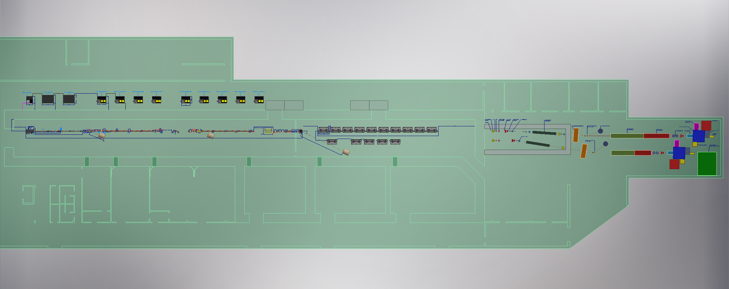
Machine Layout
Courtesy F.Cioeta & E.Di Pasquale
Sci-Com 14/11/2022

Slide 7
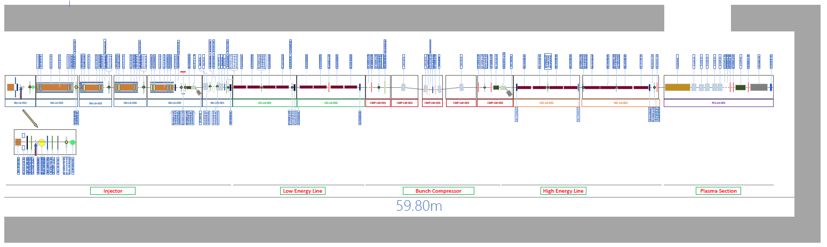
Machine Layout
Courtesy F.Cioeta & E.Di Pasquale
Sci-Com 14/11/2022

Slide 8
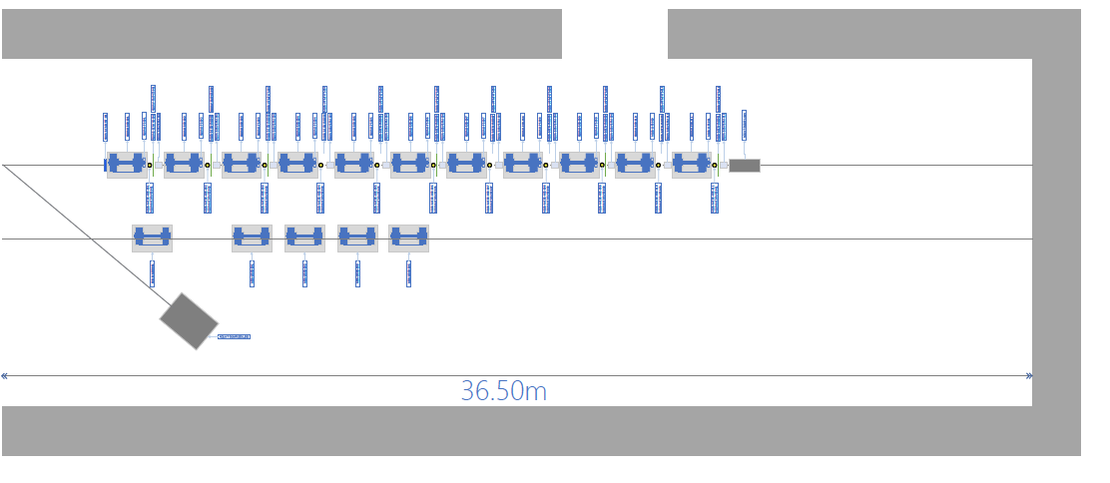
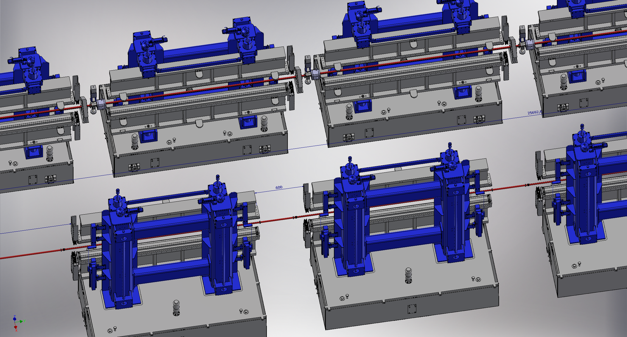
Machine Layout
Courtesy F.Cioeta & E.Di Pasquale
Sci-Com 14/11/2022

Slide 9
Injector
Injector study is now frozen and approved
Optimization of the RF distribution taking into account the X-Band linearizer and the 4 S-Band sections are ongoing
Injector layout
High charge working point
Comb Beam and S-Band optimization (3+2+2+2)
RF distribution for the S-Band system (advanced layout agreed but still to be optmized)
SW vs TW X-Band linearizer in terms of power distribution
Jitter and sensitivity studies
Sci-Com 14/11/2022

Slide 10
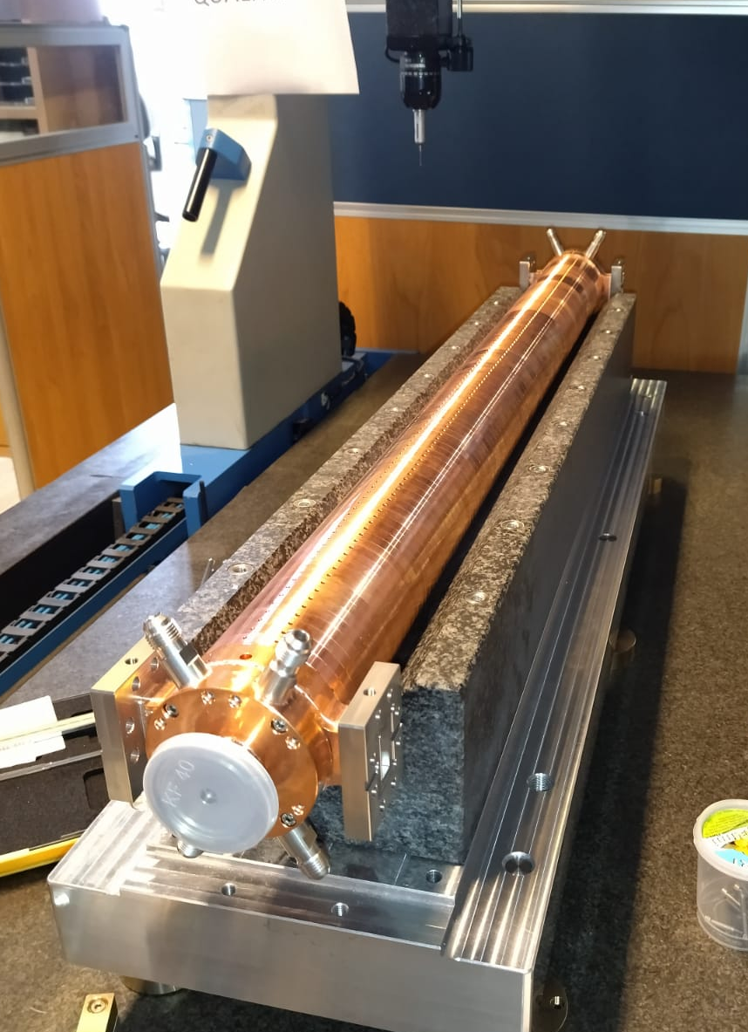
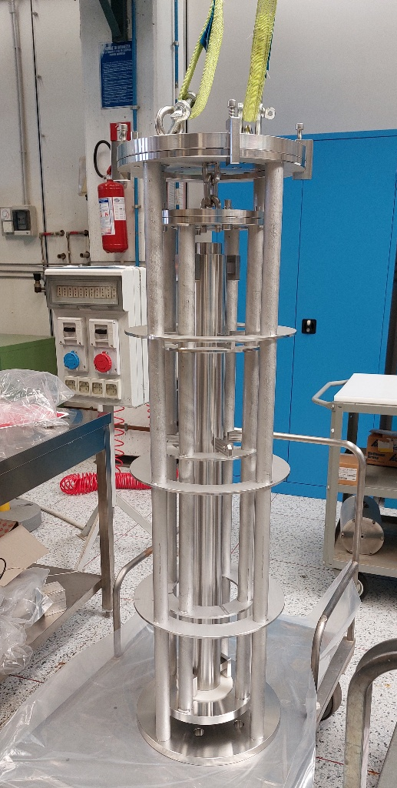
LINAC
X-Band Accelerating section. Mechanical prototype full scale built.
Dimensional check and quality control ongoing
Design of the RF full scale X-Band structure (C.I.) is completed
Procurement of material for the realization of the RF prototype has started (to be concluded late spring 2023).
LINAC Layout complete (except Laser heater and bunch compressor design still to be finalized).
Courtesy D.Alesini
Sci-Com 14/11/2022

Slide 11
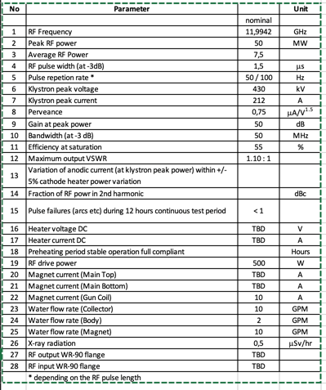
RF Power Source
High Efficiency Klystron Specs
RF design of X-Band waveguide components is completed (e.g. mode converter and pumping port)
Procurement High Efficiency High Power CPI Klystron (50MW) – Concluded. Kickoff in the following weeks.
Procurement High Repetition Rate Canon Klystron through Scandinova is ongoing – to be finalized begininning of 2023
Optimization of the RF Distribution on going (including X-band deflector and linearizer).
TEX Facility – Radioprotection authorization process completed. It should be able to start the scientific program soon (waiting for the formalization of the authorization).
Courtesy A.Gallo
Sci-Com 14/11/2022

Slide 12
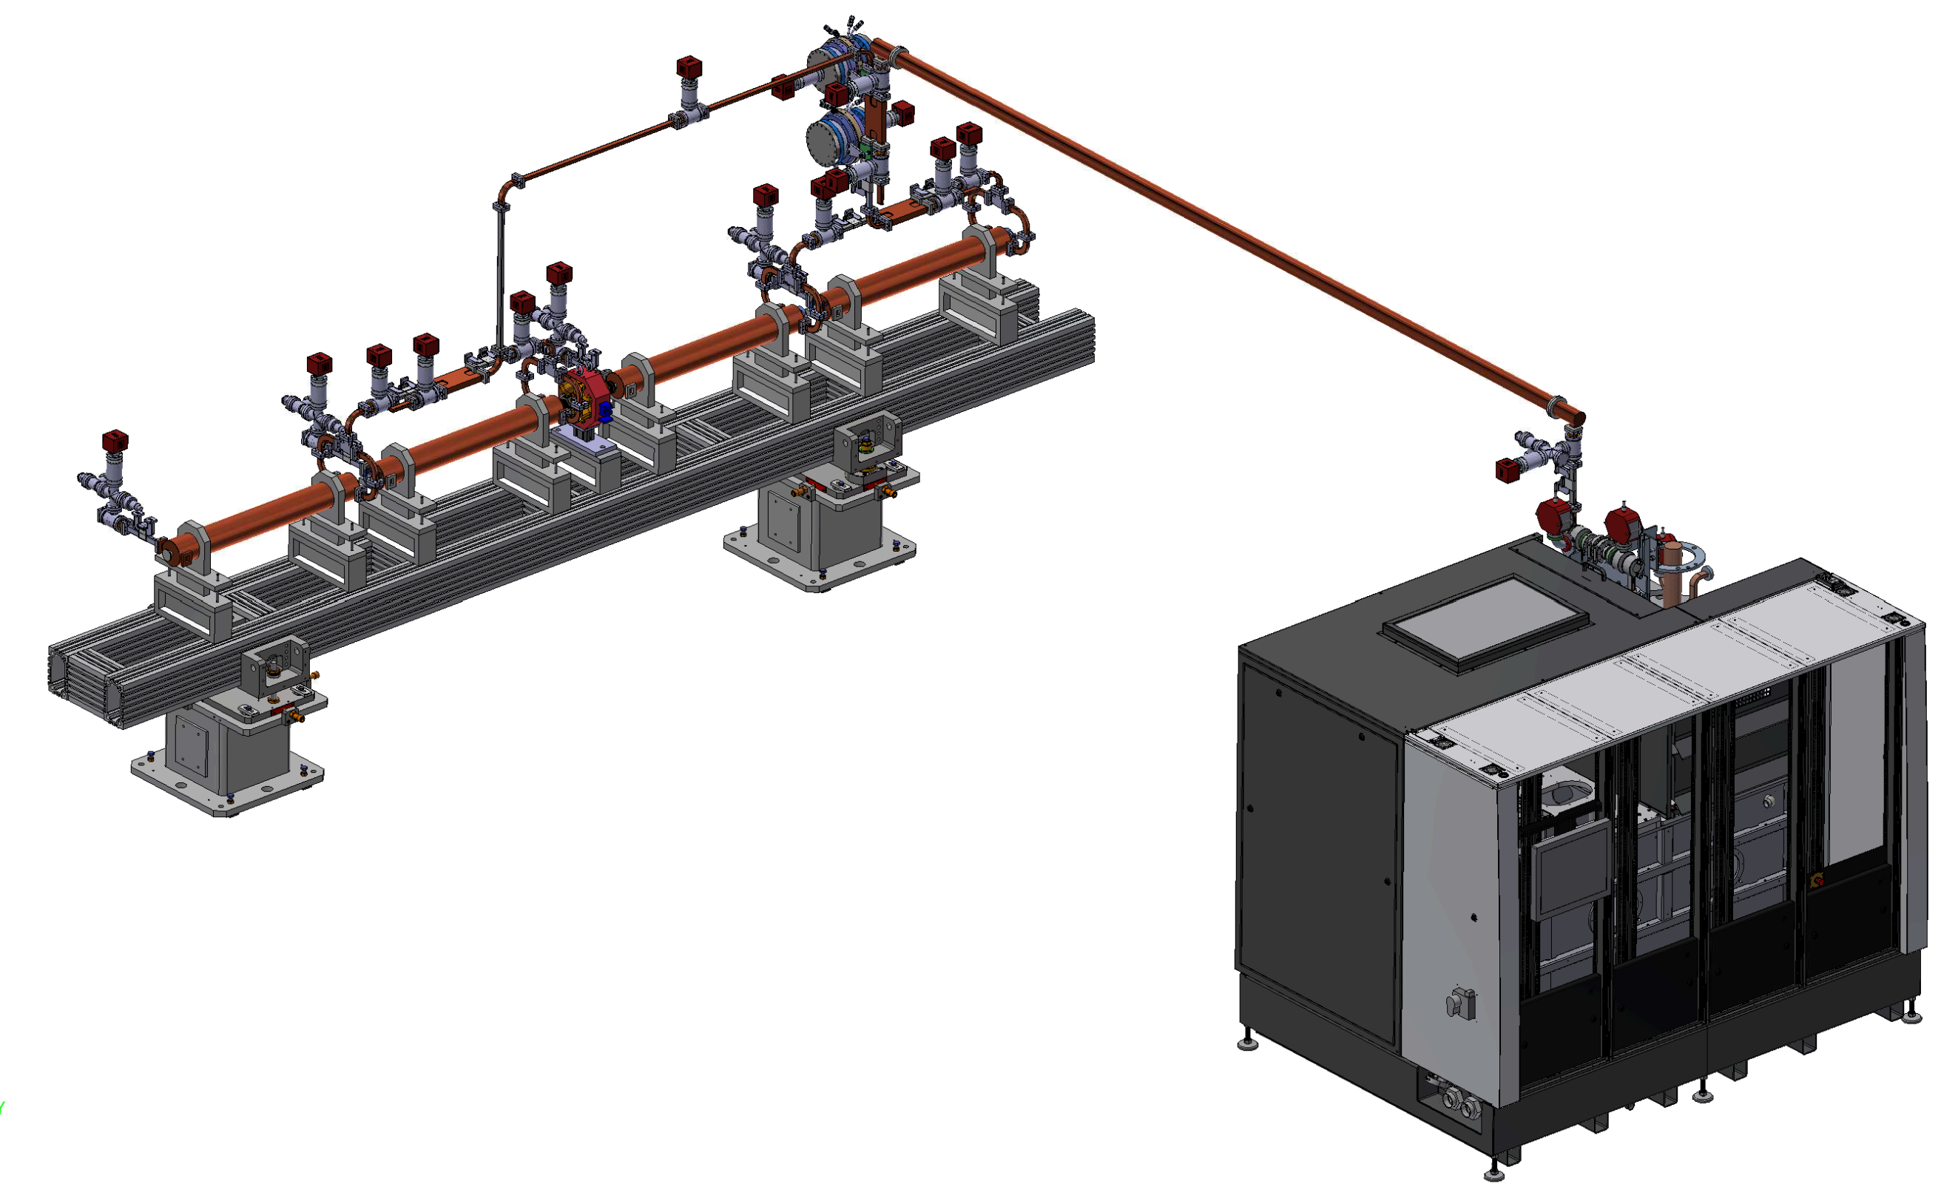
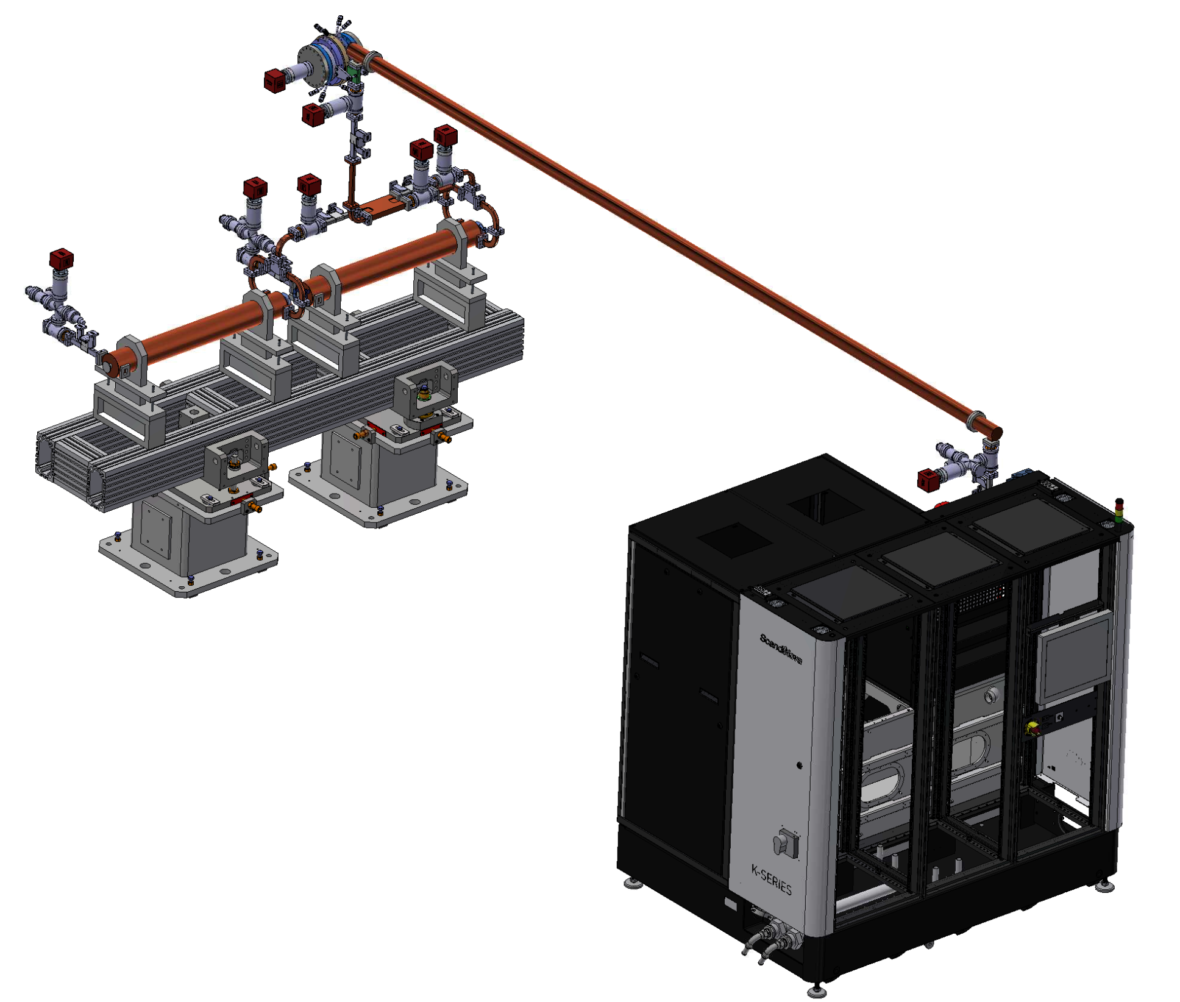
RF Power Source layout
CPI - OPTION
CANON - OPTION
2x BOC on one line
Less flexibility
Different LE and HE module layout
Lower power plants number
1x BOC on one line
Higher flexibility
Lower Modulator power requirements
Possible upgrade at high rep. rate of the Linac
2x BOC (PSI or INFN)
4.4 m
4.4 m
45 MW
22.5 MW
4.8 m
2.3 m
K400 Modulator
CPI VKX8311A (CPI VKX8311HE)
K300 Modulator
Canon E37119
Courtesy F.Cardelli
Sci-Com 14/11/2022

Slide 13
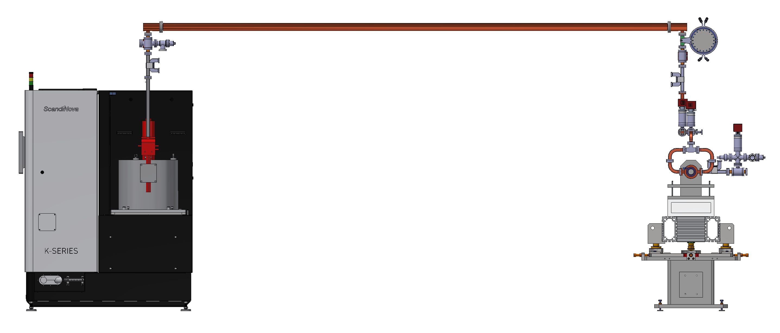
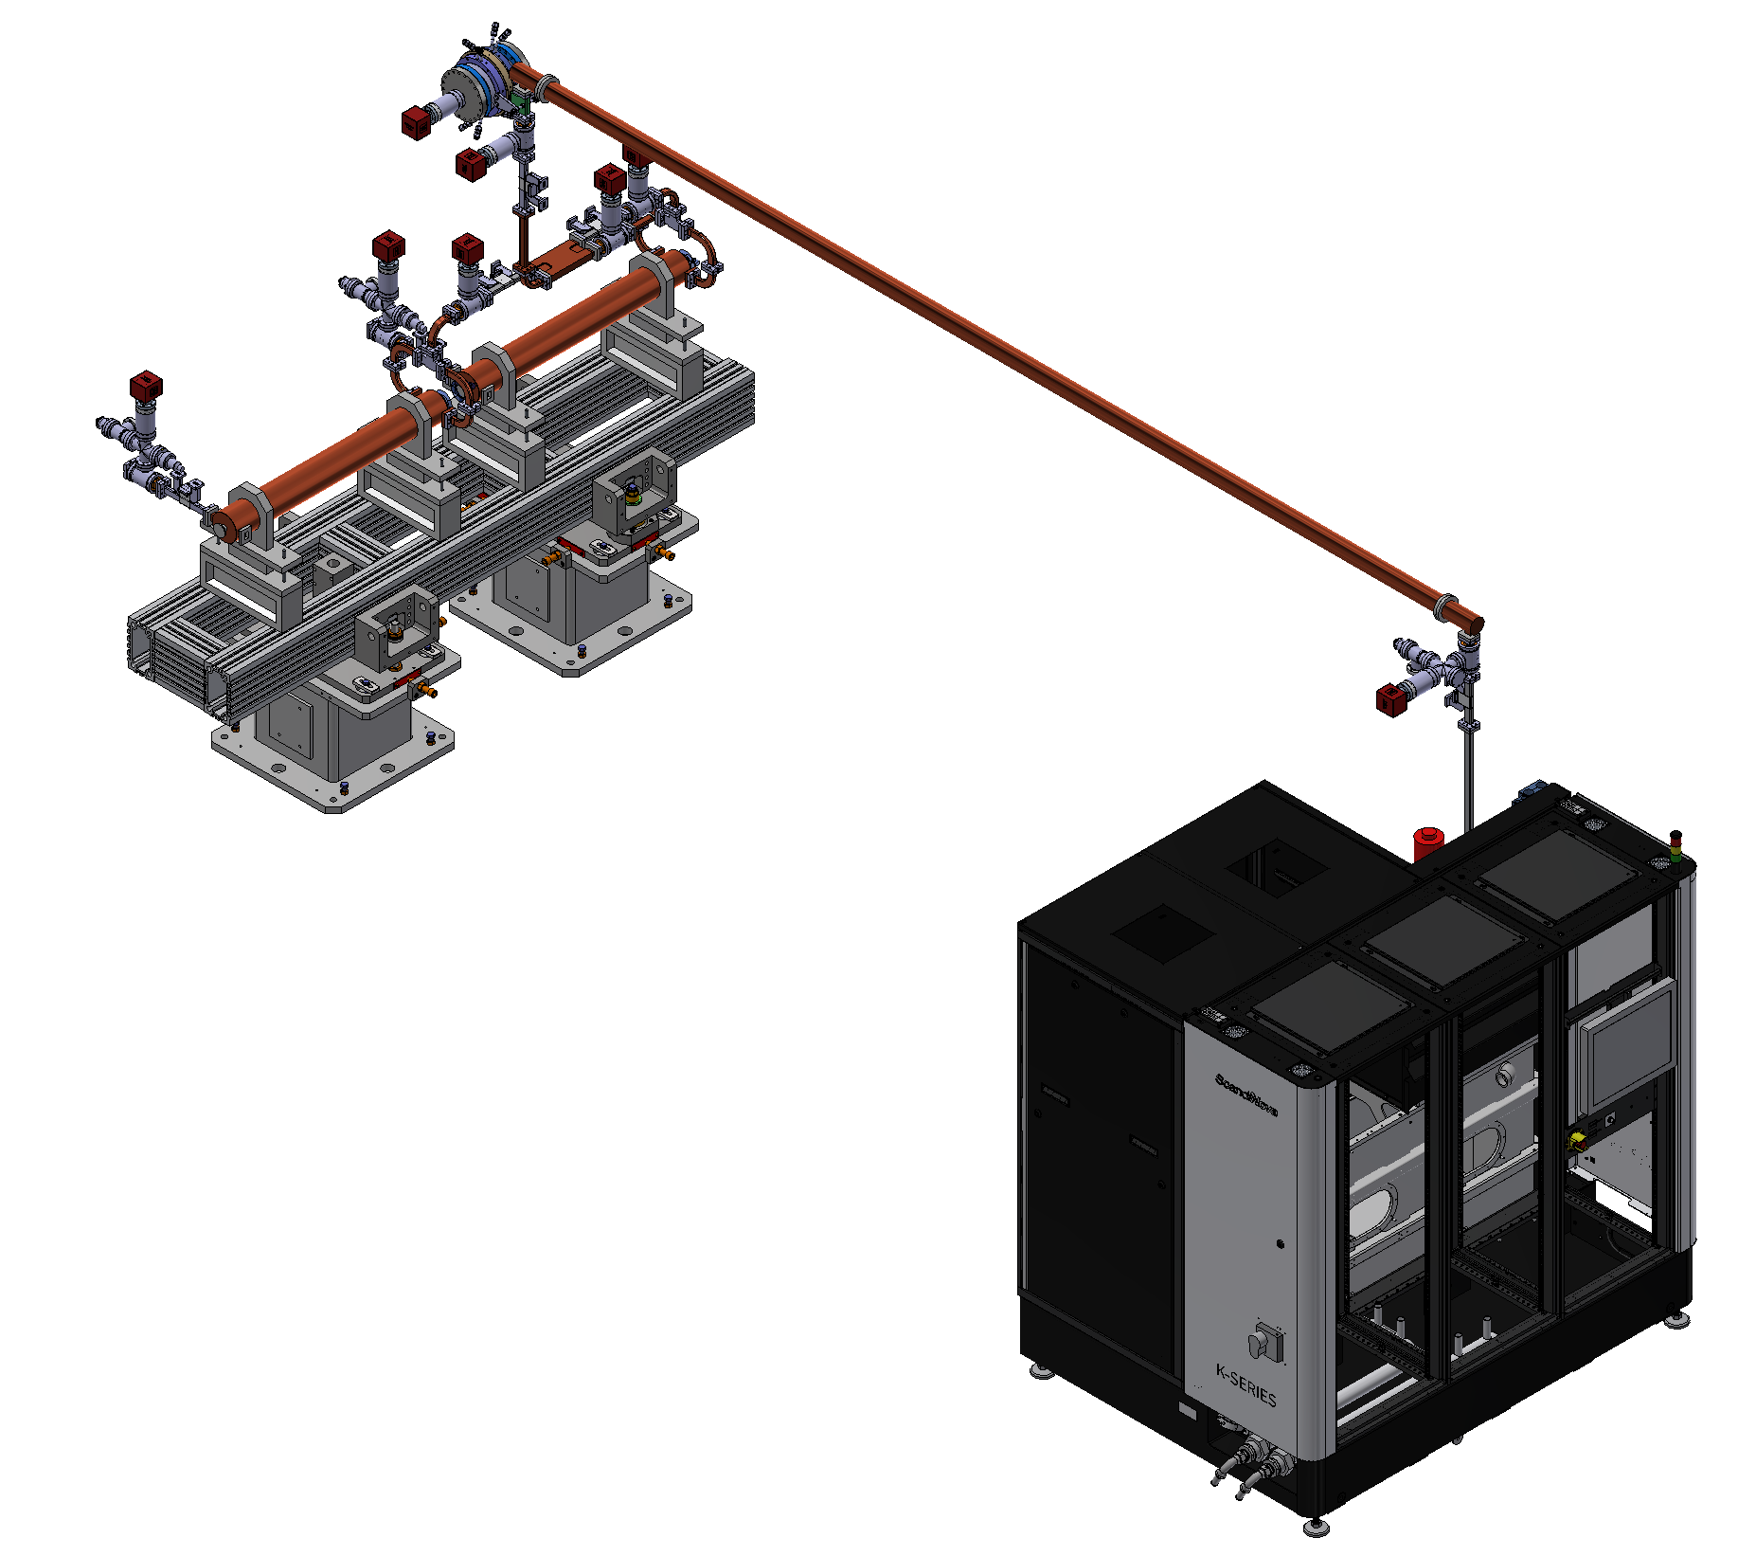
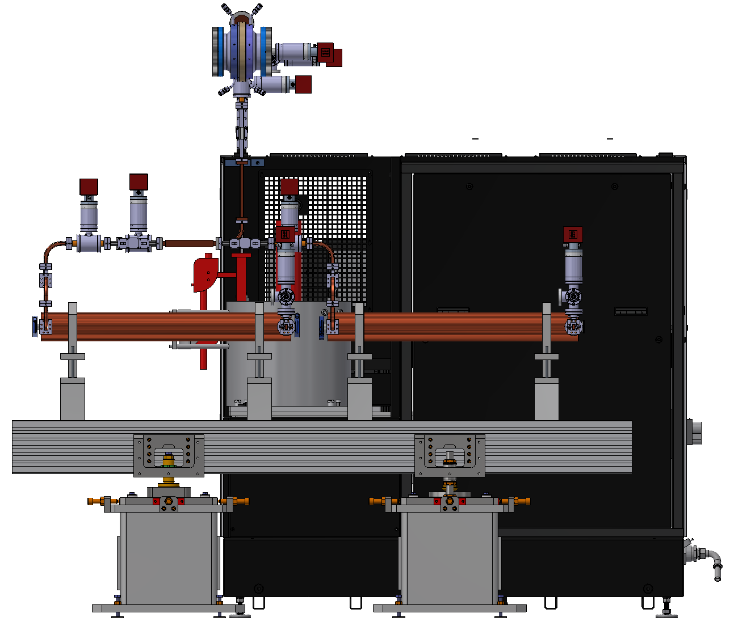
RF Power Source layout
Courtesy F.Cardelli
Sci-Com 14/11/2022

Slide 14
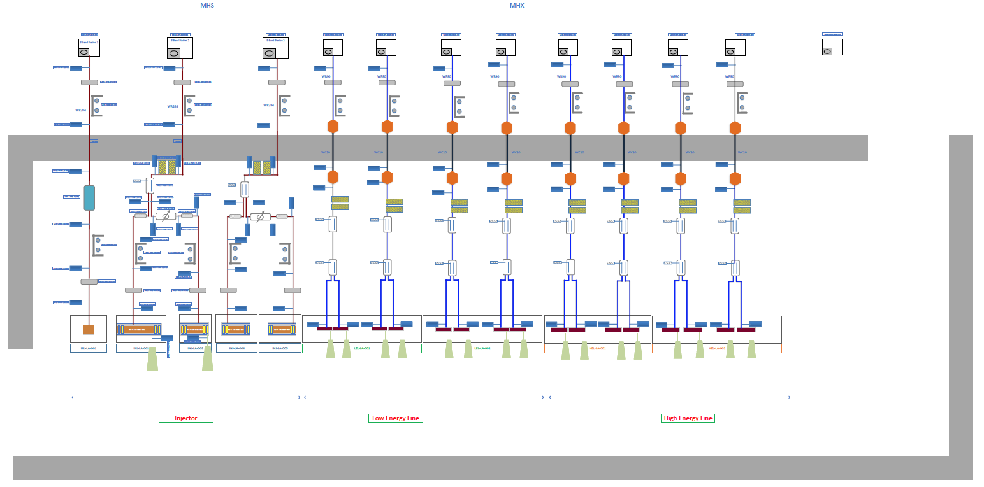
RF Power Source layout
Courtesy F.Cioeta
Sci-Com 14/11/2022

Slide 15
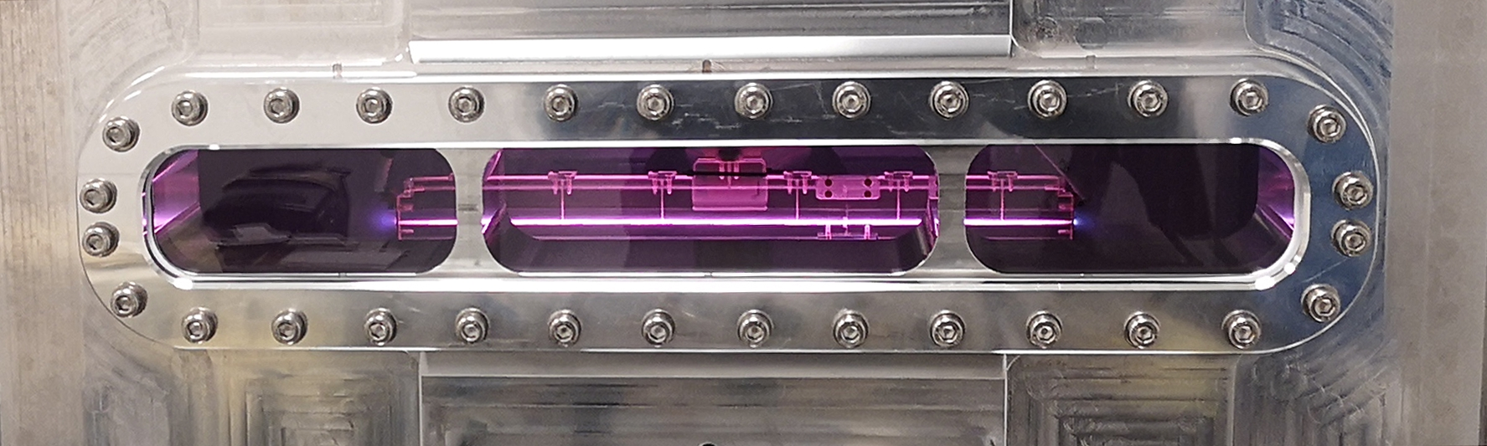
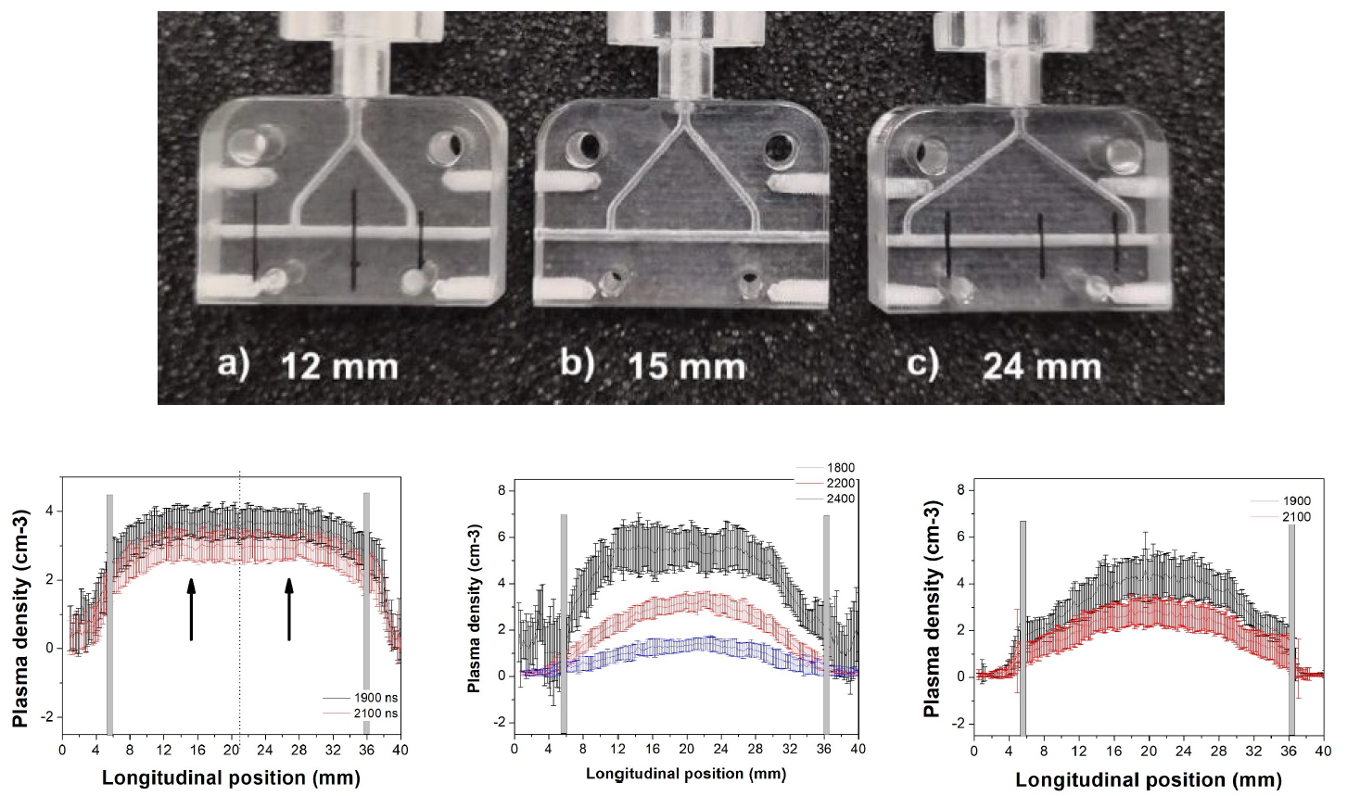
Plasma Module
Production of the first prototype of long capillary (40cm) - Already presented at the last Sci-Com meeting.
40 Cm Discharge was successfully achieved in a plastic capillary.
Plasma density completely characterized
Vacuum tests with plasma at 100Hz have been reached .
Transverse matching tests ongoing
40cm sapphire capillary tests to be performed
Courtesy R.Pompili, A.Biagioni
Sci-Com 14/11/2022

Slide 16
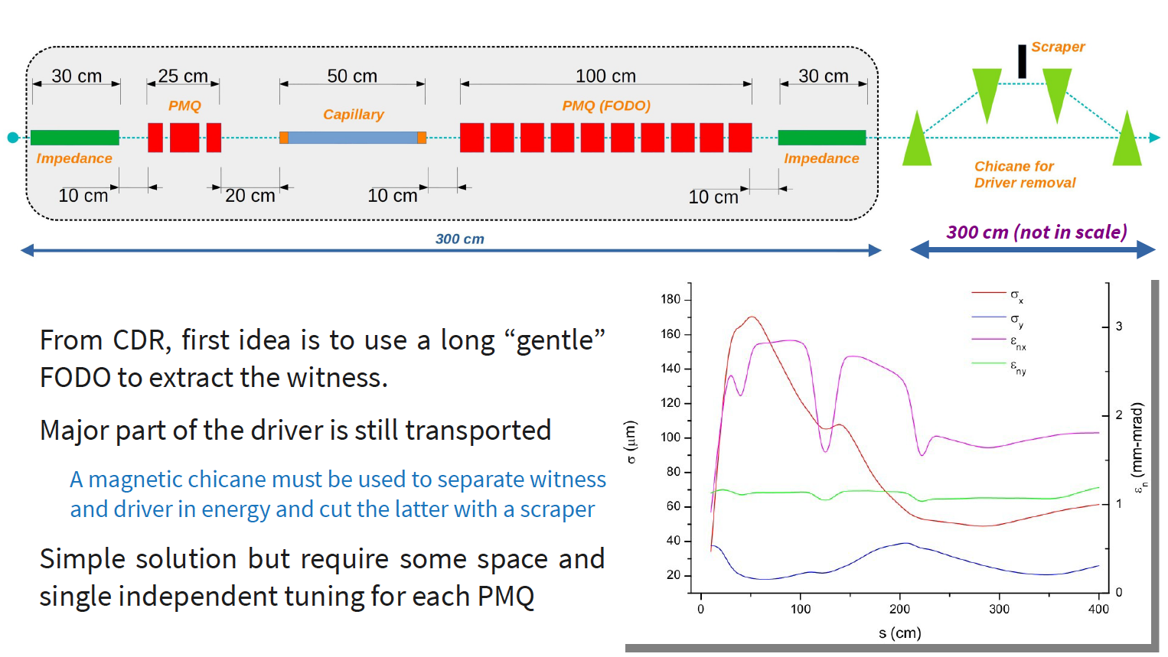
Plasma Module
Plasma module layout – Different options under investigations.
Option 1
Courtesy R.Pompili, A.Biagioni
Sci-Com 14/11/2022

Slide 17
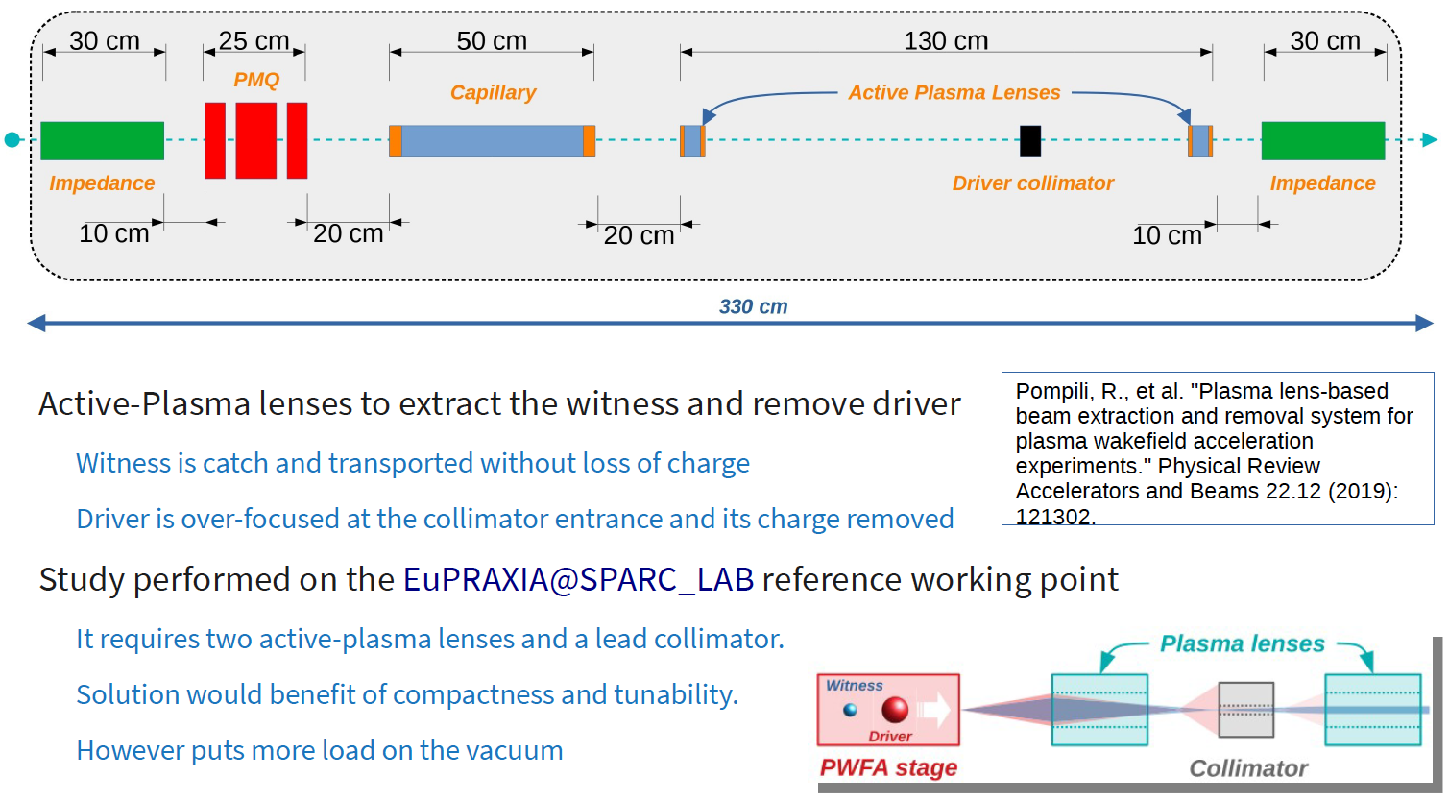
Plasma Module
Plasma module layout – Different options under investigations.
Option 2
Courtesy R.Pompili, A.Biagioni
Sci-Com 14/11/2022

Slide 18
FEL | Ondulators
ARIA - No news
AQUA
  Undulator design – Study of undulator termination and minimization wake fields
  Undulator prototyping: drawing of a model from the Sabina STEP file in progress. No updates since last meeting (MDF involved in othe activities).
  Design study of short period undulator. After delivery of SABINA Undulator, to be assigned through contract ?
  Pulsed wire measurement system under study (A. Selce, A. Petralia)
  Intrasection design (L. Sabatini, A. Vannozzi, A. Selce, F. Nguyen) Quadrupole field integral defined/discussion ongoing on having correctors embedded in quadrupoles, impedances and feedback frequency cutoff (L. Sabatini, A. Selce, A. Vannozzi)
  Simulations: testing wake fields models as also suggested by TDR Committee (F. Nguyen & N. Mirian)
  Recent S2E simulations from WA1 are showing peak currents in excess of 1.9-2kA. FEL simulations show saturation at wavelengths < 4 nm (V. Petrillo). New working point parameters ?
Courtesy L.Giannessi
Sci-Com 14/11/2022

Slide 19
User & Beamlines
Proposal for development and characterization of novel optics for focusing X-rays @Elettra
Coordination with the corresponding WP for EuPRAXIA- Preparatory Phase
Upcoming Milestones
31/12/22 Preliminary optical simulation of the beamlines
31/12/22 Evaluation of Scientific Case for other wavelengths (ARIA)
Courtesy F.Stellato
Sci-Com 14/11/2022

Slide 20
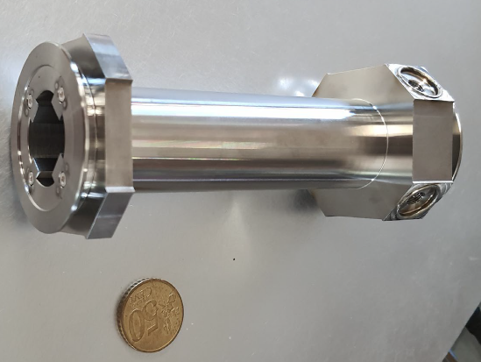
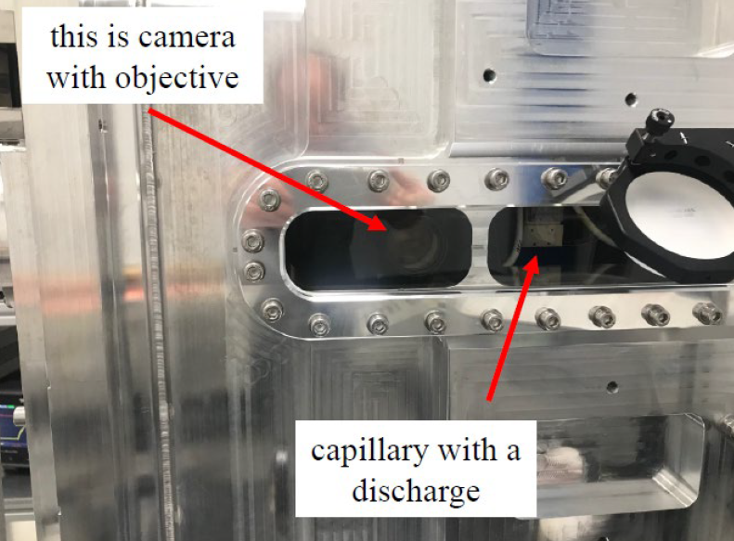
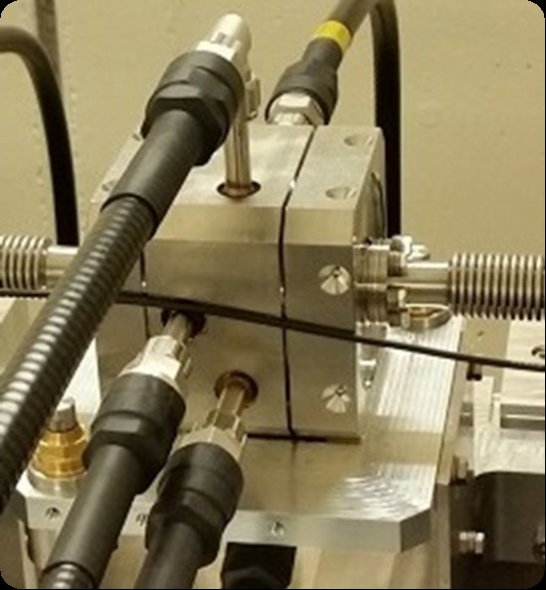
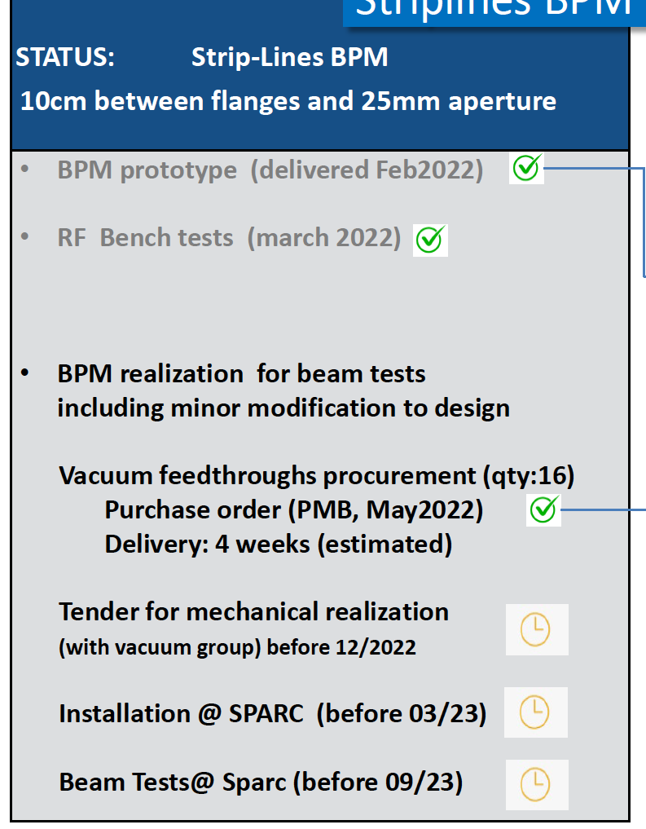
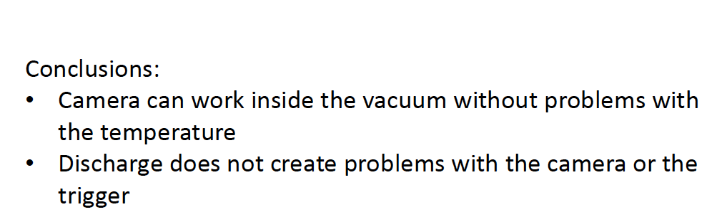
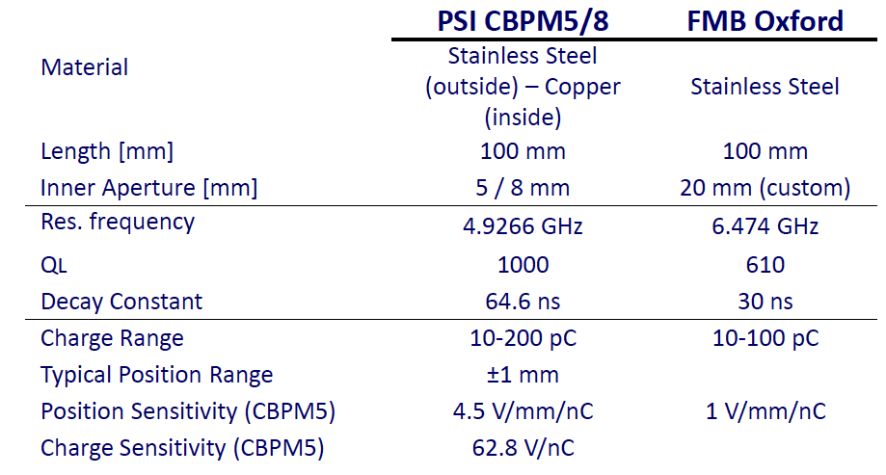
Diagnostics
Test on CCD Camera in the plasma chamber - done
CBPM – PSI Choice for intra ondulator diagnostics
Stripline prototype
Read-out electronics development under discussion
Courtesy A.Cianchi, A.Biagioni,A.Stella
Sci-Com 14/11/2022

Slide 21
Building Status
Progress in the design finalization and authorization process.
Final design is basically frozen with many further implementations in the last months.
Informal authorization from different stakeholders to proceed with the formal «Conferenza dei Servizi» (Permitting authority commitee) :
    Archeological survey
    Landscape
    Fire Dept.
Cost updated (due to current geo-political and macroeconomic scenario) to be discussed at management level
Courtesy S.Incremona, U.Rotundo
Sci-Com 14/11/2022

Slide 22
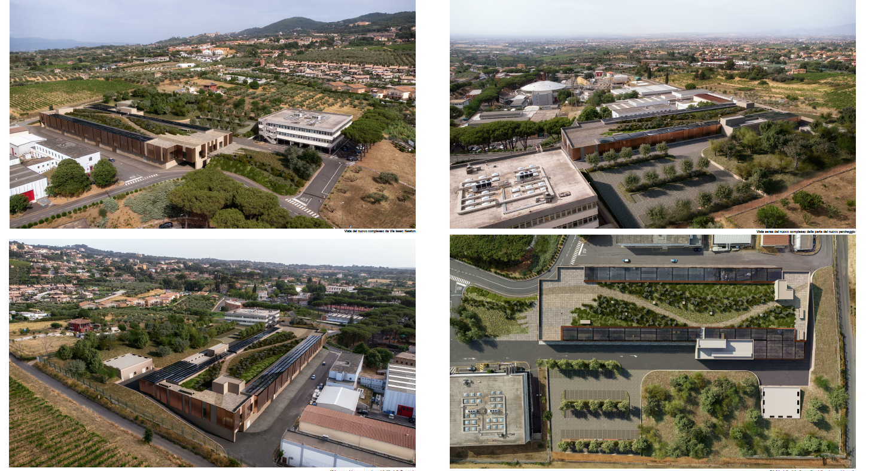
Building Status - rendering
Courtesy S.Incremona, U.Rotundo
Sci-Com 14/11/2022

Slide 23
System Engineering
Functional layout aligned to optic and mechanical layout.
Configuration Management
Cost –book
Integration
Utility Matrix and systems interface definition
Nomenclature in place
Framework for configuration database done.
Functional layout is being transformed in a Project Breakdown Structure database.
Each component is now broken down into a number of subsystems and hierarchically ordered.
Sci-Com 14/11/2022

Slide 24
Schedule update – critical milestones
2021
2022
2023
2024
2025
2026
2027
EuPRAXIA@SPARC_LAB Design Phase
Intermediate layout
Final layout & beam parameters
Preliminary layout
Layout studies
Sensitivity analysis and system requirements
1° X-Band Station commissioned
TEX activities and kystron procurement
X-Band design validated
Long capillary prototype
Plasma module optimization and matching optics design
Plasma design validated
TDR Released
EuPRAXIA@SPARC_LAB
Machine design
FEL Configuration strategy
Final design FEL
TDR Approved
Science case @ 4nm
User end station designed
EuPRAXIA@SPARC_LAB Implementation Phase
Planning
Procurement
Implementation
Building design & construction
Final design
Permitting Request
Exec. Design
Tender for Validation
Validation
Tender
EuPRAXIA@SPARC_LAB
Building
Building Construction
Utilities executive design
Tender
Implementation
Acceptance
Building ready
Application
to prep.phase
🇪🇺
Preparatory phase
EuPRAXIA - EU
Outcome ESFRI application
Eupraxia-EU TDR
& Legal framework
Sci-Com 14/11/2022

Slide 25
Schedule update and conclusions
Significant progress on the machine layout development
Still a number of open points to be more investigated
Prototyping activities on track. X-Band LLRF System prototype is under investigation
Several other EuPRAXIA related projects to be started soon will reinforce EuPRAXIA@SPARC_LAB activities.
Additional manpower will hopefully be hired in the next months (3 Through EuAPS Funding + others from funding sources ) and hiring for other project can alleviate the workload to EuPRAXIA team.
In the next weeks we will start the process to structure the TDR chapters and connect them to the intermediate milestones we are performing.
Sci-Com 14/11/2022

Slide 26
Other EuPRAXIA Related Project
EuPRAXIA – Preparatory Phase. Horizon Europe Infradev- ESFRI Project
EuPRAXIA Advanced Photon Source – EuAPS – PNNR funding
Sci-Com 14/11/2022

Slide 27
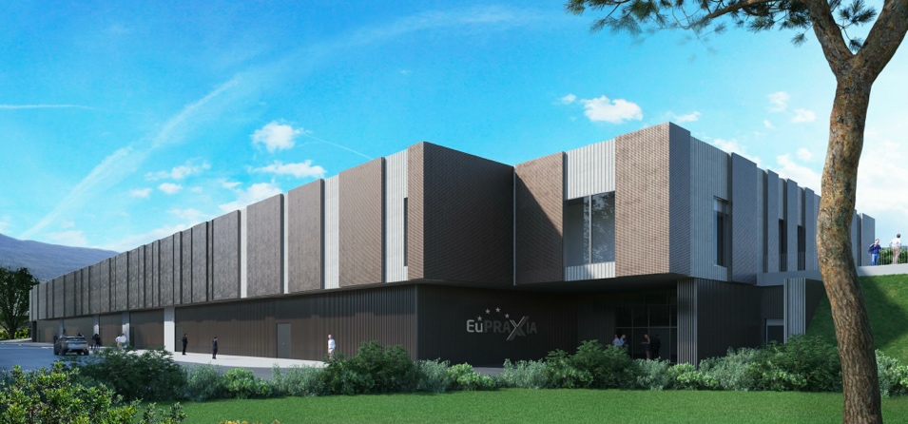
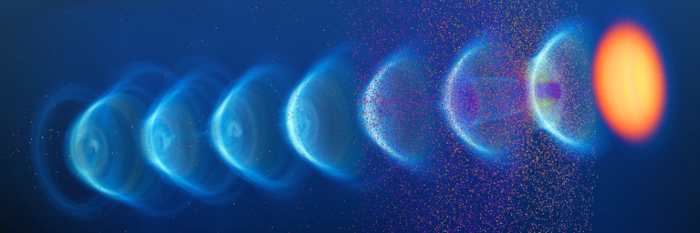
EuPRAXIA-PP (Preparatory Phase) Key Facts
Prepares the implementation of the full RI in Europe
Total project volume (including in-kind): 8.3 M€
  EU funding: 2.49 M€ (EU without in-kind)
  Outside EU 0.69 M€ (Switzerland)
  0.51 M€ (UK)
Work organized in 16 Work Packages
Project dates: 1 Nov 2022 – 31 Oct 2026
Coordinator and location of headquarters: INFN
34 participating organizations from 12 countries
Will establish a “Board of Financial Sponsors“ with representatives of funding agencies.
So far ~ 25% of total M&P funding (569 M€) secured. Site 1 is essentially financed → Massimo.

Slide 28
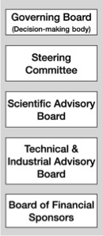
PP Steering Committee: Leaders Behind EuPRAXIA
WP1 - Coordination & Project Management
R. Assmann, INFN & DESY
M. Ferrario, INFN
WP2 - Dissemination and Public Relations
C. Welsch, U Liverpool
S. Bertellii, INFN
WP3 - Organization and Rules
A. Specka, CNRS
A. Ghigo, INFN
WP4 - Financial & Legal Model. Economic Impact
A. Falone, INFN
WP5 - User Strategy and Services
F. Stellato, U Tor Vergata
E. Principi, ELETTRA
WP6 - Membership Extension Strategy
B. Cros, CNRS
A. Mostacci, U Sapienza
WP7 - E-Needs and Data Policy
R. Fonseca, IST
S. Pioli, INFN
WP8 - Theory & Simulation
J. Vieria, IST
H. Vincenti, CEA
WP9 - RF, Magnets & Beamline
Components
S. Antipov, DESY
F. Nguyen, ENEA
WP10 - Plasma Components & Systems
K. Cassou, CNRS
J. Osterhoff, DESY
WP11 - Applications
G. Sarri, U Belfast
E. Chiadroni,U Sapienza
WP12 - Laser Technology, Liaison to Industry
L. Gizzi, CNR
P. Crump, FBH
WP13 - Diagnostics
A. Cianchi, U Tor Vergata
R. Ischebeck, EPFL
WP14 - Transformative Innovation Paths
B. Hidding, U Strathclyde
S. Karsch, LMU
WP15 - TDR EuPRAXIA @SPARC-lab
C. Vaccarezza, INFN
R. Pompili, INFN
WP16 - TDR EuPRAXIA Site 2
A. Molodozhentsev, ELI-Beamlines
R. Pattahil, STFC
WP’s on coordination & implementation as ESFRI RI (organization, legal model, financing, users)
WPs on technical implementation and sites

Slide 29
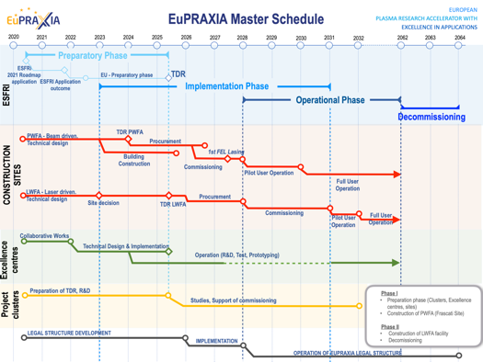
Preparatory Phase Main Goals
Managerial WP`s
  Outreach to public, users, EU decision makers and industry
  Define legal model (how is EuPRAXIA governed?), financial model, rules, user services and membership extension for full implementation
  Works with project bodies and funding agencies → Board of Financial Sponsors
Technical WP‘s (correspond to Project Clusters):
  Update of CDR concepts and parameters, towards technical design (full technical design requires more funding)
  Specify in detail Excellence Centers and their required funding: TDR related R&D, prototyping, contributions to construction
  Help in defining funding applications for various agencies
Output defined in milestones & deliverables with dates

Slide 30
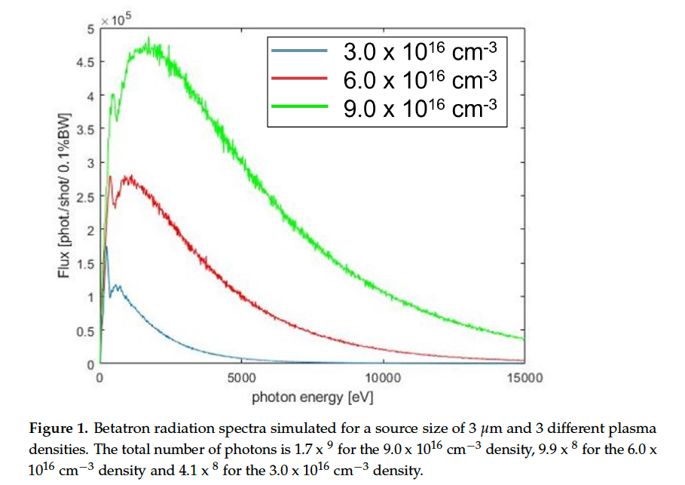
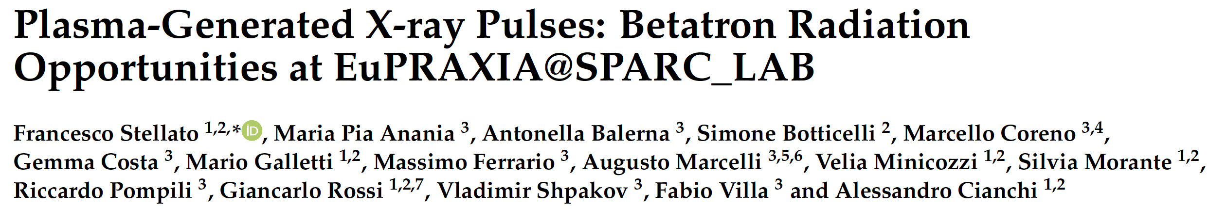
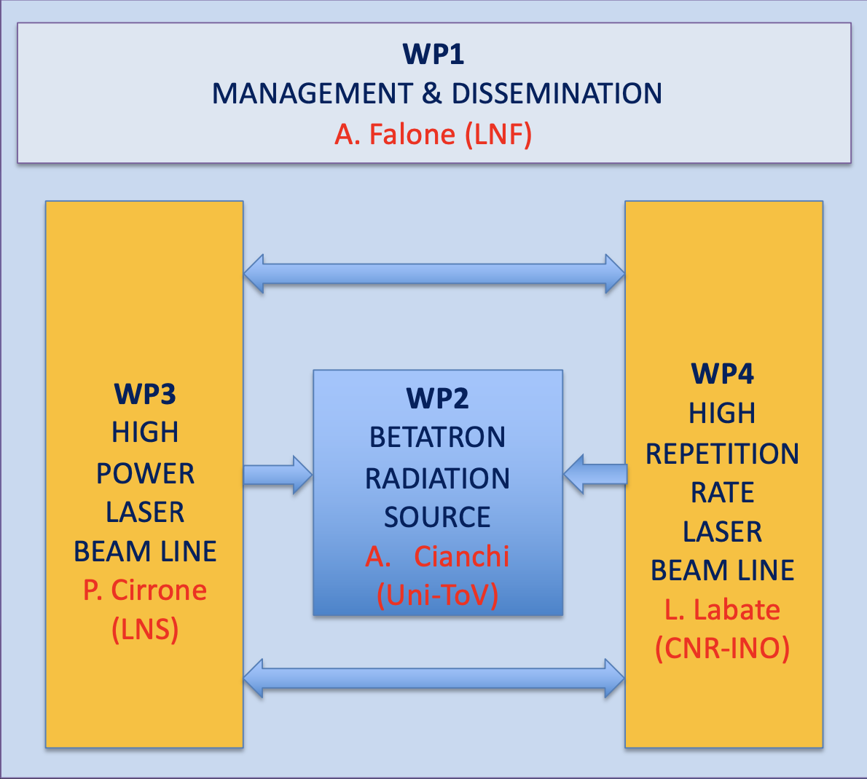



EuPRAXIA Advanced Photon Source
Ranking 1° in ESFRI Research Infrastructure call for Next Generation EU (PNRR).
Phase 1 EuPRAXIA Implementation Phase
Betatron Radiation Source for x-ray imaging
High Power Laser [1 PW]
High Repetition Rate Laser [100Hz]
The EuAPS proposal benefits from the preparatory work done in the conceptual design phase of EuPRAXIA, both for the scientific case and the technology. It focuses on an ambitious but technically achievable goal and builds on the pre-existing investments at the SPARC_LAB facilities. As stated in the EuPRAXIA CDR the following EuPRAXIA Flagship Goals will be addressed by the EuAPS Project:
Flagship Innovation Goal 2: EuPRAXIA will develop together with laser industry a new generation of high peak power lasers, advancing the presently leading technology into the regime of 20 - 100 Hz repetition rate […].
Flagship Science Goal 2: EuPRAXIA will deliver betatron X rays with up to 10¹⁰ photons per pulse, up to 100 Hz repetition rate and an energy of 5-18 keV to users from the medical area. […].
Flagship Science Goal 7: EuPRAXIA will provide access to cutting edge laser technology with short pulse length in combination with high energy photon pulses […].
We expect that the focus on a mature part of the EuPRAXIA project strongly supports project completion on the timescales that are required by PNRR.
EuAPS Scientific Coordinator: M. Ferrario (INFN-LNF)
EuPRAXIA/EuAPS Integration: R. Assmann (DESY & INFN)
Scientific Advisory Committee
Operating Units Board
INO-ISM
Scientific and Technical Board
LNF-LNS-MI
Sci-Com 14/11/2022

Slide 31
Findings & Reccomendation (I)
The implementation part of the EuPRAXIA@SPARC_LAB schedule needs further refinement. In particular, the assumptions on procurement have to be adjusted for sufficient margins. Typical procurement times for long lead items as well as the current issues with supply chains need to be considered in this context.
This certainly will be taken into account. The detailed planning of the implementation phase looks a bit early to be developed, also considering a number of boundary conditions that need to be clarified. As example the Legal Framework and the Financial models that will be adopted (which are main deliverables of WP.4 EuPRAXIA – Preparatory Phase) for the implementation of the distributed RI might have a remarkable impact on the procurement strategy and hence on the overall planning.
Sci-Com 14/11/2022

Slide 32
Findings & Reccomendation (II)
The efforts to develop the future photon user community of EuPRAXIA@SPARC_LAB have to continue.
User community will be strenghten through EuAPS and EuPRAXIA-Preparatory Phase projects that have a dedicated WP for the user exploitation. Workshop and school are foreseen in the next years.
Implementation of the staffing plan for EuPRAXIA@SPARC_LAB needs the full attention of the LNF management. This is not only a question of funding but also needs efforts to make project posts attractive for highly qualified experts. In particular, clarifying the perspectives for long-term employment early on in the hiring process could facilitate this process
We noticed a growing interest in the community on EuPRAXIA initiative. EuPRAXIA is becoming an attractive project. Of course salary and perspectives not always are aligned with the expectations of the candidates and the time needed for hiring sometime is a problem. However PNRR opportunity give us a bit of flexibility in hiring also highly qualified personnell. E.g. 1 Laser Scientist and 1 Plasma Scientist will be hired soon. The personnel hired for other PNRR project altough are not strictly correlated with EuPRAXIA they will help to alleviate the workload on the EuPRAXIA team.
Sci-Com 14/11/2022

