Slide 1
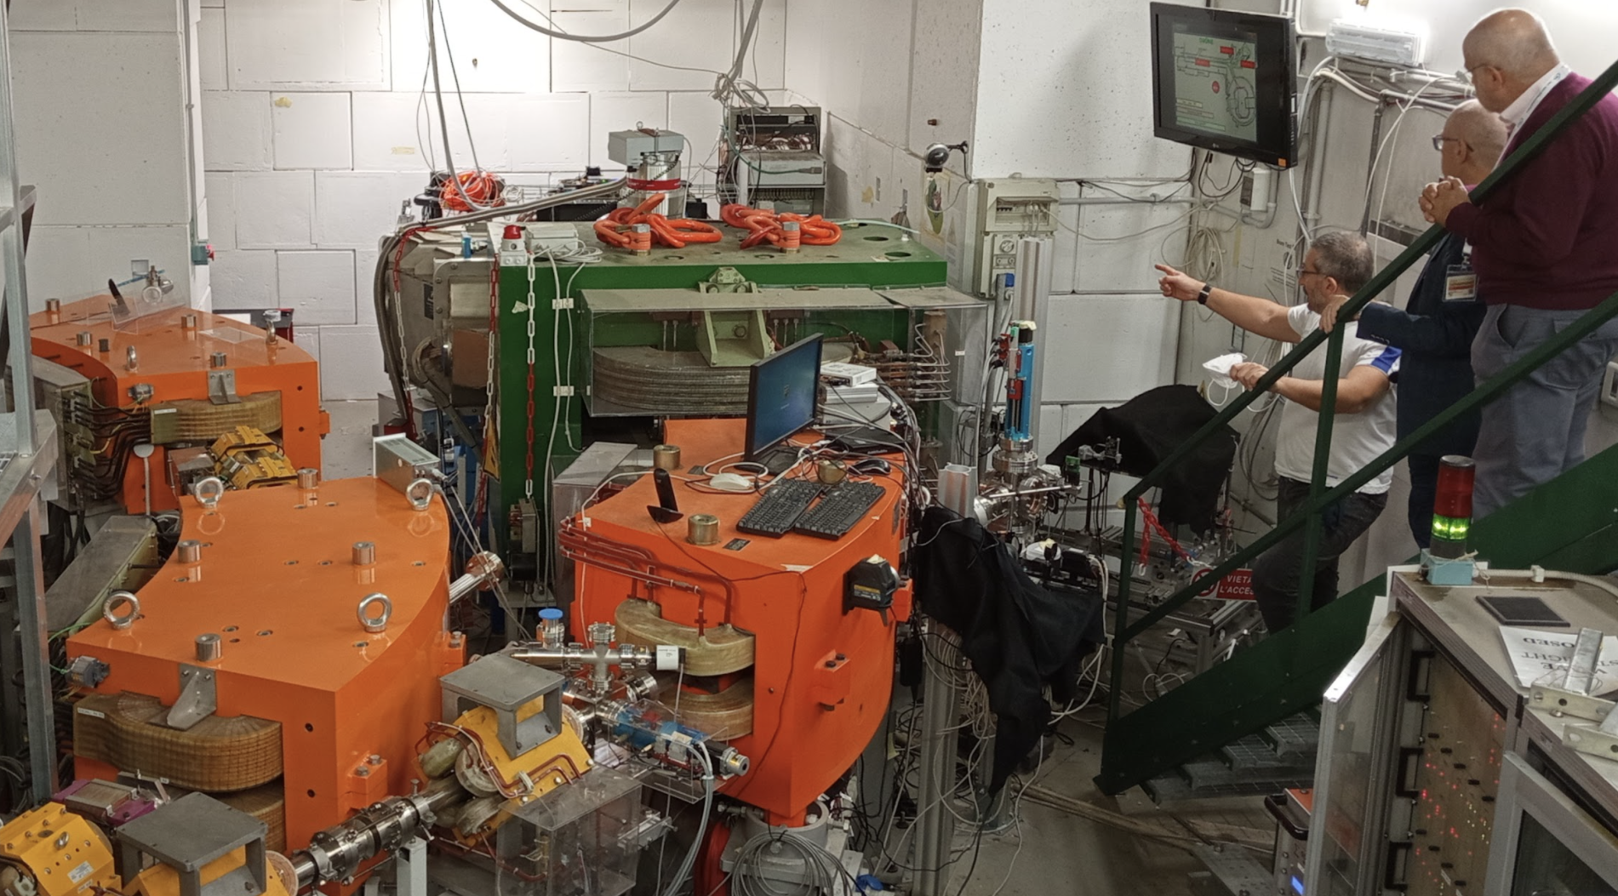
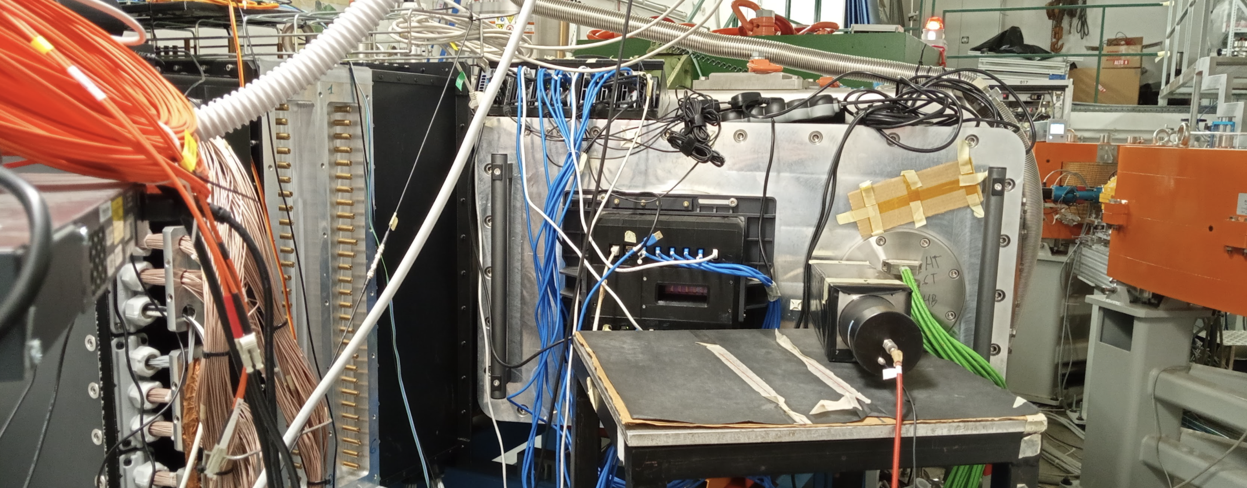
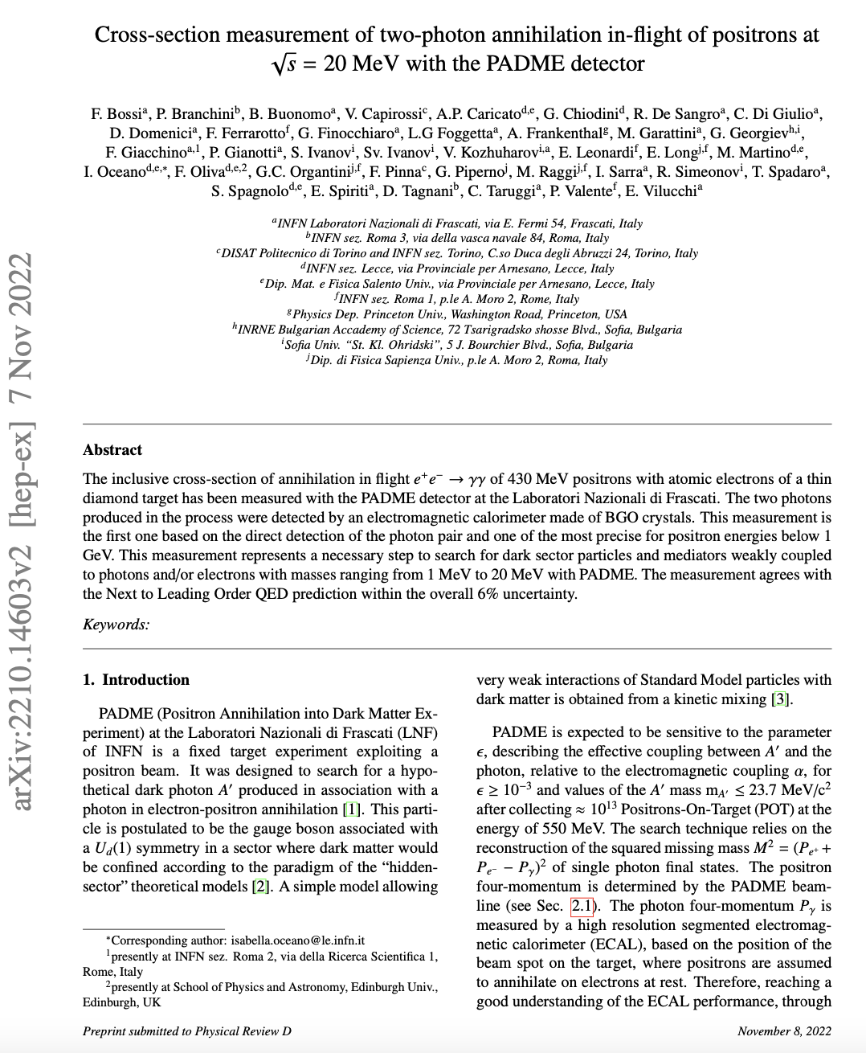
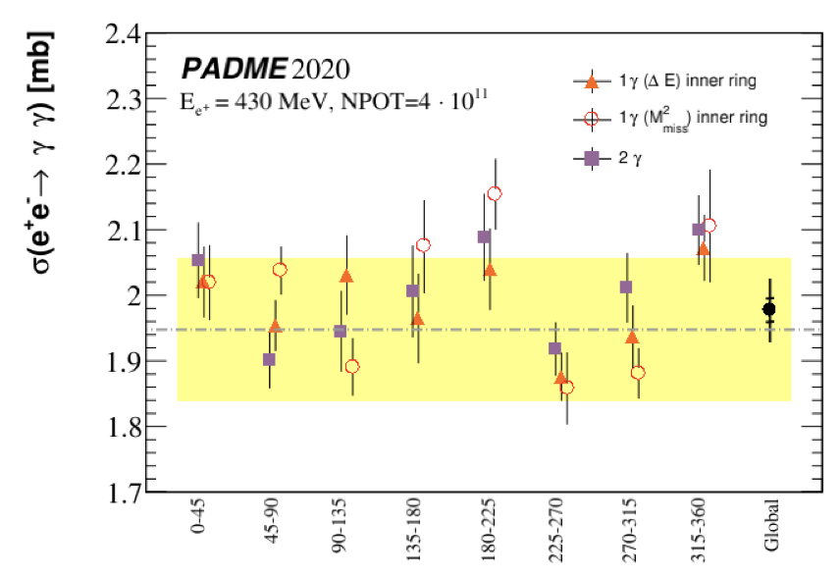
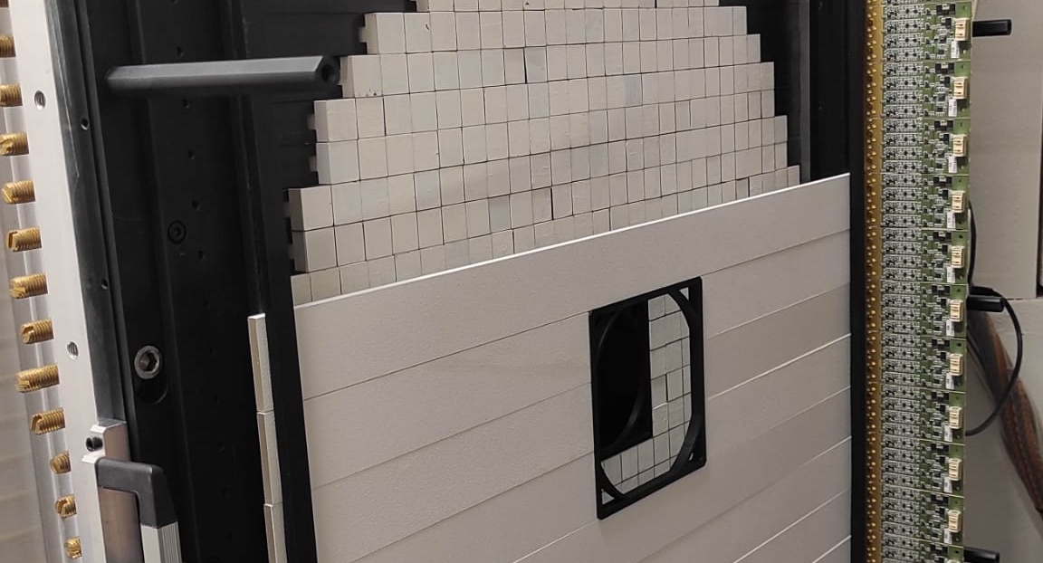
Status of the PADME experiment
M. Raggi and P. Valente for the PADME collaboration, 64Th meeting of the LNF scientific committee 14–15 Nov 2022

Slide 2
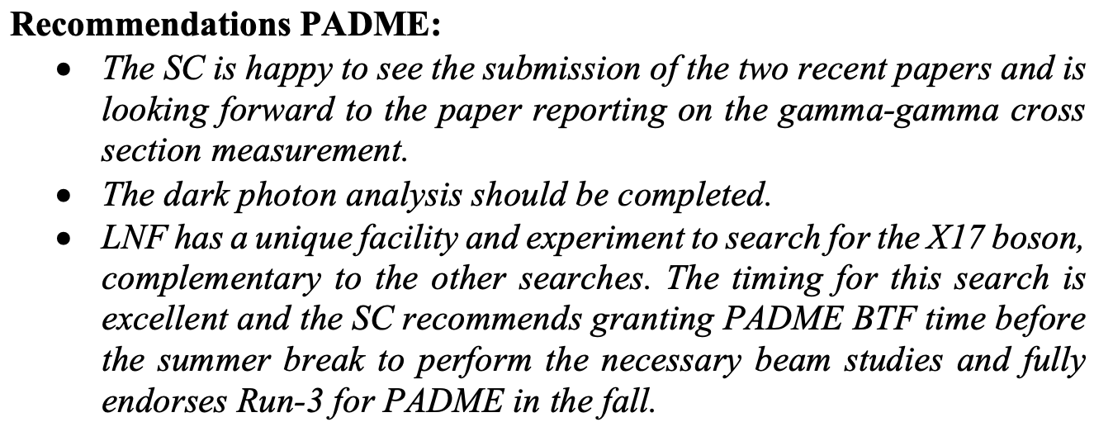
63rd Scientific Committee findings and recommendations

Slide 3
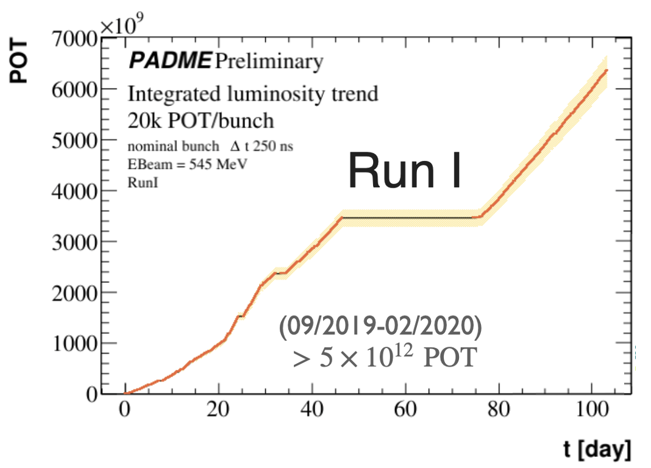
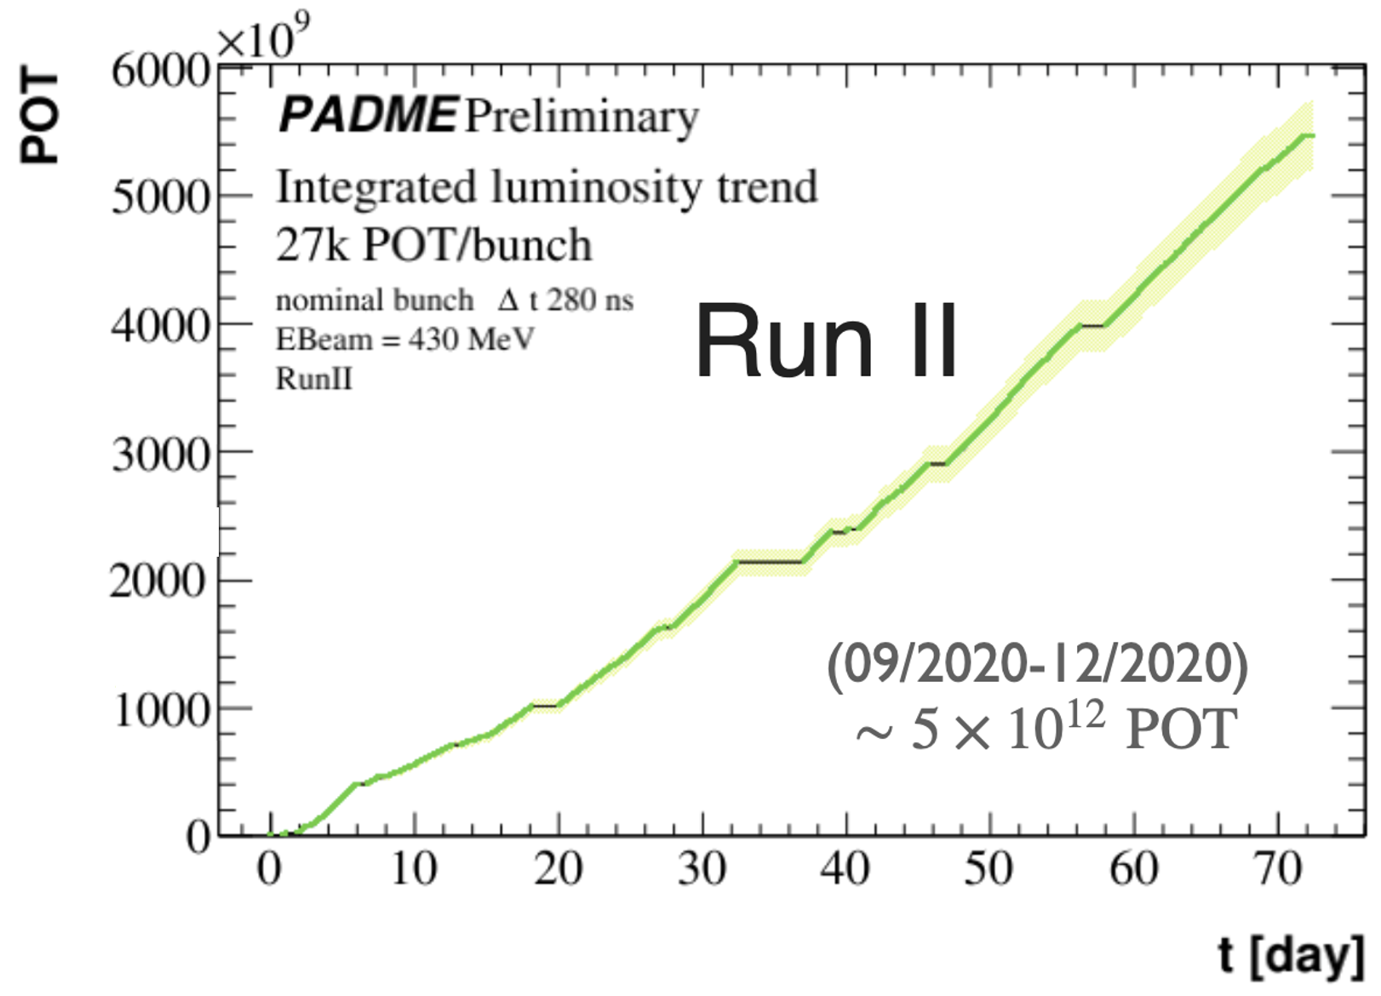
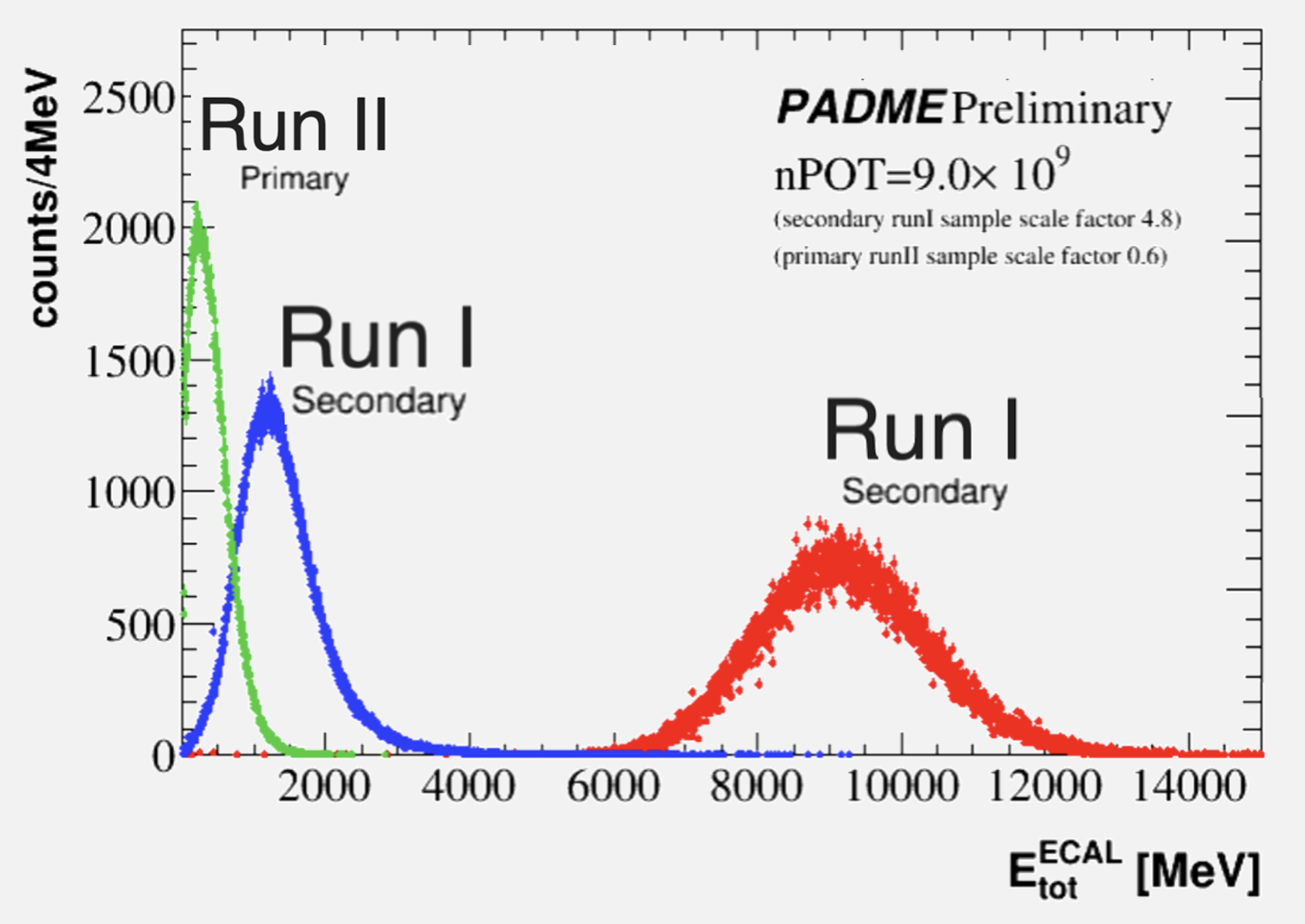
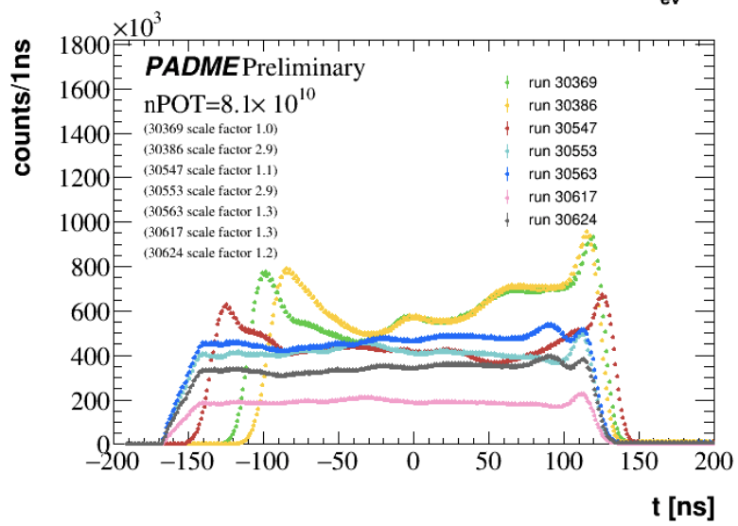
PADME data taking periods
Two physics runs Run I Oct. 2018 Feb. 19 and Run II Set-Dec 2020
Hard simulation work to understand BG in between Run I and Run II.
Run II wrt Run I
Slightly lower beam momentum in Run II, 430 MeV/$c$, wrt to Run I, 490 MeV/$c$
Improved vacuum separation between experiment and beamline
Less beam-induced background with primary wrt secondary beam
During Run II itself
Improved bunch length and structure

Slide 4
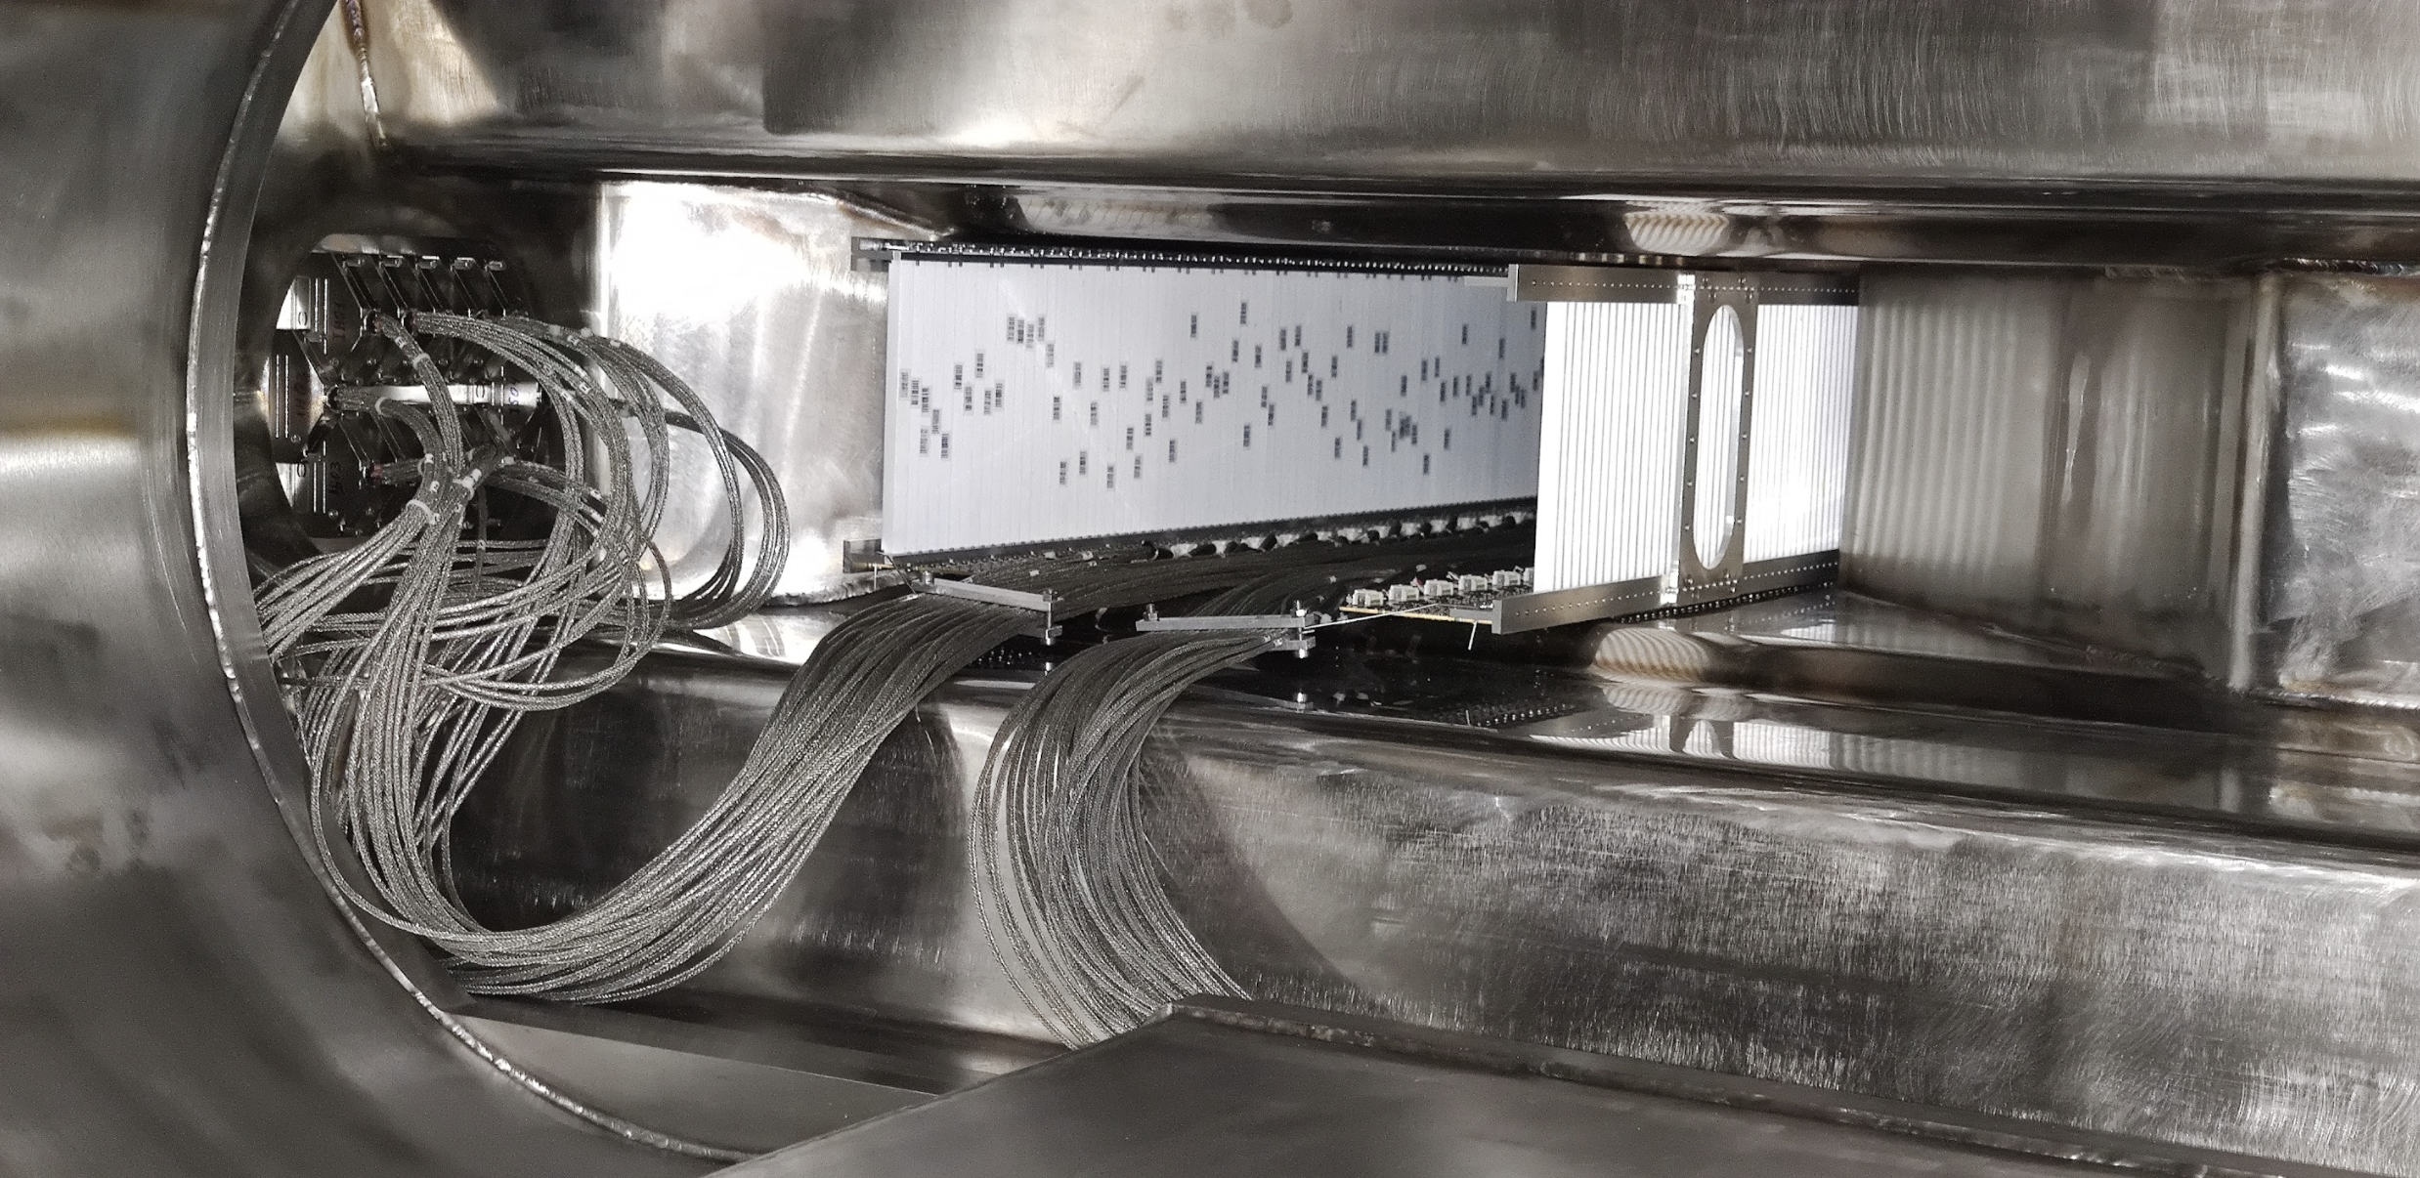
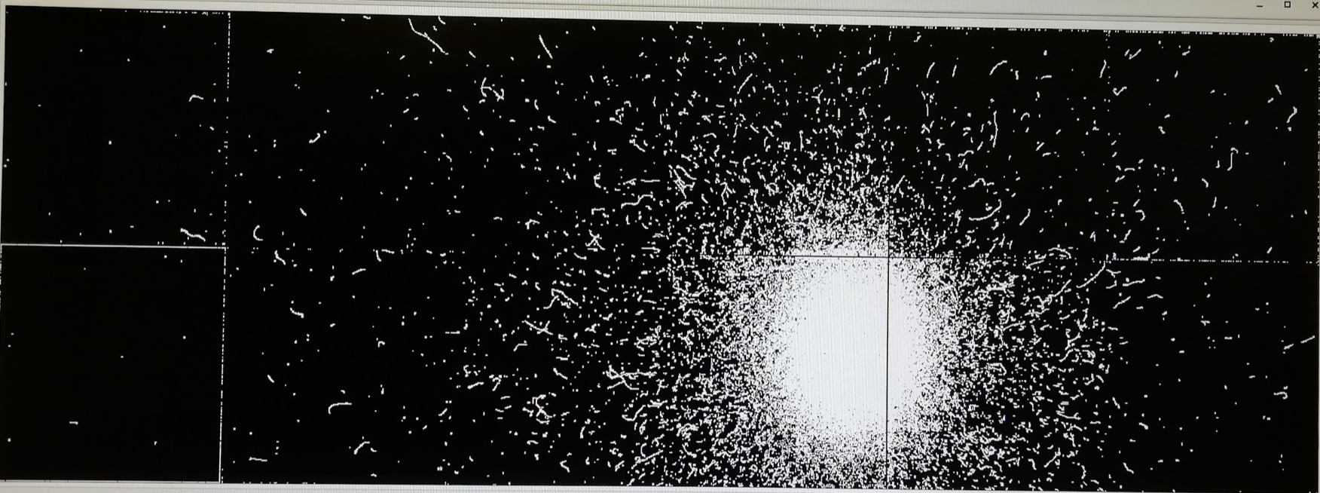
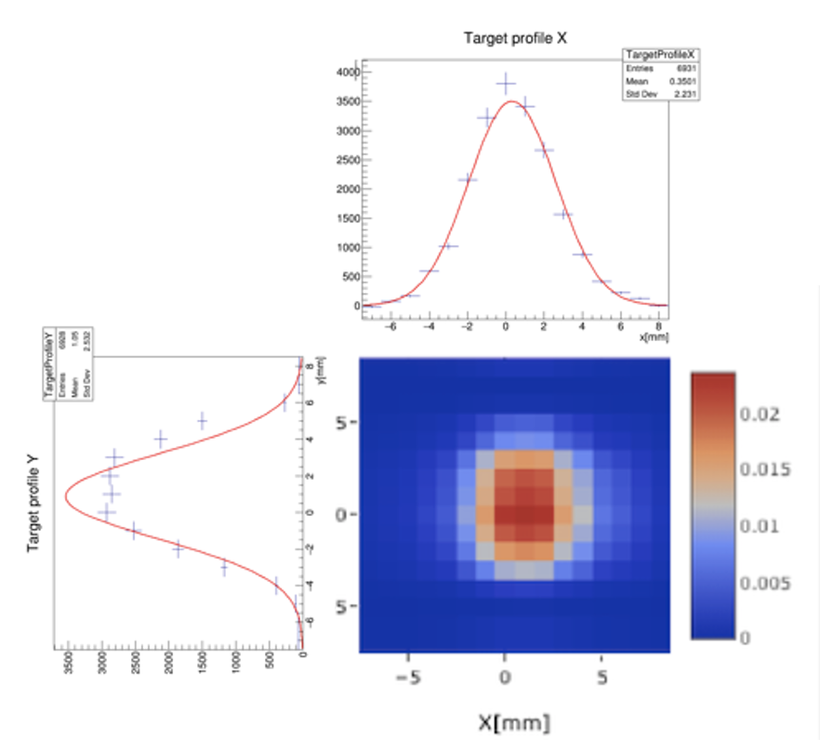
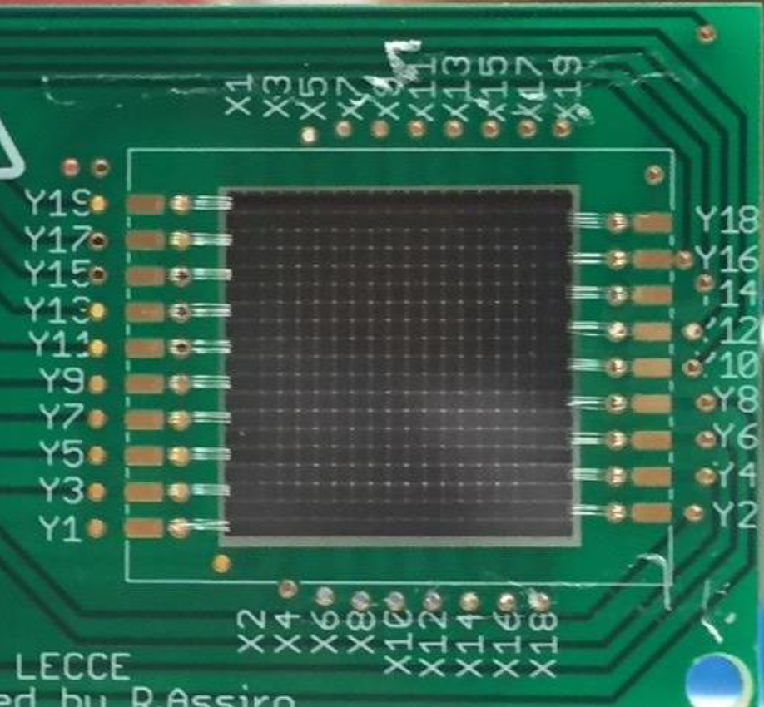
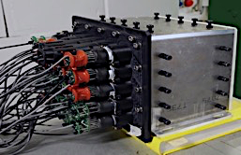
PADME Run I and Run II setup
Positron beam of $\sim$0.5 GeV/c
LINAC repetition rate 50 Hz
Macro-bunches maximum length $∆t≲$300 ns
Number of annihilations proportional to: $N_{beam}^{e^{+}}×N_{target}^{e^{−}}$
Limited intensity, due to pile-up, $\sim$3$∙$10⁴ pot/pulse
Dipole magnet in order to
Sweep away non-interacting positrons
Tag positrons losing energy by Bremsstrahlung
Scintillating bar veto detectors placed inside vacuum vessel
Positron and electron detectors inside the magnet gap
Additional veto for $e^{+}$ irradiating soft photons at beam exit
Silicon pixel (TimePix3)
e± Veto detectors
Active diamond target 100 $μ$m thick
small angle calo SAC PbF₂
BGO calorimeter (ECAL)

Slide 5
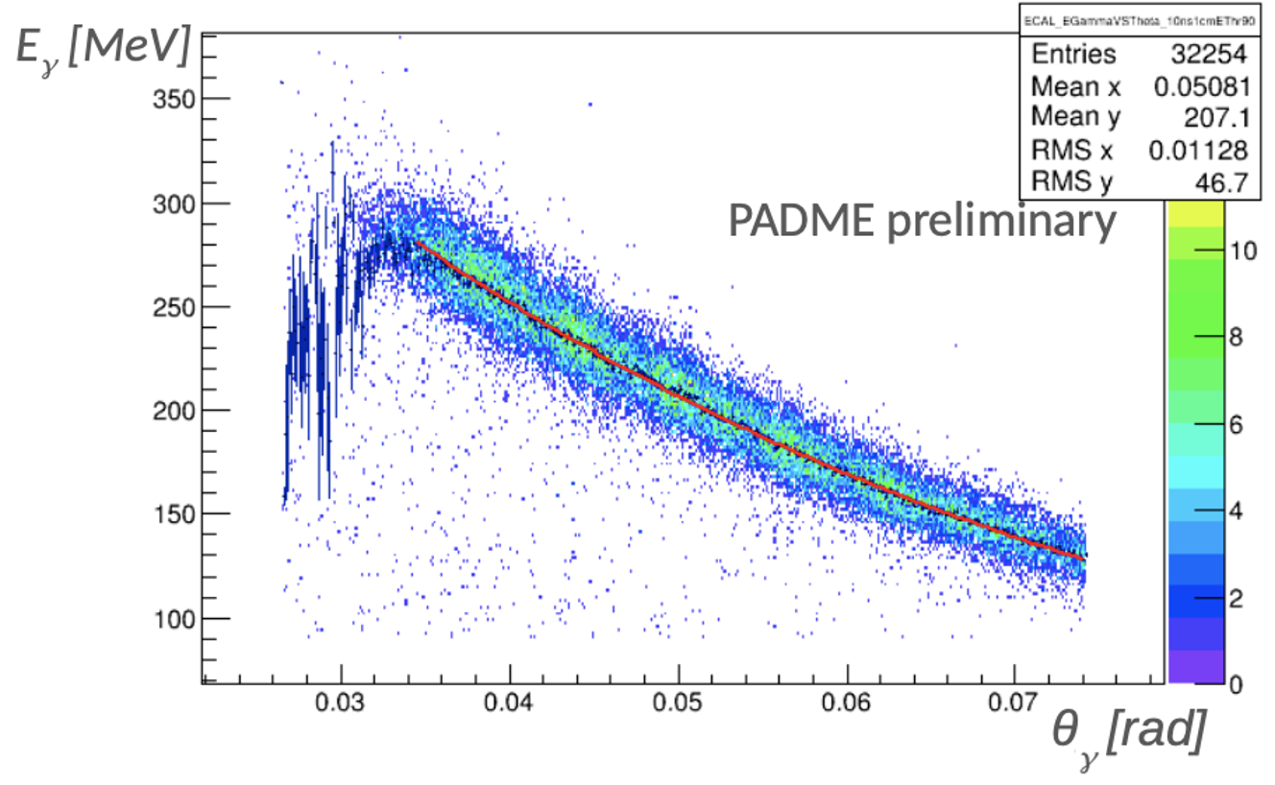
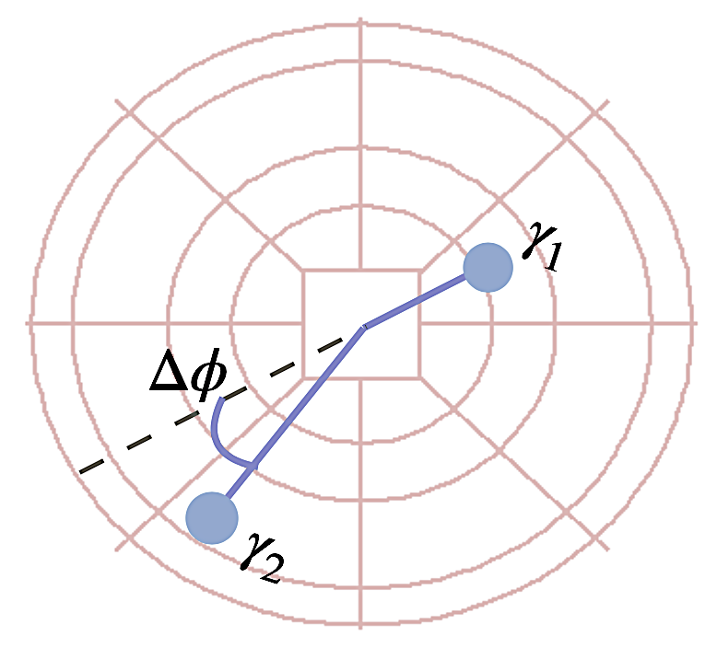
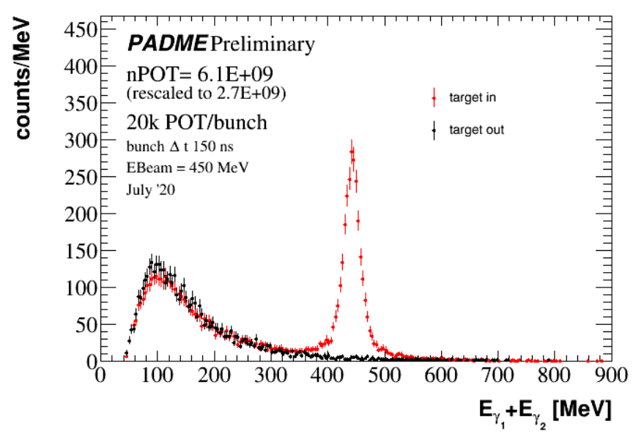
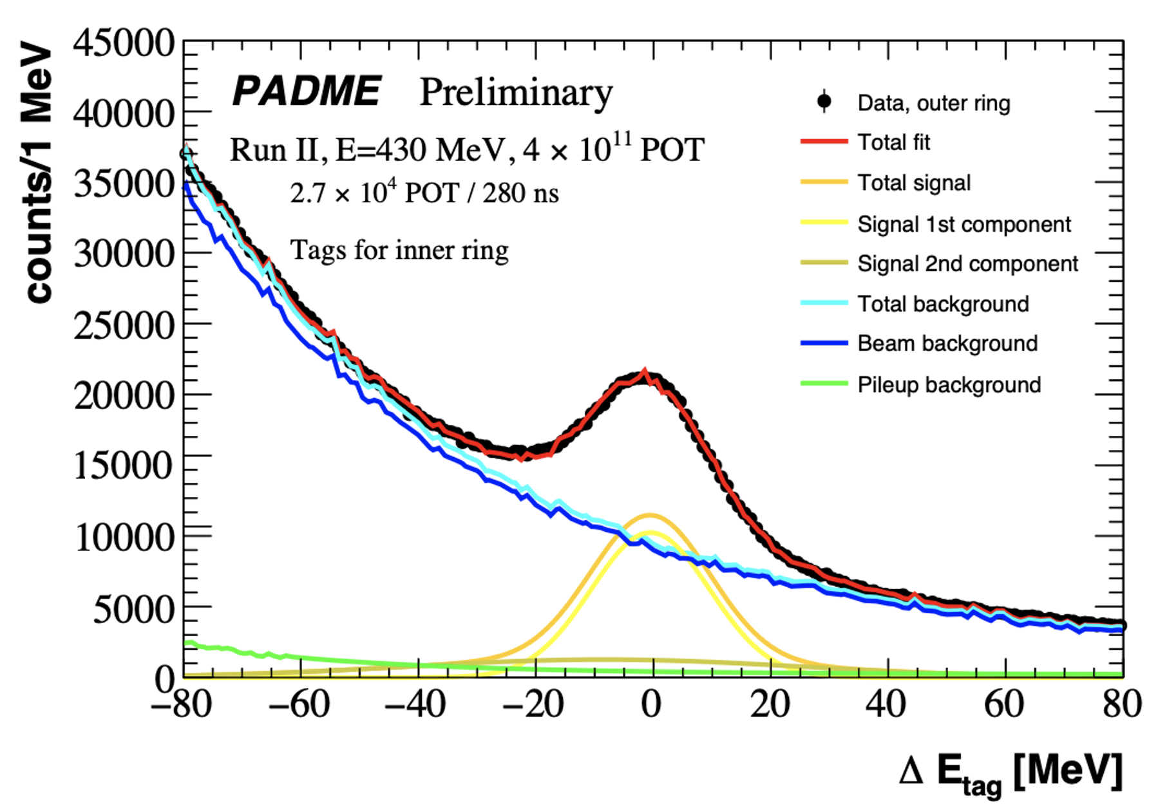
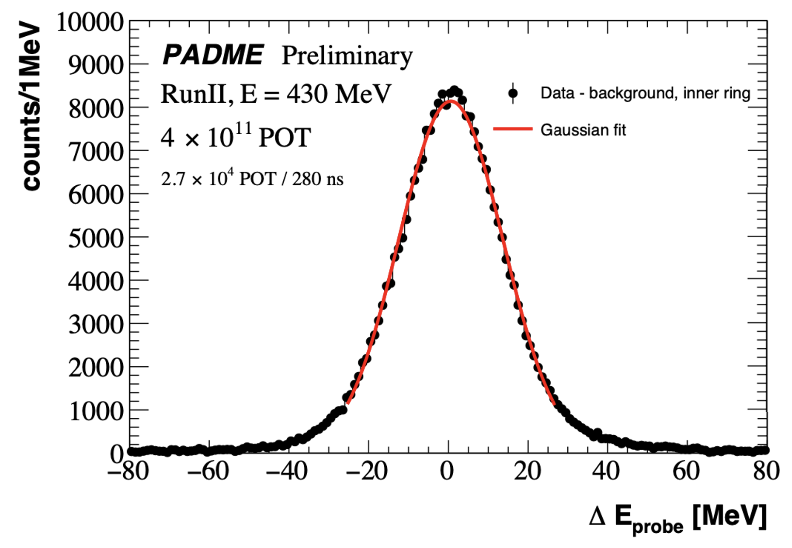
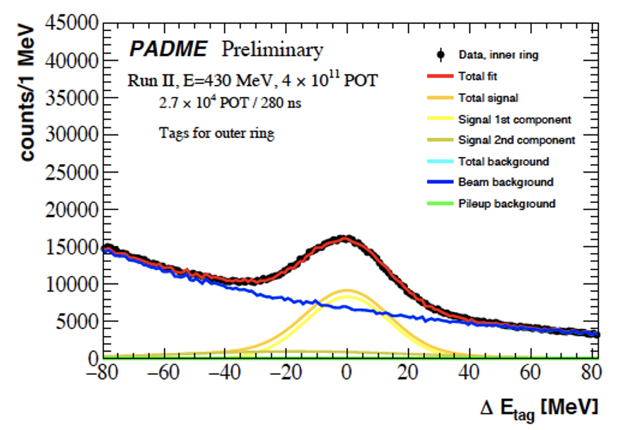
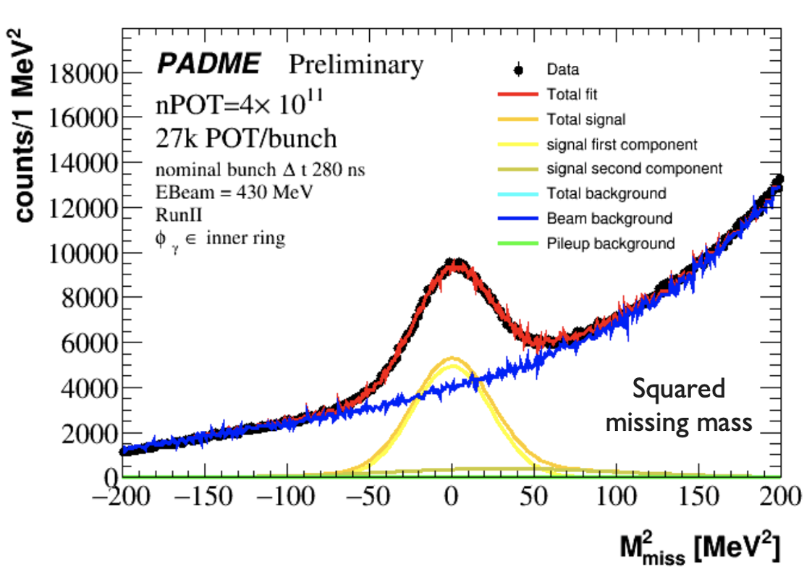
First physics result: σ(ee−>γγ) at √s=20 MeV
Normalization for single photon analysis
Independent determination of luminosity
SM Cross-section measurement
Tag-and-probe method on two back-to-back clusters
Exploit energy-angle correlation $E_{γ}=f(θ_{γ})$
Count tag photons with $E_{γ}−f(θ_{γ})\sim 0$
Match using $E_{γ1}+E_{γ2}=E_{beam}$ and count probes
Single photons selection
Subtract background from no target runs
$E_{γ}−f(θ_{γ})\sim 0$ and $m_{miss}^{2}\sim 0$
Tag photons selection
Probe photons
Single photon selection

Slide 6
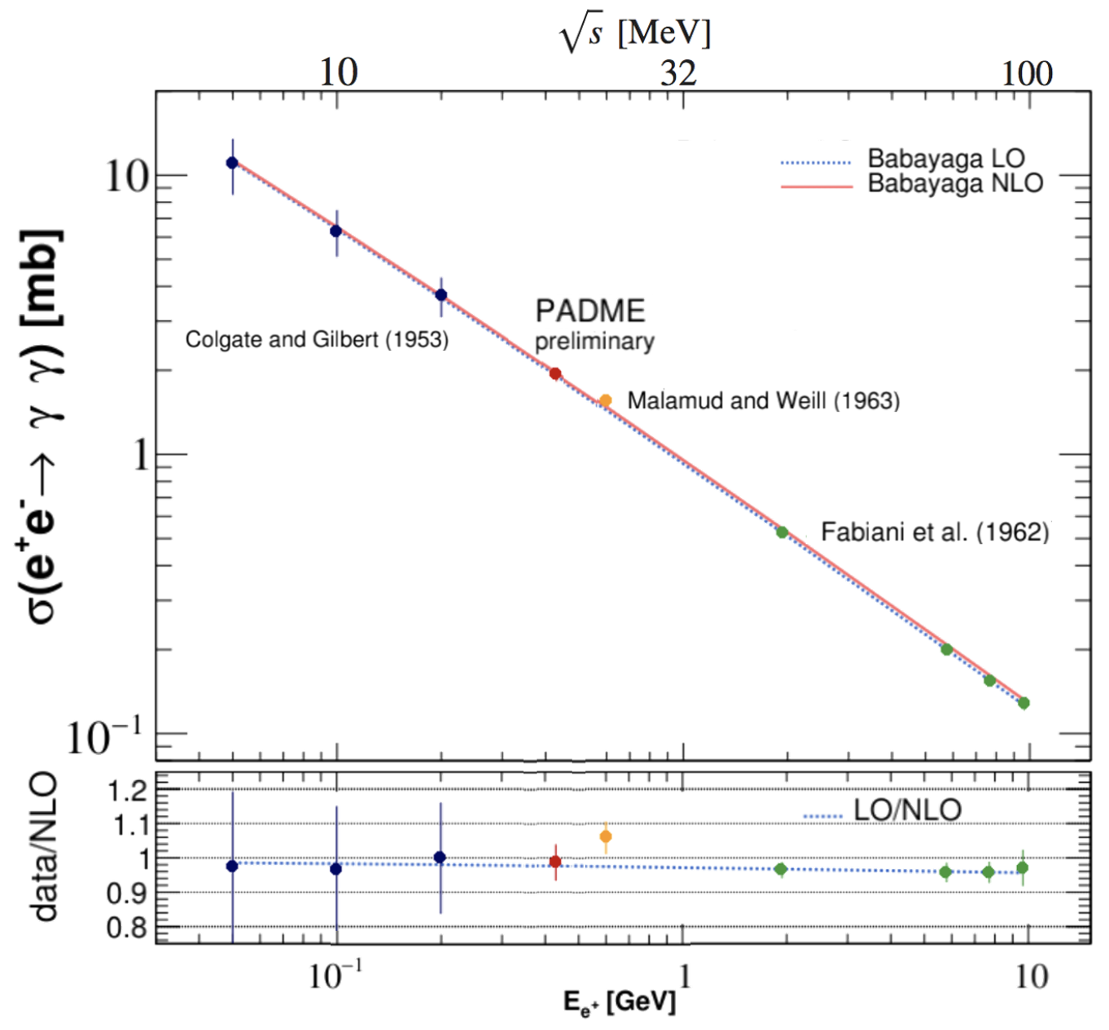
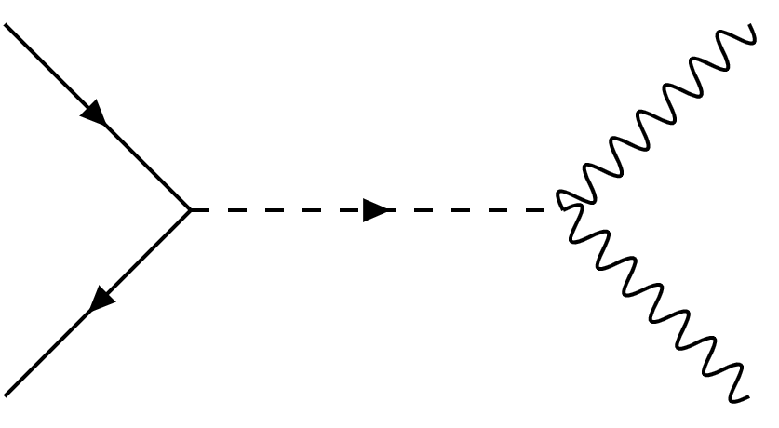
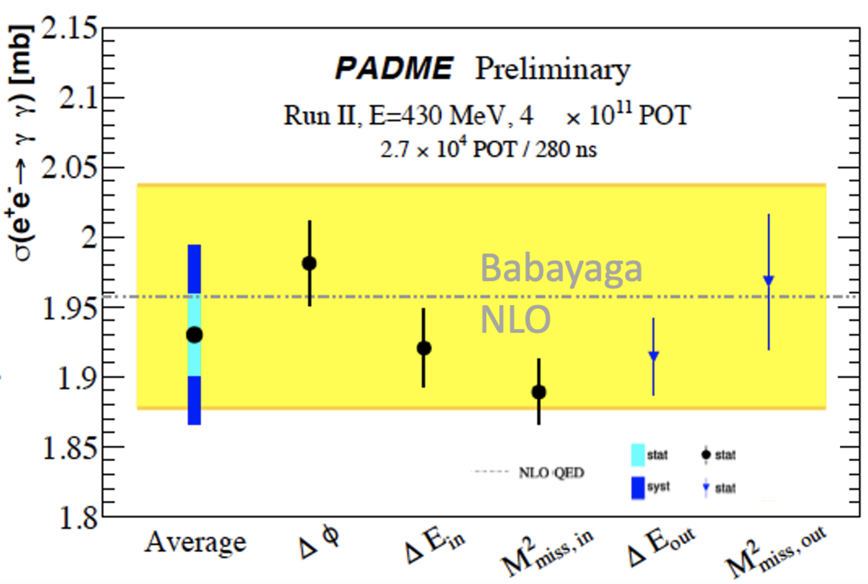
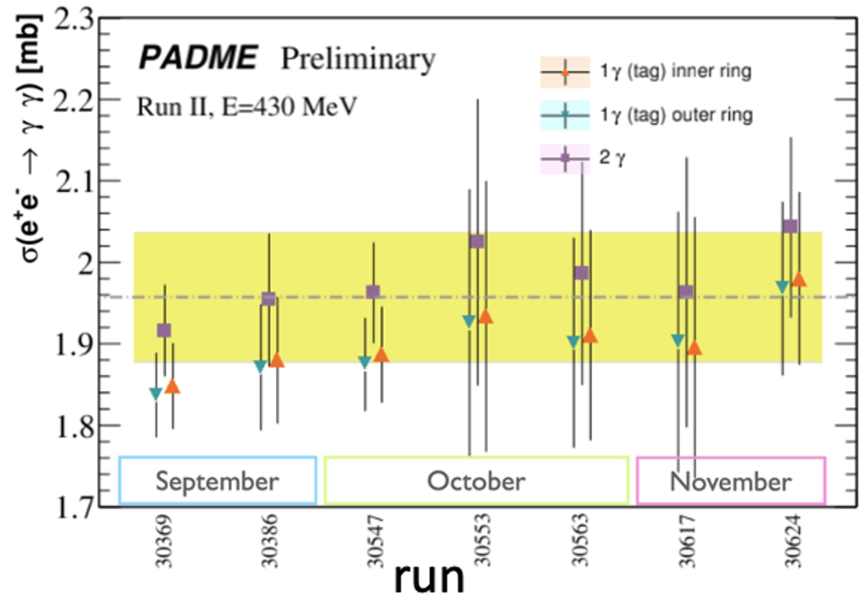
PADME σ(e⁺e⁻−>γγ) results
PADME 2020 (10% of 2020 data set)
Full details, see talk by I. Oceano at Moriond 2022
https://moriond.in2p3.fr/2022/EW/slides/3/2/5_IOceano.pdf
good agreement with NLO QED prediction:
First direct measurement of e⁺e⁻ −> γγ below 1 GeV
Both Gilbert ‘53 and Malamud ’63 measure e⁺ disappearance rates
Error dominated by luminosity measurement large room for improving.
Can constrain ALPs with both g_{e} and g_{γ} couplings
Including X17 with g_{ae} and g_{aγ} couplings
https://arxiv.org/abs/2210.14603 Submitted to PRD
e⁺
γ
a
g_{ae}
g_{aγ}
e⁻
γ
JHEP 06 (2021) 009

Slide 7
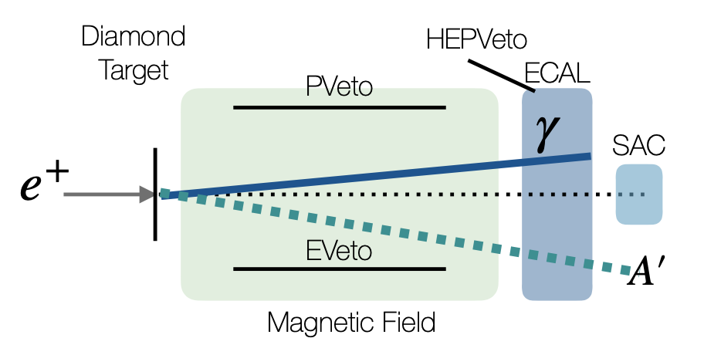
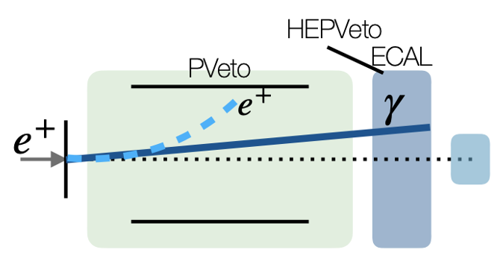
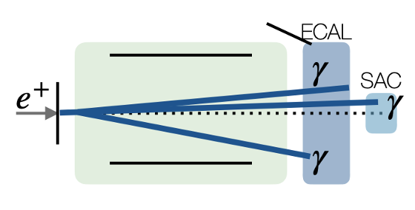
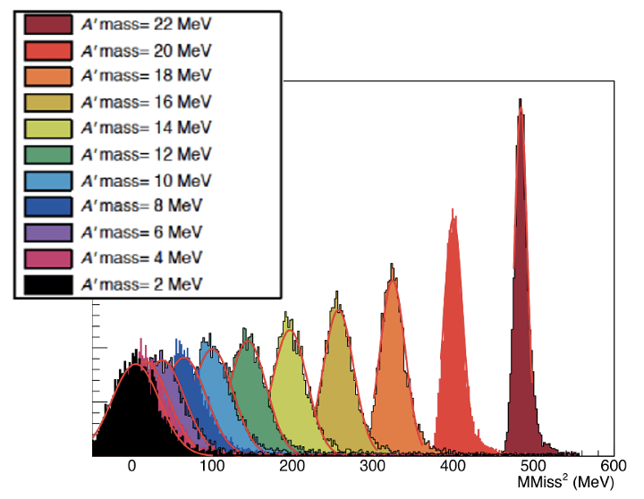
$A’$ to invisible signature Run II analysis
Signal:
Background: Bremsstrahlung
Background: $γγ$ and $γγγ$
Knowing the beam momentum ${\underline{p}}_{e^{+}}$, compute: $m_{miss}^{2}={({\underline{p}}_{γ}−{\underline{p}}_{e^{+}}−{\underline{p}}_{e^{−}})}^{2}$
Normalize to $γγ$ channel:
$$\frac{Γ\left(e^{+}e^{−}→A^{′}γ\right)}{Γ\left(e^{+}e^{−}→γγ\right)}=$$
$$=\frac{N\left(A^{′}γ\right)}{N\left(γγ\right)}\frac{Acc\left(γγ\right)}{Acc(A^{′}γ) }=εδ$$
Background: beam crash
γ
e⁺

Slide 8
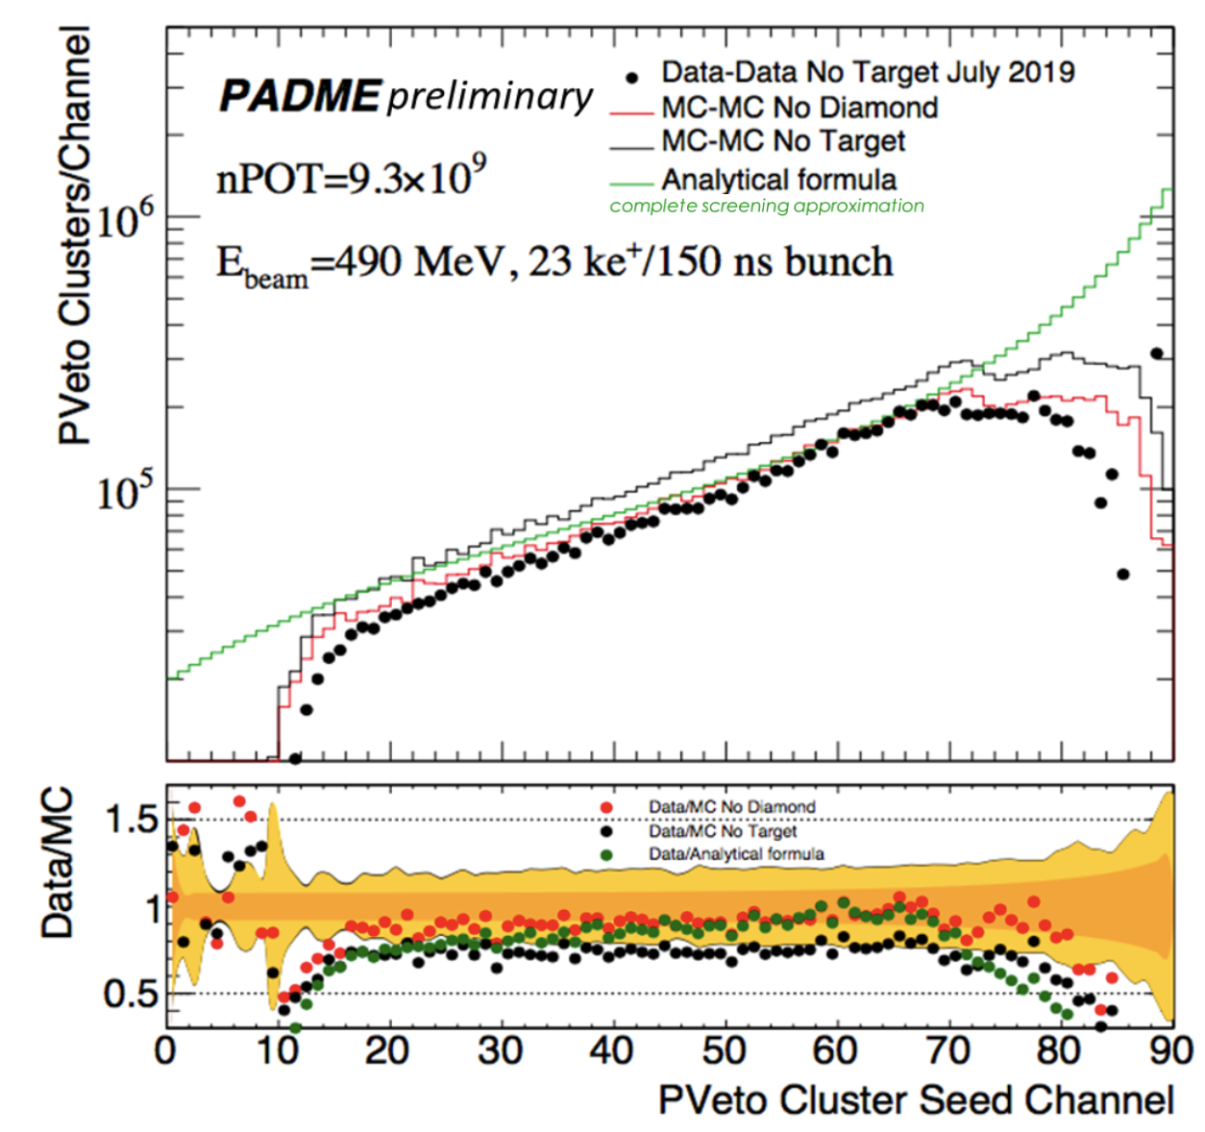
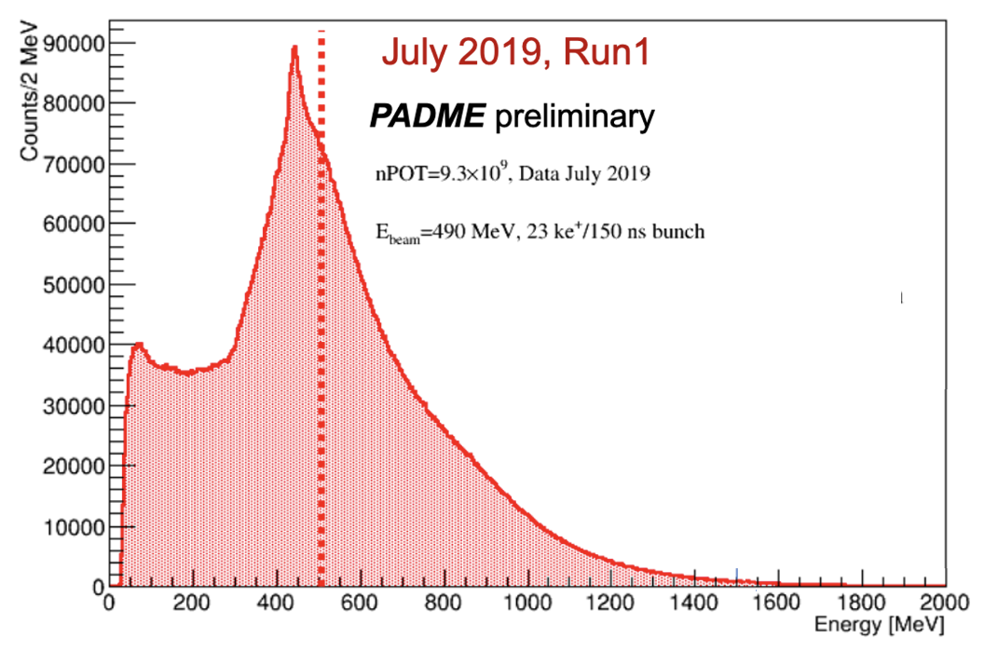
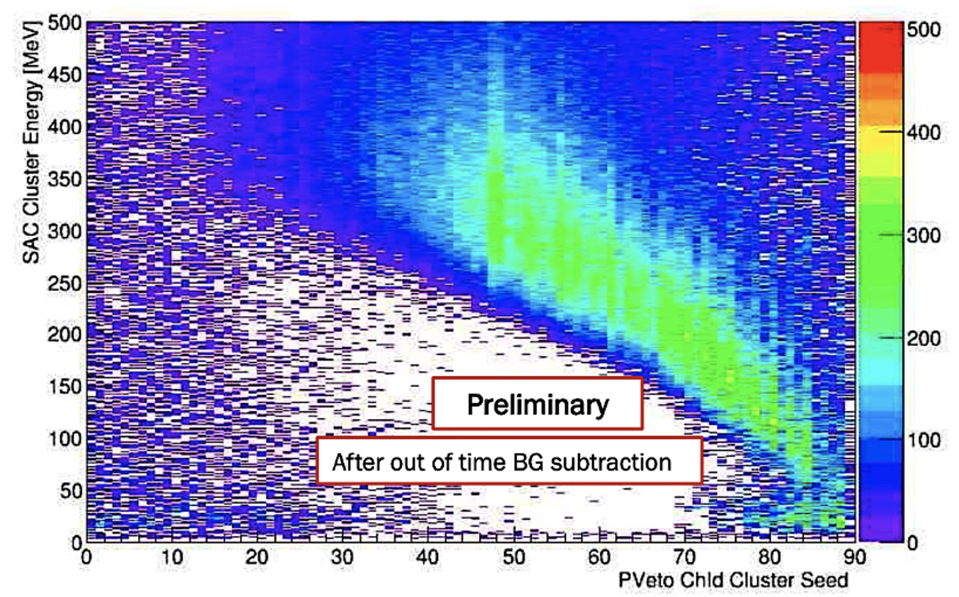
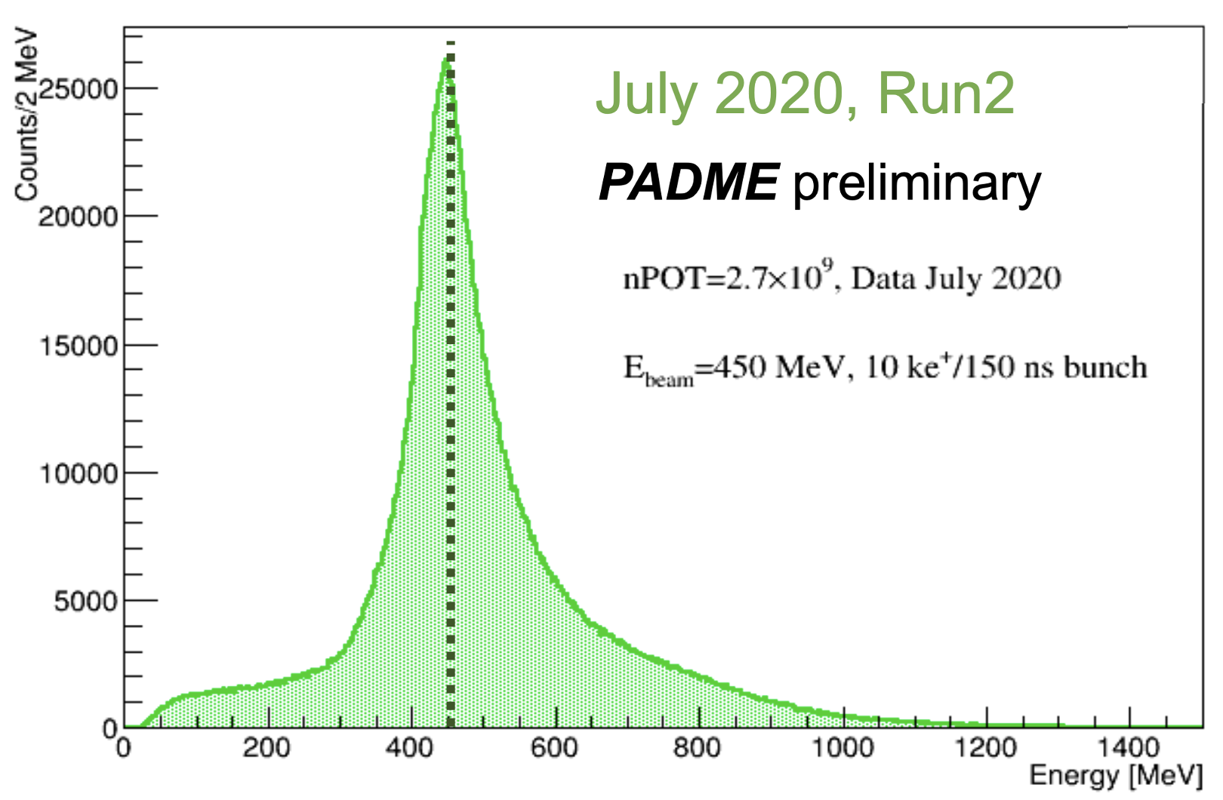
Single photon events
Physics backgrouns dominated by Bremsstrahlung:
Measured with no-target runs and subtracted
Bremstrahlung photon distribution in agreement with Monte Carlo simulation and analytical calculation
Main systematic uncertainties:
Background normalization
Positron momentum scale
n POT calibration
$p_{γ}^{ECal}+$ $p_{e^{+}}^{PVeto}$
Essential for dark photon analysis
Veto momentum vs. SAC energy
490 MeV, primary beam, $∆t<$1 ns
$p_{γ}^{ECal}+$ $p_{e^{+}}^{PVeto}$

Slide 9
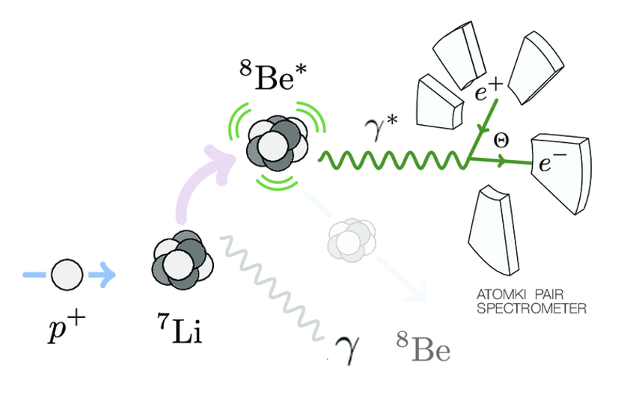
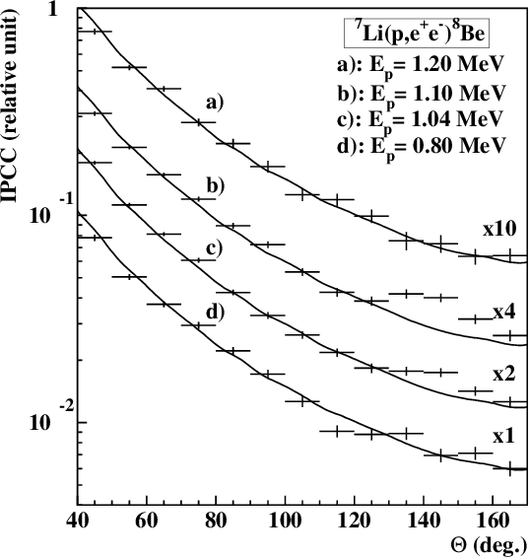
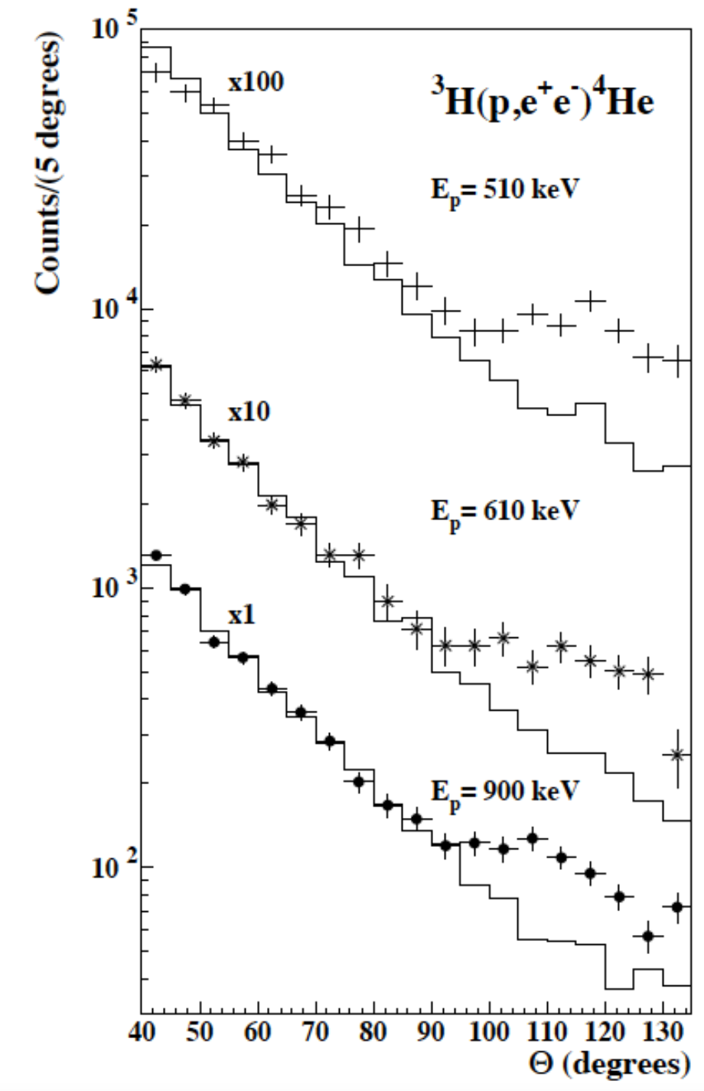
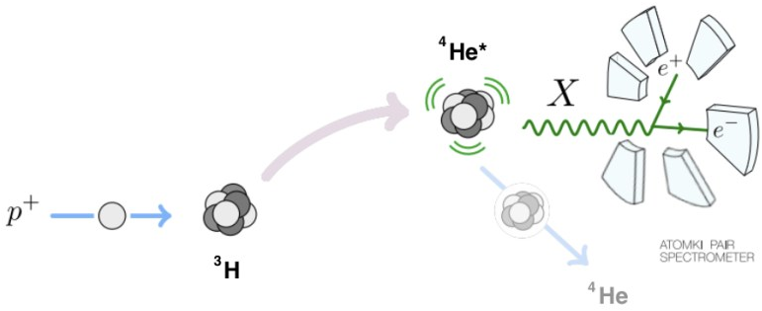
The ⁸Be and ⁴He Atomki anomaly
PRL 116, 042501 (2016)
Phys. Rev. C 104, 044003 (2021)
2016
$$7Li(p,e^{+}e^{−})8Be$$
$$3He\left(p,e^{+}e^{−}\right)4He$$
2020
$$m_{X}c^{2}=17.01 ±0.16\left(tot\right) MeV$$
PRL 116, 042501 (2016)
$$m_{X}c^{2}=16.98 ±0.16(stat) ±0.20(syst) MeV$$
Phys. Rev. C 104, 044003 (2021)
ATOMKI has confirmed the anomalous peak in the angular distribution of internal pair creation in ⁸Be with a similar one in the ⁴He transitions, with different kinematics but at the same invariant mass value.

Slide 10
The ¹²C anomaly and the vector portal
ArXiv:2209.10795v1
Sept 2022
¹²C*
$$11B\left(p,e^{+}e^{−}\right)12C$$
¹¹B
¹²C
4 different bombarding energies with strong significance
E=17.23 MeV excited state of ¹²C

Slide 11
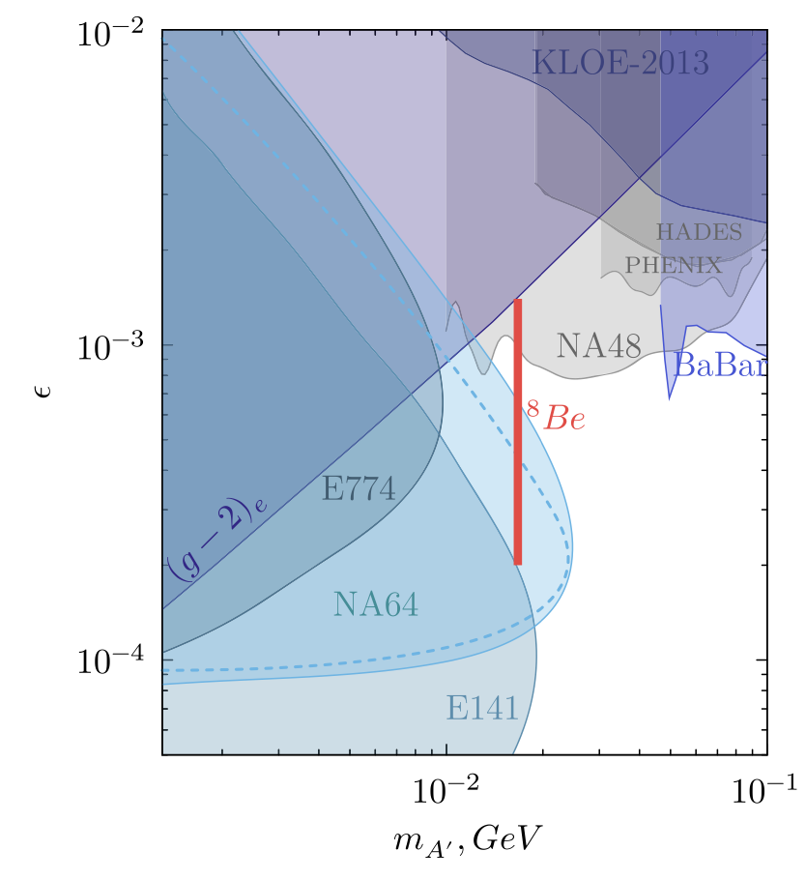
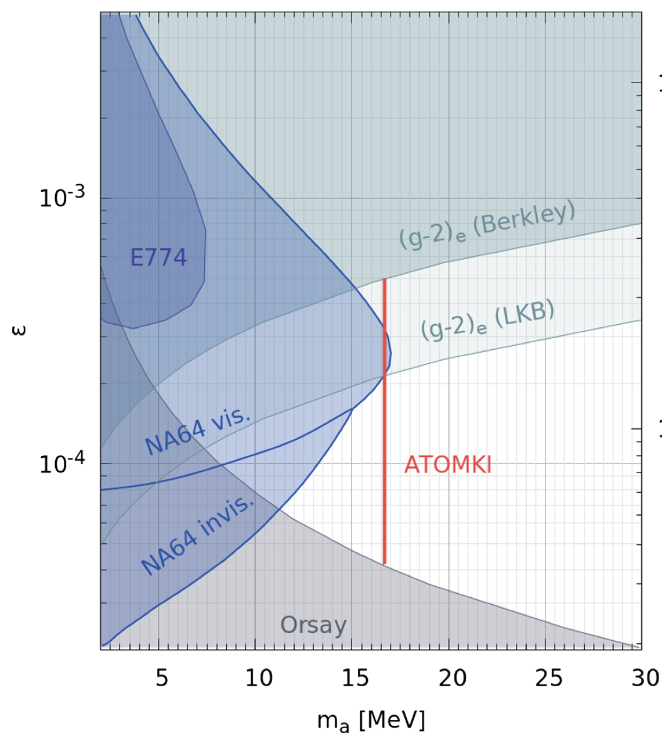
Current constraints on X17 from leptons
Phys. Rev. D 101, 071101 (R) (2020)
Phys. Rev. D 104, L111102 (2021)
X17 as a vector particle:
LKB (g-2)_{e} bound weaker for vector and model dependent
NA48/2 bound not valid for “protophobic” X17
Still a lot of free parameter space for vector X17
X17 as pseudo scalar particle:
(g-2)_{e} bound stronger for pseudo scalars
Still model dependent and with big data uncertainties
Almost unconstrained parameter space for X17

Slide 12
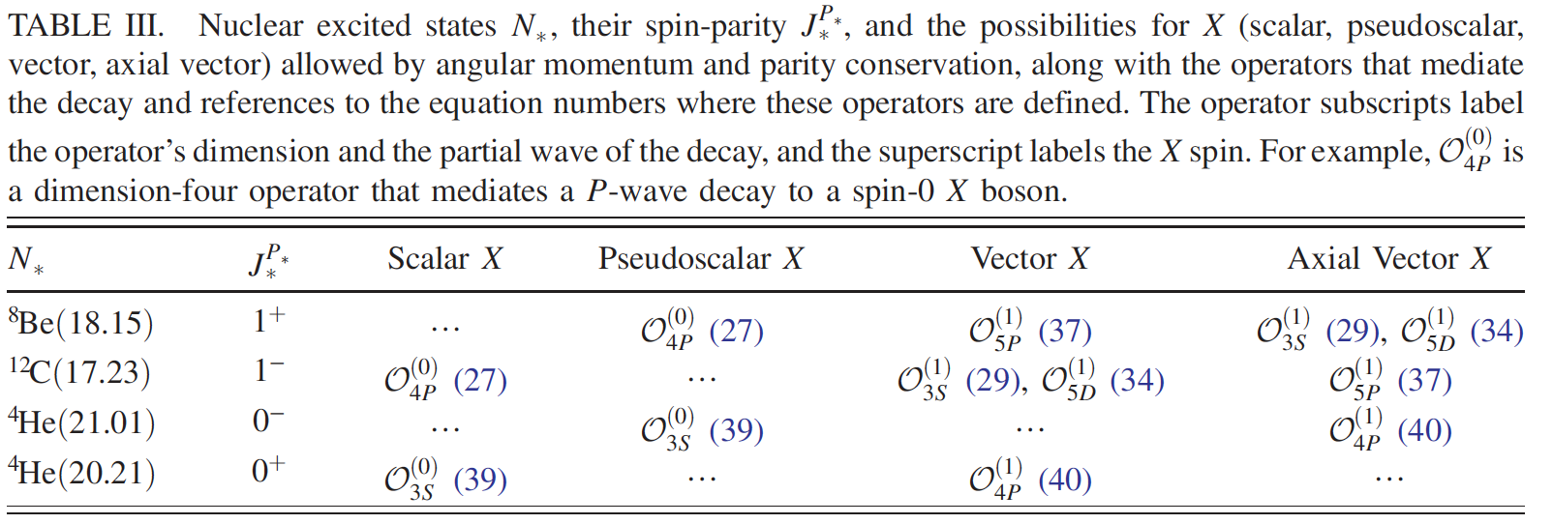
On the nature of X17
Feng and collaborators suggested that the X17 should be observed in ¹²C transitions
X17 observations in ¹²C will point to a vector or axial vector nature for X17

Slide 13
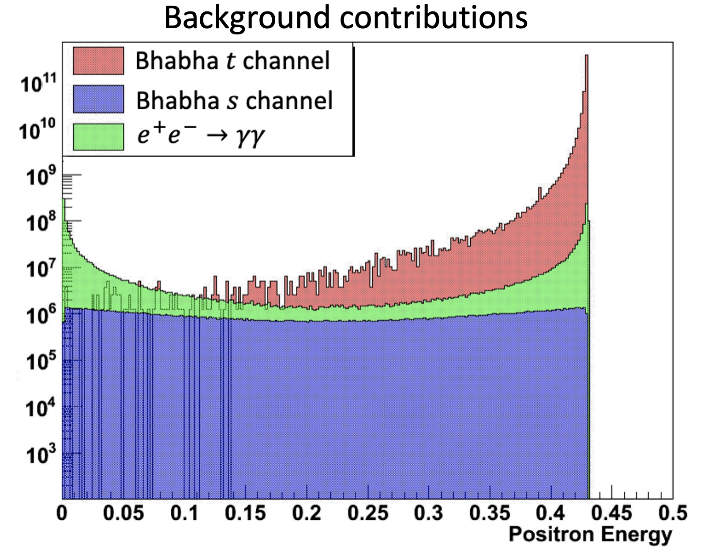
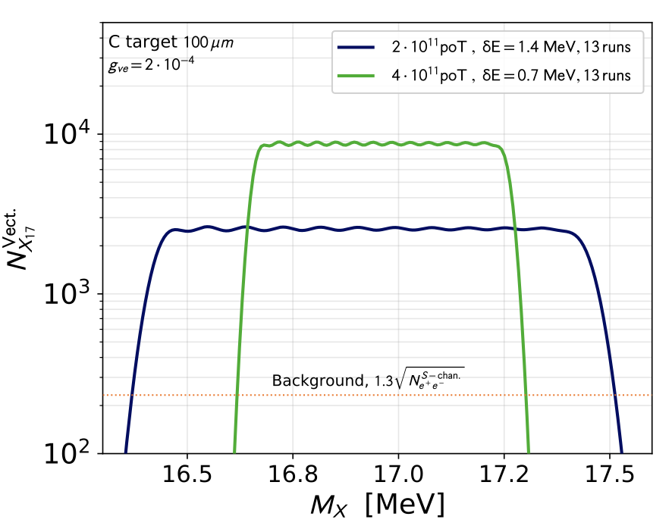
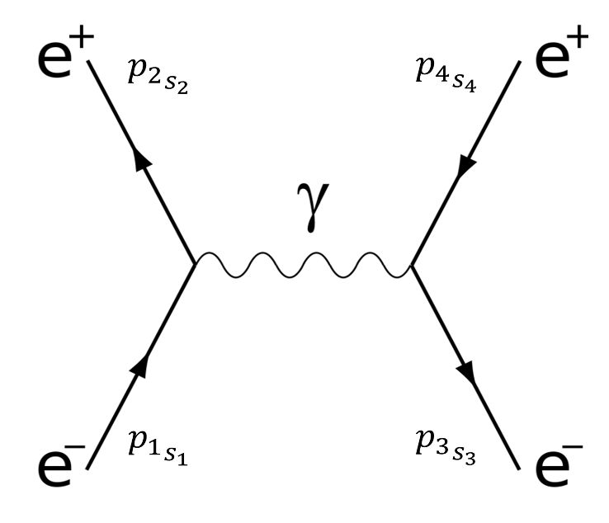
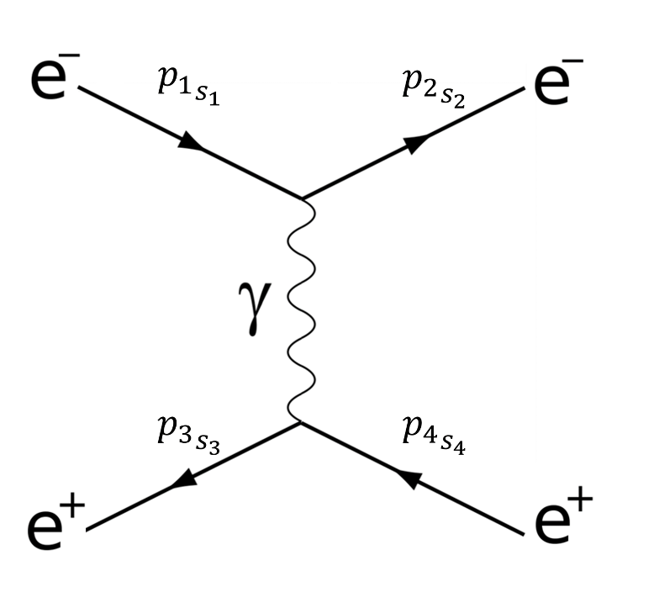
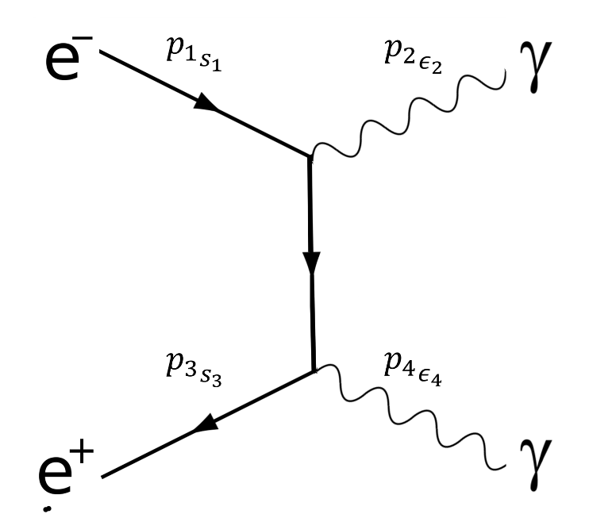
The mass scan X17 search strategy
PADME, can use resonant X17 production process
Extremely effective in producing X17 but in a very small mass range
Scan E_{beam}=260–300 MeV in ~1.5 MeV steps
Need only ~10¹⁰ POT per point
Signal should emerge on top of Bhabha BG in one point of the scan.
Critical parameter for signal to background optimization: beam energy spread
$Signal$ e⁺e⁻−>X₁₇ −> e⁺e⁻
X₁₇
$$Bhabha scattering$$
$t$channel
$s$channel
e⁺e⁻−>γγ

Slide 14
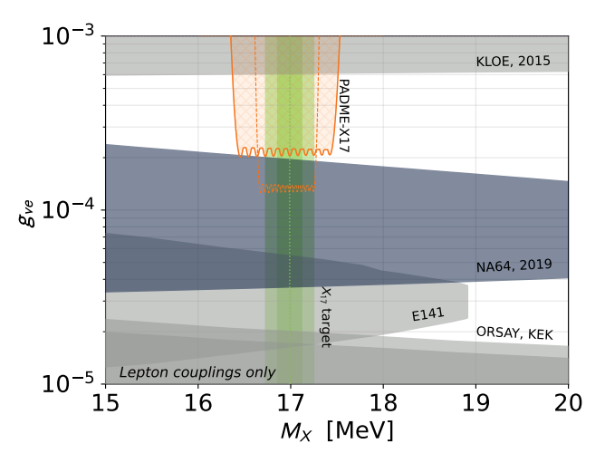
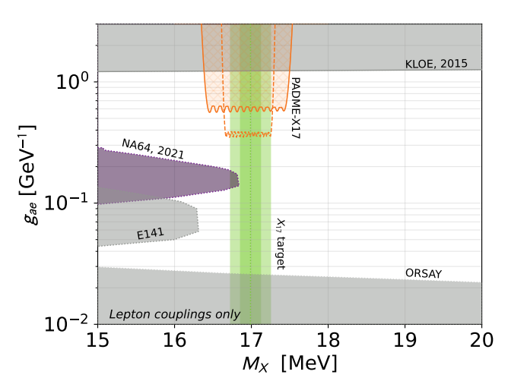
PADME expected sensitivity
L. Darmé, M. Mancini, E. Nardi, M.R. https://arxiv.org/pdf/2209.09261.pdf
Vector X17
Pseudo scalar X17
BG from SM Bhabha scattering under control down to ε = few 10⁻⁴
Challenge is to achieve an extremely precise luminosity measurement and systematic errors control
PADME maximum sensitivity in the vector case

Slide 15
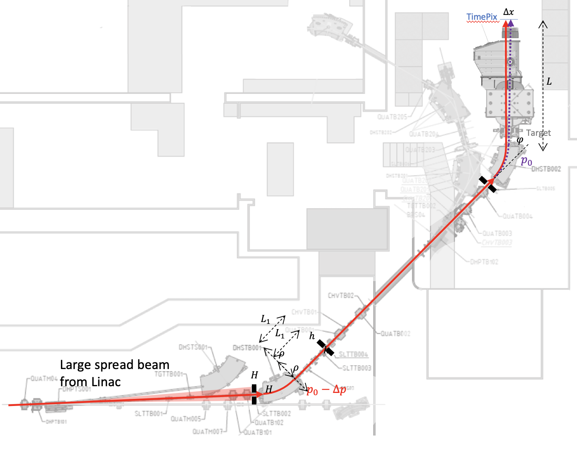
Estimating the energy spread
In a spectrometer line the horizontal position of a particle with momentum $p=p_{0}(1+δ)$ with $δ=∆p/p_{0}$, will be offset by $∆x=D_{x}δ$, where $D_{x}$is the dispersion function; $D_{x}≈Lφ$ ($L$ is the arm length and $φ$ the deflection angle)
The beam spot size is given by:
$$σ_{x}=\sqrt{εβ+{\left(\frac{D_{x}σ_{p}}{p}\right)}^{2}}$$
If the geometric beam size in absence of dispersion can be neglected,$\sqrt{εβ}≪$ $\frac{D_{x}σ_{p}}{p}$, we can get the spread from:
$$\frac{σ_{p}}{p}≈1/D_{x}∙σ_{x}$$
From a no-target run (otherwise Coulomb scattering would be not negligible) we estimate: $\frac{σ_{p}}{p}≈$ 0.24%
Can also be computed from collimators’ gaps/distances [Nucl. Instrum. Meth. A515 (2003) 524]:
$\left|\frac{∆E}{E}\right|=\frac{h}{2ρ}+\sqrt{2}\left(\frac{R_{x}}{L_{1}}+\frac{H}{2L_{1}}\right)≅\frac{h}{2ρ}+\sqrt{2}\frac{H}{L_{1}}$
With H=h=2 mm we get 0.22%

Slide 16
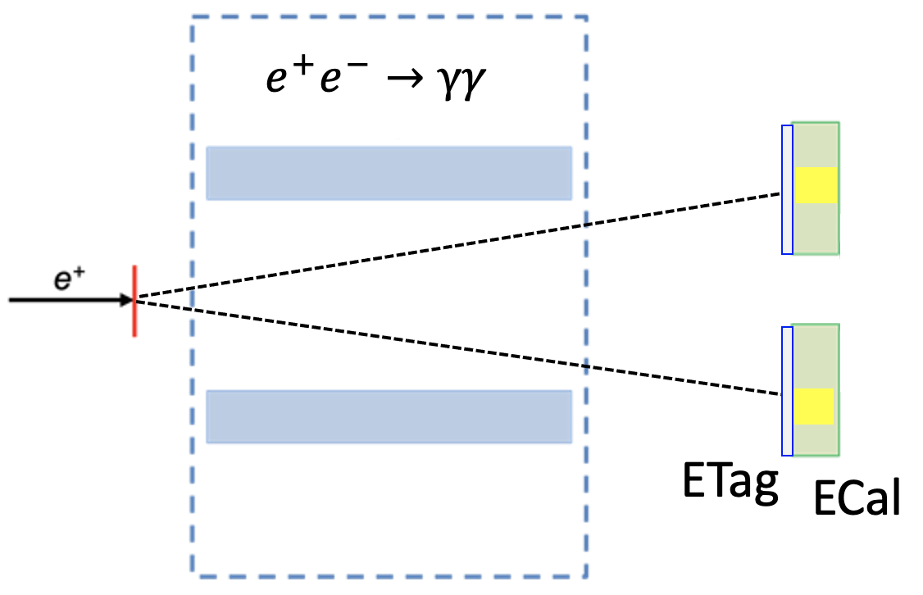
PADME Run III modified setup
PADME veto spectrometer is hard to reconstruct 𝑒⁺ 𝑒⁻ mass having no vertex detector
Idea: identify 𝑒⁺𝑒⁻→𝑒⁺𝑒⁻ using the BGO calorimeter, as for γγ events in Run II
Switch the magnet off
Both positron and electron will reach the ECal
Can measure precisely (3%) electron-positron pair momentum and angles
Can reconstruct invariant mass of the pairs precisely (small pile-up)
Identify clusters in ECal from photons or electrons
New detector, plastic scintillators, similar to PADME vetos (Electron tagger, ETag) with vertical segmentation and covering the fiducial region of ECal
Thanks to the enhanced production cross section can reduce
N_{POT}/bunch by factor 10.
Much lower pile-up and better energy resolution

Slide 17
First look at Run III data set

Slide 18
Status of the Run III data taking
Try to cover the blue scan with
the green granularity
Acquire points below and above the X17 mass to measure the SM e⁺e⁻ −>e⁺e⁻ cross section
Already covered a region of ~1MeV around the X17 resonance
Now running off resonance below 211 MeV beam energy

Slide 19
2022 PADME publication list
https://arxiv.org/abs/2210.14603 submitted to PRD

Slide 20
PADME possible future data taking
Run III has demonstrated that BTF can provide 1E10 POT/Day (2.5K/bunch)
2.5K POT/bunch with σ_{E} ~0.25%
Can move the beam energy in steps of 1.4 MeV to perform mass scan
The BG it’s due to few e⁺ scattered off trajectory by the mylar window
Using thinner mylar window (50 μm tested for SHERPA) can further reduce BG.
Can increase Npot/bunch to 5K and move to 2 points/day with 1.4 MeV steps
PADME can cover 300 MeV − 430 MeV in ~95 points ~60 days reaching 21MeV mass
PADME can cover 130 MeV − 260 MeV in ~95 points ~60 days reaching 11 MeV mass
Linac capability of providing a reliable beam (as good as in the range 210-430 MeV) down to 130 MeV has to be checked
A third energy point for cross-section extrapolation (in absence of a resonance) would be also very useful
PADME can cover 10 MeV mass range to ε~2-3x10⁻⁴ and close the exclusion gap
130<E_{B}<260 MeV
11.5<M_{X}<16.3MeV
300<E_{B}<430 MeV
17.5<M_{X}<21 MeV

Slide 21
Conclusions
PADME performed two physics runs, collecting $\sim$5$∙$10¹² POT each
Run II data-set, collected during the pandemics, with primary positron beam showed much better background conditions than Run I
The detectors are performing very well, a reliable Monte Carlo simulation, including the beamline, is also available
PADME delivered its first physics result
$σ(e^{+}e^{−}→γγ)$= 1.930 ± 0.029(stat) ± 0.099(syst) mb
5% precision, best measurement below 1 GeV
Can constrain pseudo-scalar dark sector candidates
A step towards the invisible dark photon analysis
Single photon analysis under way, Bremsstrahlung and beam crash background rejection being the key issues
PADME Run III is ongoing and will address the X17 anomaly, trying to significantly impact the vector portal scenario.
Many thanks to the BTF staff, Acc. Div. operators and technical services

Slide 22
Beam studies for X17
Requirements
Variable beam momentum: to be changed in steps of 1-2 MeV in a range 265-300 MeV/$c$
Momentum spread $∆p=$ 1-1.5 MeV, i.e. $∆p/p=$0.3-0.5%
Intensity: a few 10³ positrons/pulse, pulse lenght 100 ns or more
Main objectives of the tests:
primary beam (requires more LINAC tuning) vs. secondary beam (much lower intensity)
Target sensitivity to lowest possible intensity beam
With the secondary beam at BTF:
Intensity depends on primary starting energy and collimators gap
Collimators gap: trade-off between intensity AND momentum spread
Beam studies from July 11 to July 22:
Secondary positron beam, 290 MeV
Intensity too low with required collimator settings
Much higher background opening the collimators
No target readout to wrong HV connection
No Timepix information due to serious software issues (massive rewriting by the Sofia group)
ETag working well from the very beginning
Beam halo exceeding the ECal hole size
$≈$30 GeV in ECal /2000 positrons
$≈$80 ns pulse length

Slide 23
How can we make our life easier?
Positron beams
We need higher production cross section!
Can move from associated to resonant production
b) Radiative annihilation O(α²)
c) Resonant annihilation O(α)
Profit for a higher production in a tiny mass region

Slide 24
PADME X17 searches on Run II data
e⁺
γ
e⁻
e⁻
X17
e⁺
Final state e⁺e⁻ −> X₁₇ γ −> e⁺e⁻ γ
Use radiative return E_{beam} =430 MeV
small contribution from γγ
Large beam γ background reducing the sensitivity
Try to identify pairs of leptons using PADME veto
Large BG from BhaBha scattering
Large beam background increasing combinatorics BG
Lepton invariant mass not accessible

Slide 25
g-2e anomaly
Significant discrepancy in the last two results on the α determination
Produce a modified (g-2)_{e} exclusion which allows a region of existence of X17
https://www.nature.com/articles/s41586-020-2964-7

Slide 26
Muon g-2 anomaly
g-2 in the standard model
About 3σ discrepancy between theory and experiment (3.6σ, if taking into account only e+e−>hadrons)
Additional diagram with dark photon exchange can fix the discrepancy (with sub GeV A’ masses)
Contribution to g-2 from dark photon
g-2 and A’
A’

Slide 27
dark sectors in the future of LNF?
Background dominated: the limit scales as $\sqrt{bkg}$ so great improvement can come from a significant background reduction
Ideally, from a “single-particle” experiment with a continuous or quasi-continuous beam
Project for using DAFNE ring as pulse stretcher of the LINAC positron beam, in principle 10¹⁶ POT achievable in few years arXiv:1711.06877, Phys. Rev. Accel. Beams 25 (2022) 3, 033501

Slide 28
Extending the LINAC pulse
The more ambitious way: use a ring as pulse stretcher
Various ideas with different levels of performance/complexity:
Use the $n+\frac{1}{3}$ resonant extraction, varying the tune with synchrotron loss + chromaticity [POSEYDON, arXiv:1711.06877, J. Phys. Conf. Ser. 1067 (2018) 6, 062006]
Assist the extraction with crystal channeling in place of a electrostatic septum [SHERPA, Phys. Rev. Accel. Beams 25 (2022) 3, 033501]
Beam pulse length in the range O(10)-O(100) $μ$s or more, from 10² to 10³ more statistics with same background
A simpler way: remove the RF compression by the SLED in the LINAC
Various ideas with different levels of performance/complexity: [arXiv:2001.10258]
Beam pulse length up to O(2 $μ$s), 10 more statistics with same background
Part of the discussion on FFF (Fundamental Physics at Frascati) summarized in [Universe 7 (2021) 7, 236]

