Slide 1
LINAC & BTF
L. Foggetta on the behalf of
LINAC/BTF Group
Researchers (5):
B. Buonomo, F. Cardelli,
D. Di Giovenale, C. Di Giulio,
L. G. Foggetta
Technicians (7):
R. Ceccarelli, A. Cecchinelli,
M. Ceccarelli, G. Piermarini,
A.L. Rossi, S. Strabioli, R. Zarlenga
Retired: M. Belli, R. Clementi

Slide 2


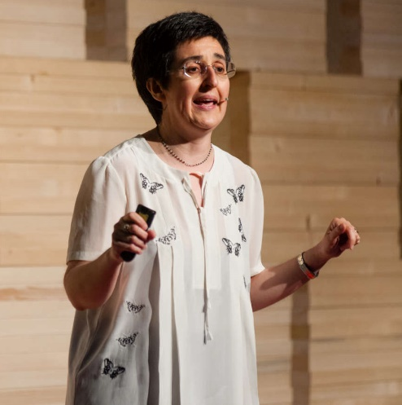
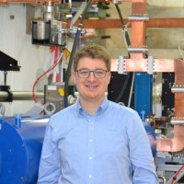
BTF user committee members
New:
Michela Prest – INFN and Università degli studi dell’Insubria (Como-IT)
Florian Burkart – DESY (Hamburg-DE)
Existing:
Vincenzo Patera - INFN and Sapienza University, (Roma-IT) - BTFUC
Bruno Buonomo – INFN-LNF - Tech. Resp. - BTFUC
Luca Foggetta – INFN-LNF - Scient. Resp. - BTFUC
Claudio Di Giulio – INFN-LNF
Domenico Di Giovenale – INFN-LNF
Fabio Cardelli – INFN-LNF
We greatly thanks BTFUC 0ct.2018-June 2022
Erika De Lucia (INFN-LNF)
Barbara Liberti (INFN-Roma2)
Giovanni Ambrosi (INFN-Perugia)
for their strong, pragmatic and extremely professional support in such a difficult previous years

Slide 3
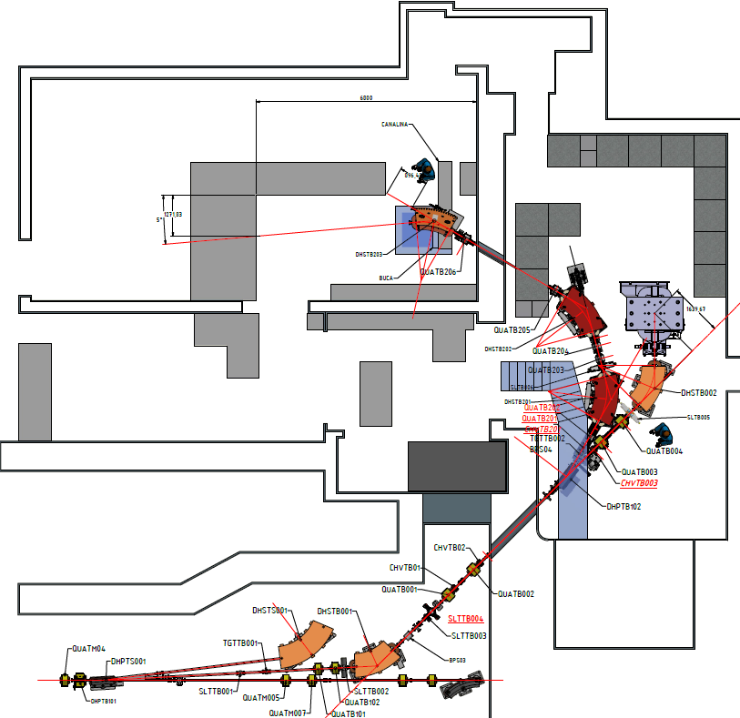
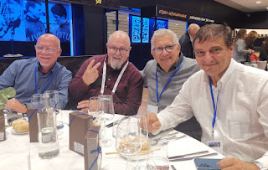
Activities
BTF1, BTF2 for user run
LINAC and BTF for X17 run
LINAC and BTF projects
27/09/2022 35° year

Slide 4

BTF

Slide 5
Brief activities summary
What we got from last SciCom (Spring 2022 – Fall 2022) – Internal activities
BTFEH2 final commissioning phase 12 Apr -> 19 Apr
LINAC for SIDDHARTA Run up to Jul
BTF user run on both BTFEH1 and BTFEH2, all of the 3 LINES up to June end
ERAD run 3 (good ended project) Jul 2022
PADME/X17 Trials revamp and preps Jul 2022
During summer shutdown
Huge maintenance on LINAC – steering replacement
Shielding on BTF1-straight increased
Some Difficulties in restart (burned different pieces) but no delays
BTF1 for X17 run 28 Sep. -> up to now

Slide 6


LNF – BTF Three Lines status
BTFEH1 – BTF1 (2 lines)
BTF EXP. HALL 1 (BTFEH1)
Hall Operative devoted to ERAD project and PADME experiment, nowadays X17
Involved in opportunistic INFN runs up to BTF2 commissioning phase 3 (FISMEL – SPARCULENS)
Upgraded vacuum line BTF1 straight for OTR charge measurement and single shot emittance test with two optical lines
Experiments
BTF2
12m²
BTF1 bend
20m²
BTFEH2 – BTF2 (1 line)
BTF1 straight
1m²
Hall operative, external users run period accomplished Apr->July 2022
Only BTF2 line to external users
  Intended for weekly based users
  Only secondary beam
  Limited performances respect to BTF1
  Foreseen external users from March 2023
Involved in EUROLABS Project, started on Autumn 2022
BTFEH2
BTFEHs
BTF-common line
Software for automated call on going:
  First release in July
  Advanced Debugging phase

Slide 7
LNF – Beam Test Facility
Parameters | BTF1 Time sharing |  | BTF1 Dedicated |  | BTF2 Time sharing | BTF2 Dedicated
 | With Cu target | Without Cu target | With Cu target | Without Cu target | With Cu target | With Cu target
Particle | e⁺ / e⁻ (User ) | e⁺ / e⁻ (DAΦNE status) | e⁺ / e⁻ (User ) |  | e⁺ / e⁻ (User )
Energy (MeV) | 25–500 | 510 | 25–700 (e⁻/e⁺) | 167–700 (e⁻) 250–550 (e⁺) | 25–500 | 25–700
Best Energy Resolution at the experiment | 0.5% at 500 MeV | 0.5%/1% | 0.5%(Energy/mult dependent) |  | 1% at 500 MeV(Energy/mult dependent)
Repetition rate (Hz) | Variable from 1 to 49 (DAΦNE status) |  | 1–49 (User) |  | Variable from 1 to 49 (DAΦNE status) | 1–49 (User)
Pulse length (ns) | 10 |  | 1.5–320 (User) |  | 10 | 10
Intensity (particle/bunch) | 1–10⁵ (Energy dependent) | 10³ to 1.5x10¹⁰ | 1–10⁵ (Energy dependent) | 1 to 3x10¹⁰ | 1–10⁴ (Energy dependent)
Max int flux | 3.125x10¹⁰ part./s |  |  |  | 1x10⁶ part./s
Beam waist size(mm) | 0.5–55 X / 0.35–25 Y (vacuum window dependent) |  |  |  | 1x1(Energy/mult dependent)
Divergence (mrad) | Down to 0.5 |  |  |  | Down to 0.5
Pulsed electron and positron beams (up to 49 pulses/second)
Wide range: from 10^10 down to single particle per bunch, continuous energy selection
Different ranges of parameters in the two running modes:
  Dedicated: only when DAΦNE collider in shutdown, exclusive BTF users
  Time sharing:
    DAΦNE spare pulse injections mode via DHPTB101 pulsed magnet
    Beam top parameters defined by DAΦNE injections

Slide 8
2022/2023 ACTIVITIES Gantt
Recommendations DAFNE-BTF SC63
• A risk analysis concerning the possible failure of Klystron C should
be conducted and mitigation or intervention plans should be
established in view of the 2023 BTF/DAΦNE run.
2022 beam planning expectations well accomplished
2023 planning performed (Oct 2022 )
Maybe DAFNE off for the most of the year (see C. Milardi pres.)
An extension of X17 Run TBD
Delayed restart in March 2023 for KlyC assestment
LINAC/BTF team mainly involved in 2023 for BTF operations
EUROLABS inclusion (1w payed)

Slide 9
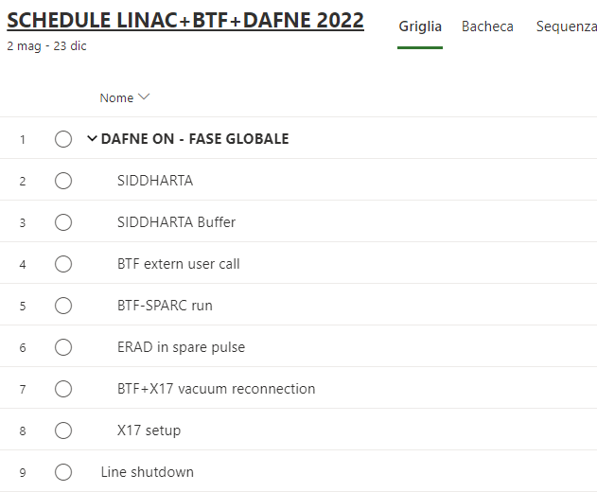
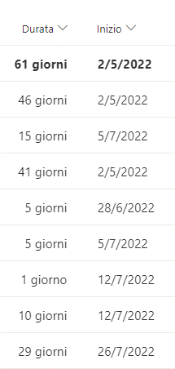
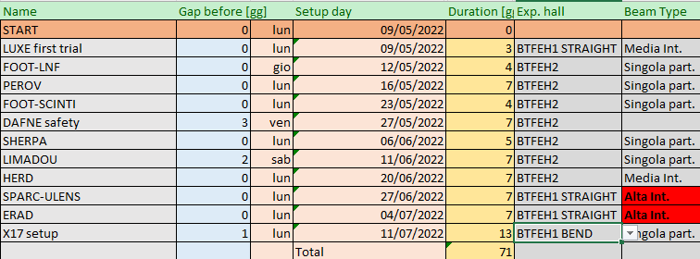
Early 2022 ACTIVITIES Gantt
From May to July
From BTF project office (Jan schedule for Spring act.):
All of the foreseen items respected
Delayed days = 0
BTF beam availability = 99,9% (just a unexpected coffee break)
71 slotted days
10 Users

Slide 10
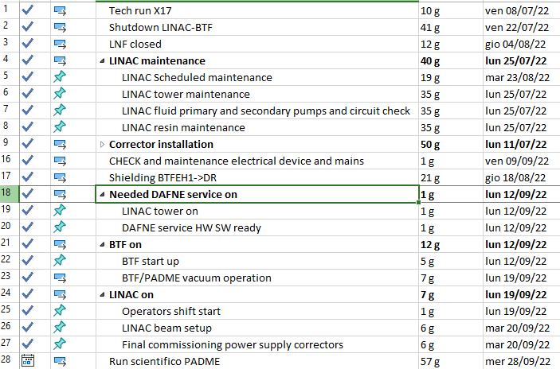
Late 2022ACTIVITIES Gantt
From BTF project office (April schedule for Summer/Fall act.):
All of the foreseened items respected
Summer time preparation
Difficult but on time restart
GANTT in working days (add 40% for 24/7 ops)
Big work in summer time exp. for LINAC
  32/46 LINAC steering correctors refurbished (Control Magnet and LINAC service deeply involved)
  Improving building in BTF/DR frontier (dismounting PS and air ducts, concrete improvements, restoring from scratch – Fluids, Electrical and Building service, Tech. Division)
Huge number of died elements and faults in restart:
  BTF: RACK PCs (thanks to R. Gargana), hv board,
  Out of service of DHPTB101 PS!!!
    Our great Magnet group switched to spare DC power supply in a week
    Problem for BTF+DAFNE ops.
Hurry for maintain starting date due to reduced personnel -> GOT IT

Slide 11
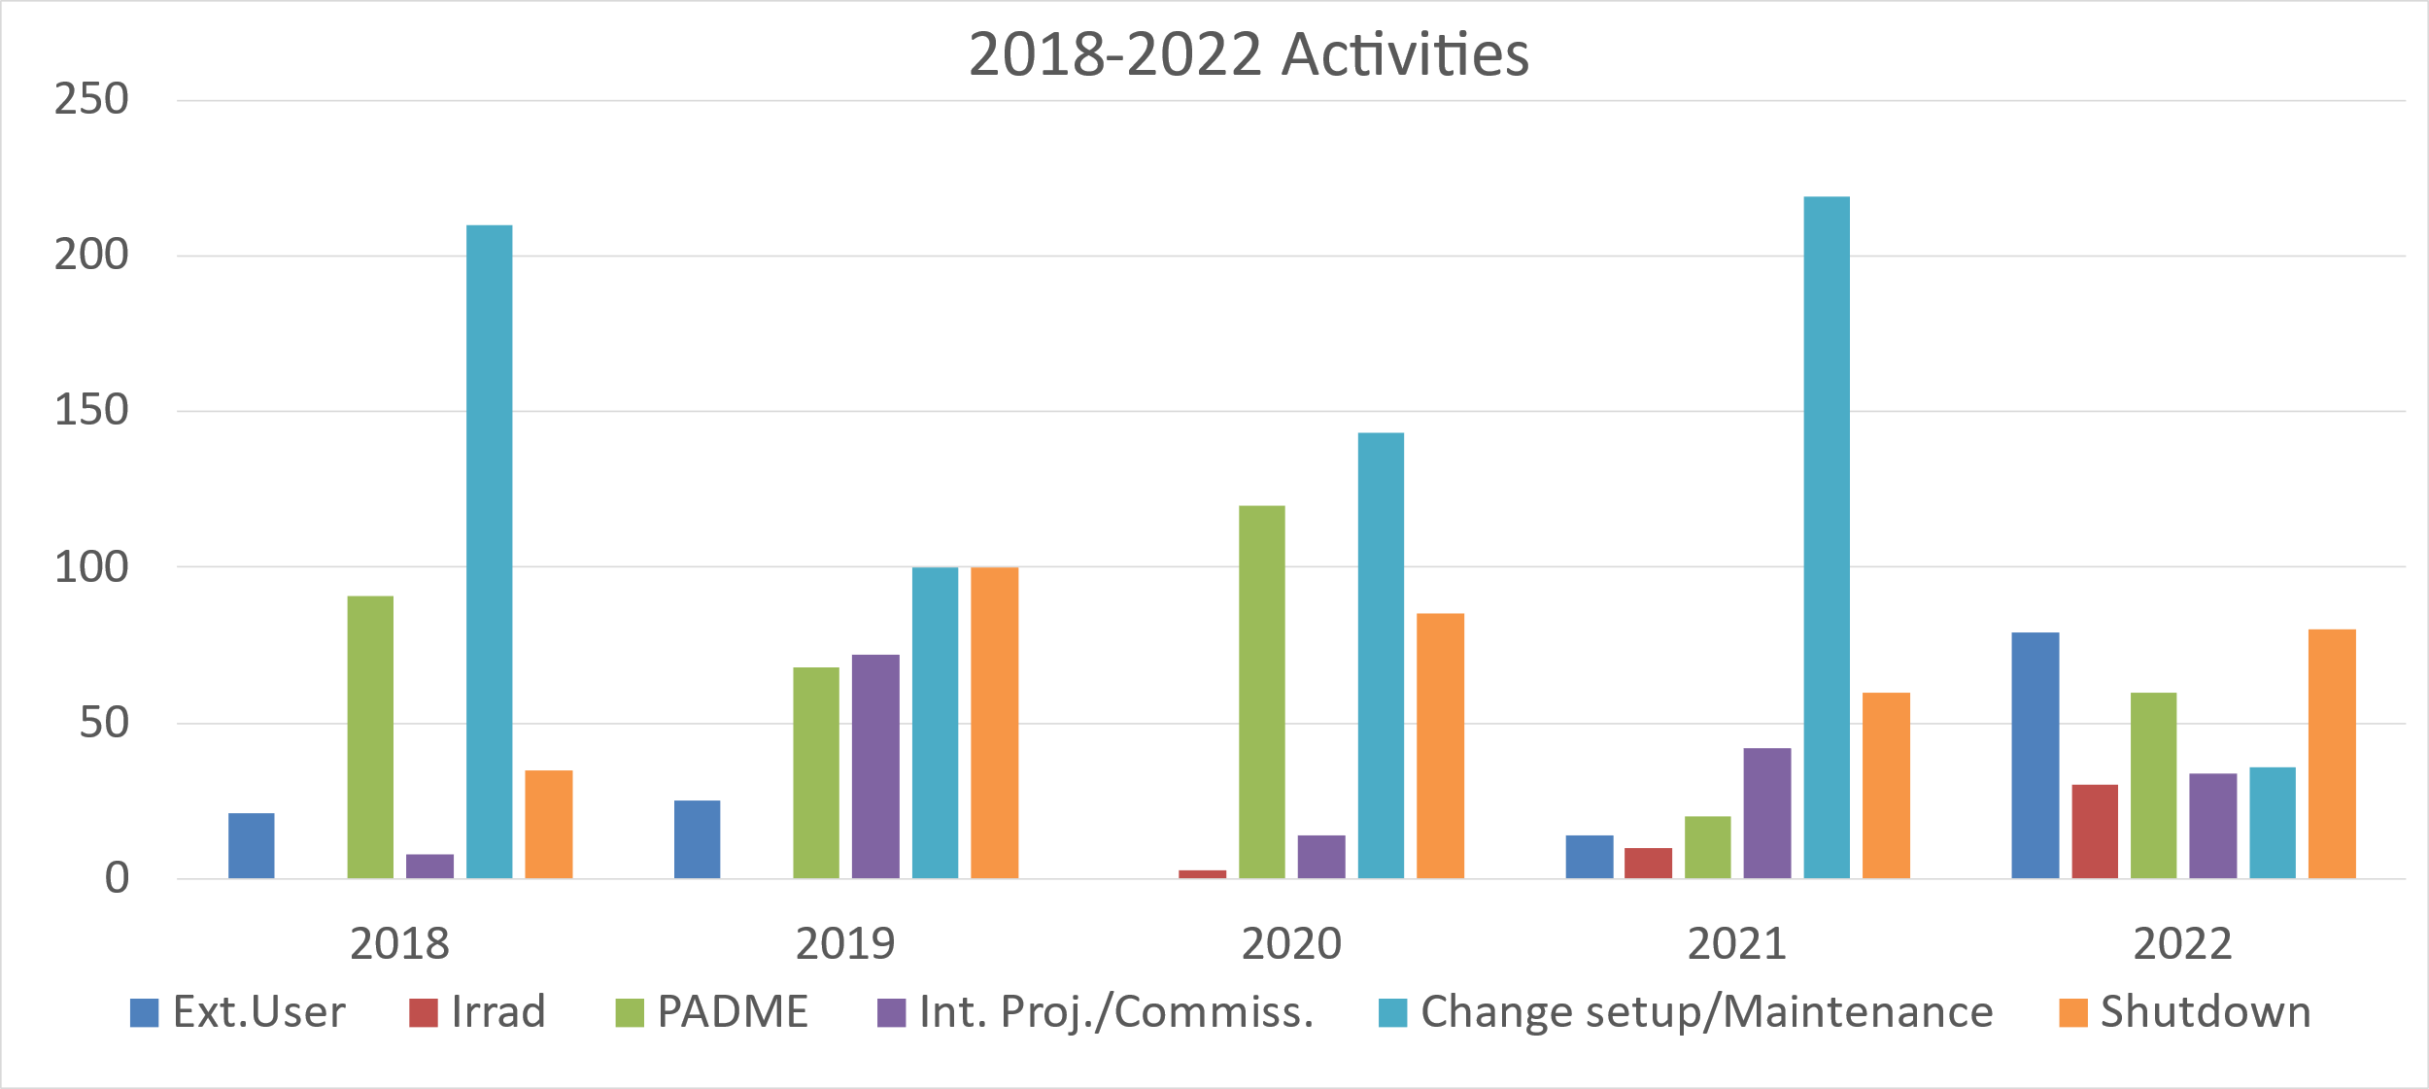
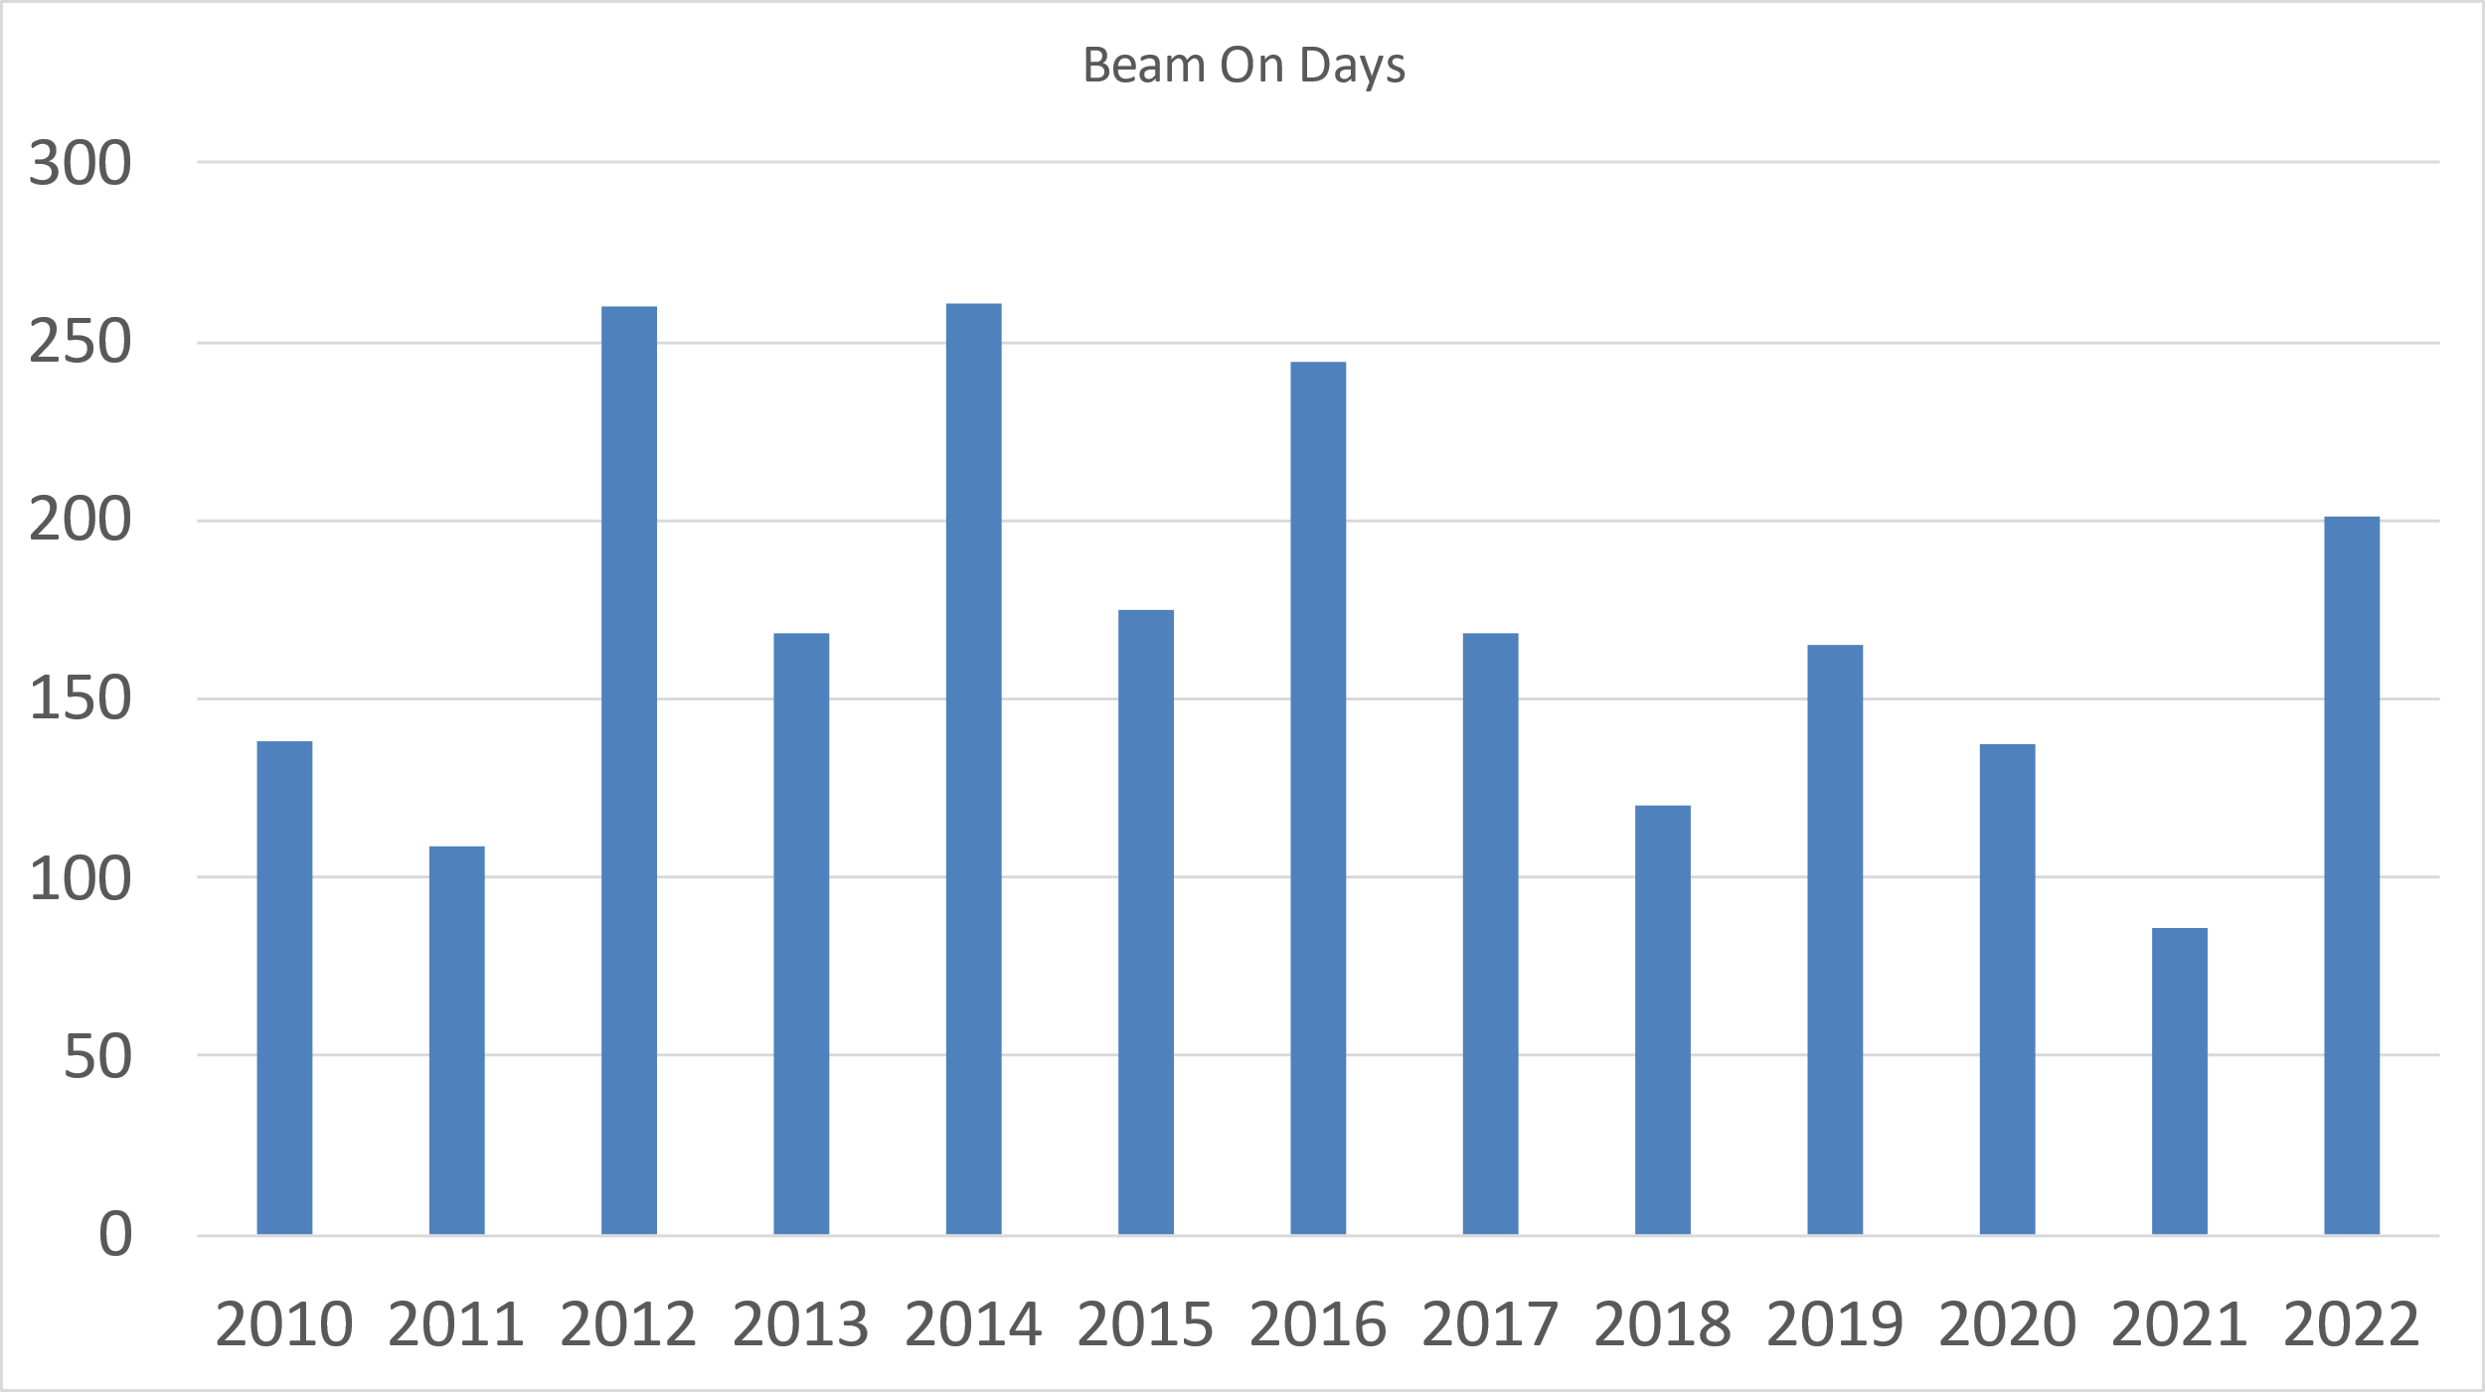
LNF – BTF numbers
2018-2022 Activities
Beam On Days
COVID-19
COVID-19
Foreseen in May 22 ~240 days at 15 Dec

Slide 12
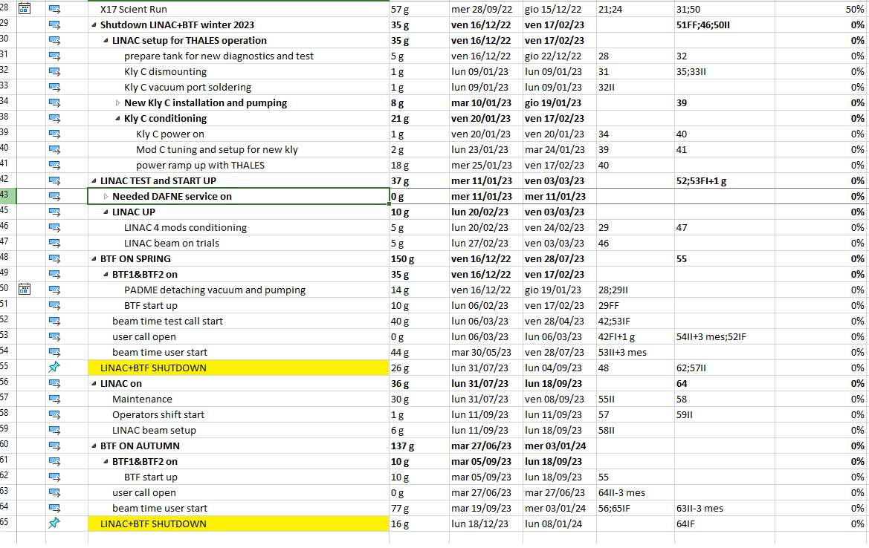
2023 GANTT
Recommendations DAFNE-BTF SC63
• A risk analysis concerning the possible failure of Klystron C should
be conducted and mitigation or intervention plans should be
established in view of the 2023 BTF/DAΦNE run.

Slide 13

Dummy CALENDAR
Recommendations DAFNE-BTF SC63
• A risk analysis concerning the possible failure of Klystron C should
be conducted and mitigation or intervention plans should be
established in view of the 2023 BTF/DAΦNE run.
2022
2023
9 May
11 Jul
15 Dec
3 Mar
28 Jul
19 Sep
18 Dec
SIDDHARTA DAFNE UP
SIDDHARTA DAFNE UP
BTF Comm
BTF Select Call
ERAD
X17
LINAC Kly C with Thales
BTF Select call
BTF User call
External users
BTF1 and BTF2
Dedicated LINAC
for BTF1
Decided in Oct22 to permit DAFNE ops
External users
BTF1 and BTF2
External users
BTF1 and BTF2

Slide 14

BTF USERS

Slide 15




2021/2022 BTF USERS
DONE (2021- Early 2022)
2022 Summer TO BE DONE
SHIP
CRILIN-KLEVER
ERAD Run 1
SPARC-ULENS (optics lines, change vacuum layout)
PADME for SAC calibration (change vacuum layout)
PADME for TPX3
PEROV
BTF detectors calibration (some time for us)
ERAD Run 2
FISMEL_TLD
AirBPM
LUXE Target
FOOT-LNF
PEROV
FOOT-SCINTI
SHERPA
LIMADOU
HERD
ERAD
FISMEL_SIM&ACTLD
SPARC-ULENS
PADME etagger
PADME trials with secondary beam

Slide 16
Citing BTF (Some of)
More than 30 paper citing BTF in 2022, some obviously from PADME collaboration.
6th International Conference Frontiers in Diagnostic Technologies (ICFDT6)
13th International Particle Accelerator Conference (IPAC’22)
The PADME beam line Monte Carlo simulation
F. Bossi (Frascati), P. Branchini (INFN, Rome3), B. Buonomo (Frascati), V. Capirossi (Polytech. Turin), A.P. Caricato (INFN, Lecce and Salento U.) et al.
Search for a Dark Photon with the PADME experiment
Stefania Spagnolo, A.P. Caricato, M. Martino, I. Oceano, F. Oliva et al.
Published in: PoS EPS-HEP2021 (2022), 186
Machine Learning Based Middle-Layer for Autonomous Accelerator Operation and Control
Stefano Pioli, Bruno Buonomo, Fabio Cardelli, Paolo Ciuffetti, Domenico Di Giovenale et al.
Published in: JACoW ICALEPCS 2021 (2022), THAL03
The physics program of the PADME experiment
PADME Collaboration • A.P. Caricato (INFN, Lecce and Salento U.) et al.
Published in: Phys.Scripta 97 (2022) 2, 024003
Simeonov, Radoslav. "PADME physics program." Journal of Physics: Conference Series. Vol. 2255. No. 1. IOP Publishing, 2022.
Sytov, A., et al. "First design of a crystal-based extraction of 6 GeV electrons for the DESY II Booster Synchrotron." The European Physical Journal C 82.3 (2022): 1-17.
Balla, A., et al. "Performance of scintillating tiles with direct silicon-photomultiplier (SiPM) readout for application to large area detectors." Journal of Instrumentation 17.01 (2022): P01038.
Atanov, Nikolay, et al. "The Mu2e Crystal Calorimeter: An Overview." Instruments 6.4 (2022): 60.
Ceravolo, Sergio, et al. "Crilin: A Semi-Homogeneous Calorimeter for a Future Muon Collider." Instruments 6.4 (2022): 62.
Garattini, M., et al. "Crystal slow extraction of positrons from the Frascati DA Φ NE collider." Physical Review Accelerators and Beams 25.3 (2022): 033501
Ceravolo, S., et al. "Crilin: A CRystal calorImeter with Longitudinal InformatioN for a future Muon Collider." Journal of Instrumentation 17.09 (2022): P09033.
Bartocci, S., et al. "Deep learning based event reconstruction for the Limadou High-Energy Particle Detector." Physical Review D 105.2 (2022): 022004.
Backe, H., et al. "Design study for a 500 MeV positron beam at the Mainz Microtron MAMI." arXiv preprint arXiv:2205.12613 (2022).
Patrinos, Konstantinos. "On the Hypothesis of the Absolute Reference System: Theoretical and Experimental Confirmation." New Trends in Physical Science Research Vol. 8 (2022): 13-36.
Amaro, Fernando Domingues, et al. "The CYGNO Experiment." Instruments 6.1 (2022): 6.

Slide 17
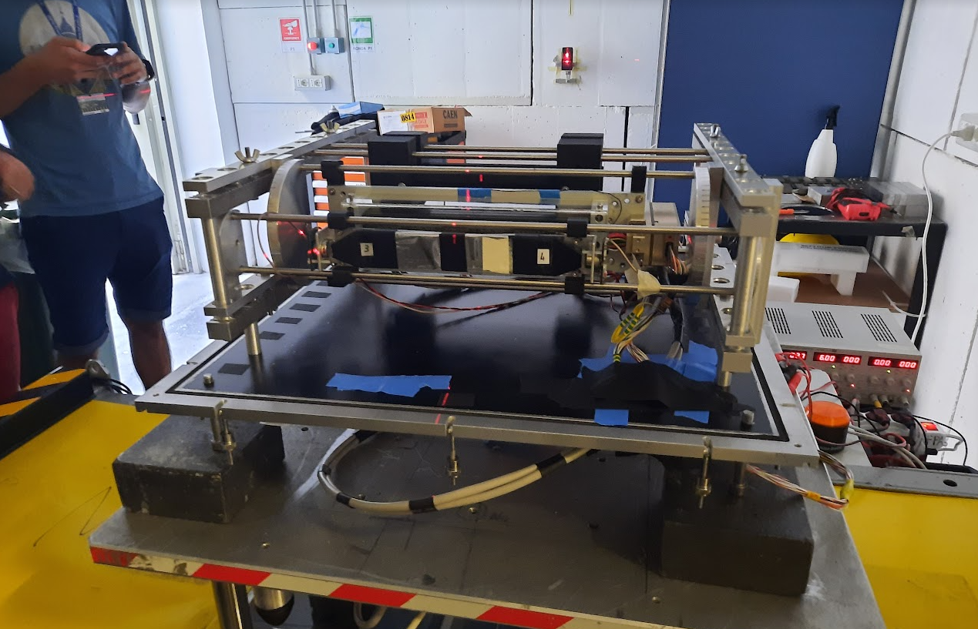
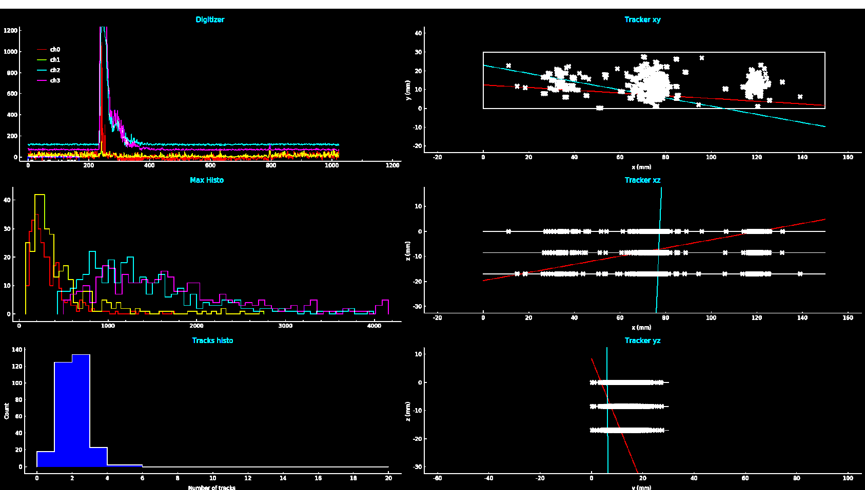
LIMADOU
LIMADOU is part of a scientific program that studies natural and anthropogenic electromagnetic fields, their emissions and possible correlations with seismic events.
https://w3.lnf.infn.it/experiments-in-btf-orbit/?lang=en
BTF USER run (SPACE Appl) : 11 Jun -> 20 Jun
Prototype: new tracker as part of second of the constellation (CSES-02) will mount an innovative particle tracker. CSES missions are part of a collaboration program between China National Space Administration (CNSA) and Italian Space Agency (ASI), and developed by China Earthquake Administration (CEA) and Italian National Institute for Nuclear Physics (INFN), together with several Chinese and Italian Universities and research Institutes.
Run with dedicated 30MeV- single particle beam
The main purpose of the test: check tracker efficiency in track reconstruction with single-particle electron beams at different energies (from 30 to 120MeV) were produced to characterize the response of the apparatus to natural events, similar events that will occur along the satellite’s orbit

Slide 18
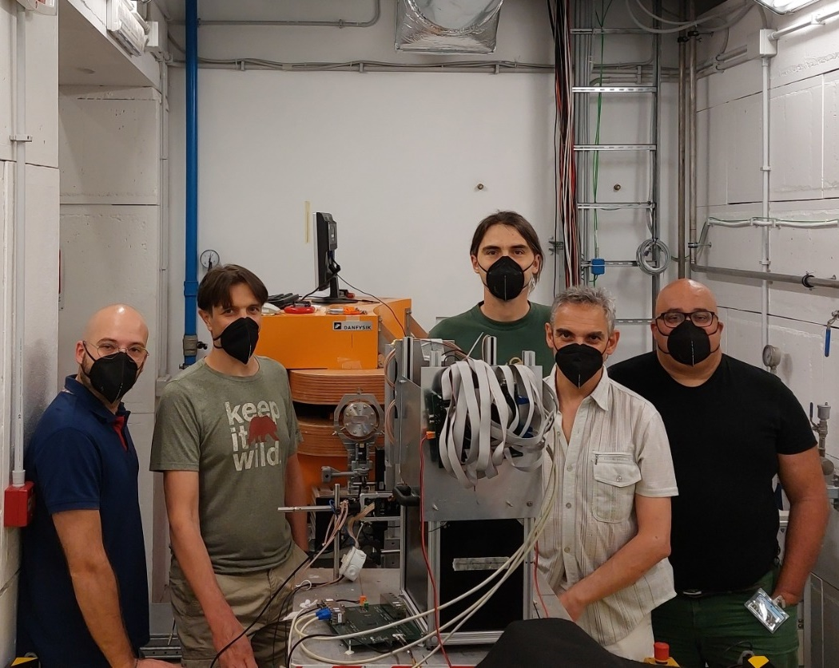
HERD
The HERD mission: will be installed on the Chinese Space station in 2027.
It will extend direct measurements of cosmic-rays up to the knee region.
https://w3.lnf.infn.it/experiments-in-btf-orbit/?lang=en
BTF USER run (SPACE Appl) : 20 Jun -> 27 Jun
Prototype: small calorimeter made of 4 layers of 3x3 LYSO crystals. Each crystal is 3x3x3 cm³
Crystals read-out: two PDs with different active areas and a wave length shifter fiber + SiPM.
The HERD (High Energy Cosmic Radiation Detection) collaboration, on the other hand, aims to install its detector in the Chinese space station
Courtesy of Nicola Mori
Output [ADC]
The main purpose of the test: check the linearity of the read-out system up to the saturation (very wide energy range!!!).
Preliminary results show a good linearity.
Additional goals: test different hardware and firmware configurations, measure the direct ionization of PDs.
Multiplicity [#]

Slide 19
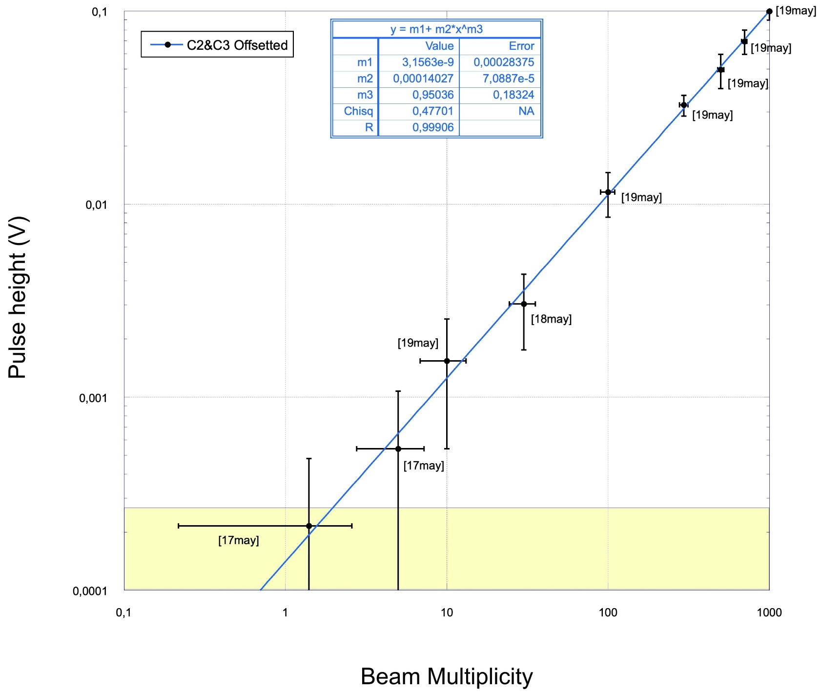
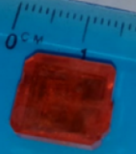
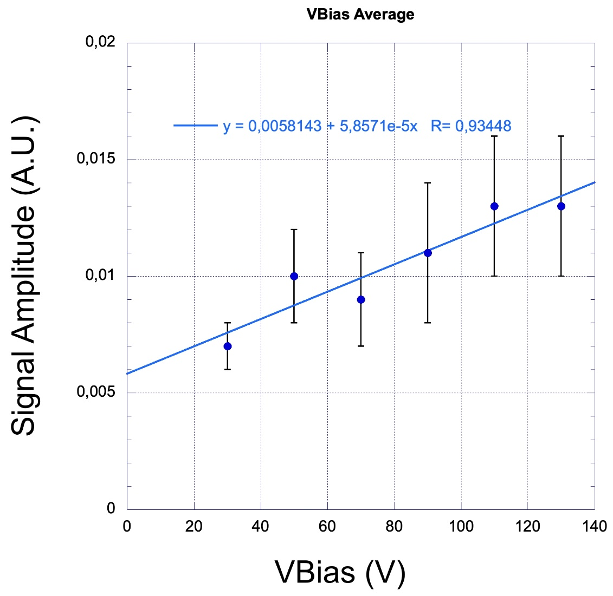
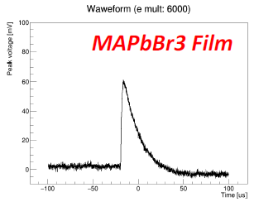
PEROV
BTF USER run (New Detector dev.) :16May -> 20 May
Multiplicity scan
Prototype: Organo Metal-Halide Perovskites, a class of hybrid organic-inorganic semiconductor materials with a perovskite unit-cell structure
MAPbBr3 bulk, different size and aspect ratio
Courtesy of Marianna Testa
First test continuation as bulk detector
As the first time confirmed a good linearity in wide range
Load curve with different beam multiplicity and energy
Tested in two different lines (BTF1-BTF2)
Load curve at fixed multiplicity

Slide 20
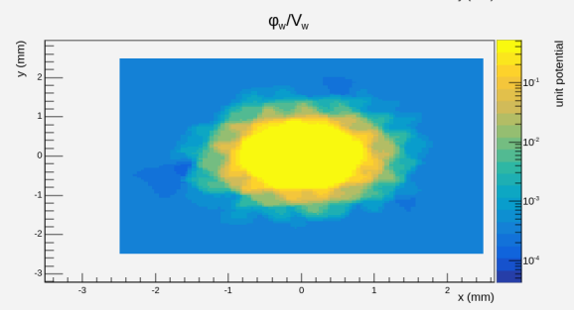
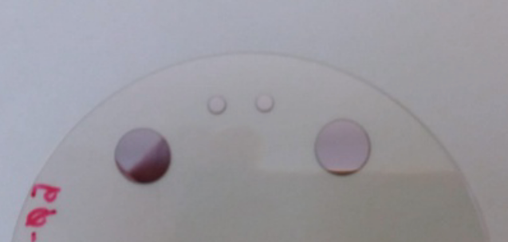
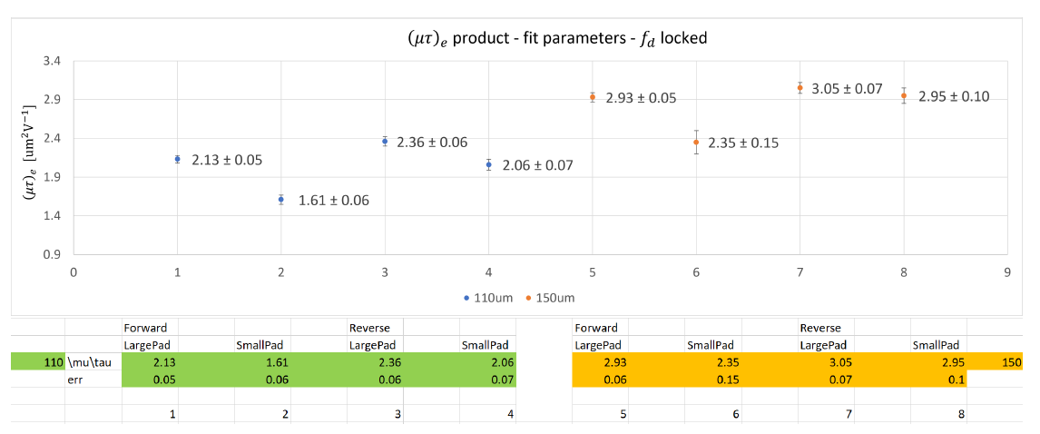
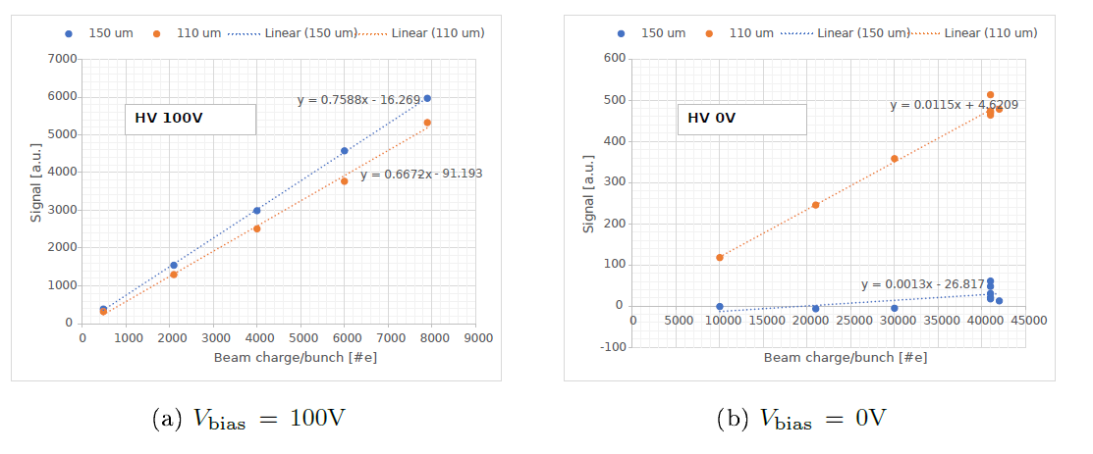
LUXE
(Laser Und XFEL Experiment) is a new experiment proposed at DESY and the European XFEL to study QED in the strong-field regime where QED becomes non-perturbative
big pads
BTF USER run (New Detector dev.): 9 May-> 13 May
BTF beam 300MeV, m=10K scan, completely contained -> sim over E field fringing effects
small pads
(Laser Und XFEL Experiment) is a new experiment proposed at DESY and the European XFEL to study QED in the strong-field regime where QED becomes non-perturbative
2 x Sapphire wafer(2in) Thick d2=0.15 mm
2 x Circular Pads R1= 0.8 mm and R2=2.75 mm
First test as Sapphire photon current integrator for LUXE experiment
As a preliminary response, impressive linearity in wide range in multiplicity and voltage scan
Team reached the goal to be first in detect such Sapphire Charge Collection Efficiency
Courtesy of P. Grutta and M. Morandin

Slide 21

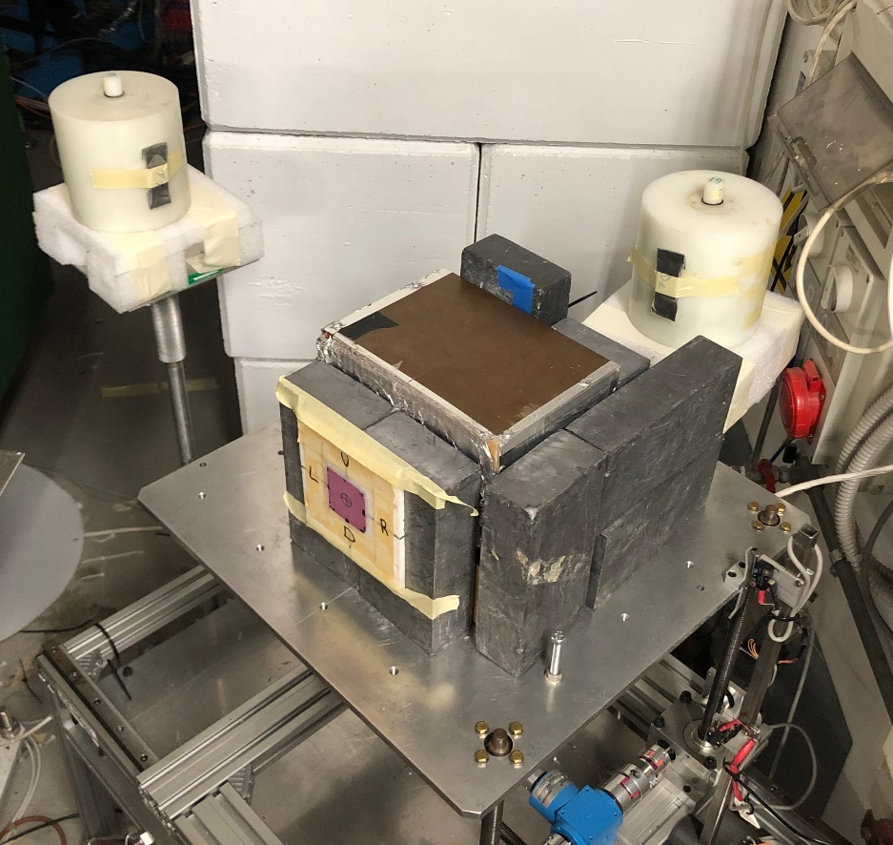
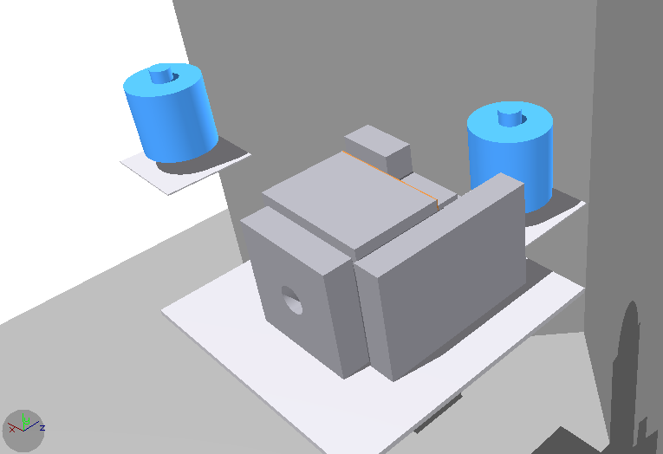
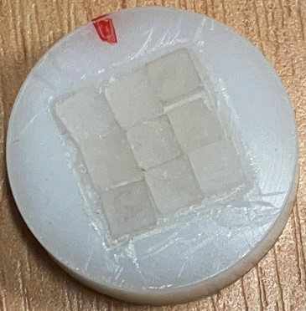
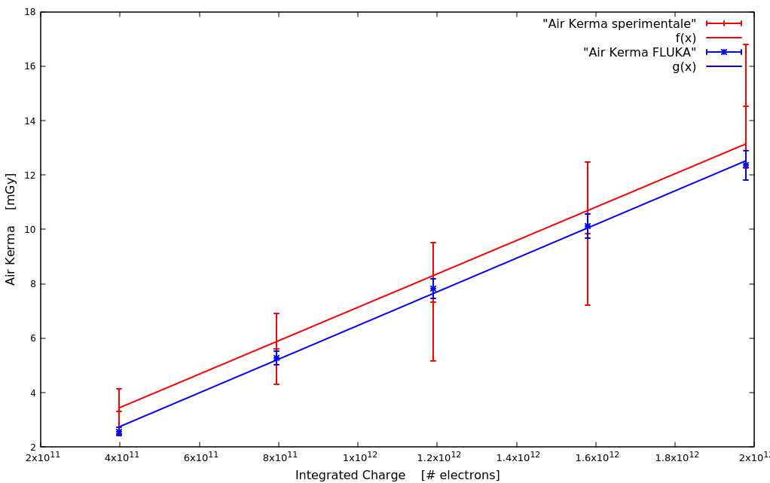
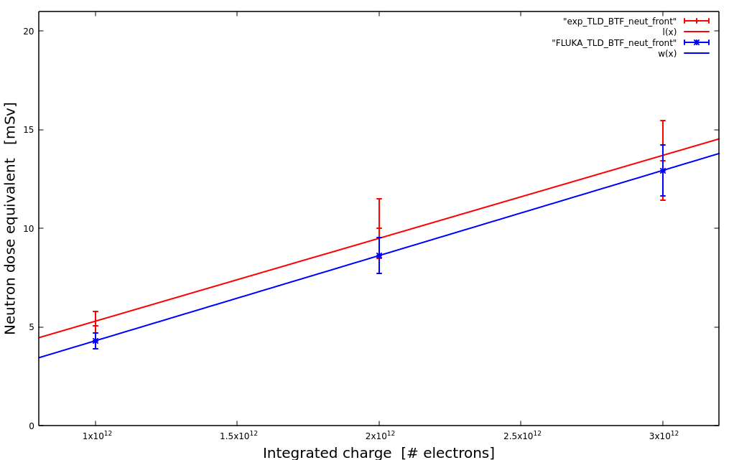


FISMEL
Dose evaluation from electrons impinging on a Pb target due to: i) Bremsstrahlung photon production; ii) photo-production of neutrons.
Thermoluminescent dosimeters used to measure doses at several charge intervals.
BTF USER run: (New Rad Dosy.) June 29->30
Work presented at SATIF-15 international workshop
Run 2 - FLUKA
BTF beam 503 MeV, 1 Hz, 109 e-/s, spot diameter around 1 cm
Beam on a ∼ 16 cm Pb target → mixed radiation field
1° run: photon Air KERMA evaluation at 0 ° (TLD700)
2° run: photon Air KERMA and neutron ambient dose equivalent evaluation at 0 ° and 90 ° (TLD700 + TLD600)
Calibration at Cs-137 and Am-Be → Data-MC comparison needed to validate the results at higher energies and benchmark the simulation (FLUKA) itself
e⁻
e⁻
Run-2 Experimental setup
Good MC-Data agreement for the Dose-electrons conversion factor:
Run 1 - $γ$
TLDs placed inside the cylinders
Run 2 - n$at 0\text{°}$
Exp : f(x) $=\left(6,1±0,9\right)∙{10}^{−12}∙x+(1,0±1,2)$
Courtesy of F. Chiarelli and R. Donghia on behalf of the FISMEL Group
FLUKA: g(x) $=\left(6,2±0,1\right)∙{10}^{−12}∙x+(0,3±0,2)$
Important results useful to estimate the mixed radiation field doses in BTF produced from HE e-beam on target
Exp : f(x) $=\left(3,7±0,3\right)∙{10}^{−12}∙x+(−1,2±0,7)$
FLUKA: g(x) $=\left(2,9±0,1\right)∙{10}^{−12}∙x+(−0,4±0,1)∙{10}^{−13}$

Slide 22
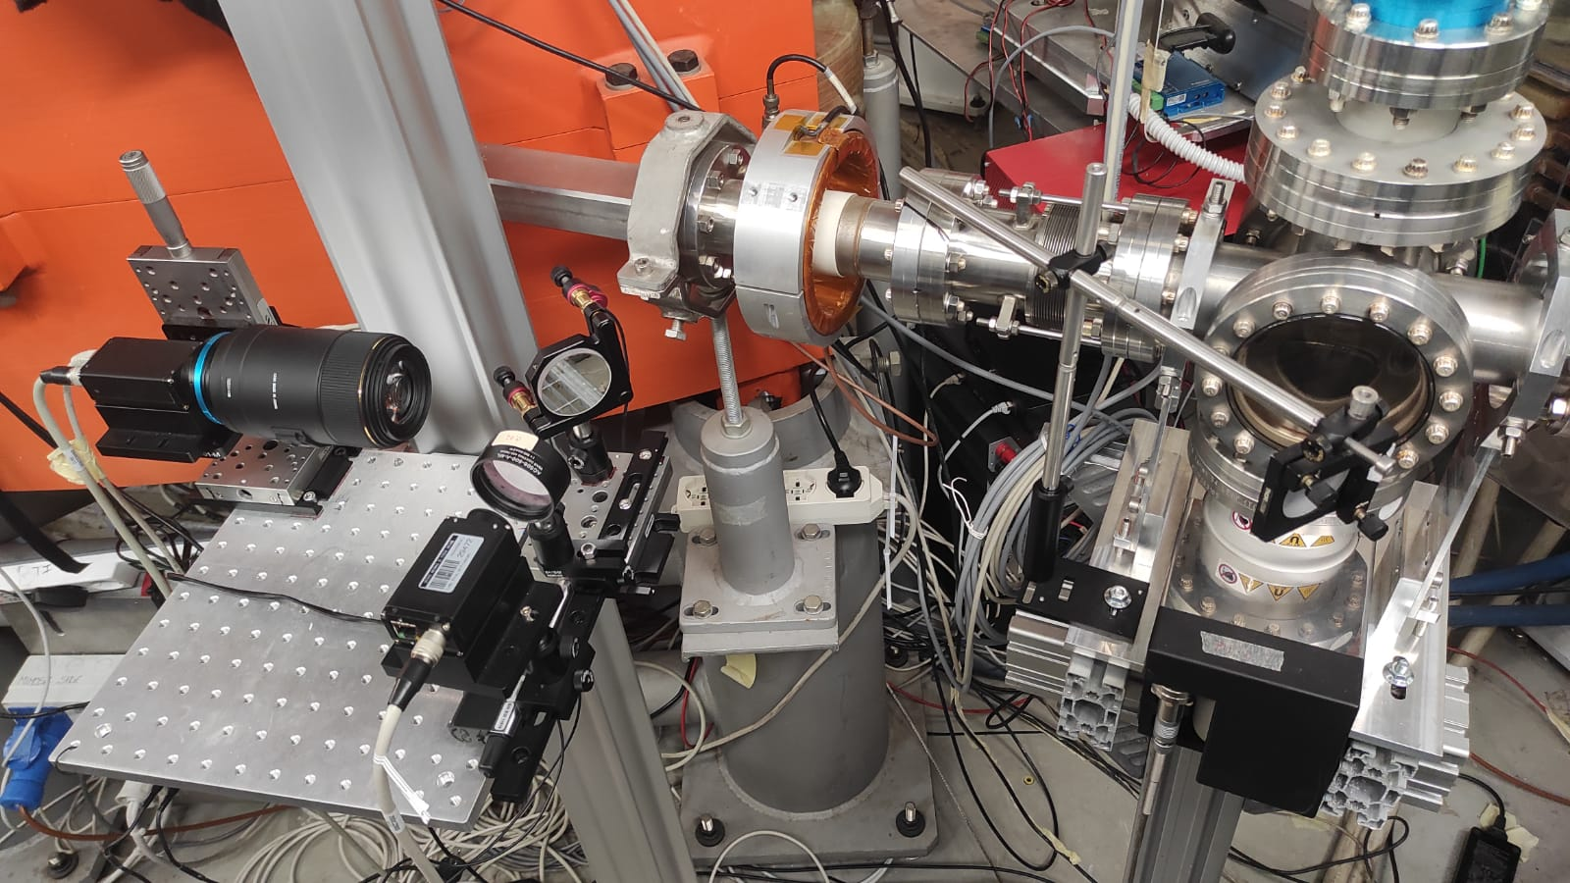
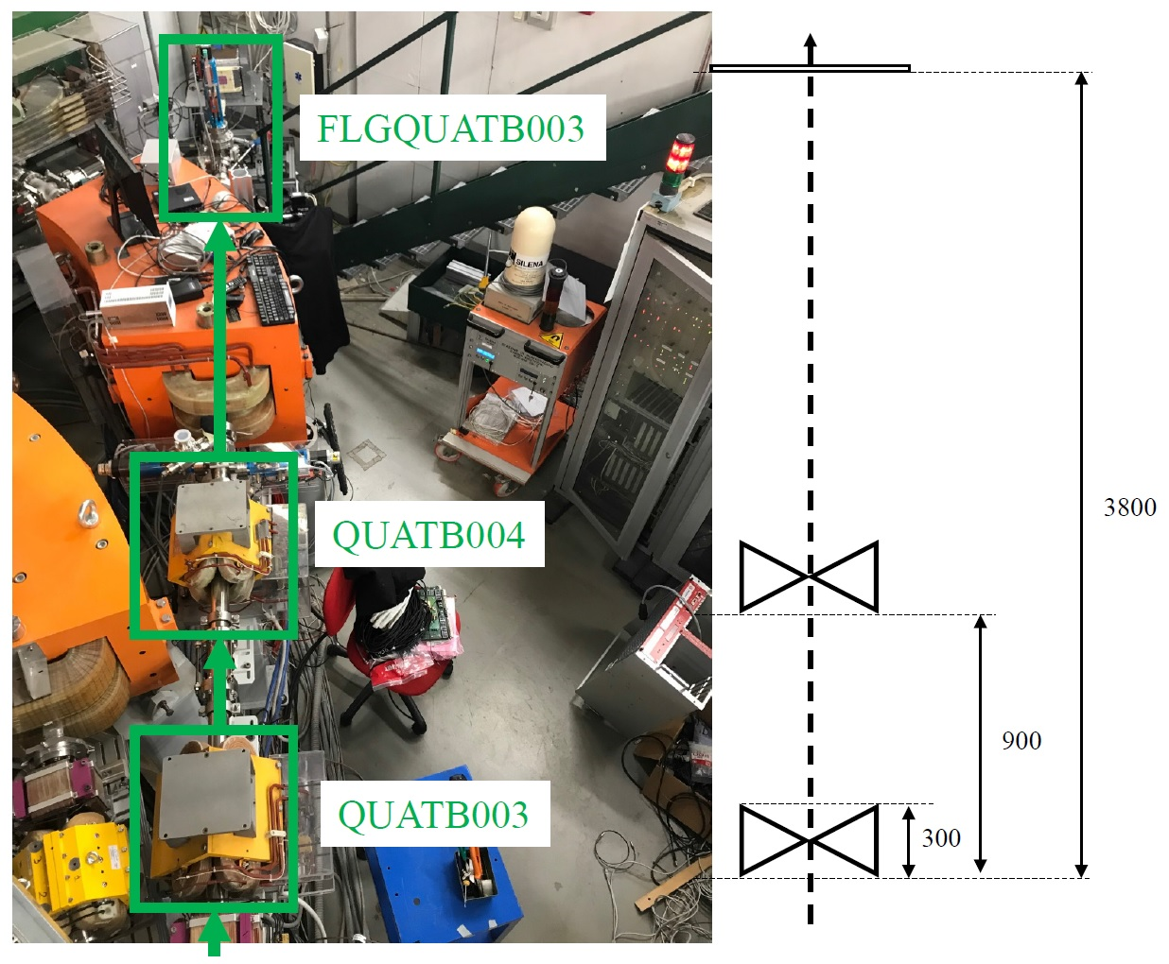
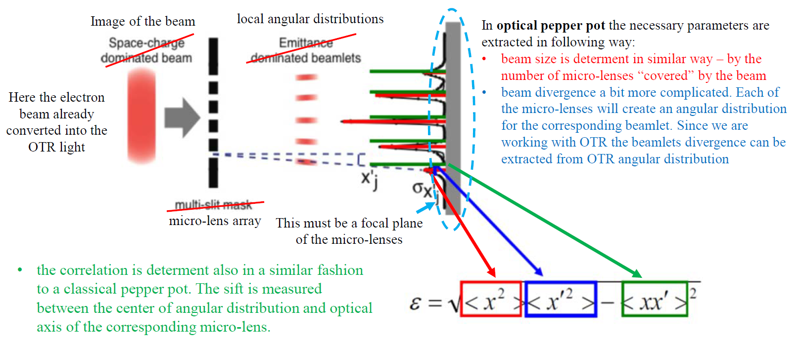
SPARC-ULENS
Synergistic emittance measurement system both for SPARC Vladimir Shpakov and BTF team.
Single-shot beam emittance via a pepper-pot-like method:
-> microlens array beamlets from the beam OTR radiation produced by the OTR radiator. Single shot measurement of beam size (OTR beam image), beam divergence (from OTR ang. distr. image), beam correlation (from microlens)
BTF USER run (New Diagn.): June 27->2Jul
Courtesy of Vladimir Shpakov
on SPARC behalf

Slide 23
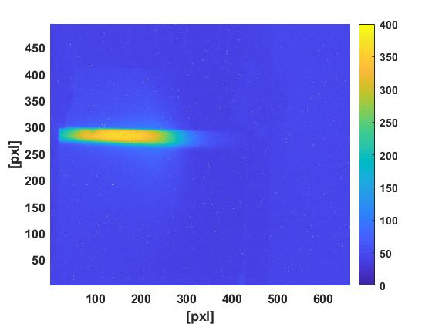
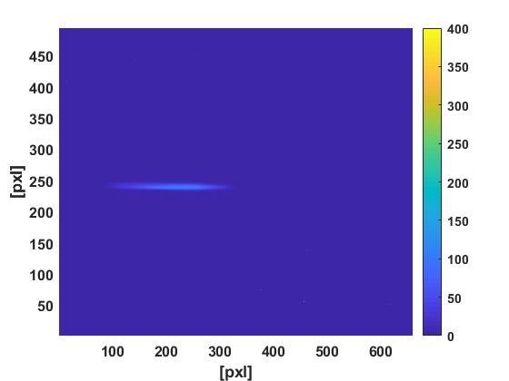
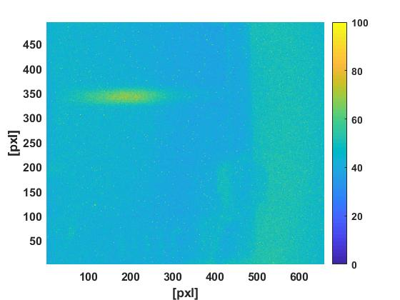
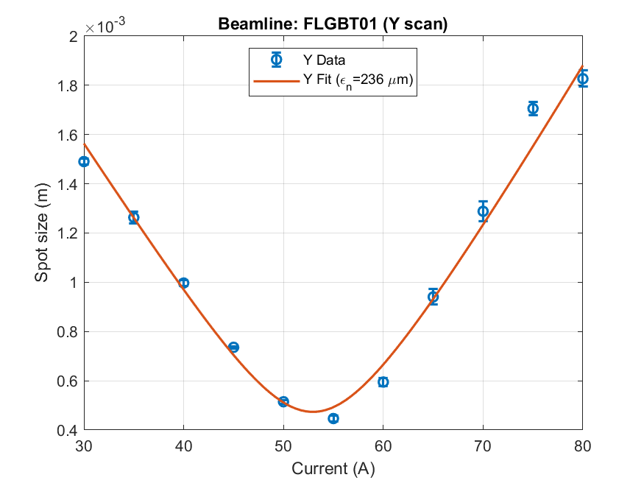
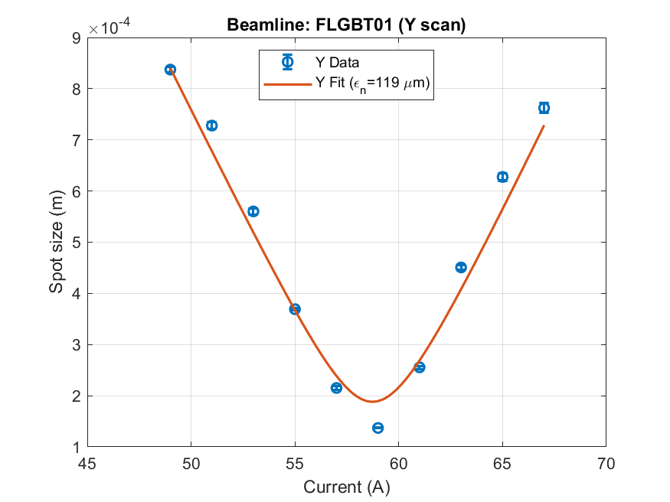
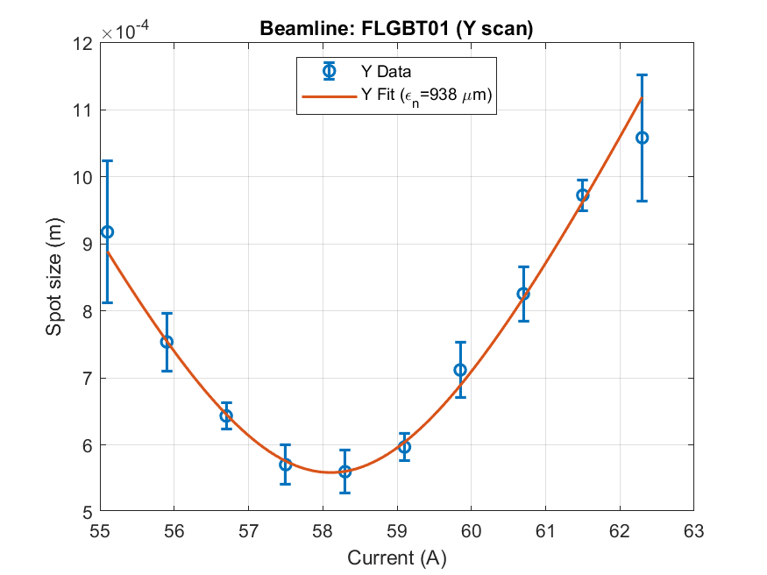
SPARC-ULENS – QUADRUPOLE SCAN
ELECTRON Beam = 503 MeV/10ns/300pC
Vertical emittance (rms) 0,2±0,05 mm x mrad
POSITRON Beam = 497 MeV/10ns/4,7pC
Vertical emittance (rms) 1±0,32 mm x mrad

Slide 24
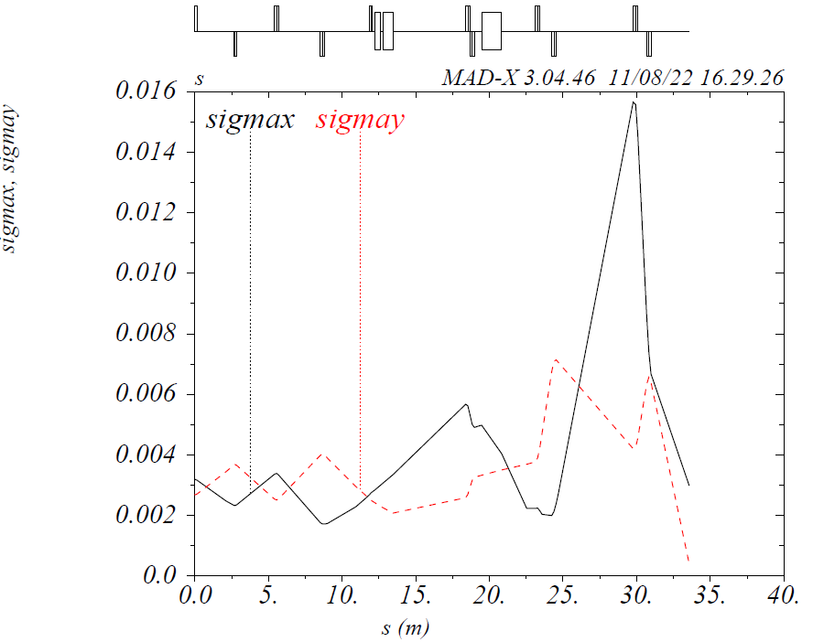
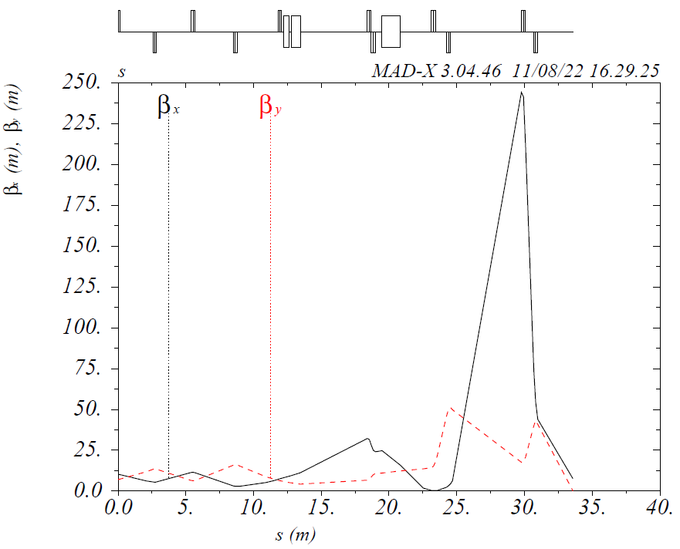
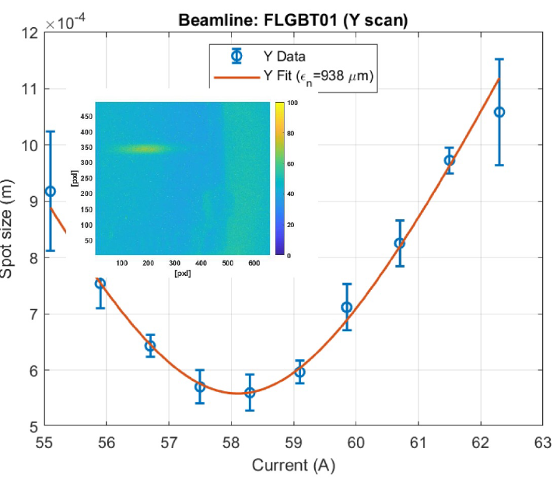
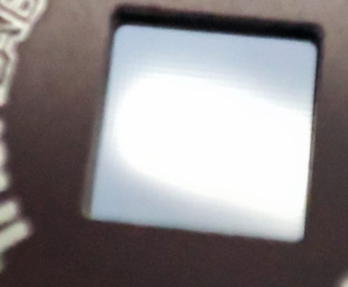
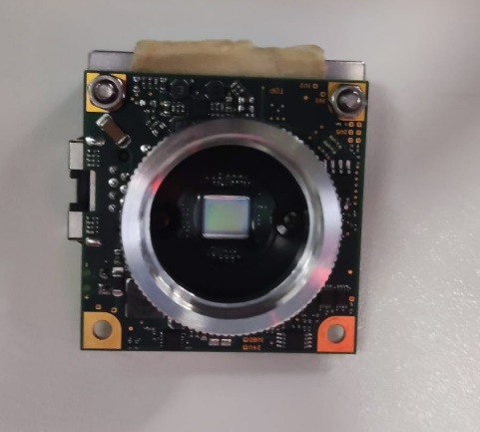
SPARC-ULENS next STEP
Demonstrated a fundamental possibility to make emittance measurements at FLGQUATB003, meaning we can (using OTR to image the beam, software, motors, optical set and alignment procedure…)
New documented measures for the BTF LINAC primary beam.
MADX Sim.
MADX Sim.
Positron Measure
MADX Sim.
C. Di Giulio

Slide 25

LINAC&BTF for DAFNE and X17

Slide 26
X17 Run calendar
Recommendations DAFNE-BTF SC63
• The beam studies to decide on the most effective way to deliver the
positron beam for the PADME run should be performed as soon as
possible, compatible with the DAΦNE and the other BTF users’ runs.
2022 Jul
2022 Sep->Dec
11 Jul
18 Jul
24 Jul
12 Sep
28 Sep
10 Oct
15 Dec
LINAC beam
comm
X17 Beam Trials
Beam Setup for detectors
X17 trails secondary Beam
LINAC Upgrade
X17 inj
Secondary Beam
Linac e-
Secondary Beam
Linac e+
Fluids Pumps&Leaks
Steering PS
Electrical
DAQ
Mods Maintenance
HW Preset LINAC for 300 and 400MeV
Beam transport study in BTF
Scan
-> 31 Beam En.
Foreseen other

Slide 27
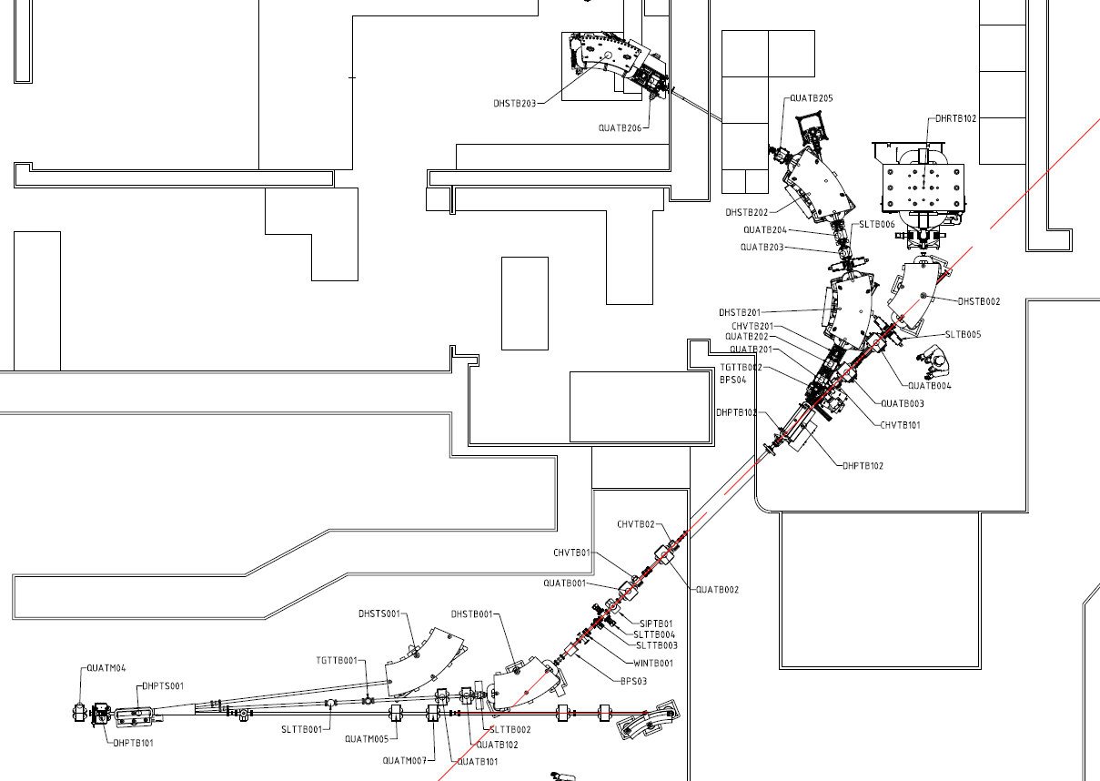
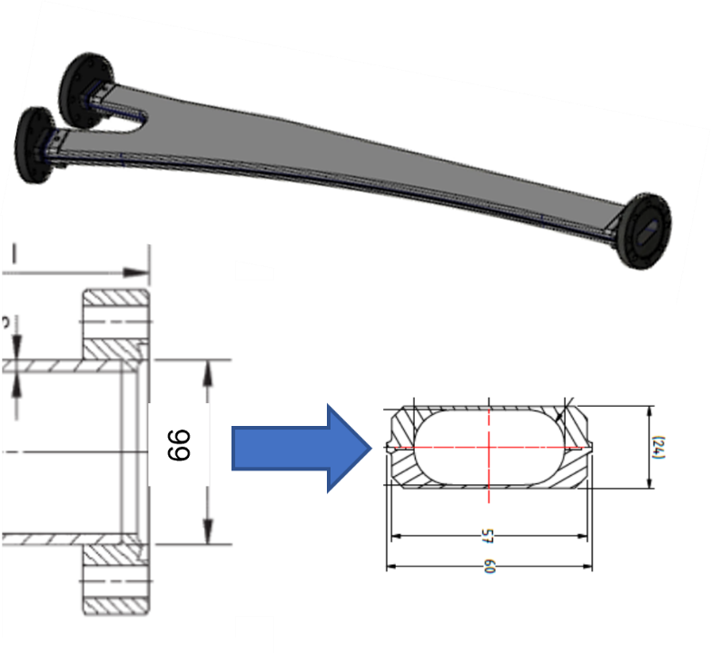
X17 vs PADME RUN
X17
Main differences from PADME RUN2 due to BTF2 Line implemented in BTFEH1:
DHPTB102 pipe -> check stay clear
SLTB005 -> used to remove halo, no induced one
Positron beam request:
  Lower Pulse Length 320ns-> at least 100ns -> 250ns reached
  Lower Pulse Charge 30kPoT -> less than 5kPoT -> 2.5 kPot delivered
  Pulse selection: from fixed energy (430MeV) ->
    Energy scan from [295-260] MeV reached
    Energy scan out of resonances in U(<220MeV) -> around 200MeV on going
    Energy scan out of resonances in U(>320MeV) -> around 400MeV feasible in next weeks
BTF
DIAG
TARGET
DHSTB002
SLTB005
DHPTB102
SLTB004
DHRTB101
SLTB002
LINAC
DHSTB001

Slide 28
LINAC BEAM
Very low charged primary positron beam
X17 received different beams type
Bunch length up to 250ns
Lower beam charge 2.5kPoTs
Improvements in beam stability and background
AGAIN HUGE improvements in respect PADME RUN2 2020 primary
Lower GUN emitted current
  Under the dynamic range for the most LINAC diagnostic, after positron converter (BCM, BPM, ICT)
  Setup done at lower current without attenuator since shorter pulse requested from experiment
Very good background in BTF1 experimental hall and X17 (now less than 180nS/h)
  Even with a reduced stay-clear factor in BTFEH1 pipes, due to BTF2 (DHPTB102) installation
    By beam steering defined gap (2mm/3A on vertical correctors)
    But harder constraint on beam passage and stability
    X17 staff happy for this
Low beam loading => Final beam energy spread around 0,5% (before BTF line selection) at 400MeV trails
  Different energy populations with different bunch length and charge
Beam pulse length and charge at Diamond Target with harder constraint in respect of initially asked by experiment:
  LINAC pulse extended from 100->200ns => improved in respect of what experiment requested

Slide 29
X17 LINAC BEAM
After July trials with secondary positron beam, X17 team preferred to move vs primary positron beam, enhancing final beam spread and top current(max multiplicity was up to 3000 secondary PoT at 400MeV).
For X17 run:
LINAC pulses 50 shots/s
Primary positrons
250ns pulse for all the energy involved (400MeV and continuously 300MeV down to 200MeV)
Lower current on target
Naive model of LINAC 250ns beam pulse
Beam pipe
Beam length 250ns
+20MeV, 80ns, 10x charge
Beam energy centroid, 150ns, 2x charge
-20MeV, 250ns, 1x charge
Good for PADME

Slide 30
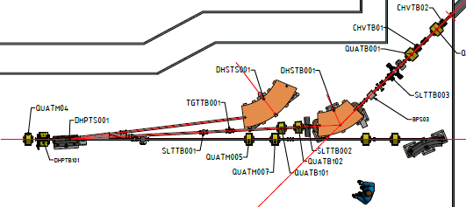
After DHSTB001 e DHRTB101, TB2 scrapering
BTF BEAM - SElection
The structured beam spread is used for time/charge selection via:
Injection angle in BTF channel
Horizontals scrapering , get final energy spread at SLTB002 level
Refining as secondary beam the SLTB004
Charge control via LINAC current is great(down to single particle multiplicity !!!!) -> no needs of target
Scrapers
TO BTFEH1
‸ X
‸ Z
Scrapers

Slide 31
BTF BEAM - SElection
To
BTFEH1
These way of beam structure leads to:
DHRTB101 - DHSTB001 act as second beam pulse flattening tool (removes head-tail peaks)
DHSTB001 sector magnet => -X sees more focusing, higher energy
  Treat this beam as secondary beam (as BTF usually do)
SLTB004 – SLTB005 scrapering downstream enhances final beam spread (< 1%)
  Limited use of downstream scrapers => lower BTFEH1 background and beam side effects
More degree of freedom to get desired beam parameters
Reduced coupling of final focus from injected beam (transverse shape are huge compared to SLTB003-004 scraper pin hole)
Mylar window is a good Bremsstrahlung radiator for an online monitor
Scrapers
TO BTFEH1
‸ X
‸ Z
Scrapers

Slide 32
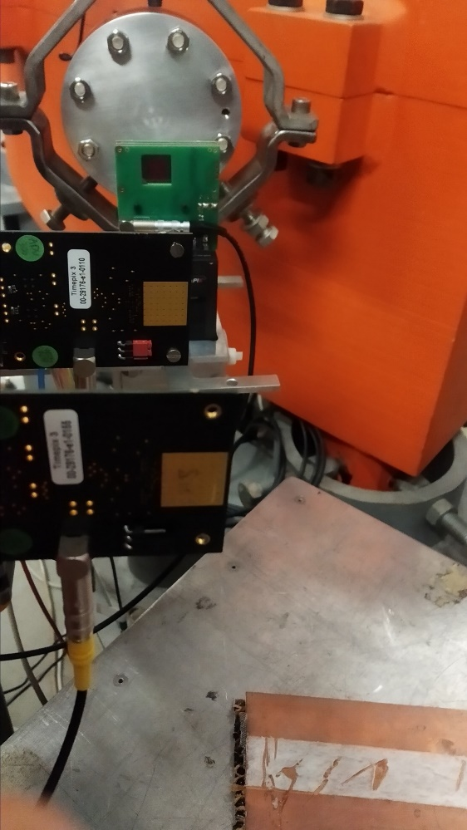
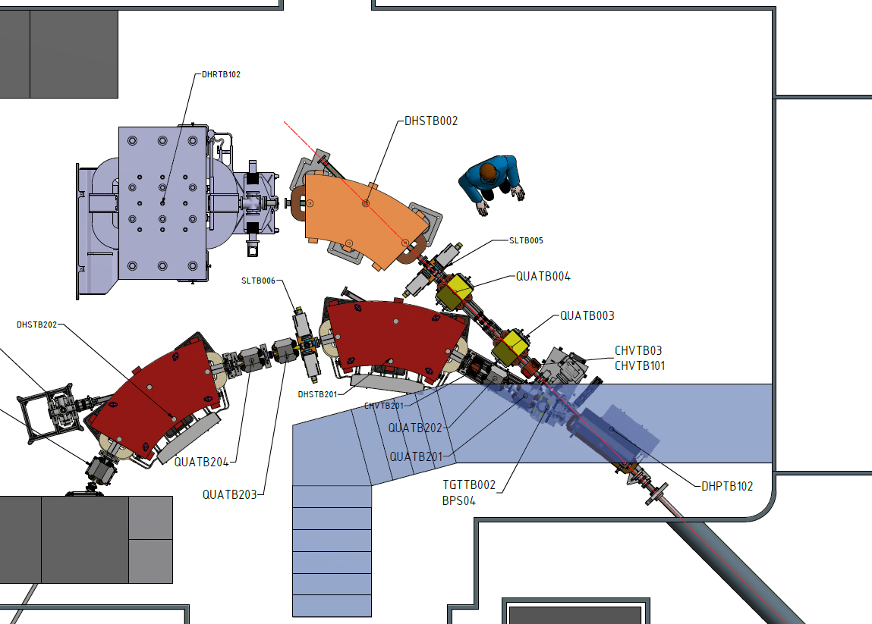
BTF BEAM – Beam Diagnostic
Fast BTF beam diagnostics
CALOBTF1 (PbWO – NA62 like)
Timepix detectors (65k Pixel TPX,TPX3 detector, ~2cm²)
Located downstream the straight pipe in the DHSTB002 dipole
Adsorber in the middle (0.05mm Ti window, 0.7 Si detectors)
Direct measurement (positrons, X17 delivered beam):
Stop injections to X17
DHSTB002 switch off
Injection in the straight DHSTB002 channel
Undirect measurement (secondary photons, run quality monitor)
Beam steered to X17
CALOBTF1 and FITPix get Bremsstrahlung photon from mylar window
Energy collected is less 0,001 of the total steered charge (12m away)
Used to monitor delivered PoT and beam length runtime
Higher measurement errors in respect to PADME RUN(20%)
Detector area
PHOTONS
POSITRONS
MYLAR WINDOW

Slide 33
BTF energy scan
X17
Measure setup (X17 decisions) and its progression:
Rules for reproducible measurements and simulations:
Maximum current limit due to experiment constraint
Minimum current obvious (Data taking)
Hit point stability on diamond target
Flat Pulse shape (ideal double step pulse in time, >100ns) for good current inj
Fixed quadrupoles current (different setup only for out of resonance trials)
Energy spread containment
DHSTB001 as energy selector
Energy scan on hysteresis loop descending branch for all the dipoles
Multiplicity correction only via scrapers
Scrapers maximum gap in tuning (+-0.1µm)
Pulse envelope shape correction only via ModA phase
TARGET
DHSTB002
SLTB005
SLTB004
DHSTB002
DHRTB101
SLTB002

Slide 34
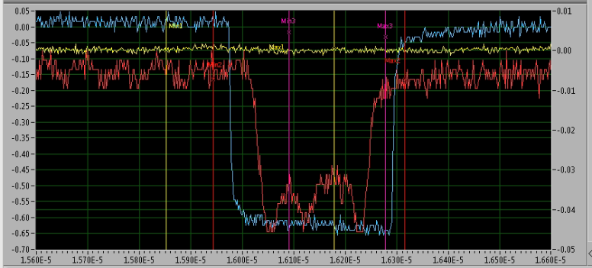
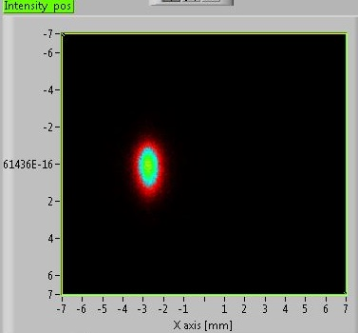
BTF energy scan
X17
Measure type:
Scan of ~1.5 MeV (around 10 PS DAC digits-> 150KeV)
Descending branch of the DHSTB001 hysteresis loop
DHSTB001 -> -1A
DHSTB002-> -1A - DAC digit
DHRTB001 -> -1A in the tails of energy scan
SLTB002 Scrapers ±0,1mm (±500PoT)
REMAINING SCRAPERS
  Halo removal
  Beam transverse reference point
  Untouched for overall data taking
Stay clear checks via steering magnets
(CHHVVTBXXX and DHPTB102)
TARGET
DHSTB002
SLTB005
DHPTB102
SLTB004
DHSTB002
DHRTB101
SLTB002

Slide 35
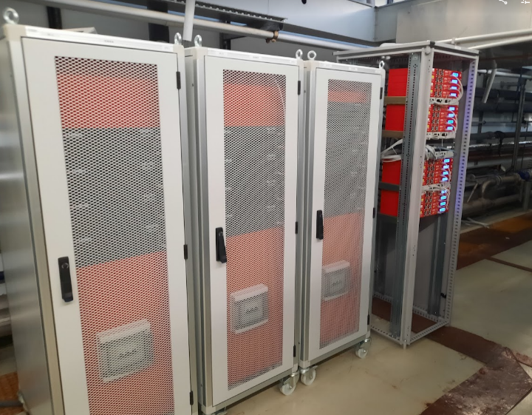
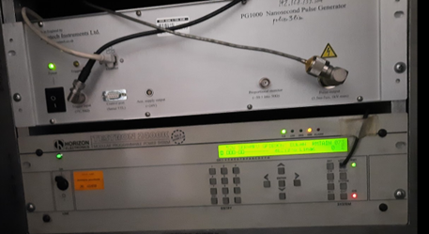
ACTIVITIES for X17
Mylar vacuum windows test-> maintain effectiveness
BTF1 line attached to PADME vessel but higher vacuum limit (~1E7mb)
LINAC maintenance and consolidation:
  HV Pulser GUN installation for PADME (40ns-1us)
  (32/46) PS correctors upgraded and Commissioned Sept. 2022
  Next 16 in the next future
  QW8-10 Power supply substitution
  Secondary Water pump substitution
  DAQ (CAMAC) maintenance
  Modulator Maintenance
X17 300MeV positron beam requires not so much high power
LINAC Kly B(2001) suffers fast trips (3#/day) for klystron pulse current that produce clipper current fault too.
Beam injections in X17
  Beam and detector study in July (22different beams, different phase)
  One energy pre-set per day -> 24H of continuous data taking -> Integrated day lumi 1E10 PoT
  Steady state condition
Kly | A | B | C | D
Vk [%] | 95 | 92 | 85 | 89
RF [%] | 51 | 97 | 91 | 56
Fault [hours] | ~6 | ~45 | ~5 | ~9

Slide 36




LINAC FAULTS
Fault Type
Fault Type
ModA
A
ModB
Fault Type
Fault Type
ModC
ModD
    LINAC FAULTS STATS 01/05/2022 - 10/11/2022 (G. Piermarini)
    KLY B clipper current
    Kly A PFN Charge current/ Pulse current
    Most of the fault with rapid recover (few minutes)

Slide 37



BTF X17 run statistics
Again, significant faults (thanks to the poissonian factor) occurring mostly in the weekend, also in this run.
The hard work of our personnel have balanced such delays
Again, the more RUN going on, the less faults appearing
In respect to PADME RUN2, the injection efficiency moves from 0.77 to 0.91 average
On the 12° Nov. evening, TERNA communicate only 1 hour to fully shutdown DAFNE complex due to emergency maintenance on this National Main Power Line branch
Now in rebooting phase, BTF up and running
More than 100 different beams and setup
Eng. Run
Trials

Slide 38



X17 run statistics
From 10 Oct. -> 12 Nov.
Starting from 28 Sept.
National power line maintenance
In respect to PADME RUN2, the injection efficiency moves from 0.77 to 0.91
Significative impact of TERNA emergency stop, uptime 91%->84% (actual)
At now, we can dilute the stop with our foreseen contingency -> end on 15° Dec.

Slide 39

X17 run statistics
Starting from 10 Oct.
Starting from 28 Sept.
Delivered suffers huge variance due to very low current (and related photons from Mylar window, see previous slides)
Delivered PoTs
  Average (0.91±0,2)x10¹⁰
  Gross total 3,57x10¹¹
We are out of total 3+2 overall day in data taking
Emergency shutdown

Slide 40
BTF Projects

Slide 41







ERAD Project
Last Test Beam in July 2022
Project ended with great success!
REGIONAL FUND ~ 690kE (FTE+Consumables)
INFN TEAM :
Project leader: B. Buonomo
Project TEAM: LINAC BTF Staff and LNF Services
AIMS:
The general aim of the project is the use of electron sources, available at the INFN-LNF to measure the behavior and resistance of electronic components intended to be subjected to radiation in the aerospace environment.
The values ​​and results acquired with these measurements will be compared with homologous measurements performed with photons in order to define comparative resistance thresholds and related indicators.

Slide 42




AIM:
Equip the region with an open research infrastructure to provide support for competitive innovation and growth for companies and stakeholders.
Joint Open Labs:
o FP4 (Health & Bio-Pharma) – F. Cardelli (Resp. BvTech) – Measurements and RF conditioning of acc. structures for medical application
o FP6 (Digital Transition) – C. Di Giulio (Resp. Thales) – Development of algorithms based on Machine learning for big-data analytics, Virtual and augmented reality and Digital Twin.
LINAC SERVICE involved with total 1.2 FTE/YEAR
(B. Buonomo, F. Cardelli, C. Di Giulio)
LNF

Slide 43
Projects income
ERAD funding
Started selection for BTF – fixed-term contract 2-years (adding 1 FTE in BTF)
  BTF people too old, looking forward also for student
PNRR - Rome Technopole funding
Expected Two young researcher – fixed-term contract 1-year (adding 2 FTE in LINAC SERVICE)
  In the next years other retirements will occur and needs overlapping actions
BTF is the right place for young people and ideas
We have to balance working hours with LINAC/BTF group personnel

Slide 44


Booking sw
Booking BTF: BTF booking management software based on an automated approval workflow. Call management.
Once the call for BTF is open, team leader can submit new booking request choosing the available dates on calendar.
Team leader must fill the BTF questionnaire in order to proceed with request.
The facility management and facility user committee will approve or deny via tech. and scient. reasons the submitted questionnaire.

Slide 45


Booking sw
Booking BTF: BTF booking management software based on an automated approval workflow. Access management.
After facility management approval, the team leader can create the team by adding INFN identities hosted in INFN identity management system.
Each team member must fill a web personal form.
Via this document workflow approval by secretariat and personnel.
Team leader can view the approval team workflow in each moment.
Once all approvals step the request is complete and team is authorized to enter the configured facility
This software manage call period, documentation and the territorial QR-code access tool.

Slide 46

EURO LABS
https://web.infn.it/EURO-LABS/

Slide 47
Operational Budget
 | Number of hours over the 4 years | Actual cost (*) | Total value | INFN in kind contribution | Project contribution
BTF | 1176 (7 weeks) | 180.75 €/h | ≈ 213 k€ | 60 % | ≈ 86 k€
SPARC | 1680 (10 weeks) | 126.75 €/h | ≈ 213 k€ | 60 % | ≈ 86 k€
(*) includes:
electric power, personnel (2 technicians h 24, 1 staff researcher h 8), user initial training
Other budget items:
user travel support, INFN staff travels, TA management

Slide 48
Discussions & Conclusions
ERAD project closed succesfully (IMT extremely happy to use electrons)
Successful Ext. User call, X17 experiment on going
  From the long stop at the end of 2019, a great deal of development has been made
  Now BTF closed for 2022 -> PADME-X17 till the end of the year
  X17 requirement had been just reached, now data taking
  Great effort from Acc. and Tech. Divisions (exp. Building and Fluids) for magnets, shielding and LINAC fluids)
  LINAC personnel and DAFNE operators fully involved in.
Long queue of people that need BTF1-BTF2
  Ex. LIMADOU satellite – exp. Launch on 2023
  > 20 Groups waiting (up to now)
Young researchers needed
  PNRR and ERAD funding will cover
  BTF People too old, looking forward also for student

Slide 49

SPARE SLIDE

Slide 50



Slide 51

Minimize impact on inline check and maintenance operations
Repetitive scheduled events

Slide 52


Btf Vacuum – SAFETY SYSTEM
To DR
Both checked at the end of Tech-RUN2 and at the RUN2 start
Fully operative Fast Valve safety system – at the vacuum vents
Fully operative Mylar window – checked at differential at ~1E-5mbar, no leak detected by pumps
2E-7 mb
PADME
4E-8 mb
BTFEH1
2E-9 mb
LINAC
WALL
Mylar
Fast Valve LINAC
4E-9 mb
Mylar Vacuum Breaking Window
From LINAC

Slide 53





Btf BEAM on X17 diag

Slide 54


Beam Performances

Slide 55

Setup O (low stat in restart):
DHSTB001: 175.925 A (276.3MeV) (5061,20g)
DHSTB002: 186.300 A (275.4MeV)
DHRTB101: 165.3 A
Original setup:
DHSTB001: 175.925 A (276.3MeV) 5071,20 G
DHSTB002: 186.240 A (275.3MeV)
DHRTB101 166.9 A
Setup A
Line PLC fault, Magnet switch off
Magnets involved: QUATMXXX, QUATB10X, QUATB001, QUATB002, DHSTB001
DHSTB001: 175.925 A (276.3MeV) (5061,20g)
DHSTB002: 186.240 A (275.3MeV)
DHRTB101: 165.3 A
0
Setup B (tune DH)
DHSTB001: 176.225 A (276.8MeV) (5070.4g)
DHSTB002: 186.240 A (274.3MeV)
DHRTB101: 165.300 A
D
A
Setup C (tune DH)
DHSTB001: 175.925 A (276.3MeV) (5061,20g)
DHSTB002: 186.240 A (274.3MeV)
DHRTB101: 166.900 A
C
Setup D (tune DH)
DHSTB001: 175.925 A (276.3MeV) (5061,20g)
DHSTB002: 186.240 A (274.3MeV)
DHRTB101: 165.300 A
B
E
F
Setup E (tune DH)
DHSTB001: 176.225 A (276.8MeV) (5070.4g)
DHSTB002: 186.240 A (274.3MeV)
DHRTB101: 165.300 A
Setup F (tune DH)
DHSTB001: 176.225 A (276.8MeV) (5070.4g)
DHSTB002: 186.240 A (274.3MeV)
DHRTB101: 166.300 A

Slide 56


Slide 57





BTF BEAM – Standard PADME PUlse
Direct positrons in FitPIX
Positrons on CALOBTF1
Good agreement in time evaluation
An indirect calibration for photons measurements
Good Luminosity monitor: seems robust to beam setup variation
1000 bunched 30kPoT
photons charge distribution
10% resolution
Photons on CALOBTF1
Photons conversion on adsorber, deltas… in FitPIX

Slide 58



BTF BEAM – 320ns pulse trialS
Extending longitudinal line acceptance with GUN improved timing:
15/10/20 trials on 320ns, 32kPoT/bunch
Measure on BTFDAQ in direct and Bremss photons
Coherent measure with PADME SAC DAQ
Flatness to be improved (no much time on it)
Very good result for a LINAC intended for 10ns pulse!!!
Positrons on CALOBTF1
Daily trends photons stripchart on CALOBTF1
Daily trends pulse width
Cumulative plot of photons conversion at FitPIX (red < cyan, Mylar image)

Slide 59



BTF BEAM – Inj to PADME
Different final focus trials maintaining:
Background level
Lower use of scrapers
Low sensibility on LINAC fluctuations
Best focus on FitPIX σ(X/Y) = (0,7/0,7) [mm]
Selected from PADME people
Y-axis focus
Better management at detector level
σ(X/Y) = (1,0/2,2) [mm]
See Raggi presentation
Best focus on PADME on single Dia Target strip
High divergence and flux
σ(X/Y) = (1,1/0,6) [mm]

