Slide 1
Techniques for hadron spectroscopy studies at LHCb
Mengzhen Wang (INFN di Milano)
2023/06/07
On behalf of the LHCb collaboration
Hadrons 2023
05-09 June 2023, Genova, Italy

Slide 2
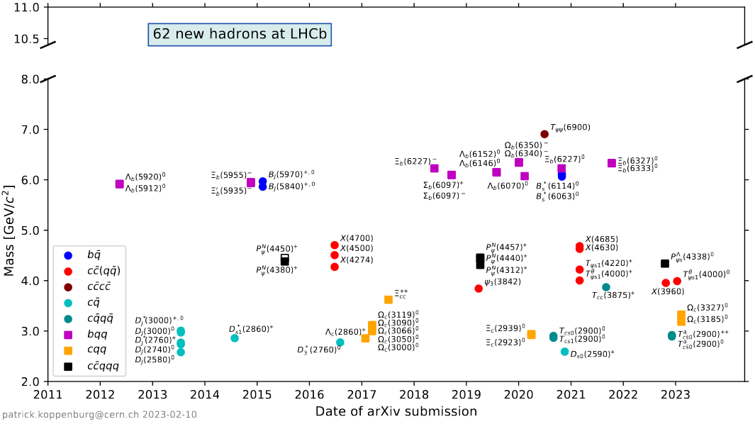
$b,c$ spectroscopy at LHCb
LHCb: one of the major players of hadron spectroscopy study
Search for new hadrons
Measure hadron properties (lineshape, lifetime, decay modes…)
[link] to the figure

Slide 3
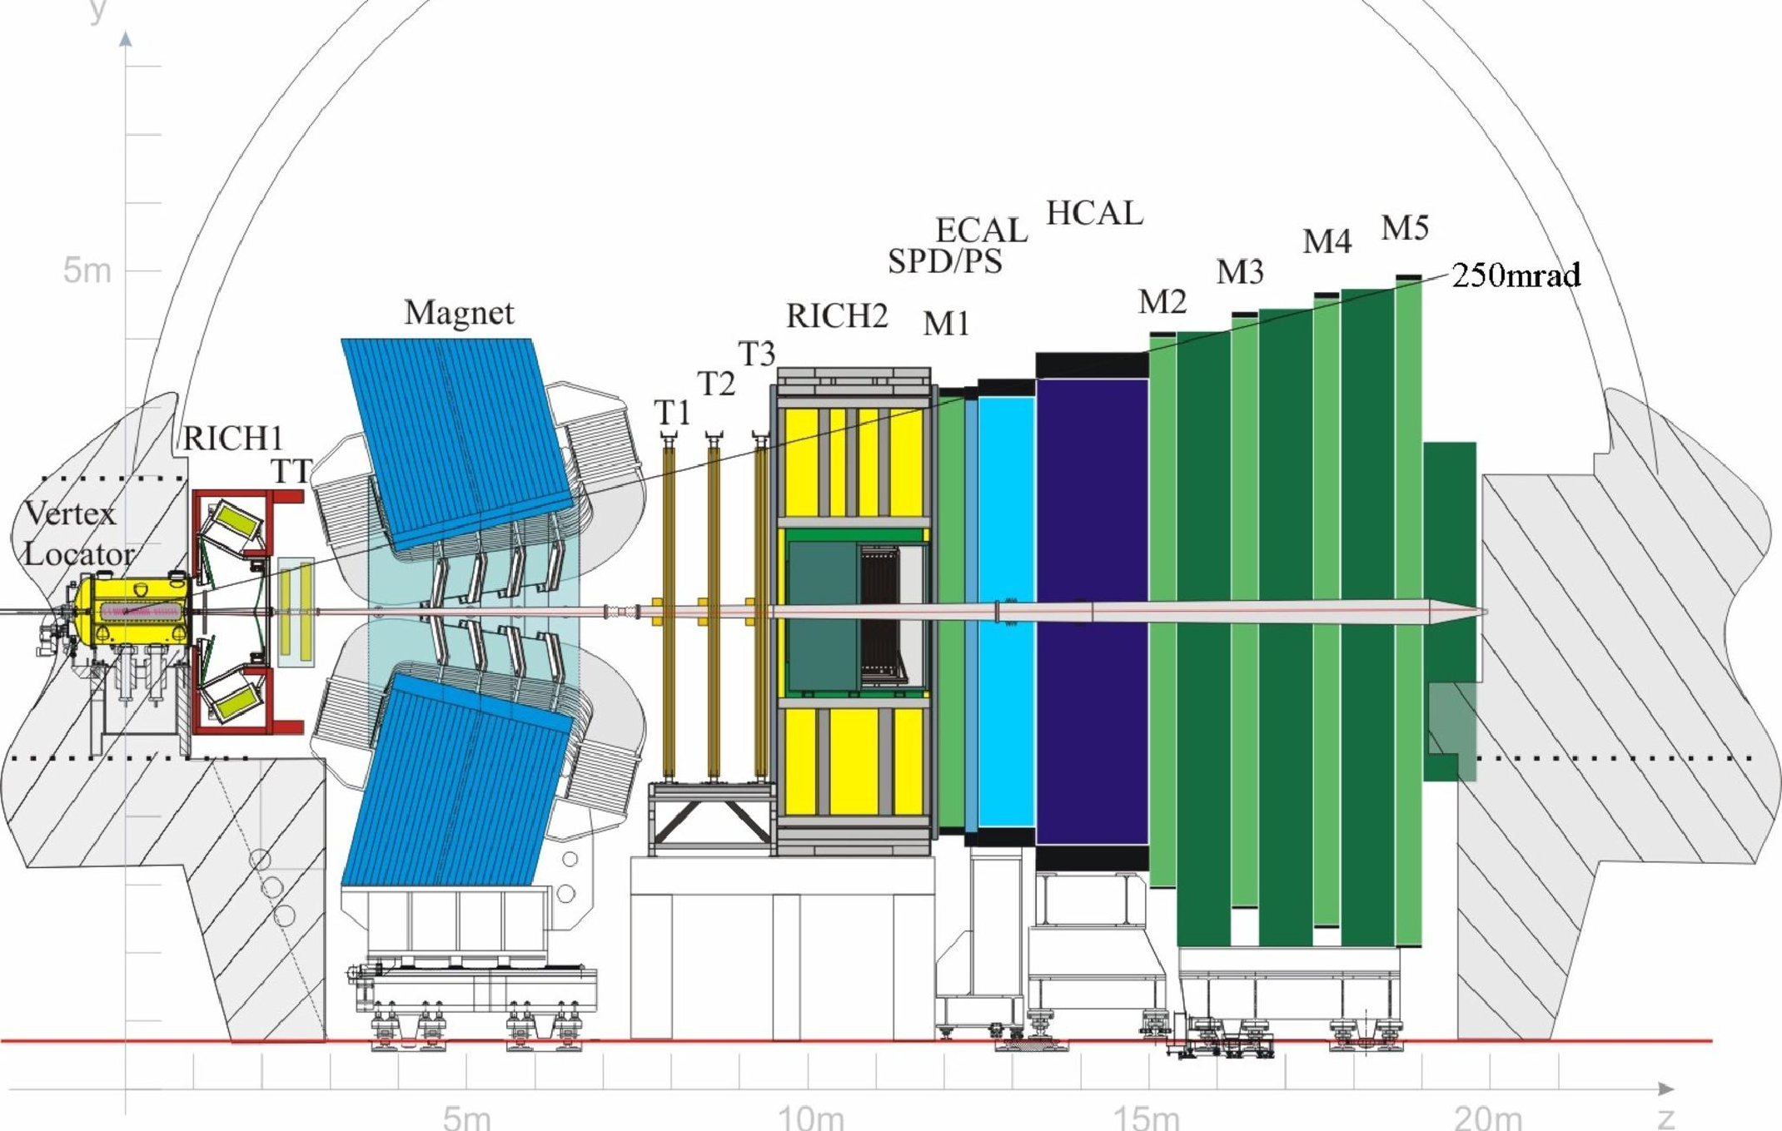
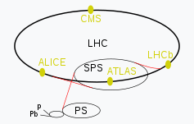
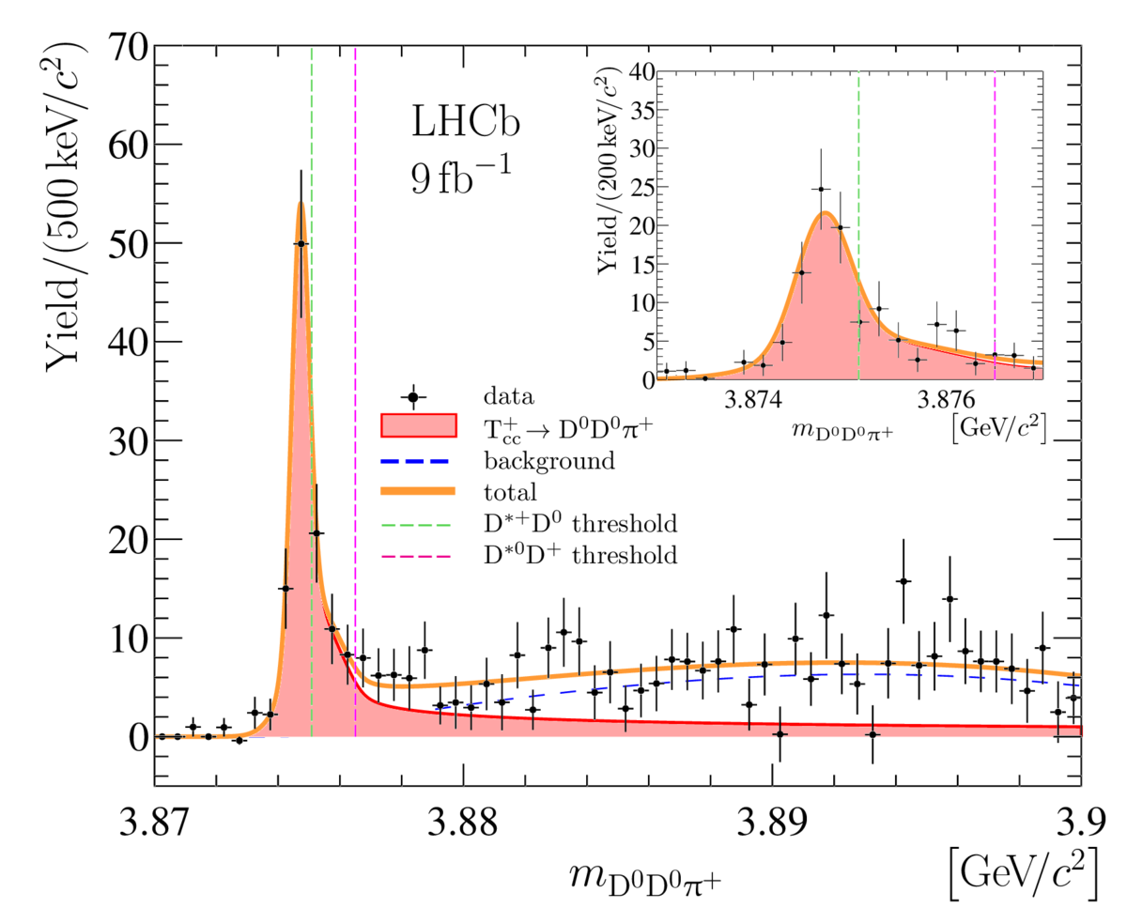
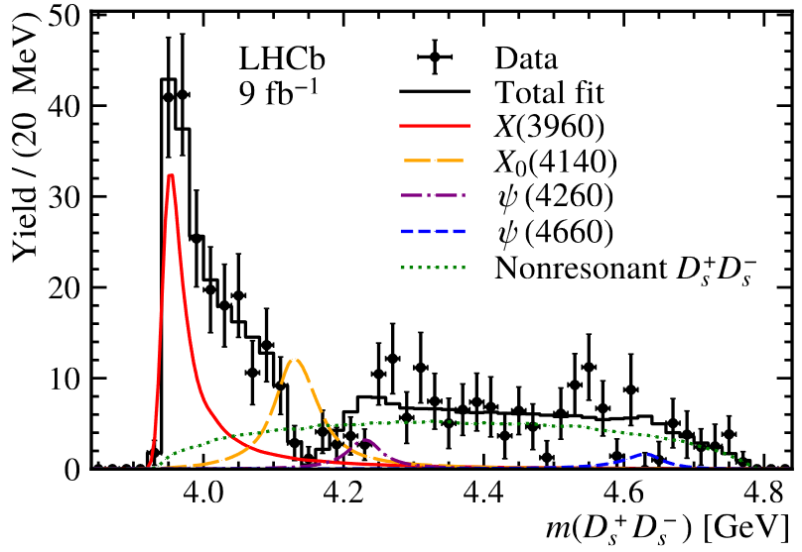
$b,c$ spectroscopy at LHCb
Benefit from...
JINST 3 (2008) S08005, IJMPA 30 (2015) 1530022
LHCb detector optimized for the collection, reconstruction and identification of $b,c$ signals
Large $b,c$ hadron production cross-section @ LHC
+
=
High-stat. and good-quality heavy flavor dataset
Figure from [wiki]
Improved knowledge about hadron spectroscopy
Data analysis
Menu of today:
Development of data-analysis techniques benefiting recent LHCb results
(Focus on amplitude analysis)
arXiv:2210.15153, Tetraquark candidate in $D_{s}^{+}D_{s}^{−}$ final state
Nature Communicatitions, 13, 3351 (2022)
Observation of doubly-charm tetraquark candidate

Slide 4
Selected topics
Development of helicity amplitude formalism
Speed up amplitude fits using GPUs
PRL 115 (2015) 072001
Annals Phys. 7 (1959) 404
$P_{c}\left(4380\right), P_{c}(4450)$ observation
Conventional helicity formalism
Advances in High Energy Physics (2020) 6674595
Chinese Phys. C 45 (2021) 063103
Phys.Rev.D 95 (2017) 7, 076010
arXiv:2208.03262
Study of $Λ_{c}^{+}→pKπ^{−}$ decay amplitude
Pentaquark evidence in $Ξ_{b}^{−}→J/ψΛK^{−}$
Science Bulletin 66 (2021) 1278
New principles for final-state alignment in helicity-based amplitude
arXiv:2210.10346
Phys. Rev. D 101 (2020) 034033
Observation of $P_{ψs}^{Λ}(4338)$
Dalitz-plot decomposition formula
arXiv:2301.04899
Evidence of tetraquark candidate $T_{ψs1}^{θ}{\left(4000\right)}^{0}$
A CUDA + RooFit based fit framework
Focus on techniques. For relevant physics results, see the talks by Elisabetta [link] and Bo [link]

Slide 5
Development of helicity-based amplitude formalisms

Slide 6
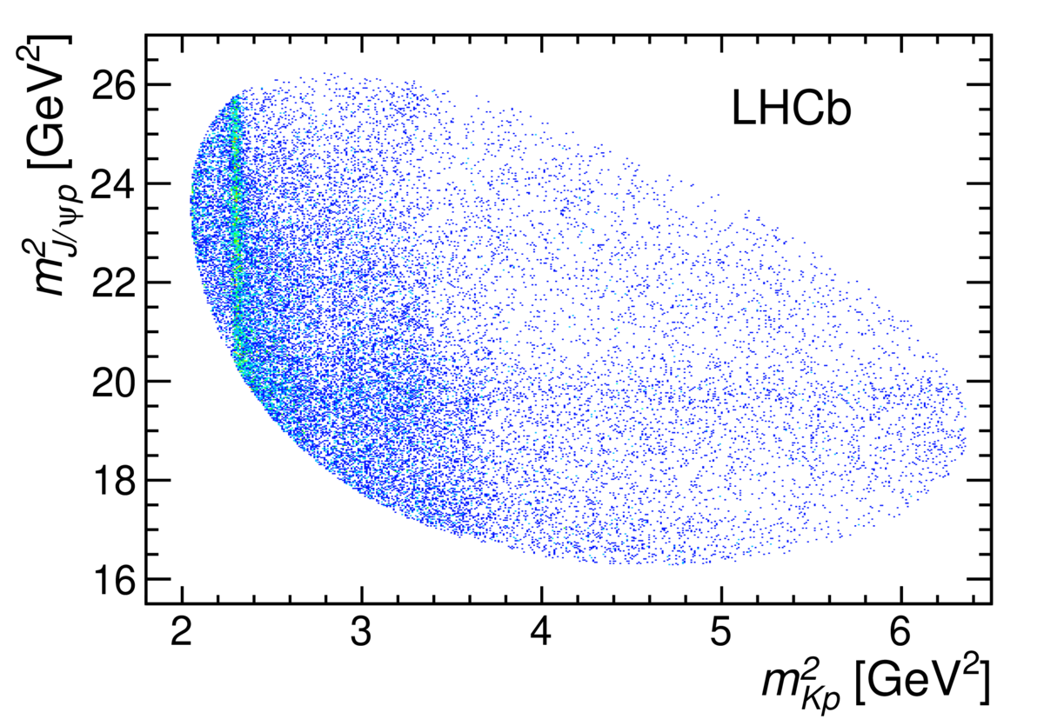
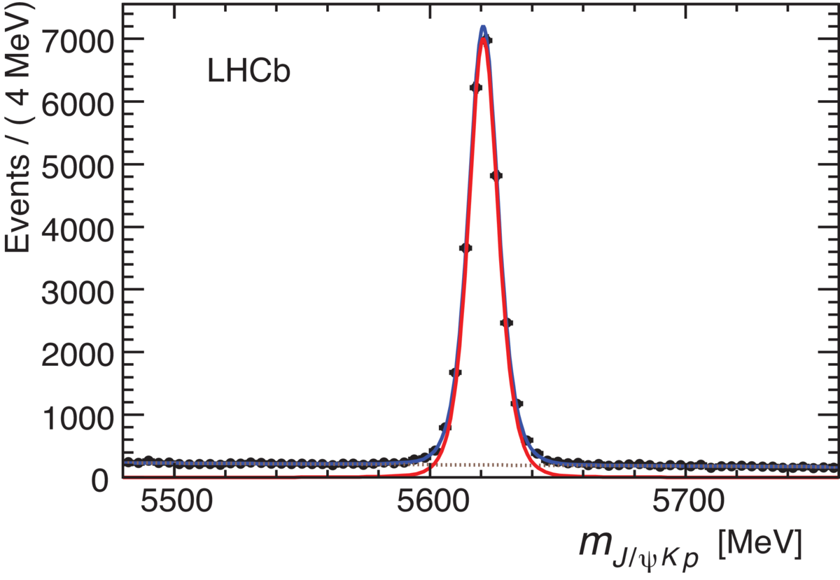
Helicity formalism & $P_{c}$ observation
PRL 115 (2015) 072001
Run 1
$$ℒ\sim 3{fb}^{−1}$$
$J/ψp$ resonance ?
$[c\overline{c}uud]$
Conventional resonances $Λ^{∗}→pK$
$\sim 20k$ $Λ_{b}^{0}→J/ψpK^{−}$ signals collected in Run1
Clear $J/ψp$ structure seen in Dalitz plot
Multi-dimension amplitude analysis to extract properties of $J/ψp$ intermediate states

Slide 7
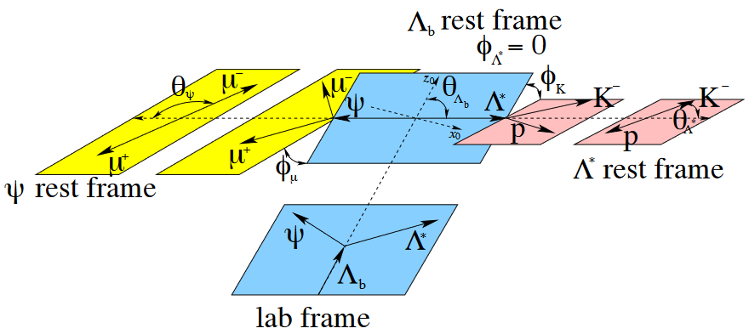
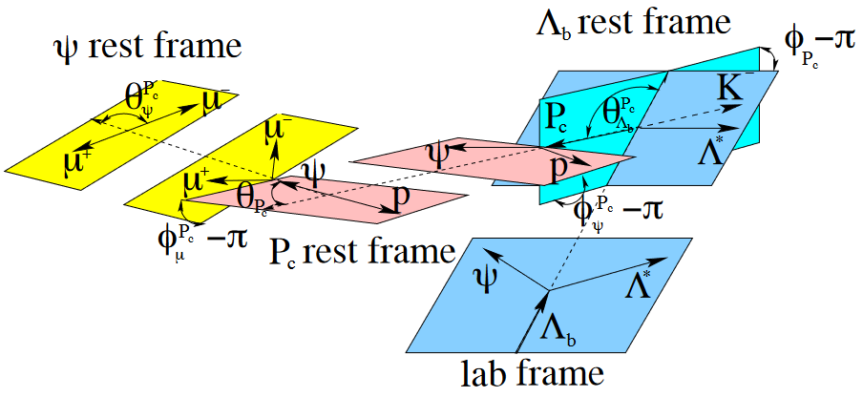
Helicity formalism & $P_{c}$ observation
PRL 115 (2015) 072001， PRL 115 (2015) 072001 supplemental
Two decay chains: $Λ^{∗}$ or $P_{c}$ as intermediate state
$Λ^{∗}$ chain:
$P_{c}$ chain:
RBW-based lineshape
Wigner-D function to associate initial & final spin states of each two-body decay node
Use angles between particle momenta/momentum planes to obtain angular variables

Slide 8
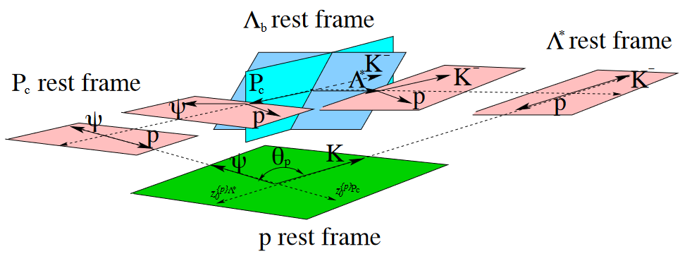
Helicity formalism & $P_{c}$ observation
PRL 115 (2015) 072001， PRL 115 (2015) 072001 supplemental
Combine two chains to get final matrix element
Need a consistent definition of initial & final spin state
Rotations in $Λ^{∗}$ chain
$Λ^{∗}$ chain final spin state
Initial spin state
Alignment rotation needed
Rotations in $P_{c}$ chain
$P_{c}$ chain final spin state
Properly align the definition of final-state spin states in different chains

Slide 9
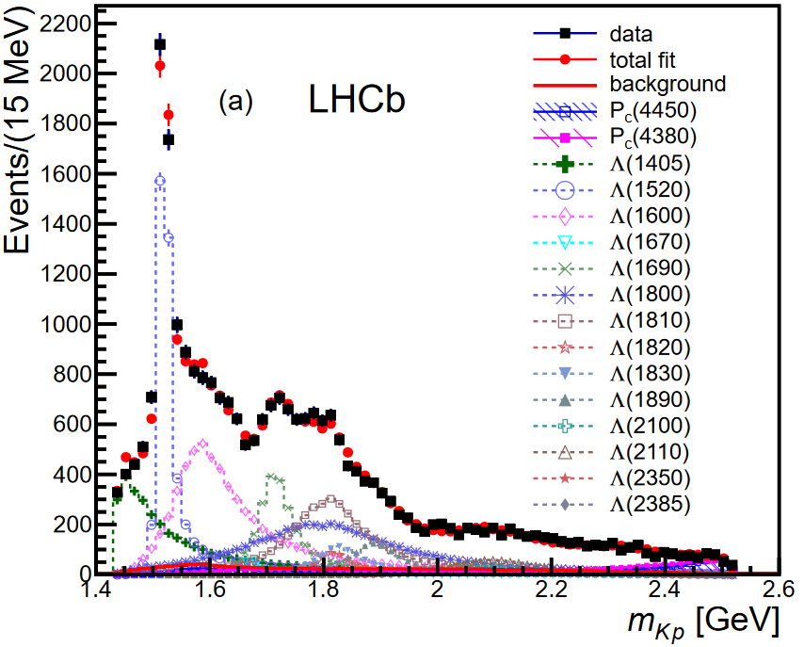
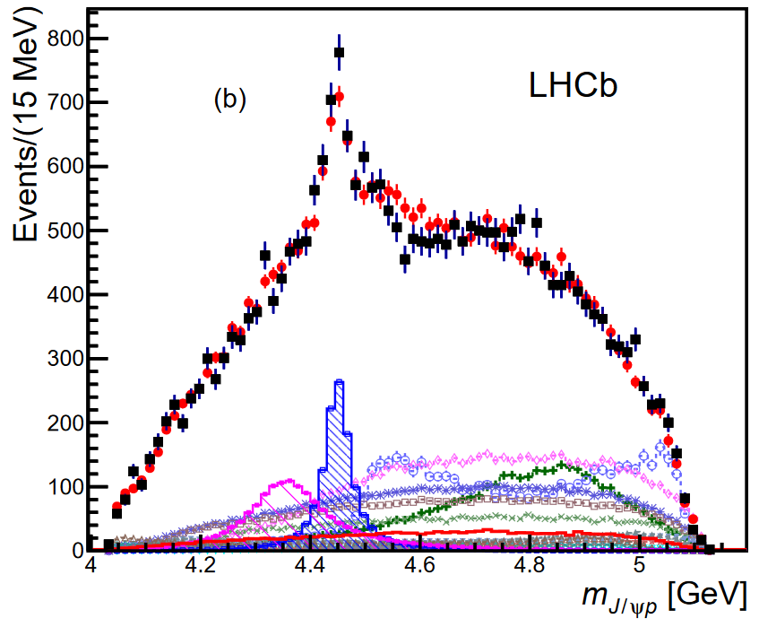
Helicity formalism & $P_{c}$ observation
PRL 115 (2015) 072001
Two $J/ψp$ resonances with significance $>5σ$
minimal quark content $[c\overline{c}uud]$, good candidate for pentaquarks
Follow-up analyses:
Confirmed in Model-independent analysis
Similar structure seen in Cabibbo suppressed $Λ_{b}^{0}→J/ψpπ^{−}$
$P_{c}\left(4312\right), P_{c}\left(4440\right), P_{c}\left(4457\right)$ observed in Run1+2 data
PRL 115 (2015) 072001
PRL 115 (2015) 072001
Run 1
$$ℒ\sim 3{fb}^{−1}$$
Run 1
$$ℒ\sim 3{fb}^{−1}$$
$$P_{c}(4450)$$
$$P_{c}(4380)$$
PRL 117(2016)082002
PRL 117(2016)082003
PRL 122(2019)222001

Slide 10
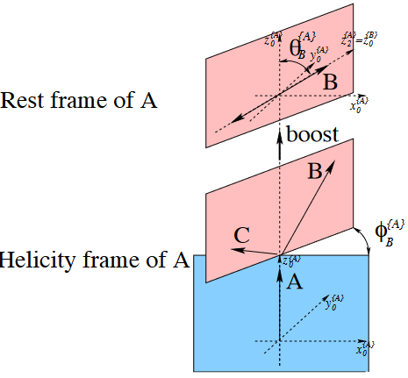
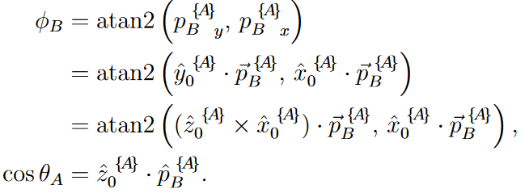
The missing quantum effect ?
Advances in High Energy Physics (2020) 6674595; Chinese Phys. C 45 (2021) 063103
The conventional helicity formalism
Arbitrary “-1” terms in any single-chain amplitudes:
Generate tricky behavior in interference of different chains
(SU2)
Fully determine
(SO3)
Decay angles rotating spin states
Rotations in momentum space
$$ℳ=$$
PRL 115 (2015) 072001 supplemental
Quantum effects missing for baryons ?
$$d_{λ_{1},λ_{2}}^{J}\left(θ_{A}\right)=−1×d_{λ_{1},λ_{2}}^{J}(θ_{A}+2π)$$
Cannot set a preference between
$θ_{A} \& θ_{A}+2π$, $φ_{B} \& φ_{B}+2π$
$$e^{iλφ_{B}}=−1×e^{iλ(φ_{B}+2π)}$$

Slide 11
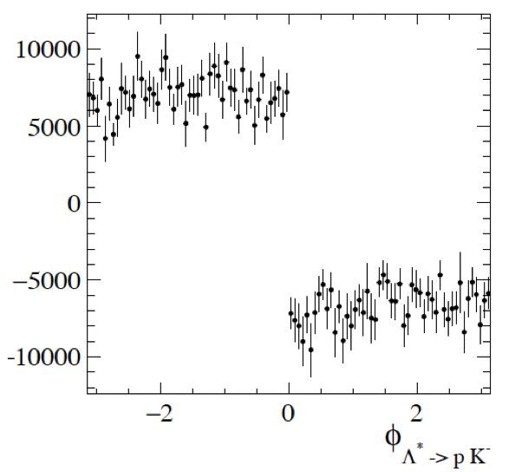
Impact on interference
Advances in High Energy Physics (2020) 6674595; Chinese Phys. C 45 (2021) 063103
The $Λ^{∗}, P_{c}$ interference using the formula for $P_{c}$ observation
Impact on the first $P_{c}$ analysis:
No impact on $Λ^{∗}$-only fit quality
Reduce the flexibility of $Λ^{∗}+P_{c}$ model
$P_{c}$ properties (to be) updated in Run1+2 analysis
Impact of missing of the quantum effects consistent with the statement in PRL 115 (2015) 072001
Interference term
An unnatural “-1” sign impacting half events
Total interference vanish
PRL 122(2019)222001: Two-peak nature of $P_{c}(4450)$ observed;
Properties of $P_{c}(4380)$ to be updated in future amplitude analysis

Slide 12
Recover the missing quantum effect
Advances in High Energy Physics (2020) 6674595; Chinese Phys. C 45 (2021) 063103
Main idea:
Origin of the issue is improper alignment of final-state definitions for each decay chain due to arbitrary “-1” term
Seek for new principles for final-state alignment
Conventional method
Rely on graphic picture
Use angles between particle momenta or momentum planes to define alignment operator

Slide 13
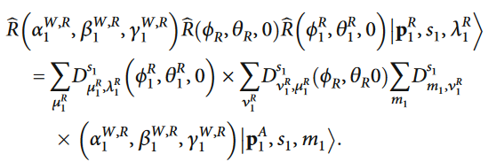
Recover the missing quantum effect
Advances in High Energy Physics (2020) 6674595; Chinese Phys. C 45 (2021) 063103
Main idea:
Origin of the issue is improper alignment of final-state definitions for each decay chain due to arbitrary “-1” term
Seek for new principles for final-state alignment
New method
Directly write down all rotation/boost operators associating initial/final spin-state frames, using a representation where $θ→θ+2π$ is visible
Conventional method
Rely on graphic picture
Use angles between particle momenta or momentum planes to define alignment operator
Advances in High Energy Physics (2020) 6674595
Advances in High Energy Physics (2020) 6674595; Chinese Phys. C 45 (2021) 063103

Slide 14
Recover the missing quantum effect
Advances in High Energy Physics (2020) 6674595; Chinese Phys. C 45 (2021) 063103
Main idea:
Origin of the issue is improper alignment of final-state definitions for each decay chain due to arbitrary “-1” term
Seek for new principles for final-state alignment
New method
Directly write down all rotation/boost operators associating initial/final spin-state frames, using a representation where $θ→θ+2π$ is visible
Conventional method
Rely on graphic picture
Use angles between particle momenta or momentum planes to define alignment operator
Advances in High Energy Physics (2020) 6674595
Advances in High Energy Physics (2020) 6674595; Chinese Phys. C 45 (2021) 063103
New method implemented in
$Λ_{c}^{+}→pKπ^{−}$ amplitude analysis
$Ξ_{b}^{−}→J/ψΛK^{−}$ amplitude analysis for pentaquark search
arXiv:2208.03262
Science Bulletin 66 (2021) 1278

Slide 15
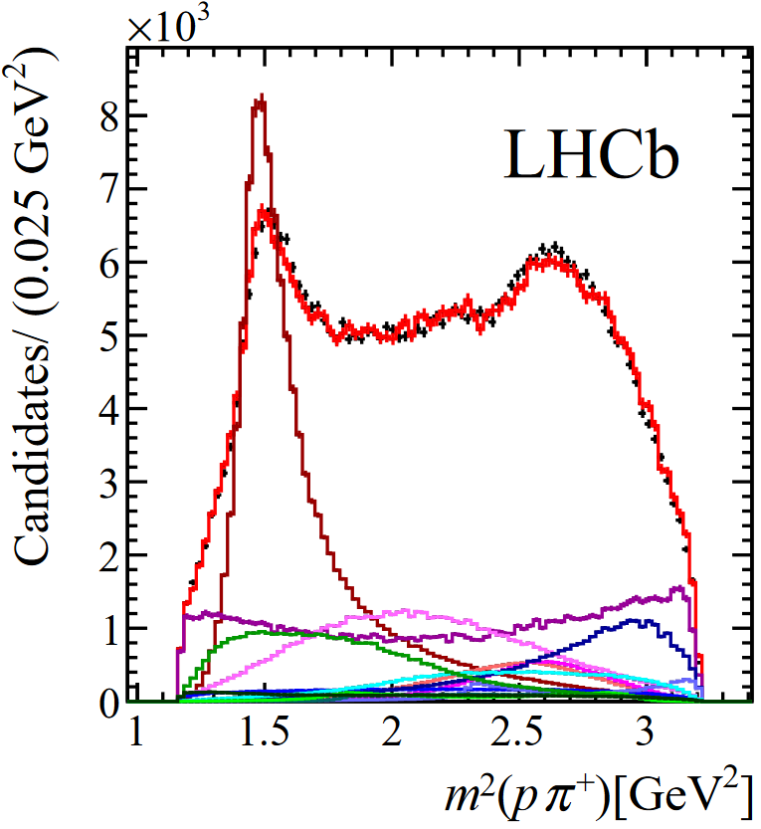
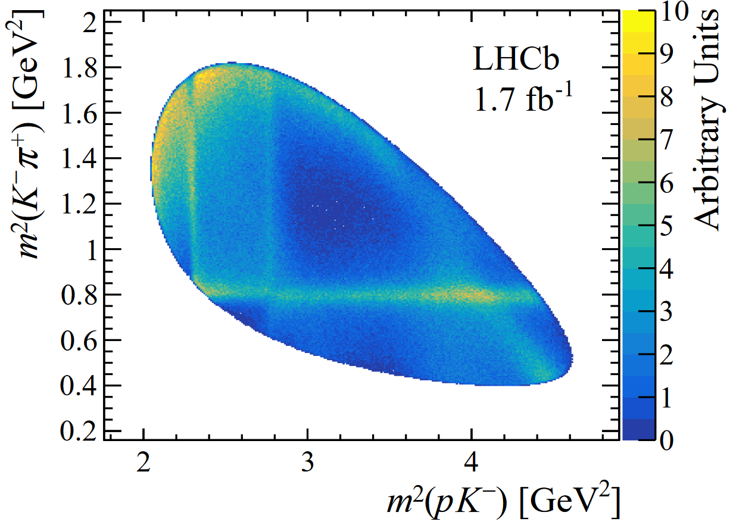
$Λ_{c}^{+}→pK^{−}π^{+}$ amplitude analysis
arXiv:2208.03262
2016 data$,𝓛=0.5{fb}^{−1}; \sim 400k$ signals;
Helicity-based Am.An.; Measure polarization, resonance fractions and decay parameters
Large interference seen between different chains
arXiv:2208.03262
arXiv:2208.03262
Large interference between $Δ{\left(1232\right)}^{++}$ and $K^{∗}(892)$

Slide 16
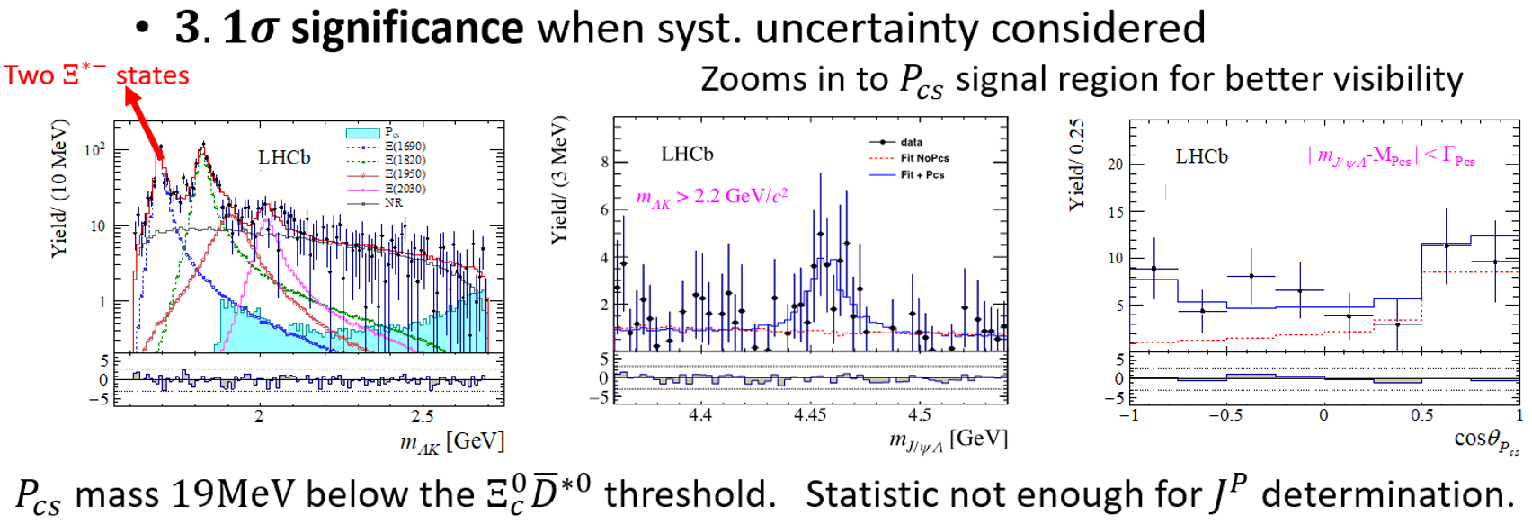
$Ξ_{b}^{−}→J/ψΛK^{−}$ amplitude analysis
See the talks by Elisabetta [link] and Bo [link]
Science Bulletin 66 (2021) 1278
Consider $Λ$as final-state particle, similar spin structure as $Λ_{b}^{0}→J/ψpK^{−}$ decay
Use same amplitude formalism, with alignment-issue fixed
Science Bulletin 66 (2021) 1278

Slide 17
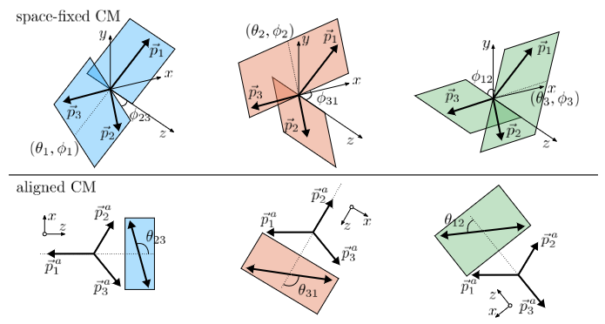
Dalitz-plot decomposition (DPD) formula
Phys. Rev. D 101 (2020) 034033
$ℳ\sim <init. \left| fin.>\sim <init. \right|\sum_{i}{R_{i}}>…<\sum_{i}{R_{i}}|fin.>$
DPD formula for 3-body decay
$0→123$
Wigner-D functions
Choice of intermediate spin state/frame not unique. Alternative choice: DPD formula
An arbitrary initial spin frame
Same Euler rotation for all decay chains
(One Wigner-D function)
All momenta (spin-axis of helicity states) aligned to x-z plane; ${\hat{p}}_{1}=−\hat{z}$
Use conventional helicity formula to write the rest part of amplitude
Phys. Rev. D 101 (2020) 034033
Angular variables can be derived using Dalitz-plot variables

Slide 18
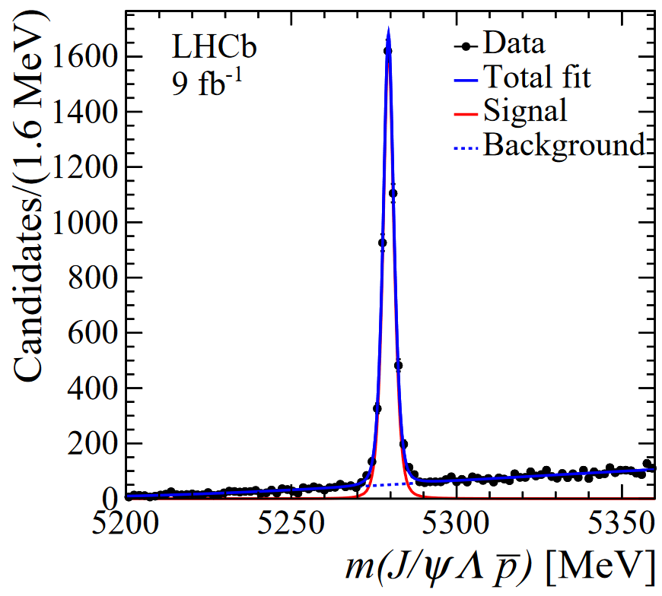
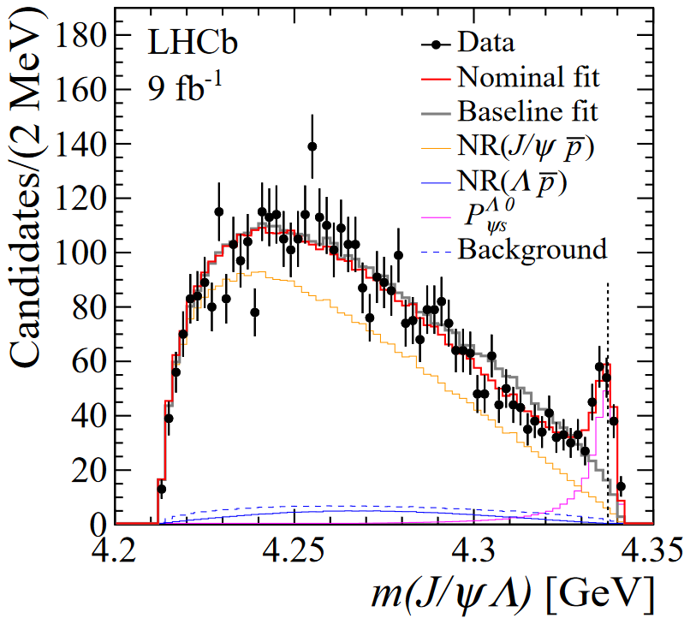
Observation of $P_{ψs}^{Λ}(4338)$
See the talks by Elisabetta [link] and Bo [link]
arXiv:2210.10346
Search for $J/ψp$ and $J/ψΛ$ states in $B^{+}→J/ψp\overline{Λ}$
$B^{+}$ is spin-zero. 1st Euler rotation is a constant term
2D Dalitz amplitude for 3-body $B^{+}$ decay (DPD)
2D amplitude of $J/ψ→μ^{+}μ^{−}$ + 2D amplitude of $Λ→pπ$
6D amplitude analysis on $\sim 4500$ $B^{+}→J/ψp\overline{Λ}$ decays
$P_{ψs}^{Λ}$ significance $>10σ$
arXiv:2210.10346; supplemental A
$$\sim 4500 B^{+}$$
$$P_{ψs}^{Λ}$$

Slide 19
Speed up amplitude fits using GPUs

Slide 20
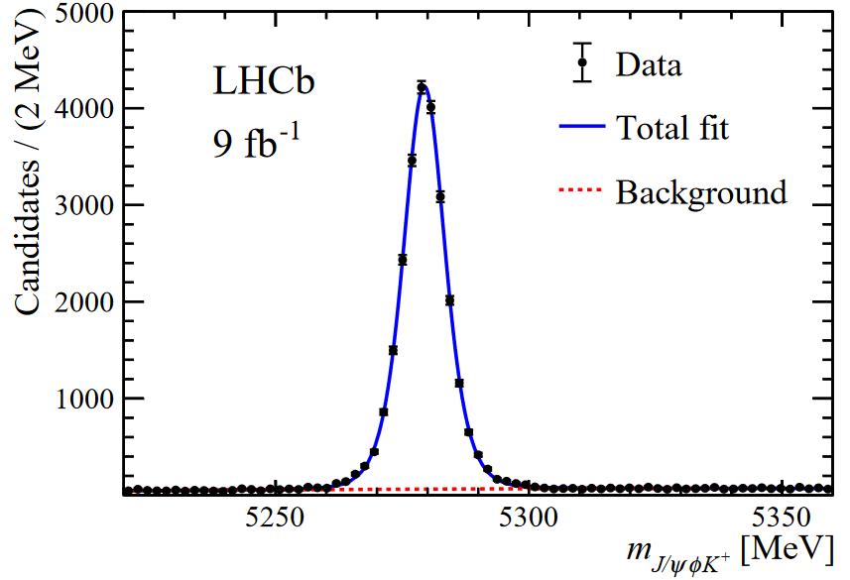
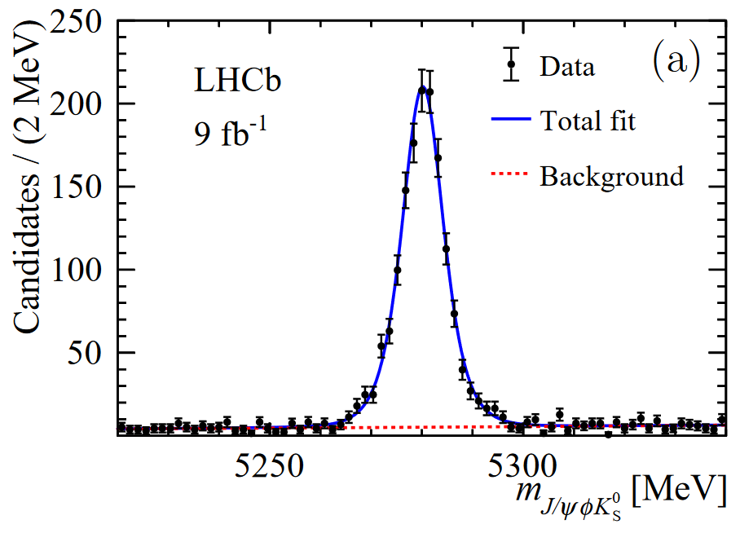
Study of $B^{0}→J/ψK_{S}^{0}φ$ decay
$T_{ψs1}^{θ}{\left(4000\right)}^{+}$ observed in $B^{+}→J/ψK^{+}φ$ channel
Search for its isospin partner in $B^{0}→J/ψK_{S}^{0}φ$ decay
Joint amplitude fit using $B^{+}→J/ψK^{+}φ$ and $B^{0}→J/ψK_{S}^{0}φ$ events collected in LHCb Run1+Run2
$\sim 20k$ signals
$\sim 2k$ signals
PRL 117 (2021) 082001
arXiv:2301.04899

Slide 21
Construction of likelihood function
To obtain a log-likelihood value:
Need to calculate matrix element for $\sim 0.4M$ times
Amplitude computations for each data/MC events are independent on each other. Use GPUs to handle the them in parallel
Loop over all data events in signal region ($\sim 20k$)
$$lnℒ=\sum_{i}{(ln\left(1−β\right)P_{i, sig }(\vec{ω})+β P_{i, bkg})}$$
Parameterized using sideband data
Signal PDF: $P_{i,sig }=\frac{{\left|𝓜_{i}(\vec{ω})\right|}^{2}×Φ_{i}×ε_{i}}{I_{norm}(\vec{ω})}$
Loop over uniform phase-space MC events passing all event selections ($400k$)
Norm. factor obtained numerically using MC:$I_{norm}=\sum_{j}{{\left|𝓜_{j}(\vec{ω})\right|}^{2}}$

Slide 22
CUDA + RooFit based framework
Including all invariant terms in minimization procedure
(for example Wigner-D functions)
Version 1
GPU type: RTA 3090

Slide 23
Optimization of the framework
zhihong.shen@cern.ch
Optimization of the GPU sector
Tools: Nsight Systems (nsys) and Nsight Compute (ncu) by Nivdia
Re-organize the task of GPU and CPU
CPU part start to dominate the time consumption
Methods | Impact on GPU time calculating one log-likelihood value
Malloc once and reuse the memory | 8.8ms -> 7.7ms
Double -> Float | 7.7ms -> 3.7ms
Use less registers | 3.7ms -> 3.4ms
Reduce branch structure | 3.4ms -> 2.6ms
Technical Tricks by chen.chen@cern.ch
GPU organize ${\left|ℳ_{i}\right|}^{2}$ to form NLL
GPU forward NLL to CPU to do minimization (Minuit)

Slide 24
Performance & achievement
See the talk by Elisabetta [link]
arXiv:2301.04899
$\sim 10mins$ to run an amplitude fit
Even fast enough for toy studies with hundreds of fits needed
Physics result
Evidence of $T_{ψs1}^{θ}{\left(4000\right)}^{0}$ seen in $J/ψK_{S}^{0}$ system ($\sim 4σ$)
Mass, width consistent with $T_{ψs1}^{θ}{\left(4000\right)}^{+}$ isospin partner

Slide 25
Summary

Slide 26
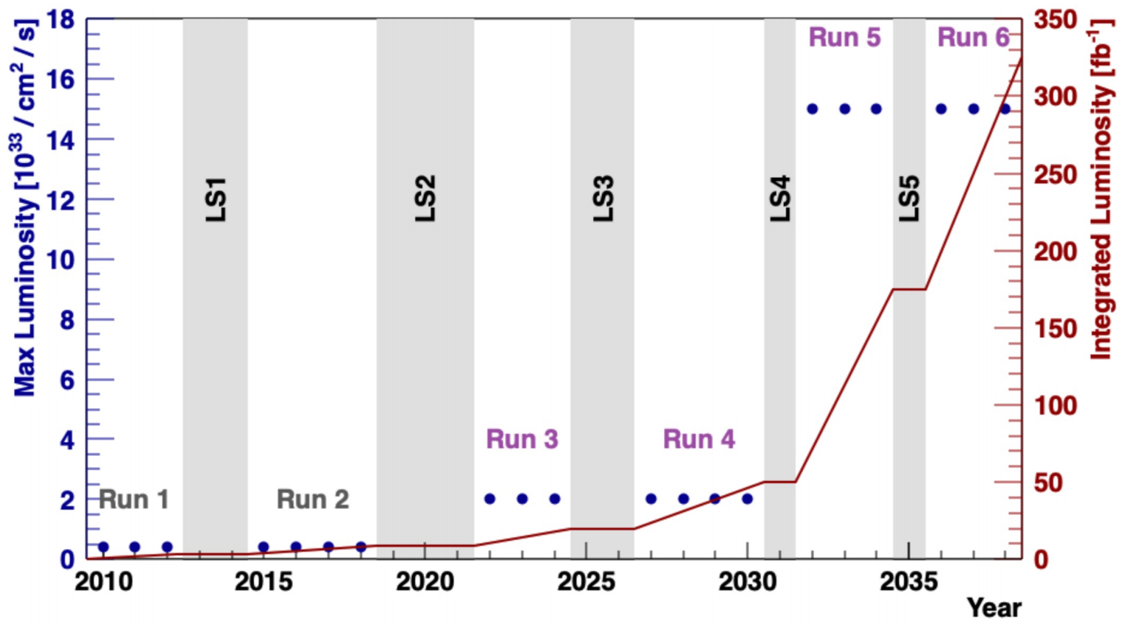
Summary
LHCb has made a great contribution to hadron spectroscopy studies, and is smoothly boosting the field to a new level
More & more high-quality data is coming. Improved stat. precision
To persist the ability of handling the ever larger data flow:
Improved trigger system, Real-Time Analysis
Advanced software tools for Data Processing and Analysis
Example in this talk:
Use GPUs to speed up amplitude analysis
Develop & use new phenomenological models in data analysis, minimize relevant systematic uncertainties, to match the ever better stat. precision
Stay tuned ☺
Thank you for your attention !
Example in this talk:
Development of the general formalism for helicity amplitudes

Slide 27
Back up

Slide 28
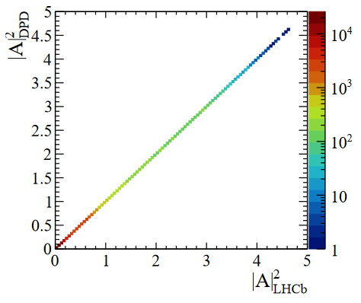
Dalitz-plot decomposition (DPD) formula
Phys. Rev. D 101 (2020) 034033
Split the amplitude into different sectors featuring different aspects of the decays
Example: $Λ_{b}^{0}→J/ψpK^{−}$ amplitude
A good agreement found with the conventional formalism
Shared by $P_{c}, Λ^{∗}$ chains
Dalitz-variable-dependent amplitude
$ℳ_{P_{c}}+ℳ_{Λ^{∗}}$, dominate the interference behavior
$Λ^{∗}$ chain
$P_{c}$ chain
$J/ψ→μ^{+}μ^{−}$ decay amplitude shared by two chains
Chinese Phys. C 45 (2021) 063103
DPD V.S. conventional helicity formula

Slide 29
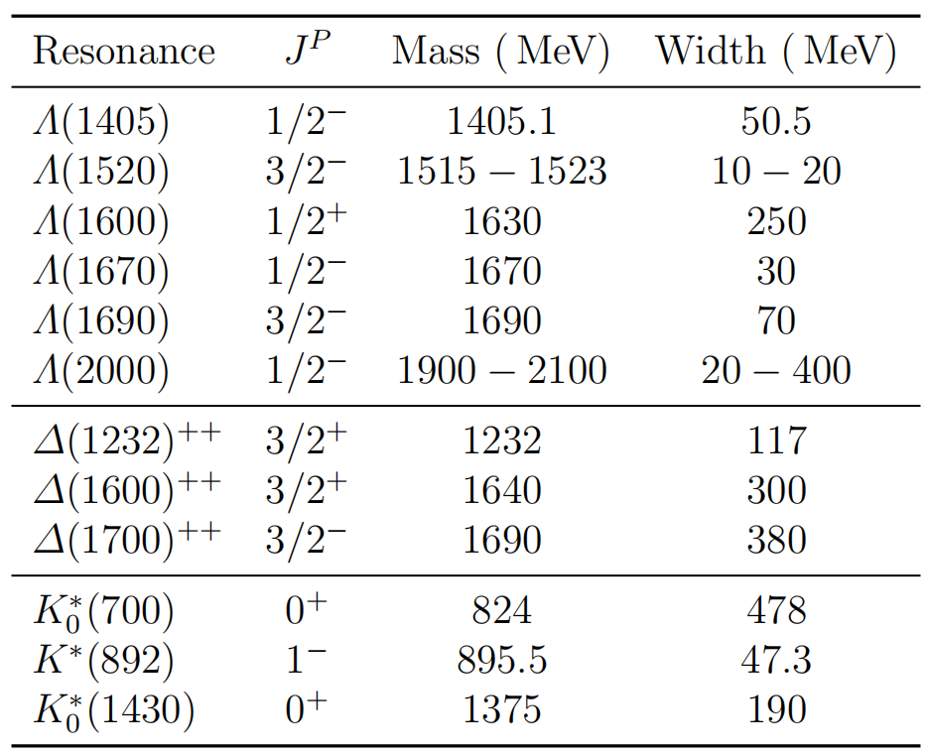
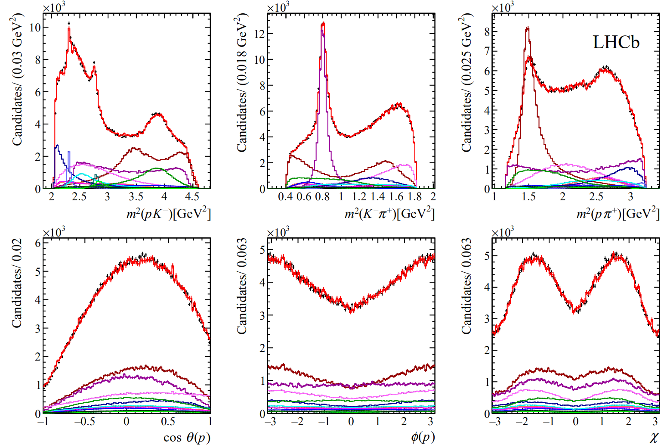
$Λ_{c}^{+}→pK^{−}π^{+}$ amplitude analysis
arXiv:2208.03262
2016 data$,𝓛=0.5{fb}^{−1}; \sim 400k$ signals; helicity-based Am.An.
All parameters of amplitude model reported
Mass and width of $Λ(2000)$ determined
$$Λ(2000)$$

Slide 30
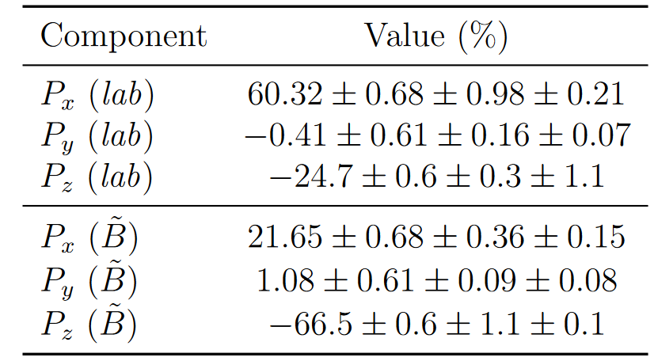
$Λ_{c}^{+}$ polarization measurement
arXiv:2208.03262
Large interference seen between different chains
Final-state kinematics
Initial spin structure of $Λ_{c}^{+}$
Advances in High Energy Physics (2020) 7463073
Large interference between $Δ{\left(1232\right)}^{++}$ and $K^{∗}(892)$
$Λ_{c}^{+}$ polarization from semileptonic $b$-decays measured, with 2 different definitions of initial spin axis
Model dependency contributes to the largest syst. uncertainty (second term)

