Slide 1
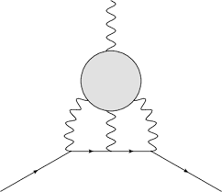
Data-driven approximations to the Hadronic Light-by-Light scattering contribution to the muon (g-2)
QCD
Pablo Roig (Cinvestav, Mexico City, Mexico) pablo.roig@cinvestav.mx
In collaboration with
Pere Masjuan (UAB-IFAE-BIST, Barcelona) masjuan@ifae.es
HLbL
HADRON 2023, Genova, Italy, 5-9 June 2023

Slide 2
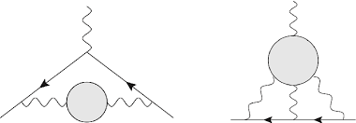
Why it matters?
SM uncertainty on the muon g-2 is dominated by that of the Hadronic Vacuum Polarization piece (see Mattia, Christoph, Francesca,Álex, Camilo & David talks). From the White Paper, Phys. Rept. '20, this error is 4.0x10⁻¹⁰.
QCD
QCD
HVP
HLbL
HADRON 2023, Genova, Italy, 5-9 June 2023 Data-driven approxs. to a_{μ}^{HLbL} Pablo Roig & Pere Masjuan

Slide 3
Why it matters?
SM uncertainty on the muon g-2 is dominated by that of the Hadronic Vacuum Polarization piece (see Mattia, Christoph, Álex, Francesca, Camilo & David talks). From the White Paper, Phys. Rept. '20, this error is 4.0x10⁻¹⁰.
The error of the HLbL piece is only 1.9x10⁻¹⁰, which contributes little to the overall theory uncertainty, of 4.3x10⁻¹⁰. Together with the error of the a_{μ} measurement, it determines its reach on new physics.
QCD
QCD
HVP
HLbL
HADRON 2023, Genova, Italy, 5-9 June 2023 Data-driven approxs. to a_{μ}^{HLbL} Pablo Roig & Pere Masjuan

Slide 4
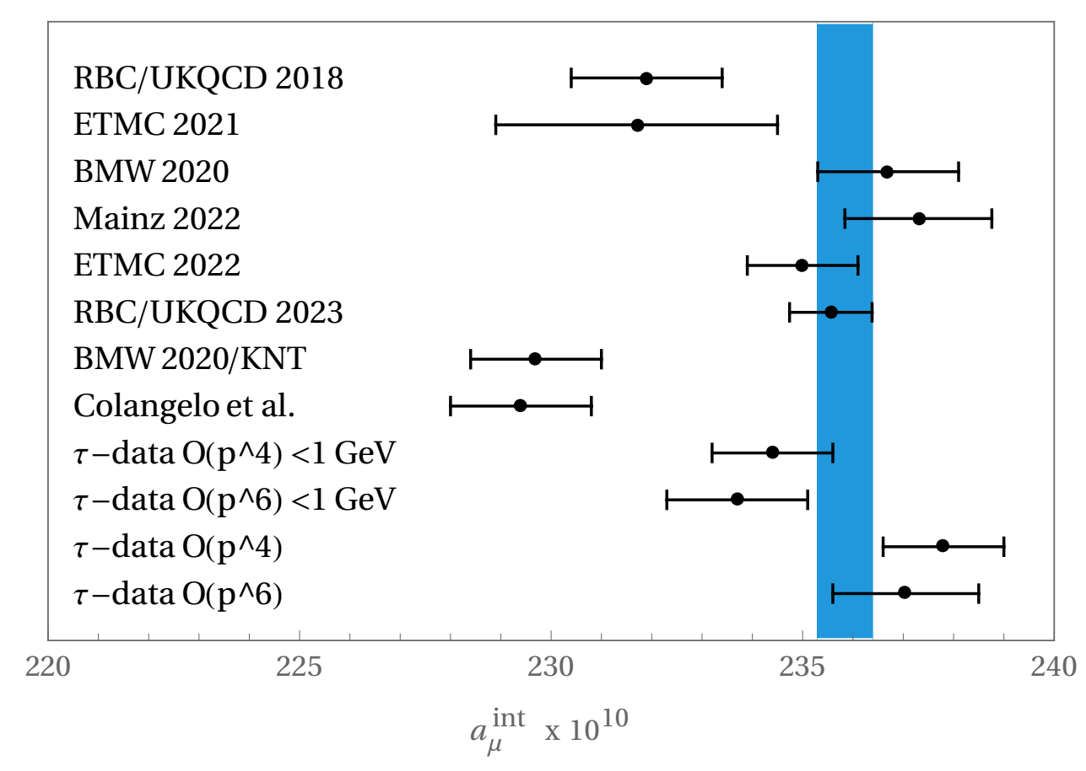
Why it matters?
So it is important (goal: halve its error), but not the most urgent thing, which is to clarify the discrepancy between lattice QCD and data-driven results for SM prediction of a_{μ}^{HVP}, illustrated for the 'intermediate window'.
Lattice QCD
(From Masjuan, Miranda & Roig '23; see Colangelo, El-Khadra, Hoferichter, Keshavarzi, Lehner, Stoffer & Teubner '22)
e⁺e⁻ data-driven
τ data-driven
HADRON 2023, Genova, Italy, 5-9 June 2023 Data-driven approxs. to a_{μ}^{HLbL} Pablo Roig & Pere Masjuan

Slide 5
Why it matters?
So it is important (goal: halve its error), but not the most urgent thing, which is to clarify the discrepancy between lattice QCD and data-driven results for SM prediction of a_{μ}^{HVP}, illustrated for the 'intermediate window'.
Lattice QCD
(From Masjuan, Miranda & Roig '23)
See particularly Christoph's talk for the discrepancies among different e⁺e⁻ to hadrons experiments.
e⁺e⁻ data-driven
τ data-driven
HADRON 2023, Genova, Italy, 5-9 June 2023 Data-driven approxs. to a_{μ}^{HLbL} Pablo Roig & Pere Masjuan

Slide 6
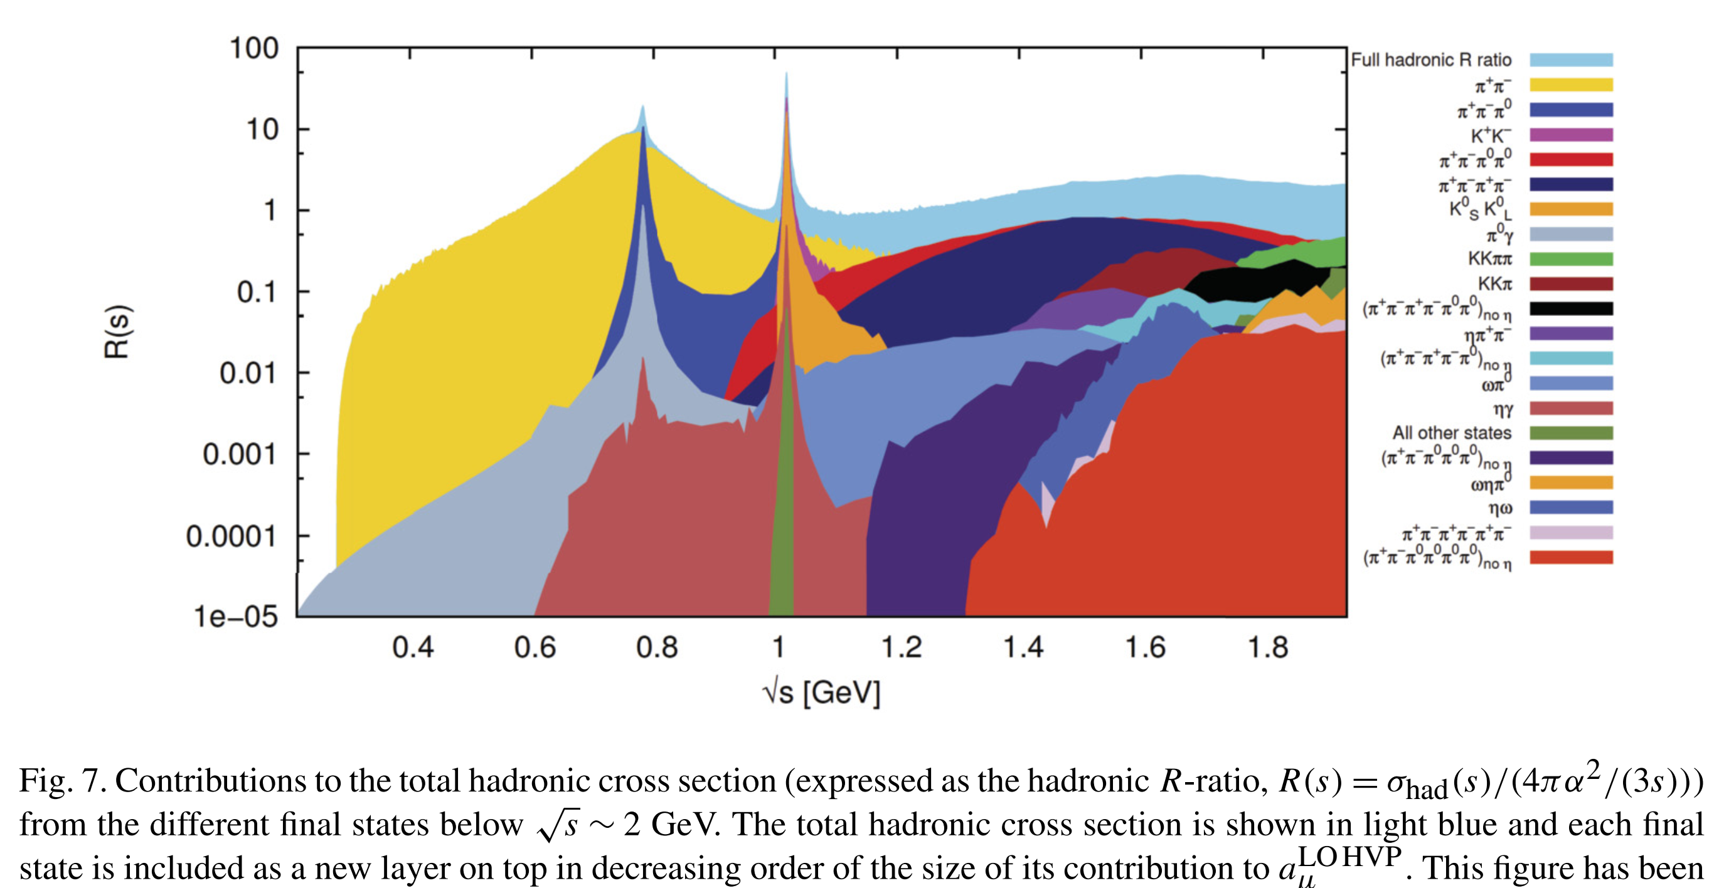
Why such a large error?
Namely, why a_{μ}^{HLbL}=9.2(1.9)x10⁻¹⁰ vs. a_{μ}^{HVP}=693.1(4.0)x10⁻¹⁰?
KNT'20
For a_{μ}^{HVP} there is a dispersion relation (Brodsky-de Rafael; Lautrup-de Rafael '68) that allows to compute the dominant part from precise e⁺e⁻ to hadrons data.
,
HADRON 2023, Genova, Italy, 5-9 June 2023 Data-driven approxs. to a_{μ}^{HLbL} Pablo Roig & Pere Masjuan

Slide 7
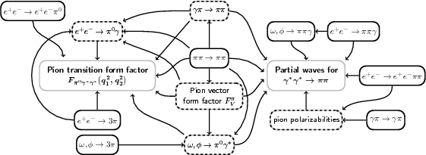
Why such a large error?
Namely, why a_{μ}^{HLbL}=9.2(1.9)x10⁻¹⁰ vs. a_{μ}^{HVP}=693.1(4.0)x10⁻¹⁰?
For a_{μ}^{HLbL} a tremendous advance towards its data-driven dispersive determination was achieved mainly by the Bern group (Colangelo-Hoferichter-Procura-Stoffer'14,'15), which provided a rationale for the well-established P-pole contributions (Knecht-Nyffeler'02) and can be used up to arbitrary multiparticle cuts.
HADRON 2023, Genova, Italy, 5-9 June 2023 Data-driven approxs. to a_{μ}^{HLbL} Pablo Roig & Pere Masjuan

Slide 8
Contributions
The HLbL tensor in terms of increasing number of n-particle cuts: It starts with the P-pole (P=π⁰,η,η',...), which basically saturates the result (other contributions are smaller and approximately cancel).
HADRON 2023, Genova, Italy, 5-9 June 2023 Data-driven approxs. to a_{μ}^{HLbL} Pablo Roig & Pere Masjuan

Slide 9
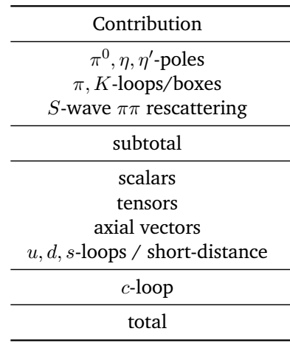
Contributions (WP numbers,x10⁻¹¹):
QCD
HLbL
HADRON 2023, Genova, Italy, 5-9 June 2023 Data-driven approxs. to a_{μ}^{HLbL} Pablo Roig & Pere Masjuan

Slide 10
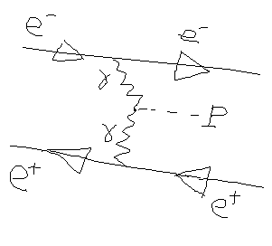
Contributions: P-pole (P=π⁰,η,η',...)
(Knecht-Nyffeler'02, ...)
Q₃²=Q₁²+Q₂²+2τQ₁Q₂
Transition FFs:
probed via
See Christoph's talk for experimental input. In addition: chiral limit and singly and doubly virtual asymptotic limits predicted by QCD.
HADRON 2023, Genova, Italy, 5-9 June 2023 Data-driven approxs. to a_{μ}^{HLbL} Pablo Roig & Pere Masjuan

Slide 11
Contributions: P-pole (P=π⁰,η,η',...)
(Hoferichter-Hoid-Kubis-Leupold-Schneider '18)
Dispersive approach
HADRON 2023, Genova, Italy, 5-9 June 2023 Data-driven approxs. to a_{μ}^{HLbL} Pablo Roig & Pere Masjuan

Slide 12
Contributions: P-pole (P=π⁰,η,η',...)
(Hoferichter-Hoid-Kubis-Leupold-Schneider '18)
Dispersive approach
Padé/Canterbury approximants
(Masjuan-Sánchez Puertas '17)
Rational approximants based on convergence theorems which make contact with n-multiplet meson dominance expressions and provide with systematic methods for evaluating their systematic uncertainties.
HADRON 2023, Genova, Italy, 5-9 June 2023 Data-driven approxs. to a_{μ}^{HLbL} Pablo Roig & Pere Masjuan

Slide 13
Contributions: P-pole (P=π⁰,η,η',...)
(Hoferichter-Hoid-Kubis-Leupold-Schneider '18)
Dispersive approach
Padé/Canterbury approximants
(Masjuan-Sánchez Puertas '17)
Dyson Schwinger eqs.
(QFT EoM)
(Eichmann-Fischer-Weil-Williams'19)
(Raya-Bashir-Roig '19)
Other approaches: RChT, Holographic QCD, ...
HADRON 2023, Genova, Italy, 5-9 June 2023 Data-driven approxs. to a_{μ}^{HLbL} Pablo Roig & Pere Masjuan

Slide 14
Contributions: P-pole (P=π⁰,η,η',...)
(Hoferichter-Hoid-Kubis-Leupold-Schneider '18)
Dispersive approach
Padé/Canterbury approximants
(Masjuan-Sánchez Puertas '17)
HADRON 2023, Genova, Italy, 5-9 June 2023 Data-driven approxs. to a_{μ}^{HLbL} Pablo Roig & Pere Masjuan

Slide 15
Contributions: P-pole (P=π⁰,η,η',...)
(Hoferichter-Hoid-Kubis-Leupold-Schneider '18)
Dispersive approach
Padé/Canterbury approximants
(Masjuan-Sánchez Puertas '17)
HADRON 2023, Genova, Italy, 5-9 June 2023 Data-driven approxs. to a_{μ}^{HLbL} Pablo Roig & Pere Masjuan

Slide 16
Contributions: P-pole (P=π⁰,η,η',...)
Padé/Canterbury approximants
(Masjuan-Sánchez Puertas '17)
Dyson Schwinger eqs.
(Eichmann-Fischer-Weil-Williams'19)
(Raya-Bashir-Roig '19)
HADRON 2023, Genova, Italy, 5-9 June 2023 Data-driven approxs. to a_{μ}^{HLbL} Pablo Roig & Pere Masjuan

Slide 17
Contributions: P-pole (P=π⁰,η,η',...)
(Hoferichter-Hoid-Kubis-Leupold-Schneider '18)
Dispersive approach
Padé/Canterbury approximants
(Masjuan-Sánchez Puertas '17)
HADRON 2023, Genova, Italy, 5-9 June 2023 Data-driven approxs. to a_{μ}^{HLbL} Pablo Roig & Pere Masjuan

Slide 18
Contributions: P-pole (P=π⁰,η,η',...)
versus
It includes NLO contribution.
HADRON 2023, Genova, Italy, 5-9 June 2023 Data-driven approxs. to a_{μ}^{HLbL} Pablo Roig & Pere Masjuan

Slide 19
Contributions: π/K-loops/boxes
sQED
HADRON 2023, Genova, Italy, 5-9 June 2023 Data-driven approxs. to a_{μ}^{HLbL} Pablo Roig & Pere Masjuan

Slide 20
Contributions: π/K-loops/boxes
(Colangelo-Hoferichter-Procura-Stoffer '17,Stamen-Hariraran-Hoferichter-Kubis-Stoffer'22)
Dispersive approach
, a_{μ}^{Κ-box}=-0.48(2)x10⁻¹¹
Dyson Schwinger eqs.
(Eichmann-Fischer-Williams '19) a_{μ}^{π-box}=-15.7(2)(3)x10⁻¹¹ , a_{μ}^{Κ-box}=-0.46(2)x10⁻¹¹
(Miramontes-Bashir-Raya-Roig '21) a_{μ}^{π-box}=-15.6(2)x10⁻¹¹ , a_{μ}^{Κ-box}=-0.48(2)x10⁻¹¹
a_{μ}^{π/Κ-box}=-16.4(2)x10⁻¹¹
HADRON 2023, Genova, Italy, 5-9 June 2023 Data-driven approxs. to a_{μ}^{HLbL} Pablo Roig & Pere Masjuan

Slide 21
Contributions: S wave ππ-rescattering
Dispersive approach
(Colangelo-Hoferichter-Procura-Stoffer '17, x2) Contributions from D & higher partial waves covered by uncertainty
HADRON 2023, Genova, Italy, 5-9 June 2023 Data-driven approxs. to a_{μ}^{HLbL} Pablo Roig & Pere Masjuan

Slide 22
Contributions: Scalars (beyond σ)
(Pauk-Vanderhaeghen '14)
Dispersive approach
(Knecht-Narison-Rabemananjara-Rabetiarivony '17, includes first excited multiplet)
a_{μ}^{scalars}=-9(2)x10⁻¹¹
Holographic QCD
(Cappiello-Catà-D'Ambrosio '21, it includes σ)
a_{μ}^{scalars}=-9(1)x10⁻¹¹
Dispersive approach
(Danilkin-Hoferichter-Stoffer '21, it includes σ)
HADRON 2023, Genova, Italy, 5-9 June 2023 Data-driven approxs. to a_{μ}^{HLbL} Pablo Roig & Pere Masjuan

Slide 23
Contributions: Tensors
(Danilkin-Vanderhaeghen '16)
HADRON 2023, Genova, Italy, 5-9 June 2023 Data-driven approxs. to a_{μ}^{HLbL} Pablo Roig & Pere Masjuan

Slide 24
Contributions: Axials & Short-distance constraints
Melnikov-Vainshtein '03 put forward that P-pole alone could not satisfy SD QCD constraints and the importance of axial resonances in that respect. Modern studies coincide in smaller contribution than M-V initially advocated.
HADRON 2023, Genova, Italy, 5-9 June 2023 Data-driven approxs. to a_{μ}^{HLbL} Pablo Roig & Pere Masjuan

Slide 25
Contributions: Axials & Short-distance constraints
(Pauk-Vanderhaeghen '14)
(Jegerlehner '17)
(Roig-Sánchez Puertas '19)
Clarified ambiguities about bases arising because of off-shell A and emphasized relationship between short-distance & axial anomaly constraints and the axial contributions (with possible relevant role of pseudoscalar resonances), a hot topic since then.
HADRON 2023, Genova, Italy, 5-9 June 2023 Data-driven approxs. to a_{μ}^{HLbL} Pablo Roig & Pere Masjuan

Slide 26
Contributions: Axials & Short-distance constraints
(Leutgeb-Rebhan '19) It includes contributions to longitudinal SDCs
(Masjuan-Roig-Sánchez '20 Puertas, Regge model)
a_{μ}^{axials}[a₁,f₁,f₁'] = (16.0^{+5.1}_{-4.5})x10⁻¹¹
(Average of holographic QCD results: Leutgeb-Rebhan'20,'21 Cappiello-Catà-D'Ambrosio-Greynat-Iyer'20 Leutgeb-Mager-Rebhan'21)
a_{μ}^{axials}[a₁,f₁,f₁'] = (17.1+1.3)x10⁻¹¹
HADRON 2023, Genova, Italy, 5-9 June 2023 Data-driven approxs. to a_{μ}^{HLbL} Pablo Roig & Pere Masjuan

Slide 27
Contributions: Axials & Short-distance constraints
Recent developments in short-distance constraints:
Bijnens-Hermansson Truedsson-Rodríguez Sánchez '19,'22
Colangelo-Hagelstein-Hoferichter-Laub-Stoffer '19,'21
Bijnens-Hermansson Truedsson-Laub-Rodríguez Sánchez '20,'21
Knecht'20
Lüdtke-Procura'20
Hoferichter-Stoffer'20
Zanke-Hoferichter-Kubis'21
Lüdtke-Procura-Stoffer'23
a_{μ}^{axials}[a₁,f₁,f₁'] = (17.1+1.3)x10⁻¹¹
Including contribution to longitudinal SDCs​.
There is agreement on a charm loop contribution of 3(1)x10⁻¹¹.
HADRON 2023, Genova, Italy, 5-9 June 2023 Data-driven approxs. to a_{μ}^{HLbL} Pablo Roig & Pere Masjuan

Slide 28
Contributions: Axials & Short-distance constraints
Recent developments in short-distance constraints:
Bijnens-Hermansson Truedsson-Rodríguez Sánchez '19,'22
Colangelo-Hagelstein-Hoferichter-Laub-Stoffer '19,'21
Bijnens-Hermansson Truedsson-Laub-Rodríguez Sánchez '20,'21
Knecht'20
Lüdtke-Procura'20
Hoferichter-Stoffer'20
Zanke-Hoferichter-Kubis'21
Lüdtke-Procura-Stoffer'23
a_{μ}^{axials}[a₁,f₁,f₁'] = (17.1+1.3)x10⁻¹¹
Including contribution to longitudinal SDCs​.
There is agreement on a charm loop contribution of 3(1)x10⁻¹¹.
As a result, this contribution 24(17)x10⁻¹¹ will be slightly shifted, with a small uncertainty reduction, in the WP update
HADRON 2023, Genova, Italy, 5-9 June 2023 Data-driven approxs. to a_{μ}^{HLbL} Pablo Roig & Pere Masjuan

Slide 29
Contributions: P-pole (P=π⁰,η,η',...)
versus
It includes NLO contribution,2(1)x10⁻¹¹, Colangelo-Hoferichter-Nyffeler-Passera-Stoffer'14
Mixed leptonic-hadronic corrections are <1x10⁻¹¹, Hoferichter-Teubner'21.
HADRON 2023, Genova, Italy, 5-9 June 2023 Data-driven approxs. to a_{μ}^{HLbL} Pablo Roig & Pere Masjuan

Slide 30
Conclusions:
The WP number 92(19)x10⁻¹¹, still stands as the data-driven SM prediction for a_{μ}^{HLbL,LO}.
The dominant uncertainty comes from short-distance + axial contributions (correlated uncertainties), with improved understanding since the WP, but still work to be done.
Measurement of di-photon resonance couplings (particularly for axials) would be very helpful (see Christoph's talk).
Lattice QCD will reach soon comparable uncertainty to data-driven determinations of this piece (see Mattia's talk).
HADRON 2023, Genova, Italy, 5-9 June 2023 Data-driven approxs. to a_{μ}^{HLbL} Pablo Roig & Pere Masjuan

Slide 31
Conclusions (WP numbers,x10⁻¹¹):
QCD
HLbL
HADRON 2023, Genova, Italy, 5-9 June 2023 Data-driven approxs. to a_{μ}^{HLbL} Pablo Roig & Pere Masjuan

