Slide 1
Progress in the Partial-Wave Analysis Methods at COMPASS
Julien Beckers and Florian Kaspar for the COMPASS Collaboration
HADRON 2023: Analysis tools
June 8th, 2023
julien.beckers@tum.de
florian.kaspar@tum.de
funded by the DFG under Germany’s Excellence Strategy – EXC2094 – 390783311 and BMBF Verbundsforschung 05P21WOCC1 COMPASS

Slide 2
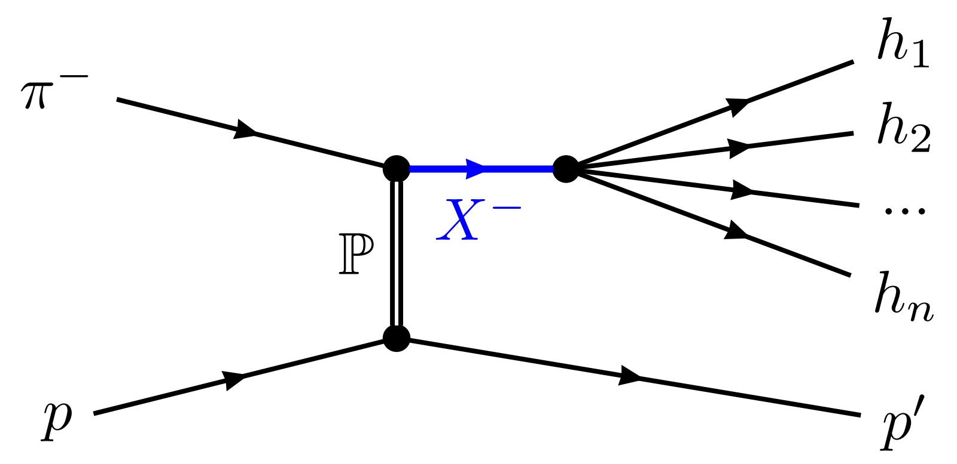
Excited Light Mesons at COMPASS
Inelastic scattering reactions of high-energetic meson beam
Strong interaction (Pomeron exchange) between beam meson and target proton
Intermediate hadronic resonances $X^{−}$ are created, then decay into $n$-body final state
$→$ wide range of allowed (spin) quantum numbers
Final-state particles measured

Slide 3
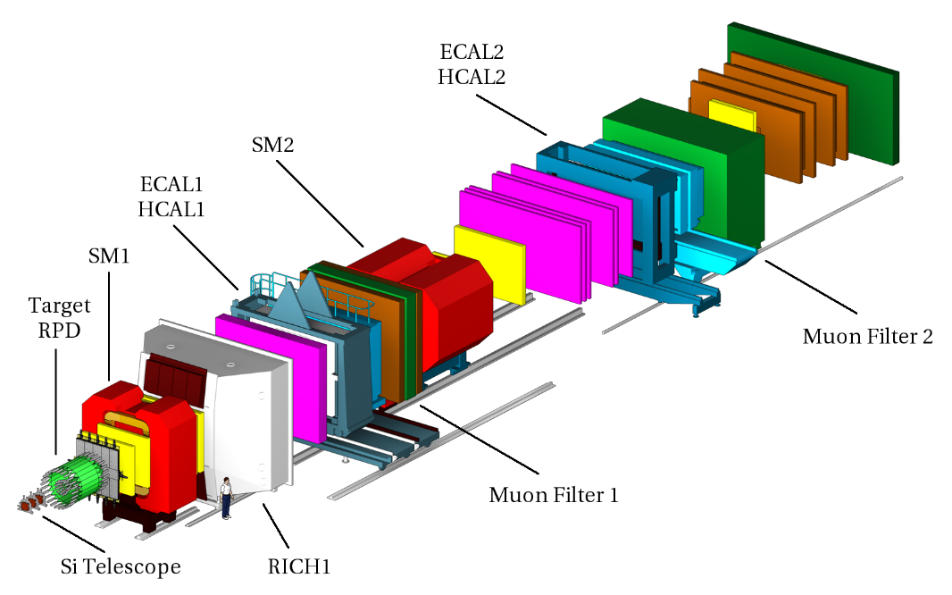
The COMPASS Experiment
Large-acceptance magnetic spectrometer @ CERN-SPS
Beam:
Secondary hadrons ($π^{−}, K^{−}$) at $190 GeV/c$
produced via primary proton beam from SPS
Spectrometer:
Liquid-hydrogen target
Two-stage spectrometer setup around two dipole magnets SM1/2
From COMPASS Collab., The COMPASS Setup for Physics with Hadron Beams (Nucl. Instrum. Methods Phys. Res. A 779 (2014), pp. 69–115)

Slide 4
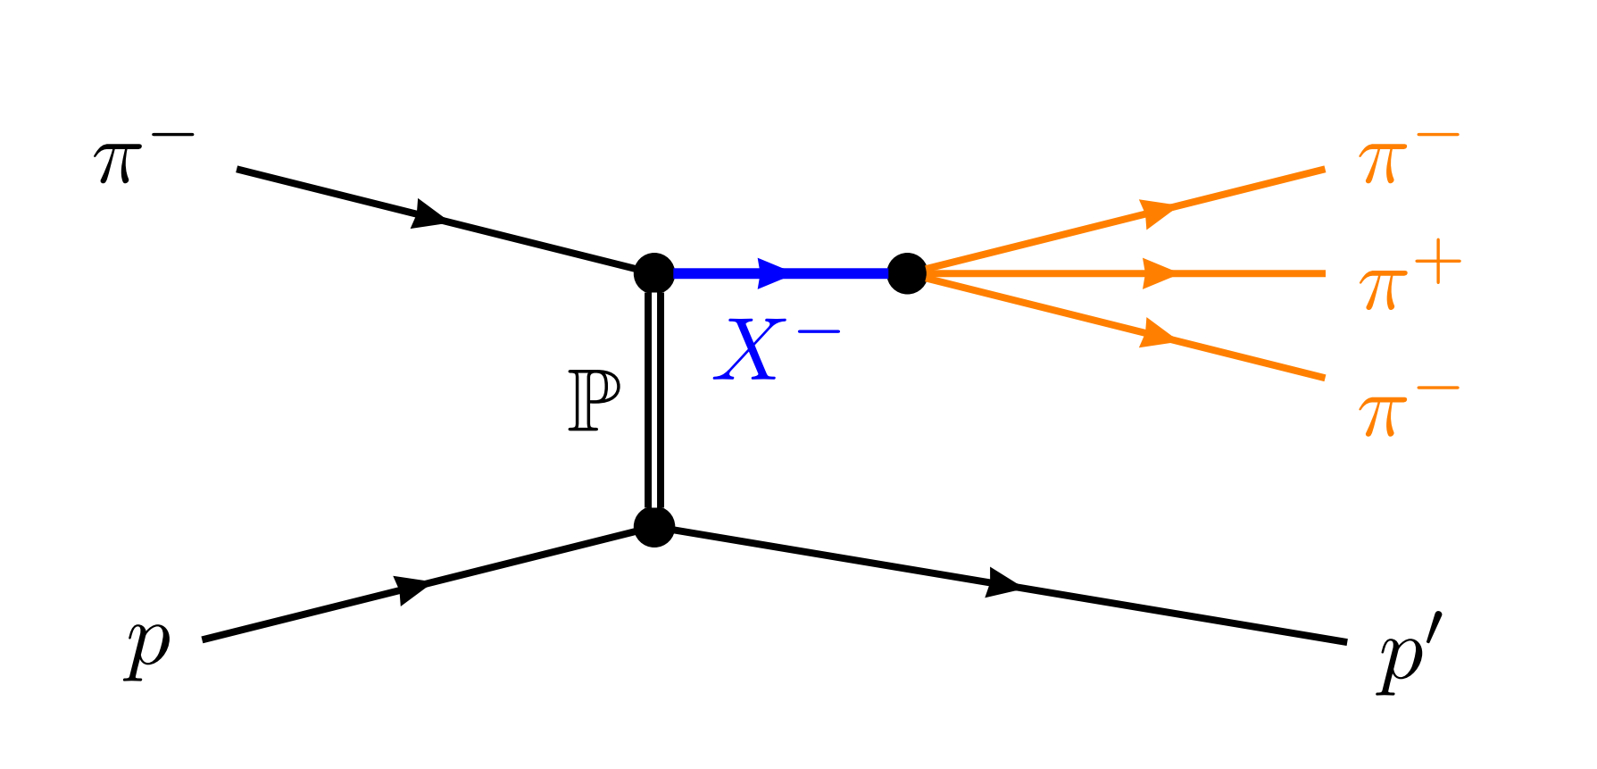
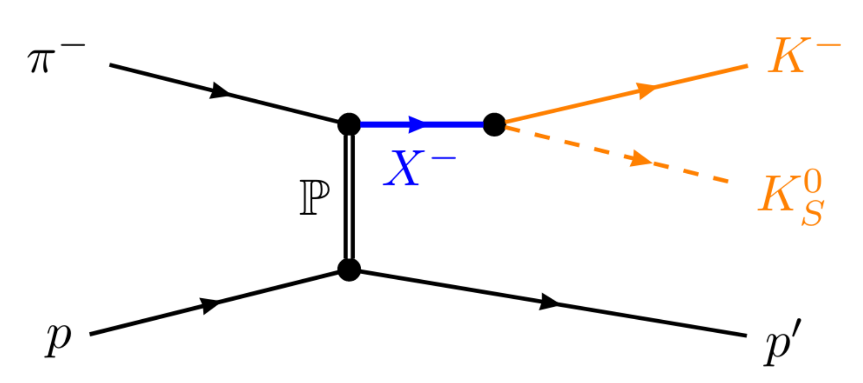
Excited Light Mesons at COMPASS
$$π^{−}+p→π^{−}π^{−}π^{+}+p$$
$$π^{−}+p→K_{S}^{0}K^{−}+p$$
Allowed quantum numbers:
COMPASS flagship channel: $115×{10}^{6}$ evts
Allowed quantum numbers:
Highly selective $→$ search for $a_{4}^{′}$, $a_{6}$
$$J^{PC}=0^{−+},1^{−+},1^{++},…$$
$J^{PC}=1^{−−},2^{++},3^{−−},…$ from decay
$→π_{J}$ and $a_{J}$ resonances
Dominated by Pomeron exchange
$$→a_{J} for even J$$

Slide 5
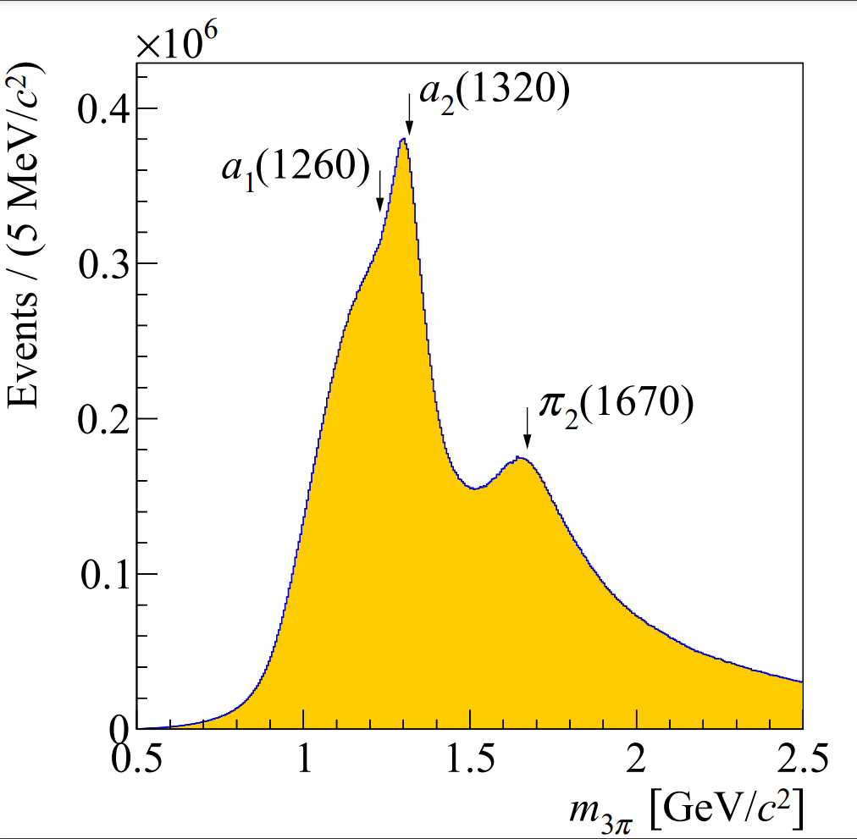
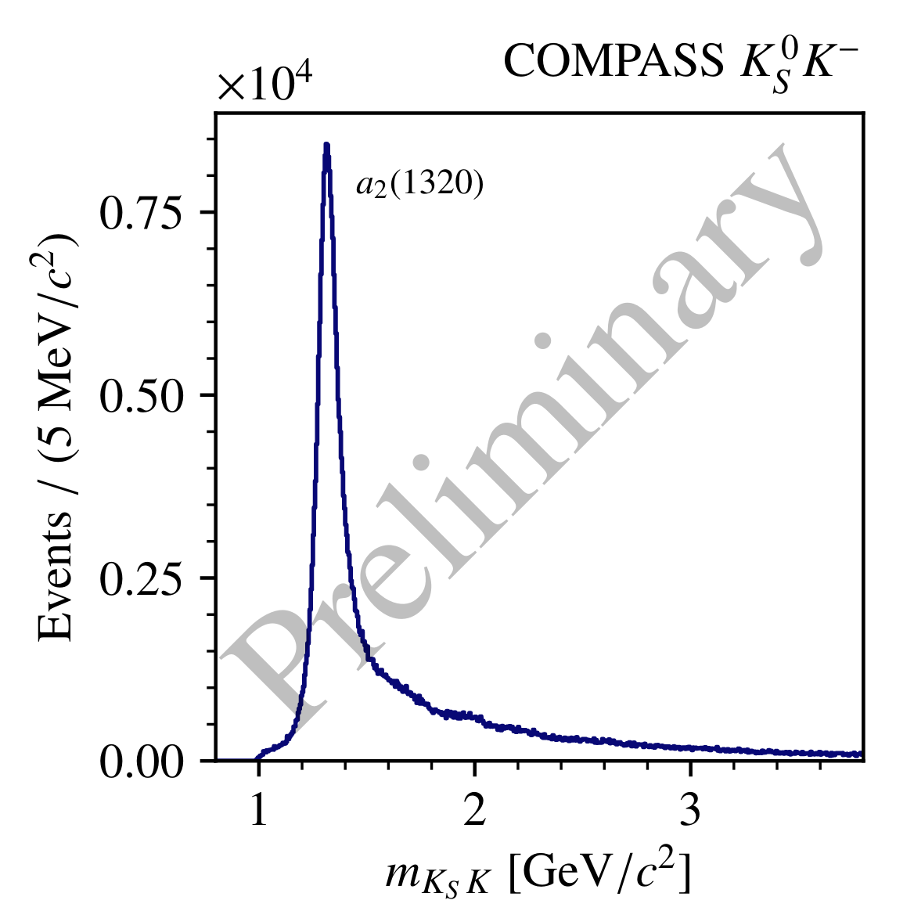
Excited Light Mesons at COMPASS
$$π^{−}+p→π^{−}π^{−}π^{+}+p$$
$$π^{−}+p→K_{S}^{0}K^{−}+p$$
Allowed quantum numbers:
COMPASS flagship channel: $115×{10}^{6}$ evts
Allowed quantum numbers:
Highly selective $→$ search for $a_{4}^{′}$, $a_{6}$
$$J^{PC}=0^{−+},1^{−+},1^{++},…$$
$J^{PC}=1^{−−},2^{++},3^{−−},…$ from decay
$→π_{J}$ and $a_{J}$ resonances
Dominated by Pomeron exchange
$$→a_{J} for even J$$

Slide 6
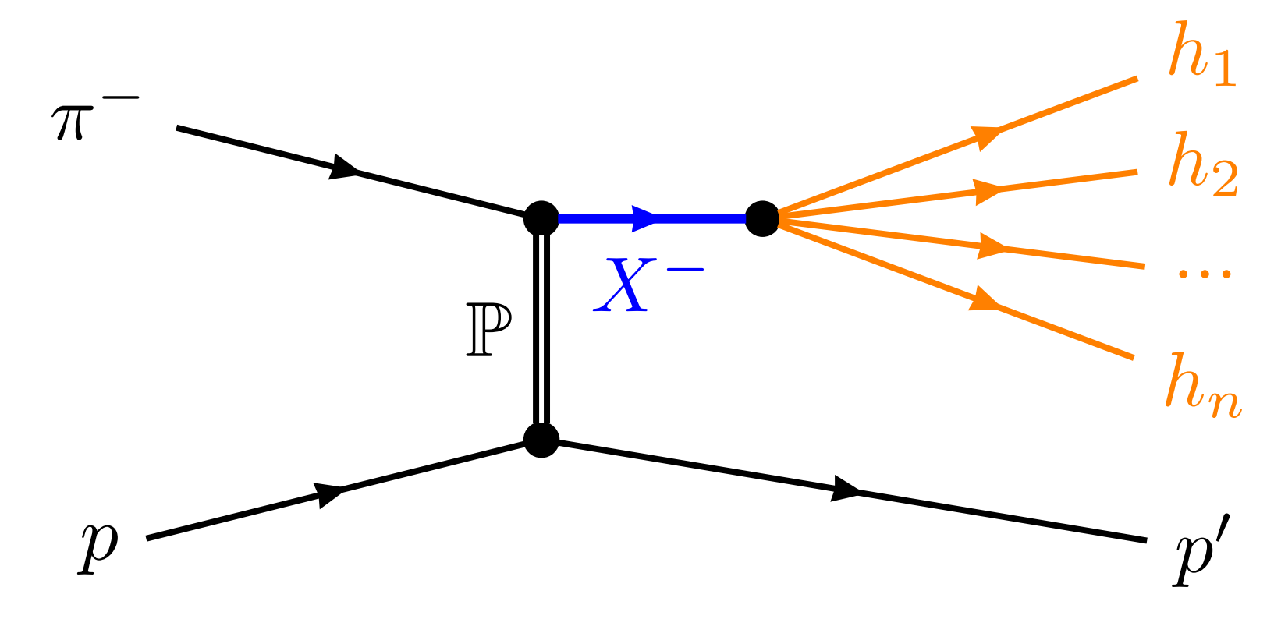
Partial-Wave Decomposition
$$I\left(m_{X},t^{′};τ_{n}\right)={\left|M_{fi}\right|}^{2}$$
$$J^{PC}M$$
Separate process amplitude into partial waves
Spin $J$ and spin-projection $M$
Parity $P$, charge conjugation $C$
…
$→$ Partial wave index $a$
Partial wave $a$:
specific $(J^{PC}M)$

Slide 7
Partial-Wave Decomposition
$$I\left(m_{X},t^{′};τ_{n}\right)={\left|\sum_{a}{T_{a}\left(m_{X},t^{′}\right) ψ_{a}(m_{X},τ_{n})}\right|}^{2}$$
$$m_{X}$$
Separate process amplitude into partial waves
$→$ Partial wave index $a$
Production, propagation of $X^{−}$:
$$t′$$
$$T_{a}\left(m_{X},t^{′}\right)$$
Partial wave $a$:
specific $(J^{PC}M)$

Slide 8
Partial-Wave Decomposition
$$I\left(m_{X},t^{′};τ_{n}\right)={\left|\sum_{a}{T_{a}\left(m_{X},t^{′}\right) ψ_{a}(m_{X},τ_{n})}\right|}^{2}$$
$$m_{X}$$
Separate process amplitude into partial waves
$→$ Partial wave index $a$
Production, propagation of $X^{−}:$
Decay of $X^{−}$:
$$t′$$
$$T_{a}\left(m_{X},t^{′}\right)$$
$$ψ_{a}\left(m_{X},τ_{n}\right)$$
Partial wave $a$:
specific $(J^{PC}M)$

Slide 9
Partial-Wave Decomposition
$$I\left(m_{X},t^{′};τ_{n}\right)={\left|\sum_{a}{T_{a}\left(m_{X},t^{′}\right) ψ_{a}(m_{X},τ_{n})}\right|}^{2}$$
$$m_{X}$$
Separate process amplitude into partial waves
$→$ Partial wave index $a$
Production, propagation of $X^{−}$:
Decay of $X^{−}$:
$$t′$$
$$T_{a}\left(m_{X},t^{′}\right)$$
$$ψ_{a}\left(τ_{n}\right)=Y_{J}^{M}(θ,φ)$$
Partial wave $a$:
specific $(J^{PC}M)$
$$τ_{n}=(θ,φ)$$
$$K_{S}^{0}K^{−}$$

Slide 10
Partial-Wave Decomposition
$$I\left(m_{X},t^{′};τ_{n}\right)={\left|\sum_{a}{T_{a}\left(m_{X},t^{′}\right) ψ_{a}(m_{X},τ_{n})}\right|}^{2}$$
$$m_{X}$$
Separate process amplitude into partial waves
$→$ Partial wave index $a$
Production, propagation of $X^{−}$:
Decay of $X^{−}:$ via isobar model
$$t′$$
$$T_{a}\left(m_{X},t^{′}\right)$$
Partial wave $a$:
specific $(J^{PC}M)$
$$π^{−}π^{−}π^{+}$$

Slide 11
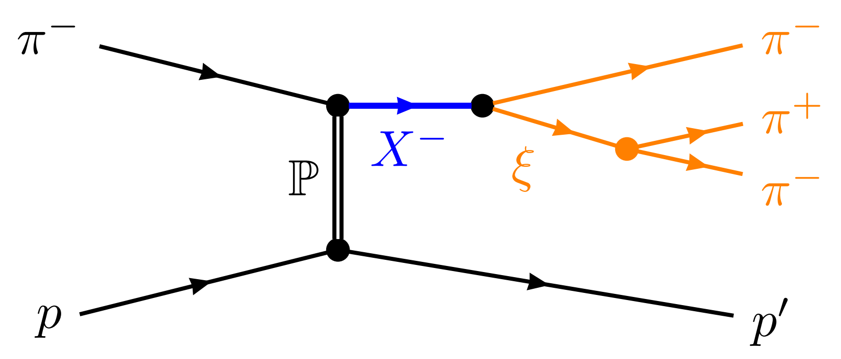
Partial-Wave Decomposition
$$I\left(m_{X},t^{′};τ_{n}\right)={\left|\sum_{a}{T_{a}\left(m_{X},t^{′}\right) ψ_{a}(m_{X},τ_{n})}\right|}^{2}$$
$$m_{X}$$
Separate process amplitude into partial waves
$→$ Partial wave index $a$
Production, propagation of $X^{−}$
Decay of $X^{−}:\text{via} \text{isobar} \text{model}$
$$t′$$
$$τ_{n}=(θ_{GJ},φ_{GJ},m_{ξ},θ_{HF},φ_{HF})$$
Partial wave $a$:
specific $(J^{PC}+decay)$
$ψ_{a}=$ $ψ_{X}\left(m_{X},θ_{GJ},φ_{GJ}\right)⋅ψ_{ξ}\left(m_{ξ},θ_{HF},φ_{HF}\right)$
$$π^{−}π^{−}π^{+}$$

Slide 12
Partial-Wave Decomposition
$$I\left(m_{X},t^{′};τ_{n}\right)={\left|\sum_{a}{T_{a}\left(m_{X},t^{′}\right) ψ_{a}(m_{X},τ_{n})}\right|}^{2}$$
$$m_{X}$$
Separate process amplitude into partial waves
$→$ Partial wave index $a$
Production, propagation of $X^{−}$
Decay of $X^{−}:$ via isobar model
Fit $I\left(m_{X},t^{′};τ_{n}\right)$ to data in $\left(m_{X},t^{′}\right)$ bins
$$t′$$
Partial wave $a$:
specific $(J^{PC}+decay)$
$→$ parametrize $T_{a}$ as step-wise functions
$→$ extract constant $T_{a}$ in each bin

Slide 13
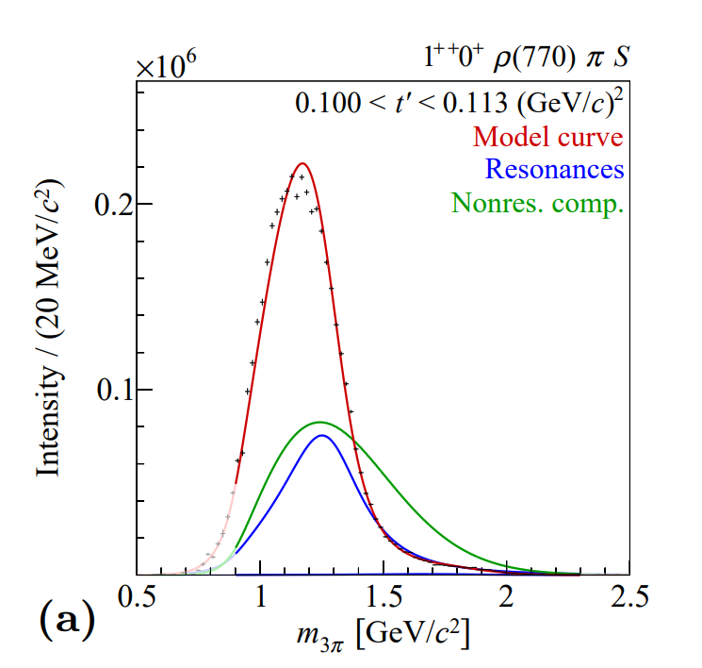
Resonance-Model Fit
Second step: extract resonance parameters
Build model for mass dep. of partial-wave amplitudes:
resonant (e.g. Breit-Wigner distribution)
+ non-resonant background components
$χ^{2}$ fit to output of partial-wave decomposition
$→$ get masses and widths of parameterized resonances
COMPASS PRD 98 (2018) 092003

Slide 14
Understanding the Ambiguities in the Partial-Wave Decomposition of the $K_{S}^{0}K^{−}$ Final State

Slide 15
Ambiguities in the Partial-Wave Decomposition
For any final state with two spinless particles ($ππ,KK,ηπ,…$):
Decomposition of intensity into $\{T_{J}^{ }\}$ is not unique (see derivation later)
The fit cannot distinguish between the mathematically equivalent solutions!
$→$ Several sets of $\{T_{J}^{ }\}$ lead to the same $I\left(θ,φ\right)$ in each $(m_{X},t′)$ bin
$$I\left(θ,φ\right)={\left|\sum_{JM}{T_{JM}^{(1)} ψ_{JM}(θ,φ)}\right|}^{2}={\left|\sum_{JM}{T_{JM}^{(2)}ψ_{JM}(θ,φ)}\right|}^{2}$$

Slide 16
Ambiguities in the Partial-Wave Decomposition
$$I\left(θ,φ\right)={\left|\sum_{JM}{T_{JM} ψ_{JM}(θ,φ)}\right|}^{2}$$
Assume strong dominance of $\left|M\right|=1$ *
Pomeron exchange dominant
$$→M≠0$$
Higher $\left|M\right|$ suppressed
*using reflectivity basis for $ψ_{JM}$ :
doi.org/10.1103/PhysRevD.11.633

Slide 17
Ambiguities in the Partial-Wave Decomposition
$$I\left(θ,φ\right)={\left|\sum_{J}{T_{J} ψ_{J}(θ,φ)}\right|}^{2}$$
Assume strong dominance of $\left|M\right|=1$ *
Pomeron exchange dominant
$$→M≠0$$
Higher $\left|M\right|$ suppressed
*using reflectivity basis for $ψ_{JM}$ :
doi.org/10.1103/PhysRevD.11.633

Slide 18
Ambiguities in the Partial-Wave Decomposition
$$I\left(θ,φ\right)={\left|\sum_{J}{T_{J} ψ_{J}(θ,φ)}\right|}^{2}$$
$$={\left|\sum_{J}{T_{J} Y_{J}^{1}(θ,0)}\right|}^{2} {\left|\sin{φ}\right|}^{2}$$
$$a(θ)$$
$$Y_{J}^{1}\left(θ,0\right)=\sum_{j=0}^{J−1}{y_{j}\tan^{2j}{θ}}$$
Polynomial in $\tan^{2}{θ}$
$$a\left(θ\right)=\sum_{j=0}^{J_{max}−1}{c_{j}\left({\{T}_{J}\}\right) \tan^{2j}{(θ)}}$$
$$=c(\{T_{J}\}) \prod_{k=1}^{J_{max−1}}{\left(\tan^{2}\left(θ\right)−r_{k}\left({\{T}_{J}\}\right)\right) }$$
$$a\left({\tan^{2}{θ}=r}_{k}\right)=0$$
root decomposition
“Barrelet zeros”
Chung, PRD 56 7299–7316 (1997)
Barrelet, Nuov Cim A 8, 331–371 (1972)

Slide 19
Ambiguities in the Partial-Wave Decomposition
$$a\left(θ\right)=c(\{T_{J}\}) \prod_{k=1}^{J_{max−1}}{\left(\tan^{2}\left(θ\right)−r_{k}\left({\{T}_{J}\}\right)\right) }$$
$$I\left(θ,φ\right)={\left|\sum_{J}{T_{J} Y_{J}^{1}(θ,0)}\right|}^{2} {\left|\sin{φ}\right|}^{2}$$
$${\{T}_{J}′\}≠\{T_{J}\}$$
$$={\left| \sum_{j=0}^{J_{max}−1}{c_{j}\left({\{T}_{J}\}\right) \tan^{2j}\left(θ\right)}\right|}^{2}{\left|\sin{φ}\right|}^{2}$$
$${\{c}_{j}′\}$$
$$=c^{2} \prod_{k=1}^{J_{max−1}}{{\left|\tan^{2}\left(θ\right)−r_{k}\right|}^{2}} {\left|\sin{φ}\right|}^{2}$$
$$=c^{2} \prod_{k=1}^{J_{max−1}}{{\left|\tan^{2}\left(θ\right)−r_{k}^{∗} \right|}^{2}} {\left|\sin{φ}\right|}^{2}$$
Notes:
tan(theta) is real -> cc entire expression eq. cc root
Cc each root/combination leads to new solution -> nmb discrete amb. Given by combination of cc’d roots

Slide 20
Study of the Ambiguities
How do the ambiguous solutions look like (continuity, signals, …)?
What are the effects of the partial-wave decomposition fit on finite data on the ambiguities?
Continuous intensity model
create an amplitude model for selected partial waves
calculate exact ambiguities
Finite pseudo-data
generate pseudo-data according to model
perform partial-wave decomposition

Slide 21
Continuous Amplitude Model
$$J^{PC}$$ | Resonances
$$1^{−−}$$ | $$ρ(1450)$$
$$2^{++}$$ | $$a_{2}\left(1320\right),a_{2}^{′}(1700)$$
$$3^{−−}$$ | $$None$$
$$4^{++}$$ | $$a_{4}\left(1970\right)$$
Continuous intensity model
create an amplitude model for four selected partial waves
In $1.0<m_{X}<2.5 GeV/c^{2}$
$m_{X}$-dependence by Breit-Wigner amplitudes (PDG parameters)
$$T\left(m_{X}\right)=\sqrt{m_{X} } \sqrt{ρ_{2}\left(m_{X}\right)} ⋅Ce^{iφ}⋅D_{BW}(m_{X};M_{0},Γ_{0})$$
phase-space factor
complex scale
$$\frac{M_{0} Γ_{0}}{M_{0}^{2} −m_{X}^{2}−iM_{0}Γ_{0}}$$

Slide 22
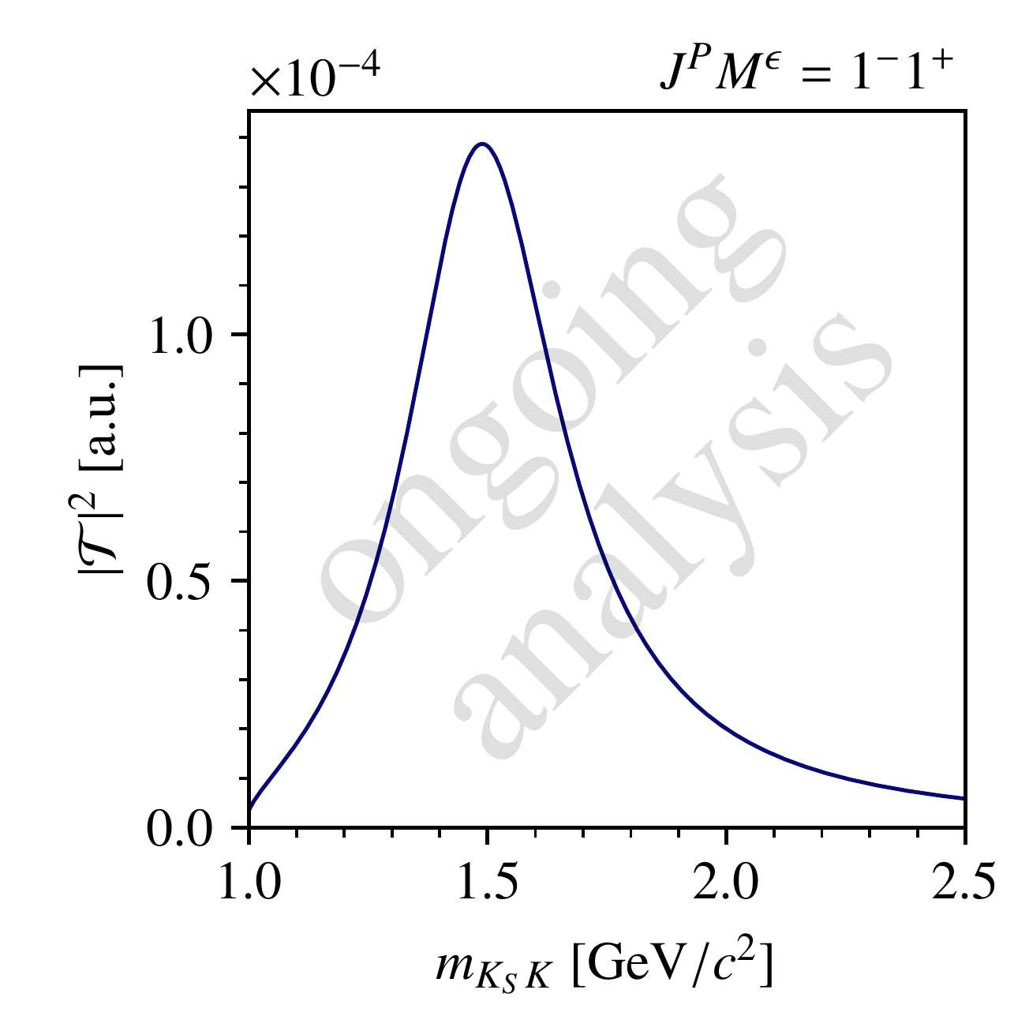
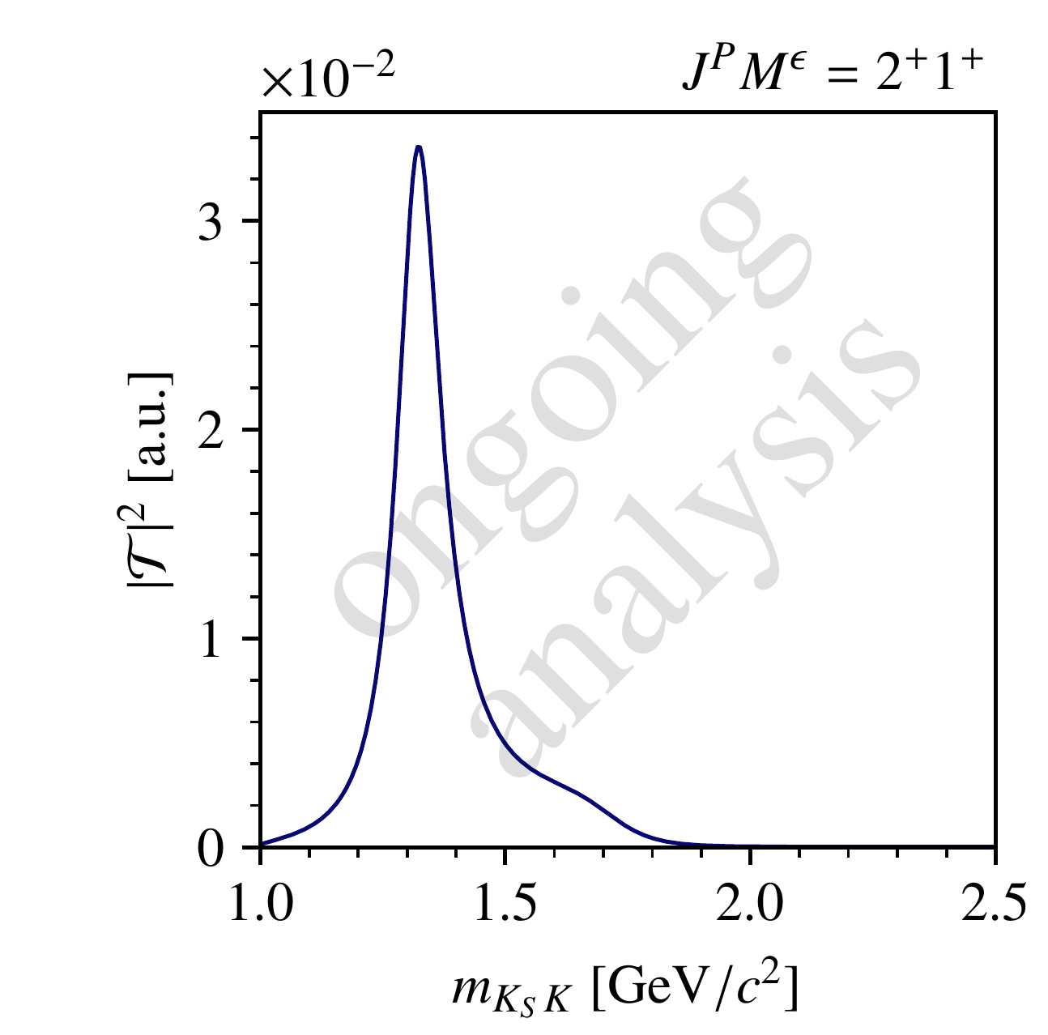
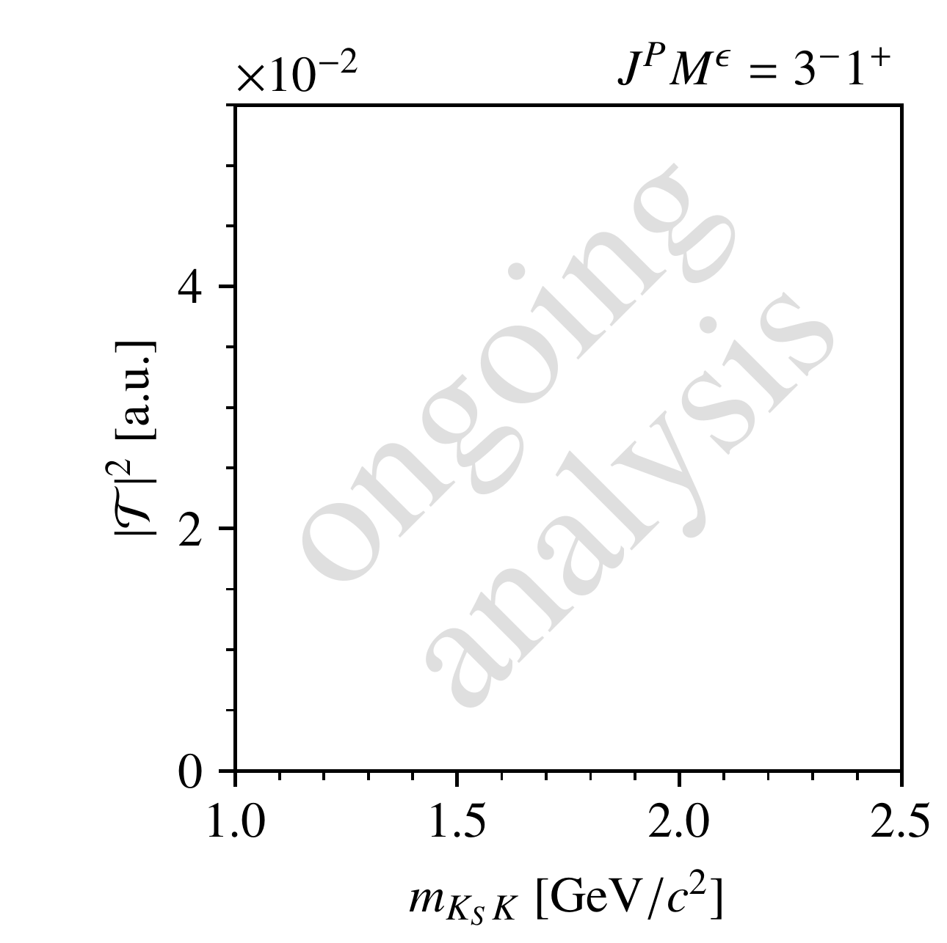
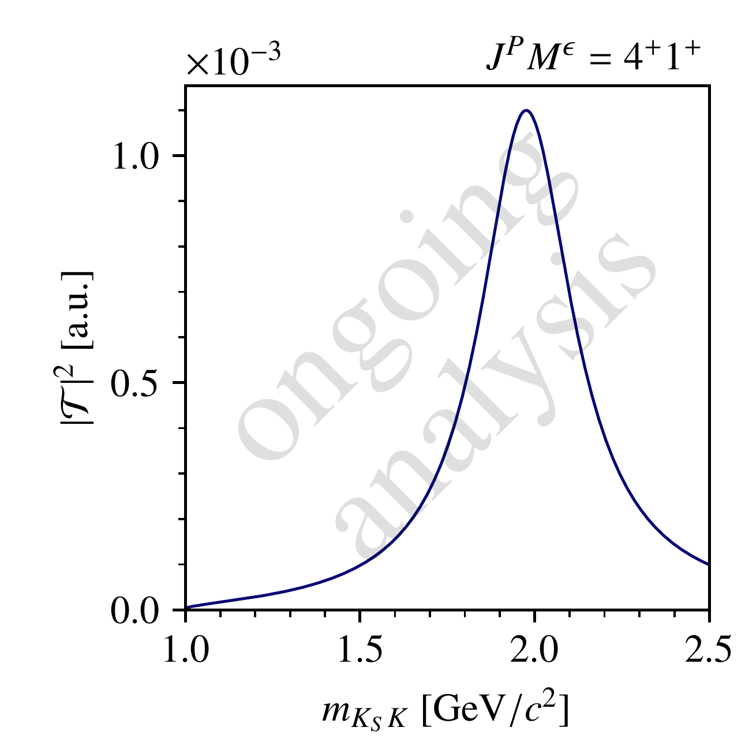
Continuous Amplitude Model
$$J^{PC}$$ | Resonances
$$1^{−−}$$ | $$ρ(1450)$$
$$2^{++}$$ | $$a_{2}\left(1320\right),a_{2}^{′}(1700)$$
$$3^{−−}$$ | $$None$$
$$4^{++}$$ | $$a_{4}\left(1970\right)$$
Continuous intensity model
create an amplitude model for four selected partial waves
In $1.0<m_{X}<2.5 GeV/c^{2}$
$m_{X}$-dependence by Breit-Wigner amplitudes (PDG parameters)

Slide 23
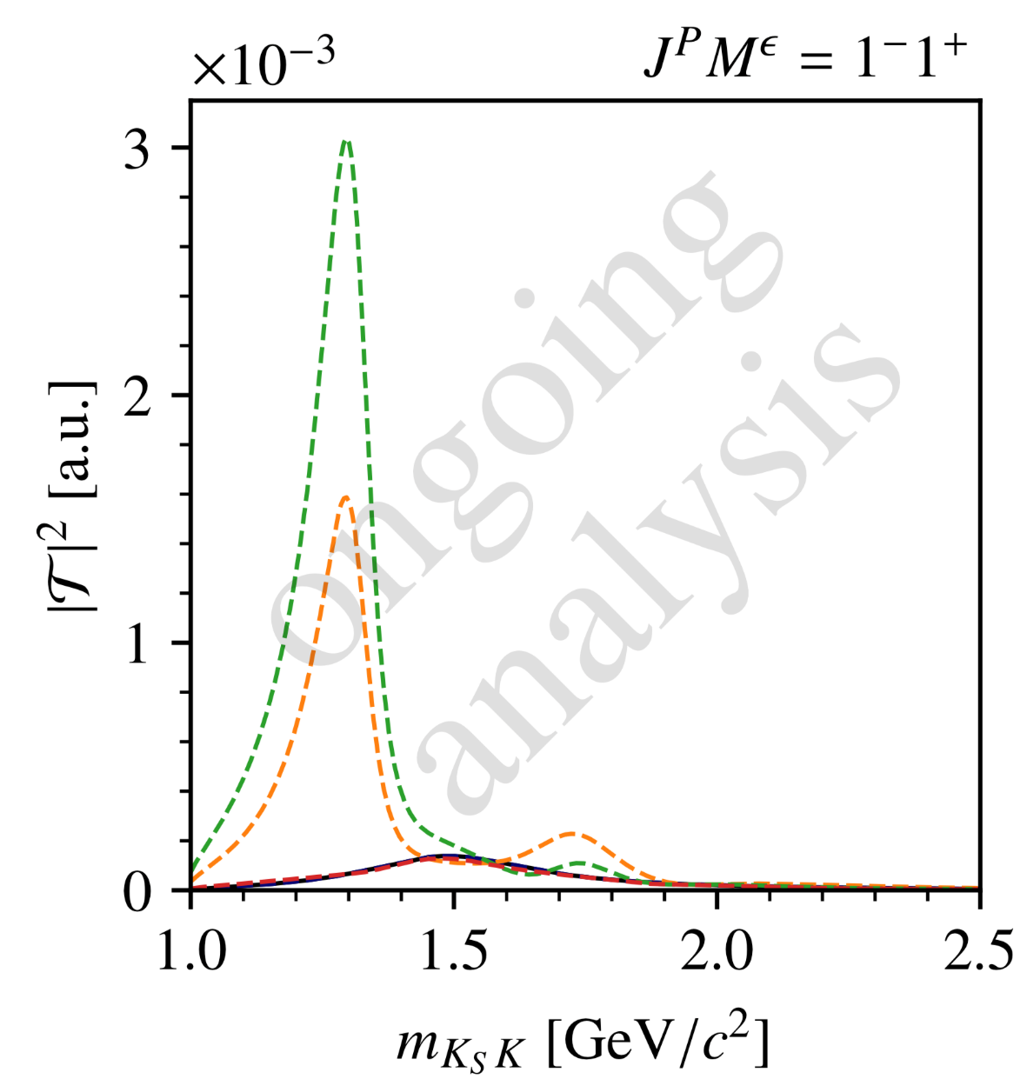
Continuous Amplitude Model
Continuous intensity model
Sample points in $m_{X}$ and calculate ambiguous solutions
Ambiguous intensities are also continuous
Not all solutions are different from each other!
Highest-spin ($4^{++}$) intensity is invariant!
$$N_{a}=3$$
sol. 1
sol. 2
sol. 3
model

Slide 24
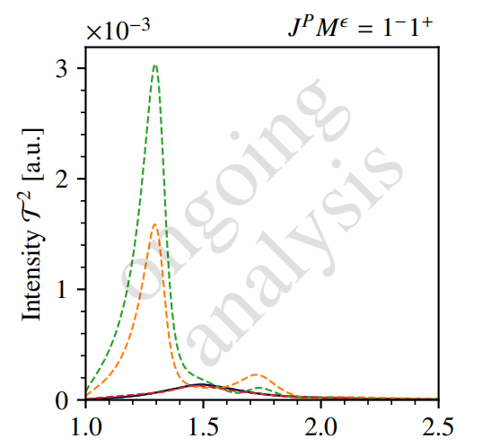
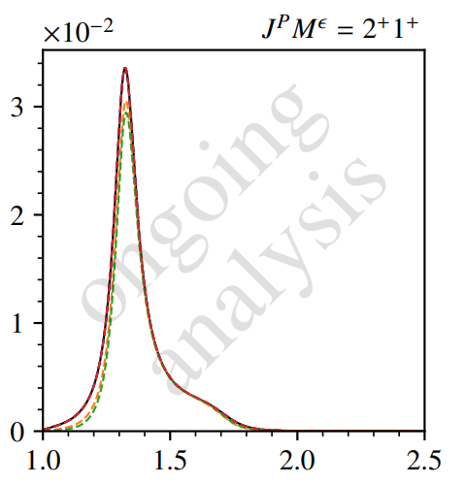
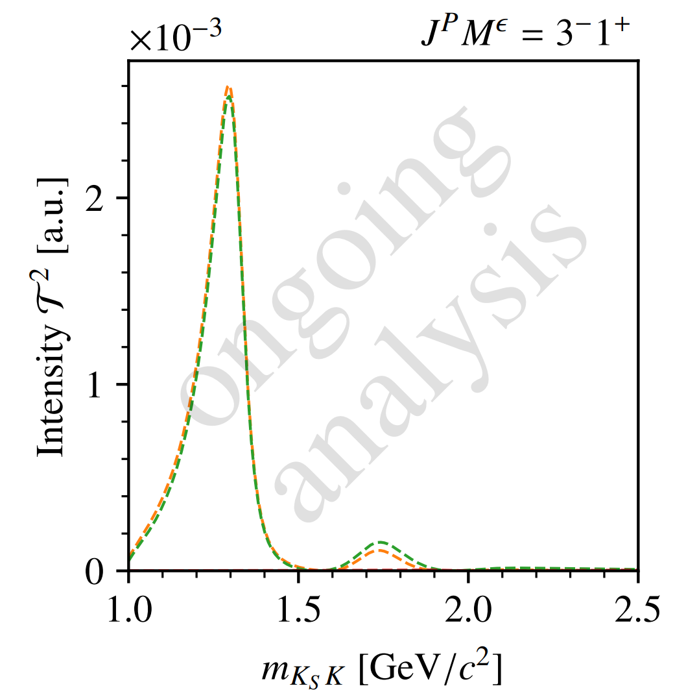
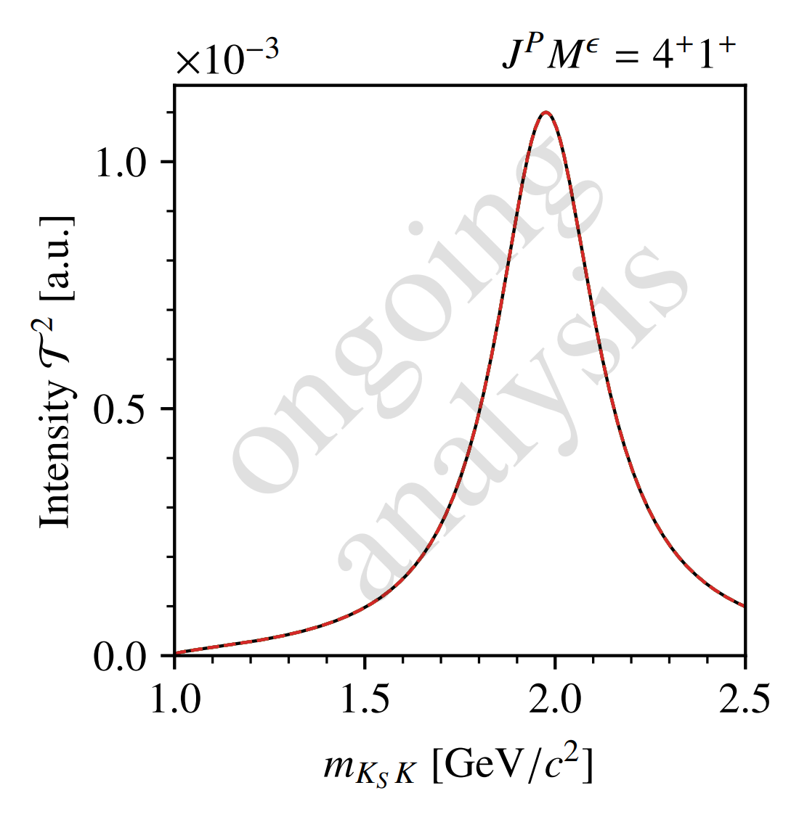
Continuous Amplitude Model
Continuous intensity model
Sample points in $m_{X}$ and calculate ambiguous solutions
Ambiguous intensities are also continuous
Not all solutions are different from each other!
Highest-spin ($4^{++}$) intensity is invariant!
sol. 1
sol. 2
sol. 3
model
$$N_{a}=3$$

Slide 25
Continuous Amplitude Model
Continuous intensity model
Sample points in $m_{X}$ and calculate ambiguous solutions
Ambiguous intensities are also continuous
Not all solutions are different from each other!
Highest-spin ($4^{++}$) intensity is invariant!
$$N_{a}=3$$
sol. 1
sol. 2
sol. 3
model

Slide 26
Study of the Ambiguities
$$J^{PC}$$ | Resonances
$$1^{−−}$$ | $$ρ(1450)$$
$$2^{++}$$ | $$a_{2}\left(1320\right),a_{2}^{′}(1700)$$
$$3^{−−}$$ | $$None$$
$$4^{++}$$ | $$a_{4}\left(1970\right)$$
Finite pseudo-data
reality: finite data and amplitudes unknown
generate pseudo-data according to model (${10}^{5}$ events)
perform a partial-wave decomposition fit
$→$ 3000 attempts with random start values

Slide 27
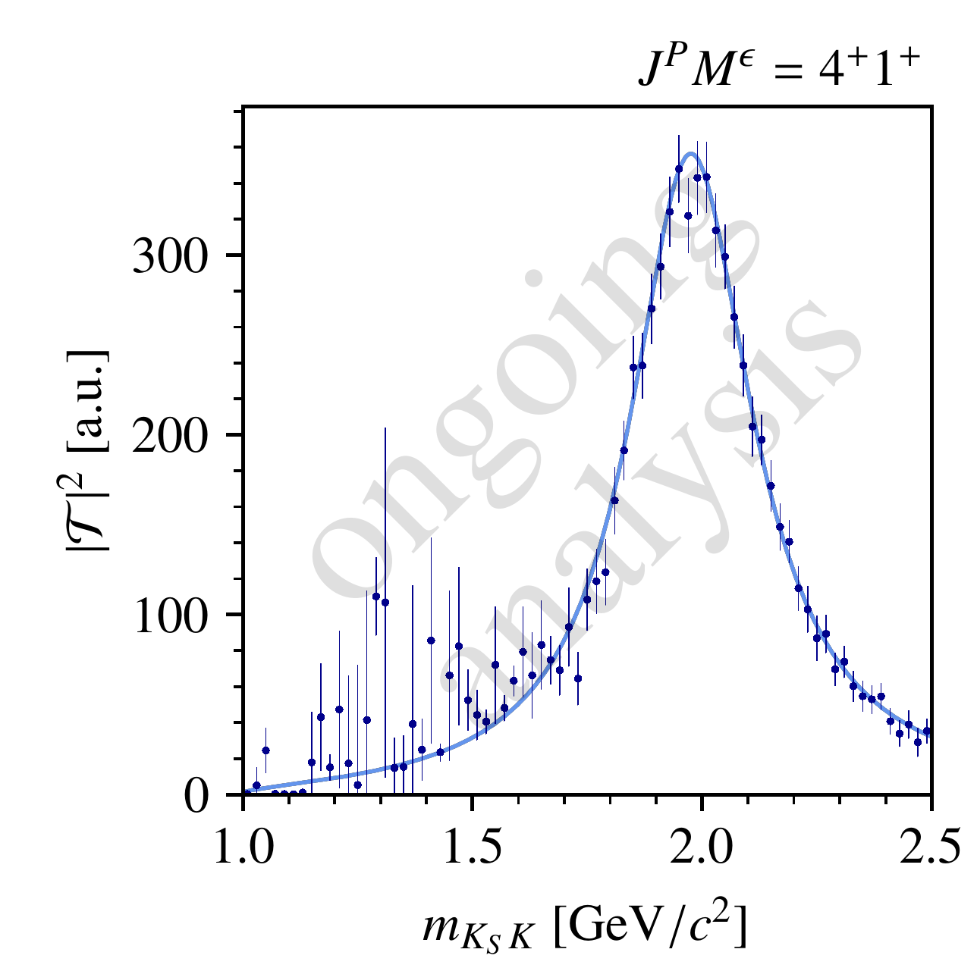
Partial-Wave Decomposition Fits on Pseudodata
Finite pseudo-data
$4^{++}$ intensity is still invariant!
Overall, amplitude values found by the fit follow the calculated distributions
Not all solutions are found in each $m_{X}$ bin
$→$ PWD fit distorts the intensity distribution!

Slide 28
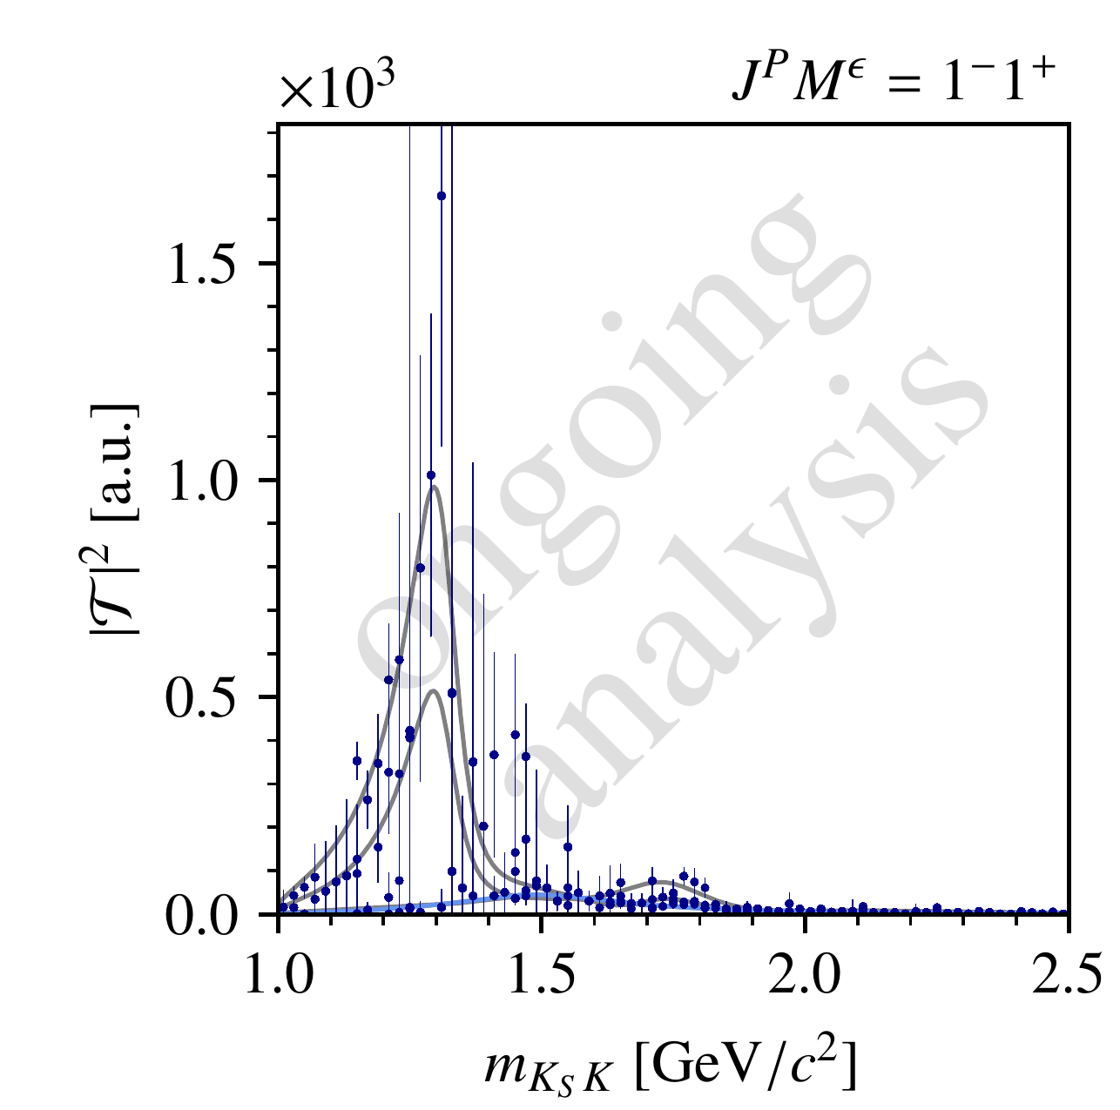
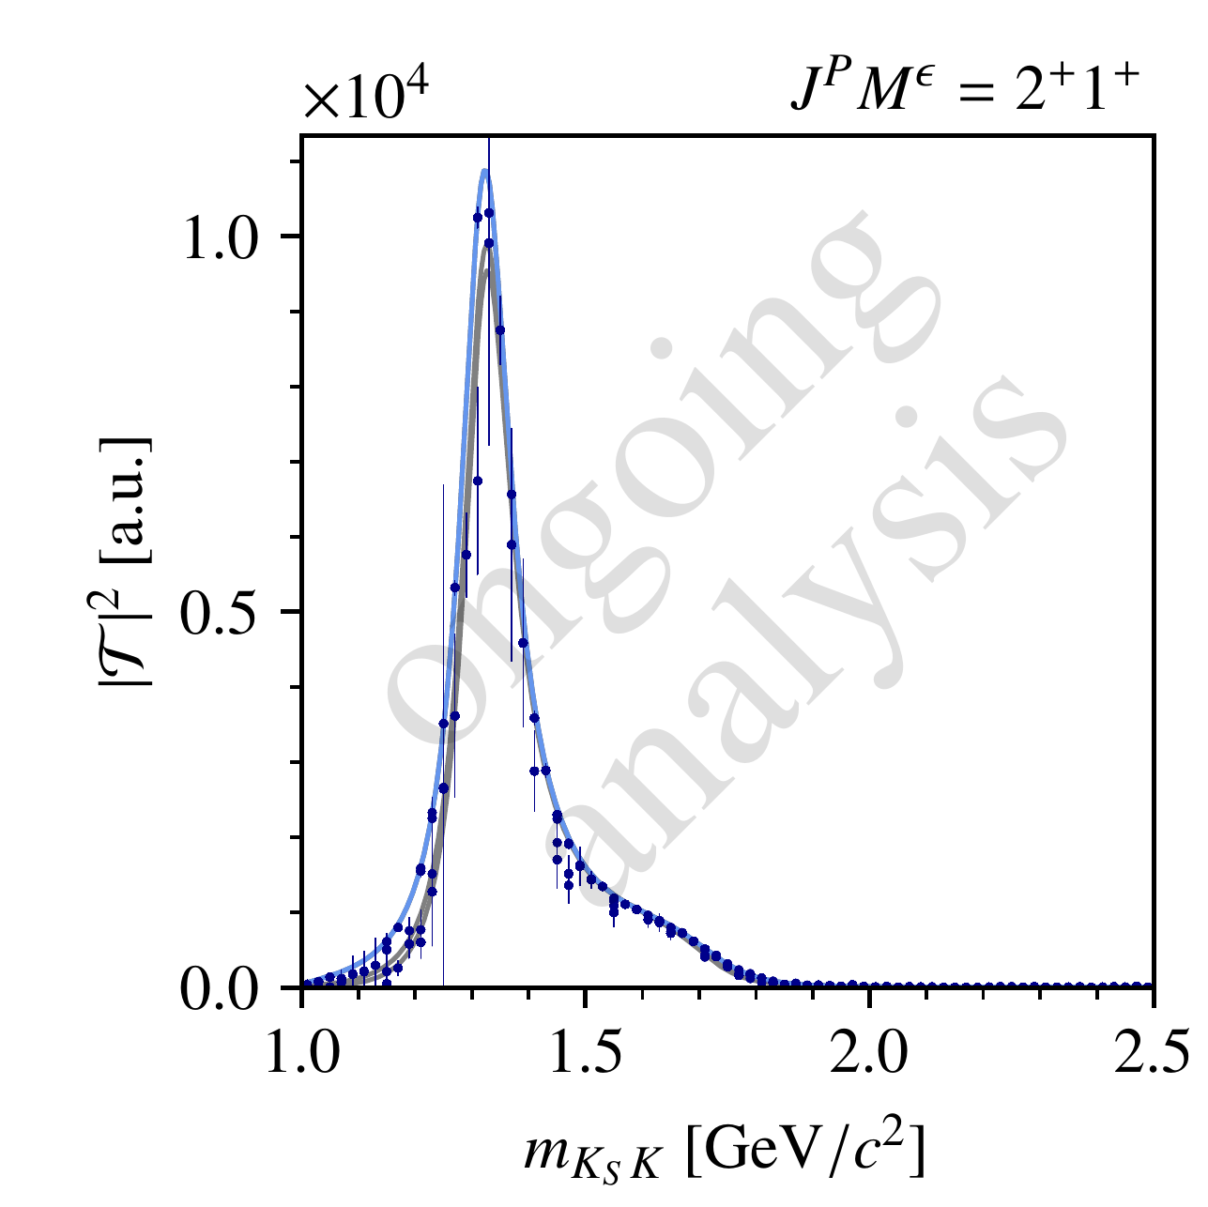
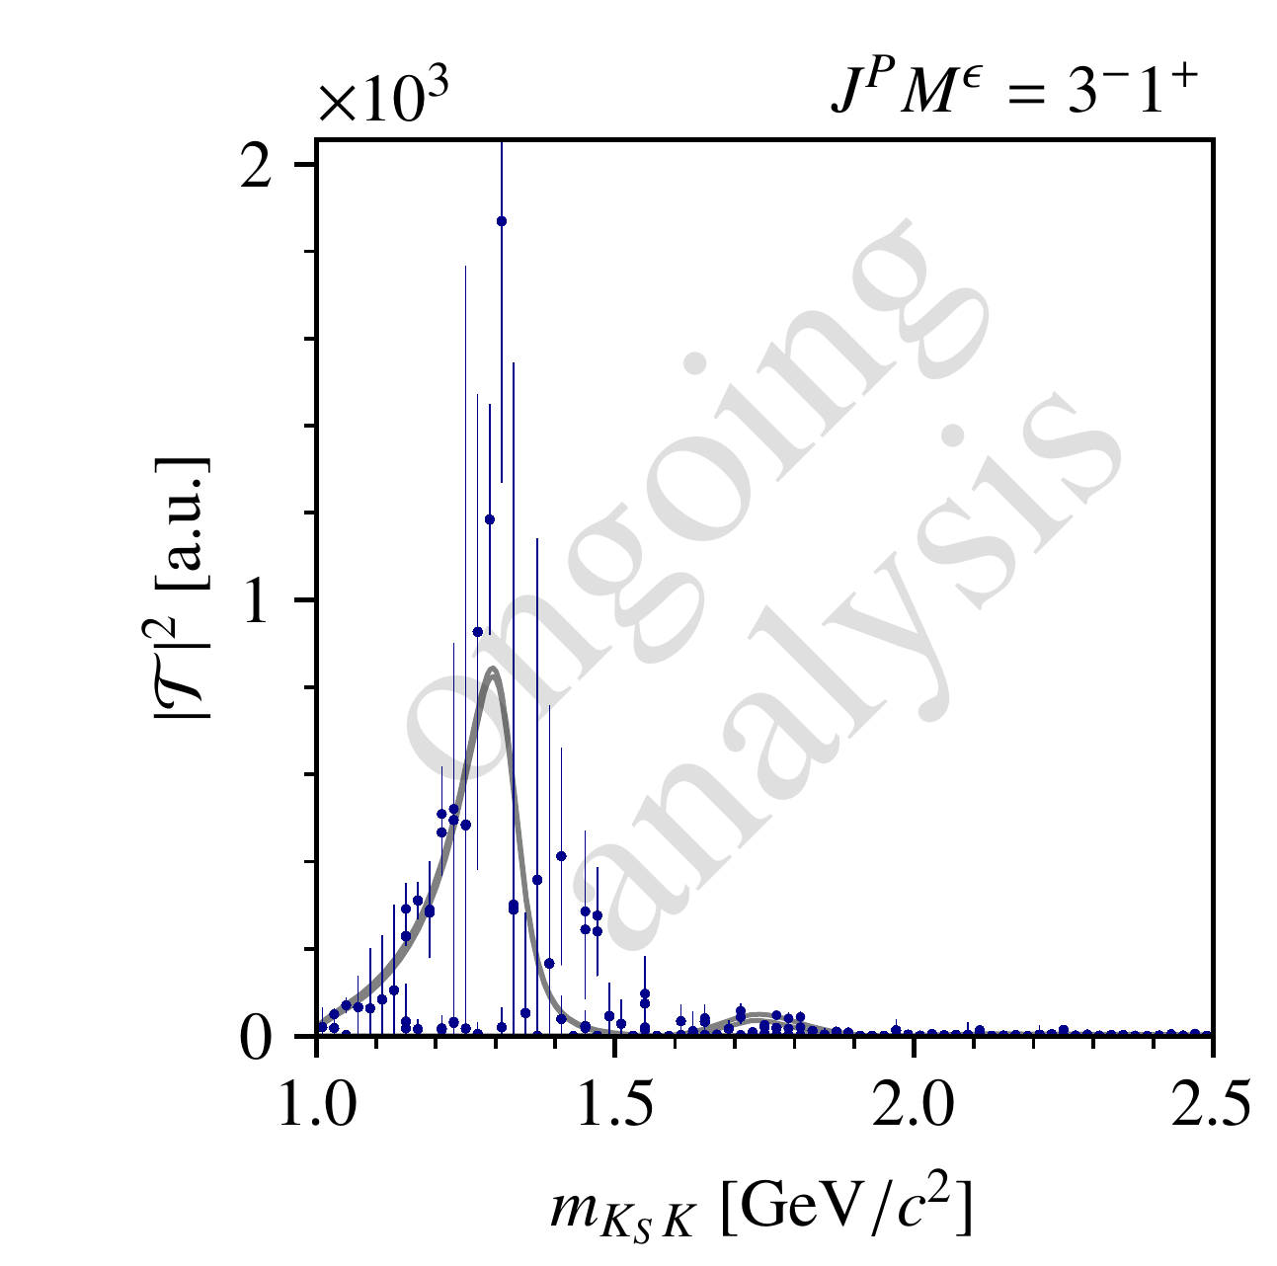
Partial-Wave Decomposition Fits on Pseudodata
Finite pseudo-data
$4^{++}$ intensity is still invariant!
Overall, amplitude values found by the fit follow the calculated distributions
Not all solutions are found in each $m_{X}$ bin
$→$ PWD fit distorts the intensity distribution!

Slide 29
Partial-Wave Decomposition Fits on Pseudodata
Finite pseudo-data
$4^{++}$ intensity is still invariant!
Overall, amplitude values found by the fit follow the calculated distributions
Not all solutions are found in each $m_{X}$ bin
$→$ PWD fit distorts the intensity distribution!

Slide 30
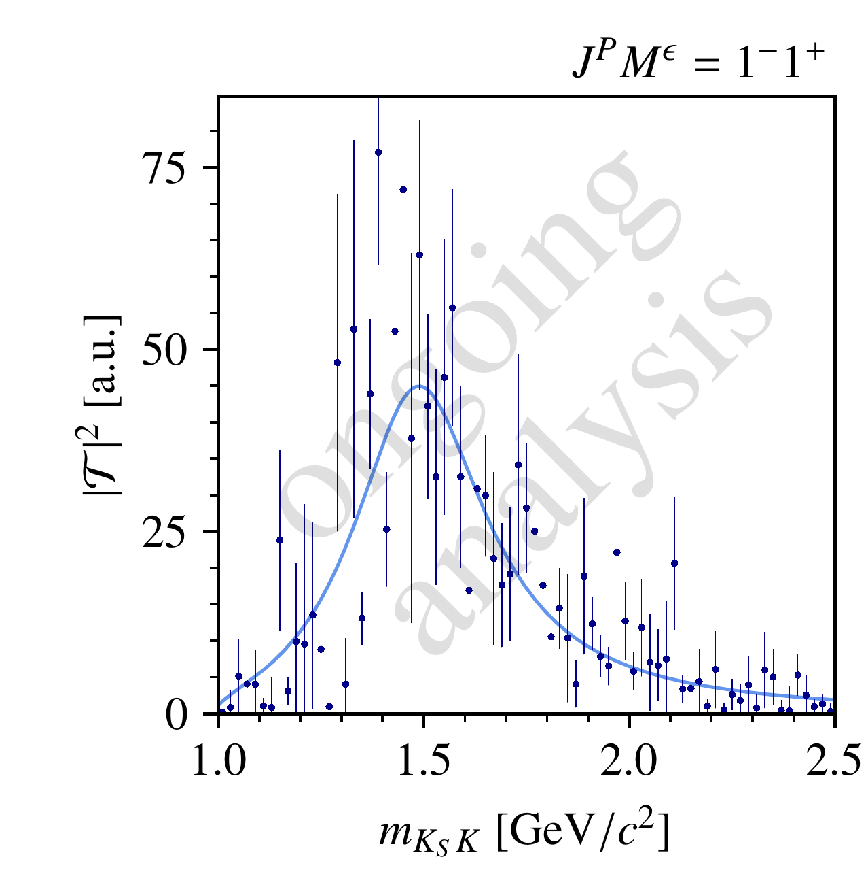
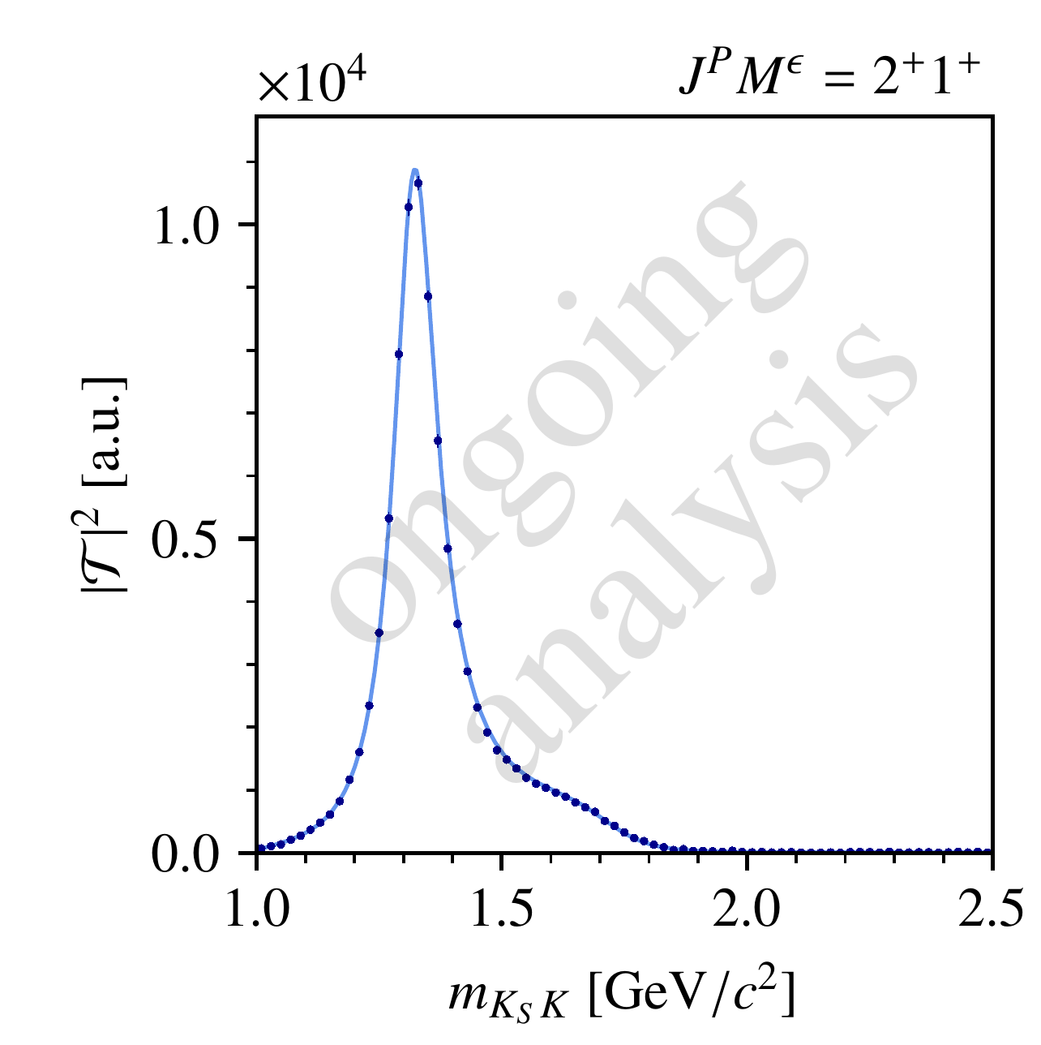
Reducing the Ambiguities
Intensity of highest-spin wave is unaffected by ambiguities
Including $M≥2 →$ allows for additional angular structure $→$ resolves ambiguities
Remove one wave with $J<J_{max} →$ resolves ambiguities

Slide 31
Continuity Constraints for Partial-Wave Analyses

Slide 32
Conventional Partial-Wave Analysis
We have some knowledge about the partial-wave amplitudes $T(m_{X},t^{′})$:
Physics should be (mostly) continuous in $m_{X}$ and $t′$
$→$ Solutions in neighboring bins should be similar ($→$ correlations between bins)
Amplitudes should follow phase-space and production kinematics
Limitations of conventional PWA:
Binned analysis limits statistics, especially for small signals
Continuity information is not imposed in the model
We need to select (“small”) subset of partial waves to include in the model
$→$ important source of systematic uncertainty
$$I\left(m_{X},t^{′};τ_{n}\right)={\left|\sum_{waves}{T_{i}\left(m_{X},t^{′}\right) ψ_{i}(m_{X},τ_{n})}\right|}^{2}$$

Slide 33
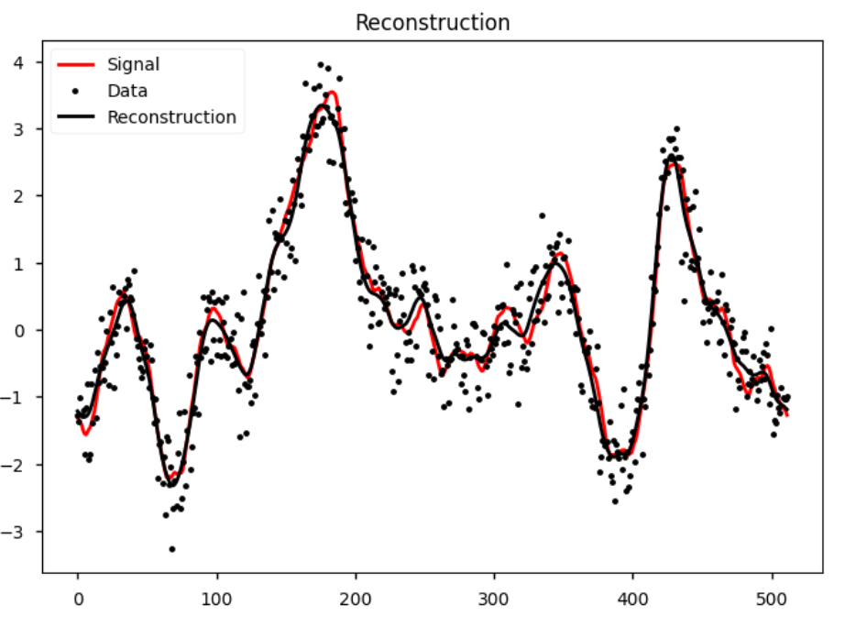
Constraints for Partial-Wave Analyses
Make use of this information to stabilize partial-wave decomposition fit:
$→$ Replace discrete amplitudes with smooth, non-parametric curves
$→$ Incorporate kinematic factors
$→$ Include regularization for small amplitudes
Framework by team from the Max-Planck Institute for Astrophysics:
NIFTY: “Numerical Information Field Theory”
Provides continuous non-parametric models
Adapt to partial-wave analysis model
Learns smoothness and shape of the amplitude curves
https://ift.pages.mpcdf.de/nifty/
Example: curve fit
This work is done in collaboration with Jakob Knollmueller
(TUM / ORIGINS Excellence Cluster )

Slide 34
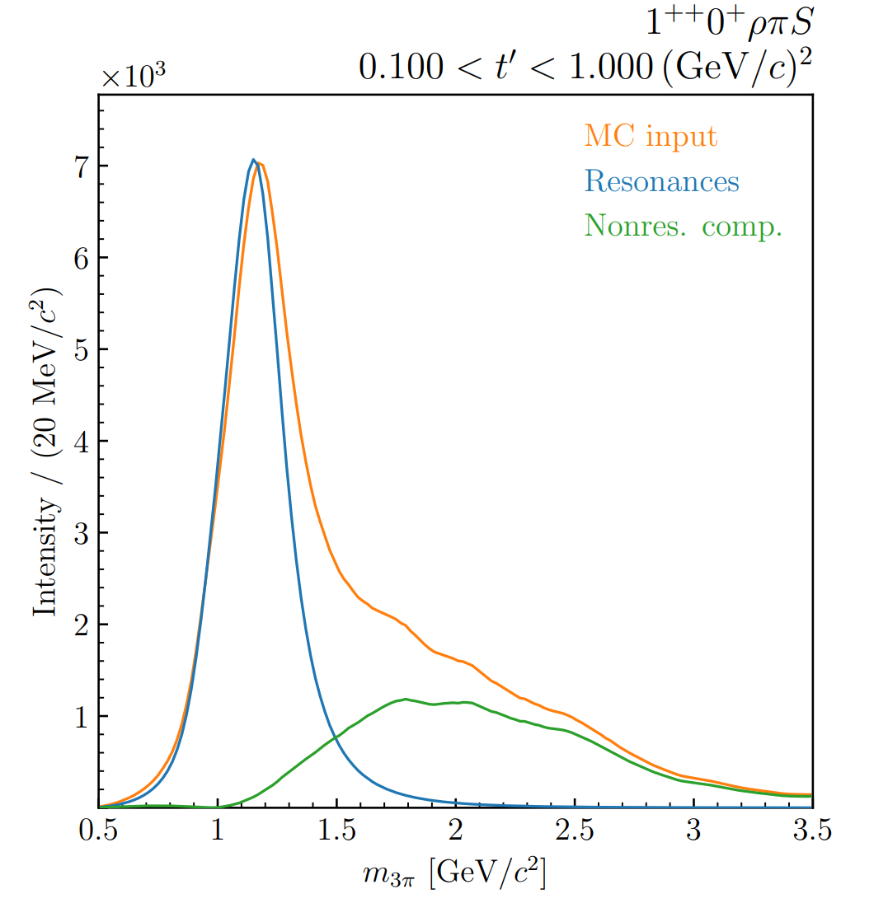
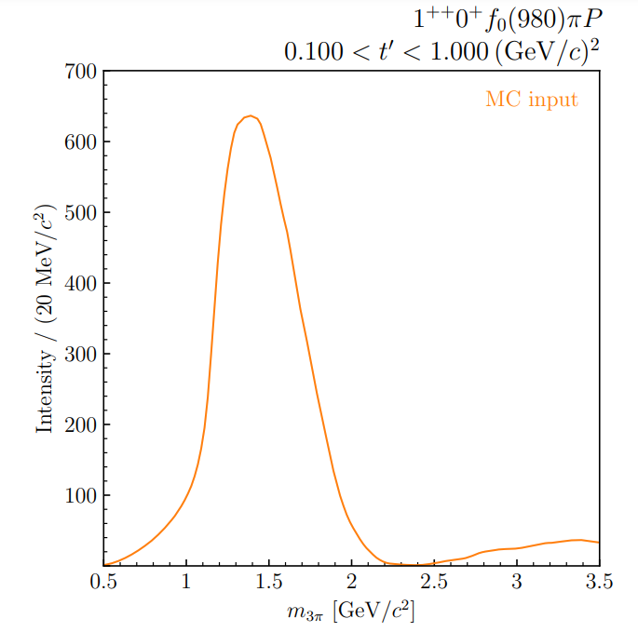
Input-Output Study
Verification on pseudodata:
Generate pseudodata according to:
smooth model in mass
81 partial waves
5 resonances in selected waves
Perform PWA fit with NIFTy model on generated dataset
Same set of partial waves
ongoing analysis
resonance(s) (Breit-Wigner)
nonres. component (broad curve)
Combined signal $→$ input model
ongoing analysis

Slide 35
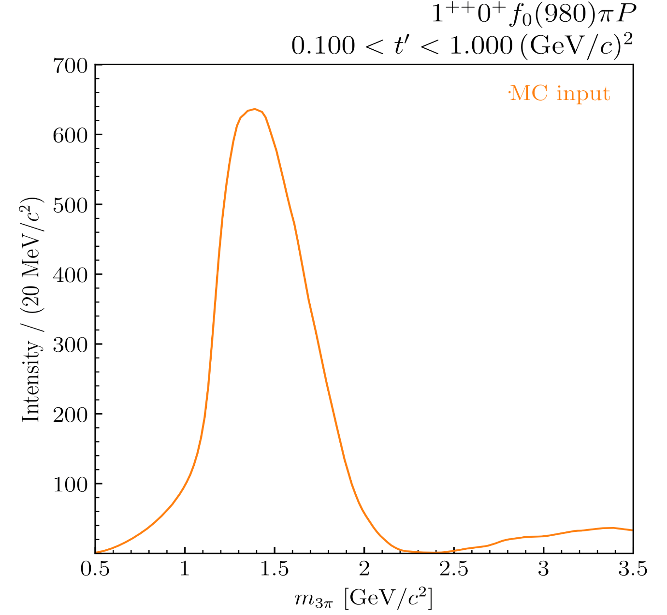
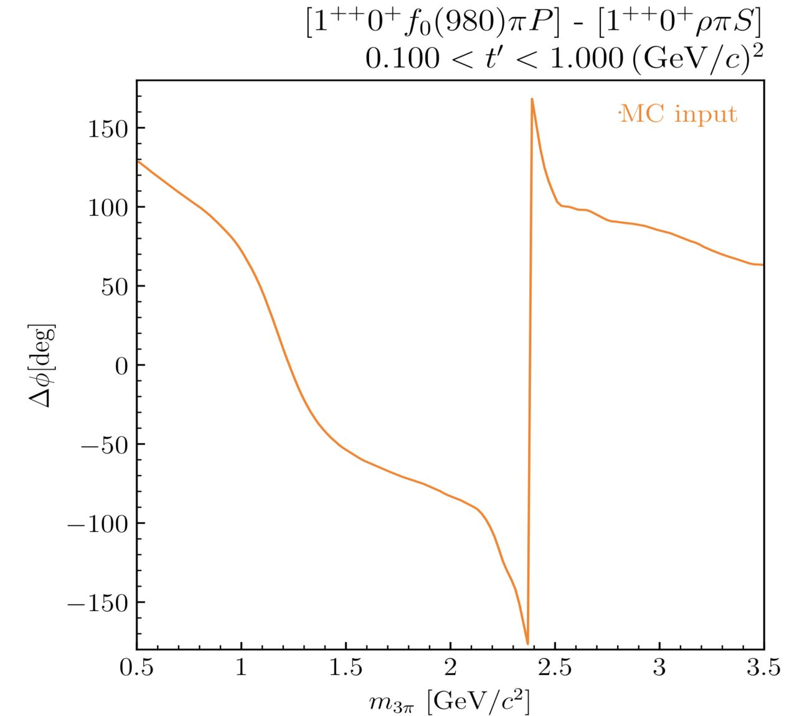
Input-Output Study
ongoing analysis
ongoing analysis

Slide 36
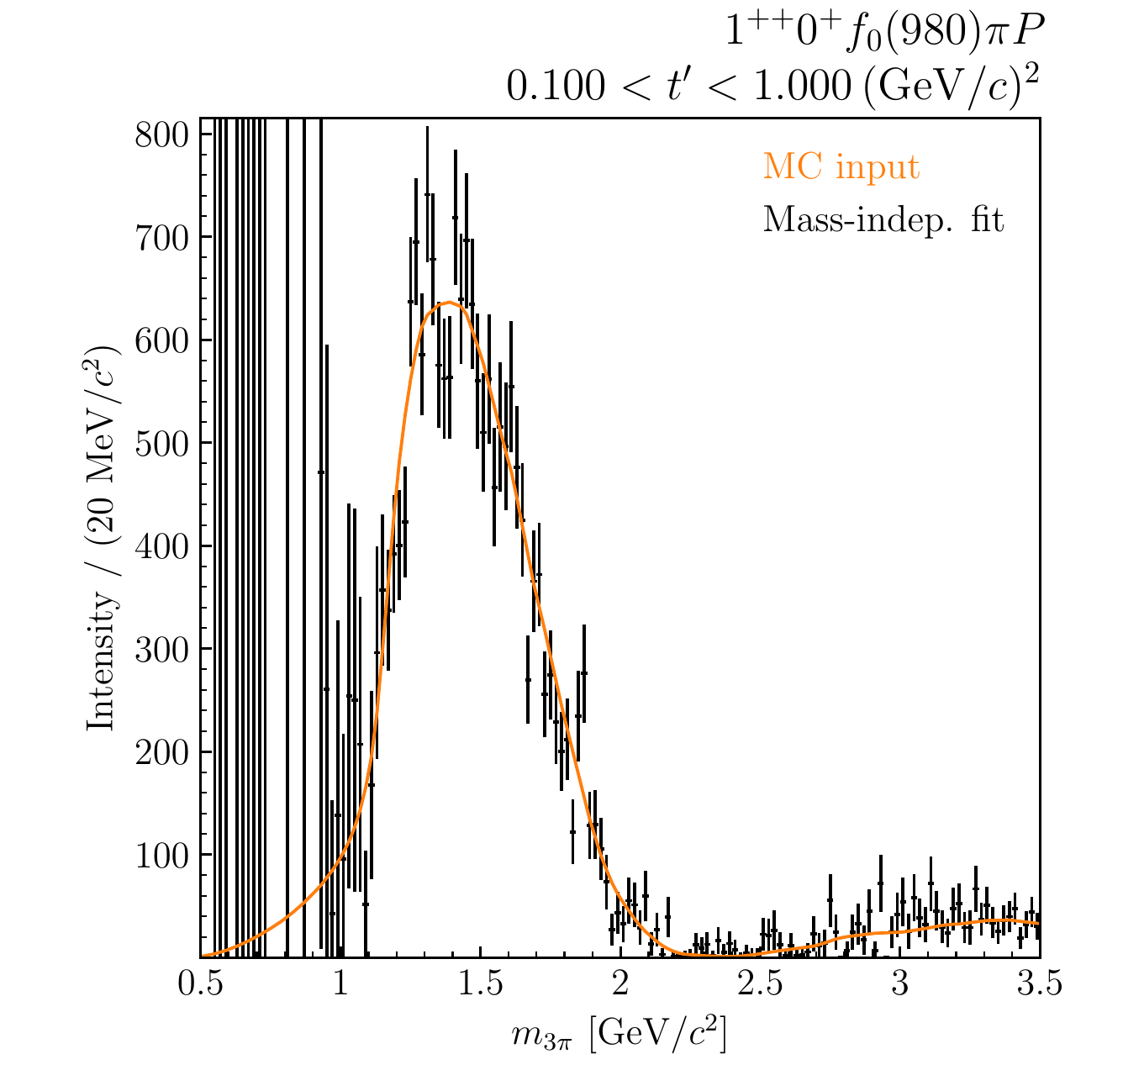
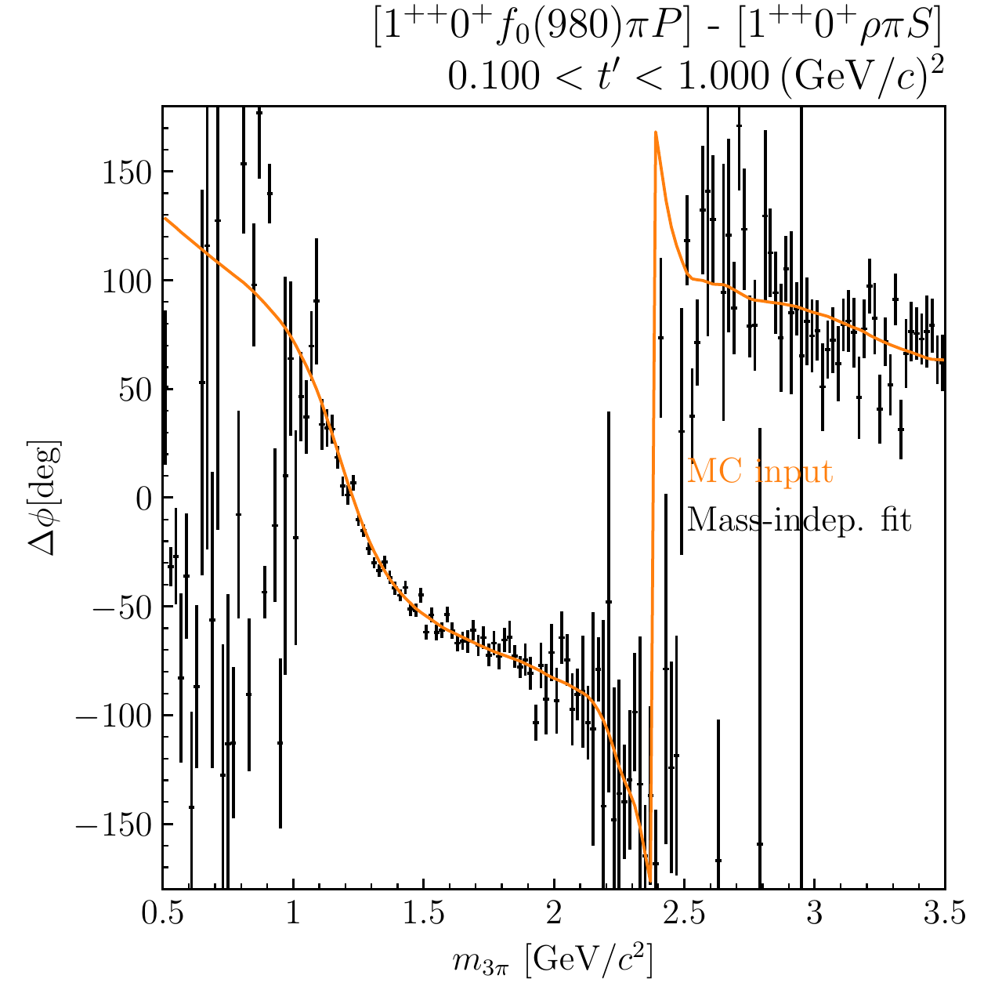
Input-Output Study
ongoing analysis
ongoing analysis
Notes:
Not a fit to data points! (the other way around)

Slide 37
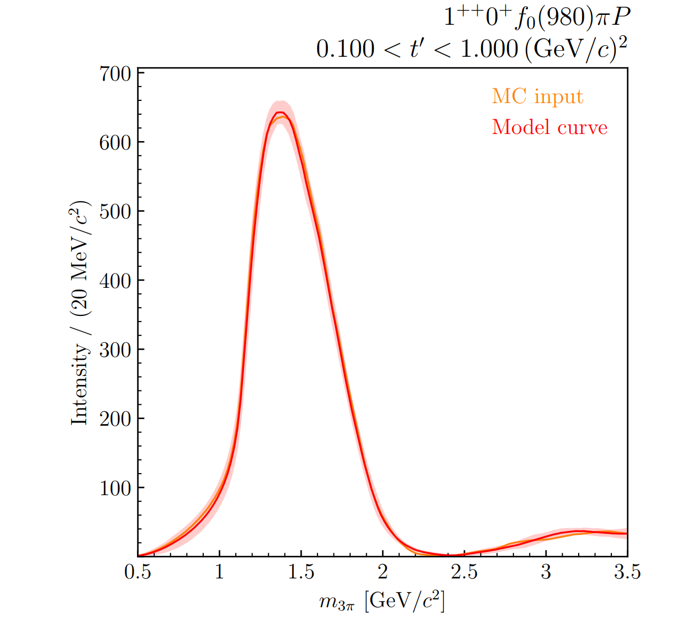
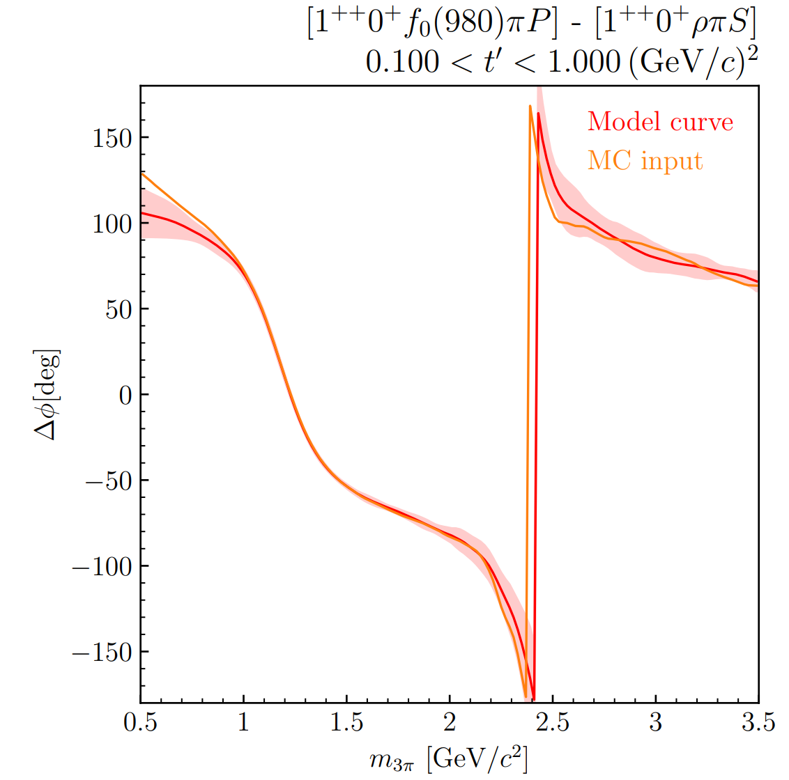
Input-Output Study
Continuous fit
Continuous fit
ongoing analysis
ongoing analysis

Slide 38
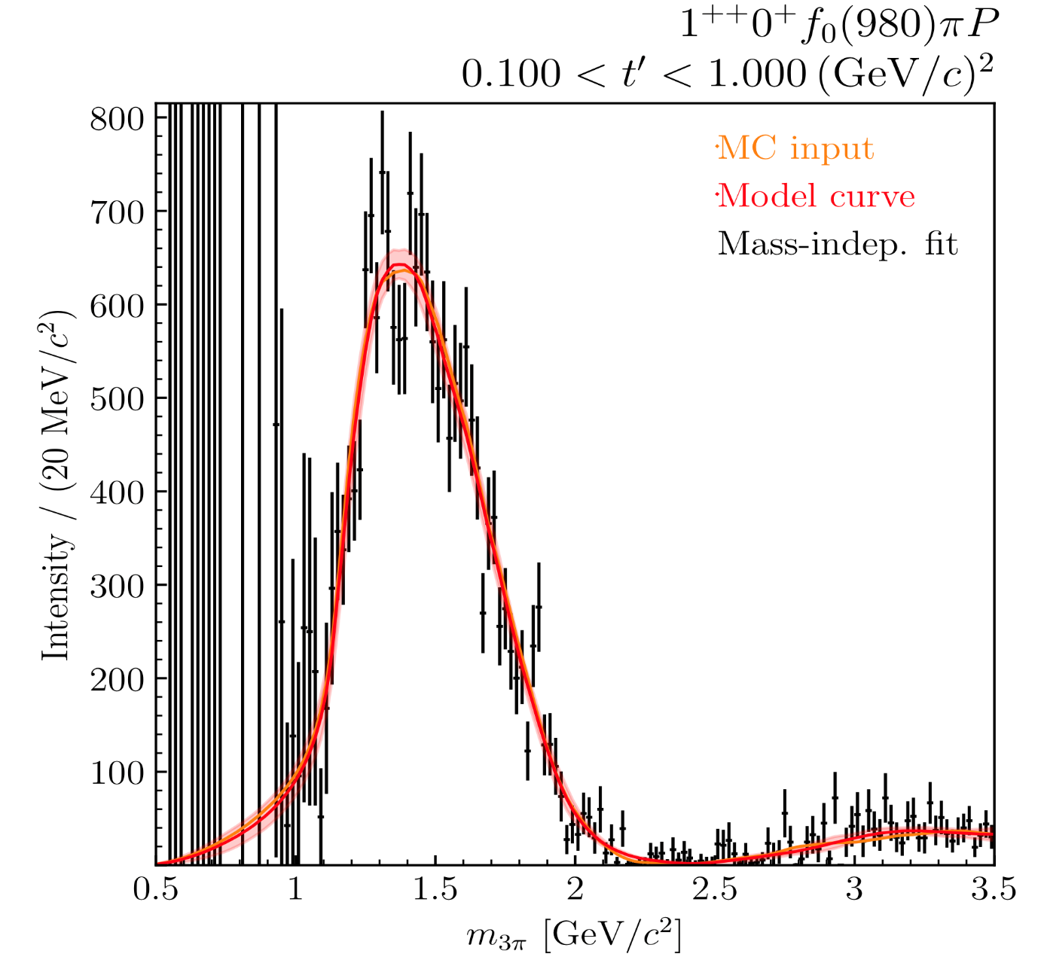
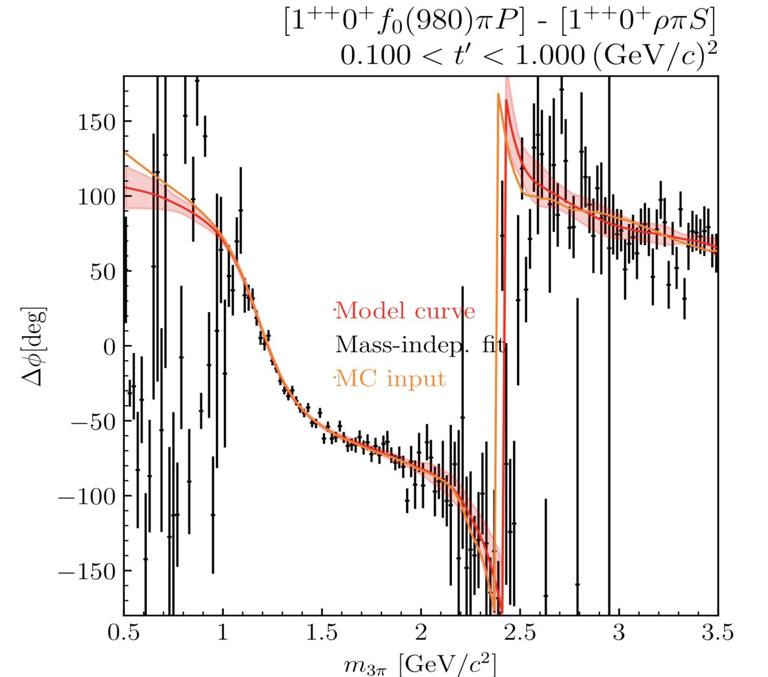
Input-Output Study
Continuous fit
ongoing analysis
ongoing analysis
Continuous fit

Slide 39
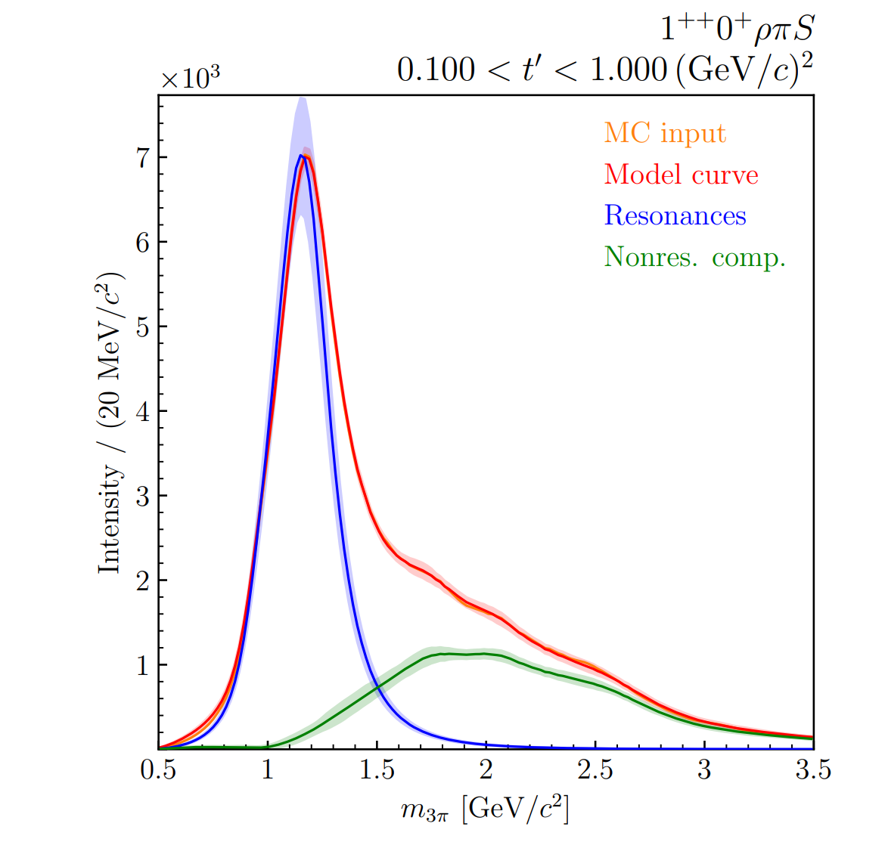
Single-Step Resonance Model Fit
We can go one step further!
In selected waves:
add resonant part
(e.g. as sum of Breit-Wigner distributions)
use NIFTy as flexible non-res. background
amplitude described by coherent sum
$→$ extract resonance parameters in a single fit
Continuous fit
ongoing analysis

Slide 40
Single-Step Resonance Model Fit
Input model
Continuous fit
ongoing analysis

Slide 41
Conclusion
High-precision data from COMPASS in $π^{−}π^{−}π^{+}$ and $K_{S}^{0}K^{−}$ allow in-depth study of $a_{J}$ and $π_{J}$ states
Ambiguities appear in the partial-wave decomposition of two-body states
Ambiguous amplitudes are continuous and can be calculated
PWD fit/finite data has an effect on ambiguous solutions
Choice of included partial waves may suppress the ambiguities
NIFTy: new approach to partial-wave analysis
Includes continuity, kinematics and regularization
Overcomes limitations of conventional approach
Can include resonance-model fit
Demonstrated in Monte Carlo pseudodata studies
Notes:
Study of a, pi states -> goal is energy-dependent extraction of amplitudes
Seen ambiguities appear: they are continuous (cannot distinguish them from physical sol. by this)
In realistic case with finite data + PWD: solutions are shifted/disappear -> continuity broken (all solutions)
-> may make selection of physical („true“) solution complicated
Second part: new approach to PWA including continuity constraints

Slide 42
Outlook
We can combine both presented topics
$→$ Apply NIFTy method on ambiguity problem in $K_{S}^{0}K^{−}$
Use continuity constraints to separate ambiguous solutions over entire mass range
Improve fit quality
Partial-wave analysis using NIFTy model is being successfully applied on real data
Thank you for your attention!

Slide 43
BACKUP

Slide 44
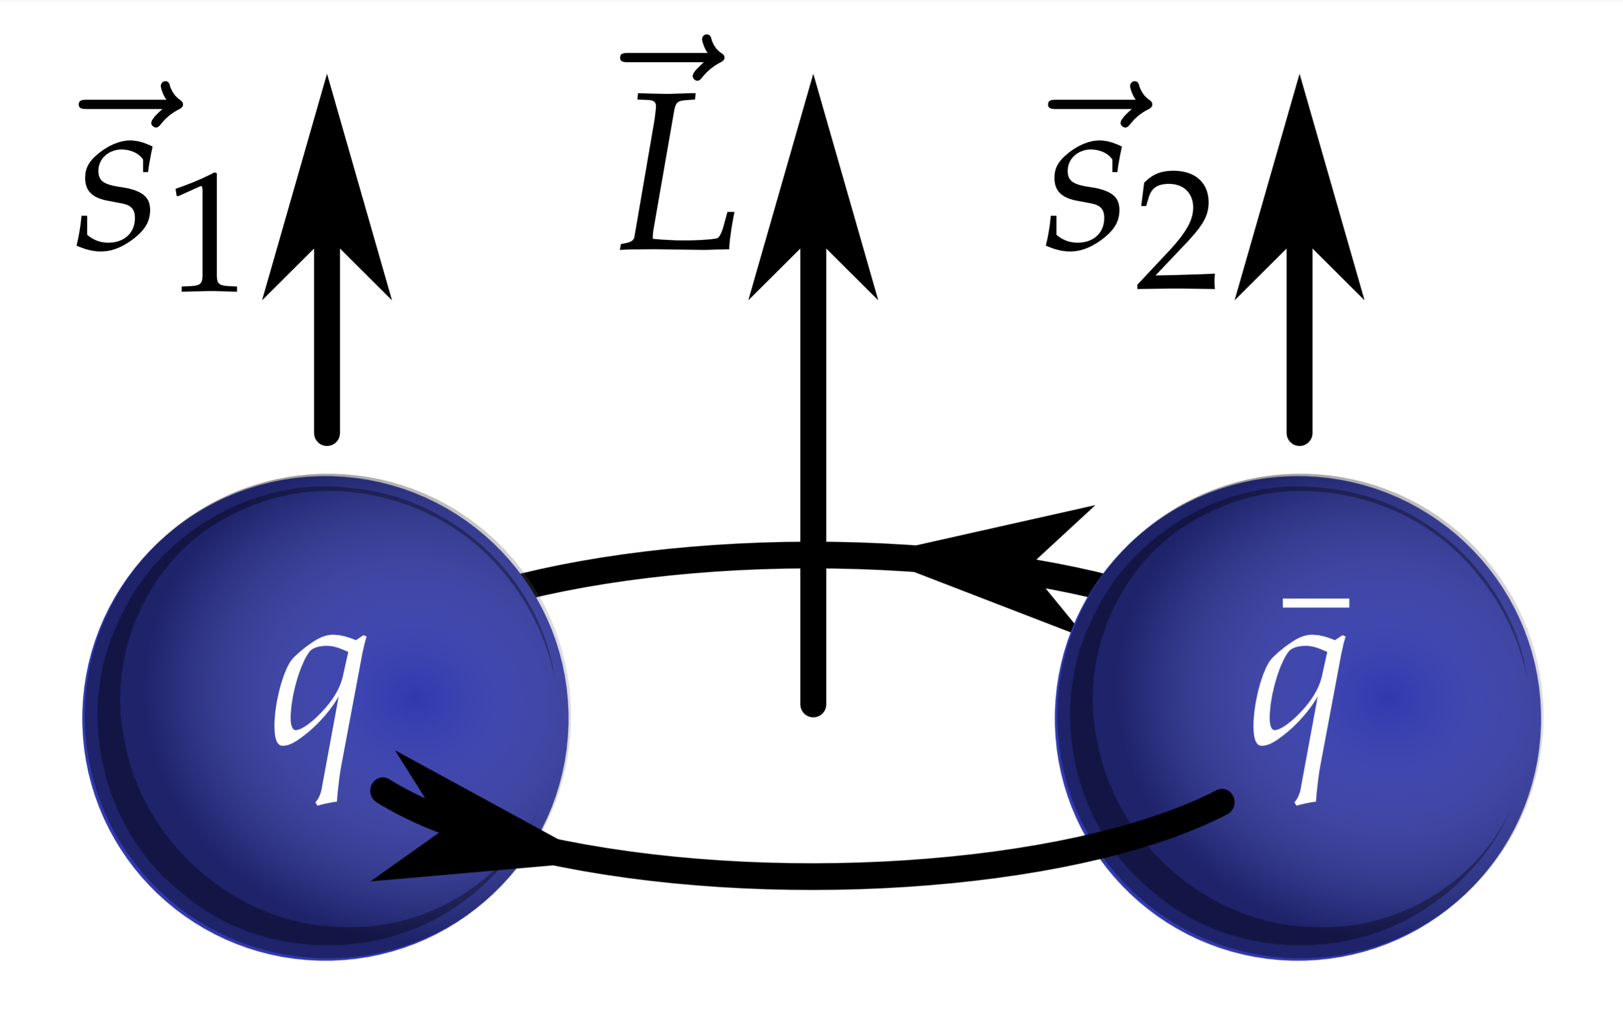
QCD in the Resonance Region
At low energies (hadron regime): QCD not solvable perturbatively
Theory: rely on models and effective theories, e.g. quark model (hadrons as bound states of valence quarks)
Experimentally: precision measurements of hadronic states and search for so-called exotic states (forbidden in the quark model)
From Prog.Part.Nucl.Phys. 113 (2020) 103755

Slide 45
Partial-Wave Decomposition
$$I\left(m_{X},t^{′};θ,φ\right)=\frac{dN}{dm_{X}dt^{′}dθdφ}={\left|M_{fi}\right|}^{2}$$
$$J,M$$
Separate process amplitude into partial waves
Spin $J$ and spin-projection $M$
$$L,M_{L}$$
$$J=L, M=M_{L}$$
$$P=C={\left(−1\right)}^{J}$$
Partial wave:
specific $(J^{PC}M)$

Slide 46
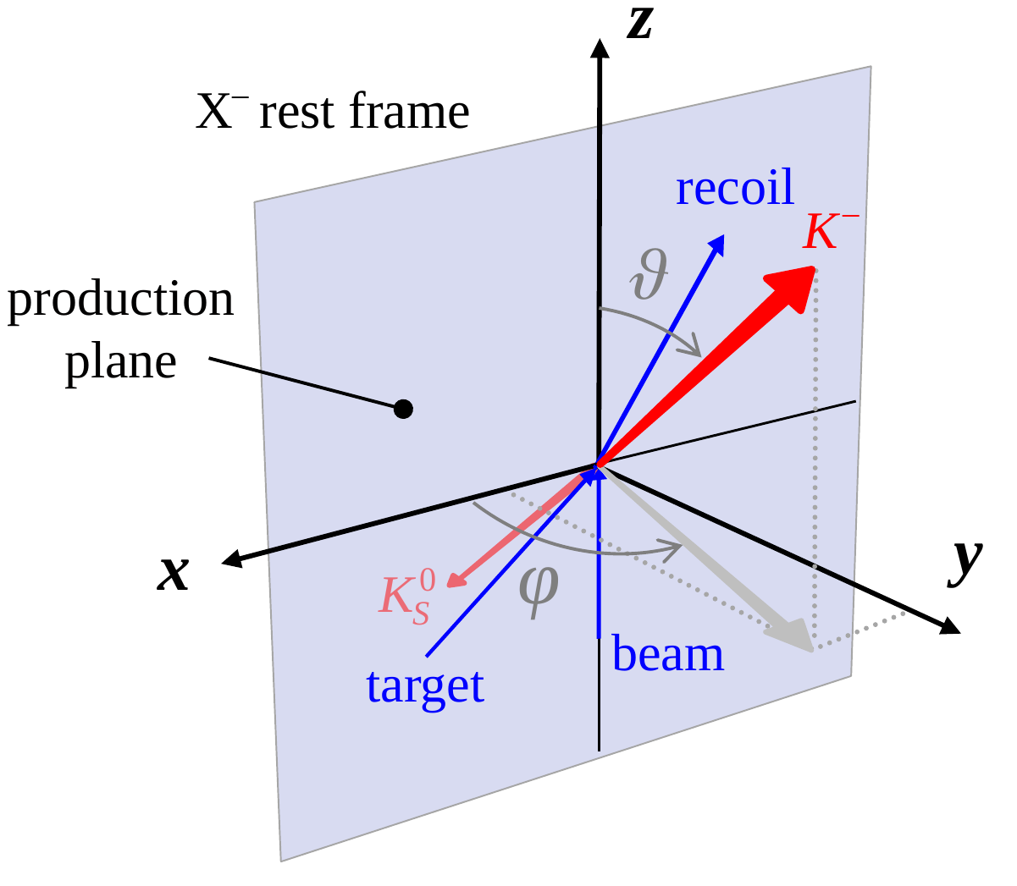
Partial-Wave Decomposition
$$I\left(m_{X},t^{′};θ,φ\right)=\frac{dN}{dm_{X}dt^{′}dθdφ}={\left|\sum_{J}{T_{J}\left(m_{X},t^{′}\right) ψ_{J}(θ,φ)}\right|}^{2}$$
Separate process amplitude into partial waves
Spin $J$ and spin-projection $M$
Production, propagation and decay of $X^{−}$
$$T_{JM}\left(m_{X},t^{′}\right)$$
$$ψ_{J}\left(θ,φ\right)=Y_{J}^{1}(θ,φ)$$
Partial wave:
specific $(J^{PC}M)$
$$M=1$$
$$(reflectivity basis, ε=−1 suppressed→M≠0 )$$

Slide 47
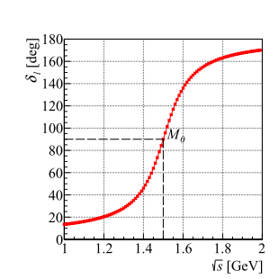
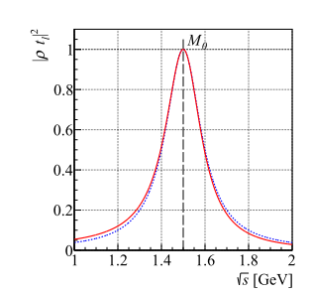
Partial-Wave Decomposition
$$I\left(m_{X},t^{′};θ,φ\right)=\frac{dN}{dm_{X}dt^{′}dθdφ}={\left|\sum_{J}{T_{J}\left(m_{X},t^{′}\right) ψ_{J}(θ,φ)}\right|}^{2}$$
$$J,M$$
Separate process amplitude into partial waves
Spin $J$ and spin-projection $M$
Production, propagation and decay of $X^{−}$
Fit $I\left(m_{X},t^{′};θ,φ\right)$ to data in $\left(m_{X},t^{′}\right)$ bins:
Choose finite set of $\{J^{PC}\}$
$$L,M_{L}$$
$$T_{J}\left(m_{X},t^{′}\right)= P\left(m_{X},t^{′}\right) D\left(m_{X}\right)$$
$$ψ_{J}\left(θ,φ\right)=Y_{J}^{M}(θ,φ)$$
$$M=1$$
Partial wave:
specific $(J^{PC})$
From B. Ketzer et al., Prog.Part.Nucl.Phys. 113 (2020) 103755, Light-Meson Spectroscopy with COMPASS

Slide 48
Ambiguities in Incoherent Sectors
$$I\left(m_{X},t^{′};θ,φ\right)={\left|\sum_{JM}{T_{JM}^{+}\left(m_{X},t^{′}\right) ψ_{JM}^{+}(θ,φ)}\right|}^{2}+{\left|\sum_{JM}{T_{JM}^{−}\left(m_{X},t^{′}\right) ψ_{JM}^{−}(θ,φ)}\right|}^{2}$$
$$ε=±1:$$
$$a_{0}^{−}=\sum_{J=0}^{J_{max}^{−}}{T_{J0}^{−} Y_{J}^{0}(θ,0)}$$
$$ε=−1, M=0$$
$$a_{1}^{−}=\sum_{J=1}^{J_{max}^{−}}{T_{J1}^{−} Y_{J}^{1}(θ,0)}$$
$$ε=−1, M=1$$
$$a_{1}^{+}=\sum_{J=1}^{J_{max}^{+}}{T_{J1}^{+} Y_{J}^{1}(θ,0)}$$
$$ε=+1, M=1$$
$a_{s}^{−}=a_{0}^{−}+a_{1}^{−}$, then same procedure as for a single sector
New amplitudes for $ε=+1$: ${\left|a_{1}^{+}\right|}^{2}={\left|a_{1}^{−}\right|}^{2}−const.$ $→$ positivity requirement!

Slide 49
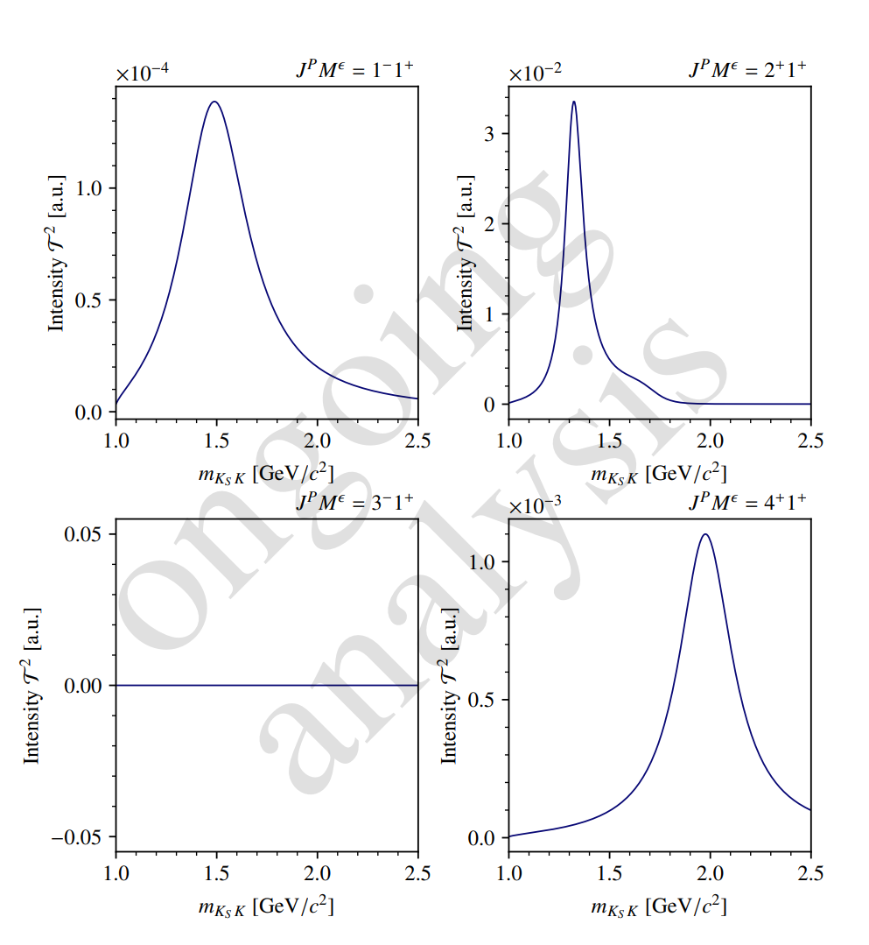
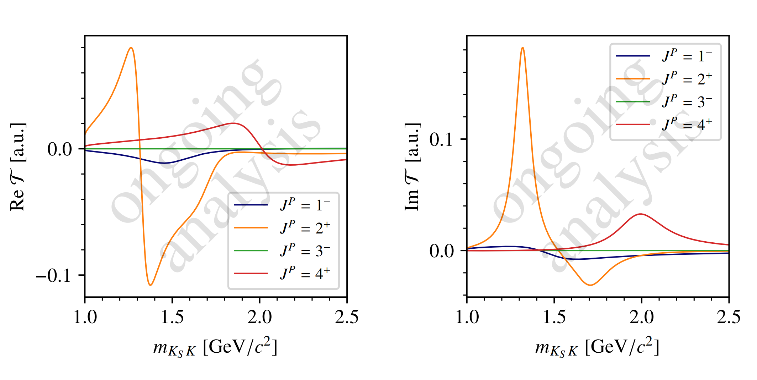
Continuous Amplitude Model
Continuous intensity model
create a model for the amplitudes in four waves
$m_{X}$-dependence by Breit-Wigner amplitudes

Slide 50
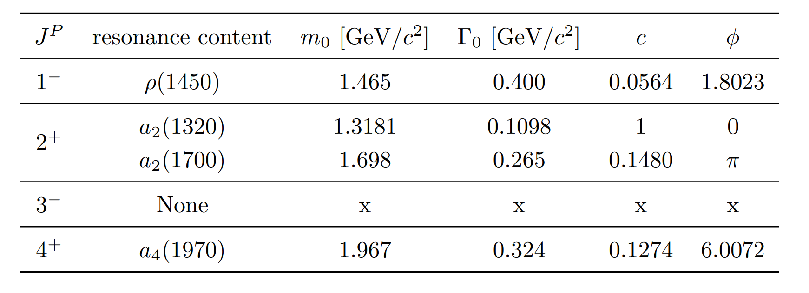

Slide 51
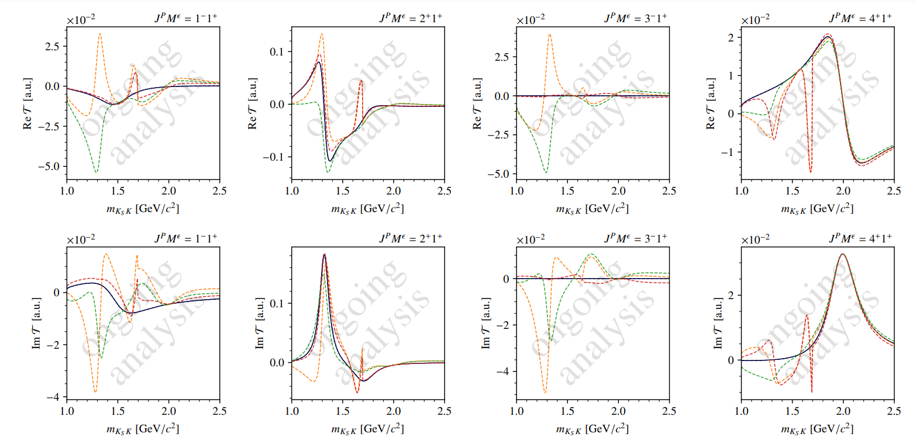

Slide 52
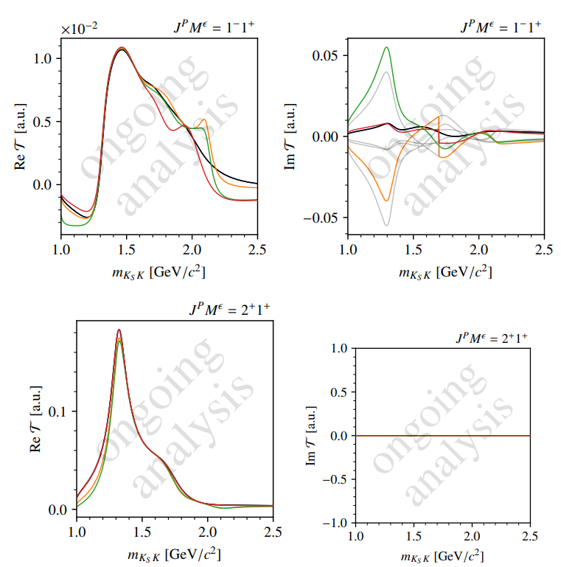
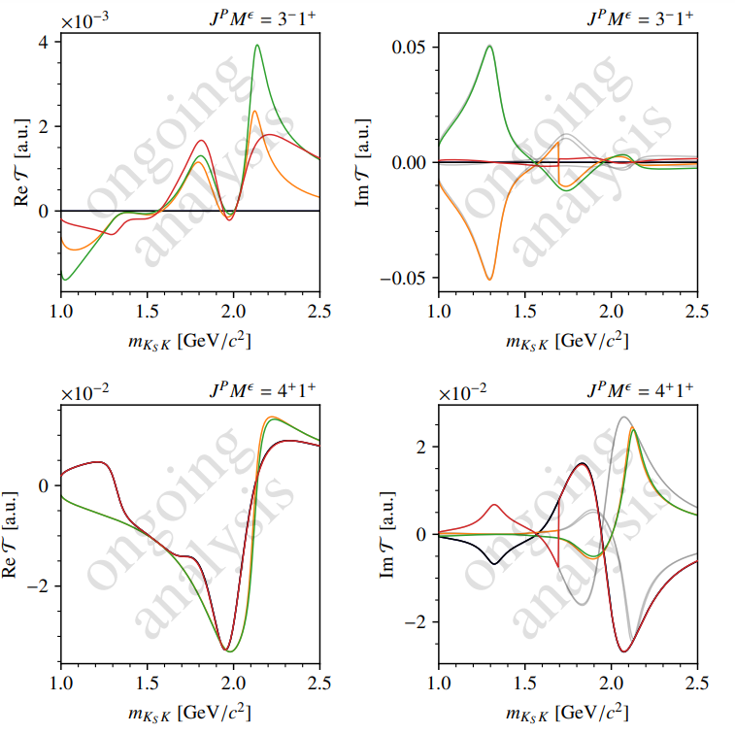

Slide 53
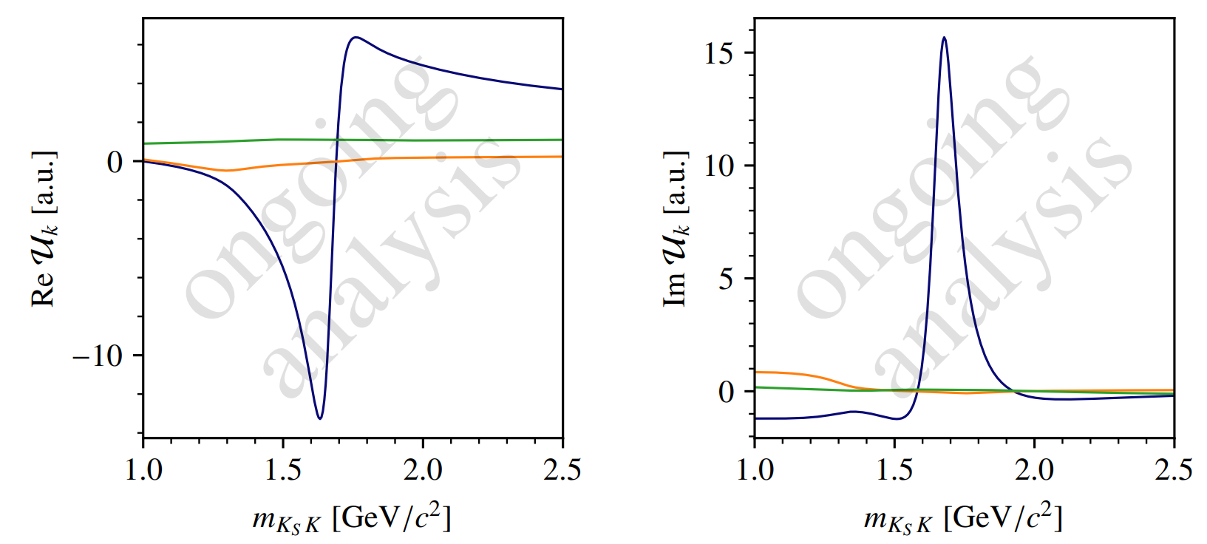

Slide 54
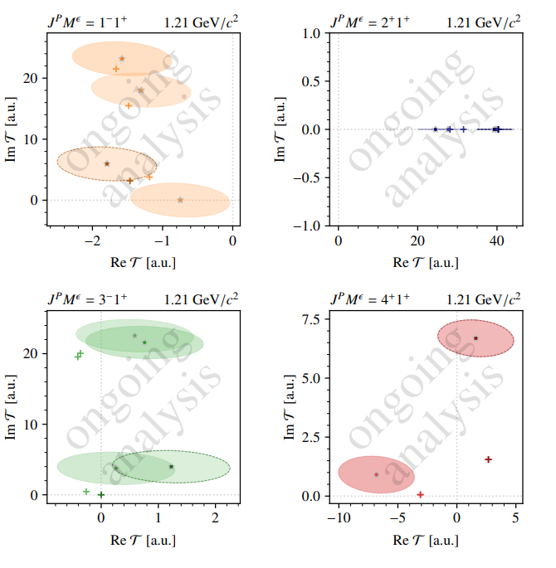
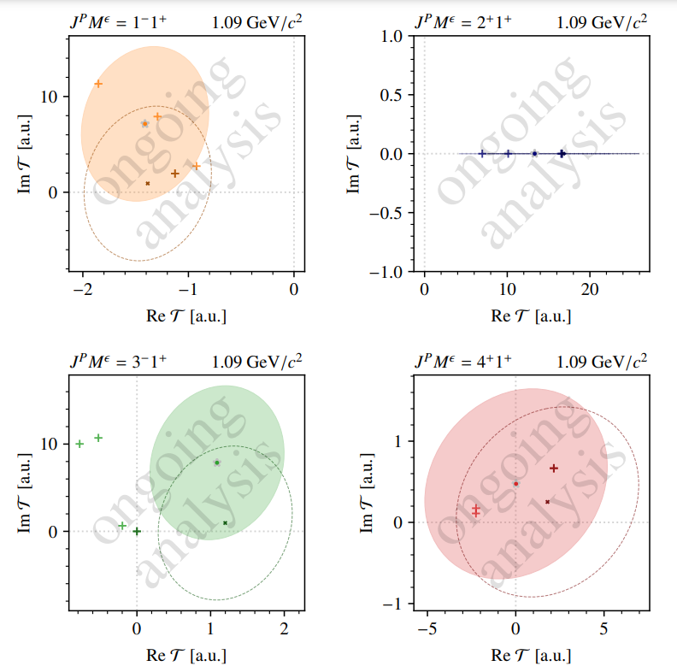

Slide 55
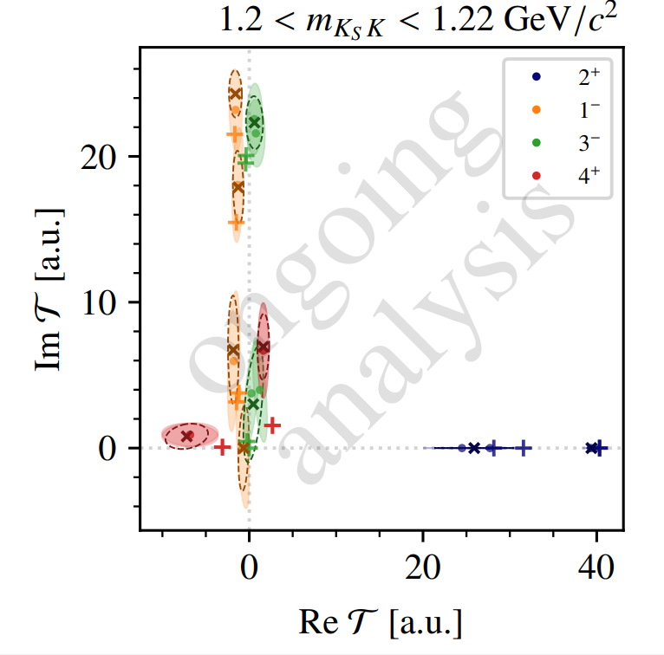

Slide 56
Implementation: NIFTy Framework
Framework by team from the Max-Planck Institute for Astrophysics:
NIFTY: “Numerical Information Field Theory”
Provides continuous non-parametric models
https://ift.pages.mpcdf.de/nifty/
https://ift.pages.mpcdf.de/nifty/user/getting_started_0.html
This work is done in collaboration with Jakob Knollmueller (TUM / ORIGINS Excellence Cluster )

Slide 57
ongoing analysis
ongoing analysis

Slide 58
Input-Output Study
Continuous fit
ongoing analysis
ongoing analysis

Slide 59
ongoing analysis
ongoing analysis

Slide 61
Outlook: NIFTy on KsK- pseudodata
ongoing analysis
ongoing analysis

