Slide 1
Phys.Rept. 658 (2016) 1
Departamento de Física Teórica
Institute of Particle & Cosmos Physics (IPARCOS)
Universidad Complutense de Madrid
Dispersive ππ→KK Amplitude and Giant CP Violation
in B to three Light-Meson Decays at LHCb
J. R. Peláez
P. Magalhaes
Based on:
R. Álvarez Garrote, J. Cuervo, P. Magalhaes, J.R.Peláez
Phys.Rev.Lett. 130, 201901 (2023)
20th International Conference on Hadron Spectroscopy and Structure (HADRON 2023)
Supported by:
Grant PID2019-106080GB-C21 funded by MICIN

Slide 2
Introduction
CP violation (CPV) relevant for bariogenesis and other open questions
within the SM
CPV observed through:
CP forbidded processes: e.g. original $K_{L}→ππ$ observation
2) Asymmetries between CP-conjugated decays
$𝓐_{CP}≡∆Γ_{f}=Γ\left(M→f\right)−Γ\left(\overline{M}→\overline{f}\right)$
In the SM quark/hadron CPV due to “weak” phase in the CKM matrix
To observe such CP phase in an asymmetry we need
interference between at least two mechanisms/diagrams
with different weak and strong phases

Slide 3
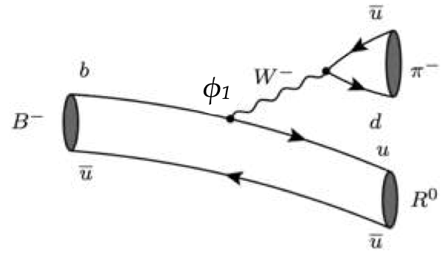
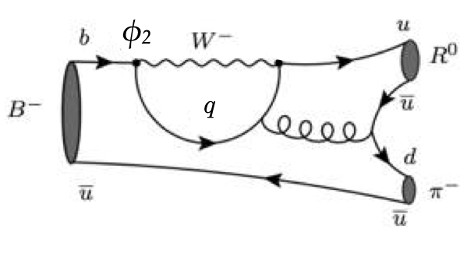
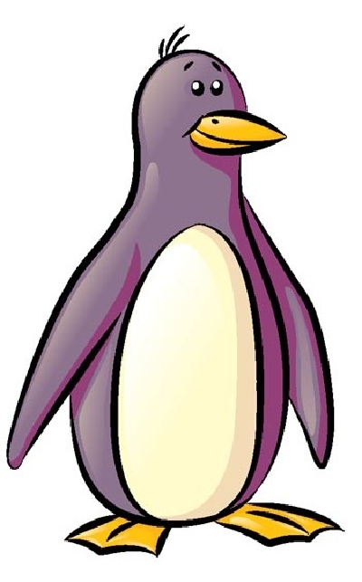
Introduction
Most popular model: “tree”+”penguin” BSS model
Bander Silverman & Soni PRL 43 (1979) 242
+
+
CPV phase appears in CKM matrix
Note that “strong” imaginary part due to the loop with quarks, which are not physical states.
However, strong phase can be generated at the “hadron level“
via Hadronic Final State Interactions (FSI) (sometimes called compound contribution)
L. Wolfenstein, Phys. Rev. D 43, 151 (1991).
M. Suzuki and L. Wolfenstein, Phys. Rev. D 60, 074019 (1999).
M. Suzuki, Phys. Rev. D 77, 054021 (2008).

Slide 4
CPV: 2-body versus 3-body decays
2-body decays
$$π$$
B
$$π$$
Decay producs momenta fixed by decaying particle mass
Hadronization/FSI is basically a number after angular integration
Simpler to estimate
$$π$$
3-body decays
$$π$$
B
$$K$$
energy distributed between three particles $∑p_{i}=M_{B}^{2}$
strong FSI phase is a FUNCTION of two energy variables, not fixed by M_{B}
Functional dependence no so simple to reproduce
Studying CPV in 3-body decays may provide more information to tell if
the energy-dependent function responds to FSI meson dynamics

Slide 5
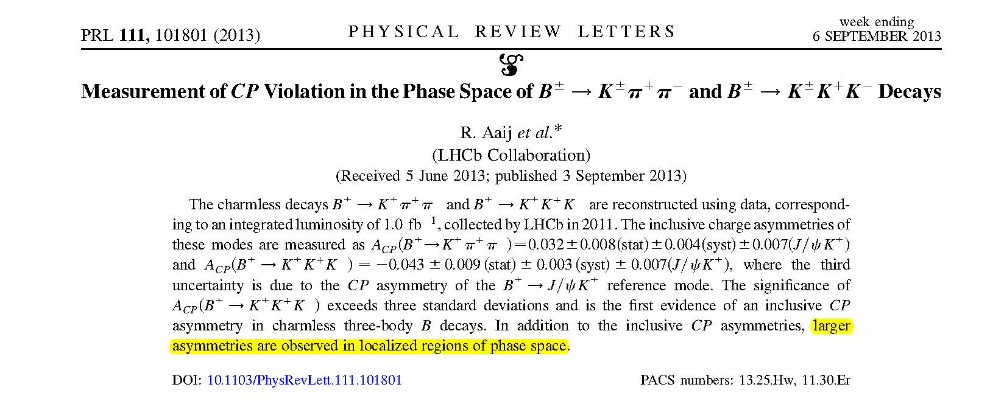
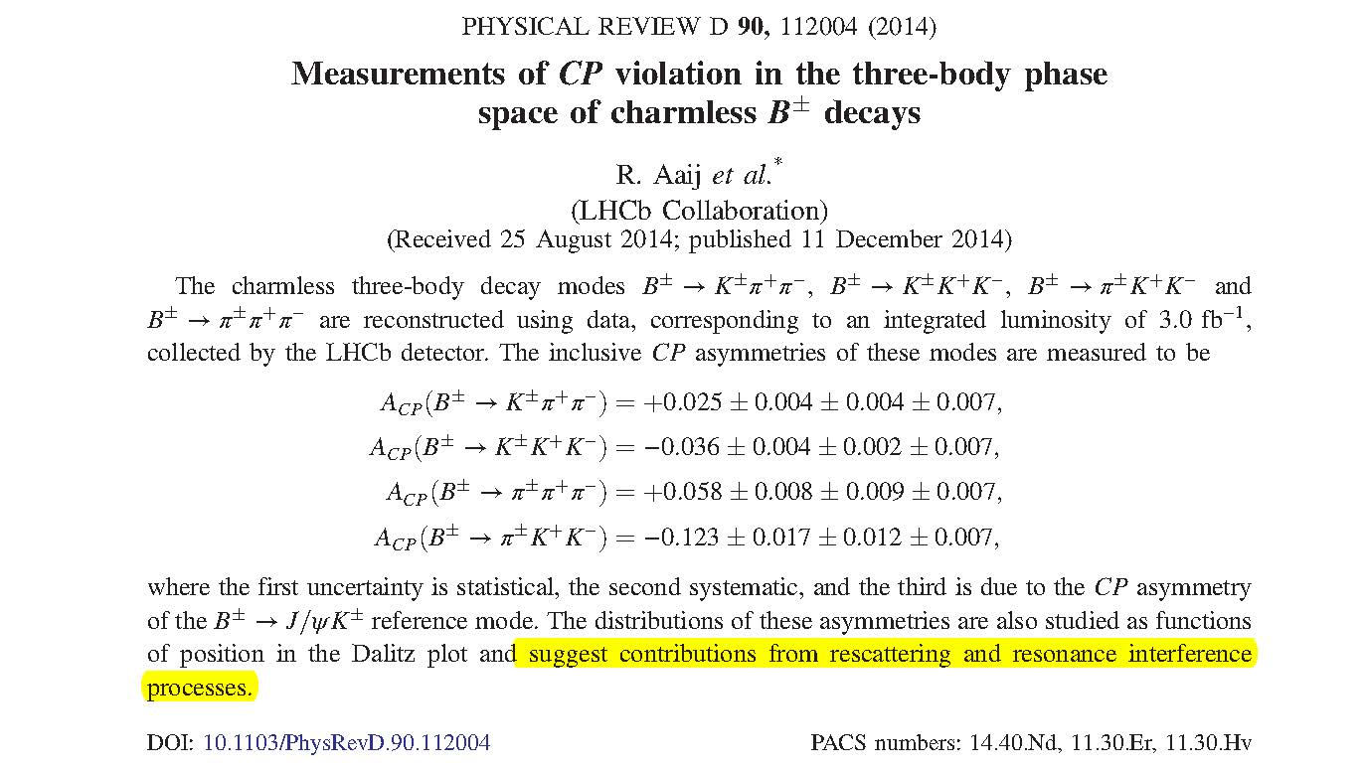
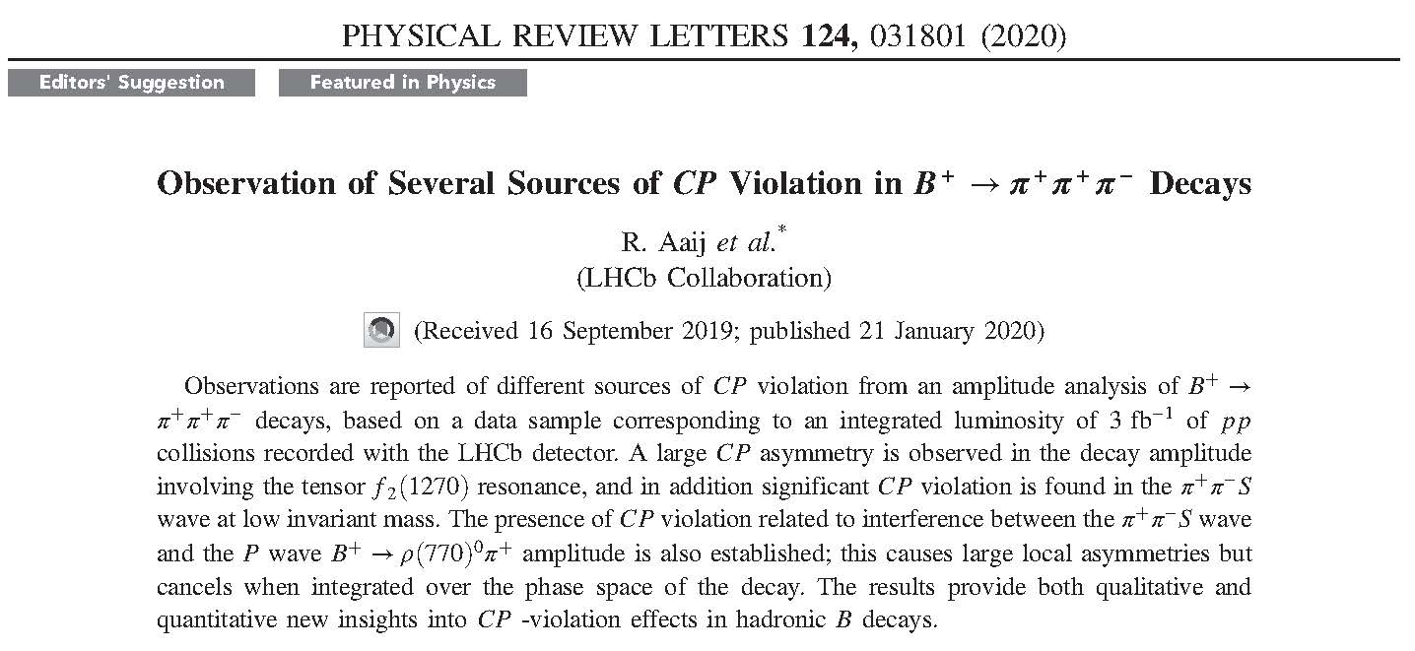
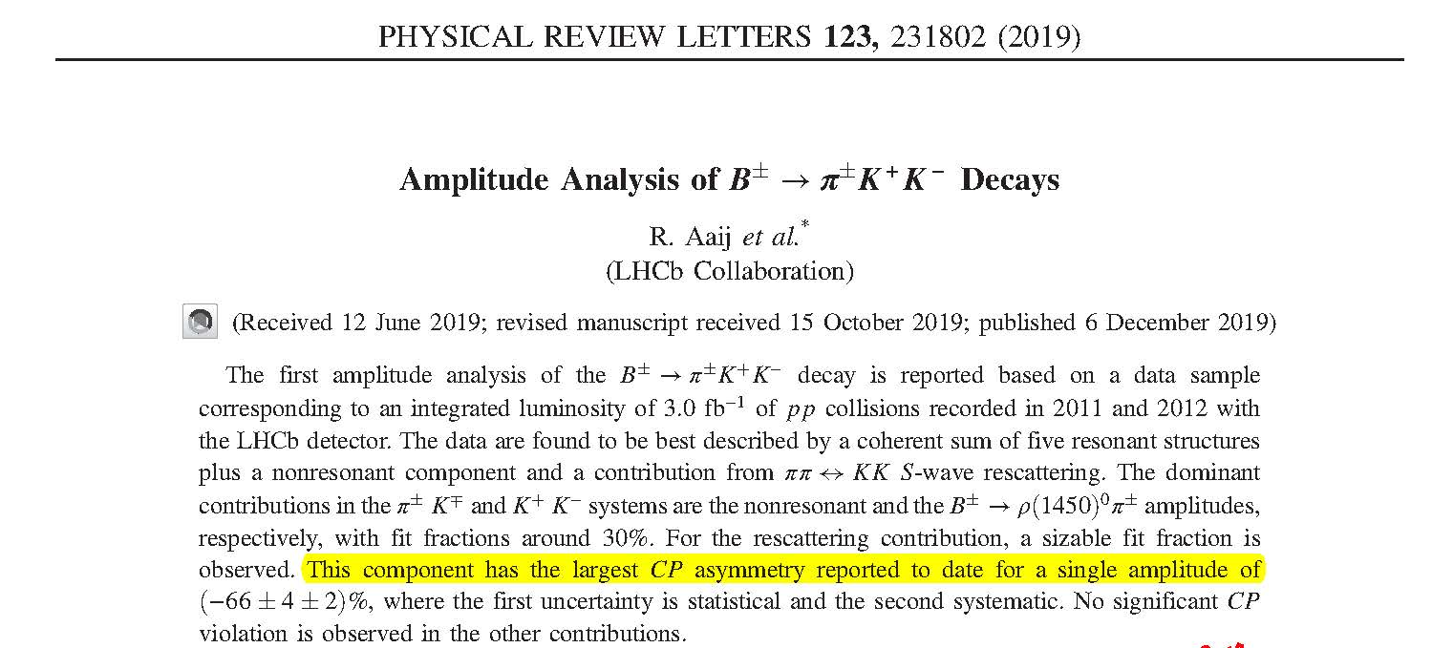
LHCb intense research program: large CPV asymmetries in $B→3M$ decays
indeed, “the largest CP asymmetry reported to date”
arXiv:2206.07622v1 [hep-ex]

Slide 6
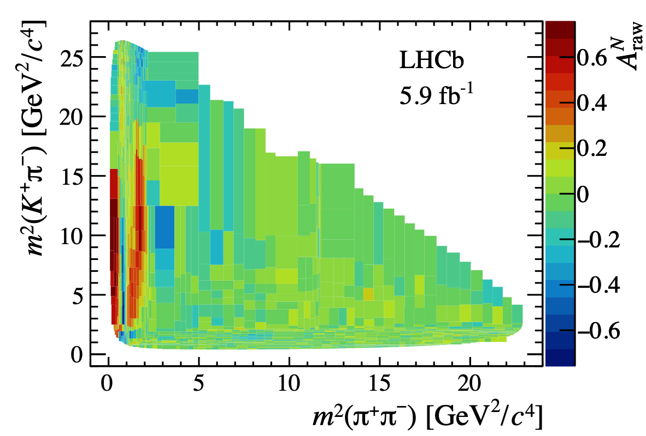
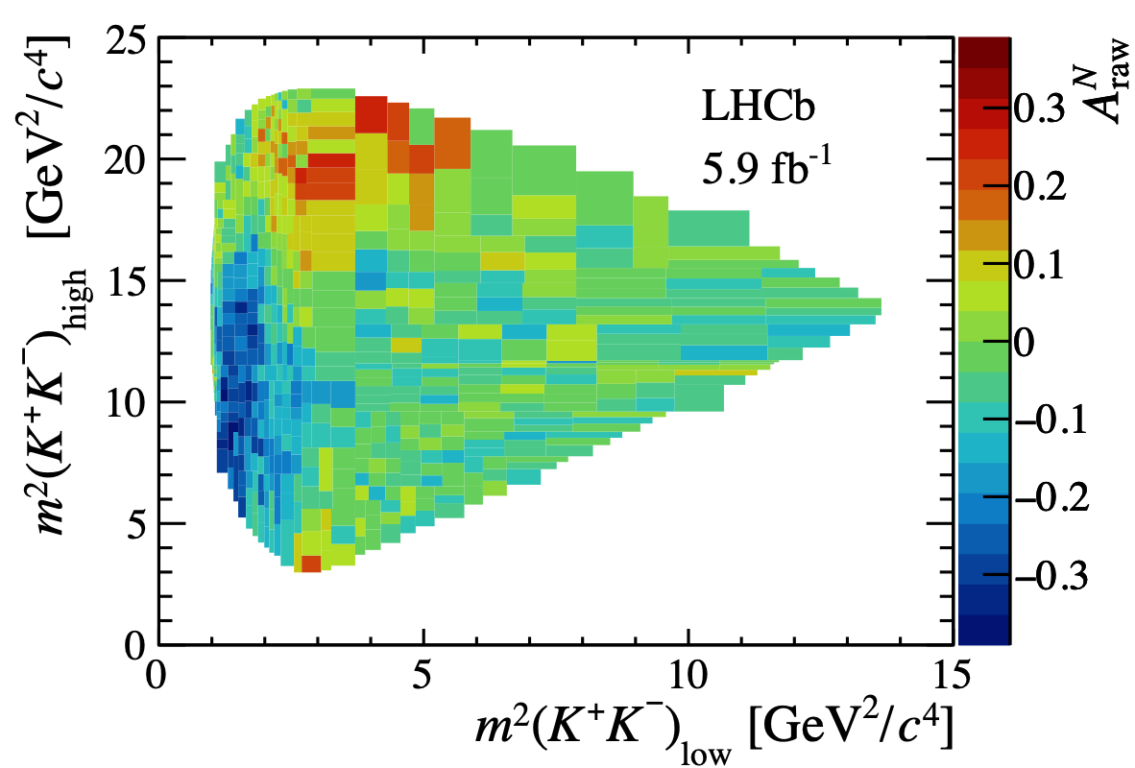
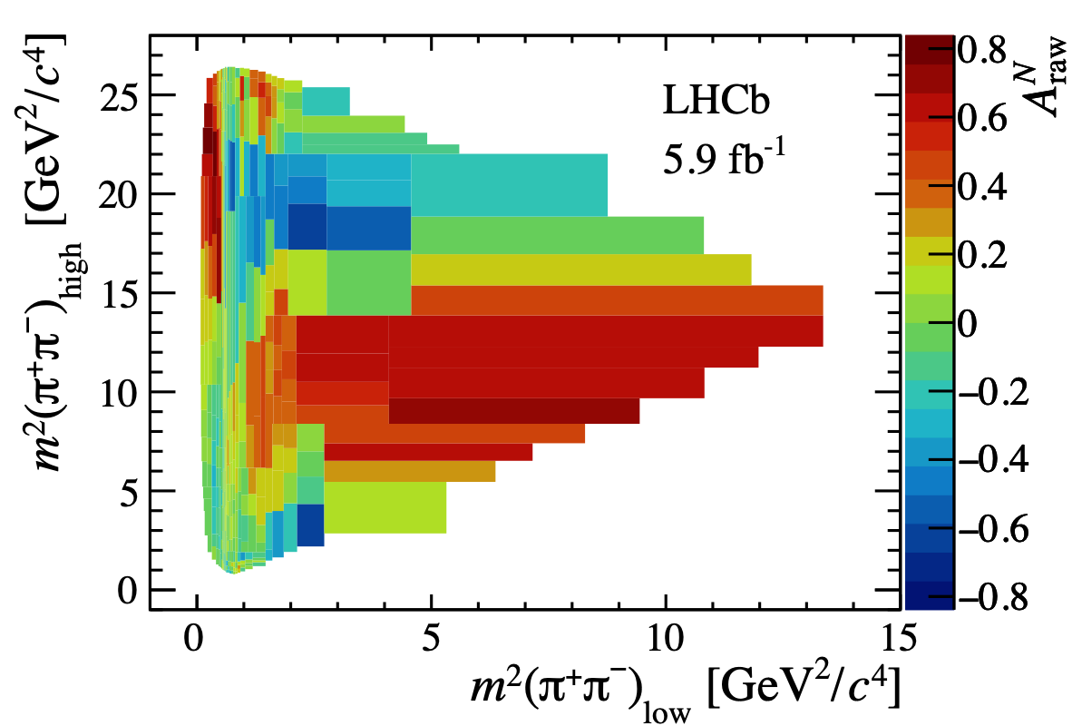
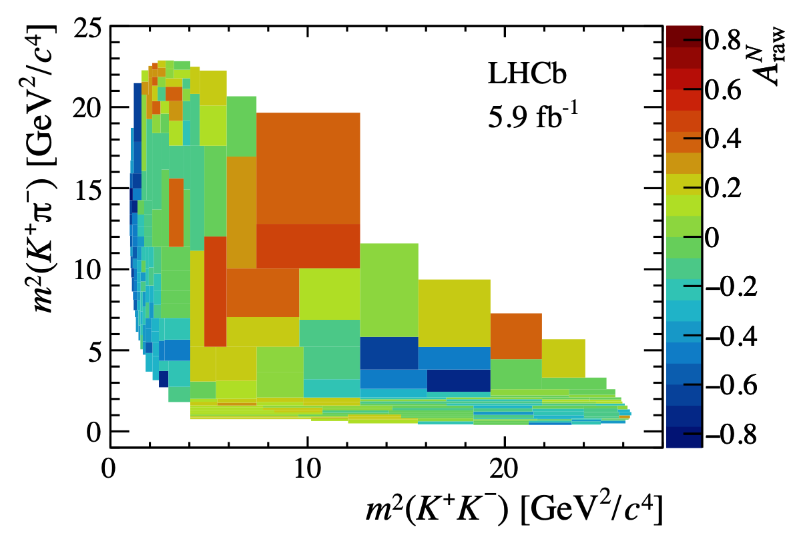
CPV in $B^{±}→M^{±}(M^{+}M^{−})$
Run II 5.9 fb⁻¹
arXiv:2206.07622 PRD 2022 XX
Integrated:
Large CPV asymmetries
Kππ
KKK
Locally:
“Giant" CPV
πππ
KKπ
CPV in heavy meson decays
Madrid 11/05/2023
Patricia Magalhães

Slide 7
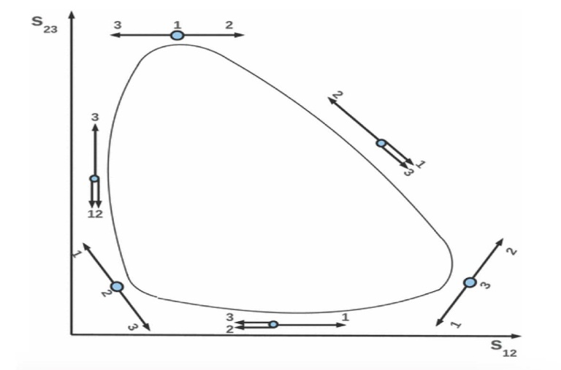
Let’s simplify a little…
Bediaga, Frederico,Lourenco,PRD89(2014)094013
However, reproducing the full 3-body Dalitz plot needs many contributions
Let us keep things simple:
Border of Dalitz plot
One of the particles is just an spectator
2) Just two coupled channels
3) Use CPT constraints at hadron level
$h$and $\overline{h}$ must have the same total width
CPV can only occur in partial widths
If only two channels….

Slide 8
Let’s simplify a little…
Bediaga, Frederico,Lourenco,PRD89(2014)094013
However, reproducing the full 3-body Dalitz plot needs many contributions
Let us keep things simple:
Border of Dalitz plot
One of the particles is just an spectator
2) Just two coupled channels
3) Use CPT constraints at hadron level
$h$and $\overline{h}$ must have the same total width
CPV can only occur in partial widths
If only two channels….
$0=∆Γ_{1}$ +$∆Γ_{2}$
The CPV asymmetry in channels 1 and 2 are OPPOSITE
$∆Γ_{1}$ = -$∆Γ_{2}$
Do we find this anywere?

Slide 9
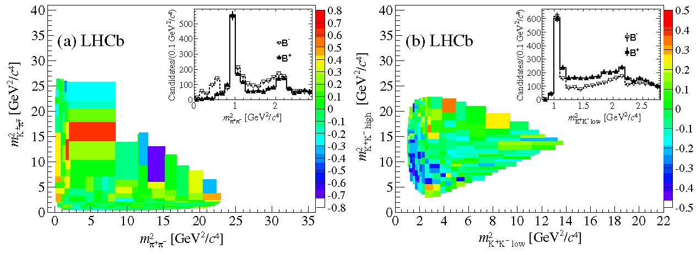
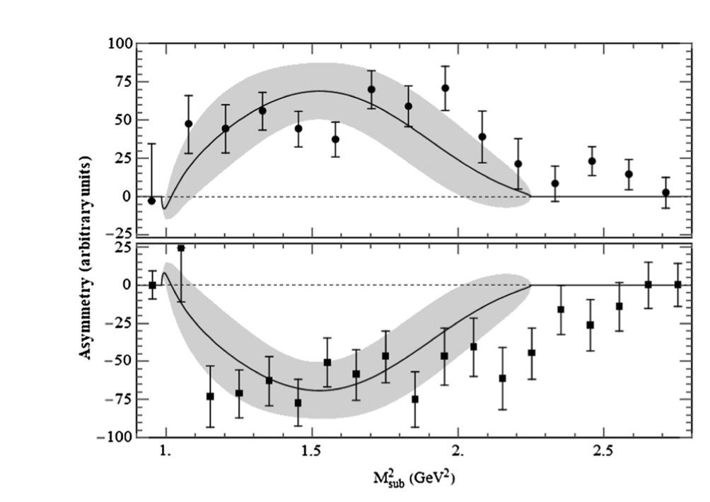
$B^{±}→K^{±}\left(K^{+}K^{−}\right)$ and $K^{±}\left(π^{+}π^{−}\right)$ in the 1-1.5 GeV region
Bediaga, Frederico,Lourenco,PRD89(2014)094013
Large asymmetries when LHCb data projected in the 1-1.5 band
$$B^{±}→K^{±}\left(π^{+}π^{−}\right)$$
Indeed, in that projection
Clear indication of dominant role of FSI between two hadronic states
$∆Γ_{ππ}$ $≈$ -$∆Γ_{KK}$
$$B^{±}→K^{±}\left(K^{+}K^{−}\right)$$

Slide 10
Simplest FSI model
R1 = Bediaga, Frederico, Lourenço PRD89(2014)094013;
R2 = Alvarenga, Bediaga, Frederico PRD 92(2015) 0954010
decay of hadron h into hadron state $λ$
A and B complex and CP symmetric
$γ$ phase changes sign under CP conjugation
If $λ$ can couple to other channels $λ^{′}$ then:
$A=S^{1/2}A^{0},$with $A^{0}$without FSI
Suzuki, Wolfenstein, PRD60(1991)074019
where
to LO:
Simplest regime when only 2-body FSI. In our case just S-wave $ππ→KK$
$F(M_{K}^{2})=$DP kinematic factor
R1

Slide 11
Two unnecessary and crude estimates inherited by LHCb analyses and other works:
$$S_{λλ´}=\left(\begin{matrix}{\left|S_{ππππ}\right|e}^{{i2δ}_{ππππ}} & i\left|S_{ππKK}\right|e^{{iδ}_{ππKK}} & ⋯ \\ i\left|S_{ππKK}\right|e^{{iδ}_{ππKK}} & {\left|S_{KKKK}\right|e}^{{i2δ}_{KKKK}} & ⋯ \\ ⋮ & ⋮ & ⋱\end{matrix}\right)$$
S-matrix
This what we need
At the time only $ππ→ππ$dispersive analysis existed. Crude approximations made:
If strict 2-channel
$δ_{ππKK}=$ ${δ_{KKKK}+δ}_{ππππ}$
1
$KK→KK$ unknown: very crude estimate
$δ_{KKKK}=$ $δ_{ππππ}$
$δ_{ππKK}= \text{2}δ_{ππππ}$ !!!
2
Took η from old and unprecise
$ππ→ππ$parameterization
$\left|S_{ππKK}\right|$=$\sqrt{1−η^{2}}$

Slide 12
Two unnecessary and crude approximations
But data exists since the 80s and a precise dispersive $ππ→KK$parameterization
Appeared in 2018 JRP, A. Rodas, Eur.Phys.J.C 78 (2018) 11, 897 & Phys.Rept. 969 (2022) 1-126
1) The crude
estimates do
not describe the data
1
2) Produce huge
uncertainties
3) Do not resolve
resonance structures
Are the conclusions still valid?
Can we do better?
2

Slide 13
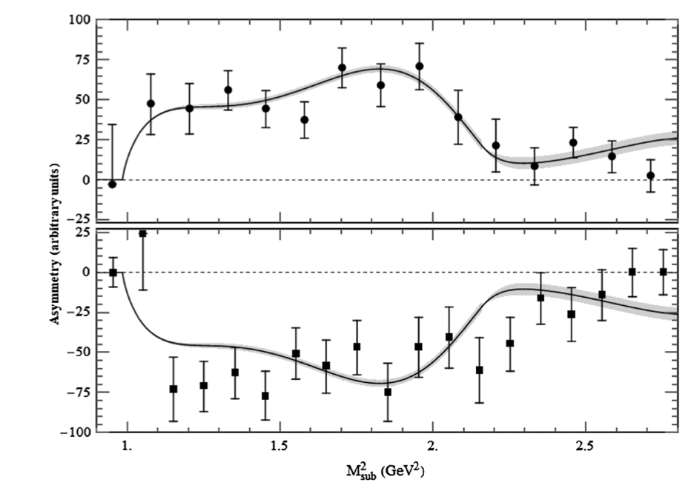
Using the dispersive $ππ→KK$ parameterization within the same model
With simplest model: only S-wave $ππ→KK$ FSI
Just use the correct $ππ→KK$ amplitude
With crude estimates
1
2
With dispersive $ππ→KK$
Before
Our work
Dramatic reduction in uncertainty, resonant features resolved,
Even beyond 1.5 GeV, still fairly reasonable.
Given these uncertainties now it makes sense to add subdominant contributions

Slide 14
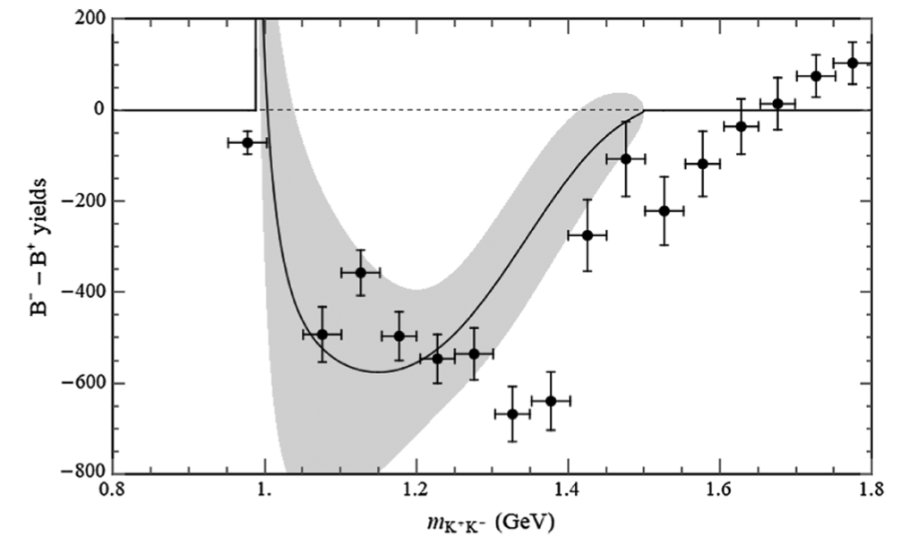
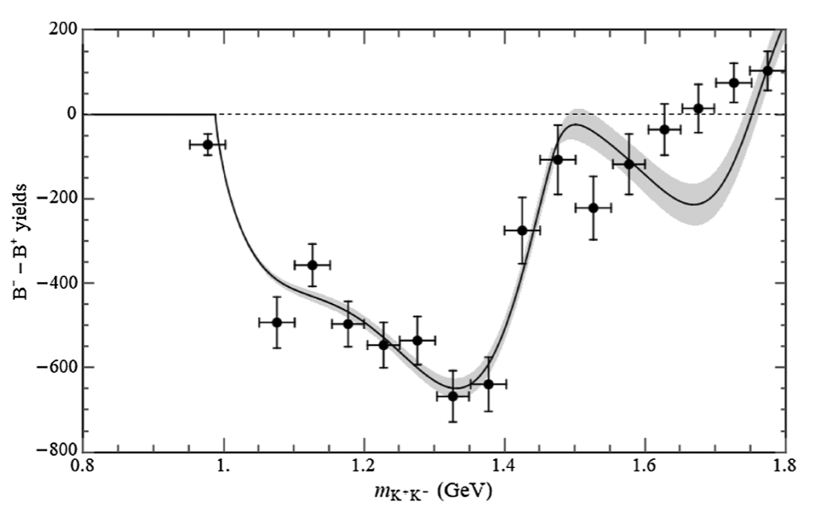
Using the dispersive $ππ→KK$ parameterization within the same model
$B→KKK$LHCb full run 1 data
Slightly modified model:
rescattering and a mimicked source term mild energy dependence
Alavenga, Bediaga, Frederico, PRD92(2015) 0954010
With crude estimates
1
2
With dispersive $ππ→KK$
Before
Our work
Also, kinematic factor correction at threshold.
Weird peak disappears
dramatically improved uncertainties

Slide 15
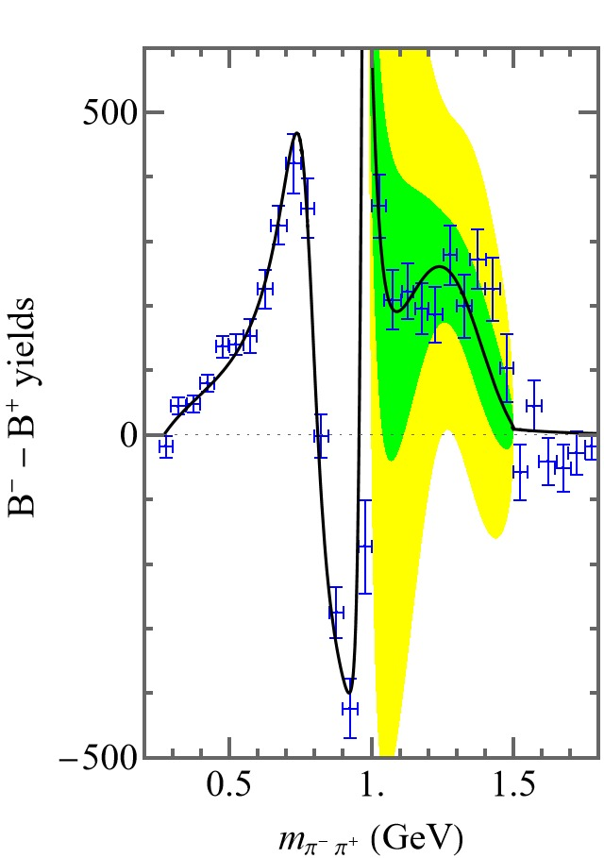
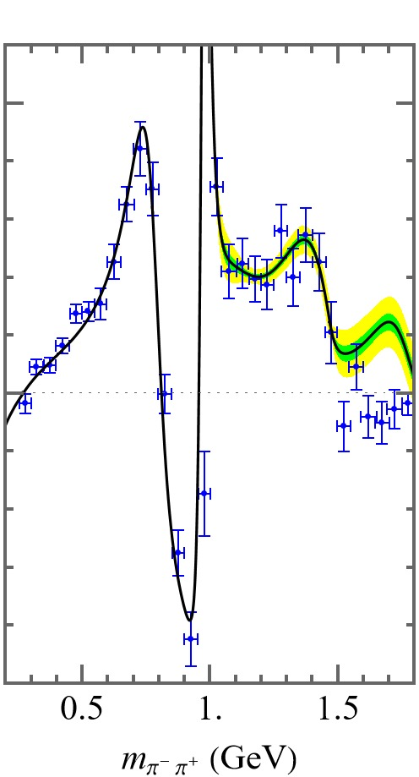
Using the dispersive $ππ→KK$ parameterizations within the same model
$B→Kππ$LHCb full run 1 data
Further improved model: rescattering, source term but crude $ππ→ππ$
Non-resonant
BW resonances for $ρ(770)$ and $f_{0}(980)$
FSI: $ππ→KK$
This is indeed the FSIl implementation by LHCb analyses
With crude estimates
1
2
With dispersive $ππ→KK$
Consistent FSI interactions
Improved accuracy
Clearer resonant stuctures
Before
Our work
Definitely the s-dependence
due to hadron dynamics

Slide 16
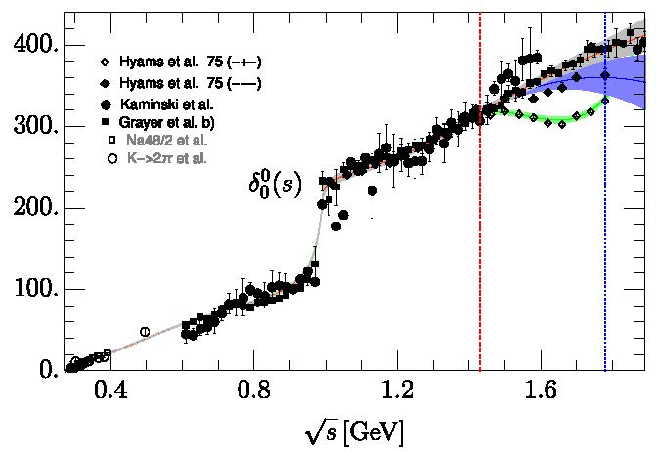
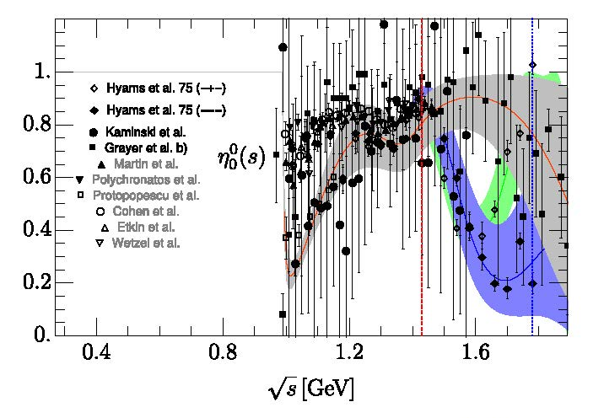
Using the dispersive $ππ→KK$ parameterization
$B→Kππ$LHCb full run 1
We have proposed the simplest improvements to make the model more realistic.
First step:
replace naive $f_{0}(980)$ Breit-Wigner with realistic (dispersive) $ππ→ππ$ S0-wave

Slide 17
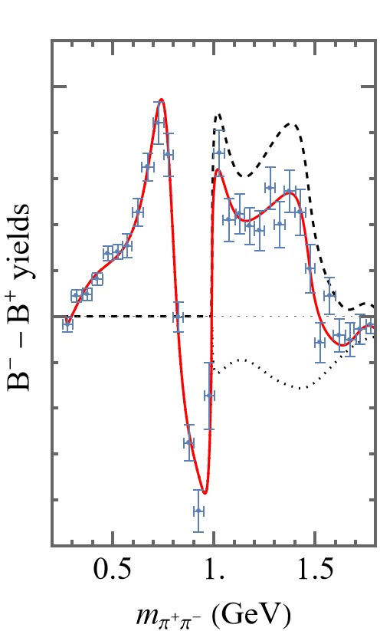
Using the dispersive $ππ→KK$ parameterization
$B→Kππ$LHCb full run 1
We have proposed the simplest improvements to make the model more realistic.
First step:
replace naive $f_{0}(980)$ Breit-Wigner with realistic (dispersive) $ππ→ππ$ S0-wave
With dispersive $ππ→KK$
but Breit-Wigner S-wave
With dispersive $ππ→KK$
and realistic $ππ→ππ,$
$ππ→$ $KK$
$f_{0}(500)/σ$ present
Spurious $f_{0}\left(980\right)$ peak removed
Not bad even beyond 1.5 GeV
rest
Our work
Confirmed!
FSI $ππ→KK$dominates CPV between 1 to 1.5 GeV
Our work

Slide 18
Summary
The claim that $ππ→KK$ FSI provide the strong phase in CPV observables, requires realistic and accurate $ππ→KK$ amplitudes
Very crude estimates where widely used in the literature, particularly by LHCb.
We have shown how to implement them easily in the models used by LHCb CPV analyses of large CPV local asymmetries in charmles $B→3M$ decays.
This leads to a dramatic increase in precision and the unveiling of distinct meson-scale dynamics (resonant shapes) in the giant CPV observations.
The predominant role of final state interactions in giant CPV in the 1-1.5 GeV range is thus established with realistic meson-meson interactions
The new precision paves the way for more rigorous studies of FSI.
The simplest improvements (S-wave $ππ→ππ$) have been implemented.
More elaborated approaches are called for: dispersión relations, 3-body
treatments, chiral approaches, etc…

Slide 19
SPARE SLIDES

Slide 20
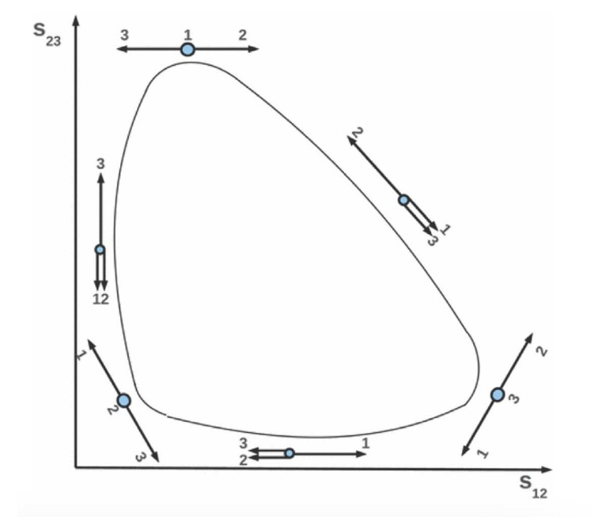
The 1-1.5 GeV region
Bediaga, Frederico,Lourenco,PRD89(2014)094013
Dalitz plot
LHCb run 1 projections
Kππ
KKK
Rescattering ππ→KK
πππ
KKπ
implemented in LHCb amplitude analysis:
PRD101 (2020) 012006; PRL 124 (2020) 031801
PRL 123 (2019) 231802

Slide 21
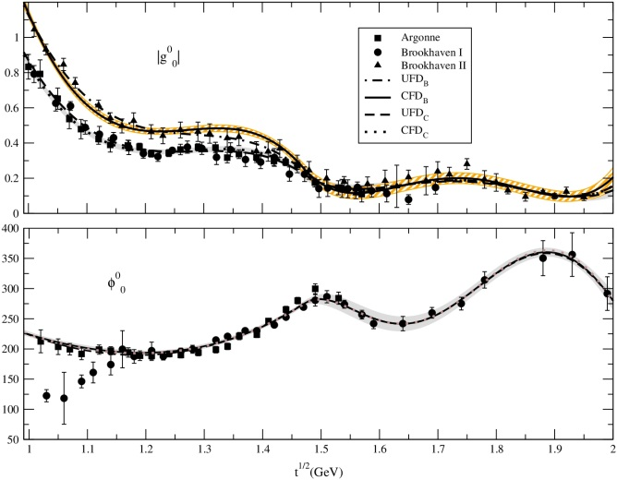
Similarly for ππ→KK Roy Steiner Equations
I=0,J=0, CFD
JRP, A.Rodas, Eur.Phys.J. C78 (2018)
No clear resonance peak in f₀(1370) region
I=0,J=0, Roy-Steiner eqs. Well satisfied up to 1.47 GeV

Slide 22
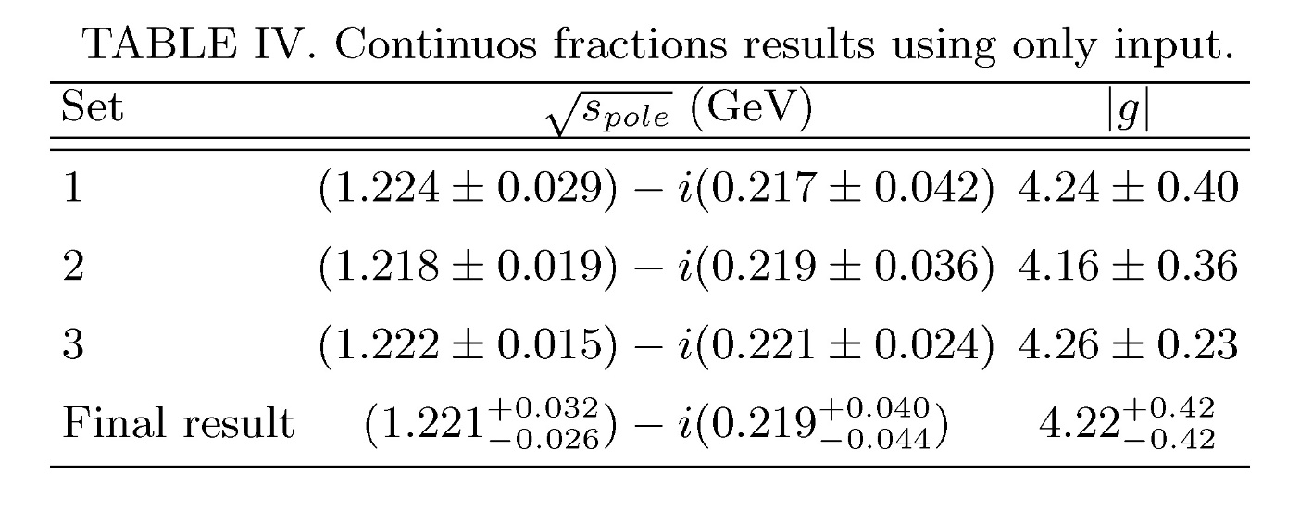
How the f0(1500) influences the result?
few MeV difference in pole
Depending on different data
above 1.4 GeV

Slide 23
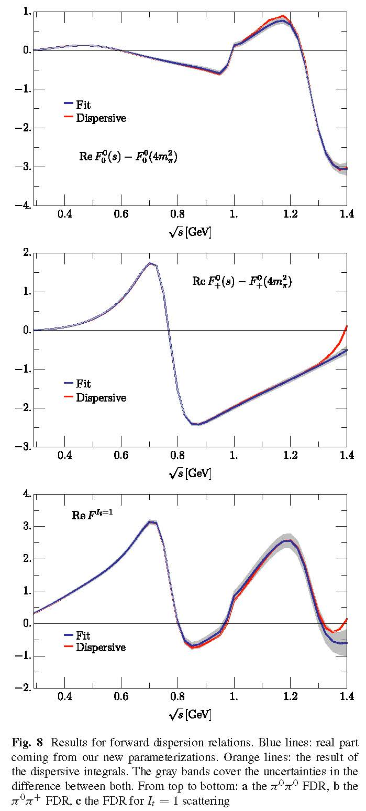
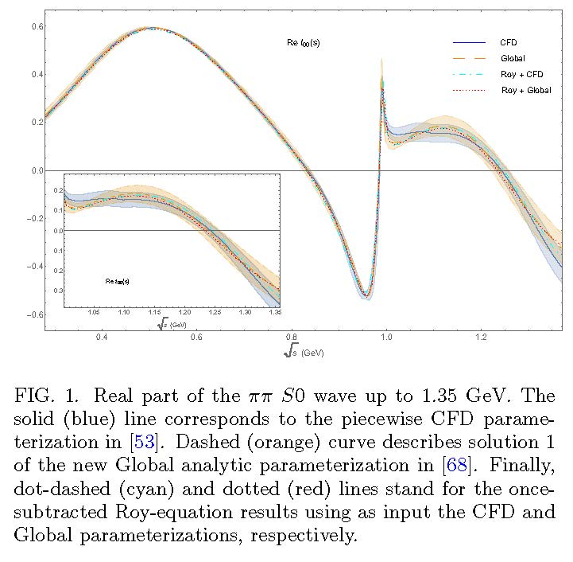
$ππ→ππ$ S0 wave: “Global fit” up to 2 GeV
This “Global fit” is actually slightly better
with respect to Dispersion Relations
We will provide results for both

Slide 24
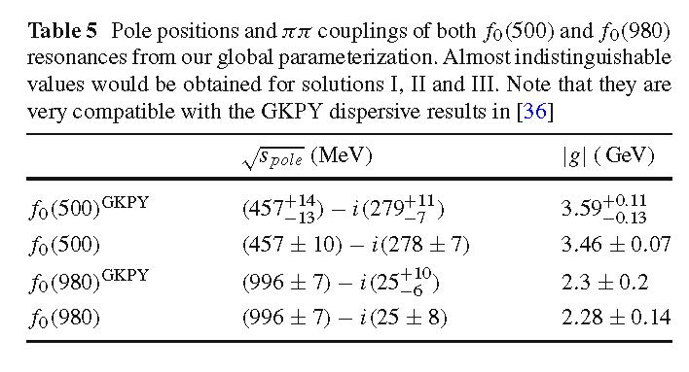
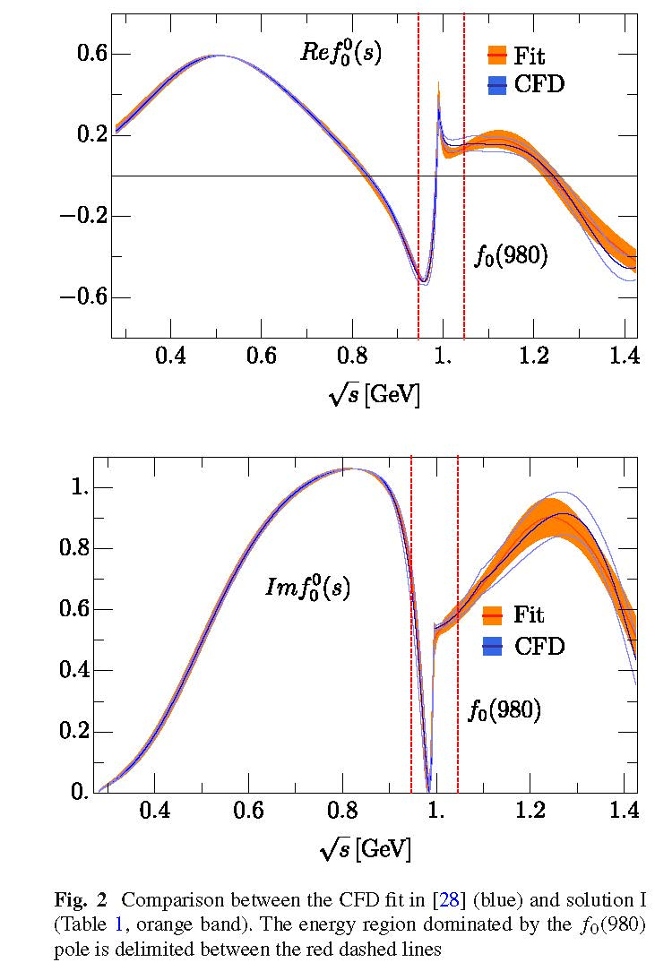

Slide 25
πK→πK and ππ→KK Hyperbolic Dispersion Relations (HDR)
g^{I}_{J} $=$π$\text{π}→KK$ partial waves. We study (I,J)=(0,0),(1,1),(0,2)
f^{I}_{J} $=K\text{π}→K\text{π} \text{partial} \text{waves}\text{. }\text{Taken} \text{from} \text{previous} \text{dispersive} \text{study}$
JRP, A. Rodas PRD 2018
$G_{J,J′}^{I}$(t,t’) =integral kernels, depend on a parameter
Lowest # of subtractions. Odd pw decouple from even pw.
Δ(t) depend on higher waves
or on Kπ→Kπ.
Integrals from
2π threshold !
“Unphysical region”
Solve in descending J order
We have used models for higher waves, but give very small contributions

Slide 26
ππ→KK Hyperbolic Dispersion Relations (HDR)
For unphysical region below KK threshold, we used Omnés function
This is the form of our HDR: Roy-Steiner+Omnés formalism
Dominant source
oferror for f0(1370)
We can now check how well these HDR are satisfied

Slide 27
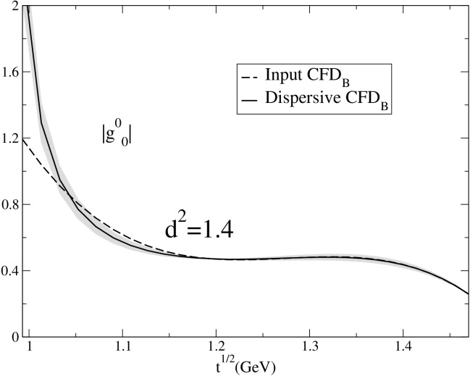
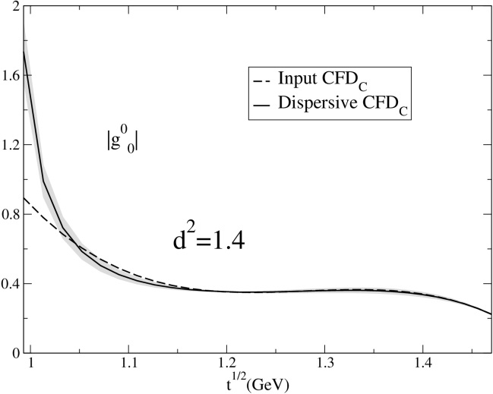
ππ→KK constrained consistent with Roy-Steiner eqs.
JRP, A.Rodas, Eur.Phys.J. C78 (2018)
Two possible solutions for S0 wave
HDR S0-wave
Constrained fits
are consistent with
Roy Steiner Eqs.
HDR S0-wave

