Slide 1
Decays of the fully open flavor state $T_{c\overline{s}0}^{0}$ in a $D^{∗}K^{∗}$ molecule scenario
Reporter: Zi-Li Yue
2023.06.06
HADRON 2023
Based on Zi-Li Yue, Cheng-Jian Xiao and Dian-Yong Chen, Phys.Rev.D 107 (2023) 3, 034018

Slide 2
Outline
Background
Molecular scenario
The Strong Decay of the $T_{c\overline{s}0}^{0}$
Numerical Results and discussions
Summary

Slide 3
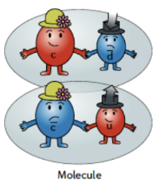
Background
Conventional hadrons
Meson($q\overline{q}$), Baryon($qqq$)
Exotic states
Molecular states: loosely bound states composed of a pair of hadrons, bound by residual interactions of strong interactions.(Candidates: $X\left(3872\right), D_{s1}\left(2460\right), X(3915)$…)
Tetraquarks: $qq\overline{q}\overline{q}$
Pentaquarks: $qqqq\overline{q}$
Hybrids: $q\overline{q}g$
Glueballs: $gg/ggg$ Phys.Lett. 8 (1964) 214-215

Slide 4
Background
Fully open flavor state composed of [$c\overline{s}u\overline{d}$] and [$c\overline{s}\overline{u}d$]
Open questions: $T_{c\overline{s}0}^{0/++}(2900)$inner structure?
Mass:
$$m_{T_{c\overline{s}0}^{0}}=(2892±14±15) MeV$$
$$m_{T_{c\overline{s}0}^{++}}=(2921±17±19) MeV$$
Decay width:
$$Γ_{T_{c\overline{s}0}^{0}}=(119±26±12) MeV$$
$$Γ_{T_{c\overline{s}0}^{++}}=(137±32±1) MeV$$
Quantum number:
$$I\left(J^{P}\right)=1(0^{+})$$
$$T_{c\overline{s}0}^{0}$$
$$T_{c\overline{s}0}^{++}$$
[LHCb], arXiv:2212.02716 [hep-ex] [LHCb], arXiv:2212.02717 [hep-ex].

Slide 5
Background
Theoretical explanations of the $T_{c\overline{s}0}^{0/++}$
Explanations | Approach | Literature
Tetraquark state | QCD sum rule | Phys. Rev. D 95, 114005
 | Constituent quark model | Phys.Rev.D 107 (2023) 9, 096020
 | Muti-quark color flux-tube model | Phys. Rev. D 106, 096023
Threshold effect | The interaction of the $D^{∗}K^{∗}$and$D_{s}^{∗}ρ$ channels | Phys.Rev.D 107 (2023) 5, 056015
 | Triangle singularity (TS) | Eur.Phys.J.C 82 (2022) 10, 955
$D^{∗}K^{∗}$ molecular state | One-boson exchange model | arXiv:2208.10196
 | QCD sum rule | J.Phys.G 50 (2023) 5, 055002
Our research: $D^{∗}K^{∗}$ molecular state; Threshold:$2902.4 (MeV)$

Slide 6
Molecular scenario
Effective Lagrangian:
$$ℒ=g_{T}T_{c\overline{s}0}^{0}\left(x\right)\int{dyΦ\left(y^{2}\right)D^{∗0μ}\left(x+ω_{K^{∗0}}y\right)K_{μ}^{∗0}\left(x−ω_{D^{∗0}}y\right)}$$
the Fourier transformation of the correlation $Φ\left(y^{2}\right)$ is,
$$Φ\left(y^{2}\right)=\int{\frac{d^{4}p}{{\left(2π\right)}^{4}}e^{−ipy}}\tilde{Φ}\left(−p^{2}\right)$$
the choices of the $\tilde{Φ}\left(−p^{2}\right)$ should satisfy the conditions that can describe the interior structure of the molecular state and fall fast enough in the ultraviolet region.
Gaussian form: $\tilde{Φ}\left(p_{E}^{2}\right)=\text{exp}\left(−p_{E}^{2}/Λ_{T}^{2}\right)$

Slide 7
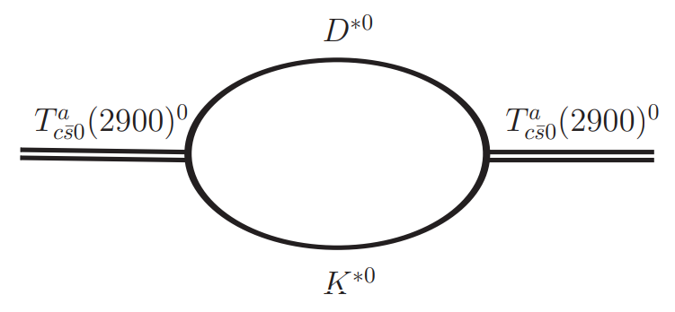
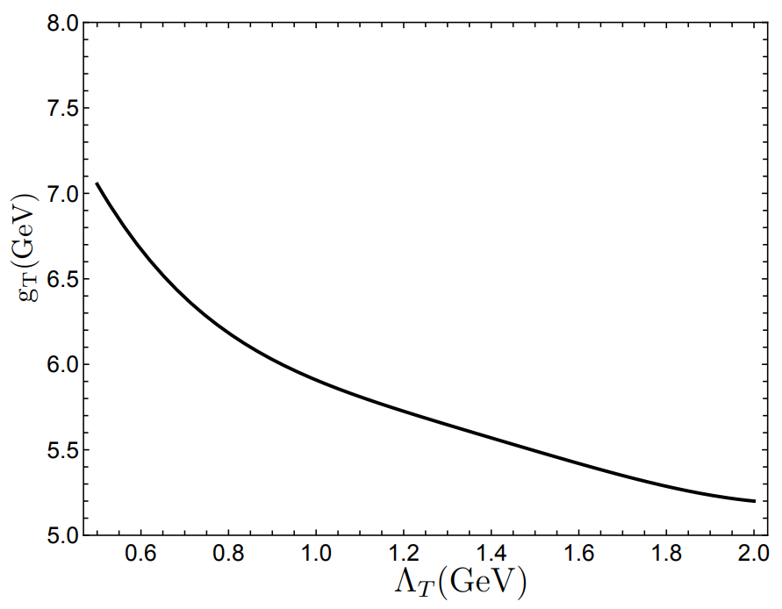
Molecular scenario
Compositeness condition:
$$Z=\left\langle Bare | Phys\right\rangle =0$$
Mass operator:
$$Π\left(m_{T_{c\overline{s}0}^{0}}^{2}\right)=g_{T}^{2}\int{\frac{d^{4}q}{{\left(2π\right)}^{4}}{\tilde{Φ}}^{2}\left[−{\left(q−ω_{D^{∗}}p\right)}^{2},Λ_{T}^{2}\right]}$$
$×\frac{−g^{μν}+q^{μ}q^{ν}/m_{D^{∗}}^{2}}{q^{2}−m_{D^{∗}}^{2}}$
$×$ $\frac{−g^{μν}+{\left(p−q\right)}^{μ}{\left(p−q\right)}^{ν}/m_{K^{∗}}^{2}}{{\left(p−q\right)}^{2}−m_{K^{∗}}^{2}}$
$$Z=1−Π^{′}\left(m_{T_{c\overline{s}0}^{0}}^{2}\right)=0⇒g_{T}$$

Slide 8
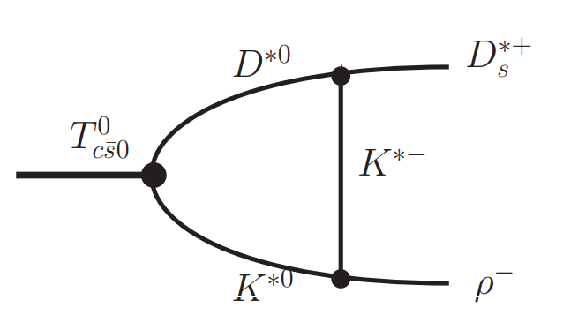
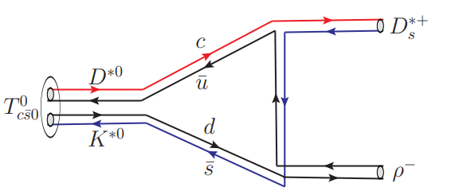
The Strong Decay of the $T_{c\overline{s}0}^{0}$
quark level
hadron level

Slide 9
The Strong Decay of the $T_{c\overline{s}0}^{0}$
The possible decay mode:
$T_{c\overline{s}0}^{0}→(c\overline{s})(\overline{u}d), (c\overline{u})(d\overline{s})$
$J^{P}$ conservation | Decay channel
$$0^{+}→0^{−}{+0}^{−}$$ | $T_{c\overline{s}0}^{0}→D_{s}^{+}π^{−}$/$T_{c\overline{s}0}^{0}→D^{0}K^{0}$
$$0^{+}→1^{−}{+1}^{−}$$ | $$T_{c\overline{s}0}^{0}→D_{s}^{∗+}ρ^{−}$$
$$0^{+}→1^{+}{+0}^{−}$$ | $T_{c\overline{s}0}^{0}→D_{s1}^{+}π^{−}$/$T_{c\overline{s}0}^{0}→D_{s1}^{′+}π^{−}$

Slide 10
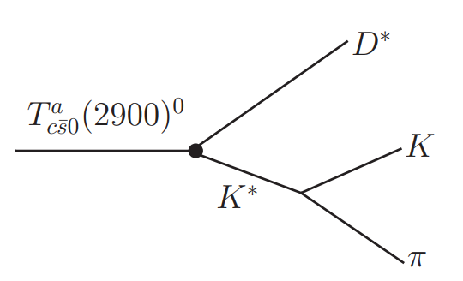
The Strong Decay of the $T_{c\overline{s}0}^{0}$
The possible decay mode:
Three body decay: $T_{c\overline{s}0}^{0}→D^{∗0}{(Kπ)}^{0}$
$K^{∗}$ decay width:$47.3±0.5 MeV$
Decay width:
$$dΓ=\frac{1}{{\left(2π\right)}^{3}}\frac{1}{32M^{3}}\overline{{\left|ℳ\right|}^{2}}dm_{12}^{2}dm_{23}^{2}$$

Slide 11
The Strong Decay of the $T_{c\overline{s}0}^{0}$
Effective Lagrangian
heavy quark limit and chiral symmetry:
$$ℒ_{𝒟^{∗}𝒟𝒫}=ig_{𝒟^{∗}𝒟𝒫}\left(𝒟^{∗μ}∂_{μ}𝒫\overline{𝒟}−𝒟∂_{μ}𝒫{\overline{D}}^{∗μ}\right)$$
$$ℒ_{𝒟^{∗}𝒟^{∗}𝒫}=\frac{1}{2}g_{𝒟^{∗}𝒟^{∗}𝒫ε_{μναβ}}𝒟_{i}^{∗μ}∂^{ν}𝒫^{ij}{\overset{⃡}{∂}}^{α}𝒟_{j}^{∗β† }$$
$SU(3)$ symmetry:
$$ℒ_{𝒦^{∗}𝒦𝒫}=−ig_{K^{∗}KP}\left(\overline{K}∂^{μ}P−∂^{μ}\overline{K}P\right)K_{μ}^{∗}$$
$$ℒ_{𝒦^{∗}𝒦^{∗}𝒫}=−g_{K^{∗}K^{∗}P}ε^{μναβ}∂_{α}{\overline{K}}_{β}^{∗}P∂_{μ}K_{ν}^{∗}$$
More detail see :
Zi-Li Yue, Cheng-Jian Xiao and Dian-Yong Chen, Phys.Rev.D 107 (2023) 3, 03401

Slide 12
The Strong Decay of the $T_{c\overline{s}0}^{0}$
Loop Integral:
$$C_{0}=\int{\frac{d^{4}q}{{(2π)}^{4}}}\tilde{Φ}\frac{1}{\left[p_{1}^{2}−m_{1}^{2}\right]\left[p_{2}^{2}−m_{2}^{3}\right][q^{2}−m_{q}^{2}] }$$
Schwinger parametrization: $$\frac{1}{m^{2}−k^{2}}=\int_{0}^{∞}{dαe^{−α(m^{2}−k^{2})}}$$
Decay width:
$$Γ_{T_{c\overline{s}0}^{0}→…}=\frac{1}{8π}\frac{\left|\vec{p}\right|}{m_{T_{c\overline{s}0}^{0}}^{2}}{\left|{\overline{ℳ}}_{T_{𝒸\overline{s}0}^{0}→…} \right|}^{2}$$

Slide 13
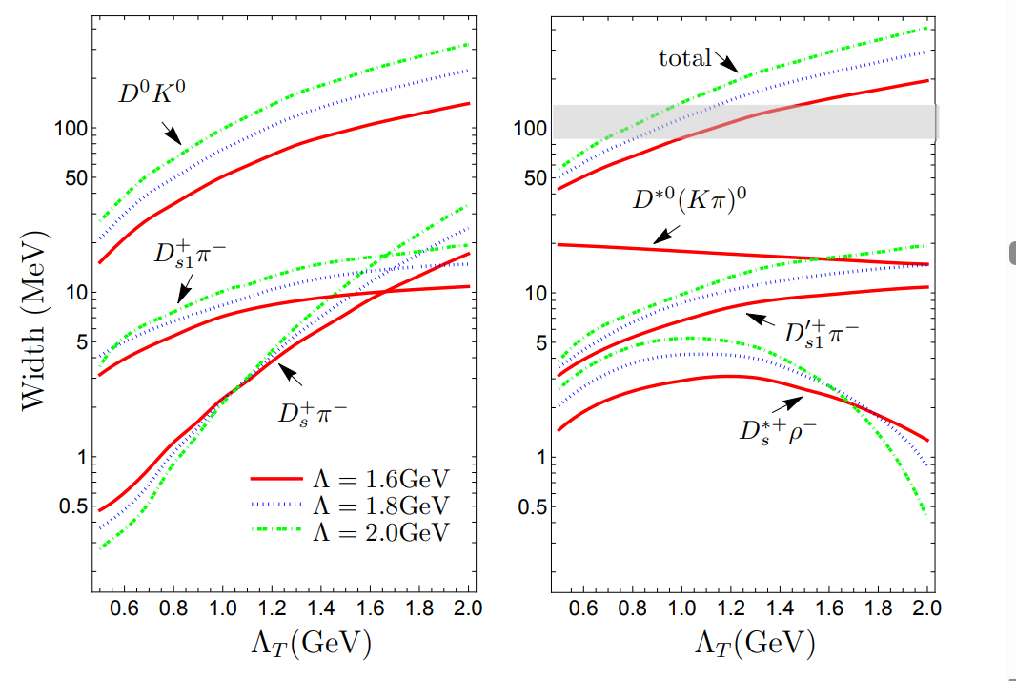
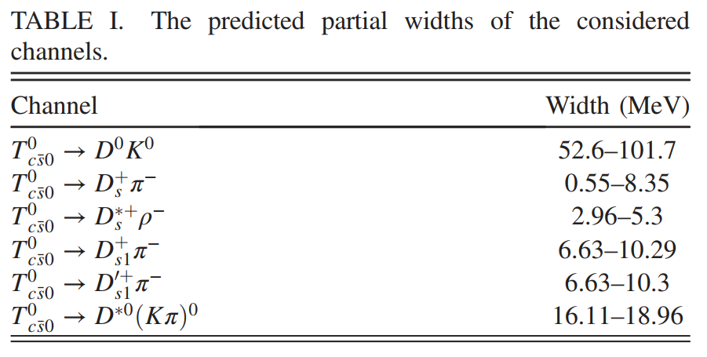
Numerical Results and discussions
$\tilde{Φ}\left(p_{E}^{2}\right)=\text{exp}\left(−p_{E}^{2}/Λ_{T}^{2}\right)$ $ℱ^{2}\left(m_{q},Λ\right)={\left(\frac{m_{q}^{2}−Λ^{2}}{q^{2}−Λ^{2}}\right)}^{2}$
Zi-Li Yue, Cheng-Jian Xiao and Dian-Yong Chen, Phys.Rev.D 107 (2023) 3, 03401

Slide 14
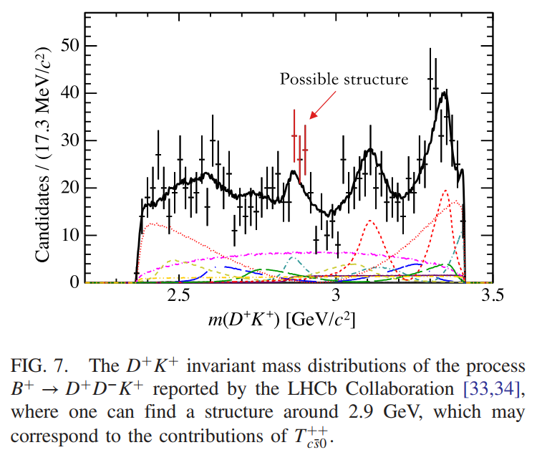
Summary
The present work investigate the decay behavior of $T_{c\overline{s}0}^{0}$ in the $D^{∗}K^{∗}$ molecular scenario by using an effective Lagrangian approach.
Our estimations indicate that the observed channel $T_{c\overline{s}0}^{0}→D_{s}^{+}π^{−}$ is sizable enough to be observed.
The calculation indicate that $T_{c\overline{s}0}^{0}$ dominantly decays into $D^{0}K^{0}.$

Slide 15
Thank you for your attention!

