Slide 1

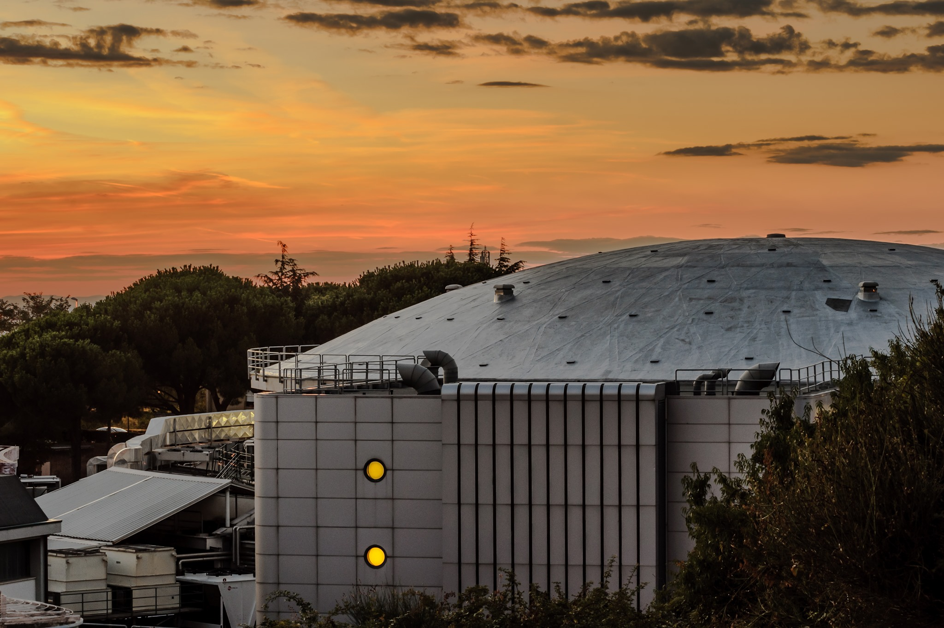

Genova 5 – 9 June 2023
High precision kaonic atoms X-ray spectroscopy with the SIDDHARTA-2 experiment at the DAFNE collider
Francesco Sgaramella
on behalf of the SIDDHARTA-2 Collaboration

Slide 2






SIDDHARTA-2 Collaboration
Silicon Drift Detectors for Hadronic Atom Research by Timing Application
LNF-INFN, Frascati, Italy
SMI-ÖAW, Vienna, Austria
Politecnico di Milano, Italy
IFIN –HH, Bucharest, Romania
TUM, Munich, Germany
RIKEN, Japan
Univ. Tokyo, Japan
Victoria Univ., Canada
Univ. Zagreb, Croatia
Univ. Jagiellonian Krakow, Poland
ELPH, Tohoku University
Francesco Sgaramella
High precision kaonic atoms X-ray spectroscopy with the SIDDHARTA-2 experiment at the DAFNE collider

Slide 3
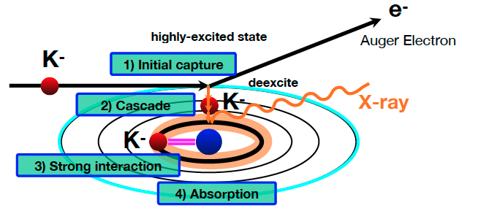
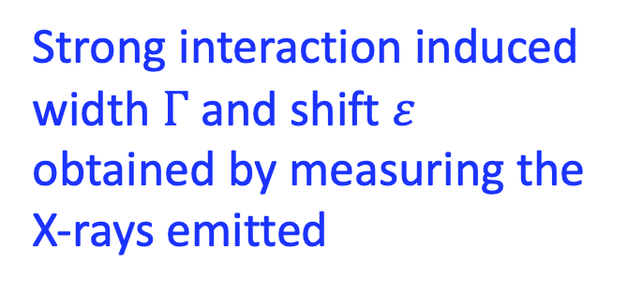
Kaonic Atom
Strong interaction induced
width $Γ$ and shift $ε$ obtained by measuring the X-rays emitted
Catalina Curceanu (A. Scordo)
3
Francesco Sgaramella
A new renaissance for kaonic atoms at DAΦNE: future measurements and perspectives
High precision kaonic atoms X-ray spectroscopy with the SIDDHARTA-2 experiment at the DAFNE collider

Slide 4
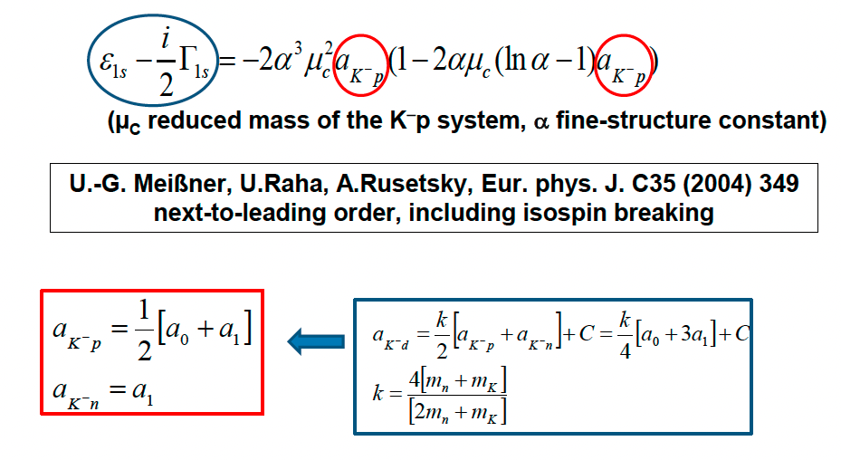
Scientific Goal
To perform the first measurement ever of kaonic deuterium X-ray transition to the ground state (1s-level) such as to determine its shift and width induced by the presence of the strong interaction.
Analysis of the combined measurements of kaonic deuterium and kaonic hydrogen
Experimental determination of the isospin-dependent
K-N scattering length
Francesco Sgaramella
High precision kaonic atoms X-ray spectroscopy with the SIDDHARTA-2 experiment at the DAFNE collider

Slide 5
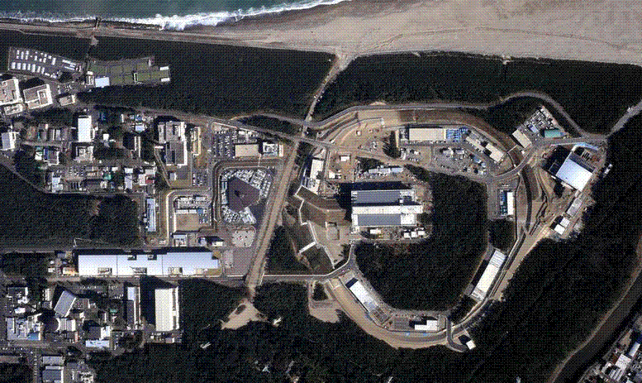
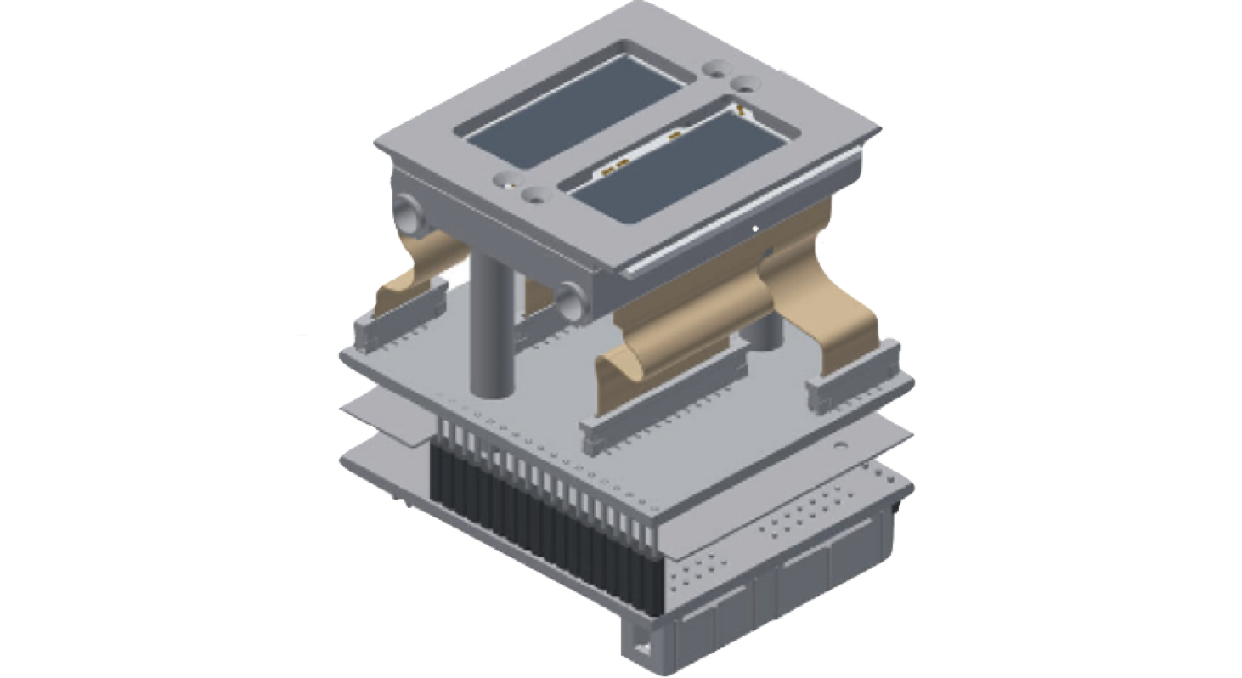
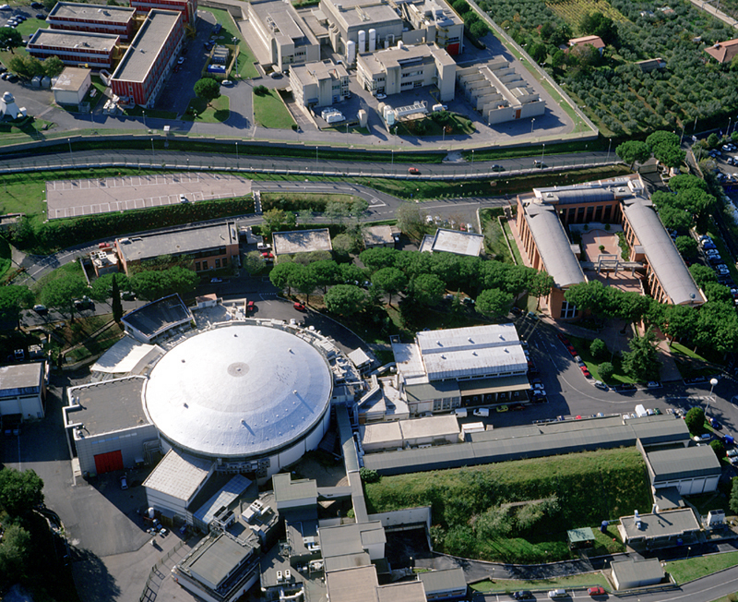
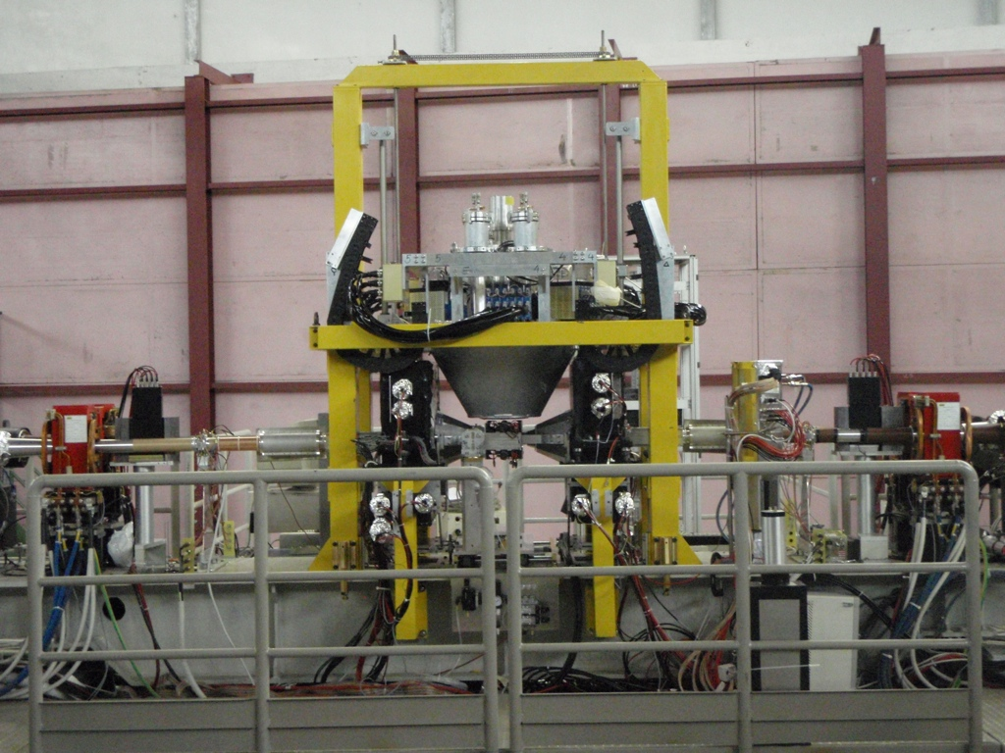
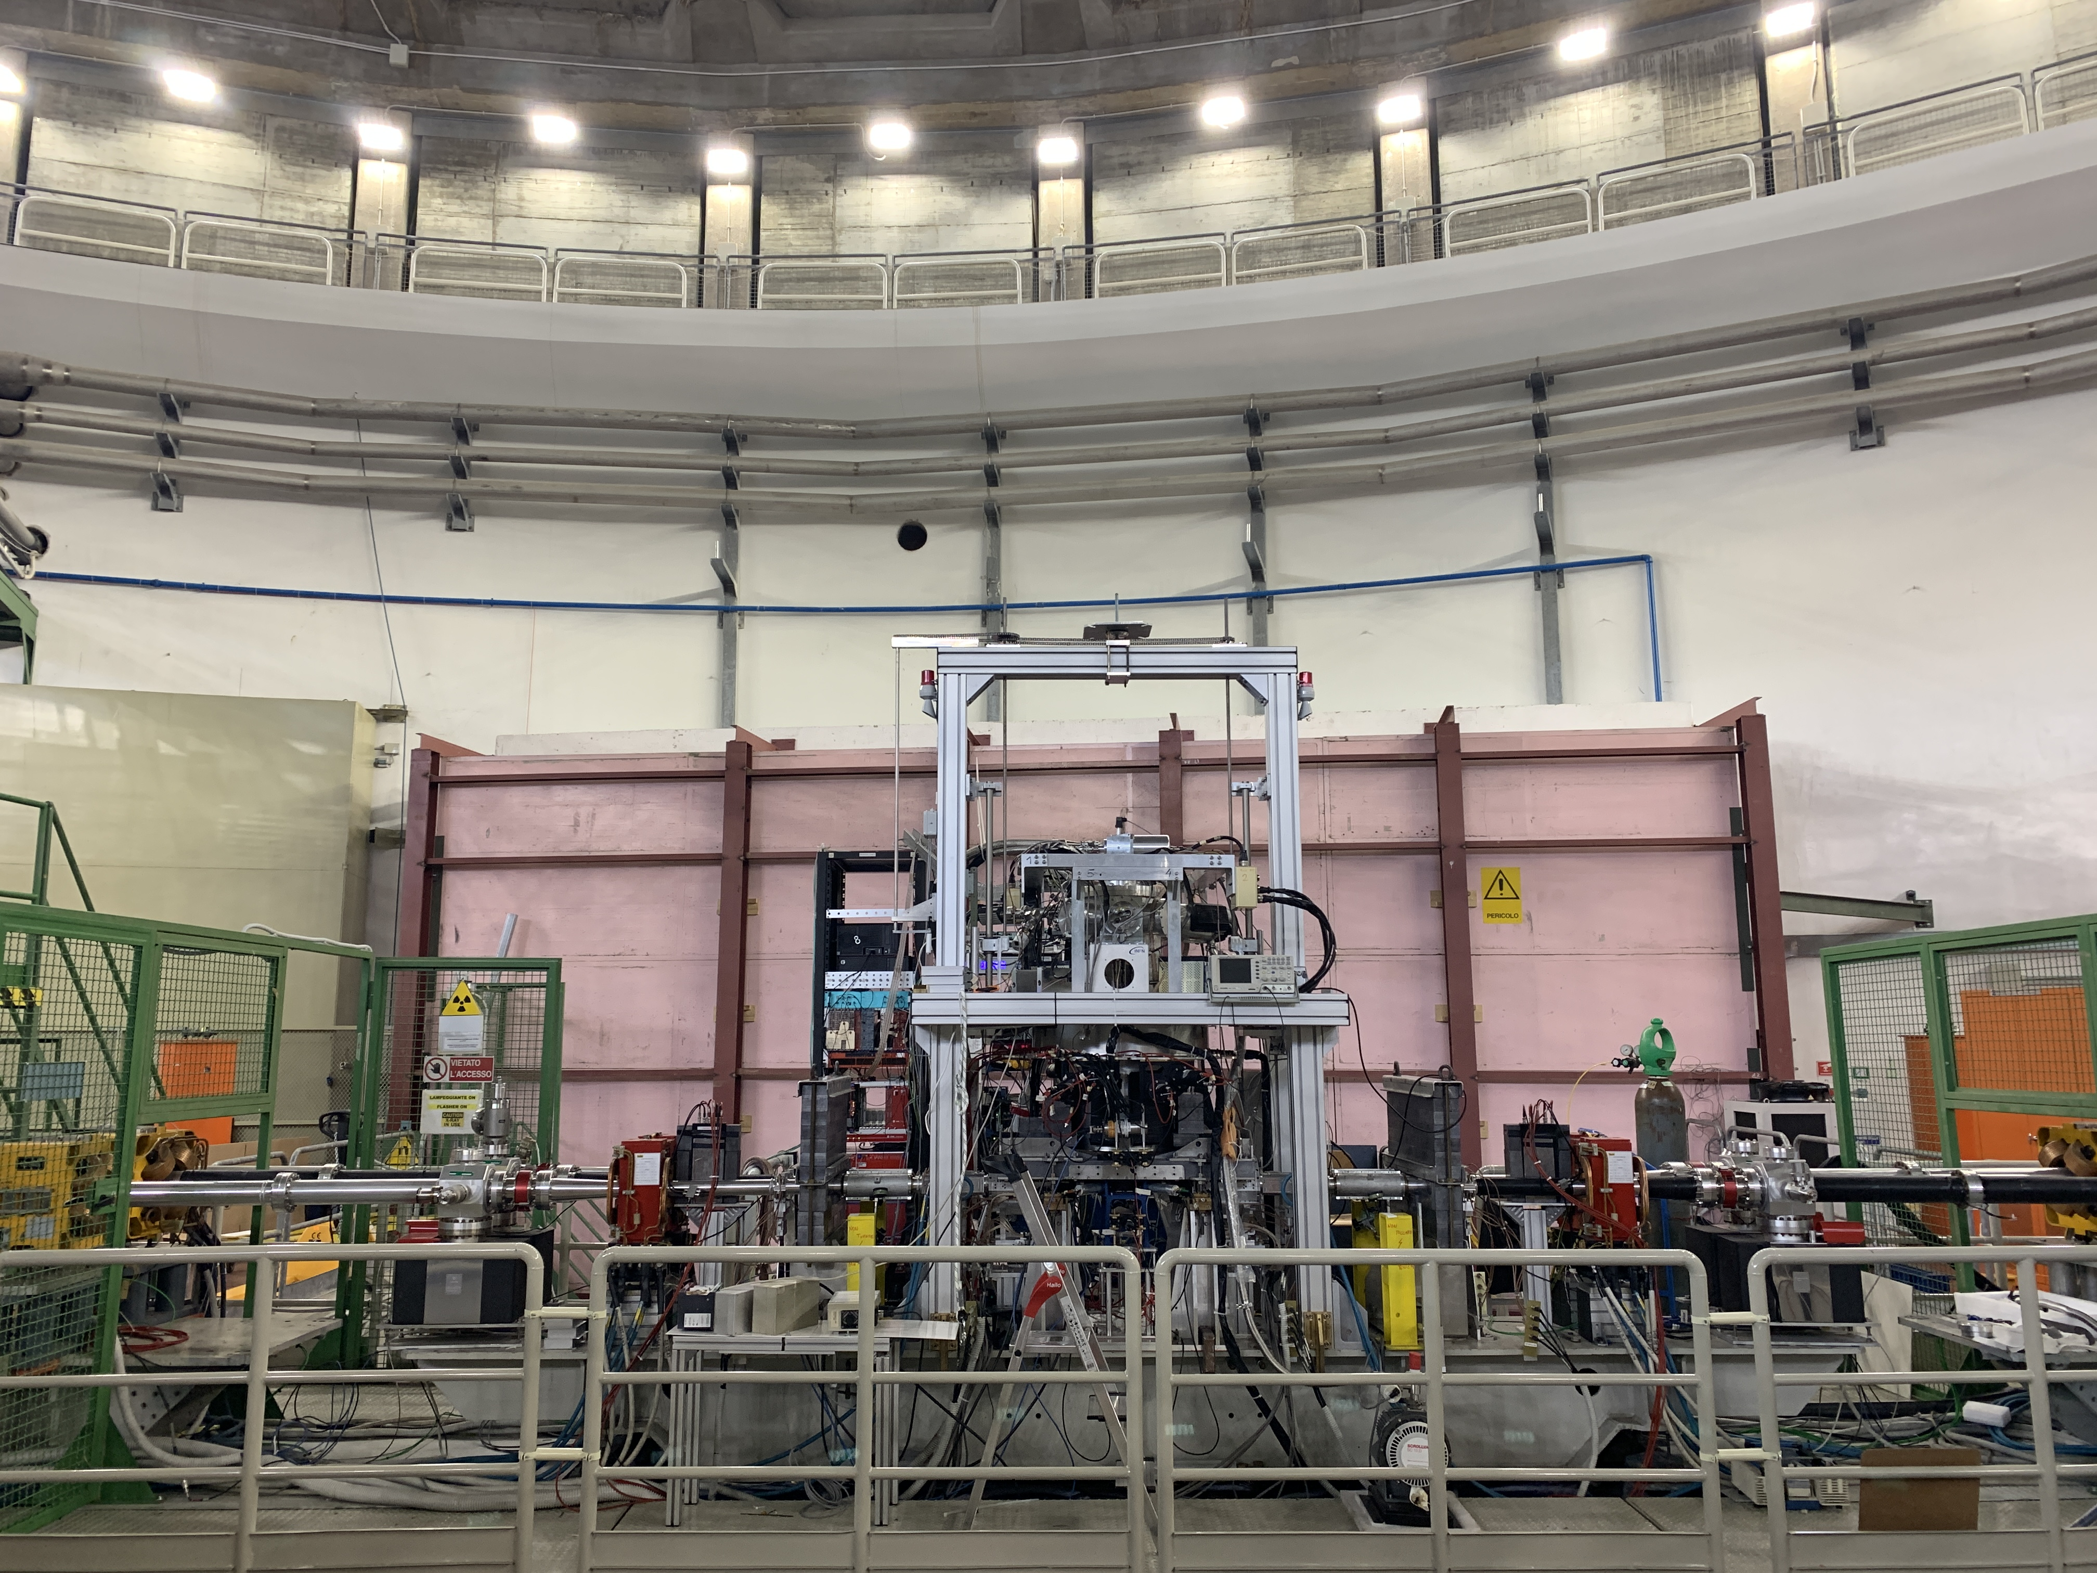
J-PARC
The modern era of light kaonic atom experiments
Catalina Curceanu, Carlo Guaraldo, Mihail Iliescu, Michael Cargnelli, Ryugo Hayano, Johann Marton, Johann Zmeskal, Tomoichi Ishiwatari, Masa Iwasaki, Shinji Okada, Diana Laura Sirghi, and Hideyuki Tatsuno
Rev. Mod. Phys. 91, 025006 – Published 20 June 2019
DAFNE
DEAR
2002
SIDDHARTA
2009
SIDDHARTA-2 2022
Francesco Sgaramella
High precision kaonic atoms X-ray spectroscopy with the SIDDHARTA-2 experiment at the DAFNE collider

Slide 6



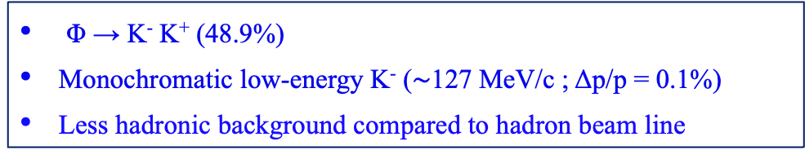


LNF – $e^{+}e^{−}$ Accelerator Complex
Φ → K⁻ K⁺ (48.9%)
Monochromatic low-energy K⁻ ($\sim$127 MeV/c ; Δp/p = 0.1%)
Less hadronic background compared to hadron beam line
Suitable for low-energy kaon physics:
kaonic atoms
Kaon-nucleons/nuclei interaction studies
DA$Φ$NE
LINAC
$$e^{+}$$
$$Φ$$
$$e^{−}$$
DAMPING RING
Francesco Sgaramella
High precision kaonic atoms X-ray spectroscopy with the SIDDHARTA-2 experiment at the DAFNE collider

Slide 7
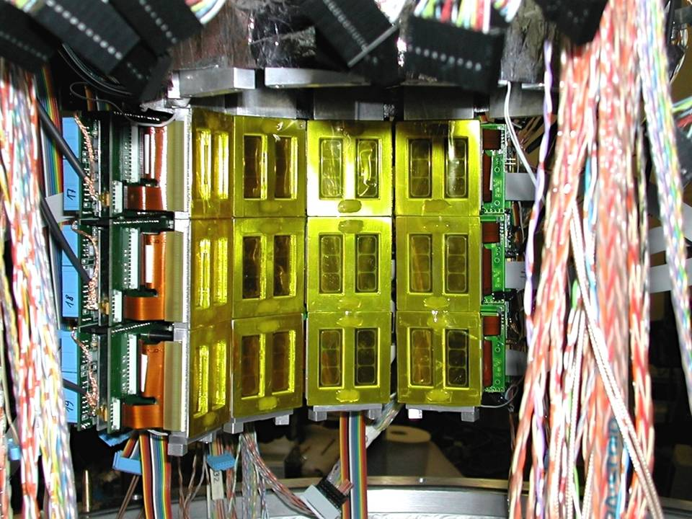

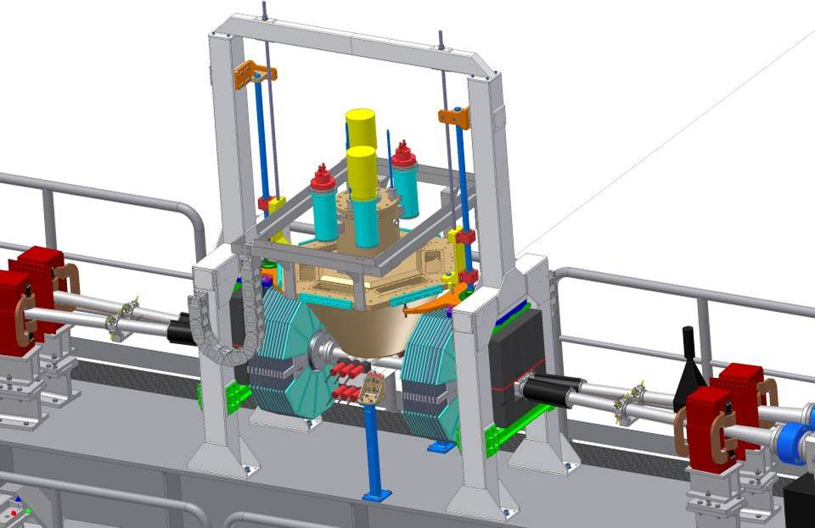

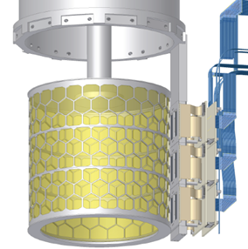

The SIDDHARTA
Experiment (2009)
Target
Detect
by SDDs
1 cm² x 144 SDDs
X-ray
K⁻
Detect by two scintillators
e⁻
Φ
510 MeV/c
e⁺
127 MeV/c
Δp/p=0.1%
y
K⁺
510 MeV/c
x
z
Francesco Sgaramella
High precision kaonic atoms X-ray spectroscopy with the SIDDHARTA-2 experiment at the DAFNE collider

Slide 8
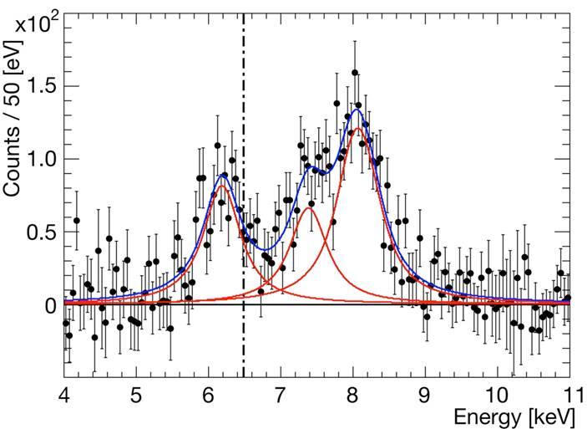
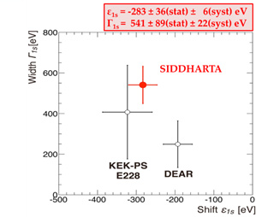
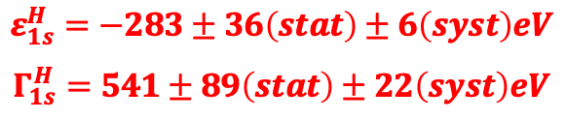
The SIDDHARTA
Experiment (2009)
Kaonic hydrogen
higher
Kα
Kβ
$$ε_{1s}^{H}=−283±36\left(stat\right)±6\left(syst\right)eV$$
$$Γ_{1s}^{H}=541±89\left(stat\right)±22\left(syst\right)eV$$
EM value
K-p Kα
C. Curceanu et al., Phys. Lett. B 704 (2011) 113
Francesco Sgaramella
High precision kaonic atoms X-ray spectroscopy with the SIDDHARTA-2 experiment at the DAFNE collider

Slide 9
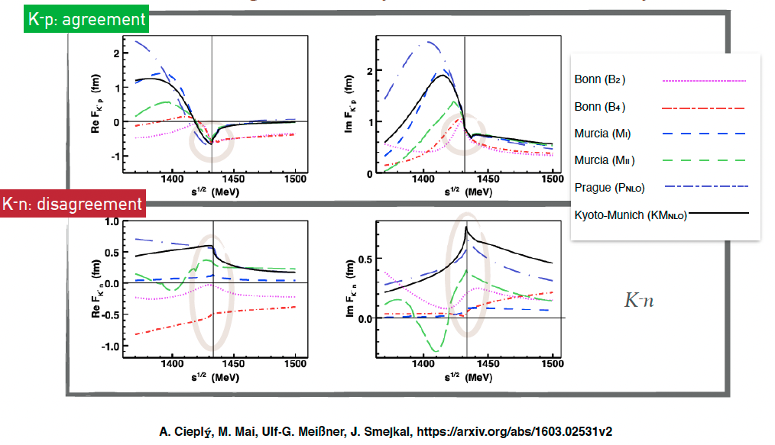
Kaon nucleon
scattering amplitude
Francesco Sgaramella
High precision kaonic atoms X-ray spectroscopy with the SIDDHARTA-2 experiment at the DAFNE collider

Slide 10
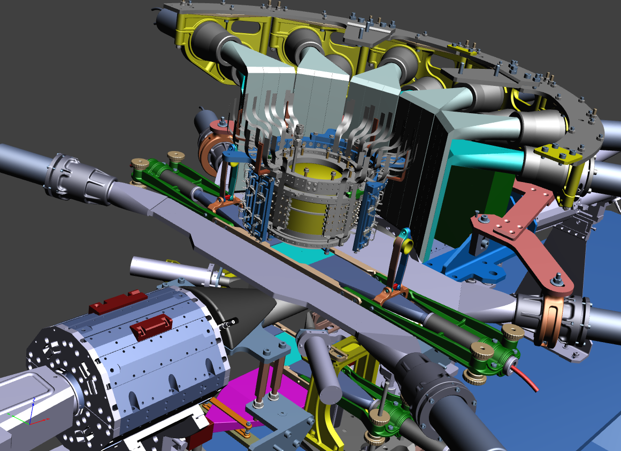
The SIDDHARTA-2 apparatus
Veto-1
Veto-2
Target
384 SDDs
Kaon Trigger
Veto-3
Francesco Sgaramella
High precision kaonic atoms X-ray spectroscopy with the SIDDHARTA-2 experiment at the DAFNE collider

Slide 11



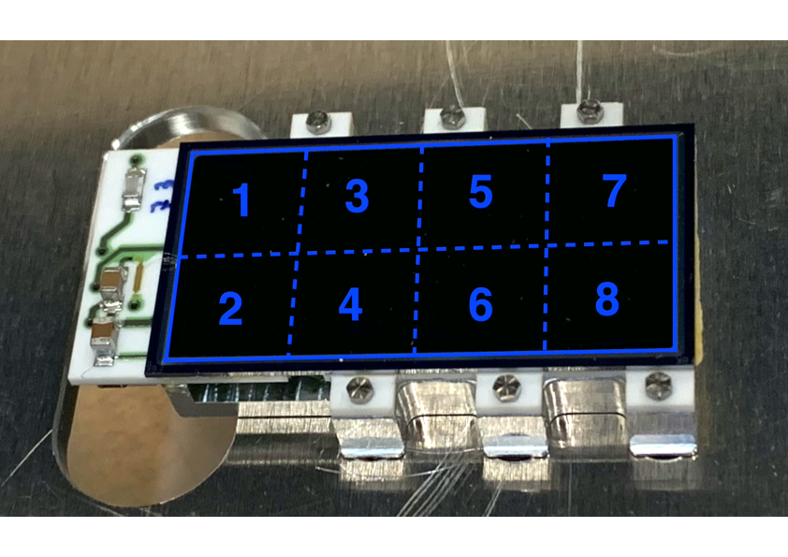
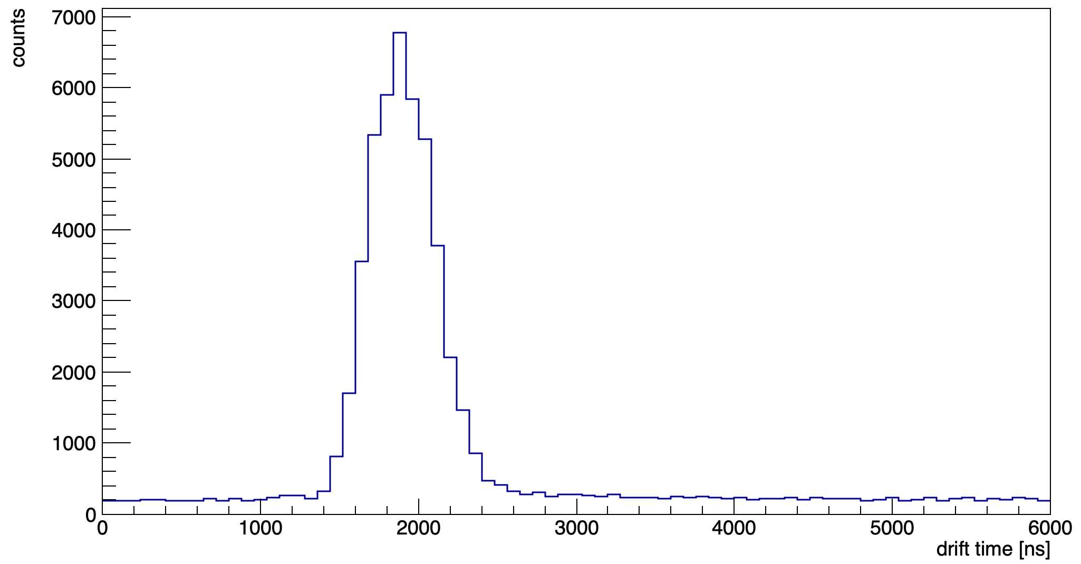
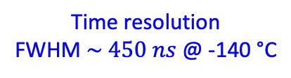
Silicon Drift Detectors
Time resolution
FWHM $\sim 450 ns$ @ -140 °C
48 arrays with 8 SDD units (0.64 cm²)
for a total active area of 246 cm²
The thickness of 450 μm ensures a high collection efficiency for X-rays of energy between 5 keV and 12 keV
M Miliucci et al 2021 Meas. Sci. Technol. 32 095501
F Sgaramella et al 2022 Phys. Scr. 97 114002
Francesco Sgaramella
High precision kaonic atoms X-ray spectroscopy with the SIDDHARTA-2 experiment at the DAFNE collider

Slide 12
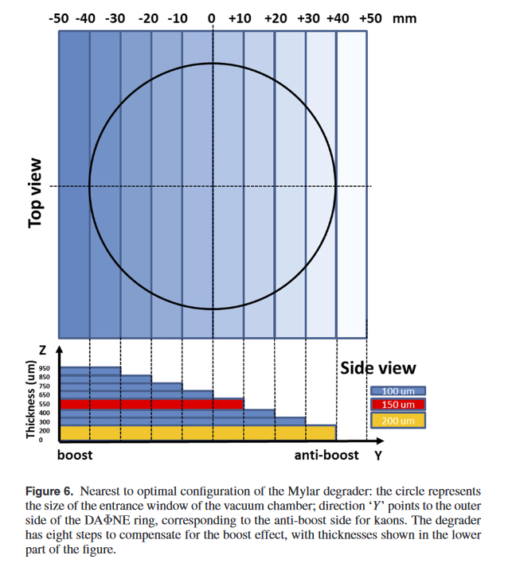
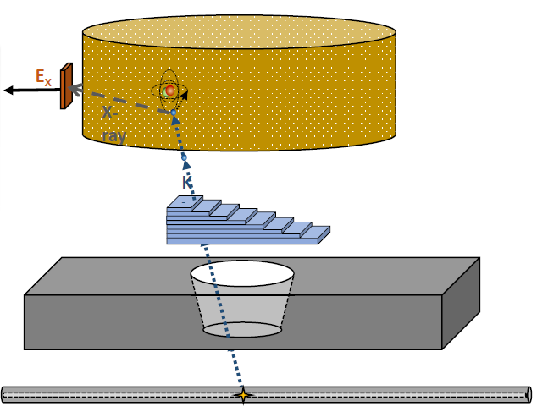
SIDDHARTINO (2021)
The degrader optimization
Degrader optimization: sensitivity to 100 microns over all material budget (about 4 mm materials of various densities)! – a very delicate and fundamental operation (knowledge of material budget at 2.5 % level)
Francesco Sgaramella
High precision kaonic atoms X-ray spectroscopy with the SIDDHARTA-2 experiment at the DAFNE collider

Slide 13
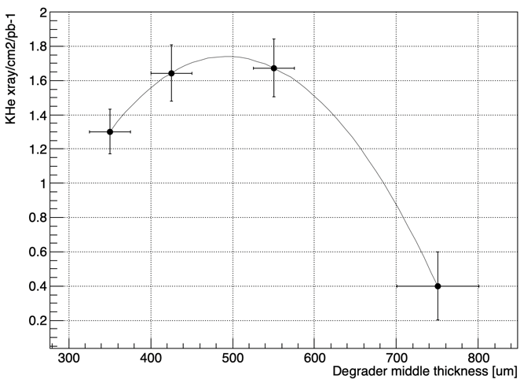
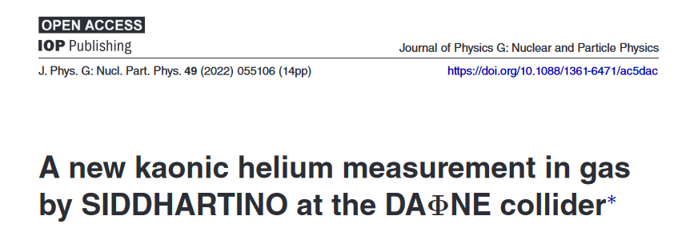





SIDDHARTINO
The kaonic ⁴He 3d->2p ($L_{α}$) measurement
Deg-2 $425 μm$
Deg-1 $550 μm$
Deg-3 $350 μm$
Deg-4 $750 μm$
Francesco Sgaramella
High precision kaonic atoms X-ray spectroscopy with the SIDDHARTA-2 experiment at the DAFNE collider

Slide 14
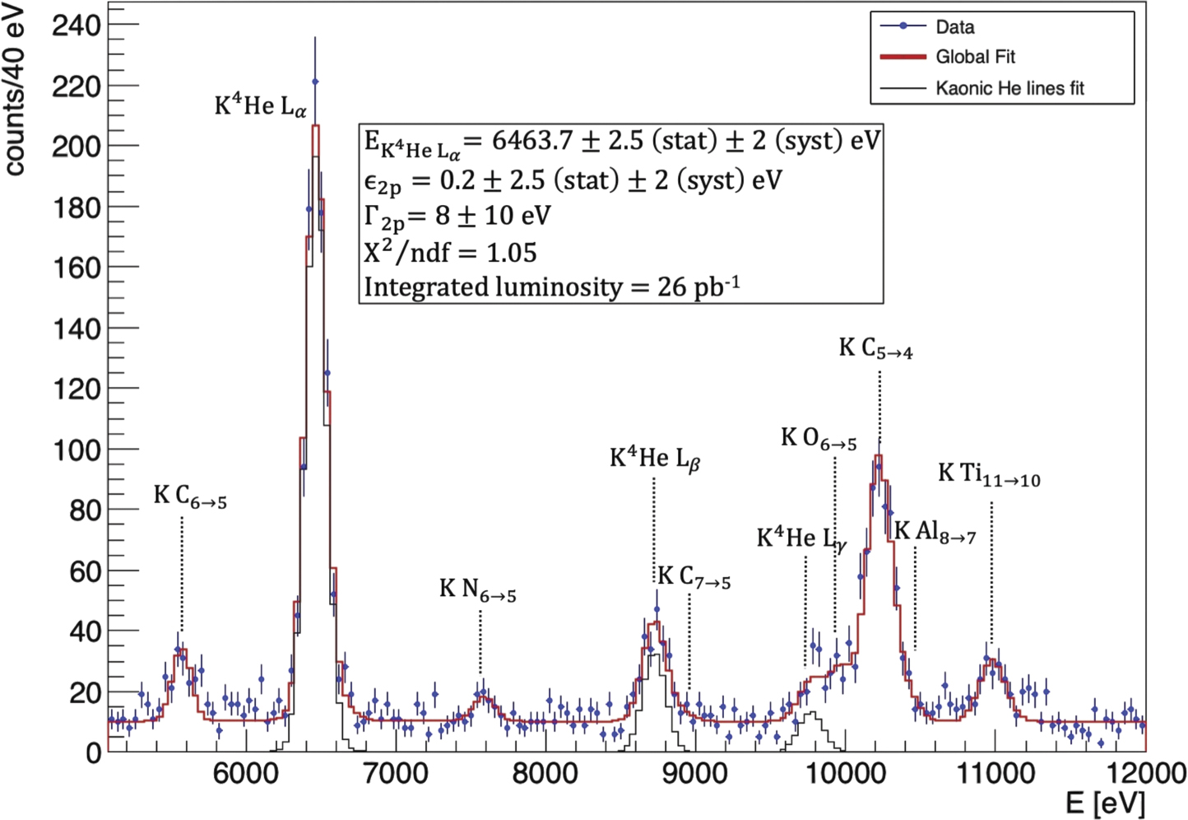
SIDDHARTINO
The kaonic ⁴He 3d->2p ($L_{α}$) measurement
K-⁴He 3d->2p shift and width:
the most precise measurement in gas!
D Sirghi et al 2022 J. Phys. G: Nucl. Part. Phys. 49 055106
Francesco Sgaramella
High precision kaonic atoms X-ray spectroscopy with the SIDDHARTA-2 experiment at the DAFNE collider

Slide 15
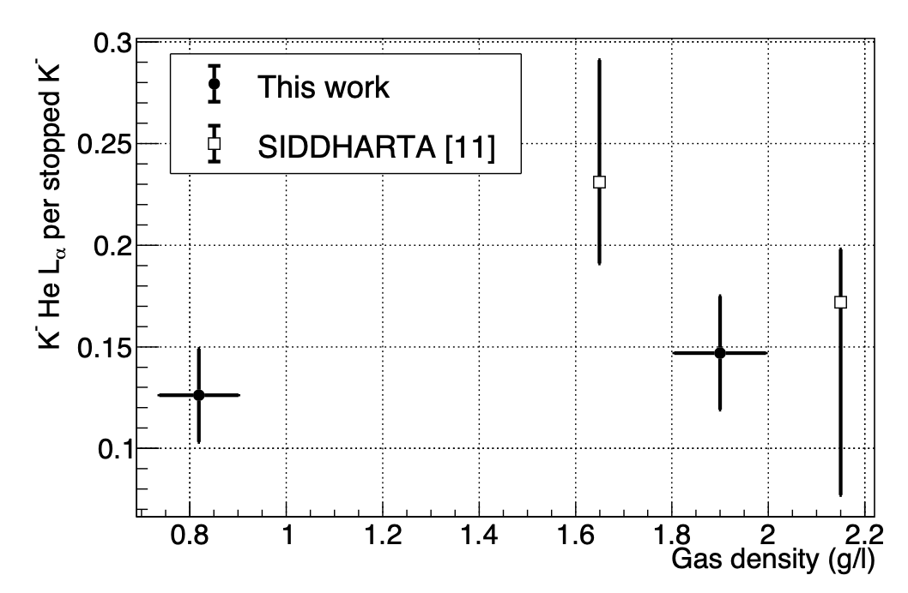
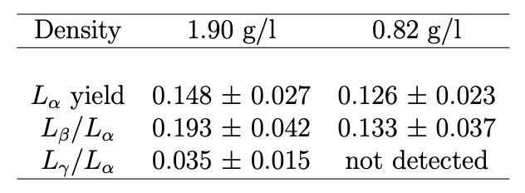
K-⁴He low density run: 0.75% liquid helium density -> yields at lowest measured density
SIDDHARTINO
The kaonic ⁴He yield measurement
D.L. Sirghi, et al. Nuclear Physics A 1029 (2023) 122567
Francesco Sgaramella
High precision kaonic atoms X-ray spectroscopy with the SIDDHARTA-2 experiment at the DAFNE collider

Slide 16
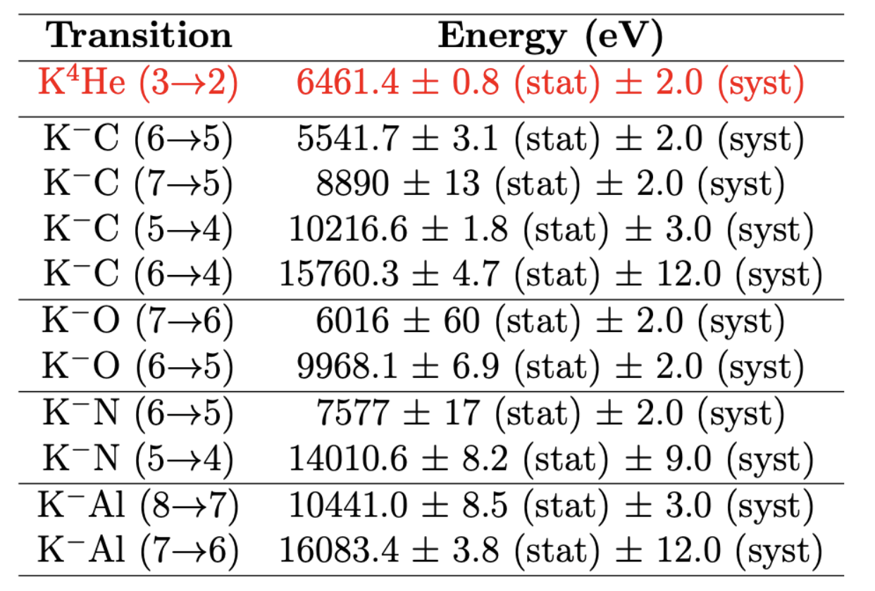
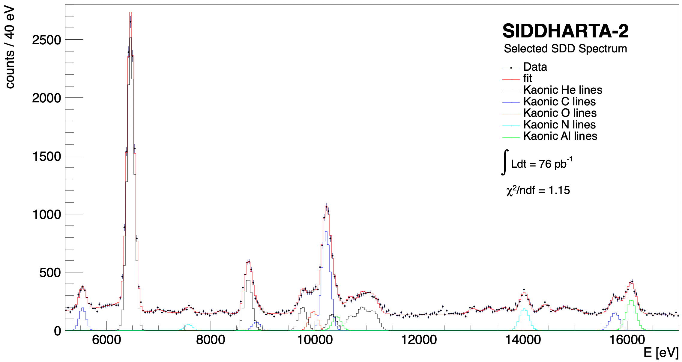
Measurements of high-n transitions in intermediate mass
kaonic atoms
SIDDHARTA-2
(2022)
K⁴He 3->2
KAl 8->7
KO 6->5
K⁴He 5->2
KC 5->4
KC 7->5
KO 7->6
K⁴He 4->2
KAl 7->6
KC 6->5
K⁴He L-high
KN 5->4
KC 6->4
KN 6->5
Sgaramella, F., al. Eur. Phys. J. A 59, 56 (2023)
Francesco Sgaramella
High precision kaonic atoms X-ray spectroscopy with the SIDDHARTA-2 experiment at the DAFNE collider

Slide 17
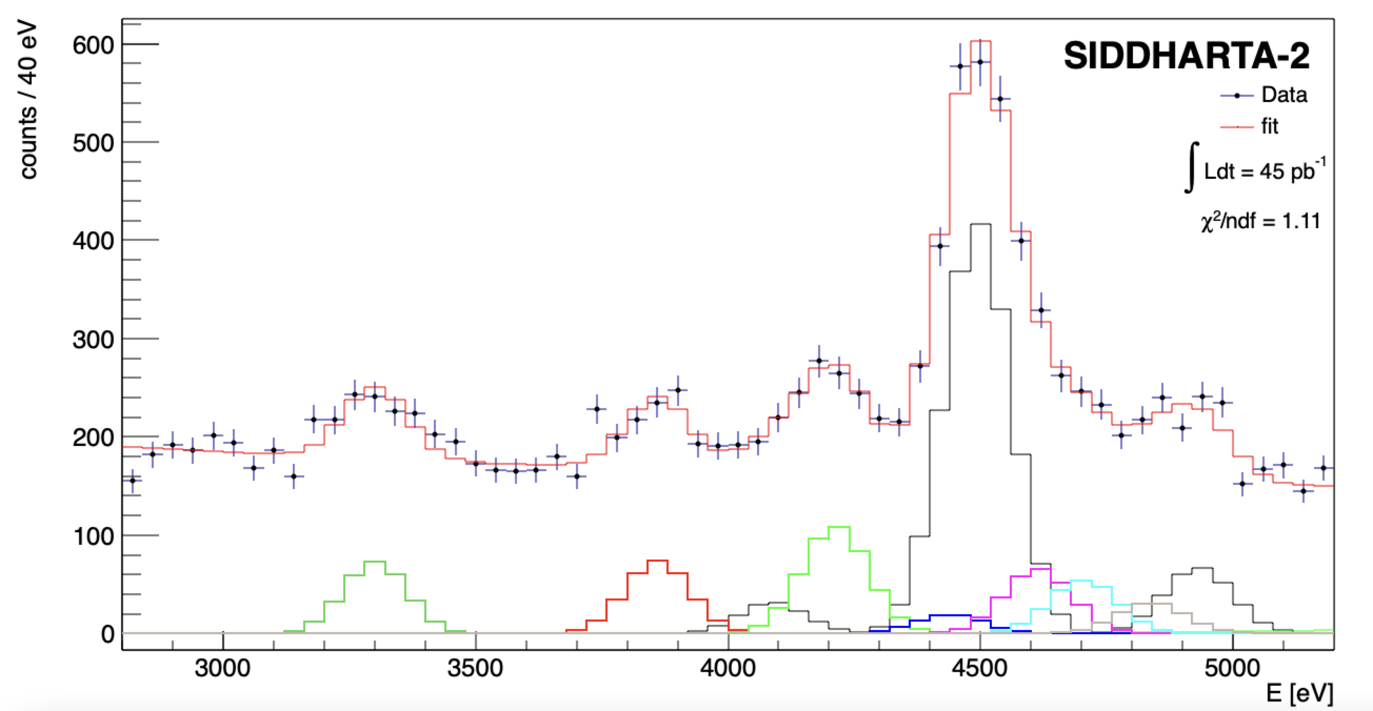
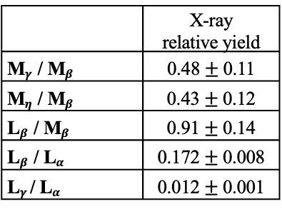





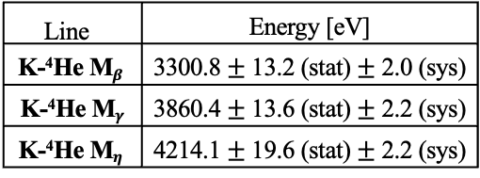
SIDDHARTA-2
Kaonic ⁴He – M-type transitions
Line | Energy [eV]
K-⁴He M$β$ | 3300.8 $±$ 13.2 (stat) $±$ 2.0 (sys)
K-⁴He M$γ$ | 3860.4 $±$ 13.6 (stat) $±$ 2.2 (sys)
K-⁴He M$η$ | 4214.1 $±$ 19.6 (stat) $±$ 2.2 (sys)
KHe 6->3
(M$γ$)
KHe 7->3
(M$η$)
KHe 8->3
4435.4 eV
KHe 9->3
4587.3 eV
KHe 11->3
4696.6 eV
 | X-ray relative yield
M$γ$/ M$β$ | 0.48 $±$ 0.11
M$η$/ M$β$ | 0.43 $±$ 0.12
L$β$/ M$β$ | 0.91 $±$ 0.14
L$β$/ L$α$ | 0.172 $±$ 0.008
L$γ$/ L$α$ | 0.012 $±$ 0.001
KHe 10->3
4696.6 eV
Ti K$α$
KHe 5->3
(M$β$)
Ti K$β$

Slide 18
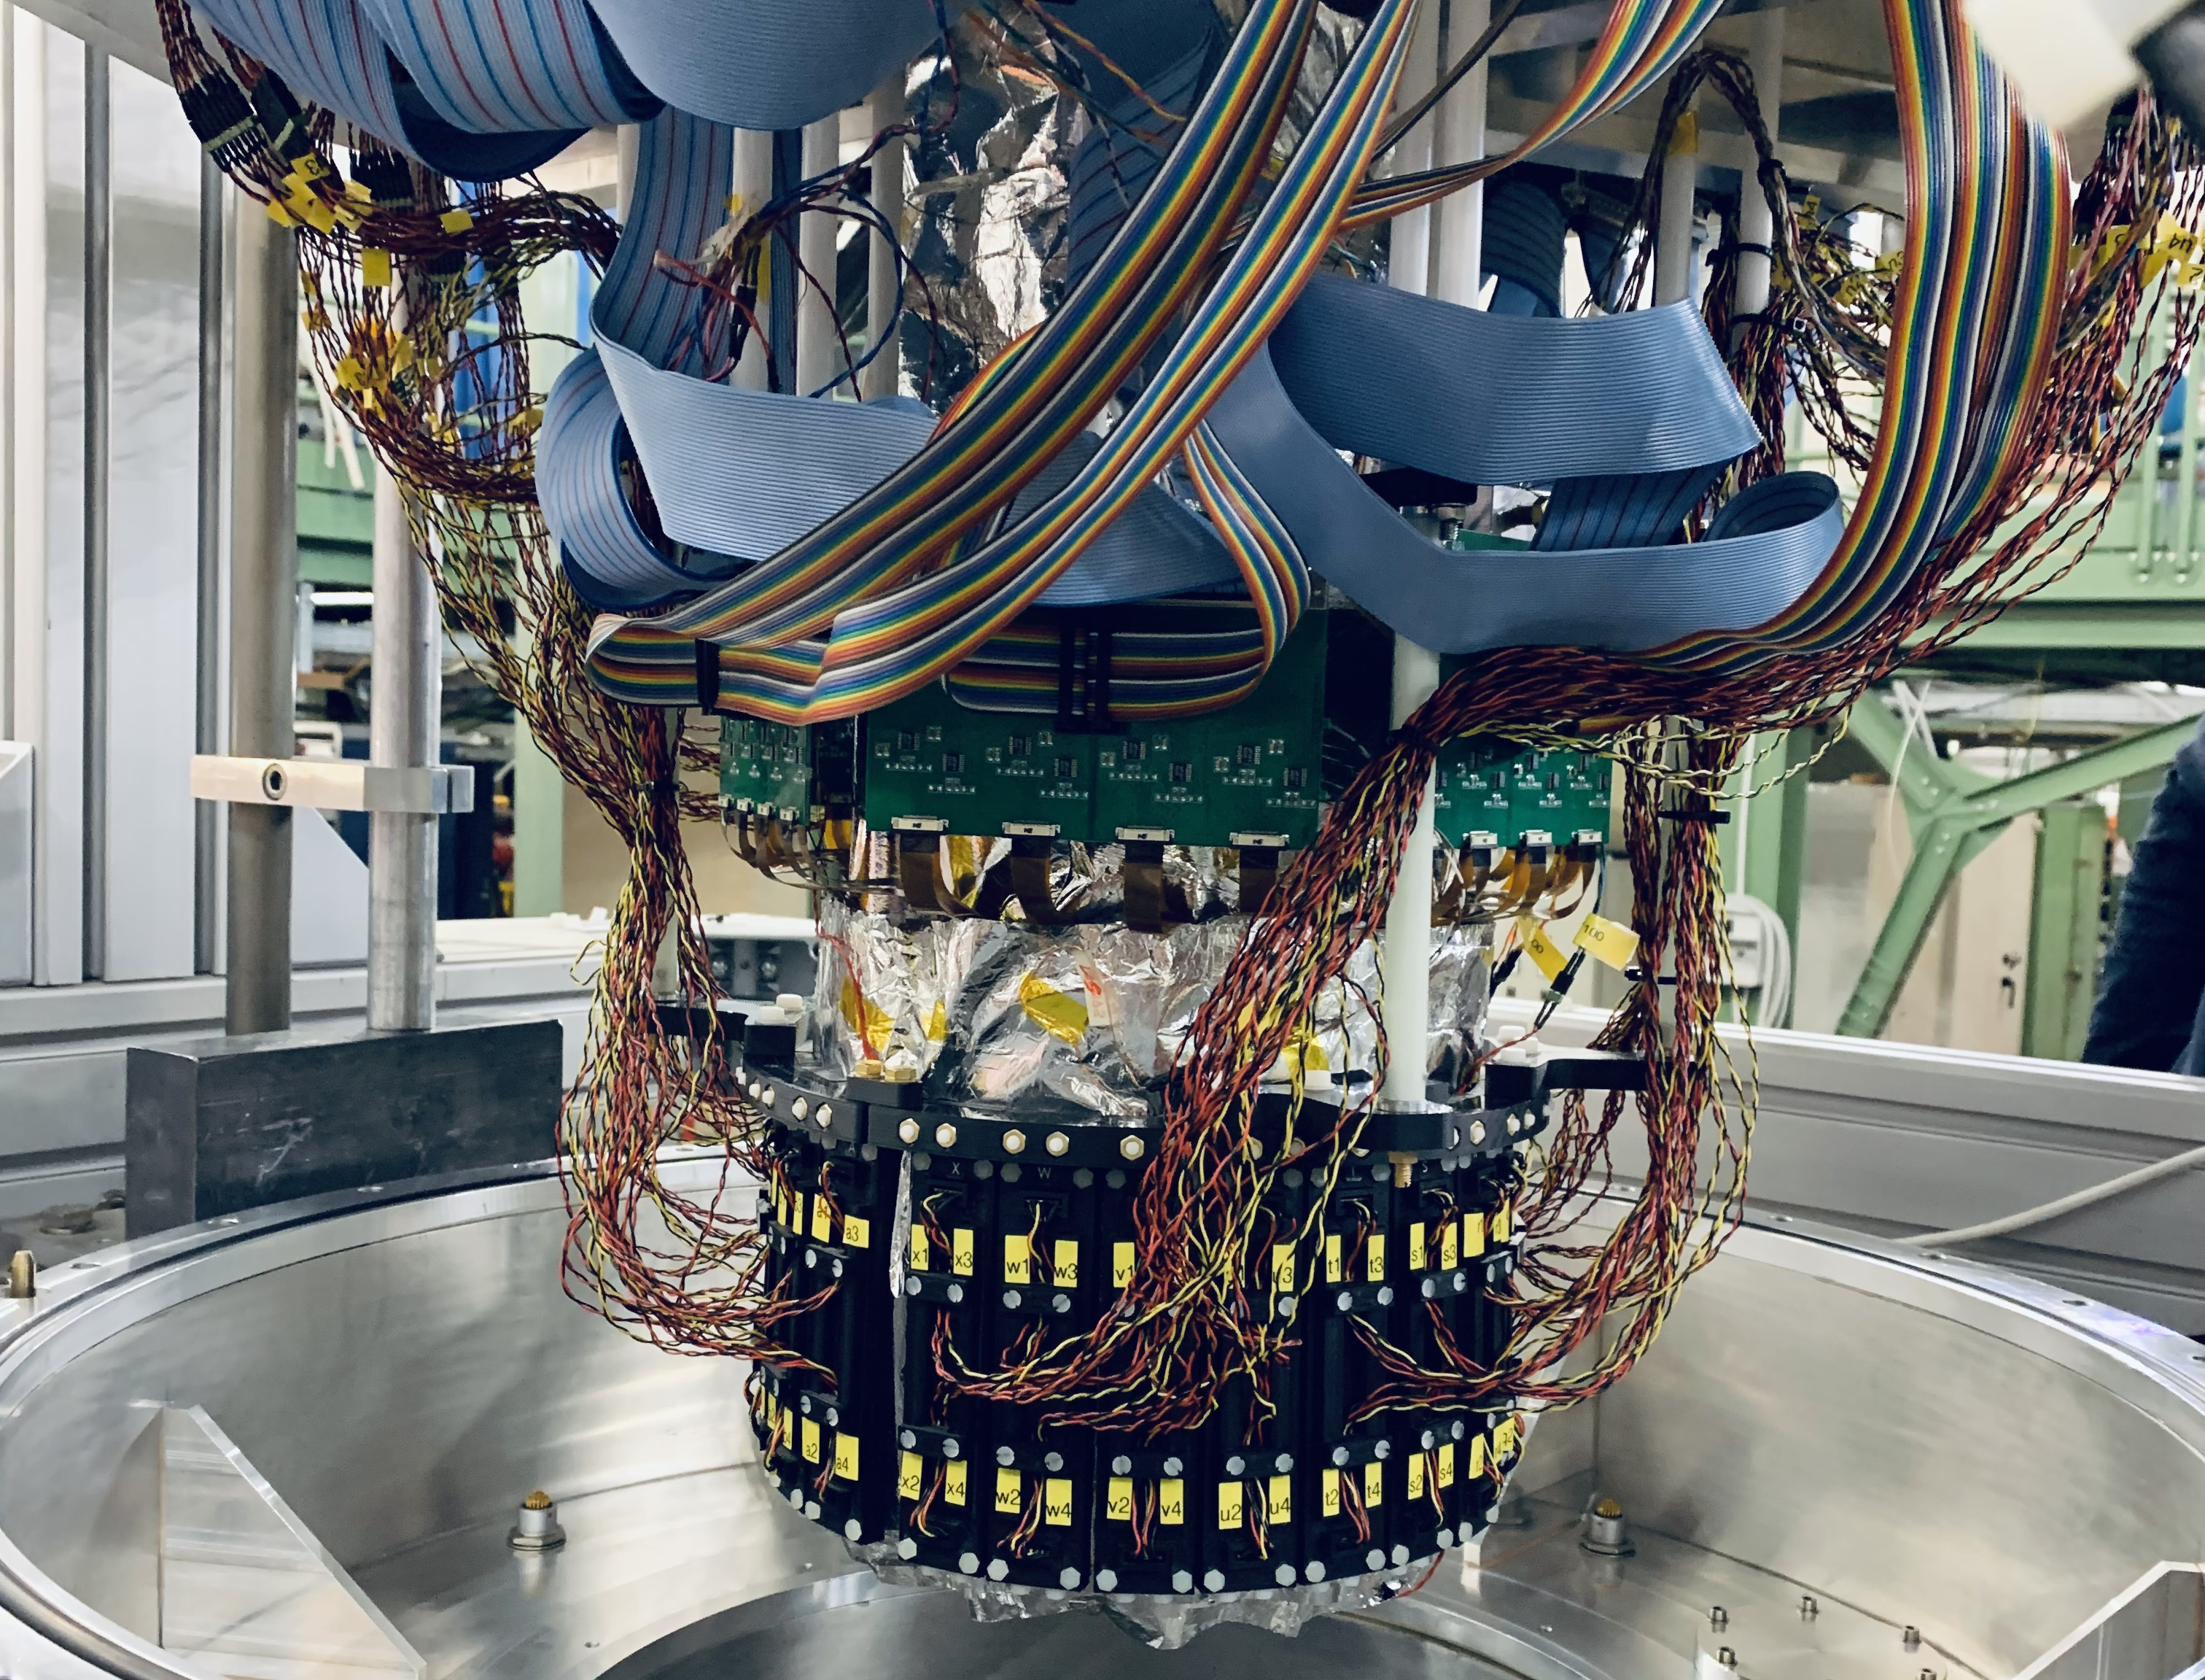
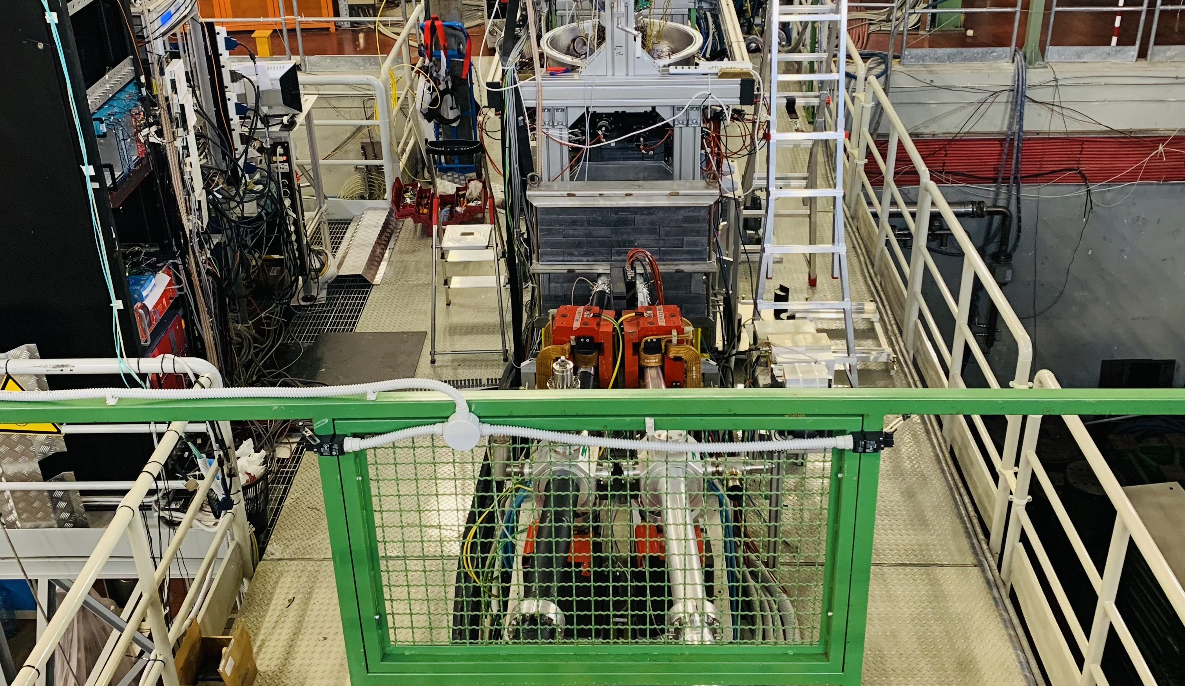
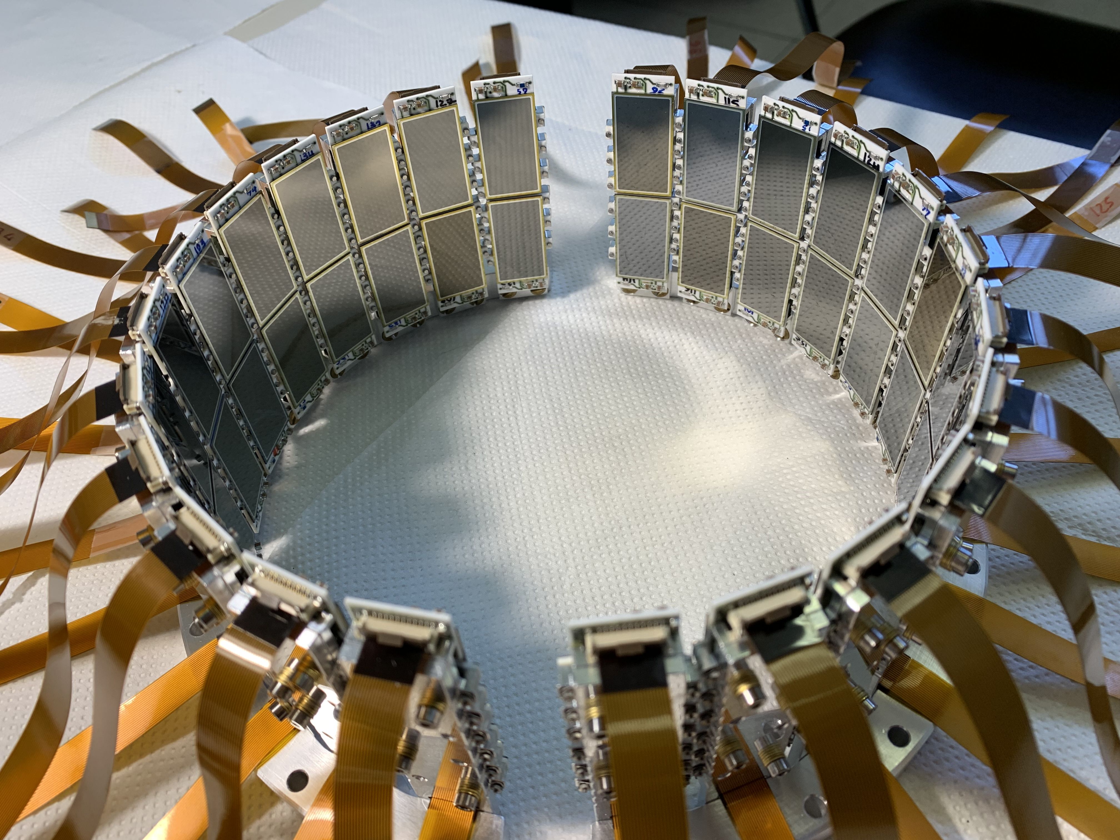

Slide 19
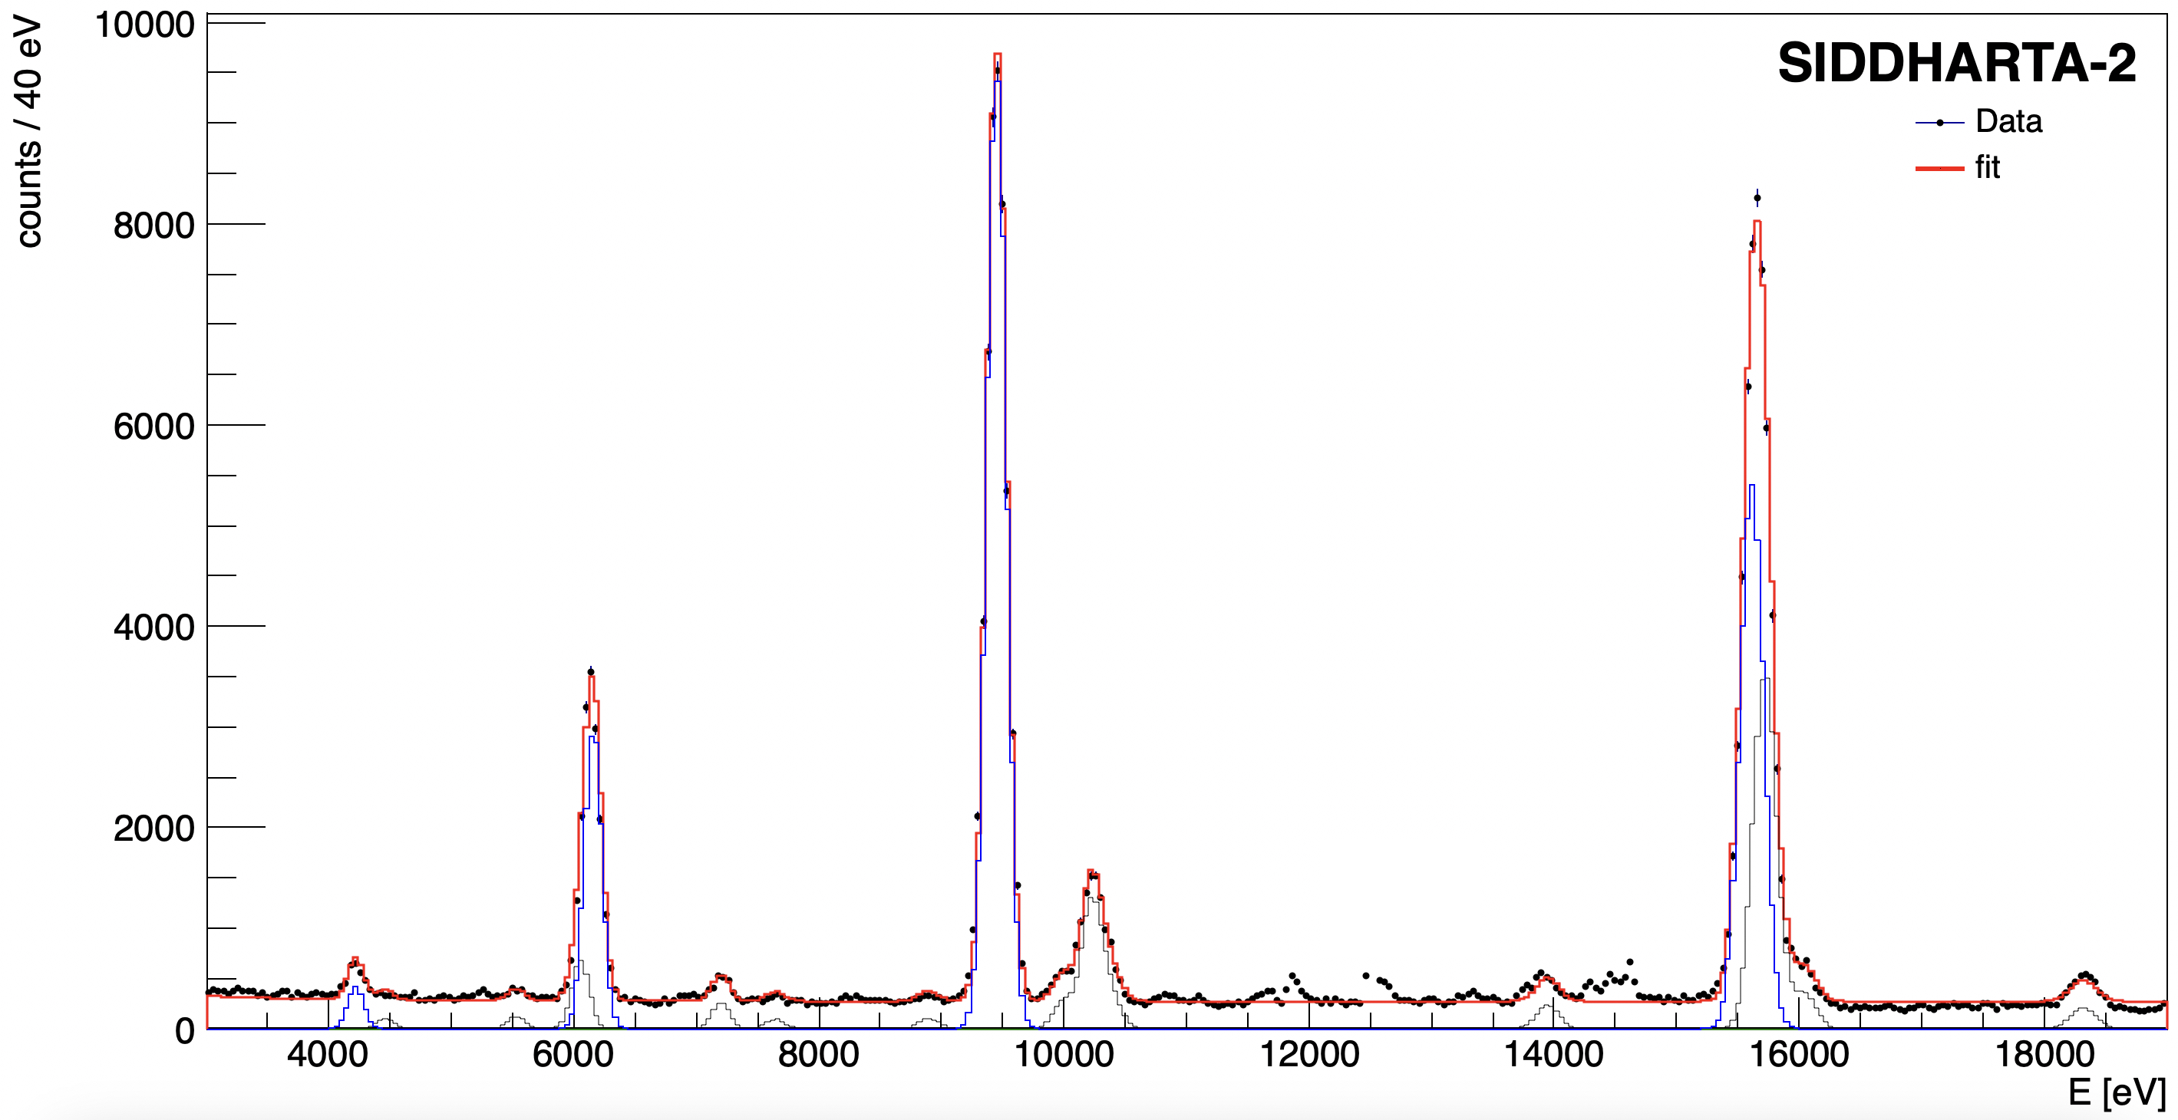

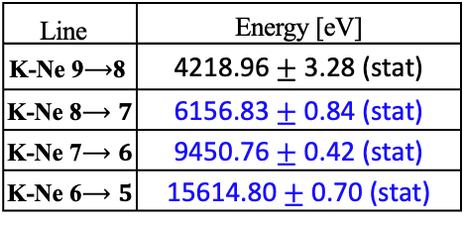



SIDDHARTA-2
Kaonic Neon (2023)
Line | Energy [eV]
K-Ne 9$⟶$8 | 4218.96$±$ 3.28 (stat)
K-Ne 8$⟶7$ | 6156.83 $±$ 0.84 (stat)
K-Ne 7$⟶6$ | 9450.76$±$ 0.42 (stat)
K-Ne 6$⟶5$ | 15614.80 $±$ 0.70 (stat)
Preliminary
K-Ne 7->6
K-Ne 6->5
K-Ne 8->7
KO 6->5
KC 5->4
K-Ne 9->8
KAl 7->6
KC 6->4
KC 7->5
KAl 8->7
KO 5->4
First K-Ne measurements – possible implications on
K- multinucleon interaction and kaon mass
Francesco Sgaramella
High precision kaonic atoms X-ray spectroscopy with the SIDDHARTA-2 experiment at the DAFNE collider

Slide 20
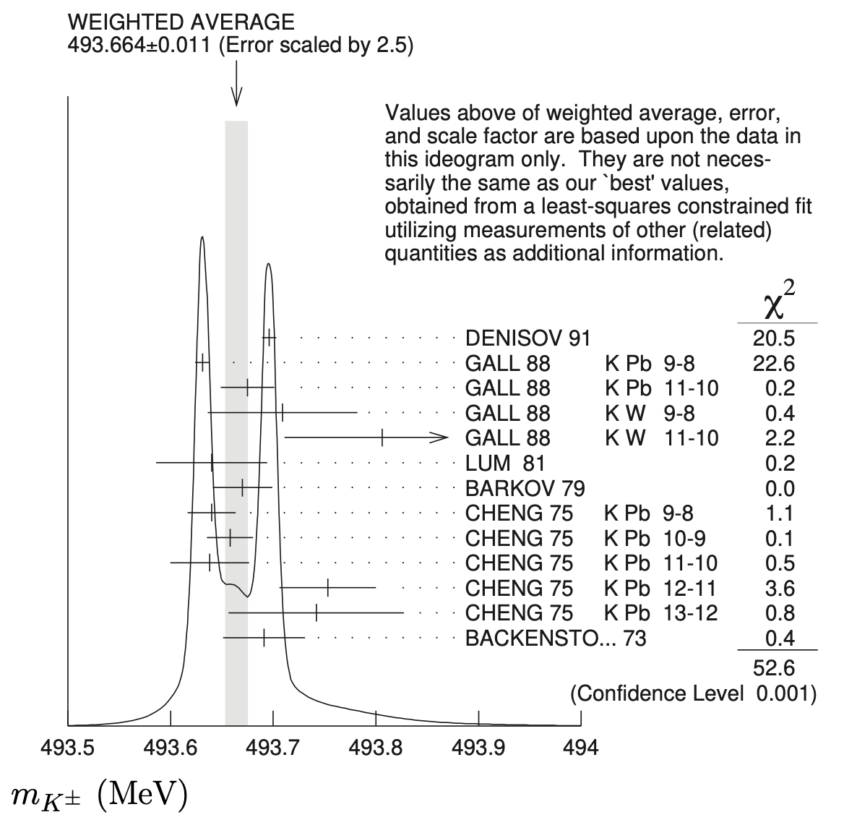
SIDDHARTA-2
Kaonic Neon (2023)
Line | Energy [eV]
K-Ne 9$⟶$8 | 4218.96$±$ 3.28 (stat)
K-Ne 8$⟶7$ | 6156.83 $±$ 0.84 (stat)
K-Ne 7$⟶6$ | 9450.76$±$ 0.42 (stat)
K-Ne 6$⟶5$ | 15614.80 $±$ 0.70 (stat)
Preliminary
K-Ne 7->6
K-Ne 6->5
P.A. Zyla et al. (Particle Data Group), Prog. Theor. Exp. Phys. 2020, 083C01 (2020)
K-Ne 8->7
KO 6->5
KC 5->4
K-Ne 9->8
KAl 7->6
KC 6->4
KC 7->5
KAl 8->7
KO 5->4
First K-Ne measurements – possible implications on
K- multinucleon interaction and kaon mass
Francesco Sgaramella
High precision kaonic atoms X-ray spectroscopy with the SIDDHARTA-2 experiment at the DAFNE collider

Slide 21
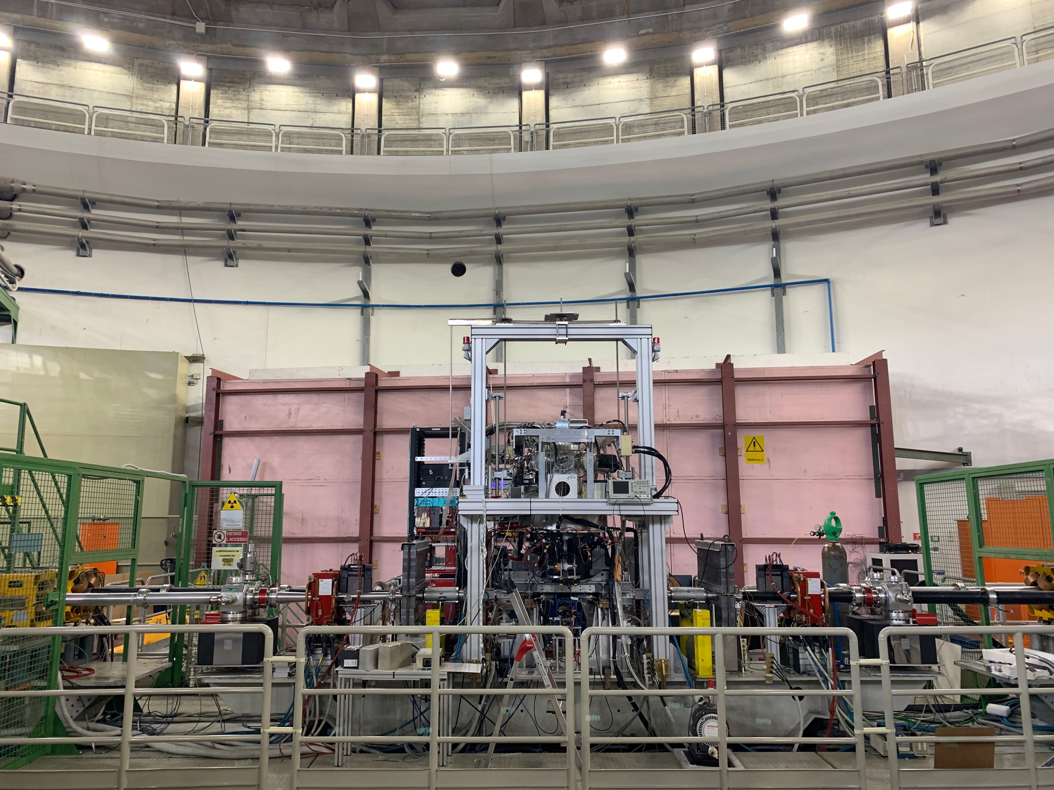
SIDDHARTA-2
ready for the kaonic deuterium measurement
Francesco Sgaramella
High precision kaonic atoms X-ray spectroscopy with the SIDDHARTA-2 experiment at the DAFNE collider

Slide 22

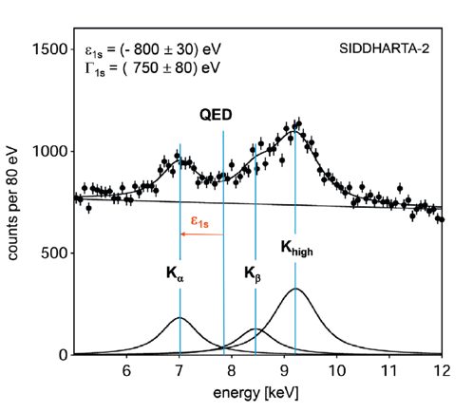
Kaonic deuterium
data taking
Kaonic deuterium run ongoing 2023/24
Monte Carlo for an integrated luminosity
of 800 pb⁻¹
to perform the first measurement of the strong interaction induced energy shift and width of the kaonic deuterium ground state
(similar precision as K-p) !
achievable precision
Monte Carlo Simulation
Significant impact in the theory of strong interaction with strangeness
Francesco Sgaramella
High precision kaonic atoms X-ray spectroscopy with the SIDDHARTA-2 experiment at the DAFNE collider

Slide 23
Kaonic deuterium shift and width
Liu 2020
achievable
precision
Weise 2017
Oset 2001
Mizutani 2013
Meißner 2011
Gal 2007
Shevchenkov 2012
Francesco Sgaramella
High precision kaonic atoms X-ray spectroscopy with the SIDDHARTA-2 experiment at the DAFNE collider

Slide 24
Kaonic deuterium shift and width
Liu 2020
achievable
precision
Weise 2017
Oset 2001
Mizutani 2013
Meißner 2011
Gal 2007
Shevchenkov 2012
Francesco Sgaramella
High precision kaonic atoms X-ray spectroscopy with the SIDDHARTA-2 experiment at the DAFNE collider

Slide 25
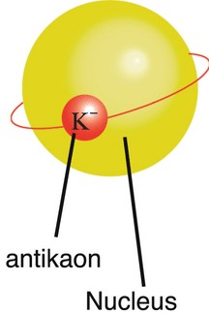
Beyond SIDDHARTA-2: EXKALIBUR
proposal to perform fundamental physics at the strangeness frontier at DAFNE
for a 3-years period (post-SIDDHARTA-2)
EXtensive
Kaonic
Atoms research: from
LIthium and
Beryllium to
URanium
We propose to do precision measurements along the periodic table at DAFNE for:
Kaonic Hydrogen: 200 pb⁻¹ – with SIDDHARTA-2 setup – to get a precision < 10 eV (KH)
Selected light kaonic atoms (LHKA)
Selected intermediate and heavy kaonic atoms charting the periodic table (IMKA)
Ultra-High precision measurements of Kaonic Atoms (UHKA)
Dedicated runs with different types of detectors: CZT detectors, HpGe, SDD 1mm, crystal HAPG spectrometer from VOXES project
Fundamental physics at the strangeness frontier at DAΦNE. Outline of a proposal for future measurements,
C. Curceanu et al., e-Print: 2104.06076
EXKALIBUR

Slide 26
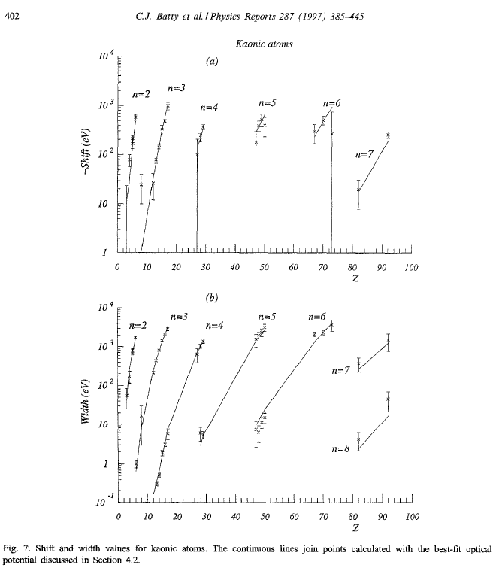
Beyond SIDDHARTA-2:
why still kaonic atoms?
Except for the most recent measurements at DAΦNE and JPARC on KHe and KH,
the database on kaonic atoms dates back to 1970s and 1980s
These data are the experimental basis for all the developed theoretical models
These theoretical models are used to derive, for example:
KN interaction at threshold
KNN interaction at threshold
Nuclear density distributions
Possible existence of kaon condensates
Kaon mass
Kaonic atoms cascade models
Francesco Sgaramella
High precision kaonic atoms X-ray spectroscopy with the SIDDHARTA-2 experiment at the DAFNE collider

Slide 27
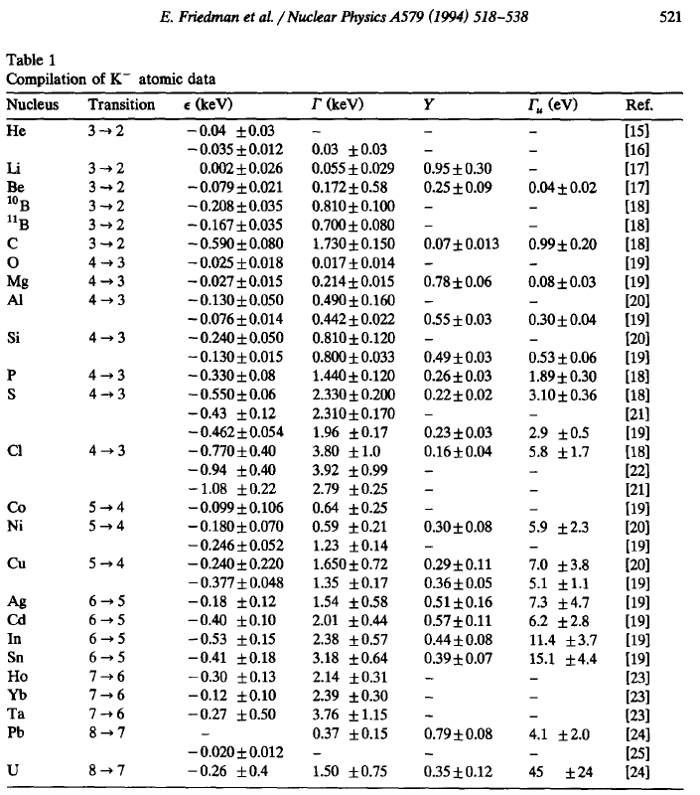
Beyond SIDDHARTA-2:
why still kaonic atoms?
The available data on “lower levels” have big uncertainties
Many of them are actually UNmeasured
Many of them are hardly compatible among each other
Relative yields with upper levels are not always measured
Absolute yields are basically unknown (except for few transitions)
The REmeasured ones have been proved WRONG
This situation would already be a proper justification for new measurements
Francesco Sgaramella
High precision kaonic atoms X-ray spectroscopy with the SIDDHARTA-2 experiment at the DAFNE collider

Slide 28
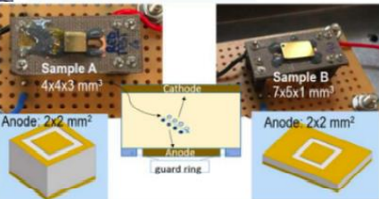
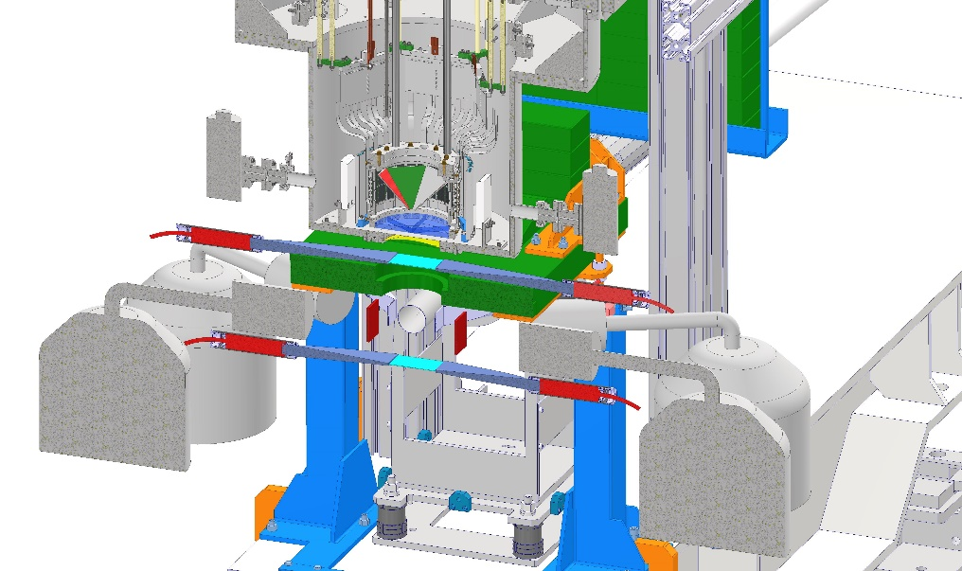
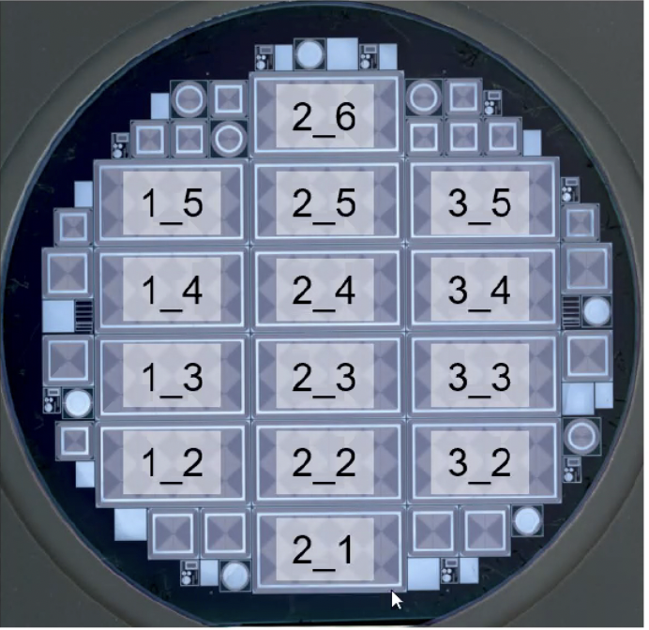
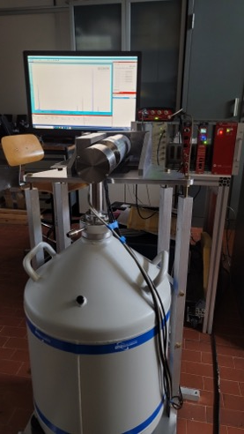
Feasibility studies in parallel with Siddharta-2
Various setups in preparation:
  HPGe
  Crystal spectrometers (VOXES)
  CdZnTe detectors
  SDD 1mm for kaonic atoms measurement
Cd(Zn)Te
SDD 1mm
Abbene, L. et al. Eur. Phys. J. Spec. Top. (2023).
HPGe
Catalina Curceanu (A. Scordo)
28
Francesco Sgaramella
A new renaissance for kaonic atoms at DAΦNE: future measurements and perspectives
High precision kaonic atoms X-ray spectroscopy with the SIDDHARTA-2 experiment at the DAFNE collider

Slide 29
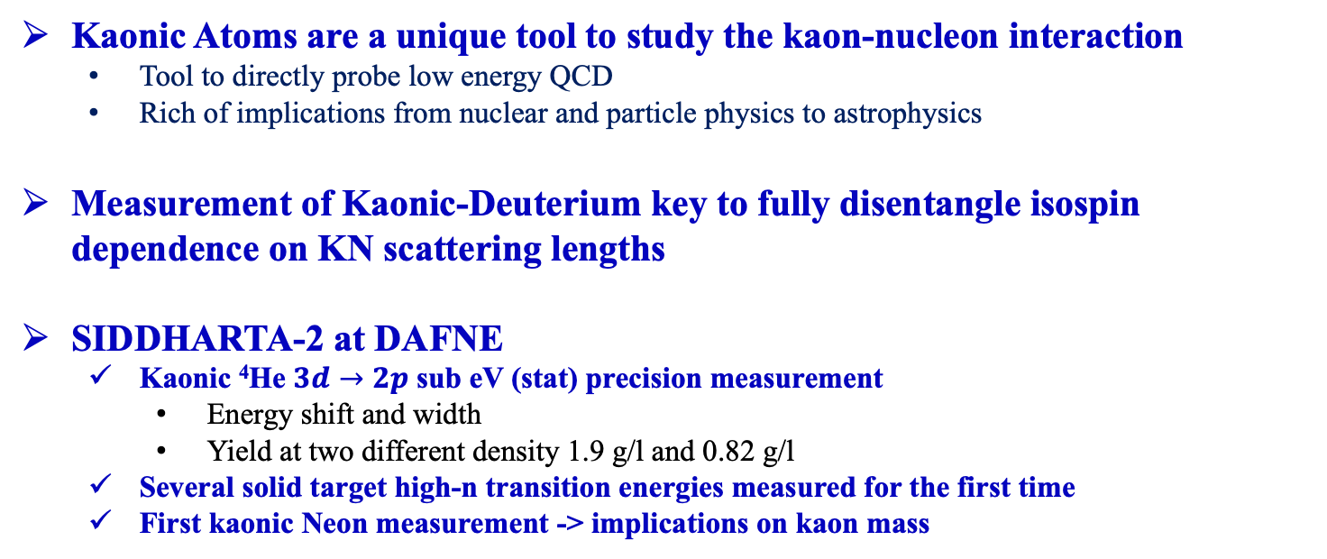
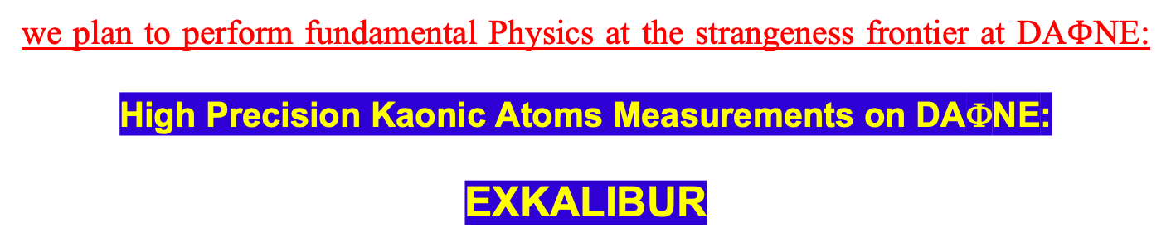
Conclusions
Kaonic Atoms are a unique tool to study the kaon-nucleon interaction
  Tool to directly probe low energy QCD
  Rich of implications from nuclear and particle physics to astrophysics
Measurement of Kaonic-Deuterium key to fully disentangle isospin dependence on KN scattering lengths
SIDDHARTA-2 at DAFNE
  Kaonic ⁴He $3d→2p$ sub eV (stat) precision measurement
    Energy shift and width
    Yield at two different density 1.9 g/l and 0.82 g/l
  Several solid target high-n transition energies measured for the first time
  First kaonic Neon measurement -> implications on kaon mass
we plan to perform fundamental Physics at the strangeness frontier at DA$Φ$NE:
High Precision Kaonic Atoms Measurements on DAΦNE:
EXKALIBUR
Francesco Sgaramella
High precision kaonic atoms X-ray spectroscopy with the SIDDHARTA-2 experiment at the DAFNE collider

Slide 30

Thank You

