Slide 1




ESSnuSB at ESS
NeuTel2023 in Venice Tord Ekelöf, Uppsala University

Slide 2

ESSnuSB Conceptual
Design Report
Published on arXive 6 June 2022:
https://arxiv.org/abs/2206.01208
and in European PhysicalJournal 6 Nov 2022
Eur. Phys. J. Spec. Top. (2022) 231: 3779-3955
https://link.springer.com/article/10.1140/epjs/s11734-022-00664-w
CDR outline:
1. Linac upgrade
2. An accumulator ring
3. A target station and 50 m decay tunnel
4. A near detector placed in the neutrino beam some 250 m downstream of the target statio
5. A far detector 360 km from the target station consisting of 2 large underground tanks filled each with 240’000 m³ of water
6. Physics performance
https://arxiv.org/abs/2203.08803

Slide 3
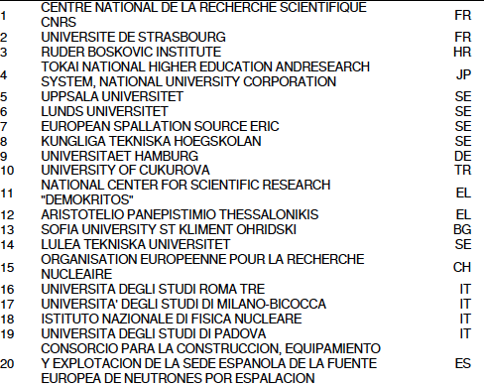
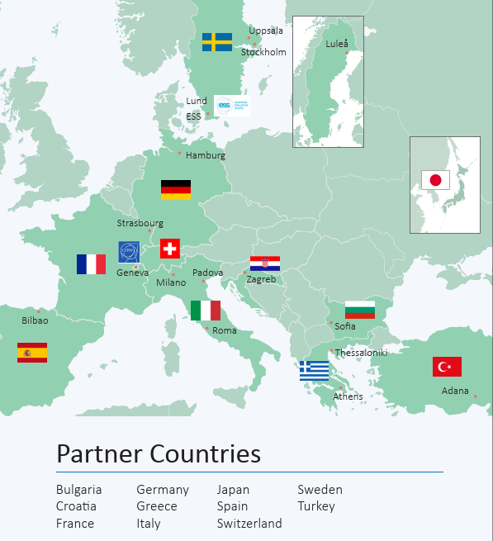
The ESSnuSB+ Collaboration

Slide 4
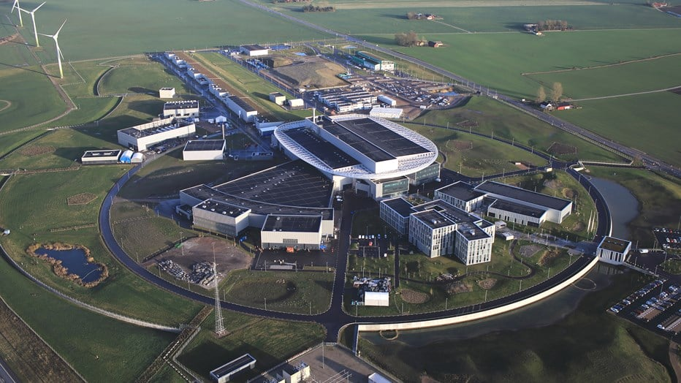
Current view of ESS
Near
Detector
Accumulator+
Target

Slide 5
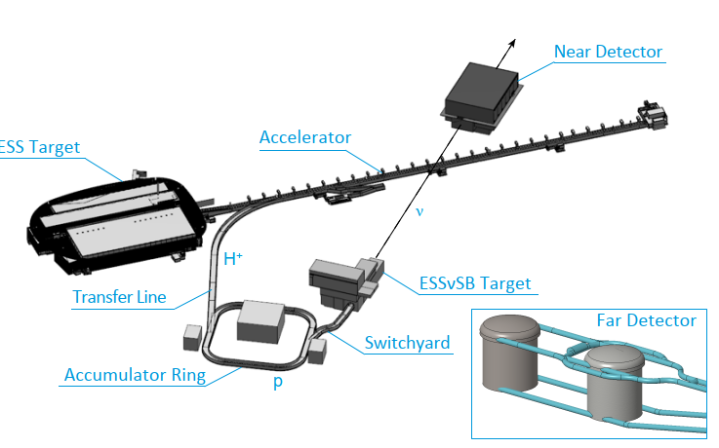
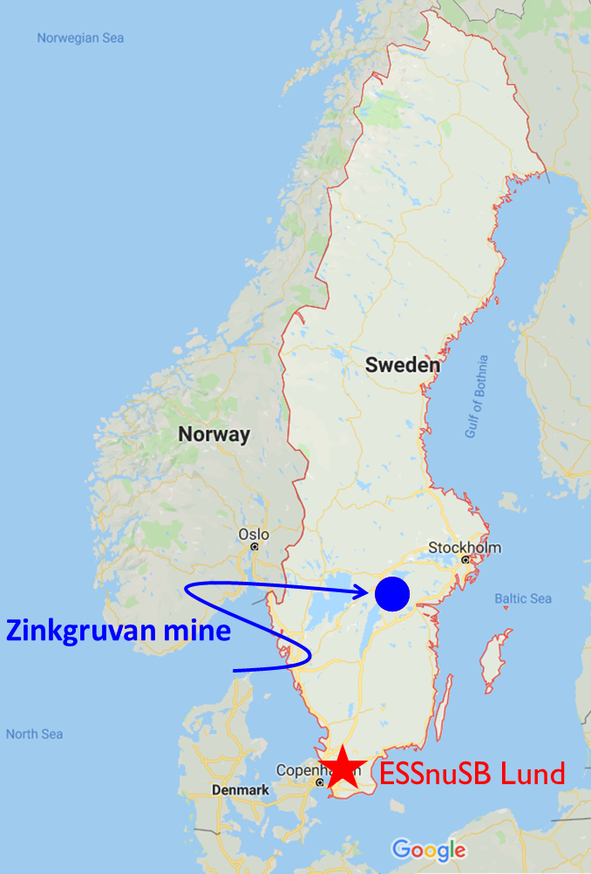
ESSnuSB lay-out
Far detector at Zinkgruvan 360 km distance

Slide 6
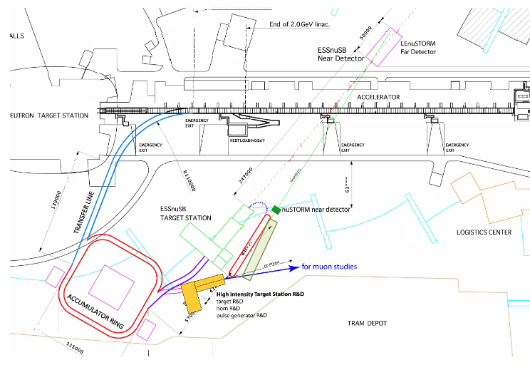
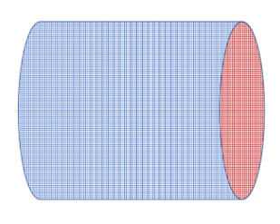
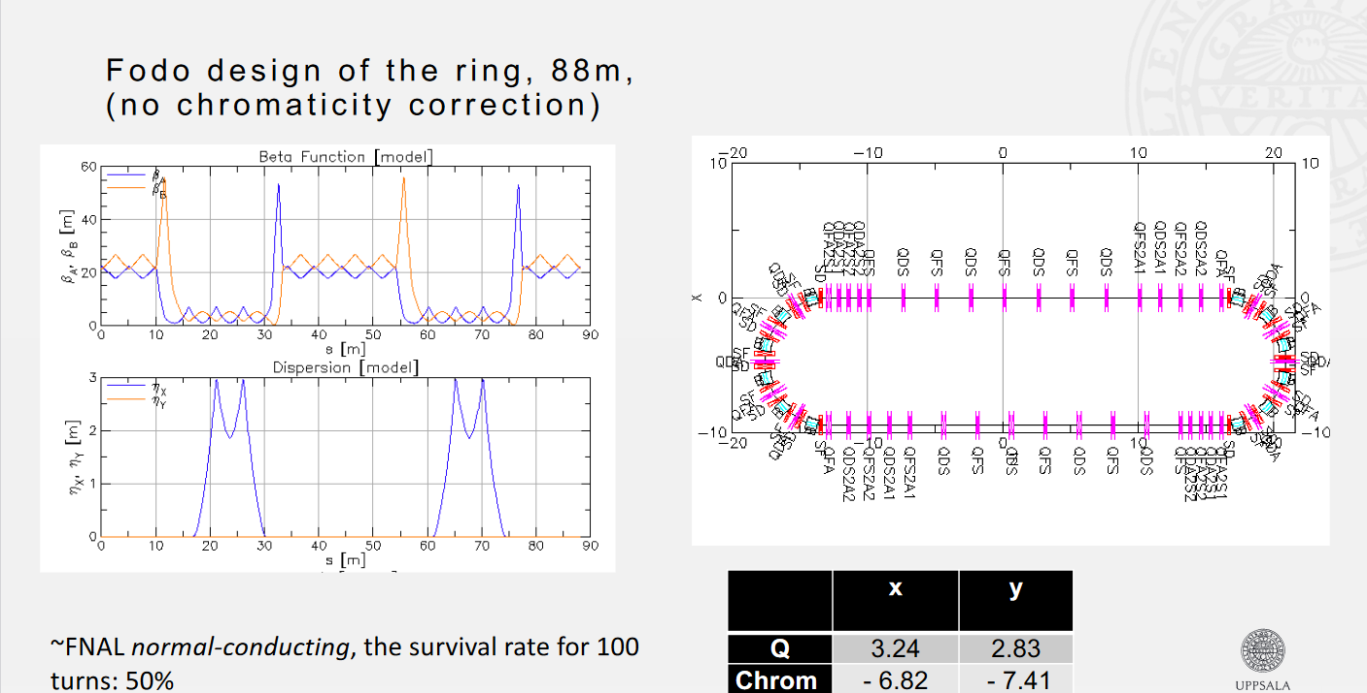
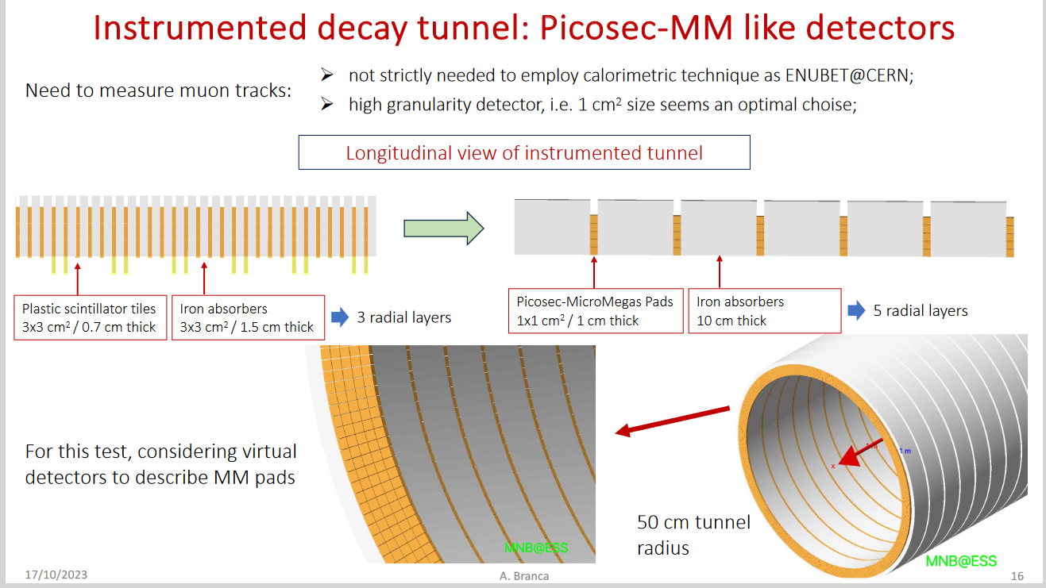
ESSnuSB+ additions for low energy cross-section measurements that will be set up in a staged process starting with LEMNB, LEMMON and the Near Detector to be followed by LEnuSTORM and then the ESSnuSB programme
LEMMOND
near-near
Water Cherenkov
Detector with
fast readot
LEnuSTORM
a low energy
nuSTROM type
racetrack ring
LEMNB, a low energy
ENUBET type
decay tunnel

Slide 7
Low Energy Monitored Neutrino Beam LEMNB for π decay
The LEMNB program will be set up as the first stage of the ESSnuSB program
Presented at the ESSnuSB+ Annual Meeting 16-20 Oct 2023 by Antonio Branca – University and INFN of Milano-Bicocca

Slide 8
Low Energy neutrinos from Stored Muons LEnuSTORM
The LEnuSTORM program will be set up as the second stage of the ESSnuSB program
Presented at the ESSnuSB+ Annual Meeting 16-20 Oct 2023 by Ting Wing Choi, Uppsala University

Slide 9
ESSnuSB at the second neutrino oscillation maximum at the Zingruvan Mine
Signal (ν_{e}) and background energy distributions

Slide 10
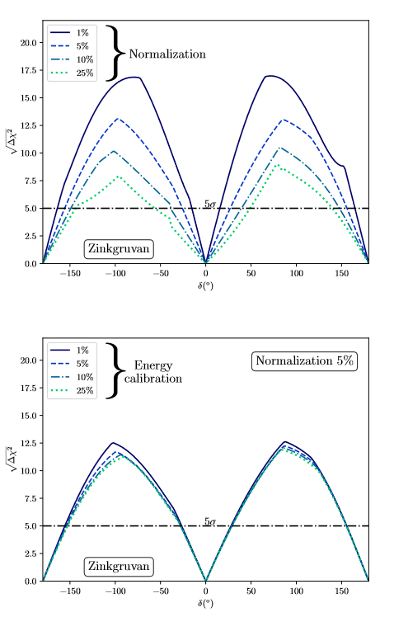
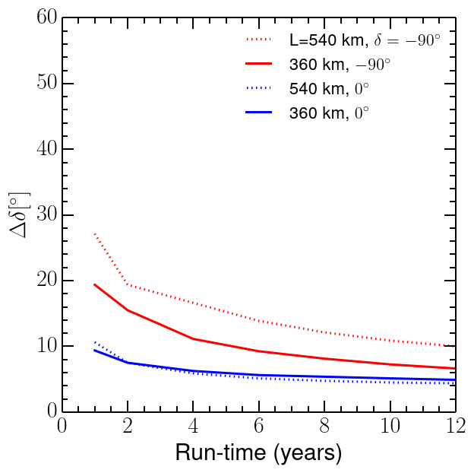
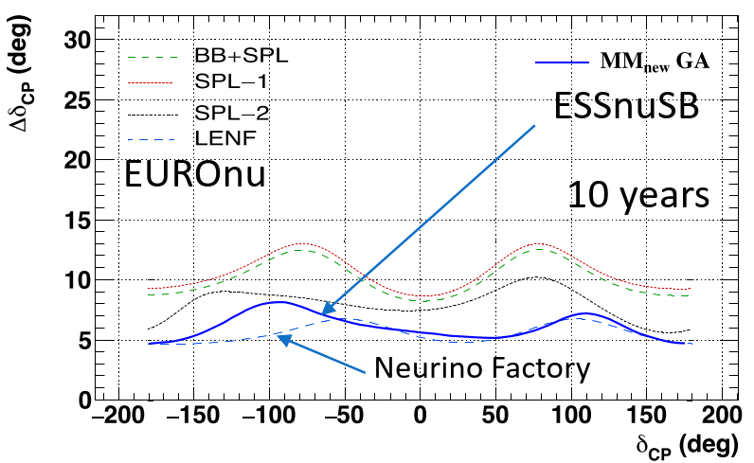
Performance for CPV discovery and δ_{CP} measurement
5%
Discovery potential vs δ_{CP} angle after
10 years with 5% normalization error
providing 70% coverage of all δ_{CP} vaues
Error in δ_{CP} angle vs δ_{CP} angle after
10 years with 5% normalization error
Error in δ_{CP} angle vs run time
with 5% normalization error

Slide 11
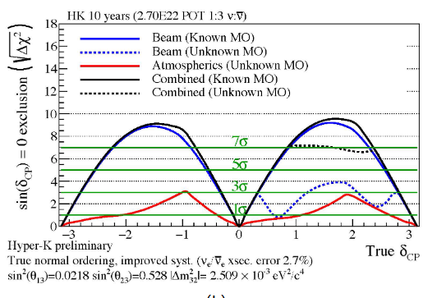
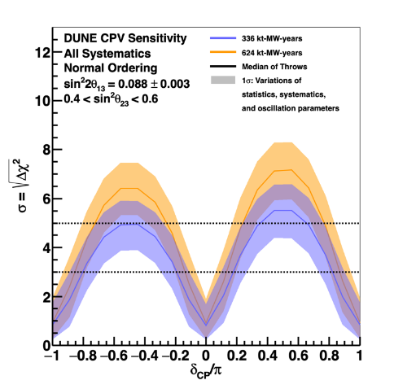
ESSnuSB in the international context – CPV discovery
5%
ESSnuSB March 2022 with 5% normalization error
DUNE Snowmass March 2022
HyperKamokande Snowmass March 2022

Slide 12
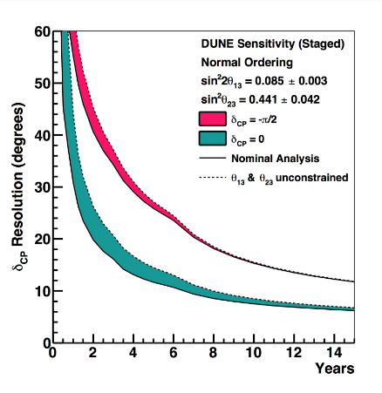
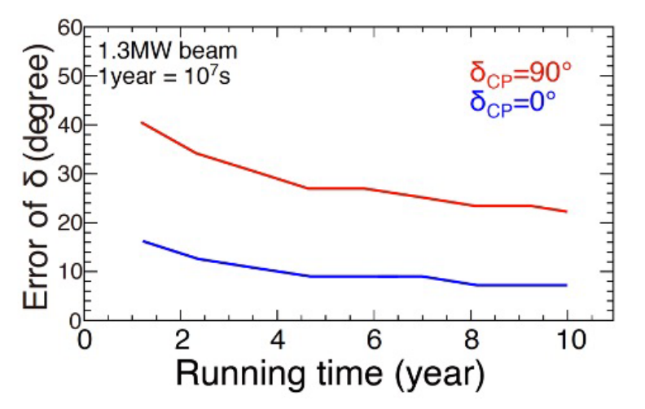
ESSnuSB in the international context – CPV resolution
ESSnuSB March 2022 with 5% normalization error
DUNE Snomass March 2022
HyperKamokande Snowmass March 2022

Slide 13
ESSnuSB in the international context – precision in δ_{CP}
ESSnuSB 10 years, light blue curves
DUNE 10 years, yellow curve
HyperKamiokande 10 years
https://arxiv.org/abs/2206.01208
p. 205
https://arxiv.org/abs/2002.03005
p. 174
https://arxiv.org/abs/1611.06118
p. 60, HKx1=one HK detector

Slide 14
On the importance of a high δ_{CP} resolution
Violation of CP symmetry was discovered in neutral K-meson decay in 1964, demonstrating that CP symmetry is not, as earlier believed, an exact symmetry of Nature. This was at the time a fundamental discovery reworded with the Nobel prize in physics. The discovery was made in the quark sector. The measured matter-antimatter asymmetry is ca 9 orders of magnitudes larger than what can be explained by the quark CP violation in the Standard Model, whereas due to the high value of the leptonic Jarlskog parameter, a significant lepton CP violation could explain the presence of matter in Universe through leptogenesis.
In order to verify or falsify specific symmetry approaches to lepton flavours and the various leptpgenesis models with Dirac CP violation phase that describe the matter-antimatter asymmetry, each of which predicts a specific value of δ_{CP}, it will be very important to make a measurement of δ_{CP} with the highest possible precision. As CP symmetry has already been shown to be broken in Nature the decisive goal should thus, in our mind, not only be to discover leptonic CP violation but to measure it in terms of the CP phase-angle δ_{CP} with the highest precision possible.
Owing to the use of the world-uniquely high power of the ESS linear accelerator the ESSnuSB project will enable a measurement of δ_{CP} with a standard error below 8° for all values of δ_{CP} to be compared with an error below 22° for all CP angles for DUNE and Hyper-K – ref. above graph. This higher precision of ESSnuSB will be decisive for the aim of confirming which of the various leptogenesis theories is valid and in which direction to go with these models.

Slide 15
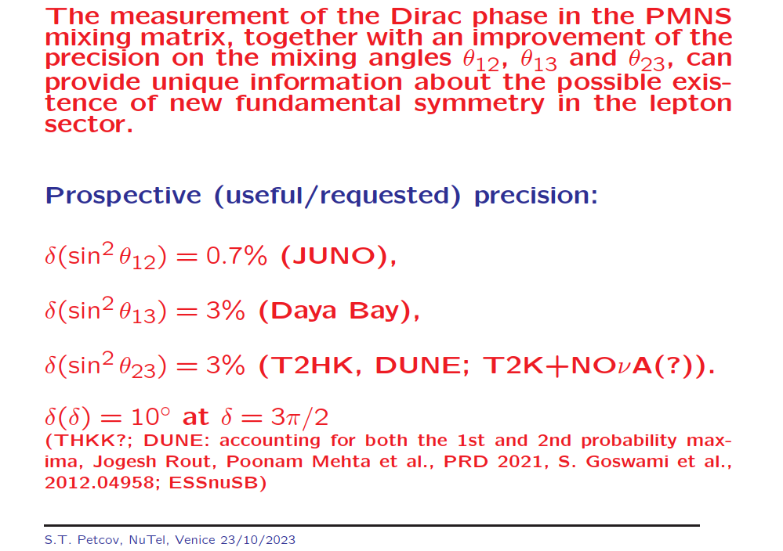
Required leptonic CP phase angle resolution
Slide from Serguey Petcov’s talk at this conference

Slide 16
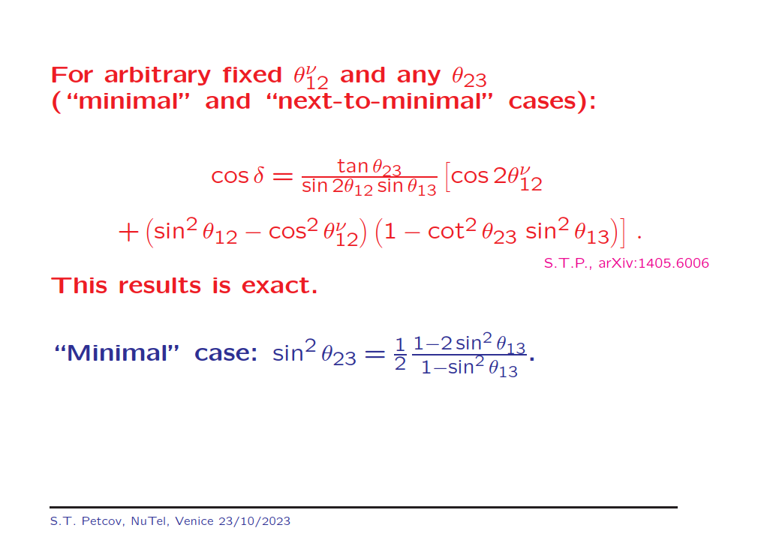
Test of flavour models
Slide from Serguey Petcov’s talk at this conference

Slide 17
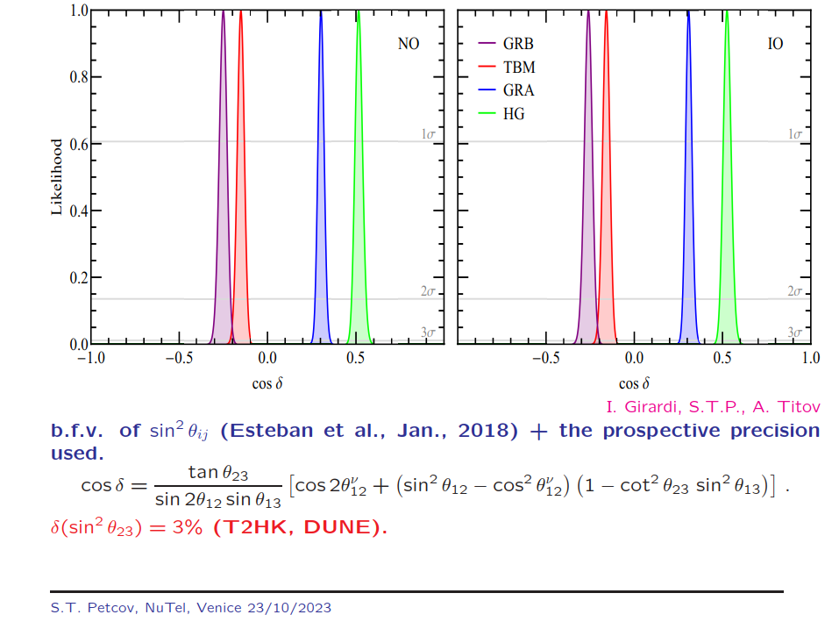
Test of flavour models
Slide from Serguey Petcov’s talk at this conference
The 4 different colors and δ_{CP} values correspond to different symmetry forms of the neutrino mixing matrix like tri-bimaximal (TBM), golden ratio A (GRA) and B (GRB), and hexagonal (HG)

Slide 18
Test of leptogensis models with Dirac CP violation phase
Slide from Silva Pascoli’s talk at NeuTel2019
Baryon ayummetry
Prediction δ_{CP}= 260°
δ_{CP}

Slide 19
Test of leptogensis models with Dirac CP violation phase
Slide from Silva Pascoli’s talk at NeuTel2019
Prediction δ_{CP}= 330°
Baryon ayummetry
δ_{CP}

Slide 20
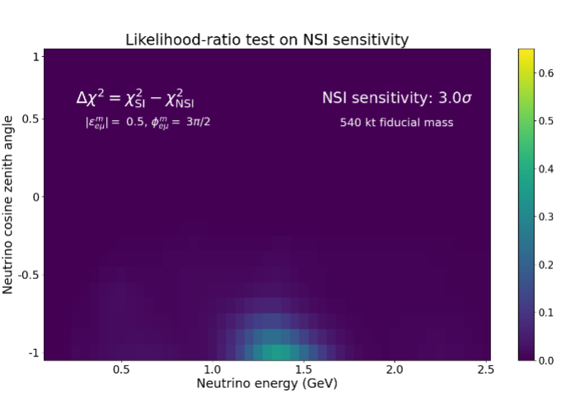
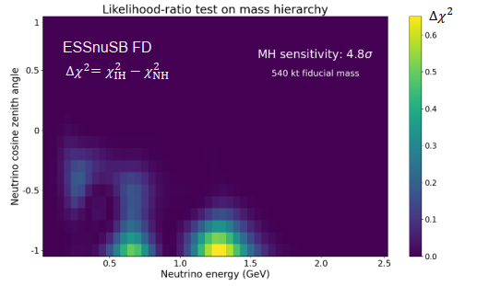
Mass Hierarchy and Non-Standard Interactions with ESSnuSB
VERY PRELIMINARY RESULT
Presented at the ESSnuSB+ Annual Meeting 16-20 Oct 2023 by Sampsa Vihonen, KTH, Stockholm

Slide 21
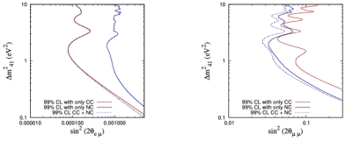
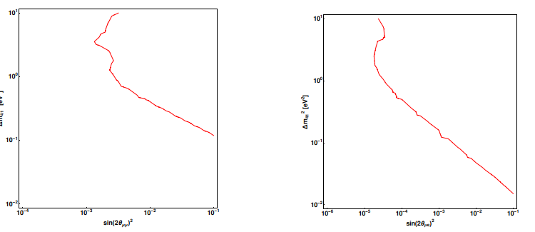
Sterile neutrino searches with ESSnuSB Near Detectors
ANALYSIS IN PROGRESS
LEnuSTORM
LEMNB
Presented at the ESSnuSB+ Annual Meeting 16-20 Oct 2023 by William Brorsson, KTH, Stockholm

Slide 22
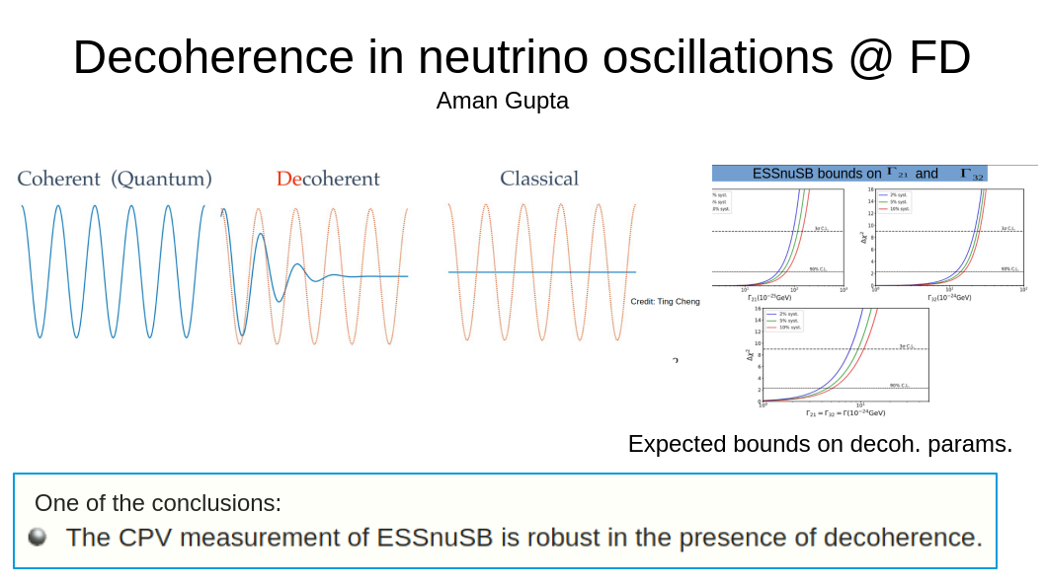
Presented at the ESSnuSB+ Annual Meeting 16-20 Oct 2023 by Aman Gupta, SINP Kolkata, India

Slide 23





EU has provided support to the project of building a long baseline neutrino facility in Europe since nearly 20 year by funding during this period a long series of design studies: CARE/BENE (FP7), EURONU (FP7), LAGUNA (FP7), LAGUNA-LBNO (FP7), EUCARD (FP7), COST Action CA15139, ESSnuSB (Horizon 2020), and ESSnuSB+ (Horizon Europe) and thereby appears as well determined to have a major neutrino project realized in Europe.
EU’s longterm support for a major European Neutrino Experiment

Slide 24
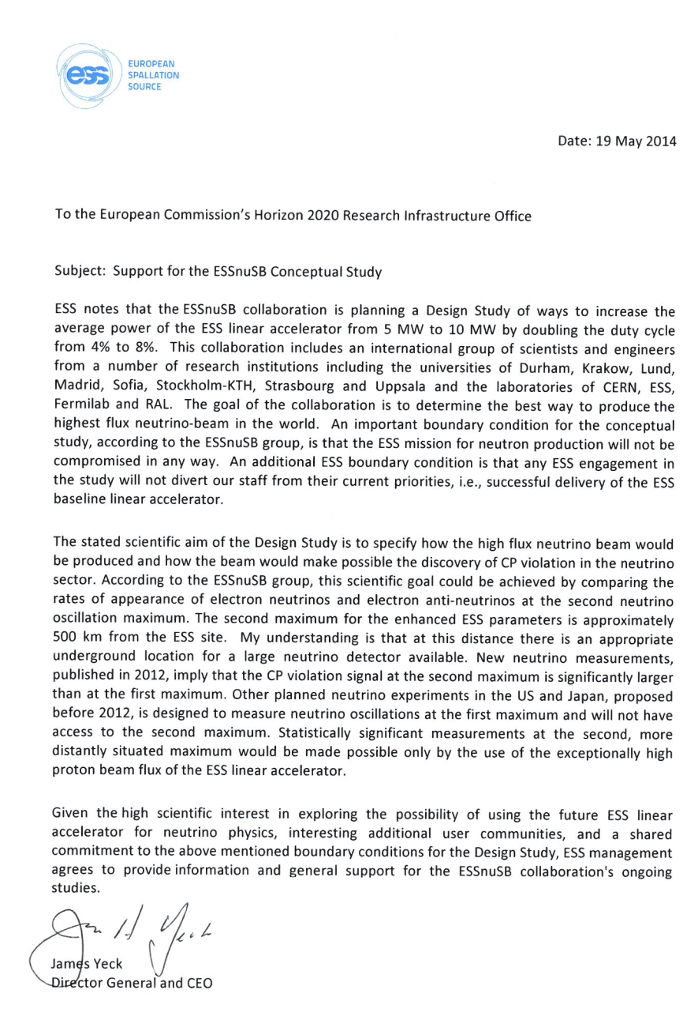
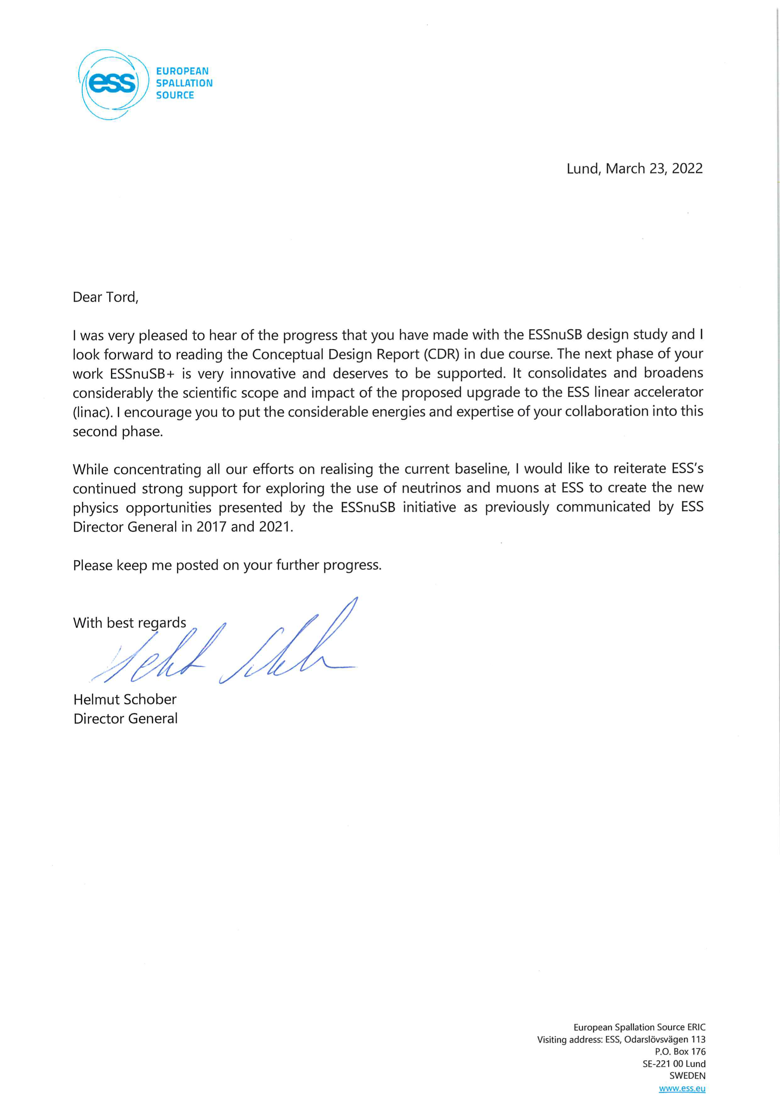
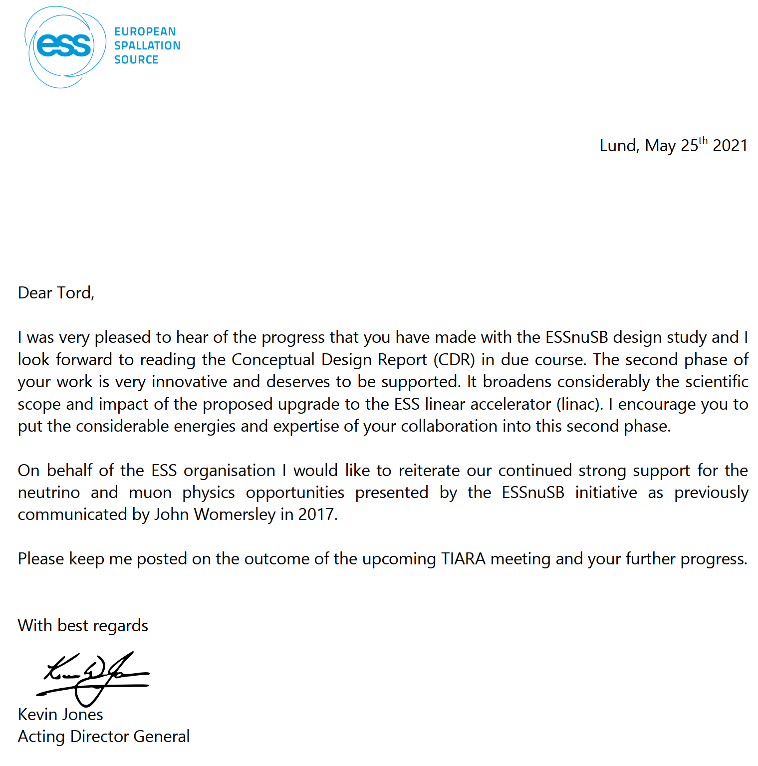
ESS management support for a neutrino physics program at ESS
The European Spallation Source (ESS) European Research Infrastructure Consortium (ERIC)
is a member of the ESSnuSB Collaboration and supports ESSnuSB strongly as documented
in recommendation letters from its four Director Generals since 2014.
Jim Jeck in 2014
John Womersly in 2017
Kevin Jones in 2021
Helmut Schober in 2022
Helmut Schober: ”I would like to reiterate ESS’s continued strong support for exploring the use of neutrinos
and muons at ESS to create the new physics opportunities by the ESSnuSB initiative as previously
communicated by ESS Director Generals in 2014- 2021.”

Slide 25
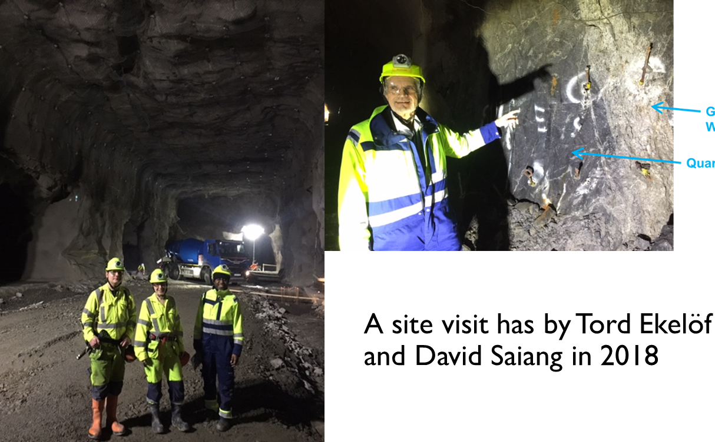
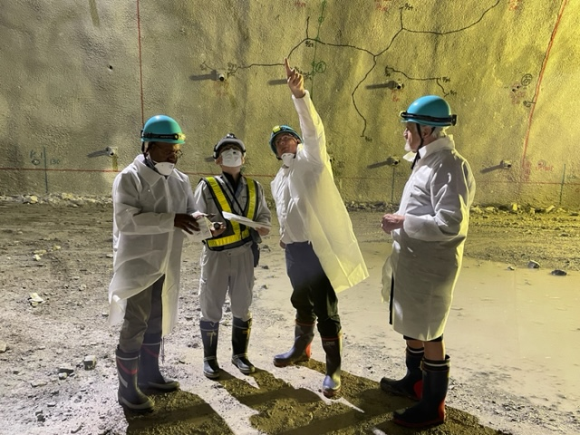
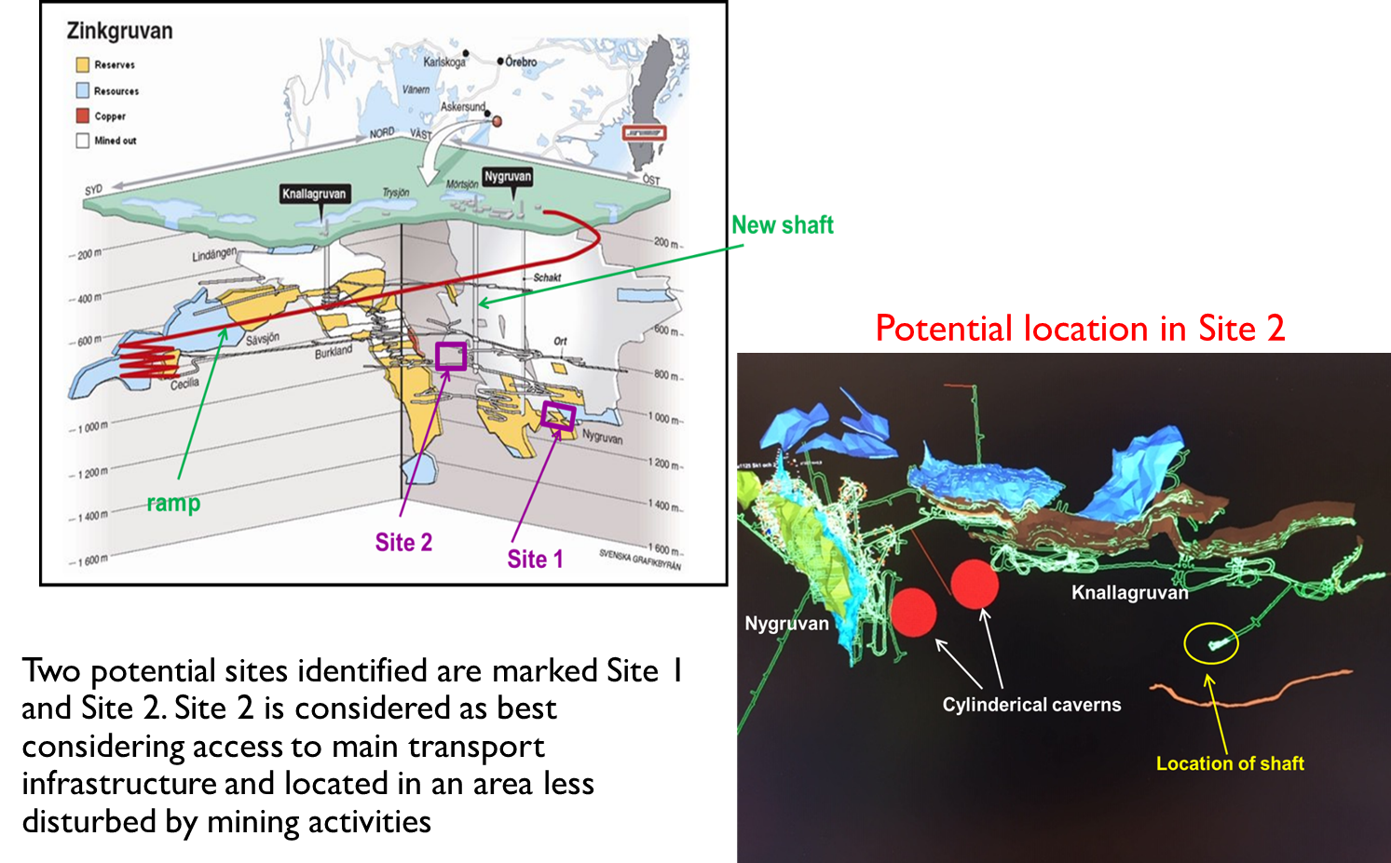
Zinkgruvan Mine Management support for ESSnuSB
Zinkgruvan Mining AB is a partner of ESSnuSB and its Mine Manager Craig Griffiths attended the ESSnuSB+ Yearly Collaboration meeting at CERN 16-19 Oct 2023
Underground lay-out of Zinkgruvan Mine and photo
from one of our visits there
Zinkgruvan Mine Manager Craig Griffiths (pointing upwards) visiting the Hyper-Kamiokande excavation site on 27 Sept 2023

Slide 26
European Particle Physics Strategy
We have taken not of the following recommendations of the CERN European Strategy Council:
"The design studies for next-generation long-baseline neutrino facilities should continue. "
"The first priority is the completion of the programme of measurements of the oscillation parameters, most notably the CP-violating phase of the mixing matrix and the neutrino mass ordering."
"Future European facilities such as FAIR, NICA and ESS envisage research programmes that are of interest to particle physics."
"The European particle physics community should work with the European Commission to shape and establish the funding instruments that are required for the realisation of common R&D projects, e.g. in the Horizon Europe programme."
"A roadmap should prioritise the technology, taking into account synergies with international partners and other communities such as photon and neutron sources, fusion energy and industry."

Slide 27
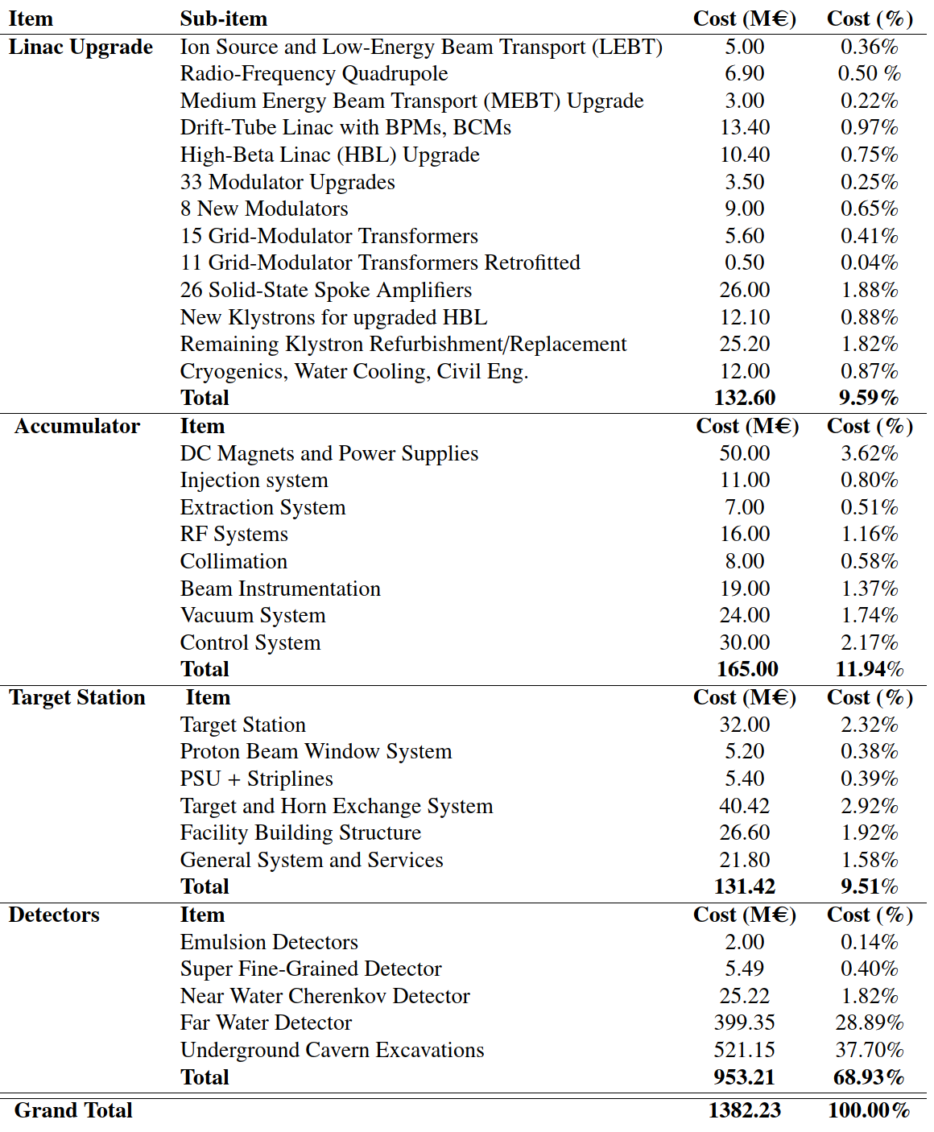
ESSnuSB Cost Esimate
as published in the ESSnuSB Conceptual Design report at
arXiv:2203.08803v1
1’382 M€
Work in progress.
The cost of civil engineering on the ESS site is not included. A cost estimate of the civil engineering will require a detailed study of the implementation of the components on the ESS site, that will be made only in the next phase of the study.

Slide 28
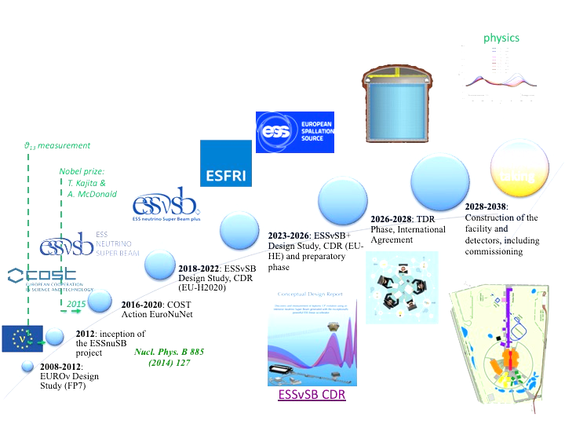
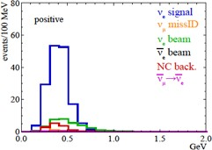
Schedule for the
ESS-based neutrino
Super Beam ESSnuSB

Slide 29
Conclusions
The first EU-supported phase of the ESSnuSB conceptual design study 2018-2021 has been successfully concluded and the results reported in the European Physical Journal, demonstrating the feasibility of the use of the ESS 5 MW linac as proton driver for a long base-line neutrino experiment with exceptional resolution in δ_{CP} (8°).
A second EU-supported phase of the ESSnuSB design 2023-2026 has started and is focussing on including facilities for high precision neutrino cross-section measurements at low energy based on the build-up of a Low Energy Monitored Neutrino Beam and Low Energy nuSTORM as first stages in the ESSnuSB programme.
The ESSnuSB Collaboration, consisting of ca 80 members from 20 universities and 11 European countries has had and has strong support from the European Union Research INFRADEV Programme (Horison2020 and Horizon Europe), from the ESS Management and from the Zinkgruvan Mine Management.
The current plan for the ESSnuSB long baseline measurements is to start data taking in 2038

Slide 30
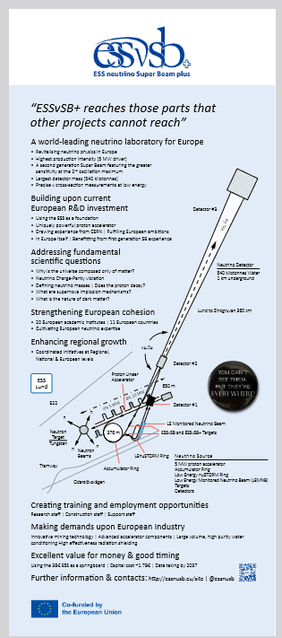
Thank you!
Outreach role-up in
the lobby

Slide 31
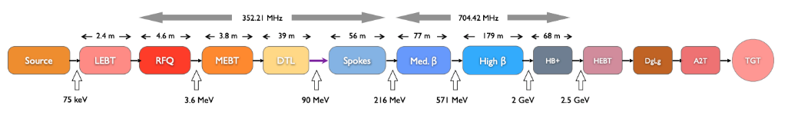
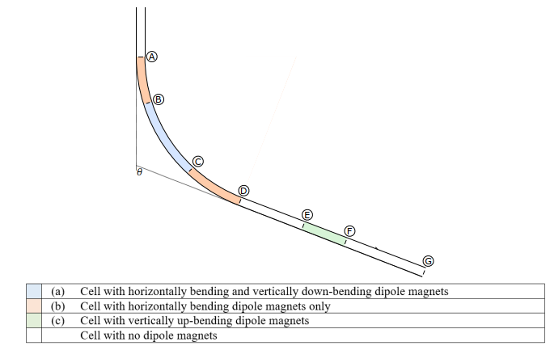
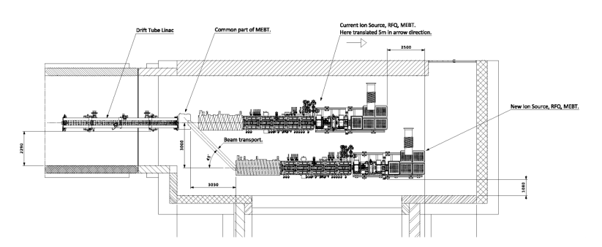
The ESS linac – status: 2 MW beam on target May 2025
2.86 ms pulses at 14 Hz pulse frequency tah will be increased to 28 Hz, implying an
increase of the beam power from 5 MW to 10 MW
Transfer Line to Accumulator
ESSnuSB addition
H⁻
p
ESSnuSB addition
The linac
Normalconducting part
Superconducting part
The merging of the H+ and the H- beams in the MEBT
Transfer Line with bending limited by H⁻ Lorenz stripping

Slide 32
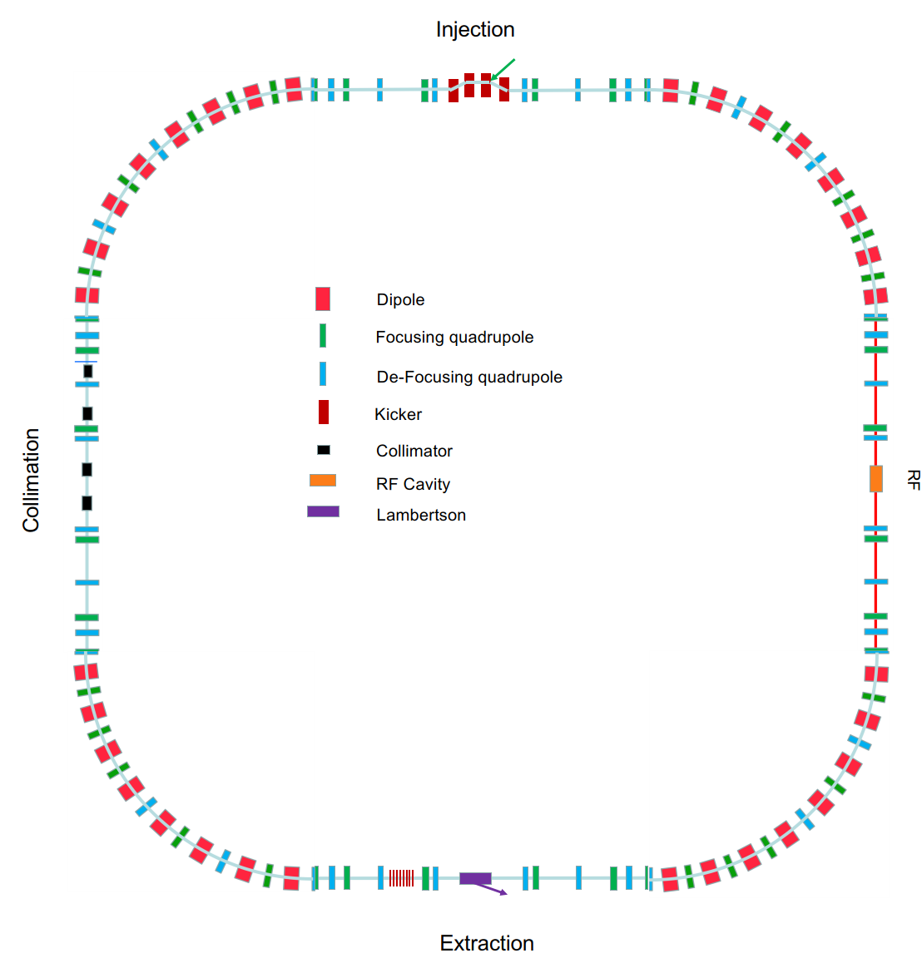
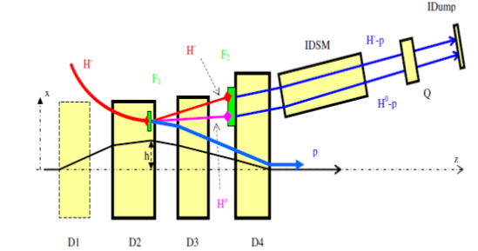
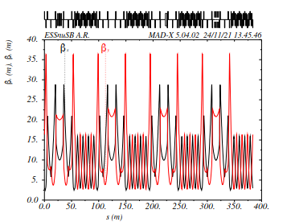
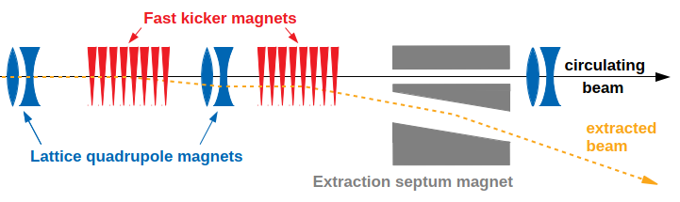
The Accmulator ring
Compresses and divides the 2.86 ms long linac pulse to four 1.2 μs long pulses
Injection with H- stripping
β funcion
around
the ring
Extraction

Slide 33
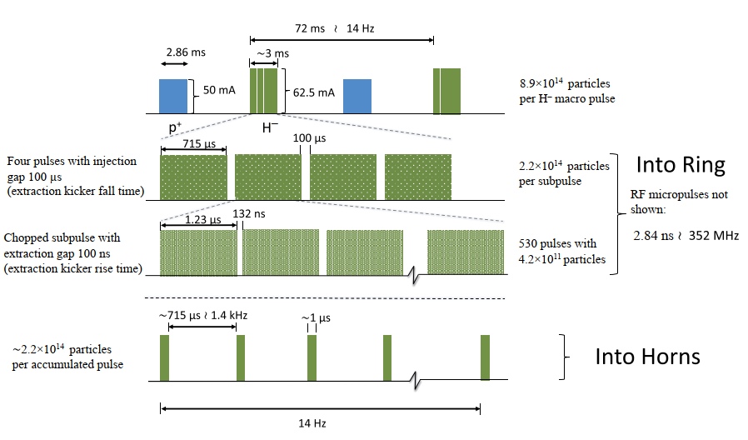
Detailed schematic of the ESSνSB pulsing scheme
Insertion of 14 extra H⁻ pulses per second between the proton pulses, chopping each such pulse into four 715 μs pulses that are sequentially injected in the accumulator ring and compressed to 1.2 μs

Slide 34
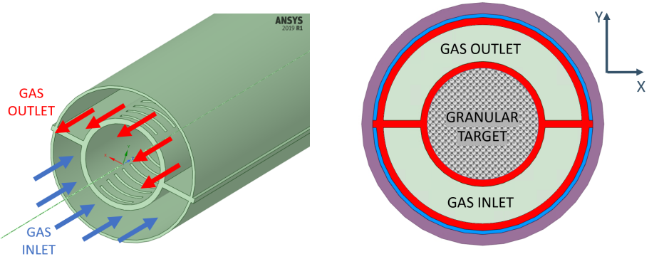
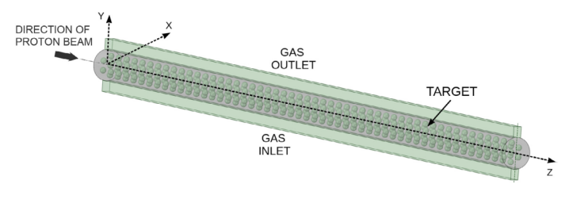
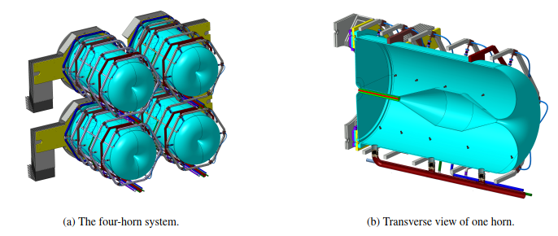
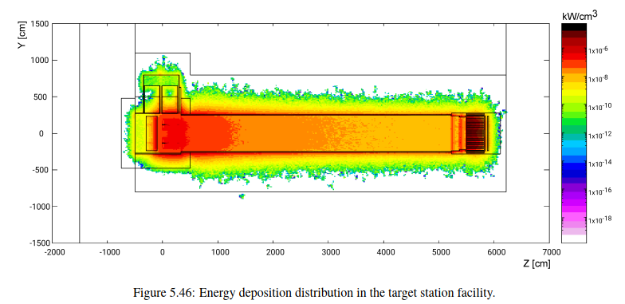
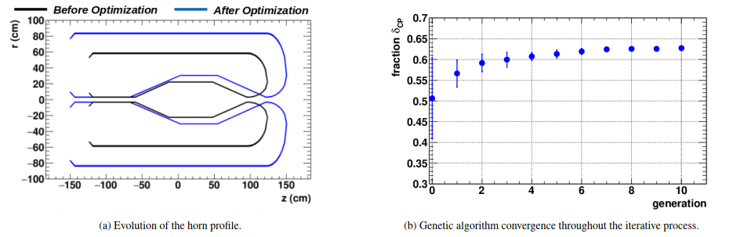
Beam switch-yard and the target station
The beam is split into four and made to hit four granular He-gas-cooled targets surrounded by focussing horns

Slide 35
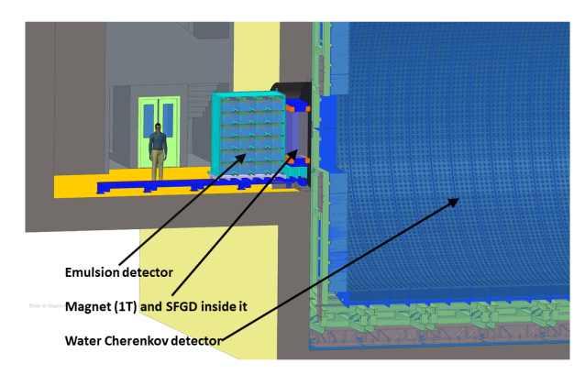
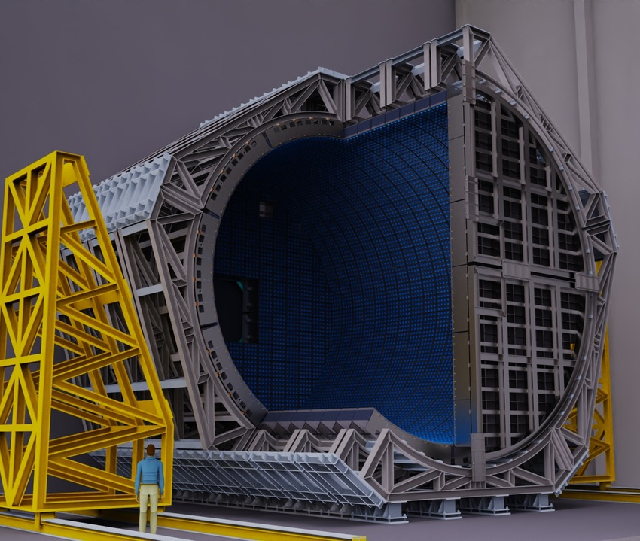
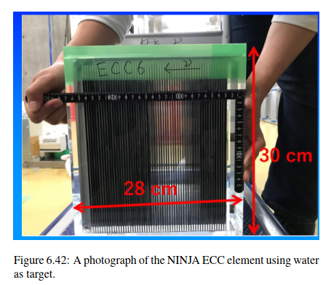


The Near Detector
Near Detector underground station
The super Fine-Grained Detector sFDG

Slide 36






The Far Detector
For Cherenkov imagies in the Far Detector see https://drive.google.com/drive/folders/1DidkJRA05GJtm0vFSqpfpCTAooNWAv22

