Slide 1
Imaging Neutrino interactions with Liquid Argon scintillation light at the DUNE Near Detector Complex
Valentina Cicero (INFN Bologna)
for the DUNE Collaboration
XX International Workshop on Neutrino telescopes
Venezia, October 23-27, 2023

Slide 2
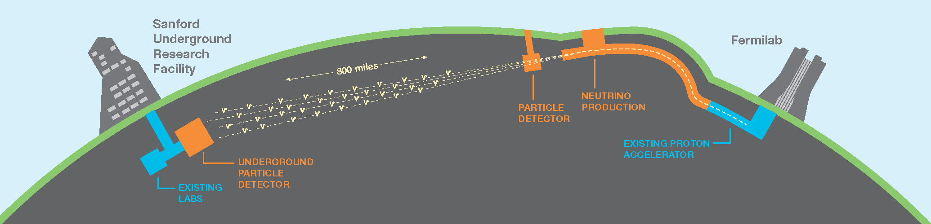
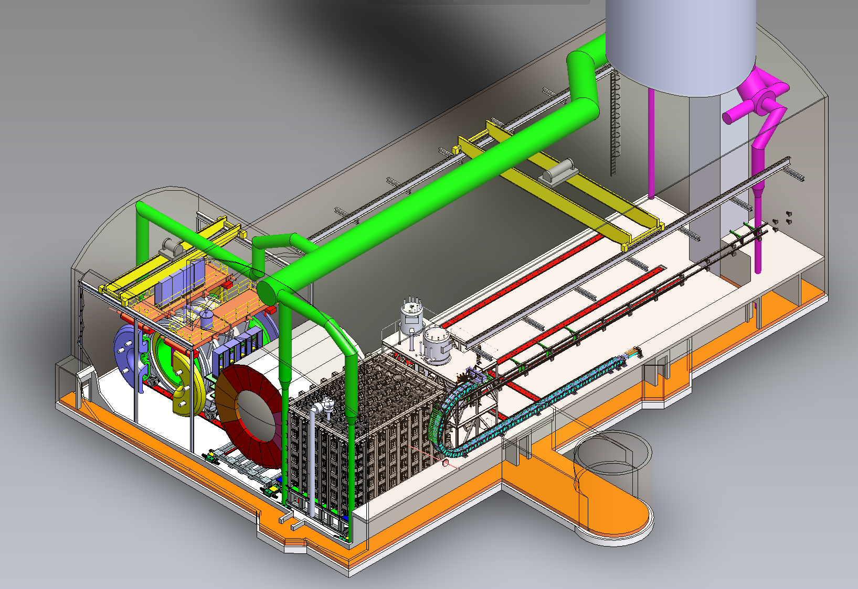
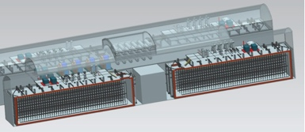

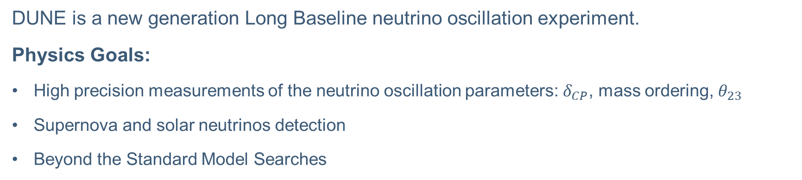

DUNE: Deep Underground Neutrino Experiment
South Dakota
Fermilab
$$ν_{μ}$$
1300 km
$ν_{μ}$,$ν_{e}$,$ν_{τ}$
ND
FD
DUNE is a new generation Long Baseline neutrino oscillation experiment.
Physics Goals:
High precision measurements of the neutrino oscillation parameters: $δ_{CP}$, mass ordering, $θ_{23}$
Supernova and solar neutrinos detection
Beyond the Standard Model Searches

Slide 3
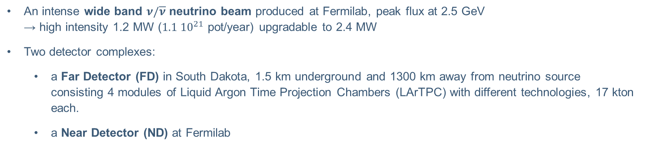
DUNE: Deep Underground Neutrino Experiment
South Dakota
Fermilab
$$ν_{μ}$$
1300 km
$ν_{μ}$,$ν_{e}$,$ν_{τ}$
ND
FD
An intense wide band $ν/\overline{ν}$ neutrino beam produced at Fermilab, peak flux at 2.5 GeV
→ high intensity 1.2 MW ($1.1 {10}^{21}$ pot/year) upgradable to 2.4 MW
Two detector complexes:
  a Far Detector (FD) in South Dakota, 1.5 km underground and 1300 km away from neutrino source
  consisting 4 modules of Liquid Argon Time Projection Chambers (LArTPC) with different technologies, 17 kton each.
  a Near Detector (ND) at Fermilab

Slide 4
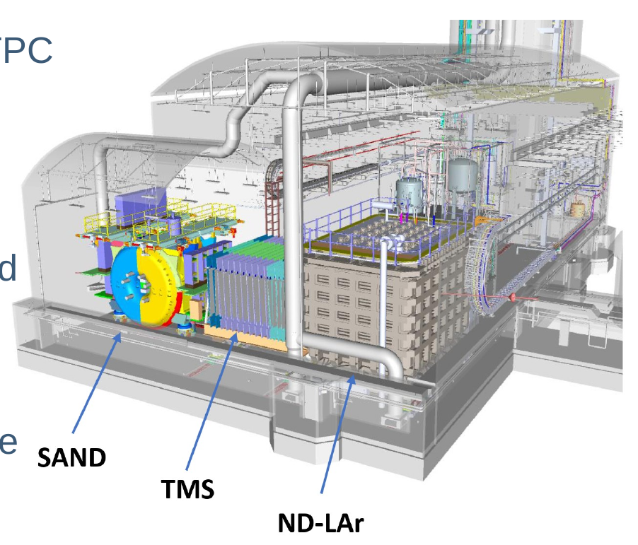
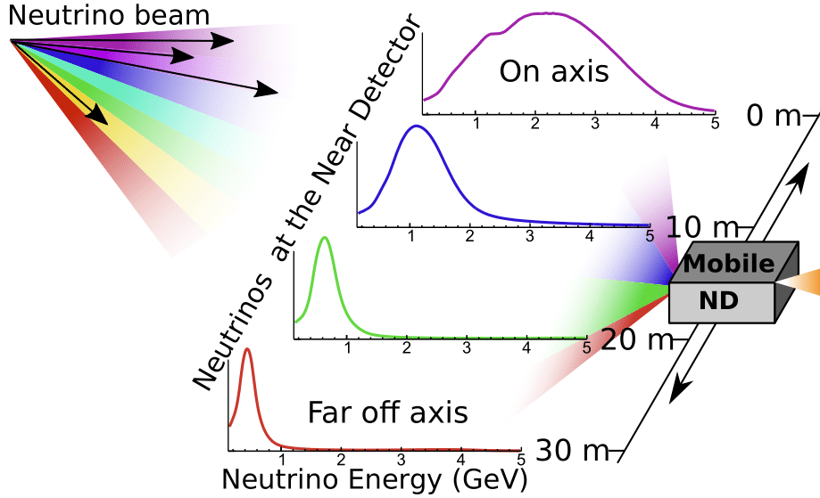
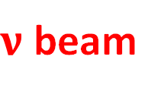
The Near Detector complex
The Near Detector complex will be located 574 m downstream of the neutrino beam.
Three main components:
ND-LAr: a 67 ton modular LArTPC
TMS: The Muon Spectrometer
SAND: System for on Axis Neutrino Detection - a magnetized multi-purpose detector
ND-LAr and TMS will move to “scan” over the spectrum of ν energies to determine the flux at the FD.
$ν$ beam

Slide 5
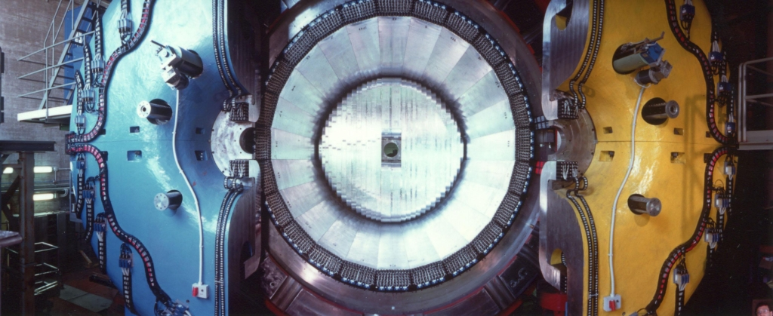
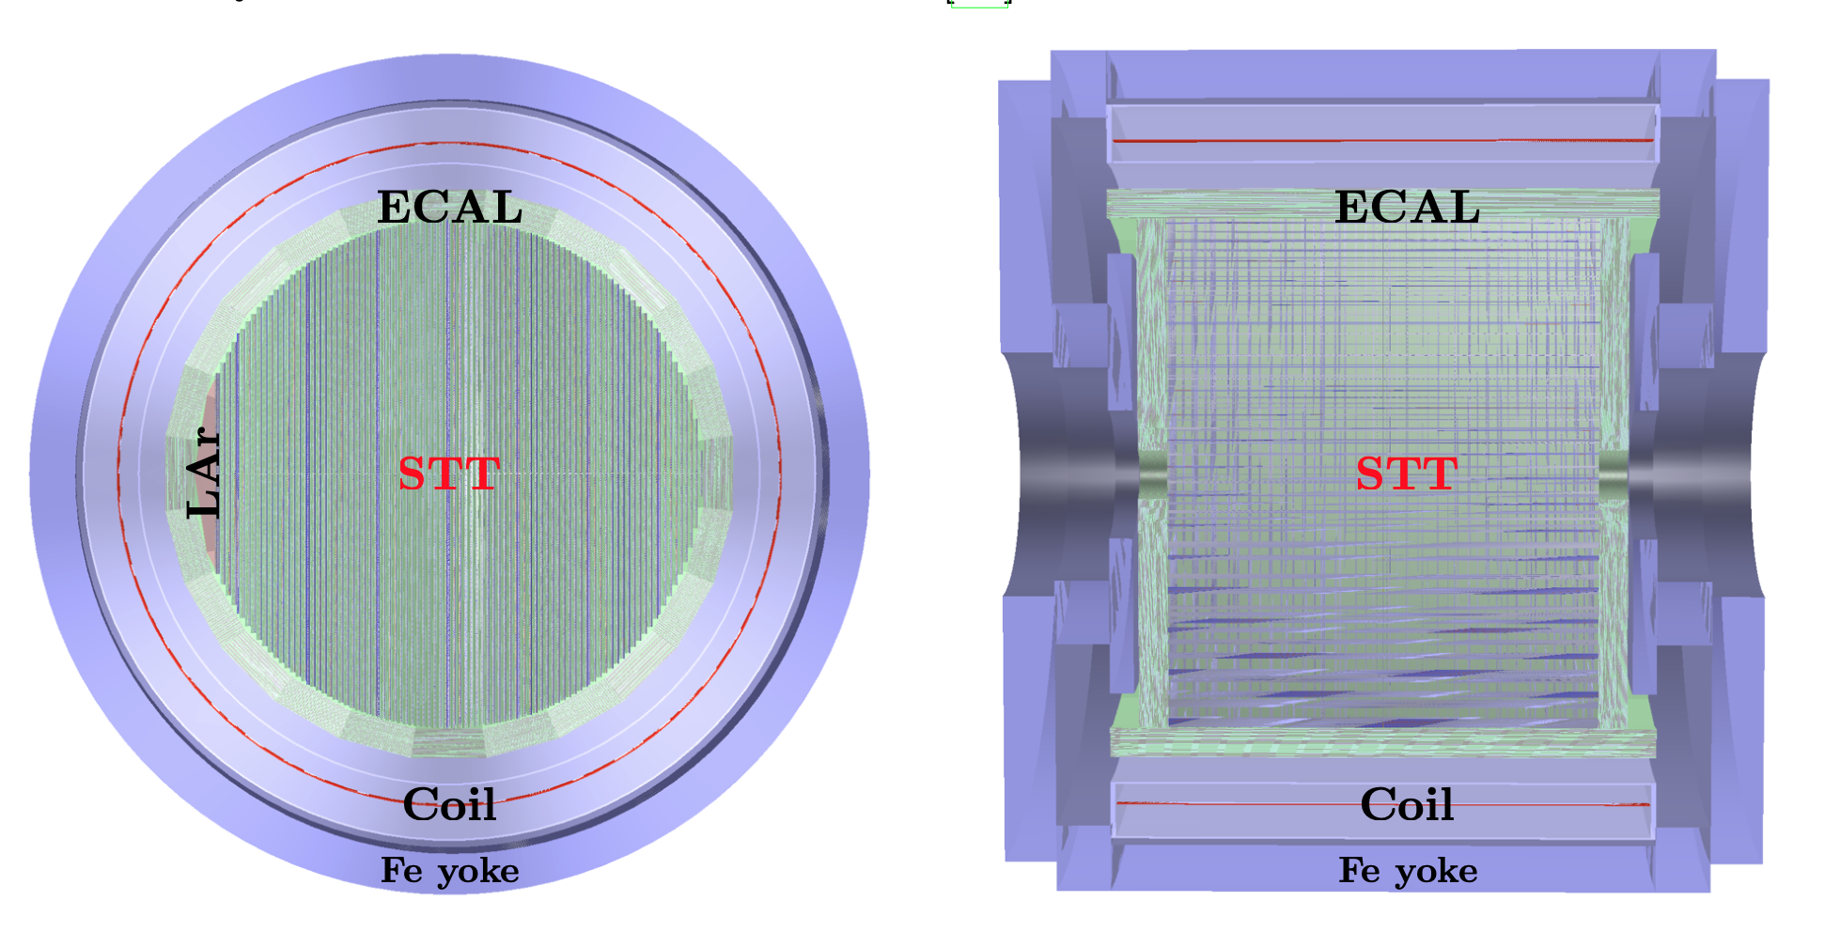
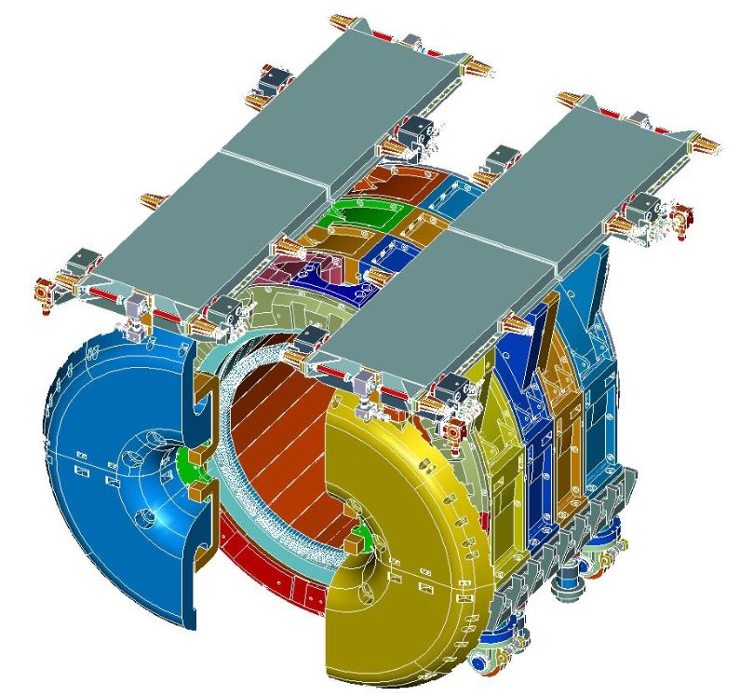

SAND
The only component of the ND that will be permanently located on-axis. SAND consists of:
Superconducting magnet
Electromagnetic Calorimeter (ECAL)
Straw-Tube-Tracker and CH₂, C target
1-ton LAr Active target (GRAIN)
}
Formerly KLOE
STT
LAr
$$ν$$
It aims at:
Monitoring of the on-axis ν spectrum to detect beam variation on a weekly basis
Flux measurements and characterization for both ν_{e} and ν_{µ}
Cross-section measurements on different nuclear targets to constraint systematic effects from nuclear effects
Exploit the unprecedented high statistics to perform a rich physics program besides oscillations

Slide 6
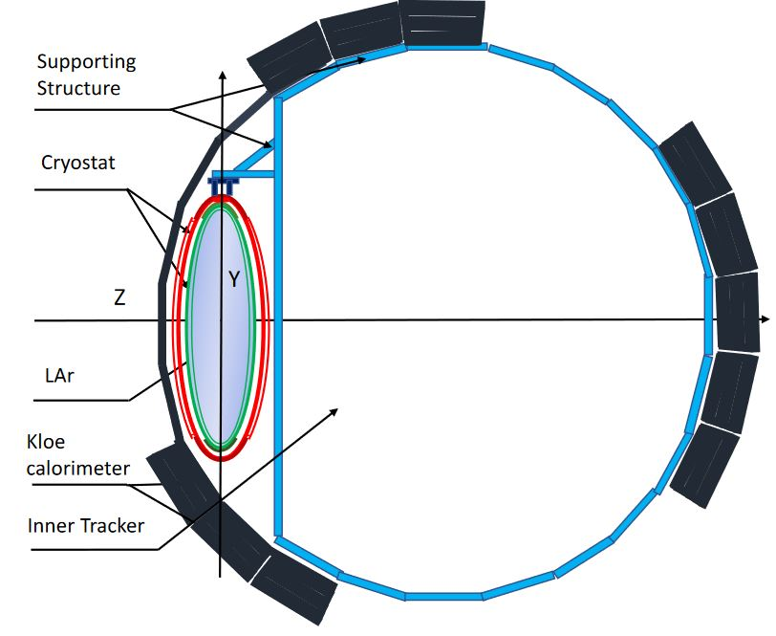
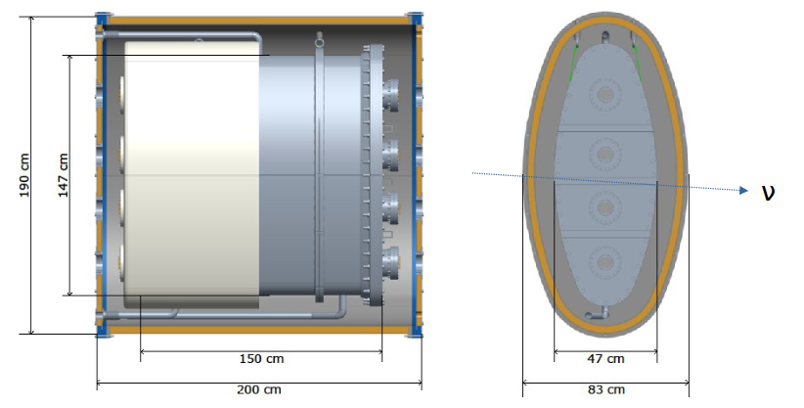

GRAIN
$$ν$$
The upstream part of SAND will be instrumented with GRAIN (GRanular Argon for Interaction of Neutrinos), a 1-ton LAr active target.
Outer vacuum vessel made of C-composite material
Inner Aluminum vessel containing the LAr
Overall radiation length ~ 1 X₀
Its role is constraining nuclear effects on Argon and being a complementary Ar target permanently located on-axis for cross-calibration

Slide 7
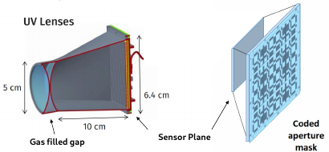
Optical Reconstruction
Equip GRAIN with an imaging device able to collect the scintillation light and perform a fast reconstruction of the events without collecting the charge.
Why
High rate capability
Possibility to work in magnetic fields
Reduced electronic noise
How
sensor: SiPM matrix (32 x 32 SiPMs)
optical system:
  UV gas-filled lenses
  Coded Aperture masks

Slide 8
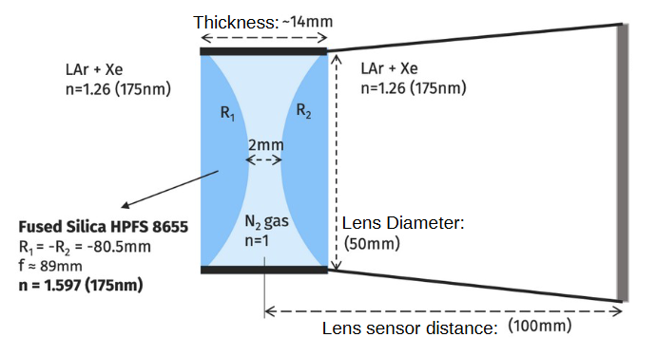
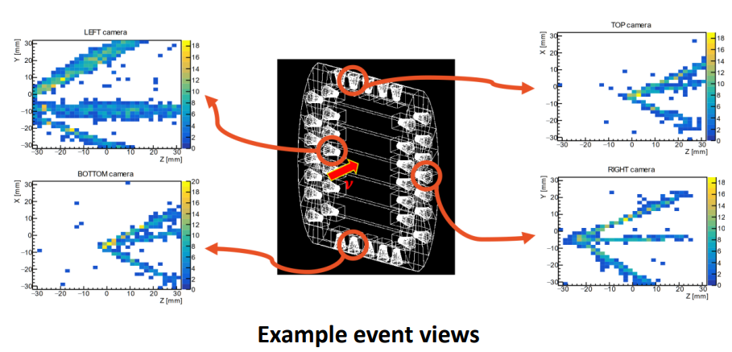
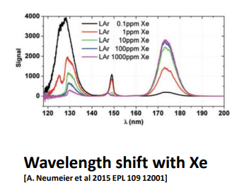
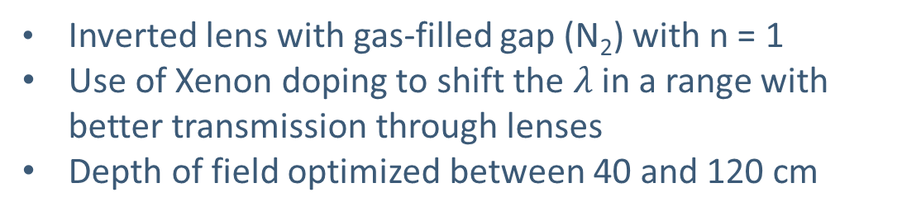
Gas Lens Cameras
Inverted lens with gas-filled gap (N₂) with n = 1
Use of Xenon doping to shift the $λ$ in a range with better transmission through lenses
Depth of field optimized between 40 and 120 cm
60 mm

Slide 9
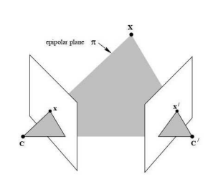
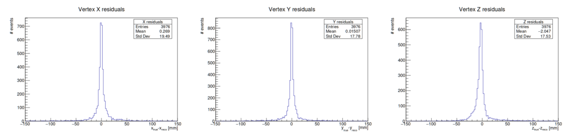
Image reconstruction (lenses)
Track fits on individual views
Epipolar and Multiple-View Projective Geometry methods applied to:
  Muon Track 3D reconstruction
  Two tracks Vertex 3D reconstruction
  Matching conditions for multiple 2D Views and Image Transfer
Excellent resolution from simulation

Slide 10
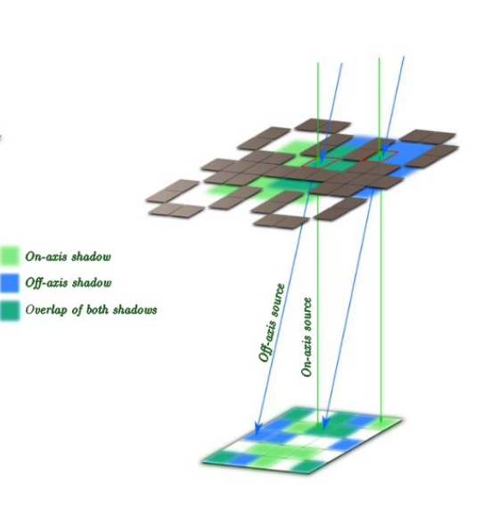
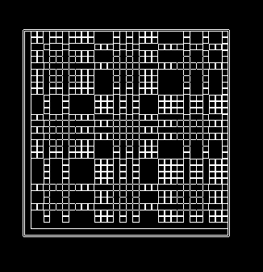
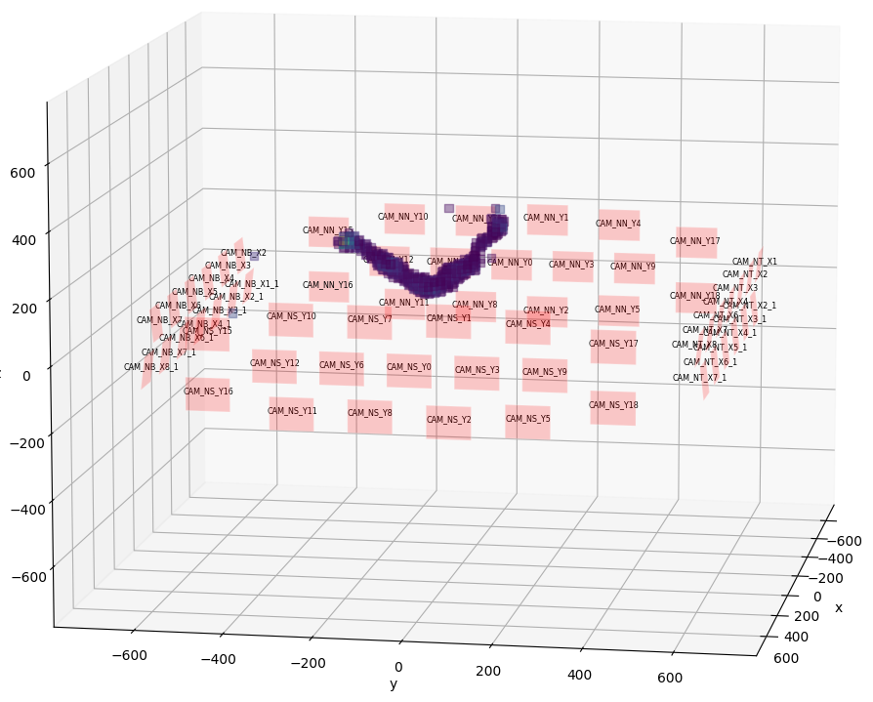
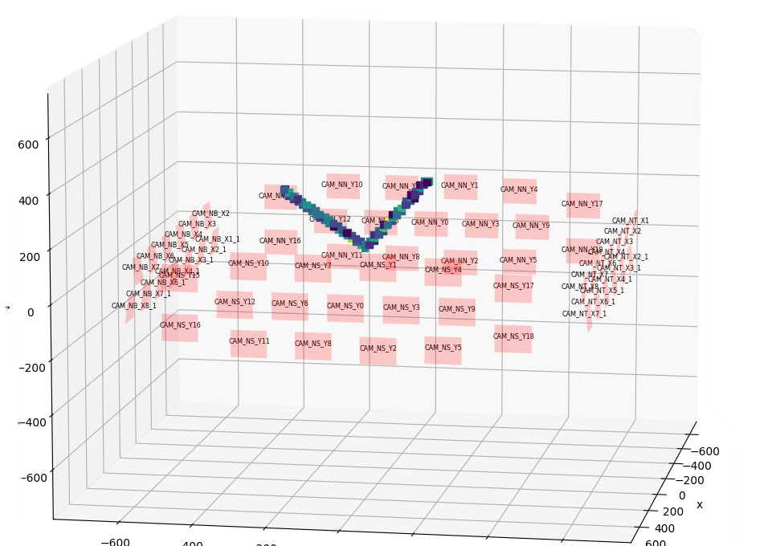
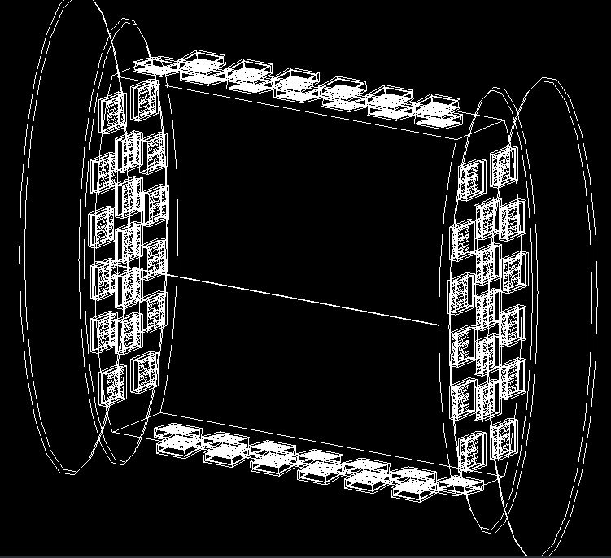

Coded Aperture Cameras
Mask-sensor
Distance: 2cm
Alternative to traditional optical system, used to avoid issues with Argon $λ$ and n.
Compact and easy to build (extension of the pinhole camera)
no Xenon doping needed
good depth of field
worse contrast than lenses
Direct reconstruction in 3 dimensions
10 cm
10 cm
concept
camera
ν_{µ} → µ + p
Reconstructed photons emission point
MC-truth photons emission point
Detector layout
Andreotti, M., et al. "Coded masks for imaging of neutrino events." The European Physical Journal C 81 (2021): 1-15

Slide 11
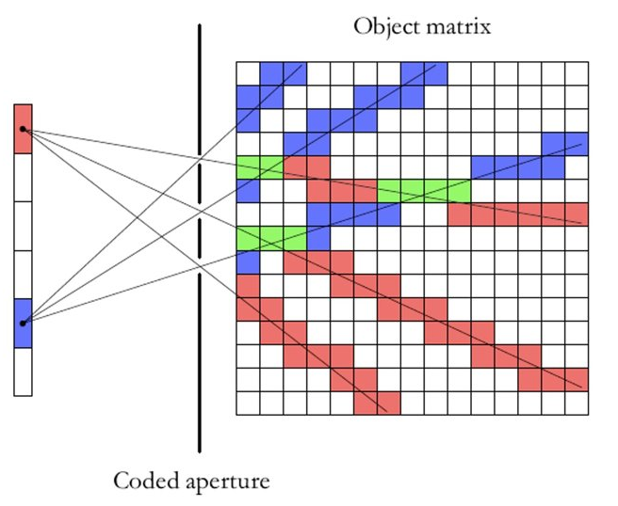
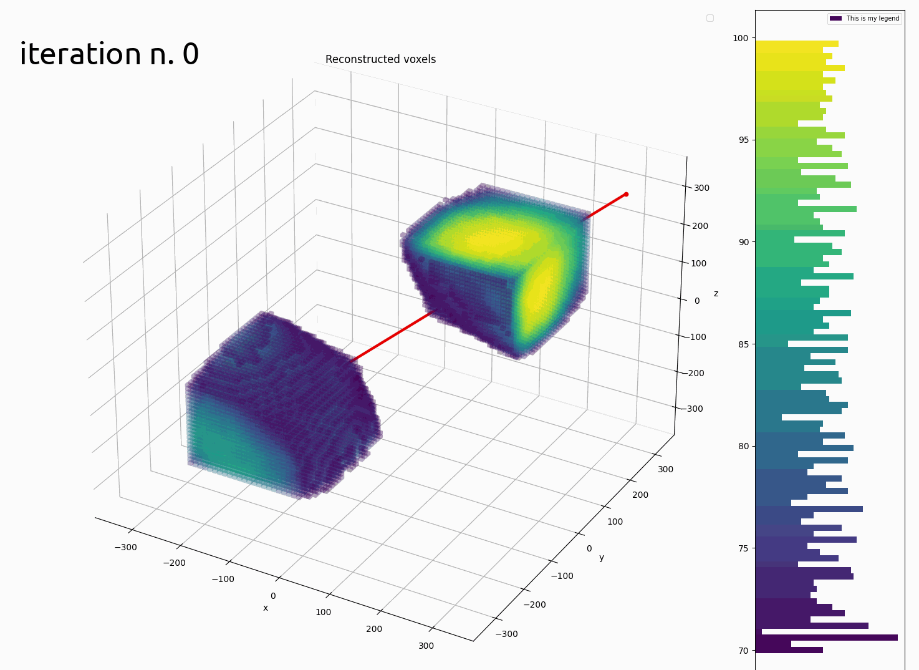
Image reconstruction (Coded Aperture)
Maximum Likelihood Expectation Maximization algorithm:
Backpropagation of the detected photons in the volume through all mask holes, weighted appropriately
Iterative algorithm converges towards the correct solution
Computationally expensive, needs GPUs and lots of RAM

Slide 12
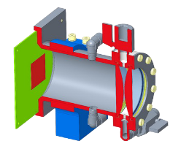
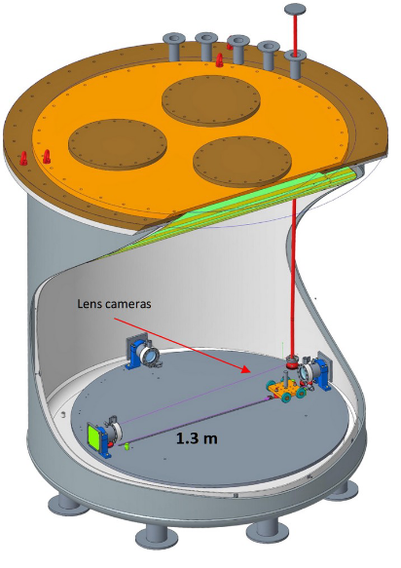
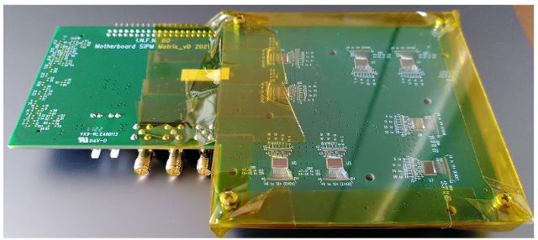
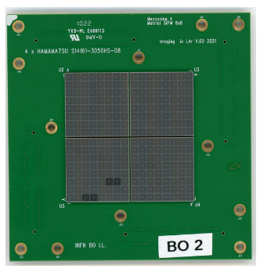
Hardware development
Ongoing activities on two facilities from GRAIN related R&D:
Artic in Genoa, 1 ton LAr cryostat for studies on sensor performance, starting soon
Integration facility in LNL, for vacuum integration studies. It will host an inner vessel prototype, currently in design phase
PCB with 8x32ch ALCOR cryo ASICs
256 channel
SiPM matrix

Slide 13
Outlook
SAND will monitor and characterize DUNE neutrino beam while also performing rich physics program besides oscillations
It will include GRAIN, an innovative detector, which will exploit the argon scintillation light to perform track and energy reconstructions.
Two optical systems are being developed: lens- and coded aperture-based camera
A Cryogenic demonstrator with 3x256 pixel cameras is almost ready
Cameras and a ASIC with 1024 pixel are under development
On track to be ready for DUNE first beams.

Slide 14
Backup Slides

Slide 15
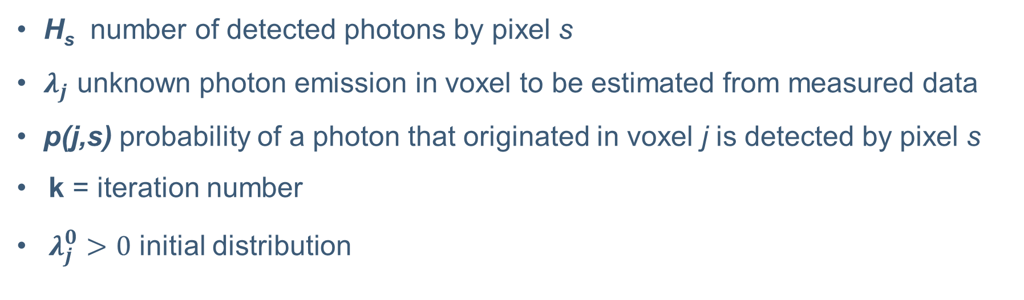
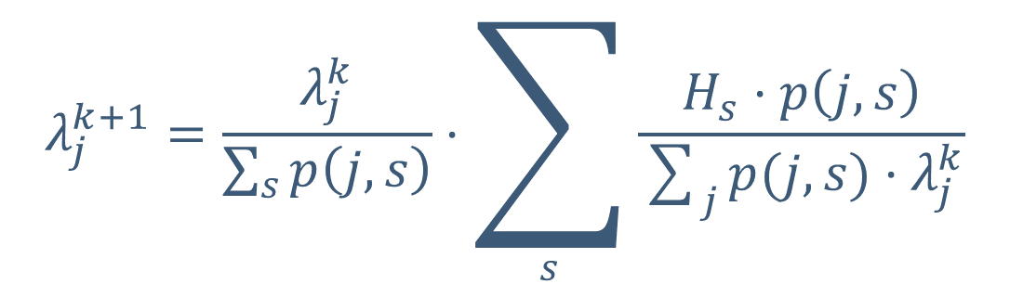
Reconstruction algorithm (Coded Aperture)
$$λ_{j}^{k+1}=\frac{λ_{j}^{k}}{\sum_{s}{p\left(j,s\right)}}⋅\sum_{s}{\frac{H_{s}⋅p\left(j,s\right)}{\sum_{j}{p(j,s)}⋅λ_{j}^{k}}}$$
[Willingale, Sims, and Turner. “Advanced deconvolution techniques for coded aperture imaging” NIM 221.1 (1984). doi: https://doi.org/10.1016/0167-5087(84)90180-7]
H_{s} number of detected photons by pixel s
$λ_{j}$ unknown photon emission in voxel to be estimated from measured data
p(j,s) probability of a photon that originated in voxel j is detected by pixel s
k = iteration number
$λ_{j}^{0}>0$ initial distribution
10/24/2023
V. Cicero| Imaging Neutrino interactions with Liquid Argon scintillation light at the DUNE Near Detector Complex ​
Notes:
Maximum Likelihood Expectation Maximization Algorithm:
The measured data are samples from a set of random variables whose pdf are related to the object distribution according to a model of the data acquisition process;
Calculate the probability that any initial distribution density in the object under study can produce the observed data.
The distribution density with the highest probability is the maximum likelihood estimate of the original object.

Slide 16
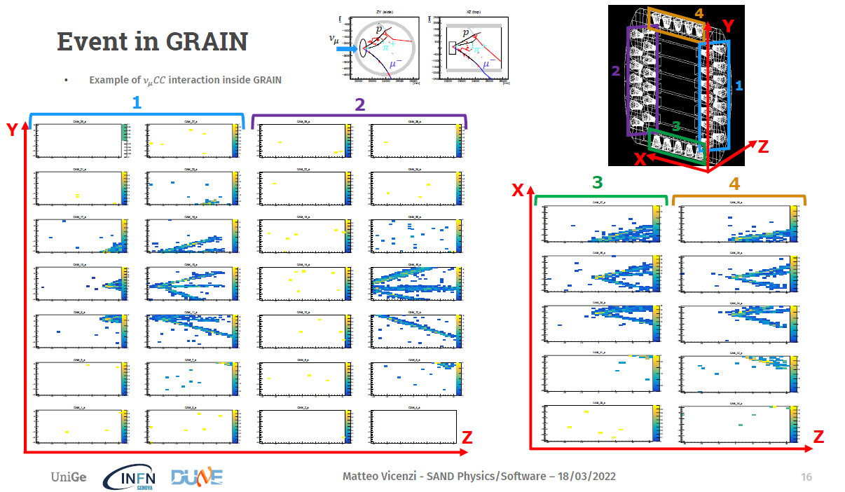
Image reconstruction (lenses)

