Slide 1
AMBER IMPROVEMENTs ON THE PBAR PRODUCTION MODELs

Slide 2
COSMIC ANTIPROTONS CROSS SECTION MODELS
There are many models that we can use to predict the production cross section and the most part of the data are about pp channel. One of the most common model used in literature for the pp channel is the Winkler parametrization (JCAP02(2017)048) that is composed by three parts:
A Tsallis distribution
$$σ_{invariant}\left(\sqrt{s},x_{R},p_{T}\right)=σ_{inel}RC_{1}{(1−x_{R})}^{C_{2}}{\left[1+X(m_{T}−m_{P})\right]}^{−\frac{1}{C_{3}X}}$$
A high energy scaling of the Tsallis distribution
$$X=C_{4}\log^{2}\left(\frac{\sqrt{s}}{4m_{p}}\right)$$
A low energy scaling
$$R=\left\{\begin{aligned}1, \sqrt{s}>10 GeV \\ \begin{aligned} \\ \left[1+C_{5}{\left(10−\sqrt{s}\right)}^{5}\right]exp\left[C_{6}\left(10−\sqrt{s}\right){\left(x_{R}−x_{R,min}\right)}^{2}\right], \\ \sqrt{s}<10 GeV\end{aligned}\end{aligned}\right.$$
JCAP02(2017)048
2
D'Angelo Francesco – INFN, Sezione di Bologna - fdangelo@bo.infn.it

Slide 3
COSMIC ANTIPROTONS CROSS SECTION MODELS
One of the most used model for heavier channels is the Korsmeier-Donato-Di Mauro (KDD) (Phys. Rev. D 97, 103019 (2018)):
$$σ_{A_{1}A_{2} }=f^{A_{1}A_{2}}σ_{pp}$$
$$f^{A_{1}A_{2}}=A_{1}^{D_{1}}A_{2}^{D_{1}}\left[A_{1}^{D_{2}}\left(1+\frac{N_{1}}{A_{1}}∆_{iso}\right)F_{pro}\left(x_{F}\right)+A_{2}^{D_{2}}\left(1+\frac{N_{2}}{A_{2}}∆_{iso}\right)F_{tar}\left(x_{F}\right)\right]$$
Fragmentation of a target in the projectile
Scaling of the total inelastic cross section
Estimation of average number of target nucleons that join the collision
Estimation of average number of projectile nucleons that join the collision
Fragmentation of a nucleons in the projectile
D'Angelo Francesco – INFN, Sezione di Bologna - fdangelo@bo.infn.it
3

Slide 4
COSMIC ANTIPROTONS: FUTURE IMPROVEMENT
MOCK-data procedure (estimation of the AMBER impact on our knowledge):
$$x^{2}=\sum_{i}{\frac{{(y_{i}−{\overline{y}}_{i})}^{2}}{σ_{i}^{2}}+\sum_{k}{\frac{{(y_{i}−{\overline{y}}_{k,AMBER})}^{2}}{σ_{AMBER}^{2}}}}$$
with an overall uncertainty not exceeding 5%:
${\overline{y}}_{k,AMBER}$ is based directly on the model (the chi-square reduced value is not so important)
$y_{i}$ is generated using a gaussian distribution with the experimental uncertainty as the sigma
$σ_{AMBER}^{2}$ is the experimental uncertainty
The MOCK TERM depends only on the experimental uncertainty and the improvement in the parameters of the model is due to the experimental uncertainty
D'Angelo Francesco – INFN, Sezione di Bologna - fdangelo@bo.infn.it
4

Slide 5
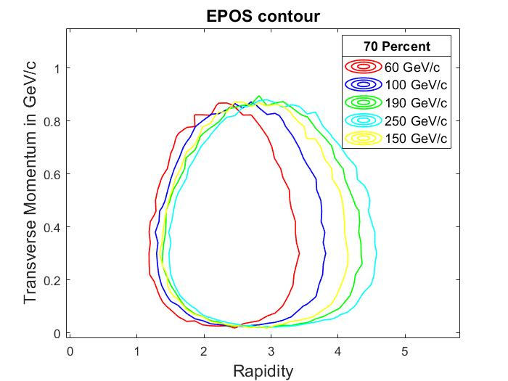
BINNING CHOICE
10 bins in transverse momentum and 10 bin in rigidity:
60 GeV/c – Pt range [0,1]GeV/c – y range [2.4,4]
100 GeV/c – Pt range [0,1]GeV/c – y range [2.4,4]
150 GeV/c – Pt range [0,1.5]GeV/c – y range [2.4,4.5]
190 GeV/c – Pt range [0,1.5]GeV/c – y range [2.4,4.5]
250 GeV/c – Pt range [0,1.5]GeV/c – y range [2.4,4.5]
D'Angelo Francesco – INFN, Sezione di Bologna - fdangelo@bo.infn.it
5

Slide 6
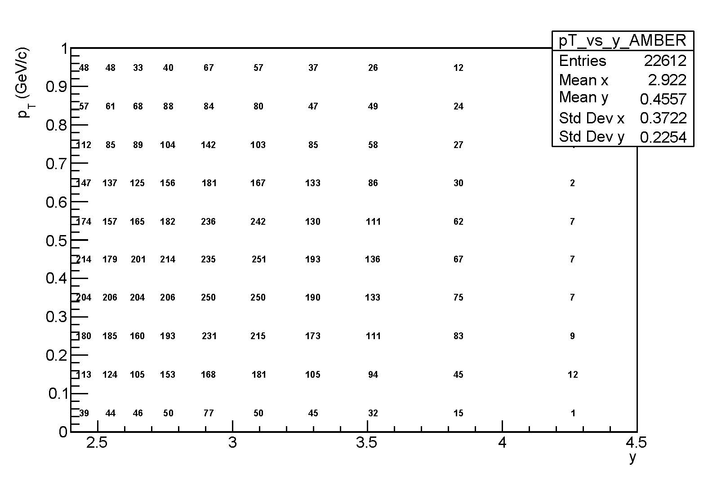
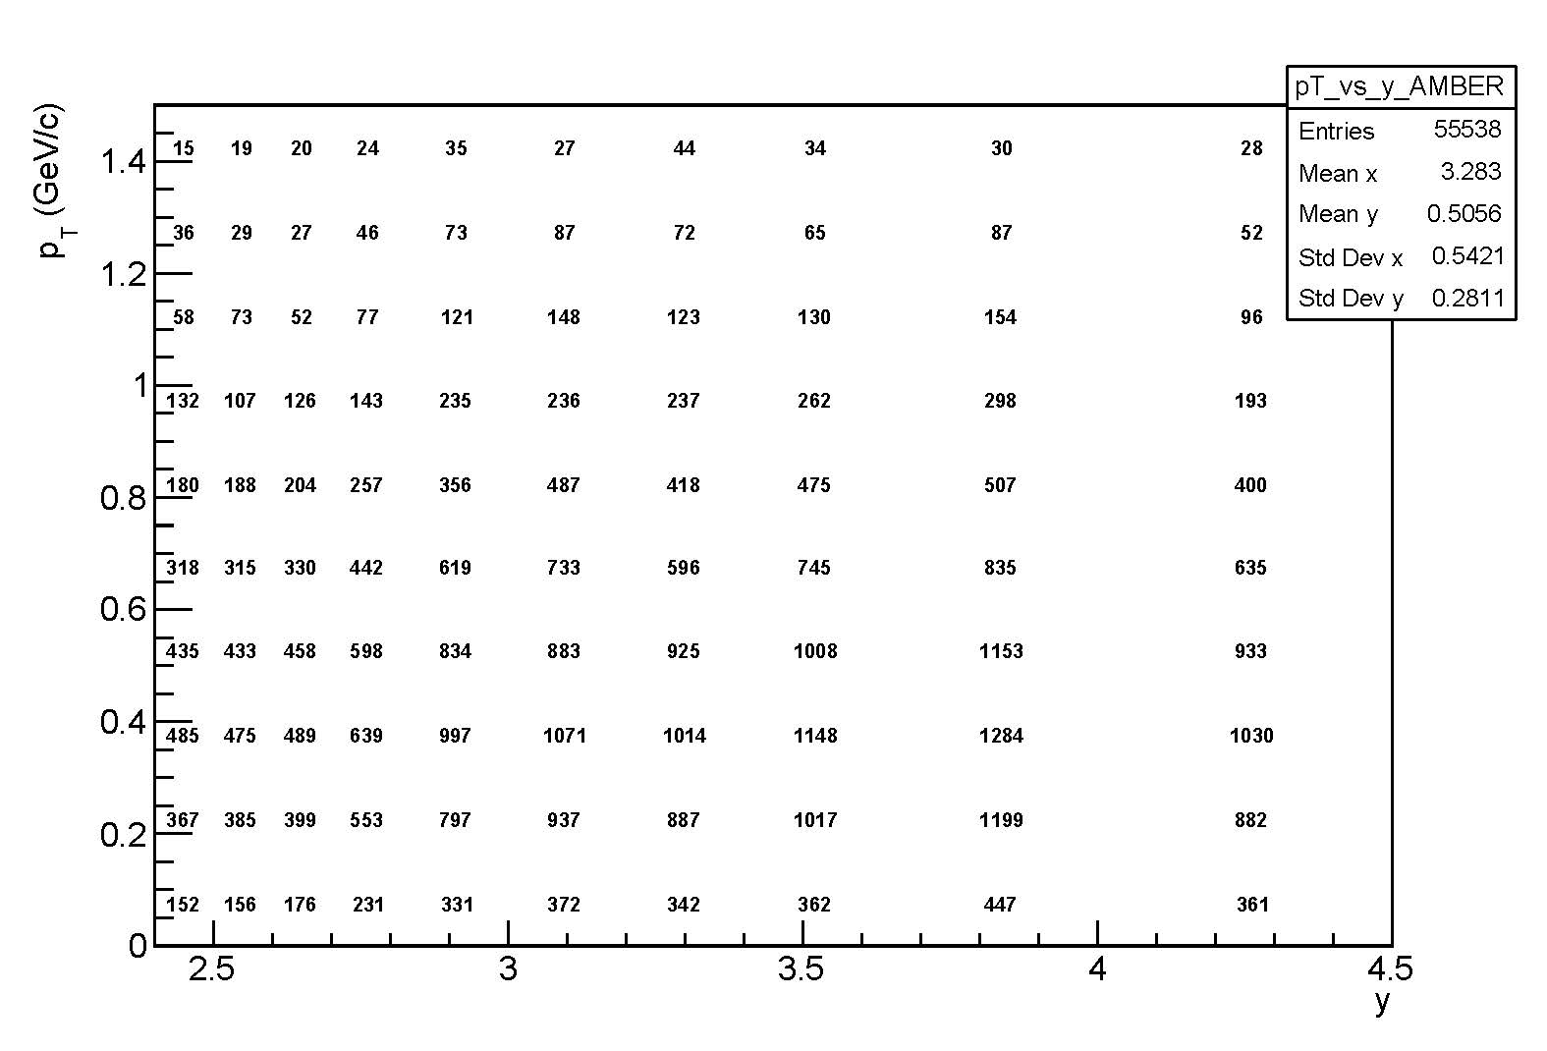
BINNING CHOIcE - SIMULATIONS
Antiproton produced in 1 millions of pHe collisions – simulated using EPOS_LHC
Incident proton 60 GeV/c
Incident proton 190 GeV/c
D'Angelo Francesco – INFN, Sezione di Bologna - fdangelo@bo.infn.it
6

Slide 7
CROSS SECTION IMPROVEMENT
I found the best-fit parameters of the previous parametrizations using the NA49, NA61, STAR, ALICE and CMS dataset. Here is shown the comparisons with the Winkler and the Korsmeier-Donato-Di Mauro fit:
PARAMETER | WINKLER | Korsmeier-Donato-Di Mauro | MINE | MINE (after MOCK data)
C1 | $$0.047$$ | $$0.0502±0.0022$$ | $$0.0530±0.0012$$ | //
C2 | $$7.76$$ | $$7.79±0.077$$ | $$7.951±0.075$$ | //
C3 | $$0.168$$ | $$0.1649±0.0012$$ | $$0.1626±0.0011$$ | //
C4 | $$0.038±0.00057$$ | $0.038±0.00057$(fixed) | $$0.0422±0.0010$$ | //
C5 | $$0.001±0.0004$$ | $$0.000474±0.000259$$ | $$0.005746±0.000974$$ | //
C6 | $$0.7±0.04$$ | $$3.70±0.64$$ | $$3.289±1.570$$ | //
Data used | Main: Na49 C4: Phenix, Star, Alice, Cms | Na49, Shine, Ps data | Na49, Shine, Star, Alice, Cms | //
D1 | // | $$0.828±0.012$$ | $$0.834±0.012$$ | 0.830$±$0.003
D2 | // | $$0.145±0.012$$ | $$0.114±0.012$$ | 0.114$±$0.005
Data used | // | SMOG (pHe), NA49 (pC) | SMOG (pHe), NA49 (pC) | SMOG(pHe), NA49 (pC), AMBER (pHe)
BEFORE
AFTER
D'Angelo Francesco – INFN, Sezione di Bologna - fdangelo@bo.infn.it
7

Slide 8
CROSS SECTION IMPROVEMENT
$$\frac{dσ}{dE_{\overline{p}} } in \frac{mb}{GeV}$$
Before mock data
Before mock data
After mock data
After mock data
Only pHe channel
Only pHe channel
D'Angelo Francesco – INFN, Sezione di Bologna - fdangelo@bo.infn.it
8

