Slide 1
Torino Group model uncertainties

Slide 2
TORINO GROUP MODEL
One of the most used model for heavier channels is the Korsmeier-Donato-Di Mauro (KDD) (Phys. Rev. D 97, 103019 (2018)):
$$σ_{A_{1}A_{2} }=f^{A_{1}A_{2}}σ_{pp}$$
$$f^{A_{1}A_{2}}=A_{1}^{D_{1}}A_{2}^{D_{1}}\left[A_{1}^{D_{2}}\left(1+\frac{N_{1}}{A_{1}}∆_{iso}\right)F_{pro}\left(x_{F}\right)+A_{2}^{D_{2}}\left(1+\frac{N_{2}}{A_{2}}∆_{iso}\right)F_{tar}\left(x_{F}\right)\right]$$
Fragmentation of a target in the projectile
Scaling of the total inelastic cross section
Estimation of average number of target nucleons that join the collision
Estimation of average number of projectile nucleons that join the collision
Fragmentation of a nucleons in the projectile

Slide 3
TORINO GROUP MODEL
One of the most used model for heavier channels is the Korsmeier-Donato-Di Mauro (KDD) (Phys. Rev. D 97, 103019 (2018)):
$$σ_{A_{1}A_{2} }=f^{A_{1}A_{2}}σ_{pp}$$
$$f^{A_{1}A_{2}}=A_{1}^{D_{1}}A_{2}^{D_{1}}\left[A_{1}^{D_{2}}\left(1+\frac{N_{1}}{A_{1}}∆_{iso}\right)F_{pro}\left(x_{F}\right)+A_{2}^{D_{2}}\left(1+\frac{N_{2}}{A_{2}}∆_{iso}\right)F_{tar}\left(x_{F}\right)\right]$$

Slide 4
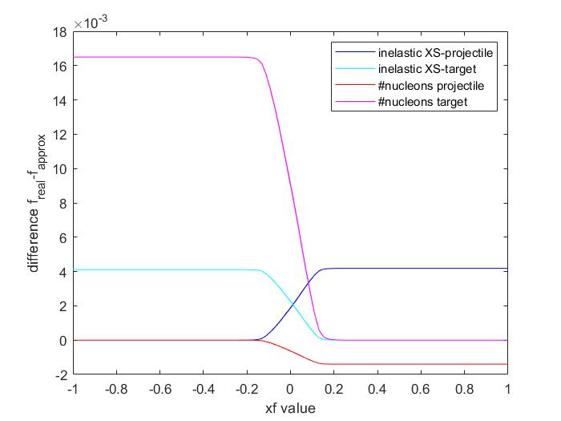
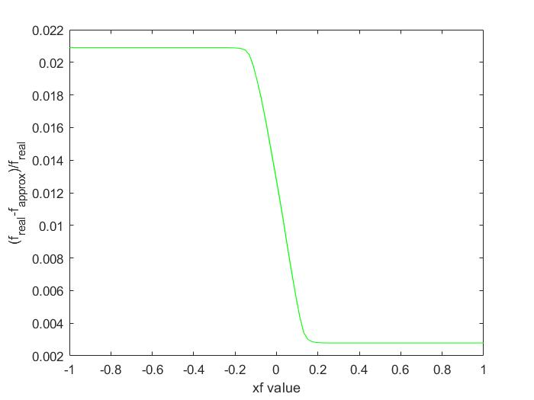
pHe channel – linear theory estimation
Underestimation of about 2% in the target fragmentation region using linear theory

Slide 5
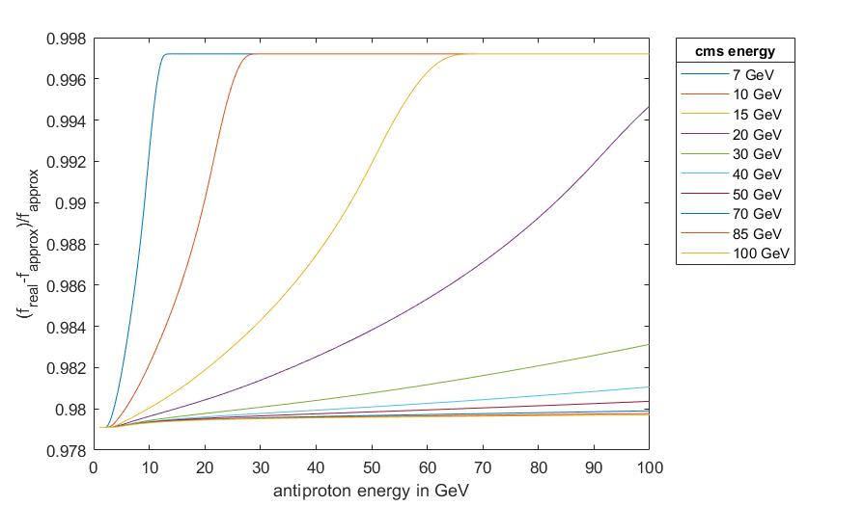
pHe channel – linear theory estimation
Underestimation of about 2% in the target fragmentation region using linear theory
Underestimation of about 2% expecially at high cms energy due to the Lorentz boost

Slide 6
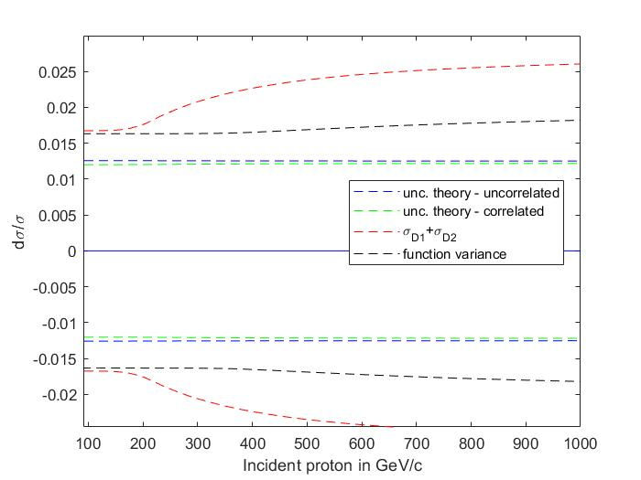
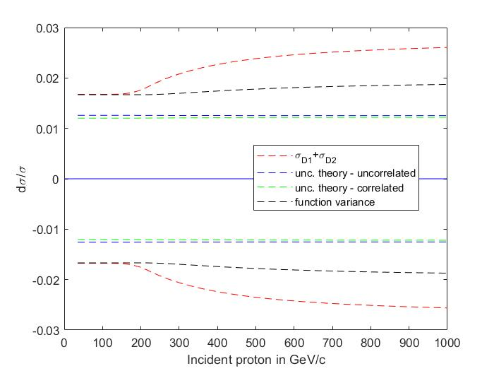
pHe channel - uncertainties
30 GeV Epbar
50 GeV Epbar
In the lab frame, higher pbar energies correspond to smaller collision angles

Slide 7
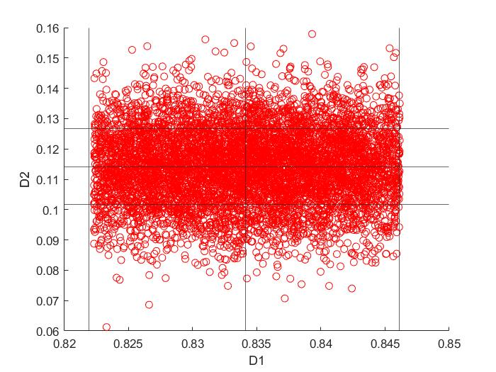
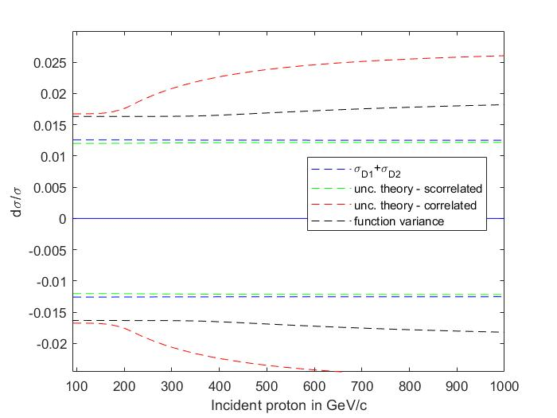
pHe channel - uncertainties
<D1>-sigmaD1
<D1>
<D1>+sigmaD1
30 GeV Epbar
50 GeV Epbar
<D2>+sigmaD2
<D2>
<D2>-sigmaD2
For low cms energies the cross section the anticorrelation between D1 and D2 is less effective and the function is more sensitive to the D1 parameter

Slide 8
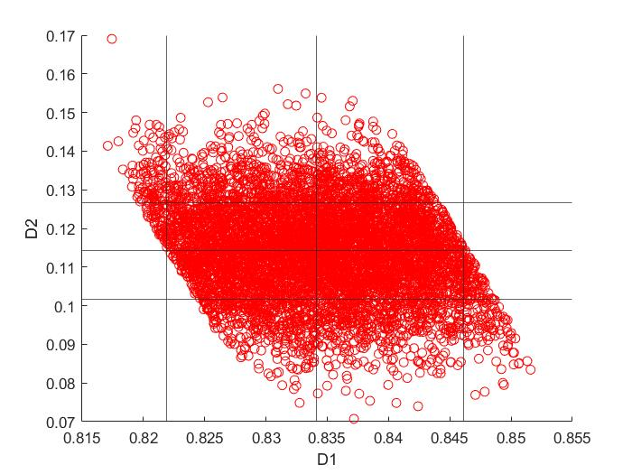
pHe channel - uncertainties
<D1>-sigmaD1
<D1>
<D1>+sigmaD1
<D2>+sigmaD2
<D2>
<D2>-sigmaD2
For high cms energy and low antiproton energies the anticorrelation between D1 and D2 generate f values in the confidence interval of +- one variance

Slide 9
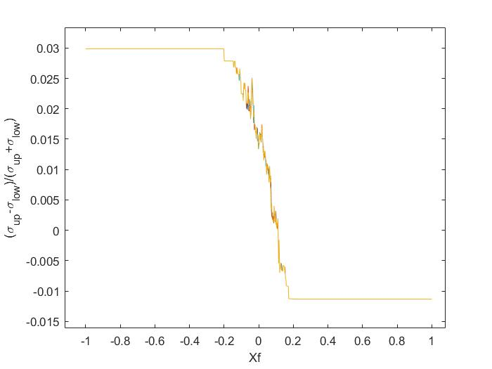
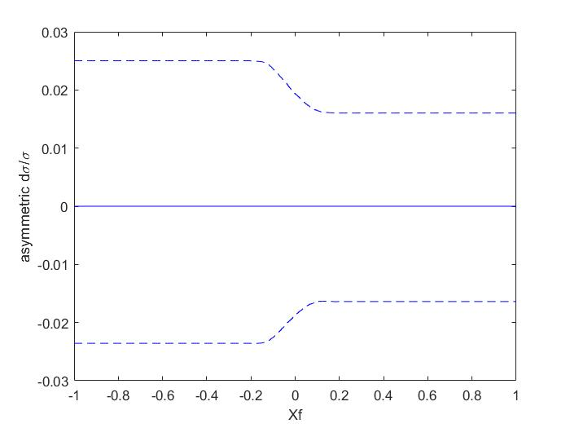
pHe channel - uncertainties
Similar for all pbar energies

Slide 10
pHe channel - uncertainties
BUT:
Sigmas are roughly 2.5% of the function
Asimmetry is at roughly 2% level (highly variable due to the statistic) so its effects on the function is at 1/1000 level

Slide 11
pHe channel - uncertainties
BUT:
ASIMMETRY EFFECTS NEGLIGIBLE FOR FUNCTION STATISTICAL UNCERTAINTIES LOWER THAN 1/10000
(10^8 points needed)
SAME PRECISION REQUESTED IN THE MODEL PARAMETERS

Slide 12
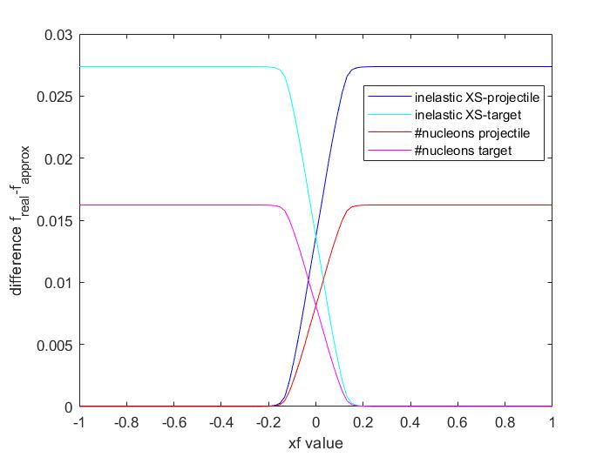
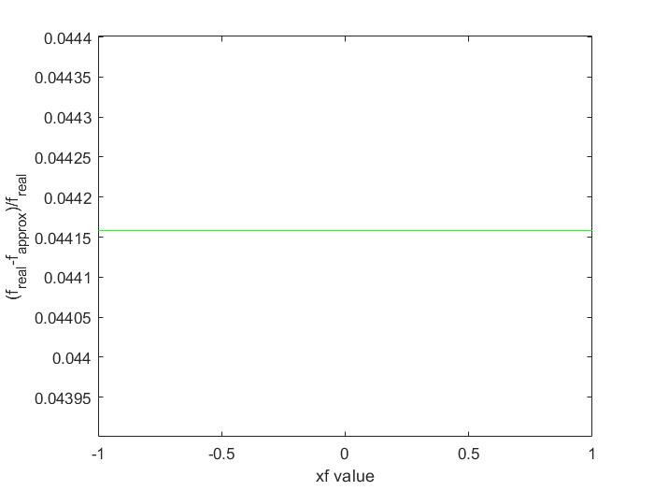
HeHe channel – symmetric collision
Underestimation of about 5% using linear theory (homogeneous in the phasespace because the collision is simmetric)

Slide 13
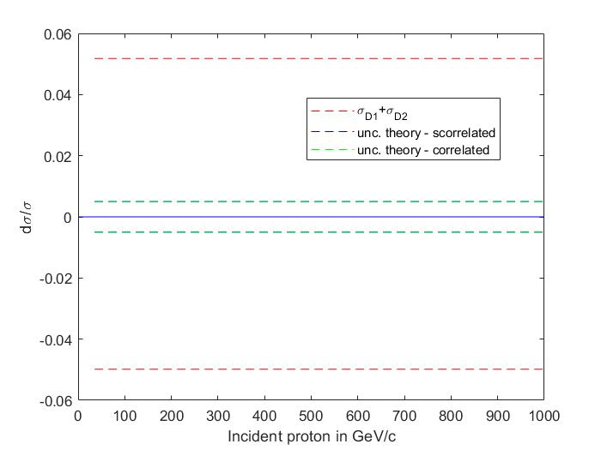
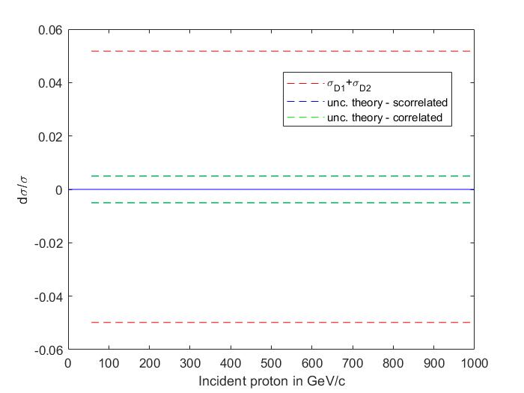
HeHe channel - uncertainties
Discrepacy doesn’t depend roughly on the antiprotons energy
50 GeV Epbar
30 GeV Epbar

Slide 14
HeHe channel - uncertainties
Discrepacy doesn’t depend roughly on the antiprotons energy
50 GeV Epbar
30 GeV Epbar
5% discrepancy between linear theory and the evaluation of uncertainties using sum of sigmas

Slide 15
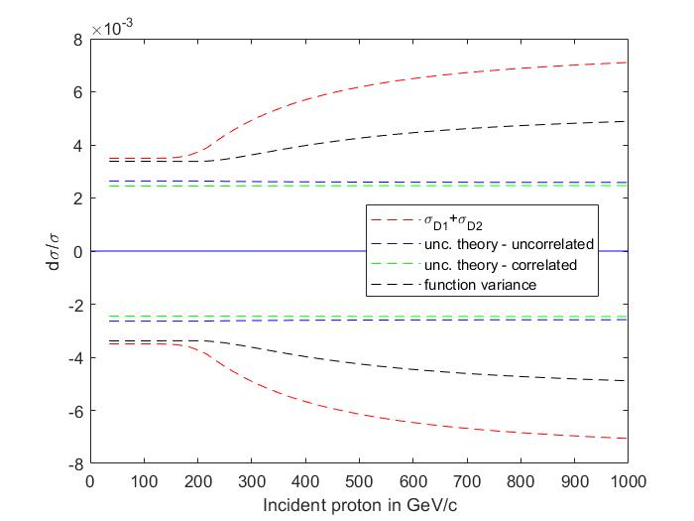
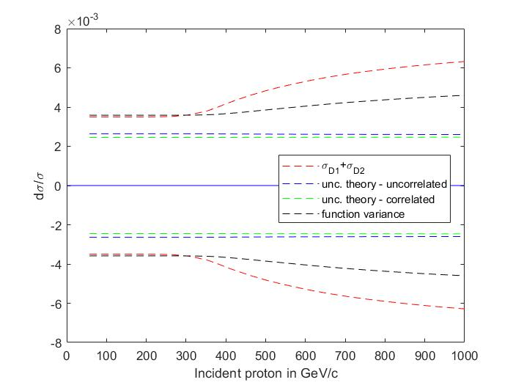
pHe channel – Mock data improvement
30 GeV Epbar
50 GeV Epbar

