Slide 1
GENERAL REVIEW

Slide 2
DATASET (pp) - REVIEW
EXPERIMENT | CMS ENERGY [GeV] | REFERENCE | NOTES
ISR | 6.1 up to 53 | M. Antinucci et al., Lett. Nuovo Cim. 6 (1973). | Old data
NA49 | 17.3 | Eur. Phys. J. C (2010) 65: 9–63
NA61 | 7.7, 8.7, 12.3, 17.3 | Eur. Phys. J. C 77, 671 (2017)
STAR | 200 | Phys.Lett.B616:8-16,2005 | No anti-hyperons correction
PHENIX | 62.4, 200 | PRC 83, 064903 (2011) | Scaling problem, tensions with other data
ALICE | 900 | Eur. Phys. J. C 71 (2011) 1655
CMS | 900, 2760 | Eur. Phys. J. C (2012) 72:2164 | 0.78 factor due to particle selection
BRAHMS | 200 | Phys. Rev. Lett. 98, 252001 | Tension with SHINE data, old data
PS | 6.1, 6.7 | Phys. Rev. 137, B962 (1965) | Old data

Slide 3
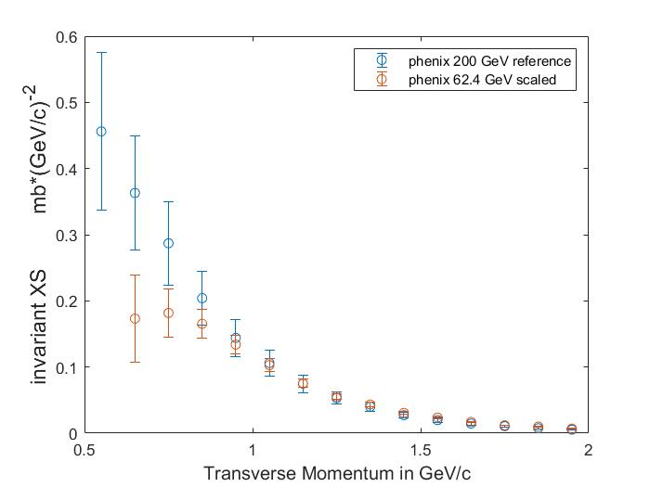
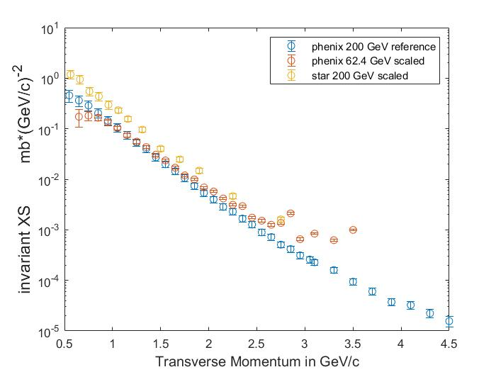
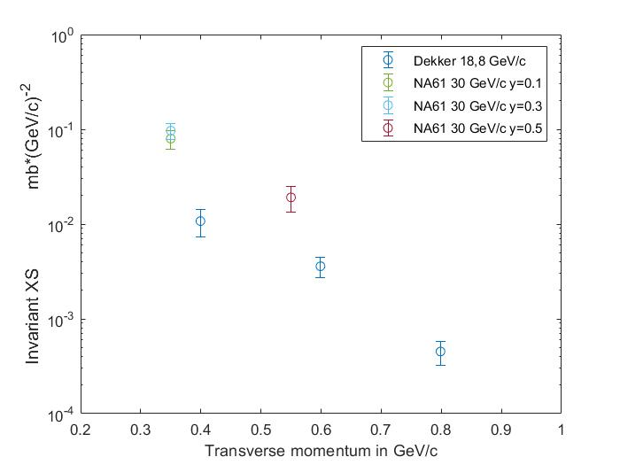
DATASET (pp) - TENSIONS
PHENIX datasets have different shapes.
The shape is also different than other experiments (cms, alice, shine, na49 and star)
PS data vs SHINE data at low energies

Slide 4
WINKLER MODEL (pp) - EXPLAINATION
There are many models that we can use to predict the production cross section and the most part of the data are about pp channel. One of the most common model used in literature for the pp channel is the Winkler parametrization (JCAP02(2017)048) that is composed by three parts:
A Tsallis distribution
$$σ_{invariant}\left(\sqrt{s},x_{R},p_{T}\right)=σ_{inel}RC_{1}{(1−x_{R})}^{C_{2}}{\left[1+X(m_{T}−m_{P})\right]}^{−\frac{1}{C_{3}X}}$$
A high energy scaling of the Tsallis distribution
$$X=C_{4}\log^{2}\left(\frac{\sqrt{s}}{4m_{p}}\right)$$
A low energy scaling
$$R=\left\{\begin{aligned}1, \sqrt{s}>10 GeV \\ \begin{aligned} \\ \left[1+C_{5}{\left(10−\sqrt{s}\right)}^{5}\right]exp\left[C_{6}\left(10−\sqrt{s}\right){\left(x_{R}−x_{R,min}\right)}^{2}\right], \\ \sqrt{s}<10 GeV\end{aligned}\end{aligned}\right.$$
JCAP02(2017)048

Slide 5
WINKLER MODEL (pp) – PARAMETER SET
PARAMETER | WINKLER | Korsmeier-Donato-Di Mauro | MINE
C1 | $$0.047$$ | $$0.0502±0.0022$$ | $$0.0530±0.0012$$
C2 | $$7.76$$ | $$7.79±0.077$$ | $$7.951±0.075$$
C3 | $$0.168$$ | $$0.1649±0.0012$$ | $$0.1626±0.0011$$
C4 | $$0.038±0.00057$$ | $0.038±0.00057$(fixed) | $$0.0422±0.0010$$
C5 | $$0.001±0.0004$$ | $$0.000474±0.000259$$ | $$0.005746±0.000974$$
C6 | $$0.7±0.04$$ | $$3.70±0.64$$ | $$3.289±1.570$$
Data used | Main: Na49 C4: Phenix, Star, Alice, Cms | Na49, Shine, Ps data | Na49, Shine, Star, Alice, Cms

Slide 6
WINKLER MODEL (pp) – CHI-SQUARE
EXPERIMENT | $\sqrt{s}$ [GeV] | Pt range [GeV/c] | y range (cm frame) | CHI-SQUARE Original Torino D’Angelo |  |  | GDL | REDUCED CHI-SQUARE Original Torino D’Angelo
NA61-SHINE | 7.7 | 0.05 ÷ 0.85 | 0.1 ÷ 0.9 | 41.3870 | 38.4457 | 60.1537 | 40 | 1.0347 | 0.9611 | 1.5038
NA61-SHINE | 8.7 | 0.05 ÷ 0.95 | 0.1 ÷ 0.9 | 91.4319 | 134.3809 | 133.6005 | 37 | 2.4711 | 3.6319 | 3.6108
NA61-SHINE | 12.3 | 0.05 ÷ 1.05 | 0.1 ÷ 1.5 | 127.2846 | 161.9192 | 157.9631 | 81 | 1.5714 | 1.9990 | 1.9502
NA61-SHINE | 17.3 | 0.05 ÷ 1.25 | 0.1 ÷ 1.9 | 98.4896 | 151.5041 | 172.2464 | 91 | 1.0823 | 1.6649 | 1.8928
NA49 | 17.3 | 0.1 ÷ 1.5 | -0.44 ÷ 2 | 302.1321 | 513.1690 | 605.5814 | 143 | 2.1128 | 3.5921 | 4.2328
PHENIX | 62.4 | 0.65 ÷ 3.3 | -0.6 ÷ 0.6 | 80.6017 | 95.2971 | 101.2070 | 27 | 2.9852 | 3.5295 | 3.7484
PHENIX | 200 | 0.55 ÷ 4.5 | -0.6 ÷ 0.6 | 59.9934 | 58.4856 | 156.4677 | 34 | 1.7645 | 1.7202 | 4.6020
STAR | 200 | 0.468 ÷ 2.75 | -0.5 ÷ 0 | 6.7838 | 6.5742 | 3.4622 | 14 | 0.4846 | 0.4696 | 0.2473
ALICE | 900 | 0.375 ÷ 2.3 | -0.5 ÷ 0.5 | 233.3357 | 175.5351 | 113.4753 | 24 | 9.7223 | 7.3140 | 4.7281
CMS | 900 | 0.375 ÷ 1.625 | -1 ÷ 1 | 592.9555 | 469.6880 | 207.7406 | 26 | 22.8060 | 18.0649 | 7.9900
CMS | 2760 | 0.375 ÷ 1.675 | -1 ÷ 1 | 1398.2 | 1182.6 | 719.8549 | 27 | 51.7870 | 43.7999 | 26.6613

Slide 7
WINKLER MODEL (pp) – CHI-SQUARE (SCALE)
EXPERIMENT | $\sqrt{s}$ [GeV] | Pt range [GeV/c] | y range (cm frame) | CHI-SQUARE Torino D’Angelo |  | GDL | REDUCED CHI-SQUARE Torino D’Angelo |  | SCALE PARAMETER Torino D’Angelo
NA61-SHINE | 7.7 | 0.05 ÷ 0.85 | 0.1 ÷ 0.9 | 34.4260 | 36.7896 | 40 | 1.2482 | 0.9197 | 1.102 | 1.14
NA61-SHINE | 8.7 | 0.05 ÷ 0.95 | 0.1 ÷ 0.9 | 196.0033 | 66.9239 | 37 | 2.1622 | 1.8088 | 1.102 | 1.14
NA61-SHINE | 12.3 | 0.05 ÷ 1.05 | 0.1 ÷ 1.5 | 253.9216 | 72.0259 | 81 | 1.1006 | 0.8892 | 1.102 | 1.14
NA61-SHINE | 17.3 | 0.05 ÷ 1.25 | 0.1 ÷ 1.9 | 283.6106 | 73.7655 | 91 | 0.8400 | 0.8106 | 1.102 | 1.14
NA49 | 17.3 | 0.1 ÷ 1.5 | -0.44 ÷ 2 | 252.3960 | 227.0141 | 143 | 2.0239 | 1.5875 | 1.047 | 1.08
PHENIX | 62.4 | 0.65 ÷ 3.3 | -0.6 ÷ 0.6 | 95.2971 | 101.2070 | 27 | 3.5295 | 3.7484 | // | //
PHENIX | 200 | 0.55 ÷ 4.5 | -0.6 ÷ 0.6 | 58.4856 | 156.4677 | 34 | 1.7202 | 4.6020 | // | //
STAR | 200 | 0.468 ÷ 2.75 | -0.5 ÷ 0 | 6.5742 | 17.4270 | 14 | 0.4696 | 1.2441 | // | 1.21
ALICE | 900 | 0.375 ÷ 2.3 | -0.5 ÷ 0.5 | 175.5351 | 123.2416 | 24 | 7.3140 | 5.1351 | // | 1.01
CMS | 900 | 0.375 ÷ 1.625 | -1 ÷ 1 | 469.6880 | 42.9190 | 26 | 18.0649 | 1.6507 | // | 0.9
CMS | 2760 | 0.375 ÷ 1.675 | -1 ÷ 1 | 1182.6 | 257.9996 | 27 | 43.7999 | 9.5555 | // | 0.9

Slide 8
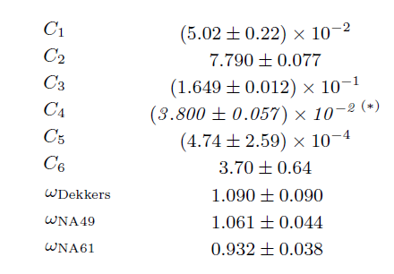
WINKLER MODEL (pp) – CHI-SQUARE (SCALE)
EXPERIMENT | $\sqrt{s}$ [GeV] | Pt range [GeV/c] | y range (cm frame) | CHI-SQUARE Torino D’Angelo |  | GDL | REDUCED CHI-SQUARE Torino D’Angelo |  | SCALE PARAMETER Torino D’Angelo
NA61-SHINE | 7.7 | 0.05 ÷ 0.85 | 0.1 ÷ 0.9 | 34.4260 | 36.7896 | 40 | 1.2482 | 0.9197 | 1.102 | 1.14
NA61-SHINE | 8.7 | 0.05 ÷ 0.95 | 0.1 ÷ 0.9 | 196.0033 | 66.9239 | 37 | 2.1622 | 1.8088 | 1.102 | 1.14
NA61-SHINE | 12.3 | 0.05 ÷ 1.05 | 0.1 ÷ 1.5 | 253.9216 | 72.0259 | 81 | 1.1006 | 0.8892 | 1.102 | 1.14
NA61-SHINE | 17.3 | 0.05 ÷ 1.25 | 0.1 ÷ 1.9 | 283.6106 | 73.7655 | 91 | 0.8400 | 0.8106 | 1.102 | 1.14
NA49 | 17.3 | 0.1 ÷ 1.5 | -0.44 ÷ 2 | 252.3960 | 227.0141 | 143 | 2.0239 | 1.5875 | 1.047 | 1.08
PHENIX | 62.4 | 0.65 ÷ 3.3 | -0.6 ÷ 0.6 | 95.2971 | 101.2070 | 27 | 3.5295 | 3.7484 | // | //
PHENIX | 200 | 0.55 ÷ 4.5 | -0.6 ÷ 0.6 | 58.4856 | 156.4677 | 34 | 1.7202 | 4.6020 | // | //
STAR | 200 | 0.468 ÷ 2.75 | -0.5 ÷ 0 | 6.5742 | 17.4270 | 14 | 0.4696 | 1.2441 | // | 1.21
ALICE | 900 | 0.375 ÷ 2.3 | -0.5 ÷ 0.5 | 175.5351 | 123.2416 | 24 | 7.3140 | 5.1351 | // | 1.01
CMS | 900 | 0.375 ÷ 1.625 | -1 ÷ 1 | 469.6880 | 42.9190 | 26 | 18.0649 | 1.6507 | // | 0.9
CMS | 2760 | 0.375 ÷ 1.675 | -1 ÷ 1 | 1182.6 | 257.9996 | 27 | 43.7999 | 9.5555 | // | 0.9
Not able to reproduce the Torino Group procedure where the scale factor of the na61 experiment is 0.932

Slide 9
WINKLER MODEL (pp) – MOCK DATA AMBER
NEEDED FURTHER INVESTIGATION
BEFORE MOCK DATA
AFTER MOCK DATA

Slide 10
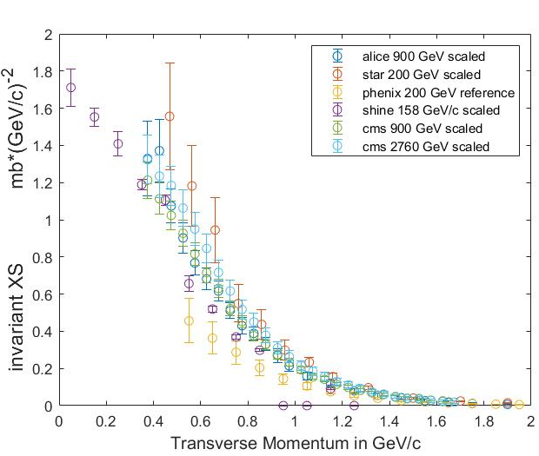
MODIFIED WINKLER MODEL (pp)
$$σ_{invariant}=A R\left(\sqrt{s},X_{R}\right){ σ}_{inelastic}\left(\sqrt{s}\right) f\left(X_{R}\right) g\left(\sqrt{s},p_{T}\right){\left(1+\left(\frac{\sqrt{s}}{\sqrt{s_{thr}}}\right)\right)}^{α}$$
$$shine: {Chi}^{2}=445, gdl=338, \frac{{Chi}^{2}}{ gdl}=1.32$$
$$na49: {Chi}^{2}=168, gdl=143, \frac{{Chi}^{2}}{ gdl}=1.172$$
$$star: {Chi}^{2}=39.91, gdl=14, \frac{{Chi}^{2}}{ gdl}=2.85$$
$$alice: {Chi}^{2}=72.91, gdl=24, \frac{{Chi}^{2}}{ gdl}=3.04$$
$$cms: {Chi}^{2}=155, gdl=53, \frac{{Chi}^{2}}{ gdl}=2.92$$
$${ totale: Chi}^{2}=881, gdl=565, \frac{{Chi}^{2}}{ gdl}=1.559$$

Slide 11
TAN & NG (pp) version 1- EXPLAINATION
$$E\frac{d^{3}σ}{{dp}^{3}}=f\left(x_{R}\right)exp⁡\left(−A\left(x_{R}\right)p_{T}−B\left(x_{R}\right)p_{T}^{2}\right)$$
$$normalization function: f\left(x_{R}\right)=3.34e^{−17.6x_{R}}step\left(0.5−x_{R}\right)+2.10{\left(1−x_{R}\right)}^{7.8}$$
$$pt−exponential cutoff:A\left(x_{R}\right)=3.95e^{−2.76x_{R}}$$
$$pt−gaussian variance:B\left(x_{R}\right)=40.5x_{R}^{2.13}e^{−3.21x_{R}}$$
$$\sqrt{s}<10 GeV scaling: R^{−1}=1−0.00625\left(e^{−0.582Q}+493e^{−5.40Q}\right)\left(e^{6.08+2.57{∆x}_{R}+7.95{∆x}_{R}^{2}}−1\right)e^{3{∆x}_{R}\left(3.09−Q\right)}$$
$$Q=\sqrt{s}−4m_{p}, {∆x}_{R}=x_{R}−\frac{\sqrt{p_{T}^{2}+m_{P}^{2}}}{E_{max}^{∗}}$$
Tan & Ng XS: J. Phys. G: Nucl. Phys. 9 227 (1983)

Slide 12
TAN & NG (pp) version 2 - EXPLAINATION
$$E\frac{d^{3}σ}{{dp}^{3}}=f\left(x_{R}\right)exp⁡\left(−A\left(x_{R}\right)p_{T}−B\left(x_{R}\right)p_{T}^{2}\right)$$
$$normalization function: f\left(x_{R}\right)=0.000105e^{−10.1x_{R}}step\left(0.5−x_{R}\right)+\left(3.15−0.000105\right){\left(1−x_{R}\right)}^{7.9}$$
$$pt−exponential cutoff:A\left(x_{R}\right)=0.465e^{−0.037x_{R}}+{2.31e}^{0.014x_{R}}$$
$$pt−gaussian variance:B\left(x_{R}\right)=0.0302{\left(x_{R}+0.399\right)}^{8.39}e^{−3.19\left(x_{R}+0.399\right)}$$
$$\sqrt{s}<10 GeV scaling: R^{−1}=1−e^{−\left(1−A\left(x_{T}\right)Q^{B\left(x_{T}\right)}\right)e^{C\left(x_{T}\right)Q+D\left(x_{T}\right)}}$$
A$\left(x_{T}\right)=0.306e^{−0.12x_{T}}$
B$\left(x_{T}\right)=0.0552e^{2.72x_{T}}$
C$\left(x_{T}\right)=0.758−0.68x_{T}+1.54x_{T}^{2}$
D$\left(x_{T}\right)=0.594e^{2.82x_{T}}$
$$Q=\sqrt{s}−4m_{p}, {∆x}_{R}=x_{R}−\frac{\sqrt{p_{T}^{2}+m_{P}^{2}}}{E_{max}^{∗}}, x_{T}=\frac{E^{∗}−m_{P}}{E_{max}^{∗}}$$
Tan & Ng XS: J. Phys. G: Nucl. Phys. 9 1289 (1983)

Slide 13
TAN & NG MODEL (pp) – CHI-SQUARE
EXPERIMENT | $\sqrt{s}$ [GeV] | Pt range [GeV/c] | y range (cm frame) | CHI-SQUARE Version1 Version2 |  | GDL | REDUCED CHI-SQUARE Version1 Version2
NA61-SHINE | 7.7 | 0.05 ÷ 0.85 | 0.1 ÷ 0.9 | 131.8784 | 63.4643 | 40 | 3.2970 | 1.5866
NA61-SHINE | 8.7 | 0.05 ÷ 0.95 | 0.1 ÷ 0.9 | 513.6963 | 453.3059 | 37 | 13.8837 | 12.2515
NA61-SHINE | 12.3 | 0.05 ÷ 1.05 | 0.1 ÷ 1.5 | 405.9481 | 749.3217 | 81 | 5.0117 | 9.2509
NA61-SHINE | 17.3 | 0.05 ÷ 1.25 | 0.1 ÷ 1.9 | 614.7622 | 970.2758 | 91 | 6.7556 | 10.6624
NA49 | 17.3 | 0.1 ÷ 1.5 | -0.44 ÷ 2 | 1943 | 4461 | 143 | 13.5845 | 31.1948
PHENIX | 62.4 | 0.65 ÷ 3.3 | -0.6 ÷ 0.6 | 93.4331 | 5573 | 27 | 3.4607 | 206.4195
PHENIX | 200 | 0.55 ÷ 4.5 | -0.6 ÷ 0.6 | 1043 | 2407 | 34 | 30.6711 | 70.7904
STAR | 200 | 0.468 ÷ 2.75 | -0.5 ÷ 0 | 99.7689 | 24.8278 | 14 | 7.1264 | 1.7734
ALICE | 900 | 0.375 ÷ 2.3 | -0.5 ÷ 0.5 | 2319 | 979.8630 | 24 | 89.1251 | 40.8276
CMS | 900 | 0.375 ÷ 1.625 | -1 ÷ 1 | 7363 | 3321 | 26 | 283.1766 | 127.7460
CMS | 2760 | 0.375 ÷ 1.675 | -1 ÷ 1 | 10845 | 7395 | 27 | 401.6621 | 273.8869

Slide 14
EPOS_LHC (pp)– CHI-SQUARE
EXPERIMENT | $\sqrt{s}$ [GeV] | Pt range [GeV/c] | y range (cm frame) | CHI-SQUARE | GDL | REDUCED CHI-SQUARE
NA61-SHINE | 7.7 | 0.05 ÷ 0.85 | 0.1 ÷ 0.9 | 100.6186 | 40 | 2.5155
NA61-SHINE | 8.7 | 0.05 ÷ 0.95 | 0.1 ÷ 0.9 | 249.6590 | 37 | 6.7475
NA61-SHINE | 12.3 | 0.05 ÷ 1.05 | 0.1 ÷ 1.5 | 12160 | 81 | 150.1295
NA61-SHINE | 17.3 | 0.05 ÷ 1.25 | 0.1 ÷ 1.9 | 7144 | 91 | 78.2051
NA49 | 17.3 | 0.1 ÷ 1.5 | -0.44 ÷ 2 | 1968 | 143 | 13.7597
PHENIX | 62.4 | 0.65 ÷ 3.3 | -0.6 ÷ 0.6 | 104.777 | 27 | 3.8806
PHENIX | 200 | 0.55 ÷ 4.5 | -0.6 ÷ 0.6 | 228.9786 | 34 | 6.7347
STAR | 200 | 0.468 ÷ 2.75 | -0.5 ÷ 0 | 27.7869 | 14 | 1.9848
ALICE | 900 | 0.375 ÷ 2.3 | -0.5 ÷ 0.5 | 75.0886 | 24 | 3.1287
CMS | 900 | 0.375 ÷ 1.625 | -1 ÷ 1 | 526.86 | 26 | 20.2638
CMS | 2760 | 0.375 ÷ 1.675 | -1 ÷ 1 | 272.5438 | 27 | 10.0942

Slide 15
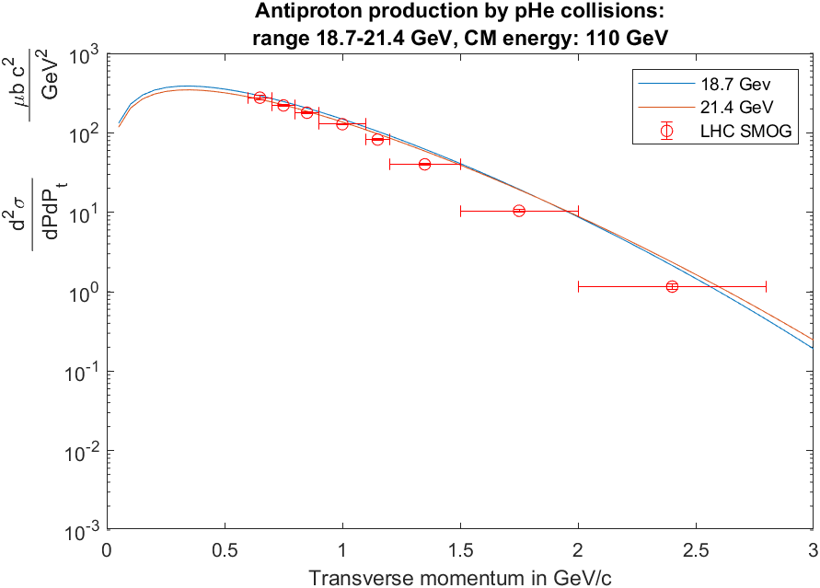
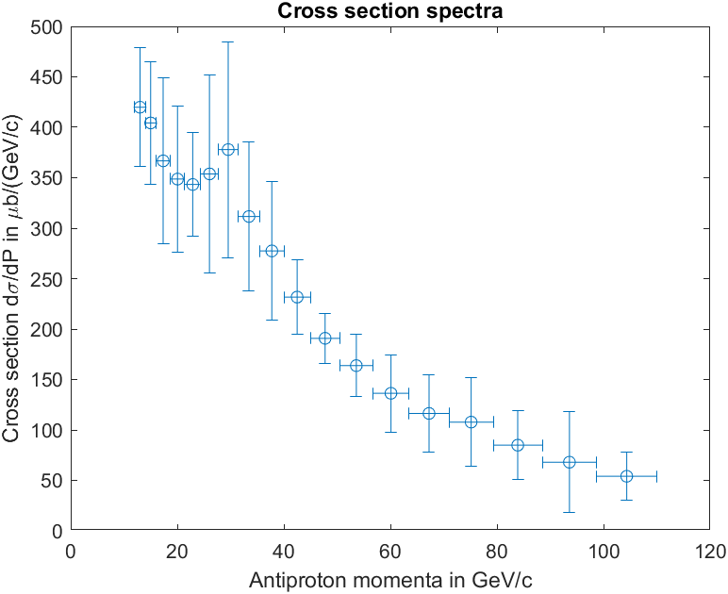
DATASET (pA) – REVIEW/PROBLEMS
No peak
Integration uncertainties
Large binning
How to consider it in the uncertainties in a model independent way?
$$f\left(P_{T}\right)=aP_{T}exp\left(−\frac{P_{T}}{b}\right)$$
The SMOG uncertainties used in the chi-square calculation are the sum in quadrature of the cross section uncorrelated and correlated ones (published by the collaboration).

Slide 16
NUCLEAR SCALING (pA) – MODELS
Constant scaling:
(energy independent)
$$ε_{AB}=\frac{1}{2}\left(\frac{σ_{pA,inel}}{σ_{AB,inel}}+\frac{σ_{pB,inel}}{σ_{AB,inel}}\right)\frac{σ_{AB,inel}}{σ_{pp,inel}}≡w_{AB}\frac{σ_{AB,inel}}{σ_{pp,inel}}, →\frac{d^{2}σ_{AB}}{dP{dP}_{T}}=ε_{AB}\frac{d^{2}σ_{pp}}{dP{dP}_{T}}$$
Estimation of number of wounded nucleons
Scaling of the total inelastic XS
Tan & Ng
For pA channels:
$$σ_{pA,inel}=45A^{0.7}\left[1+0.016sin\left(5.2−2,63lnA\right)\right]$$
For pHe channel:
$$σ_{pHe,inel}≈110mb$$
The Astrophysical Journal, 394:174-183, 1992
DTUNUC scaling:
(energy dependent)
$$\frac{d^{2}σ_{AB}}{dP{dP}_{T}}=ε_{AB}\frac{d^{2}σ_{pp}}{dP{dP}_{T}}$$
No value for pC scaling in the publication
Calculated with DTUNUC (MC generator)
Tan & Ng
The Astrophysical Journal, 499:250-257, 1998

Slide 17
NUCLEAR SCALING (pA) – CHI-SQUARE
Constant scaling (pbar-energy independent)
EXPERIMENT | $\sqrt{s}$ [GeV] | Channel | Pt range [GeV/c] | P range [GeV/c] | CHI-SQUARE (Tan & Ng) Version1 Version2 |  | GDL | REDUCED CHI-SQUARE Version1 Version2
SMOG | 110 | pHe | 0.4 ÷ 4 | 12 ÷ 110 (lab) | 2087 | 8070 | 136 | 15.3521 | 59.3371
NA49 | 17.3 | pC | 0.1 ÷ 1.5 | 0.3 ÷ 15.3 (lab) | 1026 | 1567 | 121 | 8.4819 | 12.9503
DTUNUC scaling (pbar-energy dependent)
EXPERIMENT | $\sqrt{s}$ [GeV] | Channel | Pt range [GeV/c] | P range [GeV/c] | CHI-SQUARE (Tan & Ng) Version1 Version2 |  | GDL | REDUCED CHI-SQUARE Version1 Version2
SMOG | 110 | pHe | 0.4 ÷ 4 | 12 ÷ 110 (lab) | 2132 | 7875 | 136 | 15.6782 | 57.9050

Slide 18
TORINO GROUP MODEL(AA) – MODEL
One of the most used model for heavier channels is the Korsmeier-Donato-Di Mauro (KDD) (Phys. Rev. D 97, 103019 (2018)):
$$σ_{A_{1}A_{2} }=f^{A_{1}A_{2}}σ_{pp}$$
$$f^{A_{1}A_{2}}=A_{1}^{D_{1}}A_{2}^{D_{1}}\left[A_{1}^{D_{2}}\left(1+\frac{N_{1}}{A_{1}}∆_{iso}\right)F_{pro}\left(x_{F}\right)+A_{2}^{D_{2}}\left(1+\frac{N_{2}}{A_{2}}∆_{iso}\right)F_{tar}\left(x_{F}\right)\right]$$
Fragmentation of a target in the projectile
Scaling of the total inelastic cross section
Estimation of average number of target nucleons that join the collision
Estimation of average number of projectile nucleons that join the collision
Fragmentation of a nucleons in the projectile

Slide 19
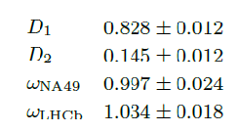
TORINO GROUP MODEL(AA)– CHI-SQUARE
EXPERIMENT | $\sqrt{s}$ [GeV] | Channel | Pt range [GeV/c] | P range [GeV/c] | CHI-SQUARE No-Scale Scale |  | GDL | REDUCED CHI-SQUARE No Scale Scale
SMOG | 110 | pHe | 0.4 ÷ 4 | 12 ÷ 110 (lab) | 509.4197 | 553.9327 | 136 | 3.7475 | 4.0730
NA49 | 17.3 | pC | 0.1 ÷ 1.5 | 0.3 ÷ 15.3 (lab) | 121.0803 | 120.9584 | 121 | 1.007 | 0.9997
Different results than the Torino Group paper for the SMOG experiment.
How are the uncertainties of the SMOG data treaten in the fitting procedure?

Slide 20
TORINO GROUP MODEL(AA)– CHI-SQUARE
EXPERIMENT | $\sqrt{s}$ [GeV] | Channel | Pt range [GeV/c] | P range [GeV/c] | CHI-SQUARE No-Scale Scale |  | GDL | REDUCED CHI-SQUARE No Scale Scale
SMOG | 110 | pHe | 0.4 ÷ 4 | 12 ÷ 110 (lab) | 509.4197 | 553.9327 | 136 | 3.7475 | 4.0730
NA49 | 17.3 | pC | 0.1 ÷ 1.5 | 0.3 ÷ 15.3 (lab) | 121.0803 | 120.9584 | 121 | 1.007 | 0.9997
Using my parameters:
$$smog: {Chi}^{2}=291, gdl=136, \frac{{Chi}^{2}}{ gdl}=2.14$$
$$na49: {Chi}^{2}=129, gdl=121, \frac{{Chi}^{2}}{ gdl}=1.07$$
$${ totale: Chi}^{2}=420, gdl=253, \frac{{Chi}^{2}}{ gdl}=1.\text{66}$$

Slide 21
TORINO GROUP MODEL(AA)– MOCK DATA AMBER
PARAMETER | WINKLER | Korsmeier-Donato-Di Mauro | MINE | MINE (after MOCK data)
C1 | $$0.047$$ | $$0.0502±0.0022$$ | $$0.0530±0.0012$$ | //
C2 | $$7.76$$ | $$7.79±0.077$$ | $$7.951±0.075$$ | //
C3 | $$0.168$$ | $$0.1649±0.0012$$ | $$0.1626±0.0011$$ | //
C4 | $$0.038±0.00057$$ | $0.038±0.00057$(fixed) | $$0.0422±0.0010$$ | //
C5 | $$0.001±0.0004$$ | $$0.000474±0.000259$$ | $$0.005746±0.000974$$ | //
C6 | $$0.7±0.04$$ | $$3.70±0.64$$ | $$3.289±1.570$$ | //
Data used | Main: Na49 C4: Phenix, Star, Alice, Cms | Na49, Shine, Ps data | Na49, Shine, Star, Alice, Cms | //
D1 | // | $$0.828±0.012$$ | $$0.834±0.012$$ | 0.830$±$0.003
D2 | // | $$0.145±0.012$$ | $$0.114±0.012$$ | 0.114$±$0.005
Data used | // | SMOG (pHe), NA49 (pC) | SMOG (pHe), NA49 (pC) | SMOG(pHe), NA49 (pC), AMBER (pHe)
Before
After

Slide 22
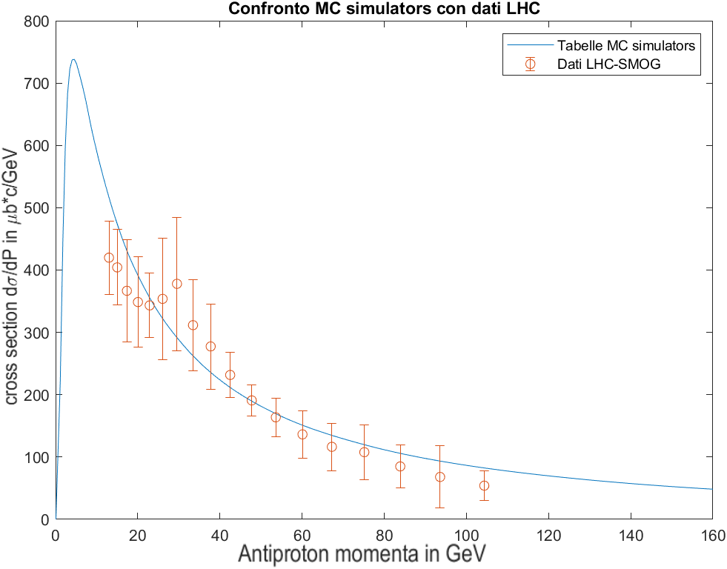
EPOS_LHC and QGSJETII-04m - COMPARISON
$$f\left(P_{T}\right)=aP_{T}exp\left(−\frac{P_{T}}{b}\right)$$
P range [GeV/c] | P range [GeV/c] | a [μb/(GeV/c)³] | b [GeV/c] | Adj R-square | SSE | ν | N
12.0-14.0 | 0.6-2.8 | 6827±826 | 0.2480±0.0087 | 0.9988 | 0.1651 | 6 | 8
14.0-16.0 | 0.6-2.8 | 6126±793 | 0.2569±0.0098 | 0.9988 | 0.2407 | 6 | 8
16.0-18.7 | 0.6-2.8 | 5106±978 | 0.2680±0.0157 | 0.9977 | 0.5859 | 6 | 8
18.7-21.4 | 0.6-2.8 | 4675±721 | 0.2731±0.0190 | 0.9985 | 0.3679 | 6 | 8
21.4-24.4 | 0.6-2.8 | 4794±614 | 0.2676±0.0105 | 0.9988 | 0.2662 | 6 | 8
24.4-27.7 | 0.4-2.8 | 5390±1287 | 0.2562±0.0179 | 0.9948 | 1.0350 | 7 | 9
27.7-31.4 | 0.4-2.8 | 6301±1565 | 0.2449±0.0166 | 0.9943 | 0.8785 | 7 | 9
31.4-35.5 | 0.4-2.8 | 4732±974 | 0.2566±0.0148 | 0.9964 | 0.6188 | 7 | 9
35.5-40.0 | 0.4-4.0 | 4008±845 | 0.2631±0.0168 | 0.9941 | 1.3320 | 8 | 10
40.0-45.0 | 0.6-4.0 | 3226±437 | 0.2680±0.0109 | 0.9982 | 0.3762 | 7 | 9
45.0-50.5 | 0.6-4.0 | 2415±263 | 0.2811±0.0099 | 0.9989 | 0.2979 | 7 | 9
50.5-56.7 | 0.7-4.0 | 2013±323 | 0.2852±0.0138 | 0.9986 | 0.3151 | 6 | 8
56.7-63.5 | 0.8-4.0 | 1554±379 | 0.2962±0.0205 | 0.9976 | 0.3333 | 5 | 7
63.5-71.0 | 0.8-4.0 | 1211±340 | 0.3100±0.0259 | 0.9968 | 0.4883 | 5 | 7
71.0-79.3 | 0.9-4.0 | 1207±439 | 0.2988±0.0275 | 0.9972 | 0.1957 | 4 | 6
79.3-88.5 | 1.1-4.0 | 883±317 | 0.3101±0.0281 | 0.9983 | 0.0929 | 3 | 5
88.5-98.7 | 1.2-4.0 | 669±459 | 0.3189±0.0427 | 0.9941 | 0.0412 | 2 | 4
98.7-110 | 1.2-4.0 | 522±213 | 0.3219±0.0255 | 0.9978 | 0.0841 | 2 | 4
ATTENTION: Model dependent fit (also the Pt uncertainties have been considered as part of the weight)

Slide 23
EPOS_LHC(pA)– CHI-SQUARE
ON DEVELOPMENT

