Slide 1
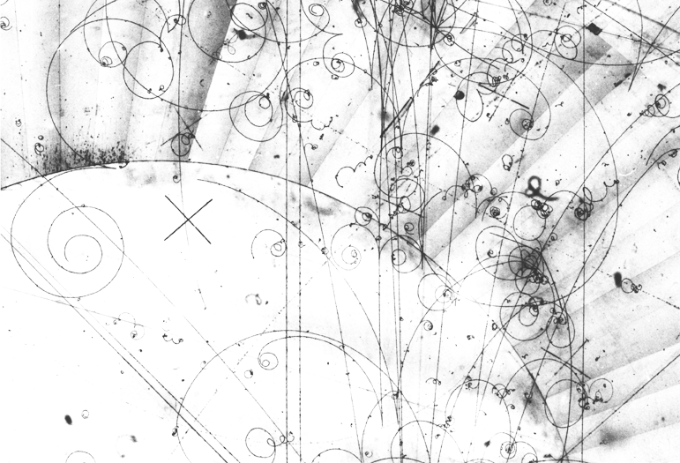
The Role of Computing in Particle Physics Research
Daniele Lattanzio, Andrea Rendina
INFN-CNAF

Slide 2
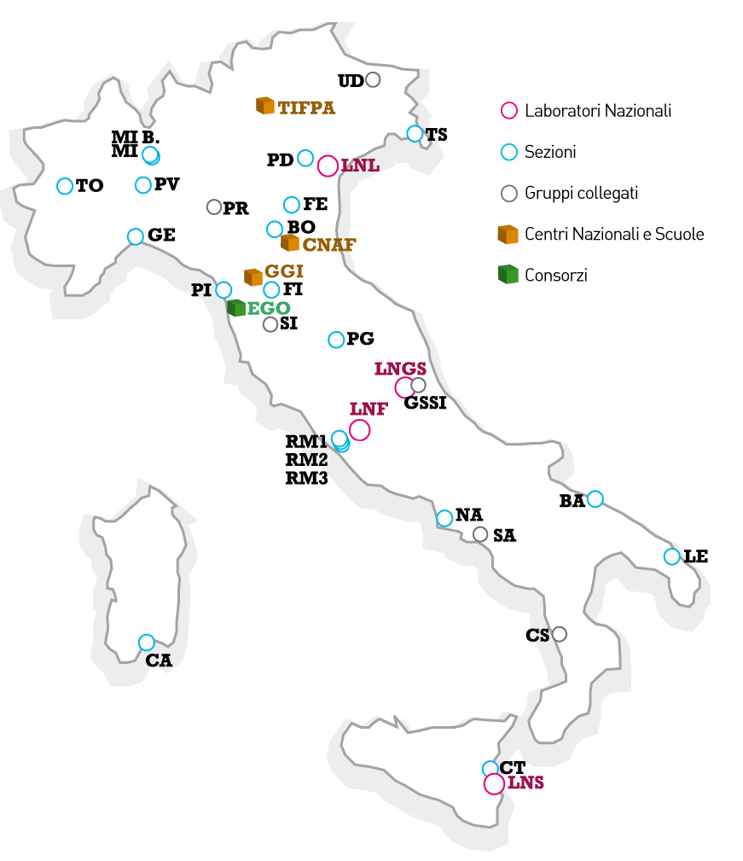
Istituto Nazionale di Fisica Nucleare
(INFN)
The National Institute for Nuclear Physics (INFN) is a public research agency dedicated to the study of the fundamental constituents of matter and the laws governing them
4 national laboratories, 20 divisions, 3 centers and schools, 1 consortium
~2000 employees, ~3500 associated personnel

Slide 3

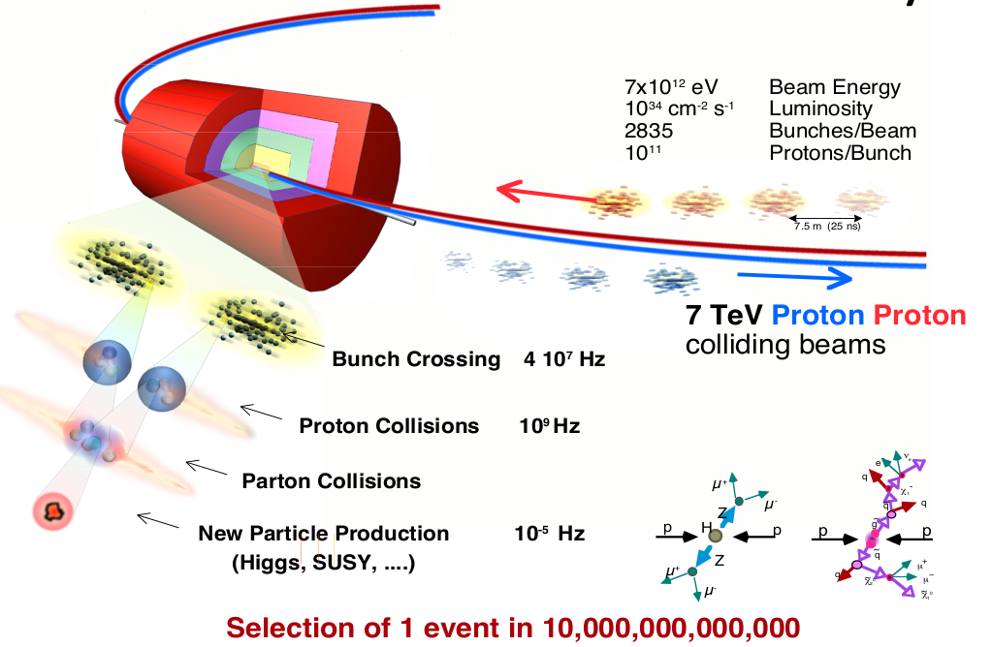
Lines of research
Particle physics (with accelerators)
  High energy → discovery of new particles
  High luminosity → measurements of rare events

Slide 4
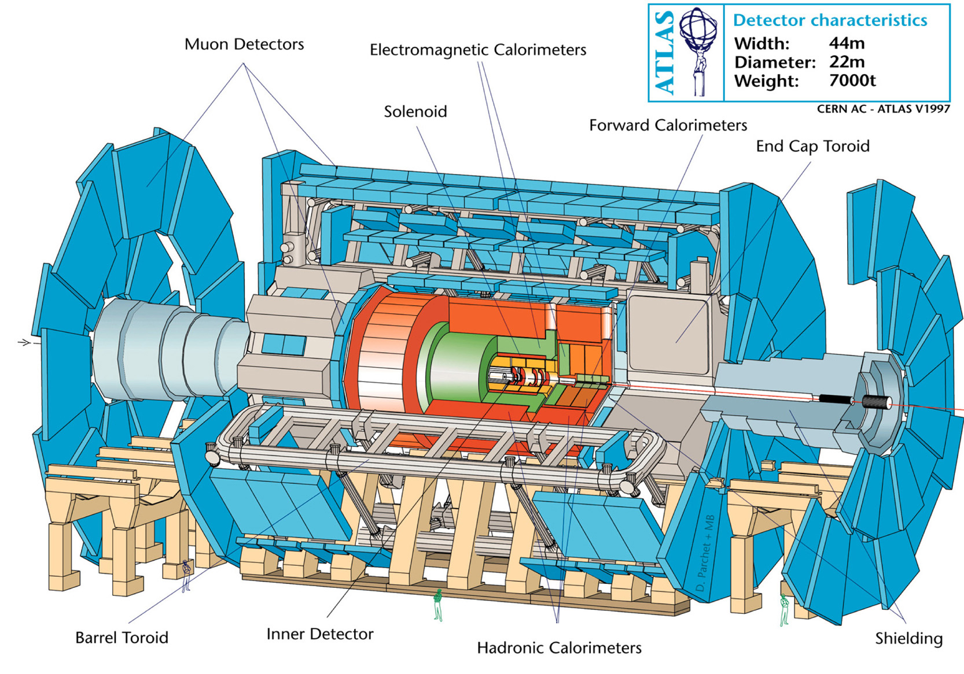
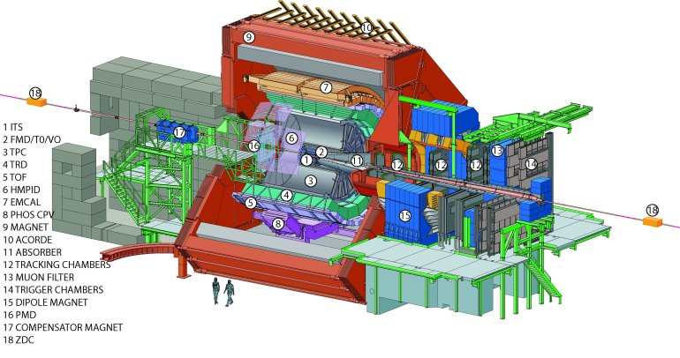
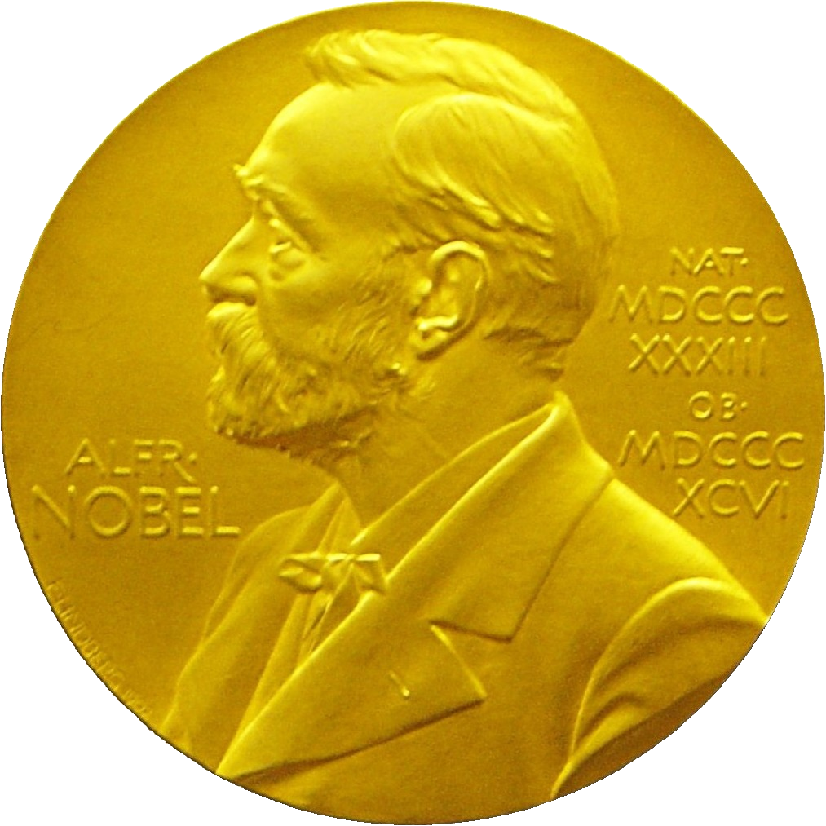
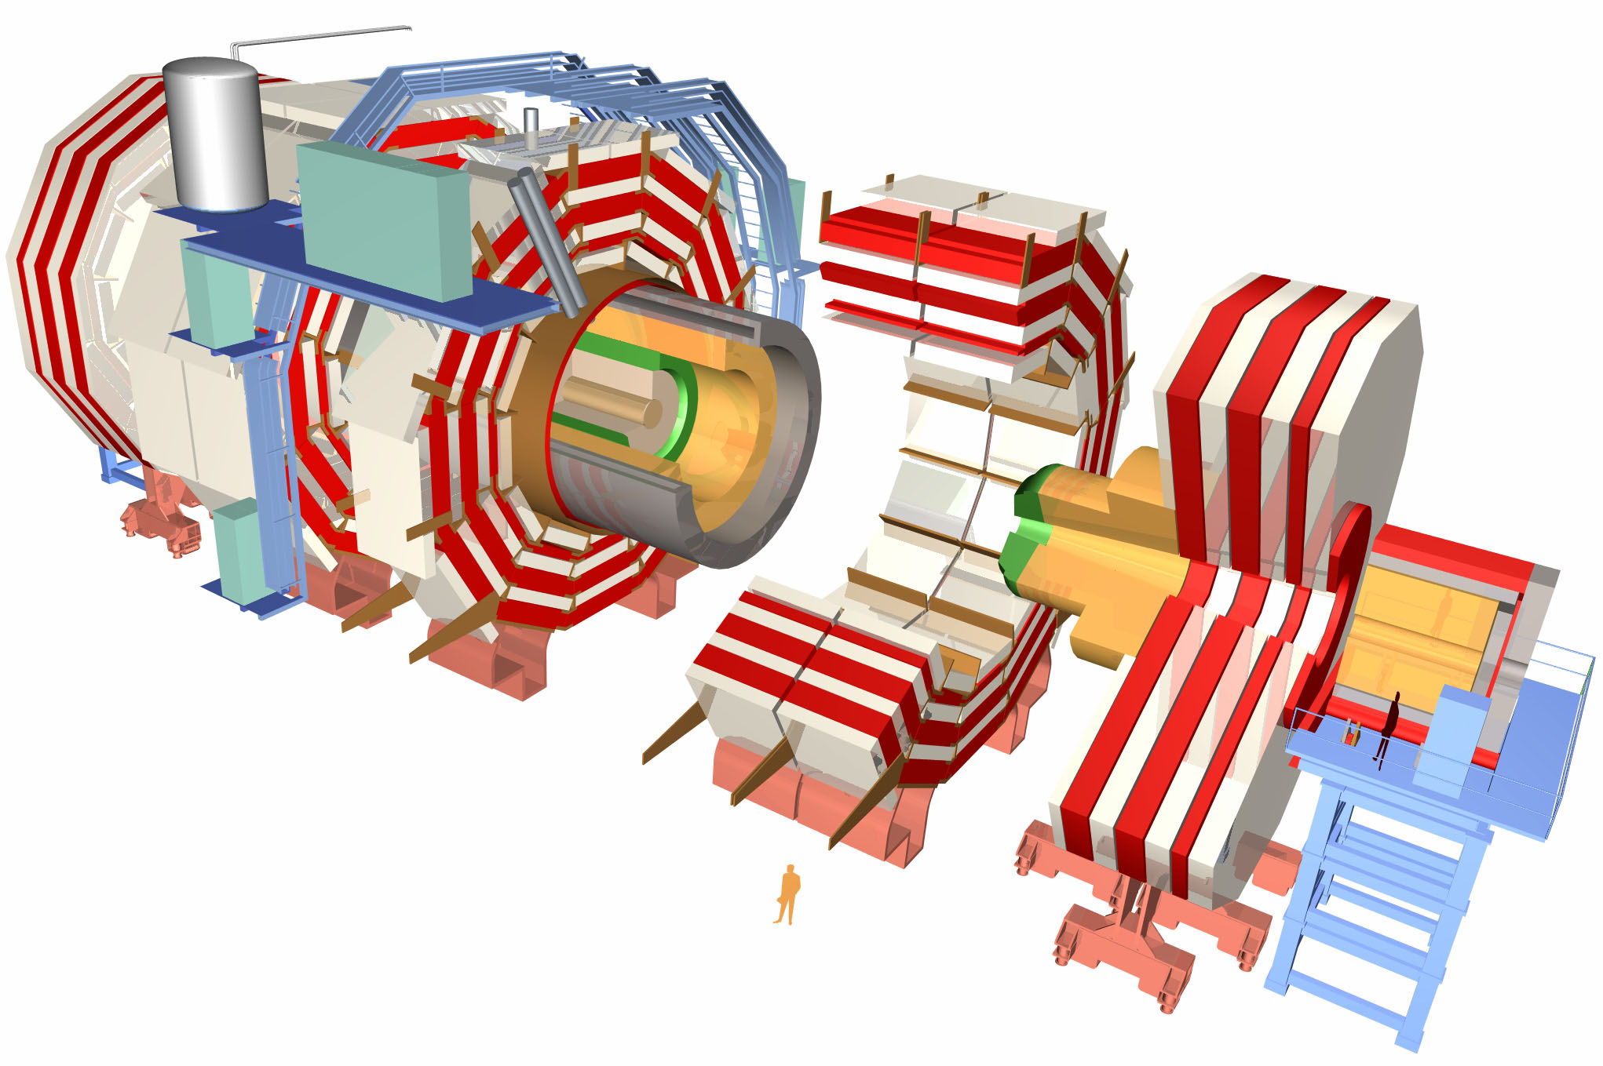
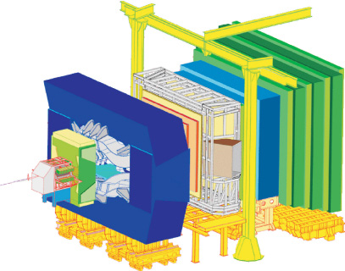
Lines of research
ATLAS
ALICE
CMS
LHCb

Slide 5
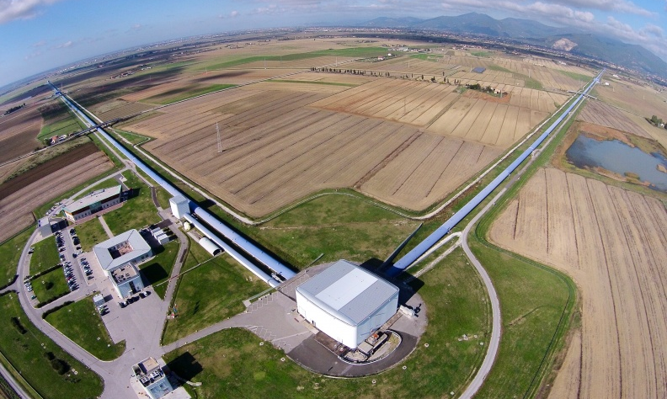
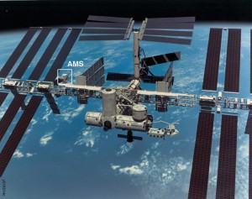
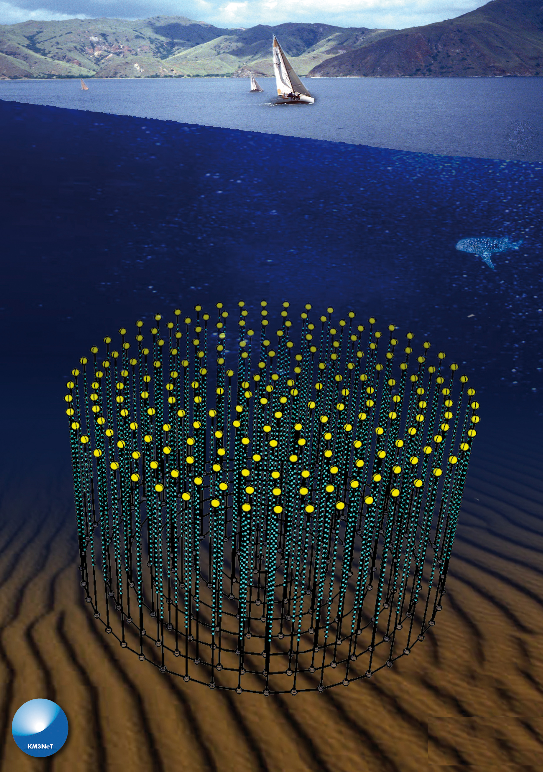
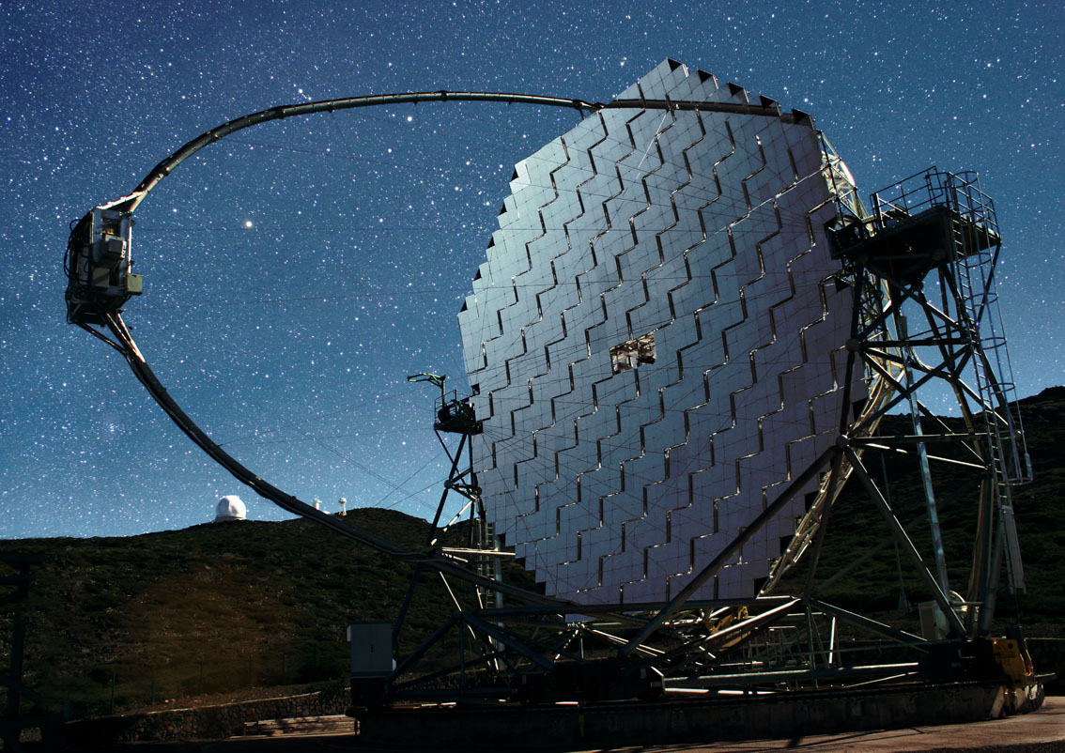
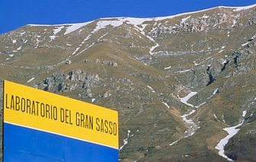
Lines of research
Astroparticle physics
  Cosmic rays, neutrinos, gravitational waves, very high energy gamma rays, dark universe

Slide 6
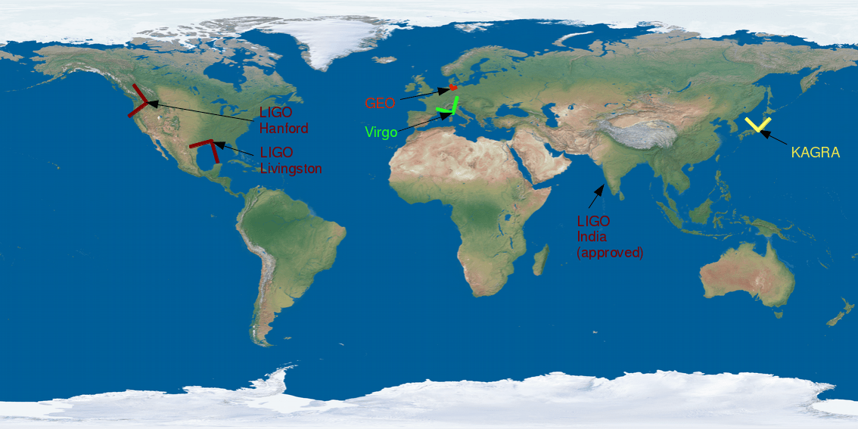
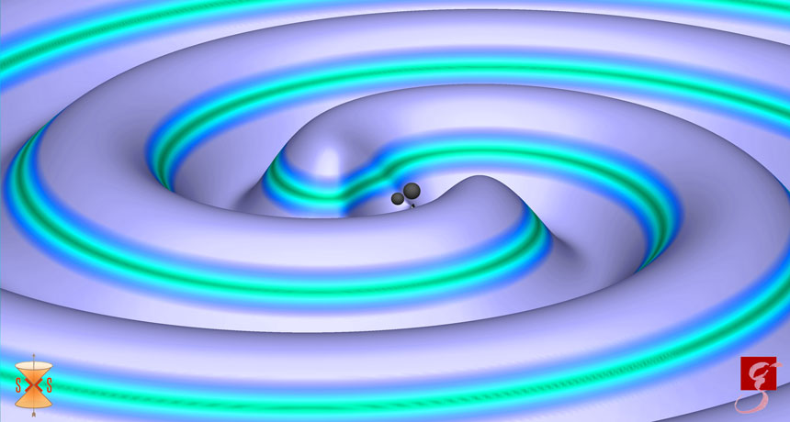
Lines of research

Slide 7
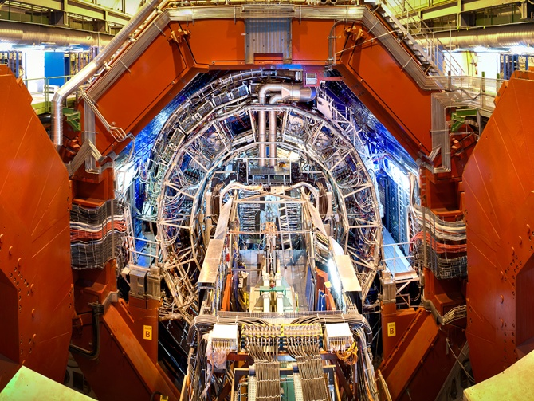
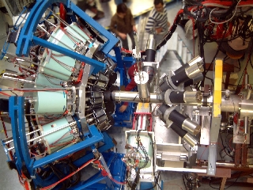
Lines of research
Nuclear physics
  Structure and dynamics of nuclear matter

Slide 8
Lines of research
Theoretical physics
  development of hypothesis, models and theories to explain already acquired experimental results and to open new scenarios for the physics of the future
  origin of the mass of elementary particles
  nature and properties of dark matter
  asymmetry between matter and anti-matter in the universe
  unification at quantum level of all fundamental interactions, including gravity

Slide 9
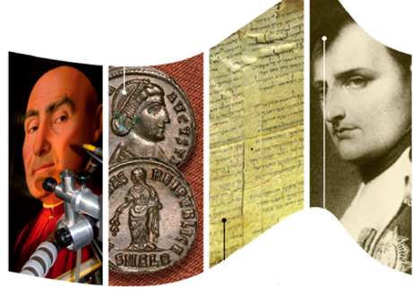
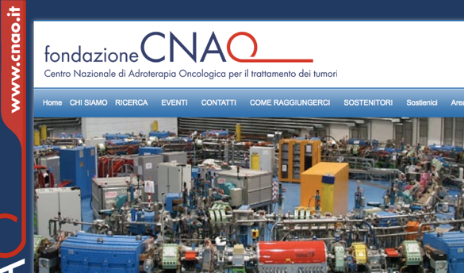
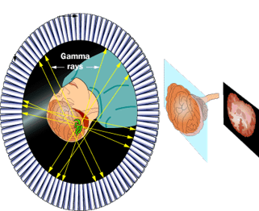
Lines of research
Technological and interdisciplinary research:
  research and prototype development of new technologies useful to the mission of INFN
  development of instruments, methods and technologies born within the domain of fundamental physics to be applied in other fields
    knowledge and technology transfer
    detectors, electronics, computing

Slide 10

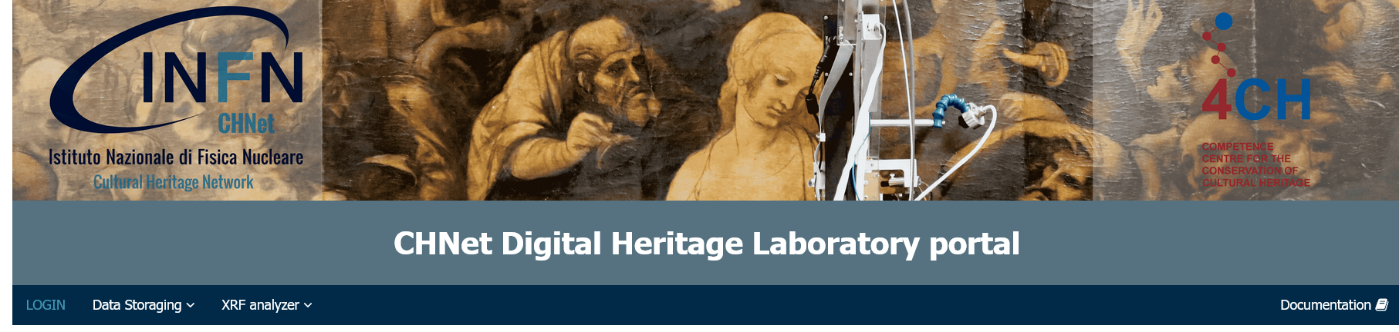
Lines of research
Cultural Heritage
CNAF is one of the 1st Level Node of the
INFN-CHNet (Cultural Heritage Network)
    The competence network dedicated to Cultural Heritage within INFN
    Founded to put together and enhance the different competences of INFN laboratories about the study and the diagnostics applied to materials in the Cultural Heritage framework
    CNAF is coordinating the CHNet digital laboratories of the network
https://chnet.infn.it
https://ch.cloud.cnaf.infn.it/

Slide 11



Lines of research
The 4CH Project
https://www.4ch-project.eu/
Competence Centre for the Conservation of Cultural Heritage (4CH)
  Aimed at designing a European
  Competence Centre for cultural
  heritage
  CNAF is supporting the Competence
  Center by providing cloud-oriented services to be used by CH community in Europe and over the World
The Save the Ukraine Monuments (SUM) initiative
  Aimed at preserving the digital documentation of Ukrainian cultural heritage
  CNAF is hosting the Data and provides the
  service for long time preservation
https://www.4ch-project.eu/sum/
Notes:
Out of solidarity with Ukraine, immediately after the invasion 4CH launched the SUM initiative to save the digital documentation of Ukrainian cultural heritage to preserve its memory and support the future restoration of assets from the damages caused by the war.

Slide 12
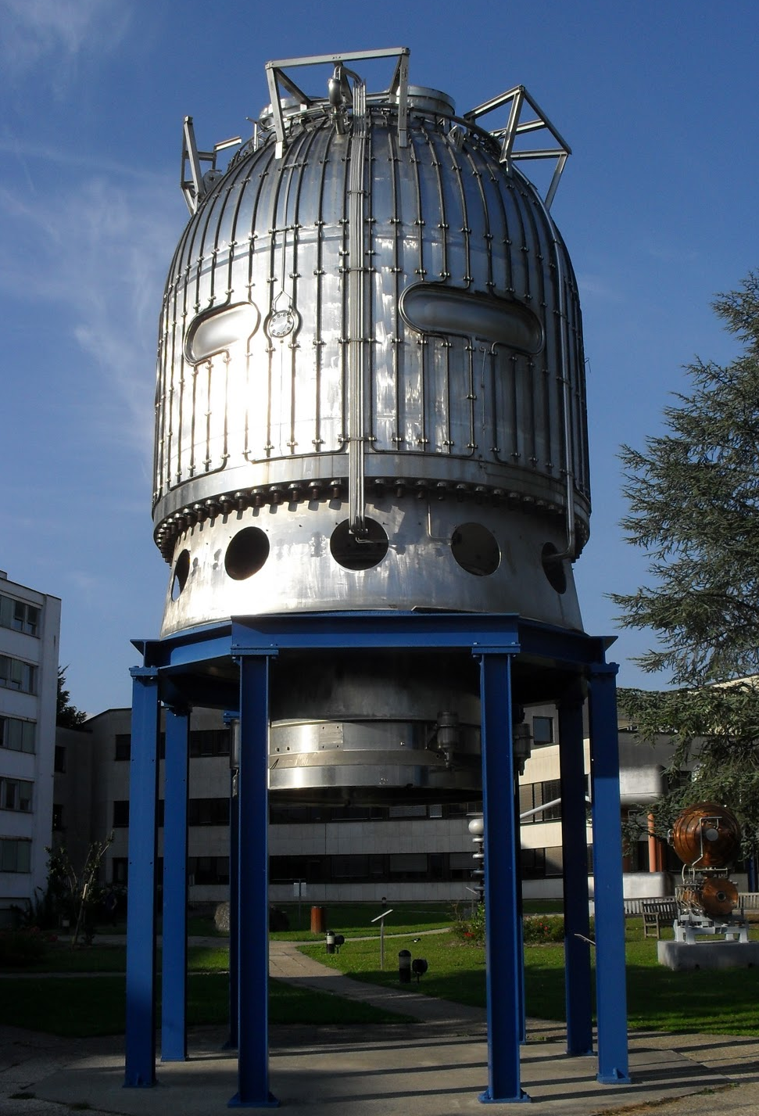
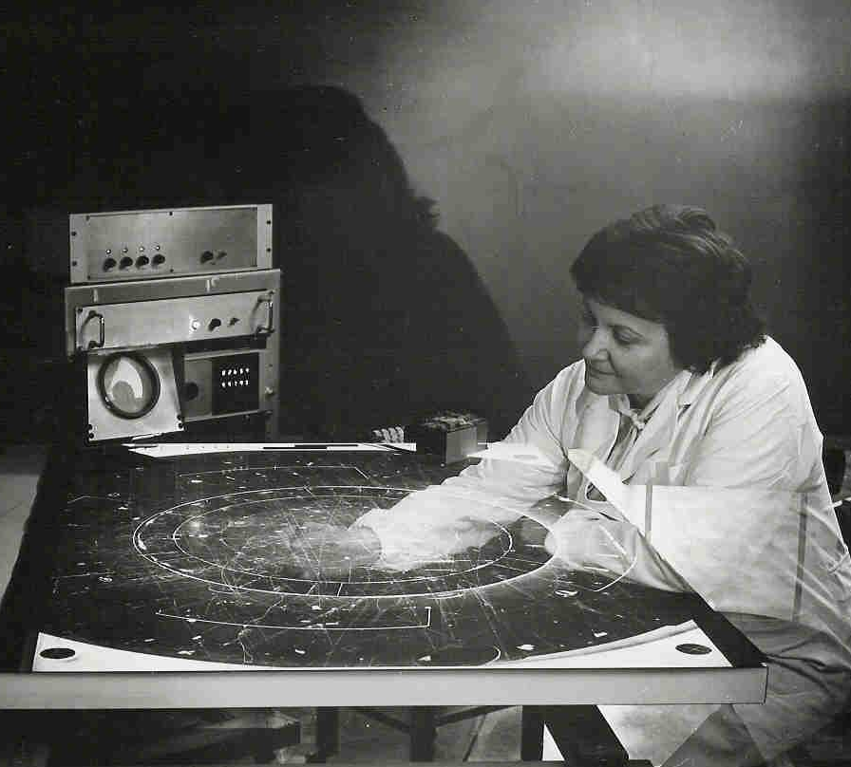
Centro Nazionale Analisi Fotogrammi (CNAF)
Yesterday

Slide 13
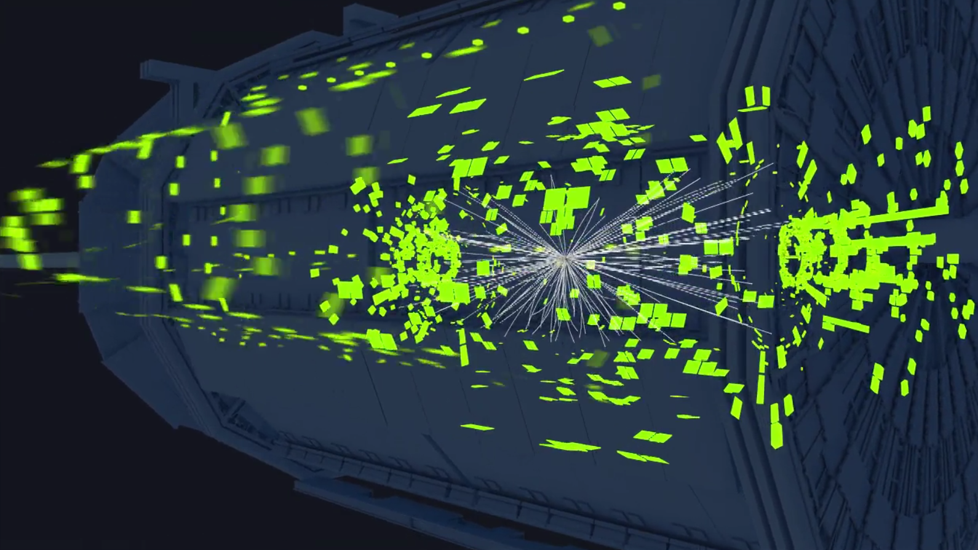
Centro Nazionale Analisi Fotogrammi (CNAF)
Today
All digital
CNAF is the national center of INFN (Italian Institute for Nuclear Physics) dedicated to Research and Development on Information and Communication Technologies
https://cds.cern.ch/record/1541893

Slide 14
The Computing Grid
The annual production of raw data is around 90 PB
Besides raw data, there are simulated data, processed data, analysis results...
  In multiple copies
Storing and processing such data happens in a coordinated manner in a geographically distributed system comprising 170+computing centers in 42 countries worldwide
  World-wide LHC Computing Grid (WLCG)
Based on its size and function, a center is classified as Tier-0 (CERN), Tier-1 or Tier-2

Slide 15
The Computing Grid
CNAF in a nutshell
CNAF hosts a WLCG Tier-1
It provides support to researchers in using the available computing tools and in software development
It investigates and develops innovative IT solutions aimed at improving the usability and the efficiency of the computing center and at enabling the use of geographically distributed systems
It provides IT services of general utility for INFN
It collaborates with private companies and public administrations to share knowledge and expertise
We are about 60 people

Slide 16
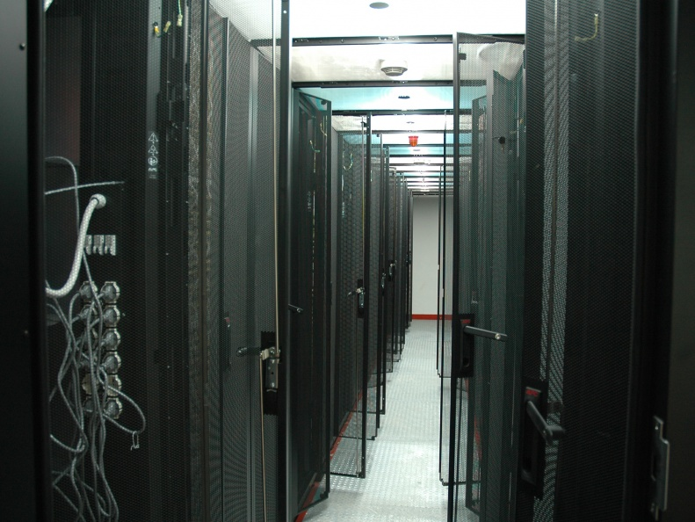
The Tier-1

Slide 17
The Tier-1
There are 60+ scientific communities using the data center
  not only LHC and not only from the physics field
2000 computing nodes, 40 000+ core
  Managed with a batch system

Slide 18
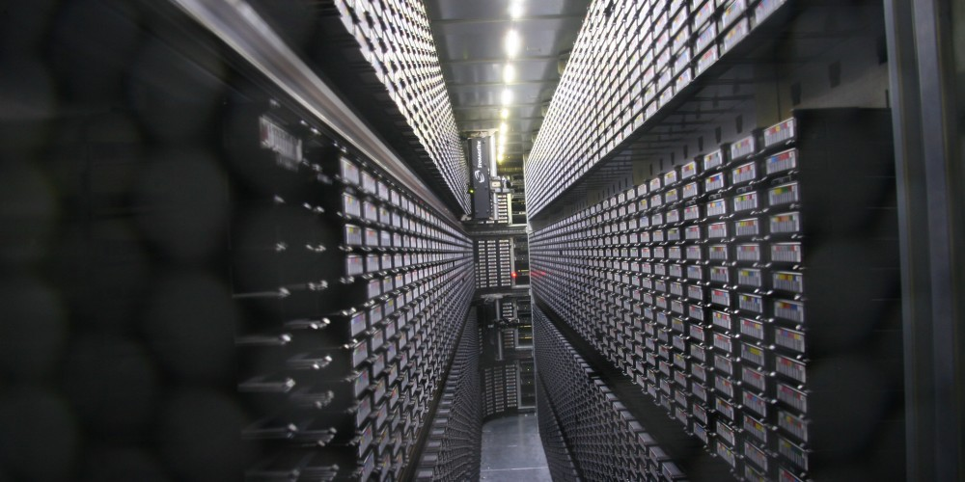
The Tier-1
50 PB of disk space shared among all nodes thanks to a distributed file system (GPFS)
130 PB of tape space

Slide 19
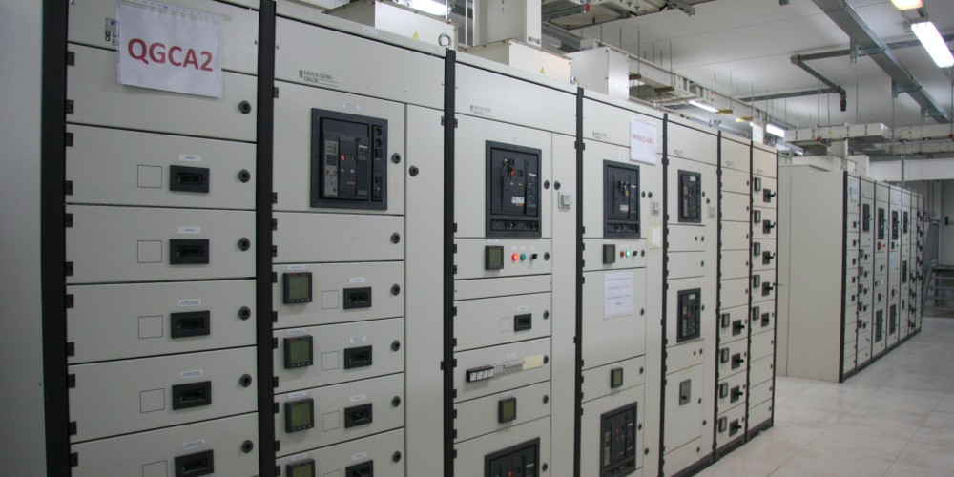
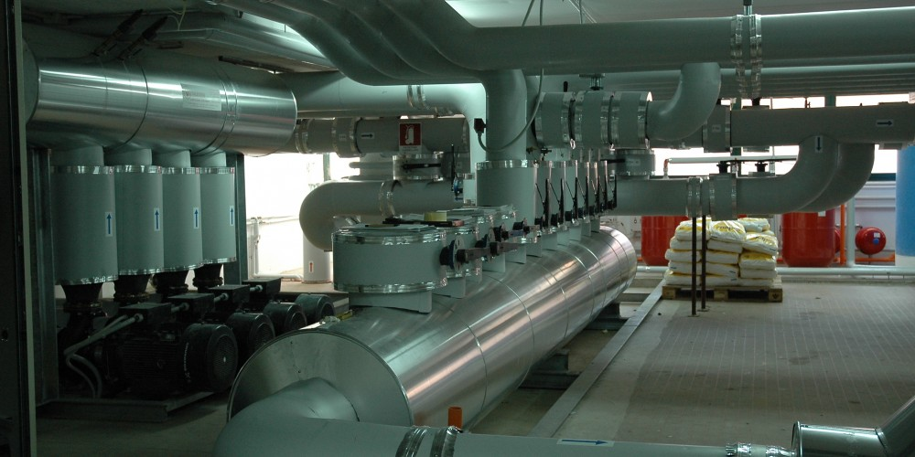
The Tier-1
Power consumption is about 800 kW → 7 Gwh/year
  The IT load is ~450 kW, the rest is for cooling, guarantee of power continuity, etc.
  A complex monitoring system is always active in order to keep under control the entire infrastructure

Slide 20
WAN@CNAF
CNAF is part of a wide high-performance network
  LHCOPN (LHC Optical Private Network) connects all worldwide TIER-1 with CERN (100Gbps)
  LHCONE (LHC Open Network Environment) all TIER-1 to all TIER-2 (100Gbps)
  2 Links (10Gbps) towards General Internet
  A direct link (1,2 Tbps) with CINECA (one of Europe’s best performing computing centre)
  (i.e., watching a movie online requires an 8Mbps connection)

Slide 21
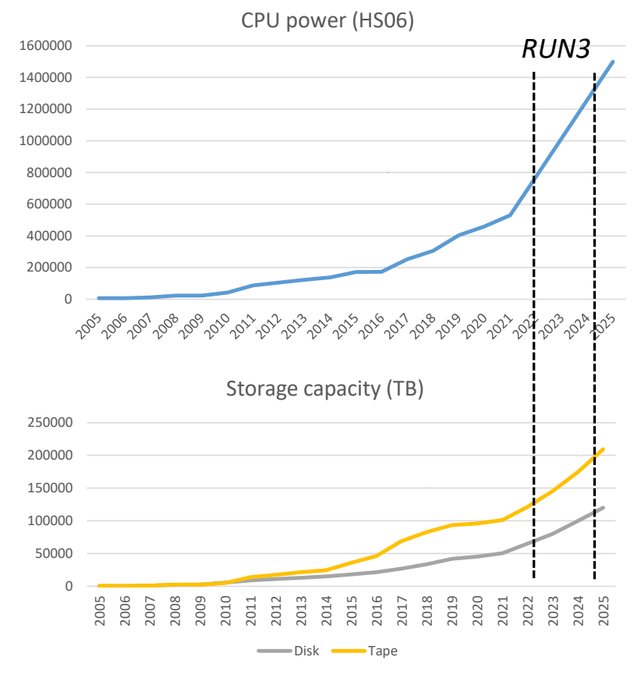
Future perspectives

Slide 22
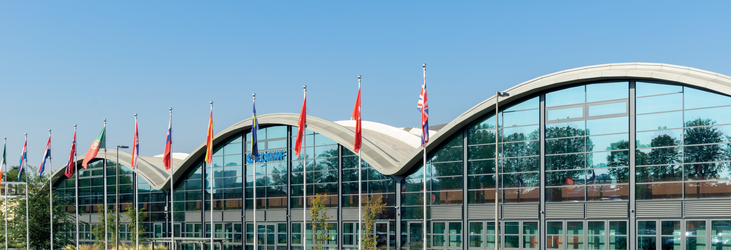
Future perspectives
Future perspectives
CNAF Tomorrow: the Data Valley Hub
Supercomputing facilities of ECMWF, CINECA and INFN
  The Italian and Emilia-Romagna Region’s largest investment in Big Data, Supercomputing and Research Infrastructure
  Hosting 80% of total computing capacity in Italy
  It will host important italian and international research institutes
  The move will begin in spring of 2023

Slide 23
Distributed Systems
We investigate innovative technological solutions so to evaluate their adoption and integration in the distributed computing system to which the Tier-1 belongs
  i.e., Cloud systems and virtualization
We develop software components to integrate the existing functionalities
  IT security and data management
  often in the context of national or international projects

Slide 24

INFN Cloud
A multi-site, extensible, federated Cloud infrastructure from INFN sites with a customizable portfolio of services targeted to scientific communities.
Enhanced Privacy and Compliance Cloud (EPIC), operated at CNAF, is a region of INFN Cloud where we implement a certified ISO/IEC 27001 27017 27018 Information Security Management Systems to comply with the requirements of health research projects INFN is involved in.

Slide 25
National services
We deploy and maintain services used by the whole INFN:
  mailing list, web hosting, calendar and address book
  DNS
  software repositories, version control systems and collaborative tools for software development
  documental archival
  central managements of licenses
  Information System Services: provisioning of interfaces between users and INFN administration
  Multimedia services

