Slide 1
Data-taking @ CNAO2022
Giacomo & Giuseppe

Slide 2
Bureaucracy and documentation
Fill satefy form (one per group)
Radioprotection.
CNAO asked for having a list the people involved to check, one by one, which documents are missing
Most likely, all the people that attended the course in the past year should just provide the medical idoneity certificate
For all the people that did not attend the course, a new one will be organised soon
I ask to each group to send me the list of people which are going to participate to the data-taking within 16th october

Slide 3
Requests (up to now)
Beam monitor characterisation vs rate (p,12C, 4-5 energies) 4h
Fast scintillator test for ST (parassitaggio, possibility to use a standalone DAQ)
Calo calibration ??
Inner tracker??
Full setup test for better vtx integration, reconstruction?

Slide 4
Geometry, mechanics, rack
Isocenter choice. Isocenter 2 seems to be the better choice (3 m available on the beam line)
A table 50x80 cm² is already present @ CNAO, height could be easily adjusted. It is not enough to contain 2 set of MSD (is it needed?)
Detector movement. The external access to the XPR is currently unavailable due to works in progress . Calo could be not easy to bring there
Rack?

Slide 5
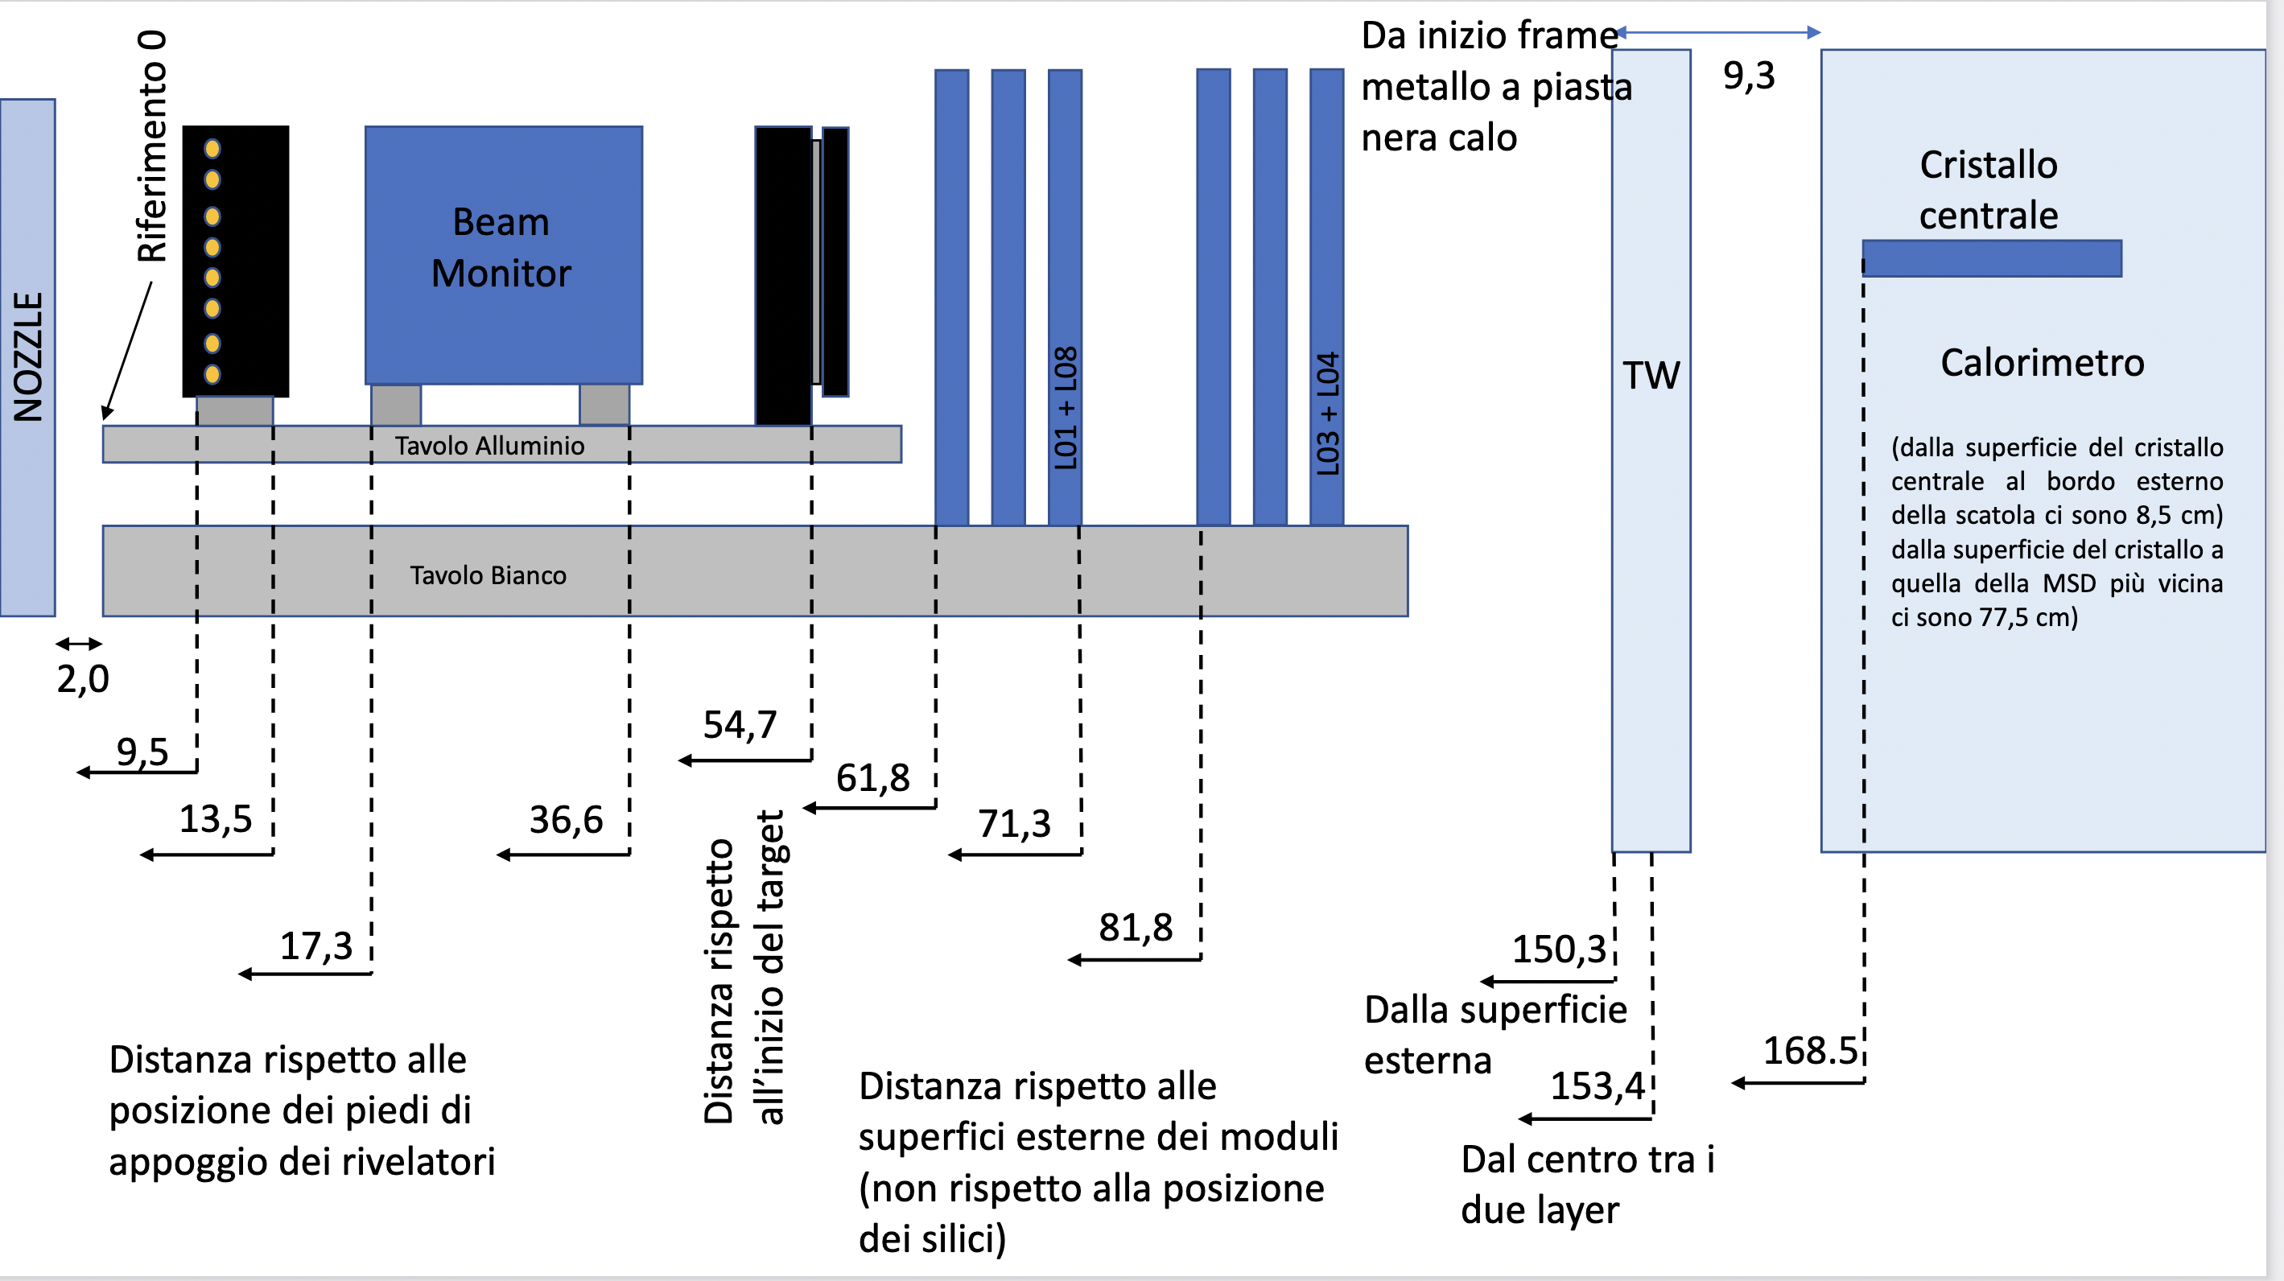
Geometry @HIT2022 (MSD run)

Slide 6
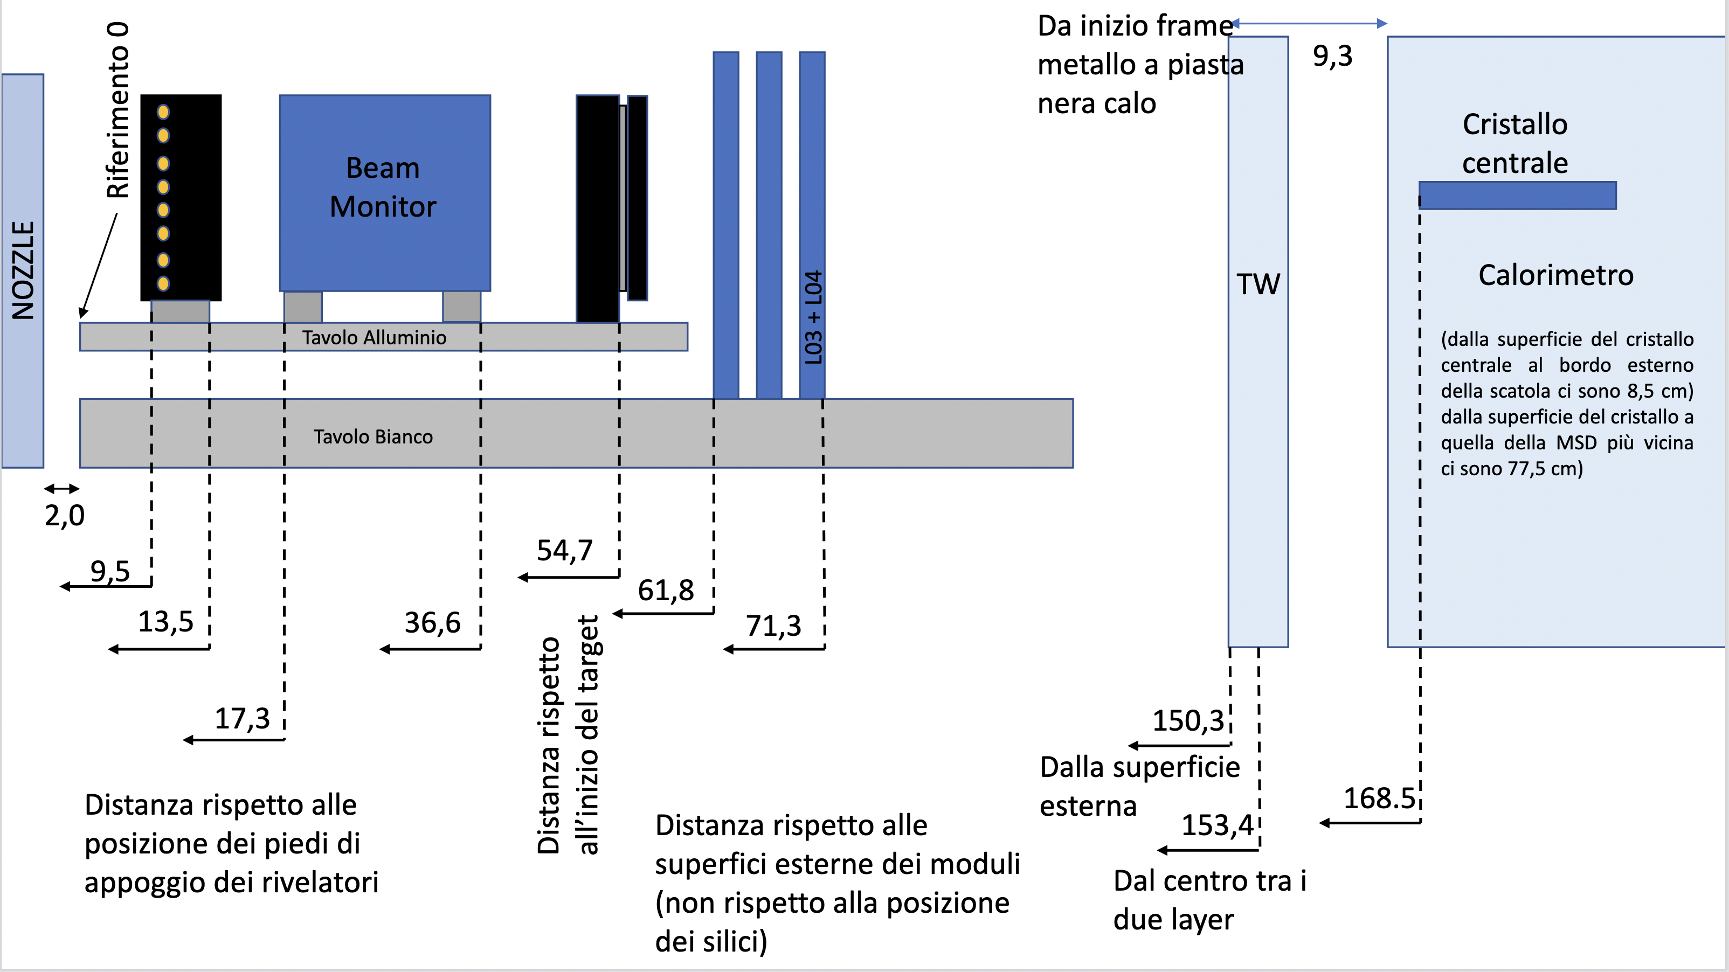
Geometry @ HIT2022 (Physics run)

Slide 7
Beam monitoring and adjustment
Possibility to bring into the synchrotron control room our plot rate vs time, beam position?

Slide 8
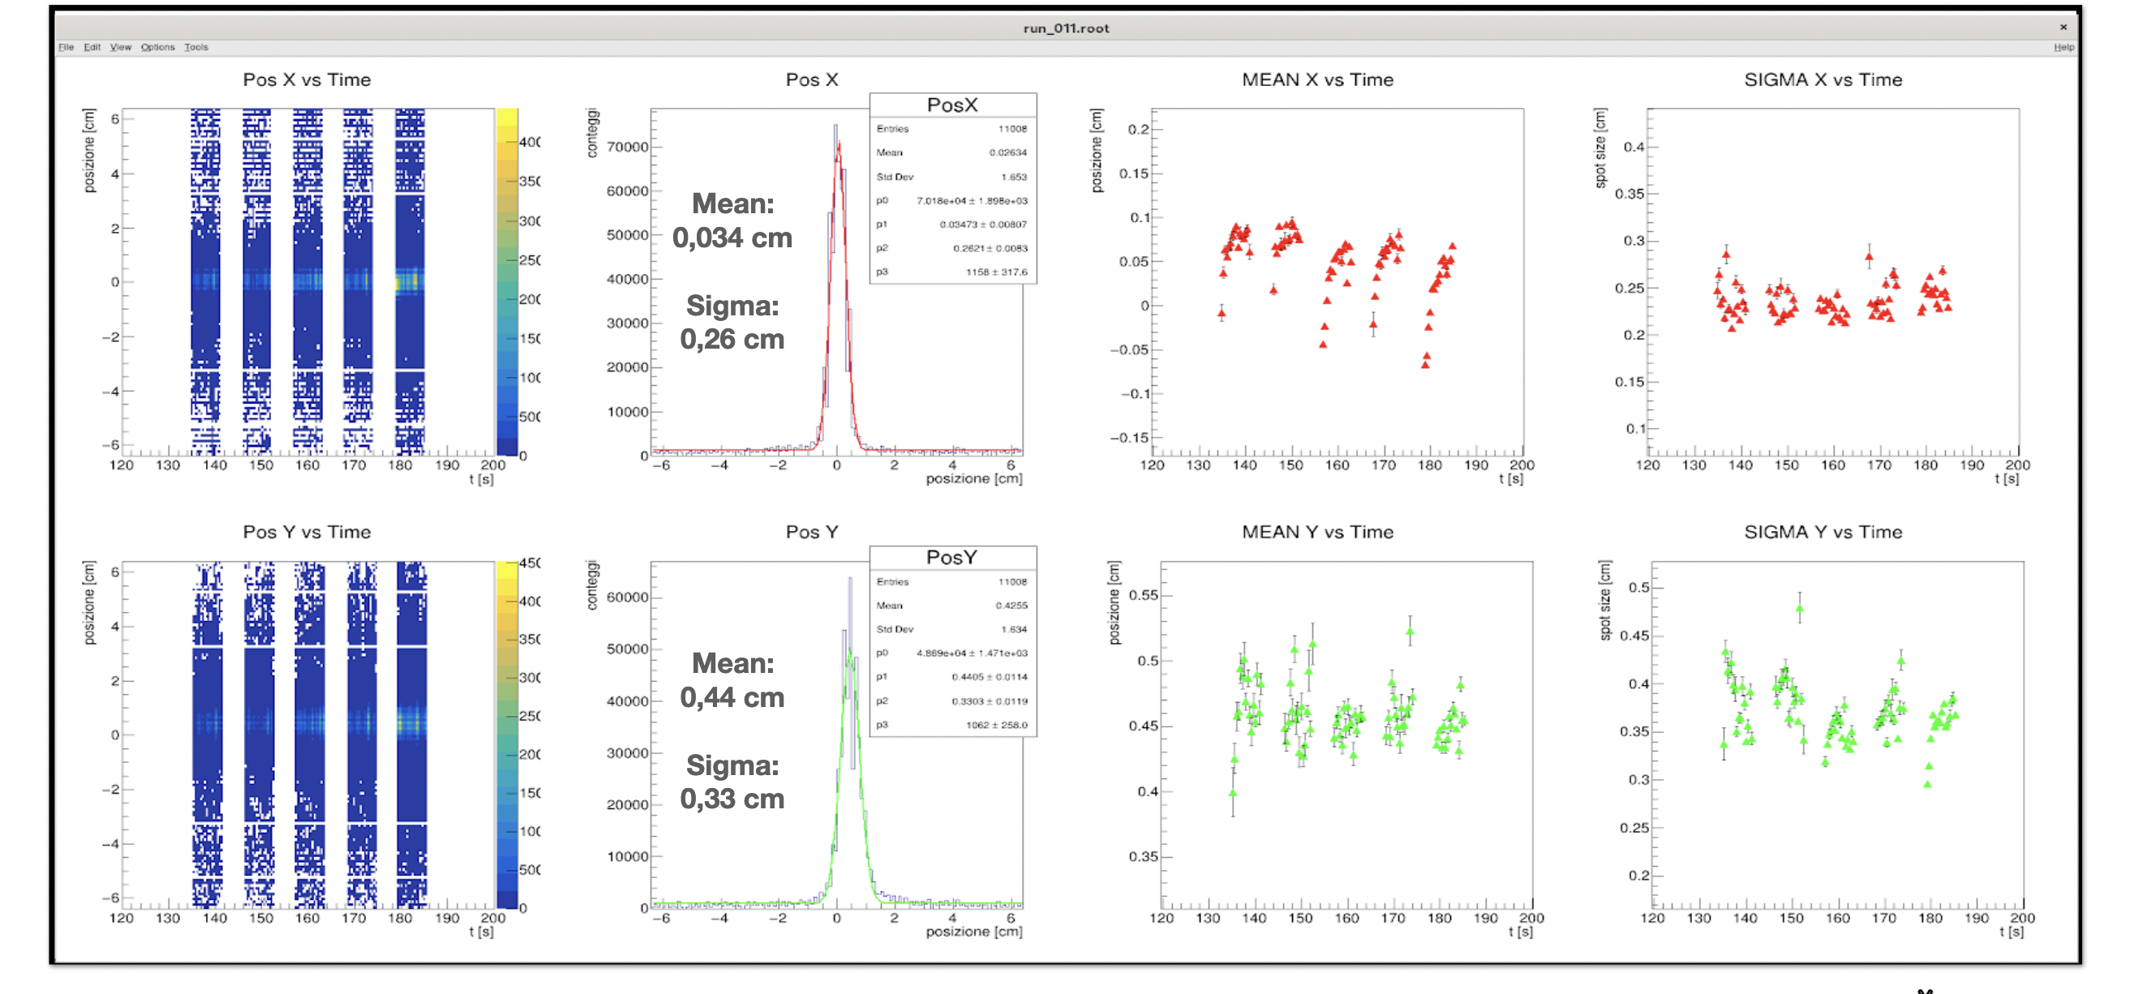
Beam setup
12C @ 400 MeV/u

Slide 9
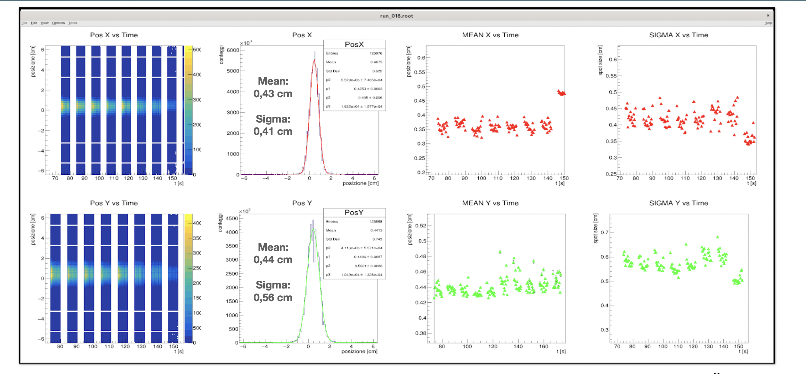
Beam setup
12C @ 115 MeV/u

