Slide 1
Data-taking @ CNAO report
G&G

Slide 2
Summary
The scan of calorimeter aiming to inter-calibrate the response of different crystals has been performed successfully. All the 12 modules has been irradiated using carbon beams at 300 MeV/u, while few modules have bene also tested with protons at 220 MeV.
The response of the drift chamber as a function of the beam rate has been studied with carbon beam @ 115 MeV/u and proton beam @ 227 MeV. The super-preliminary results got during the irradiation suggest that the chamber works properly at rates up to few hundred kHz, with some loss of efficiency that can be explained by the effect of current limitation resistors. Problems observed in previous runs were probably due to a different gas condition

Slide 3
Summary
A first test of integration of the inner tracker in the data acquisition system has been performed. In this respect, a huge step forward has been done, even if we did not succeed in acquiring an analysable data-set.
We spent a lot of time in setup the beam at 200 MeV/u to reach intensity of the order of few kHz, while keeping a time structure allowing for maximising the data collection. We came back home having a better knowledge of the beam features and having understood the way to adjust it according to the FOOT needs. The effective mean data acquisition rate (i.e taking into account the duty cycle of the beam) including start counter, beam monitor, vertex, msd, tofwall and calorimeter could be of the order of 300 Hz. According to that, we could decide the strategy and goals of the next shift in december)

Slide 4
What we learned
The beam height is not exactly 120cm from the floor (the laser is at ~123cm) . Our tracking detectors were crucial for a proper alignment. The calo height has been increased with 4 bricks.
The scanning magnets can not be used without DDS. However, The beam position can be roughly adjusted with ”correction magnets”
For safety reasons, we can not work in XPR without the supervision of CNAO personnel. We should agree with Marco Pullia to have some time to work over the beam time (afternoons?)
The beam as delivered with the “nominal setup” (rate of the order ok kHz, size of few mm) has n unexpected bunched time structure (~1 kHz). This has a significant impact on the DAQ rate, as particles are not poissonian distributed in time

Slide 5
Troubles
Three-phase power not compliant with the TW moving system.
Network for data transfer to our cluster (Tier*, GSI) not configured.
(slide da sistemare)

Slide 6
Schedule
Beam
No-beam
4 Dec – 5 Dec | 22.00 -4.00 | 6h | Full setup
5 Dec | 4.00-22.00 | 18h | -
5 Dec – 6 Dec | 22.00-4.00 | 6h | Full setup
5 Dec | 4.00-22.00 | 18h | -
6 Dec – 7 Dec | 22.00-4.00 | 6h | Full setup

Slide 7
Next shift: setup
Setup for physics:
Geometry: see the Giuseppe presentation
Mechanics: 2 tables non necessary if IT not in operation (easier mounting)
TW & CALO already cabled. DAQ,ST,BM,MSD,VTX to be re-cabled
Question: calo modules re-arranging?
ST
TGT
MSD
CA
BM
VTX
TW

Slide 8
Logistic
According to the experience gained in the past shift, 4-5 h should be sufficient to re-mount the full setup.
Arrival time: not beyond 4 December at 12.00 (10h to reboot before the beam-time)

Slide 9
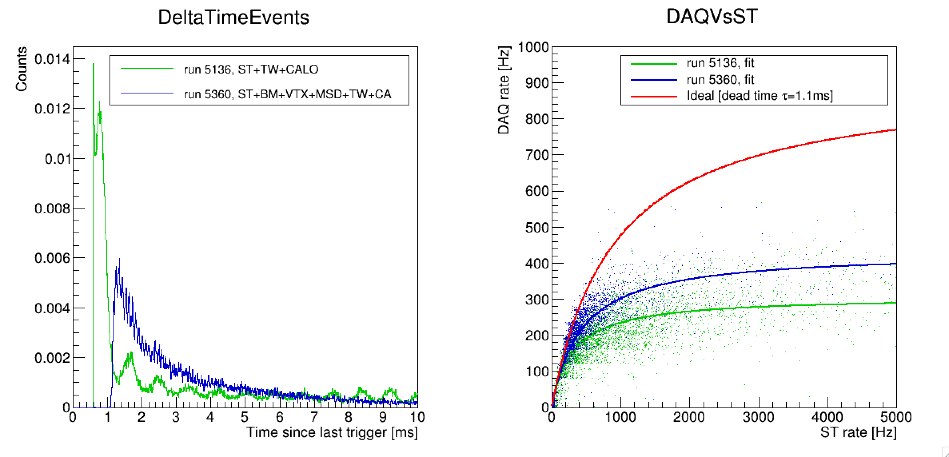
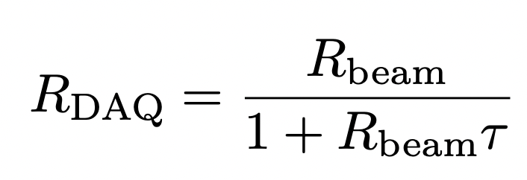
Beam structure and DAQ rates
0.6 ms
1.1 ms

Slide 10
DAQ rate: considerations
Our realistic goal is to keep a DAQ rate of 200 Hz (included beam duty cycle)
To avoid pile-up in VTX and saturation effect in other detectors due to instantaneous beam rate fluctuations, we cannot boost too much the beam rate when using fragmentation trigger.
We remind that we need to collect a certain number of events using only the MB trigger to compute efficiencies. We do not use both trigger with prescaling due to WaveDAQ firmware upgrade (the same occurred in Heidelberg). According to what we already did at Heidleberg, we need AT LEAST 1E6 events with MB trigger per energy/target → 1h 20 min.

Slide 11
Possible scenarios
Only MB. In an utopistic view in which we will be able to exploit all the beam time (18 h) @ 200 Hz → 1.3E7 events --> we can collect data at maximum for 2 energies with 1 target or 1 energy with 2 targets ( in any case with few events, but no uncertainties due to the bias due to the trigger)
MB+Fragmentation trigger. In 2021 the fragmentation trigger allowed to reduce the acquisition time of a factor 6 ( beam rate > 10KHz). As in 2022 the beam rate will be kept lower than 5kHz, we could expect a gain of a factor 2-3.
With this assumption it means that in 18h we will be able to collect 2.4E7 MB-equivalent events. In both scenario, it seems too optimistic to collect more than 2 configurations (energy or target)

