Slide 1
Cosmic-Ray Test of the 2nd IHEP SCD and the status of test beam preparation
Rui Qiao; Ke Gong; Wen-Xi Peng; Rui-Jie Wang; Bing Lu; Ruo-Si Lu

Slide 2
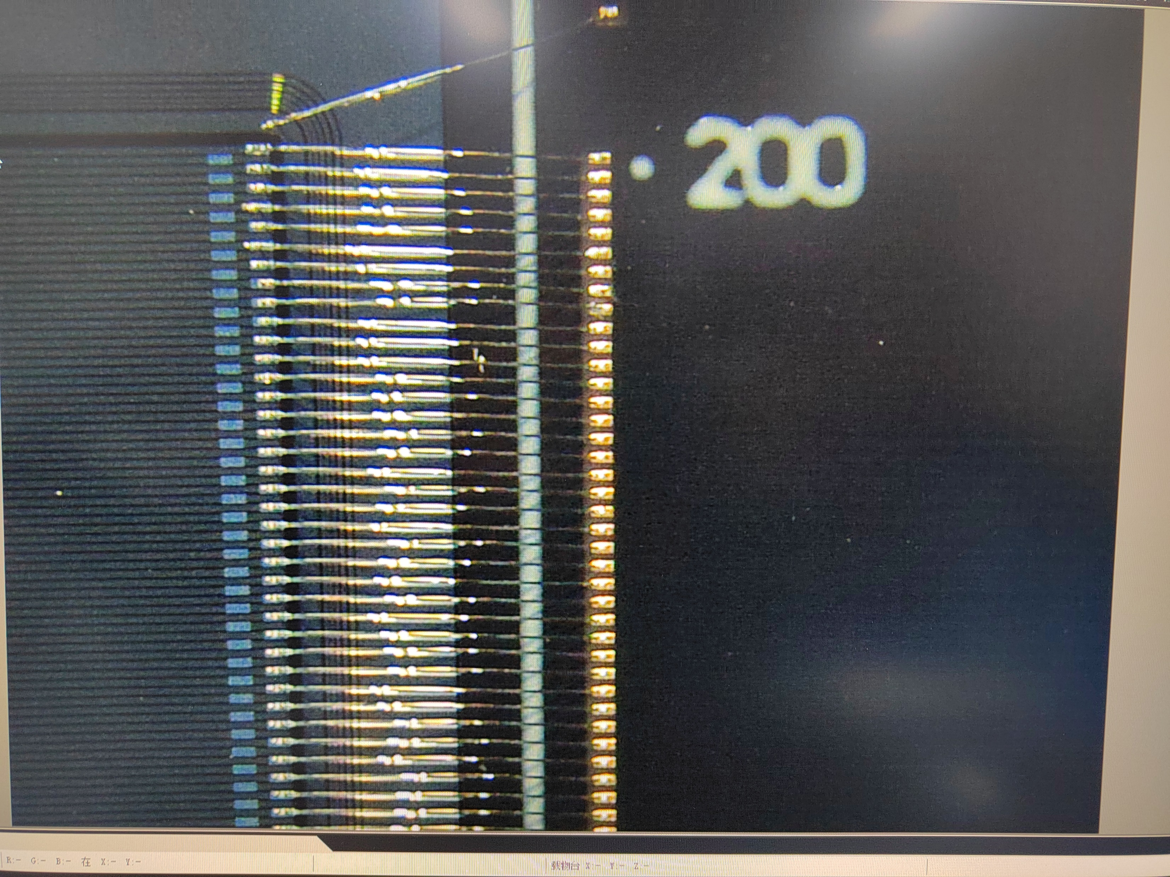
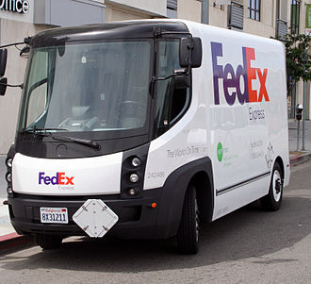
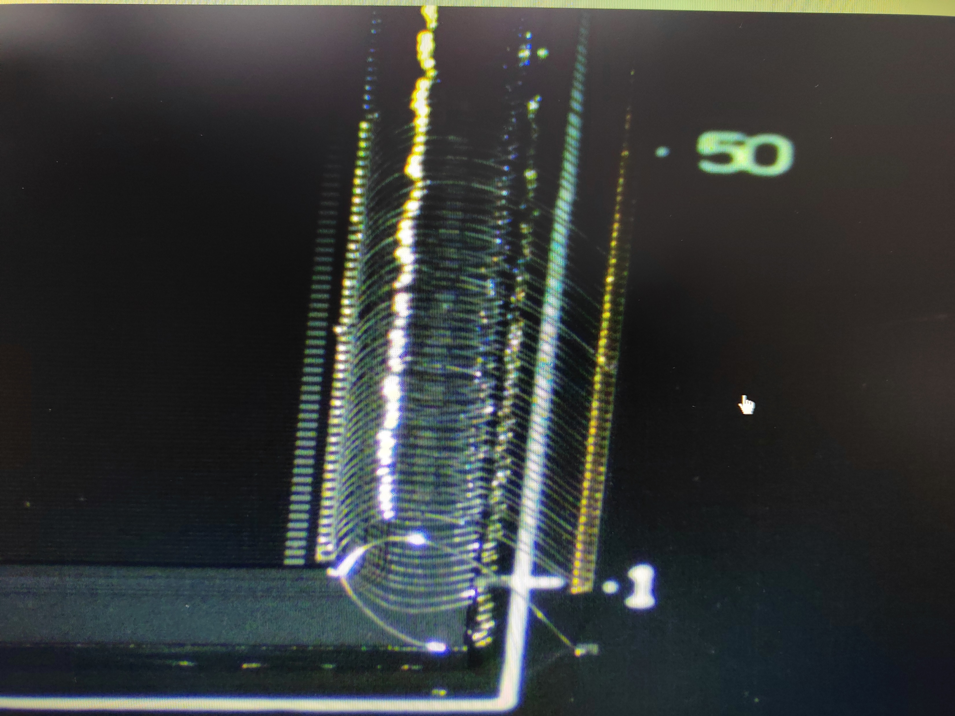
The 2nd IHEP SCD
IHEP: VA & Detector gluing. Capacitor soldering.
PMO: VA & Detector bonding.
IHEP: Pedestal & CR test.
PMO bonding of 2nd IHEP SCD
Notes:
G:\keyan\HERD项目文档\周进展\资料\20221019_紫台帮忙bonding\*

Slide 3
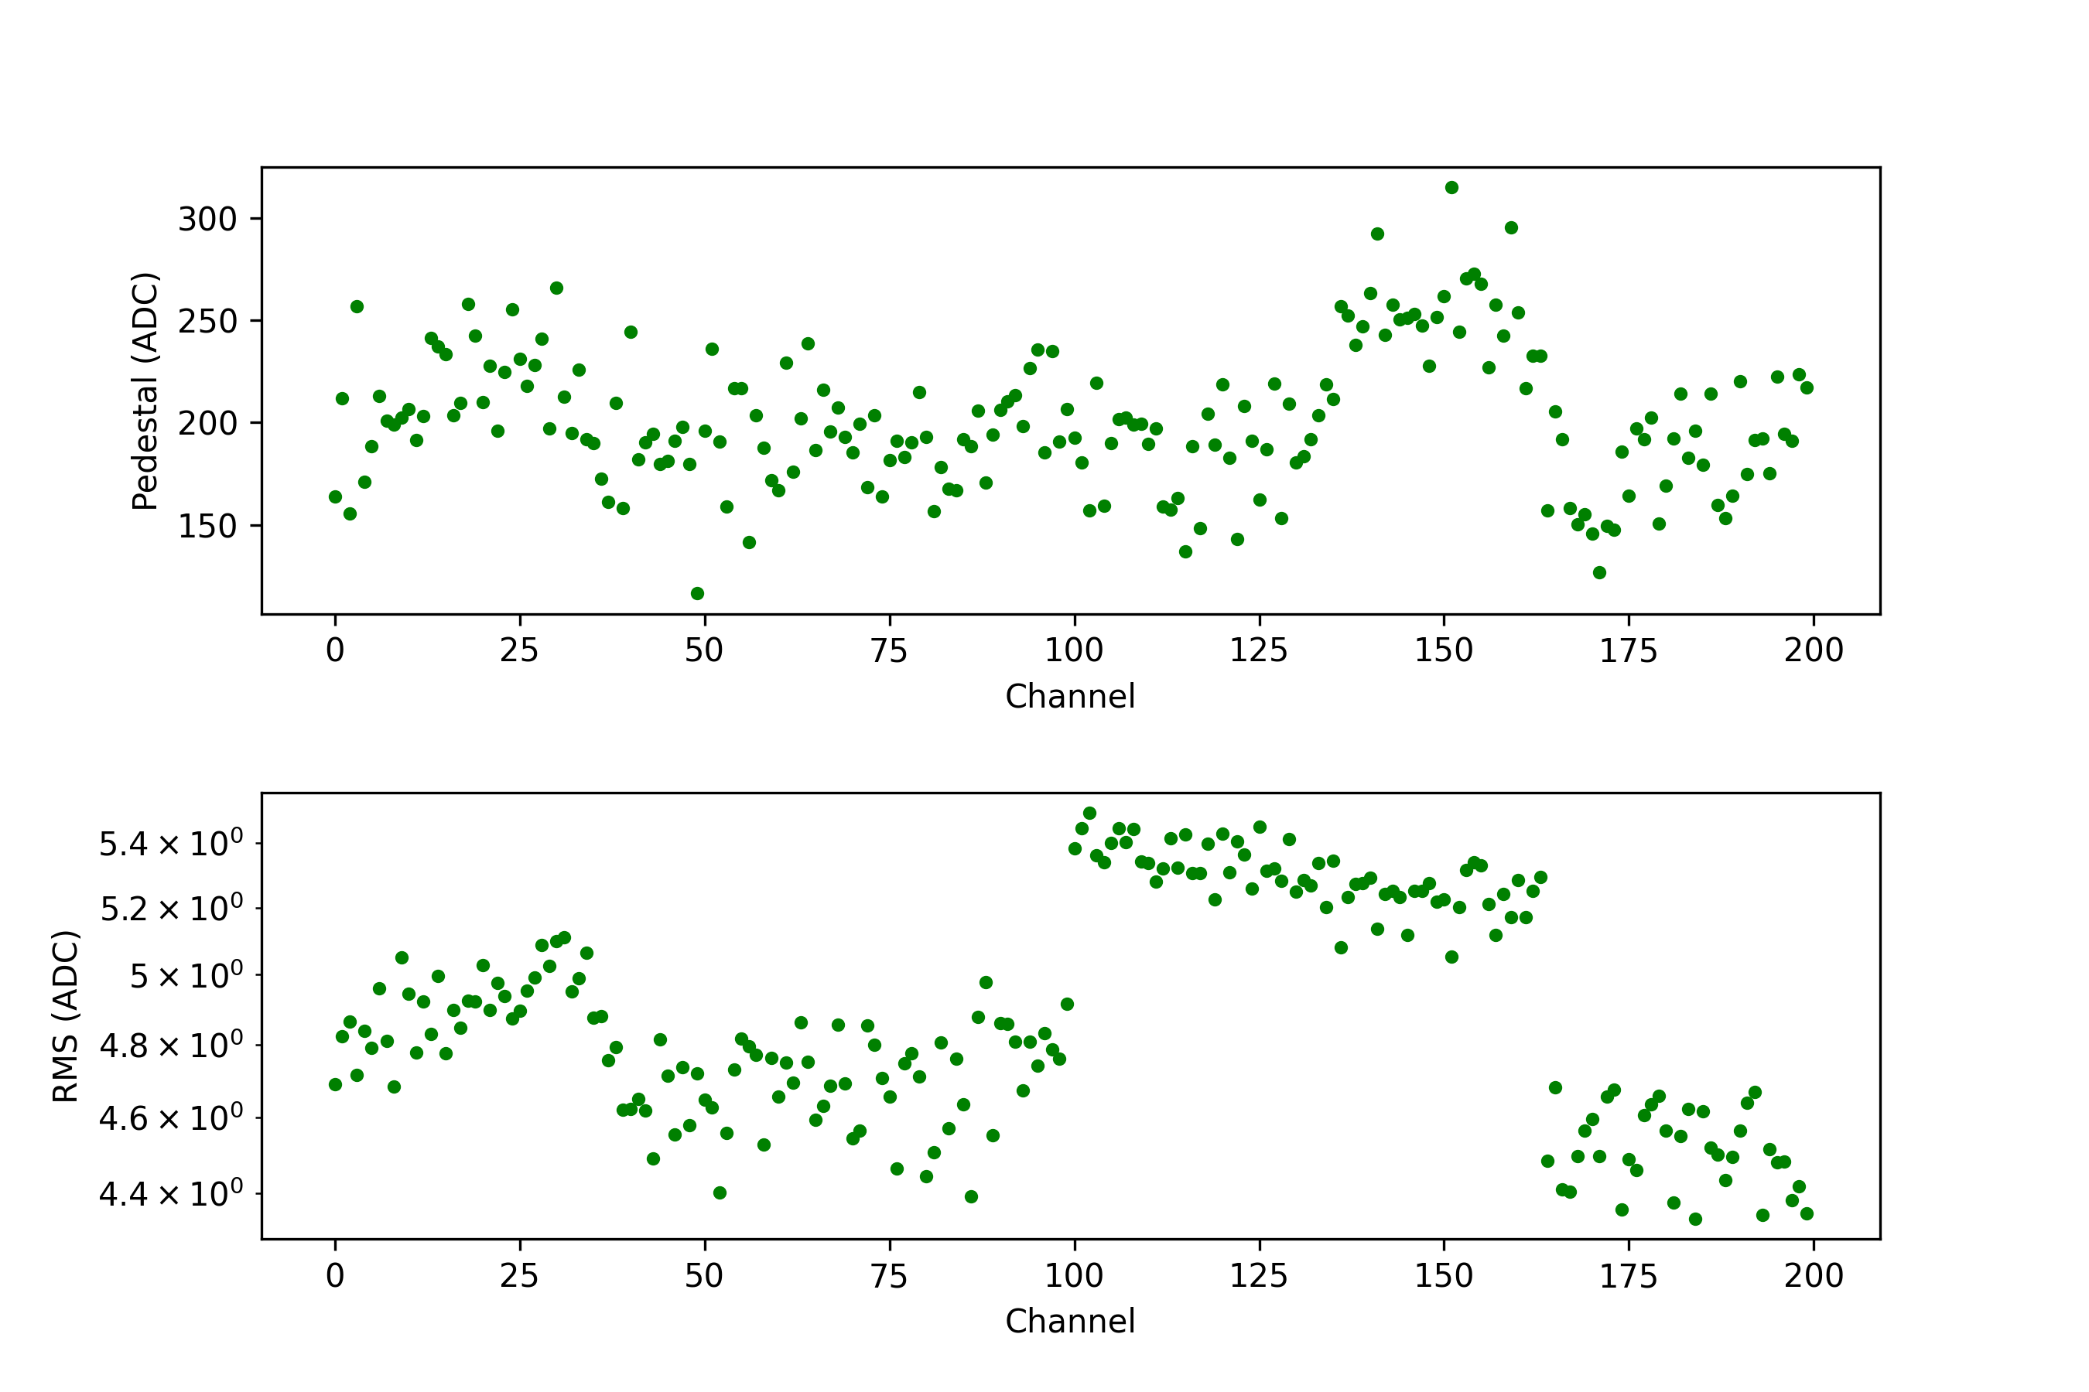
Pedestal Test
Pedestal(Y) vs Ch(X)
Sigma(Y) vs Ch(X)
The detector performance is perfect. No damage during bonding thanks to the PMO colleague.

Slide 4
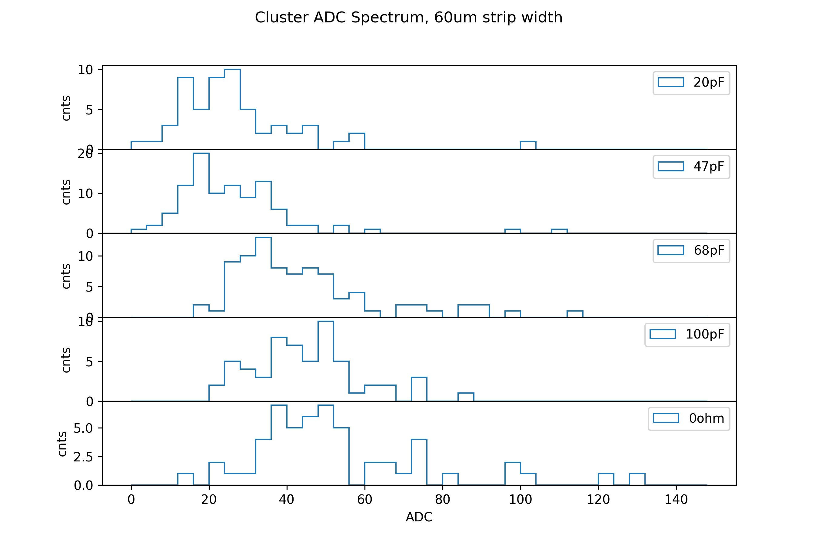
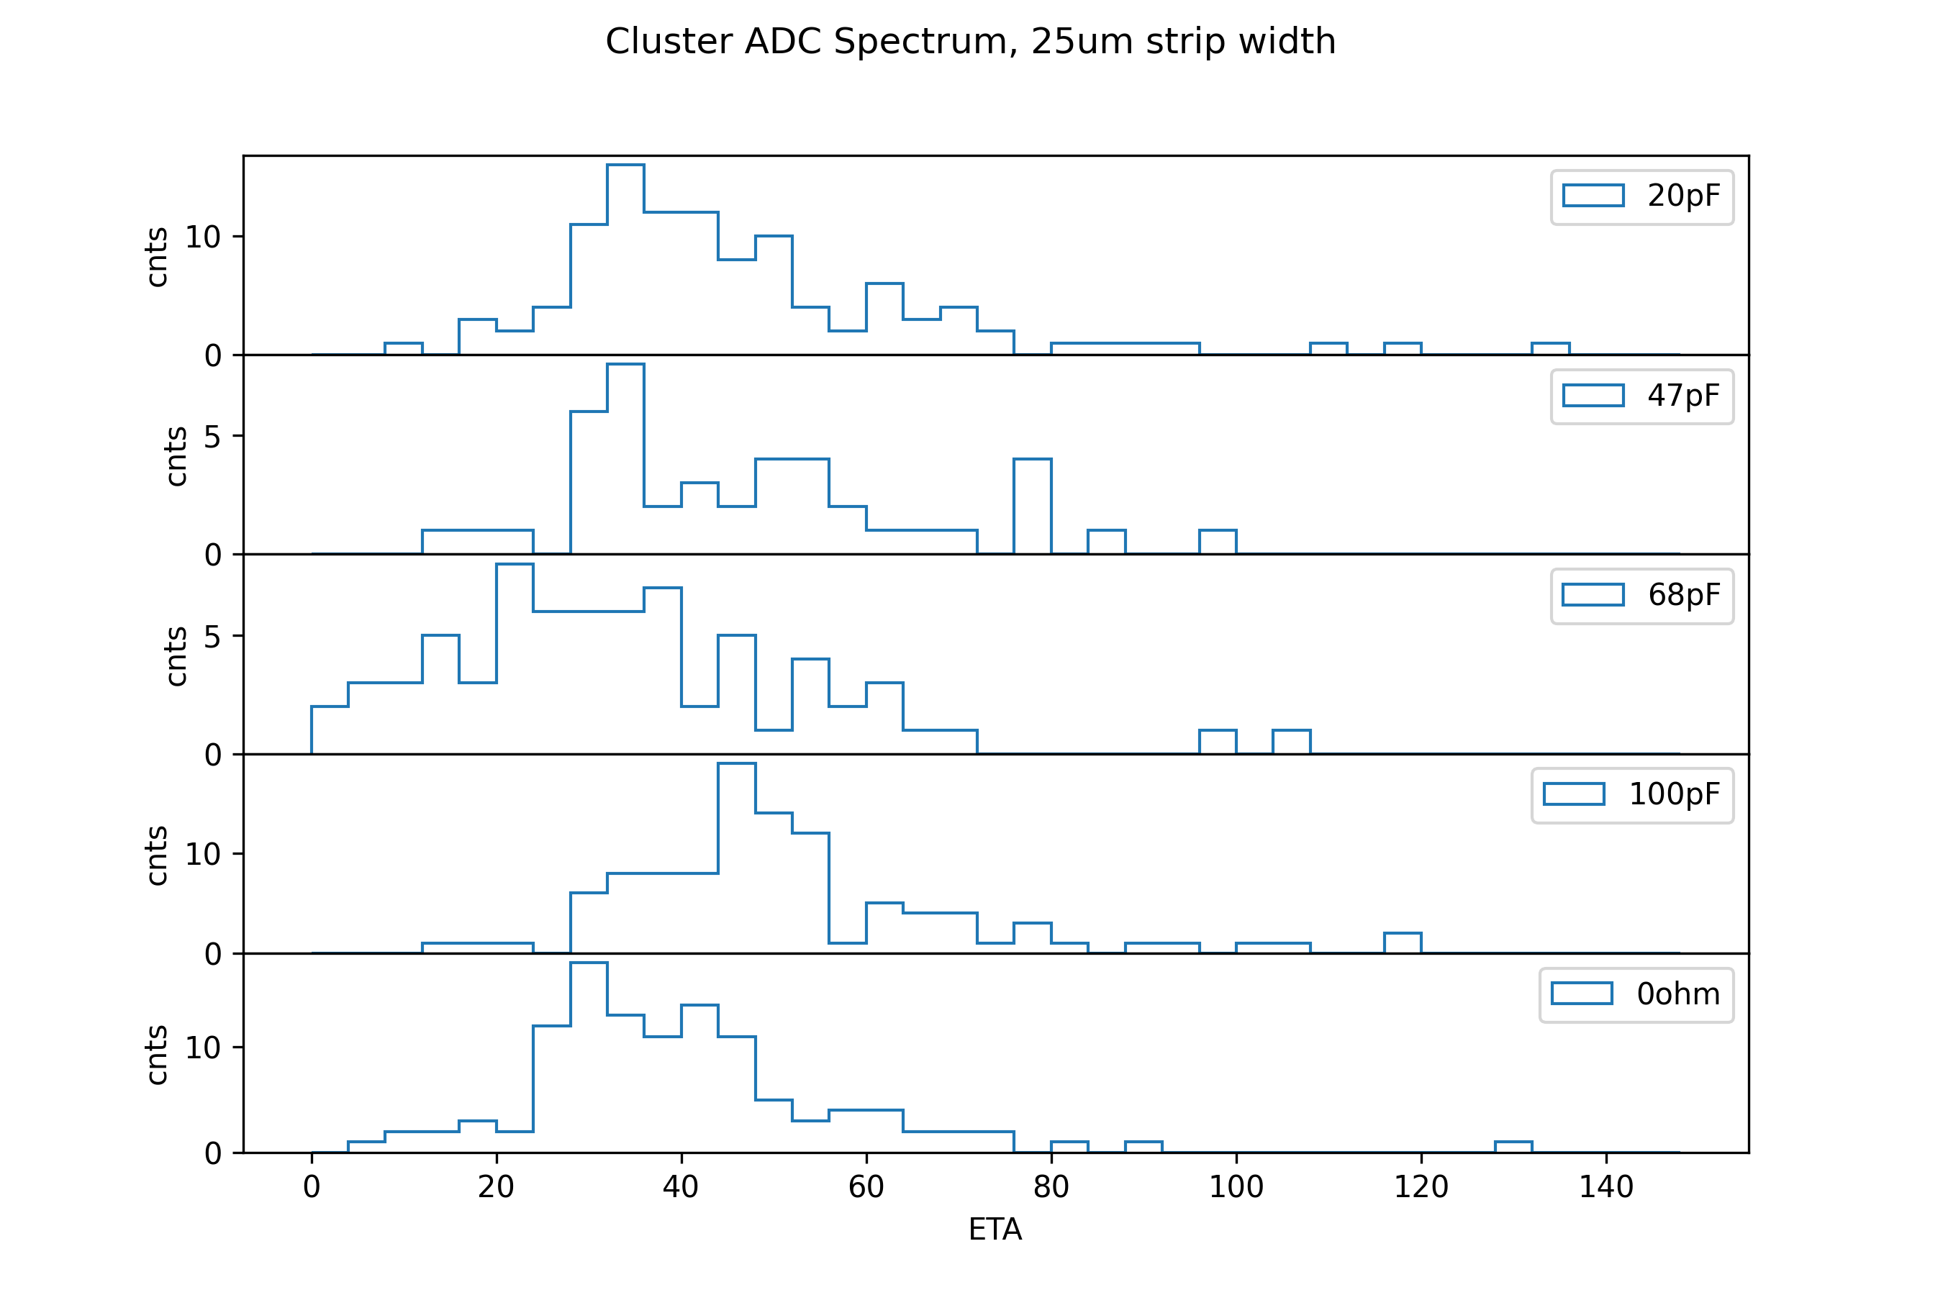
Cosmic-Ray Test
CR hitting the readout strips of 60um width section
CR hitting the readout strips of 25um width section

Slide 5
Status of test beam preparation
PMO SCD: Detector Test
IHEP SCD:
Detector Test
IHEP PSD:
Detector Test
PMO SCD: Detector Packing
IHEP SCD:
Detector Packing
IHEP PSD:
Detector Packing
Detector Assembling on test beam support
Detector test with full setups
Packing at Oct.30. Transportation at Oct.31

Slide 6
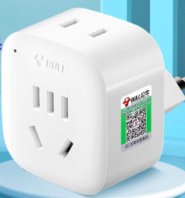
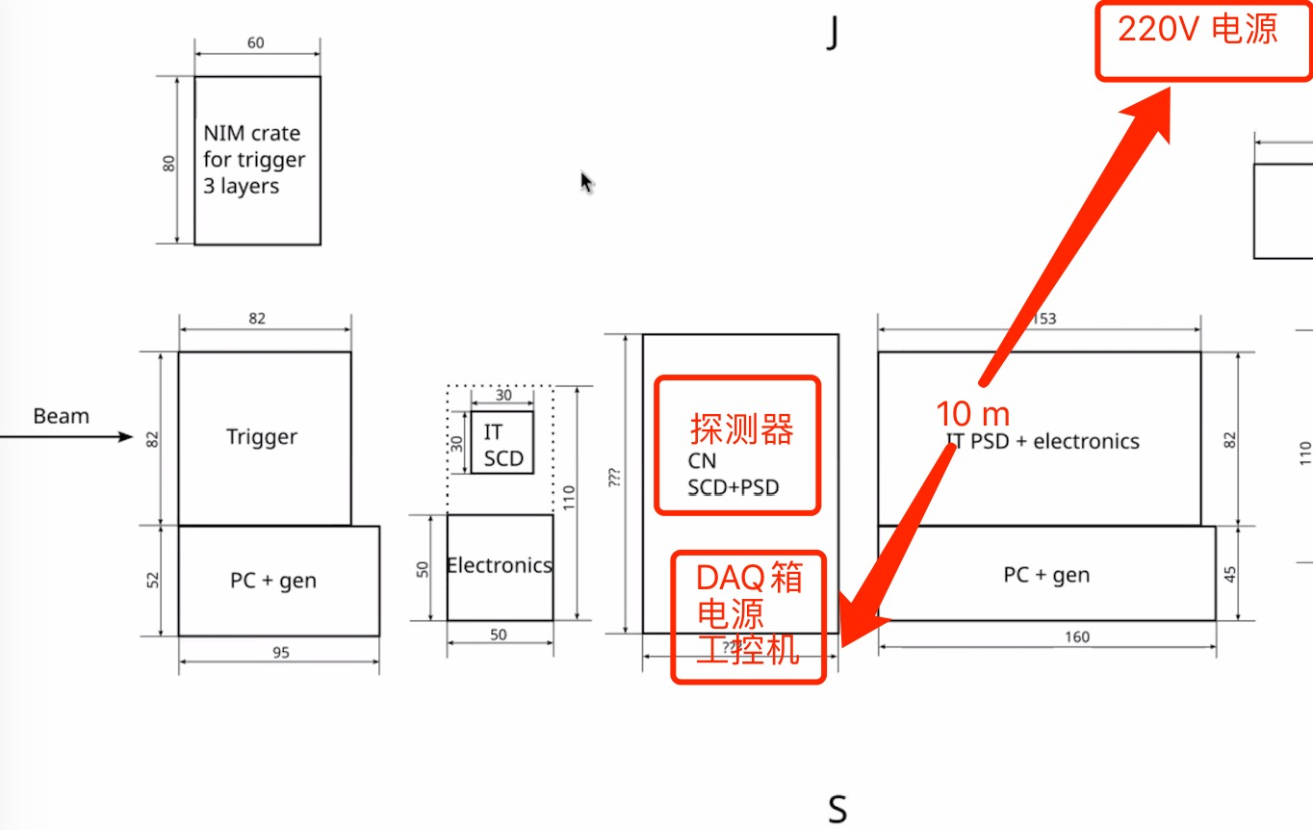
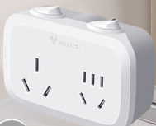
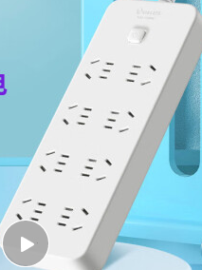
Cable routing
220V
Swiss type
Swiss->CN Convertor
10m cable
4 kW
Fanout; 4kW
5m power strip.
8 sockets. 2.5 kW.
SCD DC Power*2
PSD DC Power*3
~2.4 kW
SCD PC *4
PSD PC*1
~1.2 kW
SCD Monitor *2

Slide 7
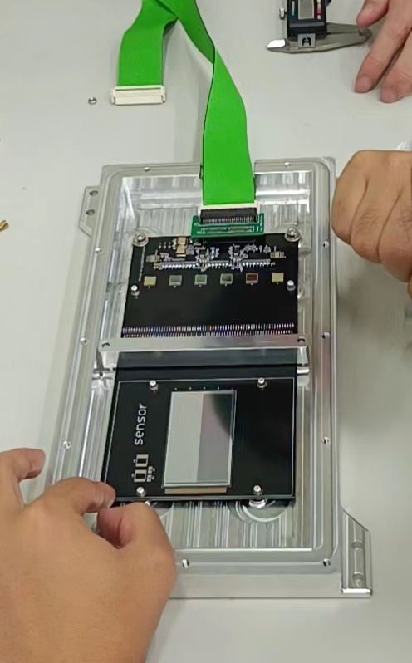
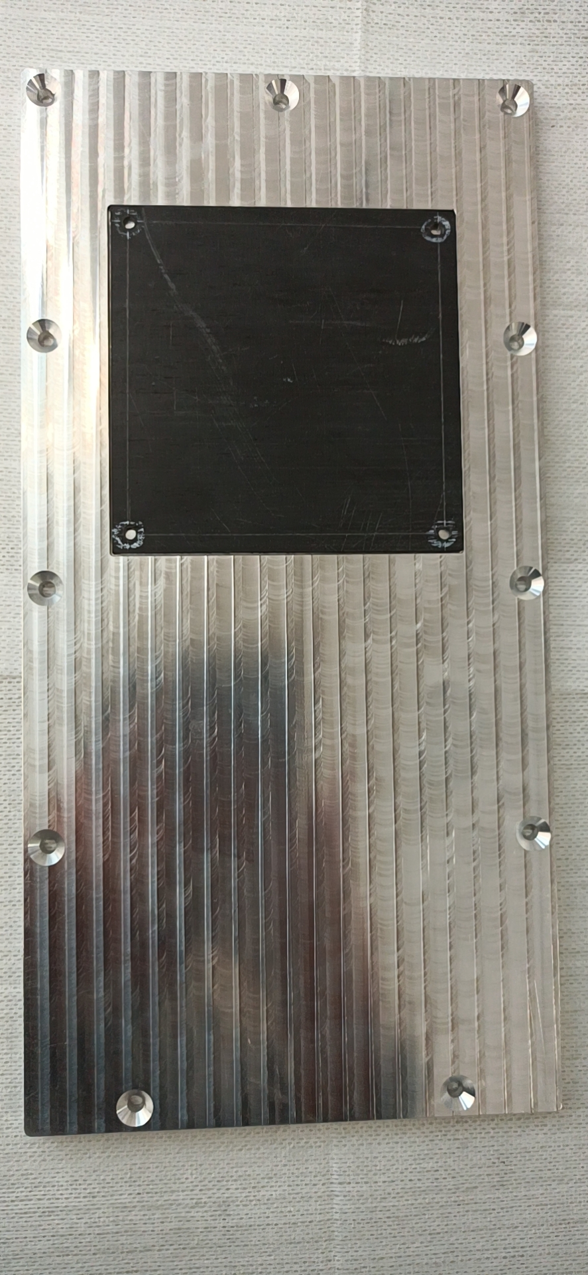
Detector Packing for IHEP SCD
carbon-fiber window
Aluminum box
& detector
Aluminum cover
Notes:
G:\keyan\HERD项目文档\周进展\资料\20221026_束流实验支撑和包装\

Slide 8
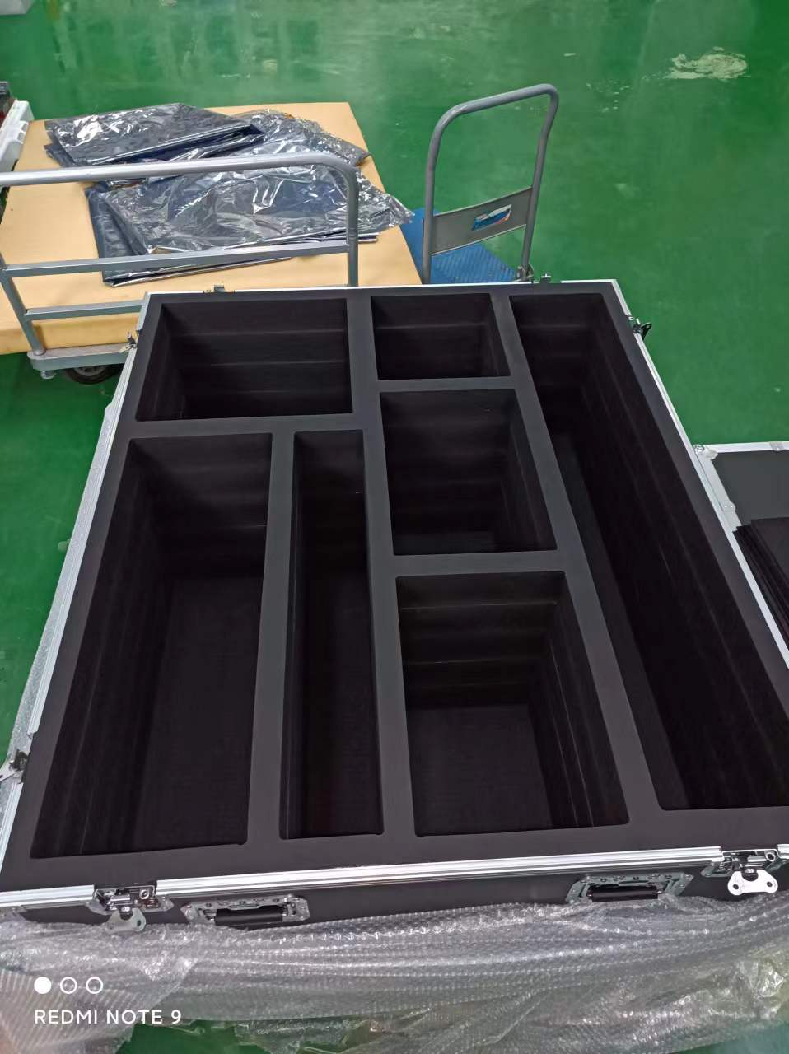
Transportation box
PMO PC*2
Monitor*2
Cables
SCD DC power*2
PMO SCD
IHEP SCD; PSD;
Notebooks*3
PSD DC power*3
Suport
Notes:
G:\keyan\HERD项目文档\周进展\资料\20221026_束流实验支撑和包装\

