Slide 1
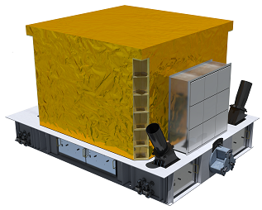
PSD&SCD Thermal Control System (TCS)

Slide 2
PSD&SCD Thermal Control
Temperature Control Index
S. No | Equipment | Subassemblies | Quantity | Thermal load(W) | Total (W) |  | Thermal control requirements
 |  |  |  |  |  |  | Interface temperature | working temperature | Storage temperature | Stability
1 | PSD | Detector |  | 0 | 0 | 66.00 | -20~ -10 | -10~+20 | -30~+40 | 5℃/hr
2 |  | Top Electronics | 4 | 5.35 | 21.4 |  |  | -10~+20 | -30~+40 | 5℃/hr
3 |  | Side Electronics | 4 | 3.45 | 27.6 |  |  | -10~+20 | -30~+40 | 5℃/hr
4 |  |  |  | 2.125 | 17 |  |  | -10~+20 | -30~+40 | 5℃/hr
5 | SCD | Detector | 5 | 0 | 0 | 349.44 | -20~ -10 | -10~+20 | -30~+50 | 5℃/hr
6 |  | Top Electronics | 4 | 28 | 112 |  |  | -10~+30 | -30~+50 | 5℃/hr
7 |  | Side Electronics | 4 | 25 | 100 |  |  | -10~+30 | -30~+50 | 5℃/hr
8 |  |  |  | 17.18 | 137.44 |  |  | -10~+30 | -30~+50 | 5℃/hr
9 | DAQ Box |  | 4 | 35 | 140 | 140.00 | -15~+45 | -15~+45 | -30~+50 | /
Total |  |  |  |  |  | 559.44

Slide 3
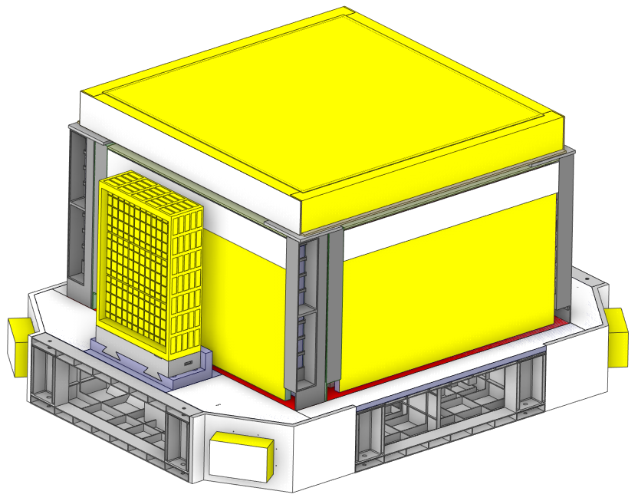
PSD&SCD Thermal Control
PSD&SCD
MLI+Betacloth:
Top aspect+4*side aspect
Multi-Layer Insulation (MLI) Blankets
Standard Axial Groove Heat Pipes
Surface Optical Coatings
Radiators
Heaters
Insulated pad
heat insulated pad
Heat Pipe Radiator（4）+Heater

Slide 4
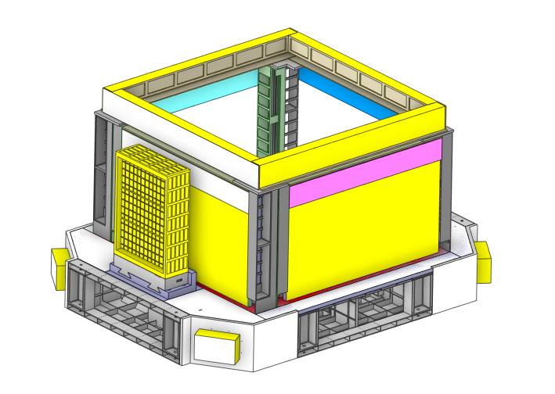
Radiators&Coatings
PSD&SCD Thermal Control
PSD&SCD Radiators include 5 Radiators
Right Radiator
0.243m²
flight direction
Use surface of body as radiator
Radiators are painted with KS-Z white paint to improve heat rejection.
Wake Radiator
0.283m²
Front Radiator1
0.39m²
Left Radiator
0.243m²
Front Radiator1
0.283m²

Slide 5
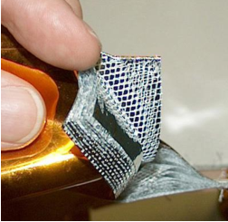
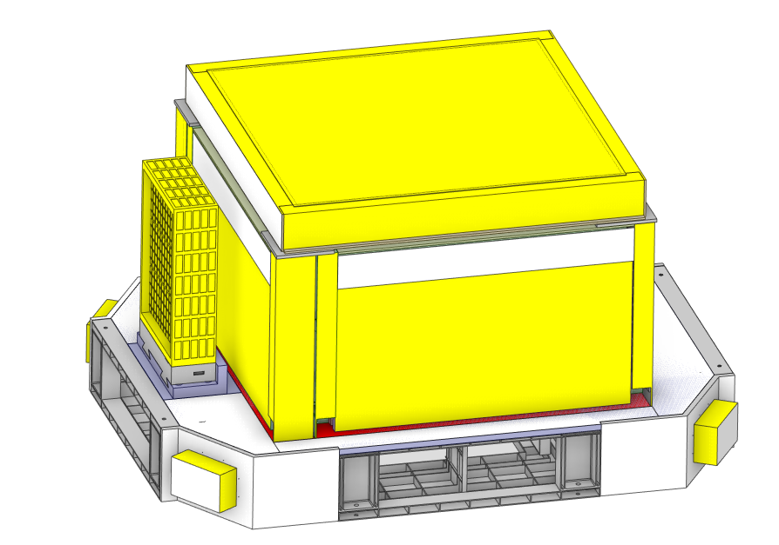
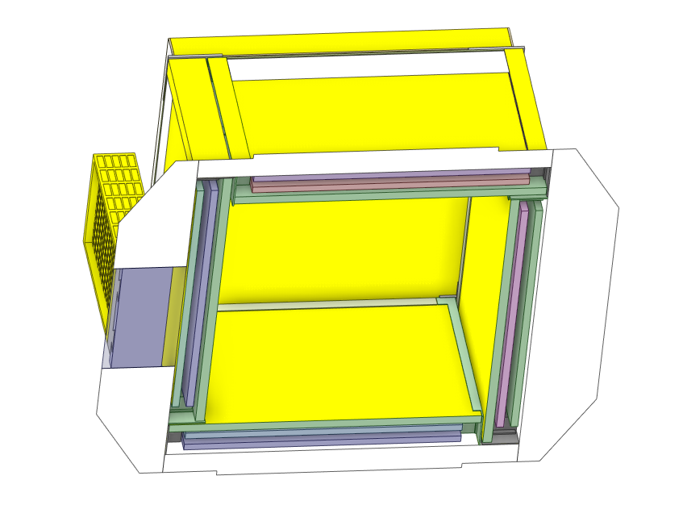
Multi-Layer Insulation (MLI) Blankets
PSD&SCD Thermal Control
Inside and outside the PSD&SCD detector and some areas of electronic equipment will be covered with MLI blankets;
All blankets will meet China Space Station Construction Standards for grounding and venting;
All blankets will be positively secured.
Typical construction will include multiple layers of aluminized Mylar separated by Dacron scrim. Betacloth will protect exposed surfaces.
External MLI
Internal MLI

Slide 6
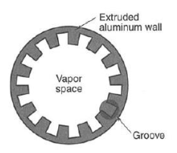
Heat Pipes
PSD&SCD Thermal Control
“L” Heat pipes
Standard axial groove heat pipes are used in several location to help distribute heat:
Connect the top and bottom, using “U”;Connect the side and other side, using “L”
“U” Heat pipes

Slide 7
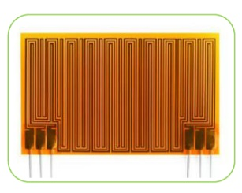
Heaters
PSD&SCD Thermal Control
Warm up components to “switch on” temperature after power outages (including initial turn-on).
Maintain components above minimum operating limits during operation.
Thaw NH₃ (heat pipes) in case of extended power outages in cold environments.
Most heaters are both thermostatically and computer controlled.
All safety critical heaters are two-fault tolerant
stick the active heater inside and the necessary thermistor attachment points

Slide 8
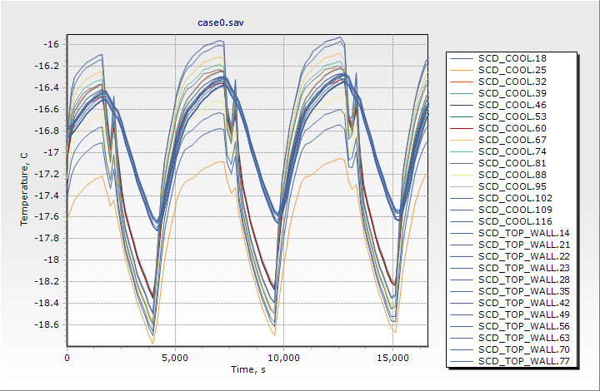
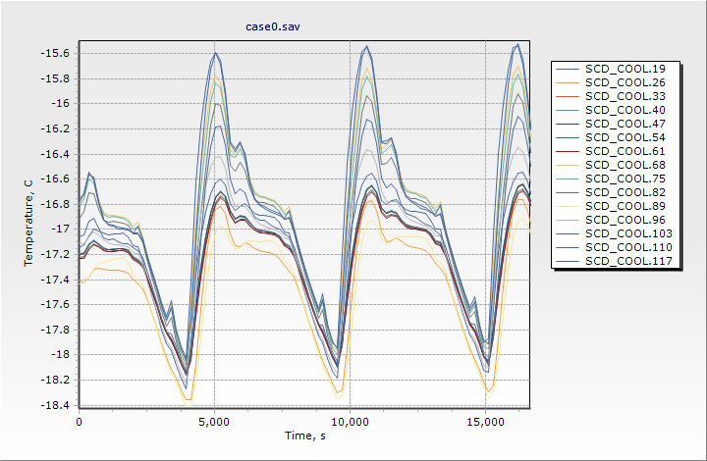
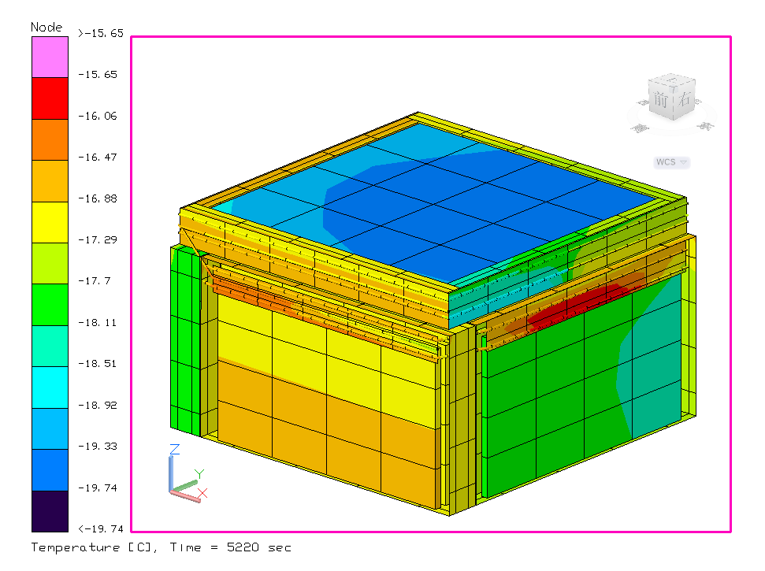
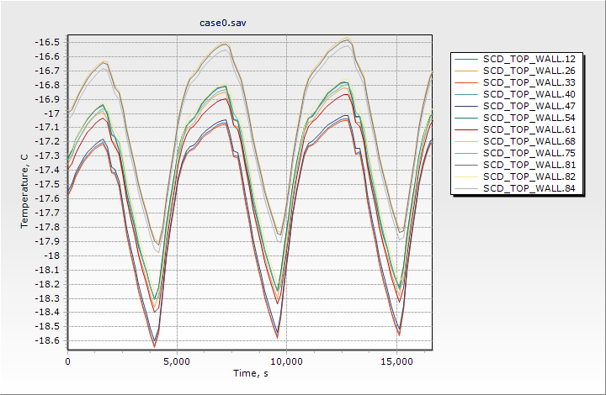
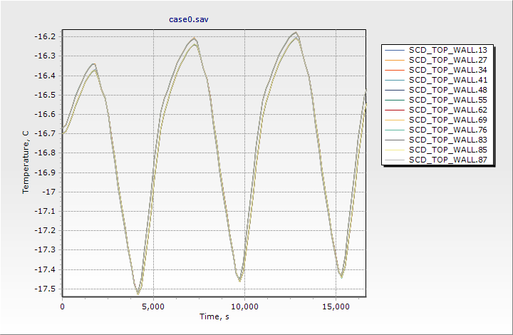
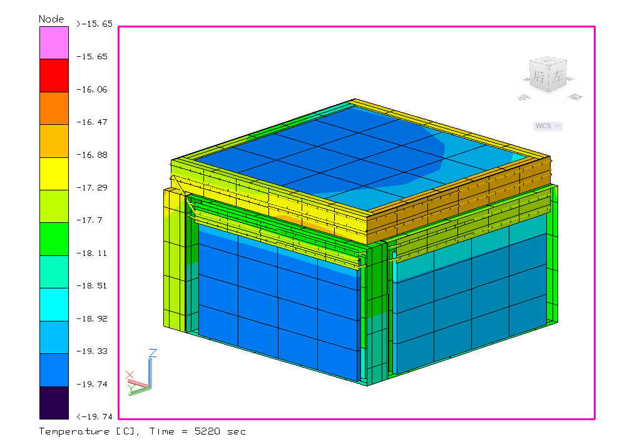
PSD&SCD Thermal Control
Thermal Analysis-Temperature Response
Beta=-65°
Right side
Front side
Wake side
Left side

Slide 9
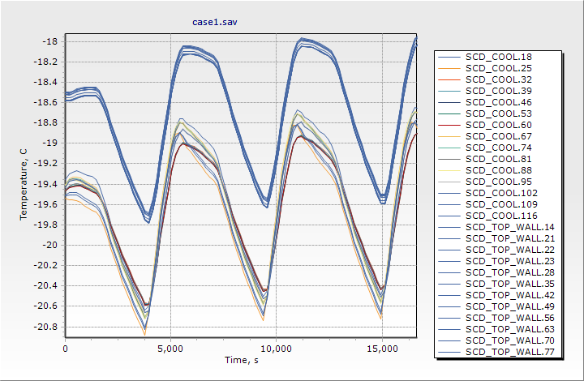
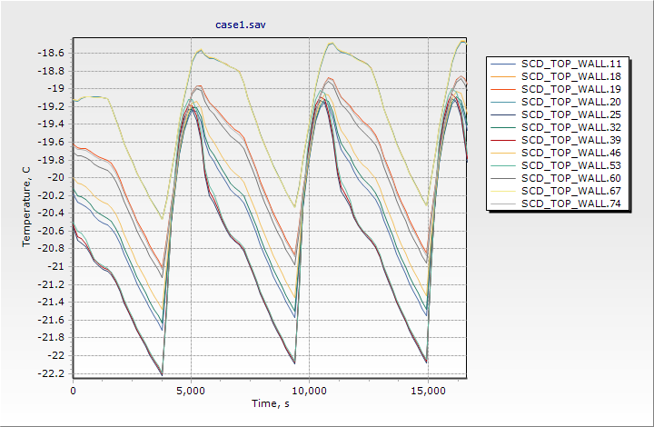
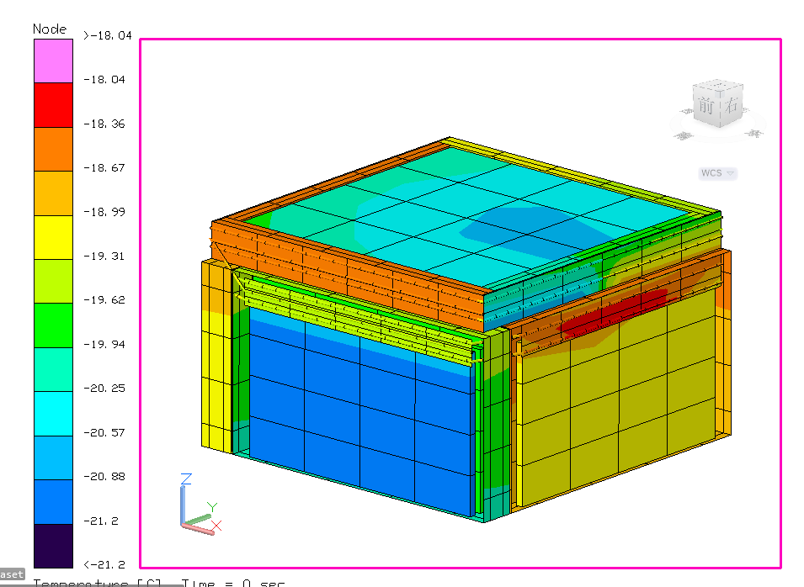
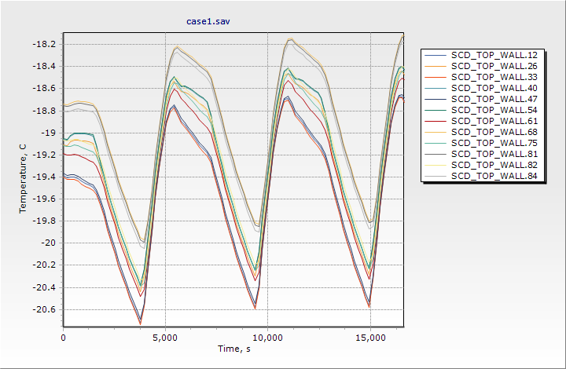
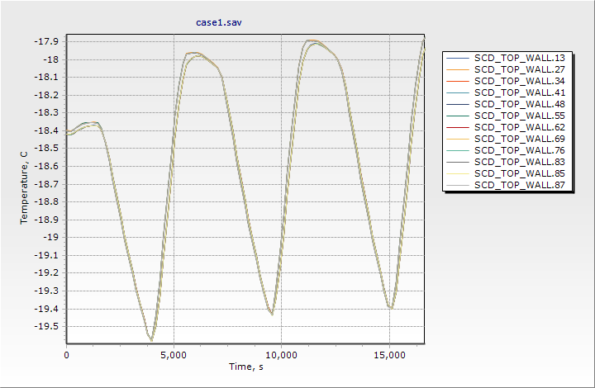
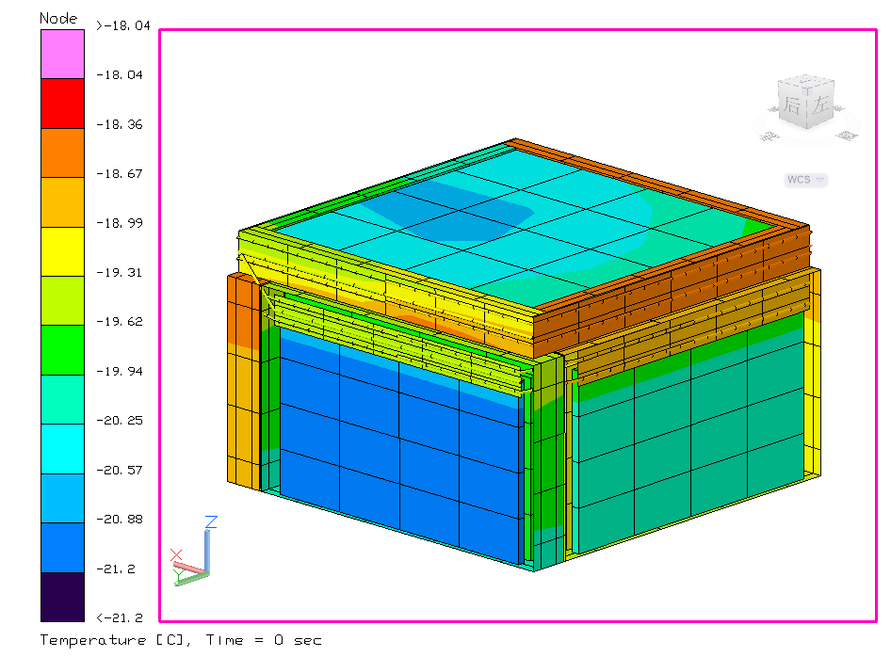
PSD&SCD Thermal Control
Thermal Analysis-Temperature Response
Beta=0°
Right side
Front side
Wake side
Left side

Slide 10
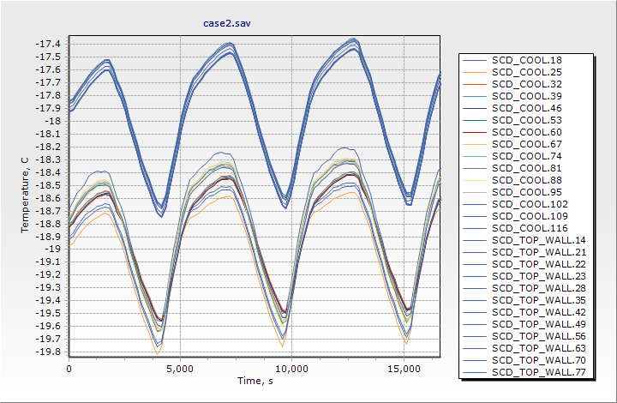
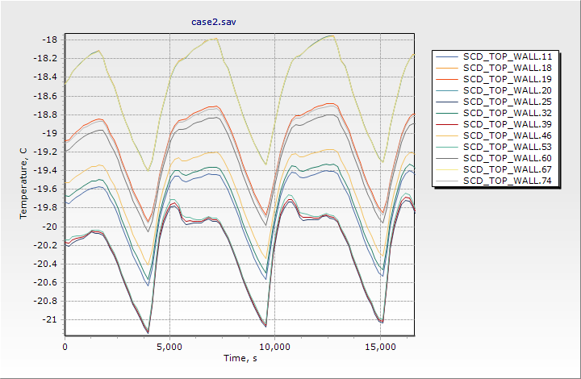
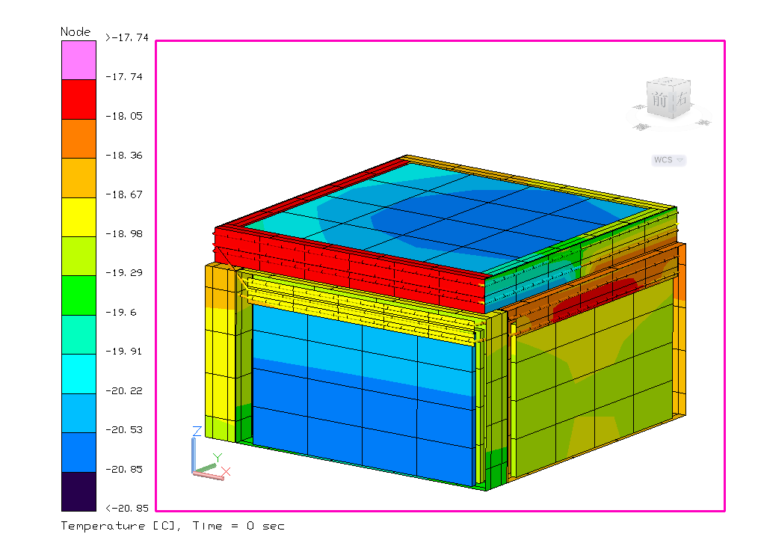
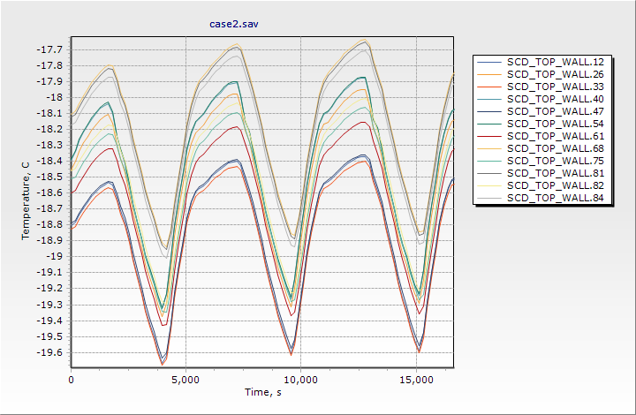
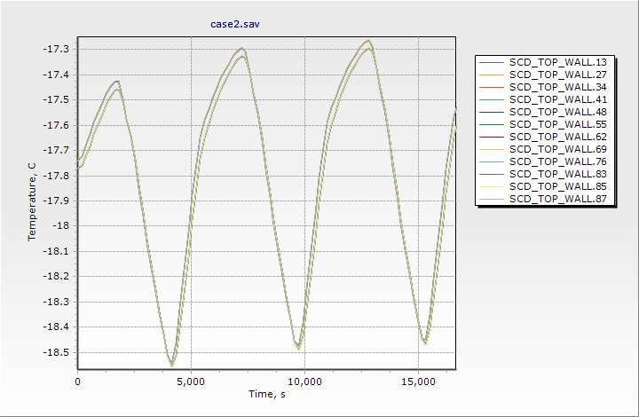
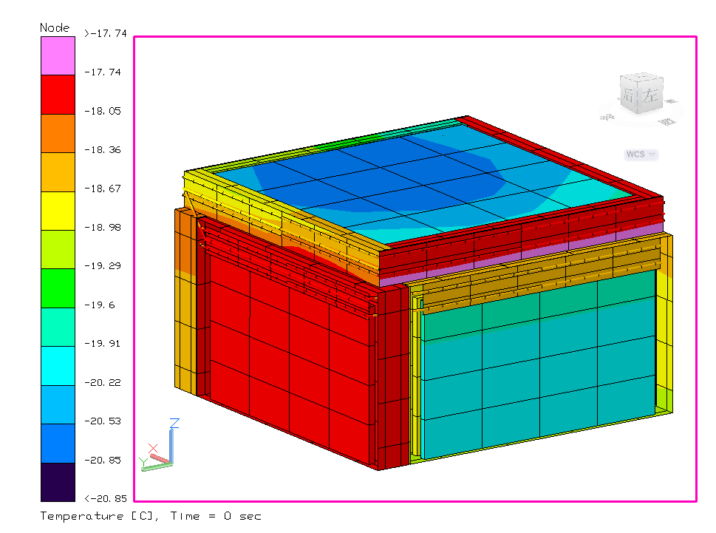
PSD&SCD Thermal Control
Thermal Analysis-Temperature Response
Beta=65°
Right side
Front side
Wake side
Left side

Slide 11
Conclusions and Recommendations
The PSD&SCD can meet the heat dissipation requirements by opening the heat dissipation surface of the body;
We suggest that the electronics of side aspect of PSD&SCD should be arranged at the Top direction, and the electronics of the top aspect should be centrally arranged, which is conducive to centralized heat dissipation.
SCD bottom and equipment cabin upper insulation design required
It is recommended to stick the active heater inside and the necessary thermistor attachment points.
The detailed scheme and resource requirements need to be repeatedly calculated and iterated with the structure.

