Slide 1
WA 8
6.10.2022
WA 8
Ongoing actions
Outcome closed actions & Decisions
To Do
Answers to Panel’s comments
Fiber diffraction experiments at EuXFEL – liquid injection tests
Coordination with the “EuPRAXIA_PPP” work
Talks with Emiliano Principi,
co-leader of users WP ???
Proposal for development and characterization of novel optics for focusing X-rays @Elettra
Review paper on spectroscopic application at the carbon K-edge
Chirality experiments review
Notes:
EuPRAXIA_PPP (europeo), come coordinarsi? Sinergie, collaborazione…
What does the project management expect for the 15 min presentation during EuPRAXIA_PPP kick-off meeting?
Fiber diffraction experiments: test sui noozles 24-28/10/22
Proposal ottiche con elettra -> Zeinab
Paper -> zeinab

Slide 2
WA 8
6.10.2022
WA 8
General comments from the panel:
The presentation at the meeting includes several exciting prospects in terms of scientific ideas.
The main beamline AQUA aims to reach the water window (∼4 nm) with a flux of in the order to 10^11 photons/pulse. This gives an excellent opportunity for experimental programs from imaging to various spectroscopy techniques in the water window. The second beamline, ARIA, aims for the VUV-wavelength range (50 to 180 nm). Both electron and photon beamlines will be set-up side-by-side, space in the hall seems to be available.
Tentative answers
We are encouraged by the panels’ comment on the scientific case.
We’ll pursue the experimental plan in the water window and push that in the VUV range.

Slide 3
WA 8
6.10.2022
Review committee: AQUA
As for AQUA, it is not clear what the radiation bandwidth is, as it is not clear how photons will be delivered to the sample (e.g., after a monochromator?). The scientific case of AQUA includes coherent diffractive imaging (CDI), X-ray spectroscopy, Raman spectroscopy, and molecular fragmentation. It is not clear whether X-ray spectroscopy includes both absorption and emission or only one of these. Also, the Raman spectroscopy plan is not explained: is this electronic Raman? Molecular fragmentation is an interesting topic, but it was not clear how it would be carried out. Are these photo-emission spectroscopy experiments (they seem more relevant for ARIA)? No liquid phase experiments are mentioned, but the presentation of test experiments at Elettra appears at the end of the presentation. This is an important development. Finally, the use of MCPs is a sound choice and their development is welcome.
Tentative answers
Coordination with WA6 about overall and single-shot bandwidth parameters
Discussion about beam monochromatization:
Depends on photon beam parameters –> a plasma feeded FEL with large jitter + monochromator would end up in no photons on the samples in most of the shots. Should we still consider the linac-feeded option?
Both XAS and XES can be in principle performed. Details on this and on Raman spectroscopy will be provided
Molecular fragmentation measurements can also be performed @AQUA
Kastirke et al. O₂ photoelectron diffraction imaging at SQS/EuXFEL (670 eV)
Also, photoemission spectroscopy experiments are ideal for the ARIA beamline wavelength range
Liquid jet: next slide
Notes:
Mono: fase zero senza e si lavora con gli elettroni
raman.: non presentati per mancaza di tempo

Slide 4
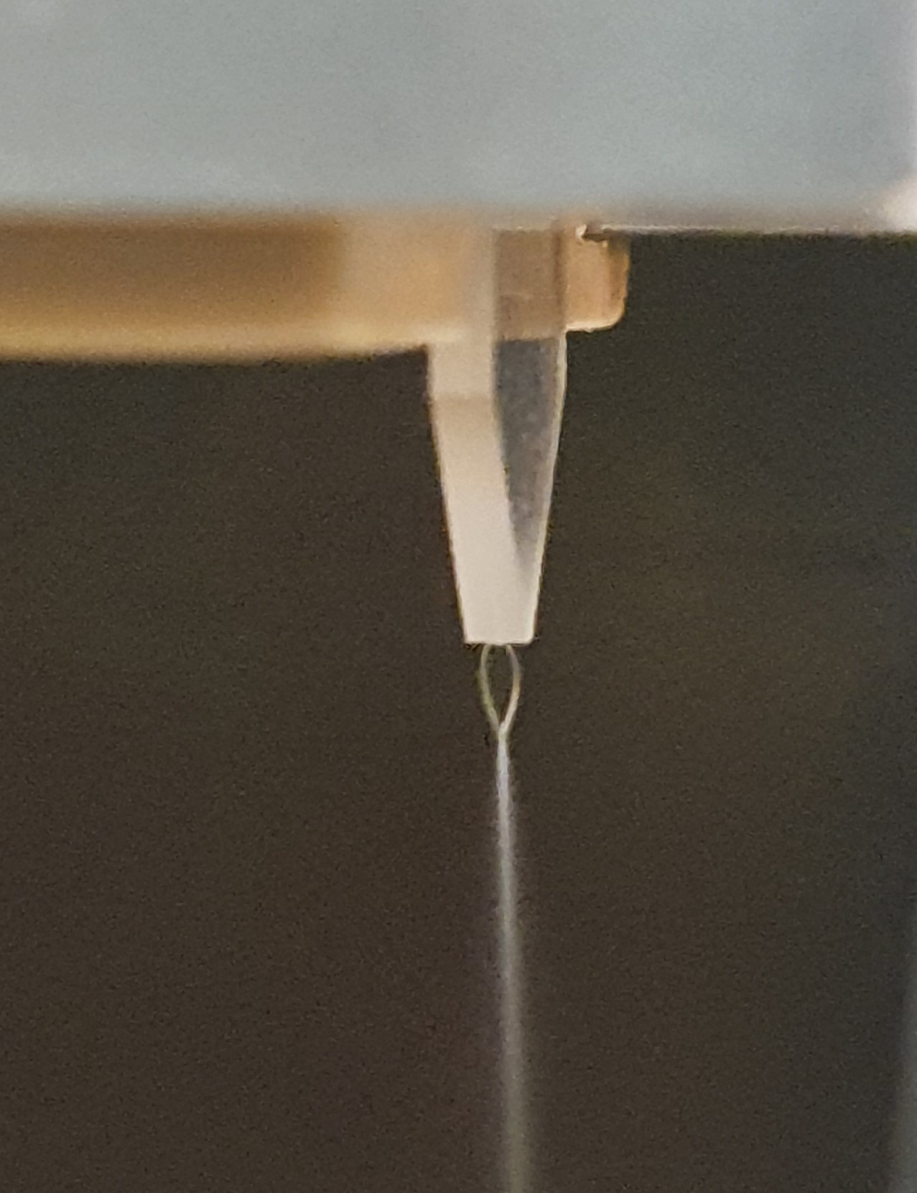
WA 8
6.10.2022
Liquid jets
Details about liquid injection -> Key for water-window imaging, among the others
3D printed GDVN,
Thin sheets under development in pilot experiments @ Elettra (courtesy of Marcello Coreno, from Gabriele Bonano’s thesis)
Gas-dynamic nozzle
Air channel: 50 μm
Liquid channel: 20 μm
HPLC and flow controller
Leaf shaped primary sheet
Adjustable dimensions
Notes:
Liquid jet: Gruppo di Coreno
Gas Dynamic Virtual Noozle
Liquido con attorno gas per jet da 5um partendo da 50um

Slide 5
WA 8
6.10.2022
Review committee: ARIA
The ARIA FEL would fill an important gap as there are hardly any vacuum ultraviolet (VUV) FEL at present (except in Dalian, China), which operates at a single energy of 24 eV. The major advantage over HHG sources is photon flux, though here again, it is not clear how the beam will be delivered to the sample. More or less the same scientific topics. WHAT DOES THAT MEAN? In none of the two cases was the option of chirality studies mentioned. These lend themselves to both photon (absorption) and electron (photoemission) spectroscopy.
Tentative answers
Beam delivered on samples: no monochromator (Seeded FEL), but focusing optics
There is an overlap of AQUA and ARIA scientific cases in terms of techniques, but we’ll clarify the issue and point out the priorities for both beamlines
Chirality experiments will be detailed
Notes:
Stesse tecniche ma campioni diversi (fase del campione, elementi…)
Chirality: stiamo studiano ora

Slide 6
WA 8
6.10.2022
Review committee: Beamlines
The photon beamlines presentation was fairly detailed in terms of mirrors, focusing optics, spectrometers, monochromators, various diagnostics, timing measurements, and other detectors. The RC was pleased to hear about the progress made in completing the photon beam diagnostic package for both beamlines, AQUA and ARIA. The RC suggests that in a next step, all diagnostic items be addressed in more detail: from design, construction and prototyping, to realization. One should start with the key components and with those requiring a long development time. Measurements of the number of photons per pulse, of spectrum, of transverse pulse shape, including the wavefront are essential for start-up FEL operation. A specific effort needs to go into the design and production of all mirrors and focusing elements (especially the KB-optics). Another important point is to understand how all the diagnostics components presented could fit into the short beamline space available. The RC wants to point out that some important parameters, such as the monochromator transmission efficiency and general stability issues, have not yet been specified. The RC would like to hear about detailed specifications of key diagnostic elements in the next meetings.
Tentative answers
We are including the synchrotron beamline group in the WP, some time is necessary for discussion and updating
We are working on a technical document (tender-like detail) collecting the information, specifications and drawings
First focused elements are the mirrors and the spectrometer
We are simultaneously working on beam transport simulations and defining each element transmission (first estimation ready for the RC in December)

Slide 7
WA 8
6.10.2022
WA 8 – WP4
Upcoming milestones
Potential risks
General Status
31/12/22 Preliminary optical simulation of the beamlines
Changes in beamlines layout
Business as usual but some issues might become critical
31/12/22 Evaluation of Scientific Case for other wavelengths (ARIA)
Commitment of the user community
It’s all ok!

