Slide 1
WA6 Updates 5/08/2022 L. Giannessi
ARIA
No news
AQUA
Undulator design (A. Petralia) – Study of undulator termination and minimization wake fields
Undulator prototyping: drawing of a model from the Sabina STEP file in progress. No updates since last meeting (MDF involved in othe activities).
Design study of short period undulator. After delivery of SABINA Undulator, to be assigned through contract ?
Pulsed wire measurement system under study (A. Selce, A. Petralia)
SC Undulator in progress, no candidate to visit FNAL, might be critical when the undulator will be delivered to Frascati.
Intrasection design (L. Sabatini, A. Vannozzi, A. Selce, F. Nguyen) Quadrupole field integral defined/discussion ongoing on having correctors embedded in quadrupoles, impedances and feedback frequency cutoff (L. Sabatini, A. Selce, A. Vannozzi)
Simulations: testing wake fields models as also suggested by TDR Committee (F. Nguyen & N. Mirian)
Recent S2E simulations from WA1 are showing peak currents in excess of 1.9-2kA. FEL simulations show saturation at wavelengths < 4 nm (V. Petrillo). New working point parameters ?

Slide 2
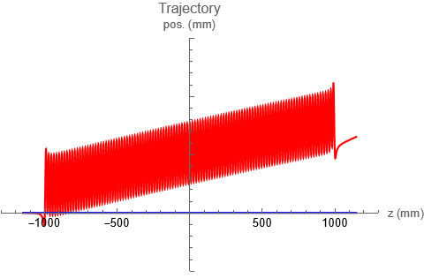
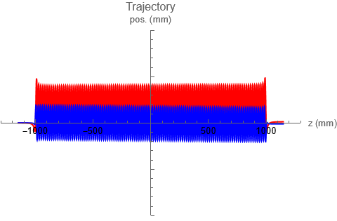
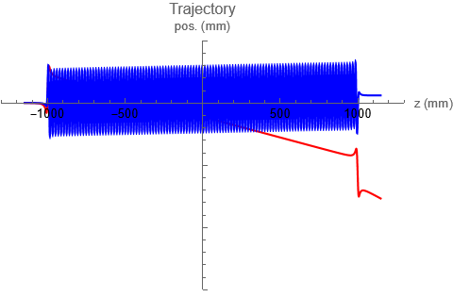
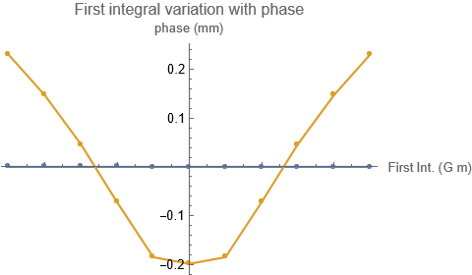
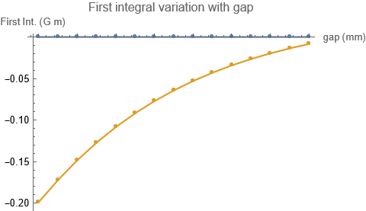
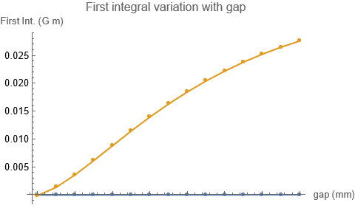
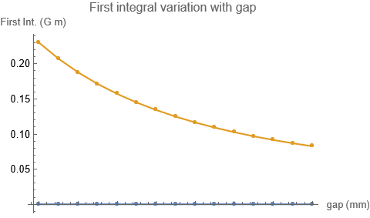

End Magnets optimization for AQUA Apple-X undulator
Undulator (sample)
y
λu
Optimized for operation in circular polarization
z
Standard block size:
bs = $λ_{u}$/4
BS1 = ¼ bs;
BS2 = ½ bs +1.53;
BS3 = ¾ bs +0.0342;
BS4= bs
$$BS1 BS2 BS3 BS4$$
$$BS4 BS3 BS2 BS1$$
Electron Trajectory
horizontal
vertical
$$\frac{∆K}{K}<0.001 \%$$
@ 10 um
0.015
0.010
0.005
0.010
0.005
Exit angle < 0.5 µrad
Exit offset < 10 µm
for all phase and gap values
0.005
-0.005
-0.005
Circular
Polarization
-0.010
Vertical
Polarization
Horizontal
Polarization
-0.005
-0.010
-0.015
Field integrals
(G m)
First integral variation with phase
First integral variation with gap
(G m)
1.5 2 2.5 3 3.5 4 4.5 5
Ix
First integral:
Ix = 0
|Iy|< 0.2 G m
Second integral: II_{x,y}=0
for all phase and gap values
0
@minimum gap
0.025
0.020
0.015
0.010
0.005
0
0.020
0.15
0.10
0.05
0
-0.05
-0.10
-0.15
-0.20
gap (mm)
Iy
-0.5 -0.4 -0.3 -0.2 -0.1 0 0.1 0.2 0.3 0.4 0.5
Horizontal
Polarization
Circular
Polarization
Vertical
Polarization
Phase = Δz/λu
1.5 2 2.5 3 3.5 4 4.5 5
1.5 2 2.5 3 3.5 4 4.5 5
gap (mm)

