Slide 1

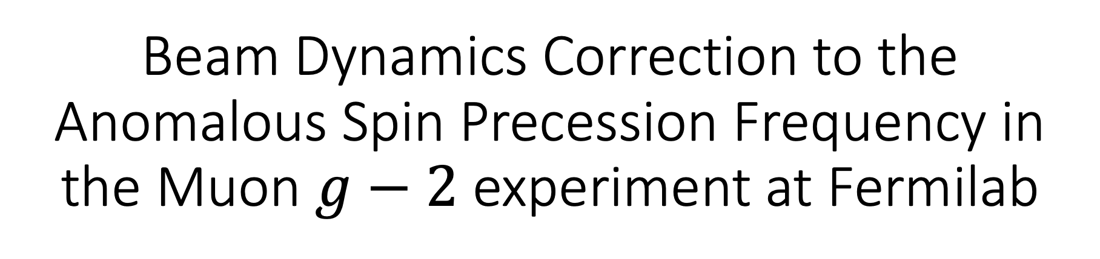
Beam Dynamics Correction to the Anomalous Spin Precession Frequency in the Muon $g−2$ experiment at Fermilab
On Kim
On behalf of Muon $g−2$ Collaboration
$NeΨ 23$ (New Physics Signals 2023)
2023 Feb. 15th

Slide 2
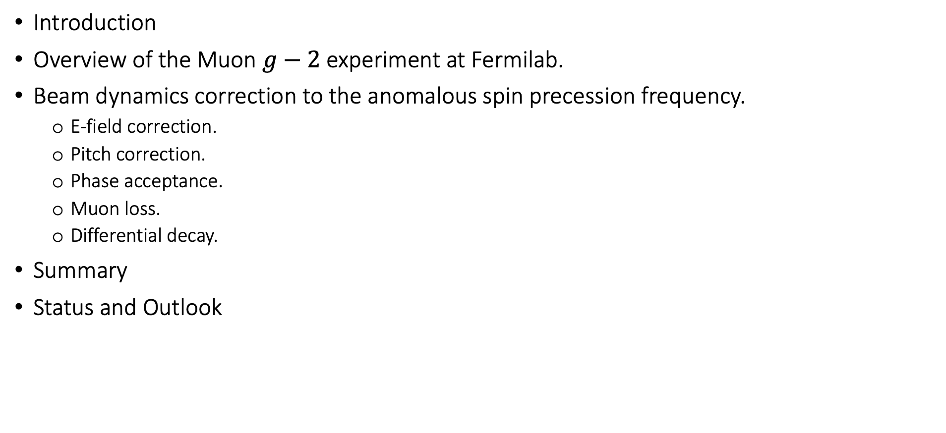
Contents
Introduction
Overview of the Muon $g−2$ experiment at Fermilab.
Beam dynamics correction to the anomalous spin precession frequency.
  E-field correction.
  Pitch correction.
  Phase acceptance.
  Muon loss.
  Differential decay.
Summary
Status and Outlook

Slide 3
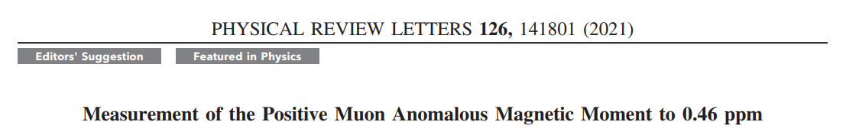
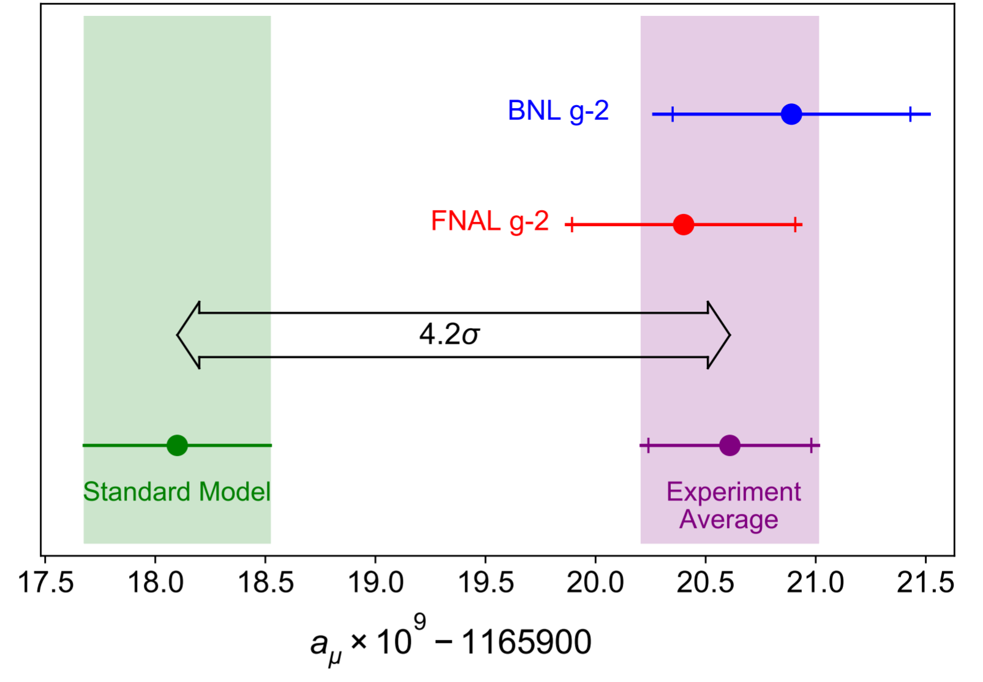
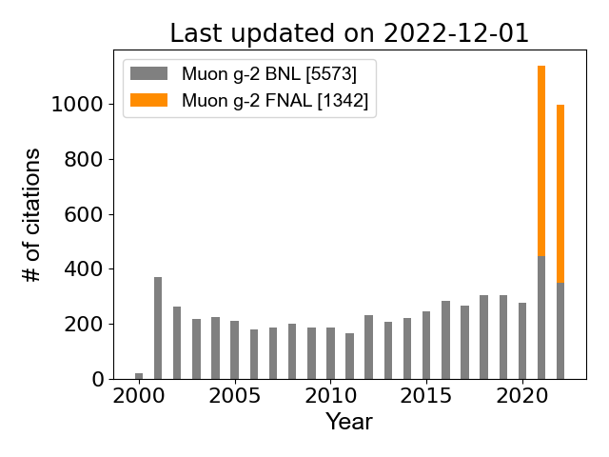


First Result (Run-1) on April 2021
2004 (3.7$σ$)
2021 (3.3$σ$)

Slide 4
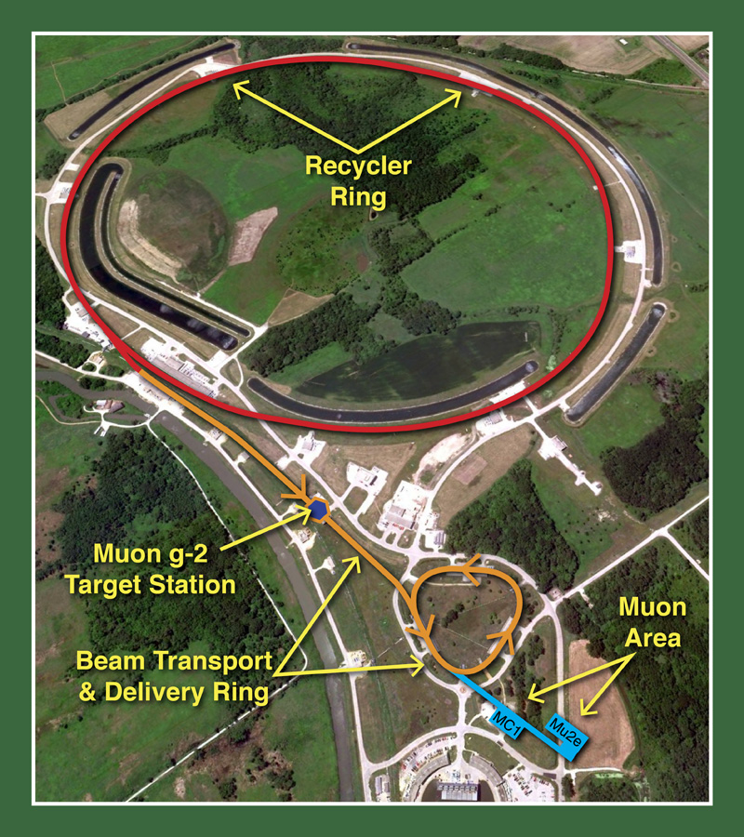
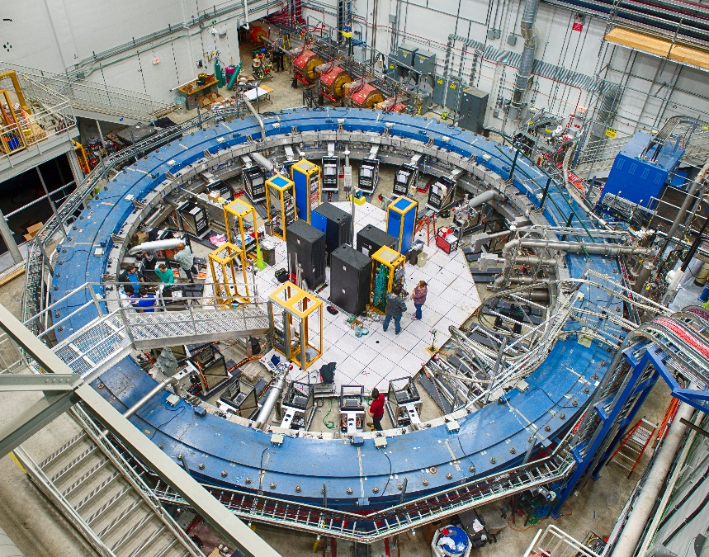

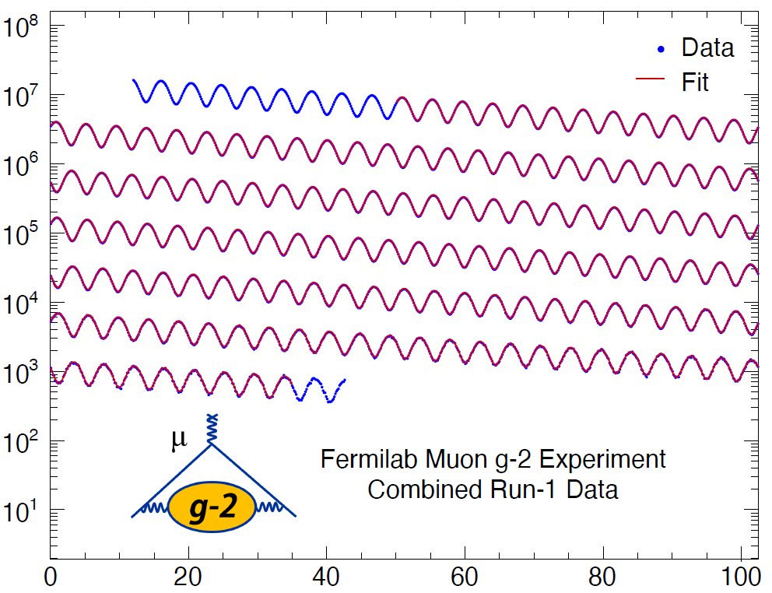
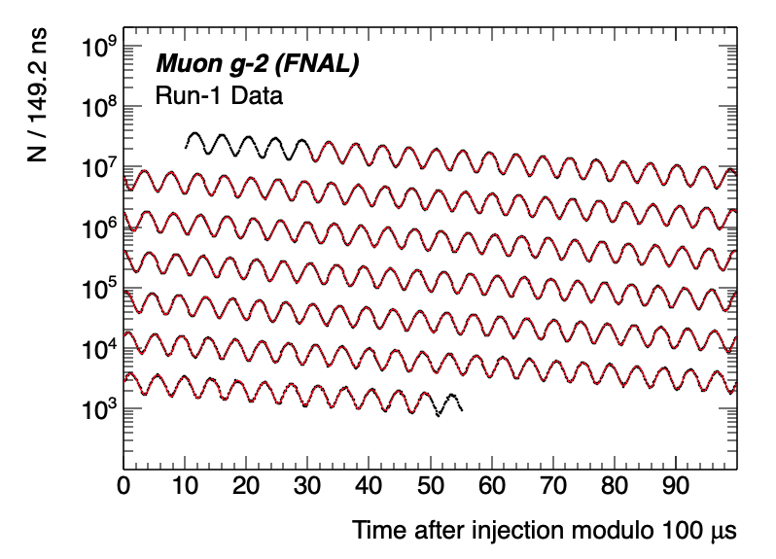



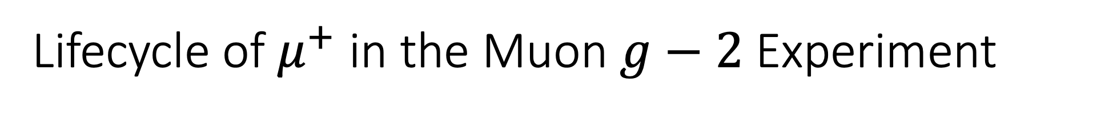
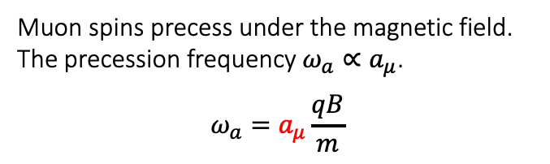





Lifecycle of $μ^{+}$ in the Muon $g−2$ Experiment
Production
Storage & Precess
Decay
$$μ^{+}$$
High energy positrons are preferentially emitted along the muon spin direction.
$$μ^{+}$$
$$μ^{+}$$
$$μ^{+}$$
$$μ^{+}$$
Pion rest frame
Muon spins precess under the magnetic field.
The precession frequency $ω_{a}∝a_{μ}$.
$$ω_{a}=a_{μ}\frac{qB}{m}$$
spin
$$ν_{μ}$$
$$μ^{+}$$
$π^{+}$
momentum

Slide 5
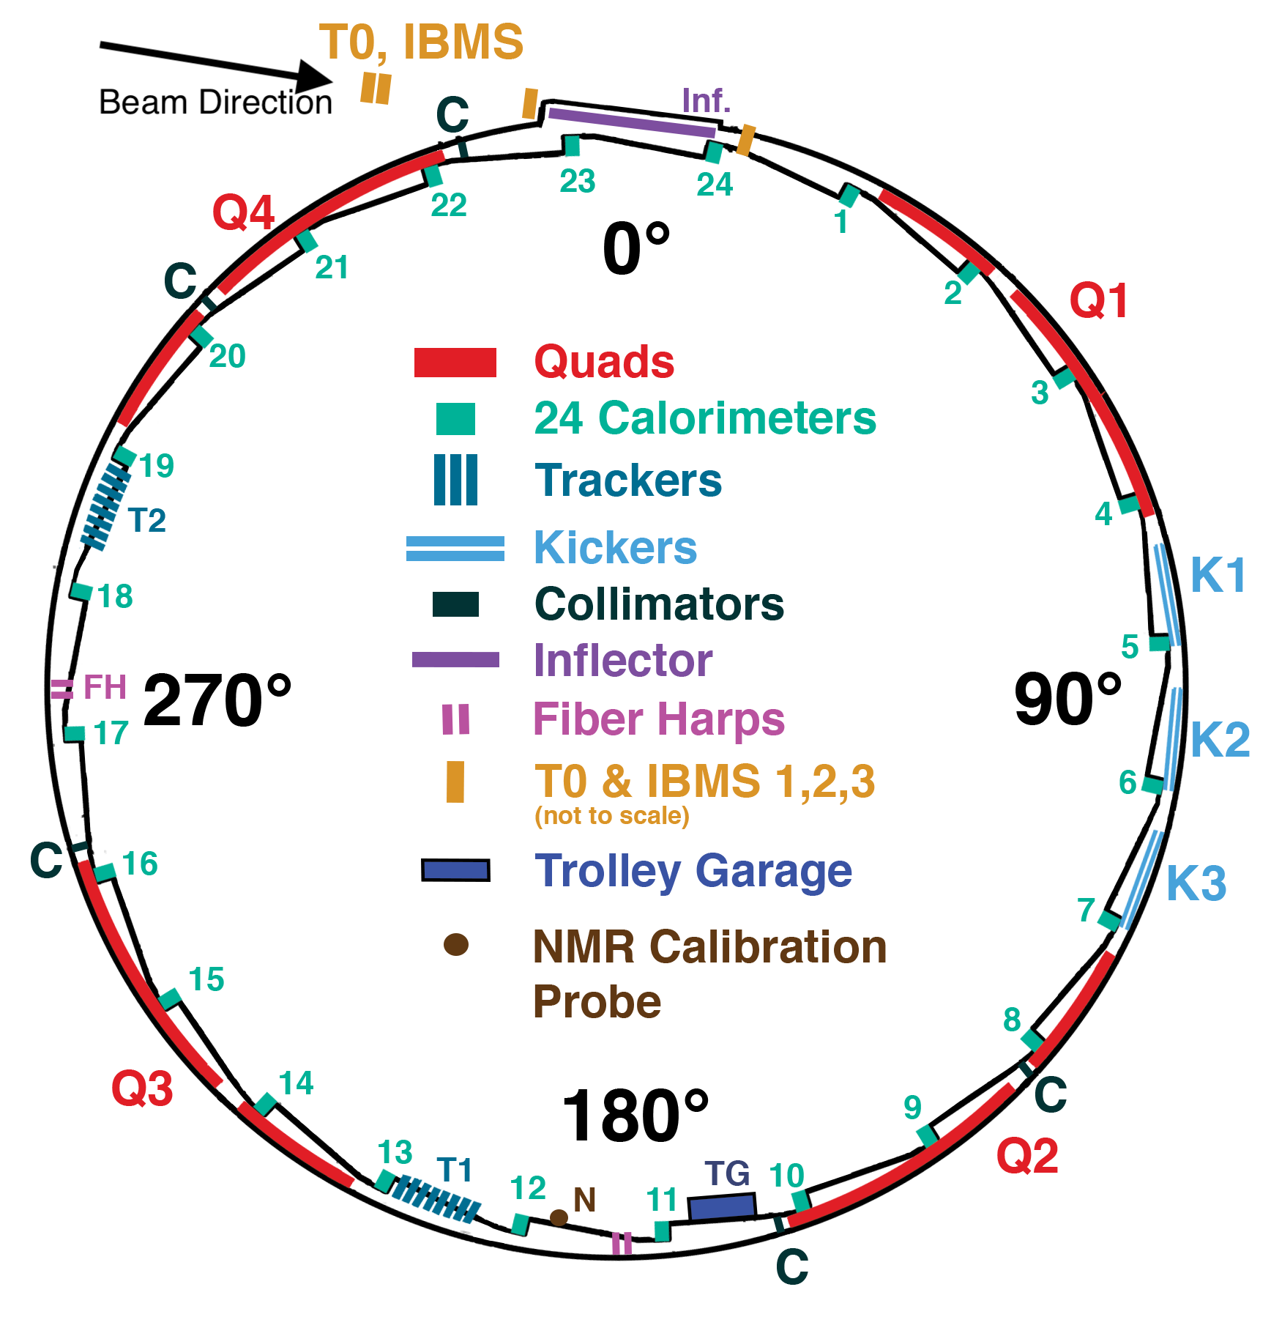

Experimental Overview
Muon $g−2$ Storage Ring
  Radius: 7.112 m.
  Homogeneous magnetic field: 1.45 T.

Slide 6
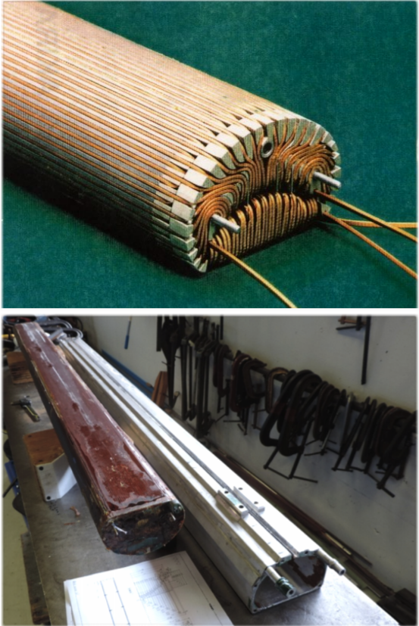
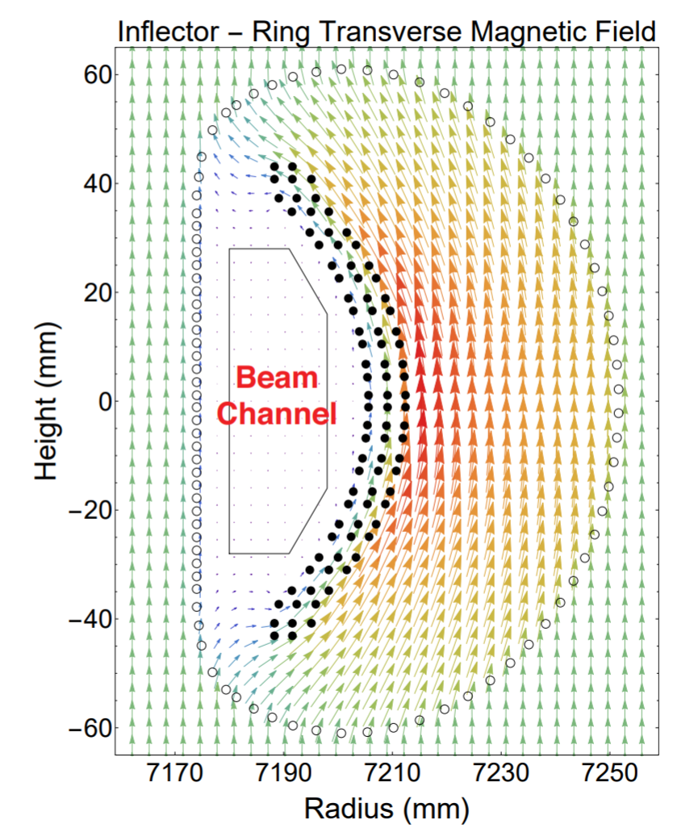

Experimental Overview
$$μ^{+}$$
Injection
  A polarized anti-muon beam (3.1 GeV) is injected into the storage ring through a superconducting inflector magnet.
  It cancels the main magnetic field to inject the beam tangentially.

Slide 7
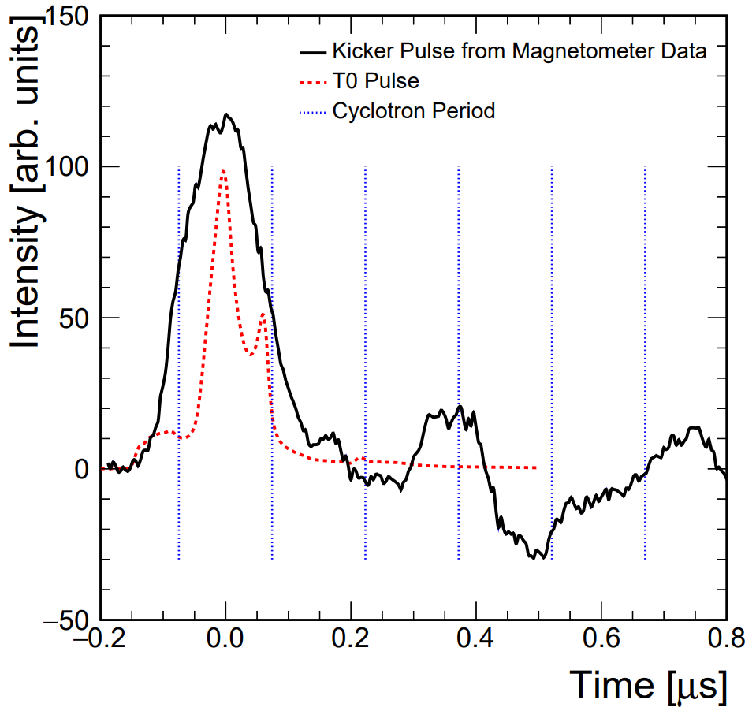
Experimental Overview
$$μ^{+}$$
Kick
  The fast non-ferric kicker magnet system kicks the muons onto the design orbit.

Slide 8
Experimental Overview
$$μ^{+}$$
Vertical Focusing
  The Electrostatic Quadrupoles (ESQ) focuses the beam vertically.
  Four Quadrupole sections cover 43% of the circumference.
S
L

Slide 9
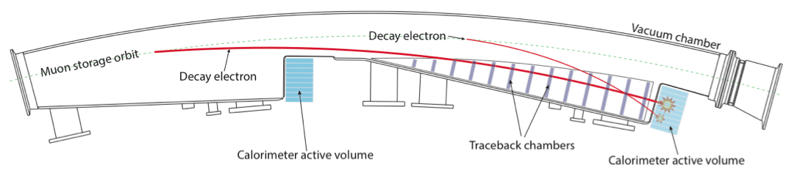
Experimental Overview
$$μ^{+}$$
Detection
  Decay positrons curl into 24 electromagnetic calorimeters surrounding the storage ring.

Slide 10



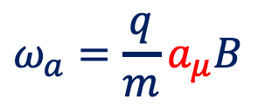

Wiggle Plot
Self-analyzing muon decay: Parity-violating weak decay causes the high energy decay positrons are preferred to be emitted along the muon spin direction.
Detected $e^{+}$ time spectrum wiggles at the spin precession frequency $ω_{a}$.
$$μ^{+}$$
$e^{+}$ counts / 149 ns
momentum
spin
$$ω_{a}=\frac{q}{m}a_{μ}B$$
Time (modulo 100 us)

Slide 11
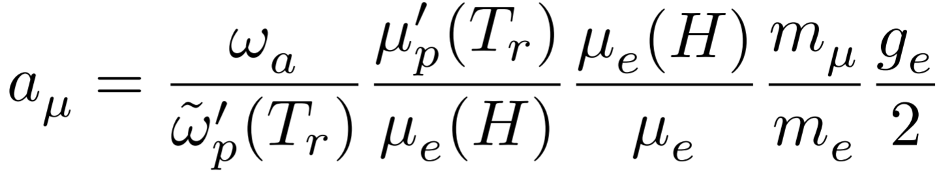
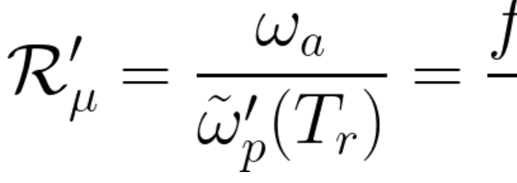
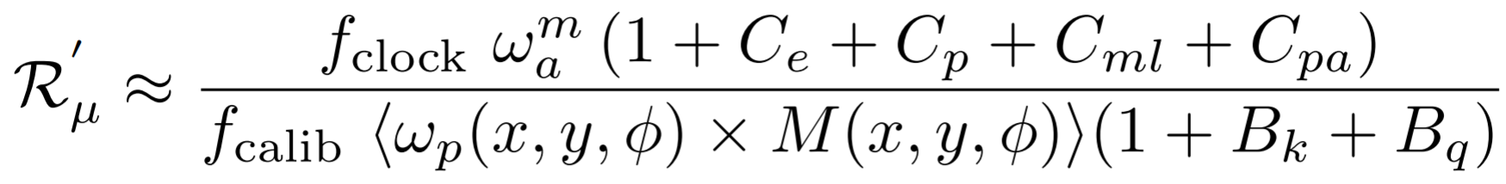

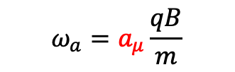
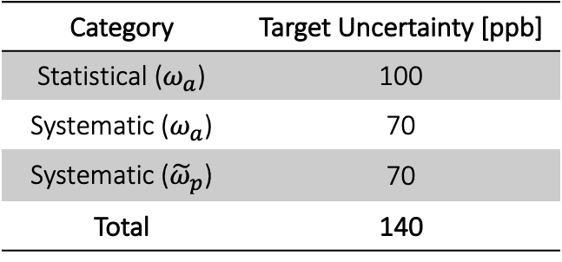





Measurement Quantity Anatomy
Known to 24 ppb
Category | Target Uncertainty [ppb]
Statistical ($ω_{a}$) | 100
Systematic ($ω_{a}$) | 70
Systematic (${\tilde{ω}}_{p}$) | 70
Total | 140
What we measure.
$$ω_{a}=a_{μ}\frac{qB}{m}$$
Corrections from
the beam dynamics systematic effects
Unblinding conversion factor
Measured $g−2$ frequency
On: $C_{e}, C_{p}, C_{ml}, C_{pa}$
Peter: ${\tilde{ω}}_{p}$
NMR probe calibration factor
Magnetic field weighted over
the muon distribution
Corrections from
the transient magnetic field
Anna: $ω_{a}$, Simulation
David: $B_{k}$
Matteo: $ω_{a}^{m}$

Slide 12

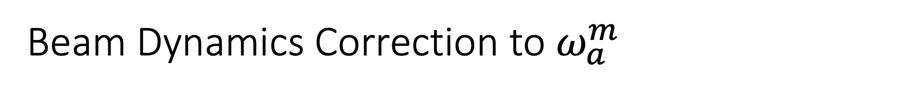
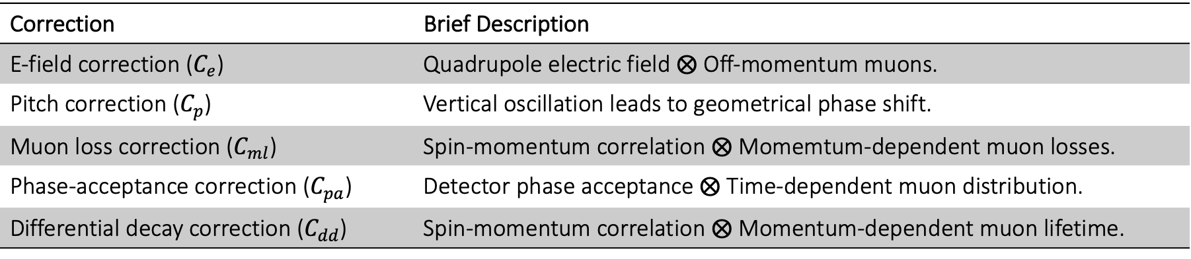
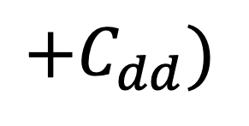
Beam Dynamics Correction to $ω_{a}^{m}$
Is measured $ω_{a}^{m}$ truly $ω_{a}=a_{μ}qB/m$? In practice, NO!
$$+C_{dd})$$
Correction | Brief Description
E-field correction ($C_{e}$) | Quadrupole electric field $⨂$ Off-momentum muons.
Pitch correction ($C_{p}$) | Vertical oscillation leads to geometrical phase shift.
Muon loss correction ($C_{ml}$) | Spin-momentum correlation $⨂$ Momemtum-dependent muon losses.
Phase-acceptance correction ($C_{pa}$) | Detector phase acceptance $⨂$ Time-dependent muon distribution.
Differential decay correction ($C_{dd}$) | Spin-momentum correlation $⨂$ Momentum-dependent muon lifetime.

Slide 13
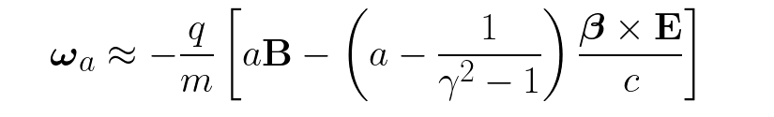
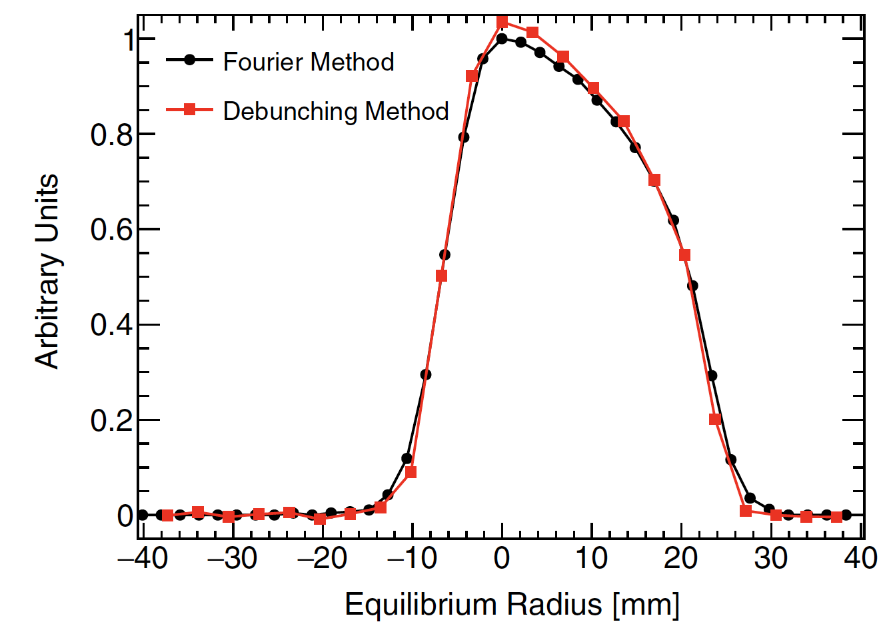
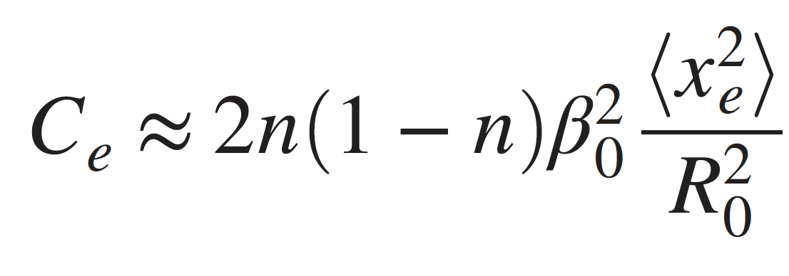
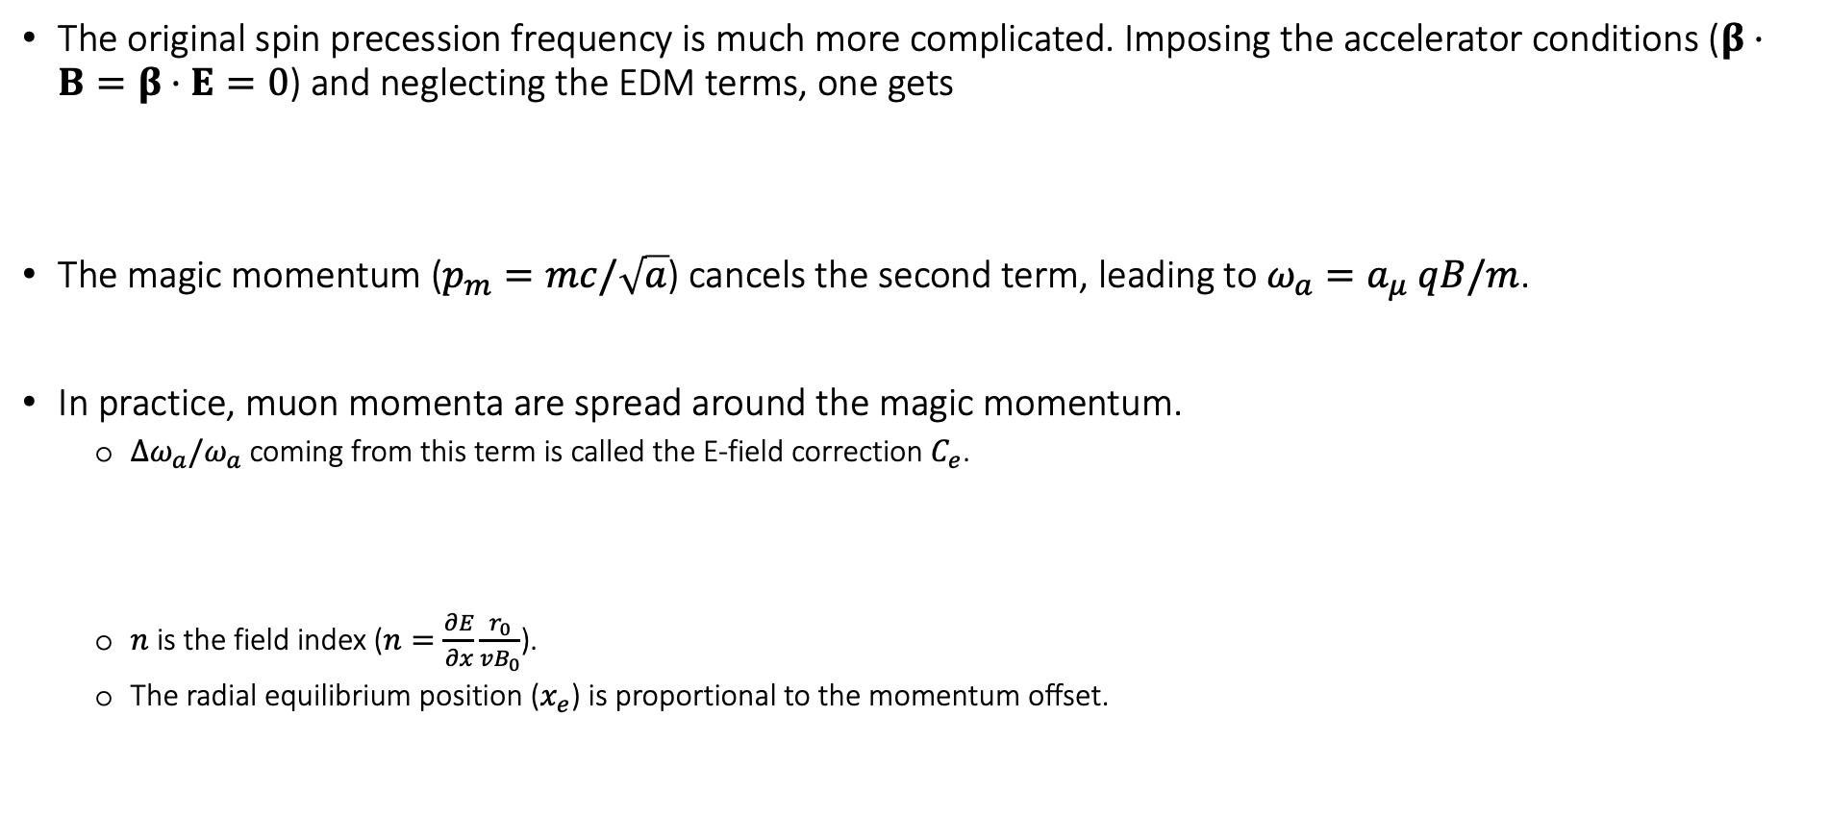
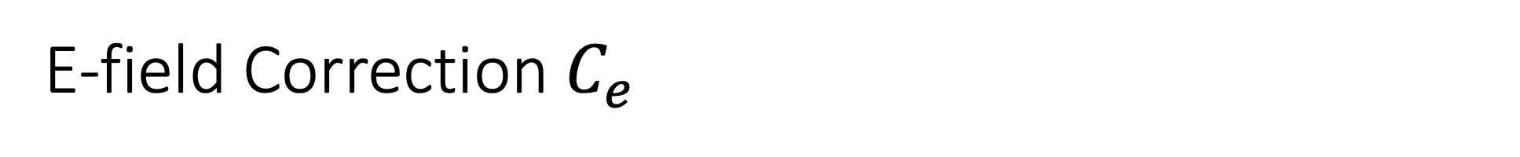
E-field Correction $C_{e}$
The original spin precession frequency is much more complicated. Imposing the accelerator conditions ($β⋅B=β⋅E=0$) and neglecting the EDM terms, one gets
The magic momentum ($p_{m}=mc/\sqrt{a}$) cancels the second term, leading to $ω_{a}=a_{μ} qB/m$.
In practice, muon momenta are spread around the magic momentum.
  $Δω_{a}/ω_{a}$ coming from this term is called the E-field correction $C_{e}$.
  $n$ is the field index ($n=\frac{∂E}{∂x}\frac{r_{0}}{vB_{0}}$).
  The radial equilibrium position ($x_{e}$) is proportional to the momentum offset.

Slide 14
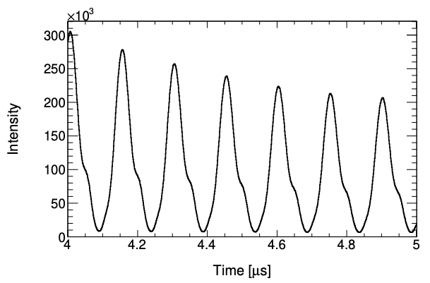
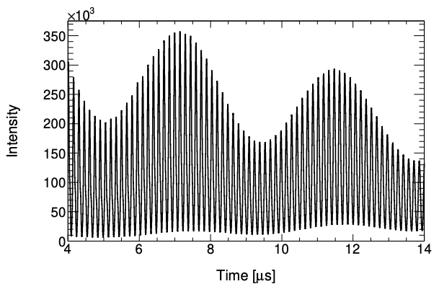
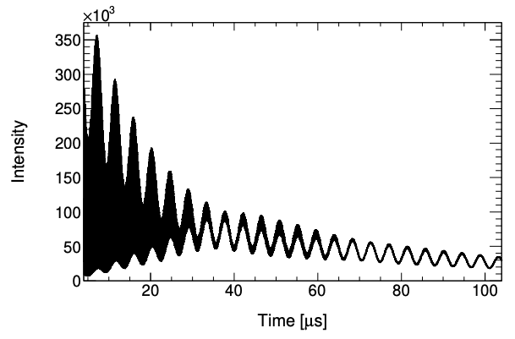
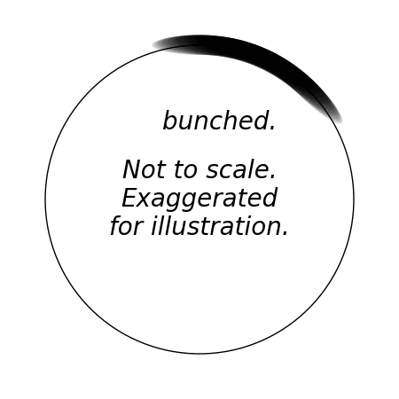



E-field Correction $C_{e}$
The radial equilibrium distribution can be measured by Fast Rotation Analysis.
Fast Rotation: Signal from the bunched beam’s cyclotron motion.
  Debunches due to the mixed cyclotron frequencies.
  $$ω_{c}≈ω_{c0}\left(1−\frac{1}{1−n}\frac{Δp}{p_{0}}\right)$$
  Debunching characteristics depend on the momentum distribution.
$$ω_{c}$$
$$ω_{a}$$
Nominal fit start time

Slide 15
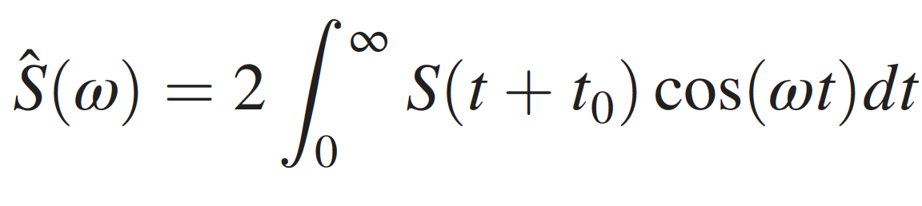
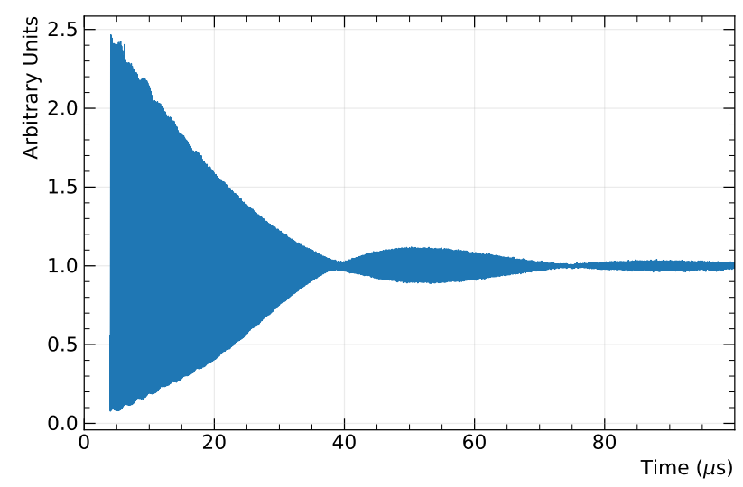
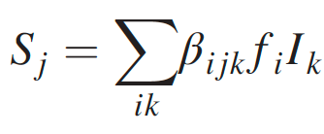
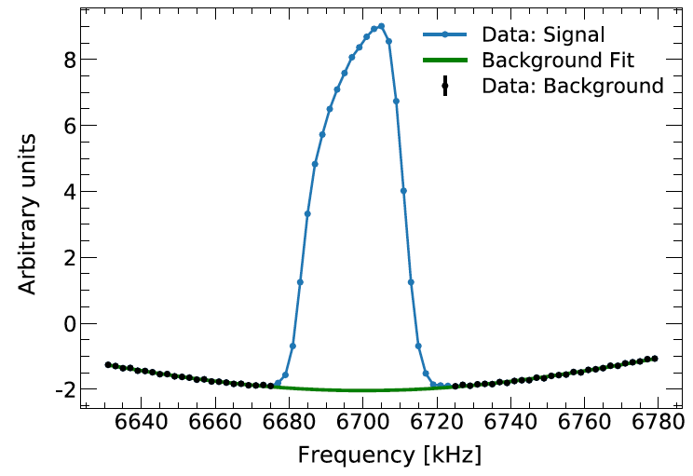
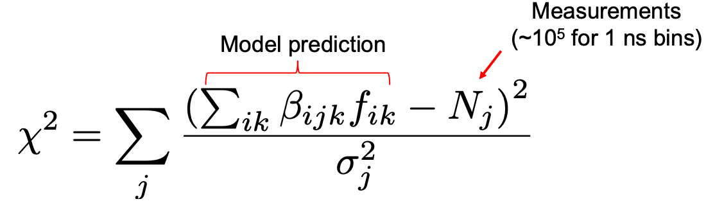

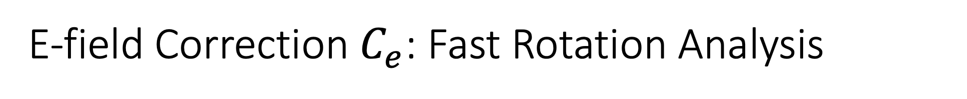
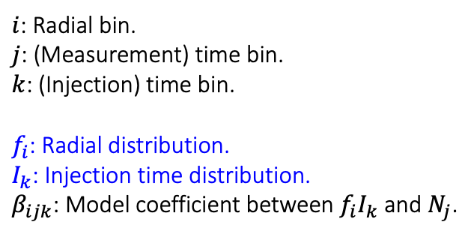
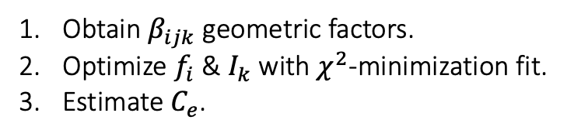
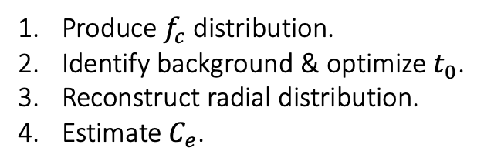
E-field Correction $C_{e}$: Fast Rotation Analysis
Fourier Method (Frequency Domain)
Fast Rotation Signal $S\left(t\right)$
Debunching Method (Time Domain)
Tunable time-shift
$i$: Radial bin.
$j$: (Measurement) time bin.
$k$: (Injection) time bin.
$f_{i}$: Radial distribution.
$I_{k}$: Injection time distribution.
$β_{ijk}$: Model coefficient between $f_{i}I_{k}$ and $N_{j}$.
Produce $f_{c}$ distribution.
Identify background & optimize $t_{0}$.
Reconstruct radial distribution.
Estimate $C_{e}$.
Obtain $β_{ijk}$ geometric factors.
Optimize $f_{i}$ & $I_{k}$ with $χ^{2}$-minimization fit.
Estimate $C_{e}$.

Slide 16
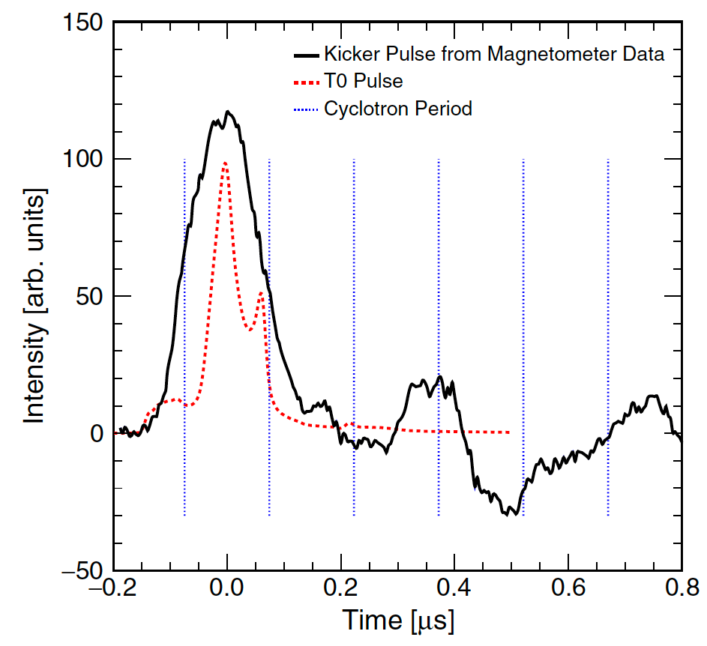
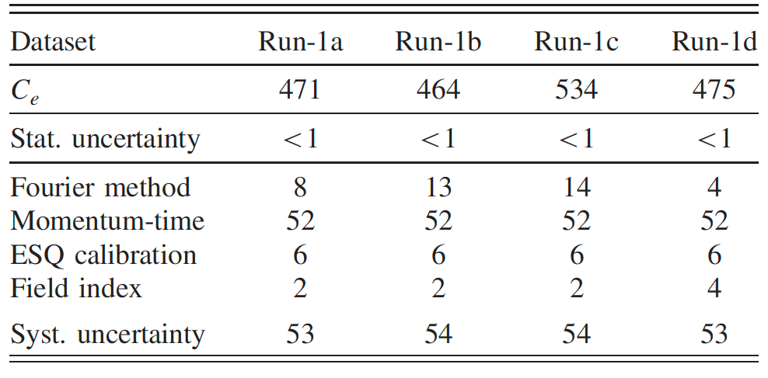
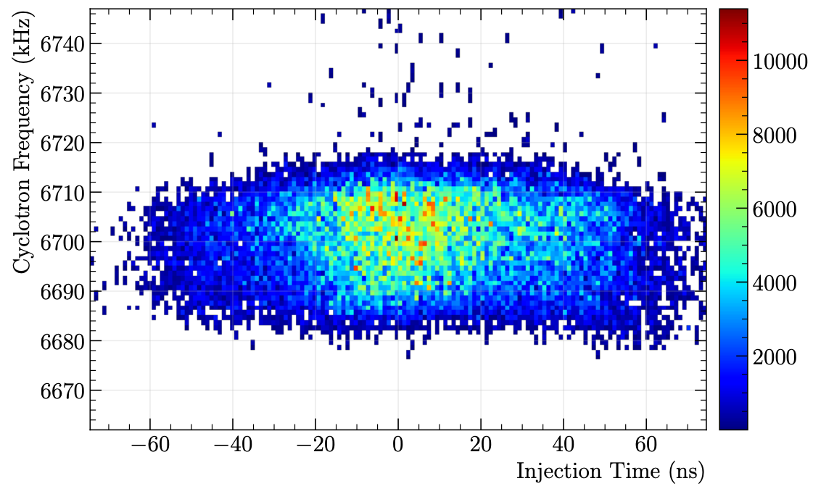


E-field Correction $C_{e}$
Radial distribution $→$ $\left\langle x_{e}^{2}\right\rangle ={\left\langle x_{e}\right\rangle }^{2}+σ_{x_{e}}^{2}$
Run-1: $C_{e}=489 \left(53\right) ppb$
Dominant systematic error source: $p$-$t$ correlation.
Momentum-time correlation
Both Fourier & Debunching FRA method assumes no correlation between the momentum and injection time distribution.
In reality, a time-dependent kick induces the correlation (under-kick $→$ more high $p$, over-kick $→$ more low $p$).

Slide 17





Pitch Correction $C_{p}$
The vertical motion (pitch motion) of the muon causes the vertical spin precession.
The horizontal precession ($ω_{a}$) is affected by the geometrical phase shift due to the vertical precession. In such case, $ω_{a}=ω_{cy}−ω_{sy}$ no longer holds.
Pitch-driven radial component of $ω_{s}$
$$ω_{sx}≈ψ_{0}ω_{y}\sin\left(ω_{y}t+φ_{y}\right)$$
Orbit plane

Slide 18




Pitch Correction $C_{p}$
The muon distribution is measured by the straw tracker.
  A straw is an ionization chamber filled with an Ar-Ethane gas and a central wire at 1.6 kV.
  It finds the trajectories of decay positrons, which are extrapolated to reconstruct the muon distribution.
Muon storage region

Slide 19



Pitch Correction $C_{p}$
Estimate $C_{p}$ from the amplitude distribution rather than the vertical distribution.
  Due to the calorimeter acceptance, the vertical positions are not evenly weighted.
  This makes the measured $\left\langle y^{2}\right\rangle$ systematically biased from the actual $\left\langle y^{2}\right\rangle$.
  The amplitude is reconstructed from the position distribution, including the acceptance correction.
Dominant systematic error source: tracker alignment and reconstruction.
Run-1: $C_{p}=180 \left(13\right) ppb$
Vertical position
Vertical oscillation amplitude

Slide 20







Muon Loss Correction $C_{ml}$
Muon loss: Unwanted muon depletion due to interactions with materials during storage.
The fraction of the muon losses can be measured by counting the triple coincidences.
$$μ^{+}$$
$$Δt=6.25 ns$$
$$Δt=6.25 ns$$

Slide 21









Muon Loss Correction $C_{ml}$
Momentum-dependent muon losses coupled with the spin-momentum correlation induces bias to $ω_{a}$.
Bias on $ω_{a}$
Spin-momentum correlation
Pre-exist before the injection due to the dipole bending magnet.
Momentum-dependent losses
Low momenta muons are lost faster than the high momenta muons at early times.
$$L\left(t\right)$$
Run-1: $C_{ml}=−11 \left(5\right) ppb$

Slide 22



Challenge in Run-1: Damaged ESQ resistors
The RC time constant of the ESQ charging is designed to be ~5 us.
  Two resistors were damaged and had far larger resistance than the desired value. It induced slow changes to beam dynamics.
Early-to-late BD effect
  Most noticeably, the CBO frequency drifted in time (designed to be constant during the 𝜔_𝑎 fit time window).
  Vertical width changed slowly in time.
  It amplified the phase-acceptance systematic effect.
Nominal
Damaged resistor

Slide 23







Phase-Acceptance Correction $C_{pa}$
The $g−2$ phase of the accepted positrons depends on the muon decay position ($x,y,φ$) and energy.
Example of a portion of the “decay cone” at the different radial positions.
Spin direction (= $g−2$ phase) decides where the high energy $e^{+}$ is emitted.
Unlike the blue cone, some $e^{+}$ in the same decay cone are not accepted simply because of the finite geometry of the calorimeter.
This leads to the (decay-)position dependence of the average phase.
This itself is not a problem at all – as long as the average phase of the accepted $e^{+}$ does not vary with time.

Slide 24









Phase-Acceptance Correction $C_{pa}$
The average muon position distribution does change.
The dominant effect from Run-1 came from the early-to-late vertical distribution change.
$g−2$ phase ($x,y,φ$)
$N$($x,y,φ,t$)
phase ($t$)
$$σ_{y}\left(t\right)$$
$$φ\left(y\right)$$

Slide 25




Phase-Acceptance Correction $C_{pa}$
The detailed analysis incorporates all information: muon decay distribution, acceptance, asymmetry, and phase maps.
In Run-1, the phase-acceptance effect was amplified by the damaged ESQ resistors.
Decay distribution ($t$)
Asymmetry map
Acceptance map
Phase map
Run-1: $C_{pa}=−158 \left(75\right) ppb$

Slide 26


Differential Decay Correction $C_{dd}$
Muons have different average lab lifetimes depending on the momentum: $τ_{lab}=γτ_{MRF}$.
  What if the average spin phase for the high momenta muons differs from the low momenta muons?
We already know there is a spin-momentum correlation even before the injection.
  In Run-1, the muon losses were significantly enhanced due to the damaged resistors.
  In Run-2/3, the muon loss correction $C_{ml}$ is negligible as the losses were highly suppressed. Instead, we scrutinize the spin-momentum correlation coupled with the differential decay.
There are three sources of the spin-momentum correlation.
  Upstream beamline.
  Kicker.
  Inflector.

Slide 27


Differential Decay Correction $C_{dd}$
Beamline
Kicker
(Inflector) Spin-Coordinate
Source: momentum-dependent acceptance in the inflector.
Source: momentum selection in the upstream beamline.
Source: injection-time-dependent acceptance after the kick. Early muons have a different phase than late muons.

Slide 28


Summary
Beam dynamics corrections.
We expect the PA uncertainty to be reduced roughly by more than a factor of 3.
$$+C_{dd})$$
Correction | Source | Run-1 (ppb)
E-field correction ($C_{e}$) | $\left(a−\frac{m^{2}}{p^{2}}\right)E$ for $p≠p_{m}$. | $$489 \left(53\right)$$
Pitch correction ($C_{p}$) | Pitch-driven geometrical phase oscillation. | $$180 \left(13\right)$$
Muon loss correction ($C_{ml}$) | $\frac{d\left\langle φ\right\rangle }{dp}×{\left(\frac{dp}{dt}\right)}_{loss}$ | $$−11 \left(5\right)$$
Phase-acceptance correction ($C_{pa}$) | $\frac{d\left\langle φ\right\rangle }{dx_{accep}}×\frac{dx_{accep}}{dt}$ | $$−158 \left(75\right)$$
Differential decay correction ($C_{dd}$) | $\frac{d\left\langle φ\right\rangle }{dp}×{\left(\frac{dp}{dt}\right)}_{dd}$ | $$⋅$$

Slide 29

Status and Outlook
We are operating our final physics run (Run-6), presumably until July 2023.
Run-2/3 analysis is on its way! Projected uncertainty is half of Run-1. Stay tuned!
2004 (3.7$σ$)
2021 (3.3$σ$)
Thanks for your attention!

Slide 30
Backups

Slide 31





Related talks
Talks about the Muon $g−2$ experiment at Fermilab.
  We measure two frequencies: $ω_{a}$ and $ω_{p}$ to measure $a_{μ}$.
This talk: $ω_{a}$
$$ω_{p}$$
$$ω_{a}$$
$$ω_{p}$$
$$ω_{a}$$

