Slide 1
Searching for Anomalies with Graphs
Graziella Russo
PhD seminars
09/11/22

Slide 2
Introduction
1. Why? Physics motivation for the search
2. What is an anomaly?
3. How? A Machine Learning approach
4. Brief introduction to Machine Learning and AutoEncoders
5. Graph Anomaly Detection in High Energy Physics analysis

Slide 3
Why? Starting from the beginning
Up to 2012 Standard Model was not complete: some particles still missing
Higgs boson?
2012: discovery of the Higgs boson
up
charm
top
gluon
Dark Matter?
neutrino mass?
down
strange
bottom
photon
Still many unanswered questions
Dark Energy?
electron
muon
tau
Z boson
strong CP problem
Hierarchy problem
electron
neutrino
muon
neutrino
tau
neutrino
W bosons
matter/antimatter asymmetry?

Slide 4
Why? Looking for New Physics
extra-dimensions
SUperSYmmetric theory
At LHC experiments: hunt for New Physics
WIMPs
loop quantum gravity
Axions
Even more proposed theories
M-theory
Sterile neutrinos
M-theory
String theory
primordial Black Holes
lepto-quarks

Slide 5
What is an Anomaly?
Anomalies are items, events or observations that are anomalous if compared to an established pattern
cyber-security intrusion detection, medical diagnosis, system health monitoring
Anomaly Detection (AD) is an Machine Learning (ML) technique to identify such abnormal behaviours

Slide 6
How? LHC, a big data factory
1 out of 1M events passes the trigger selection
1.7 PB data per experiment per year
600 million collisions every second
MC simulations for comparison between data and theoretical distributions

Slide 7
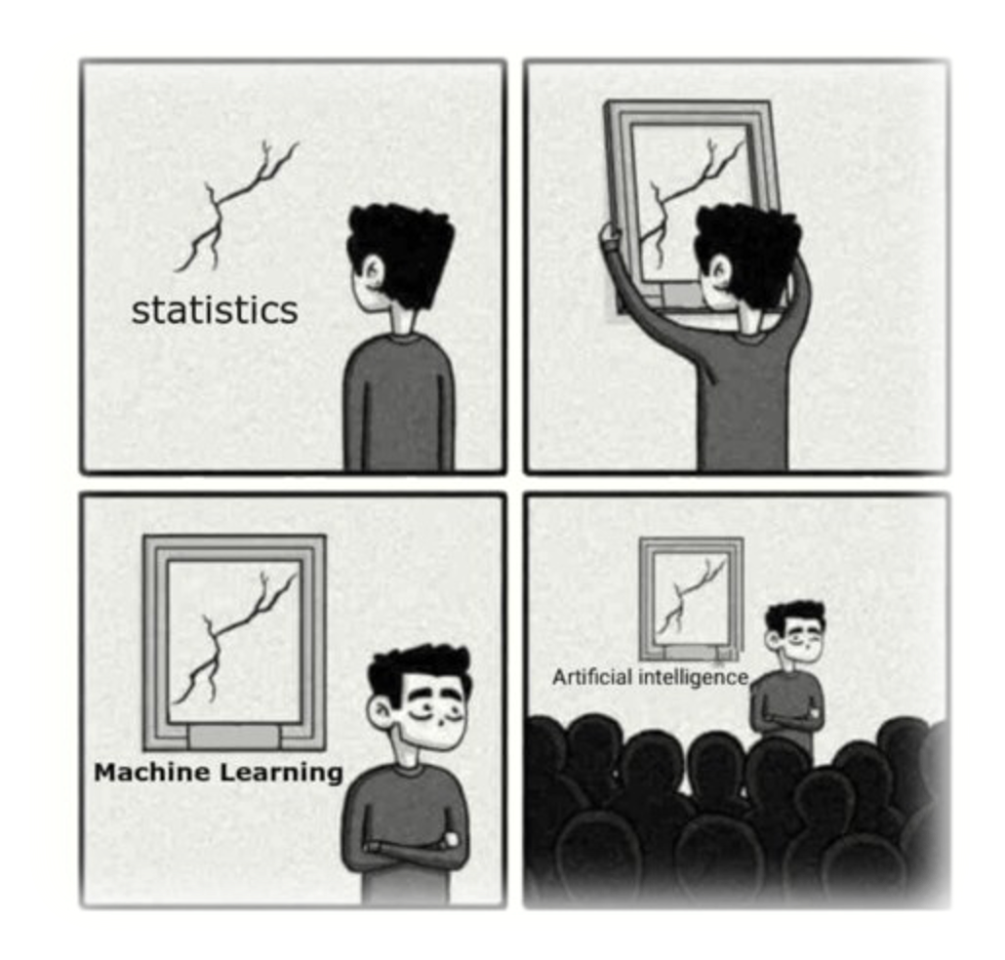
How? With Machine Learning
Machine Learning is building algorithms that learn a task by using experience
2 main phases: training and testing
given a metric (loss), optimising the parameters
It’s a fish!
ML
fish
Unsupervised
AD
Supervised
Semi-Supervised
AD

Slide 8
AutoEncoders
AutoEncoders are models that learn how to recreate the input (generative models), ignoring insignificant data (noise)
X
X’
Bottleneck
Encoder
$$g_{φ}$$
Z
Decoder
$$f_{θ}$$
Task: minimise distance(X, X’)
How can we use it in High Energy Physics experiments?

Slide 9
Data in High Energy Physics experiments
Many sub-detectors to identify different particles
Particles leave tracks and energy deposits in the detector
We can rearrange data in order to feed a ML algorithm

Slide 10
Jets and Graphs
Jet: narrow cone of particles produced by the hadronization of quarks and gluons
Graph: set of points (nodes) that can be connected (edges)
jets have a complex substructure
not simple to identify a jet
New Physics hidden inside the jet?
Useful for sparse data and whenever links are important

Slide 11
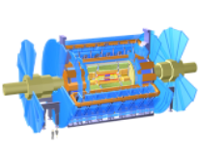
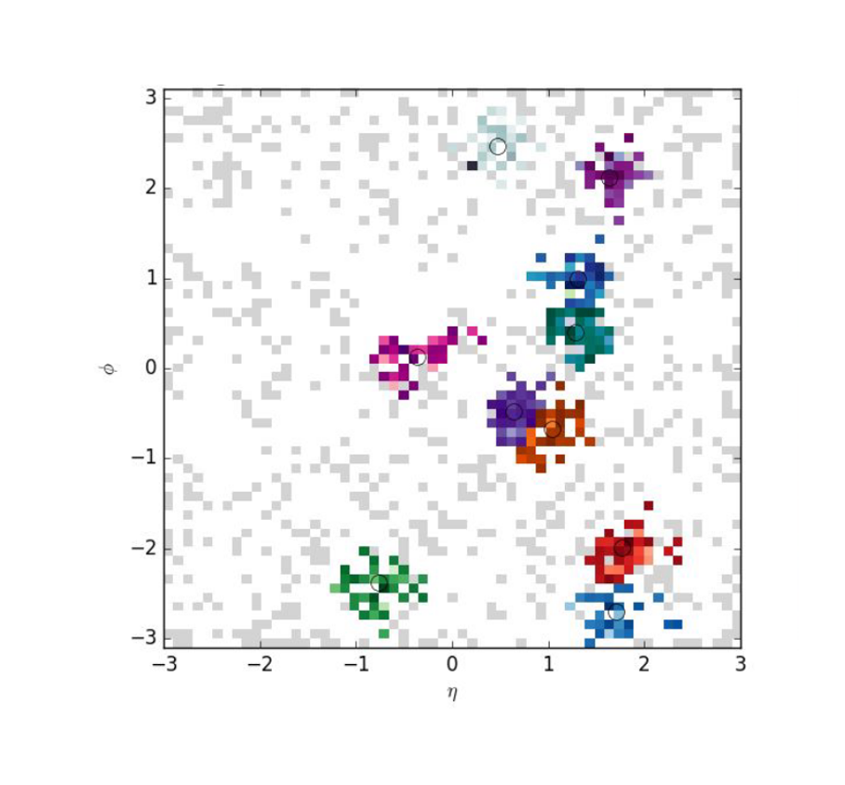
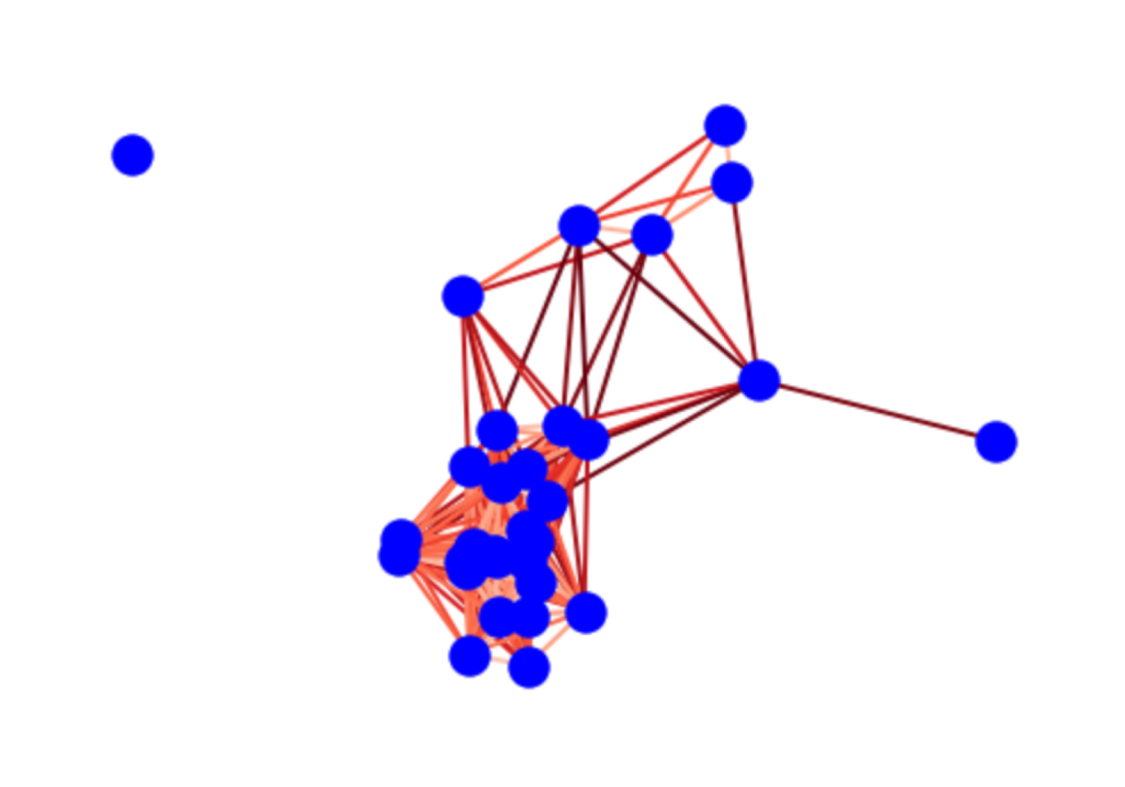
Graphs of Jets
$$φ$$
$$η=0$$
In the $(η,φ)$ plane jets can be considered as graphs
$$η=∞$$
nodes: $(η,φ)$
node features: transverse momentum
edge: $ΔR_{ij}<ΔR_{cut}$
$$ΔR_{ij}=\sqrt{(φ_{i}−φ_{j})^{2}+(η_{i}−η_{j})^{2}}$$
$$φ$$
$$η$$

Slide 12
Semi-Supervised approach
Training only on Standard Model jets
The algorithm learns to minimise the distance between input and reconstructed standard graphs
dist( , ) $≈$ $0$
Different distance distributions between Anomalous and Standard!
Test with also anomalous jets
With anomalous jets distance between input and reconstructed graphs won’t be minimal
dist( , ) $≠$ $0$

Slide 13
Take-home messages
We experimentalist are not giving up searching for New Physics
So many events and data that ML algorithms definitely helps
Jets may be the key to New Physics and can be reinterpreted as graphs for Graph Anomaly Detection

