Slide 1
Superfluid Optomechanics for
Dark Matter & Gravitational Waves
Glen Harris, Peter Cox, Matthew Dolan, Maxim Goryachev, Christopher Baker, Ben McAllister and Warwick Bowen
Notes:
Thankyou and good afternoon! I really appreciate the opportunity to present these (I would say speculative) idea’s today, but full disclosure; my background is not in Gravitational waves, but rather in the field of quantum optomechanics and in particular superfluid optomechanics.
This talk will start with optomechanics and morph into Dark matter and then finally GW detection
So my journey from optomechanics to dark matter started with these two

Slide 2
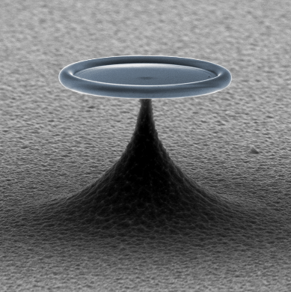
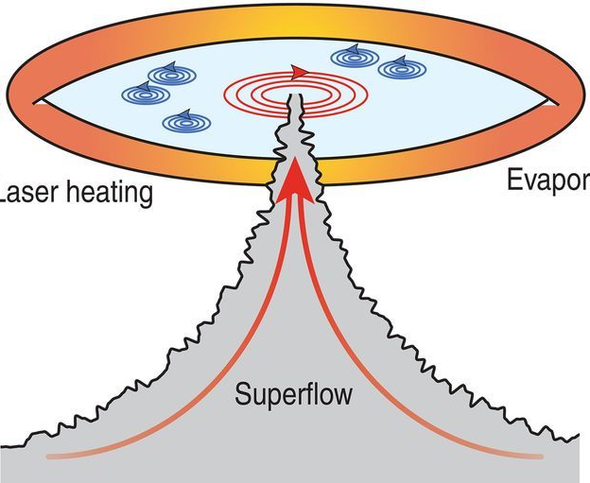
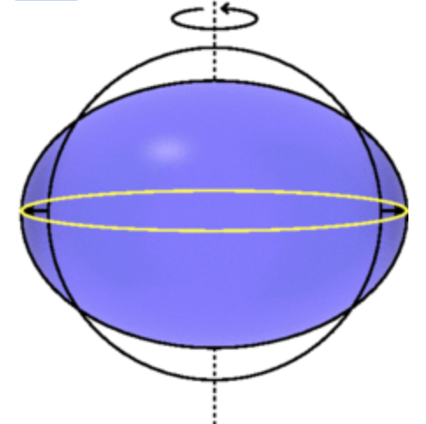
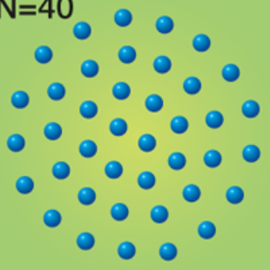
Superfluid Helium Optomechanics
University of Queensland – Thin Films
Prof. Warwick Bowen
Yale University – Bulk Superfluid
Prof. Jack Harris
Vortex dynamics
Nonlinear hydrodynamics
Optomechanics
Electron “crystal”
Notes:
UQ
At prior to that I worked at Yale on optical detection of bulk Helium. On both droplets and fabry perot cavities immersed in Helium
That is where I met;
Dan Mckinsey, Scott Hertel (LUX)
Steve Lamoreaux, Ben Brubaker (ADMX Haystack Haloscope)

Slide 3
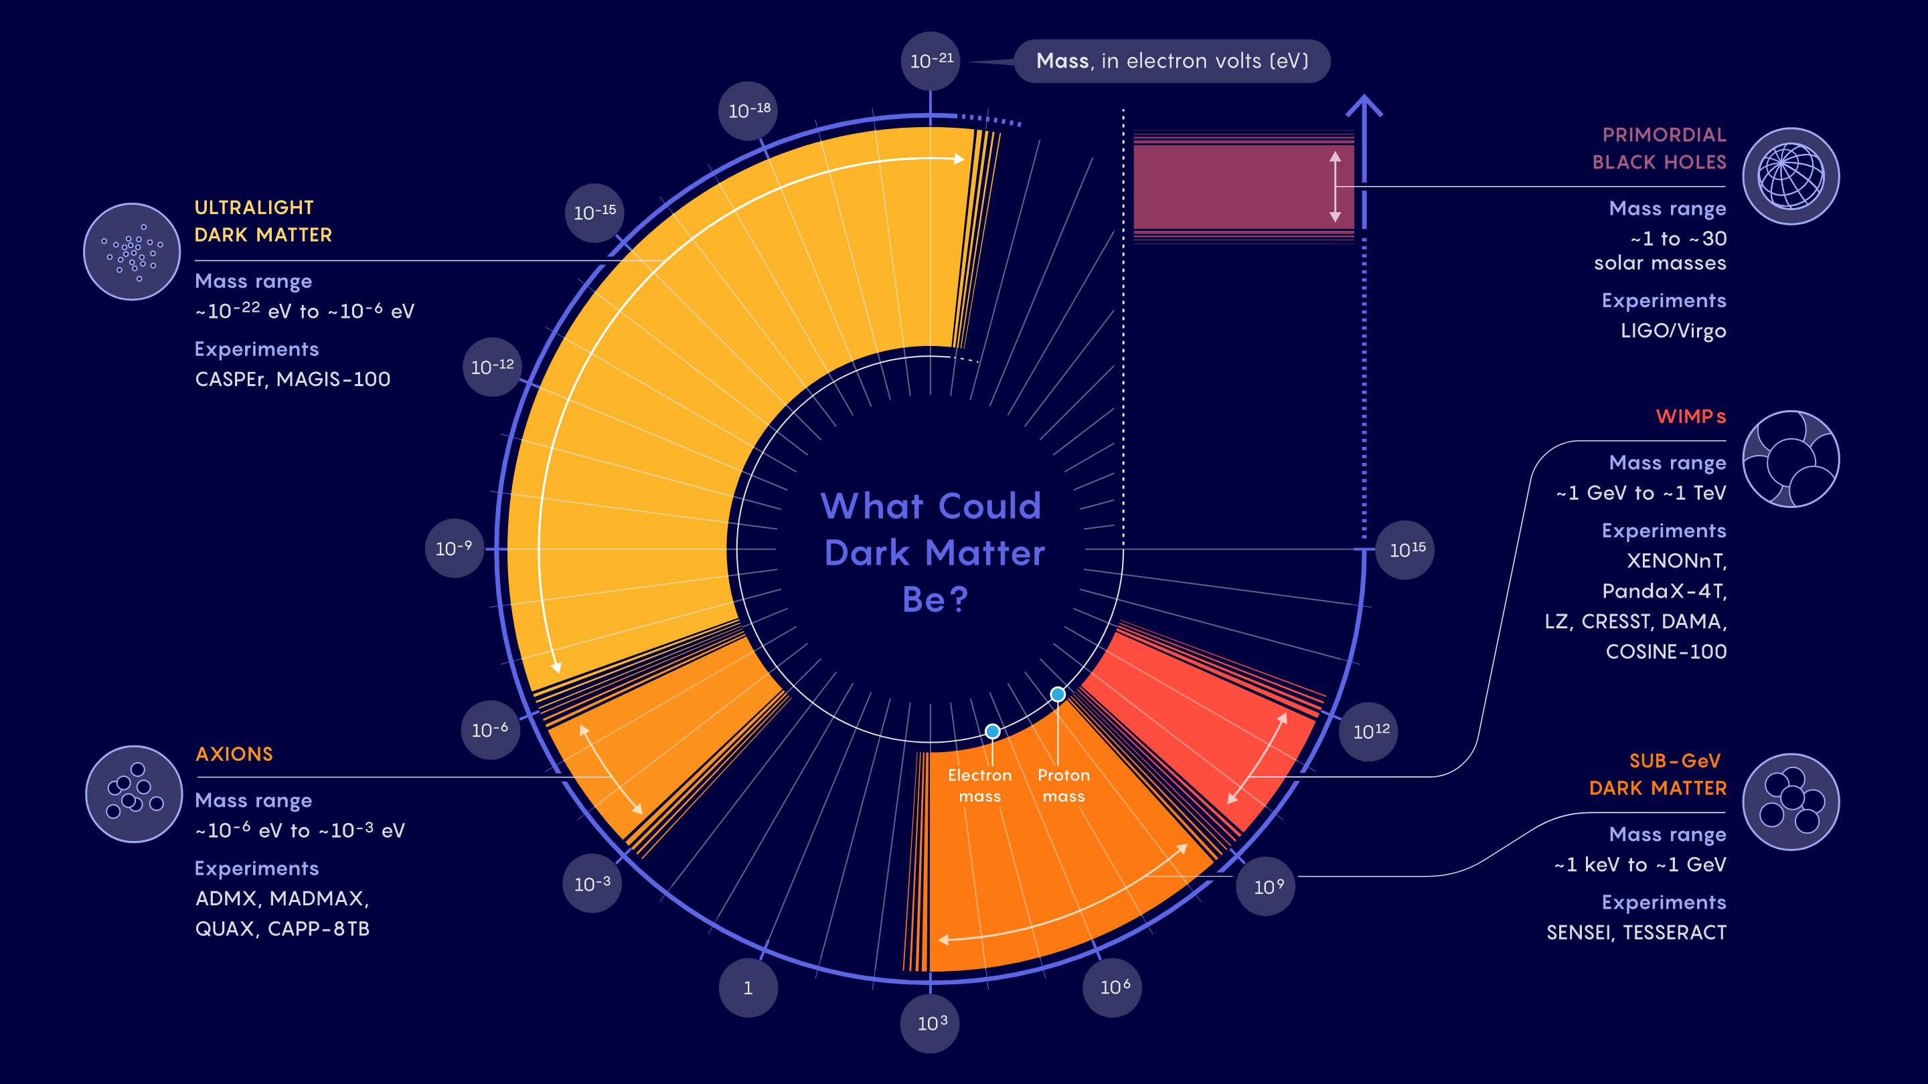
Direct Evidence for Dark Matter
Notes:
What is the mass.
The first are Axions; were particles invented to solve a separate problem in the standard model related to symmetry, and then it is was discovered that it also could potentially be a dark matter candidate! Here is a non exclusive list. They have a feature that in the presence of an electromagnetic field, they should sometimes spontaneously convert to easily detectable photons. So these experiments that essentially have a large field and a axion scatters and makes a low energy photons (ueV) DM!
For reference, GeV is proton. MeV is electron. Neutrinos are ~eV
The other option is WIMPS: There exists no clear definition of a WIMP, but broadly, a WIMP is a new elementary particle which interacts via gravity and any other force (or forces), potentially not part of the Standard Model itself, which is as weak as or weaker than the weak nuclear force. They typically use a target mass, the first 3 use Xenon, SK is water and SABRE is crystal. Shout out to the Australian contributions
SABRE (Sodium Iodide with Active Background Rejection Experiment)
Both of which are part of Centre of excellence for Dark Matter Particle Physics
ORGAN is an axion detection lead by Mike Tobar at UWA
None of these have detected anything… It prompted the director of LUX-Zeplin to say “..”.
So we want something to bridge the gap between light Axion searches and heavy WIMP! Helium! Explain figure!

Slide 4
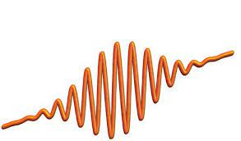
Superfluid Helium Dark Matter Detector
Helium II
Filter
cavity
CLICK!
CLICK!
CLICK!
CLICK!
CLICK!
CLICK!
CLICK!
CLICK!
CLICK!
SNSPD
Notes:
Now instead of moving element, you can also investigate vibrations residing in liquids or solids. For example submerge in LHE and it defines acoustic modes in the same way and set up a standing wave. Shown here. The periodic array of high low pressure look like a brag mirror, and that’s how the interaction is.
So if dark matter where to deposit energy, we’d be able to read it out… How do I know what the phonon occupation is from DM? Particularly due to notable differences in previous incarnations? Like the bucket… This is high resonant! Only sensitive to certain modes.
Noise!

Slide 5
Superfluid Helium Dark Matter Detector
Helium II
Filter
cavity
CLICK!
SNSPD
Notes:
We spent the last year looking at various noise sources.

Slide 6
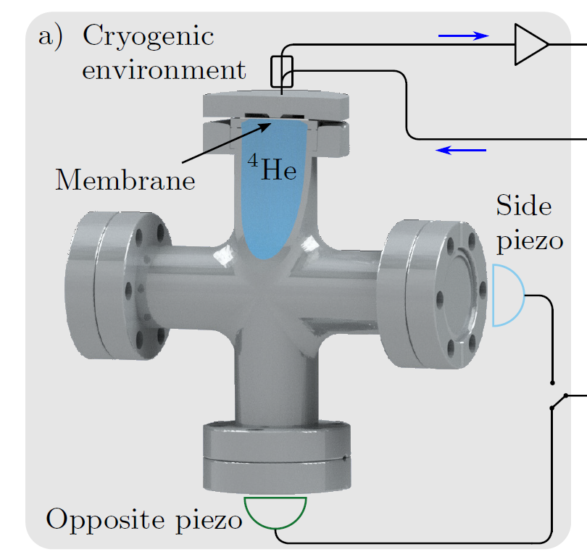
Gravitational Wave Detector…?
Strain sensitivity:
$${10}^{−18} {Hz}^{−1/2}$$
Resonance frequency:
$$1−10 kHz$$
Bandwidth:
$1 mHz$ ($Q\sim {10}^{6}$)
Thermomech. noise limited.
Tuneable frequency

Slide 7
Superfluid Helium Gravitational Wave
Helium II
Filter
cavity
SNSPD

Slide 8
Superfluid Helium Gravitational Wave
Low order mode!
Strain sensitivity:
$${10}^{−20}−{10}^{−22} {Hz}^{−1/2}$$
Frequency:
$$1−10 kHz$$
Bandwidth:
$1 μHz$ ($Q\sim {10}^{8}$)
Helium II

Slide 9
Superfluid Helium Gravitational Wave
Very preliminary work but….
Competitive strain sensitivities (?).
Compact form, so could be deployed across multiple sites.
Best suited for highly coherent sources.
System needs:
Collaboration!
Prototype to be built.
Vibration isolation.
Thank you!

Slide 10
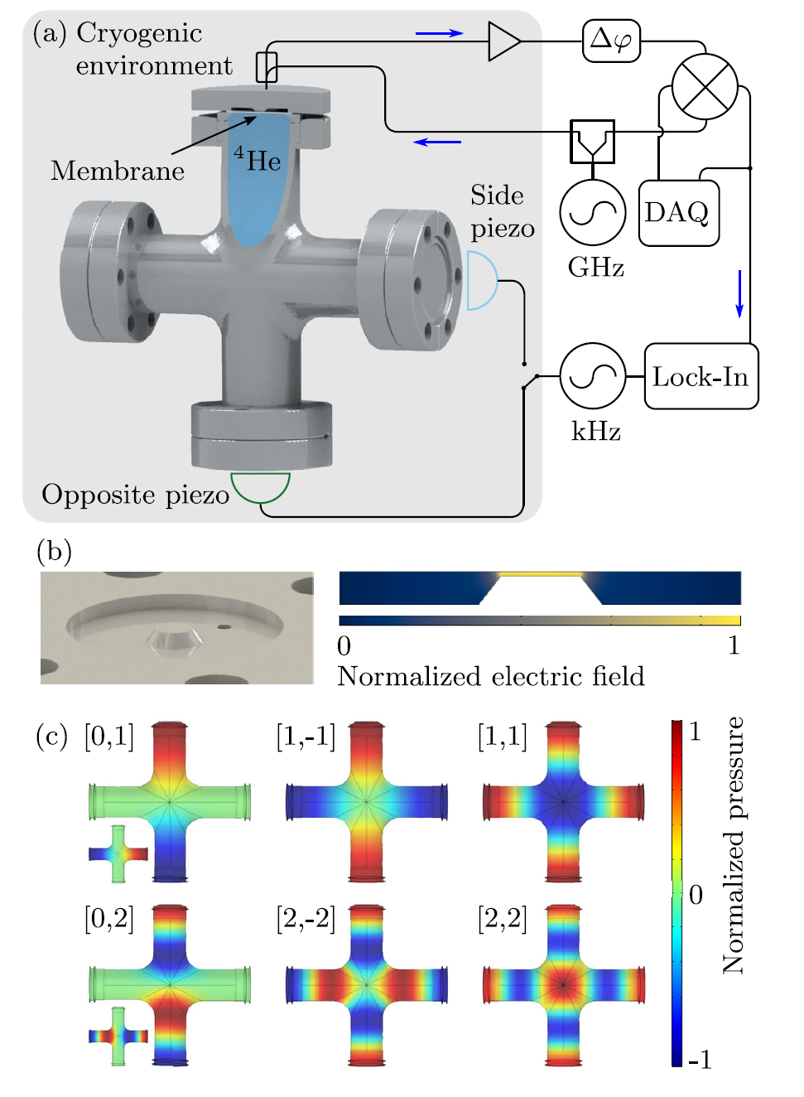

Slide 11
Dark Matter-Phonon coupling

Slide 12
Dark Matter-Phonon coupling

Slide 13
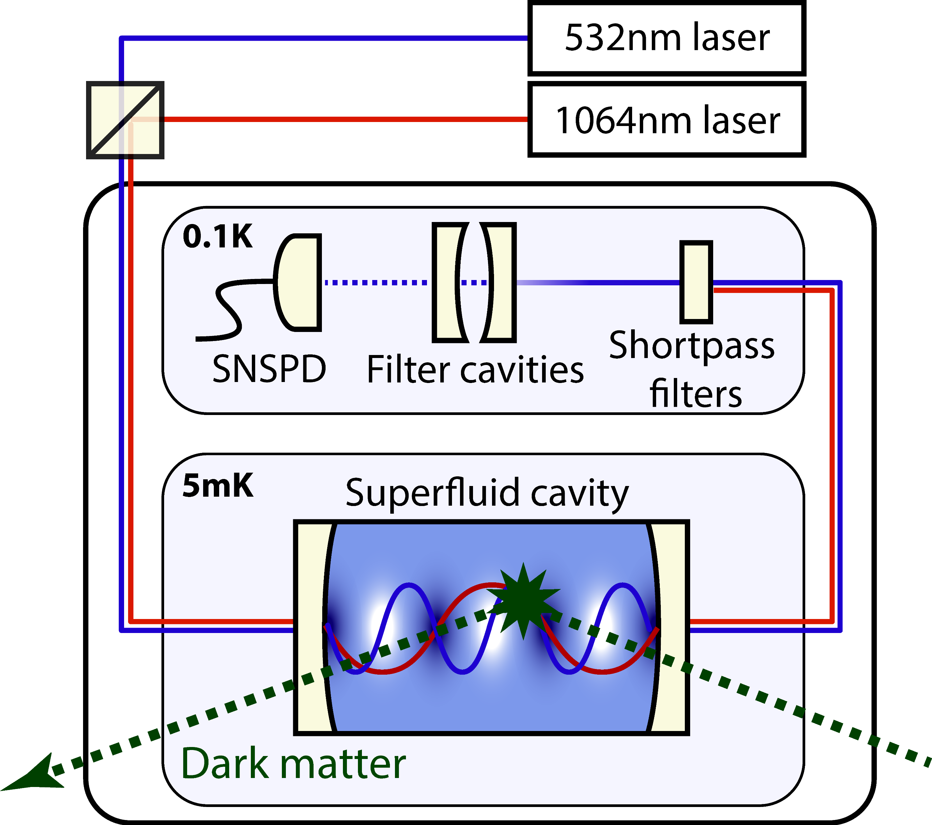
Superfluid Dark Matter Detector
Notes:
So what would it look like? Well you need a dilution unit

Slide 14
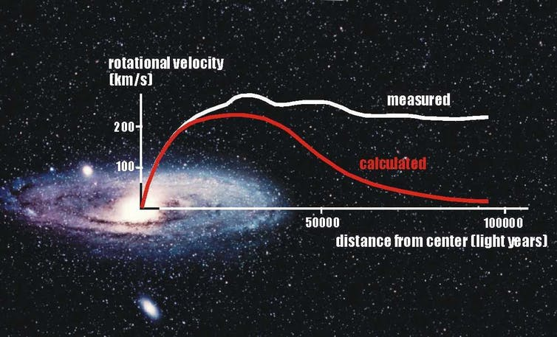
Indirect Evidence for Dark Matter
1) Unobserved mass of a type that we have already detected.
2) Unobserved mass of a type that we haven’t detected.
3) Einstein’s theory of gravity is incomplete.
Notes:
What is dark matter?
The motivation for dark matter came from astronomical observations. In the 1940s, astrophysicist Fritz Zwicky and Vera Rubin was observing the rotations of galaxies. The mass can be estimated, based on the light they emitted, and it was found that at the speed at which the galaxies were moving, they should have flown apart. This is indicated in the figure here. There is currently unknown physics that govern the dynamics of the galaxies. What are the options to plug that gap?
1) There is mass there that we’re familiar with, and is just very faint. Often called massive astrophysical compact halo object (MACHO)
2) This option requires an extension to SM; adding particles into the zoo pre-existing particles to give that behaviour. Those particles have to be Weakly interacting and Massive.
3) Alternatively, ….
There is substantial work on all three, but my understanding is the consensus is #2 is the most likely. There are two common variations of SM that add particles, Axions and WIMPS, and they both are proposed for direct detection.

Slide 15
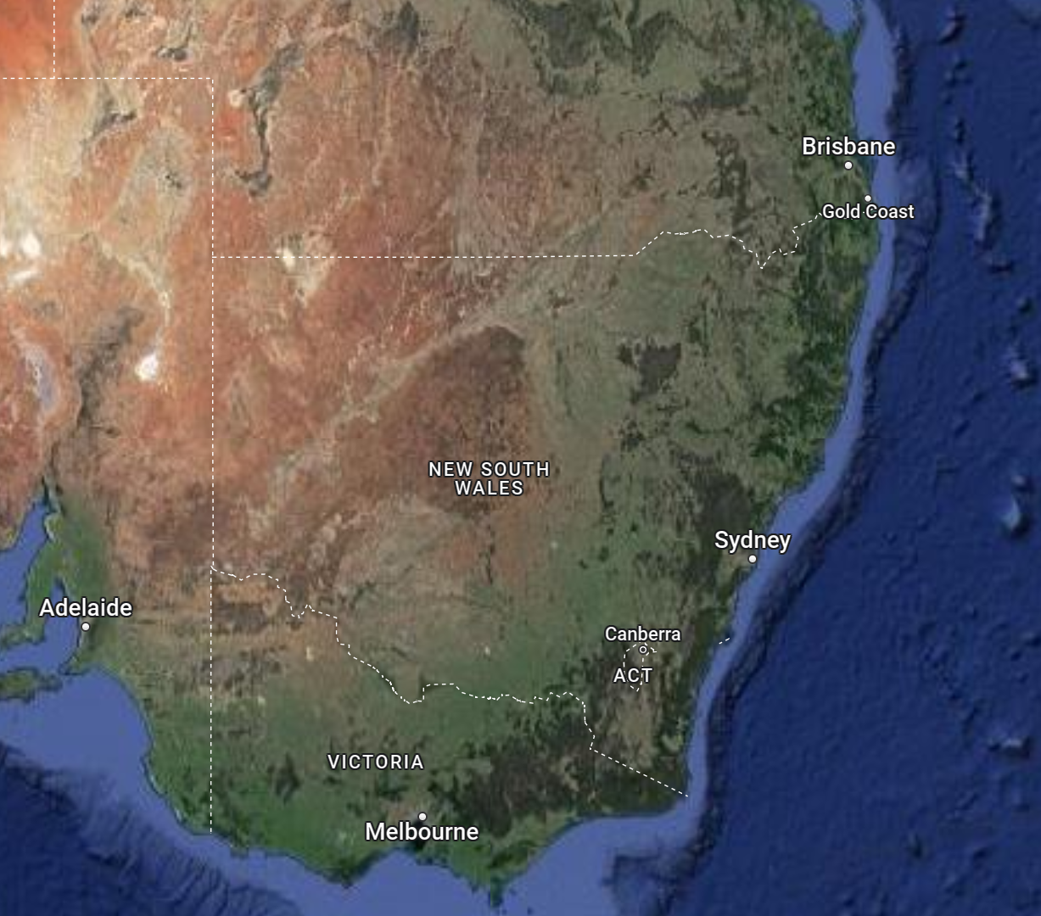
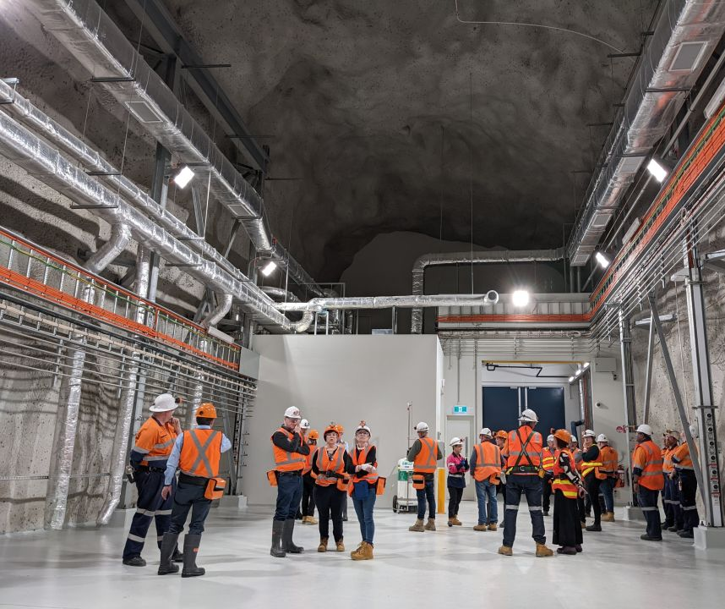
Stawell Underground Physics Laboratory - SUPL
Notes:
CUTE – super CDMS Si and Ge crystal for
CUORE- double beta decay TeO2

Slide 16
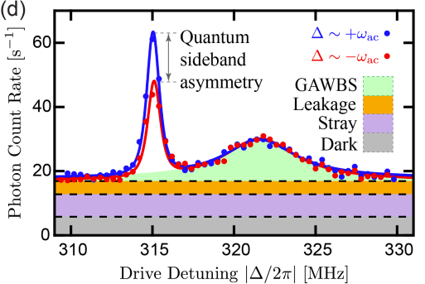
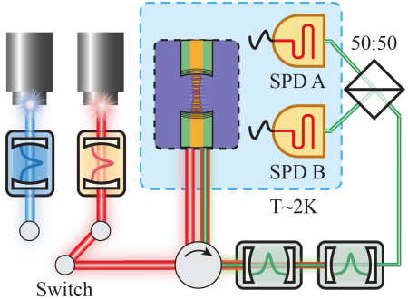
Superfluid Optomechanics: Phonon Counting
Frequency of acoustic mode
Difference on 1 phonon!
Y. S. S. Patel, et. al., “Measuring High-Order Phonon Correlations in an Optomechanical Resonator”, arXiv:2201.07340v1
Notes:
And so the experimental system to do thermomemtry of a specific modes is shown here… I should say that this work was done the lab were I did my postdoc, but this particular result was completed after I left, so I wasn’t directly involved! We have a laser that couples into
Monitor the click stream in real time, looking for sudden changes in temperature.

Slide 17
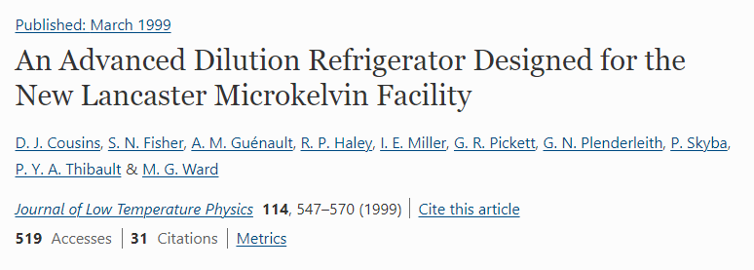
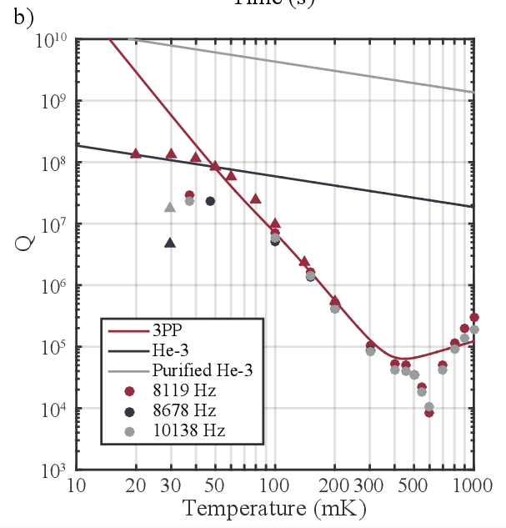
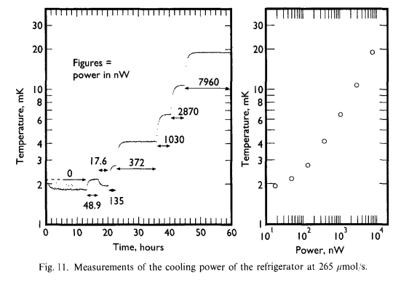

Slide 18
Optomechanical Detection of Dark Matter
DM
Phonons modes (10⁻⁶ eV)
Very different detection scheme.
Capable of resolving thermal motion (~ueV).
Distributed sensing throughout medium (compare to bolometers at the wall).
Simultaneously measure multiple modes.
Questions/concerns:
Can only observe specific modes (i.e. narrow energy band).
What is the rate/cross-section and emission pattern?
2-phonon scattering generates non-classical state…!
Cavity enhanced scattering (i.e. Purcell-like enhancement)?
Could also optically detect
Helium Excimers (10eV)
Detect via fluorescence of long lived triplet state.
Rotons (10⁻³ eV)
Detected via optical scattering.
Phonons
1m
1cm
Design for macroscopic cavity filled with LHe
Notes:
And so the thought is that we can scale up to meter scale (kg scale). I’ve gone some way to that, scalling up to cm scale… This
The primary challenge in such systems is not energy threshold, but instead understanding how coupling energy into the phonon modes of interest (which are often purposefully decoupled from the bulk phonon modes in the system to avoid thermal noise)

Slide 19
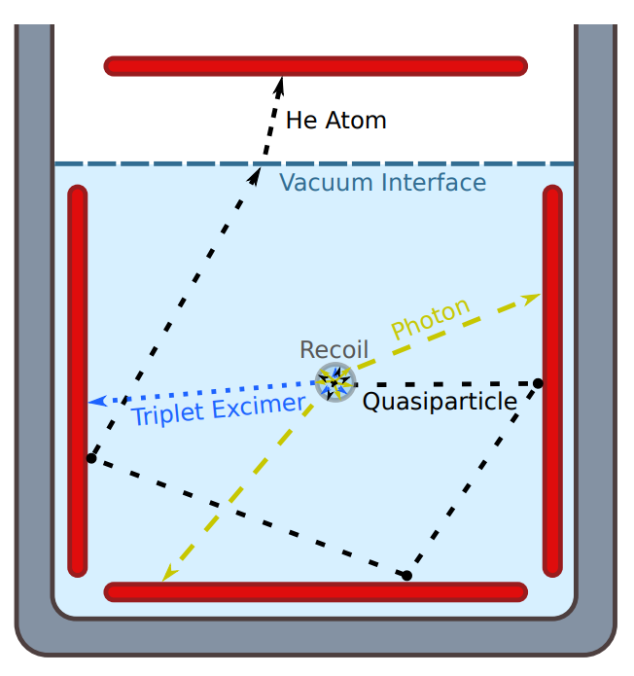
Helium as a target material
athermal evaporation
Low nuclear mass → efficient transfer of KE
Multiple signal channels → allows signal discrimination
High radiopurity (no isotope) and freeze-out of impurities → low spurious signals
A large band gap energy of 19eV → low spurious signals
A liquid state down to 0K → reduce thermal noise
Cheaper than Xenon by x10!
Notes:
DM interaction will introduce a “shower” of particles. It will tear an electron of He atom and create excimers, those will decay rotons/phonons/photons
Here is a list of benefits of using Helium!
But still calorimetry based, athermal evaporation. Have ~1eV sensitivity, borrowed from the SNSPD technology! Immune to phonon modes!
I think would be amazing is a differenct sensing modality based on optomechanical measurements.
My claim is there are a bunch of optical detection techniques that could be borrowed from the OM community that could/would compliment DM search's.

Slide 20
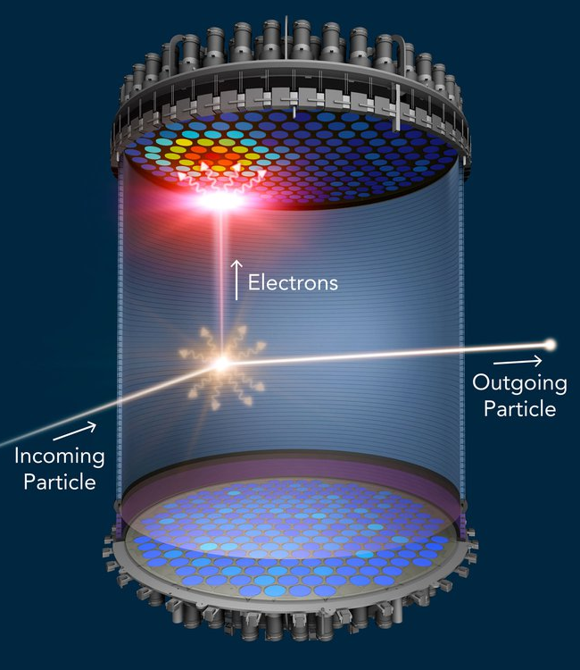
Superfluid Helium Dark Matter
Dr. Ben Brubaker
Yale University
A/Prof Scott Hertel
UMass. Amherst
Notes:
Started with conversation with these two... Pointed out that helium might be an interesting target material because it opens up a previously unexplored region of parameter space in the search for dark matter.
The canonical experiment looks something like this; there is a bucket of helium, an interaction that generates excimer or roton that then travels to walls for detection.
Two problems; 1) resolution limited by sensor threshold. 2) High energy is thought to cascade to lower energies, into phonons which.
And so that made be think; is there a way to leverage optomechanics? So, to facilitate introduce optomechanics and salient features of it…

Slide 21
Optomechanical Interaction
Linearize by taking
Optomechanical entanglement
Optomechanical beam splitter
Heating
Cooling
Intra cavity power
Intra cavity power
Frequency
Frequency
Notes:
Add sideband picture. Comment on cooling (sideband constraint) and parametric instability

Slide 22
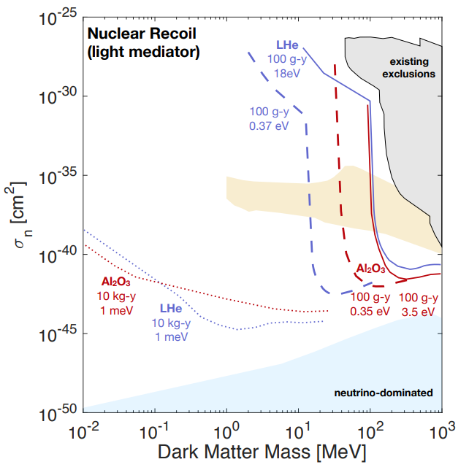
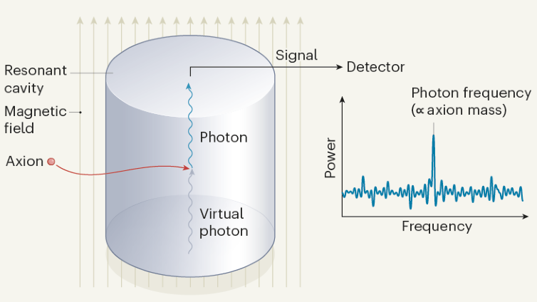
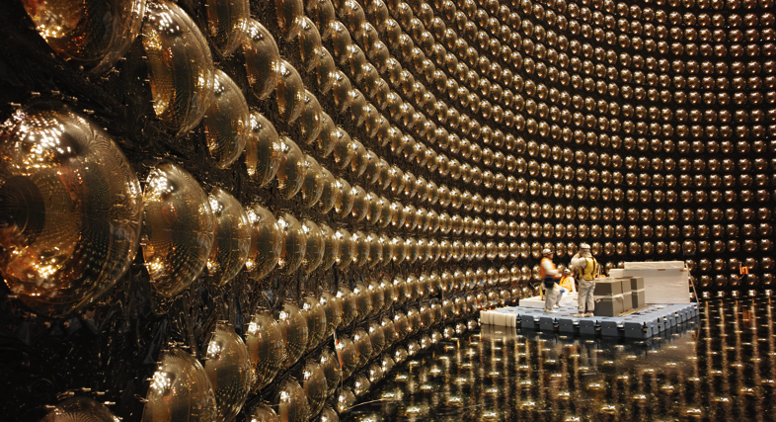
Direct evidence for Dark Matter
Axion
WIMP
The TESSERACT Dark Matter Project
XENONnT (Italy)
LUX-Zeplin (USA)
PandaX (China)
Super-Kamiokande (Japan)
SABRE (Italy/Australia)
HAYSTACK (USA)
ADMX (USA)
ORGAN (Australia)
“You could say we’re the world’s best at finding nothing.”
-Murdock Gilchriese
Director of LUX-ZEPLIN
Notes:
The first are Axions; were particles invented to solve a separate problem in the standard model related to symmetry, and then it is was discovered that it also could potentially be a dark matter candidate! Here is a non exclusive list. They have a feature that in the presence of an electromagnetic field, they should sometimes spontaneously convert to easily detectable photons. So these experiments that essentially have a large field and a axion scatters and makes a low energy photons (ueV) DM!
For reference, GeV is proton. MeV is electron. Neutrinos are ~eV
The other option is WIMPS: There exists no clear definition of a WIMP, but broadly, a WIMP is a new elementary particle which interacts via gravity and any other force (or forces), potentially not part of the Standard Model itself, which is as weak as or weaker than the weak nuclear force. They typically use a target mass, the first 3 use Xenon, SK is water and SABRE is crystal. Shout out to the Australian contributions
SABRE (Sodium Iodide with Active Background Rejection Experiment)
Both of which are part of Centre of excellence for Dark Matter Particle Physics
ORGAN is an axion detection lead by Mike Tobar at UWA
None of these have detected anything… It prompted the director of LUX-Zeplin to say “..”.
So we want something to bridge the gap between light Axion searches and heavy WIMP! Helium! Explain figure!

Slide 23
Superfluid Helium

Slide 24
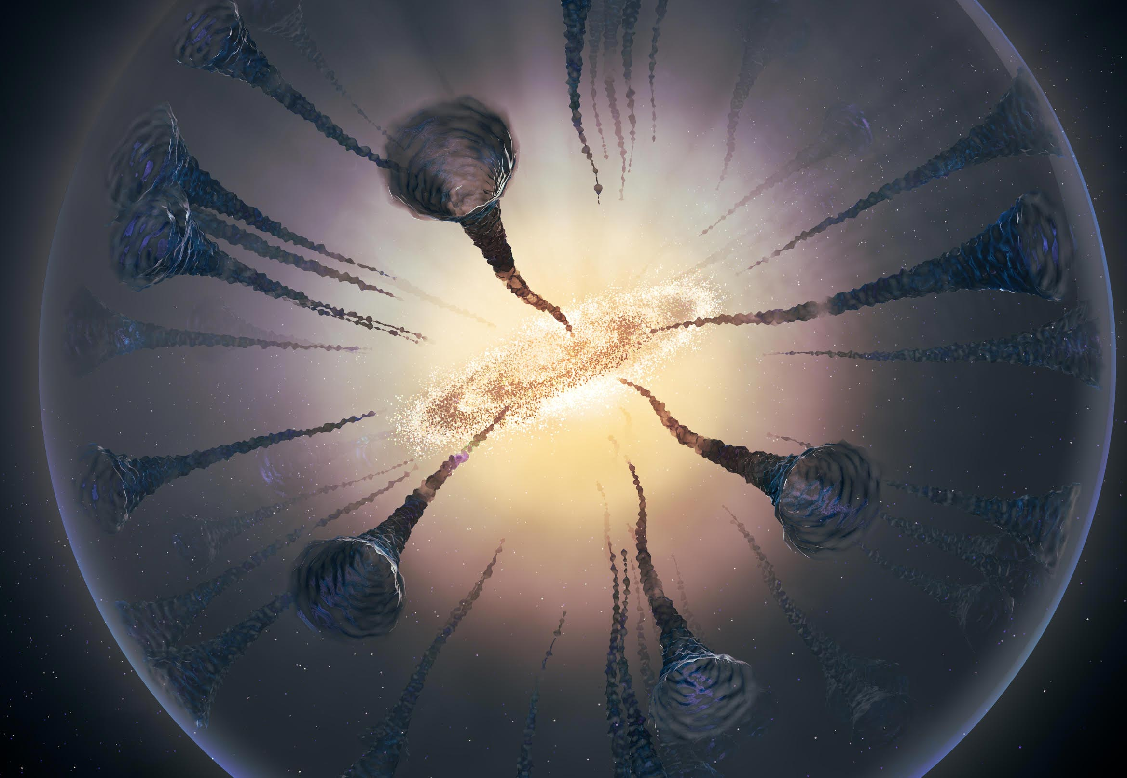
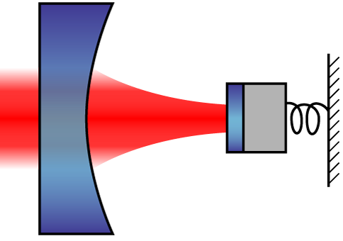
Superfluid Helium
Dark Matter
Superfluid He
HFGW
Optomechanics

