Slide 1
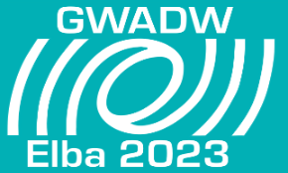
A Bildungsroman of the TCS in Advanced Virgo
M. Lorenzini, E. Cesarini, M. Cifaldi, V. Fafone, P. Giri, M. Ianni, D. Lumaca, Y. Minenkov, I. Nardecchia, P.P. Palma, A. Rocchi, C. Taranto
GWADW – Gravitational-Wave Advanced Detector Workshop, May 21st-27th, 2023 Hotel Hermitage, La Biodola, Isola d'Elba

Slide 2
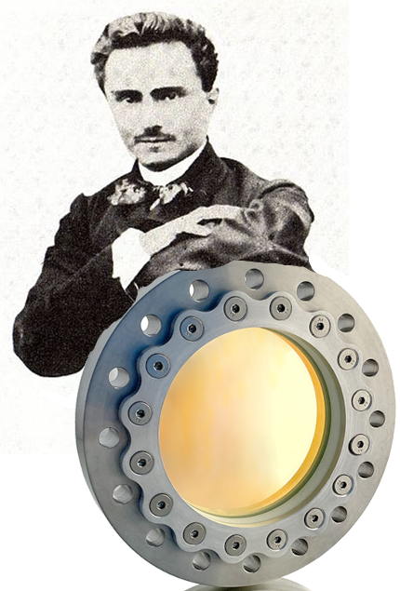
Outline
The story of the Thermal Compensation System in Virgo and in Advanced Virgo has been long, rich of twists, learned lessons, new ideas, people’s suggestions and original contributions, intertwining with the events of the interferometer commissioning and ineluctably transforming a specialized sub-system in a versatile and continuously evolving environment.
It really resembles the framework of a novel, a Bildungsroman of TCS.
CHAPTER 1: The Thermal Compensation System in Advanced Virgo
CHAPTER 2: TCS concepts: design and operation
CHAPTER 3: Hartmann Wavefront Sensors (HWS) and simulations at work
CHAPTER 4: Real Double Axicon System OPL correction for simulations
CHAPTER 5: The impact of DAS irregularities and how to deal with
CHAPTER 6: Monitoring the CO2 actuators, a key feature of TCS
CHAPTER 7: Other TCS highlights at the GWADW
M. Lorenzini GWADW – Gravitational-Wave Advanced Detector Workshop, May 21st-27th, 2023

Slide 3
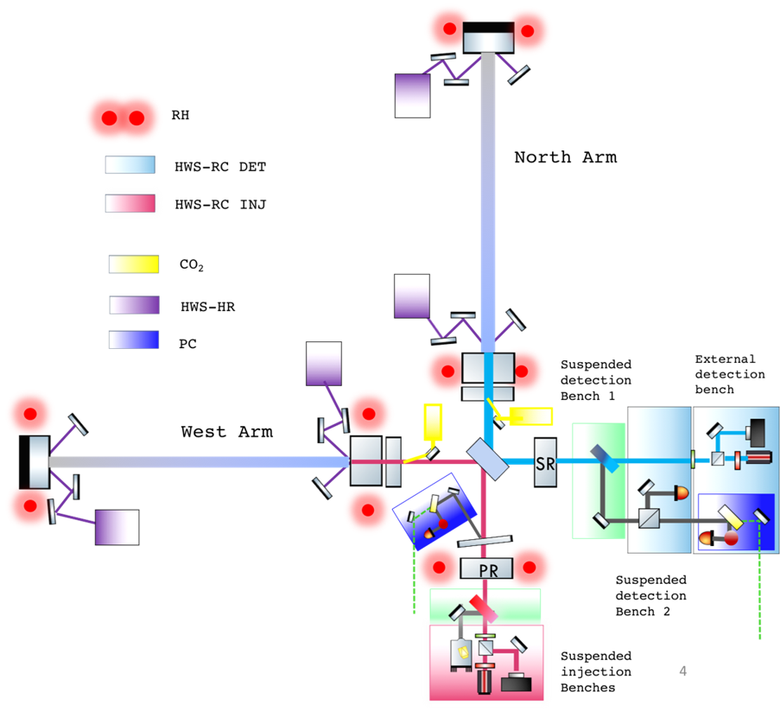
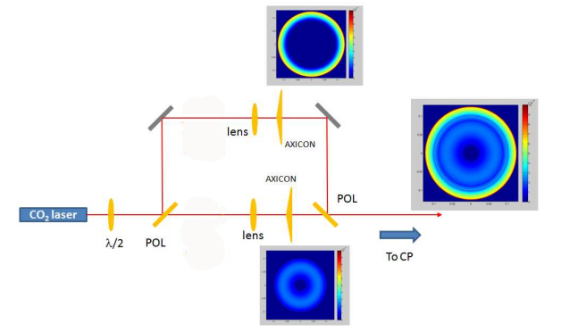
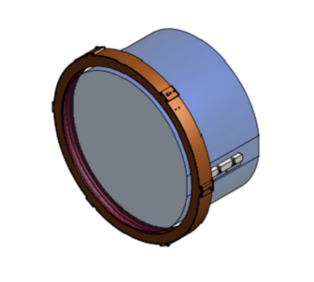
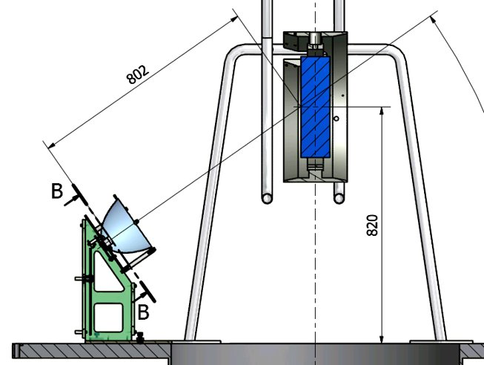
TCS in Advanced Virgo (in 1 slide)
TCS actuators :
CO₂ laser projector (50 W)
Ring Heater
CHRoCC (PR & SR)
TCS sensing :
HWS-RC
HWS-HR
Phase Cameras
M. Lorenzini GWADW – Gravitational-Wave Advanced Detector Workshop, May 21st-27th, 2023

Slide 4
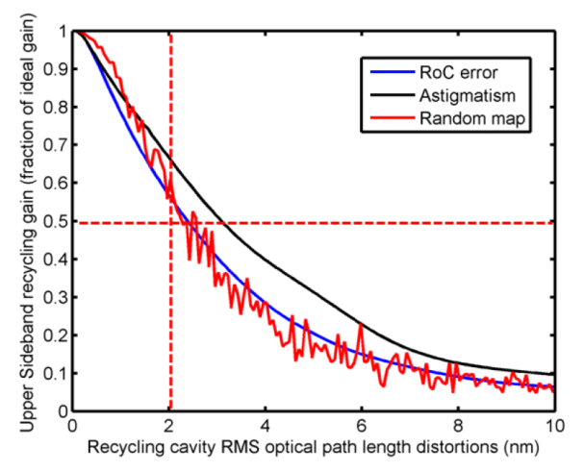
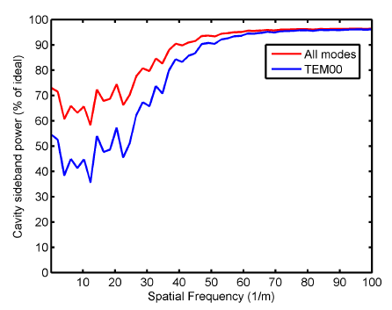
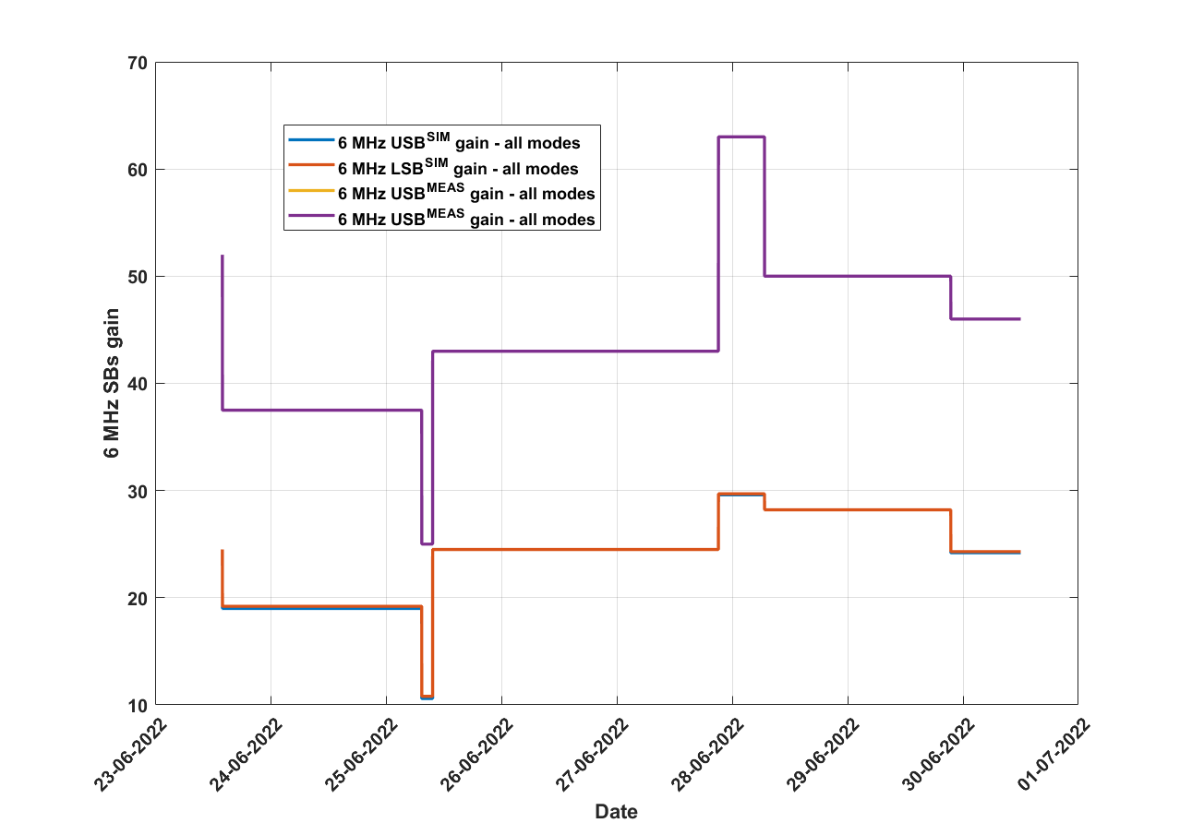
TCS concepts
Original picture
Advanced Virgo desing phase provided requirements (mostly due to marginally stable cavities):
In terms of sidebands gain/power (controllability)
2 nm RMS maximum aberration budget (Gaussian weigthed)
TCS designed accordingly
Sideband power as a function of residual aberration RMS. VIR-0128A-12
Sideband power as a function of aberration spatial frequency. From VIR-0389A-11
Commissioning figures of merit (FOMs)
CITF
Carm null
TCS closed loop operation → TCS tuning
Several FOMs for the TCS optimization have been explored during O4 preparation:
Sidebands gain/shape (phase camera)
Common mode rejection factor
Angular signals (actuators alignment)
Dark fringe power/shape
Arm cavity power transients
Other less specific? (double cavity pole, optical spring, …)
56 MHz
☹
6 MHz
M. Lorenzini GWADW – Gravitational-Wave Advanced Detector Workshop, May 21st-27th, 2023

Slide 5
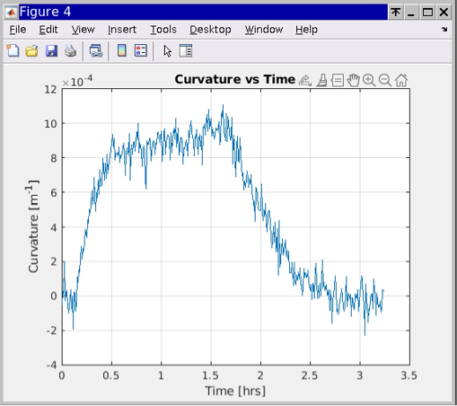
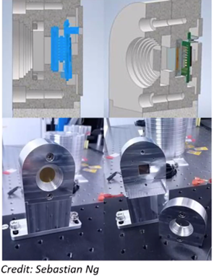
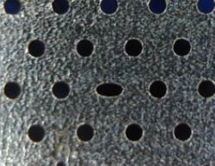
HWS-RC
HWS is accurate in providing good «error signals» from the TMs in the central interferometer, however there are caveats:
TM center is precisely determined with RHs w.r.t. HWS beam position
Alignment changes (YAG position, SRM,PRM,BS, DET and INJ optics) are strongly coupled
Is it possible to recover informations on tilt couplings directly from HWS illumination maps?
Requires settling the ITF ideal reference state at low power.
CH+DAS
CH
HWS-RC are undergoing a «restyling» operation in collaboration with University of Adelaide
DALSA Panthera CCD discontinued
New C-MOS Ximea sensors are being characterized in compact, custom-designed thermal housing
The study will review HWS system parameters (impact of lever arms, plate, temperature, number of averages, SLED power…)
Same plate but with elliptic holes to reference orientation
M. Lorenzini GWADW – Gravitational-Wave Advanced Detector Workshop, May 21st-27th, 2023

Slide 6
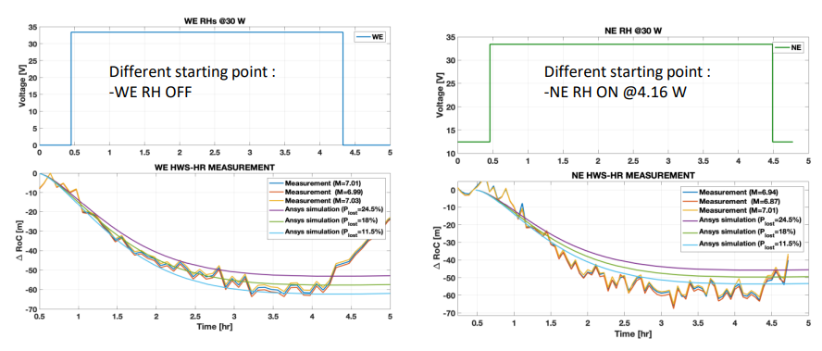
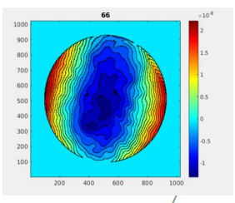
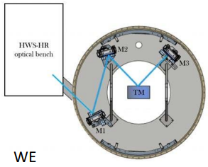
HWS - HR
HWSs-HR provide a direct measurement of the thermo-elastic deformation (TE) of TM surfaces:
Both on ITMs and ETMs
Unique tool to look at thermal effects on ETMs (no HWSs in trasmission)
Direct way of spotting point absorbers
Independent check of TM coating absorption (need high power since TE is intrinsically small compared to thermo-optic)
Profiting of the WI TM re-installation in fall 2022, HWS-HR operation was tested again against RH TE on ETMs at high RH power (30 W):
10⁻⁸ m
ITF beam
2
1
0
-1
Reconstructed wavefront,
piston and tilt removed
Uncertainty limits from P_{LOST}, see I Nardecchia et al., Optimized radius of curvature tuning for the Virgo core optics, CQG 40 (2023)
M. Lorenzini GWADW – Gravitational-Wave Advanced Detector Workshop, May 21st-27th, 2023

Slide 7
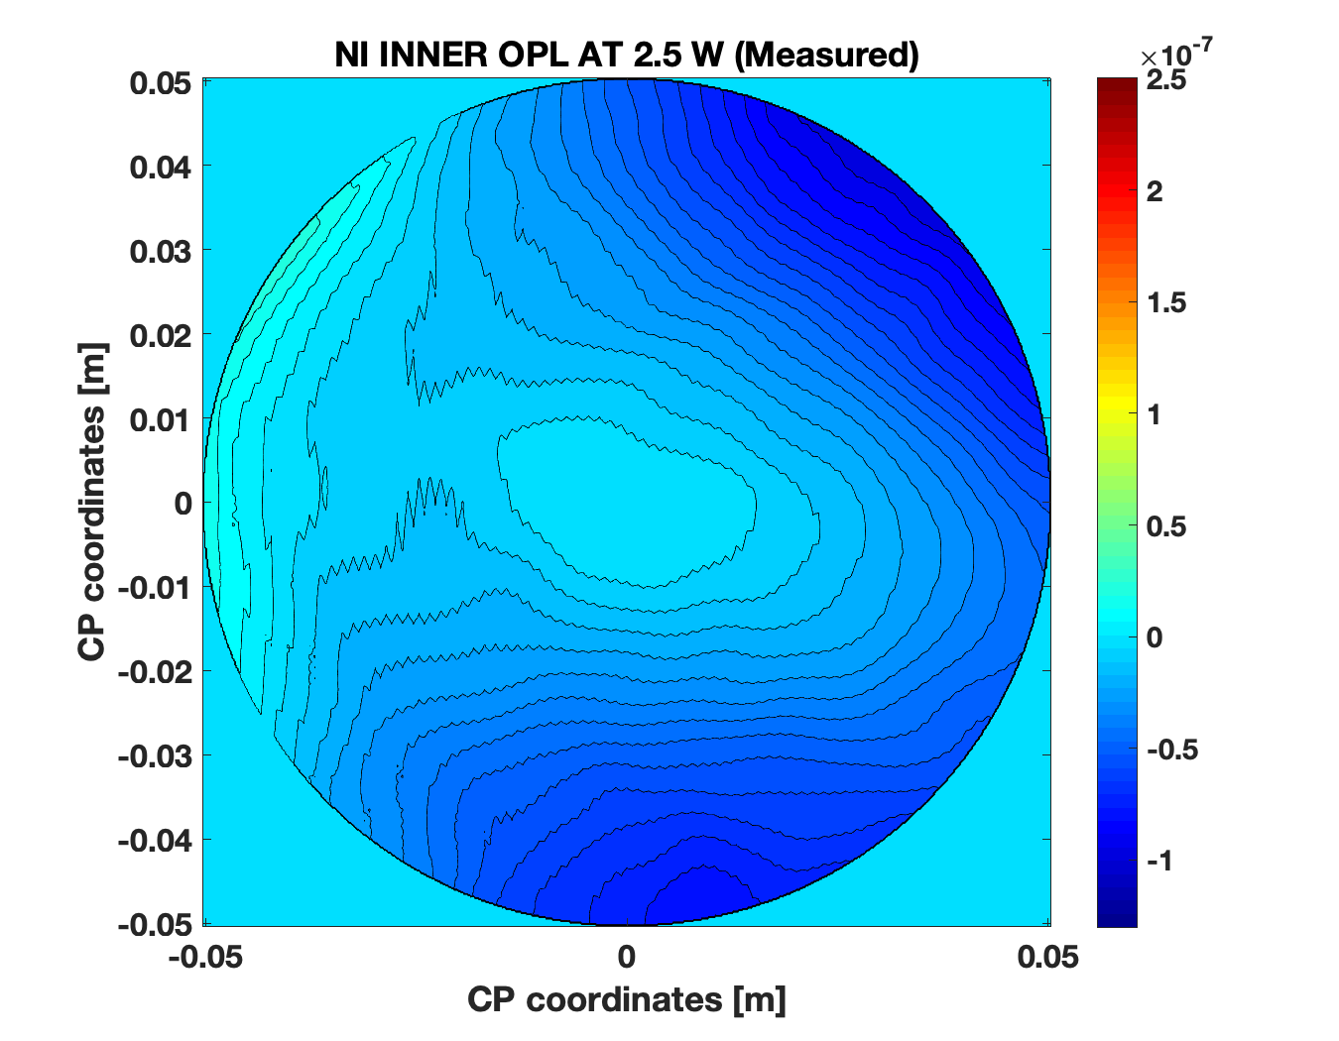
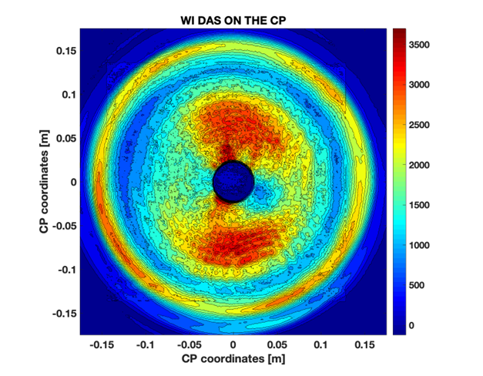
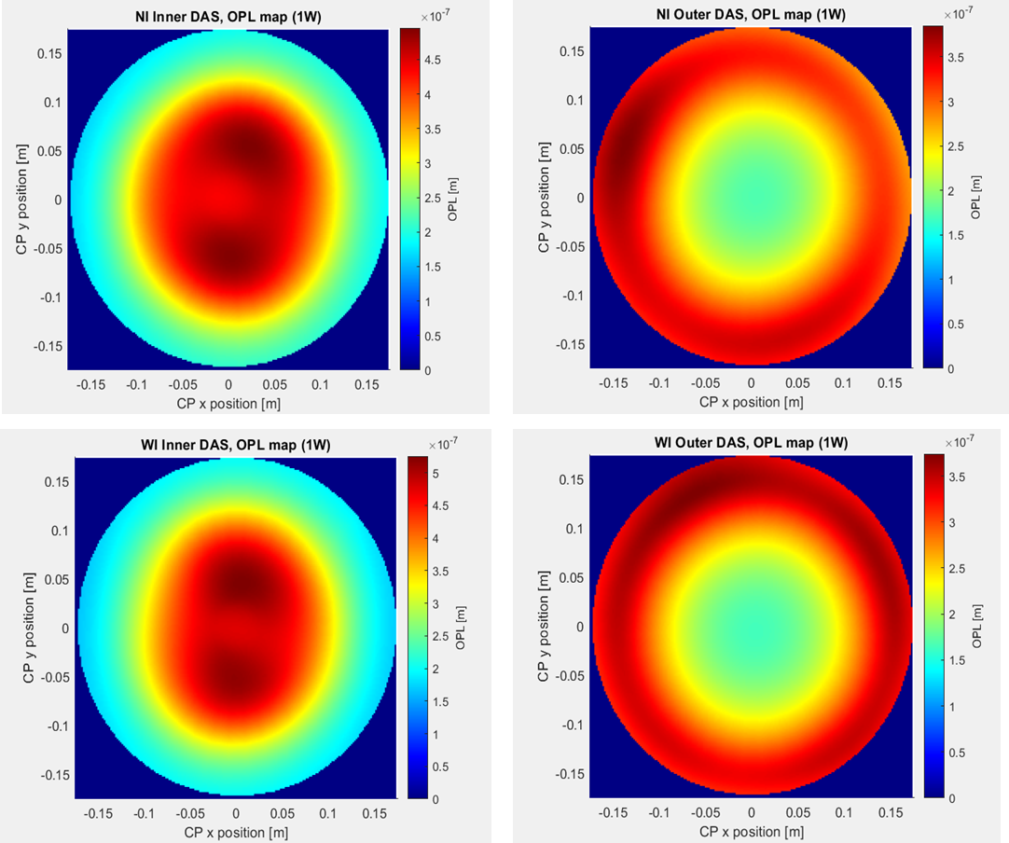
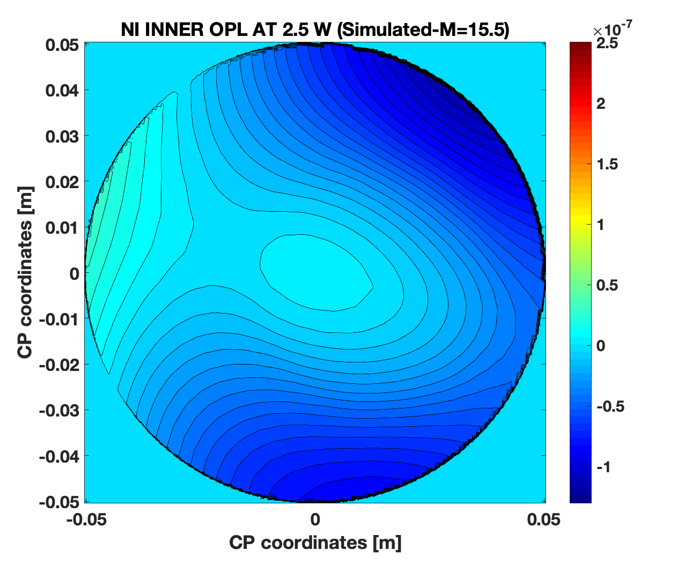
Characterization of DAS OPLs
Real wavefront aberration thermal sources need to be modeled or characterized to be input for simulations.
OPL maps can be computed from heating patterns (ANSYS, Matlab) or measured with HWS
YAG and CH can be modeled as Gaussian spots
Real DAS OPLs require a measurement to take into account asymmetries
Indirect method
Direct method
Measure the DAS intensity maps on the object plane
Project the maps onto the CP and compute the OPLs
Measure the OPL variation on ITM whit HWS
Indirect method allows to compute OPL over the whole CP aperture. Direct method provides evidence from ITF.
Final OPLs are provided from computation after it is validated using HWS data in the central area
M. Lorenzini GWADW – Gravitational-Wave Advanced Detector Workshop, May 21st-27th, 2023

Slide 8
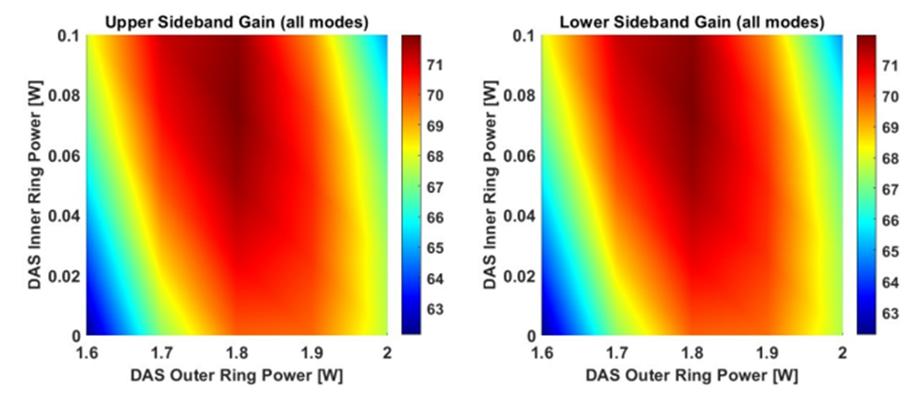
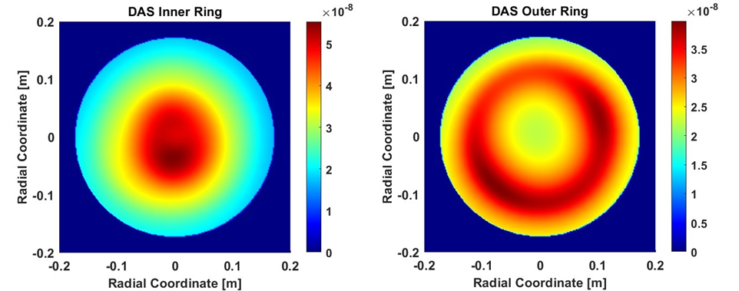
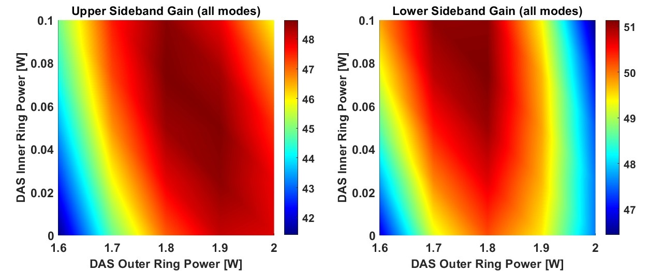
DAS simulations (NI CP cold lens compensation)
From DAS OPLs, Oscar simulations provide the tools to study TCS tuning starting point.
The case of NI CP cold lens
6 MHz sb
56 MHz sb
Simulations to recover ideal ITF gains
Tuning done starting from simulations indications
Tuning done by equalizing Narm to Warm matching
Simulation indications
Tuning results
M. Lorenzini GWADW – Gravitational-Wave Advanced Detector Workshop, May 21st-27th, 2023

Slide 9
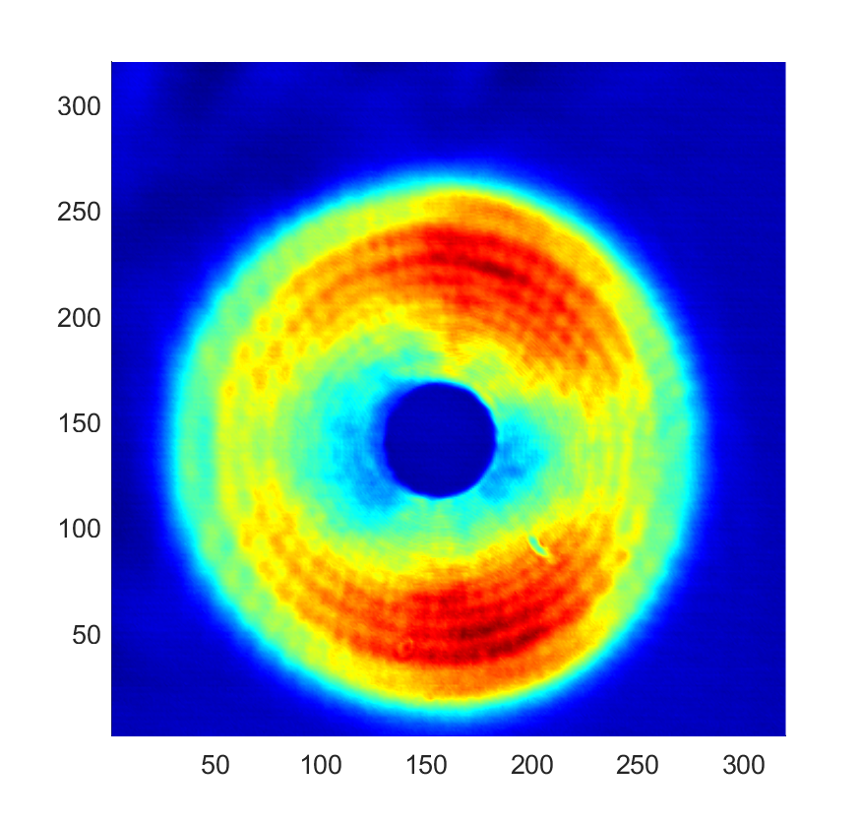
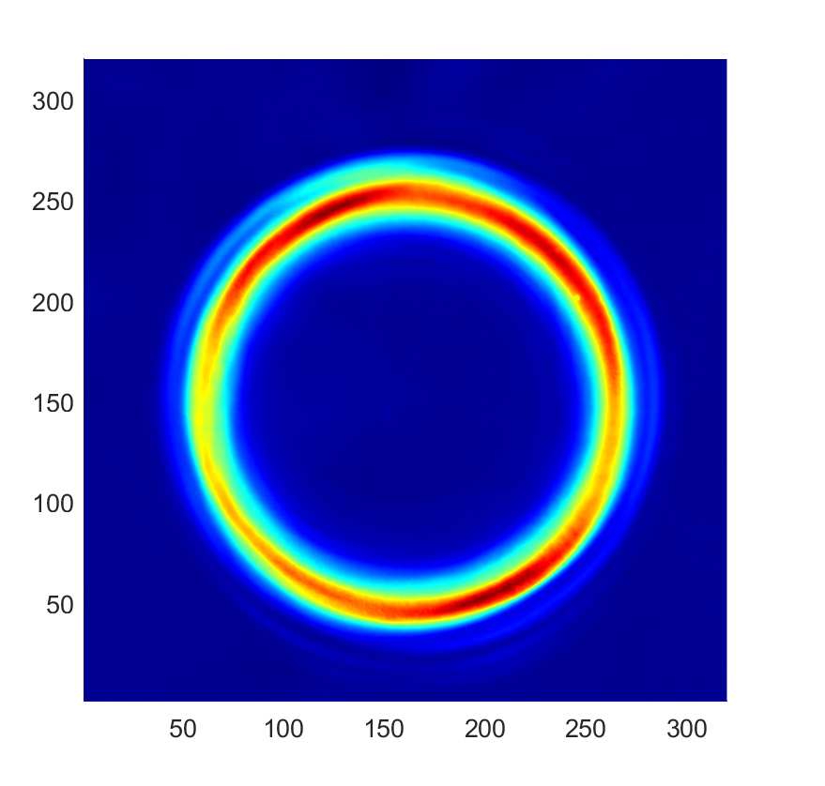
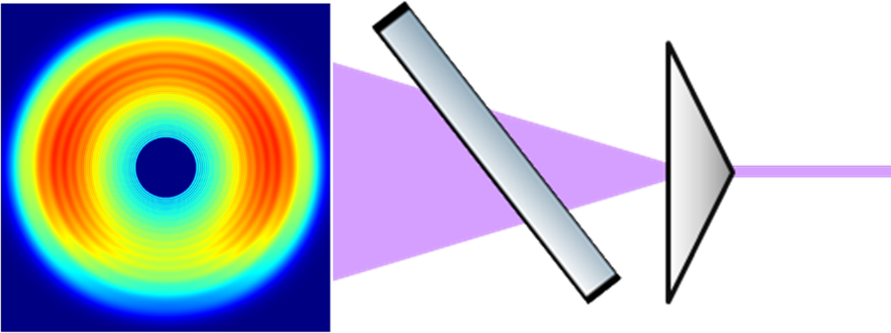
HOMs in the CO2 beam
Efficiency of the correction is directly related to the quality of the heating pattern;
No matter how this is realized (diffractive optics, masks, active optical elements...), the final result is affected by the quality of the laser beam;
FFT simulations and measurements in the test facility have allowed to relate these imperfections to:
HOMs in the CO2 laser beam;
Specific features of the current optical layout.
Measured DAS rings intensity distributions
Left-Right asymmetry due to beam AOI on partially reflecting optics
FFT simulation with astigmatic input beam
M. Lorenzini GWADW – Gravitational-Wave Advanced Detector Workshop, May 21st-27th, 2023

Slide 10
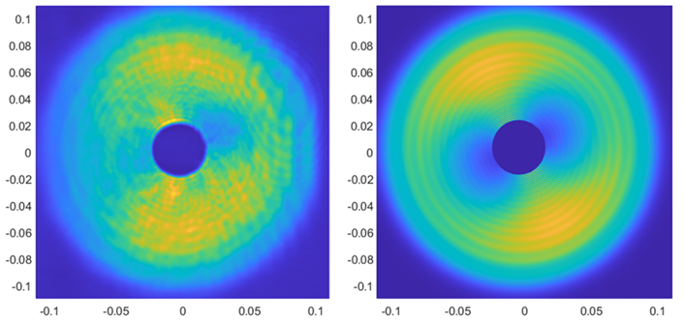
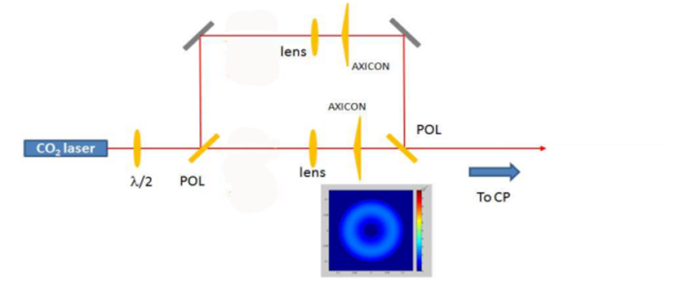
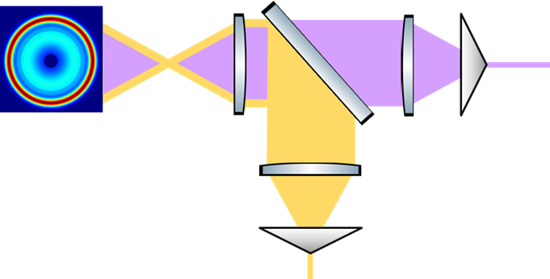
HOMs in the CO2 beam
measured
Simulated (AOI+HOMs)
FOM for the characterization of the impact of an irregular DAS: residual OPL increase (Gaussian weighted RMS) to be compared with the PRC requirement in AdV (2 nm RMS)
OPL increase budget mostly from inner DAS
80 W input power (O5-like)
Clean inner DAS gives less than 1 nm RMS
Actual inner DAS (as in figure) gives ~20 nm RMS
Solution for the impact from AOI was already studied (D. Lumaca’s master thesis) and is part of TCS upgrades for O5:
M. Lorenzini GWADW – Gravitational-Wave Advanced Detector Workshop, May 21st-27th, 2023

Slide 11
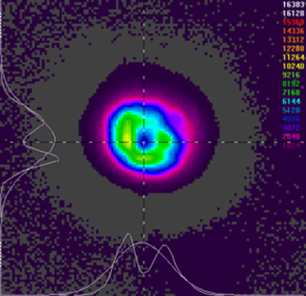
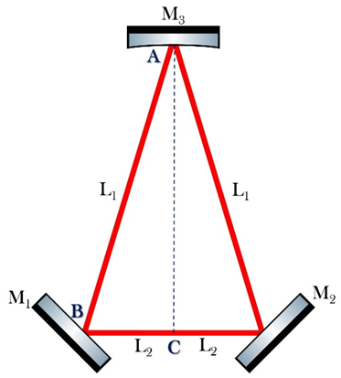
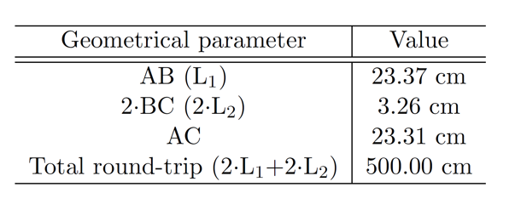
MC for the CO2
Residual OPL increase in DAS due to HOMs in the CO₂ source beam is still in the range of 10 nm RMS (80 W).
HOMs content in a TCS CO2 source (Access 50W) is of the order of few %
Spatial filtering with a pinhole causes a drop of available power (50%!) and cannot totally remove HOMs
2 nm RMS max OPL increase requires <0.1% of HOMs in the beam reaching the DAS
Beam throughput (when HOMs are removed) is required >85% of input power
The best strategy is represented by a mode cleaner cavity:
Triangular configuration (to avoid back-propagation when lacking Faraday isolators for CO2)
EOM is very expensive for CO2 wavelength
Dithering lock is the designed solution
Invar case to avoid large drift due to high power buildup
Finesse 100, input source 50 W!
Prototyping at low power
Push up input power to explore operability
(references in L. Aiello’s PhD thesis)
M. Lorenzini GWADW – Gravitational-Wave Advanced Detector Workshop, May 21st-27th, 2023

Slide 12
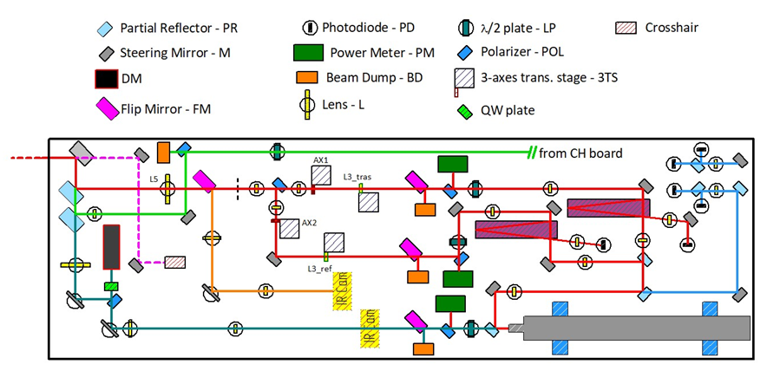
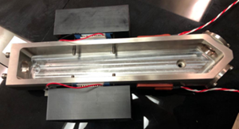
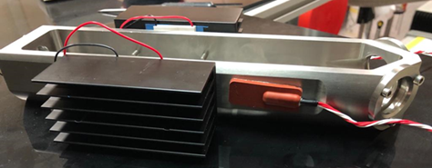
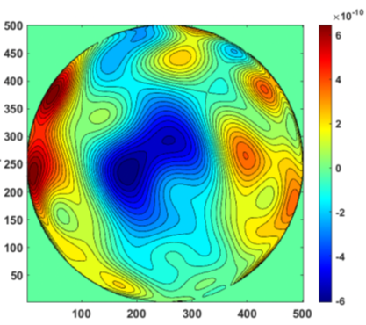
MC for the CO2
(references in P. Giri’s PhD thesis)
As a risk reduction, O5 bench upgrade is designed with two MCs, working at limited power (few W)
A prototype version of the MC is being develped at ToV
Invar cavity spacer controlled in temperature with Peltier cells (stability at the 1 mK level RMS)
ZnSe mirrors with low absorption (1/1000) measured with HWS
Phase noise of CO2 source (50W CCW from Access) characterized with a Mach-Zender setup
Diter locking strategy using a piezo actuator on the curved mirror.
M. Lorenzini GWADW – Gravitational-Wave Advanced Detector Workshop, May 21st-27th, 2023

Slide 13
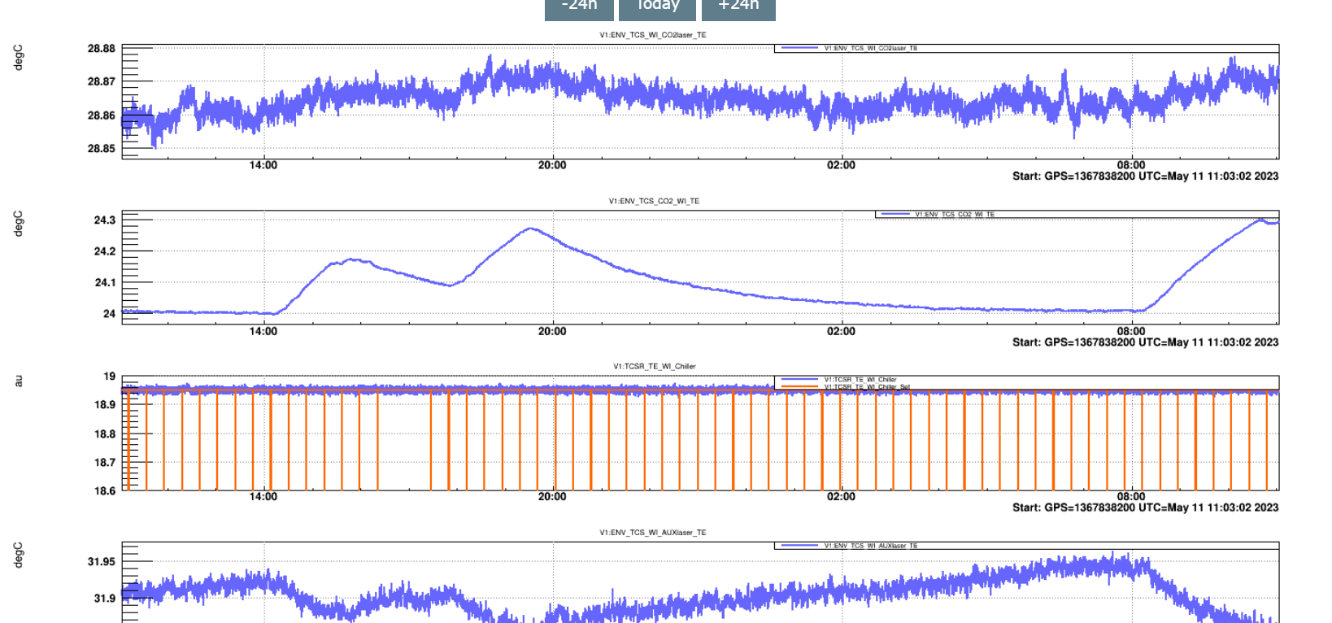
Diagnostics of CO2 actuators
Relative alignment of YAG/DAS/CH is a key parameter affecting the ITF working point
Misalignments can cause a set of unwanted effects:
Deflection of YAG beam propagation after ITM;
High residual aberrations even upon optimal correction;
Spurios thermal transients in the arm power buildup after
the locking;
…
But also the reversed statement:
If the YAG/DAS/CH relative alignment is not well known, misalignments can be suspected to be the cause of observed misbehaviors of the ITF
Are observed changes in CO2 bench status params (temperatures, flips,…) to be assumed as hints for changes in actuators alignment?
Monitoring the YAG/DAS/CH relative position is needed to:
Keep under control the TCS working point (when untouched and at tuning steps)
Disentangle CO2 actuators stability/alignment from other sources affecting the ITF operation
Provide information about the overall status of CO2 benches
M. Lorenzini GWADW – Gravitational-Wave Advanced Detector Workshop, May 21st-27th, 2023

Slide 14
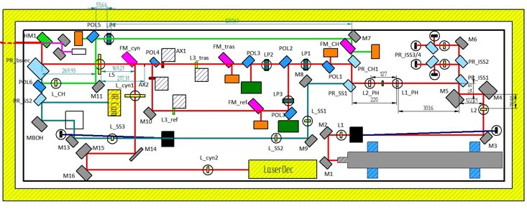
Diagnostics of CO2 actuators
Diagnostic lines were already implemented in the CO2 bench layout, however they were not meant to remotely monitor at the CP position:
hot mirror HM
Toward the CP
FM-cyn monitoring (orange shadowed): intensity map of DAS rings, acceptance issues, image of the object plane;
Direct IR cam (blue arrow): DAS intensity maps, requires on bench intervention (access to benches, long thermal times);
Look just before the vacuum (green arrow): CH+DAS positions on CP, by installing steering optics toward a screen and looking at profiles with an IR cam. Requires on bench intervention (access to benches, long thermal times);
M. Lorenzini GWADW – Gravitational-Wave Advanced Detector Workshop, May 21st-27th, 2023

Slide 15
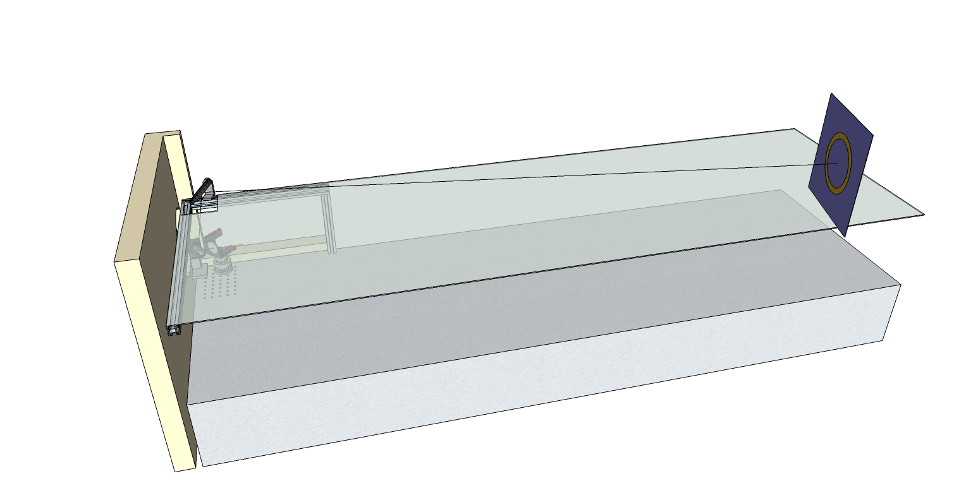
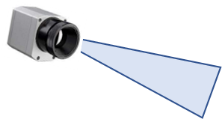
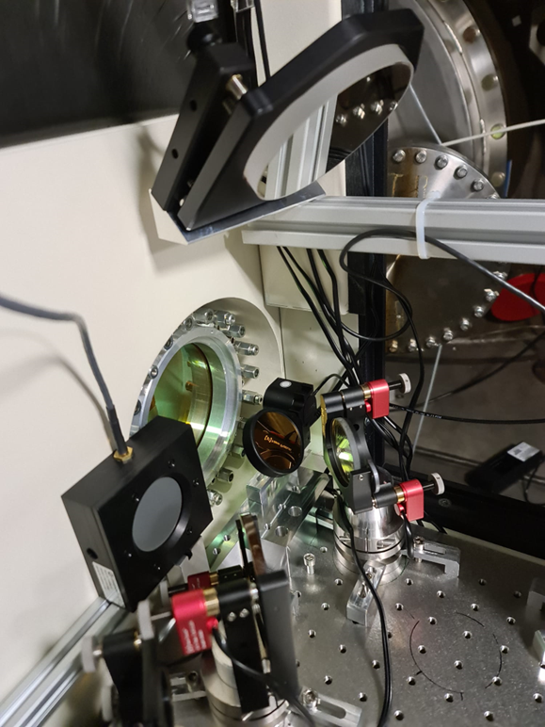
Diagnostics of CO2 actuators
A solution was designed for the O5 upgrade phase: remote monitoring CH+DAS (intensity and position at CP) using a pick-off just before vacuum and a dedicated line (VIR-0501C-22).
Positioning issues emerged strongly in O4 preparation → solution was adopted in a simplified version:
Monitor of CH+DAS positions at CP (no intensity)
Very simple optical layout
IR camera acquisition on cardboard screen
Pick-off managed by a flip mirror
Carboard
IR Camera
M. Lorenzini GWADW – Gravitational-Wave Advanced Detector Workshop, May 21st-27th, 2023

Slide 16
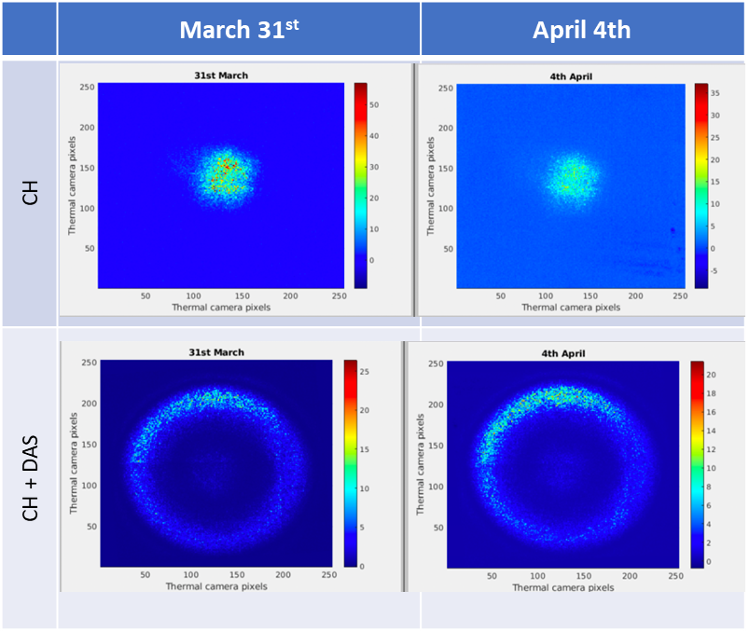
Diagnostics of CO2 actuators
Example of image processing:
Background is subtracted
Maps are normalized to the average
Normalized maps are converted to binary using an optimized threshold
The position is estimated as the barycenter of the binary mask
Maps are superimosed by shifting the barycenter at the origin
The uncertanty is evaluated by estimating the shift that maximizes the superposition integral
Done both for the CH alone and for OUTER DAS+CH
CH and DAS do not move when unattended, even if environmental conditions change;
CH and DAS effective displacement are in the range of the expected movements when remotely displaced by acting on the steering mirror HM;
Position errors usually in the range of few mm on CP.
M. Lorenzini GWADW – Gravitational-Wave Advanced Detector Workshop, May 21st-27th, 2023

Slide 17
Other TCS highlights at GWADW
RH thermal lens mitigation
RHs around the ITM are tricky to use, due to the fact that they induce a large themrmal lens in the ITM bulk.
The RH thermal lens cannot be totally compensated by changing the input beam matching
→ A coupled RH design can be exploited to disentangle the RoC actuation from the thermal lens (see Matteo Ianni’s poster)
Asymmetric residual OPL correction
Even after optimal DAS correction, non axi-symmetric residual aberrations can be relevant.
Scanning system approach implies injecting a frequency dependent noise
→ New approach using a deformable mirror actuator (see Claudia Taranto’s poster)
Point absorbers
The presence of point absorbers (PAs) on the TM coatings intorduces high spatial frequency wavefront aberrations with short onset times.
→ A dedicated actuator for the correction of PAs was developed (see Maria Cifaldi talk in this session)
M. Lorenzini GWADW – Gravitational-Wave Advanced Detector Workshop, May 21st-27th, 2023

Slide 18
Conclusions
TCS for Advanced Virgo was extensively operated during ITF commissioning, evolving both in concepts and in complexity : tuning the TCS working point in MSRC commissioning proved to be challenging
TCS strategy evolved from «closed loop» operation to «tuning» the working point
Tuning requires a definition of relevant FOMs and the individuation of the optimal channels to look at them
Simulations are the fundamental ingredient to link TCS sensors outcome to the tuning strategy
TCS will exploit new ideas and upgrades suggested by experience:
HOMs must be removed from the CO2 beam → MC for CO2 sources
Improved design of the CO2 bench layout
Deformable mirrors for non axi-symmetric compensation
Diagnostic system for CO2 actuators
HWS characterization of PAs, OPLs, RH actions, ecc
…
The story of the Thermal Compensation System in Virgo and in Advanced Virgo ineluctably transformed a specialized sub-system in a versatile and continuously evolving environment. (so the talk reveal its ringstruktur…)
M. Lorenzini GWADW – Gravitational-Wave Advanced Detector Workshop, May 21st-27th, 2023

