Slide 1
Advanced LIGO Detector Commissioning Observing Run 4
Elenna Capote
LSC Fellow, LIGO Hanford Observatory
Gravitational-Wave Advanced Detector Workshop
May 2023

Slide 2
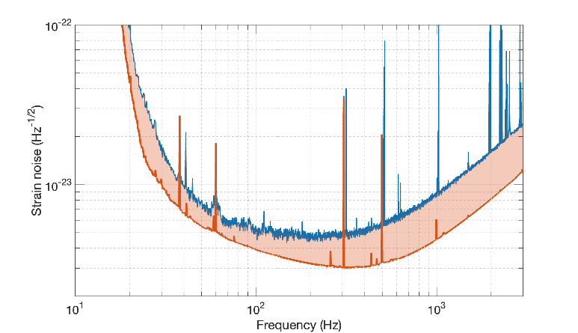
O4 Commissioning Goals
L1 O3 (130 Mpc)
Double O3 circulating power (~400 kW in arms)
Reduce technical noises
Achieve 4.5 dB of frequency -dependent squeezing
Addressed in later talk
Achieve 160+ Mpc of BNS inspiral range
Reduced radiation pressure & technical noise
Double laser power
More squeezing
Reduce technical noise (2x)
Optimistic O4 projection (190 Mpc)
Credit: P. Fritschel, G2300213

Slide 3
Pre-O4 Status

Slide 4
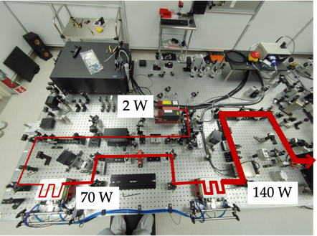
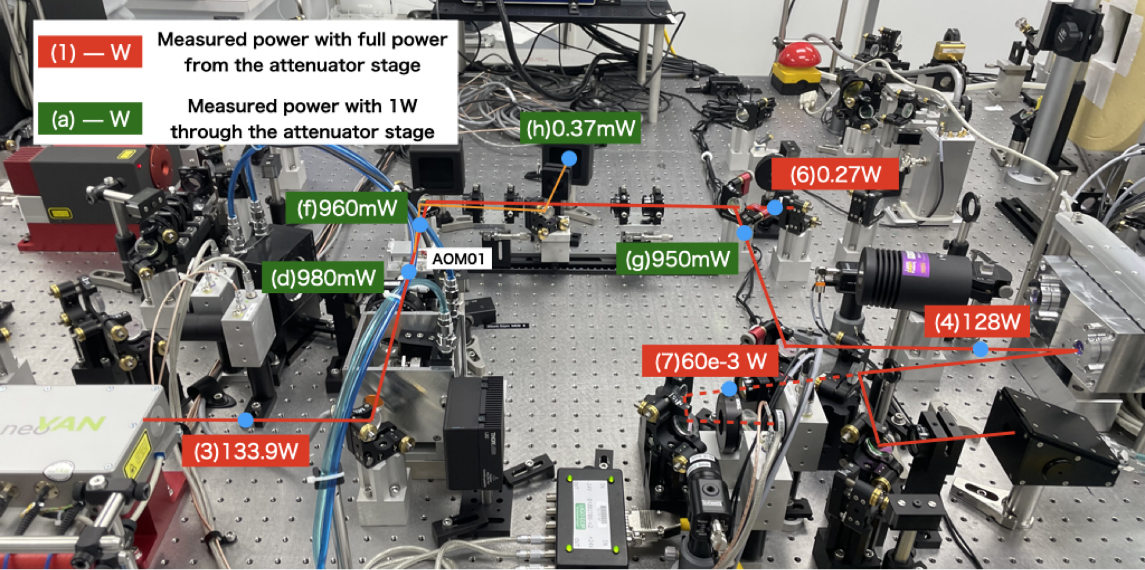
Pre-Stabilized Laser
2W NPRO seed laser, 2 neoVAN-4S-HP amplification stages
Serves 110W to vacuum
LHO
LLO
J. Driggers
M. Nakano

Slide 5
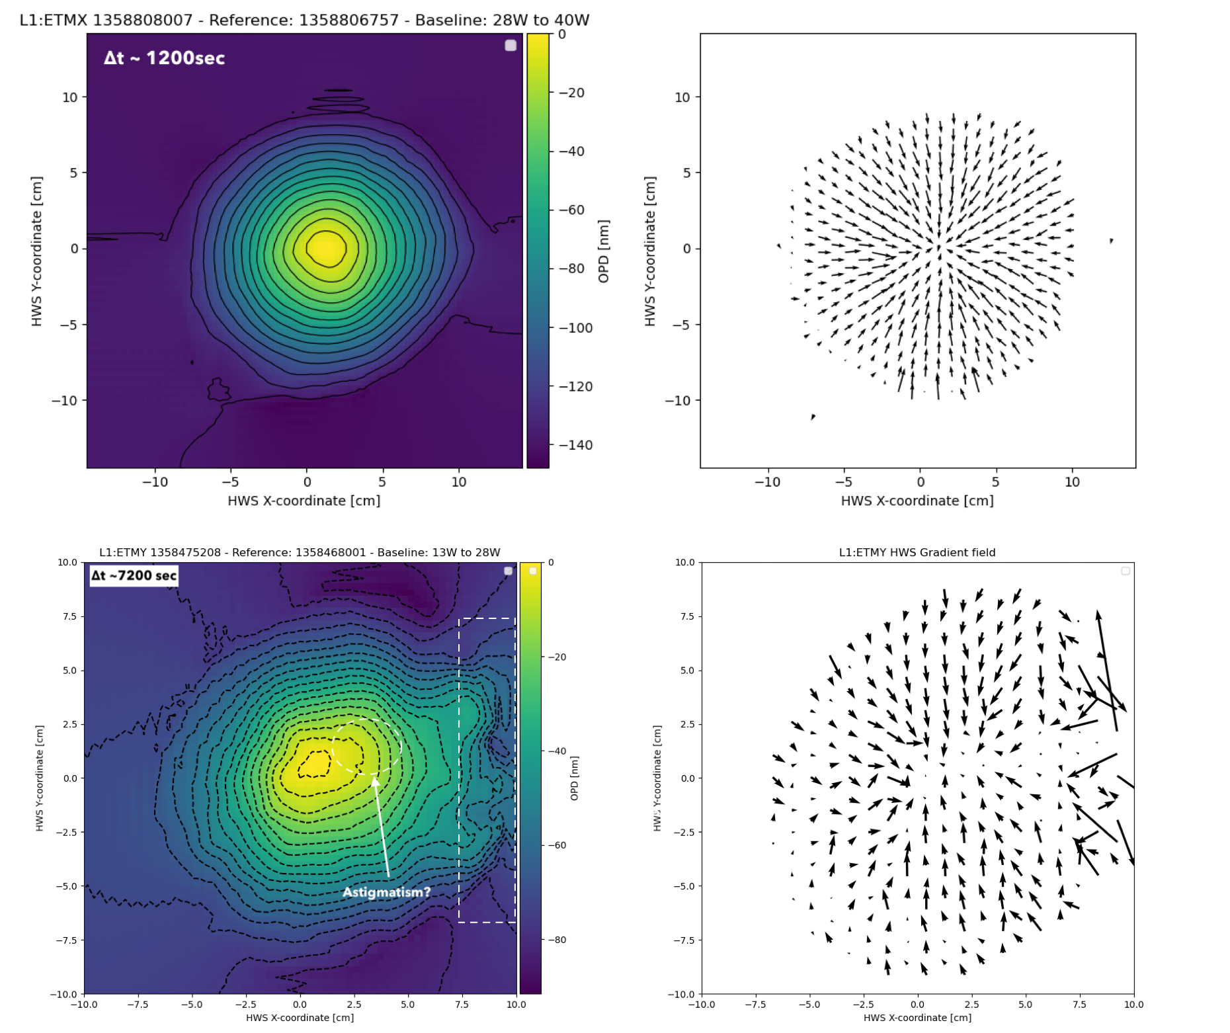
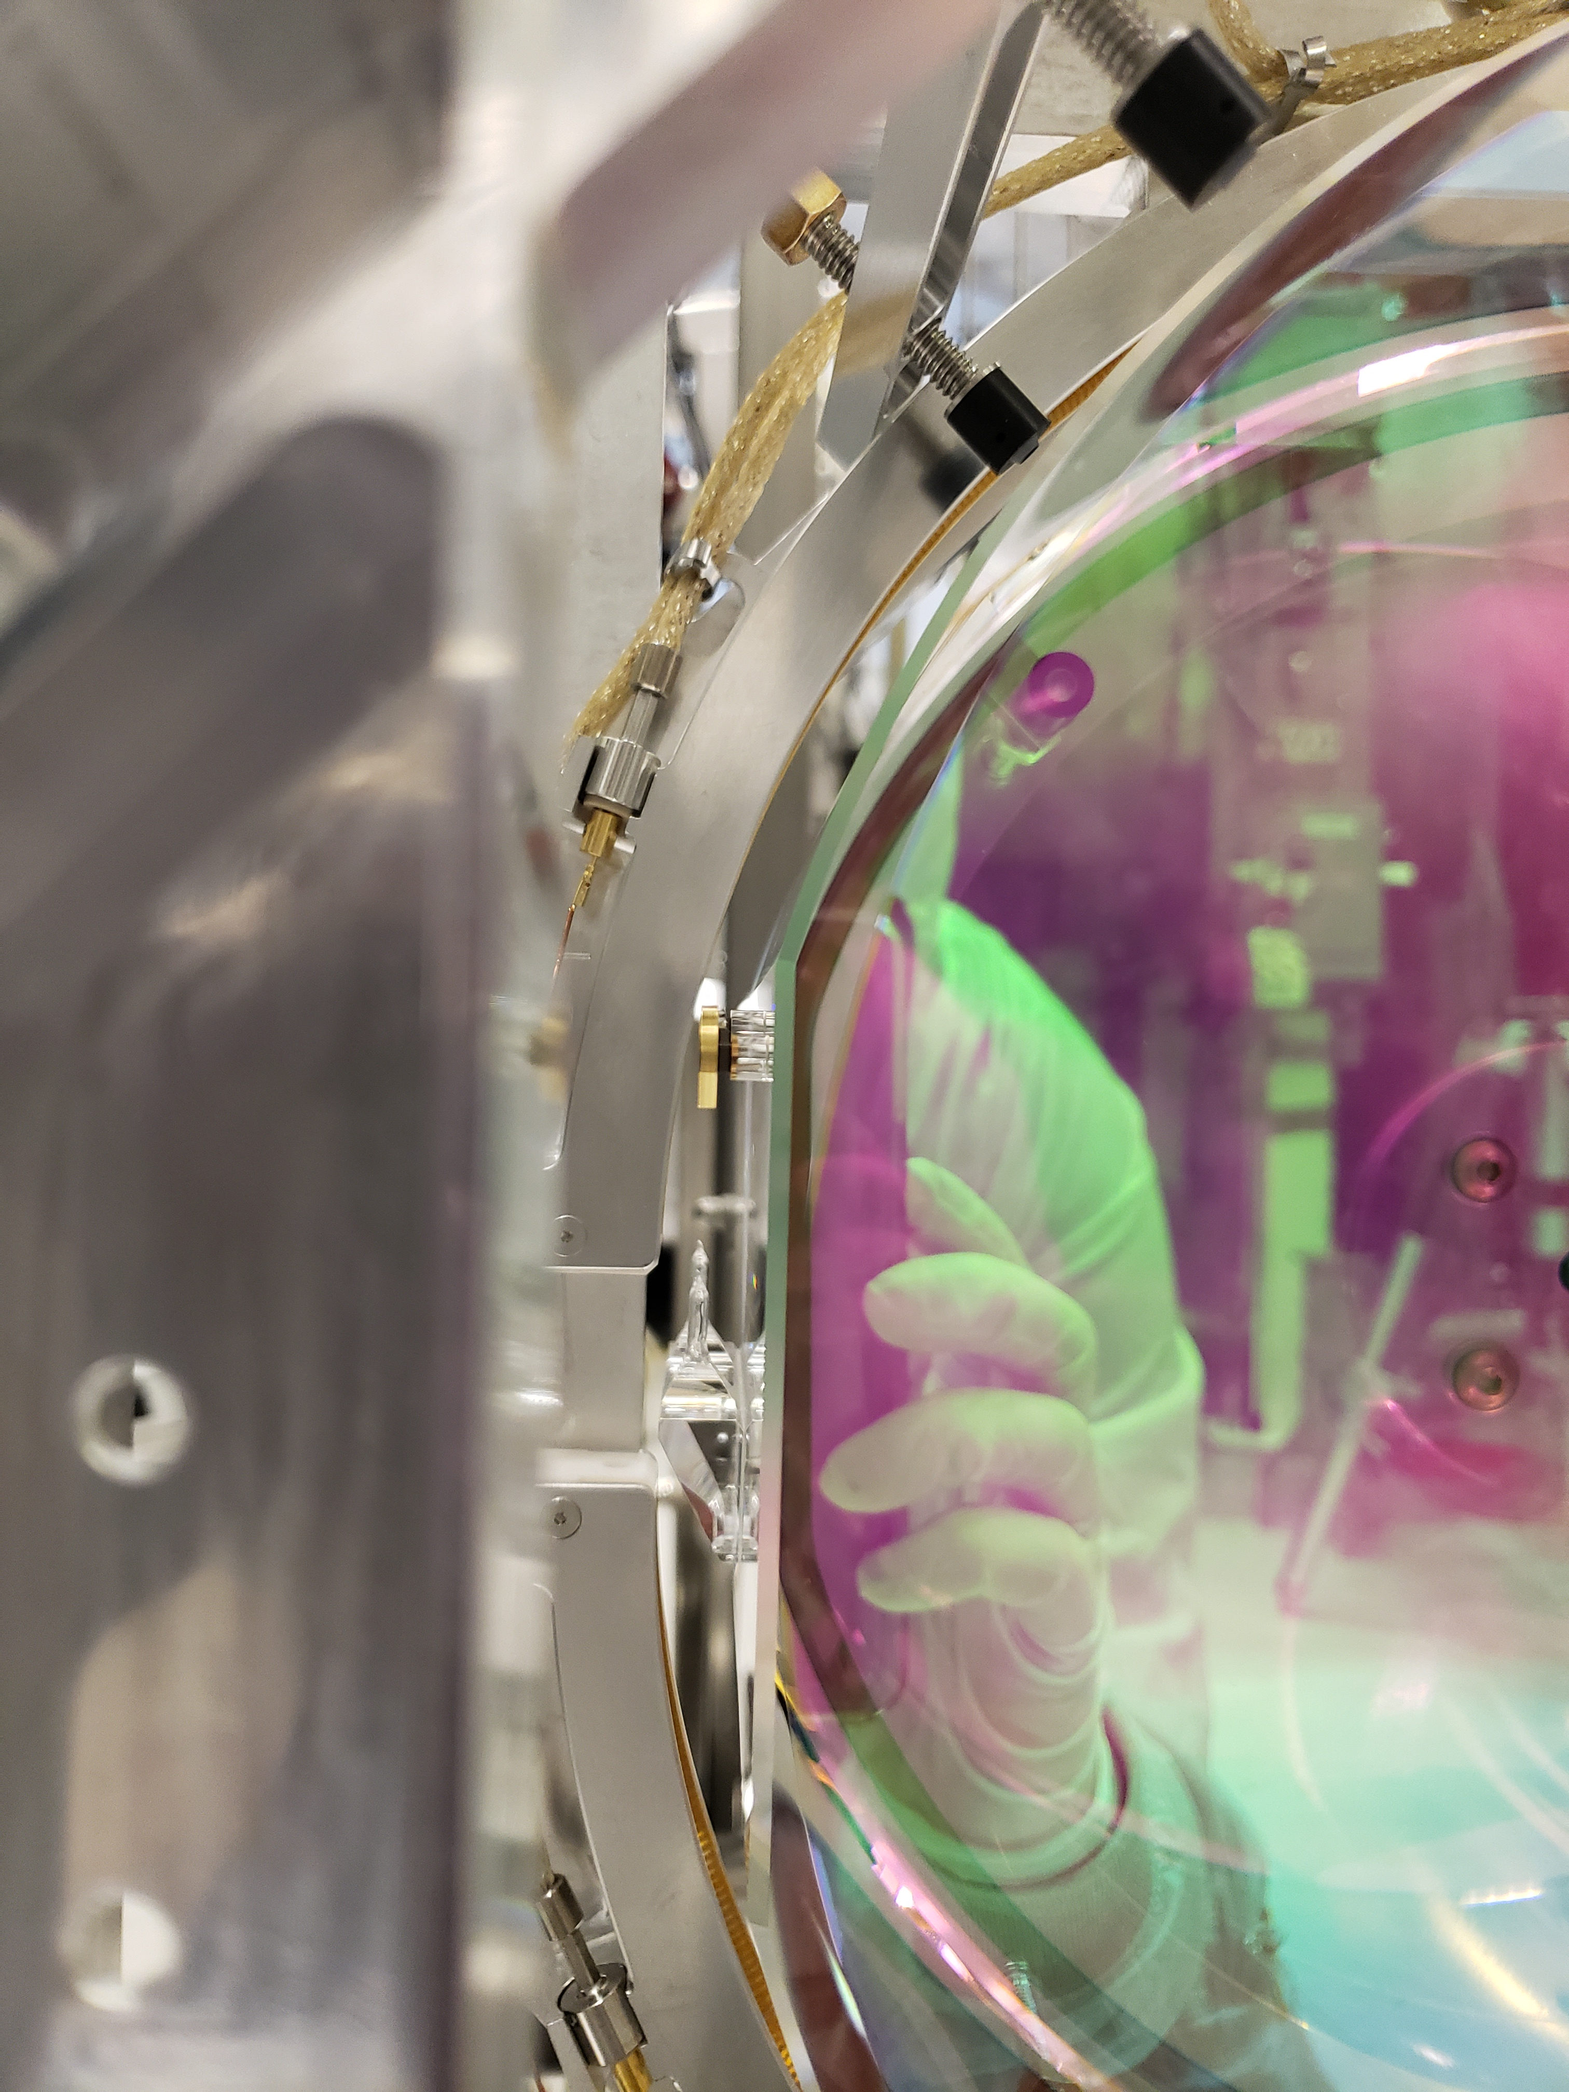
Test Mass Replacements
ITMY installation, LHO
Hartmann Wavefront Sensors, LLO
ITM replaced at LHO, ETMs replaced at LLO
Eliminates point absorbers limiting high power operation, reduces beam jitter coupling
Enabled new violin and acoustic mode damper installation
ETMX
ETMY
B. Weaver
M. Nakano

Slide 6
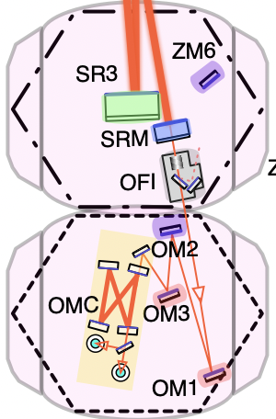
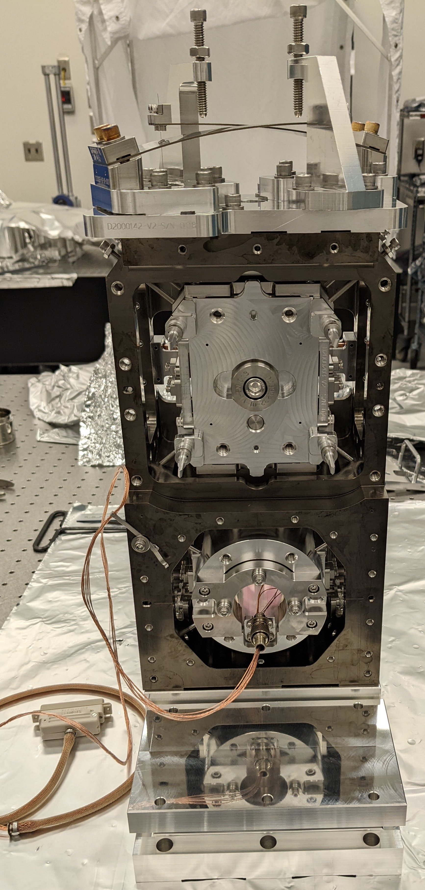
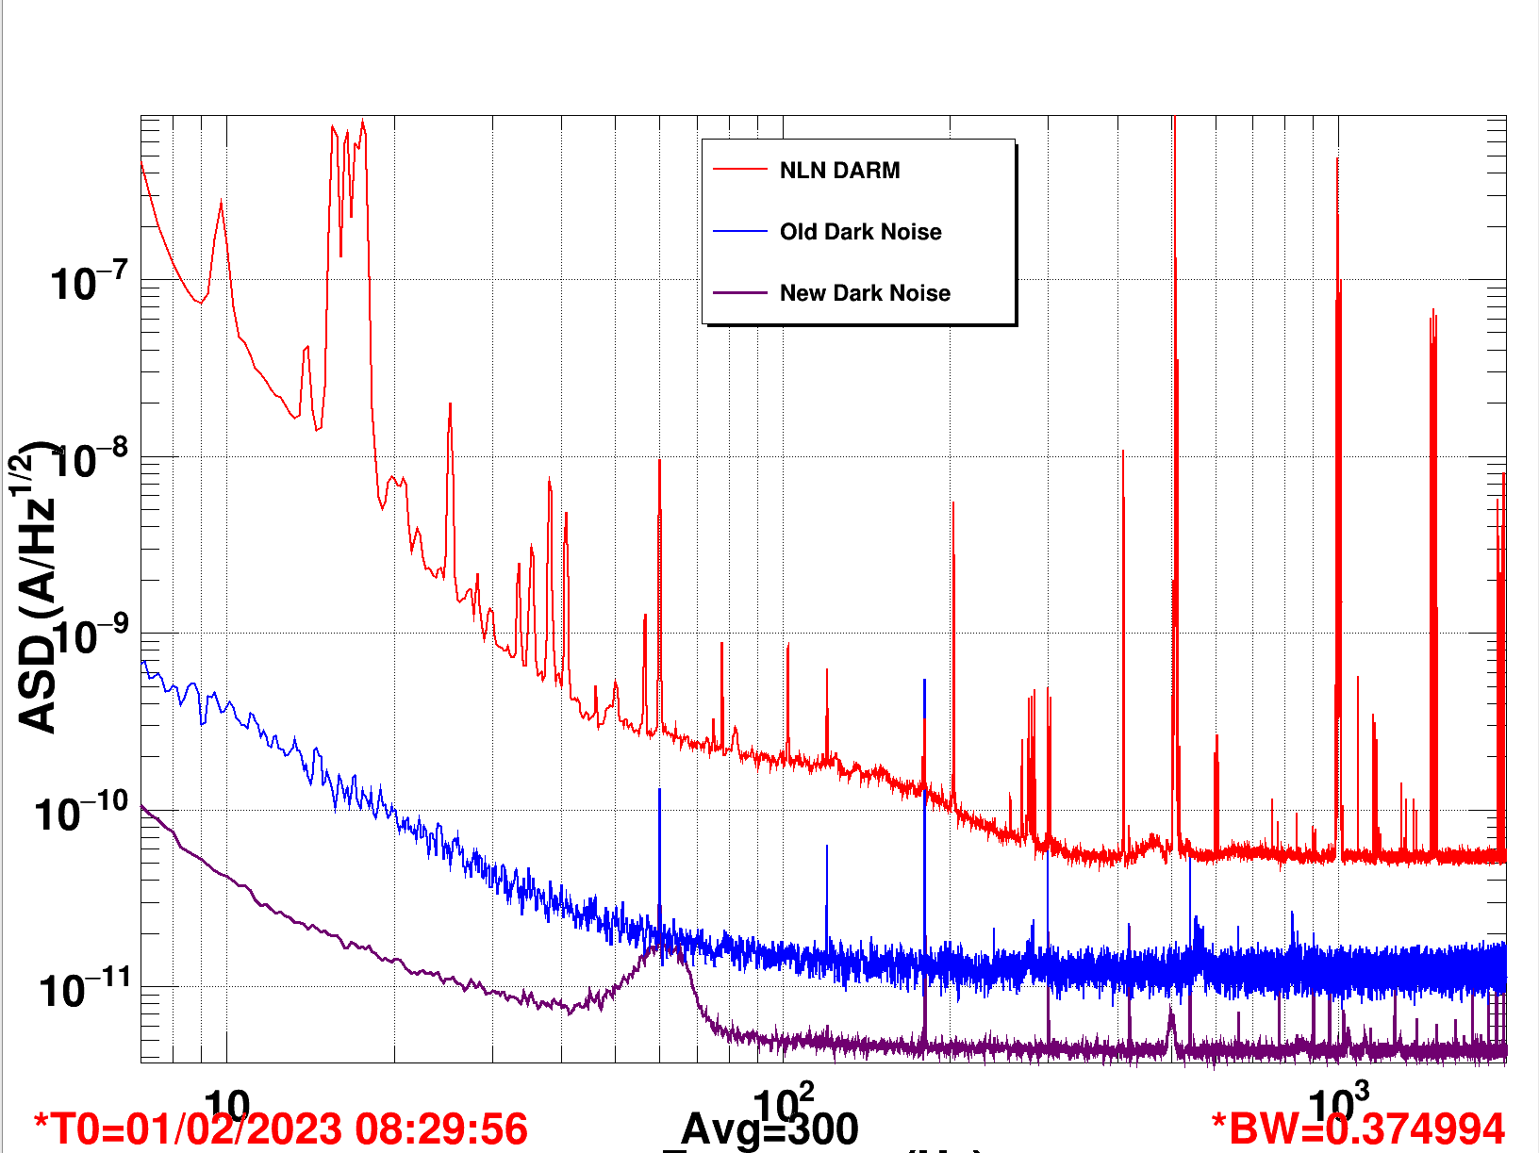
Output Port Upgrades
New low loss faraday isolator (both sites)
Thermal radius of curvature actuator on Output Mirror 2
Allows improvement of IFO to OMC mode matching
New lower loss OMC (LLO)
Low noise DARM
Old Dark Noise
New Dark Noise
New electronics for Output Mode Cleaner photodetectors
New transimpedance amplifier
New whitening filter
lower noise, higher range ADC
Improved electrical isolation
10
100
1000
Frequency [Hz]

Slide 7
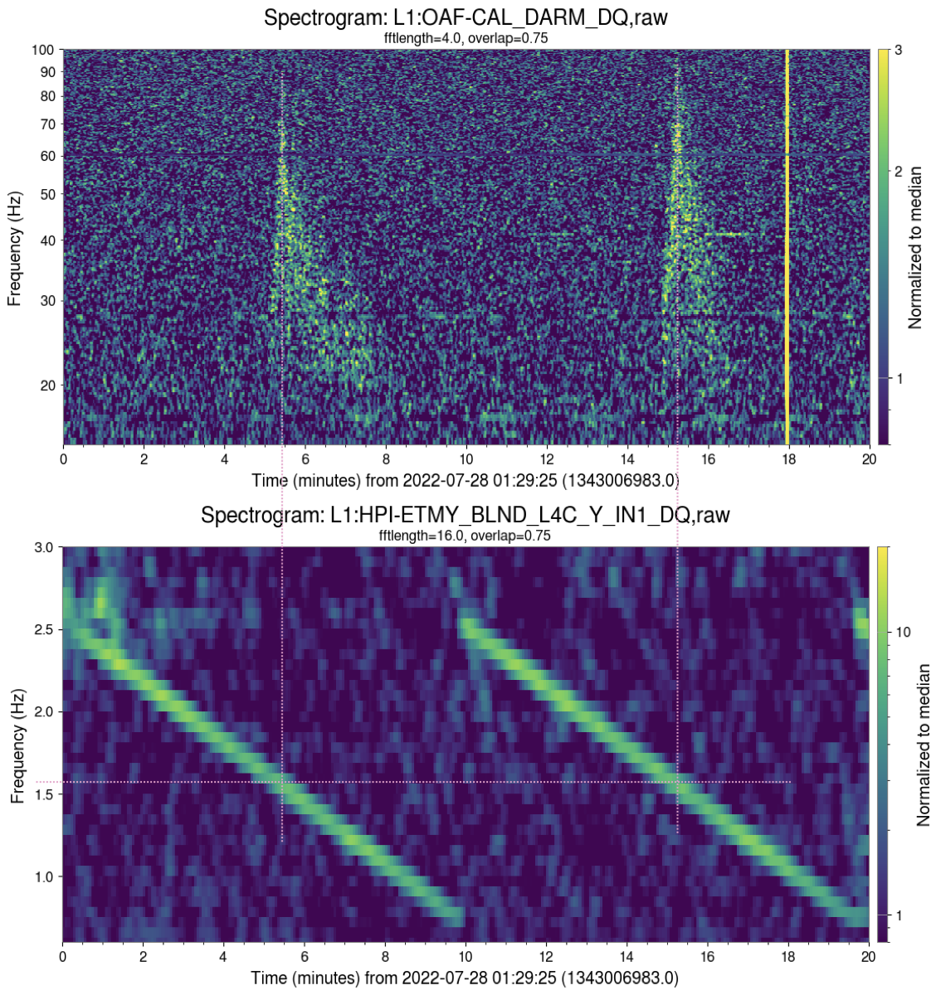
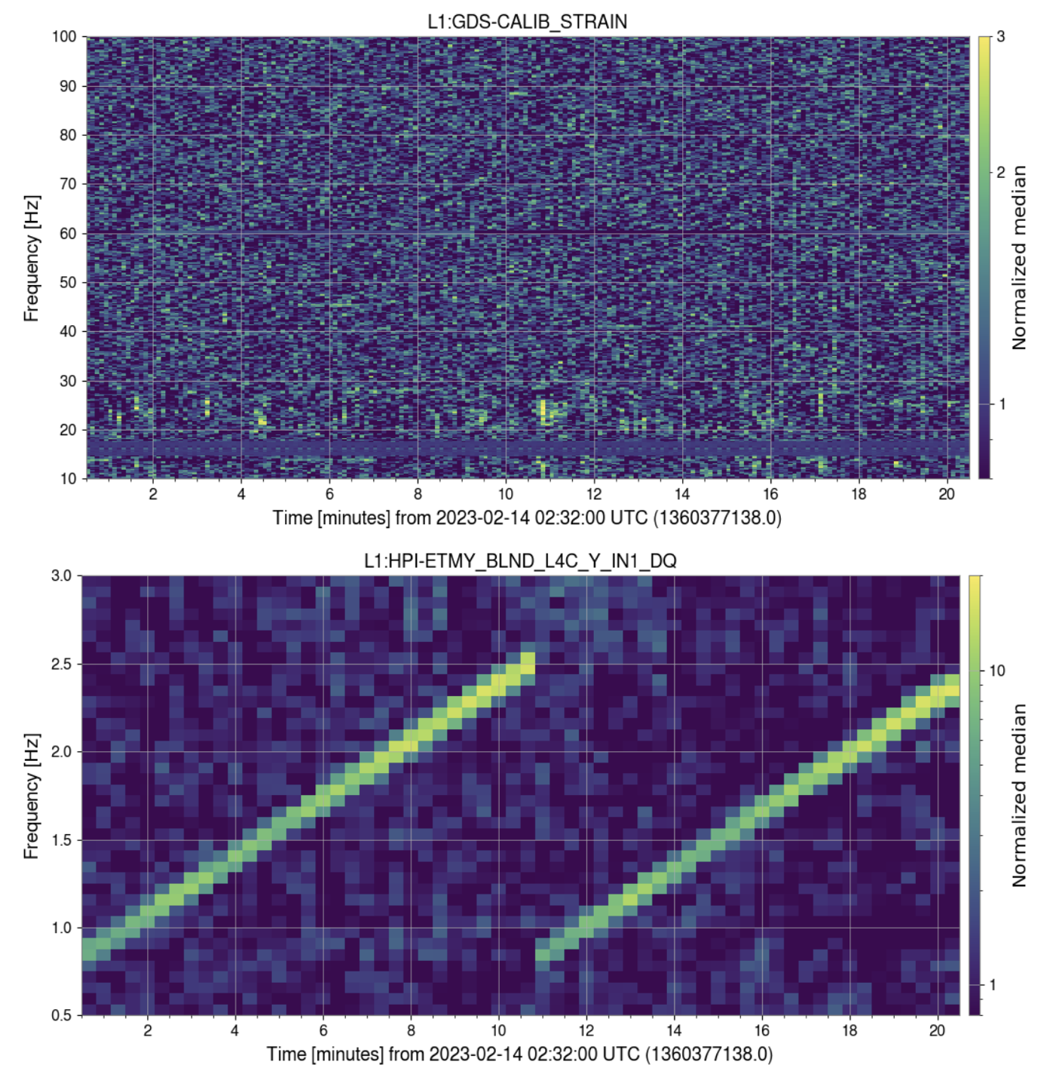
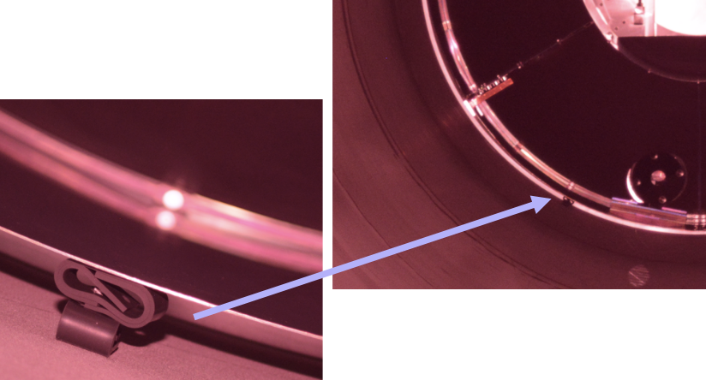
Scatter Mitigation
Before/After Arm Cavity Baffle Damping, LLO
Removal of window between HAM5 and HAM6 at output port
DARM (LHO)
S. Soni, LLO
RED: Pre-O4, septum window present
BLUE: after removal of window
Damping the high-Q suspended baffles to reduce their velocity
10
100
Frequency [Hz]

Slide 8
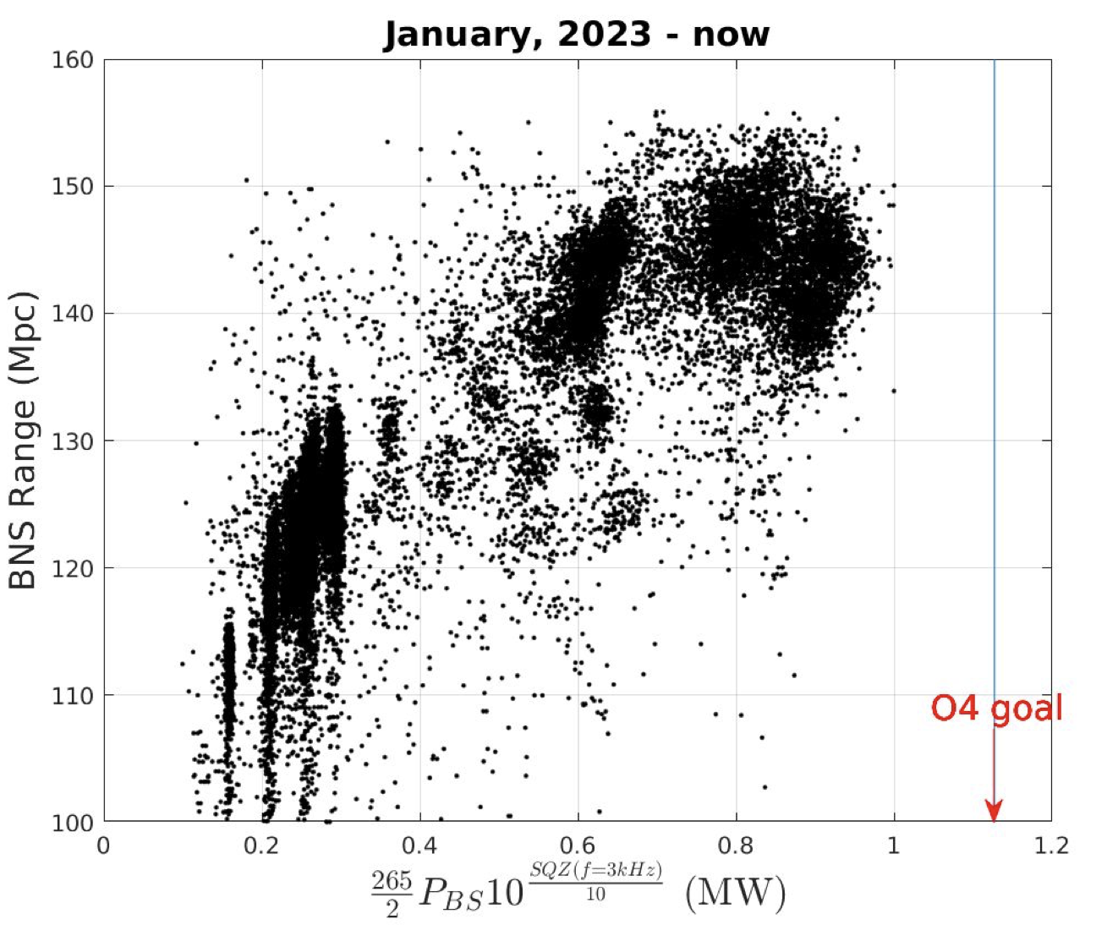
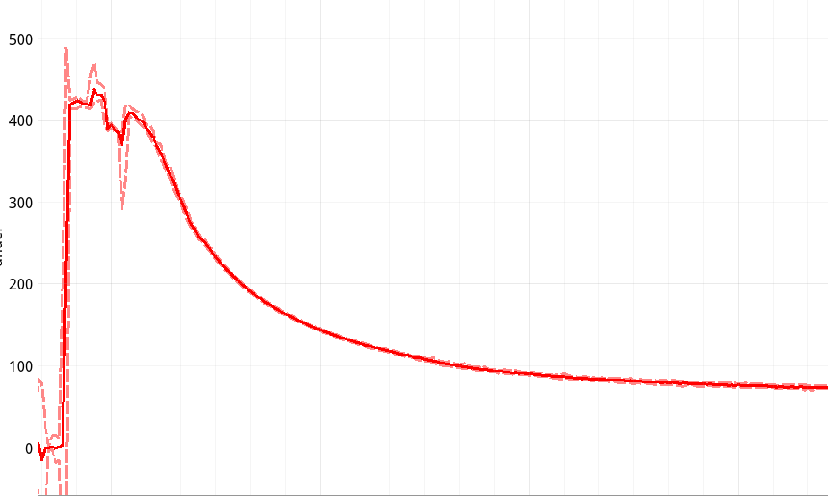
High Power Operation
 | LHO | LLO
Input Power (W) | 76 | 63.6
Power Recycling Gain | 45.6 | 37.8
Arm Power (kW) | 430 | 325
New challenge: IFO thermalization
PRCL optical gain [au]
Sideband gain, cavity detuning, noise couplings, arm power evolve for over 6 hours of initial lock stretch
3600
7200
10800
14400
Time [sec]
Effective Arm Power (MW)
V. Frolov

Slide 9
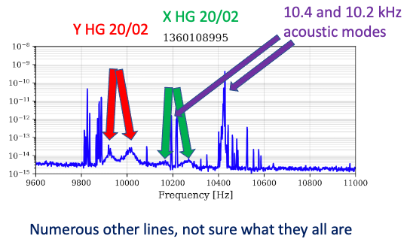
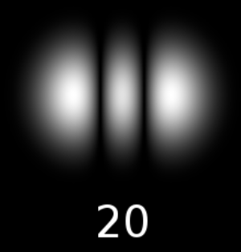
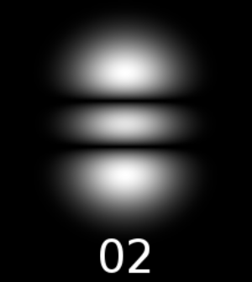
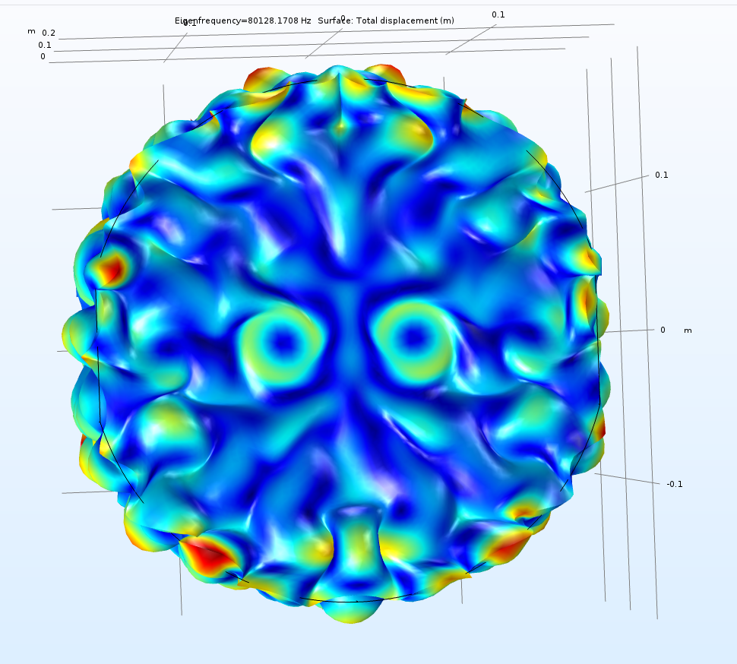
High Power/Mode Matching Challenge: Parametric Instabilities
(Not covered by acoustic mode damping)
D. Brown
Source: Wikipedia, Gaussian beam
High power operation limited by arm cavity HOM interaction with acoustic modes
COMSOL simulation of 80 kHz PI
A. Brooks

Slide 10
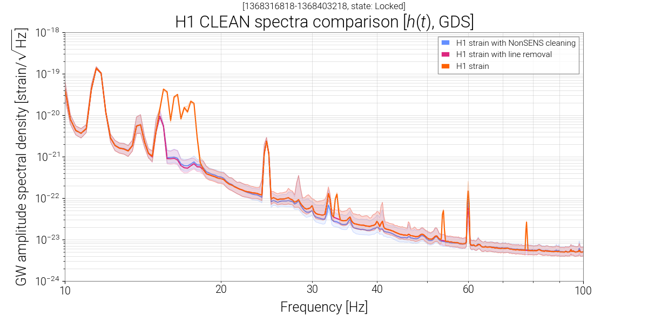
Online Noise Subtraction
Apply NonSENS algorithm online for noise subtraction
Can subtract:
calibration line sidebands
length and angular sensing and controls noise
jitter noise
frequency noise
Calibration lines subtracted separately
Pictured: subtraction of calibration lines, jitter noise, length sensing and control

Slide 11
Limiting Noises: LLO
Improvements:
Angular controls noise
Quantum noise
Length sensing and control (MICH+SRCL)
Current challenges:
(assumed) Excess coating Brownian noise
Unknown noise, 10-30 Hz

Slide 12
Limiting Noises: LHO
Improvements:
Angular controls noise
Laser frequency noise (1-5 kHz)
Quantum noise
Challenges:
Beam jitter noise (100-1000 Hz)
Laser frequency noise (20-40 Hz)
Length sensing and controls noise
Unknown noise, 20-100 Hz

Slide 13
Thank you! Questions?

Slide 14
Extra Slides

Slide 15
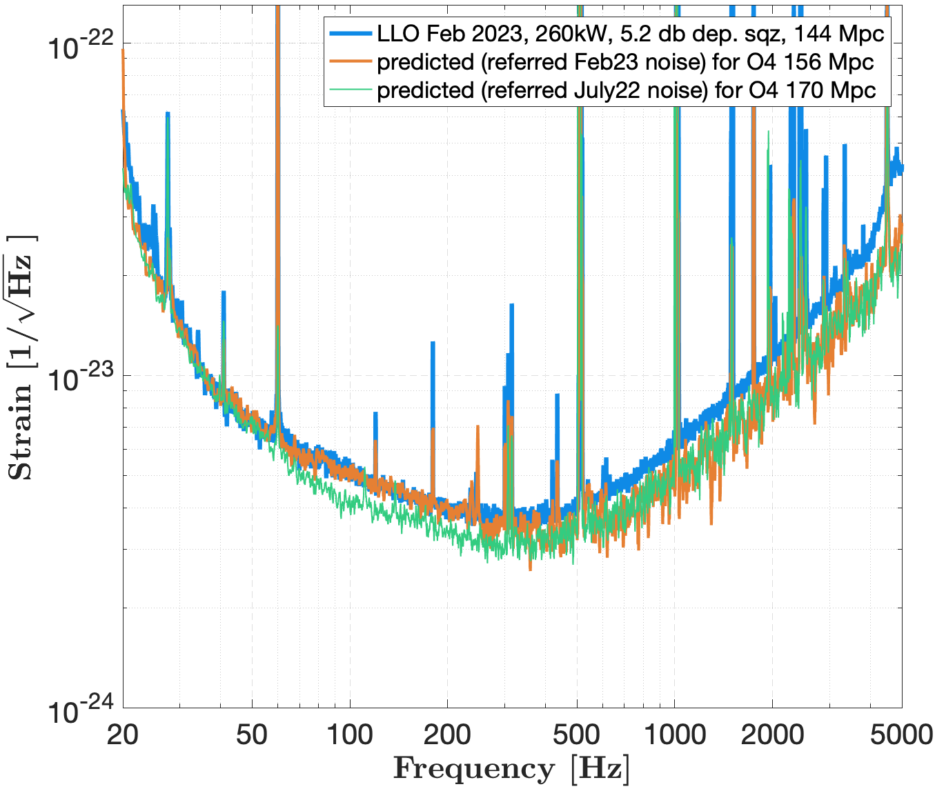
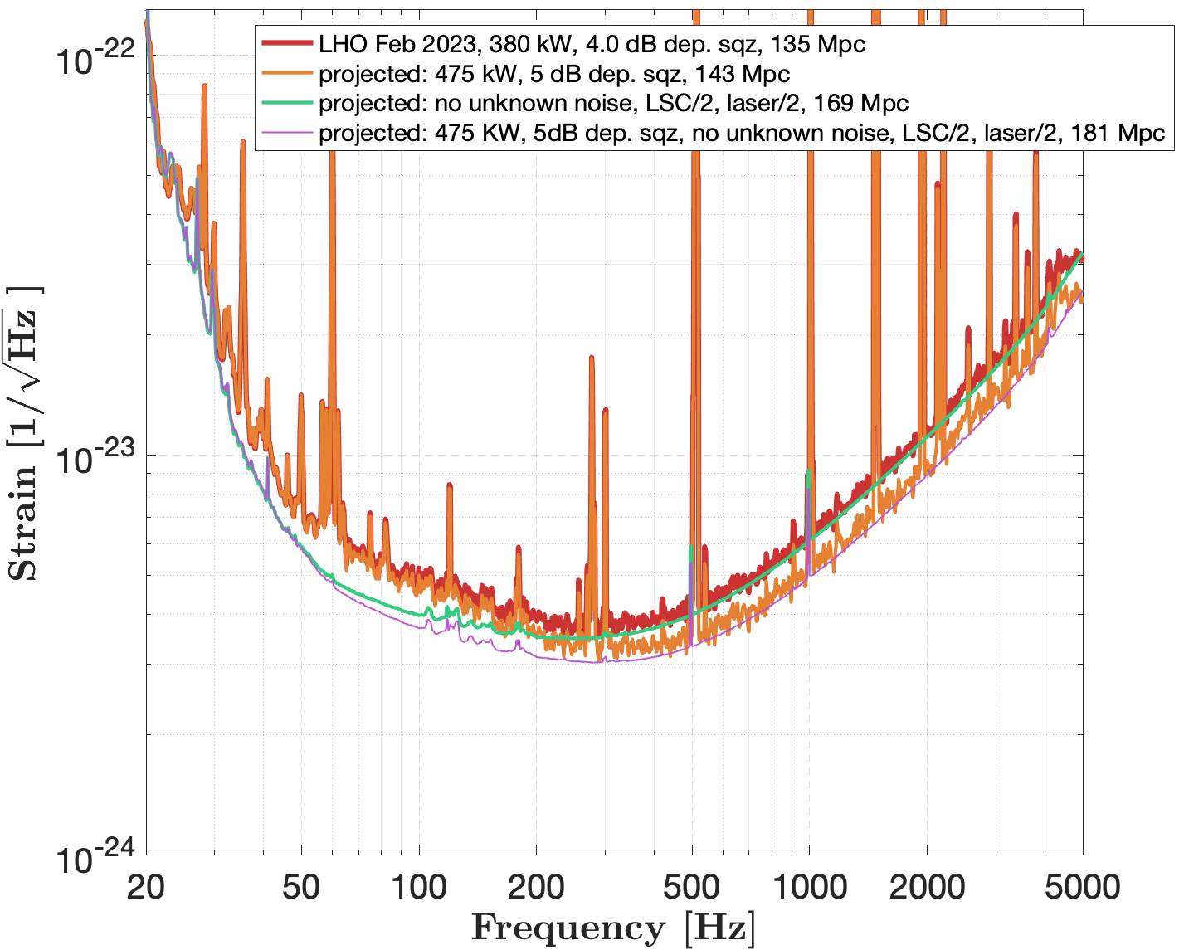
Projections

