Slide 1
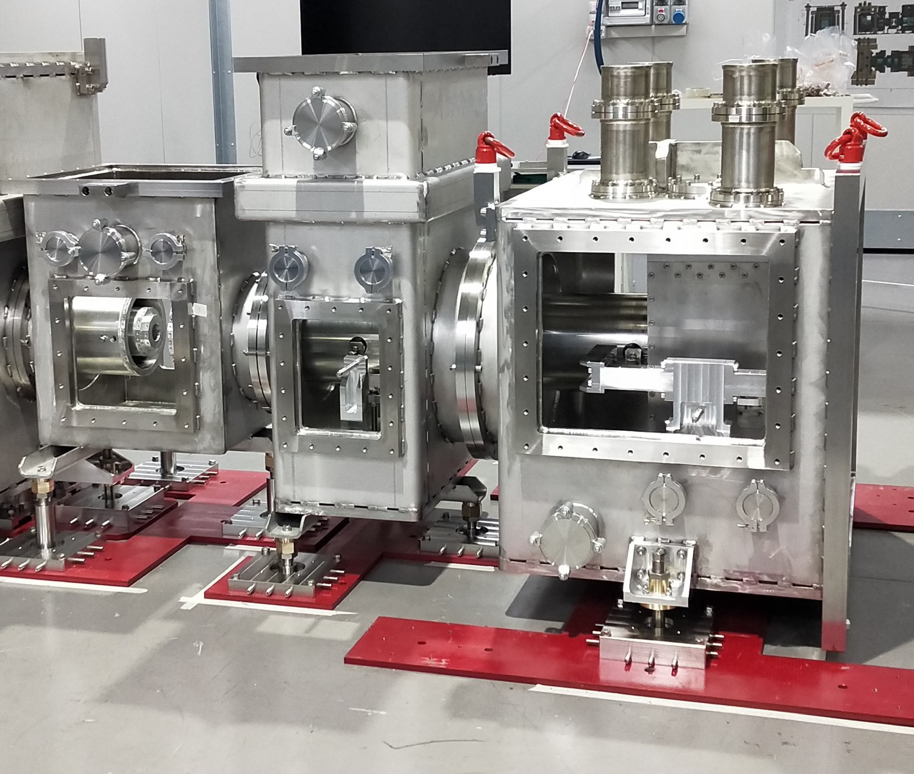




Prototyping cryogenics development for ET at the Amaldi Research Center
Valentina Mangano and Marco Ricci
on behalf of the ETIC group at
INFN-RM1 and Sapienza University Dep. of Physics
GWADW Elba 2023 – Infrastructures - Cryogenics – Isola d’Elba 21-27 May 2023

Slide 2
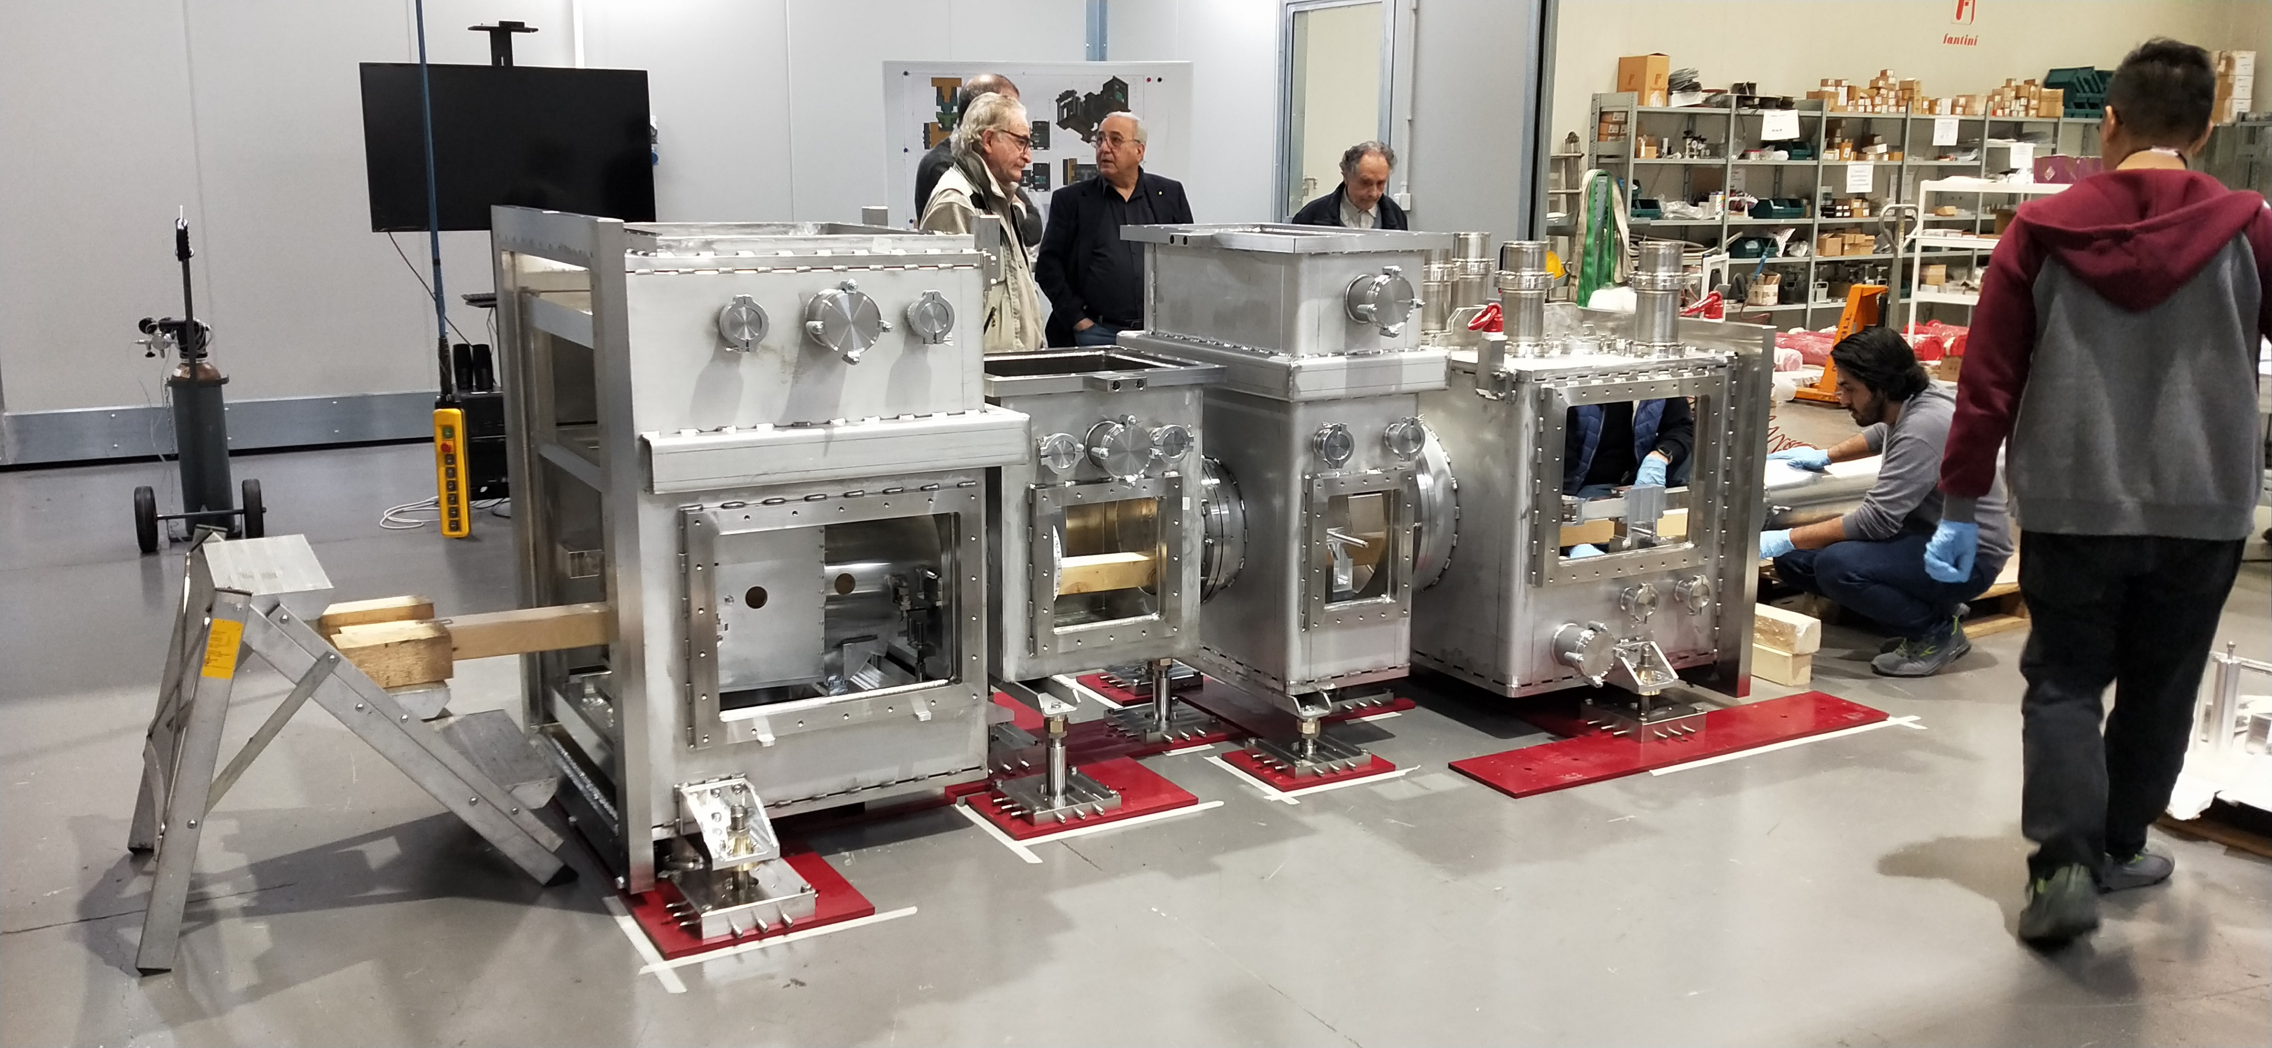
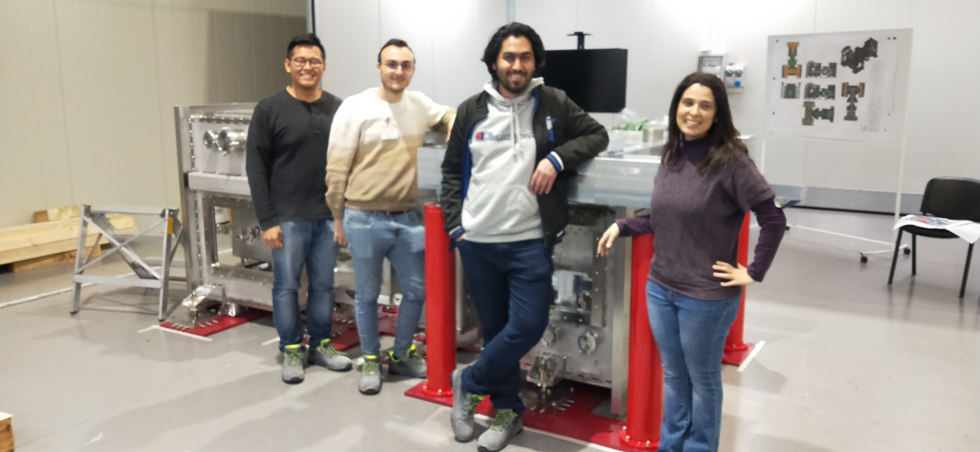
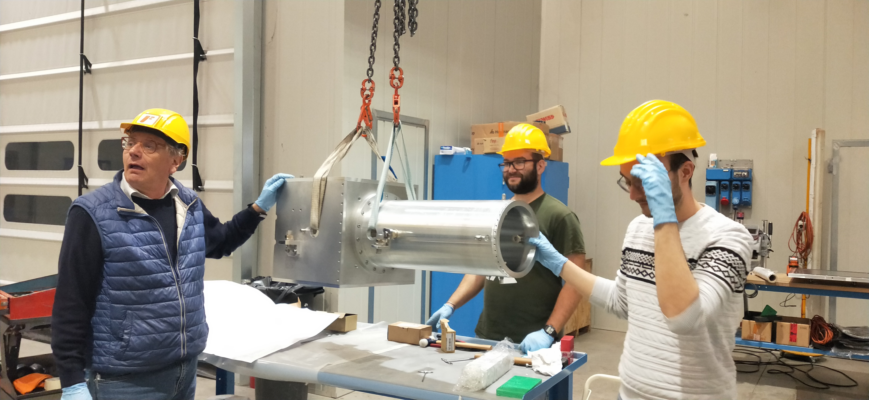
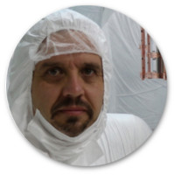
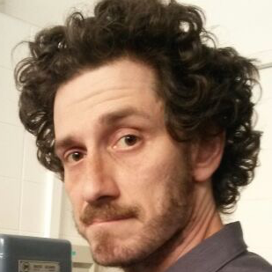
ETIC group at INFN-RM1 and Sapienza University Dep. of Physics
F. Bronzini⁴, A. Cruciani², V. L. Hoang^{1,2}, E. Majorana^{1,2}, V. Mangano^{1,2}, A. Marra⁴, L. Naticchioni², D. Pasciuto², M. Perciballi², S. Pirro³, P. Puppo², P. Rapagnani^{1,2}, A. Rezaei^{1,2}, F. Ricci^{1,2}, M. Ricci^{1,2}
1. Department of Physics, University of Rome Sapienza, Italy 2. INFN Sezione di Roma, Italy 3. INFN Laboratori Nazionali del Gran Sasso, Italy 4. Tecni.Com.Srl, Italy

Slide 3
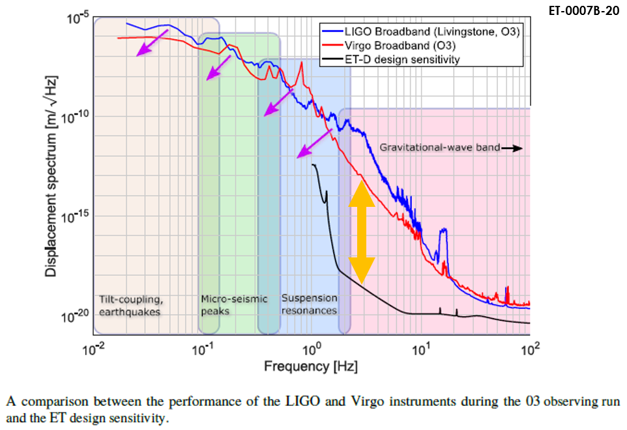
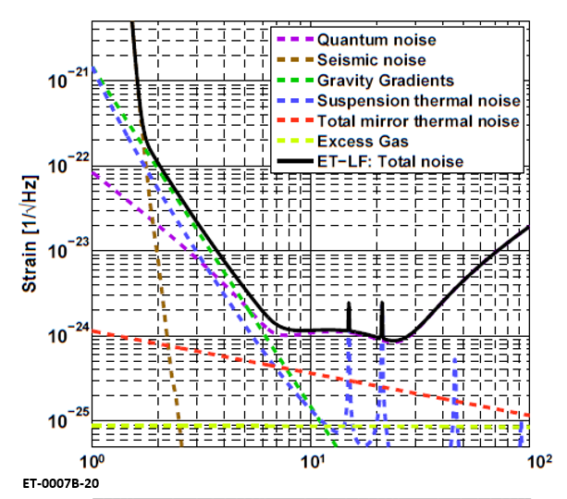
Einstein Telescope (ET) will be the European
Third-Generation Gravitational Wave Observatory,
designed to be sensitive especially at low frequencies (ET-LF).
The facility would be 200-300 meters underground
to minimise the influence of residual seismic and environmental noise,
and cooled to cryogenic temperature to suppress thermal noise.
Both measures improve the sensitivity at low frequencies,
at least 10 times better than that of current detectors,
extending the reach below 10 Hz.
ET is million times better at 3Hz than 2G detectors
Some strategies to reduce the thermal noise impact:
development of innovative technologies associated to cryogenics;
revision of mechanical design for test mass suspension;
cooling of main optics and their suspensions down to 10-20 K;
choice of materials with large thermal conductivity and low
mechanical dissipation below 20 K (sapphire and silicon).

Slide 4
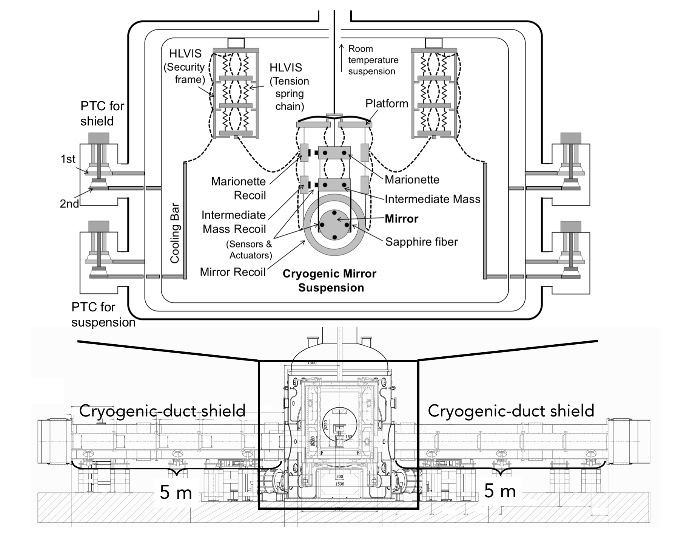

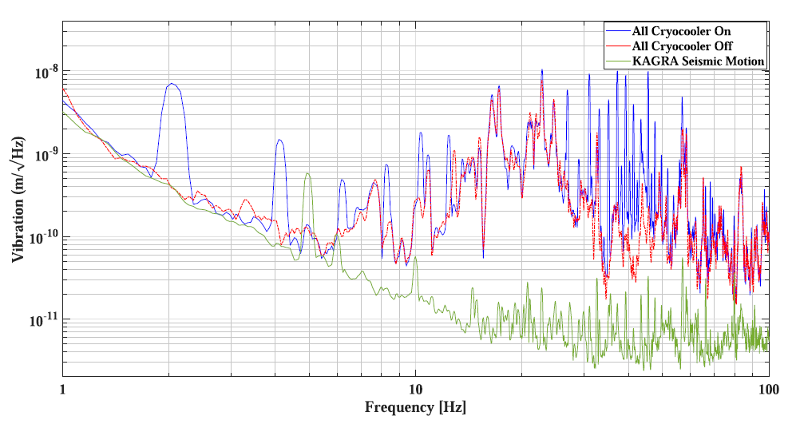
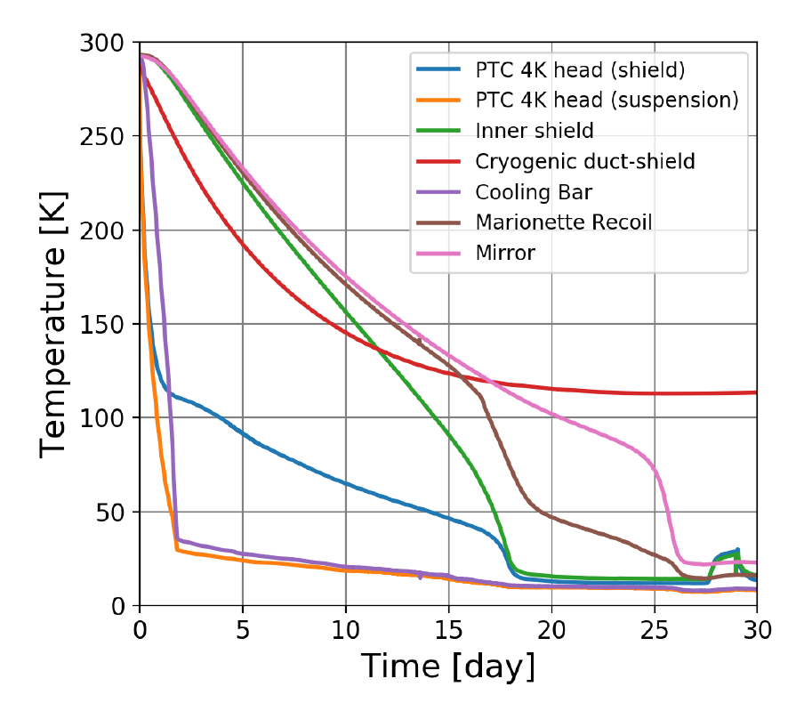
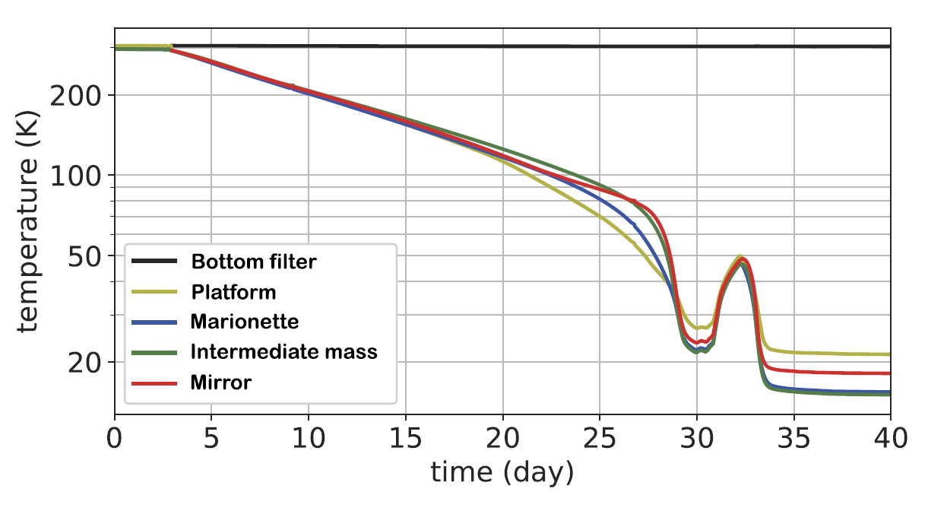
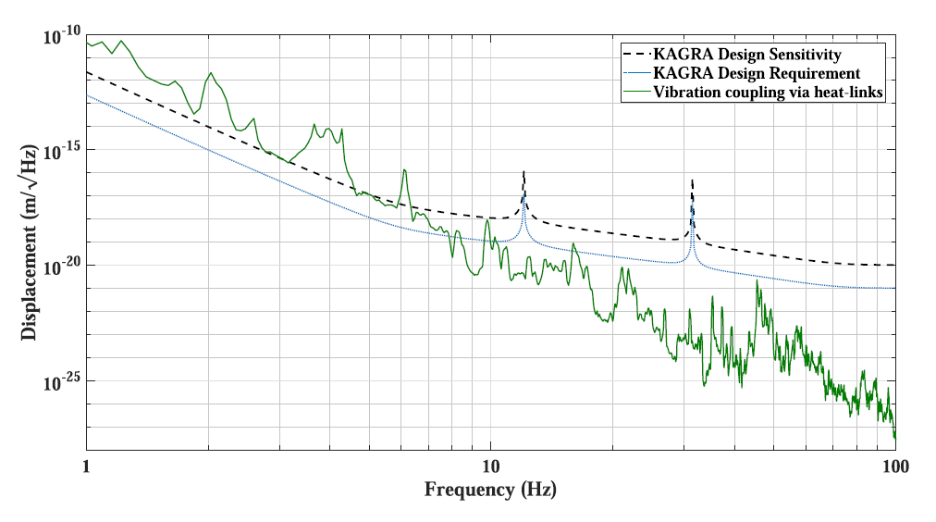
https://iopscience.iop.org/article/10.1088/1742-6596/1857/1/012002
Lowering the temperature of the test masses without injecting vibration noise from the refrigeration system is a technological challenge.
Therefore, it is extremely important to not only ensure an efficient thermal connection between payload and refrigeration system, but also preserve the mechanical isolation.
The refrigeration system planned for ET-LF is based on
pulse-tube technology
and thermal conduction:
cryocoolers are connected via a heat path to the cryogenic payload
(like KAGRA).
https://iopscience.iop.org/article/10.1088/1361-6382/ac7cb5
Radiation shield vibration spectra at 12 K
Cooling curve
during bKAGRA
phase 1
Nominal cooling curves
Radiation shield vibration coupling to test mass
https://iopscience.iop.org/article/10.1088/1742-6596/1857/1/012002
https://iopscience.iop.org/article/10.1088/1361-6382/abe9f3

Slide 5
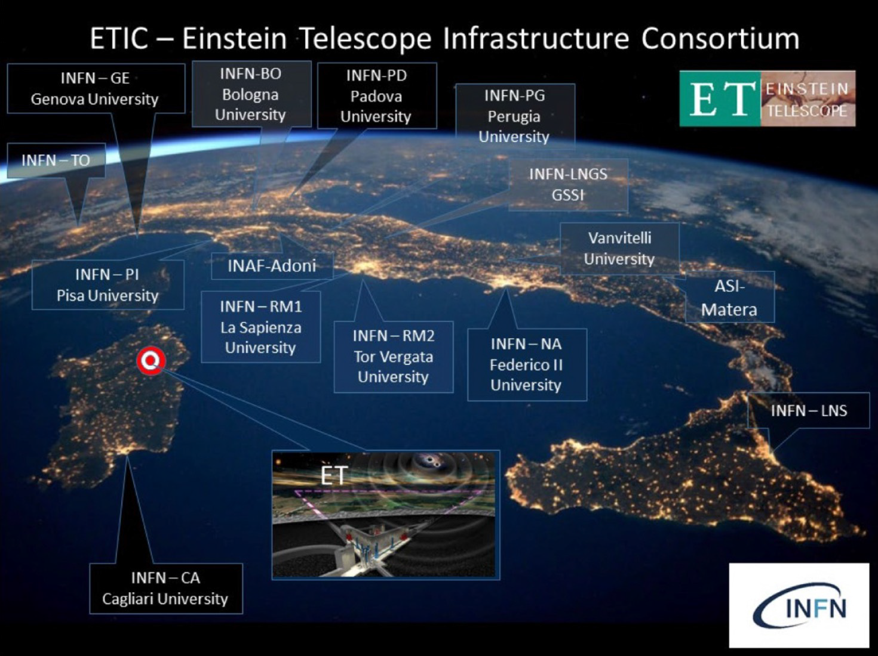
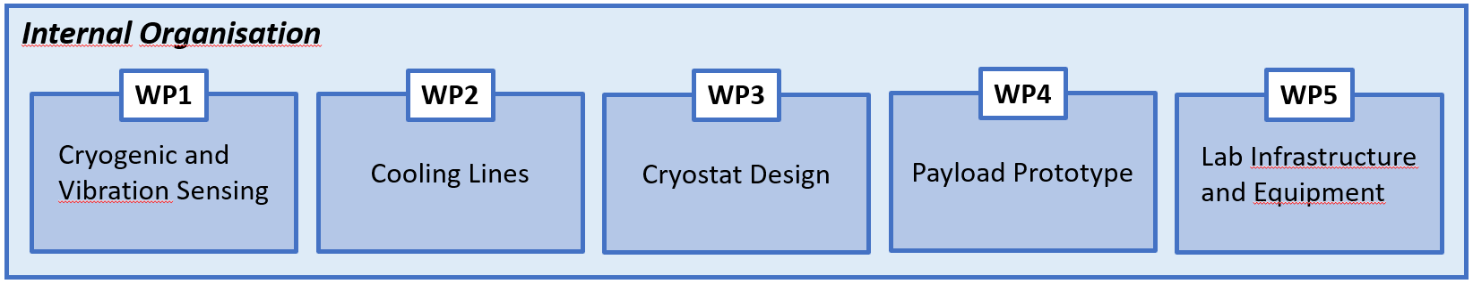
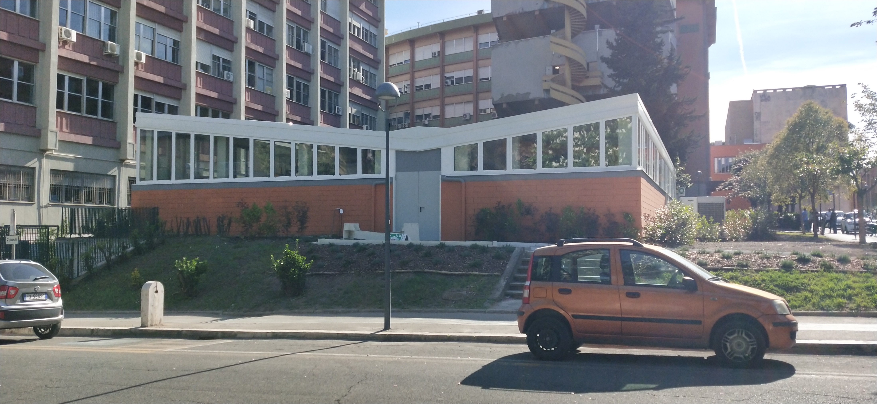
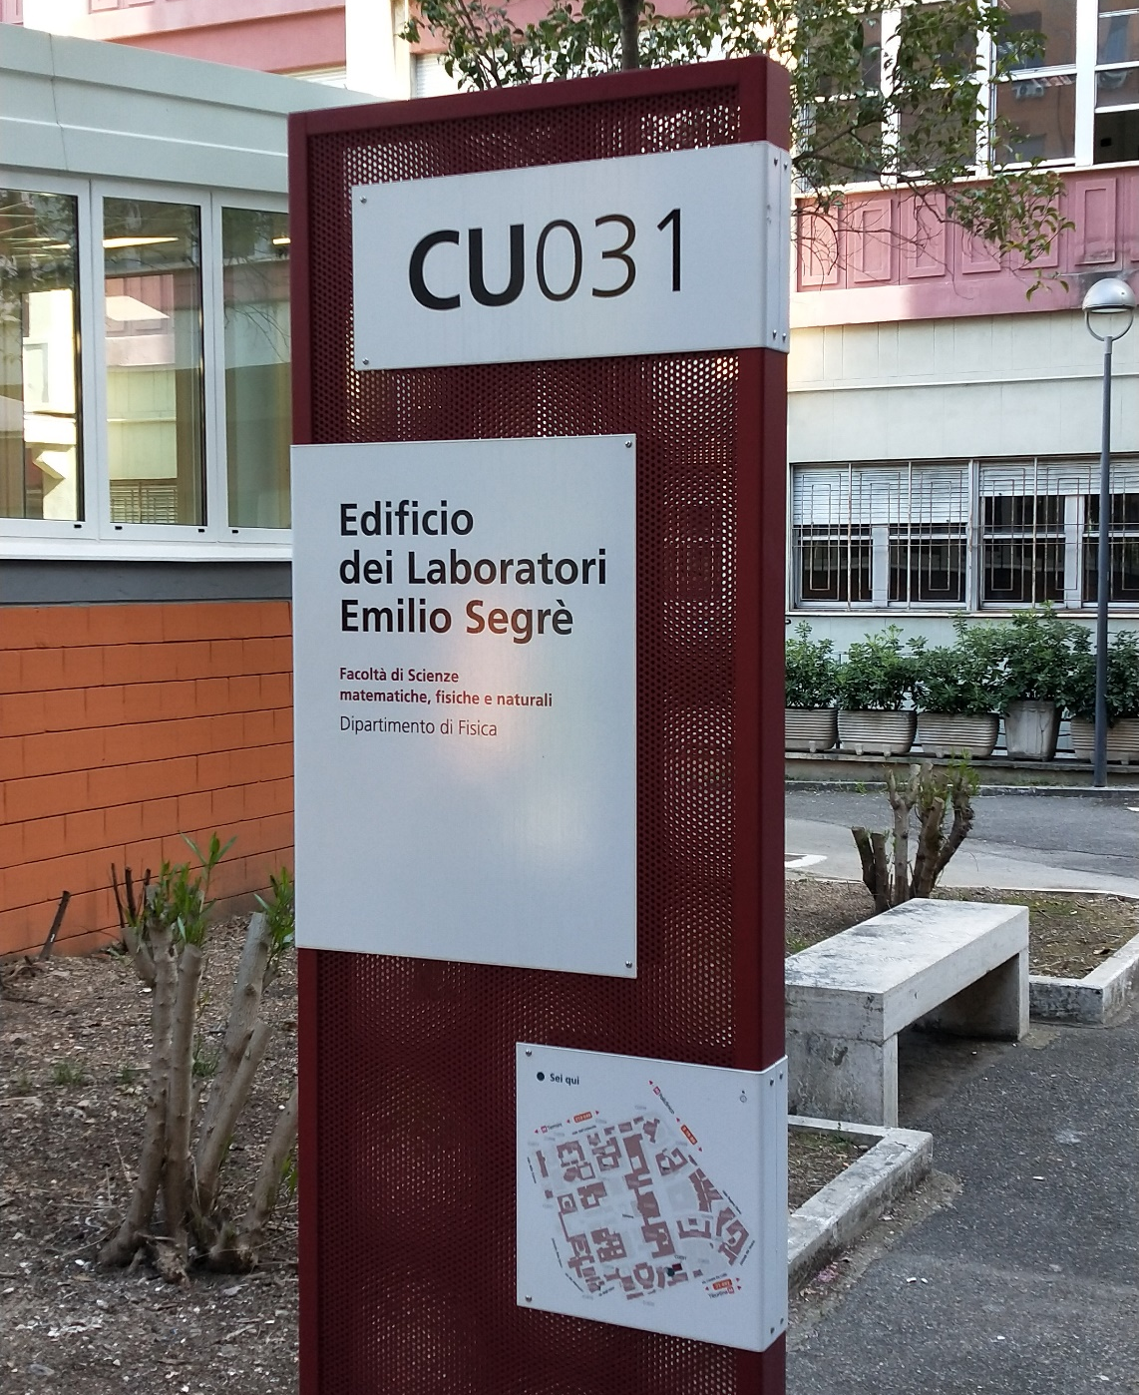
  With a total investment of 50 million euros (PNRR, 19-12-2022), ETIC will be responsible for:
  the feasibility and characterisation studies of the disused mine of Sos Enattos
  in Sardinia, one of the European candidate sites for hosting ET;
  and the creation of a network of research laboratories and dedicated facilities
  for the development of the technologies needed for achieving the sensitivity
  envisioned by ET.
  INFN-RM1 and Sapienza are involved in the project
  and the R&D will be focused on Cryogenics and Payload.
  Amaldi Research Center (ARC) at Sapienza in Rome will host and test
  the first prototype of ET-LF refrigeration system.
  This system is funded by both ETIC and ARC and may be implemented in ET-LF.

Slide 6
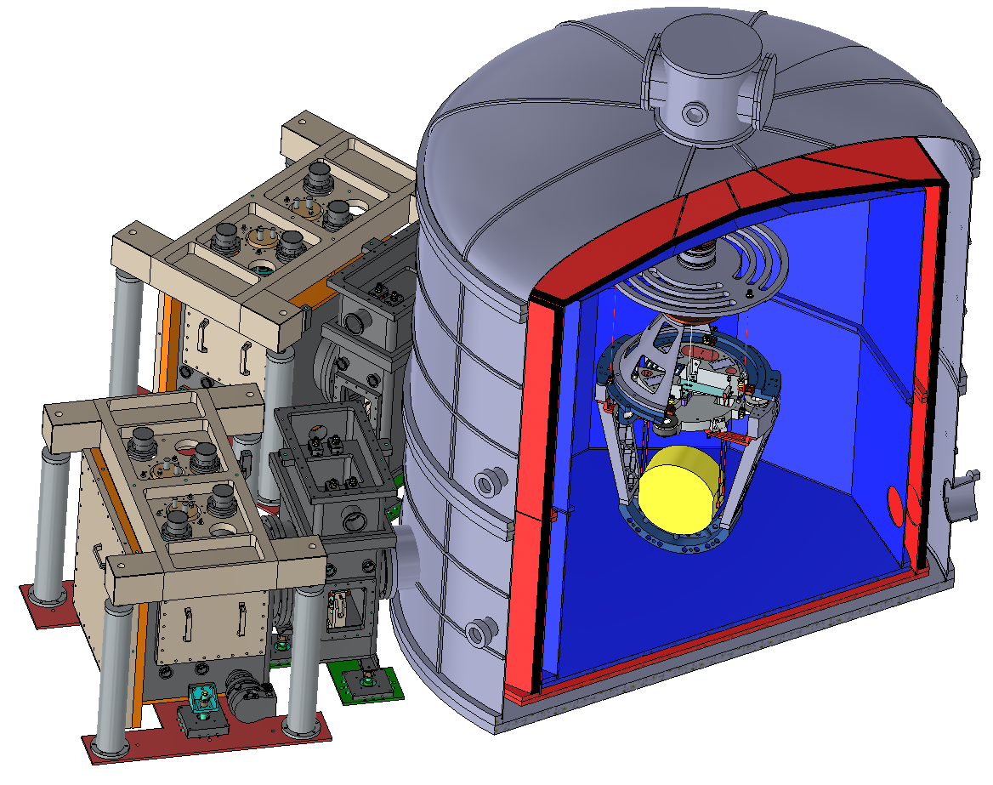
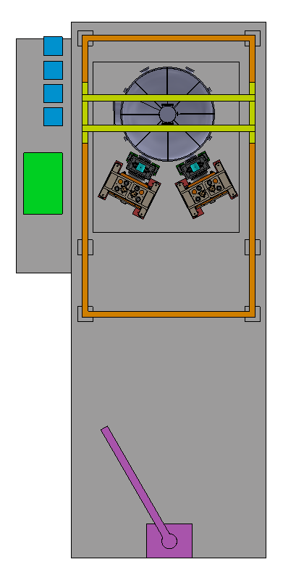
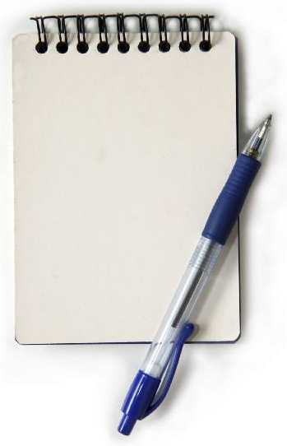
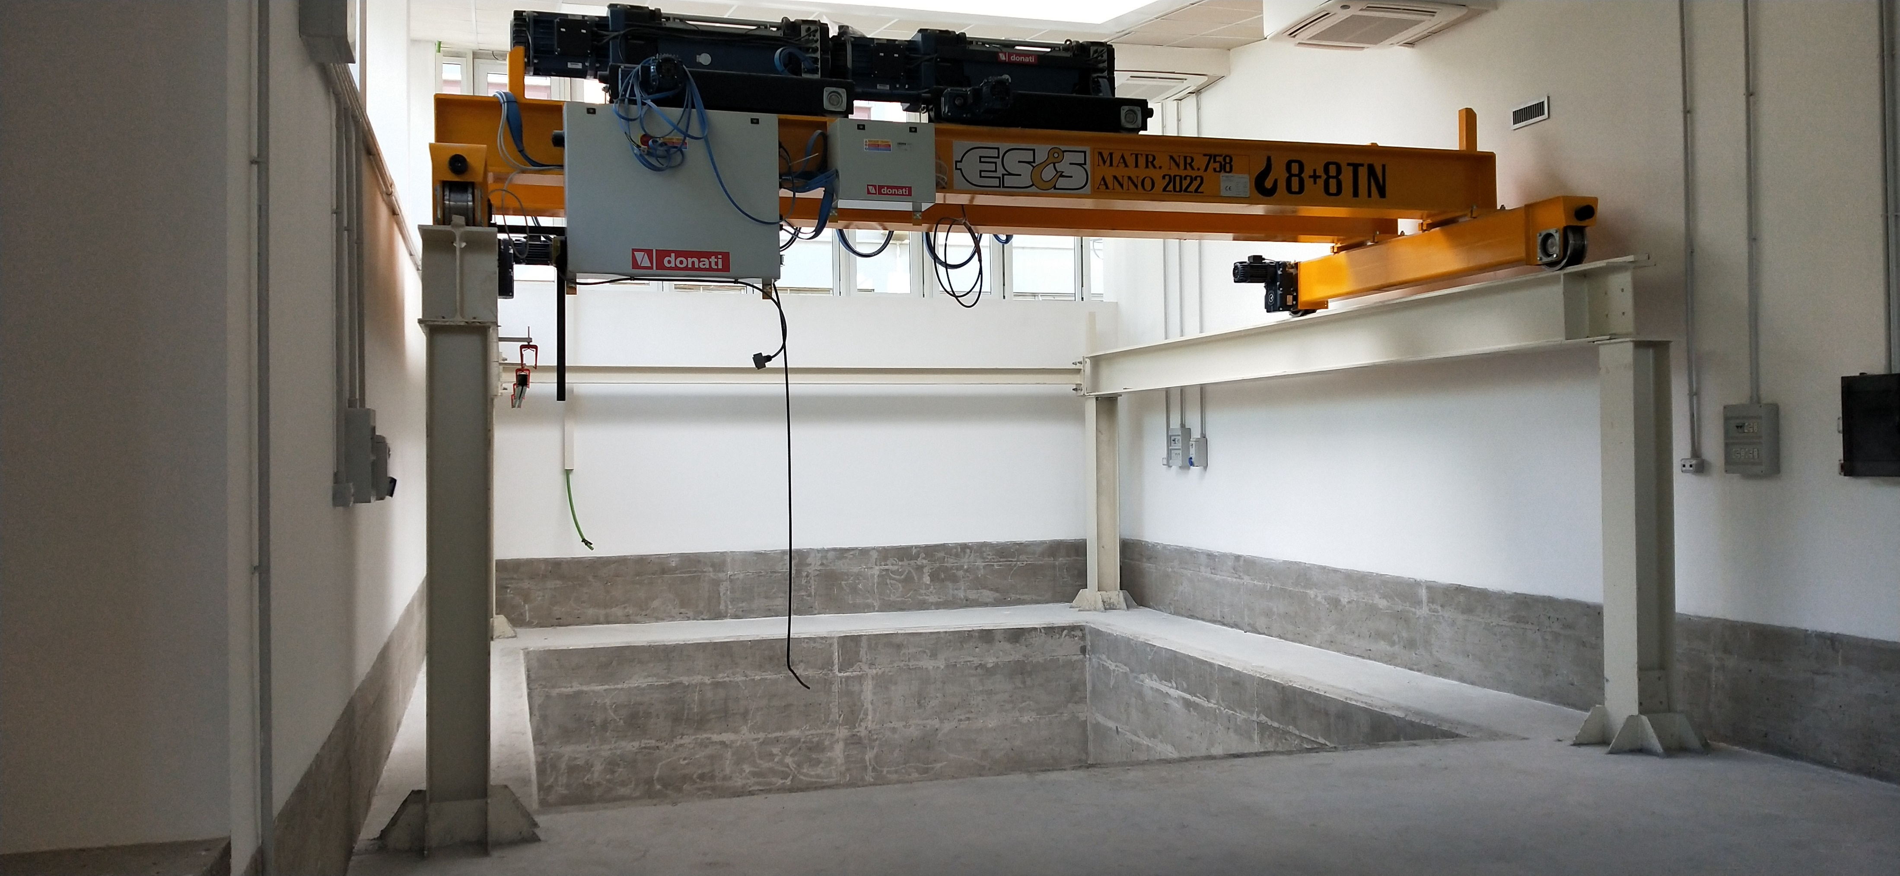
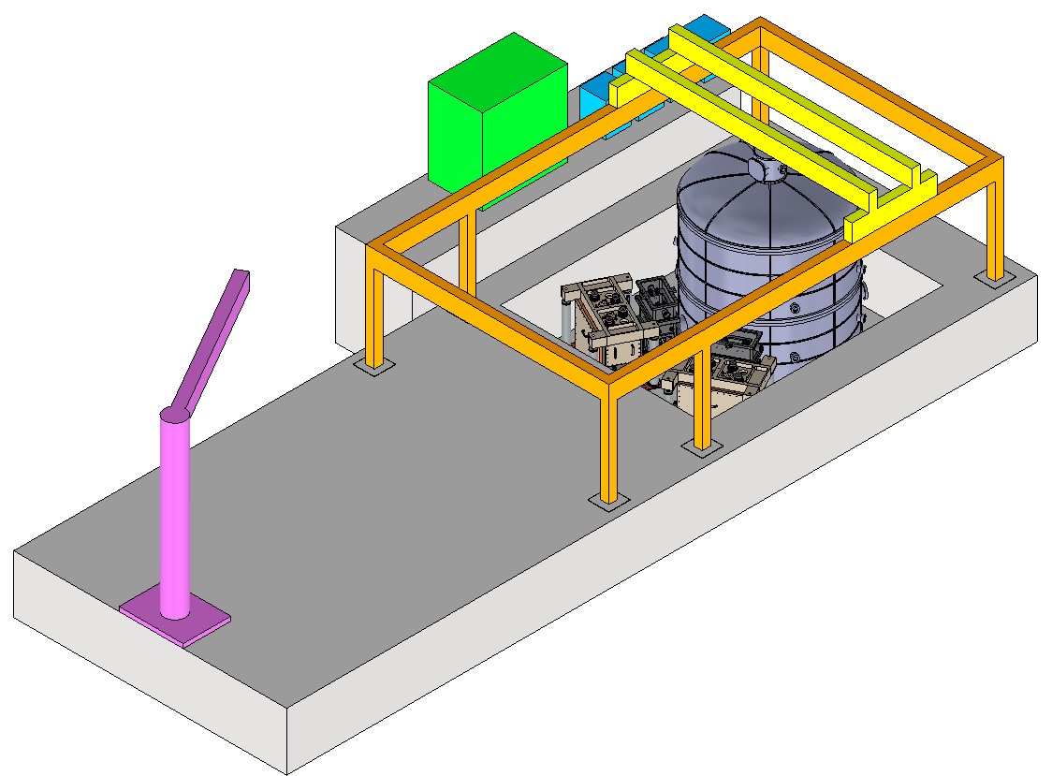
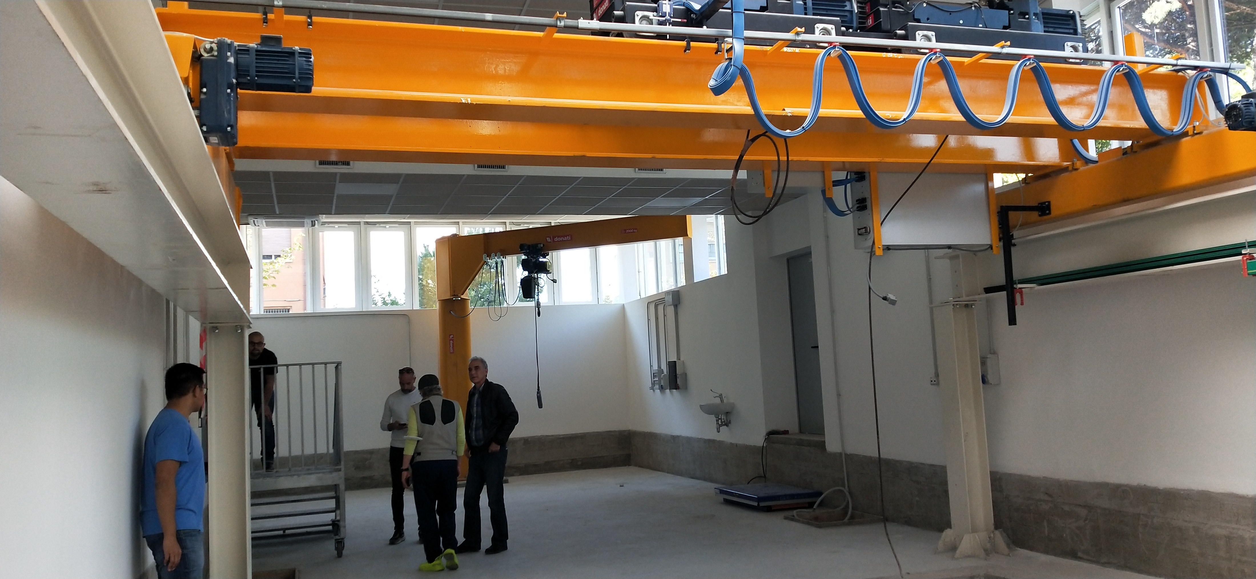
  Refrigeration system
  Two low-vibration conductive refrigeration lines will be connected by means of soft thermal links to a cryostat hosting a realistic-sized cryogenic payload.
To Do List
test of the pulse-tube refrigeration station
payload design followed by one-by-one tests on crucial parts and then by prototype construction
cryostat design driven by cutting-edge solutions on basic payload structure and cooling procedure, but close to feasibility
test of the payload prototype in
clean room at room temperature
and study of the characteristic frequencies with their dissipation
at high and low frequency
cryostat construction
followed by cryogenic tests
payload integration and
test of the integrated
system
designs by F. Bronzini, V. L. Hoang, A. Marra, D. Pasciuto, A. Rezaei

Slide 7
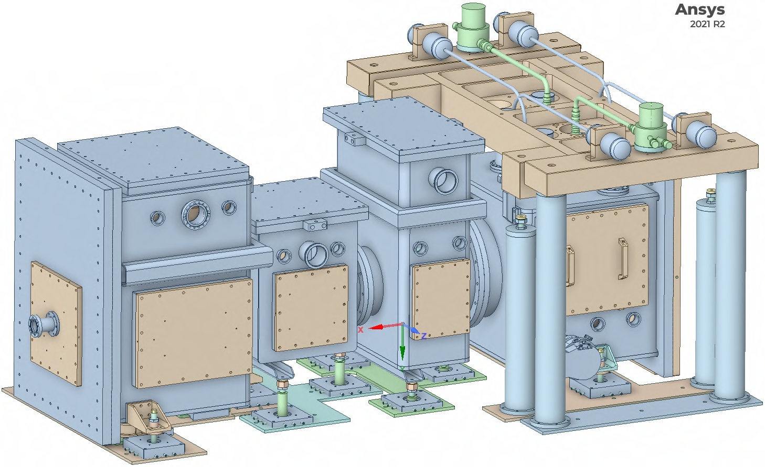
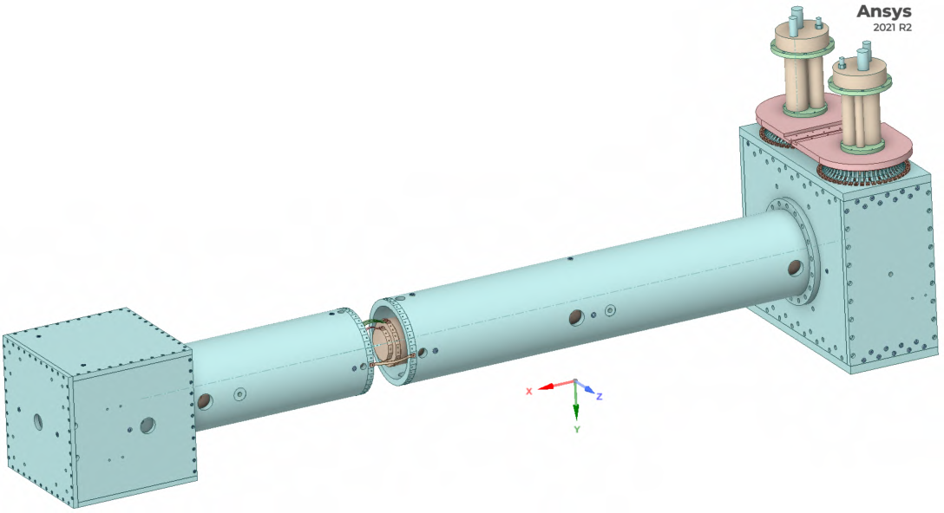
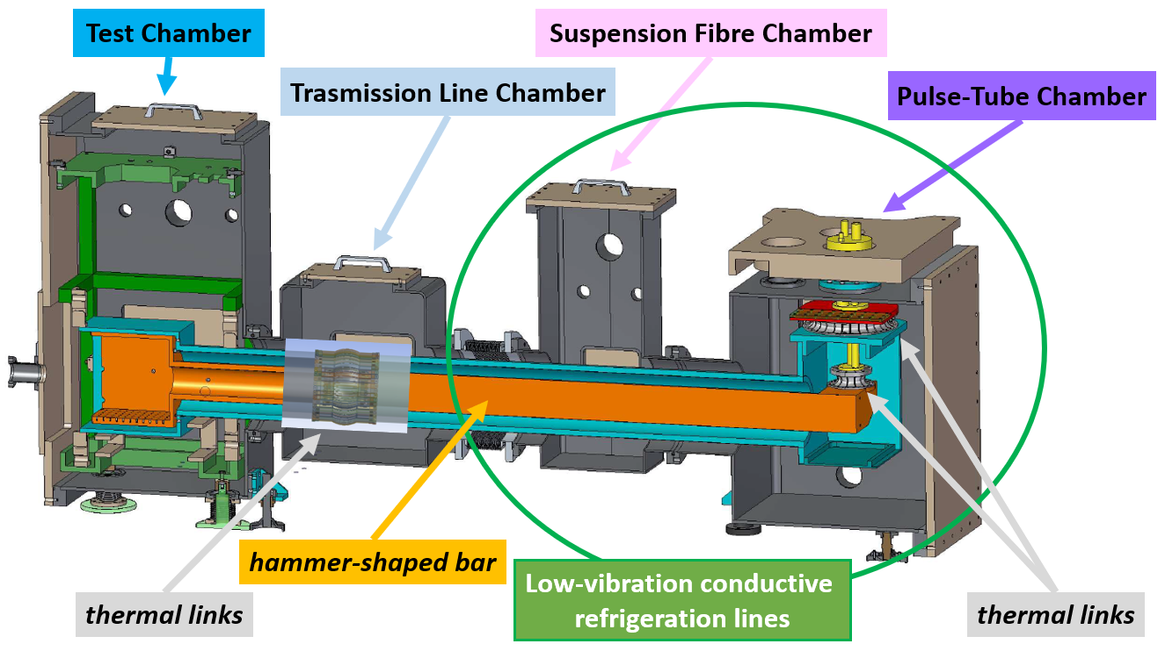
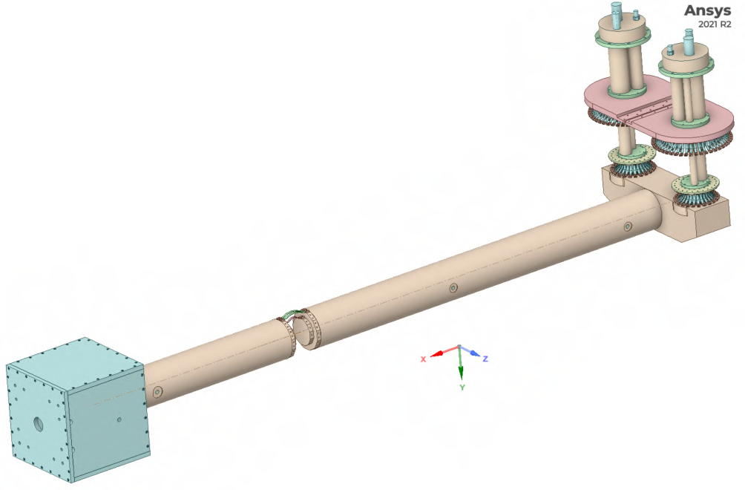
Refrigeration Lines
designs by F. Bronzini, A. Marra, M. Ricci
Vacuum Chamber
Thermal Shield
Heat Path
One line is composed of two pulse-tube cryocoolers (in counterphase) whose second stages are connected by soft thermal links (99.9999% pure metal, Al6N or Cu6N) to the head of a hammer-shaped bar (99.999% pure aluminium, Al5N).
The hammer bar is suspended by long wires and placed into a suspended Thermal Shield, cooled at its turn by the first stages of the two pulse-tubes.
The hammer bar and its thermal shield are the lines
through which the refrigeration power is applied.
Initially, the refrigeration line will be connected to a suspended Test Chamber, thermally soft linked and thus mechanically decoupled from the hammer bar.
The connection will take place in a Transmission Line Chamber.
The current system is composed of four Vacuum Chambers which ensure the vacuum insulation of the cryogenic system.
They host a hammer bar and a small chamber for performing the first cryogenic tests, both inserted into the Thermal Shield.

Slide 8
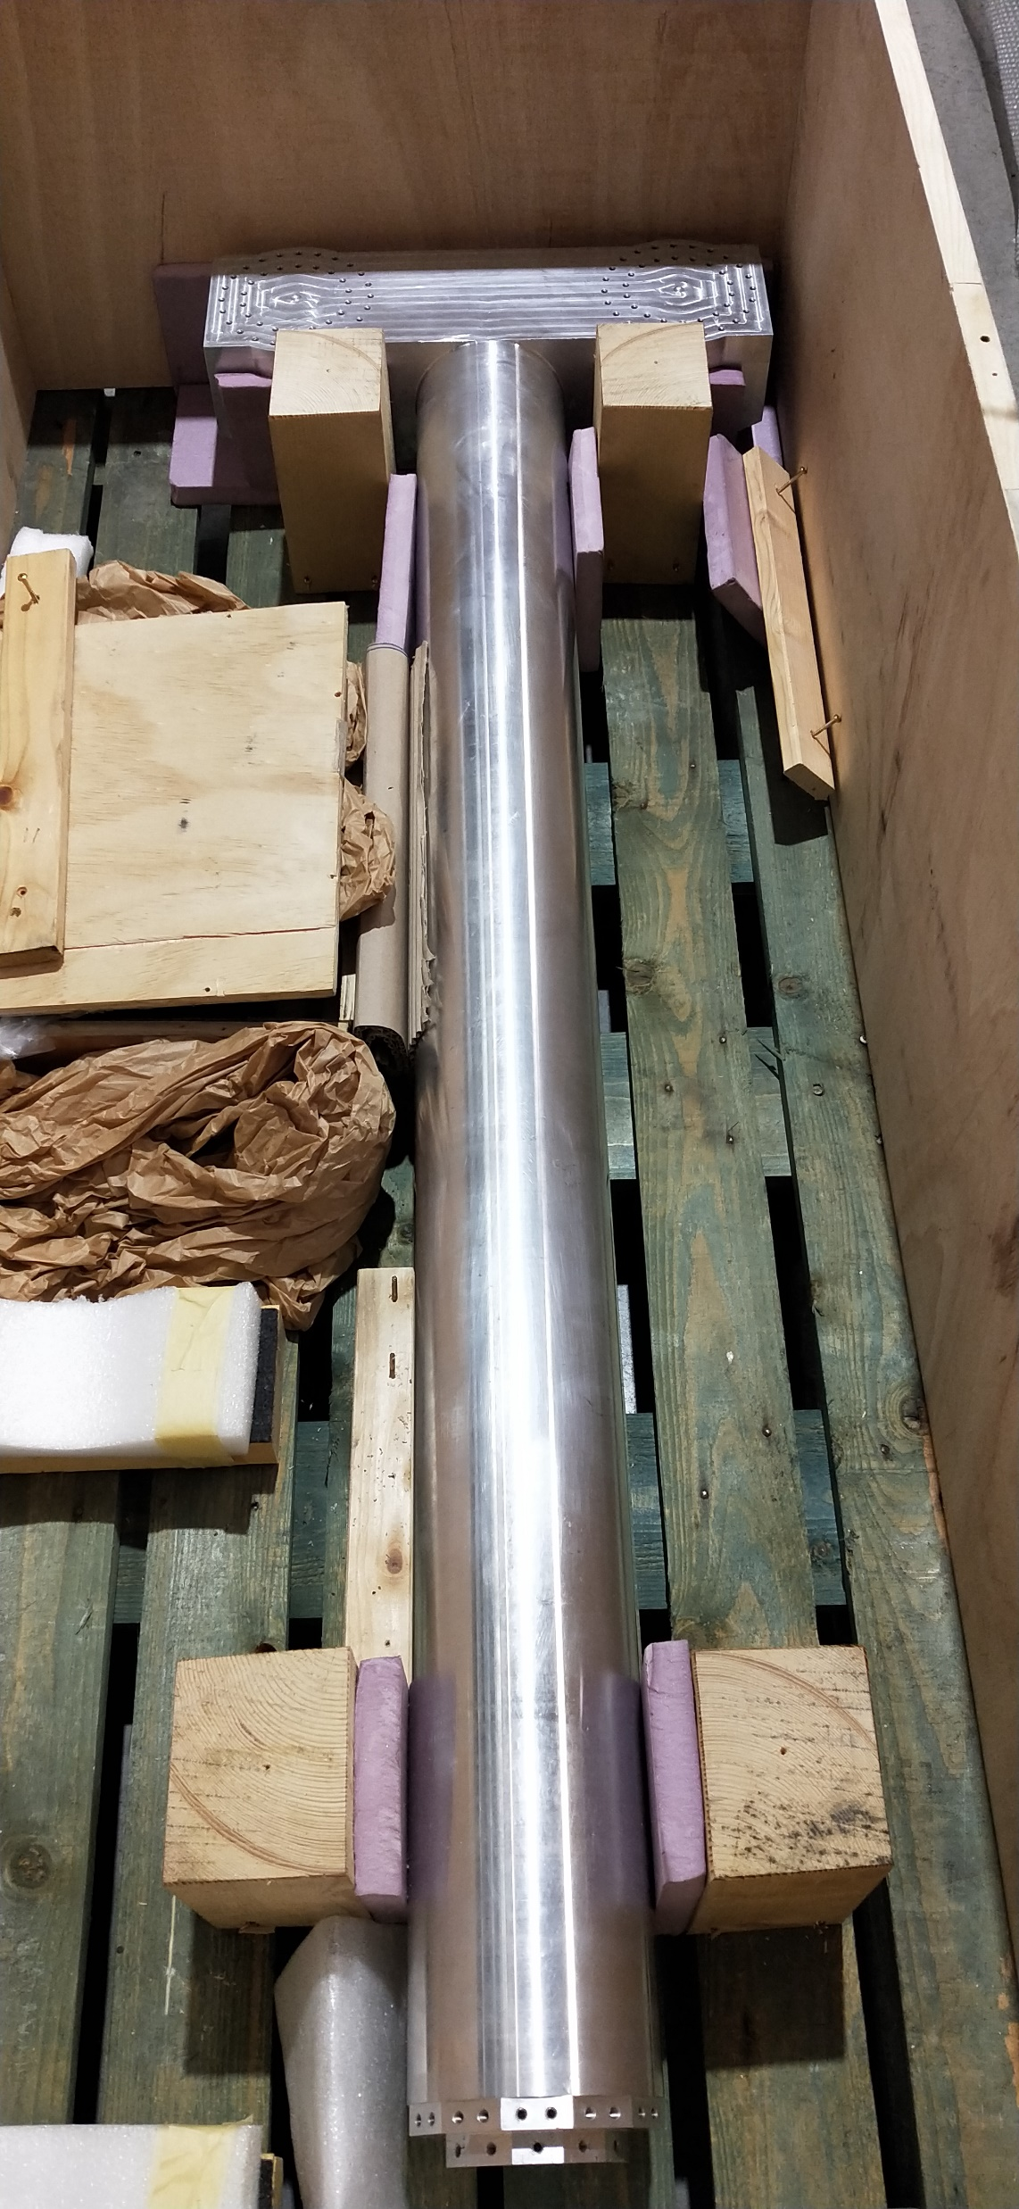
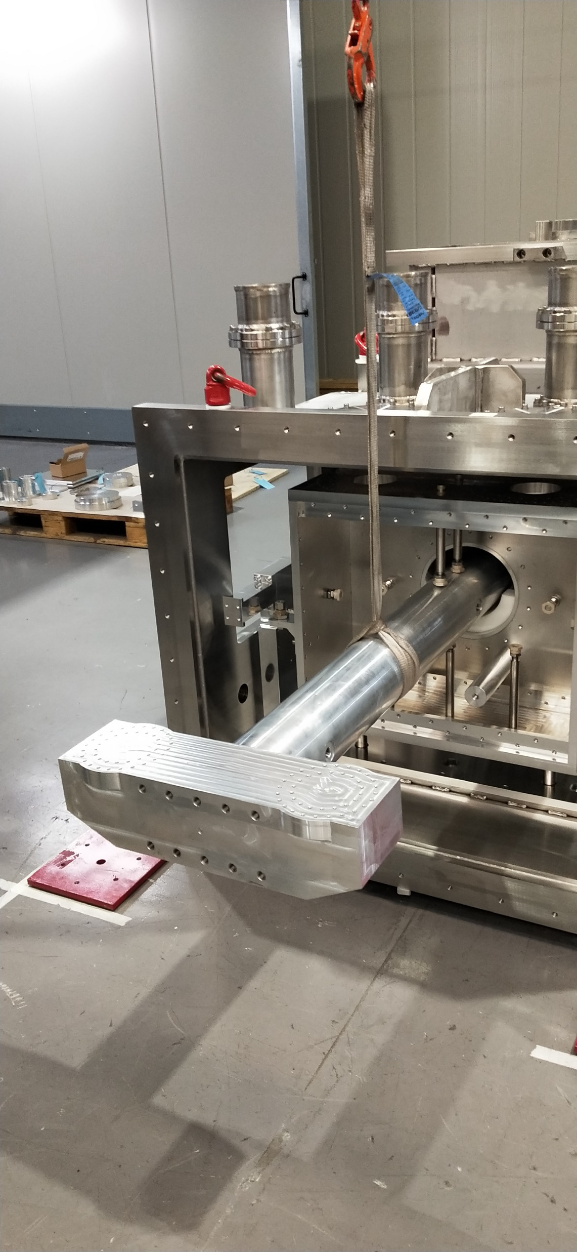
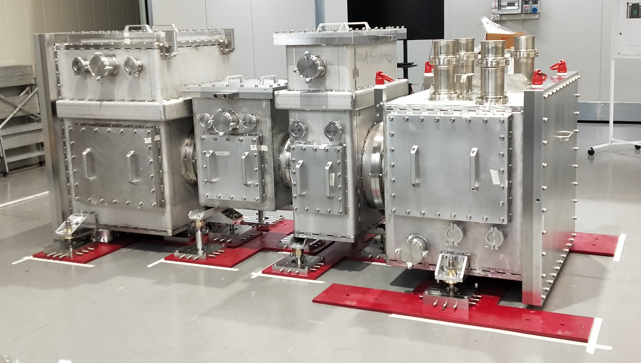
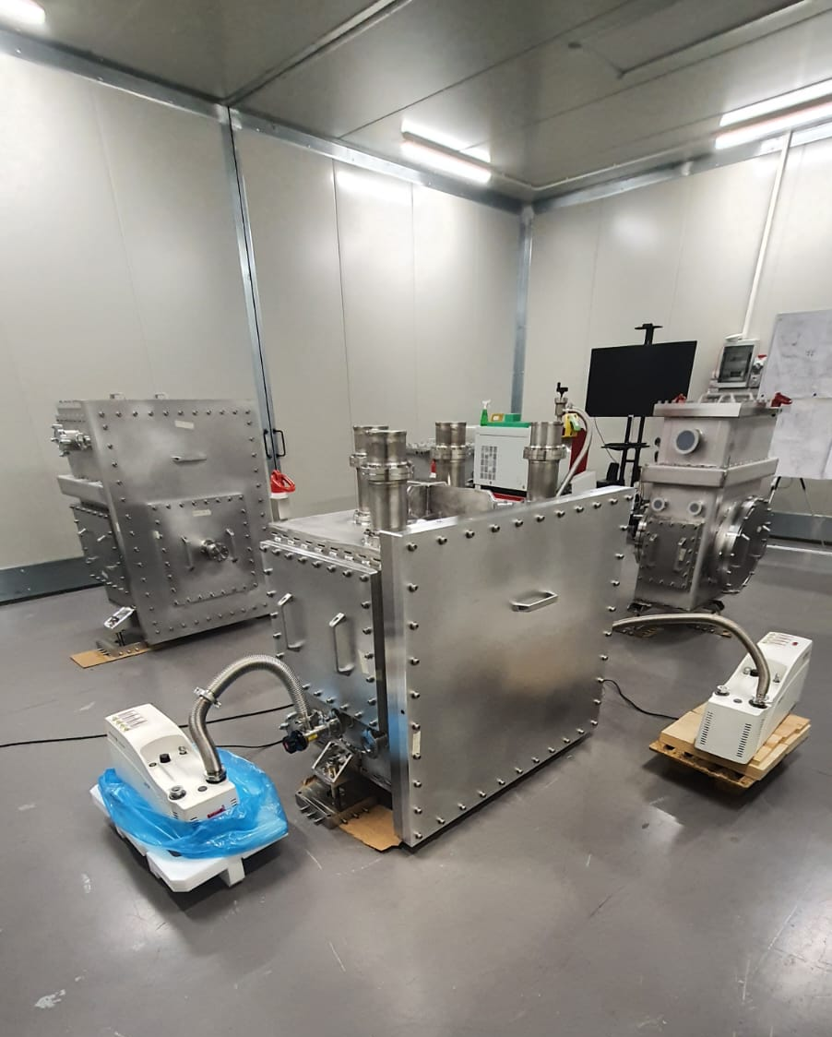
1 out of 2 lines has already
been manufactured and mounted in a clean area of the company Fantini Sud S.p.A. (Anagni, FR).
Vacuum tests of the chambers were performed, and no leaks have been detected at a sensitivity level better than ~5x10⁻¹⁰ mbar l/s.
The Al5N hammer-shaped bar was assembled at CERN: head and cylindrical rod were jointed using the Electron Beam Welding technique in vacuum.
Its weight is 86 kg.

Slide 9

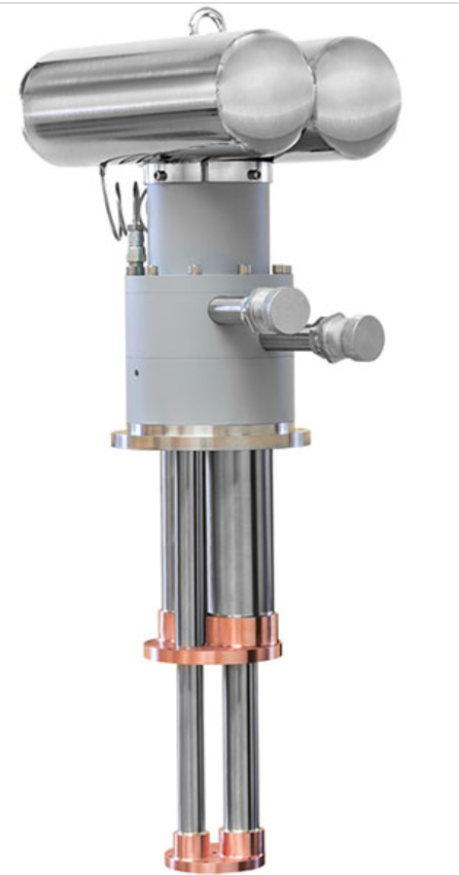
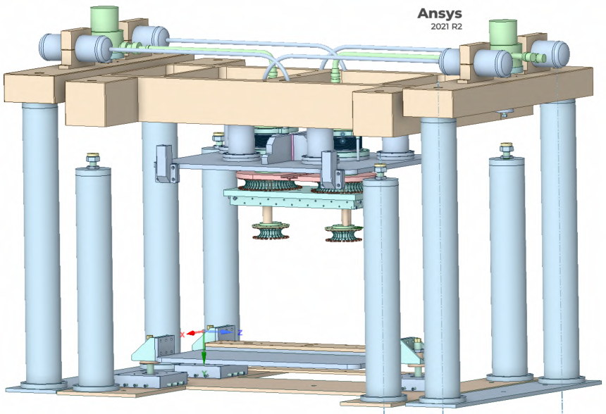
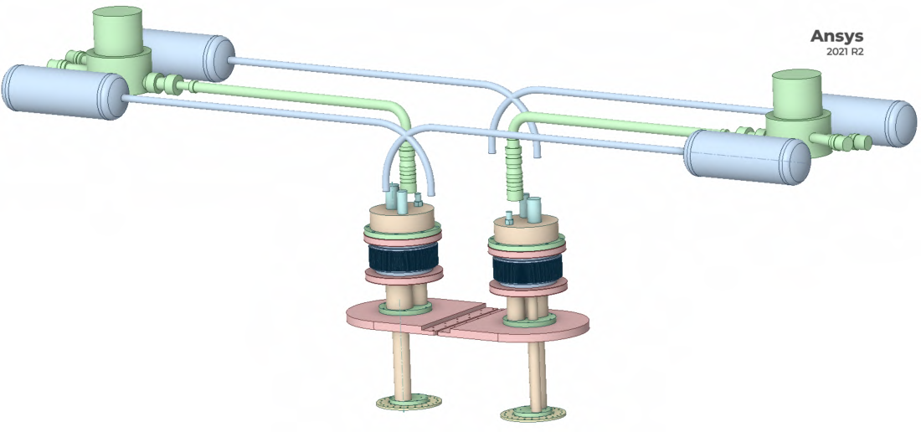
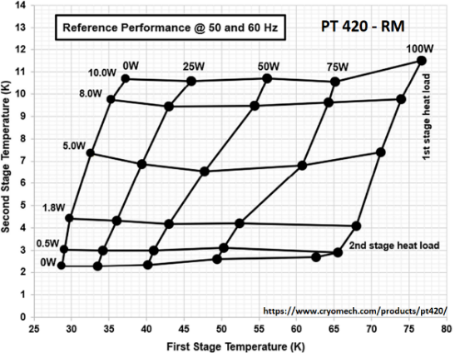
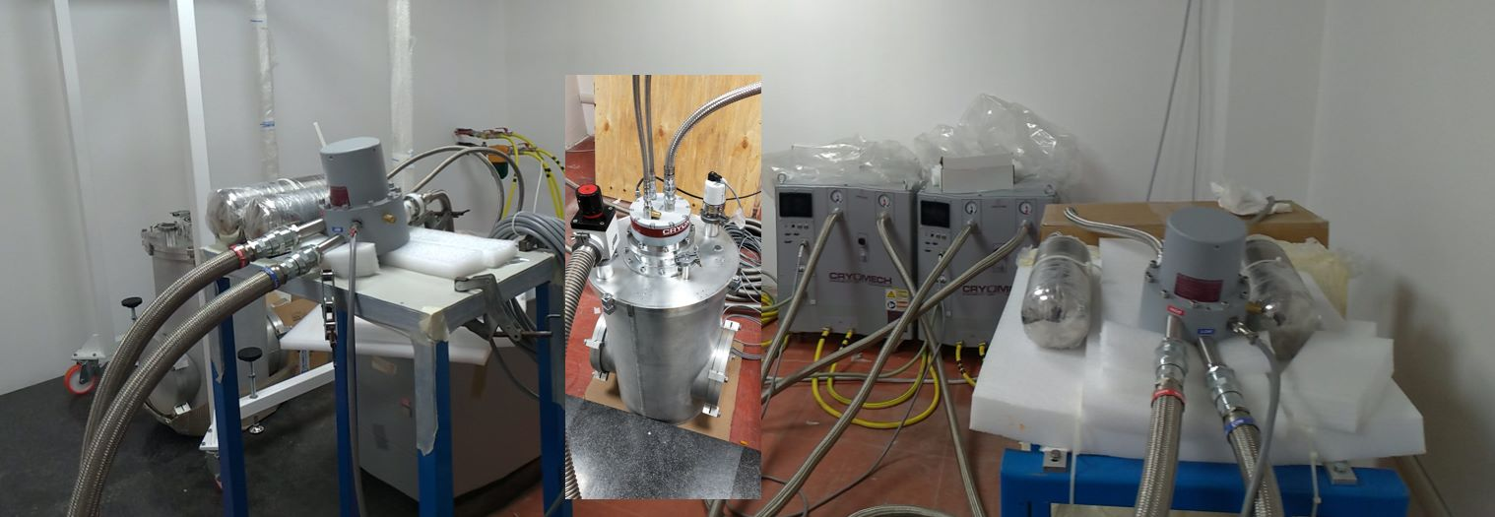
Pulse-tube cryocoolers
Model
PT 420-RM
designs by F. Bronzini, A. Marra
Cryomech PT 420-RM
1.8 W @ 4.2K
50.0 W @ 45.0 K
https://www.cryomech.com/products/pt420/
Two pulse-tubes Cryomech PT 420 with Remote Motor have already been bought by ARC and will be used to cool down the refrigeration line.
Thermal simulations are based upon the pulse-tubes performance described by the Capacity Curve.

Slide 10
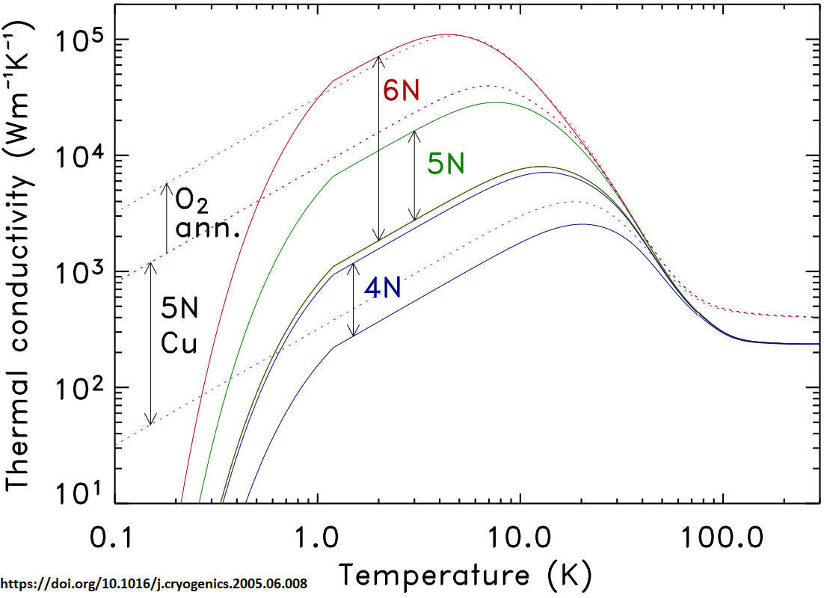
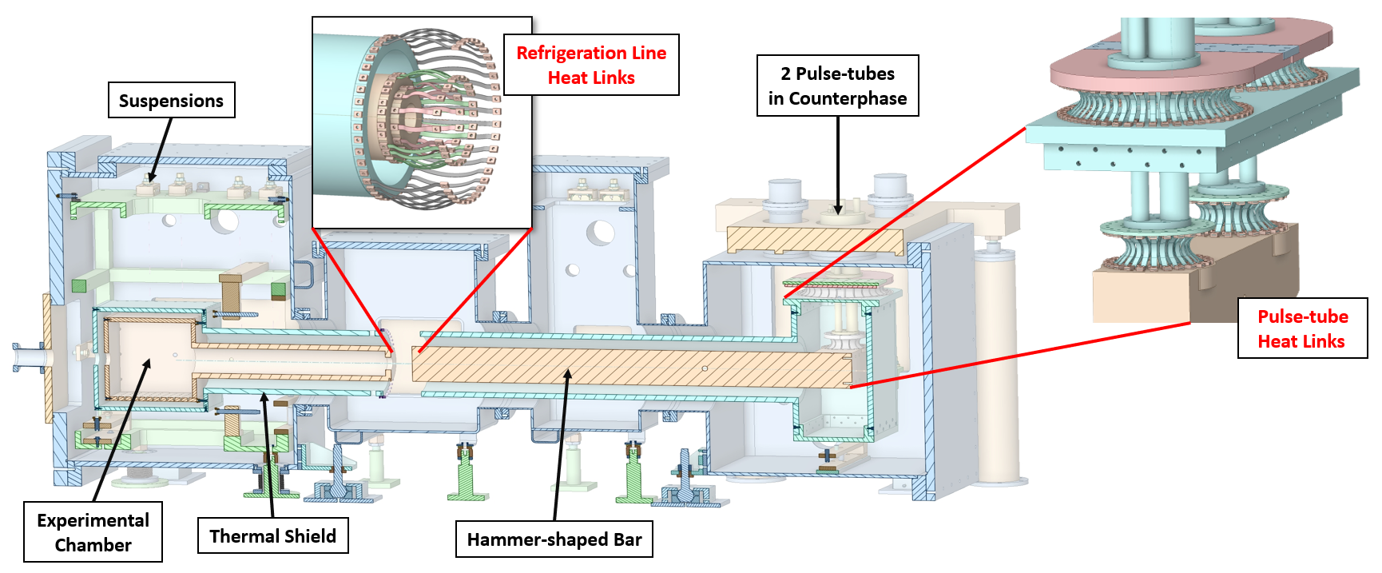
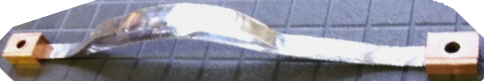
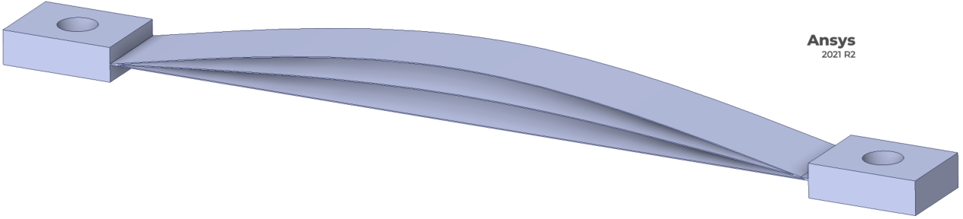
Vibrations: heat links
Problem: Vibrations coming from pulse-tube cryocoolers must be reduced so that
vibrational noises do not affect the mirror position dynamics.
Solution: Refrigeration line components connected through heat links.
Heat links must be:
Soft → to reduce vibrations
Conductive → to transfer heat efficiently
High purity materials
(such as Al6N or Cu6N)
will be used
Thermal simulations are used to set constraints on the number of heat links and foils.
First heat link prototypes have 3-5 thin Al6N foils clamped by two Cu5N terminals.
(length: 90 – 160 mm thickness: 100 µm)
designs by F. Bronzini, A. Marra, M. Ricci

Slide 11
Why Thermal Simulations?
Possibility to foresee the expected temperature and cooling trend
Set up constraints for engineering
Need of powerful methods to solve Partial Differential Equations (PDEs): Finite Elements Analysis (FEA)

Slide 12
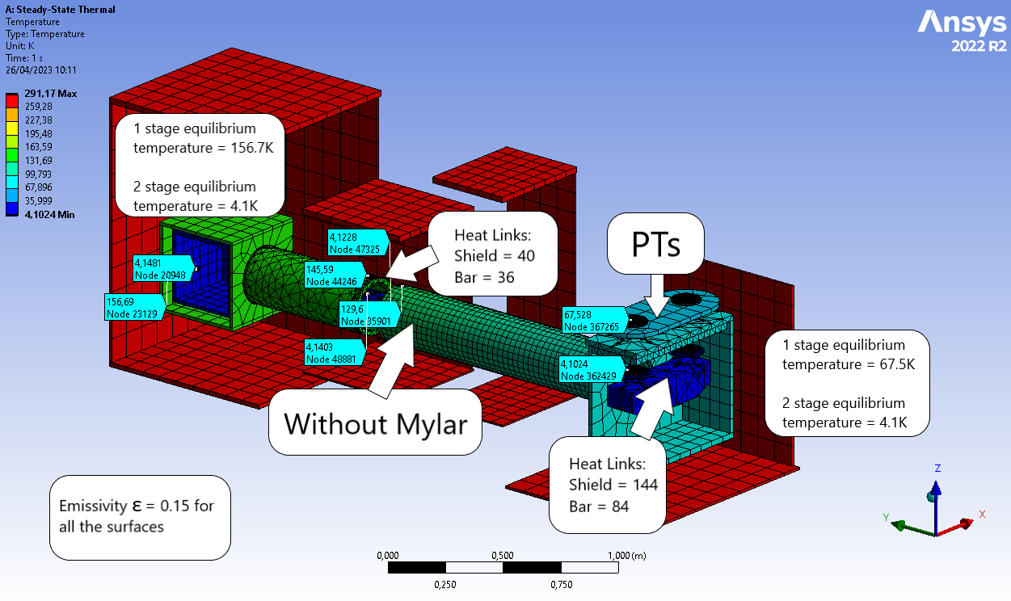
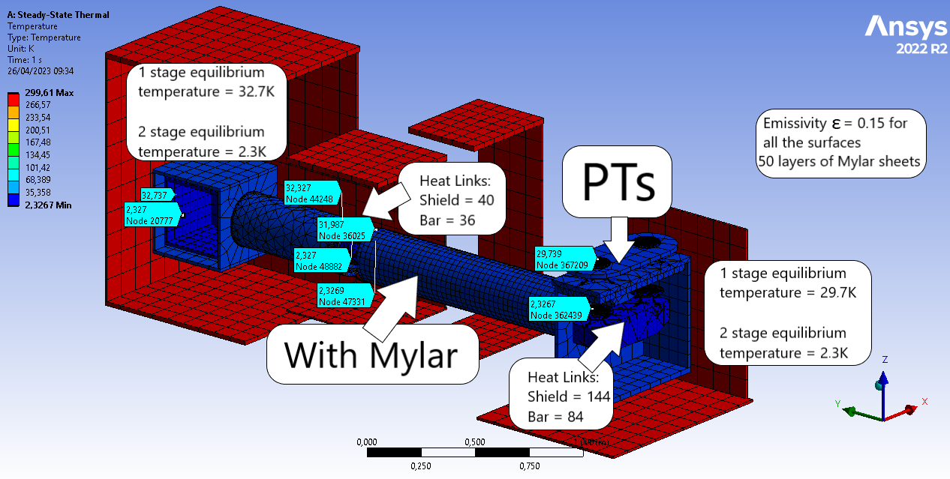
Steady-State Simulations
Steady-State thermal simulations show the need of a super-insulation system on the radiative shield.
Considering 50 layers of aluminised Mylar sheets, the equilibrium temperature of the cooling bar is reduced by 44%, while the radiative shield one by 56%.
Moreover, the temperature gradient on the radiative shield is reduced by 96.6%.
In a super-insulated shield the temperature gradient along it is vanished.

Slide 13
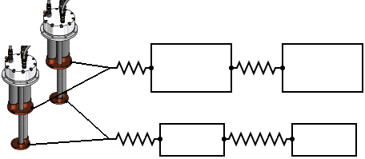
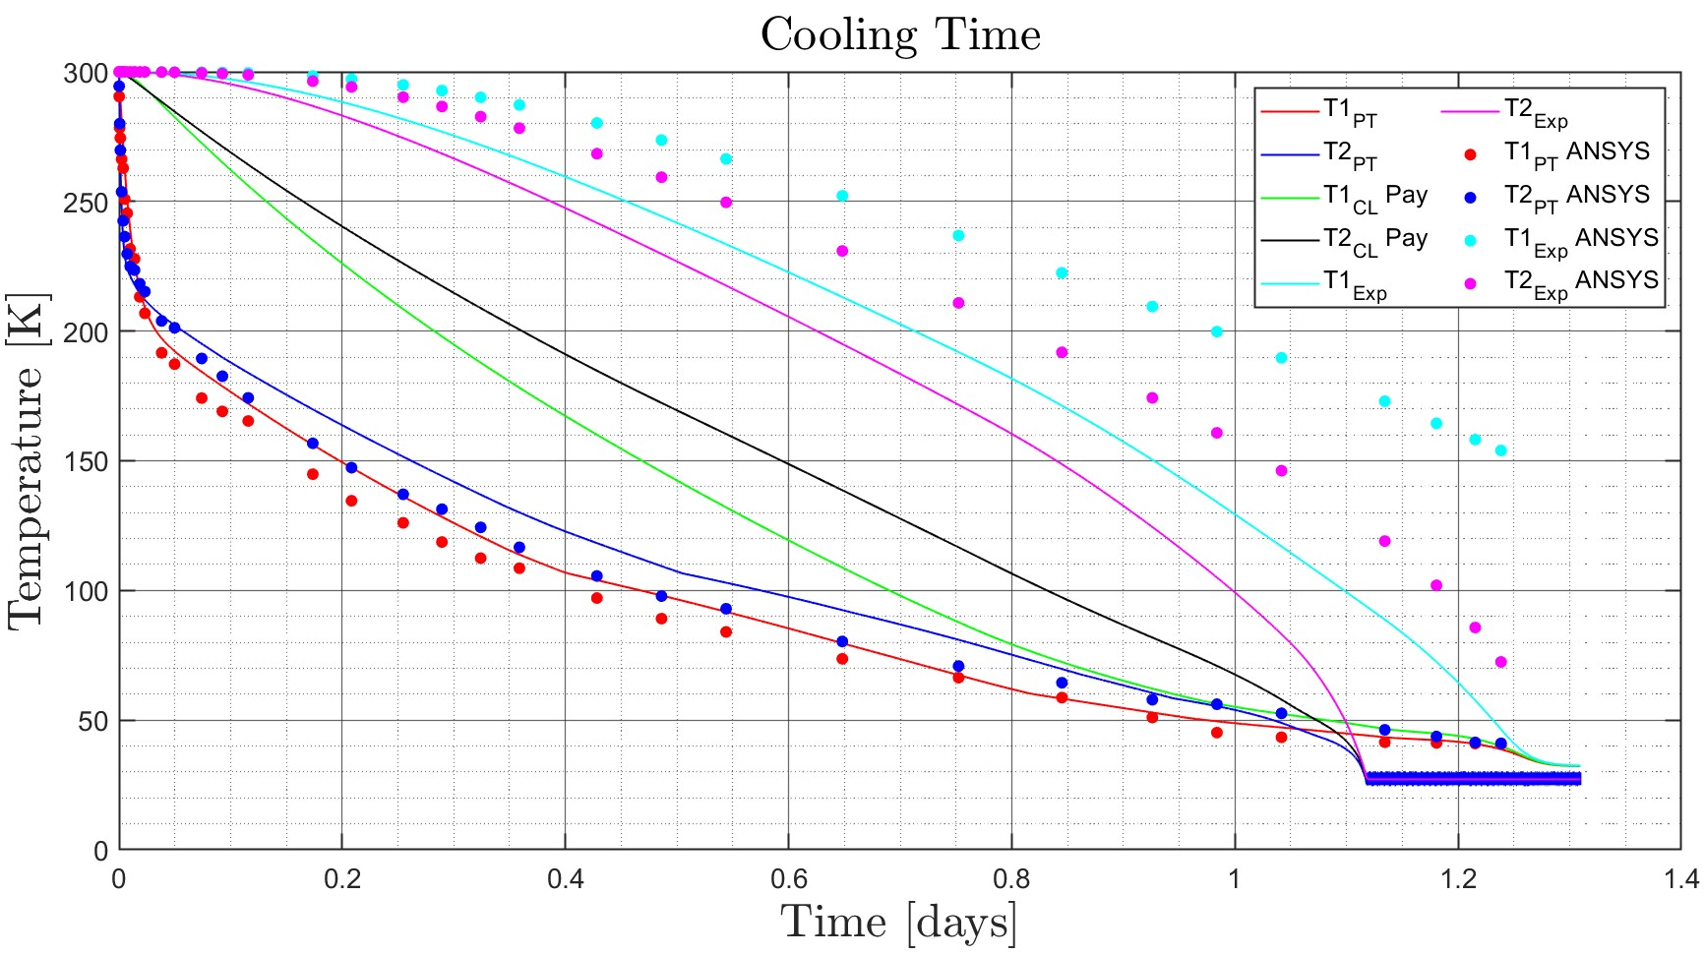




Transient Simulations
MATLAB code diagram
2 PTs
$G_{PT 1 stage}$
Refrigeration Line Shield
$G_{Shield}$
Experimental Chamber Shield
= Conduction
Transient thermal simulations are compared with a simplified MATLAB code.
Similar trend for the cooling of the experimental chamber but slower (it consider the actual view factors for the surface to surface radiation).
= Radiation
$G_{PT 2 stage}$
Refrigeration Line
$G_{Bar}$
Experimental Chamber
A cooling time of 3 - 4 days is expected
Considering a factor 4X for the conductance, the cooling time is reduced to 1.5 – 2 days.
Vibrations measurements should be performed on the setup to constrain the maximum number of heat links.

Slide 14
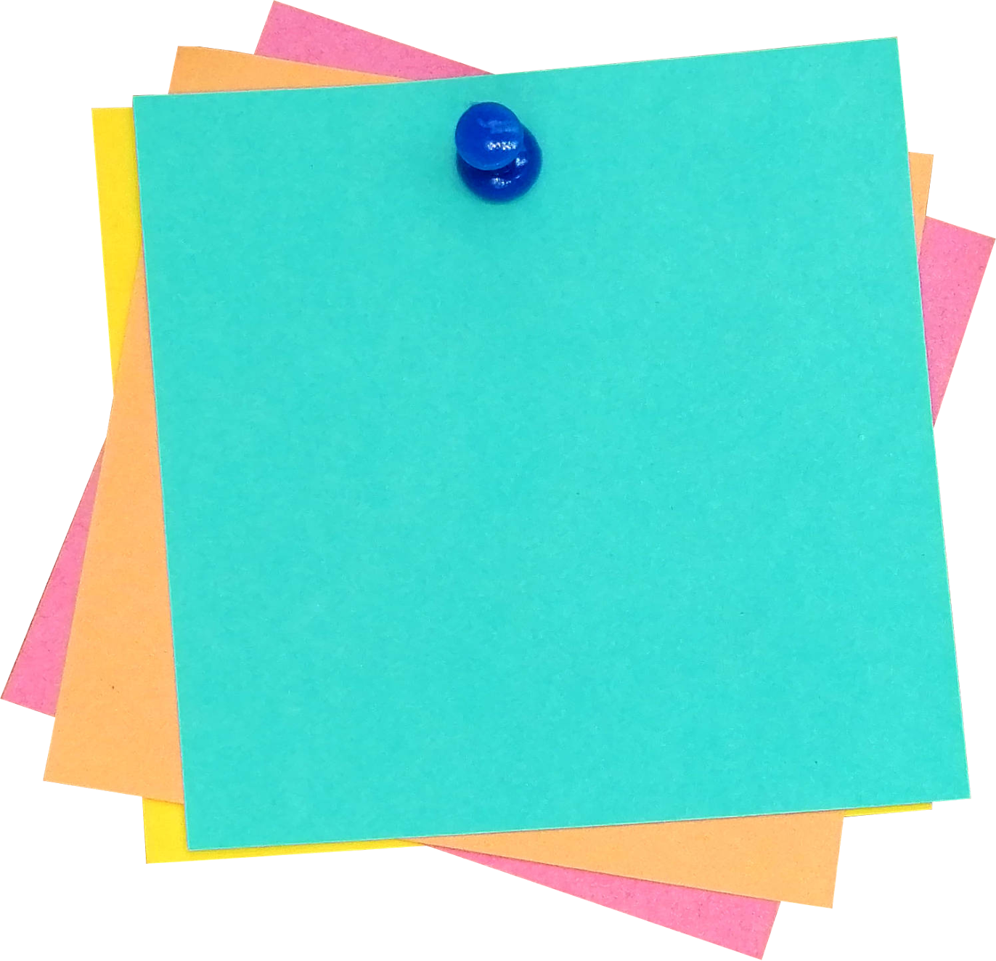
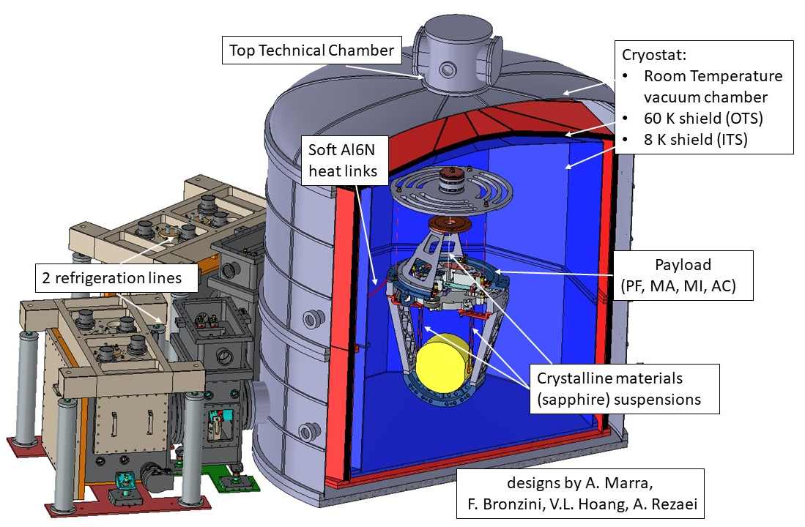
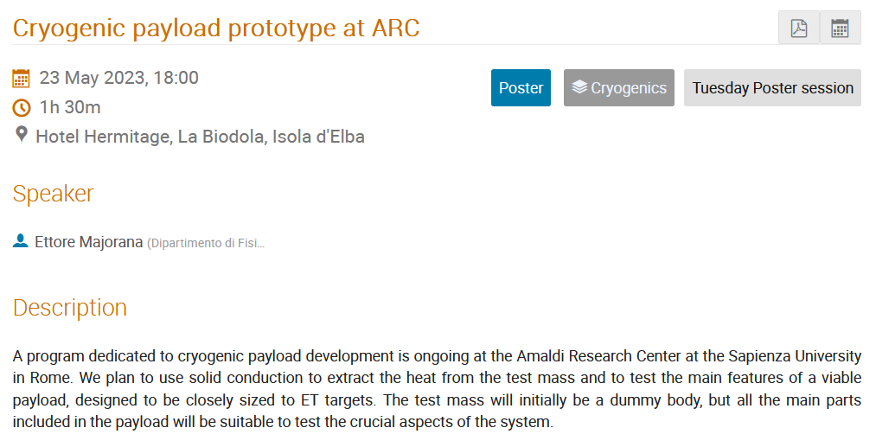
What’s Next?
A cryostat prototype: a cryogenic system to test key solutions.
Though the shape cannot be actual the one envisaged for ET, key features are:
Big-size cold mass
Solid conduction
Super-insulation
see Majorana et al. poster:
“Cryogenic payload prototype at ARC”

Slide 15

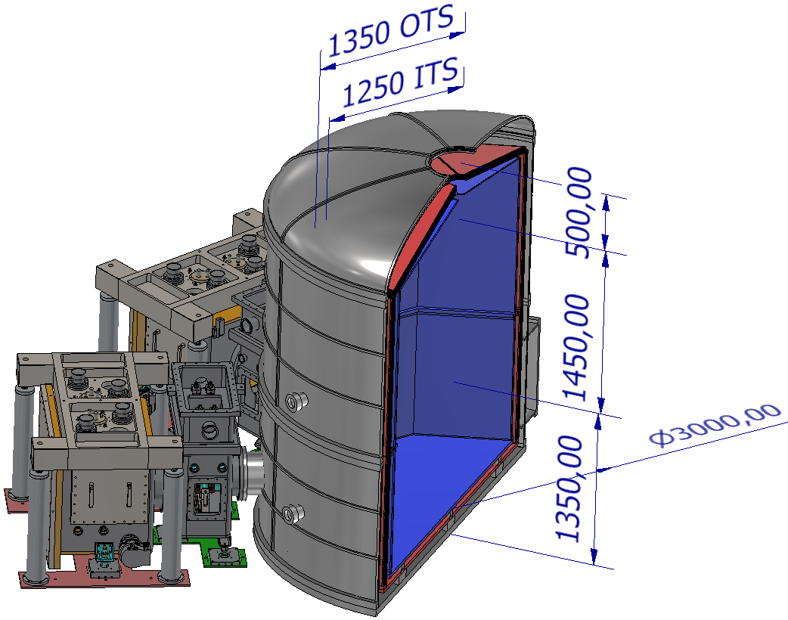
Cryostat Shielding
ITS
OTS
OTS: outer thermal shield
ITS: inner thermal shield
Distance between each thin shield (thickness 0.4 mm) is 4.3 mm
Using Mylar for the super-insulation, in the single-vacuum-cryostat hosting actual ET mirrors, may be critical concerning pollution and outgassing
We are studying the implementation of multiple thin shields (0.4 mm thickness), considered as an alternative solution for the insulation.
Nominally OK, though the challenging mechanical design in our specific case.
designs by F. Bronzini, A. Marra, V.L. Hoang

Slide 16
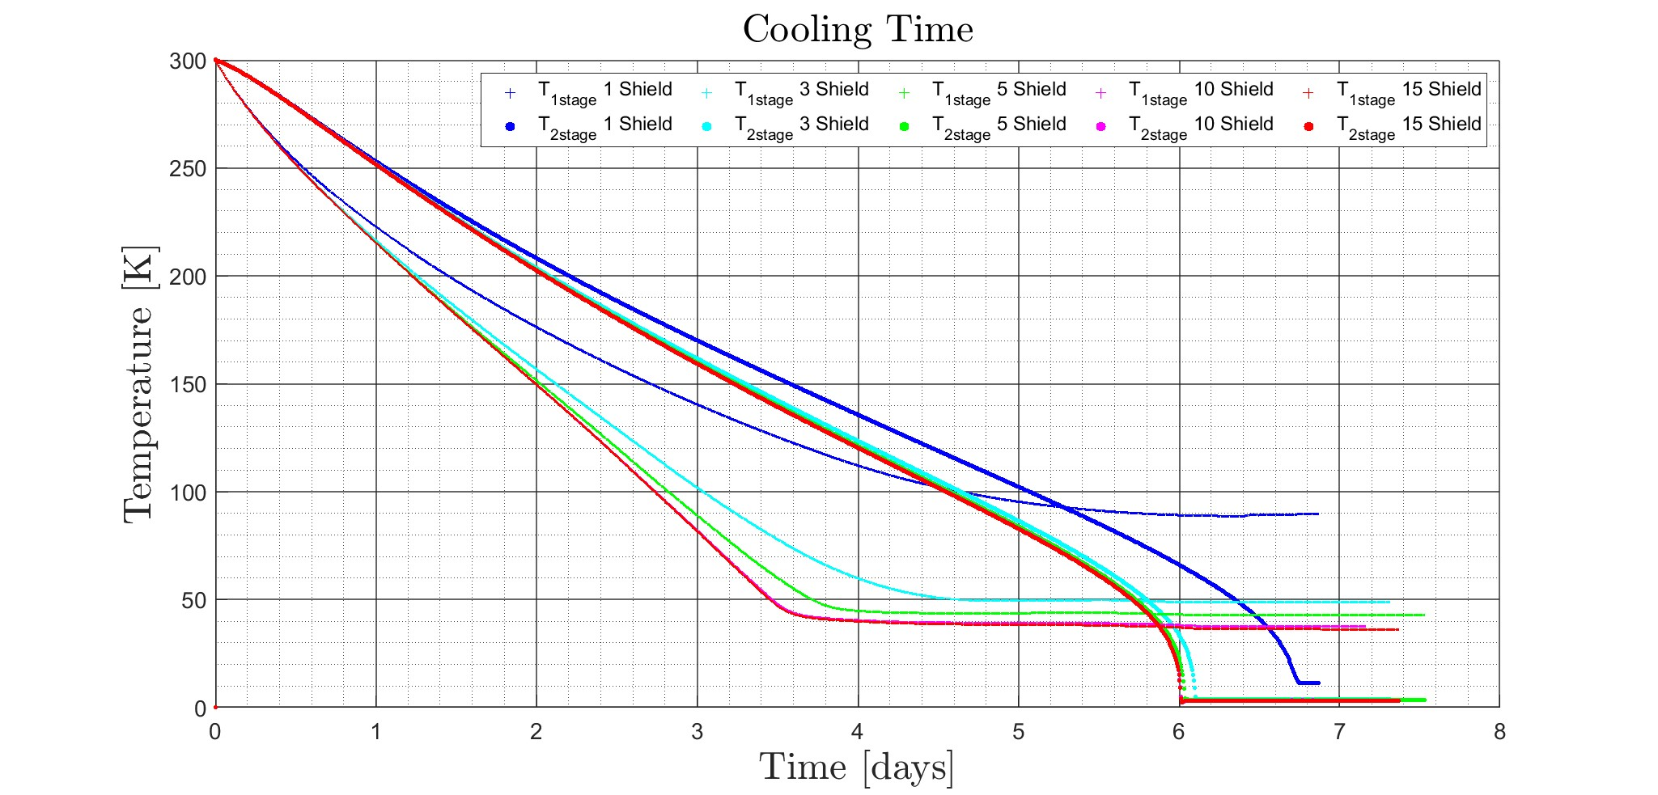
Cryostat: Radiative Simulations
Radiative thermal simulations with MATLAB are useful to obtain a lower limit for the cooling time of the cryostat considering the multiple shields solution.
Increasing the number of the shields, the equilibrium temperature and the cooling time of the first stage are reduced.
Considering more than 10 shields, the equilibrium temperature on the first stage is 38K while on the second 3.3K. The cooling time in this configuration is 6 days.
Temperature gradients and conduction are supposed to increase both the equilibrium temperature and cooling time.
Aim: cooling time lower than 30 days.
High number of shield =
cooling time and equilibrium temperature of the first stage reduced

Slide 17
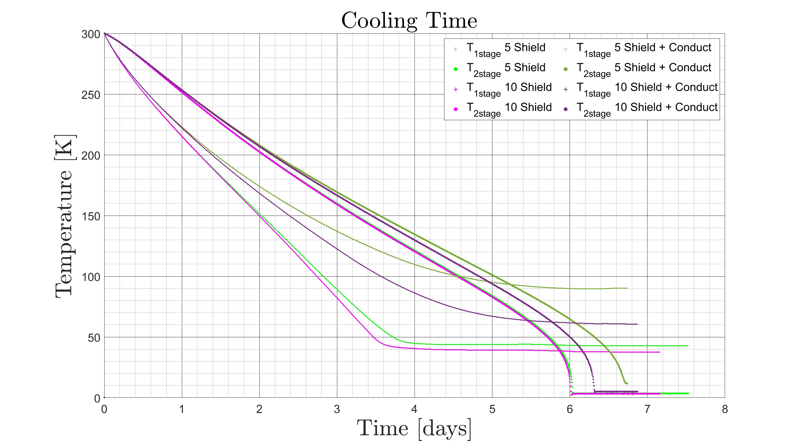

Cryostat: Radiative Simulations + Conduction
The first step to approximate the real model is to consider the heat transferred through conduction by the insulating material composing the shield structure.
We consider PEEK as material for the simulations
$P∼k \frac{A}{L} ΔT$ $\frac{A}{L}=$70 m
Cooling time increases of $∼$10% (depending on the number of shield).
Aim: modify the geometry of the insulating structure to reduce the conduction contribution.
Conduction of the insulating structure =
cooling time and equilibrium temperature of the first stage increased

Slide 18


Cryostat Shielding Feasibility
ITS
OTS
Insulating rods have been designed to firmly sustain and pull the multiple shields.
The contact area of the rods with the shield has been reduced to decrease the effect of conduction.
Pulling Pin
designs by V.L. Hoang

Slide 19
Milestones
1
2
3
4
5
6
7
8
In the next weeks, the first refrigeration line will be installed in Segrè Laboratory (ARC) and tested at low temperature.
Measurements of the refrigeration power, generated by the pulse-tube system, and the spectrum of the residual vibration.
Technical drawing of the full-scale payload and cryostat which will host it are in progress.
Thermo-mechanical simulations on the cryostat and payload should follow the technical drawing, setting up constraints on geometries.
First heat links prototypes will be used and characterised in the first tests of the refrigeration line.
Study of a multi-layer insulation system (Mylar?) to block the radiation coming from the room temperature vacuum chamber further.
The second refrigeration line, payload and cryostat will be built.
First prototype of refrigeration system will be available for cryogenic tests on different types of ET full-scale payloads.

Slide 20








Some References…
https://agenda.infn.it/event/26121/contributions/136323/
https://www.mdpi.com/2075-4434/10/3/65
https://pubblicazioni.dsi.infn.it/tesi/gettesi.php?filename=533320.pdf
https://agenda.infn.it/event/26121/contributions/136339/

Slide 21

GWADW Elba 2023 – Infrastructures - Cryogenics – Isola d’Elba 21-27 May 2023

Slide 22
Extra Slides

Slide 23



ET will be a 3G GW underground observatory in Europe with:
a sensitivity at least 10 times better than the (nominal) advanced detectors
on a large fraction of the (detection) frequency band;
wideband (possibly wider than the current detectors) accessing
the frequency band below 10Hz.
ET will consist of three nested detectors in a triangular arrangement.
Each detector will be composed of two interferometers:
one with low power and cryogenic temperatures for detecting low-frequency GWs (ET-LF)
one with high power and high temperatures for detecting high-frequency GWs (ET-HF).
ET-0007B-20

Slide 24



Due to the good performance of the multistage pendulum suspensions the influence of seismic noise can be limited to the frequency range below 2 Hz.
Below 7 Hz the sensitivity is limited by comparable amounts of quantum noise, gravity gradient noise, and suspension thermal noise.
The operation at cryogenic temperatures reduces the influence of suspension thermal noise in the frequency range above 7 Hz to below the quantum noise.
In the frequency range from about 7 Hz to 30 Hz the sensitivity is limited by suspension thermal noise, resulting from the interferometer being operated at room temperature.
From 30 Hz to 500 Hz mirror thermal noise is limiting the overall sensitivity.
At frequencies above 500 Hz the dominating noise source is photon shot noise.
https://doi.org/10.3390/galaxies10030065
ET-0007B-20

Slide 25





After 20 years of effort, the technique for designing and building payloads has become more and more standardized.
Virgo 2003
Virgo First scientific run.
20 kg mirror,
steel wires suspension
?
Virgo+ 2010
First scientific run with 20 kg mirror with monolithic suspensions,
Advanced Virgo 2017
The discoveries and the observations runs.
40 kg mirrors with monolithic suspensions
Advanced Virgo+ phase 2 2023
O5 Run in 2023: 100 kg mirrors, monolithic suspensions
The new challenge: ET cryogenic payloads:
200 kg mirrors, with monolithic suspension at T≤ 20 K
ET-0075A-22

Slide 26





Vacuum Chamber
Thermal Shield
Heat Path

Slide 27


https://arxiv.org/ftp/physics/papers/0611/0611031.pdf

Slide 28




designs by F. Bronzini, V. L. Hoang, A. Marra, A. Rezaei
OTS: 1700 kg
ITS: 900 kg
mirror
125 kg
marionette
150 kg
Vacuum chamber
7000 kg
Hammer-shaped bar
86 kg

