Slide 1

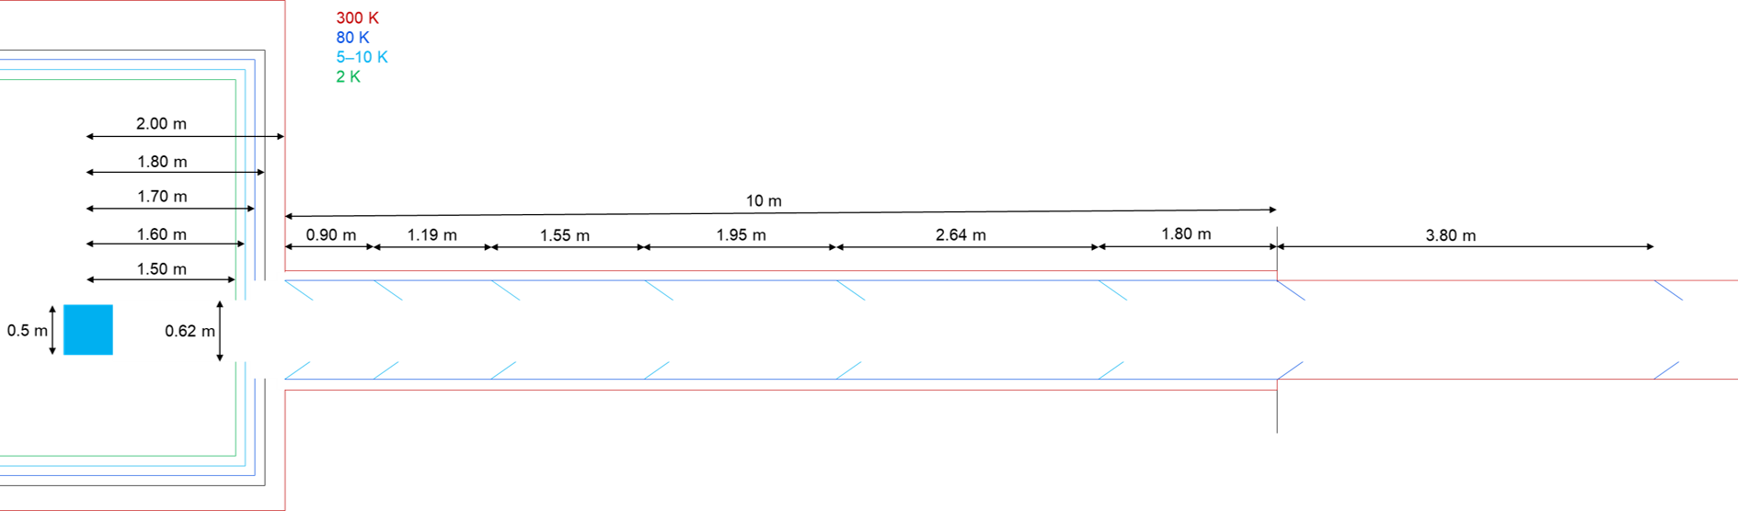
Design development of the cryogenic pumps for the low frequency interferometer of the Einstein Telescope
K. Battes, S. Hanke, X. Luo, C. Day 26 May 2023 katharina.battes@kit.edu

Slide 2
Gas sources towards cryogenic mirror of ET-LF
S2) from upper part of
suspension tower
Consideration of all gas sources and simplified geometry with TPMC model (in-house code ProVac3D)
Reduction of outgassing
Pumping requirements
Design of shielding
and design of cryopumps
S3) from adjacent
tower (high flow)
S1) from 10 km long
beam pipe
Resulting local
pressures
Frost formation and
recovery
→ All combined flows have to fulfill pressure and adsorption requirements.

Slide 3
S1) Beam pipe gas source towards cryogenic mirror
Pumping requirements
and design of cryopumps
Design of shielding
Reduction of outgassing
Frost formation and
recovery
Resulting local
pressures

Slide 4
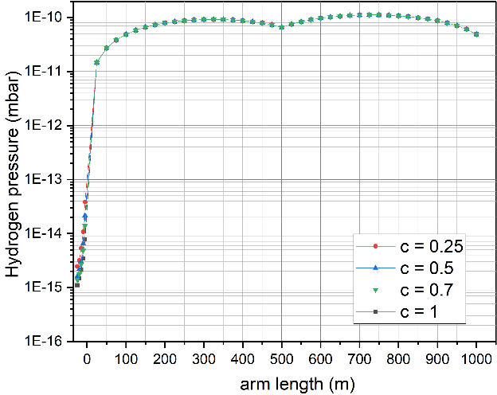
S1) Pressure profiles and flow rates from long beam pipe towards cryogenic mirror
Assumptions
  Total outgassing is 50/50 H₂/H₂O
  Outgassing of 2.5∙10⁻¹¹ Pa m³/(s m²) each
  Warm pumping station with 5 m³/s every 500 m
Variation of length and capture coefficient with ProVac3D
Required beam pipe conditions have to be established
by low outgassing rates, not by stronger pumping
Beam pipe vacuum strongly decoupled from cryostat vacuum
Cryogenic hydrogen pumping not needed with additional pumping
station at warm end of cryopump
Water is well manageable
by a 80 K cryopump (acceptable
water ML formation times)
Length of cryopump (m) | Water flow to mirror (Pa m³/s)
5 | 2.5E-10
10 | 1.2E-10
20 | 5.5E-11
30 | 3.1E-11
50 | 1.6E-11
70 | 1.1E-11
Finding: The cryopump at the beam pipe side of the cryostat can be operated at 80 K.

Slide 5
S2) Upper tower gas source
Reduction of outgassing
Pumping requirements
Minimisation of
conductance
Design of shielding
Frost formation and
recovery
Resulting local
pressures

Slide 6

S2) Gas flow from upper part of the tower towards cryogenic mirror
Some geometric solution of tower interface is needed (e. g. tube)
Extra pressure reduction by factor ~10 in tower is advisable by additional means to reduce outgassing and/or increase pumping speed (most probably cryopumping), implementation of special baffles possible
High uncertainties in outgassing composition and tower pressure
→ Assumed value for further simulations: 2.10⁻⁹ Pa.m³/s
 | Radius suspension | Radius opening | Radius opening 2 | Clearance | Orifice/tube length | Transmission surface | Transmission probability | Conductance | Gas flow to mirror
 | r_{i} | r_{o} | r_{o2} | dr | l | A | P | C | Q
 | (mm) |  |  |  |  | (m²) |  | (m³/s) | (Pa m³/s)
orifice | 6 | 12 |  | 6 | 0.5 | 3.39E-04 | 0.95 | 1.41E-01 | 1.41E-06
 | 6 | 7 |  | 1 | 0.5 | 4.08E-05 | 0.80 | 1.43E-02 | 1.43E-07
 | 6 | 6.5 |  | 0.5 | 0.5 | 1.96E-05 | 0.70 | 6.03E-03 | 6.03E-08
tube | 6 | 12 |  | 6 | 300 | 3.39E-04 | 0.055 | 8.19E-03 | 8.19E-08
 | 6 | 12 |  | 6 | 500 | 3.39E-04 | 0.035 | 5.21E-03 | 5.21E-08
 | 6 | 12 |  | 6 | 800 | 3.39E-04 | 0.025 | 3.72E-03 | 3.72E-08
 | 6 | 12 |  | 6 | 1000 | 3.39E-04 | 0.020 | 2.97E-03 | 2.97E-08
cone | 6 | 7 | 12 | 1 | 300 | 4.08E-05 | 0.067 | 1.21E-03 | 1.21E-08
 | 6 | 6.5 | 12 | 0.5 | 300 | 1.96E-05 | 0.070 | 6.01E-04 | 6.01E-09
 | 6 | 6.5 | 12 | 0.5 | 500 | 1.96E-05 | 0.043 | 3.70E-04 | 3.70E-09
 | 6 | 6.5 | 12 | 0.5 | 800 | 1.96E-05 | 0.028 | 2.37E-04 | 2.37E-09
 | 6 | 6.5 | 12 | 0.5 | 1000 | 1.96E-05 | 0.022 | 1.91E-04 | 1.91E-09
Finding: Pumping in upper tower and conductance minimisation is assumed.

Slide 7
S3) Adjacent tower gas source
Design of shielding
Pumping requirements &
design of cryopumps
Frost formation and
recovery
Resulting local
pressures

Slide 8
S3) Gas flows from adjacent tower towards cryogenic mirror
Source from adjacent warm tower/optics is separated by only 50 m from cryogenic mirror
Releasing high gas flows with 10⁻⁷ Pa m³/s for H₂ and 10⁻⁶ Pa m³/s for water (much higher flows as from other two sources)
Cryopump section needed to handle H₂ flow,
low temperature cryopump section seems indispensable -
3.7 K or 10 K with some dust-free sorbent (→ R&D)
Water trapping with longer 80 K section
Finding: Cryopump section for hydrogen needed, additional to water pumping main section.

Slide 9
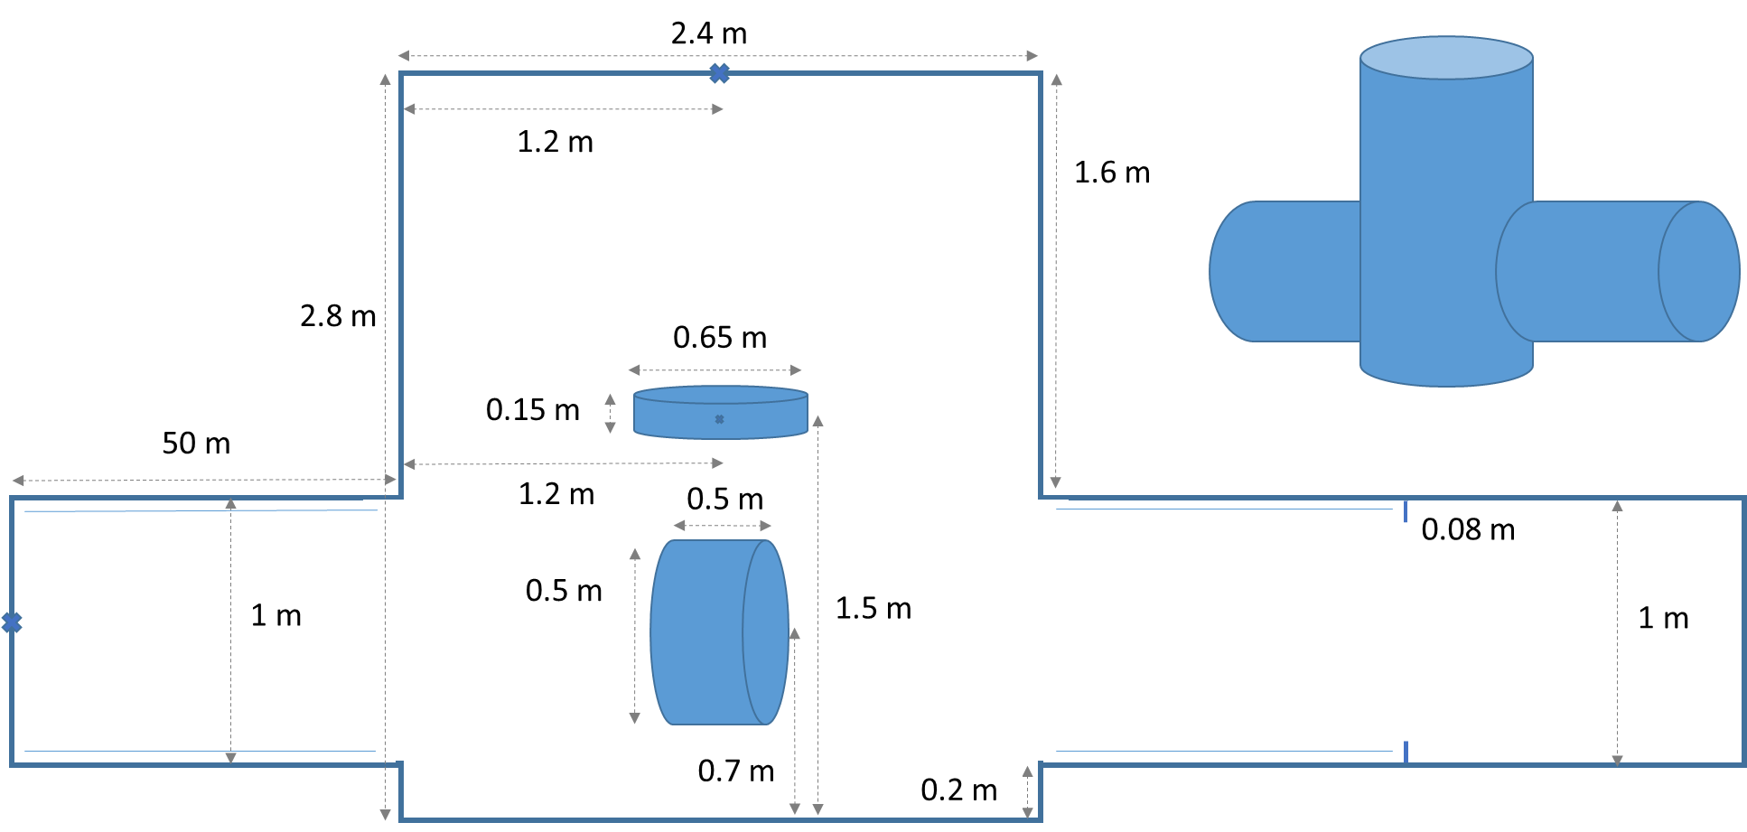
Complete model established
All three sources implemented
With time evolving detailness (implementation of cold H₂
pumping marionette, cold inner cryostat shield pumping water
or even H₂, investigation of hom. distribution on mirror)
1 km
more

Slide 10
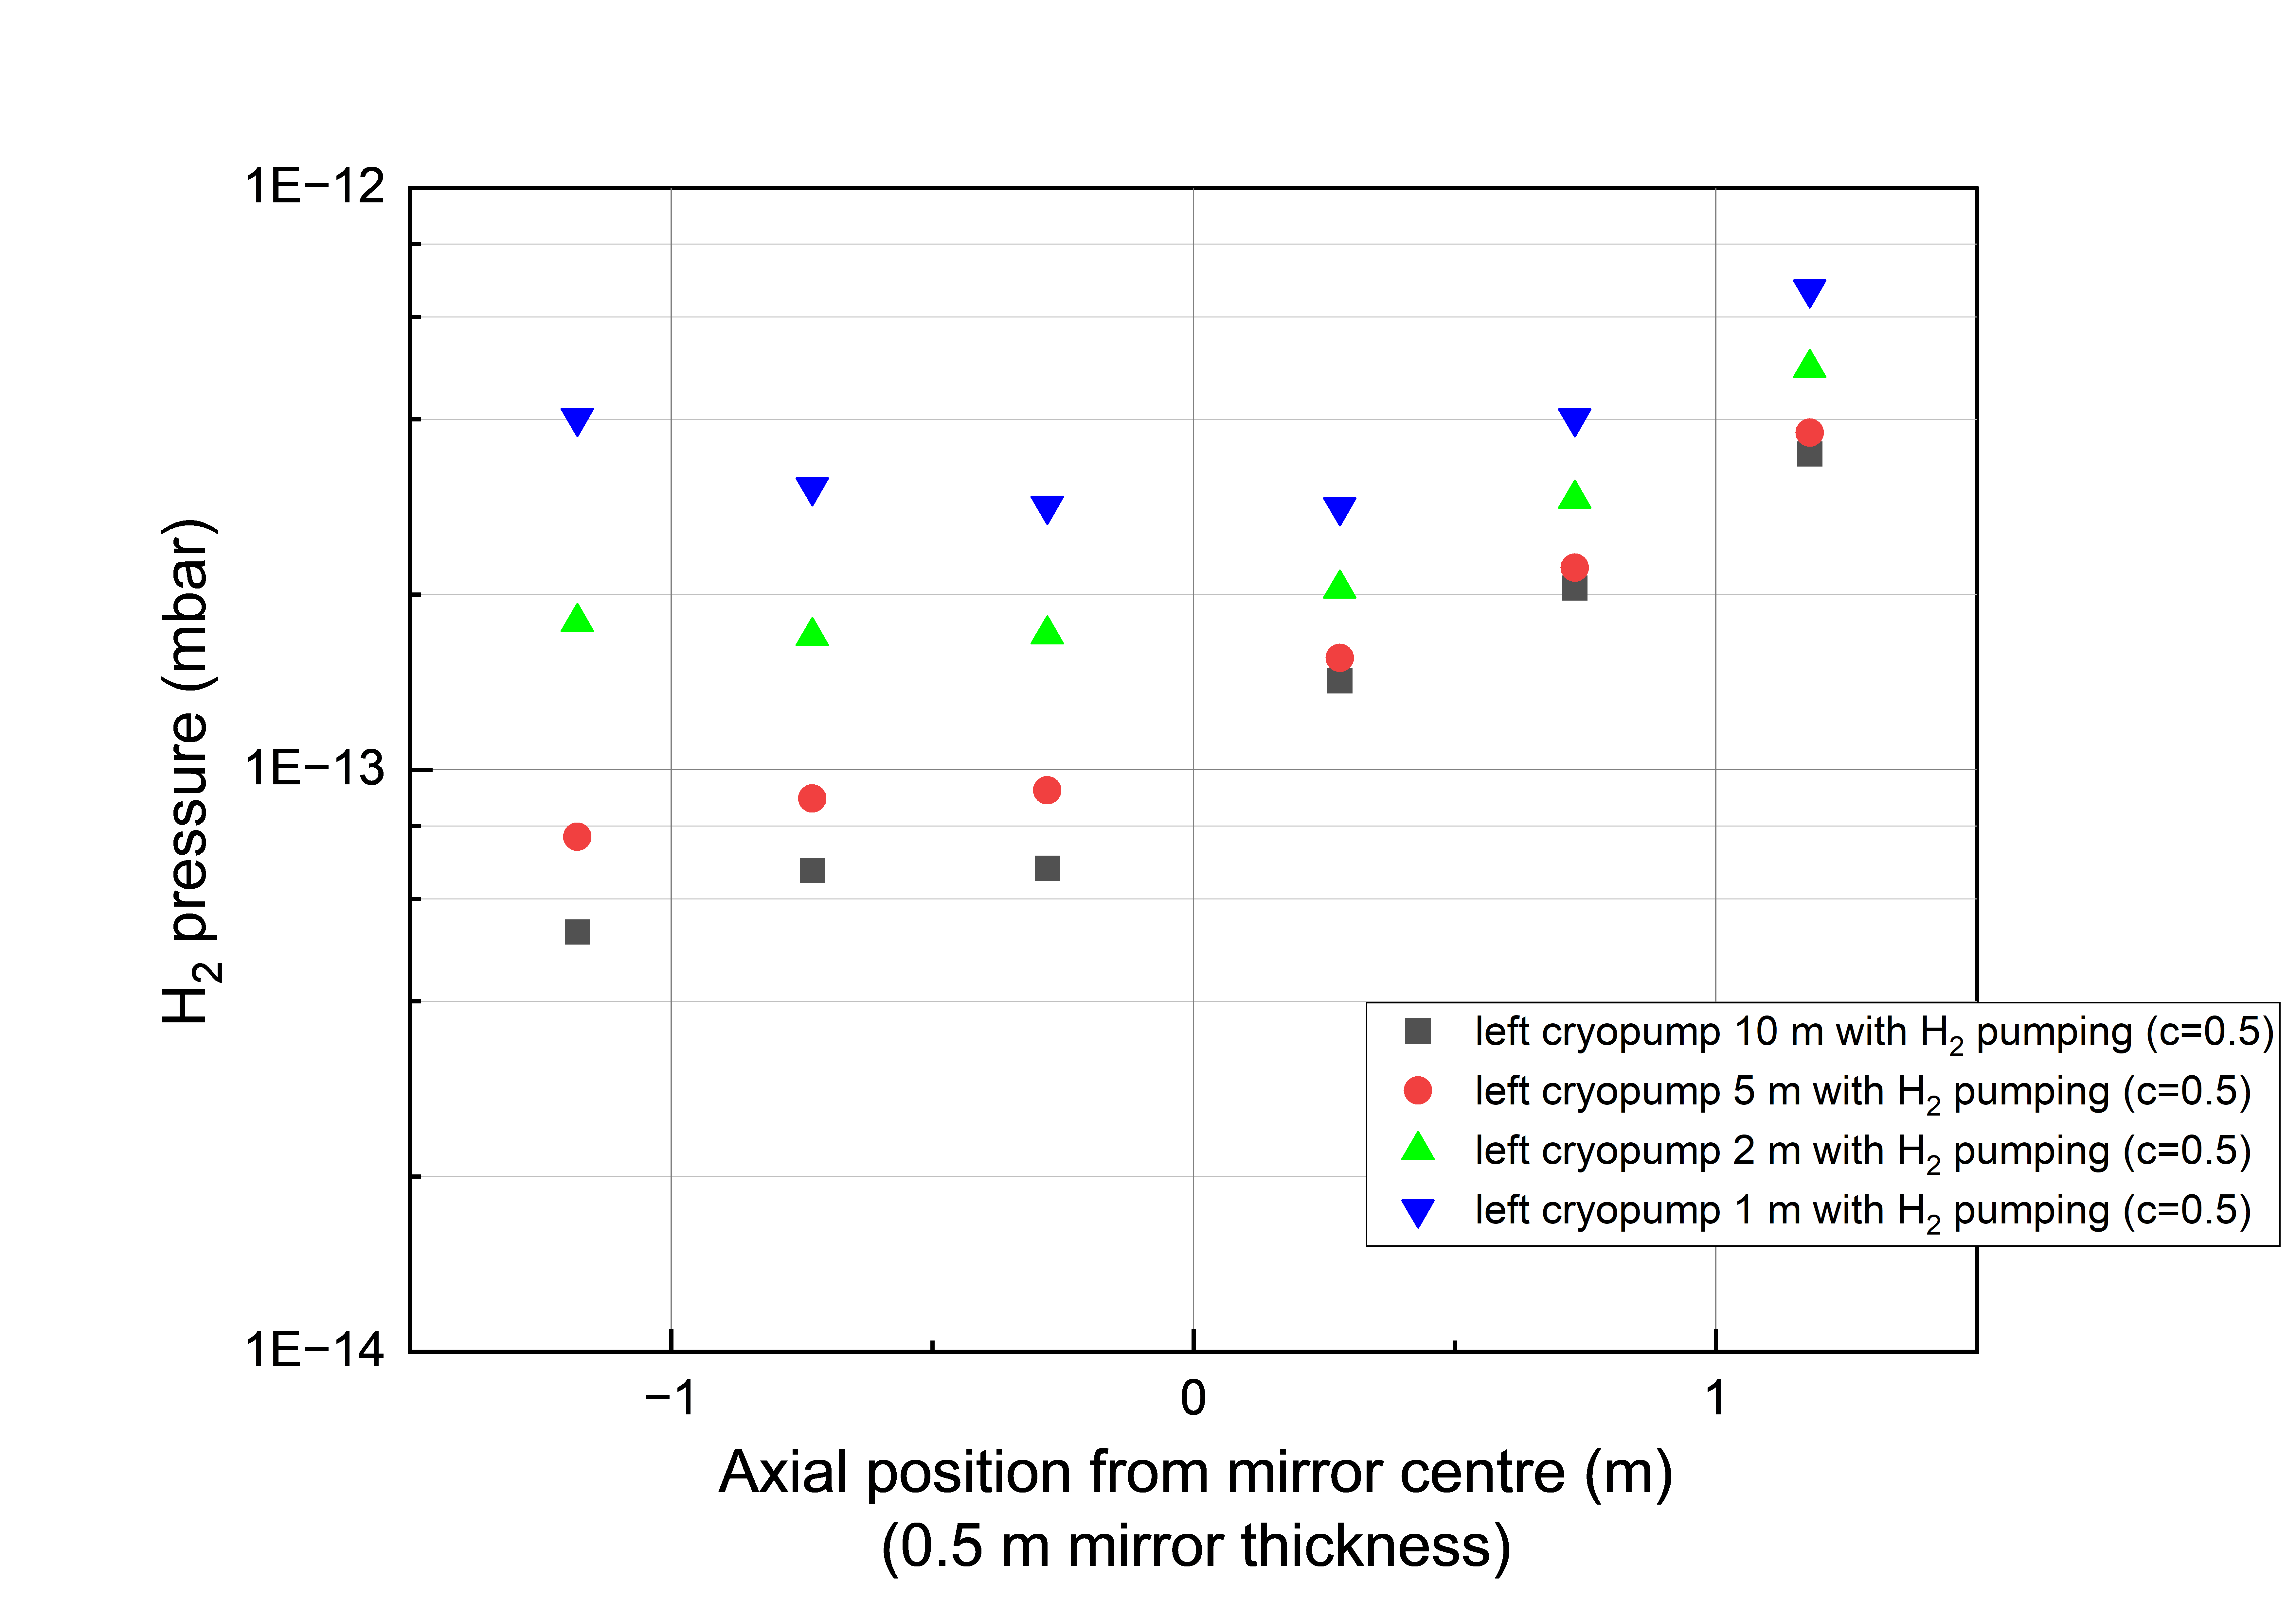
Hydrogen pressures near cryogenic mirror
Hydrogen – Some H₂ pumping on adjacent tower side needed, but short section sufficient (3.7 K or 10 K with sorbent).

Slide 11
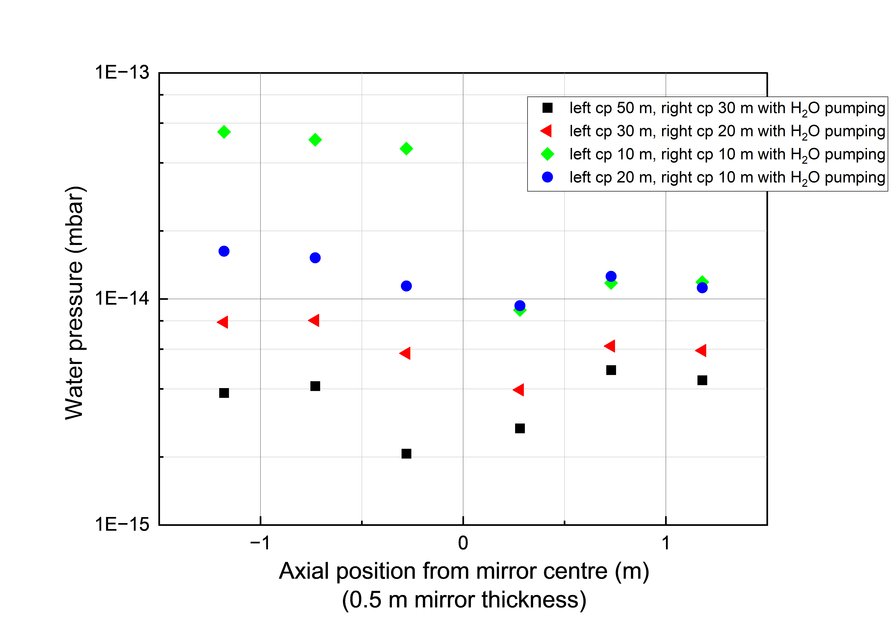
Water pressures near cryogenic mirror and frost formation
Monolayer time
180 d
Water – Cryopumps on both sides needed
(80 K). Frost on mirror drives more than pressure, long ML times feasible.
660 d
930 d
1.400 d
3.900 d

Slide 12
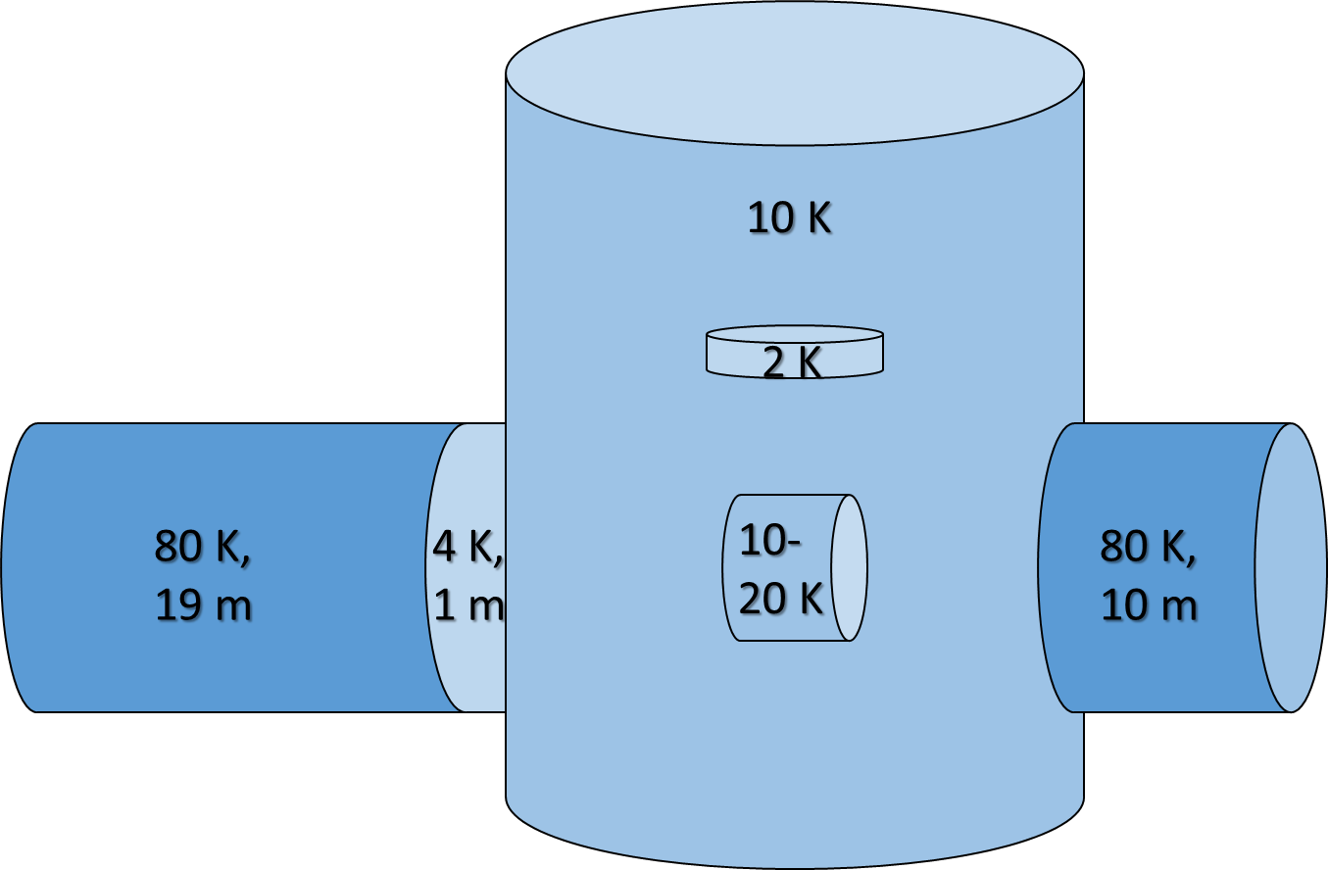
Results
Source 1:
cryopump 80 K for water trapping sufficient
10 km beam pipe conditions via low outgassing
(instead of high pumping speed)
Source 2:
conductance minimisation plus (cryo)pumping in upper tower needed to reduce flow according needs
more options will be studied (e.g. special water baffle upwards)
Source 3:
cryopump section for hydrogen needed, additional to water pumping main section
Pressures around mirror - H₂: 3∙10⁻¹³ mbar, H₂O: 1∙10⁻¹⁴ mbar,
water ice build-up ~2 years for 1 ML
→ Developed pumping concept fulfils all gas related requirements,
but thermal loads on the cryogenic mirror have to be addresssed.

Slide 13
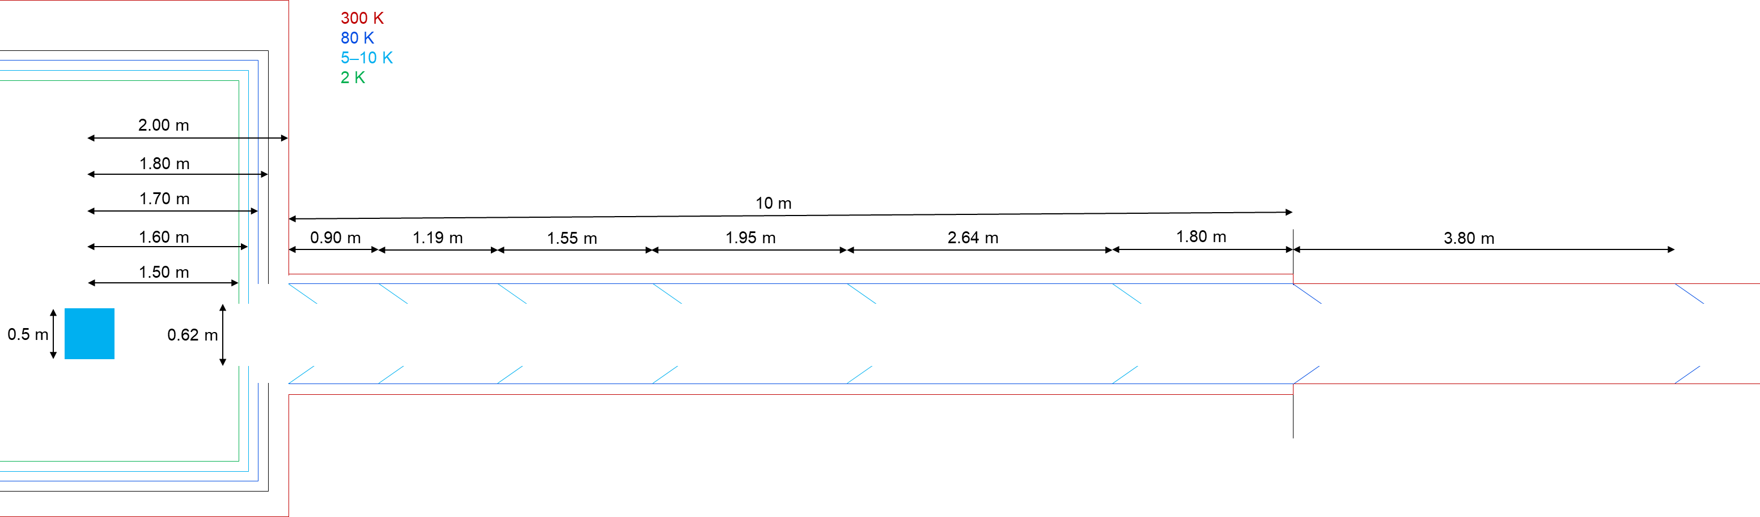
Heat load criticalities
Pump concept sound for vacuum requirements
But heat loads towards mirror (and 2 K cryostat shield) from 80 K and 300 K need to be addressed
Solutions have to be found based on input needed from noise and beam optics experts
Cryogenic mirror requires cold environment → cryopump needs to start at 0 m
Cryostat shields/baffles reduce the opening of the beam pipe to reduce thermal radiation load
→ remaining 0.62 m diameter assumed (based on input from scattered light experts)
Baffles need to be at 10 K in the 80 K pump

Slide 14
Cryopump Proposal
80 K cyropump with integrated 10 K baffles and cyrostat inner shields with aperture of 0.62 m to reduce heat loads on cyrogenic mirror

Slide 15
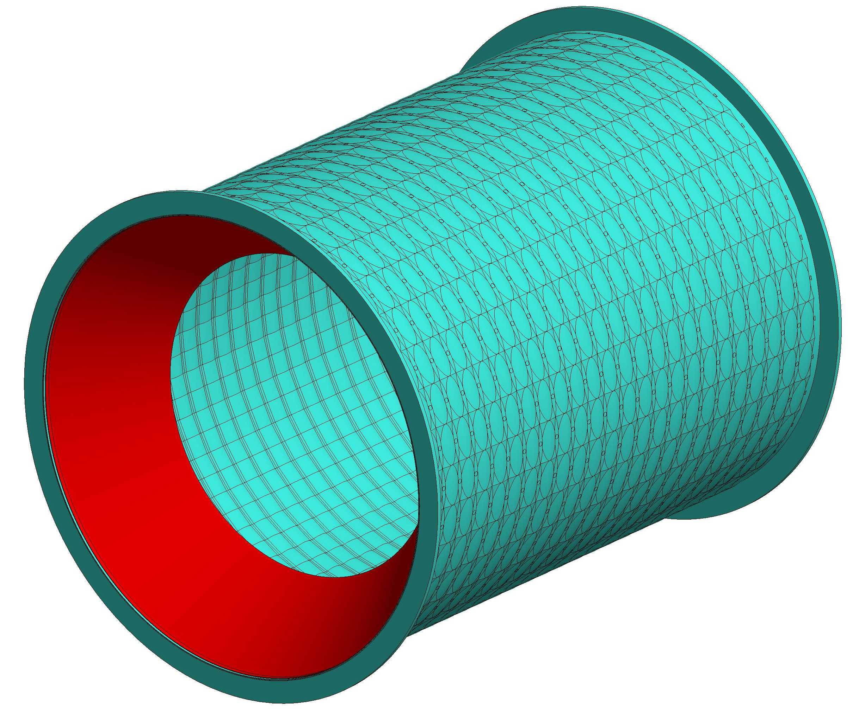
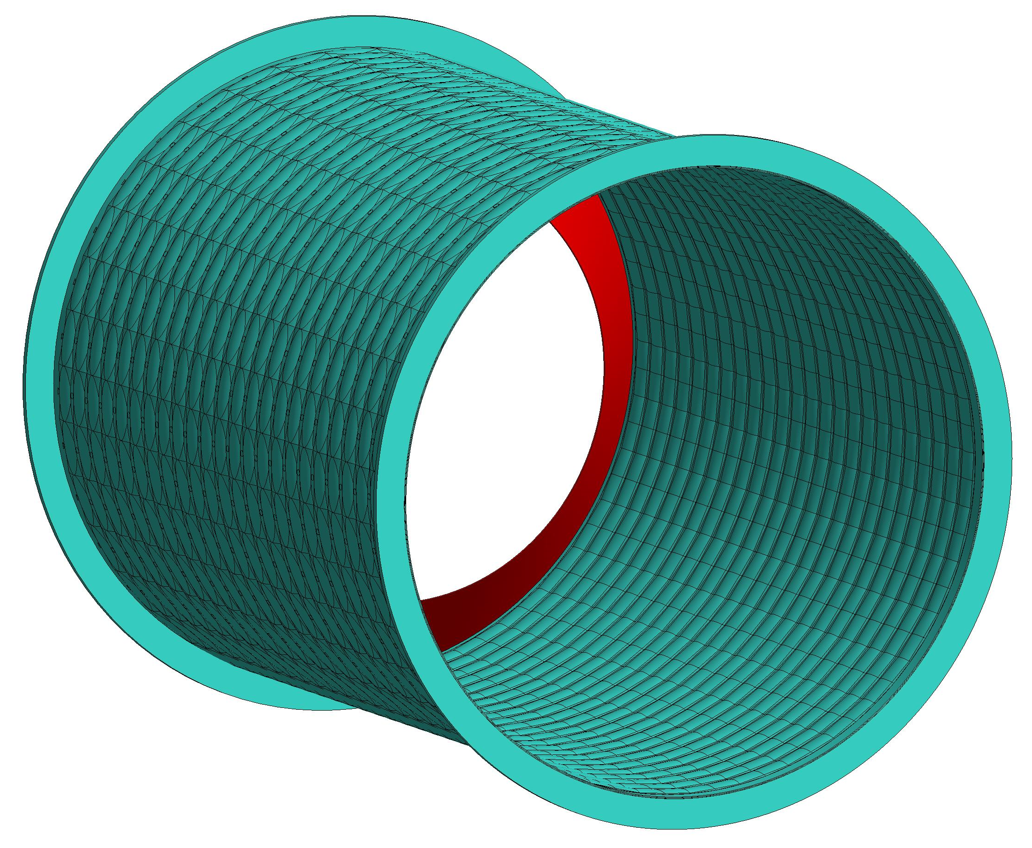
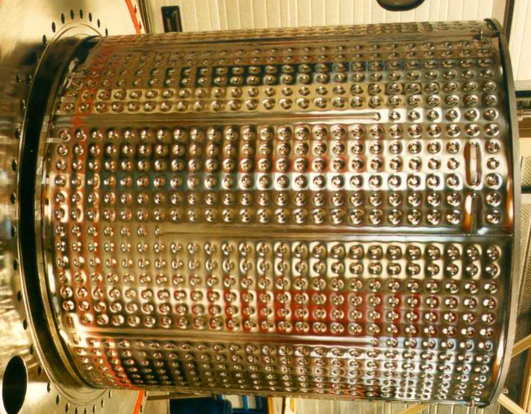
Next step: Cryopump design in tubes
Example for 80 K cryopump module:
hydroformed, with baffle at ~10 K
Beam pipe diameter of ~1.5 m, whereever a cryopump is located
Passive shielding between 80 K and beam pipe wall
Hydroformed panels usually in fusion, also other options possible
Modular system → any length possible
Cryogenic supply needs several in- and outlets for such long pumps
Upcoming design work with simulation support
(same code and modified model):
Heat load estimation for cryoplant sizing
Heat load contribution on mirror (reflectivity needed)

Slide 16
Conclusion
Cryogenic pumping concept that fulfils all gas related requirements has been developed
(left: 20 m H₂O and 1 m H₂ pumping, right: 10 m H₂O pumping)
First technical design ideas for a modular in-pipe type cryopump are shown
But concept has to be advanced regarding thermal loads optimization
→ TPMC simulations concerning heat loads will be performed in a next step

